Slide 1
Low-Dimensional Few-Body Collisional Processes in Atom-Ion Traps
V. S. Melezhik
Joint Institute for Nuclear Research, Dubna, Russia
EFB24, Guildford UK, 6 September 2019

Slide 2
Outline
Why it is interesting: confinement-induced resonances (CIRs) in hybrid atom-ion systems
Problem: Ω_{rf} ≈ 2MHz >> ω_{I} ≈ 100kHz >> ω_{A} ≈ 10kHz
Method: ion (classical) ← coupling → atom (quantum)
3D Schrödinger ← splitting-up approach in 2D DVR
3 coupled classical Hamiltonian eqs.← Störmer-Verlet
Results: CIRs in Li – Yb⁺
CIRs in two-center confined problem in pseudo-potential approach
Notes:
Preperation of a tunable few-fermion system
Tuning the interaction strength
Analytic theory for two fermions
Experiments with two fermions - Fermionization
Center of mass motion and relative motion coupling
Spectroscopic toolbox and Outlook

Slide 3
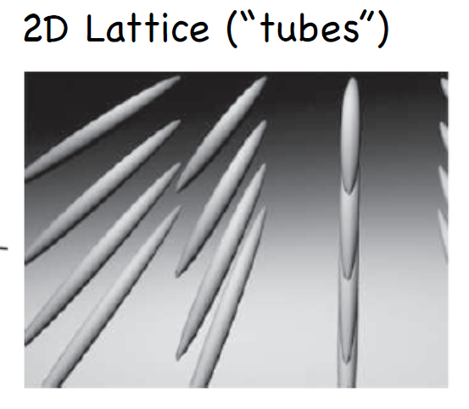
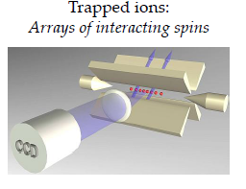
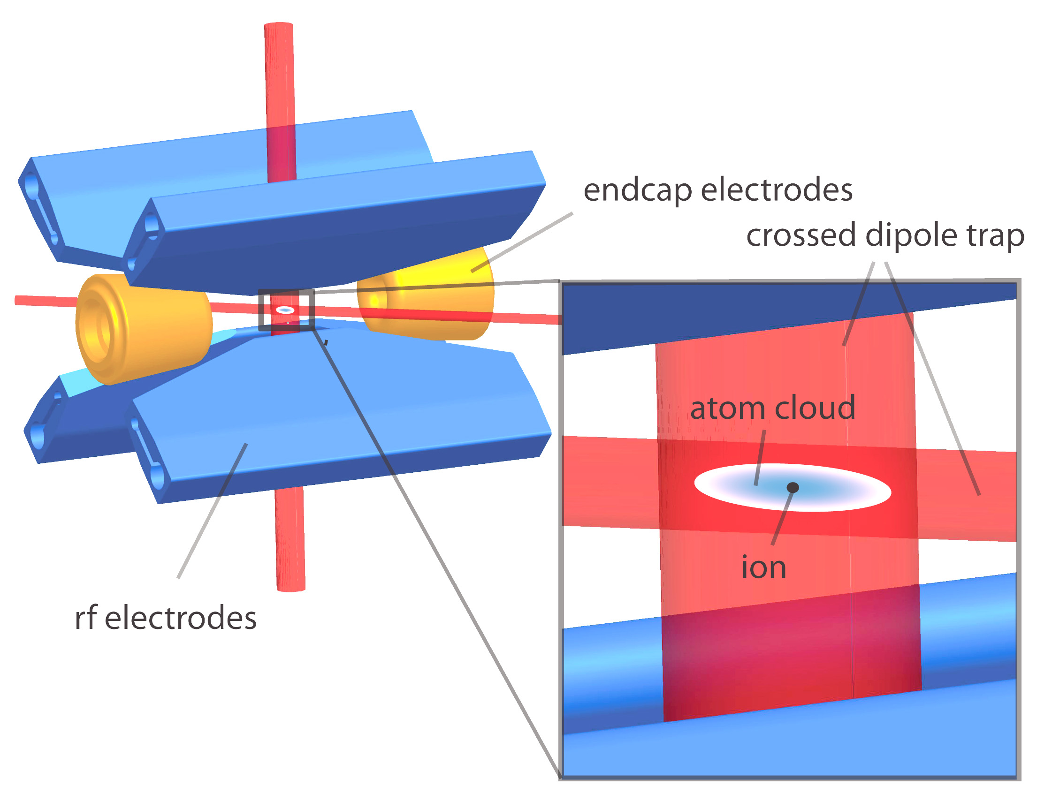
Why it is interesting
ultracold atoms optical traps
cold ions RF Paul traps
last few years: hybrid systems ``atom+ion’’
new quantum systems with different energy and length scales
with respect to ultracold atoms and molecules
Notes:
Preperation of a tunable few-fermion system
Tuning the interaction strength
Analytic theory for two fermions
Experiments with two fermions - Fermionization
Center of mass motion and relative motion coupling
Spectroscopic toolbox and Outlook

Slide 4
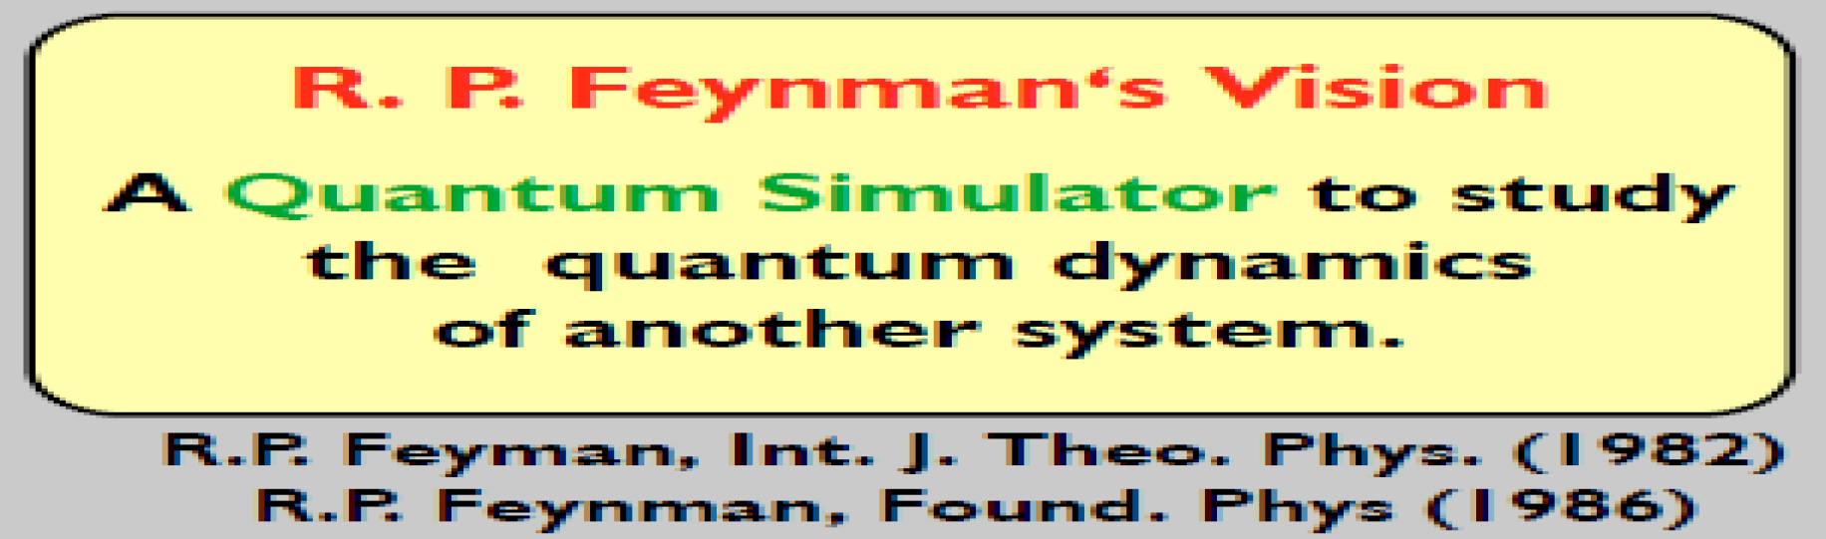
Why it is interesting
ultracold atoms optical traps
cold ions RF Paul traps
last few years: hybrid systems ``atom+ion’’
new quantum systems with different energy and length scales
with respect to ultracold atoms and molecules
Notes:
Preperation of a tunable few-fermion system
Tuning the interaction strength
Analytic theory for two fermions
Experiments with two fermions - Fermionization
Center of mass motion and relative motion coupling
Spectroscopic toolbox and Outlook

Slide 5
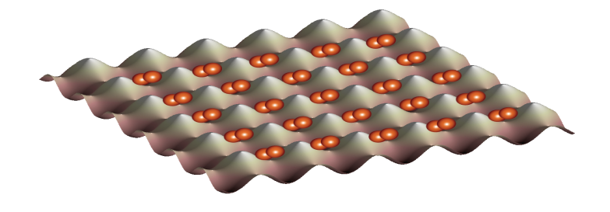
Quantum simulation with fully controlled
few-body systems
control over: quantum states, particle number, interaction
attractive interactions BCS-like pairing in finite systems
repulsive int.+splitting of trap entangled pairs of atoms
(quantum information processing)
+ periodic potential quantum many-body physics
(systems with low entropy to explore
such as quantum magnetism)
...
Bose-Hubbard Physics

Slide 6
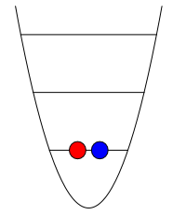
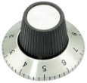
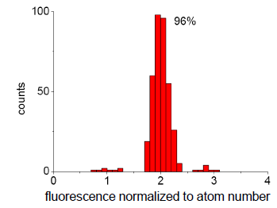
Experiments with deterministically prepared quantum systems
control interparticle interaction
2 interacting particles in a 1D potential
magnetic Feshbach
resonance
control over quantum states and
particle number with long lifetime
quantum simulation with fully controlled few-body systems
..
G.Zurn et. al. Phys. Rev. Lett. 108, 075303 (2012)

Slide 7
Experiments with deterministically prepared quantum systems
control interparticle interaction
2 interacting particles in a 1D potential
magnetic Feshbach
resonance
control over quantum states and
particle number with long lifetime

Slide 8
Experiments with deterministically prepared quantum systems
control interparticle interaction
2 interacting particles in a 1D potential
magnetic Feshbach
resonance
control over quantum states and
particle number with long lifetime
quantum simulation with fully controlled few-body systems
..
G.Zurn et. al. Phys. Rev. Lett. 108, 075303 (2012)

Slide 9
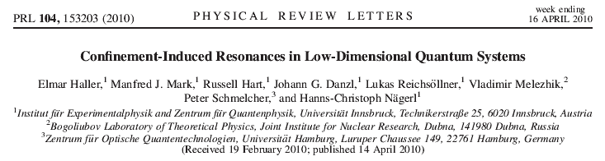
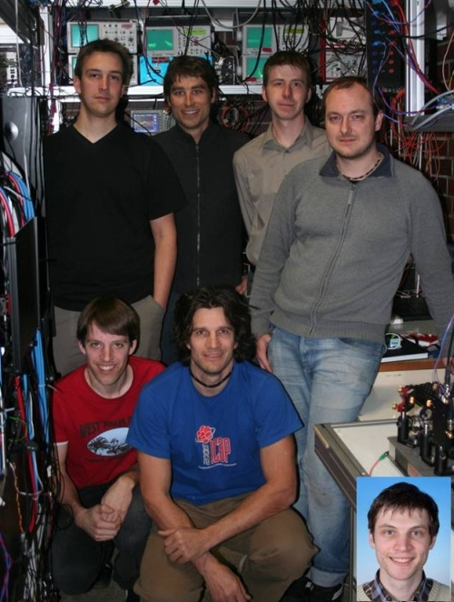


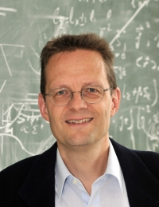

Slide 10
Shifts and widths of Feshbach resonances in atomic waveguides
Sh.Saeidian, V.S. Melezhik,and P.Schmelcher, Phys.Rev. A86, 062713 (2012)
d-wave FR at 47.8G develops in waveguide as
depending on minimums and stable maximum
of transmission coefficient T

Slide 11
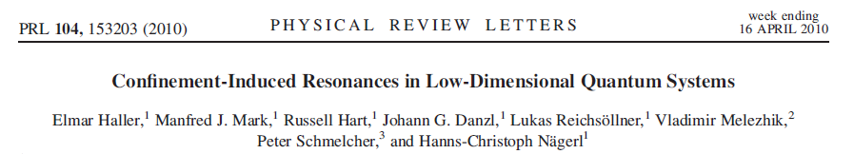
Shifts and widths of Feshbach resonances in atomic waveguides
Sh.Saeidian, V.S. Melezhik ,and P.Schmelcher, Phys.Rev. A86, 062713 (2012)
d-wave FR at 47.8G develops in waveguide as
depending on minimums and stable maximum
of transmission coefficient T
experiment

Slide 12

Shifts and widths of Feshbach resonances in atomic waveguides
Sh.Saeidian, V.S. Melezhik ,and P.Schmelcher, Phys.Rev. A86, 062713 (2012)
d-wave FR at 47.8G develops in waveguide as
depending on minimums and stable maximum
of transmission coefficient T
experiment
theory
theory prediction ( M.Olshanii PRL (1998) )

Slide 13
Why it is interesting
ultracold atoms optical traps
cold ions RF Paul traps
last few years: hybrid systems ``atom+ion’’
new quantum systems with different energy and length scales
with respect to ultracold atoms and molecules
Notes:
Preperation of a tunable few-fermion system
Tuning the interaction strength
Analytic theory for two fermions
Experiments with two fermions - Fermionization
Center of mass motion and relative motion coupling
Spectroscopic toolbox and Outlook

Slide 14
Why it is interesting
ultracold atoms optical traps
cold ions RF Paul traps
last few years: hybrid systems ``atom+ion’’
new quantum systems with different energy and length scales
with respect to ultracold atoms and molecules
Notes:
Preperation of a tunable few-fermion system
Tuning the interaction strength
Analytic theory for two fermions
Experiments with two fermions - Fermionization
Center of mass motion and relative motion coupling
Spectroscopic toolbox and Outlook

Slide 15
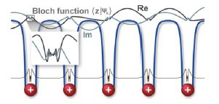

Why it is interesting
quantum simulation with cold atoms and ions
proposals: formation of molecular ions, polarons,
density bubbles, collective excitations,
quantum information processing (two-qubit gate),
mesoscopic entanglement …
Notes:
Preperation of a tunable few-fermion system
Tuning the interaction strength
Analytic theory for two fermions
Experiments with two fermions - Fermionization
Center of mass motion and relative motion coupling
Spectroscopic toolbox and Outlook
<number>

Slide 16
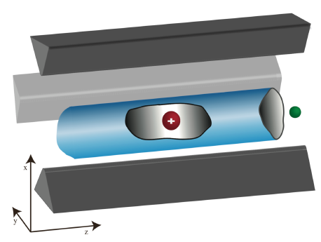

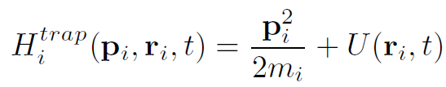
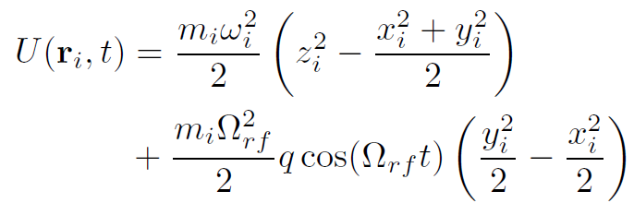
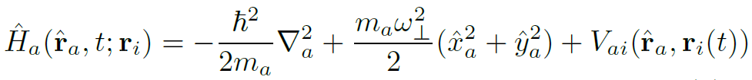








Resonant Processes in Hybrid Atom-Ion Systems
Notes:
Preperation of a tunable few-fermion system
Tuning the interaction strength
Analytic theory for two fermions
Experiments with two fermions - Fermionization
Center of mass motion and relative motion coupling
Spectroscopic toolbox and Outlook

Slide 17








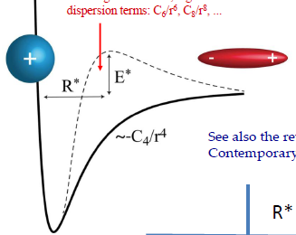

Resonant Processes in Hybrid Atom-Ion Systems:
Static Approximation
Notes:
Preperation of a tunable few-fermion system
Tuning the interaction strength
Analytic theory for two fermions
Experiments with two fermions - Fermionization
Center of mass motion and relative motion coupling
Spectroscopic toolbox and Outlook

Slide 18



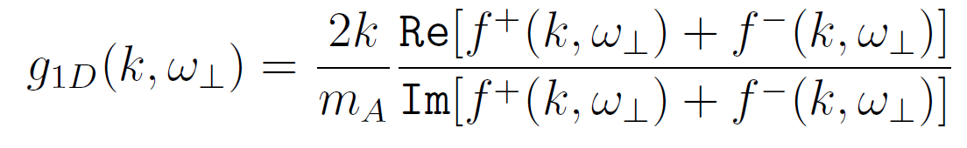

Resonant Processes in Hybrid Atom-Ion Systems:
Static Approximation
Notes:
Preperation of a tunable few-fermion system
Tuning the interaction strength
Analytic theory for two fermions
Experiments with two fermions - Fermionization
Center of mass motion and relative motion coupling
Spectroscopic toolbox and Outlook

Slide 19
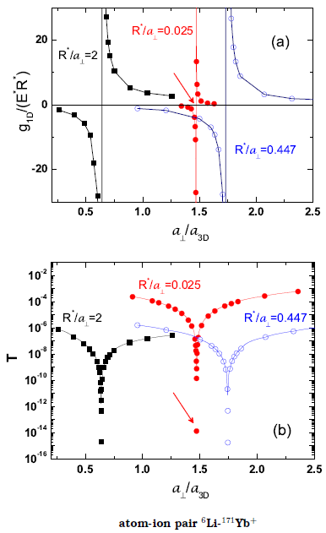






Atom-ion CIR ?
Notes:
Preperation of a tunable few-fermion system
Tuning the interaction strength
Analytic theory for two fermions
Experiments with two fermions - Fermionization
Center of mass motion and relative motion coupling
Spectroscopic toolbox and Outlook

Slide 20
Resonant and Heating/Cooling Processes in Hybrid Atom-Ion Systems
Notes:
Preperation of a tunable few-fermion system
Tuning the interaction strength
Analytic theory for two fermions
Experiments with two fermions - Fermionization
Center of mass motion and relative motion coupling
Spectroscopic toolbox and Outlook

Slide 21
Resonant and Heating/Cooling Processes in Hybrid Atom-Ion Systems
Notes:
Preperation of a tunable few-fermion system
Tuning the interaction strength
Analytic theory for two fermions
Experiments with two fermions - Fermionization
Center of mass motion and relative motion coupling
Spectroscopic toolbox and Outlook

Slide 22


Resonant and Heating/Cooling Processes in Hybrid Atom-Ion Systems
Notes:
Preperation of a tunable few-fermion system
Tuning the interaction strength
Analytic theory for two fermions
Experiments with two fermions - Fermionization
Center of mass motion and relative motion coupling
Spectroscopic toolbox and Outlook

Slide 23
atoms in optical waveguide-like traps
Method
non-direct product 2D discrete-variable representation ( npDVR )
1D DVR: J.C.Light et al J.Chem.Phys. 1985
2D DVR: V.Melezhik Phys.Lett. 1997
V.Melezhik AIP Conf Proc 1479, 2012
V.Melezhik EPJ Web of Conf (MMCP15) 2016
multi-channel scattering problem as a boundary-value problem
V.Melezhik & C.-Y. Hu Phys.Rev.Lett. 2003
S.Saeidian & V. Melezhik & P.Schmelcher Phys.Rev.A 2008
V. Melezhik EPJ Web of Conf (MMCP15) 2016
splitting-up method for time-dependent 3D and 4D Schrödinger eqs.
V.Melezhik Phys.Lett. 1997
V.Melezhik & D.Baye Phys.Rev. C 1999
V.Melezhik & P.Schmelcher New J. Phys 2009
V.Melezhik EPJ Web of Conf (MMCP15) 2016

Slide 24
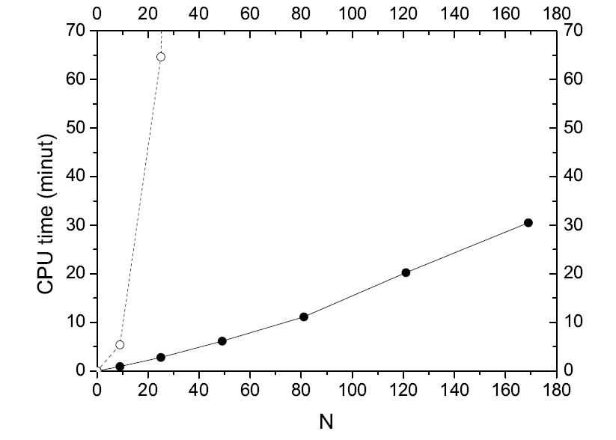



economic computational scheme
BLTP JINR two-core Intel processor Xenon 5160 with 3GHz frequency

Slide 25
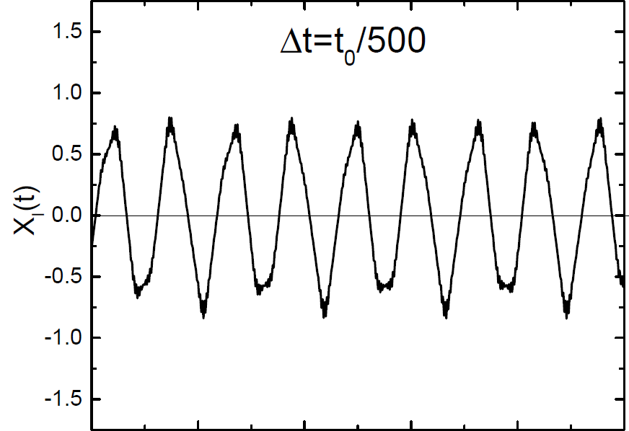
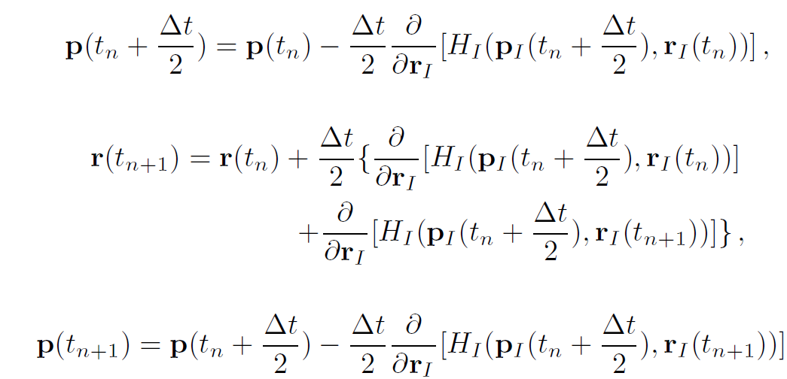
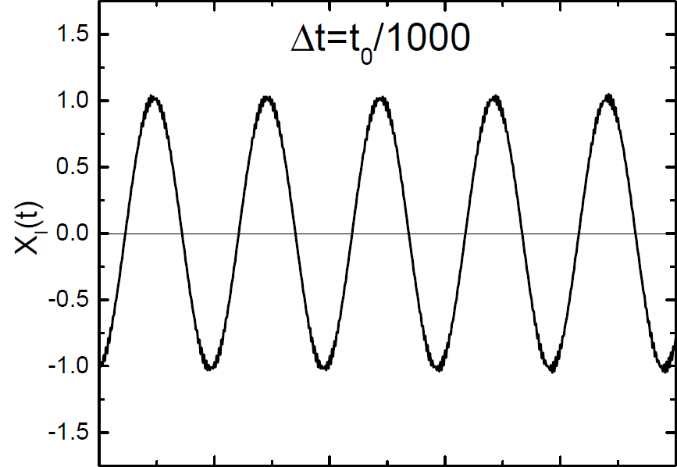
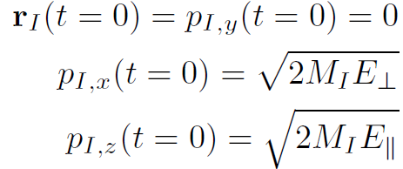
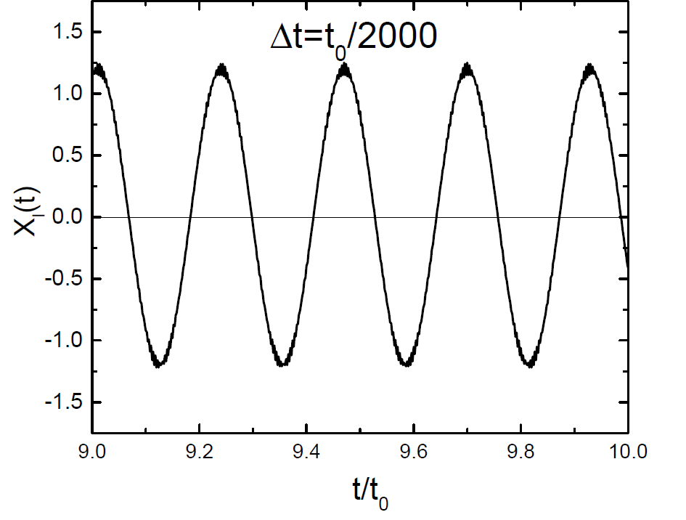
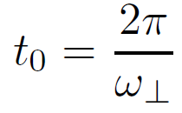
ion in Paul trap
ion in Paul trap екф екф trap
2-order Störmer-Verlet
ion in Paul trap
Atom-Ion Hybrid System

Slide 26



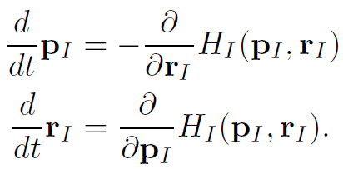

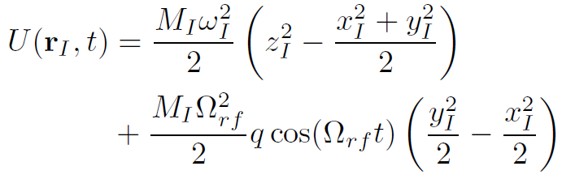
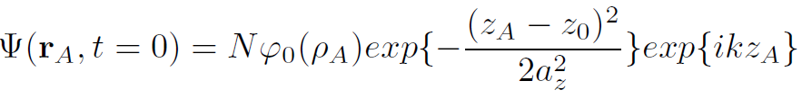
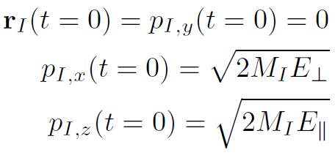
Quantum-Quasiclassical Approach for Atom-Ion Systems
Notes:
Preperation of a tunable few-fermion system
Tuning the interaction strength
Analytic theory for two fermions
Experiments with two fermions - Fermionization
Center of mass motion and relative motion coupling
Spectroscopic toolbox and Outlook

Slide 27


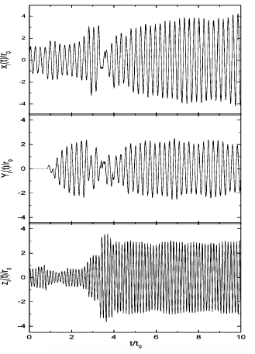
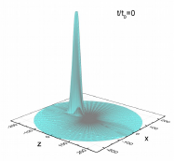
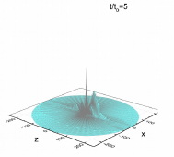
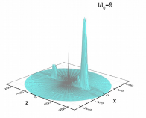


Slide 30
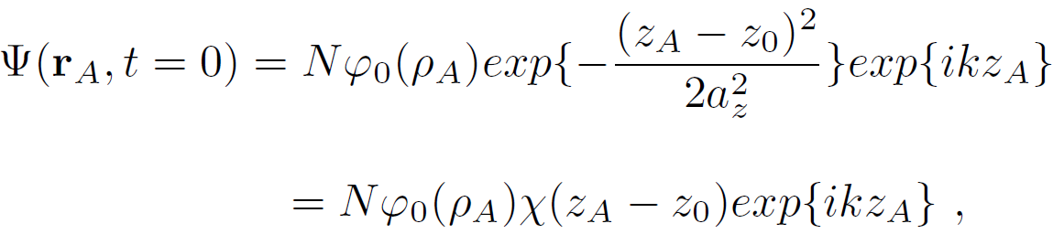
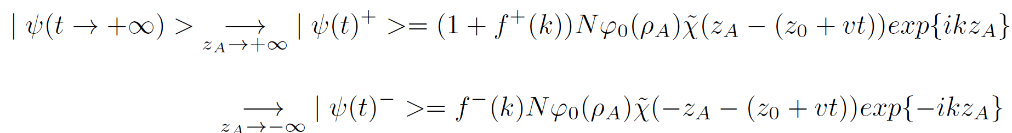

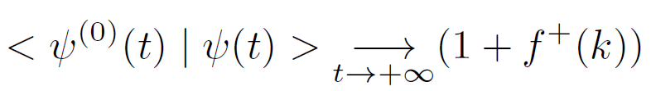

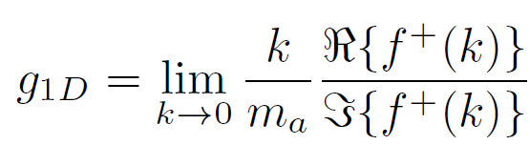

Scattering Observables
Notes:
Preperation of a tunable few-fermion system
Tuning the interaction strength
Analytic theory for two fermions
Experiments with two fermions - Fermionization
Center of mass motion and relative motion coupling
Spectroscopic toolbox and Outlook

Slide 31
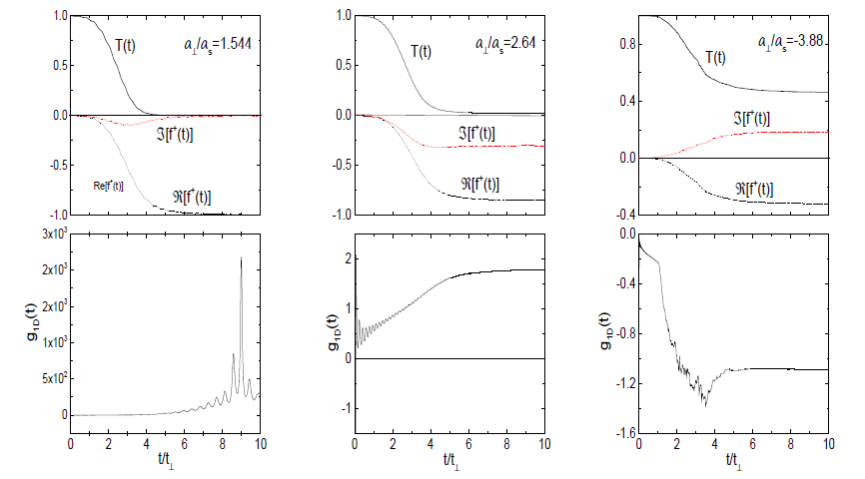


Slide 32
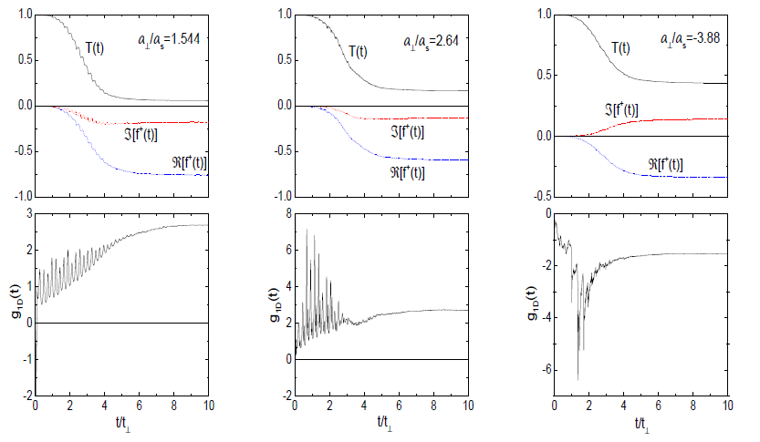


Slide 33
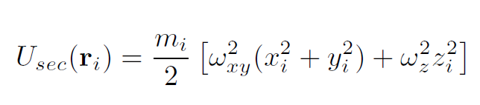
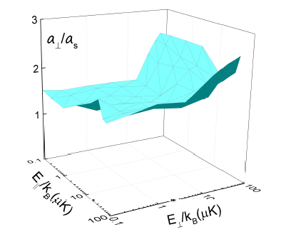
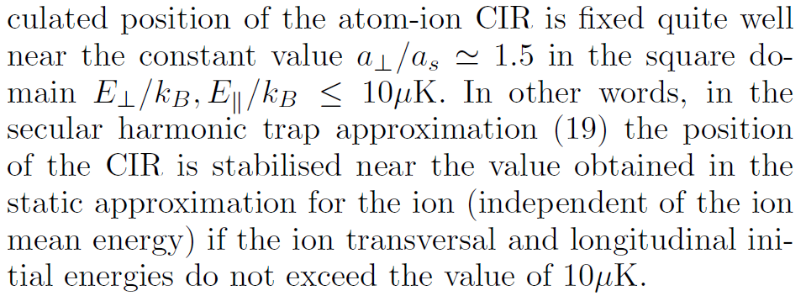
Impact of Ion Motion on CIR
secular time-independent ion trap
Notes:
Preperation of a tunable few-fermion system
Tuning the interaction strength
Analytic theory for two fermions
Experiments with two fermions - Fermionization
Center of mass motion and relative motion coupling
Spectroscopic toolbox and Outlook

Slide 34
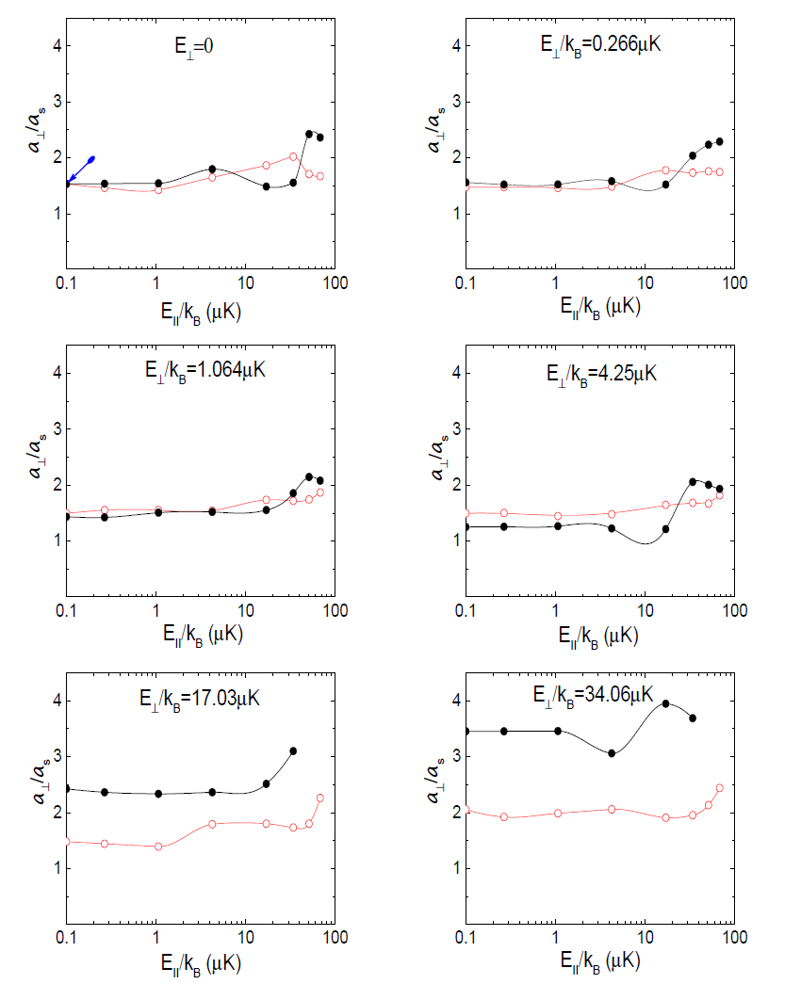
Olshanii

Slide 35
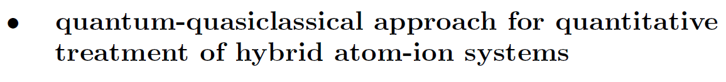
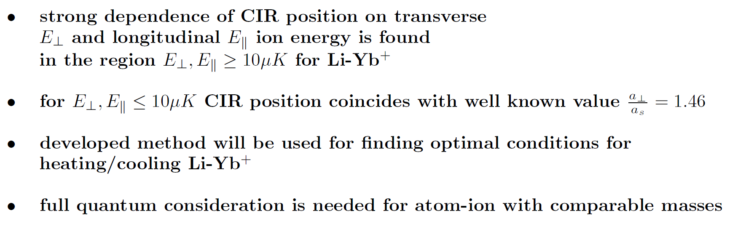
Conclusion & Outlook (I)
Notes:
Preperation of a tunable few-fermion system
Tuning the interaction strength
Analytic theory for two fermions
Experiments with two fermions - Fermionization
Center of mass motion and relative motion coupling
Spectroscopic toolbox and Outlook

Slide 36
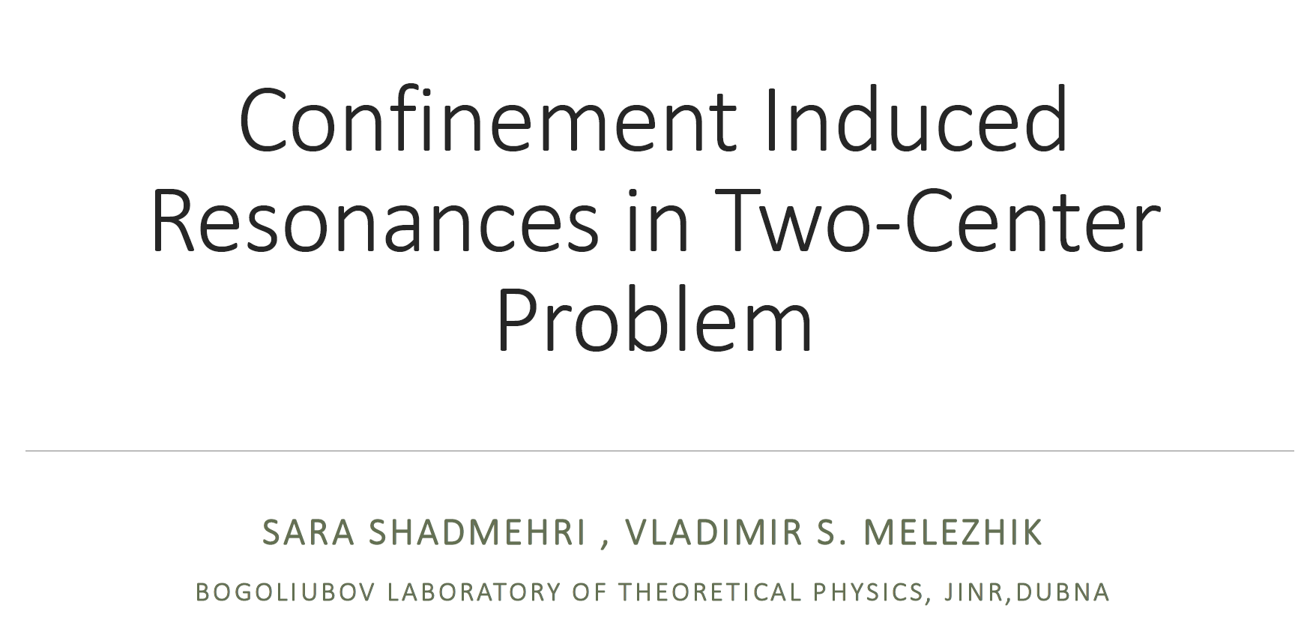

Slide 37

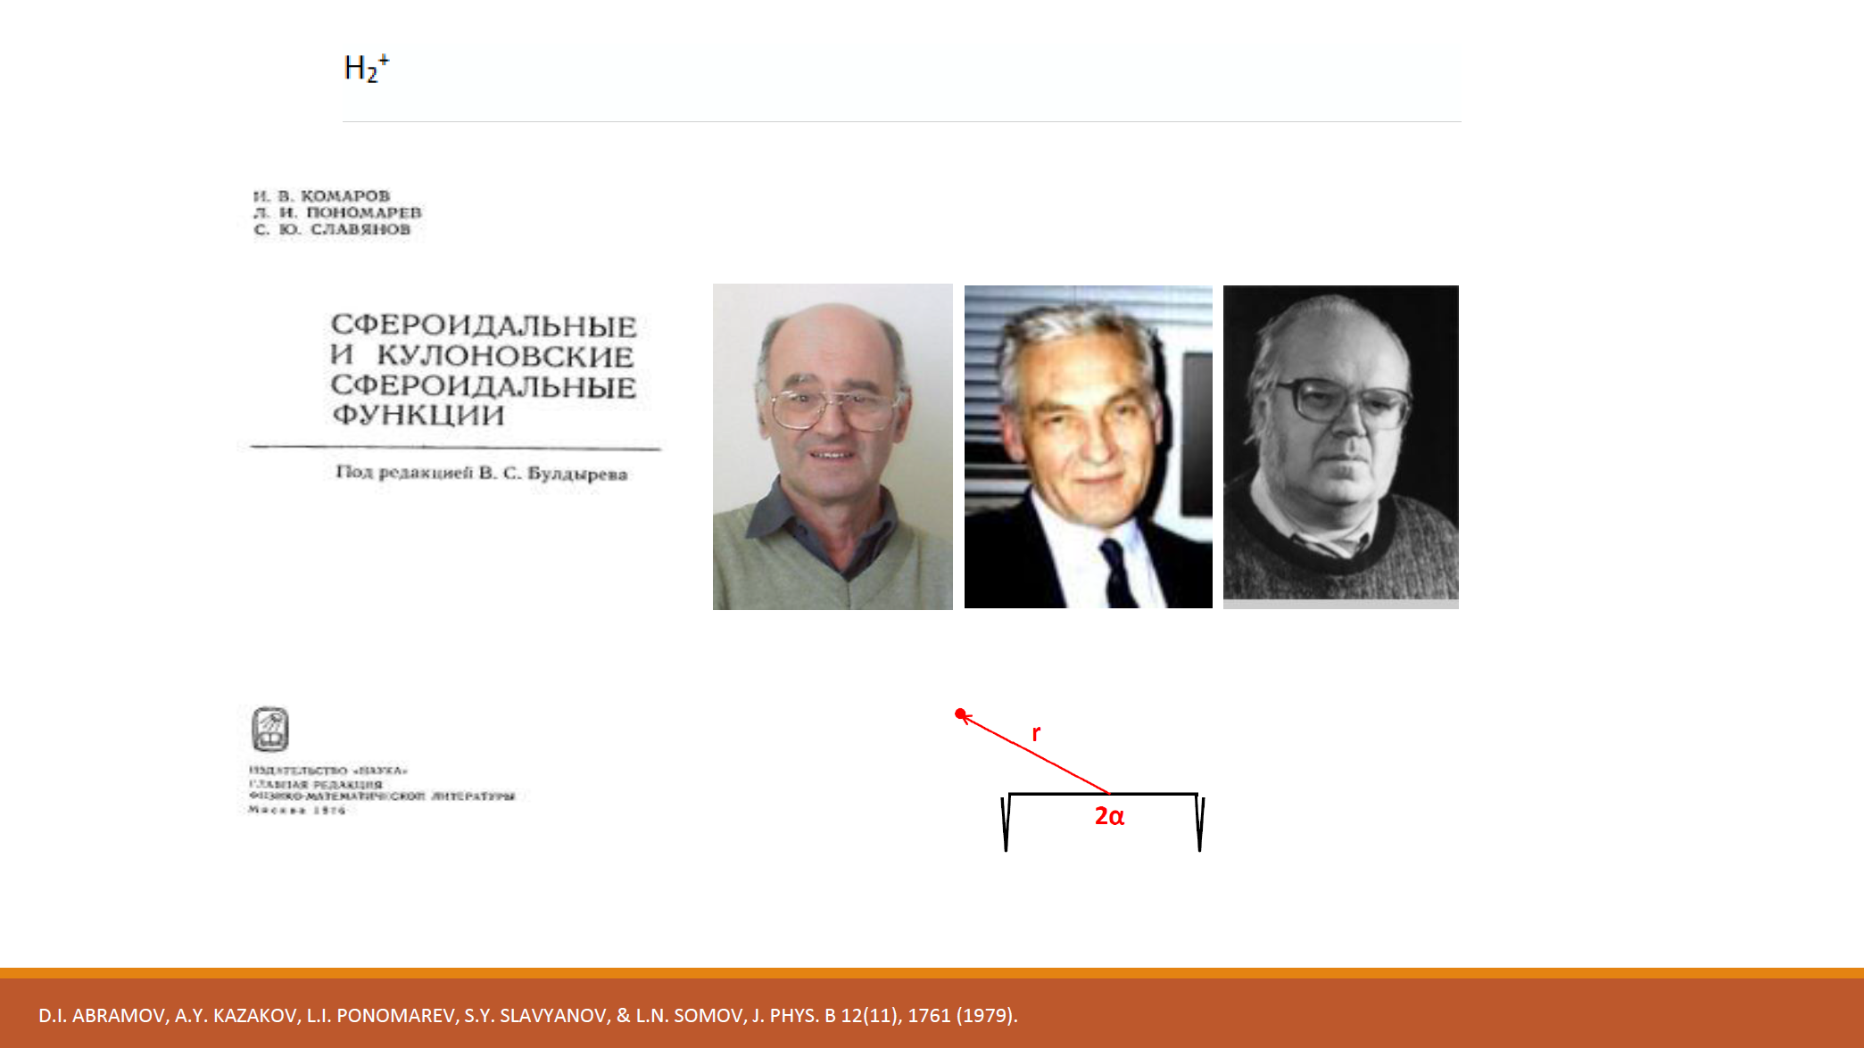

Slide 38
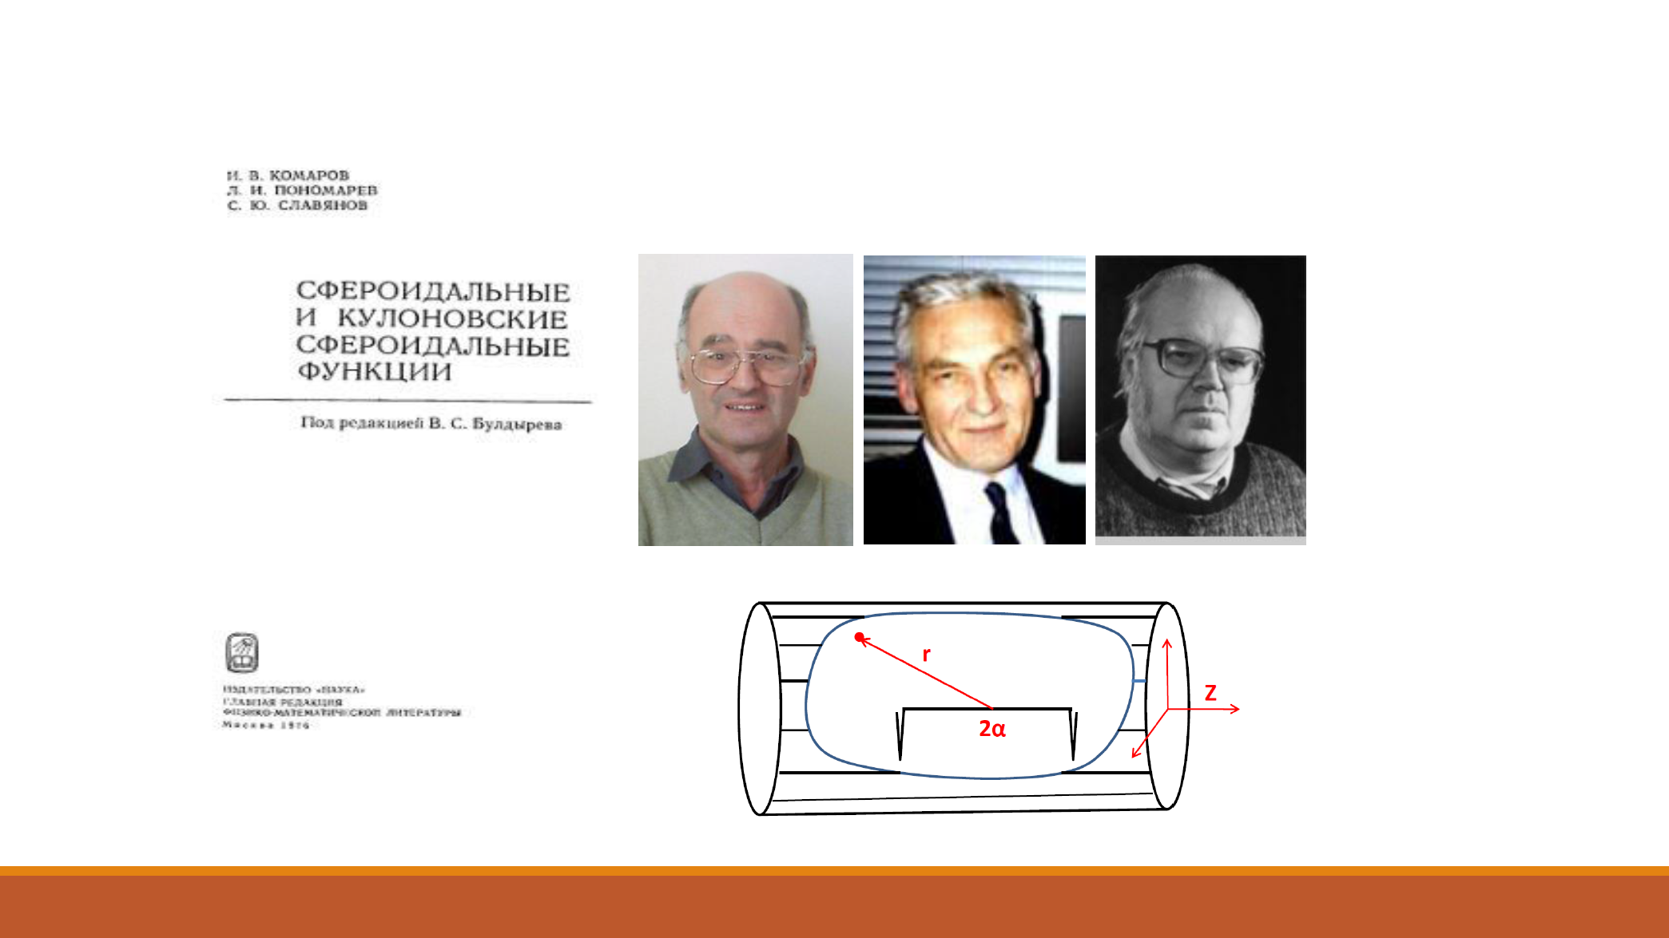

Slide 39


Slide 40


Slide 41


Slide 42


Slide 43


Slide 44


Slide 45


Slide 46


Slide 47


Slide 48


Slide 49


Conclusion & Outlook (II)
Notes:
Preperation of a tunable few-fermion system
Tuning the interaction strength
Analytic theory for two fermions
Experiments with two fermions - Fermionization
Center of mass motion and relative motion coupling
Spectroscopic toolbox and Outlook

Slide 50
Collaboration:
Theory:
P. Schmelcher Hamburg University, Germany
A. Negretti Hamburg University, Germany
S. Saeidian IASBS, Iran
P. Giannakeas Purdue University, USA
Z. Idziaszek Warsaw University, Poland
S. Shadmehri JINR, Dubna, Russia
Experiment:
E. Haller Innsbruck University, Austria
H.-C. Nägerl Innsbruck University, Austria
Notes:
Preperation of a tunable few-fermion system
Tuning the interaction strength
Analytic theory for two fermions
Experiments with two fermions - Fermionization
Center of mass motion and relative motion coupling
Spectroscopic toolbox and Outlook

