Slide 1
Weakly bound nuclei:
A unified description of intrinsic and relative degrees of freedom
Eduardo Garrido
Instituto de Estructura de la Materia, CSIC, Madrid, Spain

Slide 2
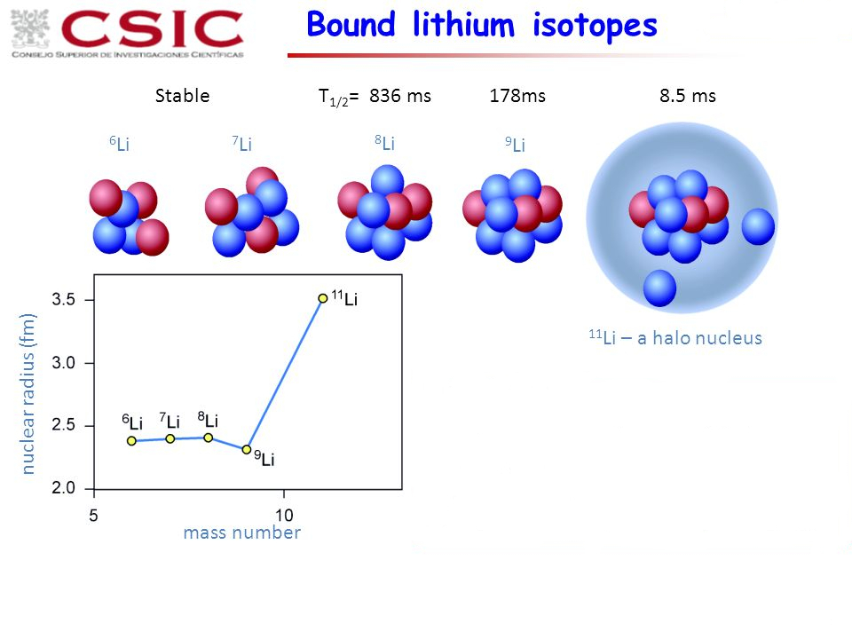
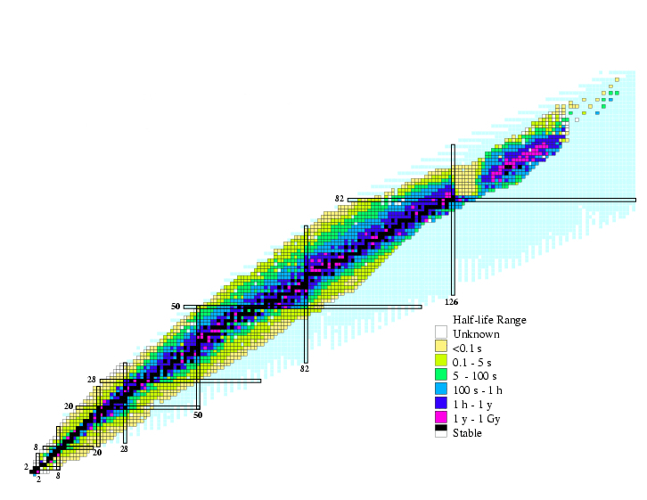
Weakly bound nuclei:
A unified description of intrinsic and relative degrees of freedom

Slide 3
Weakly bound nuclei:
A unified description of intrinsic and relative degrees of freedom
The core is assumed to be an inert particle.
What to do when experimental information is not available.

Slide 4
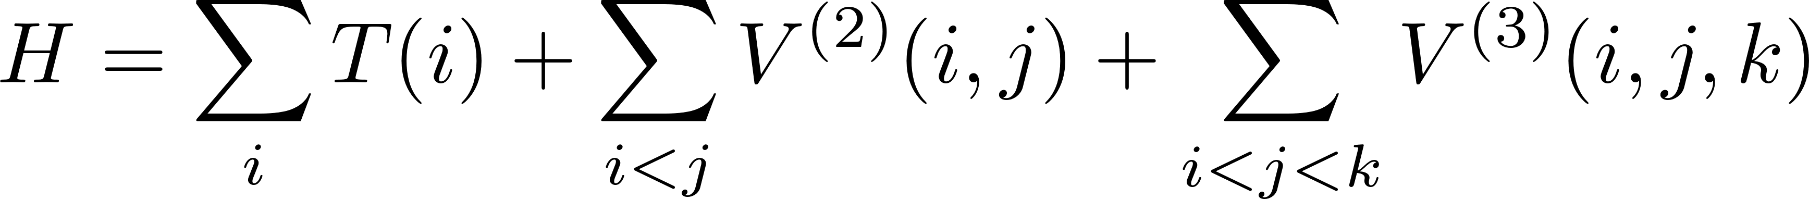
Weakly bound nuclei:
A unified description of intrinsic and relative degrees of freedom

Slide 5
Weakly bound nuclei:
A unified description of intrinsic and relative degrees of freedom
The particles do not interact with each other, but through an average mean-field.
The complex N-body wave function is replaced by a Slater determinant.

Slide 6



Weakly bound nuclei:
A unified description of intrinsic and relative degrees of freedom
The mean-field determines the interaction with the loosely bound nucleons.
Three-body problem
The particles do not interact with each other, but through an average mean-field.
The complex N-body wave function is replaced by a Slater determinant.

Slide 7

Weakly bound nuclei:
A unified description of intrinsic and relative degrees of freedom
The mean-field determines the interaction with the loosely bound nucleons.
Three-body problem
The presence of the loosely bound nucleons distorts the mean-field.
The distorted mean-field modifies the core-nucleon interaction and the wave function of the valence nucleons.
The particles do not interact with each other, but through an average mean-field.
The complex N-body wave function is replaced by a Slater determinant.
Self-consistent calculation

Slide 8
Weakly bound nuclei:
A unified description of intrinsic and relative degrees of freedom
Some formal hints about the formalism
The case of ²⁶O
Proton dripline: ⁷⁰Kr
Approaching the dripline: Ca isotopes
Summary and possible extensions

Slide 9
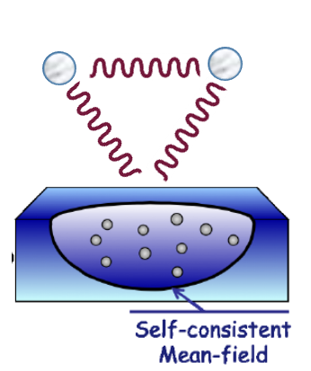


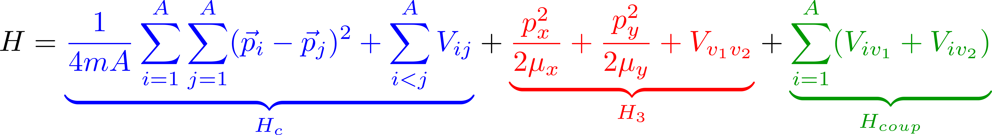
Formalism:

Slide 10
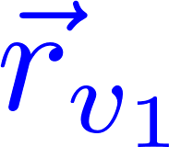
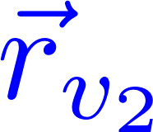
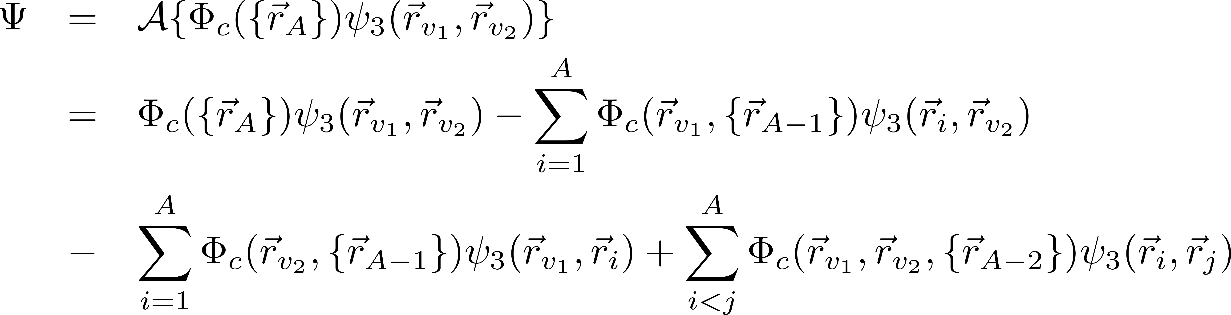
Formalism:

Slide 11
Formalism:

Slide 12
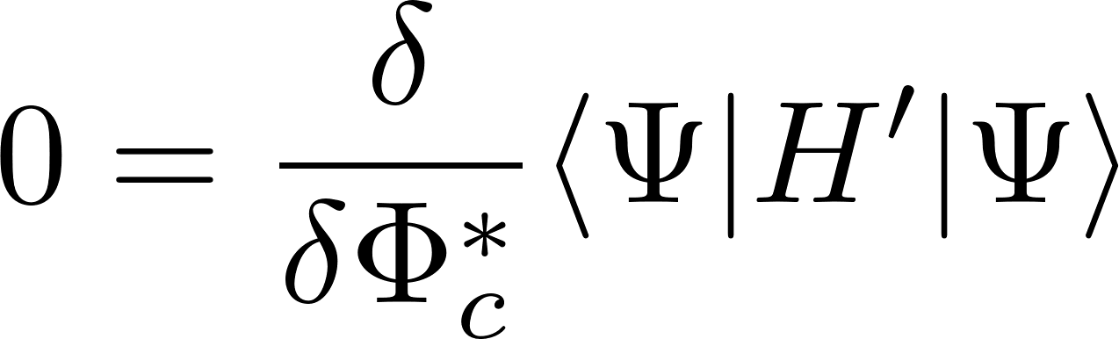
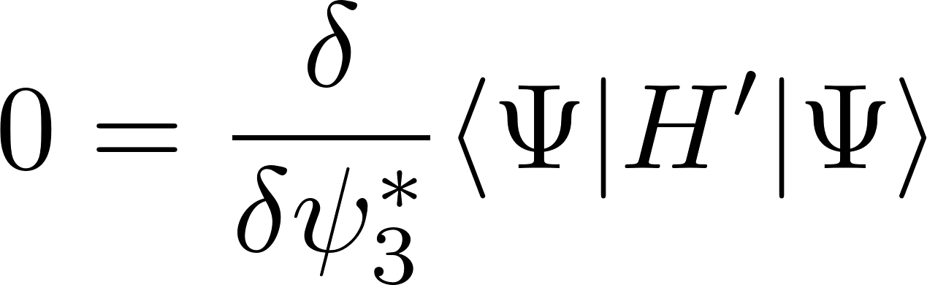
Formalism:

Slide 13
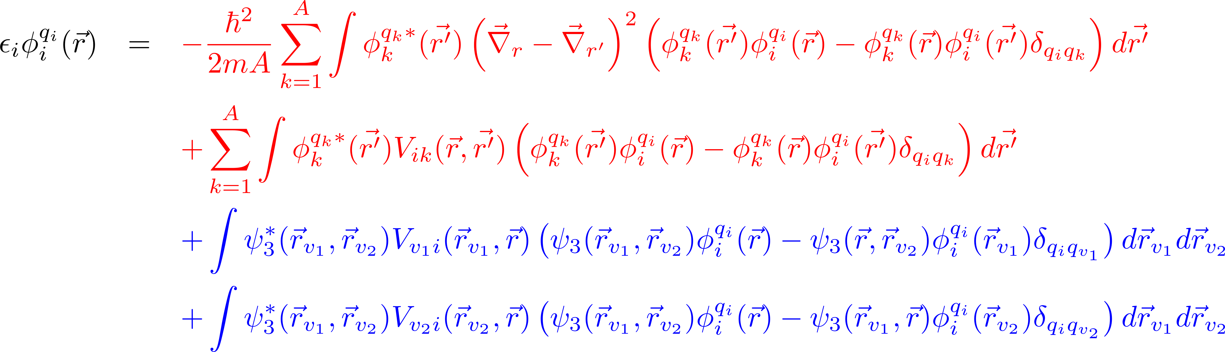
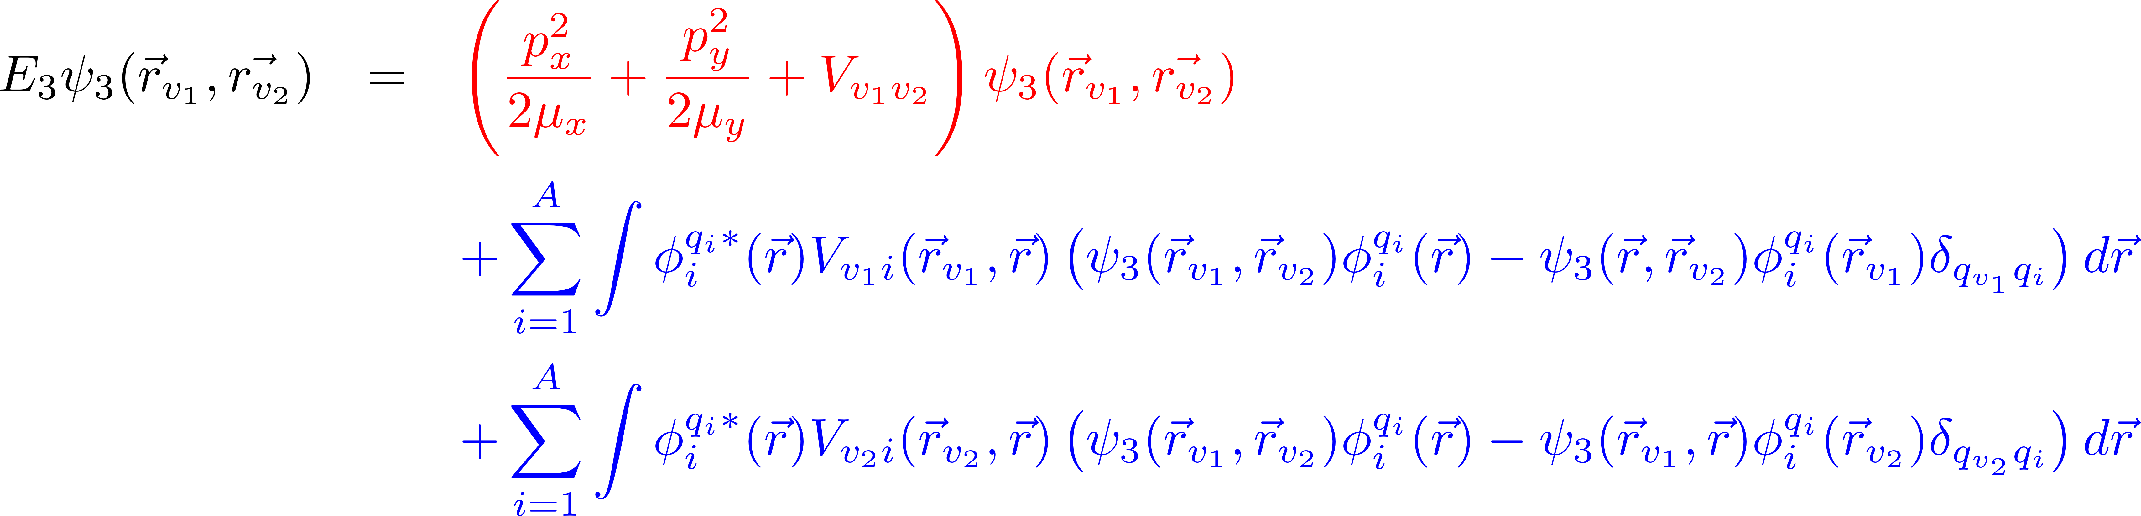
Formalism:

Slide 14
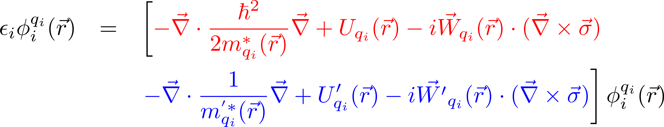
Hartree-Fock Calculations with Skyrme's Interaction. I. Spherical Nuclei
D. Vautherin and D.M. Brink
PRC 5 (1972) 626

Slide 15
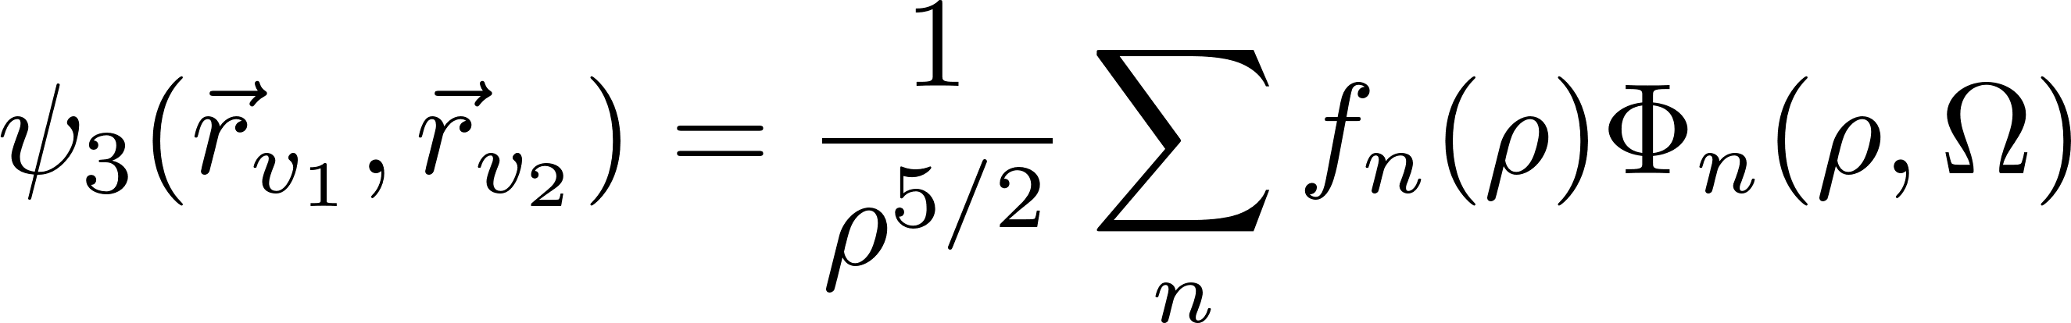
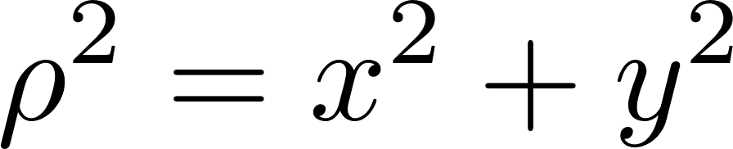
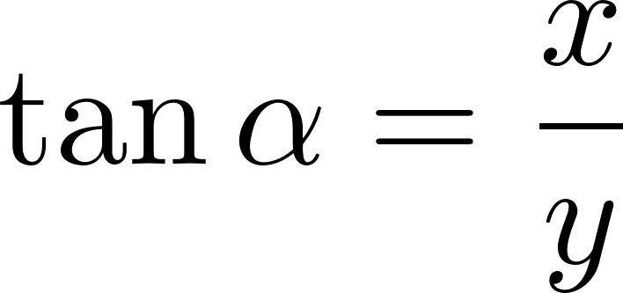
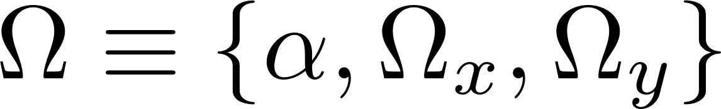
Hartree-Fock Calculations with Skyrme's Interaction. I. Spherical Nuclei
D. Vautherin and D.M. Brink
PRC 5 (1972) 626
Adiabatic Expansion Method

Slide 16
Hartree-Fock Calculations with Skyrme's Interaction. I. Spherical Nuclei
D. Vautherin and D.M. Brink
PRC 5 (1972) 626
Adiabatic Expansion Method

Slide 17
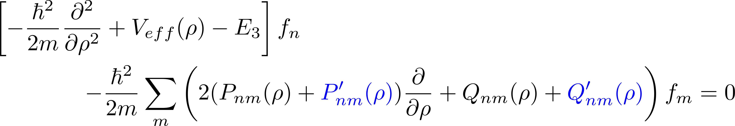
Hartree-Fock Calculations with Skyrme's Interaction. I. Spherical Nuclei
D. Vautherin and D.M. Brink
PRC 5 (1972) 626
Adiabatic Expansion Method
D. Hove et al., JPG 45, 073001 (2018)

Slide 18
The case of ²⁶O:
²⁴O is, to a large extent, a spherical nucleus

Slide 19
The case of ²⁶O:
Experimental information about ²⁶O is available

Slide 20
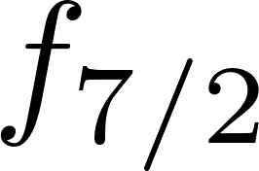
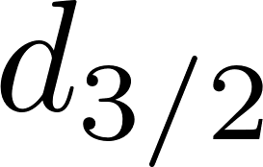

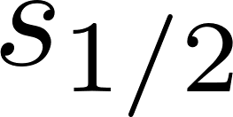
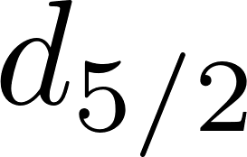
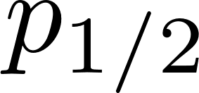
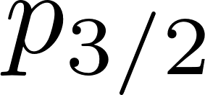
The case of ²⁶O:
Valence neutrons
16 neutron states occupied by the neutrons in the ²⁴O core.
 | SLy4 | SkM* | Sk3
E_{d3/2} | 0.85 | 0.83 | 1.23
E_{d3/2}(HF) | -0.96 | -1.15 | -0.53
Adiabatic Expansion Method
s, p, d, and f waves are included in the calculation

Slide 21
The case of ²⁶O:
Valence neutrons
16 neutron states occupied by the neutrons in the ²⁴O core.
Pauli forbidden to the valence neutrons !!!
Adiabatic Expansion Method
The adiabatic channels associated to Pauli forbidden states are removed from the calculation
s, p, d, and f waves are included in the calculation

Slide 22
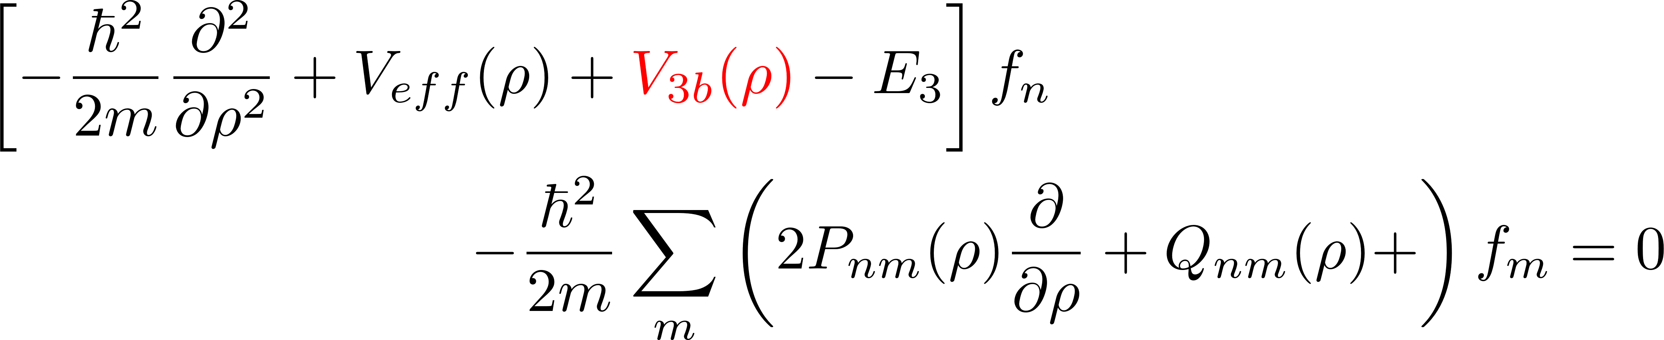
The case of ²⁶O:
The adiabatic channels associated to Pauli forbidden states are removed from the calculation
s, p, d, and f waves are included in the calculation

Slide 23
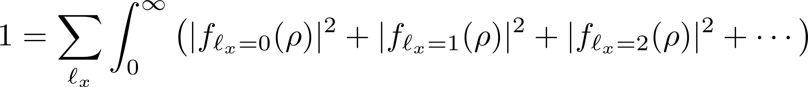
The case of ²⁶O:
The adiabatic channels associated to Pauli forbidden states are removed from the calculation
 | (d_{3/2},d_{3/2}) | (f_{7/2},f_{7/2}) | (p_{3/2},p_{3/2})
% of the norm | 90.1 | 3.7 | 2.1
s, p, d, and f waves are included in the calculation

Slide 24
The case of ²⁶O:
 | (d_{3/2},d_{3/2}) | (f_{7/2},f_{7/2}) | (p_{3/2},p_{3/2})
% of the norm | 90.1 | 3.7 | 2.1

Slide 25
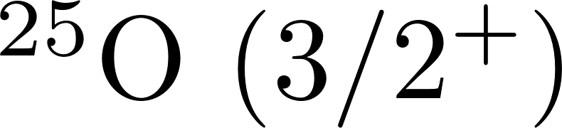
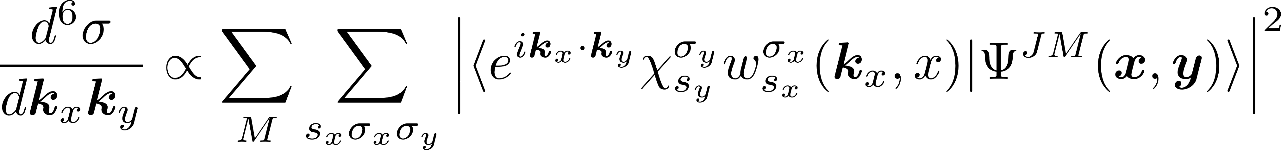
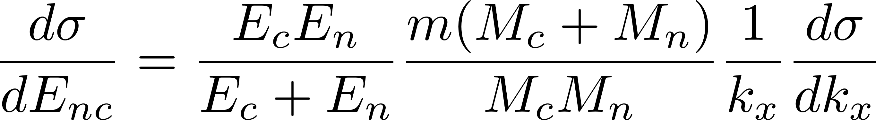
The case of ²⁶O:
Sudden approximation

Slide 26
The case of ²⁶O:
Sudden approximation
Once the NN interaction has been chosen, the invariant mass spectrum is fully determined.

Slide 27
Two-proton capture: ⁷⁰Kr
A.M. Rogers et al., PRL 106, 252503 (2011)

Slide 28
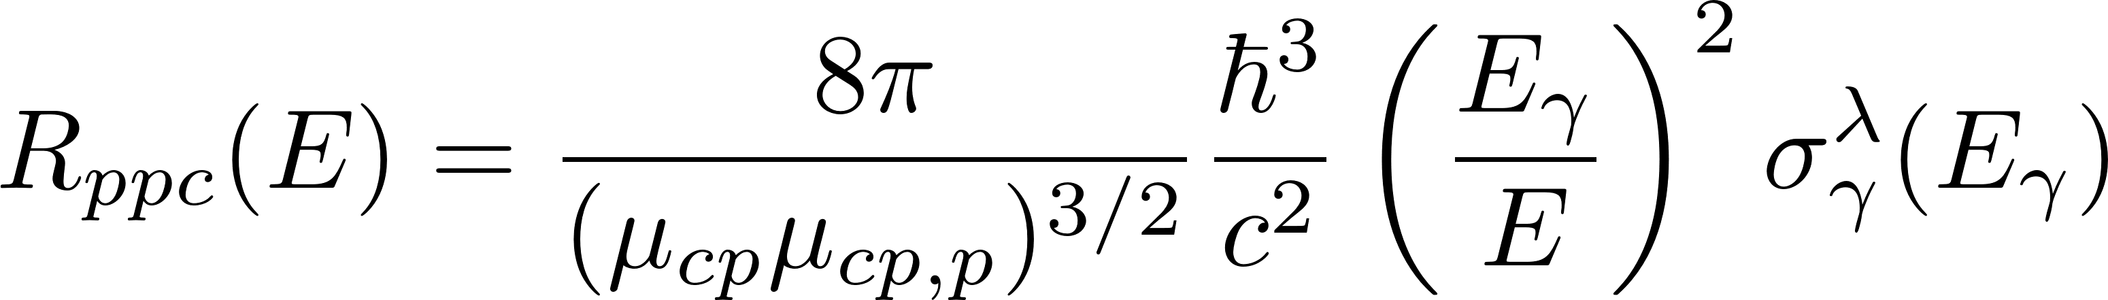
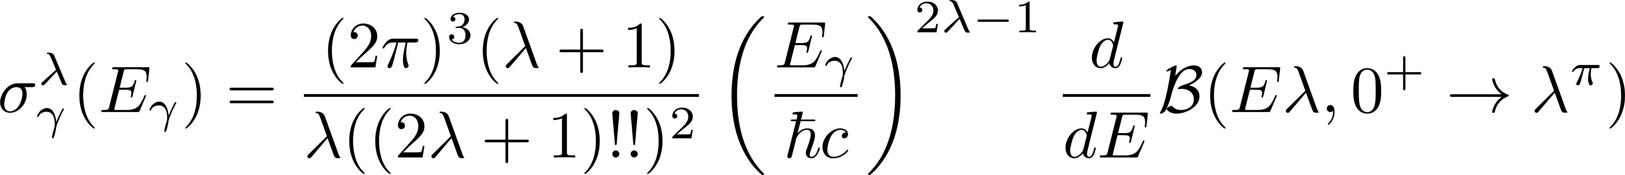
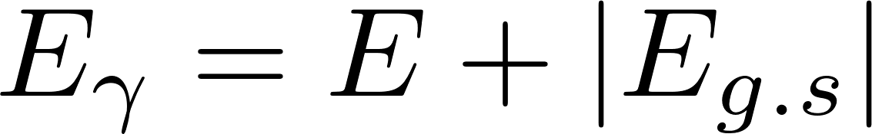
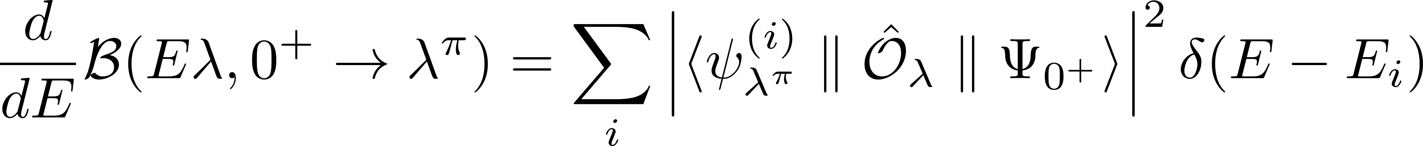
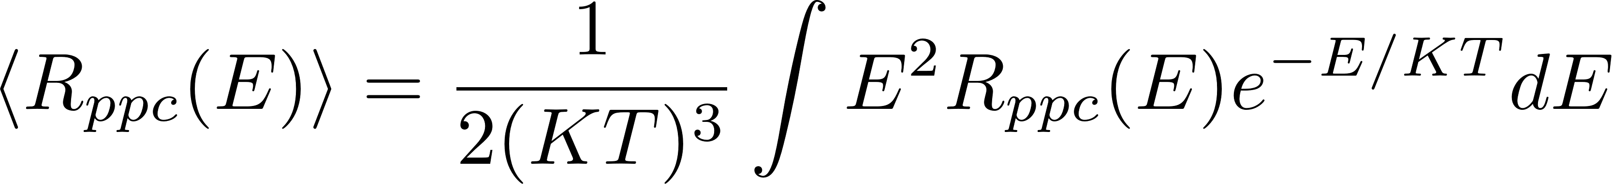
Two-proton capture: ⁷⁰Kr
A.M. Rogers et al., PRL 106, 252503 (2011)
Dominated by the E2 transition 2⁺ → 0⁺

Slide 29
Two-proton capture: ⁷⁰Kr
Dominated by the E2 transition 2⁺ → 0⁺

Slide 30
Two-proton capture: ⁷⁰Kr
Dominated by the E2 transition 2⁺ → 0⁺

Slide 31
Two-proton capture: ⁷⁰Kr
Dominated by the E2 transition 2⁺ → 0⁺

Slide 32
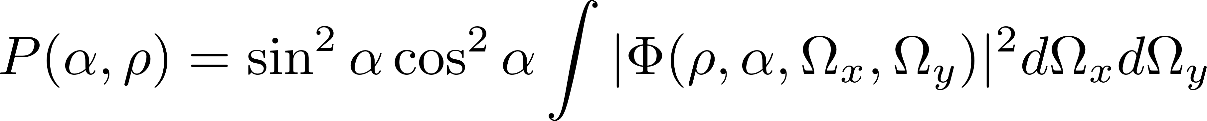
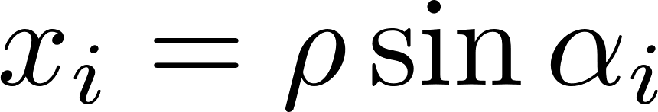
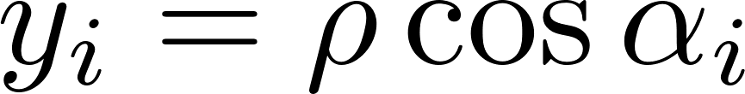
Two-proton capture: ⁷⁰Kr
Capture mechanism
Sequential capture through the f_{5/2} resonance in ⁶⁹Br at 0.6 MeV.
D. Hove et al., PLB 782, 42 (2018)

Slide 33
Summary:
The model presented here treats the many-body core and the two valence particles self-consistently:
Core: Spherical Skyrme Hartree-Fock
The mean-field determines the interaction with the loosely bound nucleons.
Core deformation?
Finite range NN interactions?
odd-odd nuclei?
Three-body problem
Three-body calculation: Adiabatic expansion
The presence of the loosely bound nucleons distorts the mean-field.
The distorted mean-field modifies the core-nucleon interaction and the wave function of the valence nucleons.
Three-body force from the mean field?
Generalization to more than one cluster and more than two valence nucleons
Self-consistent calculation

Slide 34
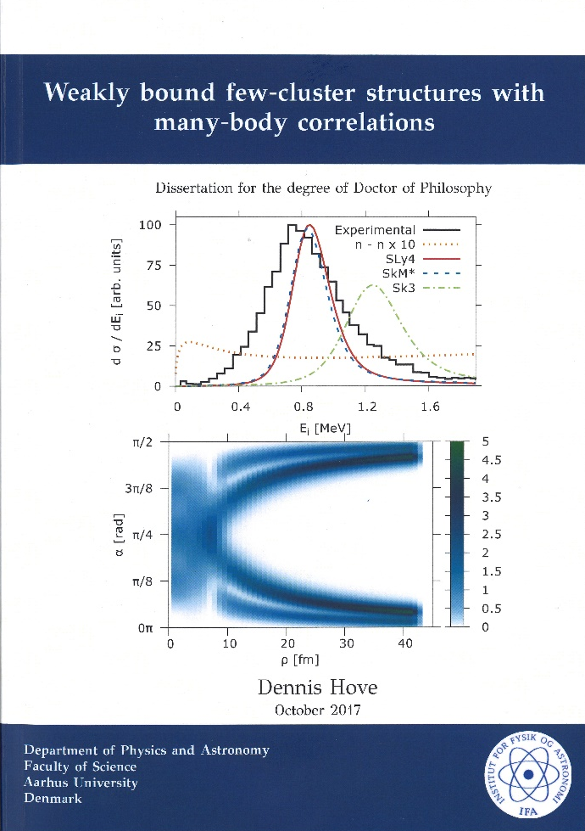


Weakly bound nuclei:
A unified description of intrinsic and relative degrees of freedom
Dennis Hove, Aksel S. Jensen
Aarhus University, Denmark
Pedro Sarriguren, Eduardo Garrido
IEM-CSIC, Madrid, Spain
Eduardo Garrido
Instituto de Estructura de la Materia, CSIC, Madrid, Spain

