Slide 1




Solutions of the Fadddeev-Yakubovsky equations
for five-nucleon systems
R. Lazauskas

Slide 2
Contents
5-body Faddeev-Yakubovsky equations
Some applications
  N-⁴He elastic scattering
  pv in low-energy n-⁴He scattering
  Resonances in ⁵H
01/09/2019
2
2
R. Lazauskas
R. Lazauskas
Notes:
2

Slide 3
Introduction
Non-relativistic Collisions
How to take care of the boundary condition?
  Conceptual difficulties to uncouple different particle channel, to constrain assymptotes of the solutions in all directions and thus get unique (physical) solution to the Schrödinger eq.
  It is ok, as long as there is single particle channel (elastic plus target/projectile excitations)
  Mathematically Ill-conditioned problem when several particle channels are open
Faddeev-Yakubovsky equations efficiently separates asymptotes of the binary channels
In configuration space wave functions extend to infinity!
Increasingly complex asymptotic behaviour for A>2 systems!!
…
L. D. Faddeev, Zh. Eksp. Teor. Fiz. 39, 1459 (1960). [Sov. Phys. JETP 12, 1014(1961)].
O. A. Yakubovsky, Sov. J. Nucl. Phys. 5, 937 (1967).
01/09/2019
3
3
R. Lazauskas
R. Lazauskas
Notes:
3

Slide 4
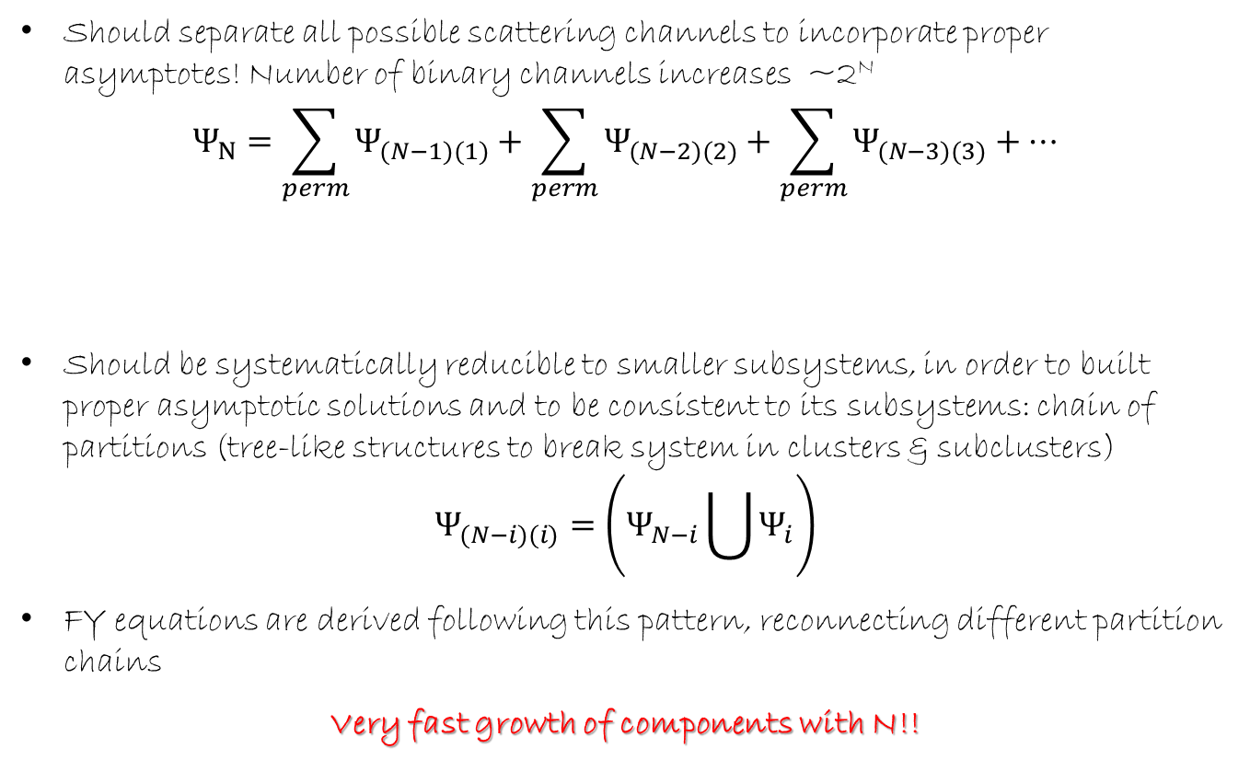
Properties of the rigorous scattering eq.
Should separate all possible scattering channels to incorporate proper asymptotes! Number of binary channels increases ~2^{N}
$$Ψ_{N}=\sum_{perm}{Ψ_{(N−1)(1)}+\sum_{perm}{Ψ_{(N−2)(2)}+\sum_{perm}{Ψ_{(N−3)(3)}+…}}}$$
Should be systematically reducible to smaller subsystems, in order to built proper asymptotic solutions and to be consistent to its subsystems: chain of partitions (tree-like structures to break system in clusters & subclusters)
$$Ψ_{(N−i)(i)}=\left(Ψ_{N−i}\bigcup{Ψ_{i}}\right)$$
FY equations are derived following this pattern, reconnecting different partition chains
Very fast growth of components with N!!
01/09/2019
4
4
R. Lazauskas
R. Lazauskas
Notes:
4

Slide 5


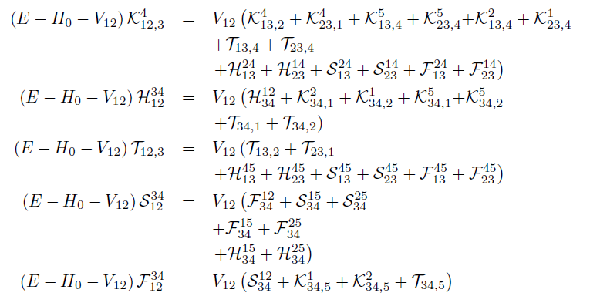
5-body Faddeev-Yakubovski eq
2
1
2
1
2
1
2
1
3
4
3
2
1
3
4
3
4
4
4
3
5
5
5
5
5
01/09/2019
5
5
R. Lazauskas
R. Lazauskas
Notes:
5

Slide 6
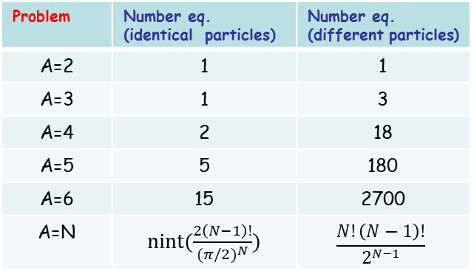
Faddeev-Yakubovsky eq
2
1
2
1
2
1
2
1
3
4
3
2
1
3
4
3
4
4
4
3
5
5
5
5
5
Merits:
Handling of symmetries
Boundary conditions for binary channels
Easy reduction to subsystems
3BF implemented at reasonable price
Built for short-ranged interactions.
Treatment of Coulomb – true adventure,
still reasonable for repulsive case.
Price
Overcomplexity with N
Problem | Number eq. (identical particles) | Number eq. (different particles)
A=2 | 1 | 1
A=3 | 1 | 3
A=4 | 2 | 18
A=5 | 5 | 180
A=6 | 15 | 2700
A=N | nint($\frac{2\left(N−1\right)!}{{(π/2)}^{N}})$ | $$\frac{N!\left(N−1\right)!}{2^{N−1}}$$
01/09/2019
6
6
R. Lazauskas
R. Lazauskas
Notes:
6

Slide 7
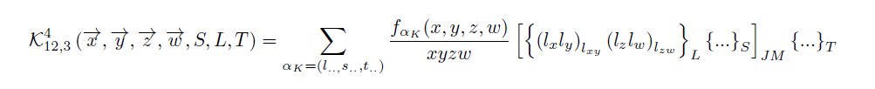
5-body Faddeev-Yakubovski eq
2
1
2
1
2
1
2
1
3
4
3
2
1
3
4
3
4
4
4
3
5
5
5
5
5
NUMERICAL SOLUTION
*R.L., PhD Thesis, Université Joseph Fourier, Grenoble (2003).
PW decomposition of the components K,H,T,S,F
Radial parts expanded using Lagrange-mesh method
D. Baye, Physics Reports 565 (2015) 1
Resulting linear algebra problem solved using iterative methods
Observables extracted using integral relations
01/09/2019
7
7
R. Lazauskas
R. Lazauskas
Notes:
7

Slide 8
Numerical costs
2
1
2
1
2
1
2
1
3
4
3
2
1
3
4
3
4
4
4
3
5
5
5
5
5
Problem | Number eq. (ident particles) | Number eq. (diff. particles) | PW basis. | Radial disc.
2N | 1 | 1 | 2 | ~N
3N | 1 | 3 | ~100 | ~N²
4N | 2 | 18 | ~10⁴ | ~N³
5N | 5 | 180 | ~10⁶ | ~N⁴
NUMERICAL SOLUTION
*R.L., PhD Thesis, Université Joseph Fourier, Grenoble (2003).
PW decomposition of the components K,H,T,S,F
Radial parts expanded using Lagrange-mesh method
D. Baye, Physics Reports 565 (2015) 1
Resulting linear algebra problem solved using iterative methods
Observables extracted using integral relations
01/09/2019
8
8
R. Lazauskas
R. Lazauskas
Notes:
8

Slide 9
n-⁴He scattering
NCSMC: P. Navratil et al., Physica Scripta 91 (2016) 053002
01/09/2019
9
9
R. Lazauskas
R. Lazauskas
Notes:
9

Slide 10
n-⁴He scattering
NCSMC: P. Navratil et al., Physica Scripta 91 (2016) 053002
01/09/2019
10
10
R. Lazauskas
R. Lazauskas
Notes:
10

Slide 11
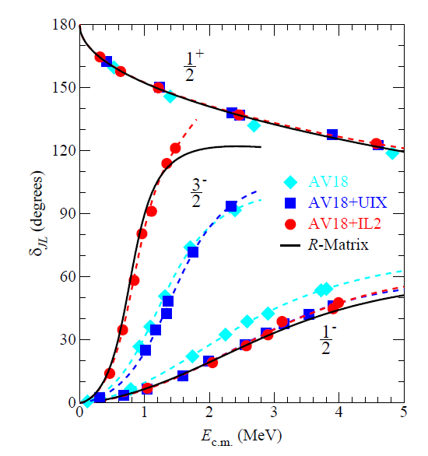
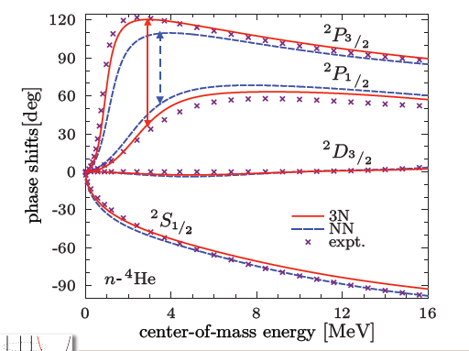
n-⁴He scattering
Idaho N3LO pot.
P. Navratil et al., Physica Scripta 91 (2016) 053002
K.M. Nollett et. al., Phys.Rev.Lett.99:022502,2007
01/09/2019
11
11
R. Lazauskas
R. Lazauskas
Notes:
11

Slide 12
Case of little interest: S-wave
Experimental n-⁴He scattering length …
nothing should be as easy to measure…
NIST (Neutron News 3, 1992)
 | Coh a (fm) | Inc b (fm)
¹H | -3.7406(11) -3.79406(11) | 25.274(9)
²H | 6.671(4) | 4.04(3)
³H | 4.792(27) | -1.04(17)
³He | 5.74(7)-1.483(2)i | -2.5(6)+2.568(3)i
⁴He | 3.26(3)
TUNL: D.R. Tilley et al., Nucl. Phys. A708 (2002) 3
NIST: https://www.ncnr.nist.gov
Experimental data:
D.C.Rorer et al., Nucl. Phys. A 133 (1969) 410
S.F.Mughabghab, Atlas of Neutron Resonances (2006)
R.Genin et al., Journal de Physique 24 (1963) 21
01/09/2019
12
12
R. Lazauskas
R. Lazauskas
Notes:
12

Slide 13
Case of little interest: S-wave
TUNL: D.R. Tilley et al., Nucl. Phys. A708 (2002) 3
NIST: https://www.ncnr.nist.gov
S. Ali PSA: S. Ali et al., Rev. Mod. Phys. 57 (1985) 923
Bang-Gignoux pot: J. Bang, C. Gignoux, Nucl. Phys. A 313 (1979) 119
NCSMC: P. Navratil et al., Physica Scripta 91 (2016) 053002
GFMC: K.M. Nollett, PRL99, 022502 (2007)
01/09/2019
13
13
R. Lazauskas
R. Lazauskas
Notes:
13

Slide 14
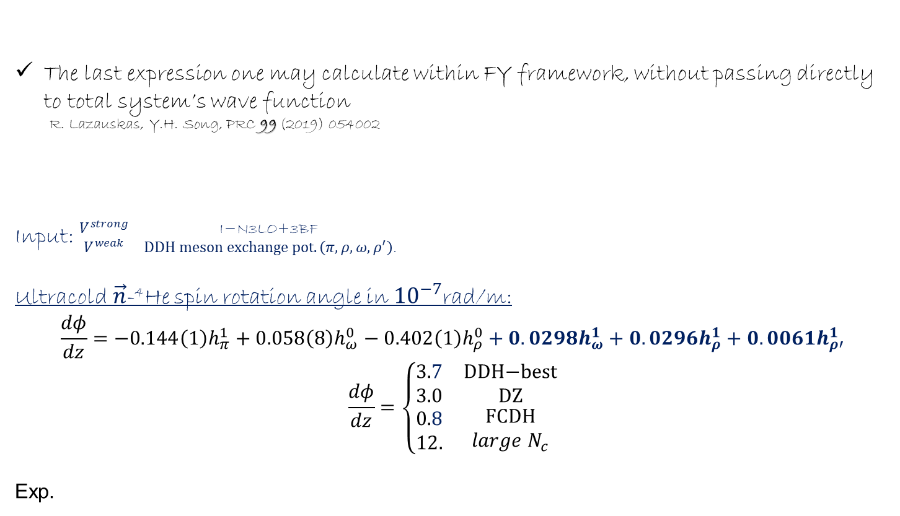

PV violation for $\vec{n}$-⁴He
Slow $\vec{n}$ spin rotation studyt at NIST $\frac{dφ}{dz}=2.1±8.3(stat.)\begin{matrix}+2.9 \\ −0.2\end{matrix}(sys)×{10}^{−7}$rad/m
E. Swanson et al. PRC 100 (2019) 015204
1st order perturbation:
Weak process $V^{weak}≪V^{strong}$
The last expression one may calculate within FY framework, without passing directly to total system’s wave function
R. Lazauskas, Y.H. Song, PRC 99 (2019) 054002
Input: $\begin{matrix}V^{strong} & \text{I}\text{−}\text{N}\text{3}\text{LO}\text{+3}\text{BF} \\ V^{weak} & DDH meson exchange pot. \left(π,ρ,ω,ρ^{′}\right)\text{.}\end{matrix}$
Ultracold$\vec{n}$-⁴He spin rotation angle in ${10}^{−7}$rad/m:
$$\frac{dφ}{dz}=−0.144\left(1\right)h_{π}^{1}+0.058\left(8\right)h_{ω}^{0}−0.402\left(1\right)h_{ρ}^{0}+0.0298h_{ω}^{1}+0.0296h_{ρ}^{1}+0.0061h_{ρ′}^{1}$$
$$\frac{dφ}{dz}=\left\{\begin{matrix}3.7 & \text{DDH}\text{−}\text{best} \\ 3.0 & \text{DZ} \\ \begin{aligned}0.8 \\ 12.\end{aligned} & \begin{aligned}\text{FCDH} \\ {large N}_{c}\end{aligned}\end{matrix}\right.$$
Exp.
B. Desplanques et al, Ann.Phys. 124 (1980) 449 .
R. Lazauskas, Y.H. Song, PRC 99 (2019) 054002.
S. Gardner et al., Ann. Rev. Nucl. Part. Sci. 67 (2017) 69
01/09/2019
14
14
R. Lazauskas
R. Lazauskas
Notes:
14

Slide 15
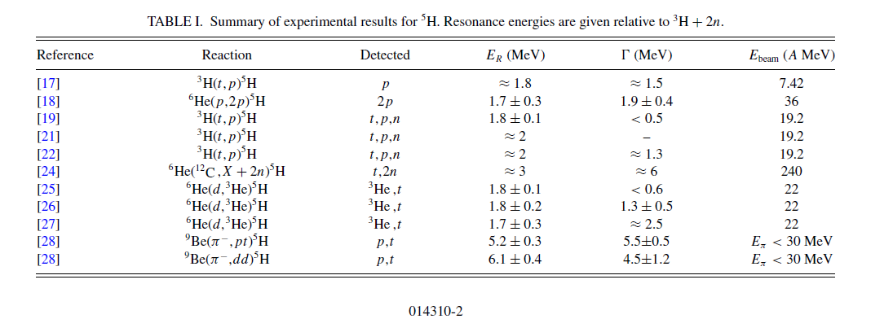
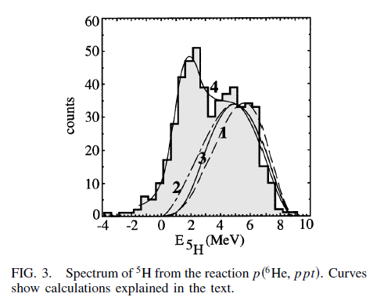
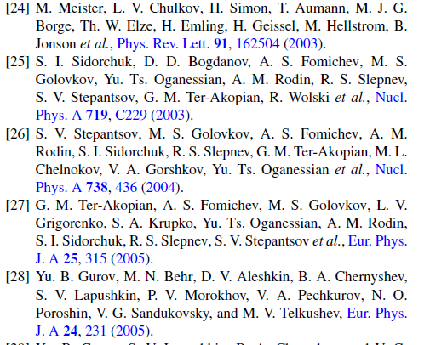
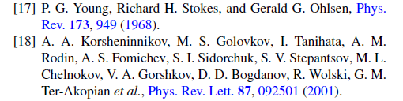

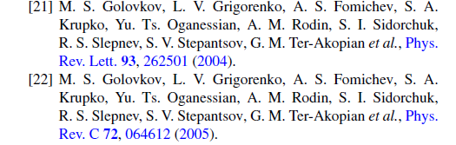
⁵H resonances: experiment
01/09/2019
15
15
R. Lazauskas
R. Lazauskas
Notes:
15

Slide 16
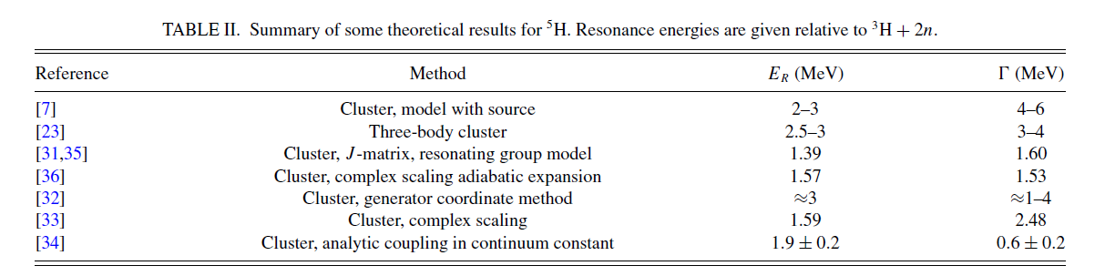

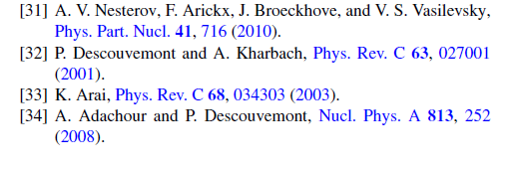
⁵H resonances?
Predictivity?
⁵H states does not appear naturally
Cluster models, involvig approximations for 5-body dynamics
³H+n+n models: without n-antisymetrization between the core &valence
³H+n+n models: including n-antisymmetrization, however by freezing ³H core
01/09/2019
16
16
R. Lazauskas
R. Lazauskas
Notes:
16

Slide 17
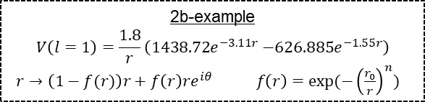
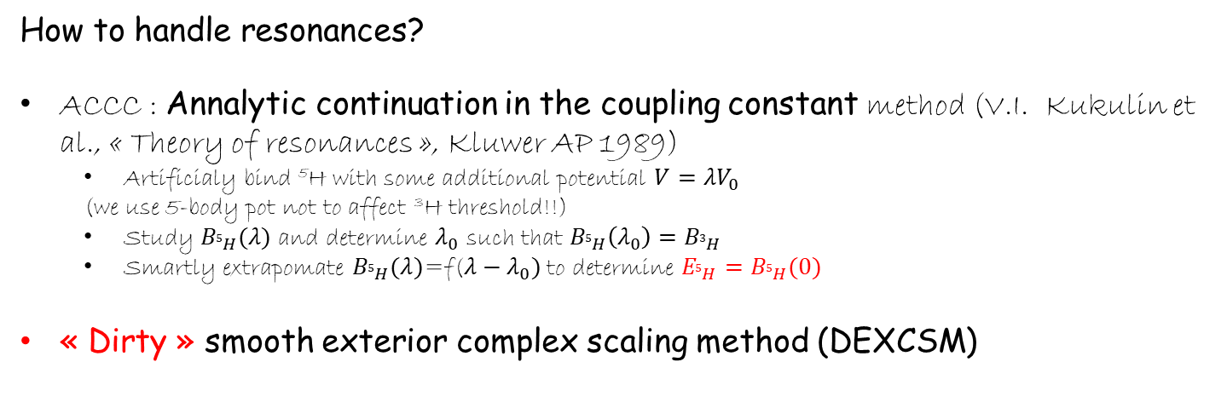
⁵H resonances?
How to handle resonances?
ACCC : Annalytic continuation in the coupling constant method (V.I. Kukulin et al., « Theory of resonances », Kluwer AP 1989)
  Artificialy bind ⁵H with some additional potential $V=λV_{0}$
  (we use 5-body pot not to affect ³H threshold!!)
  Study $B_{5H}(λ)$ and determine $λ_{0}$ such that $B_{5H}\left(λ_{0}\right)=B_{3H}$
  Smartly extrapomate $B_{5H}(λ)$=f($λ−λ_{0})$to determine $E_{5H}=B_{5H}(0)$
« Dirty » smooth exterior complex scaling method (DEXCSM)
B. Simon. Phys. Letters A, 71 (1979) 211
Choose sharp transformation function, which almost does not affect r in r<r₀
Fix r₀ beyond the physical interaction region
Ignore inconsisitencies in transformation between different Jacobi bases
2b-example
$$V\left(l=1\right)=\frac{1.8}{r}\left({1438.72e}^{−3.11r}{−626.885e}^{−1.55r}\right)$$
$r→\left(1−f(r)\right)r+f\left(r\right)re^{iθ} f\left(r\right)=exp(−{\left(\frac{r_{0}}{r}\right)}^{n})$
01/09/2019
17
17
R. Lazauskas
R. Lazauskas
Notes:
17

Slide 18

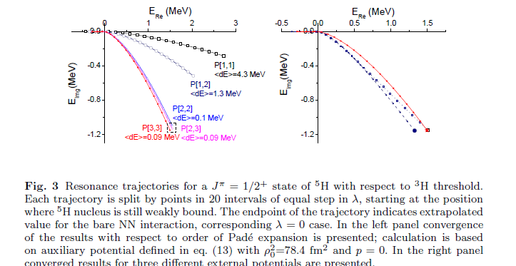
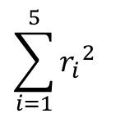
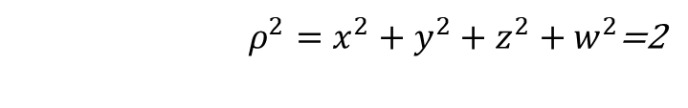
⁵H(J=1/2⁺)
nn interaction described by the MT I-III potential
auxilliary potential for ACCC
$$\sum_{i=1}^{5}{{r_{i}}_{}^{2}}$$
$ρ^{2}=x^{2}+y^{2}+z^{2}+w^{2}$=2
E(⁵H)-E(³H)=1.4(1)-i1.2 (1)
E(⁵H)-E(³H)=1.7(2)-i1.2 (1)
01/09/2019
18
18
R. Lazauskas
R. Lazauskas
Notes:
18

Slide 19
⁵H(J=1/2⁺)
nn interaction described by the MT I-III potential
J=1/2⁺ (L=0⁺, S=1/2)
ACCC:
DEXCSM:
E(⁵H)-E(³H)=1.4(1)-i1.2 (1)
E(⁵H)-E(³H)=1.6(2)-i1.2 (1)
J=5/2⁺ (L=2⁺, S=1/2)
DEXCSM:
E(⁵H)-E(³H)=2.50(15)-i1.90 (15)
Negative parity states & ones with S=3/2 are much more broader
To compare with ⁴H resonances:
1.08(1)-i2.04 (2) (S=1, L=1⁻)
0.88(3)-i2.20(4) (S=0, L=1⁻)
E(⁴H)-E(³H)=
R. Lazauskas, Few-Body Syst. 59 (2018) 13.
01/09/2019
19
19
R. Lazauskas
R. Lazauskas
Notes:
19

Slide 20
⁵H(J=1/2⁺)
INOY Potential
N₃LO Potential
E(⁵H)-E(³H)=1.65(5)-i1.26(6)
DEXCSM: 1.8(1)-i1.2(1)
E(⁵H)-E(³H)=1.8(1)-i1.15(15)
DEXCSM: 1.85(10)- i1.20(5)
To compare with ⁴H resonances J=2⁻:
E(⁴H)-E(³H)=1.31(3)-2.08(2)
E(⁴H)-E(³H)=1.17(3)-1.99(3)
R. Lazauskas, E. Hiyama, J. Carbonell, Phys. Lett. B 791 (2019) 335
01/09/2019
20
20
R. Lazauskas
R. Lazauskas
Notes:
20

Slide 21
Conclusion
FY eq. formalism remains reference in few-body scattering calculations. The first solutions of 5-body FY equations are presented.
Reliable results have been obtained for n-⁴He scattering at low energies using realistic interactions. Satisfactory description is obtained when using Idaho N3LO NN +N2LO NNN interactions.
The first fully realistic calculation of weak process in 5-nucleon sector is performed.
Description of the ⁵H resonant states have been performed for the first time using fully realistic description and two different methods to calculate resonance positions. Presence of broad resonant states is confirmed!
Acknowledgements: The numerical calculations have been performed at IDRIS (CNRS, France). We thank the staff members of the IDRIS computer center for their constant help.
21
R. Lazauskas
Notes:
21

Slide 22
n-⁴He scattering
Experimental n-⁴He scattering length …
nothing should be as easy to measure…
NIST (Neutron News 3, 1992)
 | Coh a (fm) | Inc b (fm)
¹H | -3.7406(11) -3.79406(11) | 25.274(9)
²H | 6.671(4) | 4.04(3)
³H | 4.792(27) | -1.04(17)
³He | 5.74(7)-1.483(2)i | -2.5(6)+2.568(3)i
⁴He | 3.26(3)
TUNL: D.R. Tilley et al., Nucl. Phys. A708 (2002) 3
NIST: https://www.ncnr.nist.gov
Experimental data:
D.C.Rorer et al., Nucl. Phys. A 133 (1969) 410
S.F.Mughabghab, Atlas of Neutron Resonances (2006)
R.Genin et al., Journal de Physique 24 (1963) 21
01/09/2019
22
22
R. Lazauskas
R. Lazauskas
Notes:
22

Slide 23
n-⁴He scattering
01/09/2019
23
23
R. Lazauskas
R. Lazauskas
Notes:
23

