Slide 1
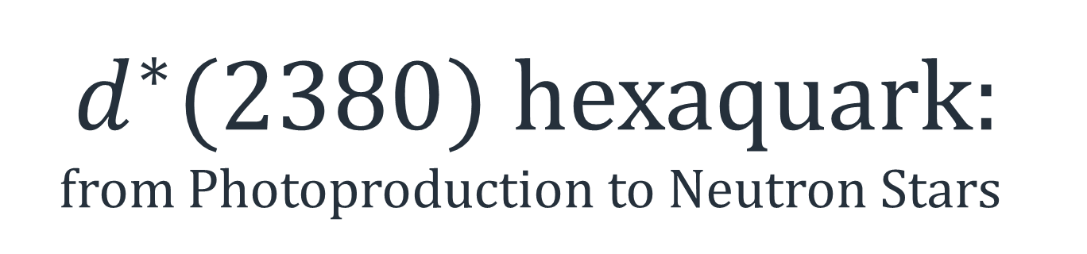
$d^{∗}(2380)$ hexaquark: from Photoproduction to Neutron Stars
Mikhail Bashkanov

Slide 2
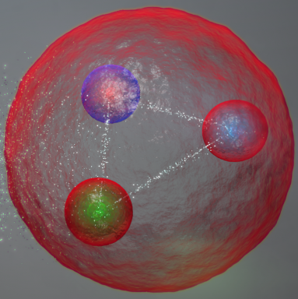
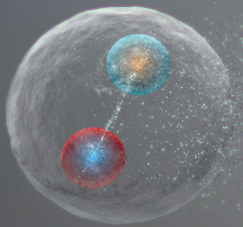
Well known friends
Meson
Baryon
2

Slide 3
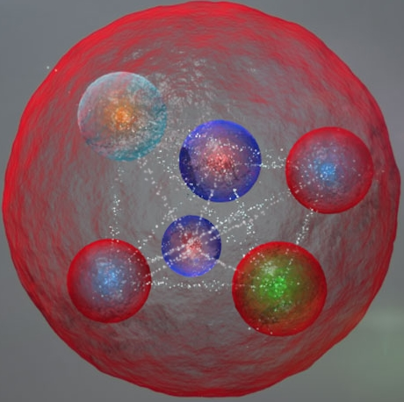
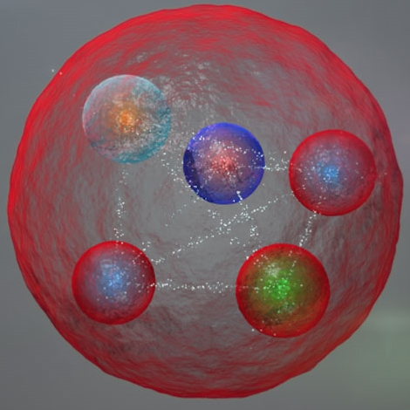
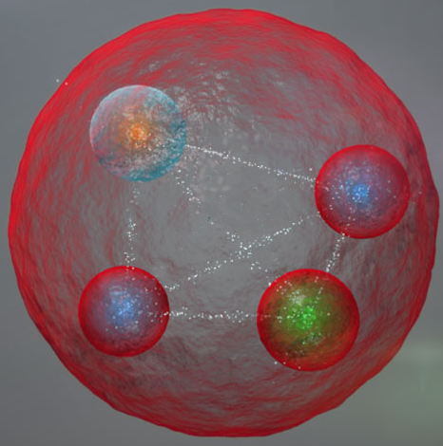
Prospective Newbies
Tetra-
quark
Penta-
quark
Hexa-
quark
3

Slide 4
Multiquark vs Molecule
Tetra-
quark
Penta-
quark
Hexa-
quark
Meson-Meson molecule
Meson-Baryon molecule
Baryon-Baryon molecule
4

Slide 5
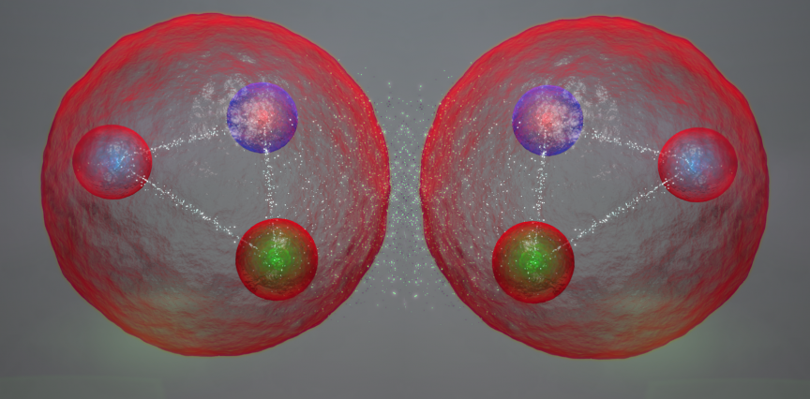
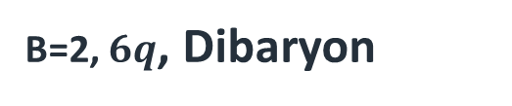
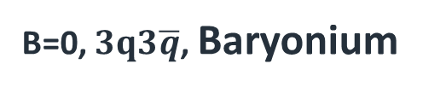
Six quark systems
By baryon number:
B=2, $6q$, Dibaryon
B=0, $3q3\overline{q}$, Baryonium
By internal structure:
Genuine hexaquark
Baryon-baryon molecule
5

Slide 6
Dibaryons prehistoric studies

Slide 7
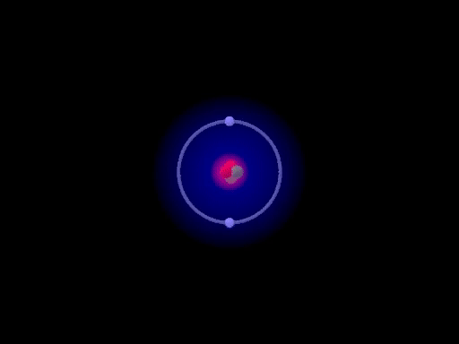
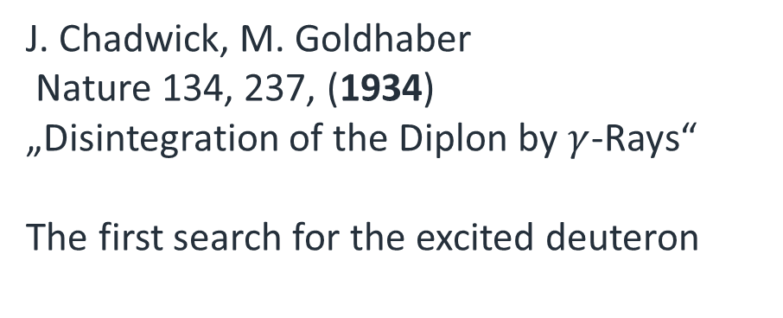
Ancient history
Deuteron – “trivial dibaryon”
proton neutron
1931 Harold Urey,
Nobel prize 1934
Deuteron phtotdisintegration
J. Chadwick, M. Goldhaber
Nature 134, 237, (1934)
„Disintegration of the Diplon by $γ$-Rays“
The first search for the excited deuteron
7

Slide 8
Quark era
Six non-strange dibaryons
F. J. Dyson, N.-H. Xuong, Phys. Rev. Lett. 13, 815 (1964).
Mirrored quantum numbers
Mass
I=0, J=3
I=3, J=0
ΔΔ threshold
I=1, J=2
I=2, J=1
NΔ threshold
I=0, J=1
I=1, J=0
NN threshold
8

Slide 9

Quark era
Six non-strange dibaryons
F. J. Dyson, N.-H. Xuong, Phys. Rev. Lett. 13, 815 (1964).
I=0, J=3
I=3, J=0
ΔΔ threshold
~70 MeV
Δ
Δ
Δ
Δ
PLB 762 (2016) 455
$$d^{∗}(2380)$$
I=1, J=2
I=2, J=1
NΔ threshold
~10 MeV
~10 MeV
N
Δ
N
Δ
PRL 121 (2018) 052001
D. Arndt
resonance
I=0, J=1
I=1, J=0
66 keV
NN threshold
2.2 MeV
NN-FSI
p
n
p
n
9
deuteron

Slide 10
Quark era
Loosely Bound/Unbound == Molecular
I=0, J=3
I=3, J=0
ΔΔ threshold
~70 MeV
Δ
Δ
Δ
Δ
PLB 762 (2016) 455
$$d^{∗}(2380)$$
I=1, J=2
I=2, J=1
NΔ threshold
~10 MeV
~10 MeV
N
Δ
N
Δ
PRL 121 (2018) 052001
D. Arndt
resonance
I=0, J=1
I=1, J=0
66 keV
NN threshold
2.2 MeV
NN-FSI
p
n
p
n
10
deuteron

Slide 11
Quark era
Strongly Bound
Far from thresholds
potential Hexaquark
I=0, J=3
I=3, J=0
ΔΔ threshold
~70 MeV
Δ
Δ
Δ
Δ
PLB 762 (2016) 455
$$d^{∗}(2380)$$
I=1, J=2
I=2, J=1
NΔ threshold
~10 MeV
~10 MeV
N
Δ
N
Δ
PRL 121 (2018) 052001
D. Arndt
resonance
I=0, J=1
I=1, J=0
66 keV
NN threshold
2.2 MeV
NN-FSI
p
n
p
n
11
deuteron

Slide 12
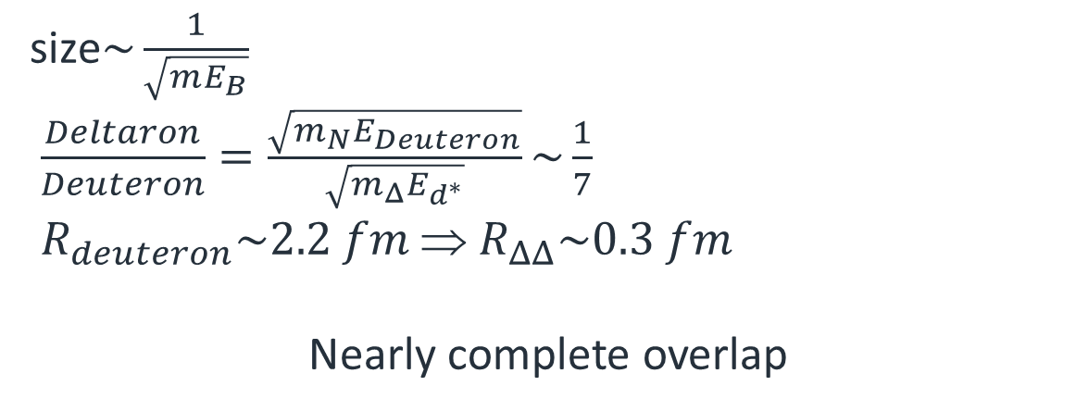
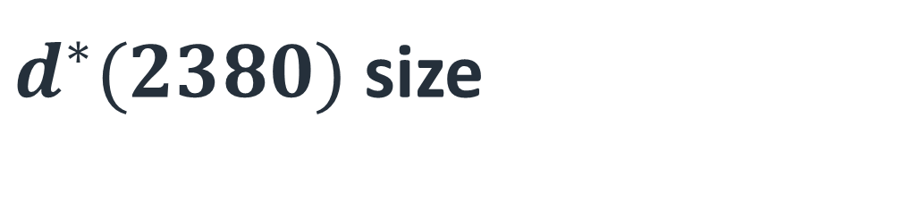
$d^{∗}(2380)$ size
Deuteron
Deltaron
size$\sim \frac{1}{\sqrt{mE_{B}}}$
$\frac{Deltaron}{Deuteron}=\frac{\sqrt{m_{N}E_{Deuteron}}}{\sqrt{m_{Δ}E_{d^{∗}}}}\sim \frac{1}{7}$
$R_{deuteron}\sim 2.2 fm$ ⇒ $R_{ΔΔ}\sim 0.3 fm$
Nearly complete overlap
12

Slide 13
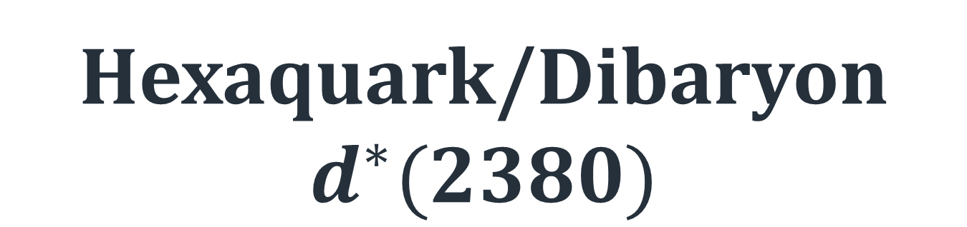
Hexaquark/Dibaryon
$$d^{∗}(2380)$$
13

Slide 14
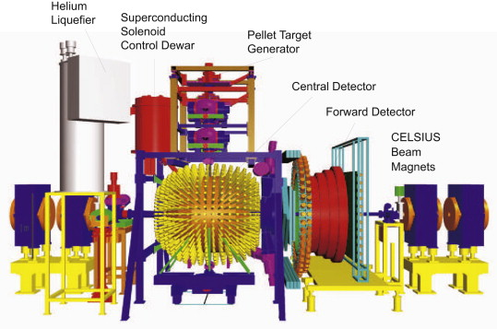

Pathway to discovery
π
γ
γ
p
d
n
γ
γ
π
14

Slide 15
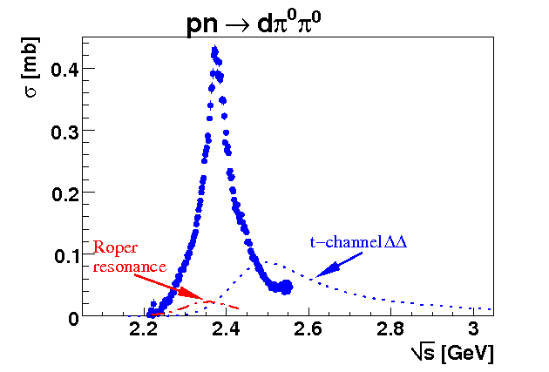

New peak to climb
d*(2380) hexaquark
Γ∼70 MeV → lifetime $\sim 10^{−24}s$
NN*
background
ΔΔ
background
P. Adlarson et. al Phys. Rev. Lett. 106:242302, 2011
15

Slide 16
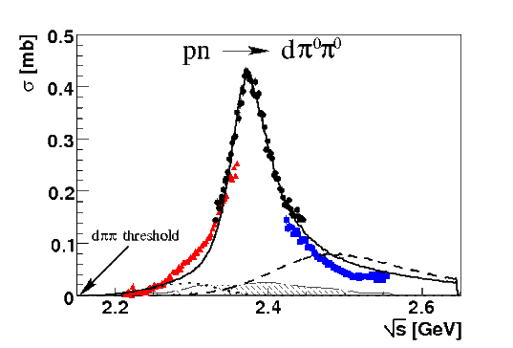









Pathway to discovery
$$dπ^{0}π^{0}$$
$$dπ^{+}π^{−}$$
d*(2380)
$$pn$$
$$ppπ^{−}π^{0}$$
$$pnπ^{0}π^{0}$$
$$pnπ^{+}π^{−}$$
d*
d*
d*
16

Slide 17
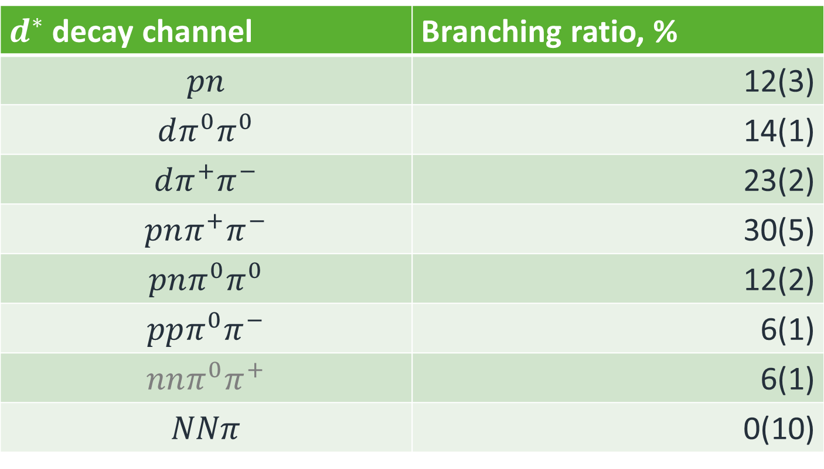
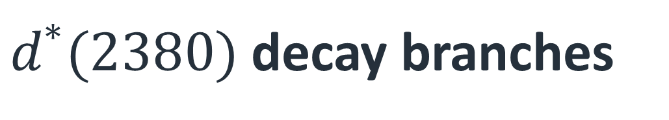
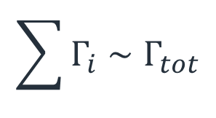
$d^{∗}(2380)$ decay branches
$d^{∗}$ decay channel | Branching ratio, %
$$pn$$ | 12(3)
$$dπ^{0}π^{0}$$ | 14(1)
$$dπ^{+}π^{−}$$ | 23(2)
$$pnπ^{+}π^{−}$$ | 30(5)
$$pnπ^{0}π^{0}$$ | 12(2)
$$ppπ^{0}π^{−}$$ | 6(1)
$$nnπ^{0}π^{+}$$ | 6(1)
$$NNπ$$ | 0(10)
$$\sum{Γ_{i}}∼Γ_{tot}$$
Eur.Phys.J. A51 (2015) 7, 87

Slide 18
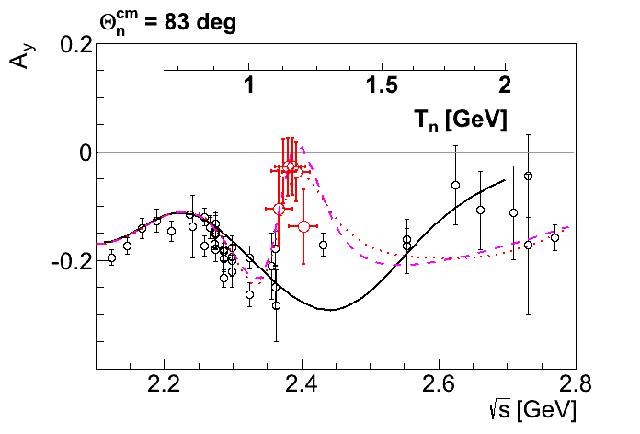
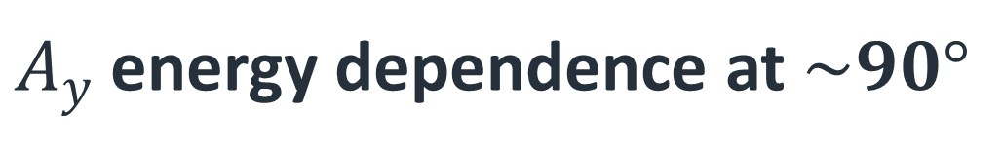
$A_{y}$ energy dependence at $\sim 90°$
p
p
n
n
SAID
New SAID
solutions
P. Adlarson et al. Phys. Rev. Lett. 112, 202301, (2014)
18

Slide 19
Argand plot
P. Adlarson et al. Phys. Rev. Lett. 112, 202301, (2014)
P. Adlarson et al. Phys. Rev. C 90, 035204 , (2014)
19

Slide 20
$$d^{∗}\left(2380\right) internal structure$$
EXPERIMENTAL VERIFICATION
20

Slide 21

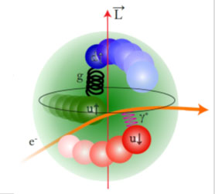

Hexaquark Autopsy
3
$$d^{∗}$$
1/2
electron
γ*
p
p
d
1/2
p
n
21

Slide 22
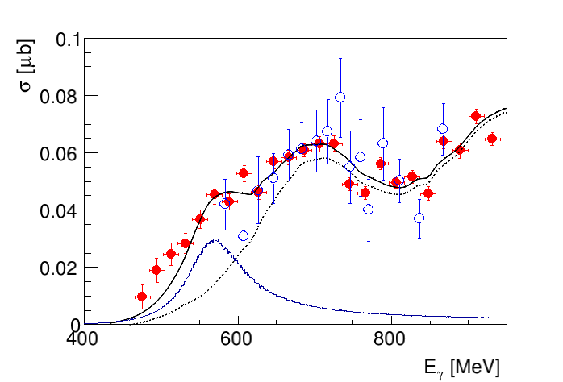




d*(2380) photoproduction
$$π^{0}$$
γ
d*
$$π^{0}$$
d
d
$γd→dπ^{0}π^{0}$
$γd→dπ^{0}π^{0}$
Conventional Background
M. Egorov, A. Fix,
Nucl.Phys. A933 (2015) 104-113
$$d^{∗}$$
B. Krusche, NStar 2019
T. Ishikawa et al. Phys.Lett. B772 (2017) 398
22

Slide 23

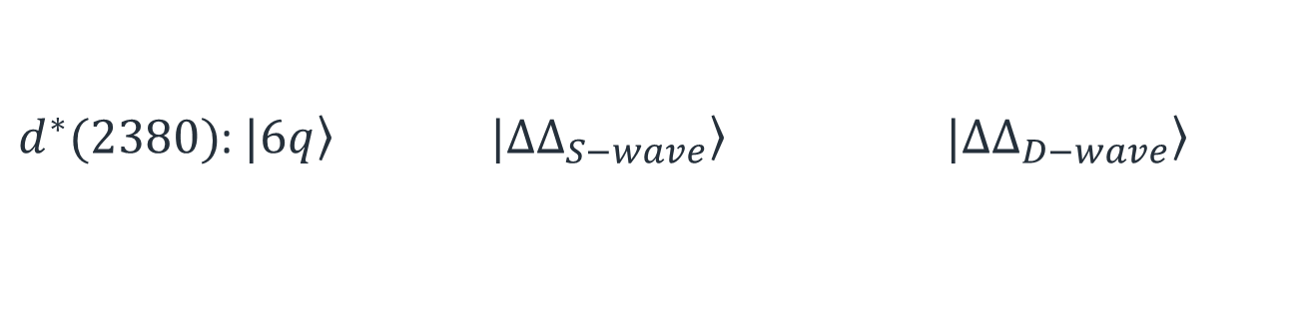


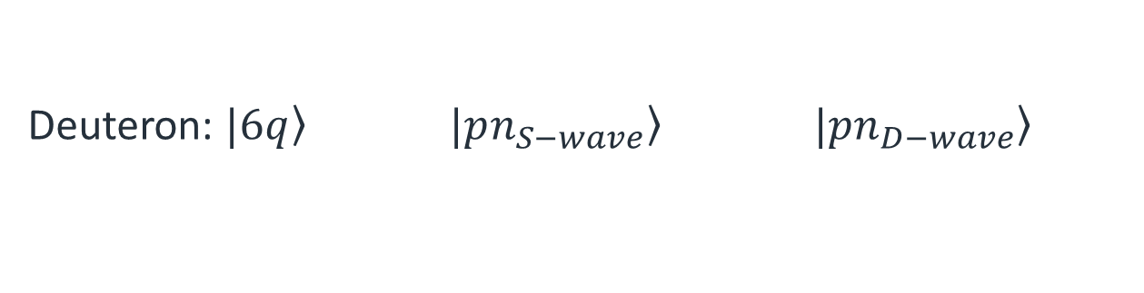






d → d*(2380) transitions
0.15%
5%
Deuteron: $\left.|6q\right\rangle$ $\left.|pn_{S−wave}\right\rangle$ $\left.|pn_{D−wave}\right\rangle$
$$γ$$
$$γ$$
$d^{∗}(2380)$: $\left.|6q\right\rangle$ $\left.|ΔΔ_{S−wave}\right\rangle$ $\left.|ΔΔ_{D−wave}\right\rangle$
66%
30%
2%
E2, ($2^{+}$)
$$γ$$
d
d*(2380)
M3, ($3^{+}$)
$$γ$$
d
$$E_{γ}\sim 570 MeV$$
E4, ($4^{+}$)
$$γ$$
d
deuteron
23

Slide 24
d → d*(2380) transitions
0.15%
5%
Deuteron: $\left.|6q\right\rangle$ $\left.|pn_{S−wave}\right\rangle$ $\left.|pn_{D−wave}\right\rangle$
$$γ$$
$$γ$$
$d^{∗}(2380)$: $\left.|6q\right\rangle$ $\left.|ΔΔ_{S−wave}\right\rangle$ $\left.|ΔΔ_{D−wave}\right\rangle$
66%
30%
2%
E2, ($2^{+}$)
$$γ$$
d
d*(2380)
M3, ($3^{+}$)
$$γ$$
d
$$E_{γ}\sim 570 MeV$$
E4, ($4^{+}$)
$$γ$$
d
deuteron
24

Slide 25
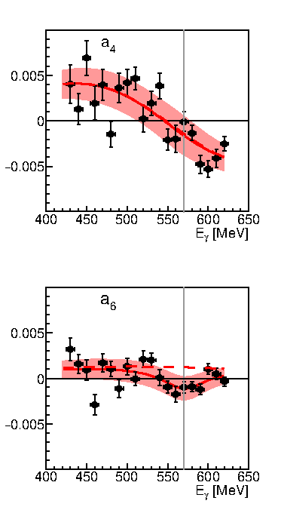


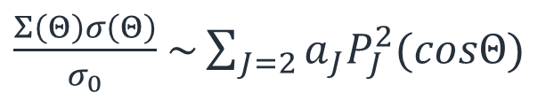


Photon beam spin asymmetry
$$φ$$
p
$$γ$$
d
$\frac{Σ\left(Θ\right)σ\left(Θ\right)}{σ_{0}}$ $\sim \sum_{J=2}{a_{J}P_{J}^{2}(cosΘ)}$
n
$d^{∗}$ E2 transition likely to be small
$d^{∗}$ M3 transition seems to be preferable
M. Bashkanov et al., Phys. Lett B789, (2019), 7-12
25

Slide 26

Is $d^{∗}(2380)$ compact?
Small E2 transition → compact
26

Slide 27
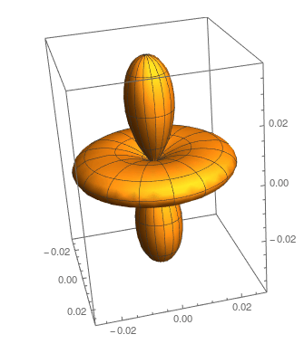
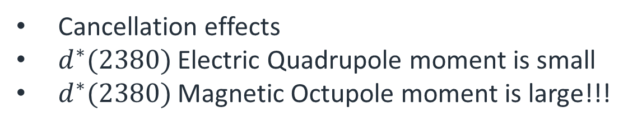
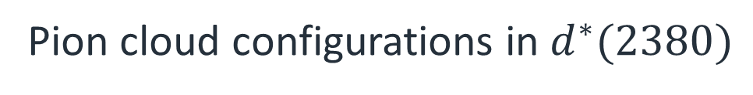
Is $d^{∗}(2380)$ compact?
Small E2 transition → compact
Not necessary
Pion cloud configurations in $d^{∗}(2380)$
Cancellation effects
$d^{∗}(2380)$ Electric Quadrupole moment is small
$d^{∗}(2380)$ Magnetic Octupole moment is large!!!
M. Bashkanov, D.P. Watts, A. Pastore: PRC 100 (2019) no.1, 012201
27

Slide 28





Experimentum crucis
$$γd→d^{∗}→p\vec{n}$$
$$γ$$
p
$$n$$
$$Θ,φ,E$$
p
Target
$$Θ^{′},φ′$$
Polarimeter
28

Slide 29
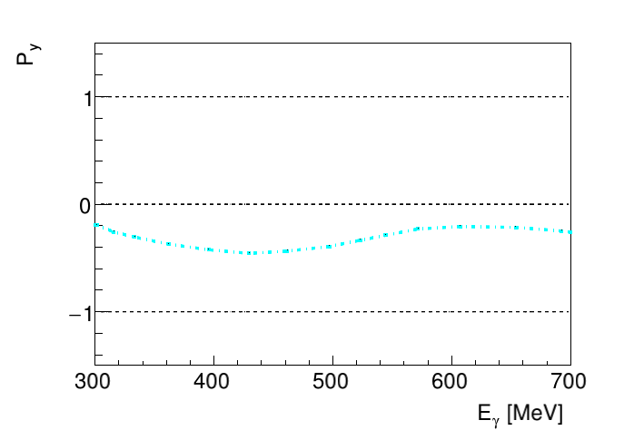



Nucleon polarisation at $90°$
$$γd→d^{∗}→p\vec{n}$$
$$γd→d^{∗}→\vec{p}n$$
Conventional background, Kang et al
29

Slide 30
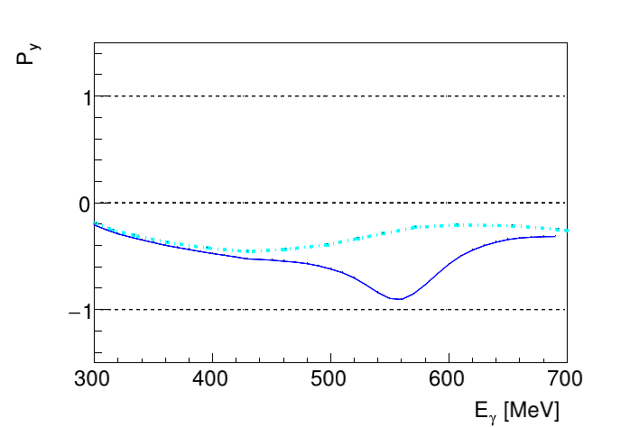
Nucleon polarisation at $90°$
$$γd→d^{∗}→p\vec{n}$$
$$γd→d^{∗}→\vec{p}n$$
Conventional background, Kang et al
30

Slide 31
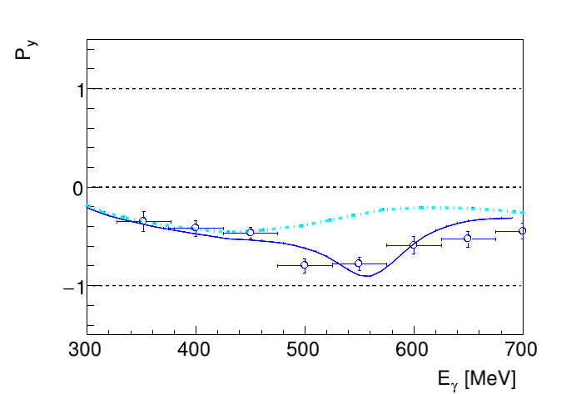
Nucleon polarisation at $90°$
$$γd→d^{∗}→p\vec{n}$$
$$γd→d^{∗}→\vec{p}n$$
proton
Conventional background, Kang et al
31
H. Ikeda et al., Phys. Rev. Lett. 42, May 1979, 1321

Slide 32
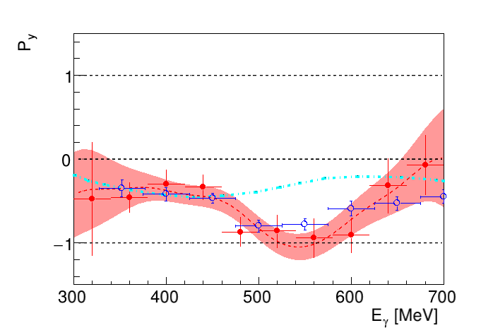
Nucleon polarisation at $90°$
$$γd→d^{∗}→p\vec{n}$$
$$γd→d^{∗}→\vec{p}n$$
neutron
proton
M. Bashkanov et al., to be published soon
32

Slide 33

Nuclear matter at high density
d*
n
p
33

Slide 34
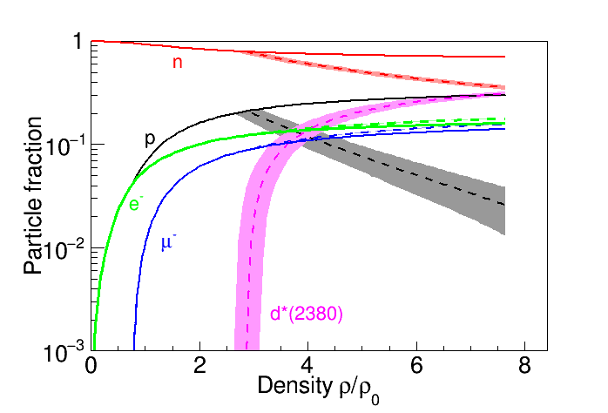
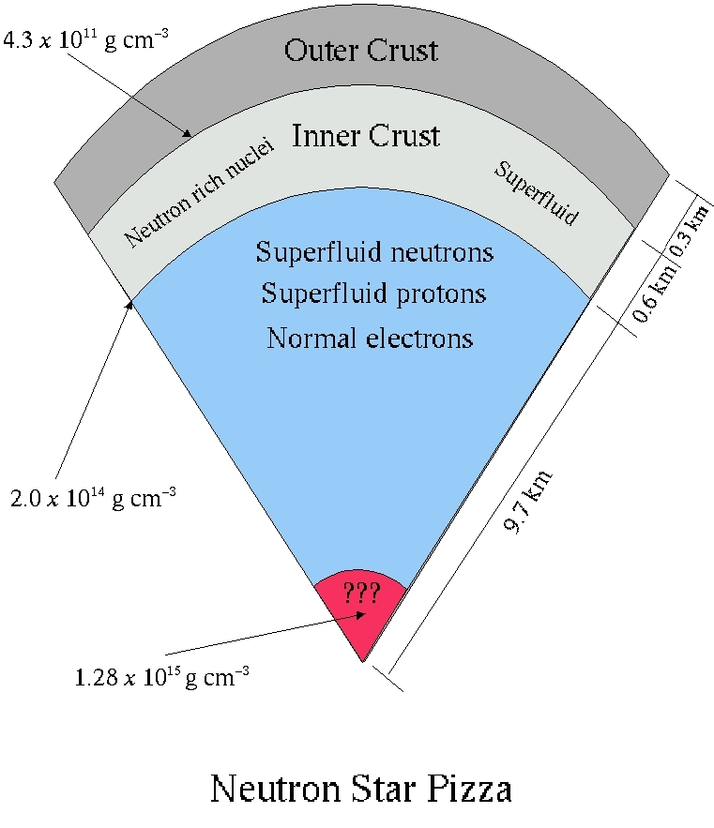

Hidden interior
$$d^{∗}(2380)$$
I. Vidaña, M. Bashkanov, D.P. Watts, A. Pastore
Phys.Lett. B781 (2018) 112-116
34

Slide 35
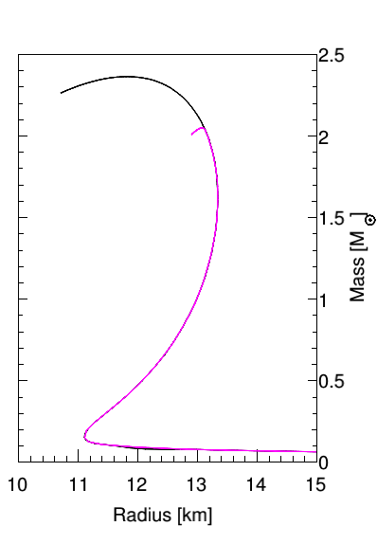
Hexaquarks in Neutron Stars
Nuclear Matter
Hexaquark Matter
I. Vidaña, M. Bashkanov, D.P. Watts, A. Pastore
Phys.Lett. B781 (2018) 112-116
35

Slide 36
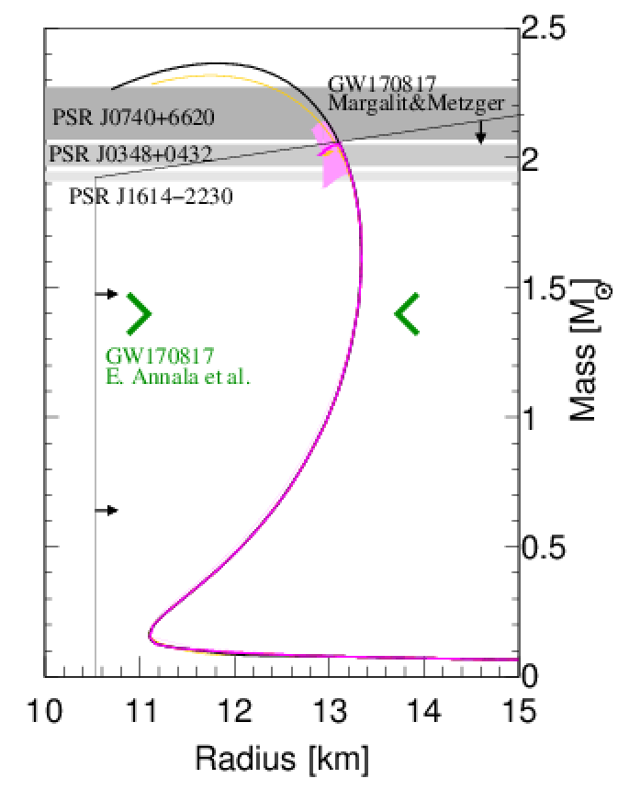
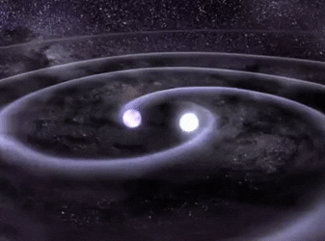
Hexaquarks in Neutron Stars
Nuclear Matter
Hexaquark Matter
I. Vidaña, M. Bashkanov, D.P. Watts, A. Pastore
Phys.Lett. B781 (2018) 112-116
Submitted to arXiv: 28.06.2017
36

Slide 37

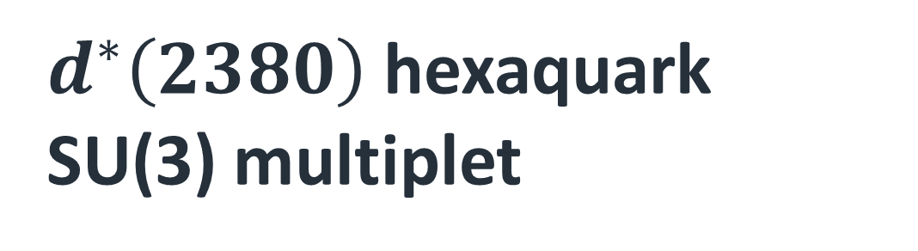



$d^{∗}\left(2380\right)$hexaquark SU(3) multiplet
J^{p} = 3⁺
ΔΔ
$$d^{∗}(2380)$$
ΔΣ*
$$d_{s}^{}(2.53−2.60)$$
ΔΞ*
$$d_{ss}^{}(2.68−2.76)$$
ΔΩ
$$d_{sss}^{}(2.82−2.90)$$
37

Slide 38
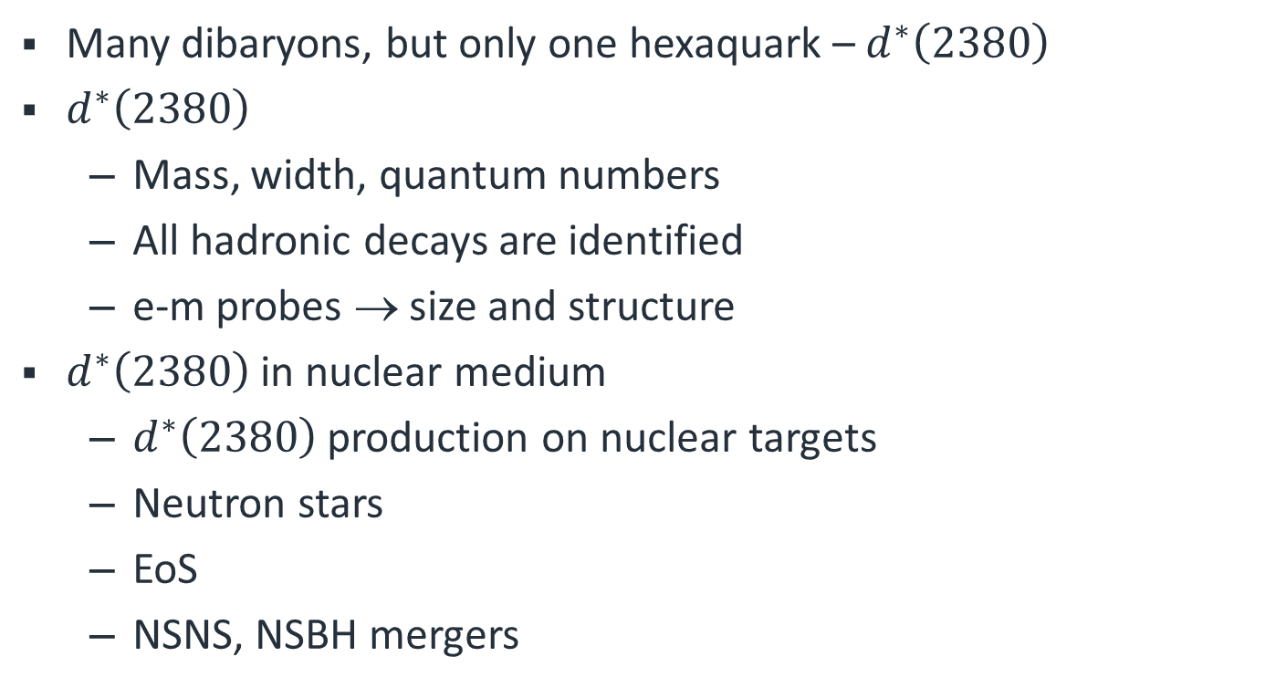
Conclusion
Many dibaryons, but only one hexaquark – $d^{∗}\left(2380\right)$
$d^{∗}\left(2380\right)$
  Mass, width, quantum numbers
  All hadronic decays are identified
  e-m probes → size and structure
$d^{∗}\left(2380\right)$ in nuclear medium
  $d^{∗}\left(2380\right)$ production on nuclear targets
  Neutron stars
  EoS
  NSNS, NSBH mergers
38

Slide 39


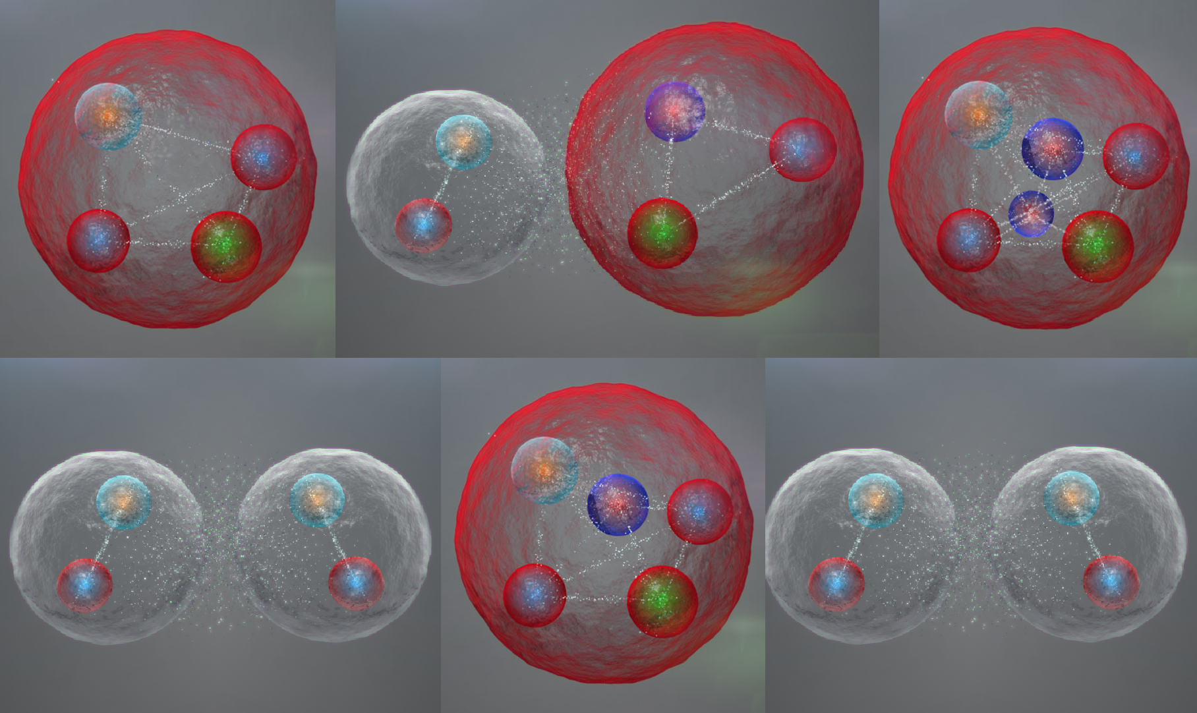
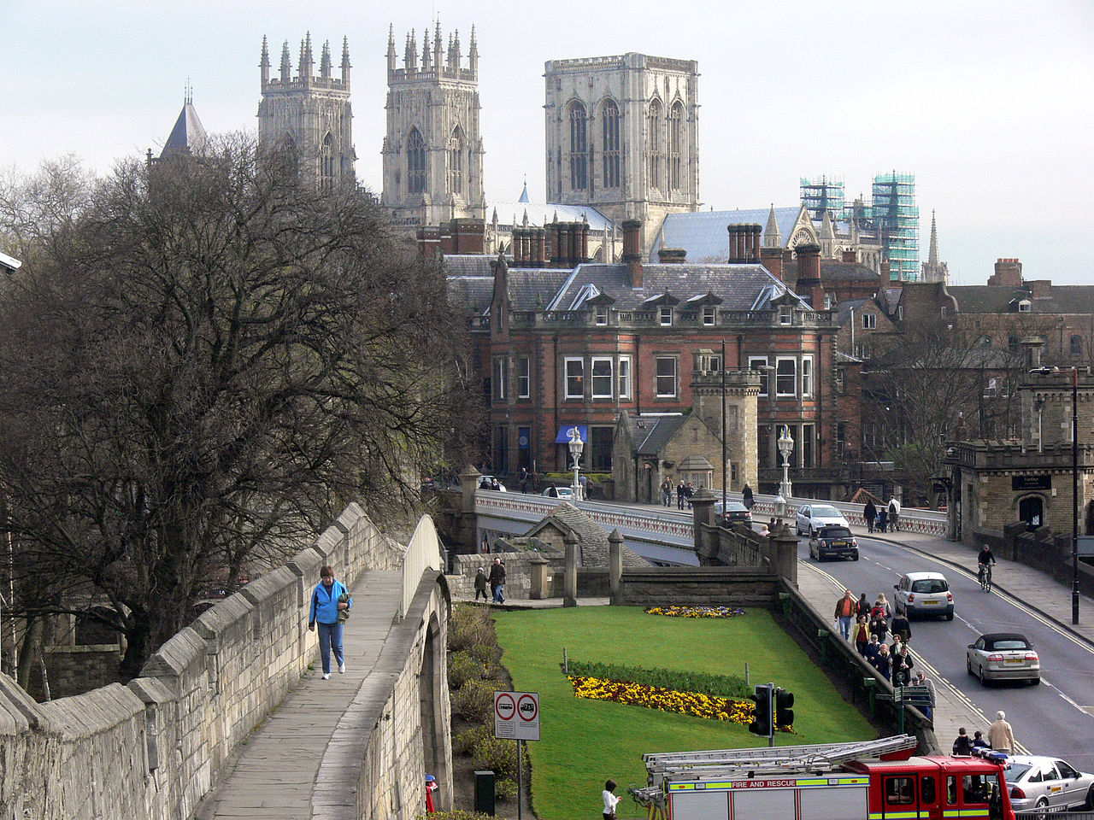
Exotic Hadron Spectroscopy Workshop
12—13, December 2019, York, UK
https://events.iop.org/exotic-hardon-spectroscopy-2019

Slide 40
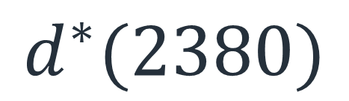
$$d^{∗}(2380)$$
ΔΔ
Thank you
ΔΣ*
ΔΞ*
ΔΩ

Slide 41
Δ⁻Δ⁻
Δ⁺⁺Δ⁺⁺
ΔΔ
Loosely bound or unbound
ΔΣ*
PLB 762 (2016) 455
Σ*Σ*+ΔΞ*
Ξ*Σ*+ΔΩ
Ξ*Ξ*+Σ*Ω
Ξ*Ω
ΩΩ
Bound by ~ 1 MeV, Lattice QCD (HAL-QCD)
Phys.Rev.Lett. 120 (2018) no.21, 212001

