Slide 1


Slide 2
In-House Distributed RD Detection Algorithm Development
October 2023
Nuclear Threat Reduction, Detection Science, Data Assessment
John Garrood, Paul Kendall, Maria Kopec, Phil Martin, Jonty Rougier
philip.martin@awe.co.uk

Slide 3
Talk Outline
In-house Algorithm Development
Why?
How?
GROUSE
Overview
Hospital case study (SIGMA P3)
Output example
Comparison against extant SIGMA algorithm
Summary of case study performance
Conclusions
Next steps

Slide 4
In-house Algorithm Development – Why?
While AWE is not an RN detection systems integrator or vendor
We are expected to advise UK Gov on RN detection systems which includes algorithm performance
We have groups on site who use RN detection systems
The relevant RN detection mission space is narrow
Commercial development targets larger markets
We can directly fund work but need to know what to fund
What approaches add value?
What potential does a given approach have?
What timescales are applicable?
We have multiple programmes that need ongoing input on a well understood timescale
e.g. Distributed Detection, more specifically the detection and tracking of RN material that is within the UK (sourced within the UK or already crossed a border)

Slide 5
In-house Algorithm Development – How?
Multiple steps are required
Identification and down-selection of relevant techniques
Development of down-selected techniques to a point where they can be demonstrated/tested
Demonstration/testing of down-selected techniques
Should include side by side comparisons to other relevant techniques
Provision of data
Modelled
Real
Both (injected threats)
We can do some of these steps but lack the resource do them all
Partner with other institutions
We have a particularly advanced capability in a numbers of areas
Modelling
Acquisition of relevant datasets

Slide 6
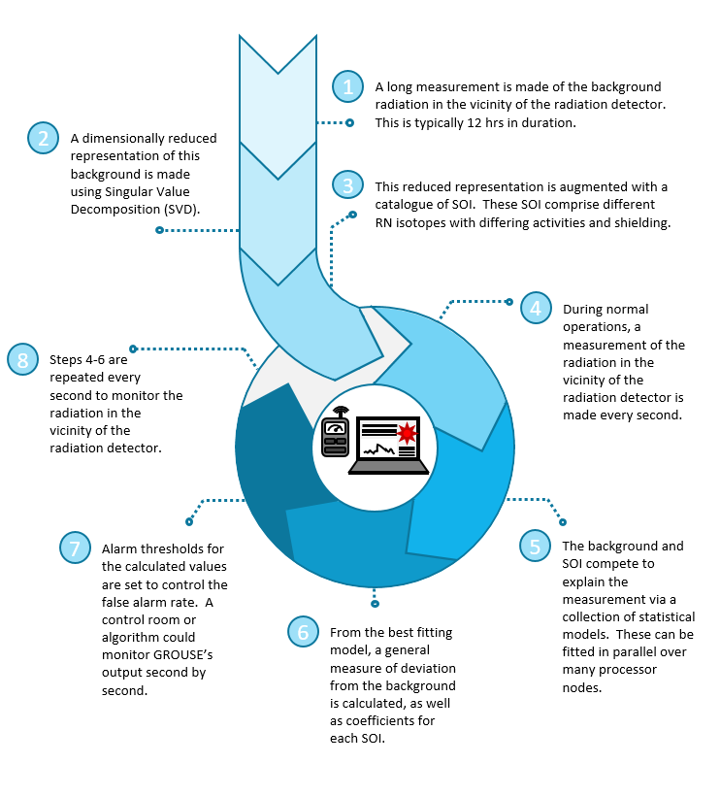
GROUSE – what is it?
Gamma Radiation Observer Using, SVD, EOF
A tool for real-time detection and attribution of anomalies in second-by-second gamma spectral counts
Comprises a statistical model and a fitting method, adapted to multiple cores, for speed and flexibility
POC1 (FY21/22) developed GROUSE and demonstrated it in a small synthetic study with measurements and data collected from opportunistic sources. POC1 did not run in real-time
The objective of POC2 (FY22/23) is to develop GROUSE into a production tool, to demonstrate it in a realistic case-study, running in real-time, and to compare it with other algorithms
M. Kopec, “what is GROUSE” 2022

Slide 7
Case Study: Outside a hospital [more detail at NSS2023]
A major London hospital offers a variety of RN sources
We used St Thomas’ (sensor ID 16354445), Tue 27 Nov 2018, 07:00 – 19:00, with the previous week (20 Nov) used to train the background
We created templates created for four medical RN sources: F18, Tc99, I123, and Ba133
We analysed every second of data in the 12h window. On DIDO with 36 cores (one node) each second of data took about 0.6s wall-clock time, so we were running in real-time
We can compare to the results from the SIGMA system, for which we have alarms for the same interval

Slide 8
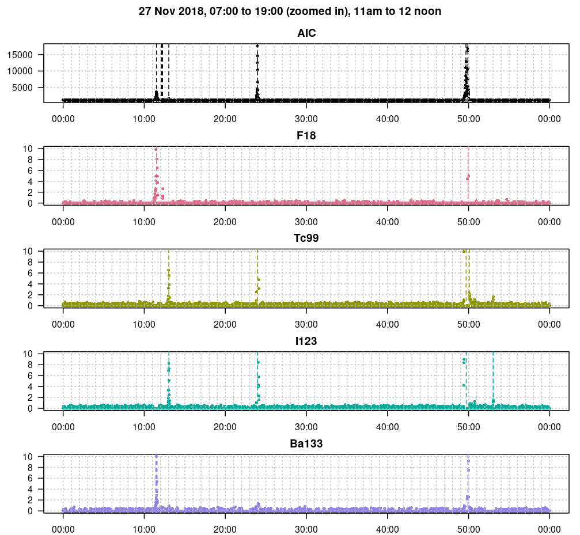
GROUSE output (example)
This is just one hour out of twelve (3600 seconds)
AIC shows unattributed deviations from background
The other four panels show attributed deviations from background for each of the four medical RNs
Adding additional RNs would be straightforward, and not change the run-time

Slide 9
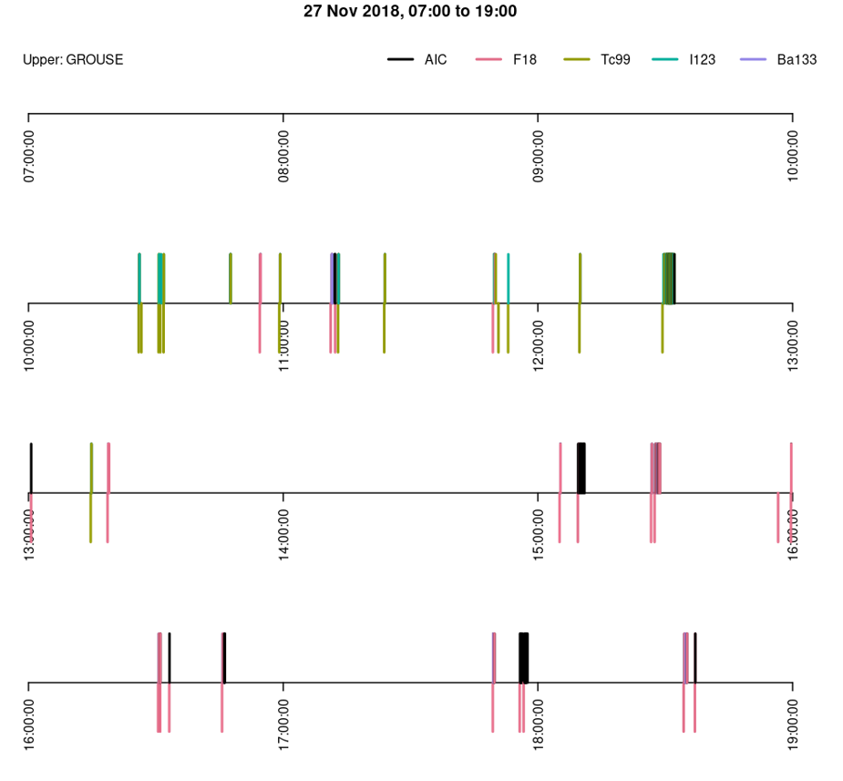
GROUSE versus extant SIGMA algorithm
With one exception (just before 16:00), GROUSE identified all of the expected alarms
GROUSE found an additional alarm (about 10:50)
GROUSE attributes to all four RIs, while SIGMA only attributes to F18 and Tc99
Some GROUSE alarms were unattributed deviations from background (AIC)

Slide 10
Drill-down into differences
Cases to look at:
GROUSE missed F18 alarm at c15:55
GROUSE raised Tc99 alarm with no SIGMA alarm at c10:50
GROUSE says I123 while SIGMA says Tc99 at c11:50
GROUSE says AIC while SIGMA says F18 at c13:00
GROUSE says AIC while SIGMA says F18 at c11:10

Slide 11
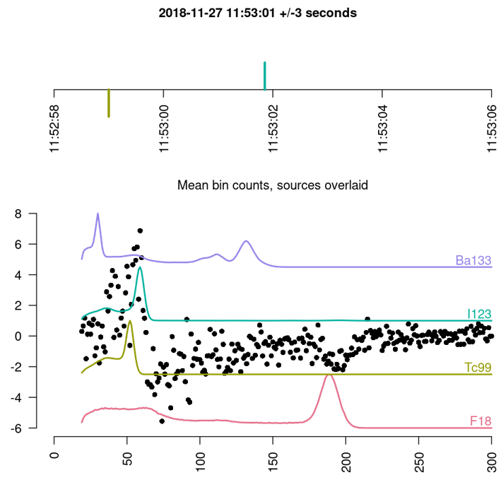
GROUSE says I123 while SIGMA says Tc99 at c11:50
Hard to call this one, but there’s definitely a I123 peak

Slide 12
GROUSE POC2 performance
These results for GROUSE are ‘out of the box’, with no tuning
Straightforward to set the thresholds for alarms to meet additional criteria, including False Alarm Rates which could depend on the RN
Adding more RN sources is straightforward, including threats
We can test out on more days, but here are some other options:
The fitting code in the GROUSE package could be substantially improved, which would likely double the speed in R
The peak-ID algorithm is quite rudimentary: it uses the change in gradient of a +/-3 second centred moving average. This can assign several peaks where there is only one source. Probably we need a more sophisticated algorithm with two moving averages
Also, the case study data had some unexpected surges in counts for low frequencies – it would be nice to know what was going on here

Slide 13
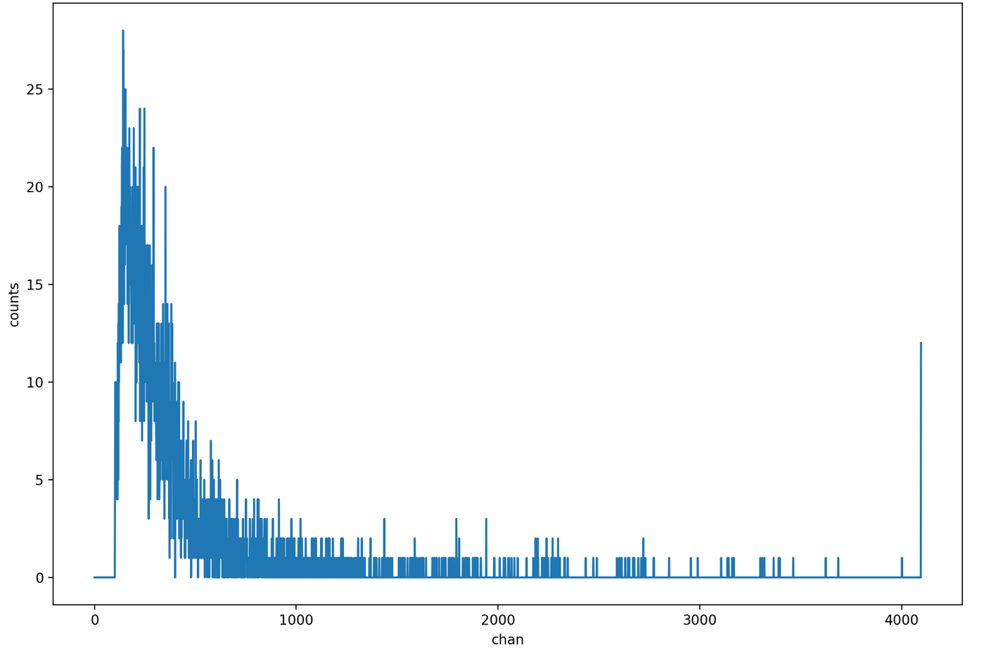
Summary
Successes
Performance appears good
Currently run on a limited subset of SIGMA P3 data
Generation of templates straight forward (GADRAS)
Comparisons with other technique straight forward
Limited to extant SIGMA algorithm
Challenges
Real-time
Currently ~10 cloud cores for each detector
Will speed up as code is improved
Will slow down as more templates are added
Scaling to thousands of detectors
An interface would be needed to deal with the locations and alarms of a large collection of detectors
Illustration of low counts alarm, D3S SIGMA P3 sum of 120 one second spectra. This is challenging, particularly ID.

Slide 14
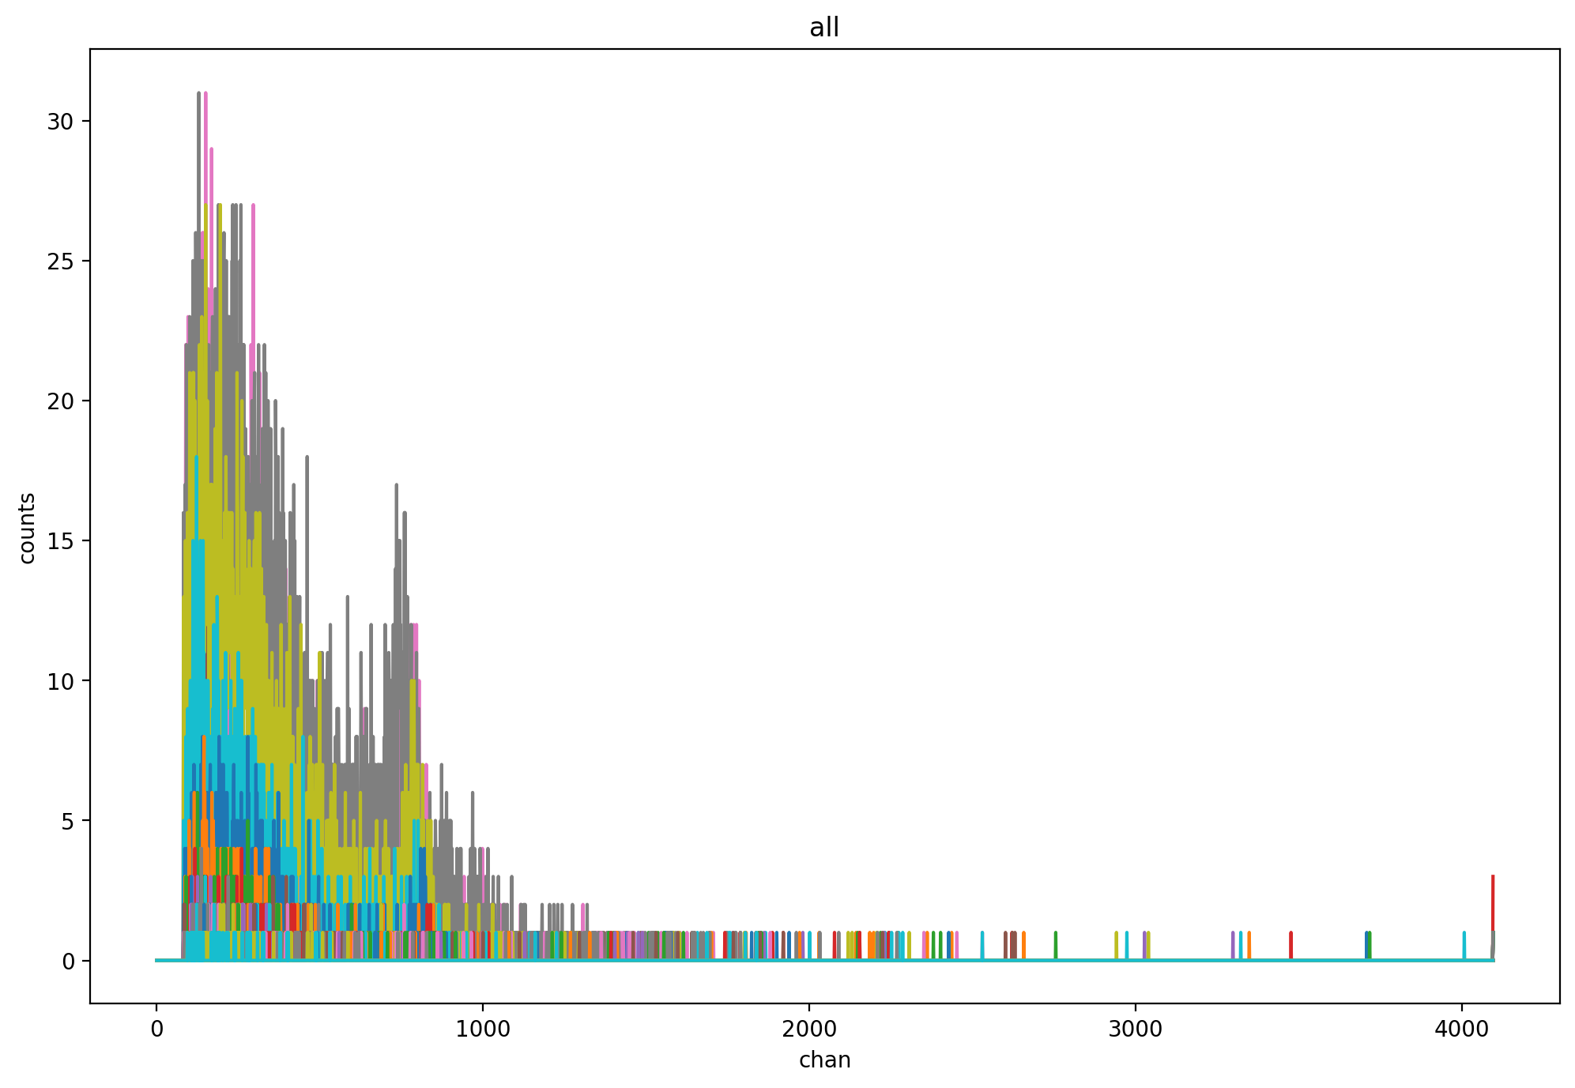
Next Steps
Port code to HPC
We have access to world class HPC but at a higher classification than Official
Generate more templates
Too few will degrade ID performance
Too many will slow algorithm
Test on larger subset of P3 data
Quantify PFA
Warm start
Quantify PD
May require threat injection i.e. Modelling
Side by side comparison to other algorithms
120 overlaid spectra from a higher count rate D3S SIGMA P3 alarm.

Slide 15
Questions?

