Slide 1
SIGMA Threat Injection Methodology
Nuclear Threat Reduction, Detection Science, Data Assessment
Dr. Rafael Hunt-Stokes
rafael.hunt-stokes@awe.co.uk

Slide 2
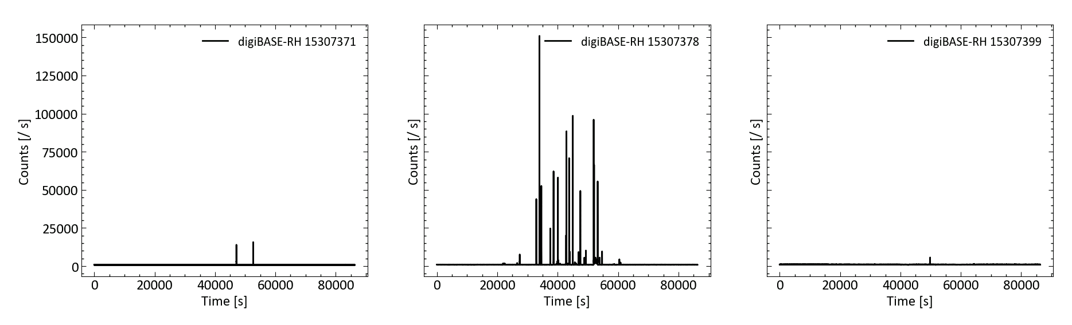
Overview
SIGMA p3 data collected Aug. 2018 – Feb. 2019
~ 140 days of data
11x NaI detectors in various locations (outside hospital, bus stops, tube stations)
Data made available to academic community
Many interesting features – no ground truth!

Slide 3
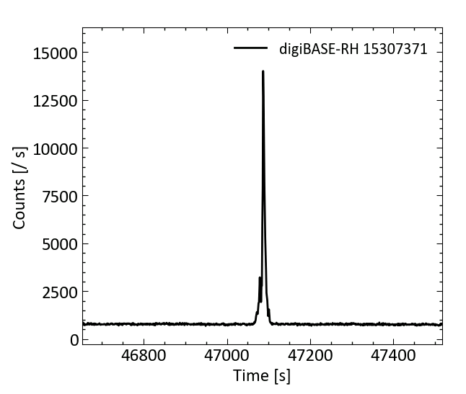
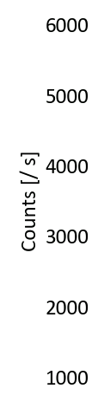
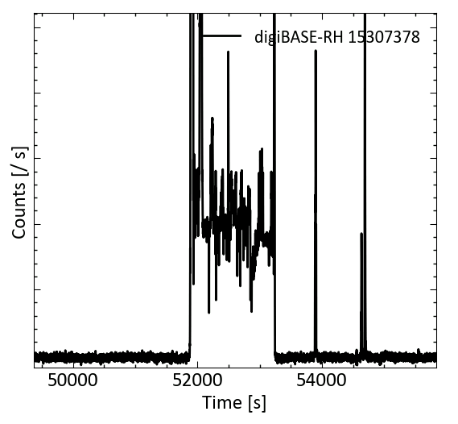
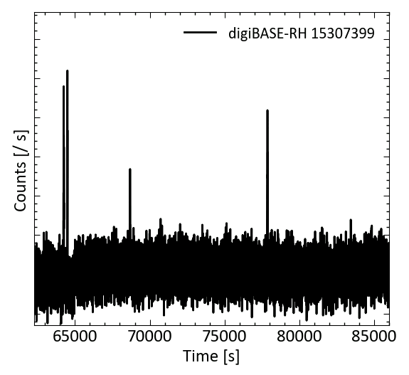
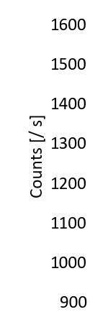
Overview
Many interesting features – no ground truth!

Slide 4
Overview
SIGMA Inject Dataset (IJD) provides testbed for detection and source ID algorithms, with ground truth information provided
Real Background
Simulated Threats
SIGMA Inject Dataset
IJD data will replicate SIGMA p3 format: 0 – 3 MeV binned energy spectra read out once per second
Saved in hdf5 format

Slide 5
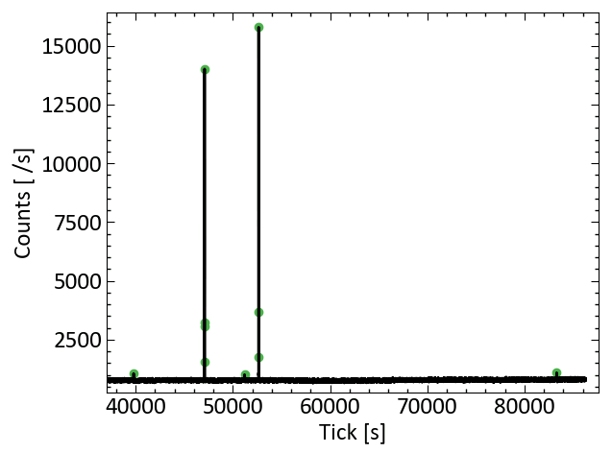
Real Background
Simulated Threats
SIGMA Inject Dataset
Selecting regions of background to inject within needs three steps:
Anomaly Detection
Peak prominence used to ID bursts in rate
scipy find_peaks() func.

Slide 6
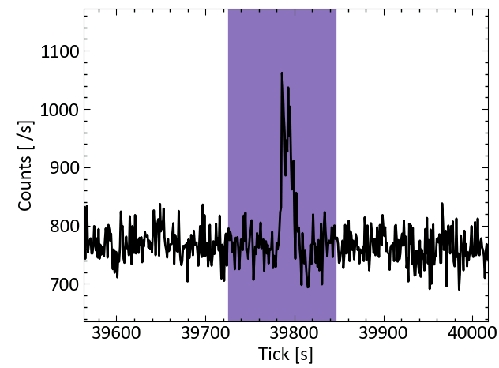
Real Background
Simulated Threats
SIGMA Inject Dataset
Selecting regions of background to inject within needs three steps:
Anomaly Detection
Anomaly Removal
+- 60 s around each anomaly is flagged for removal

Slide 7
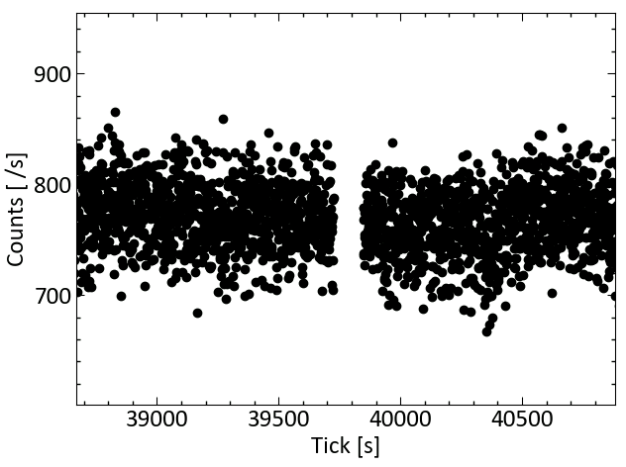

Real Background
Simulated Threats
SIGMA Inject Dataset
Selecting regions of background to inject within needs three steps:
Anomaly Detection
Anomaly Removal
Timestamp Shifting
$$t^{′}=t −Δt$$

Slide 8
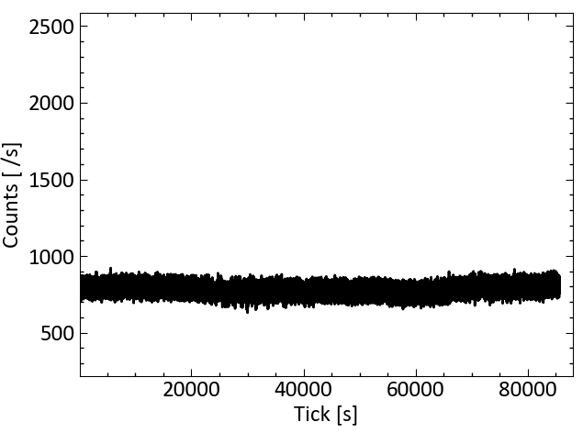
Real Background
Simulated Threats
SIGMA Inject Dataset
Selecting regions of background to inject within needs three steps:
Anomaly Detection
Anomaly Removal
Timestamp Shifting

Slide 9
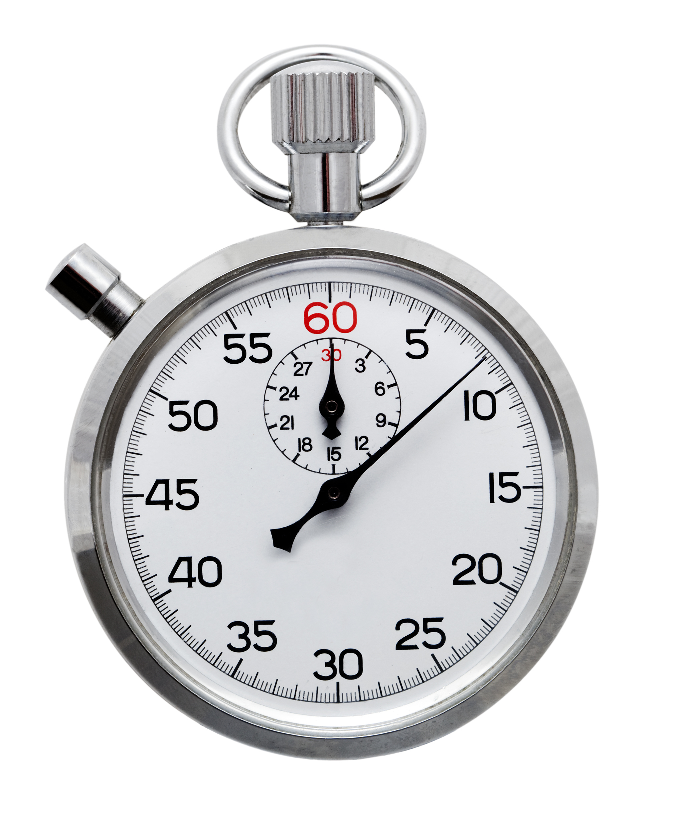
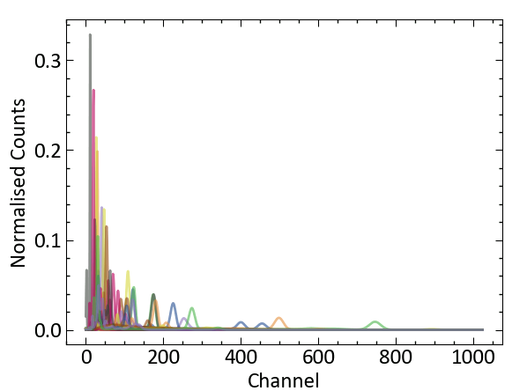
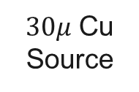

Real Background
Simulated Threats
SIGMA Inject Dataset
Ready to inject simulated sources into the background data
A library of 34 source templates simulated using GADRAS for comparable NaI detector geometry
See appendix for full list
Templates are binned into 1024 channels (0 – 3 MeV) to match SIGMA data
Templates are ‘mis-calibrated’ to match K-40 peak position in data
0.5 m
Normalised GADRAS Templates
$τ$ = 300 s
$30μ$ Cu Source
3” x 5” x 15” NaI Detector

Slide 10

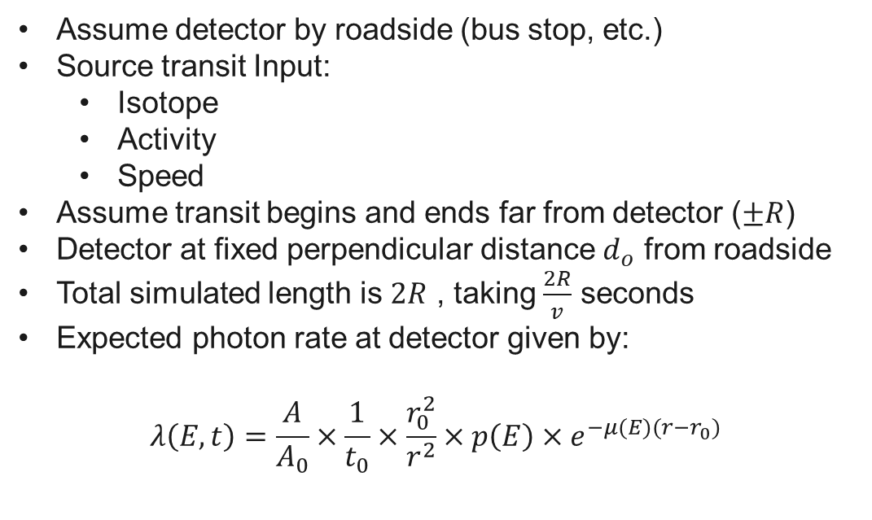



Simulating a Source Transit
Real Background
Simulated Threats
SIGMA Inject Dataset
Assume detector by roadside (bus stop, etc.)
Source transit Input:
Isotope
Activity
Speed
Assume transit begins and ends far from detector ($±R$)
Detector at fixed perpendicular distance $d_{o}$ from roadside
Total simulated length is $2R$ , taking $\frac{2R}{v}$ seconds
Expected photon rate at detector given by:
$$λ\left(E, t\right)=\frac{A}{A_{0}}×\frac{1}{t_{0}}×\frac{r_{0}^{2}}{r^{2}}×p\left(E\right)×e^{−μ(E)(r−r_{0})}$$
Detector
$$r$$
Source
$$d_{0}$$
$$R−vt$$
$$R$$
Scaling from GADRAS detector simulation result

Slide 11
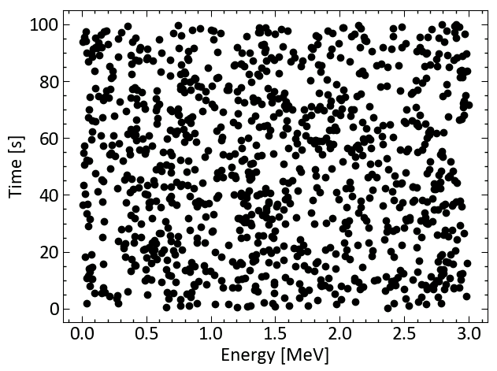
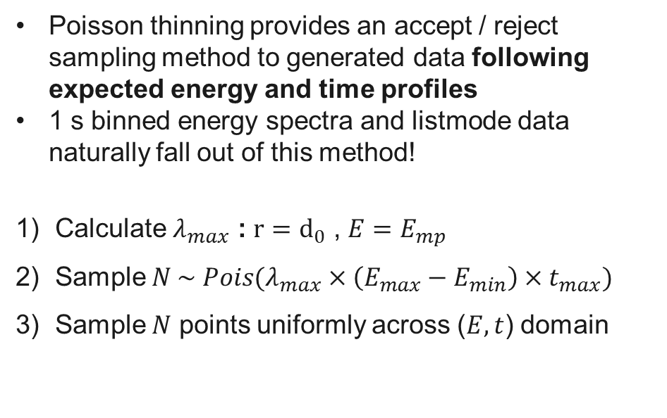
Poisson Thinning
Real Background
Simulated Threats
SIGMA Inject Dataset
Poisson thinning provides an accept / reject sampling method to generated data following expected energy and time profiles
1 s binned energy spectra and listmode data naturally fall out of this method!
Calculate $λ_{max}$ : $r=d_{0}$ , $E=E_{mp}$
Sample $N \sim Pois(λ_{max}×\left(E_{max}−E_{min}\right)×t_{max})$
Sample $N$ points uniformly across ($E, t$) domain
N Uniform Samples in Energy and Time

Slide 12
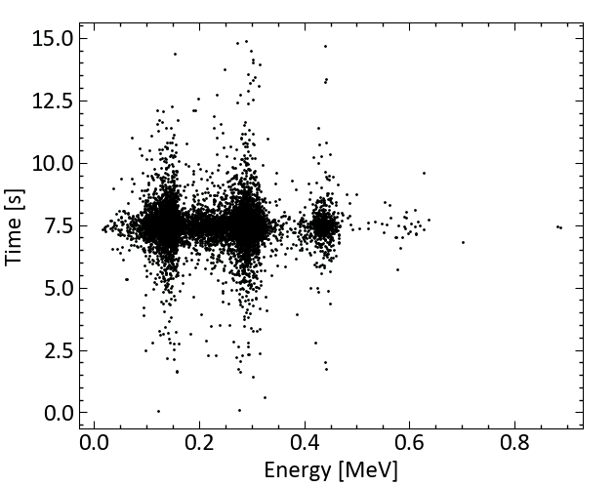
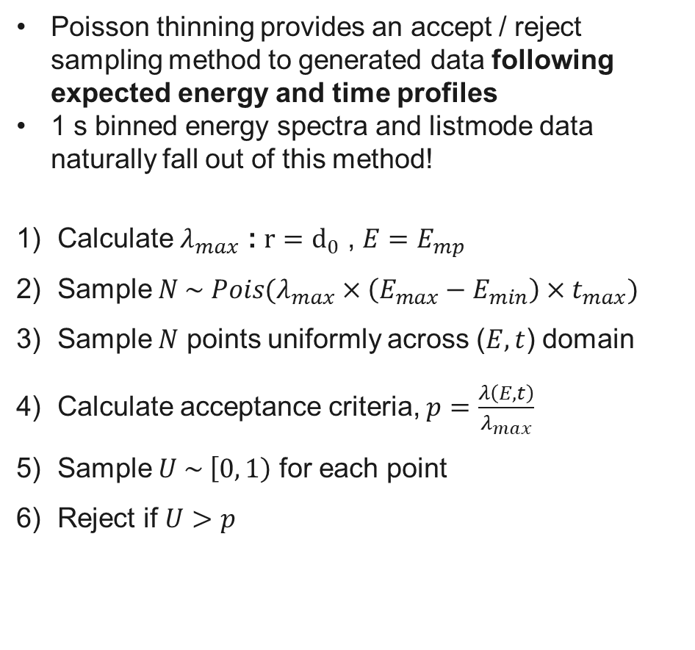
Poisson Thinning
Real Background
Simulated Threats
SIGMA Inject Dataset
Poisson thinning provides an accept / reject sampling method to generated data following expected energy and time profiles
1 s binned energy spectra and listmode data naturally fall out of this method!
Calculate $λ_{max}$ : $r=d_{0}$ , $E=E_{mp}$
Sample $N \sim Pois(λ_{max}×\left(E_{max}−E_{min}\right)×t_{max})$
Sample $N$ points uniformly across ($E, t$) domain
Calculate acceptance criteria, $p=\frac{λ\left(E, t\right)}{λ_{max}}$
Sample $U \sim \left[0, 1\right)$ for each point
Reject if $U>p$

Slide 13
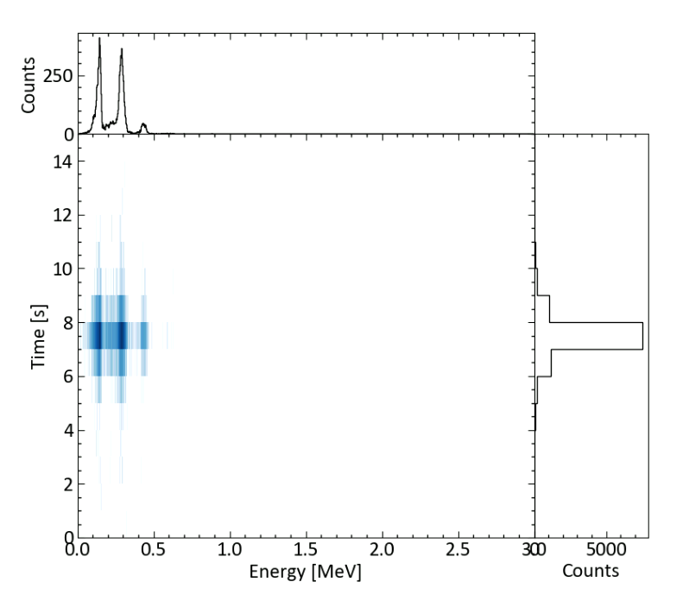
Poisson Thinning
Real Background
Simulated Threats
SIGMA Inject Dataset
Impose time and energy binning
Every 1s width row is a readout spectrum

Slide 14
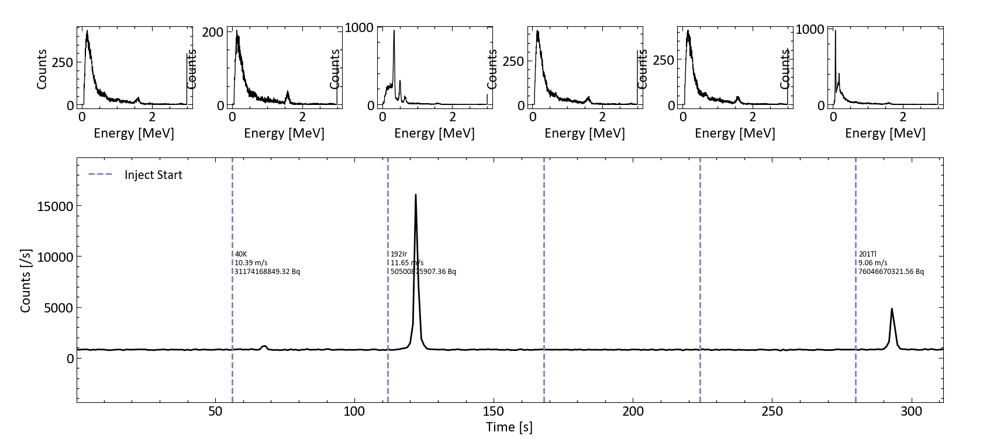
SIGMA Inject Dataset
Real Background
Simulated Threats
SIGMA Inject Dataset
Speed and isotope uniformly sampled
Activity sampled from triangle distribution to weight more strongly lower activity injects (more challenging)
50 % chance nothing is injected into a given window

Slide 15
Conclusions
Real Background
Simulated Threats
SIGMA Inject Dataset
Developed codebase to create simulated source transits and inject into real SIGMA background data
Peak Prominence is used to identify anomalies
Anomalies are removed and timestamps shifted to make continuous background-only data
Poisson Thinning is used to create the injected spectra
Assuming a perpendicular source transit with given speed and activity
Poisson Thinning gives natural way to create 1 s time sliced energy spectra according to simulated PDFs
An existing GADRAS template library for comparable NaI detectors are provide the energy PDFs
Sigma Inject Dataset output is hdf5 format: one file per day, 1 group per detector
Matched the previously used format

Slide 16
Appendix

Slide 17
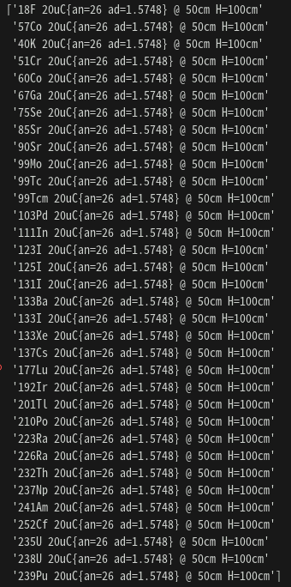
Source Template Library

