Slide 1
Seeing Beta Clearly: Diamond Spectrometers for in-situ Nuclear Characterisation
Nuclear Security Detection Science Workshop 2026
National Physical Laboratory, Teddington
Wednesday 11 March^{th} February 2026
Professor Neil A Fox

Slide 2
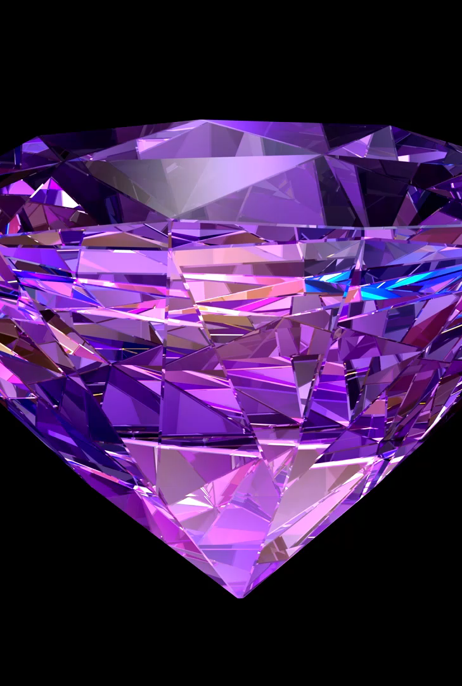
Outline
Background
Tritium Sensing
Beta Spectrometry
Concluding Remarks

Slide 3
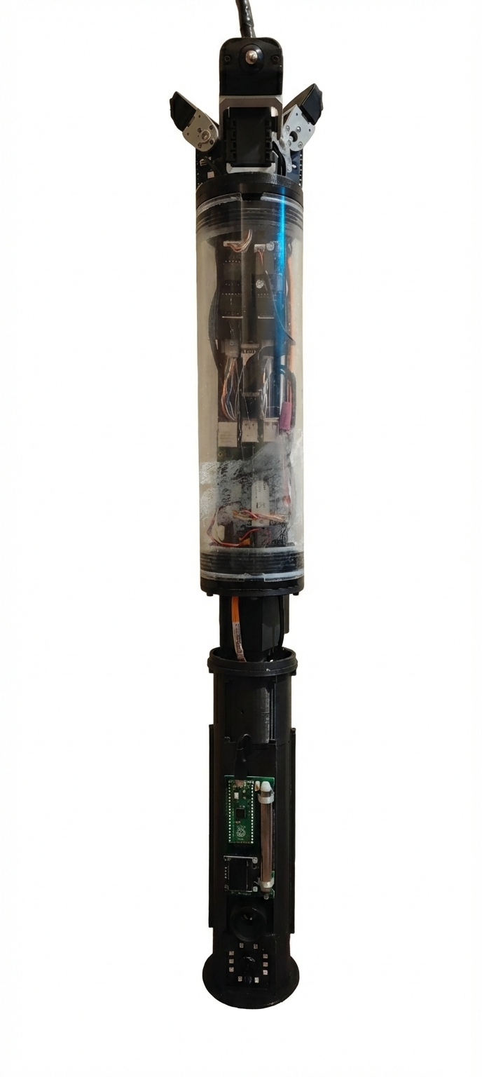
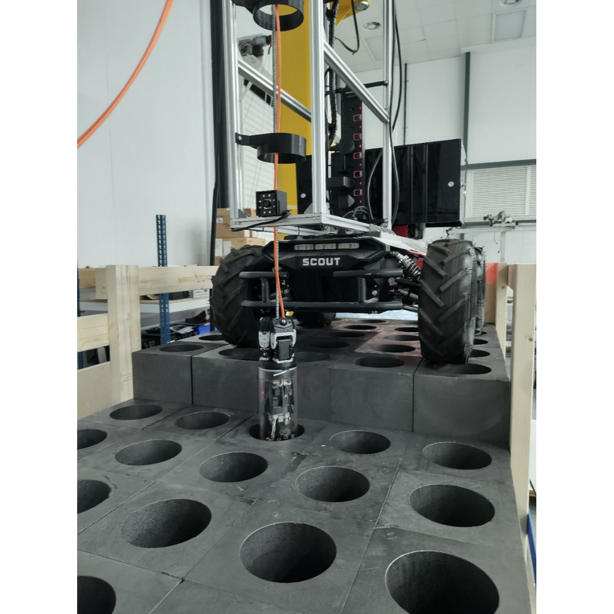
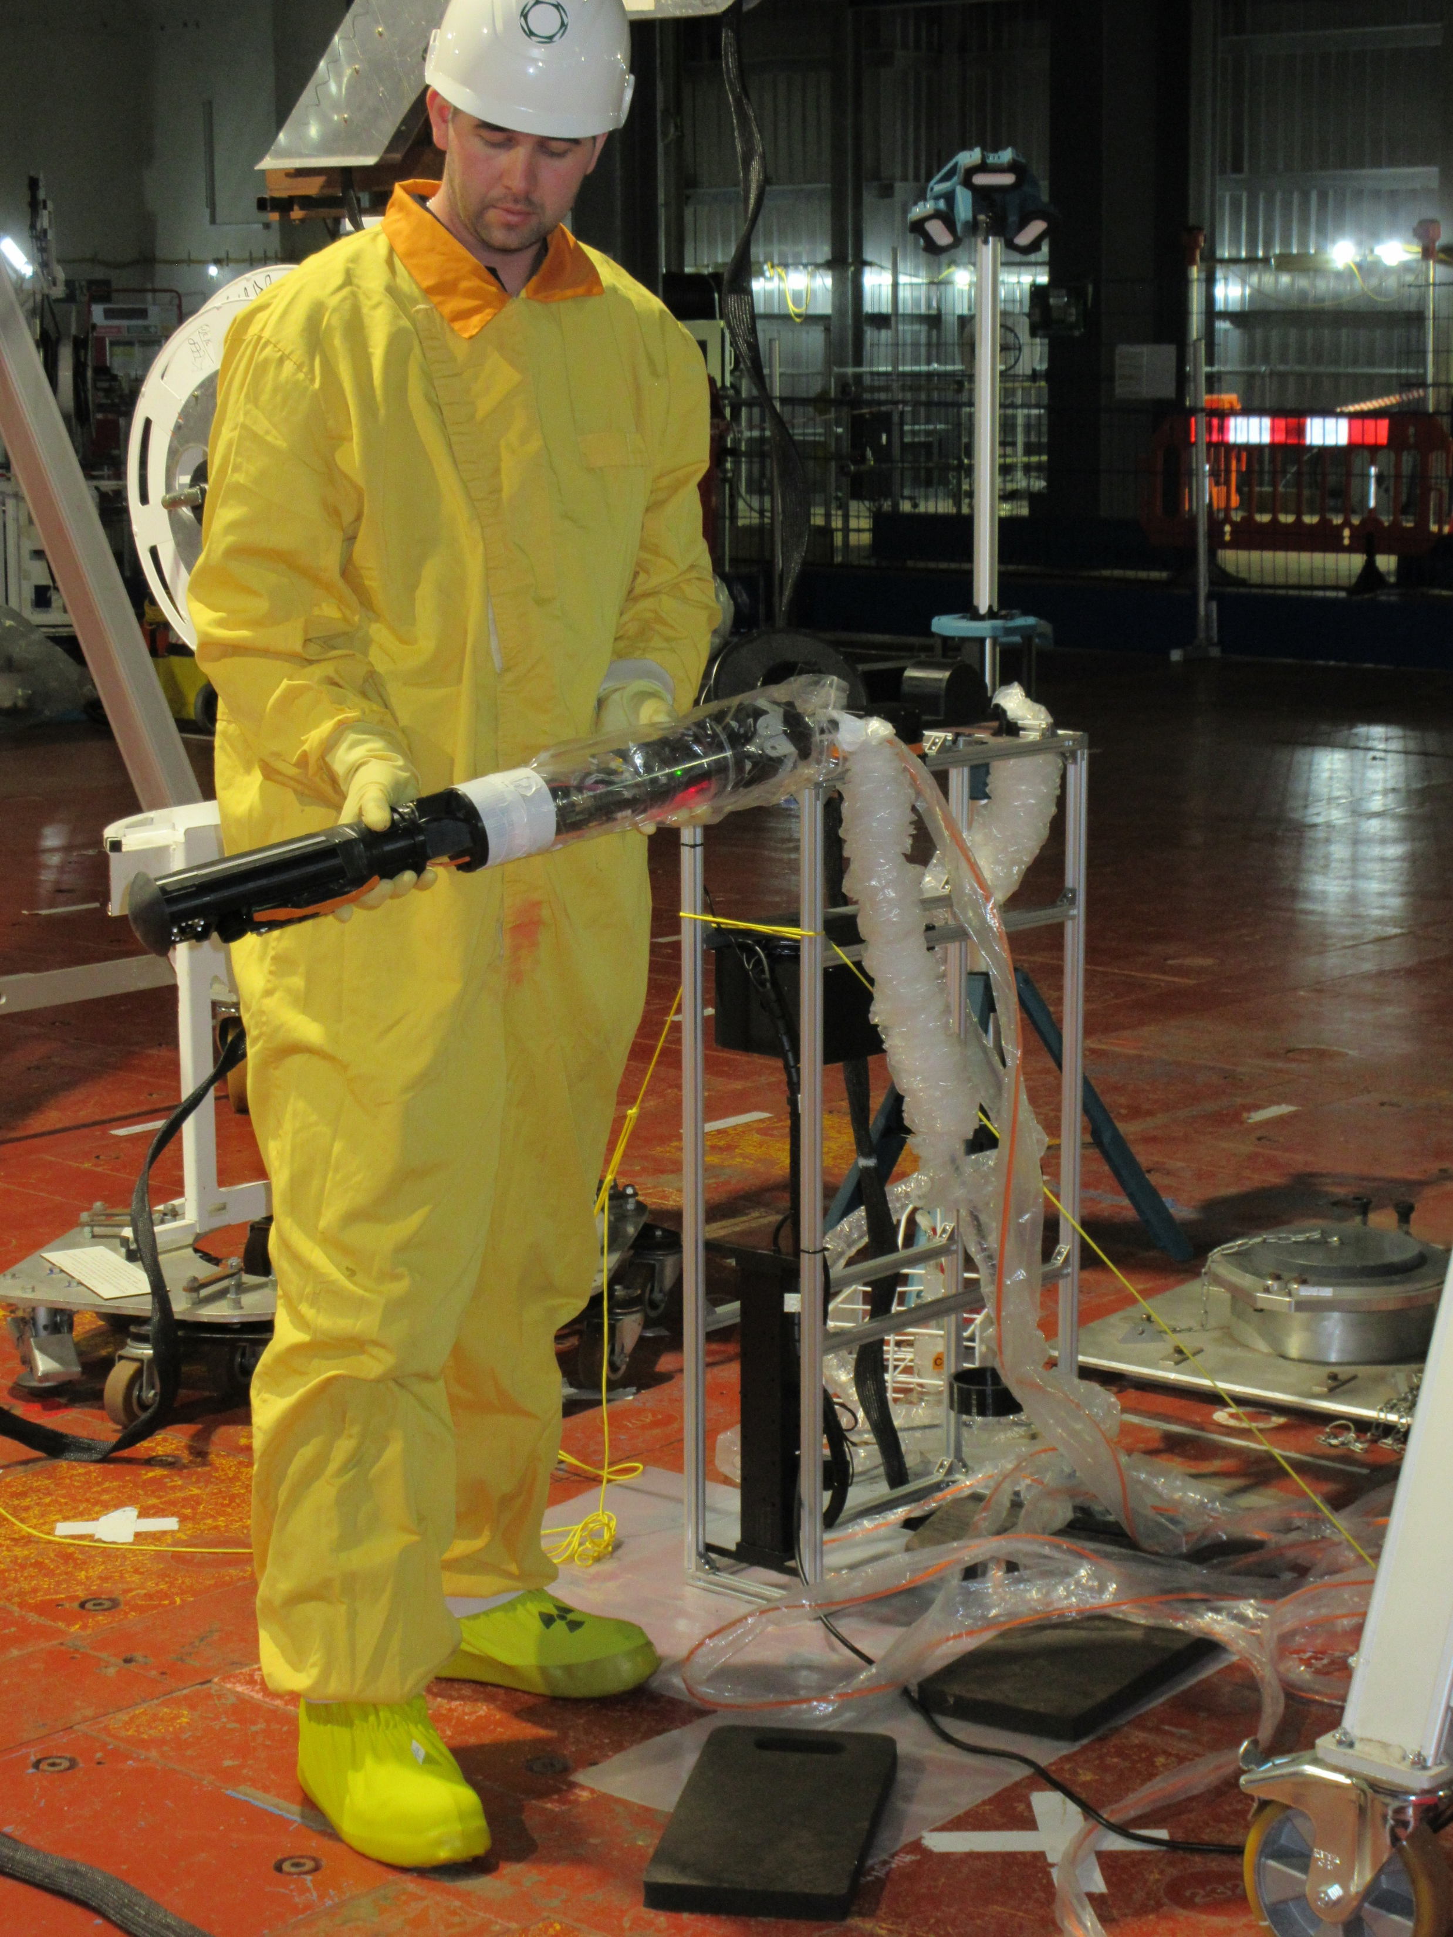
Surveying the Isotopic Content of Magnox Reactor Cores
.
Background
(Left) Inspection probe created by Jarred Minards at the University of Bristol.
(Top) System on the pile-cap of Trawsfynydd reactor 1 during deployment
The Graphite inspection system
being demonstrated at NCC
in Bristol.

Slide 4

UKRI Research on Diamond Beta Voltaics
Background
Conventional Configuration
External beta source
e
Schottky contact
Intrinsic diamond
P-type diamond
Load
V
Ohmic contact
I
University of Bristol Concept
e
Depletion region
Schottky contact
Repurposing C-14 recovered from
ILW Graphite waste to make micro-power sources
¹⁴C in ¹²C diamond
P-type ¹²C diamond
Load
V
Modulation
doping
Ohmic contact
I

Slide 5
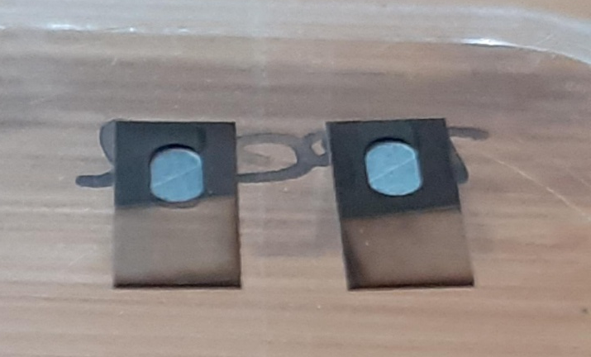
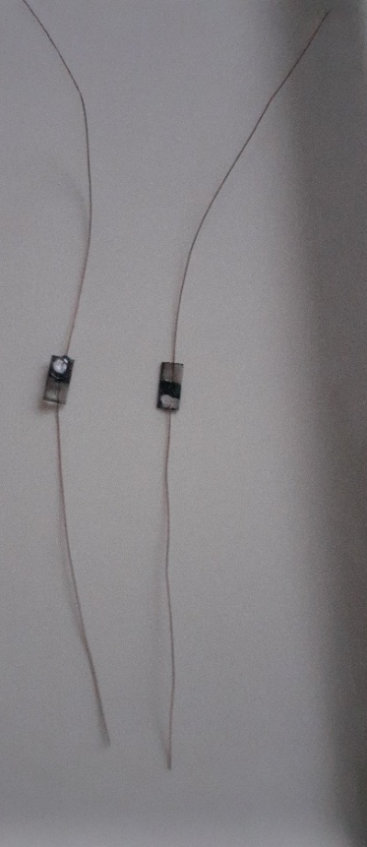
Why use thin film diamond for Radiation Detection?
Background
Diamond Film: Single Crystal, CVD-grown diamond.
Thickness: Thin enough (~0.5–10 µm) for low-energy beta detection.
Surface Quality: Smooth, with minimal surface recombination.
Electrodes: Thin, conductive, and minimally obstructive to beta particles.
Boron Doping: Controlled for optimized charge collection.
SCD Membrane Diodes

Slide 6

UKAEA-funded STRIDES
Project
Tritium Sensing
Develop a novel diamond-based tritium detector prototype.
Solid State Detector to operate at low voltages.
Able to sense tritium in a wide range of environments.
Low-cost, COTS design, easily scalable prototype sensor head.
High gain pre-amplifier electronics remote from sensor, use of rad hard MOSFETs.
³H
³H
³H
³H
³He
₁
₂
³H
³H
e⁻
e⁻
e⁻
e⁻
Electron transparent Graphene Schottky contact
Single crystal intrinsic diamond layer
e⁻
e⁻
e⁻
e⁻
P-type/N-type single crystal diamond
h⁺
h⁺

Slide 7
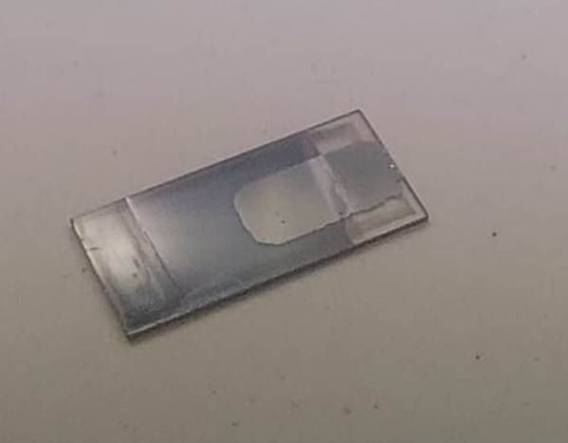
STRIDES Diode Sensor
Tritium Sensing
Schottky Diode Type II on SC diamond wafer
  Higher rectification ratio needed for weaker beta emissions
  Response to simulated tritium beta radiation of 5.6 keV.
4.8 mm
2.5 mm
Diamond Diode Active Area
ca 2.8 mm x 3 mm

Slide 8
Sensor Electronics
Tritium Sensing
Designed for low-cost unit production, high gain (0.5M), ultra low noise Charge Sensitive Amplifier (CSA)
UoB designed & tested, assembly by Philtronics and Cubik to the appropriate QA standards.
Completed a sub-system design and matched FET front-end to increase sensitivity.
Two COTS Electronics designs
(right) Cremat CR-110 Charge Sensitive Amplifier
(left) TI OPA818 Instrument
Amplifier

Slide 9
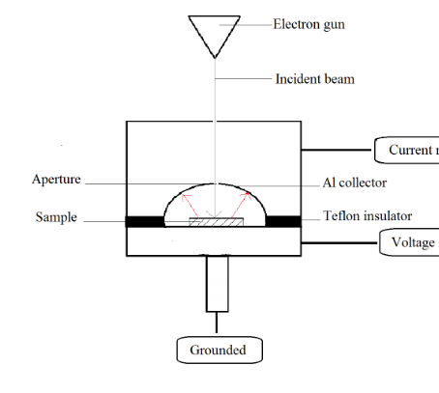
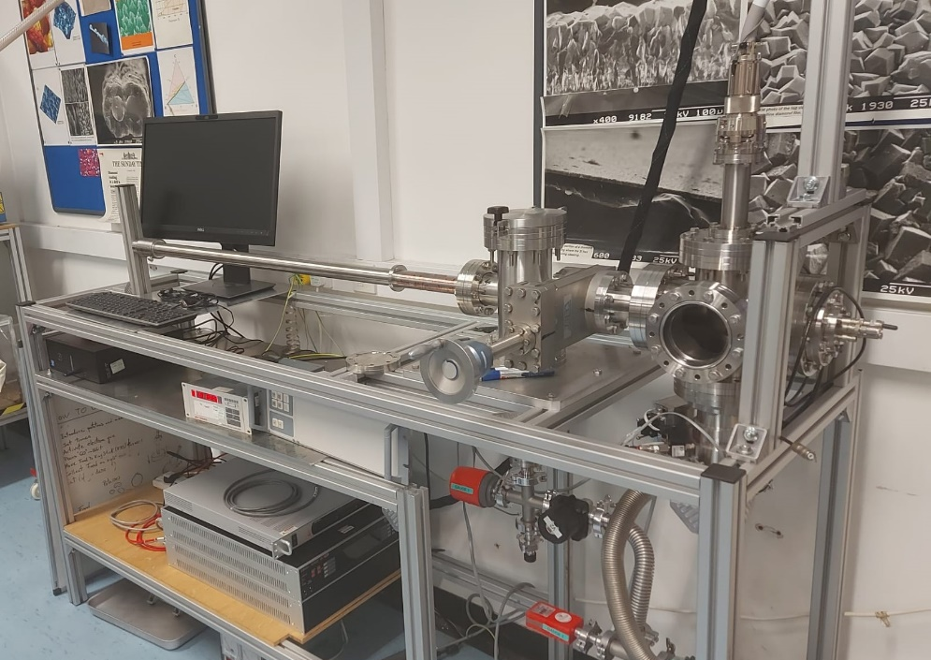
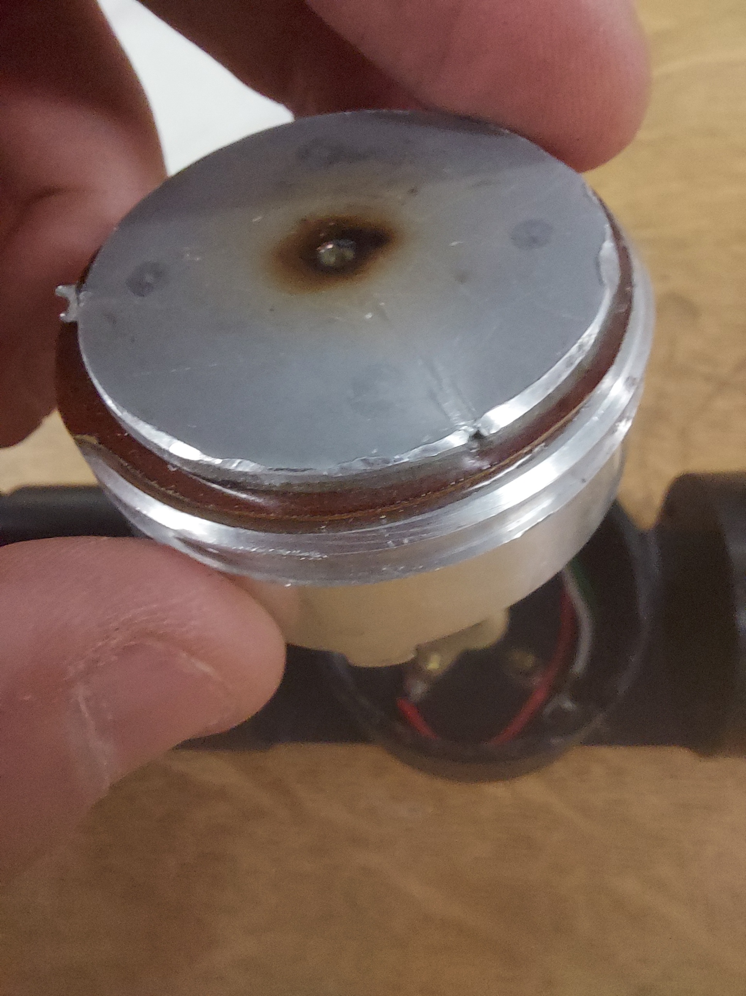
E-Beam Irradiation System
Tritium Sensing
(a)
(d)
(b)
(c)
(e)
The main components which compose the external parts of the equipment: (a) electron gun, (b) view port for visual control (fully covered during the measurements), (c) feedthroughs for biasing and current reading, (d) loading port and (e) electron gun control box.
Simulating Tritium Beta Energy Spectrum

Slide 10
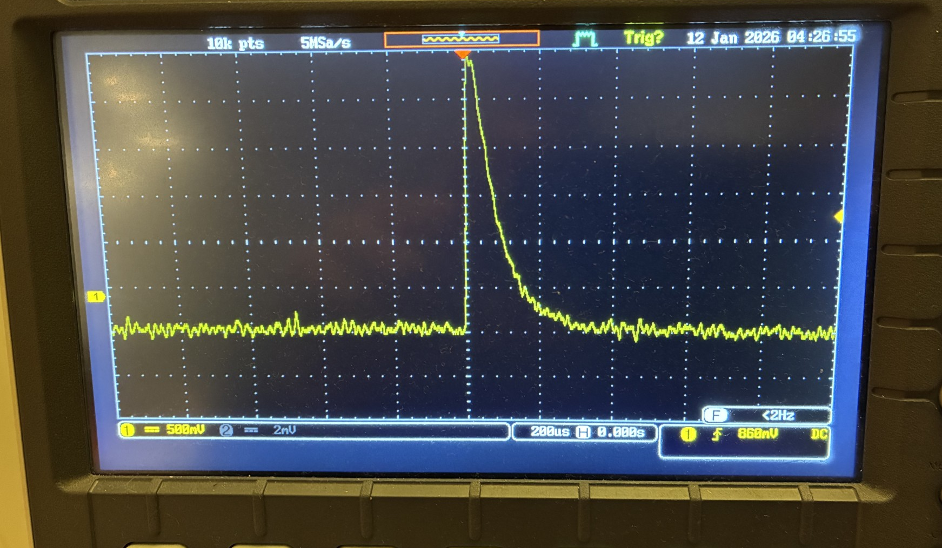
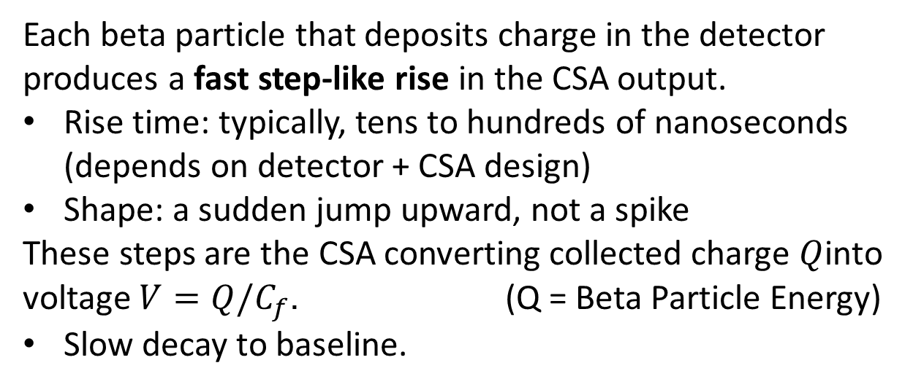
Visualising Single Beta Decays
Tritium Sensing
Each beta particle that deposits charge in the detector produces a fast step‑like rise in the CSA output.
Rise time: typically, tens to hundreds of nanoseconds (depends on detector + CSA design)
Shape: a sudden jump upward, not a spike
These steps are the CSA converting collected charge $Q$into voltage $V=Q/C_{f}$. (Q = Beta Particle Energy)
Slow decay to baseline.

Slide 11
What do you need to perform real isotope separation?
Beta Spectrometry
With a mixture of isotopes present, no obvious signature identifying which isotope produced which pulse.
To distinguish isotopes, you need:
a charge‑sensitive preamp
a shaping amplifier or digital pulse processor
a multichannel analyser (MCA) or digitiser
a calibrated energy scale
reference spectra for each isotope
a fitting algorithm (least squares, maximum likelihood, etc.)
Notes:
Bi‑207 emits several well‑known internal conversion electron (ICE) lines, for example (approximate values):
~482 keV
~976 keV
~1048 keV
Each of these gives you a sharp feature in your pulse‑height spectrum—an “anchor point” for your calibration curve.

Slide 12
Looking at pulse height distributions
Beta Spectrometry
Counts
Possible distribution obtained by collecting many pulses
H-3
Ni-63
C-14
Cl-36
Pulse height (energy)
Pulse‑height distribution for a charge‑sensitive amplifier exposed to multiple weak beta emitters will have a very recognisable shape.
Histogram of pulse heights that generate a spectrum
How is this interpreted?
LHS: A large cluster of very small pulses (H-3, Ni-63)
Middle: C‑14 (endpoint ~156 keV) contributes a broader, lower peak.
RHS: A long, sparse high‑energy tail due to Cl-36
Notes:
Energy bins 1 keV more at
Most probable energy = peak counts
Magnetic filters to deselect low energy beta or aperture

Slide 13
Making sense of multiple beta signatures
Beta Spectrometry
Because the isotopes emit betas with different endpoint energies, and because energy deposition is stochastic, the pulse amplitudes vary:
H‑3 → very small pulses, ~4-5keV (max ~18 keV)
Ni‑63 → small pulses, ~15-20keV (max ~67 keV)
C‑14 → moderate pulses, ~40-50keV (max ~156 keV)
Cl‑36 → larger pulses, ~100-150keV (max ~709 keV)
End Point Energies and Beta Spectra
But even though all four produce continuous beta spectra, their endpoints and spectral slopes differ, enabling beta emissions to be associated with a specific radioisotope.

Slide 14
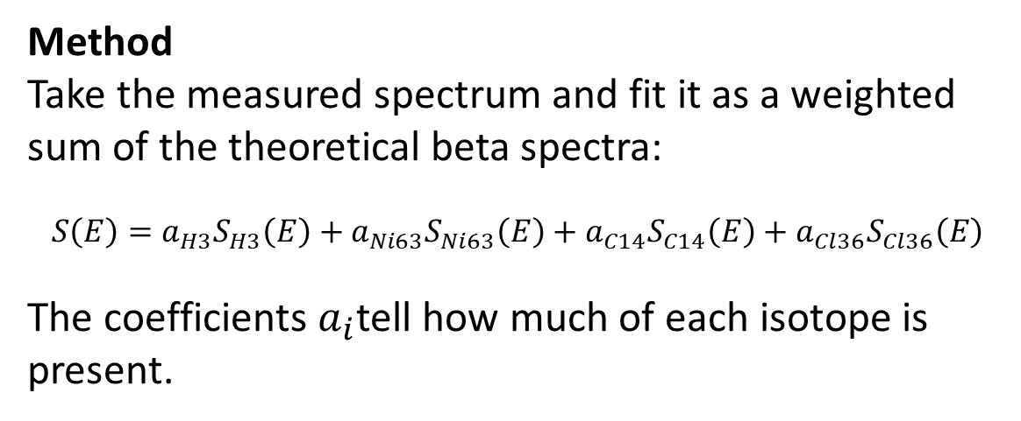
Moving from raw oscilloscope pulses to doing actual spectroscopy
Beta Spectrometry
Method
Take the measured spectrum and fit it as a weighted sum of the theoretical beta spectra:
$$S\left(E\right)=a_{H3}S_{H3}\left(E\right)+a_{Ni63}S_{Ni63}\left(E\right)+a_{C14}S_{C14}\left(E\right)+a_{Cl36}S_{Cl36}\left(E\right)$$
The coefficients $a_{i}$tell how much of each isotope is present.
Even though the shapes overlap, each isotope contributes differently to:
the low‑energy rise
the mid‑energy plateau
the high‑energy tail
the endpoint cutoff
These differences give the fitting algorithm enough structure to separate them.
For example:
H‑3 contributes almost nothing above ~20 keV
Ni‑63 dies out by ~70 keV
C‑14 fills the 50–150 keV region
Cl‑36 dominates everything above ~200 keV

Slide 15
Challenges and Issues to be solved
Beta Spectrometry
Graphite fuel and cooling channels
Fuel channels are likely to contain transmuted fuel casing material with decay chains convoluted with weak beta emissions.
Improving Signal to Noise
Large datasets may be required to separate and quantify beta emitting isotopes.
Improving detection performance
Use of Neural Networks to improve the speed and identification of attenuated beta primaries from graphite volumes.

Slide 16

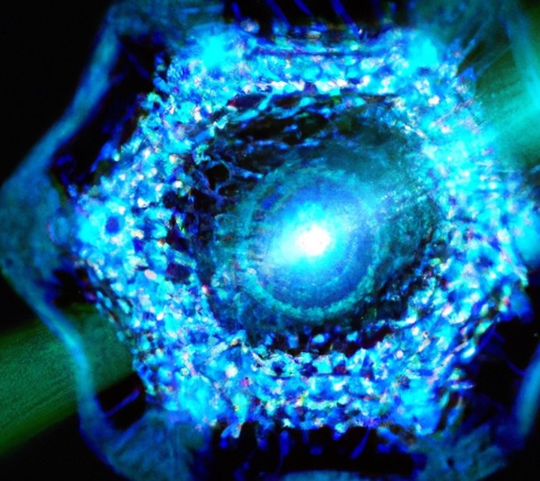
Closing Remarks
Diamond diode sensors have been fabricated and evaluated using a bespoke e-beam irradiation system to simulate tritium beta decay.
COTS detector electronics have been designed and set to work with diamond sensor chips and used to analyse low activity lab beta sources.
Next steps will involve:
diamond diode sensor calibrations
spectrometry of neutron irradiated graphite samples
Integration/testing of diamond sensors on robotic probe system
Site Deployment of Robotic System

Slide 17
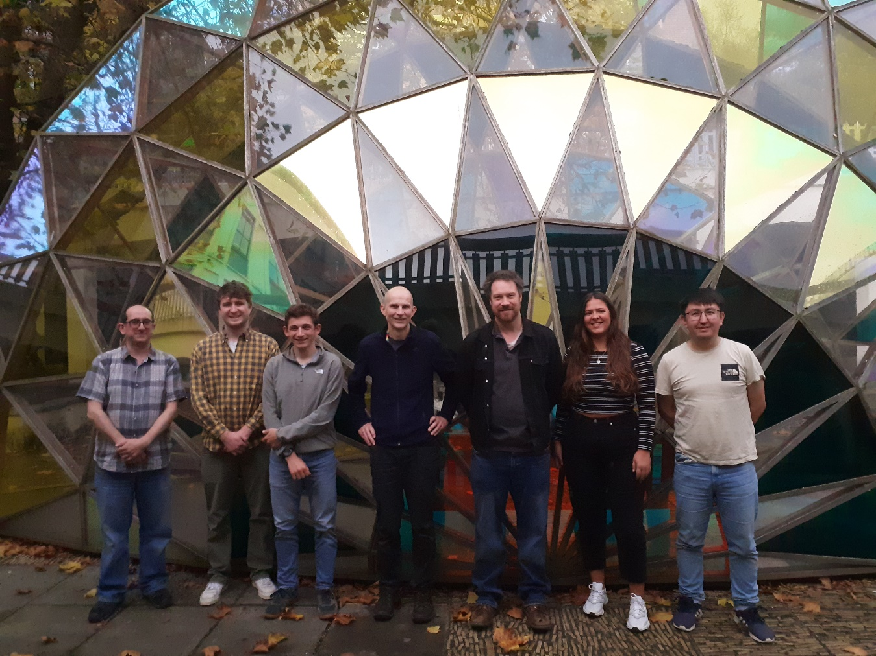
Acknowledgements
Bristol Team members
Prof Tom Scott
Dr James Smith
Dr Ramiz Zulkharnay
Dr Jude Laverock
Dr Liam Cullingford
Dr James Pittard
Miss Catherine Monk
Ian Bickerton CEng
Dr Jarred Minards
Dr Chris Hutson
Mr Josh Saunders
SBRI/UKAEA FIP Challenge CONTRACT No 12680

Slide 18
CVD Diamond Thin Film Properties
High Purity
Material: Synthetic diamond, typically grown via Chemical Vapor Deposition (CVD), is preferred.
Reason: High-purity diamond minimizes background noise and ensures a clear signal from the low-energy beta particles.
Impurity Level: Nitrogen and boron impurities should be minimized to prevent charge carrier trapping.
Controlled Doping
Requirement: N-type or intrinsic diamond layers are common for radiation detection.
Reason: Proper doping allows the formation of a diode junction, enabling efficient electron-hole separation and charge collection.
Low Defect Density
Requirement: The diamond film should have minimal grain boundaries, dislocations, or inclusions.
Reason: Defects act as charge traps, reducing detector efficiency and increasing noise.
The SEY of boron doped diamond has been calculated to be maximum at boron concentrations of approximately 10¹⁹ atoms.cm⁻³.
The desired thickness of the device can be approximated by calculating the penetration depths of electrons in diamond- this can be done using the Kanaya and Okayama equation.
18.6 keV primaries have R value ≅ 1.7-2.0 um.
5.7keV primaries have R value of 223nm.
Using structures with an inbuilt electric field, or applying a bias, can help to `pull' the generated secondaries through the material and allow for thicker structures.

Slide 19
Requirements of a Diode Electrode Structure
If an incoming electron has to penetrate through a metal to reach the diamond structure, then the metal coating will capture a proportion of the primary electron's energy.
The amount of energy lost in the metal contacts will vary dependent on the metal used and its thickness.
For a common ohmic contact to diamond (30 nm Ti/50 nm Au), the energy lost is approximately 3.3 keV and only the remaining electron energy will contribute to the secondary electron generation.
Stopping power for H-3 (5.7keV, 18.6keV):
  S_{Cr}≈ 2 keV/μm, for 100nm, ca 200eV lost per beta
  S_{Pt/Pd} ≈10 keV/μm, for 100nm, ca 1keV lost per beta {17%}
  S_{dia} ≈10-15 keV/μm
The energy to create an electron-hole pair (E_{e-h}) in diamond is fixed and can be calculated using the following equation:
At 5.7 keV, SEY=0.35, E_{lost} =1 keV,
-> E_{e-h} = 13.4 eV
Electron Gain: Number of free carriers produced from splitting E_{e-h} pairs in a diamond diode.
-> 5700/13.4 = 425 electron carriers

