Slide 1
Single Particle Uranium Analysis by Triple Quadrupole Time of Flight Mass Spectrometry for Nuclear Forensics
By: Michael Romero, Adam Gaghan, Joseph Brennan, Jon M. Schwantes
NuSec Detection Science Workshop 2026
London, UK

Slide 2
Goals
Develop novel single particle analysis techniques for nuclear forensics using the Nu Vitesse time of flight inductively coupled plasma mass spectrometer (TOF-ICP-MS).
Detection of uranium particles from swipe samples:
Suspended particle analysis
Laser Ablation
Quantify
²³⁵U/²³⁸U ratio of U-bearing particles
Stretch goals: ​
Measure ²³⁴U/²³⁸U ratio of U-bearing particles
Exploit TOF to measure chemical association with uranium
Compare performance of new single particle analysis techniques to conventional approaches

Slide 3
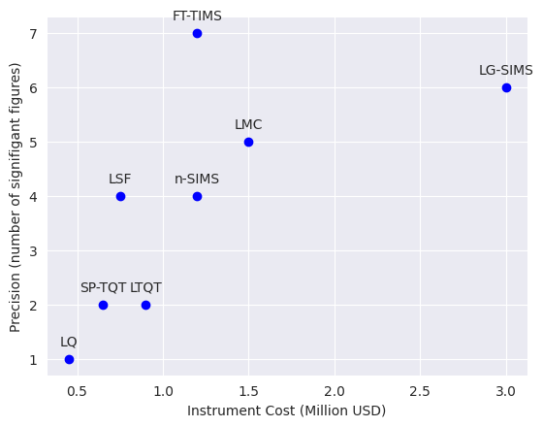
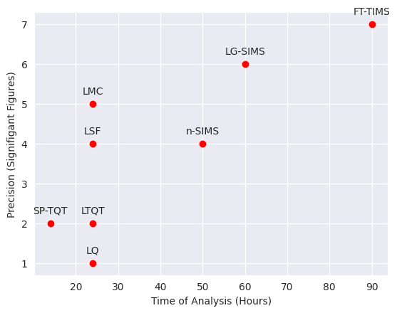
Background
The IAEA’s NWAL performs particle analysis of swipe samples for the monitoring of nuclear facilities with two focuses:​ [1][2]
Detection of U-bearing particles​
Confirmation of declared enrichment​
Current analysis performed by LG-SIMS or FT-TIMS [3]
The number of samples needing analysis is increasing rapidly, challenging the capacity of NWAL.​ [4]
TOF provides a possible fast and cost-effective analytical screening method to keep up with the growing number of samples.
Figure 1: Approximate precision of methods compared to cost and analysis time.
Notes:
Point out LG-SIMS and FT-TIMS, and our instrument SP-TQT/LTQT. LG-SIMS is a lot more expensive but the axis stops at 3 millAlso FT-TIMS requires access to a reactor

Slide 4

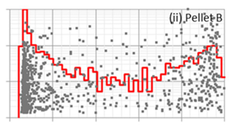

Single Particle Analysis VS Bulk Dissolution: Detecting a Needle in a Haystack
Bulk Analysis
~1% LEU
Bulk dissolution homogenizes individual particles
Homogenized particles give an average signal of the bulk make up
Single particle analysis retains this information [4]
Heterogeneity can be used to infer sample history [4]
Figure 2: A plot of normalized counts versus enrichment demonstrating the ability to differentiate a sample’s heterogeneity on an LG-SIMS [4]
Notes:
Lose range of enrichment, chemical information

Slide 5
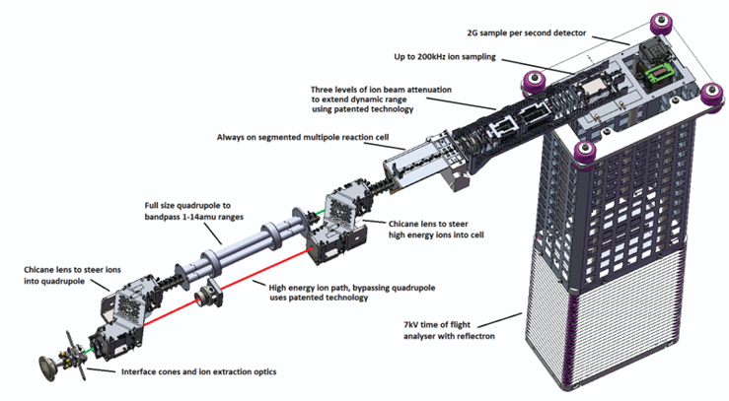
Nu Vitesse Inductively-Coupled-Plasma Time-of-Flight Mass-Spectrometer
Triple Quadrupole addition (QQQ)
Prevents isobaric interferences
Pairs with a laser ablation system
Mass Range: 6-280 AMU
Full range spectral acquisition in 30 𝜇s
Dynamic Range: 10⁶
10⁹ with ion beam attenuator
²³⁸U sensitivity bulk solution:
>50,000 cps/ppb
>160,000 cps/ppb with beam attenuator
Sample Detector
200kHz Sample Injector
Beam Attenuator
ser
Reaction Cell
Quadrupole and high energy bypass
7kV TOF Reflection
Figure 3: skeleton diagram of Nu Vitesse instrument [5]
Notes:
Note: Dynamic mass range is the ratio of the largest to the smallest signal measurable

Slide 6
Suspended Particles in Solution
Fast acquisition speed of TOF system allows differentiation of suspended particles from solution [6]
Continuously inject sample and rapidly take spectra
Signal from suspended particles superable from background solvent
Corelate spectra in time for chemical analysis differentiate form of uranium
Analysis of nanoparticles [6]
Sample injector
detector
Suspended particle solution
Atomizer
Quadrupole
Time of flight chamber
ICP chamber
reaction cell
Figure 4: Path of uranium nanoparticles through ICP-TOF-MS
Notes:
Re-highlight the 30 microsec FSAT

Slide 7
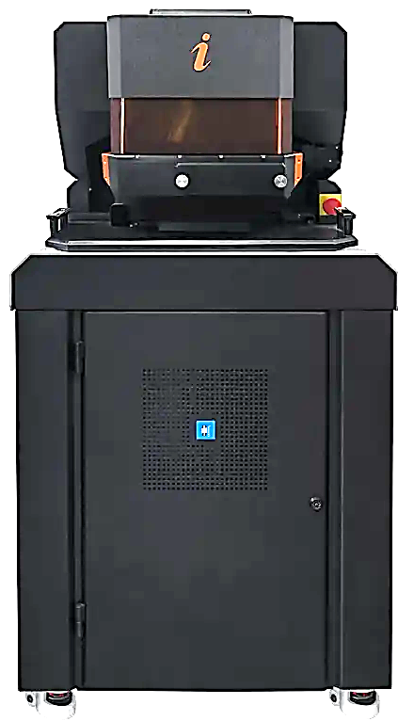
ESL Image Geo 193 Laser Ablation System
193nm ArF excimer laser
>15 J/cm² fluence
1-220µm variable spot size
Fast washout (limiting factor analysis speed)
<1ms single pulse response for 1000 pixels/s scan rate
Sealed precision stage to prevent contamination
Internal camera for imaging target area (<0.55µm resolution, 20x objective lens)
²³⁸U sensitivity with laser ablation system:
>250 cps/ppm
Beam Shaping
Ablation Chamber
Internal Camera
Laser Source
Beam Delivery
System
Water Cooling
Figure 5: Image Geo 193 Laser ablation system [7]

Slide 8
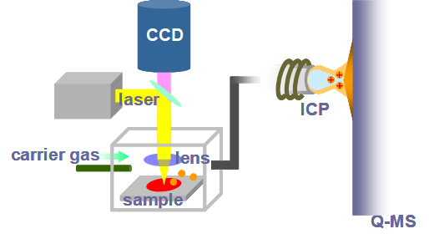
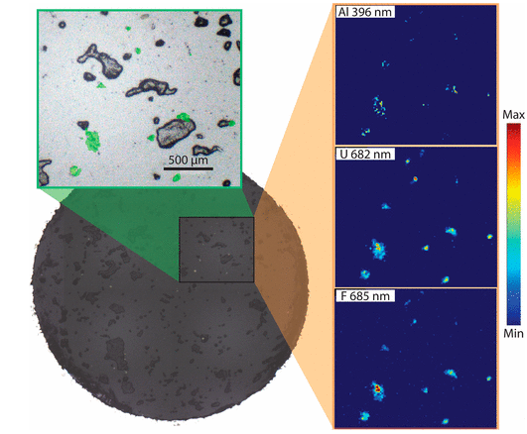
Laser Ablation from Swipe Sample
Laser ablation allows ablation of particles on a swipe sample or solid samples
Directly ablate selected particles
Spatial isotopic imaging
Camera
Dry sample prep is fast and allows other imaging techniques such as SEM
Modular system allows combination with other instruments such as laser induced breakdown spectrometer
Figure 6: sample path of laser ablation system [8]
Figure 7: UO₂F₂ particles imaged using laser ablation system coupled with LIBS [9]

Slide 9

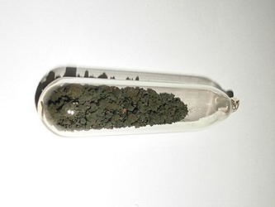
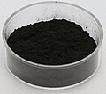
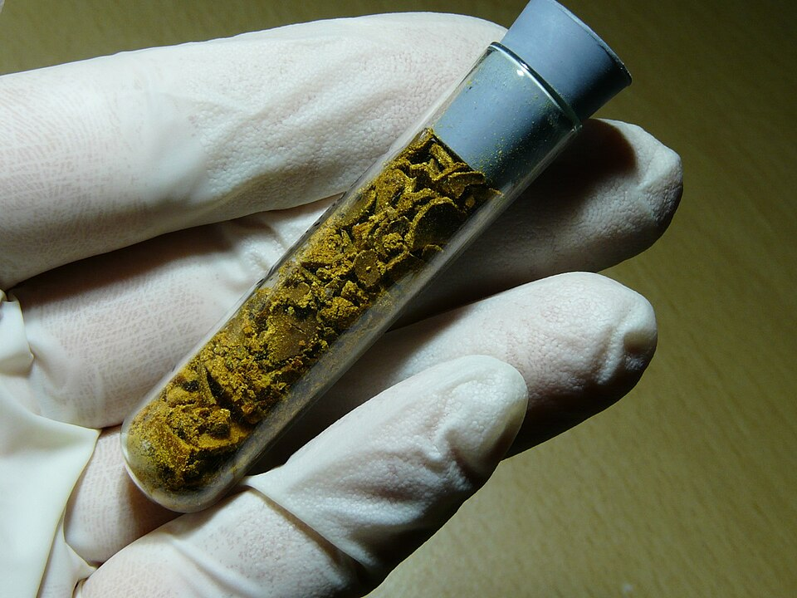
TOF corelative chemical analysis
Able to differentiate chemical form e.g. UO₂F₂, UF₄, yellowcake, nat. U minerals
Methods of performing corelative chemical analysis:
Spatial correlation of sample with laser (~1µm)
Time correlation with the TOF
Knowing U form gives information about process history, intended use, source
Figure 8: Powders of, from left to right UO₂, U₃O₈, ADU, UF₆ [10-13]

Slide 10
Current Status
Step | Status
Instrument acquisition | Completed
Lab renovations | June 2026
Instrument installation | July 2026
Method development | Ongoing
Notes:
Instrument is currently in storage on penn states campus, and we are currently awaiting construction

Slide 11
Conclusions
Has potential to support nuclear forensic applications for single particle analysis by increasing the speed of analysis and reducing cost
Comes at the expense of sensitivity
Nanoparticle analysis of suspension provides a great size advantage to
Pursuing development of two particle analysis techniques:
Direct suspention measurement
Laser ablation

Slide 12

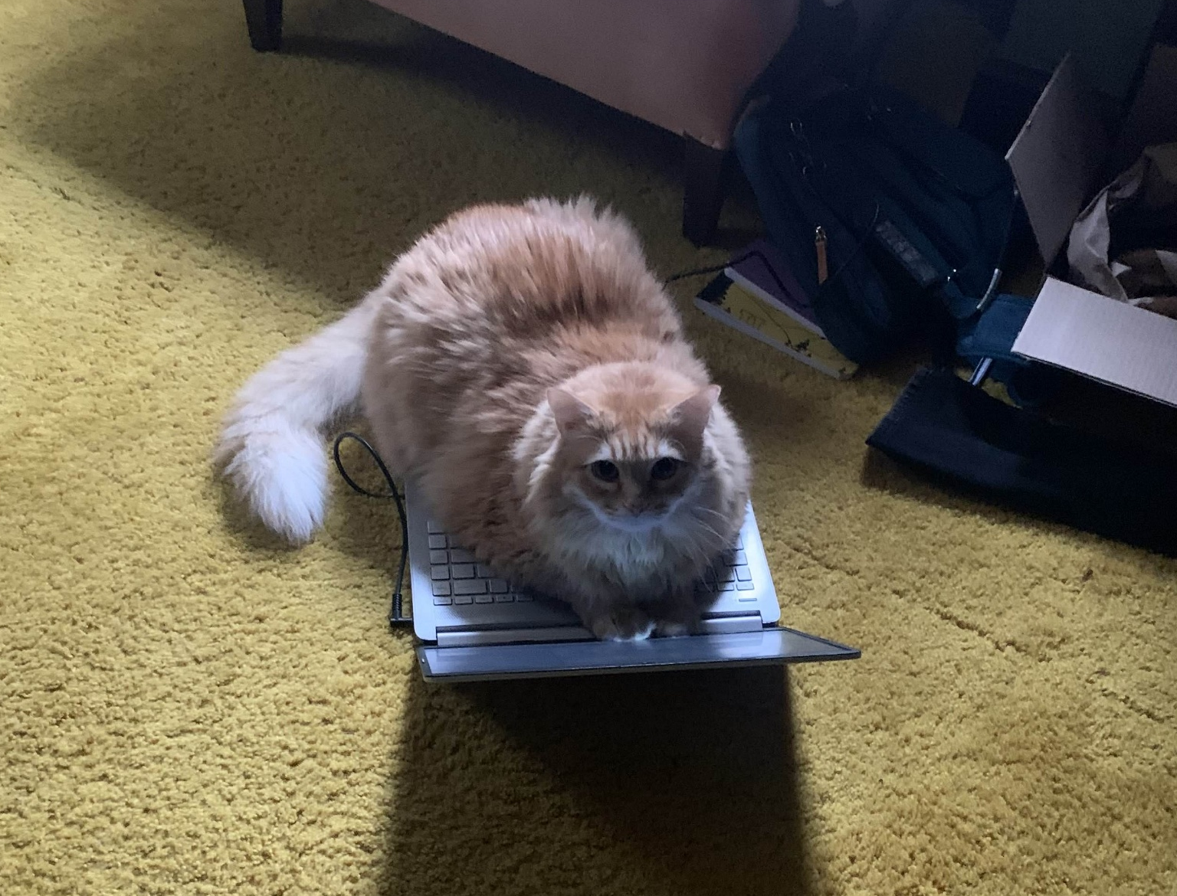

Acknowledgements
This work was developed in collaboration with collogues of the Consortium for Nuclear Forensics who are funded by Department of Energy, National Nuclear Security Administration award number DE-NA0004142.
Why am I not listed as an author?

Slide 13
Citations
[1] “The IAEA Safeguards Analytical Laboratories.” International Atomic Energy Ascociation, Oct. 2012. Accessed: Feb. 02, 2026. [Online]. Available: chrome-extension://efaidnbmnnnibpcajpcglclefindmkaj/https://www.iaea.org/sites/default/files/safeguardslab.pdf
[2] “National Nuclear Security Administration missions,” Nonproliferation. Accessed: Feb. 02, 2026. [Online]. Available: https://www.energy.gov/nnsa/nonproliferation
[3] S. V. Jovanovic et al., “Uncovering uranium isotopic heterogeneity of fuel pellets from the fifth collaborative materials exercise of The Nuclear Forensics International Technical Working Group,” Journal of Radioanalytical and Nuclear Chemistry, vol. 326, no. 3, pp. 1853–1866, Dec. 2020, doi: 10.1007/s10967-020-07470-5.
[4] S. Balsley, M. Humphrey, and S. Baude, “THE IAEA NETWORK OF ANALYTICAL LABORATORIES (NWAL) AND THE NEED TO EXPAND FOR ENVIRONMENTAL SAMPLE ANALYSIS,” presented at the Institute of Nuclear Materials Management, Austria, 2024. [Online]. Available: chrome-extension://efaidnbmnnnibpcajpcglclefindmkaj/https://cdn.fourwaves.com/static/media/formdata/b12613f9-28b7-4568-a069-5c7cfeff3c8e/099f0850-a6d3-423d-8c77-d49b268ed938.pdf
[5] “Vitesse Time-of-Flight ICP-MS.” Nu Instruments Ltd, 2021. Accessed: Feb. 02, 2026. [Online]. Available: chrome-extension://efaidnbmnnnibpcajpcglclefindmkaj/https://www.nu-ins.com/-/media/ameteknuinstruments/files/products/brochures/vitesse_2021.pdf?la=en&revision=9003d984-cc91-4469-b999-c03acd38b8ae
[6] M. Tharaud, L. Schlatt, P. Shaw, and M. F. Benedetti, “Nanoparticle identification using single particle ICP-ToF-MS acquisition coupled to cluster analysis. From engineered to natural nanoparticles,” J. Anal. At. Spectrom., vol. 37, no. 10, pp. 2042–2052, 2022, doi: 10.1039/D2JA00116K.
[7] “Image Geo 193.” Elemental Scientific Lasers LLC, Bozeman, MT. Accessed: Feb. 02, 2026. [Online]. Available: chrome-extension://efaidnbmnnnibpcajpcglclefindmkaj/https://www.icpmslasers.com/files/Data-Sheets/imageGEO193%2022190UFM.pdf
[8] Schematic diagram of LA-ICP-MS. 2026. [Digital]. Available: https://www.toray-research.co.jp/en/technical-info/analysis/LA_ICP_MS.html
[9] B. T. Manard et al., “Uranium Single Particle Analysis for Simultaneous Fluorine and Uranium Isotopic Determinations via Laser-Induced Breakdown Spectroscopy/Laser Ablation–Multicollector–Inductively Coupled Plasma–Mass Spectrometry,” J. Am. Chem. Soc., vol. 146, no. 21, pp. 14856–14863, May 2024, doi: 10.1021/jacs.4c03965.
[10] Argonne National Laboratory, “Uranium hexafluoride crystals sealed in an ampoule” https://en.wikipedia.org/wiki/Uranium_hexafluoride#/media/File:Uranium_hexafluoride_crystals_sealed_in_an_ampoule.jpg
[11] Weirdmeister, Ammonium Diuranate, Accessed: Feb. 7, 2026. available: https://commons.wikimedia.org/w/index.php?curid=37291020
[12] Leiem, Triuranium octoxide prepared by heating ammonium diuranate. 3.0 grams, Jan. 13, 2024. accessed: Feb. 7, 2026. available: https://commons.wikimedia.org/wiki/File:Triuranium_octoxide.JPG
[13] Chemolunatic, UO2 Powder used for making reactor fuel, Jan. 31, 2020. Accessed: Feb. 7, 2026. available: https://commons.wikimedia.org/wiki/File:UO2_Powder.jpg

Slide 14
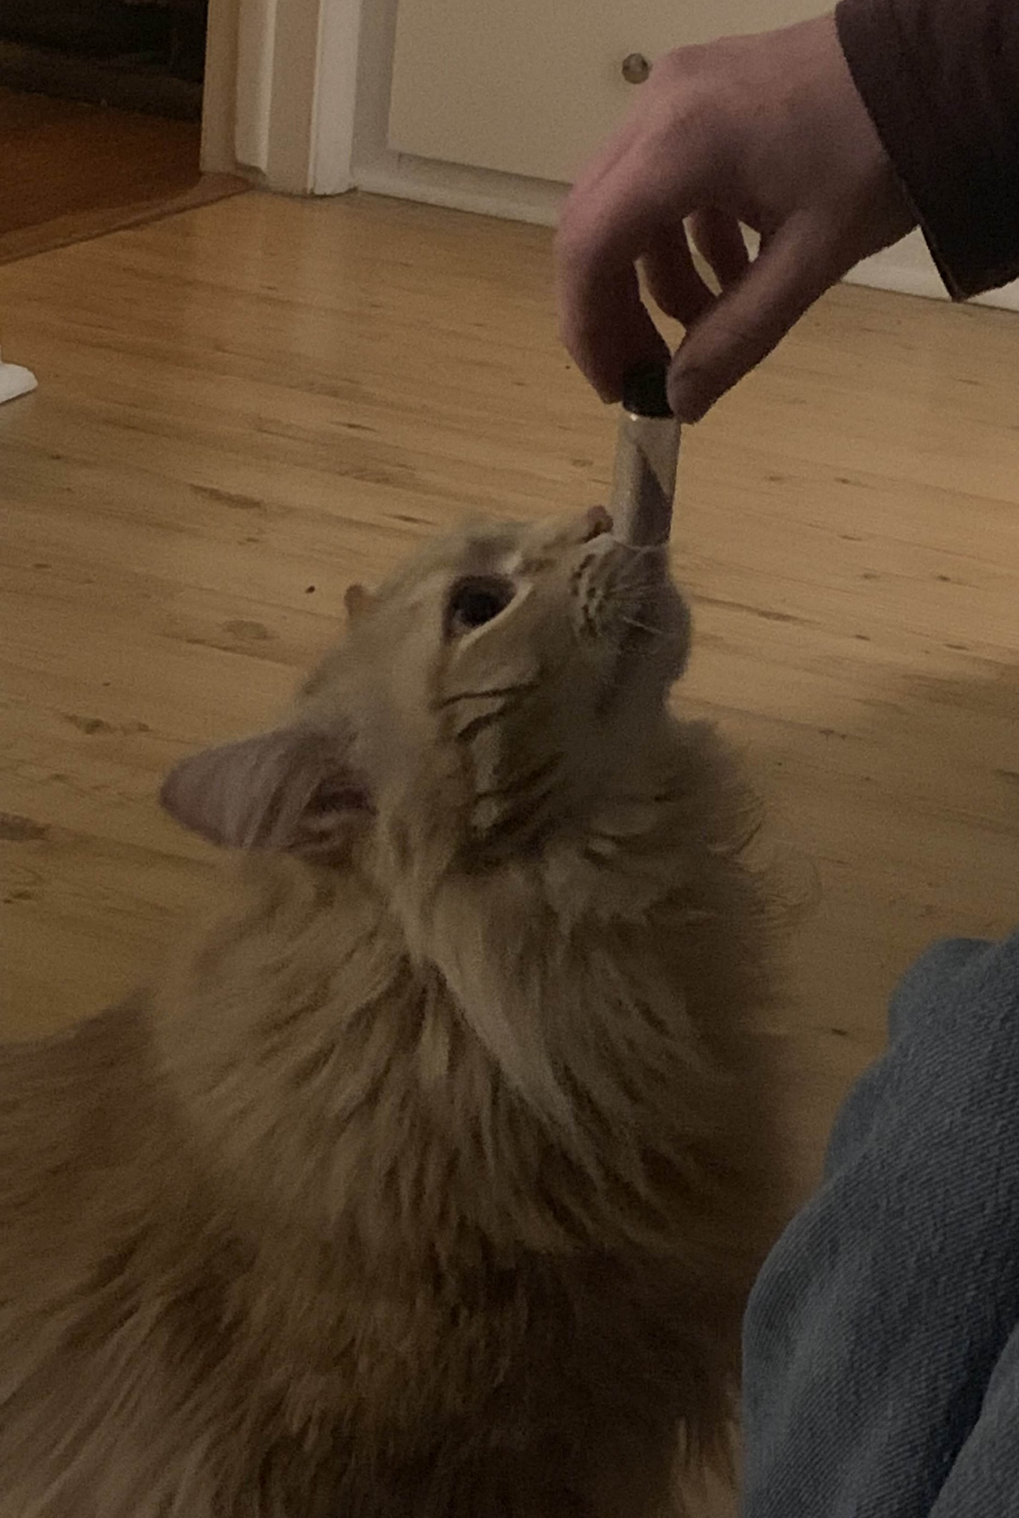
Questions?
Sample?
Mass
spectrometer?

Slide 15
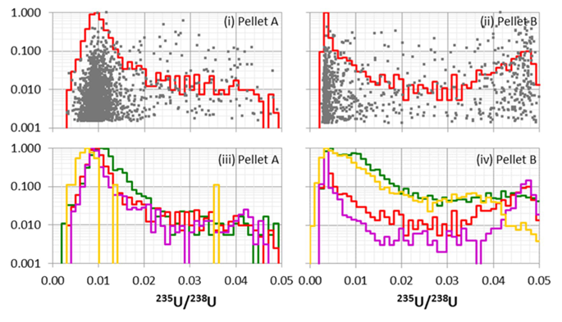
Supplimental

