Slide 1


Using a HPGe-PIPSBox detector system to compare the noble gases produced by fission from ²³⁵U(n,f) and ²⁴⁸Cm(SF)
Sifa Poulton^{1,2}, Steven Bell², Matt Goodwin³, Ayrton Jenkins³, Andy Pearce², Andrew Petts⁴, Paddy Regan^{1,2}, Matt Ryan⁵, Robert Shearman²
¹ University of Surrey, Guildford, UK, GU2 7XH
² National Physical Laboratory, Teddington, UK, TW11 0LW
³ Atomic Weapons Establishment, Reading, UK, RG7 4PR
⁴ EDF Hartlepool NPP, UK, TS25 2BZ
⁵ National Nuclear Laboratory, Cumbria, UK, CA20 1PG

Slide 2


Motivation
Fission yields are affected by many factors including the parent isotope
Comparing ratios of produced isotopes can help distinguish between sources
Noble gasses are chemically inert and therefore easy to extract from samples

Slide 3
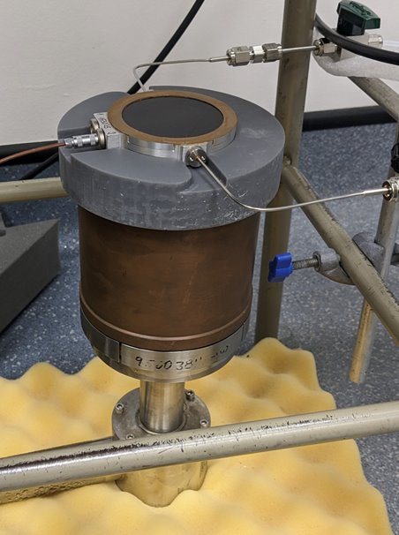
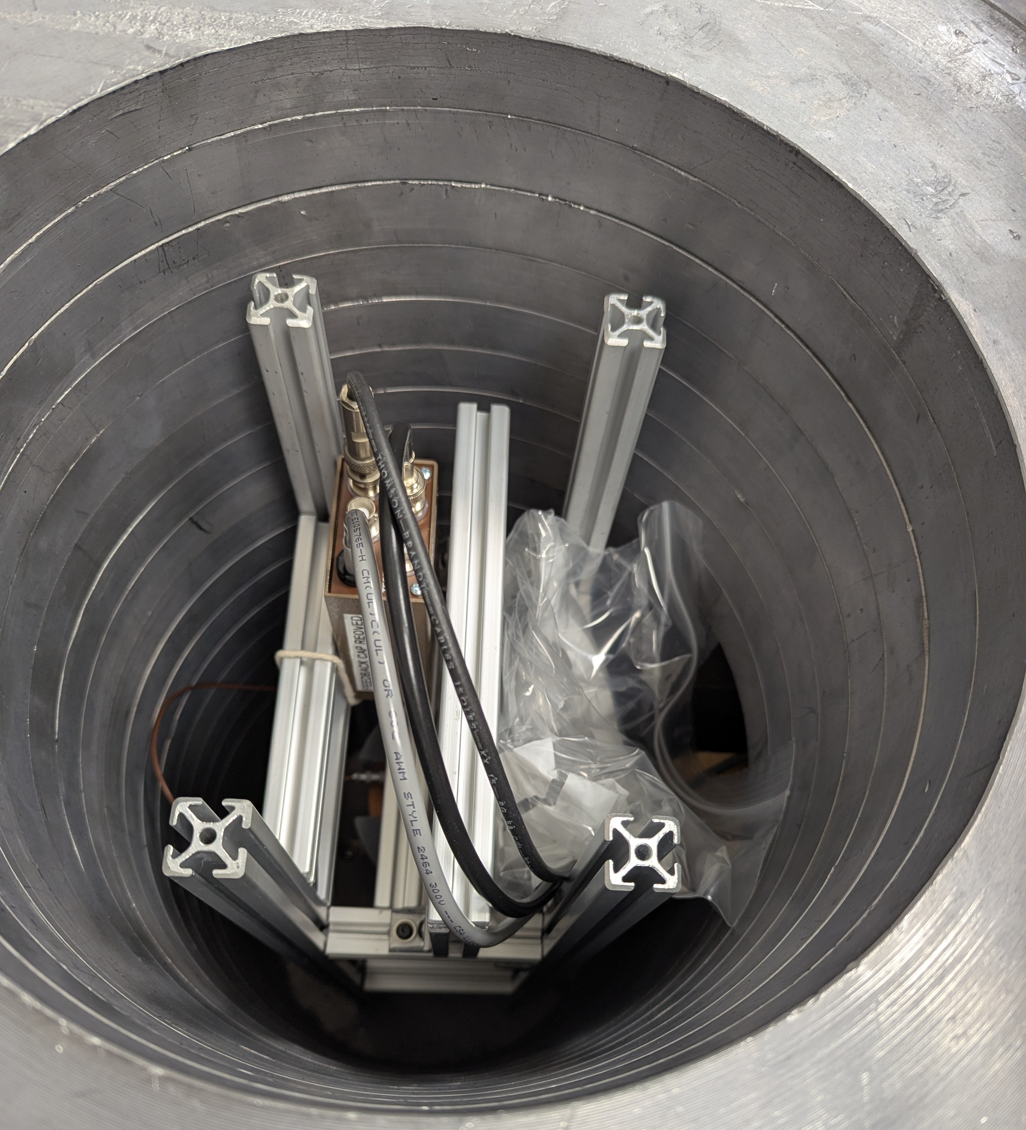
²³⁵U(n,f) Experimental design
Gasses extracted from U-235 sample (600 Bq) irradiated in NPL’s thermal pile for 5 hours with fluence averaging 2 x10⁷ cm⁻²s⁻¹
PIPSBox - two silicon detectors (1200mm² x 500µm) either side of a 10.6 mL gas volume
HPGe “Odin”
Detectors placed in lead shielding
Notes:
PIPSBox 2x1200-500PA comprising two silicon detectors eitherside of a gas volume [6] for beta detection – one detectorchannel used
A single GEM-SP9430-LB-C-HJ-S HPGe [7] for gammameasurement
Digitiser: CAEN DT5780M 2 channel digitiser [8] with DPP-PHA firmware [9]
PIPSBox preamp: CAEN A1422 4 channel [10]
Mixed Xe-133/Xe-131m source (0.5 Bq and 3 Bq respectively)

Slide 4
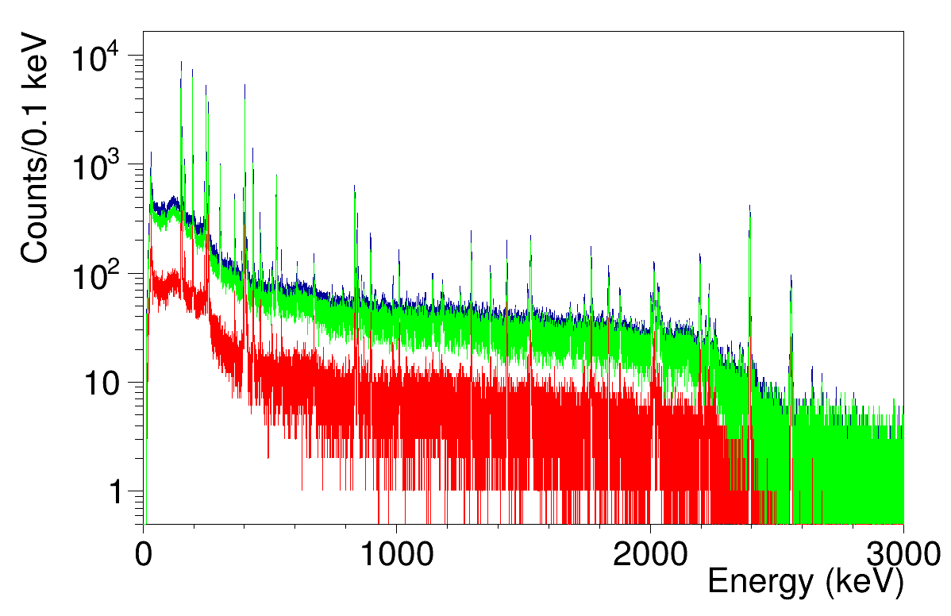
²³⁵U(n,f) gamma spectra
Singles
Anti-Coincidence
Beta-gated
Notes:
First 15 minutes – to best mimic a real world situation close to a reactor
Very active sample – very busy, lots of background from Compton and overlapping lines, so use beta tag to clean up a bit

Slide 5
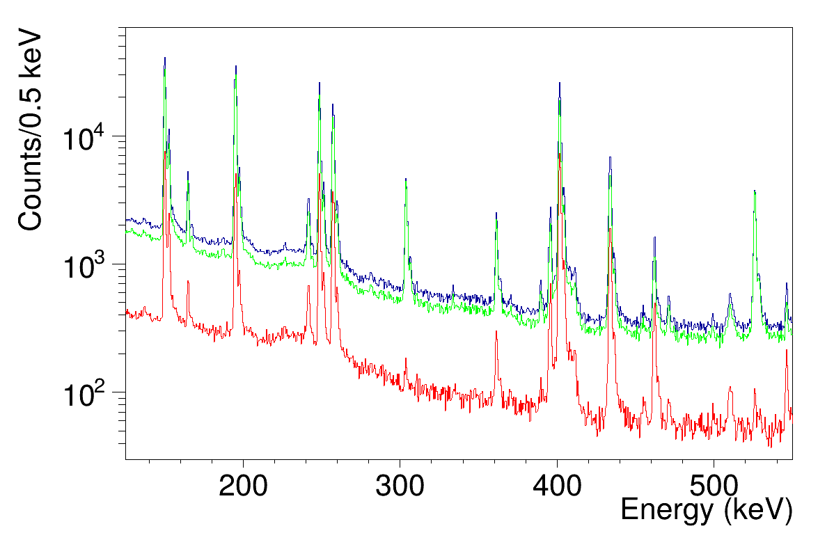
²³⁵U(n,f) gamma spectra
⁸⁸Kr
Singles
Anti-Coincidence
Beta-gated
¹³⁵Xe
^{85m}Kr
¹³⁸Xe
^{85m}Kr
⁸⁸Kr
^{135m}Xe
^{131m}Xe
Notes:
Zoom in 125 to 575 range – where a lot of gamma rays for isotopes key for criticality monitoring are found
Picked out a few key isotopes here – anti-coincidence can be useful for metastables where you have a de-excitation via gamma ray to ground state. Example – 135mXe area uncertainty drops from 18% in singles to 2.5% in anti-coincidence
Beta gating – 88kr peak at 196, the secondary smaller peak (unassigned!) is reduced in the gated spectrum (potentially electronic noise?)

Slide 6
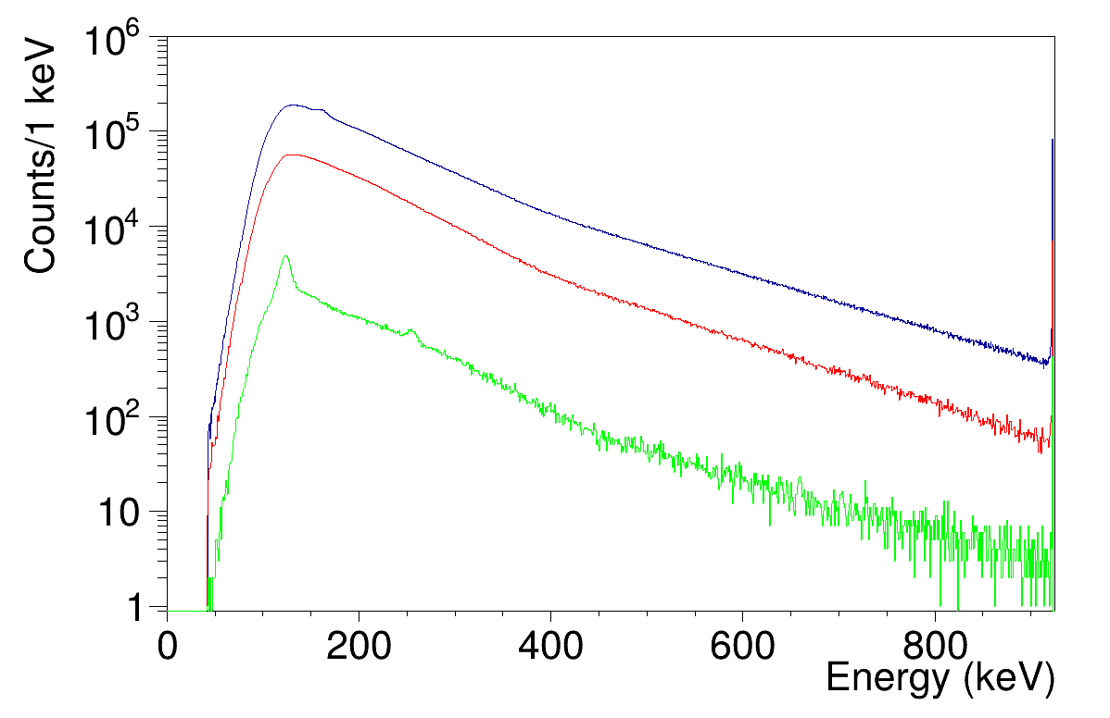
²³⁵U(n,f) beta spectra
Singles
Beta-gated
Gated on 29-36 keV (Xe and Cs X-rays)
Notes:
Zoom in 125 to 575 range – where a lot of gamma rays for isotopes key for criticality monitoring are found
Picked out a few key isotopes here – anti-coincidence can be useful for metastables where you have a de-excitation via gamma ray to ground state. Example – 135mXe area uncertainty drops from 18% in singles to 2.5% in anti-coincidence
Beta gating – 88kr peak at 196, the secondary smaller peak (unassigned!) is reduced in the gated spectrum (potentially electronic noise?)

Slide 7
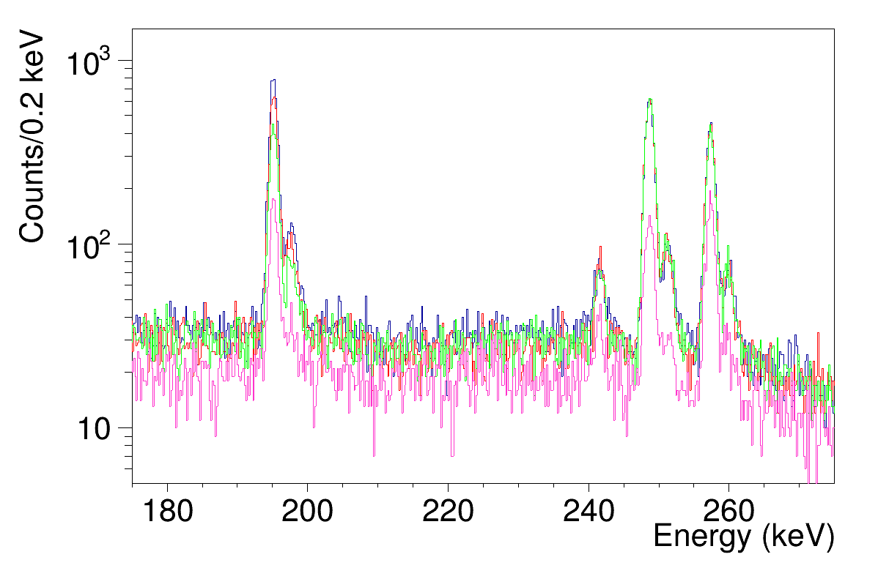
²³⁵U(n,f) gamma spectra
⁸⁸Kr
Gated betas 100 to 150 keV
Gated betas 150 to 200 keV
Gated betas 200 to 300 keV
Gated betas >300 keV
¹³⁵Xe
¹³⁸Xe
Notes:
Go a step further with a active sample and gate on different ranges in the beta spectrum (just under 1 MeV range) Things with higher energy betas are present in more spectrum
These secondary peaks – noise? – are significantly reduced at higher gatings for beta minus decays with high q values
88kr – 3 MeV
135 xe – 1.2 MeV
138 xe – 3 MeV

Slide 8
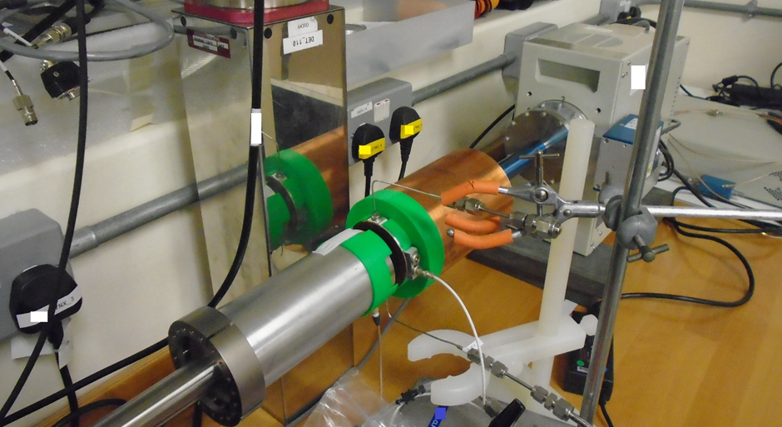
²⁴⁸Cm(SF) Experimental design
2 HPGes
Source: head gases from a ²⁴⁸Cm source (injected)
PIPSBox (one working channel)
Standalone PIPS
Notes:
Set up – test for experiment talk about later
Therefore trying out options to deal with one broken PIPSBox channel – add a standalone. Didn't work, won't show the results from that
4 hrs

Slide 9
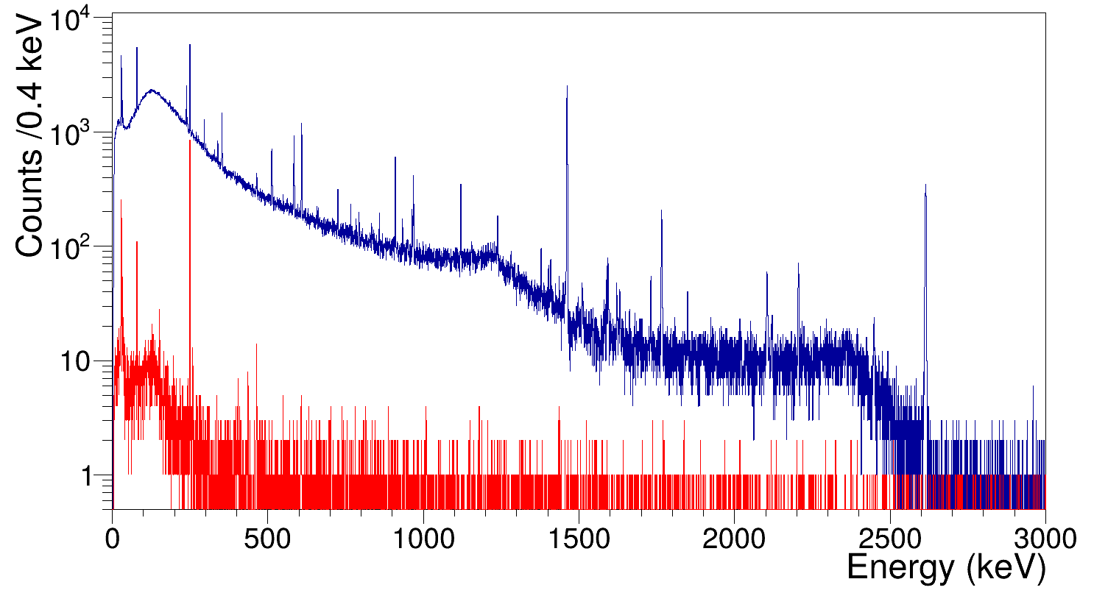

²⁴⁸Cm(SF) gamma spectra
Notes:
Norm background drop out – the peaks in red are the gamma rays in coincidence with a beta signal
Peaks in red don't align with the NORM peaks

Slide 10
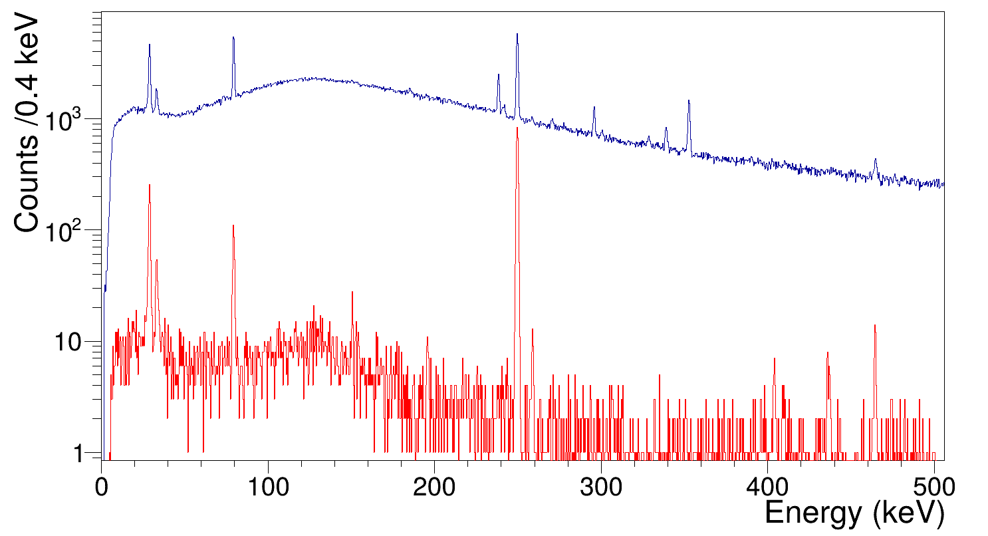
²⁴⁸Cm(SF) gamma spectra
¹³³Xe
81 keV
¹³⁵Xe
250 keV
¹³⁸Xe
435 keV
^{85m}Kr
151 keV
⁸⁸Kr
196keV
¹³⁸Xe
258 keV
⁸⁷Kr
402 keV
¹³⁸Cs
462 keV
Notes:
Back to that 0 to 500 range and several species can be identified including daughter decay product of 138Xe

Slide 11
⁸⁸Kr : ¹³⁵Xe ratio
²³⁵U(n,f) |  | ²⁴⁸Cm(SF)
1 : (0.0584 ± 0.0035) | Singles | 1 : (17.4 ± 5.6) Gated
1 : (0.0762 ± 0.0048) | All beta
1 : (0.0610 ± 0.0043) | 100-150 keV beta gate
1 : (0.0768 ± 0.0054) | 150-200 keV beta gate
1 : (0.1092 ± 0.0079) | 200-300 keV beta gate
1 : (0.084 ± 0.010) | 300-400 keV beta gate
1 : (0.0671 ± 0.0072) | 300+ keV beta gate
Notes:
All these ways to get the data, let’s see what they tell us about the sources
Statistics too low on Cm for multiple gatings – high uncertainty anyway (32%) Range in U235 is 6-12%
Despite these errrors, very clearly tell U235 from Cm248. This is per Kr88 atom, how many 135Xe atoms
Heavy peak (Xe) stays very similar in fission fragment distribution, so lighter peak increases in mass to make up for it so more Xe to Kr ratio
Independent yield of U-235 give 1 : 0.1

Slide 12
Any questions?

