Slide 1



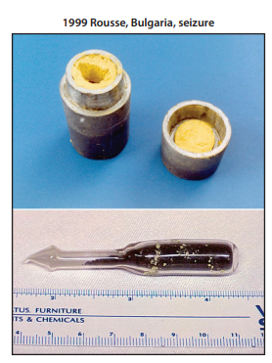
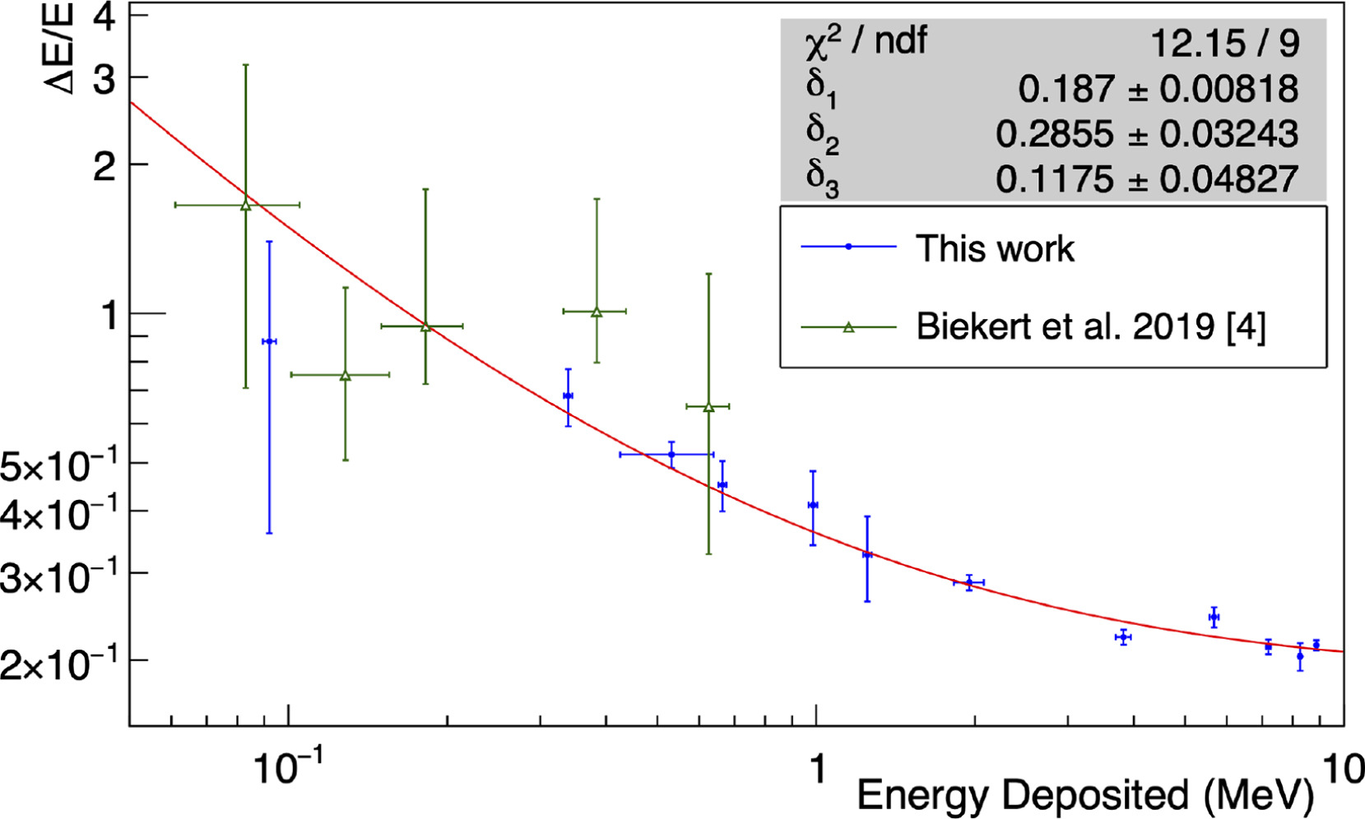
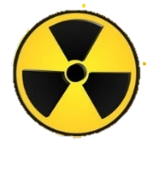
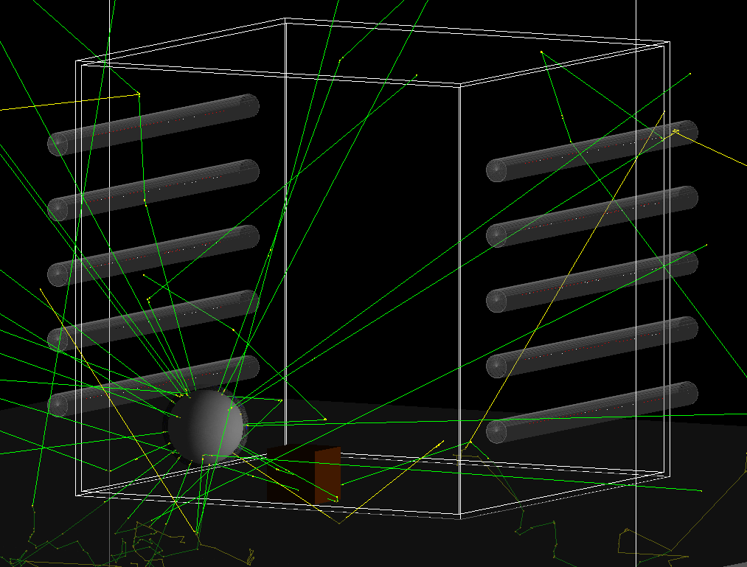
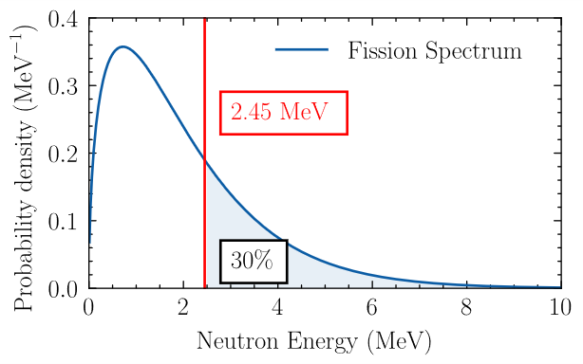
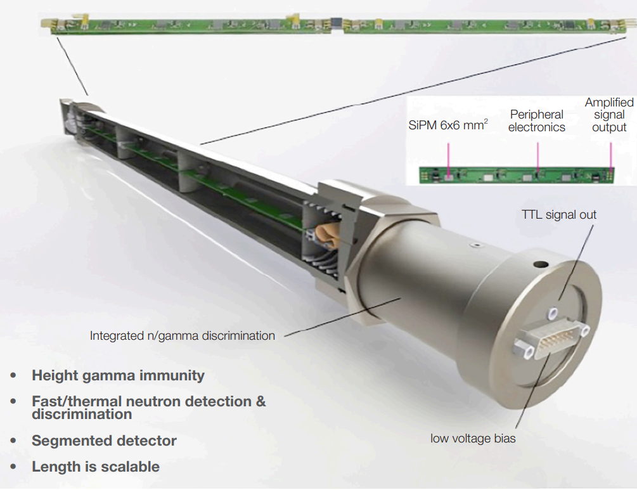
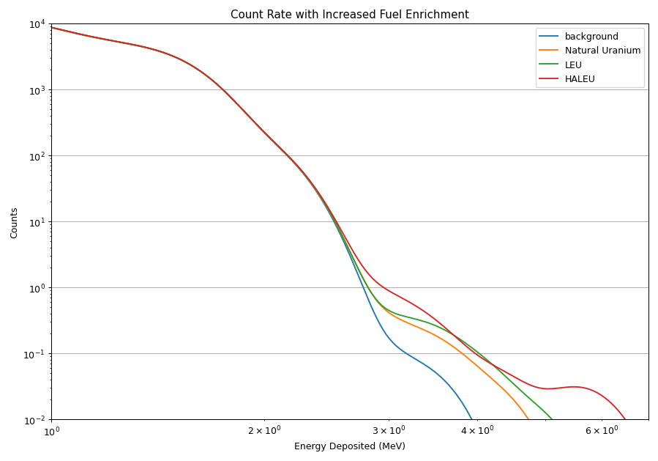



A TENA Based Interrogation Setup for the Detection of SNM Utilising ⁴He Scintillation Detectors
Edward Martin, School of Physics, University of Bristol, UK
Mahmoud Bakr and Thomas B. Scott
This work presents initial steps toward assessing the feasibility of using high-pressure helium-4 (He-4) scintillation detectors in an active-interrogation system utilising the Threshold Energy Neutron Analysis (TENA)[1][2] technique for the detection of special nuclear materials (SNMs). The proposed setup consists of a deuterium–deuterium (DD) based Inertial Electrostatic Confinement (IECF) fusor as the interrogation source, arrays of Arktis S670 He-4 detectors, and the detection of neutrons with energies higher than the probing source (~2.45 MeV), which serves as a robust indicator of the presence of SNM.
Background
Wavelength Shifting Coating
Special Nuclear Material (SNM) refers to plutonium and materials enriched in fissile uranium isotopes (${}_{}^{235}U,{}_{}^{233}U$)[3]
Active interrogation techniques rely on inducing secondary emissions that can act as a clear detection signature, driving interest in novel portable detection capabilities. [4] This can provide an increased effectiveness compared to a passive system were the SNM shielded or concealed.
Recoil ⁴He atoms excite and ionise the gas, generating ultraviolet scintillation photons (λ ≈ 80 nm).
A wavelength-shifting (WLS) material converts the UV scintillation light to visible wavelengths (λ ≈ 420–450 nm).
Existing literature reports an energy resolution of between 50-20% [8]. Energy deposition spreading will be applied in post-processing.
n
He
He+
80nm
420 – 450 nm
n
?
6x6 mm
²
SiPM
Figure 5: Diagram of ⁴He recoil scintillation and light collection
Commonly used performance standards (e.g. ANSI N42.41-2021) are aligned with the IAEA “Nuclear Security Recommendations on
Physical Protection of Nuclear Material and
Nuclear Facilities” requiring active interrogation systems to be capable of detecting 2 kg of fissile material (SNM). [5]
Figure 1: Images of the uranium oxide seizures from Rousse, Bulgaria (1999)[6]
Detection Technique
Figure 6: Experimental Energy Resolution of Arktis ⁴He Detector
Threshold Energy Neutron Analysis (TENA) utilises a deuterium –deuterium (DD) fusor to generate neutrons through:
$$D^{+}+ D^{+}→He+n(2.45 MeV)$$
The neutrons are used to interrogate a cargo, inducing fission in the presence of any potential SNM.
A typical detection setup is shown in Fig.2
Neutron Source
Detector Array
Simulation
Prompt Fission Neutron
A Geant4 simulation based on the TENA experimental setup [1] has been developed, consisting of:
Neutron source
Multiple ⁴He detectors (5 on each side)
20 kg masses of U02 (UNat, LEU, HALEU)
Stainless-steel container
Concrete floor
Both the energy deposited into the ⁴He is recorded to gain an understanding of the expected counts from the detector.
Detector Array
Probing Fusion Neutron
Stainless Steel
Container
Detector Array
Figure 2: Diagram of Typical Experimental Setup
Approximately 30% of secondary neutrons will have energies greater than the probing source, generating a distinct energy signature. Detecting this signature provides a robust indicator of the presence of SNM. [1]
Figure 7: Geant 4 Simulation Visualisation
Results
Figure 3: Fission Neutron Probability Density Function
Each simulation run consisted of $2×{10}^{9}$ neutrons. The results show the number of counts per source neutron when masses of 20 kg of UO2 with varying enrichment levels are positioned inside the container. Using the background run as the threshold (max neutron energy of 2.45 MeV) an increase in the counts of higher energy deposits with increasing enrichment can be seen.
The detector contains high-pressure (~180 bar) helium (⁴He) as the active medium.
Fast neutrons interact primarily via elastic scattering on ⁴He nuclei, producing energetic recoil helium atoms.
Figure 4: Diagram of Arktis S670 Detectors [7]
Figure 8: Simulated energy deposition data.
Discussion & Further Work
The results show that there is an increase in high-energy deposits into the detector when UO2 is located inside the container, increasing with the enrichment of the material, indicating the detection setup may be a viable solution for the detection of SNM.
Future work will look to
Investigate the impact of different experimental setups varying the position of material, amount of material, number of detectors, neutron rate and shielding material
Extend the simulation model to produce and collect scintillation light to improve the accuracy of the model.
Compare simulation results to experimental setups
References
[1] Masuda, Kai, Yoshiyuki Takahashi, Tsuyoshi Misawa, Norio Yamakawa, Thomas B. Scott, and Mahmoud Bakr. ‘Fusion Neutron Source and Array of Particle Detectors for Nondestructive Interrogation of Special Nuclear Materials’. Journal of Applied Physics 136, no. 11 (17 September 2024): 114503. https://doi.org/10.1063/5.0225179.
[2] Bakr, Mahmoud, Kai Masuda, Yoshiyuki Takahashi, Tsuyoshi Misawa, Norio Yamakawa, and Tomas Scott. ‘Nondestructive and Active Interrogation System for Special Nuclear Material: Proof of Principle and Initial Results’. Nuclear Science and Techniques 35, no. 5 (31 May 2024): 87. https://doi.org/10.1007/s41365-024-01458-6.
[3] ] Atomic Energy Act of 1954, as amended, §11(aa), 42 U.S.C. §2014(aa) — Definition of Special Nuclear Material.
[4] Nuclear Security Systems and Measures for the Detection of Nuclear and Other Radioactive Material out of Regulatory Control. n.d.
[5] IAEA. ‘Nuclear Security Recommendations on Physical Protection of Nuclear Material and Nuclear Facilities (INFCIRC/225/Revision 5)’. Text. 16 September 2016. https://doi.org/10.61092/iaea.ko2c-dc4q.
[6] Kristo, Michael J., Amy M. Gaffney, Naomi Marks, Kim Knight, William S. Cassata, and Ian D. Hutcheon. ‘Nuclear Forensic Science: Analysis of Nuclear Material Out of Regulatory Control’. Annual Review of Earth and Planetary Sciences 44, no. 1 (2016): 555–79. https://doi.org/10.1146/annurev-earth-060115-012309.
[7] ‘Fast Neutron Dose Rate Monitoring Using off the Shelf Helium-4 Scintillation Detectors - ESARDA’. Accessed 27 January 2026. https://esarda.jrc.ec.europa.eu/publications/fast-neutron-dose-rate-monitoring-using-shelf-helium-4-scintillation-detectors_en.
[8] Searfus, O., P. Marleau, and I. Jovanovic. ‘Response of a High-Pressure 4He Scintillation Detector to Nuclear Recoils up to 9 MeV’. Nuclear Instruments and Methods in Physics Research Section A: Accelerators, Spectrometers, Detectors and Associated Equipment 1066 (September 2024): 169608. https://doi.org/10.1016/j.nima.2024.169608.
© British Crown Copyright 2025/AWE
This document is of United Kingdom origin and contains proprietary information which is the property of the Secretary of State for Defence. It is furnished in confidence and may not be copied, used or disclosed in whole or in part without prior written consent of Defence Intellectual Property Rights DGDCDIPR-PL- Ministry of Defence, Abbey Wood, Bristol, BS34 8JH, England.

