Slide 1




The Development of Hard X-ray Imaging Detectors at STFC
Dr. Matthew C. Veale et al.
11/02/2026

Slide 2
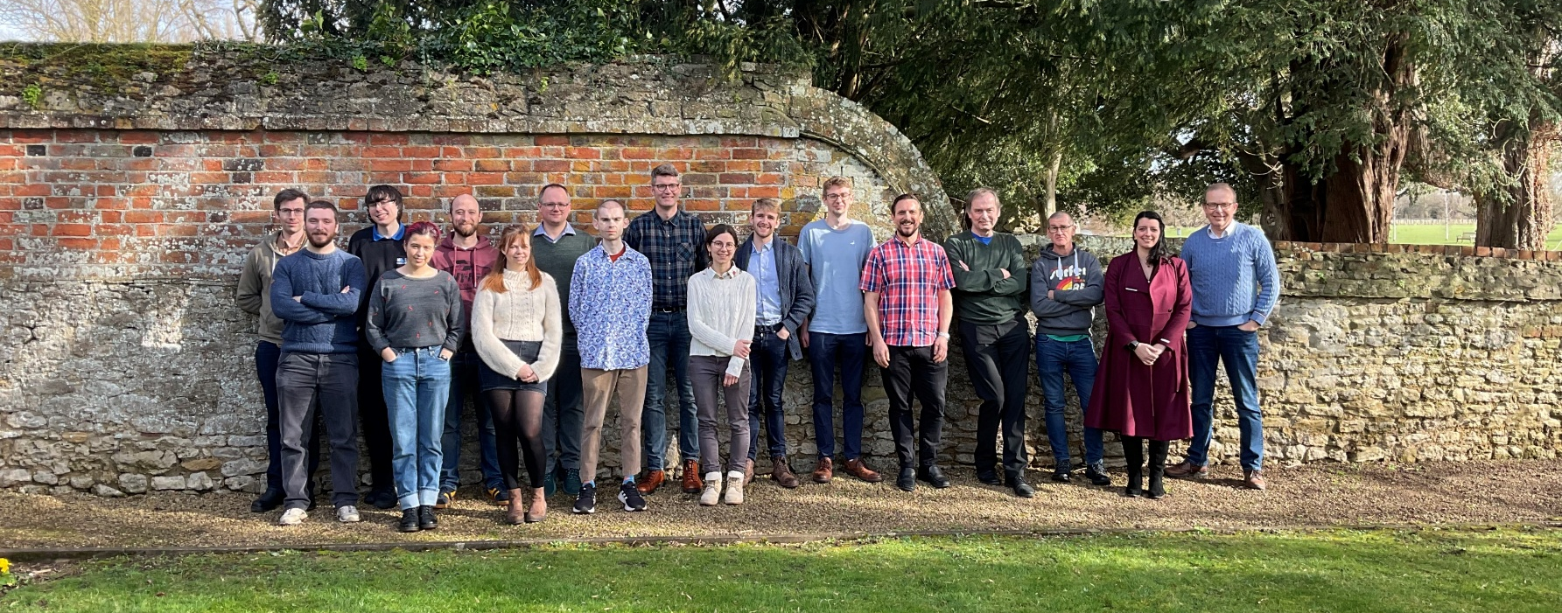
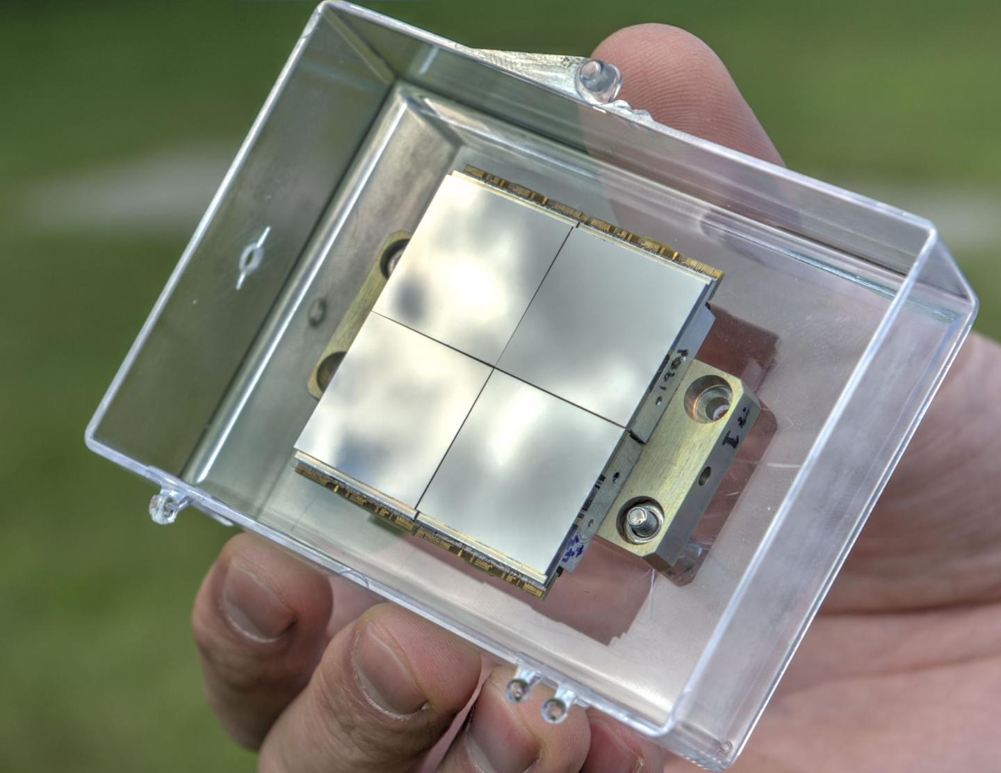
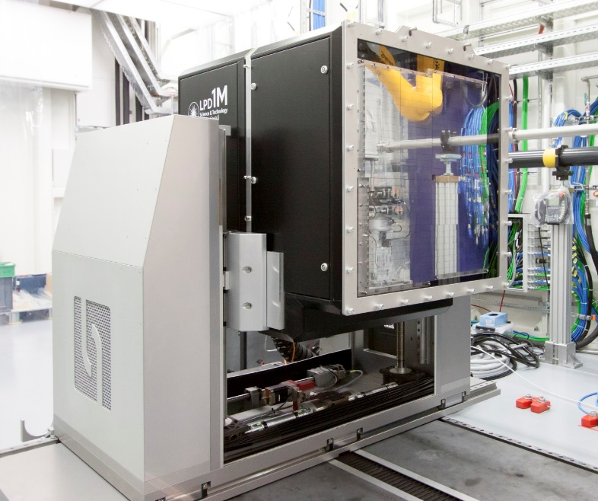
STFC Detector Development Group
Group of 16 people
Expertise in:
  High-Z Semiconductors
  DAQ Development
  Electrical Engineering
  Neutron Detectors
  Scintillator-Based Imaging
2

Slide 3
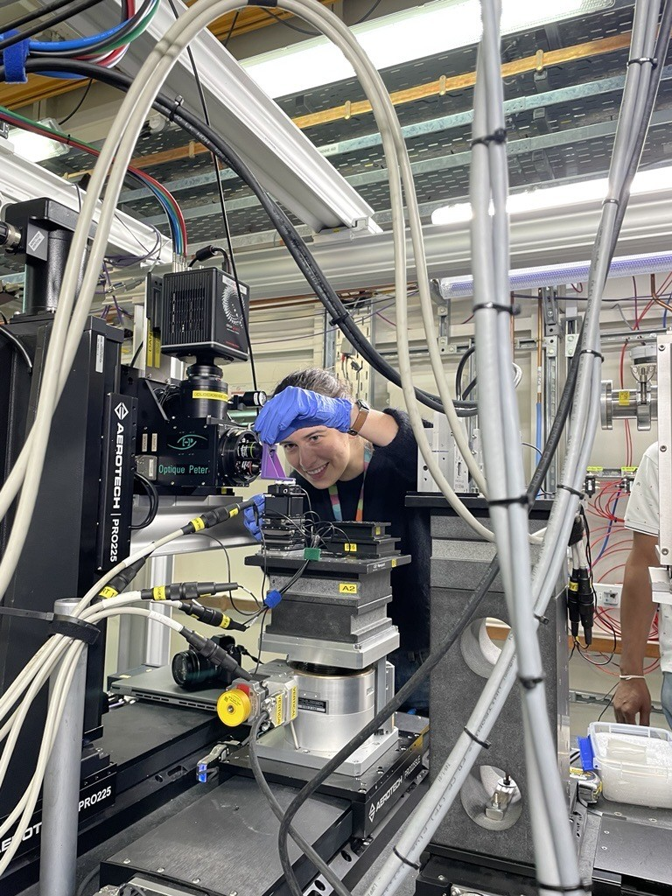
Clear and Bright X-Ray Imaging with Nanophotonic Scintillators
Dr. Issy Braddock et al.
11/02/2026
10:45
3

Slide 4
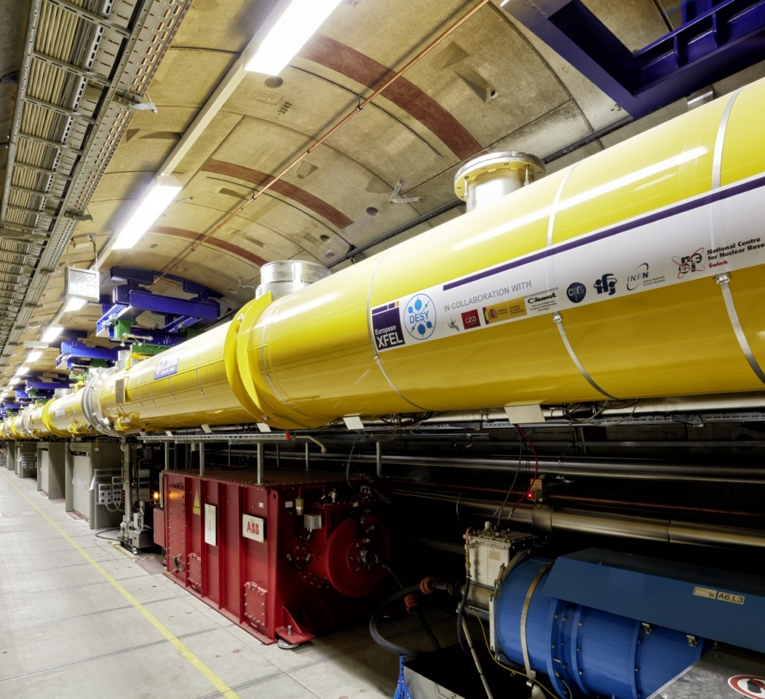
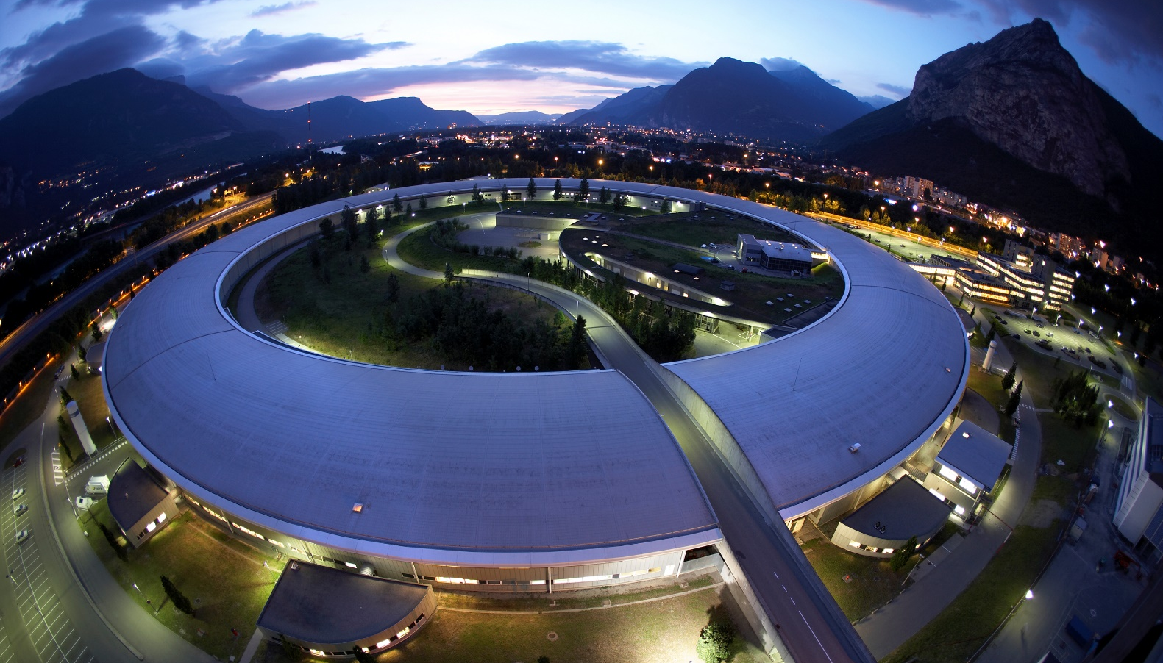
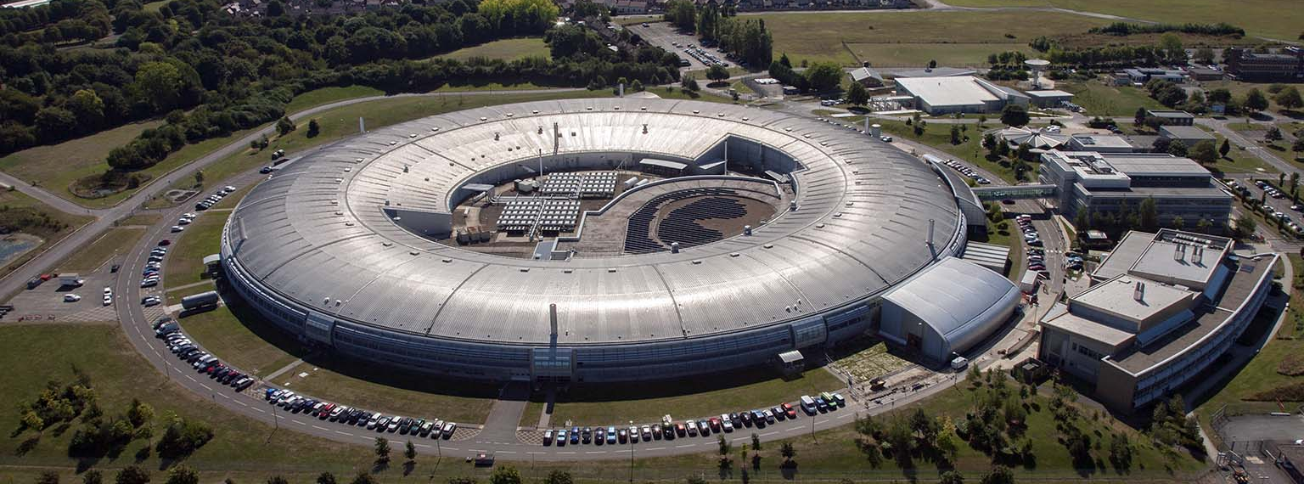

Slide 5


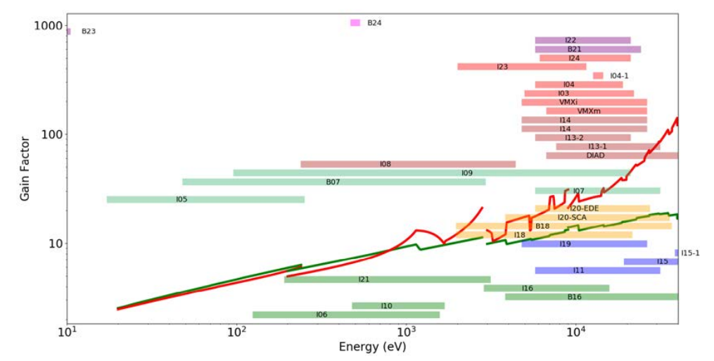
DLSR Synchrotrons
DLSR = Diffraction Limited Storage Ring
Increase in the number and quality of bending and focusing magnets
Reduction of the beam size by over an order of magnitude
×100 increase in brightness
Diamond-II increase in average X-ray energy too (> 20 keV)
5

Slide 6

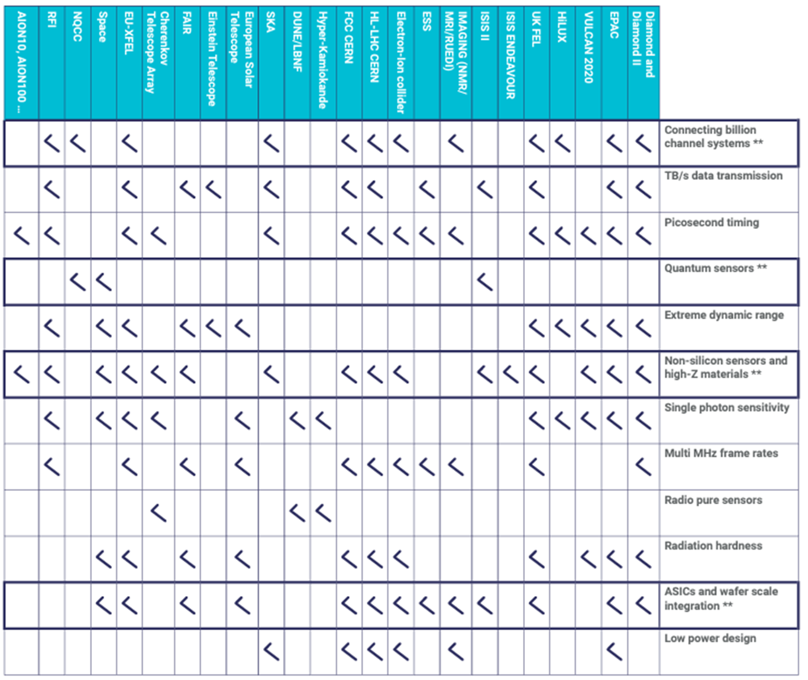
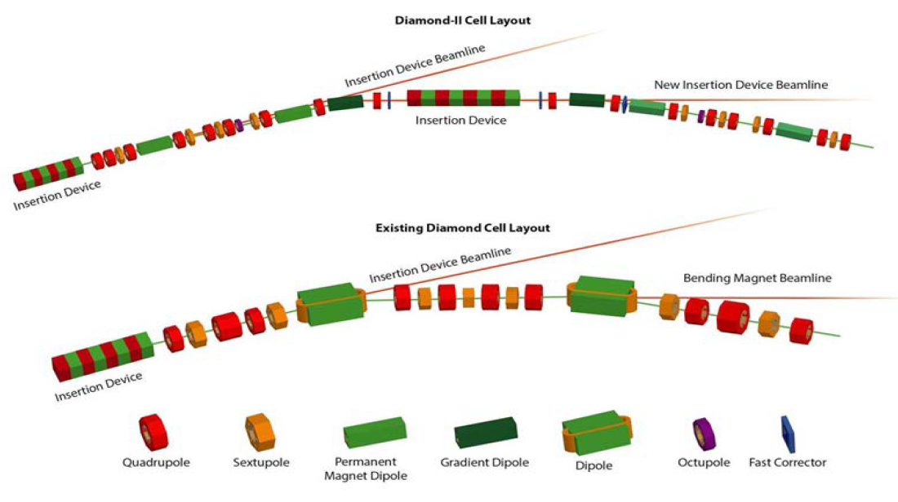
DLSR Synchrotrons
Next-Gen Detectors
DLSR = Diffraction Limited Storage Ring
Increase in the number and quality of bending and focusing magnets
Reduction of the beam size by over an order of magnitude
×100 increase in brightness
Diamond-II increase in average X-ray energy too (> 20 keV)
Hard X-Rays
High Fluxes
Single Photon Resolution
High Spatial Resolution
Temporal Resolution
Large Areas
6

Slide 7

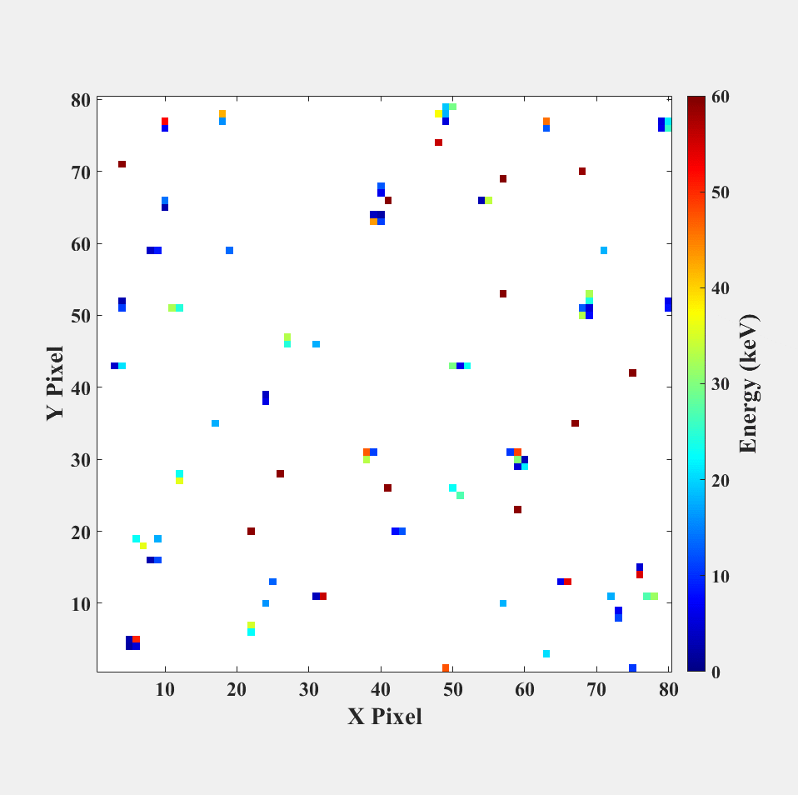
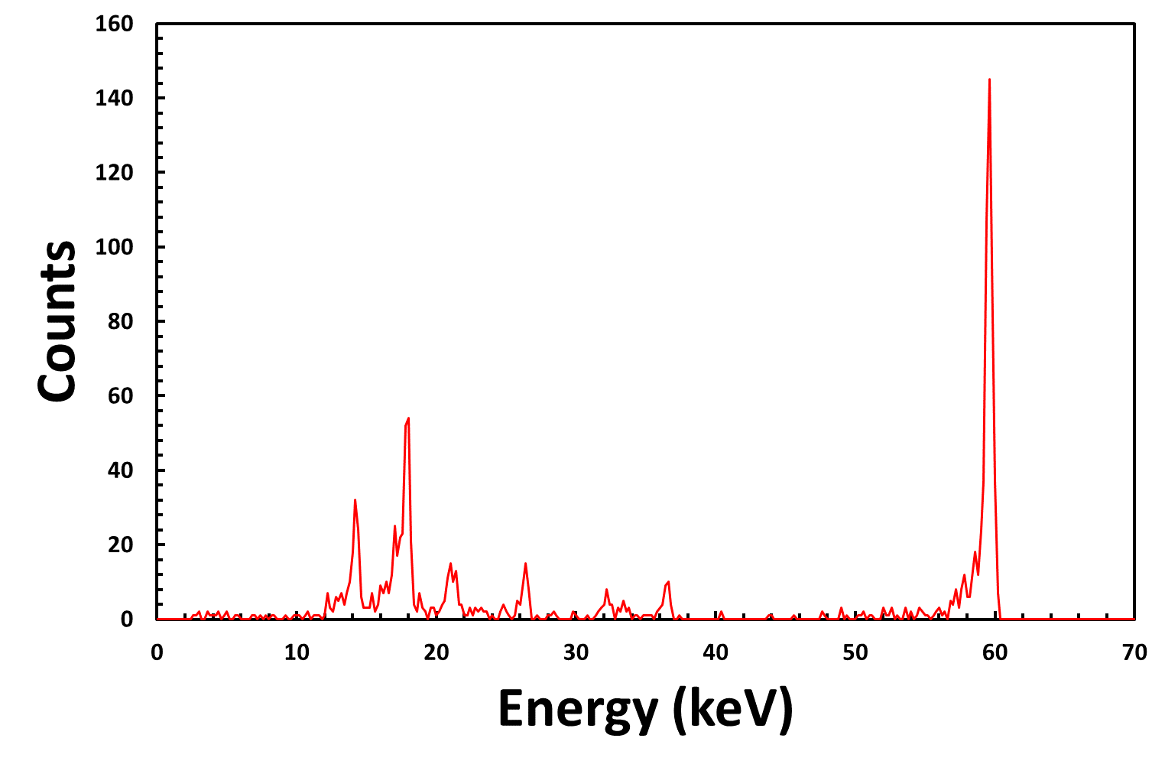
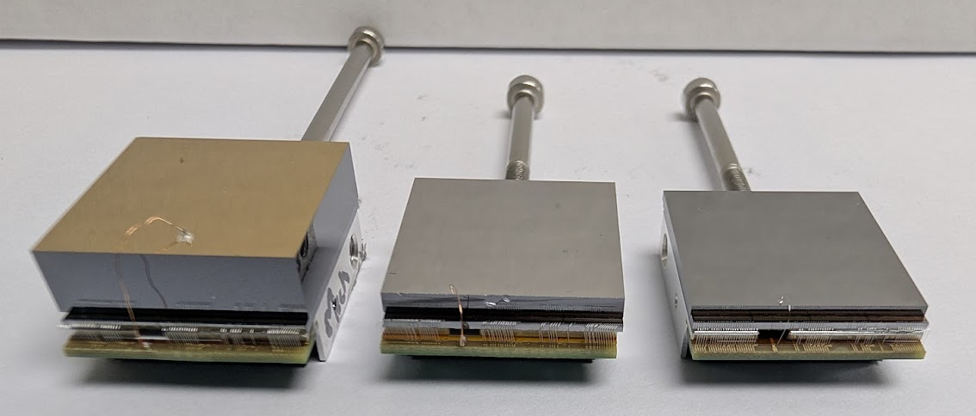

HEXITEC specifications
Parameter | HEXITEC
Pixel Pitch (µm) | 250
Array Size | 80×80
Max Frame Rate (kHz) | ~10
Max Spectroscopic Flux (ph s⁻¹ mm⁻²) | ~10⁴
Digitisation | Off-chip
Detector Type | Peak Track + Hold
Gain stages (keV in CZT) | 200
 | 600
FWHM_{@100keV} (keV) | CdZnTe: 0.79keV Si: 0.59keV
Fully spectroscopic X-Ray Imaging Detector
80 × 80 pixel array on a 250 μm pitch
Maximum 10 kHz data output (∼100 MB s⁻¹)
Multiple frames
²⁴¹Am Spectrum
7
Notes:
Here is a basic overview of HEXITEC.I won’t go into any detail but in short it provides spectroscopic X-ray imaging on an 80x80 pixelated array with a 250 µm pitch.
Key to the context of HEXITEC-MHz is that it is a peak track and hold detector, and that analogue voltages are read out each frame to 4 off-chip ADCs at a maximum frame rate of approximately 10 kHz.
The chip has a programmable dynamic range and was designed for electron readout using high-Z materials including CdZnTe and CdTe, and the 250 μm pixel pitch. These attributes have resulted in experimentally measured FWHM at 100 keV of less than 1 keV. In fact, in high-flux CZT sensors, the FWHM of the Am²⁴¹ 59.54 keV photo peak has been reported to be 0.79 keV, whilst it has been measured to be 0.59 keV in 300 μm thick p-type Si.

Slide 8
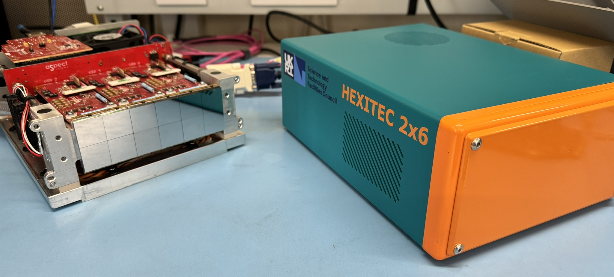
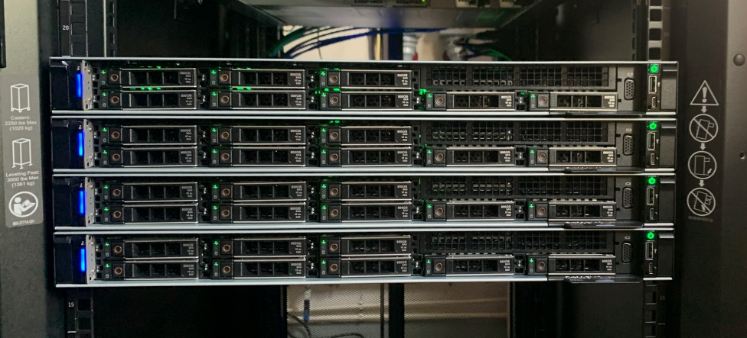


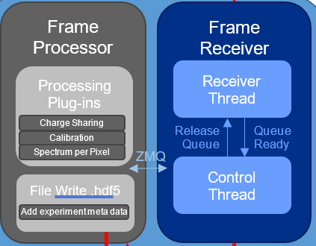
Server Computing Nodes
2x 10G UDP Ethernet
Raw Data Frames
ODIN DATA
Spectra per pixel in .hdf5
2023
2×6 Camera
Speed/latency depends on computing power, processing plug-ins, storing to disk…
8

Slide 9


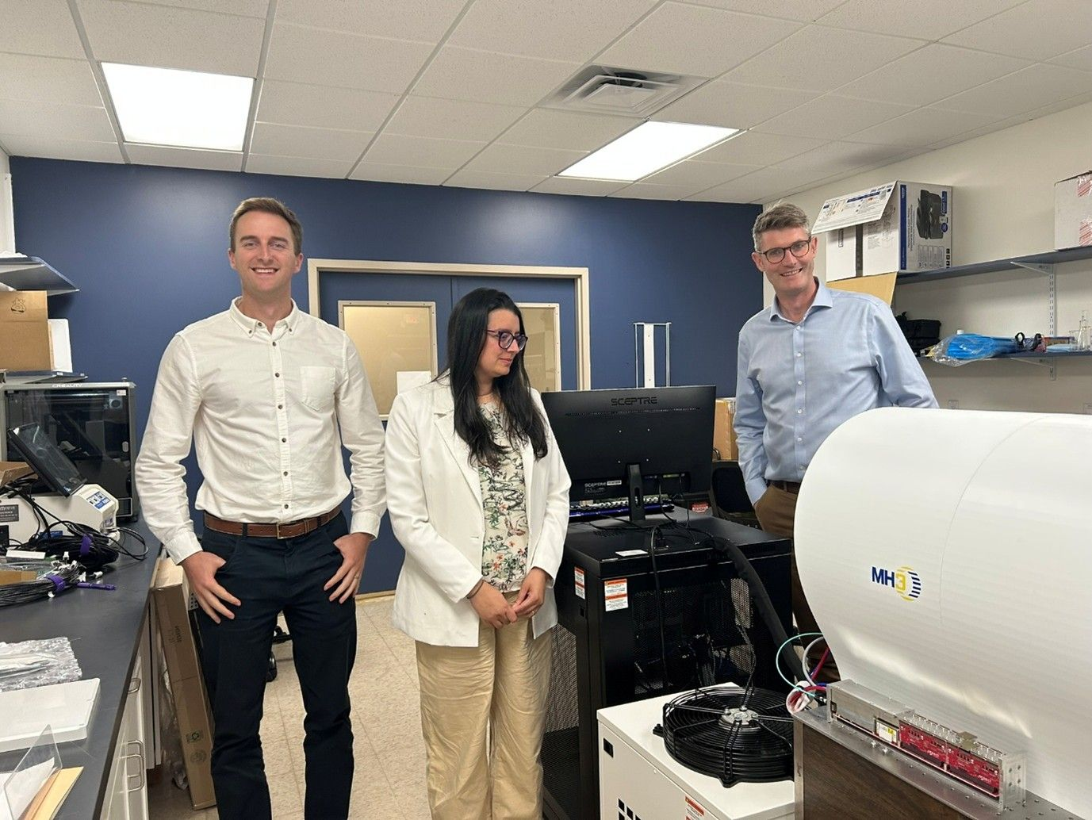
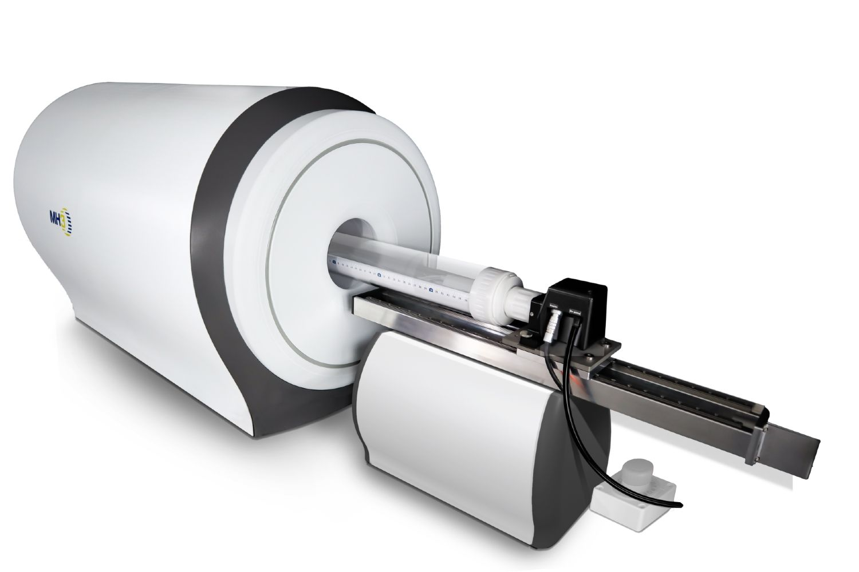
9

Slide 10
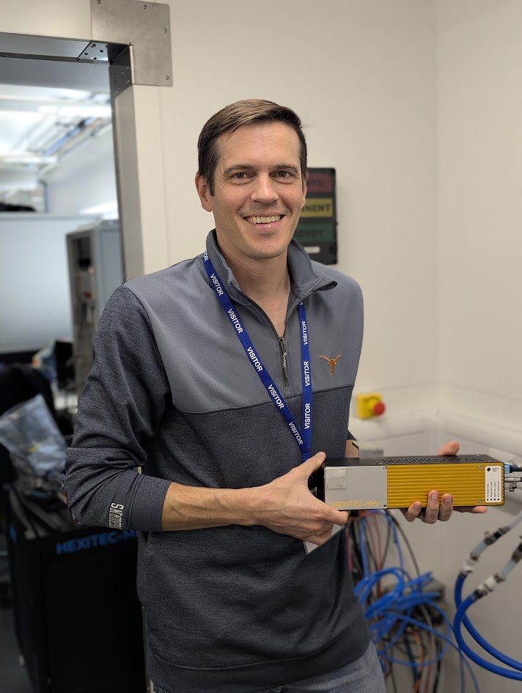
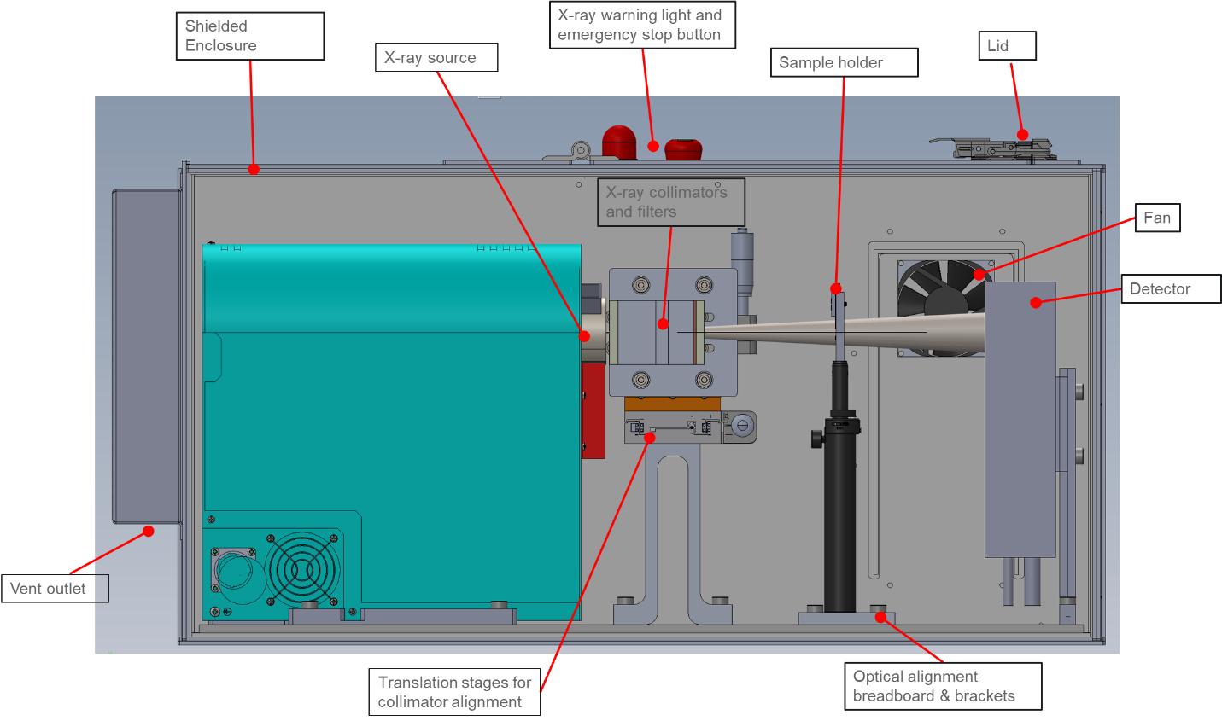
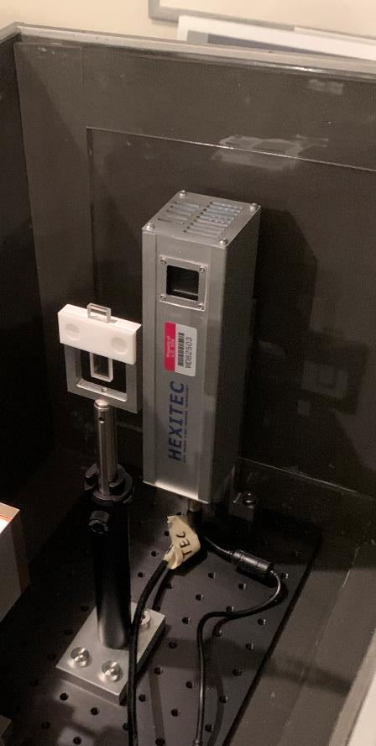

Spectral X-ray Radiography for Uranium Assay
Andy Gilbert
Pacific Northwest National Laboratory
10

Slide 11
Data Analysis
A least-squares fitting algorithm finds the uranium composition that is most consistent with the observed data
  Acquisition times = 30 minutes per sample
Output of algorithm is areal densities (g/cm²) for each element at each detector pixel, which is used to calculate uranium mass
Radiography, energy summed
Transmitted spectra
Estimated uranium mass
11
11

Slide 12
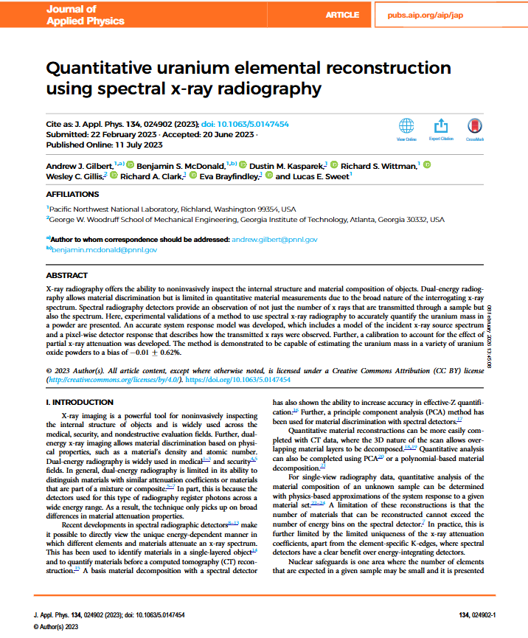
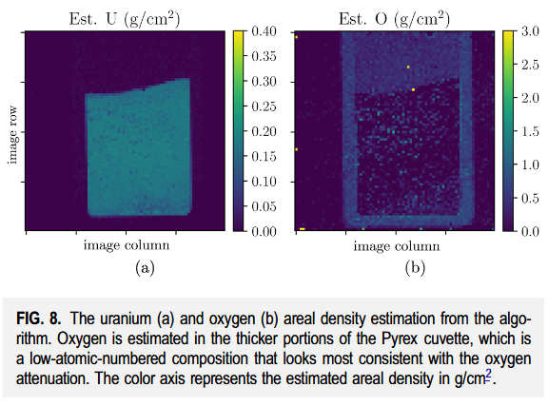

Data Analysis
A least-squares fitting algorithm finds the uranium composition that is most consistent with the observed data
  Acquisition times = 30 minutes per sample
Output of algorithm is areal densities (g/cm²) for each element at each detector pixel, which is used to calculate uranium mass
Radiography, energy summed
Transmitted spectra
Estimated uranium mass
12
12

Slide 13

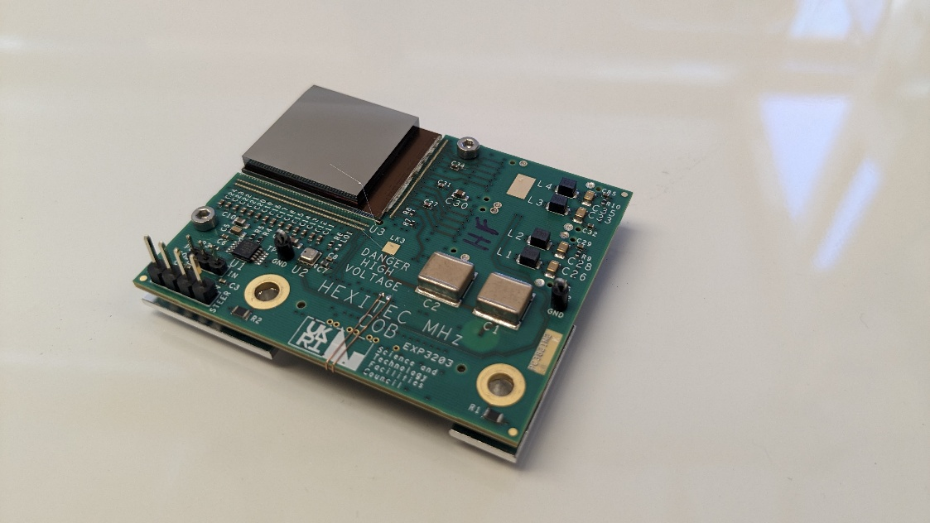
Key specifications:
  80 × 80 pixels @ 250 μm pitch
  <1 keV FWHM @ 2 – 300 keV
  Static gain
  1 MHz continuous frame rate
  2-side buttable
  13W (~ 2 mW chn⁻¹)
Per pixel spectroscopy @ 2×10⁶ ph s⁻¹ mm⁻²
  ×100 increase in capability ☺
Parameter | Value
Pixel Pitch (μm) | 250
Array Size | 80 × 80
Max Frame Rate (MHz) | 1.0
High Gain (keV) | 2 – 100
Medium Gain (keV) | 2 – 200
Low Gain (keV) | 2 – 300
FWHM_{@100keV} (keV) | 1
https://doi.org/10.1088/1748-0221/18/07/P07048
13

Slide 14
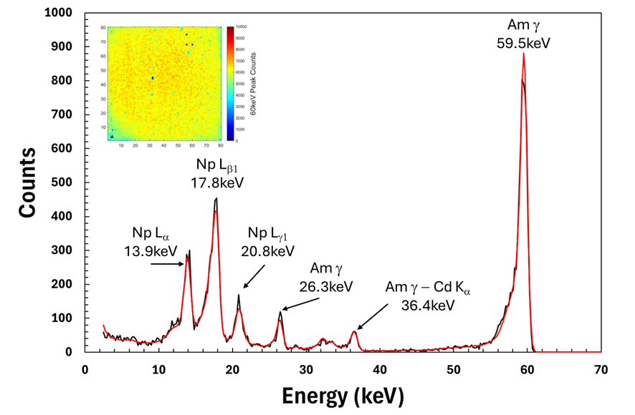
Key specifications:
  80 × 80 pixels @ 250 μm pitch
  <1 keV FWHM @ 2 – 300 keV
  Static gain
  1 MHz continuous frame rate
  2-side buttable
  13W (~ 2 mW chn⁻¹)
Per pixel spectroscopy @ 2×10⁶ ph s⁻¹ mm⁻²
  ×100 increase in capability ☺
Parameter | Value
Pixel Pitch (μm) | 250
Array Size | 80 × 80
Max Frame Rate (MHz) | 1.0
High Gain (keV) | 2 – 100
Medium Gain (keV) | 2 – 200
Low Gain (keV) | 2 – 300
FWHM_{@100keV} (keV) | 1
https://doi.org/10.1088/1748-0221/18/07/P07048
14

Slide 15
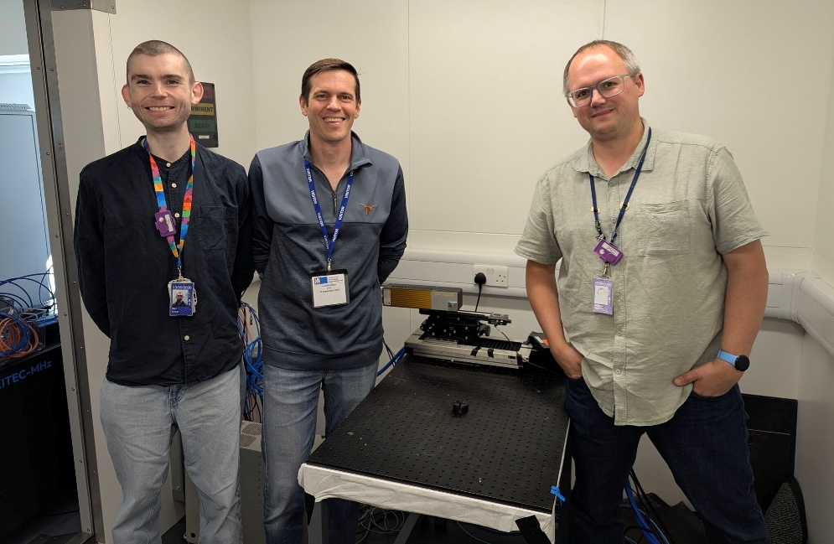
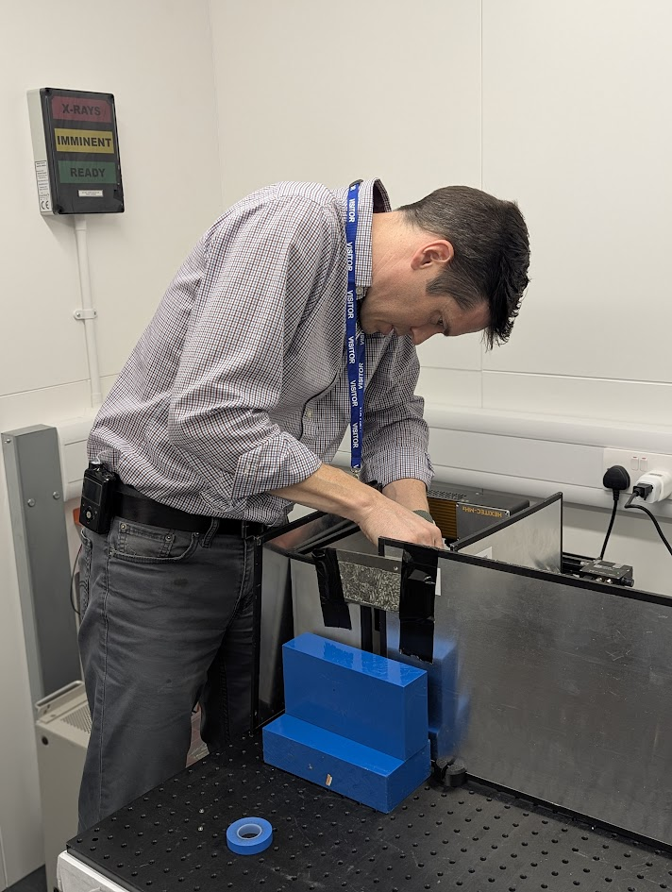
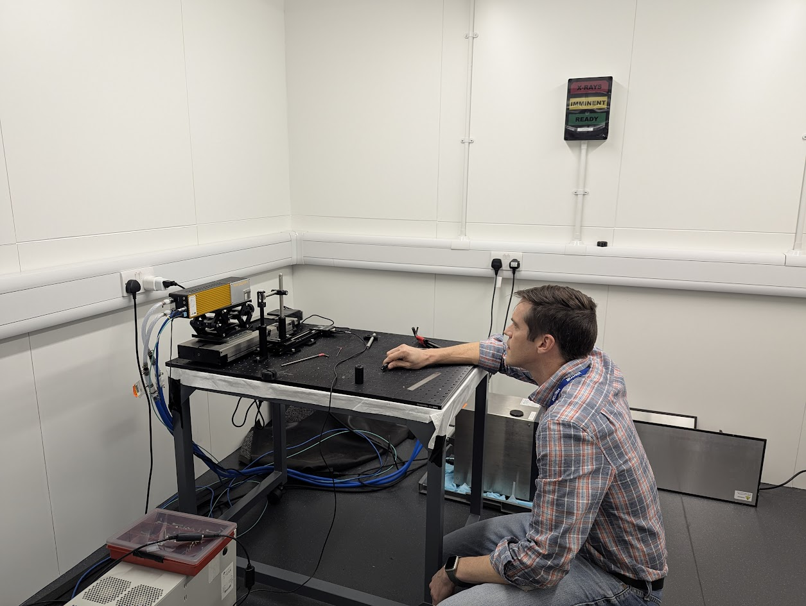
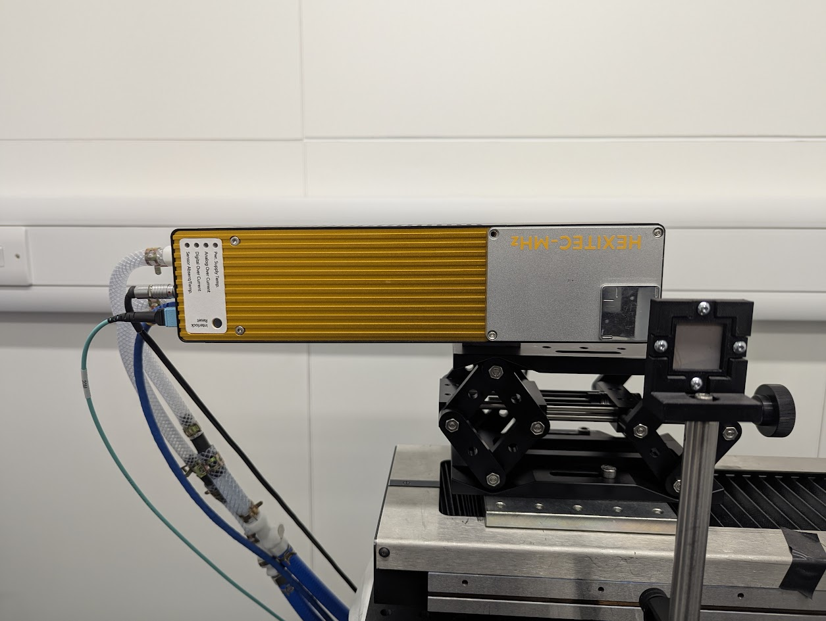
Application
Spectroscopic radiography
  High-Z elements separated by n=1
Dynamic spectroscopic radiography
  Ion drift in solution with dt = 250ms
Radiography, Energy & Angular Diffraction Imaging (READI)
  High-Z powder samples
15

Slide 16
Spectroscopic Radiography
1-minute, single pixel
8-minutes, 5x5 pixel average
K-edges
K-edges
Spectroscopic radiography
  High-Z elements separated by n=1
16

Slide 17
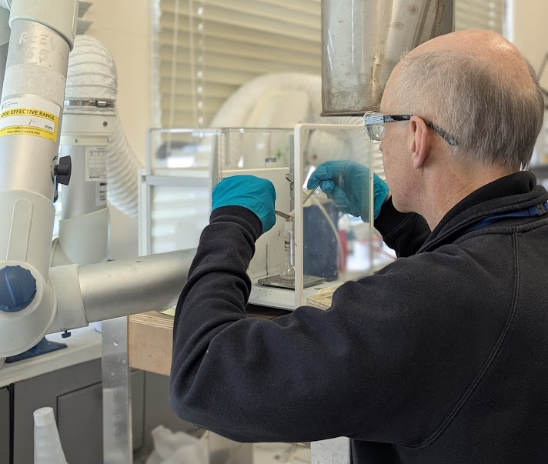
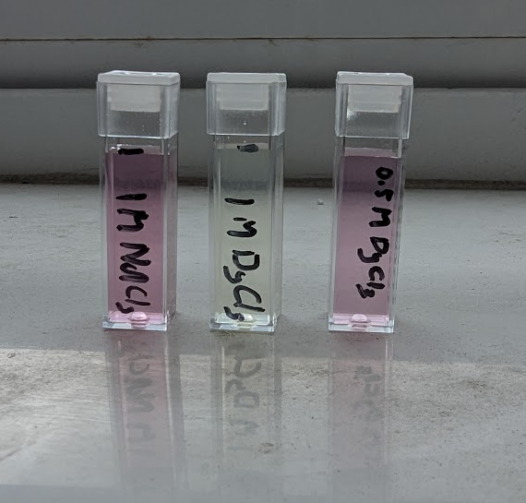
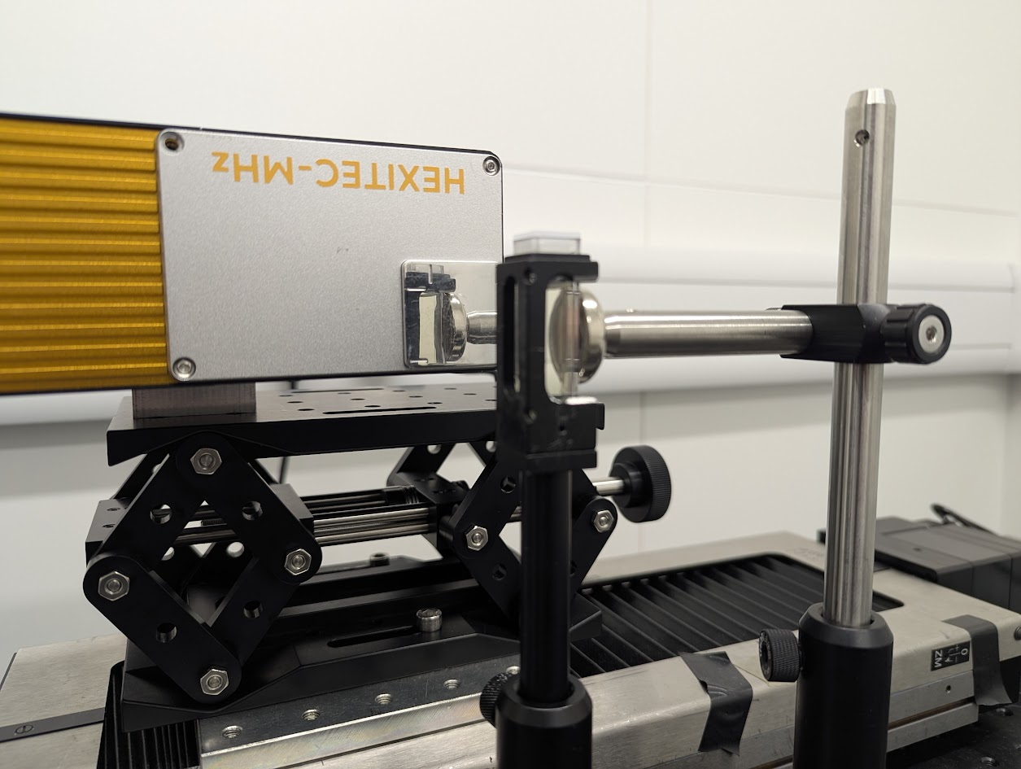
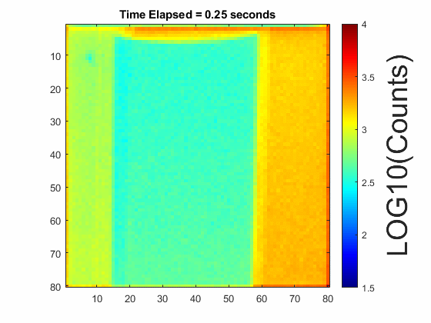
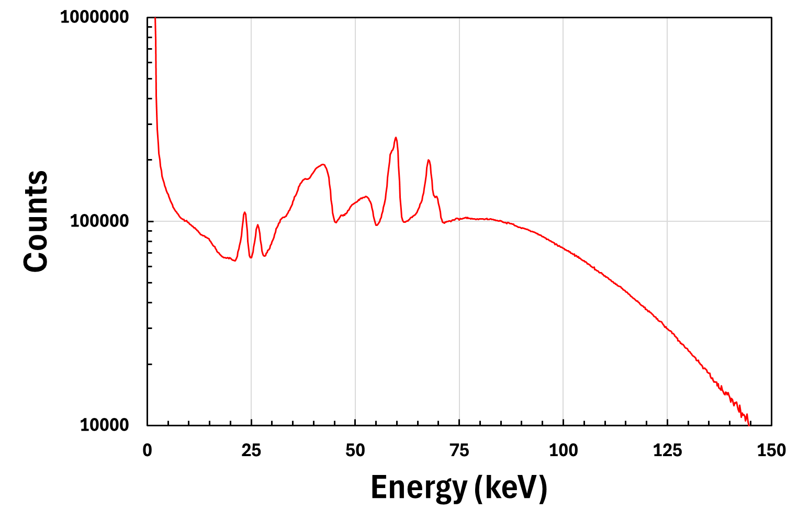
Dynamic Measurements
Dynamic spectroscopic radiography
  Ion drift in solution with dt = 250ms
17

Slide 18


X-ray READI
La K-edge
READI: Radiography, Energy & Angular Diffraction Imaging
  High-Z powder samples (LaB6)
18

Slide 19


Application
HEXITEC User Meeting 2026
Institute of Physics – 27/02/26
La K-edge
Spectroscopic Radiography + ED-XRD + AD-XRD
  High-Z powder samples (LaB6)
19

Slide 20

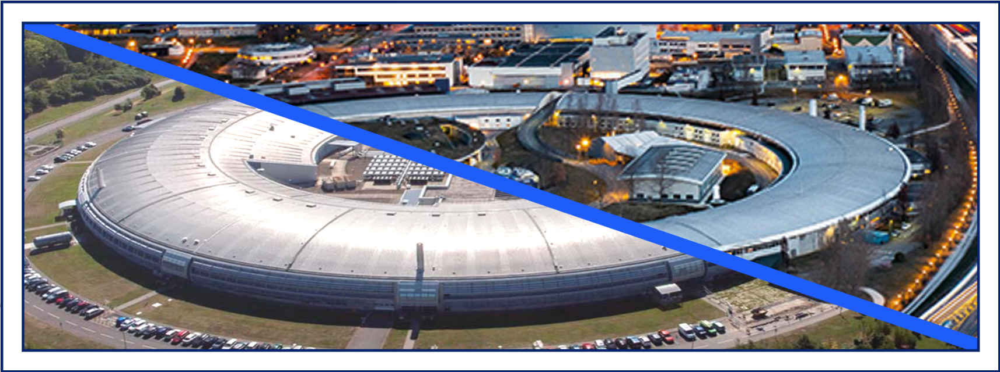

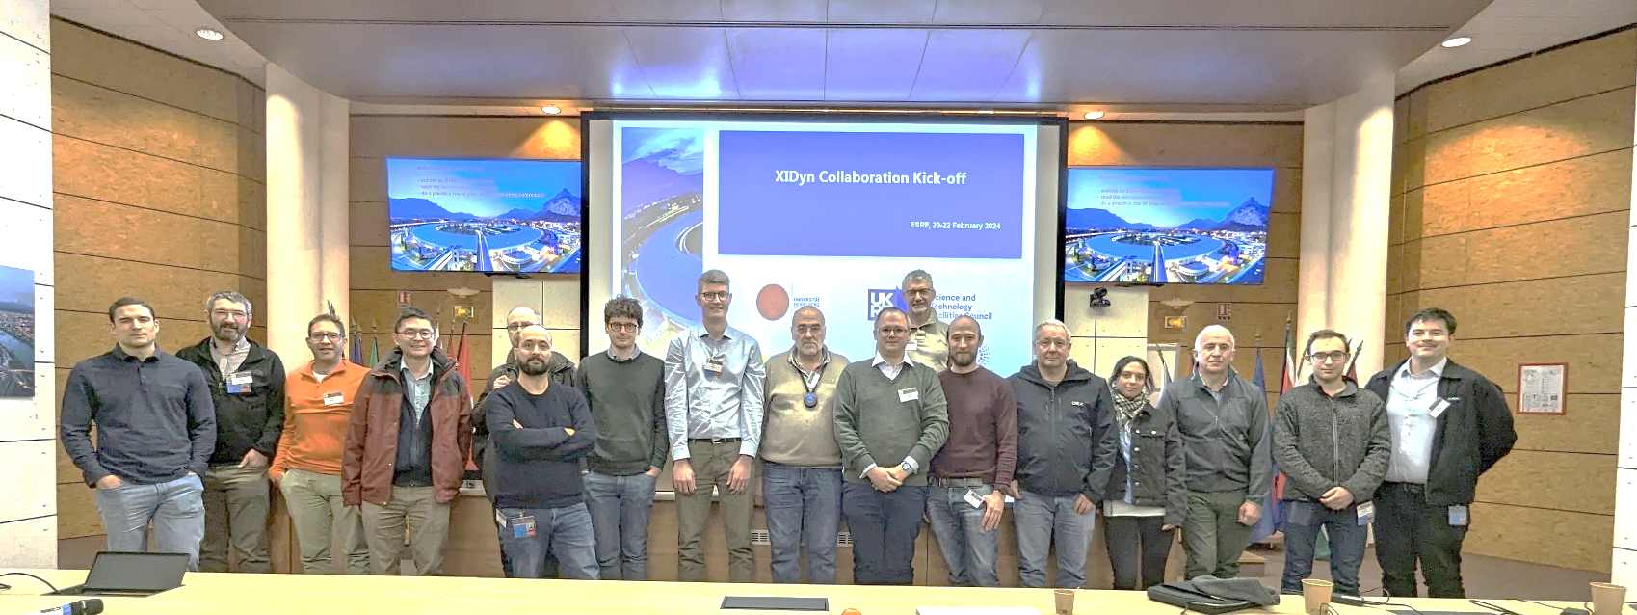



The XIDyn Collaboration
20

Slide 21
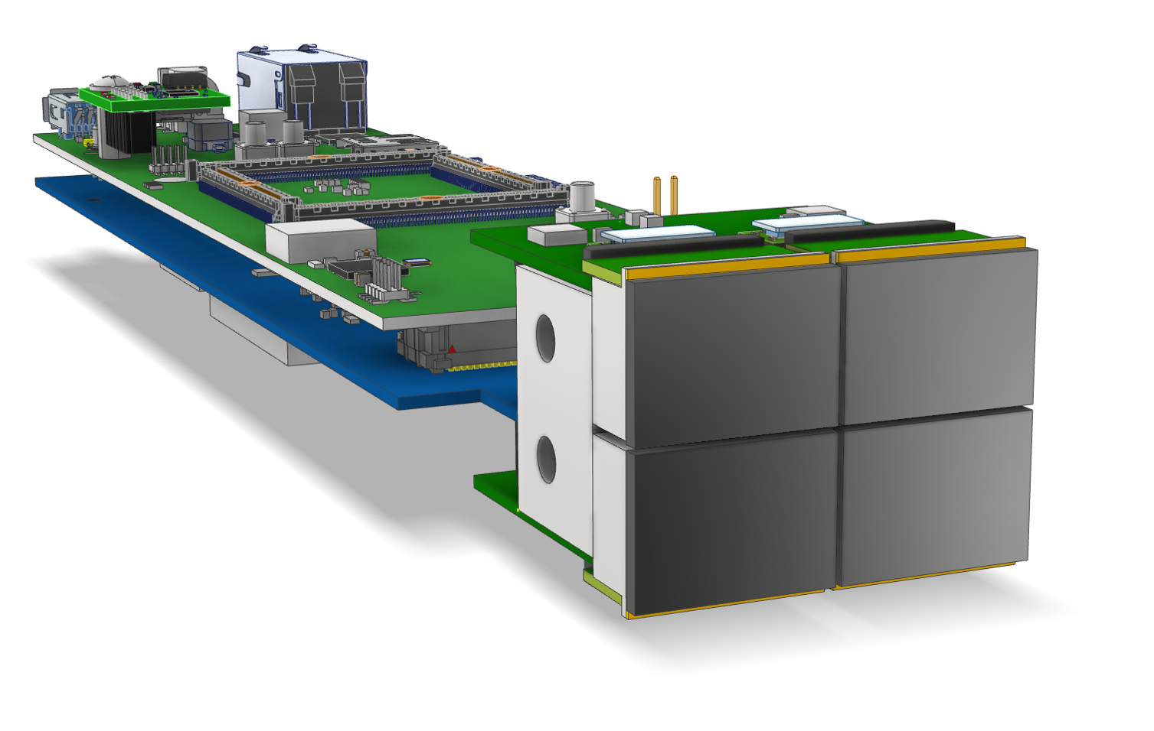

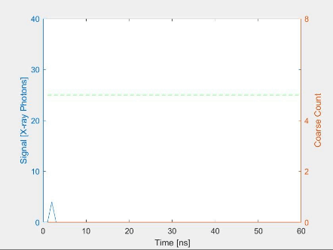
TSMC 65nm process
192×144 pixels, 110μm pitch
>100kHz frame rate
Flux capability > 10¹¹ ph s⁻¹ mm⁻²
2-stage charge cancelation architecture
Full chip submission March 2026
Quad demonstrator early 2027…
The XIDyn Detector
21

Slide 22
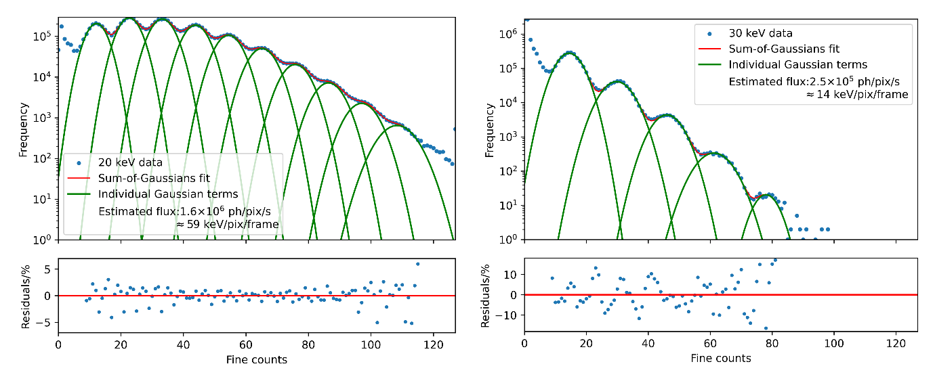
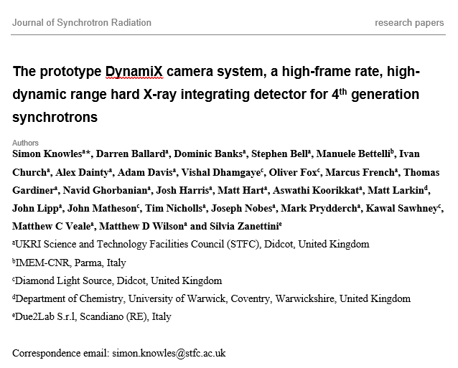
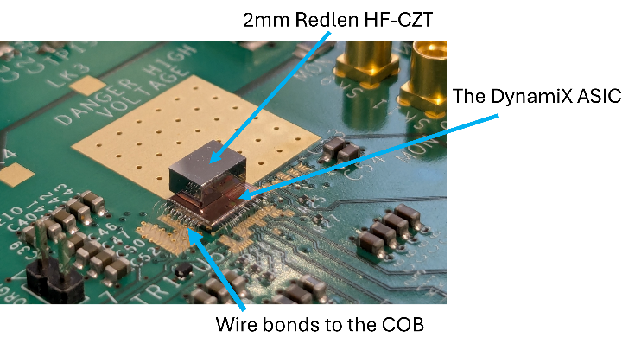
TSMC 65nm process
192×144 pixels, 110μm pitch
>100kHz frame rate
Flux capability > 10¹¹ ph s⁻¹ mm⁻²
2-stage charge cancelation architecture
Full chip submission March 2026
Quad demonstrator early 2027…
The XIDyn Detector
22

Slide 23
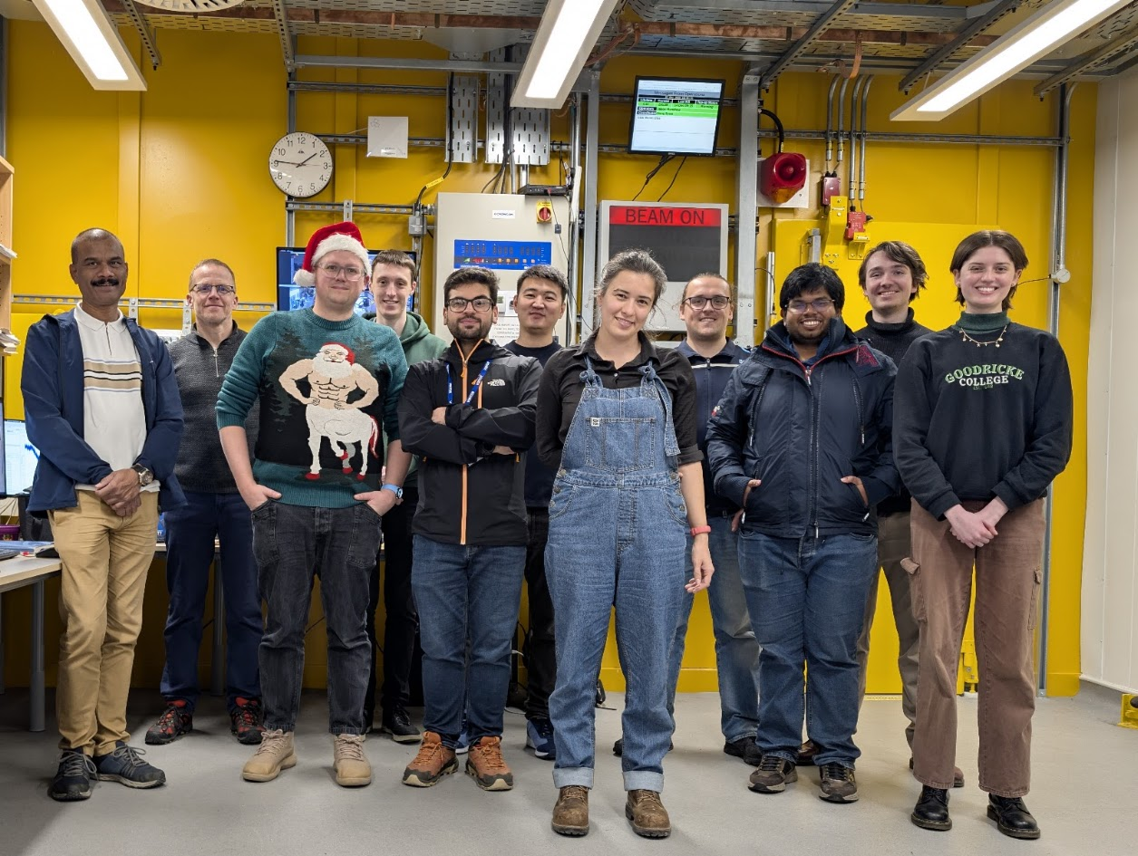

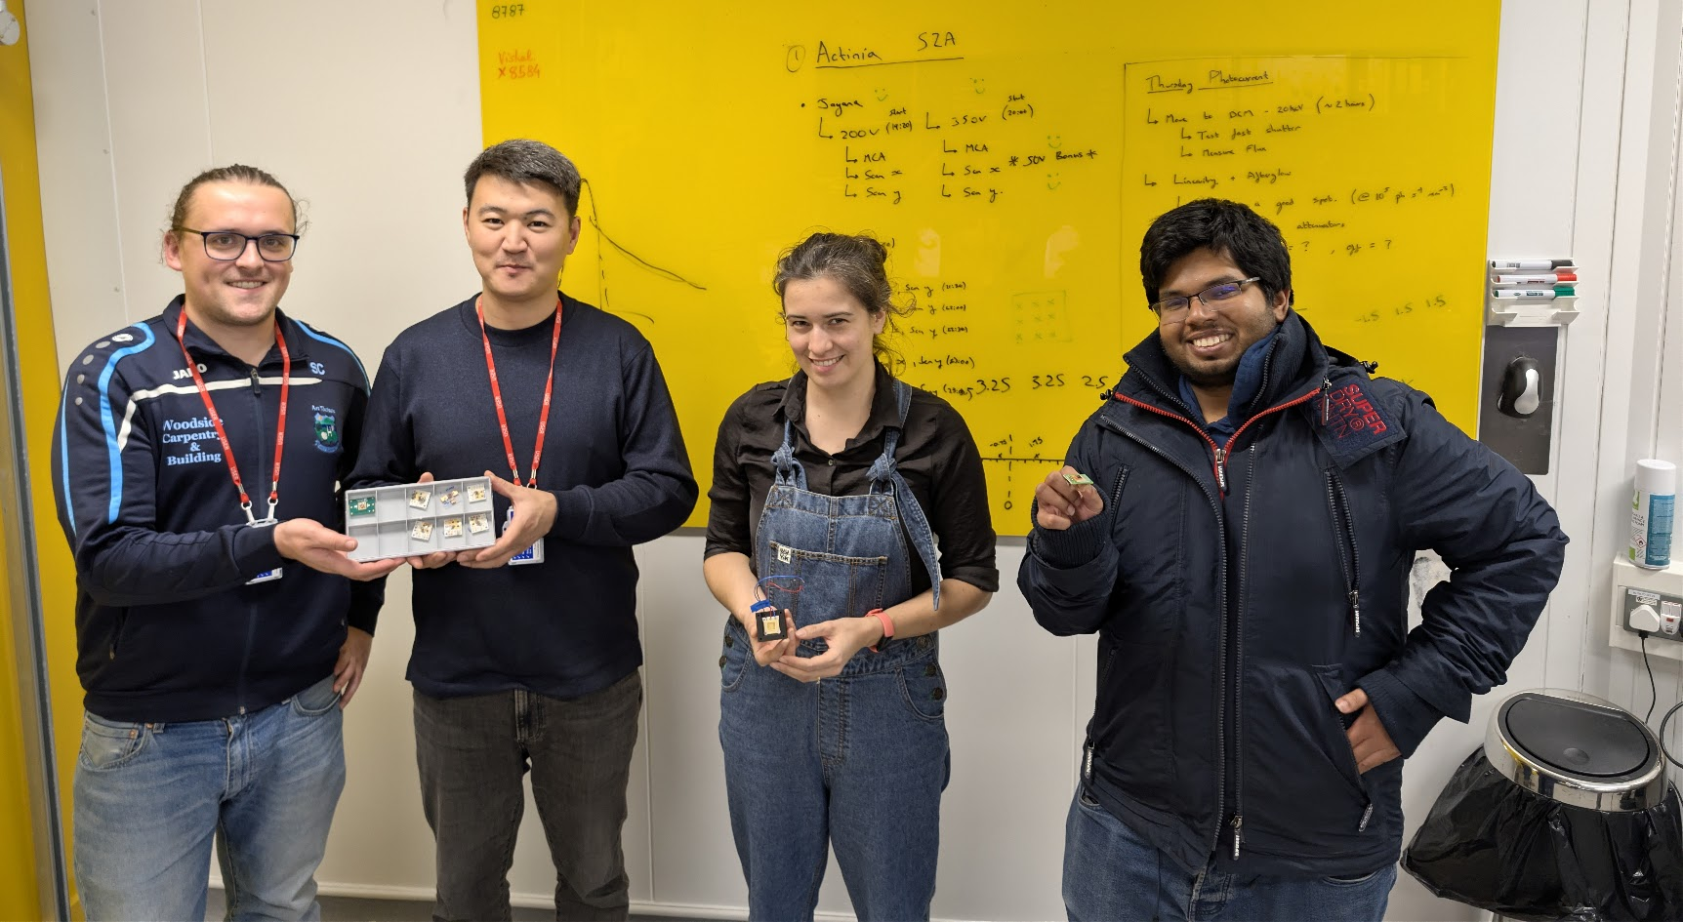
Sensor Materials are Critical!

Slide 24



Notes:
The abstract pattern can be removed or repositioned if required. Be careful to ‘Send to Back’ so that it does not obscure any important information.

Slide 25
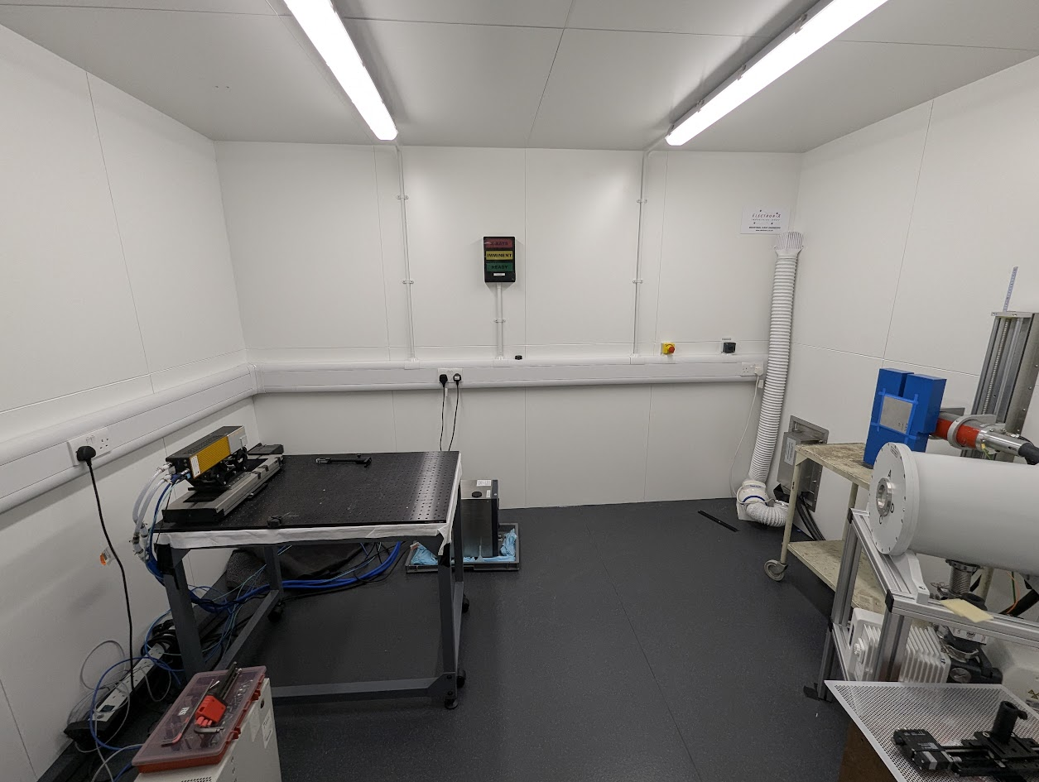
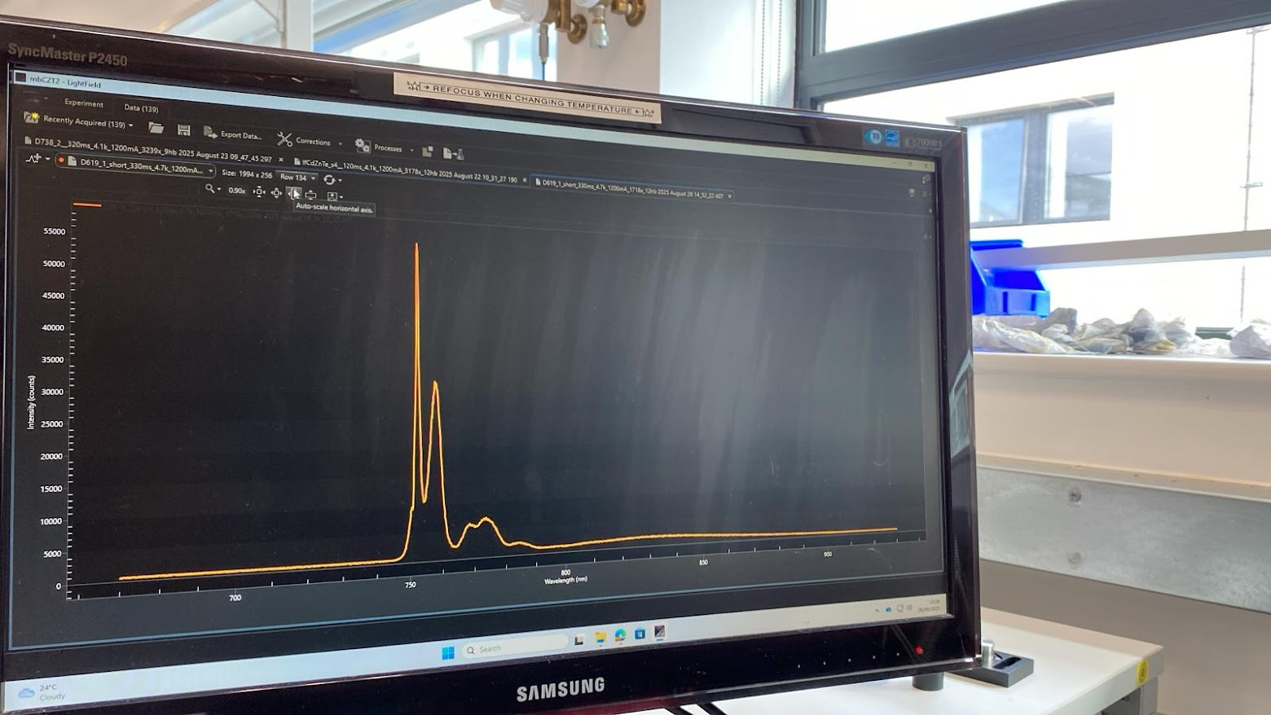
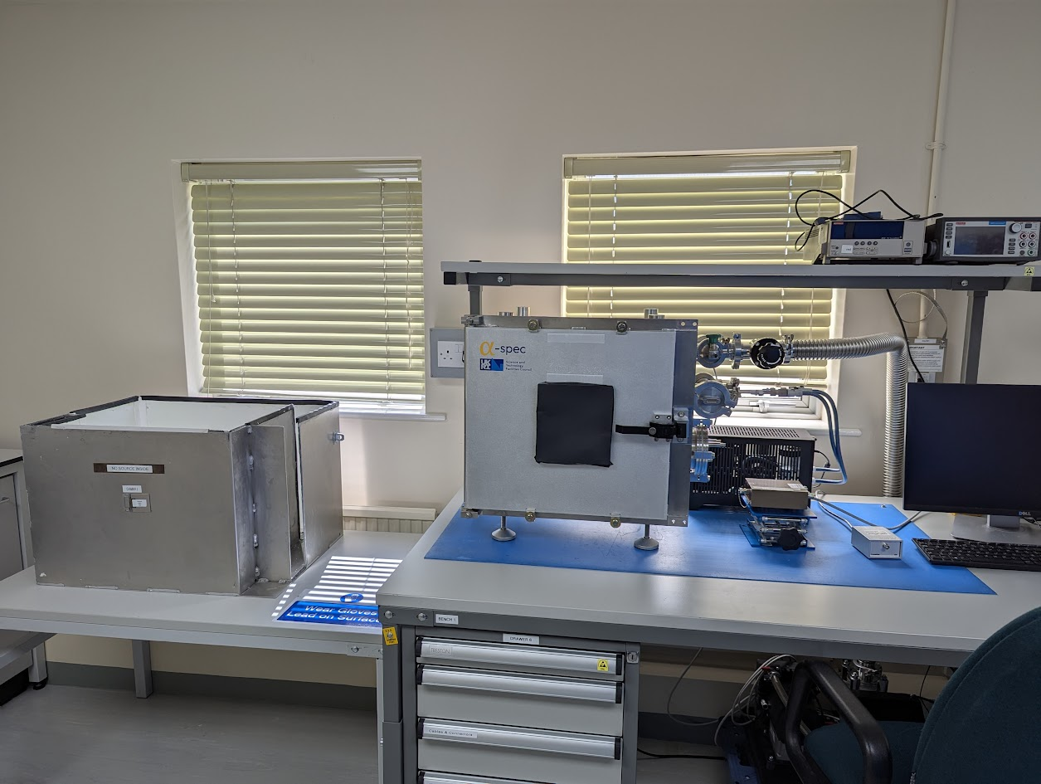
STFC Detector Development Group
X-ray Bay (160kV)
Photocurrent & Imaging
4K Photoluminescence
Optoelectronic Characterisation
Alpha Particle Spectroscopy
(μτ Evaluation)
25

Slide 26
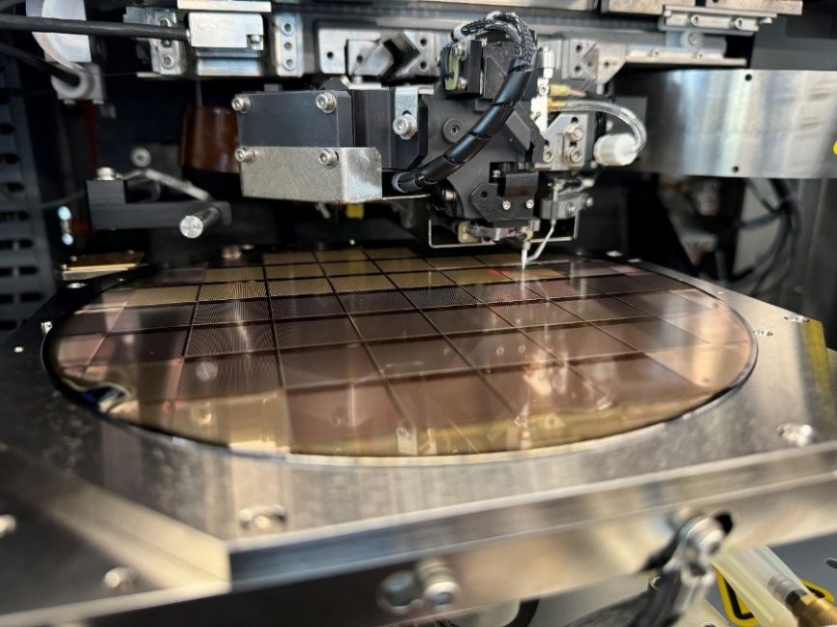
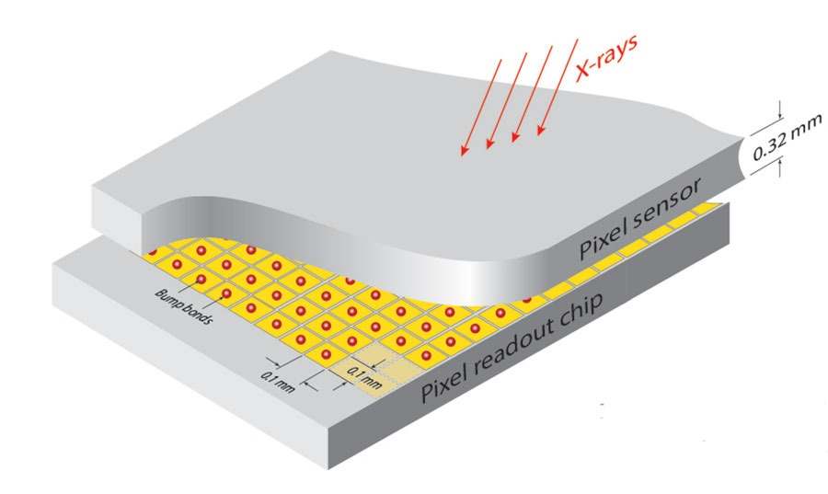
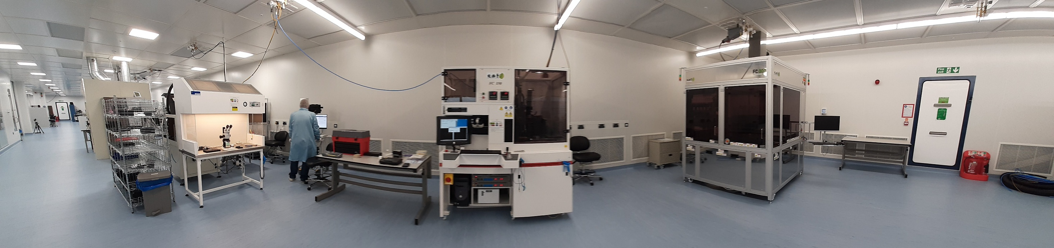
STFC Detector Development Group
ASIC Technology & Hybridisation Capabilities
26

