Slide 1
Data-driven analysis of gamma-ray spectra from the London SIGMA sensor network
Daniel Binks, Valerie Livina, Steven Bell

Slide 2
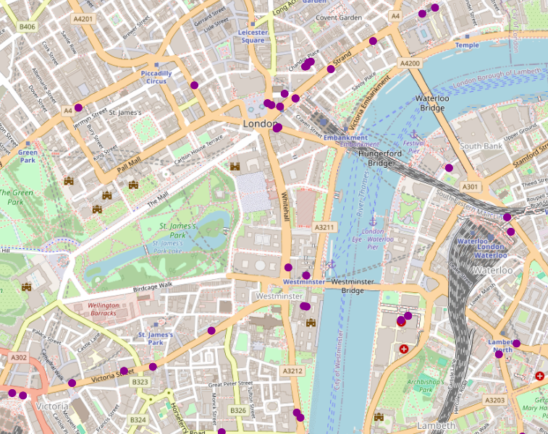
Contents:
Dataset Introduction
Hospital Data
Correlations
Gaussian Processes
2

Slide 3
The Data
SIGMA Data Challenge:
  NuSec and AWE pilot project
  159 gamma-ray detectors across London
  06/08/2018 – 19/12/2018
  Data stored in hdf5 files – one file per day
  Can be treated as a sensor network
3

Slide 4



Data Format
Radiation
Reading
Spectrum
Detector 1
Sensor Status
Time
  x 139 Files
Detector 2
HDF5
Device Status
  06/08/2018 – 19/12/2018
Detector 3
Latitude
Location
Reading
Longitude
4

Slide 5

File Reading:
H5Py
Data Handling:
pandas
HDF5
File
Date
[ Date List ]
Visualisation,
Data manipulation, etc.
Detector Name
[ Detectors List ]
Groups
[ Spectrum List ]
DataFrame
Spectrum, Time…
[ Time List ]
Datasets
5

Slide 6
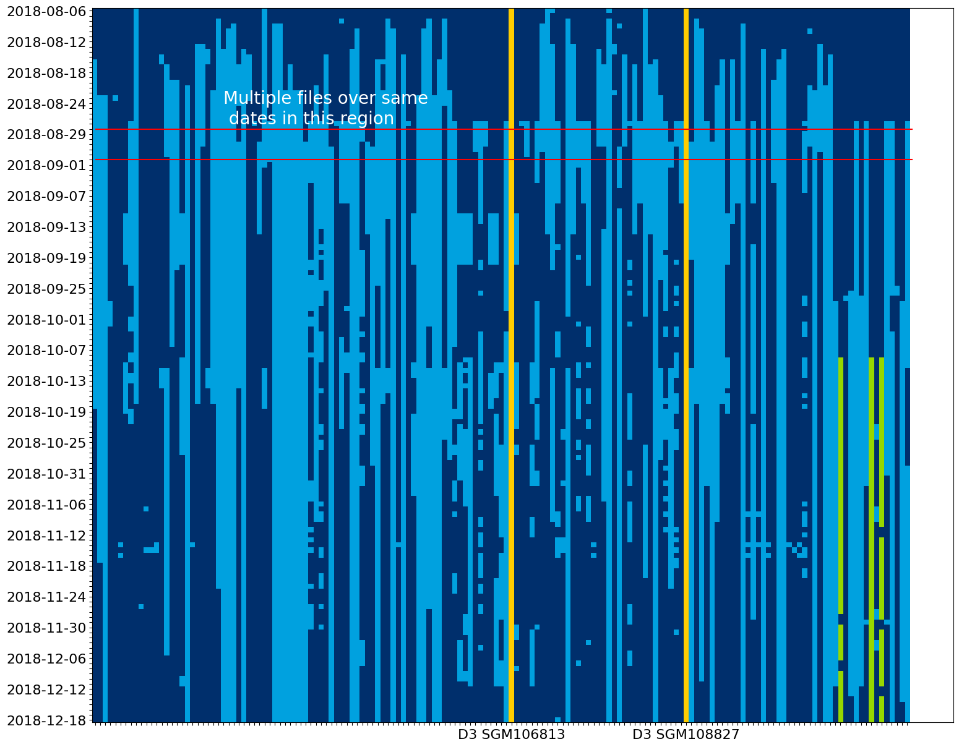
Active Detectors
Detectors in yellow (D3 SGM106813 and D3 SGM108827) are active throughout the dataset. They allow us to look at long-term trends.
Detectors in green are close to St. Thomas’ Hospital. Can look at spikes in data and short-term trends due to hospital and patient activities.
6

Slide 7
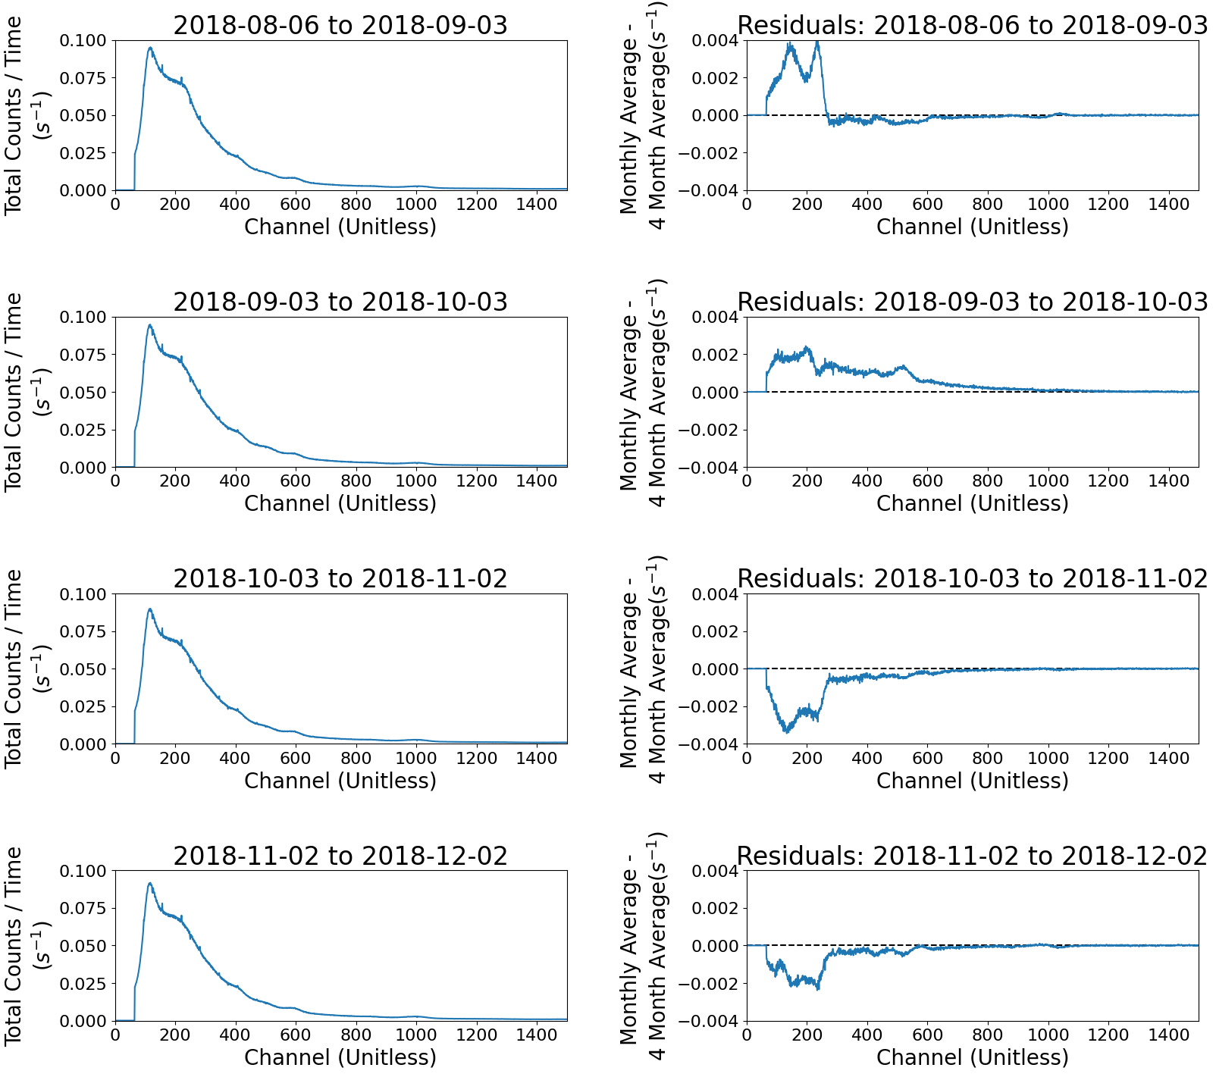
Monthly Average
The D3 SGM108827 is active over the 4-month period.
Look at averages and trends over long periods of time.
Can establish environmental reasoning for trends in data.
7

Slide 8
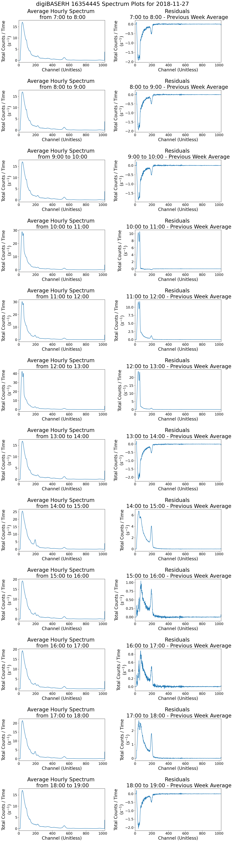
Hospital Detectors – Hourly Averages 27/11/2018
Detector: digiBASERH 16354445
Peak in counts at 10am (Orange, above)
Dip between 1pm – 2pm (Green, right)
Dip again at 6pm (not shown)
8

Slide 9
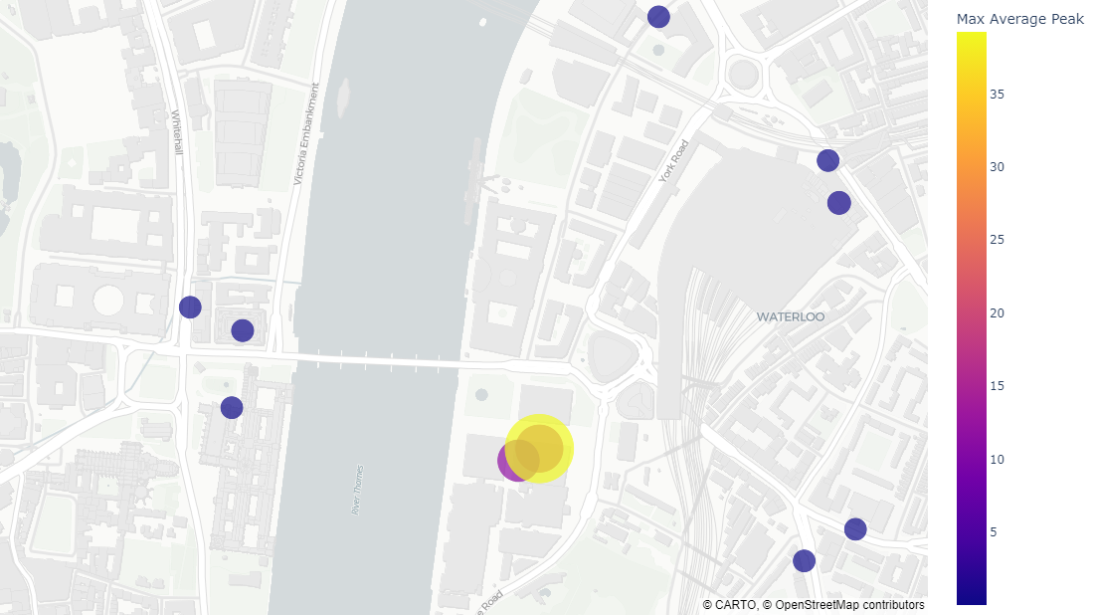
Hospital Area Correlations
Residual peaks from 11am – 12am on 27/11/2018
Detectors at St Thomas’ Hospital (red box) show peaks at the same hours.
Detectors around the area don’t show obvious peaks in spectra:
Detector location
Detector type
Counts / Time (s⁻¹)
9

Slide 10
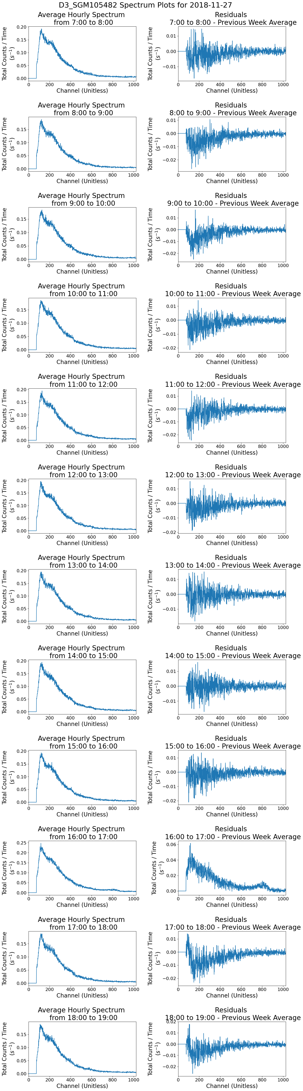
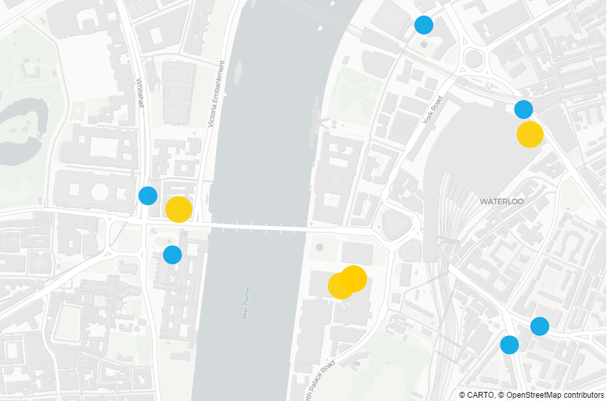
Detector Types
Hospital detectors are digiBASE-RH (yellow, large)
Two other digiBASE-RH detectors are underground (yellow, large)
Other detectors are D3 detectors (blue, small)
10

Slide 11
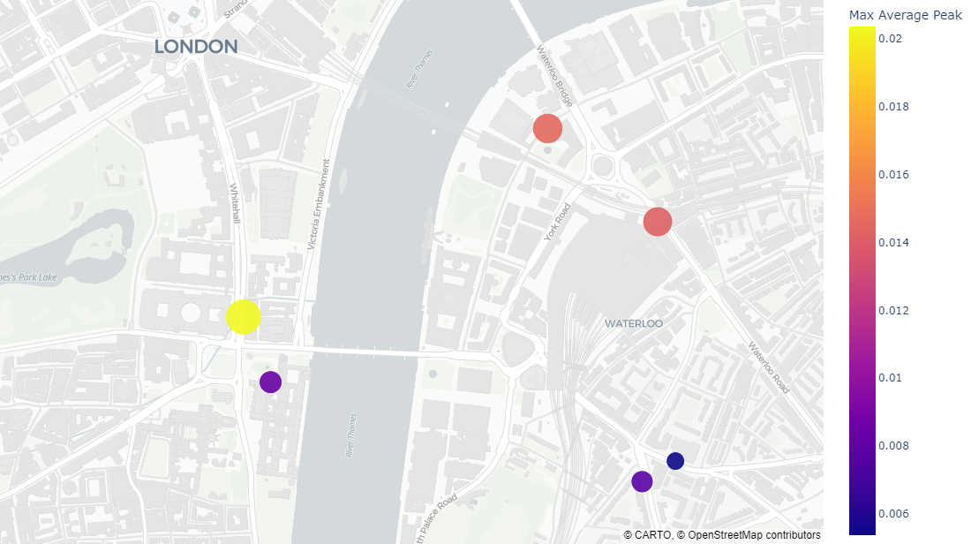
Hospital Area Peaks with D3 Detectors
Residual peaks for D3 detectors from 10am – 11am on 27/11/2018
Yellow (left):
Area with a high and low peak in gamma-ray count
Orange (top right):
Area with medium peak in gamma-ray count
Blue (bottom right):
Area with low peak in gamma-ray count
Red (middle):
Hospital location
Counts / Time (s⁻¹)
11

Slide 12
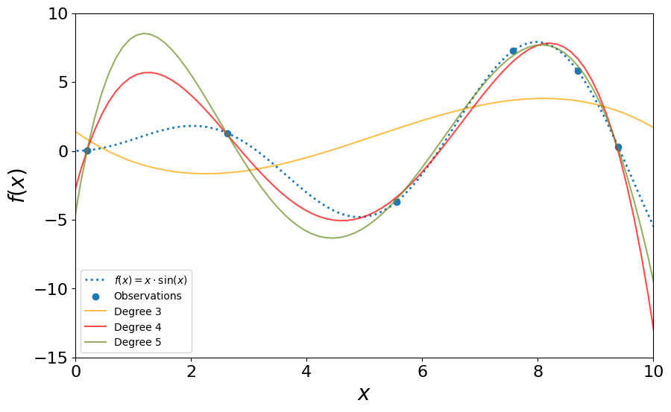
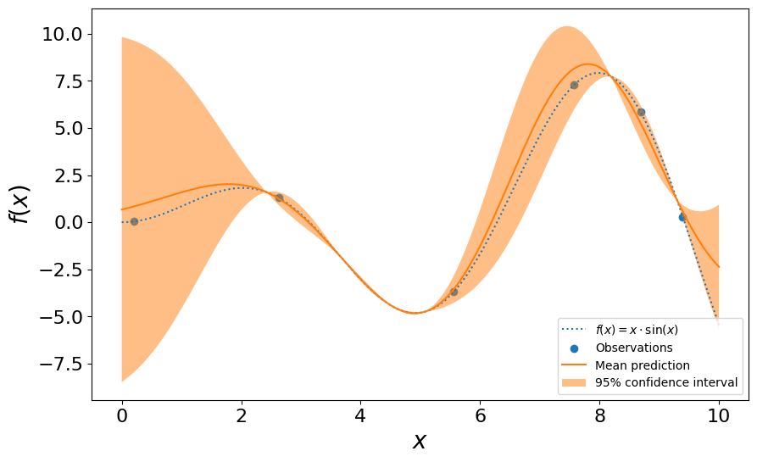
Gaussian Processes - Explanation
Polynomial Regression:
Gaussian Processes Regression:
‘A Gaussian process is a probability distribution over possible functions that fit a set of points.’
Can generalise across multiple spatial dimensions (i.e. latitude and longitude) to give a distribution of peak gamma-ray counts over an area
Examples adapted from sci-kit learn.
See https://scikit-learn.org/stable/auto_examples/linear_model/plot_polynomial_interpolation.html and https://scikit-learn.org/stable/auto_examples/gaussian_process/plot_gpr_noisy_targets.htm
12

Slide 13
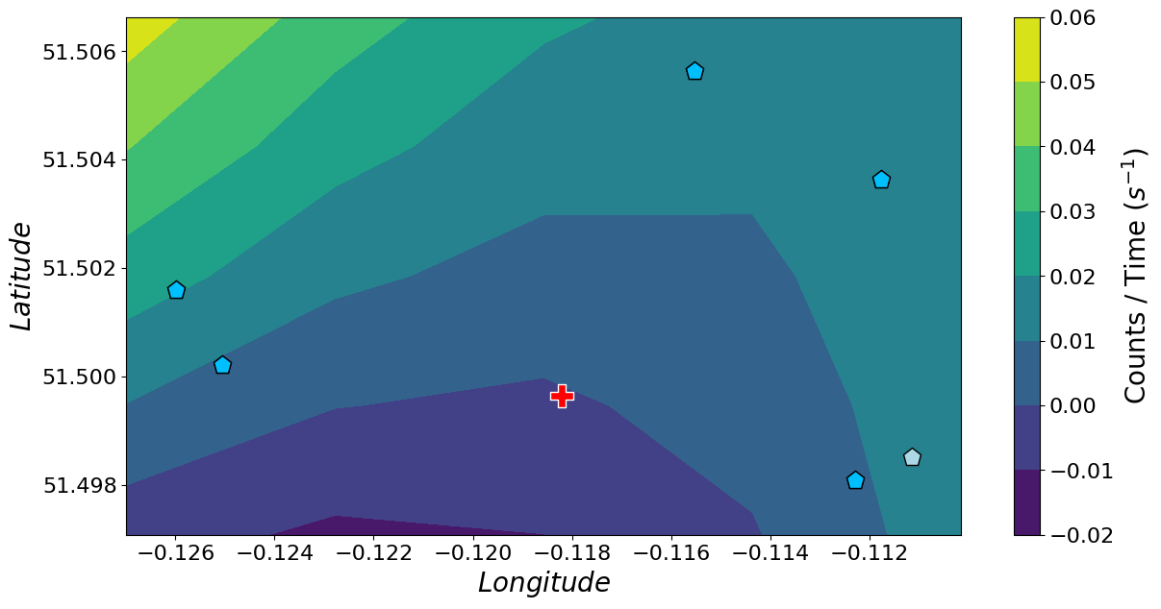
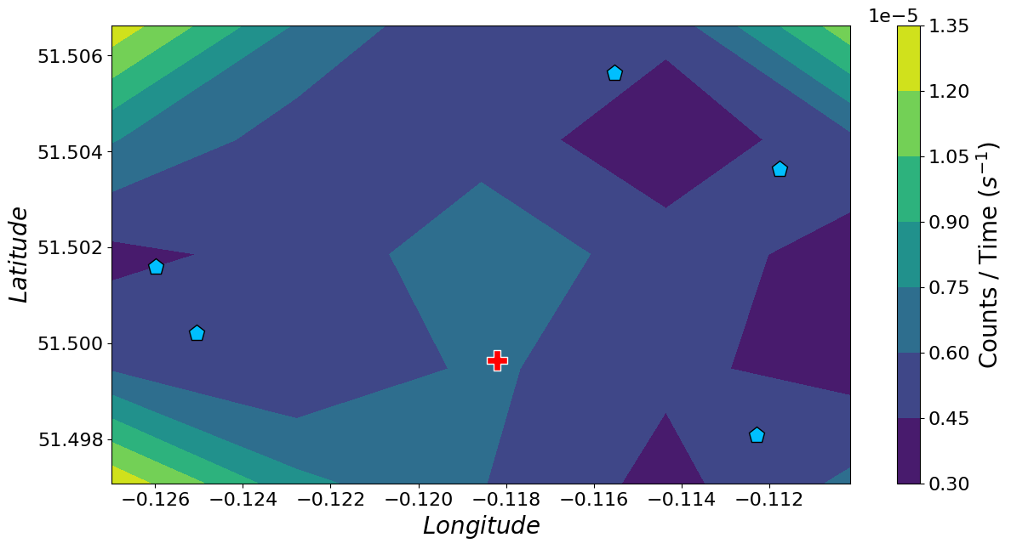
Gaussian Processes
Applying Gaussian Processes on residual peaks for D3 detectors from 10am – 11am on 27/11/2018
Make prediction of peak for hospital location
Gamma-count predictions:
Standard Deviation:
Blue: Known detectors Red: Location of hospital
Hospital location is far from other sensors, expect a high standard deviation
13

Slide 14
Future Work:
Normalise Detectors
Fine-tune Gaussian Processes
Investigate Neural Processes
Apply physics-based techniques
14

Slide 15
Contact: daniel.binks@npl.co.uk
This project was funded by the UK Government’s Department for Science, Innovation, & Technology through the UK’s National Measurement System programmes

