Slide 1

Neutron-Sensitive Detectors Using 3D Printed Scintillators
Adam Barr, Cinzia Da Vià, Mosst Tasnim Binte Shawkat, Mike Taylor, Stephen Watts, John Allison
Email: adam.barr@manchester.ac.uk
This work supported by a grant from the Nuclear Security Science Network

Slide 2
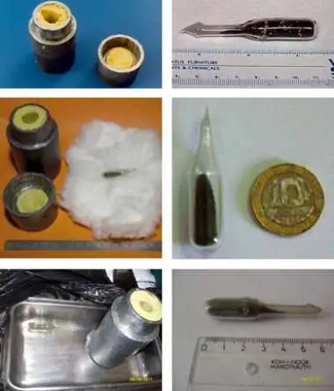
Neutrons and Nuclear Security
Fissile materials – e.g. HEU, Pu – key targets for nuclear security due to high proliferation risk.
Fission neutrons provide key signature
Hard to hide, but also hard to detect
Various uranium samples seized by law enforcement
(image from Centre for Public Integrity)

Slide 3
Neutron Detection Methods
Use nuclides with high neutron-capture cross-sections (E.G. ⁶Li, ¹⁰B)
  Measure charged particles/gamma rays released by reaction
  Need to discriminate between radiation background and neutrons
Three main methods
  Gas proportional detectors
  Semiconductors
  Scintillators: Organic/Inorganic

Slide 4
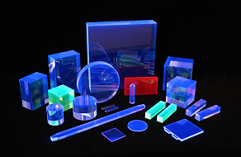
Organic Scintillators
Advantages:
  Fast response times
  Reasonable light output
  Resilient
Disadvantages:
  Can be costly to produce
  Degrades with radiation exposure
Image from phoenix-dosimetry.co.uk
Notes:
Response times order nanoseconds
Resilient to changes in external conditions – temp in particular
Light output good for most cases, but not as good as inorganics
Disadvantages:
Degrades over time, due to radiation damage to plastic
Requires significant equipment to produce; not something easily accessible
3d Printing can solve these issues

Slide 5
Why 3D Print Scintillators?
Allows for customization of scintillator geometry
Gives control over composition of scintillator
Makes production much cheaper & quicker
Easily scalable
Notes:
Can customize external geometry, to target specific particles or conditions, and internal geometry, allowing for complex internal geometries that can be used to maximise light output
Control over scintillator composition; can put exactly what you want into it, and allows for precise control of amounts to suit user’s needs
Requires only commercial off-the-shelf hardware; makes production much cheaper and accessible to any laboratory. Much quicker, allows for rapid prototyping and refinement of scintillators
Scales easily, can be done at both laboratory-scale and industrial scale

Slide 6
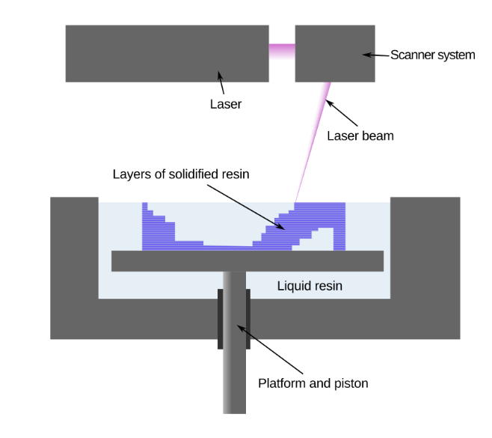
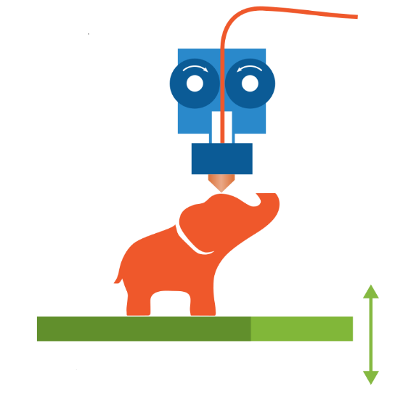
3D Printing Methodologies
Stereolithography (SLA)
Fused Deposition Modelling (FDM)
UV-cured resins
Allows for finer details
Easier to include additives
Resins pose health hazard
SLA printers more costly
Extruded plastic filament
Allows for multi-material printing
Lower initial cost
Using additives requires filament maker
Diagrams from wikimedia.org
Notes:
Two main methods for 3d printing plastic; both use same basic principle of printing layers that build up over time.
SLA: Tank of resin, surface cured by UV laser
FDM: extruded filament
SLA key advantages:
Finer details, limit is laser resolution
As resin is liquid until cured, easier to add extras; just pour in to the tank of resin
SLA key disadvantages:
Health hazards of resin – toxic, harmful to skin
Complexity and thus cost of printers
FDM key advantages:
Lower cost
Can print with multiple materials in same build
- But custom filaments require additional equipment in terms of filament extruder

Slide 7
3D Printed Scintillators
SLA widely used
  e.g. Dosovitskiy et al. (2017), D. Kim et al. (2022)
  Stowell et al. (2021), Y. Kim et al. (2023) have produced neutron-sensitive scintillators with SLA
FDM also being explored
  Berns et al. (2020), Berns et al. (2022) produce organic scintillator using FDM
  Sibilieva et al. (2023) use inorganic scintillator in plastic matrix
Notes:
Area of current research; has mostly focused on SLA due to ease of including additives
FDM being explored more in recent years
Neutron sensitivity a key goal, but not yet explored for FDM

Slide 8
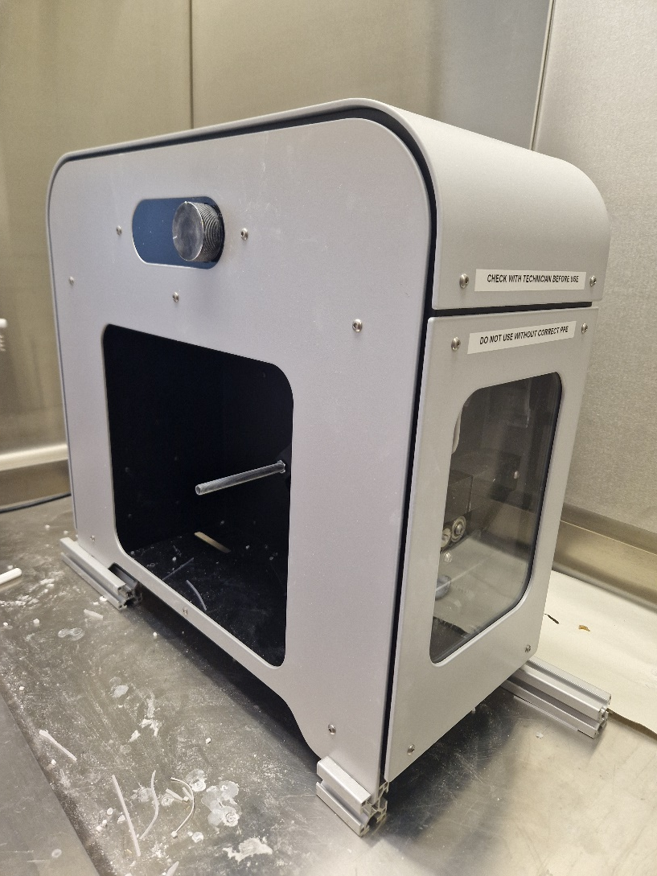
Filament Production
Requires:
  Scintillator: Polystyrene
  Primary fluorophore: PTP
  Secondary fluorophore: POPOP
  Plasticiser: Biphenyl
  Neutron sensitivity: ⁶LiF
Filament produced using 3Devo Composer filament maker (right)
Notes:
Simple synthesis; take required materials, mix thoroughly to ensure homogeneous filament, and put in filament maker, which will extrude the filament. Polystyrene used as base material, with p-terphenyl and POPOP (long complicated name) to give visible scintillation.
Polystyrene doesn’t have flexibility required for 3d printing, too brittle and breaks easily, needs a plasticiser; biphenyl works well with the PS
Needs additive for neutron sensitivity
Li-6 chosen for first test,
LiF has high Li concentration per unit mass, useful as want to keep additive mass to a minimum.

Slide 9
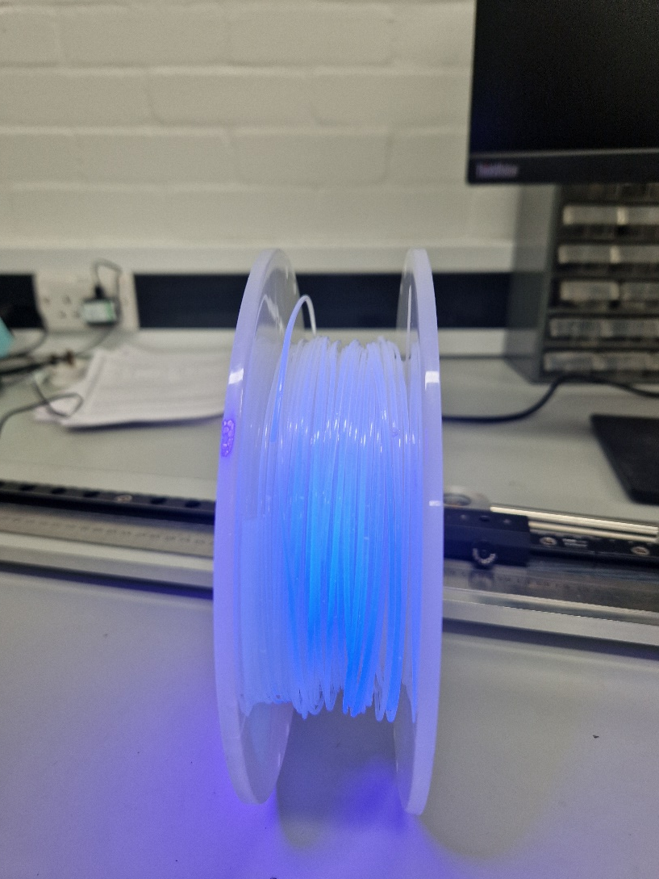
Filament Production
0.05% POPOP, 2% PTP gives optimum light output
7.5% Biphenyl required for flexibility, without reducing light output
Neutron sensitivity introduced using 0.4% ⁶LiF
⁶Li-containing filament produced in Manchester, Summer 2024
Notes:
Filament composition tested; ratios for fluorophores gives maximum light output without excess self-absorption
Add minimum amount of biphenyl required to give suitable mechanical properties, avoids reduction to light output.

Slide 10
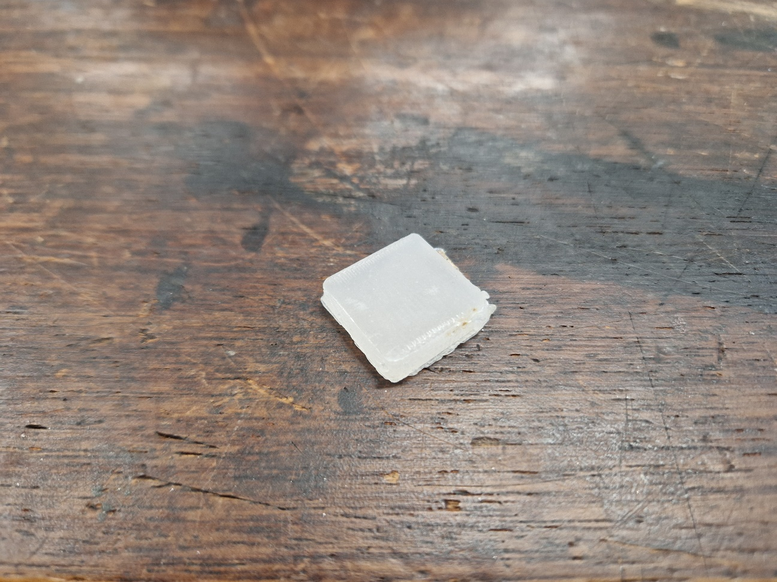
Printing
Create 3D Model
Slice
  Full infill
  Minimal layer heights
Print
  High temperatures (255°C)
  High flow rates (105% normal)
  Reduced speed
Polish
Prototype ⁶Li-containing scintillator
Notes:
Create model – any CAD program
Slice – turns 3d model into form printer can read
Prints usually use shell around infill; for this, to make it transparent, need to make it a solid object.
Minimal layer heights – ensures solidity
Printing – want the plastic to fill the entirety of object, to prevent air bubbles that increase opacity
All mentioned settings work towards this, all in order of importance
High temperatures, extra flow rates do reduce accuracy of printing; but can be adjusted with post-print processing
Polish – removes surface imperfections and print lines, makes it transparent

Slide 11
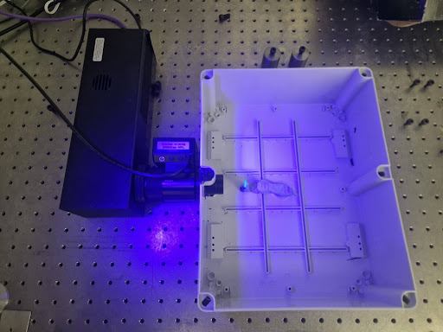
Detector Integration
Printed Scintillator
  2 cm × 2 cm × 0.5 cm cuboid
Photonis Cricket Image Intensifier
  Gives single-photon capability
  Peak QE 400-500 nm
  Fast response (100 ns) phosphor
ASI TPX3CAM
  Fast optical camera based on TimePix3 readout chip
  High time resolution – 1.56 ns
  Good spatial resolution
Notes:
Detector:
Scintillator in light-proof box, with image-intensified optical camera pointed at it.
Image intensifier chosen to give peak output at scintillator output – needed to maximise light output
Camera – based on TimePix3 chip, fast response ASIC circuit, gives rapid readout and strong spatial resolution.

Slide 12
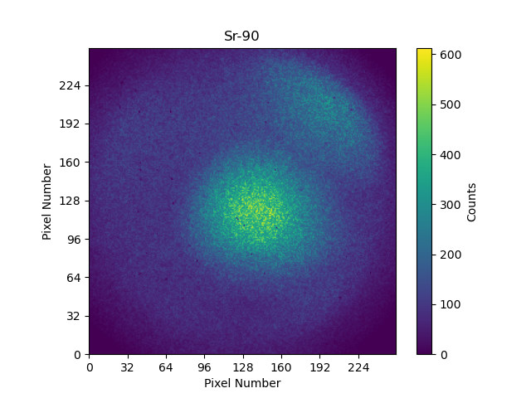
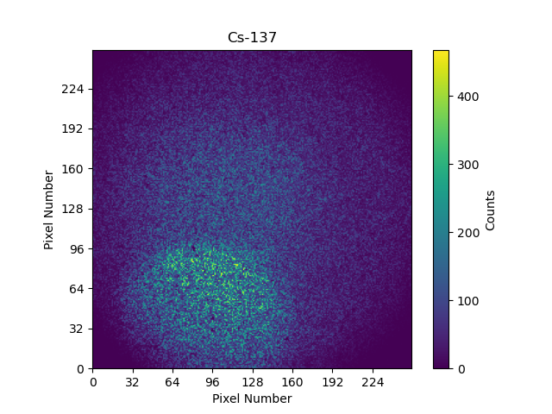
Testing
Expose scintillator to ⁹⁰Sr, ¹³⁷Cs
  Clear response to β,γ
  30±5 photons/MeV light output
Use ²⁵²Cf as neutron source, plus HDPE thermalizer
Weak response to neutrons
  Limited detections only
Notes:
Testing scintillators with ionising radiation:
- Scintillator placed in box, 10 cm from source
- Strontium/Caesium sources used for this
- Clear response above background
- 50 visible photons per MeV observed
- Variance between different printed scintillators, image intensifier main issue with this
Neutrons
- Cf252
- Source 10 cm from scint, with plastic thermalizer added
- Increase in total photons observed above background
- But no clear response as seen with Sr/Cs

Slide 13
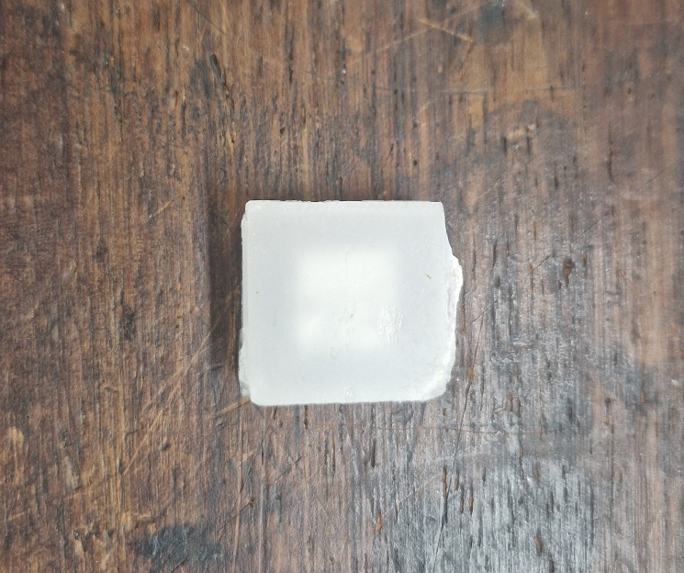
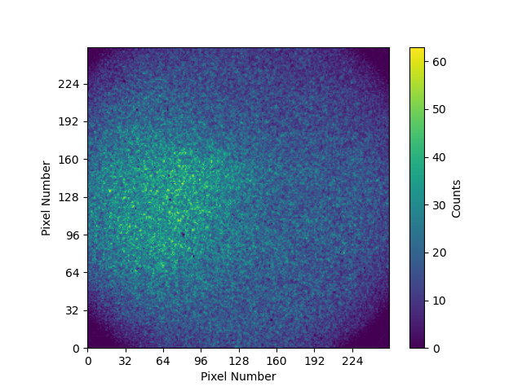
Redesign
Issues with neutron detection:
  Low ⁶Li mass (0.002 g) means low likelihood of reaction
  Low transparency of Li-containing scintillator
Redesign scintillator
  Cavity containing 0.1 g ⁶LiF powder
  Increases Li content without increasing opacity
  Significant increase in neutron detection with ²⁵²Cf
Notes:
This results from two main issues:
- Low Li content – less likely to react
- Low transparency – less likely to see photons from reaction
- Increasing Li content will decrease transparency further
Solve with redesign
- Print two-part detector with cavity
- Fill cavity with Li powder
- Can print this in low-Li content scintillator -> good transparency
- But has high Li content
- Gives clear increase in ability to detect neutrons

Slide 14
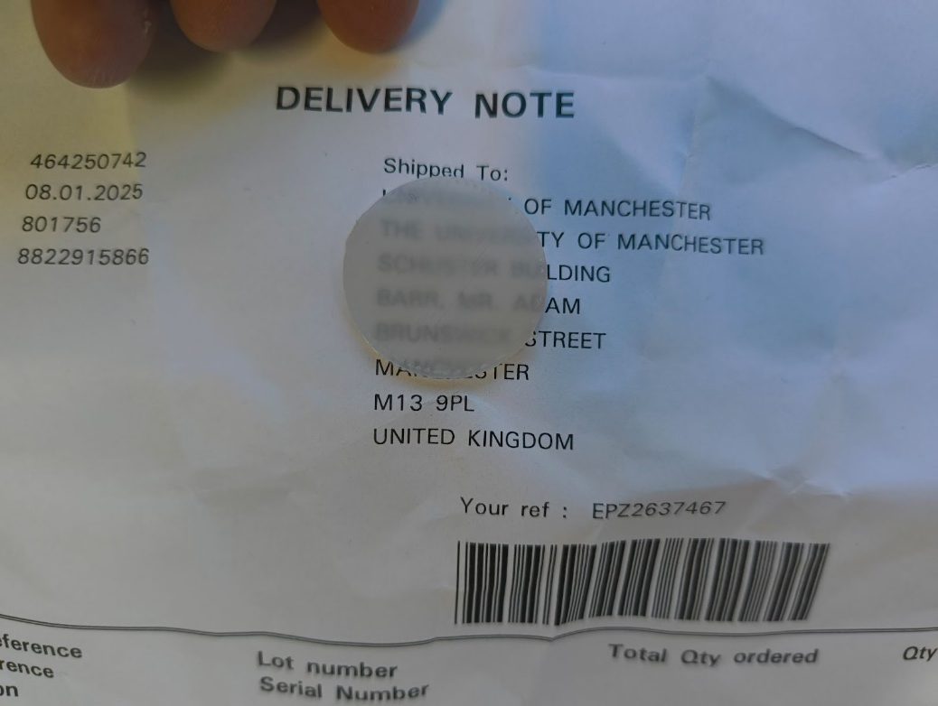
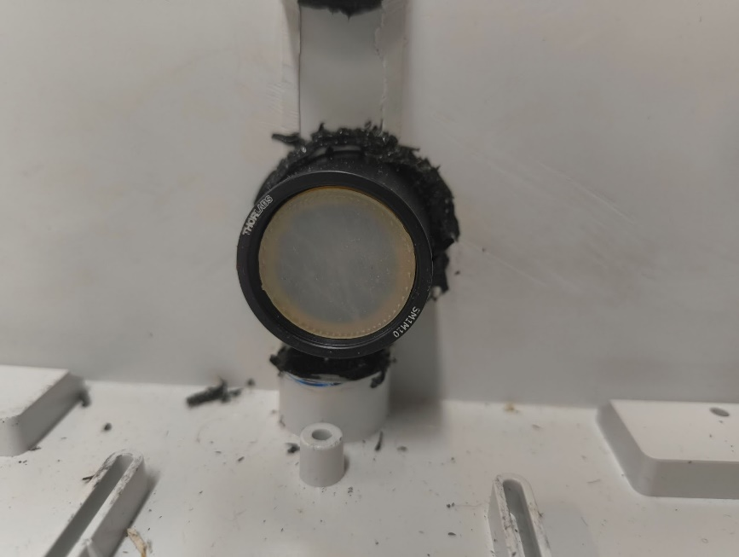
Portability
Initial iterations of detector not easily portable – requires light-tight box.
Can be improved through capabilities of 3D-printing.
Print scintillator that fits inside camera lens cap for light-tightness.
Significantly reduces size of system.

Slide 15
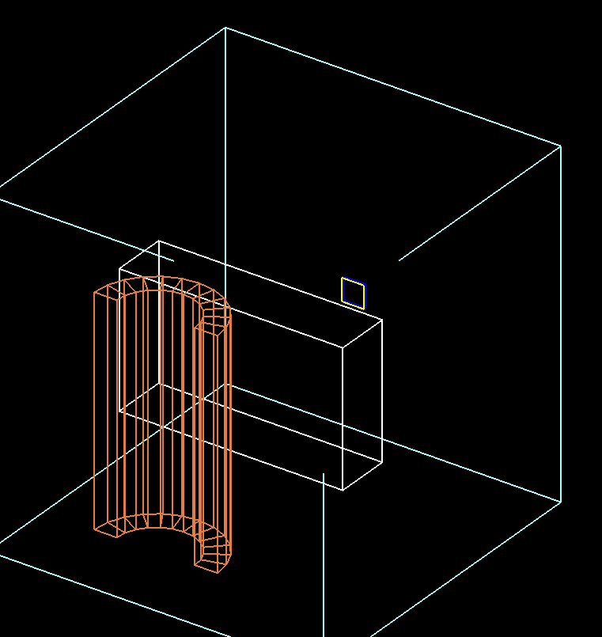
Simulations
Geant4 used to simulate neutron-scintillator interactions
Used to determine optimal thickness, design of scintillator for maximum light output
Used to predict neutron spectrum at scintillator
  Two peaks, from thermal and fast neutrons.
The detector set-up used in the simulation, with lead-jacketed ²⁵²Cf source and HDPE thermalizer

Slide 16
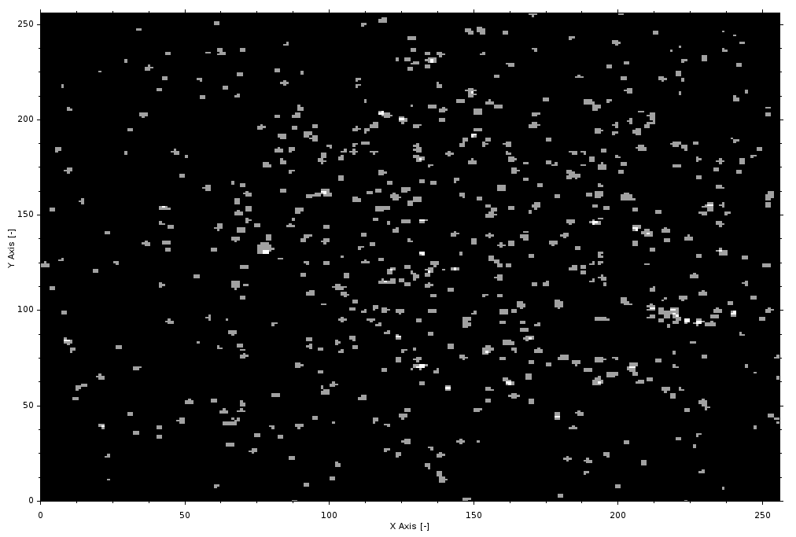
Neutron-Gamma Discrimination
Distinguishing γ from neutrons
  TimePix allows for more direct detection
  Thermal neutron interactions create more photons than gammas
  Detected simultaneously in multiple pixels – a ‘cluster’
  Algorithm searches for this signature
TimePix frame from scintillator exposed to ²⁵²Cf
Notes:
Could apply PSD, but image intensifier confounds this
But TimePix allows for direct detection of neutrons
- Neutron creates bright pulse – many more photons
- Shows up on multiple nearby pixels simultaneously
- Search for this signature – example in image
- Sum photons to get estimate of neutron energy

Slide 17
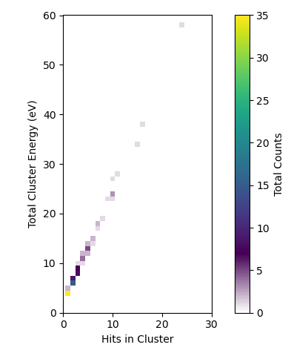
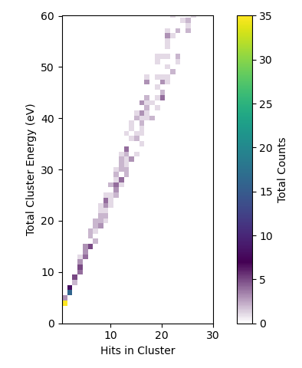
Neutron-Gamma Discrimination
Geant4 Simulations used to confirm this – clear association between presence of neutrons and larger clusters of photons.
662 KeV gamma rays only
²⁵²Cf neutrons only

Slide 18
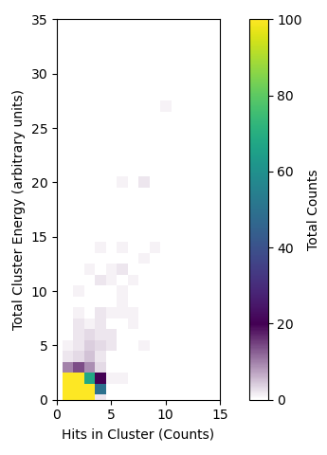
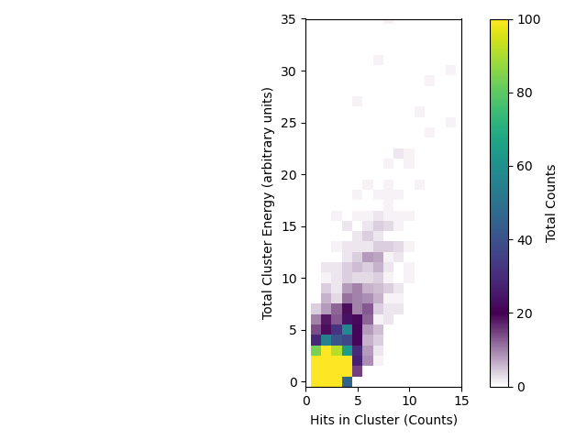
Neutron-Gamma Discrimination
Simulation results confirmed by real-world tests
Significantly more clusters with more than five hits when neutrons present than when not.
Cluster time resolution set by response time of image intensifier.
Cluster hits/energy plot for Cs-137
Cluster hits/energy plot for Cf-252

Slide 19
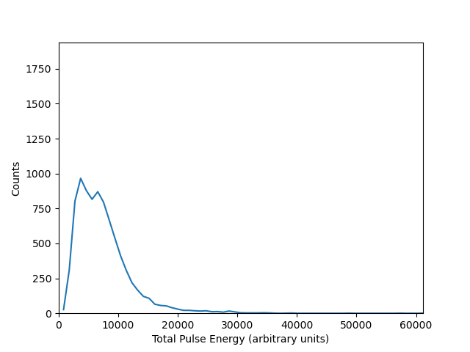
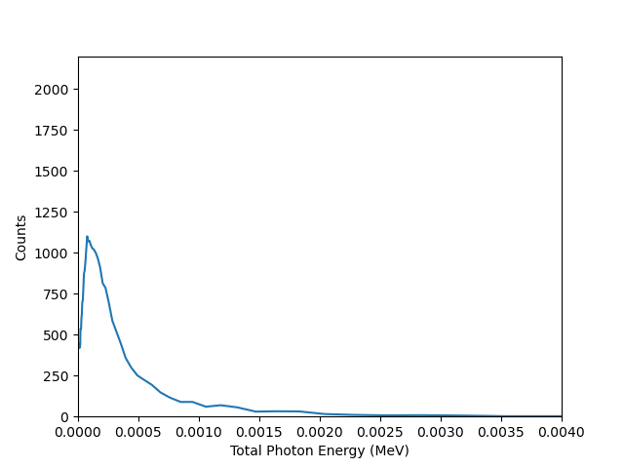
Neutron Spectrum
Measured energy spectrum for ²⁵²Cf (left) compares well to thermal neutron peak from simulations (right)

Slide 20
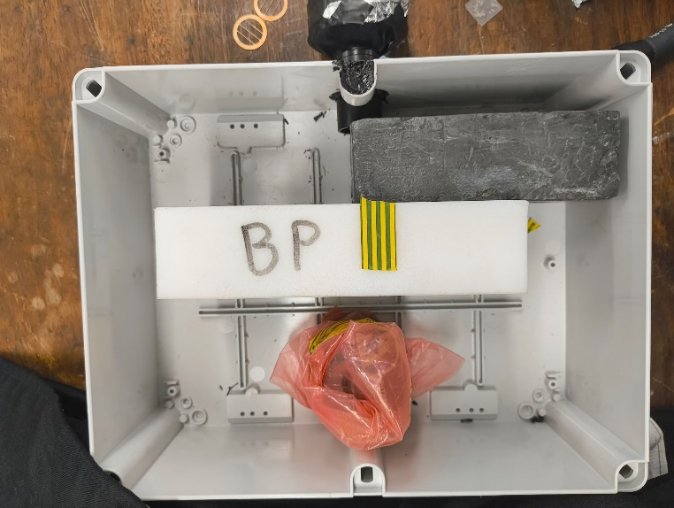
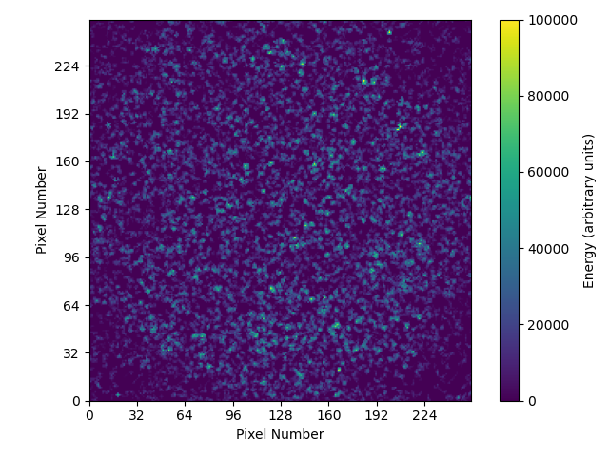
Neutron Imaging
Use lead mask to remove gamma rays, other radiation
Create image of mask using neutrons
Positive results, but limited by low neutron flux of available sources
Neutron image (bottom) from half-aperture mask (top)

Slide 21
Perovskites
Detection capability limited by low light output of polystyrene scintillator
Perovskites offer higher light outputs – but are limited by difficulties in synthesis
But can be integrated into 3D-printer filament to ease production, allow for inclusion of additives.
Build on existing techniques for including inorganic materials in printer filament.

Slide 22
Perovskites: Experimental Method
Synthesize perovskite scintillators
  Two chosen: CsPbBr₃, (PEA)PbBr₃:Li
Grind to 400 μm
Mix with inert binder plastic
  PETG and PLA both possible; PLA preferred
Print
Work currently ongoing; need to synthesize effective perovskites

Slide 23
Conclusions
⁶Li-containing scintillator filament obtained and printed
Scintillator integrated into detector
Demonstrated neutron detection
Neutron/gamma separation demonstrated for thermal neutrons – but not sensitive to fast neutrons
Work ongoing on improving detector using perovskites
Notes:
Key points:
- can produce Li6 filament, and print with it
- Explored methods for producing most effective scintillator
- Integrated design into detector
- Demonstrations of neutron detection
- Able to separate neutrons from gamma background
Future work:
- Explore other neutron sensitive materials – Boron, organic Li/B salts soluble in PS
- Continue refining algorithm for neutron separation
- Many more Geant4 Sims, more data gathering, to finalise calibration

