Slide 1

3-D Position Sensitive Semiconductor Gamma-Ray Detectors & Applications
Zhong He
NuSec Workshop, London – March 5, 2025
Acknowledgements
DOD DTRA, DOE NA-22 & DHS CWMD
Cleared for Public Release

Slide 2
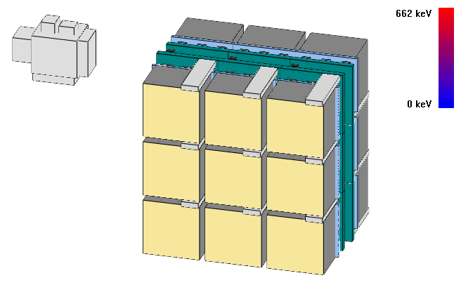
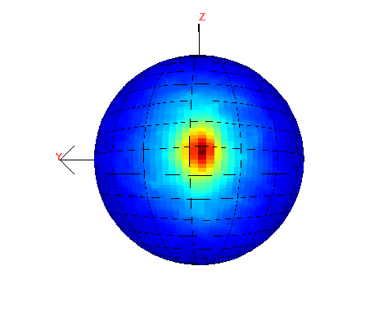
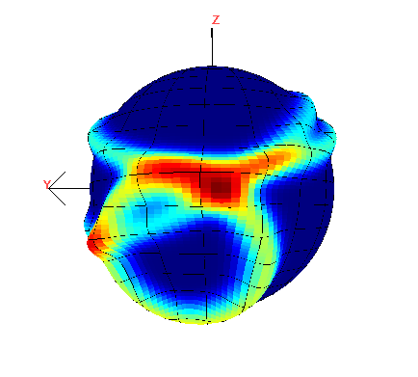
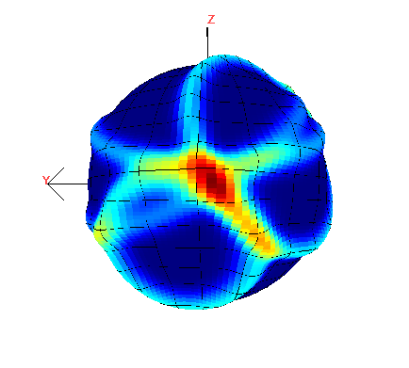
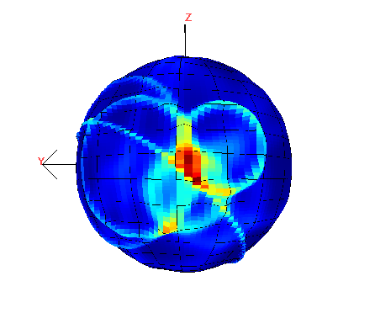
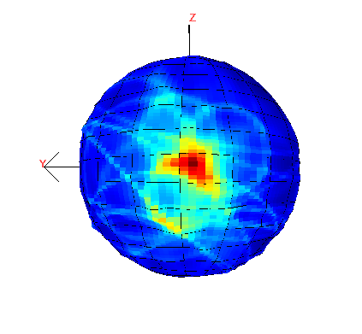
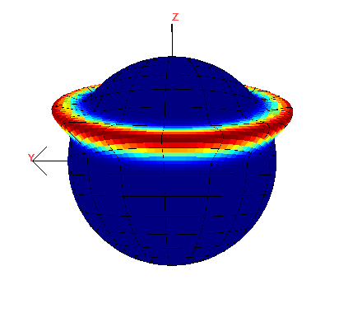
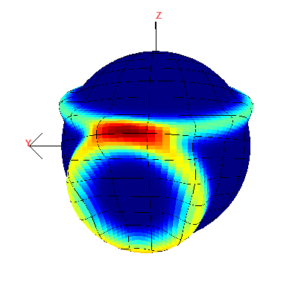
Performance Goals
ΔE/E ≤ 0.5% FWHM (at 662 keV)
Real-time γ Imaging + isotope I.D.
3-D γ-Ray Detectors
γ
Eighteen 2×2×1.5 cm³ CdZnTe detectors (108 cm³, 648 grams = 1.43 lb)
θ
θ
E₂
E₁
Number of photons:
18
97
2033
3
4
1
2

Slide 3
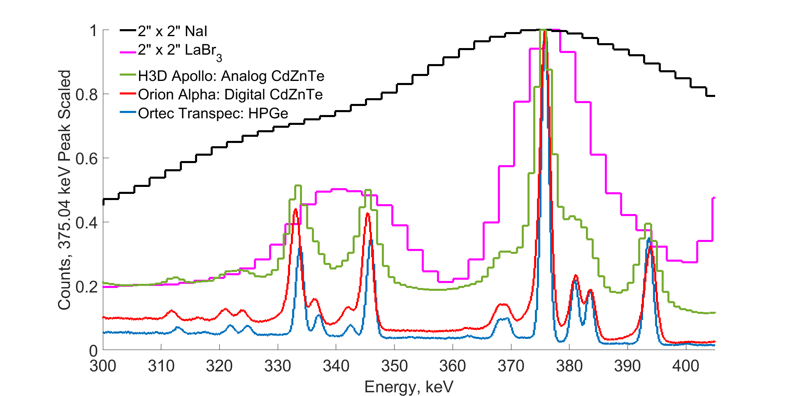
Typical Gamma-Ray Spectrometers
Measured plutonium spectrum

Slide 4
Perovskite Semiconductor Gamma-Ray Detectors
Goals
Explore alternative room-temperature semiconductor gamma detectors to achieve energy resolution ΔE/E ≤ 1.0% FWHM at 662 keV
Thickness ≥ 1.0 cm (for required detection sensitivity)
The majority charge carrier (e or h) μ⋅τ ≥ 10⁻² cm²/V (Ref: CdZnTe (μ⋅τ)_{e} ≈ 4×10⁻² cm²/V )
Wider band-gap than that of CZT (1.6 eV) – to lower noise in hotter temperatures (≥ 50°C)
Lower cost

Slide 5
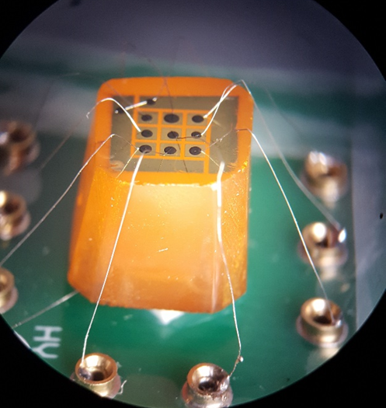
2021 Results on CsPbBr₃ #YH-UM-6R (~12mm thick)
(Without near pixel events)
¹³⁷Cs
Bias = 200 V
1.03%
FWHM
K_{α} & K_{β}
Summary:
Hole mobility 22 – 65 cm²/V⋅s on different CsPbBr₃ samples
Two-bias (150V & 200V) method ⇒ (μ⋅τ)_{h} ≈ 6.3×10⁻² cm²/V & τ_{h} ≈ 970 μs
Notes:
Measurement condition: (1) Gage card sampling rate = 5 MHz, +/-200mV Digital Rail; (2) Preamp decay correction, trapezoidal filtering for amplitude, CR-RC⁴ for timing; (3) Ran for 14 hours (then the single anode starts breakdown, pixel cathodes are still working.)
Notes: From: Matthew Petryk <mpetryk@umich.edu>
Date: Sat, Oct 16, 2021 at 5:49 PM
Subject: Re: Question on your hole mu-tao estimate on perovskite (slides #4 & 5)
To: Zhong He <hezhong@umich.edu>
I don't expect it to be ballistic deficit, since the shaping times should be long enough in both cases.
The slides may present it a little confusingly. The Cs photopeak did not drop to 1364 ADC at 150V - the 344 keV photopeak is at 1364 ADC at that bias. There is no Cs photopeak in the 150V measurement. Since I did not have a Cs source at the same time, and because the linearity is good, I estimated that 662 would be at 2624 ADC at 150V based on the positions of the 122, 244, and 344 peaks. This is compared to 2725 ADC for 662 keV at 200V. The assumption is that 344 and 662 keV clouds undergo the same trapping mechanisms.
The drop from 200V to 150V is about 3.7%. There is very little hole trapping at both biases, which does mean more uncertainty in the calculation. For that reason I agree it's better to call 6e-2 a lower limit. I want to take a measurement at 25 - 50V bias, where we should see more clear trapping.

Slide 6
Depth Corrected ¹³⁷Cs Spectra from All 9 Pixel Electrodes
Pixel # | FWHM Resolution 662 keV (%)
1 | 1.30
2 | 1.29
3 | 1.68
4 | 1.76
5 | 1.03
6 | 1.72
7 | 1.91
8 | 1.64
9 | 4.21
ΔE/E < 2% FWHM at 662 keV on 8/9 pixel electrodes.
Notes:
Notes: Results were from Matthew Patryk’s October 2021 progress report

Slide 7
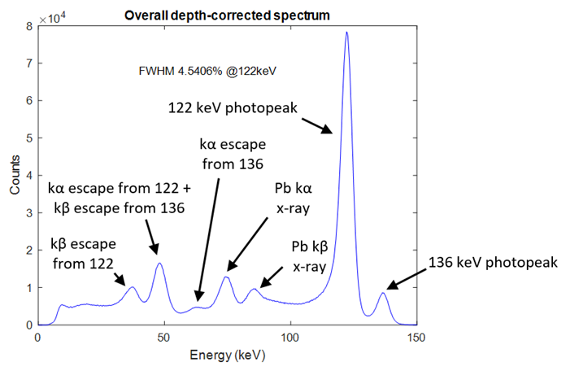
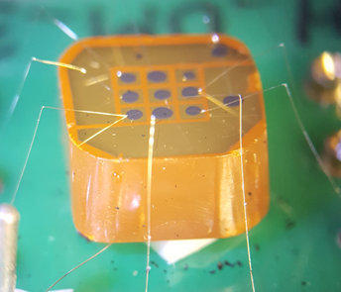
Northwestern CsPbBr₃ # YH-UM-3VK (2022)
Thickness ~4 mm
All nine pixel electrodes performed similarly

Slide 8
Northwestern CsPbBr₃ #YH-UM-3VK (¹³⁷Cs)
Best pixel ΔE/E = 0.91% FWHM
Notes:
Notes: YH-UM-3VK is a 3.95 mm thick 3x3 pixelated CsPbBr₃ with 1.2 mm pixel pitch, refabricated by Vladislav Klepov from old samples grown by Yihui He. This results from Matthew Petryk’s report of August, 2022.

Slide 9
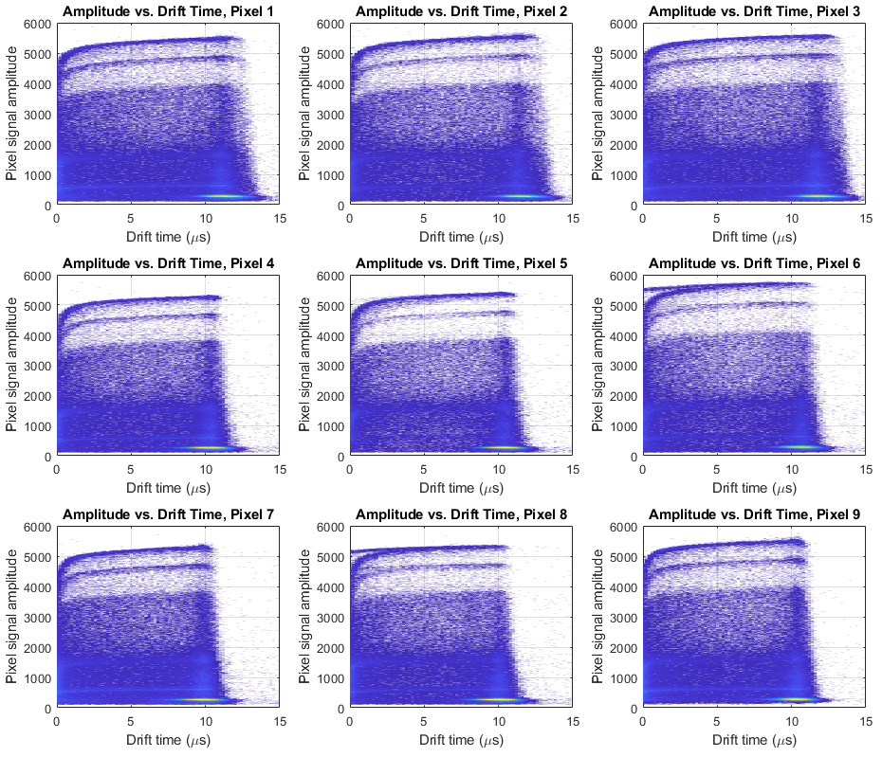
Diagnostic Measurements on Charge Transport Properties, Material Uniformity and Stability
Pixelated
electrodes
h+ e-
Planar
electrode
NW’s CsPbBr₃ # YH-UM-3VK
(Photopeak amplitude versus hole drift time at 662 keV)

Slide 10
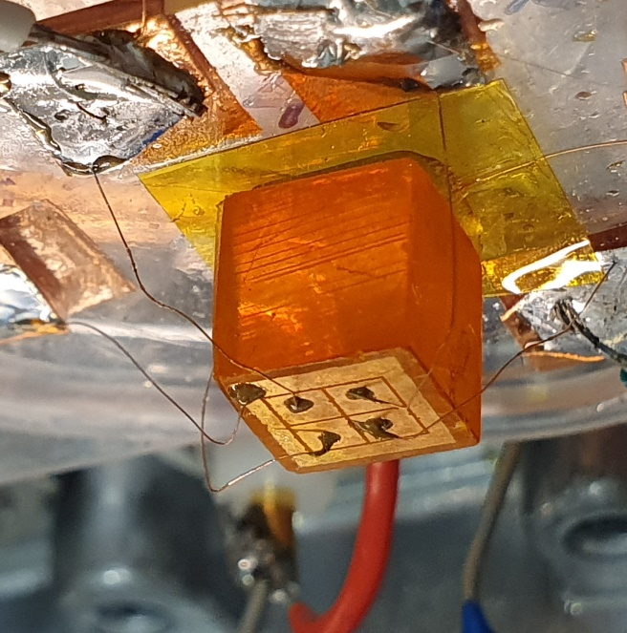
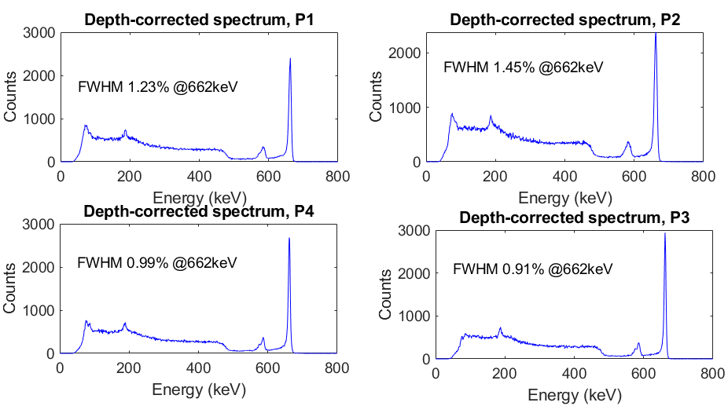
Northwestern Univ. & Argonne National Lab. CsPbBr₃ in 2024
7.5×7.0×6.8 mm³
Det. # QP2304-7-R1(3) Fabricated on 07/16/24
(Operated for more than 4 months under bias)
7.5×7×6.8 mm³ CsPbBr₃

Slide 11
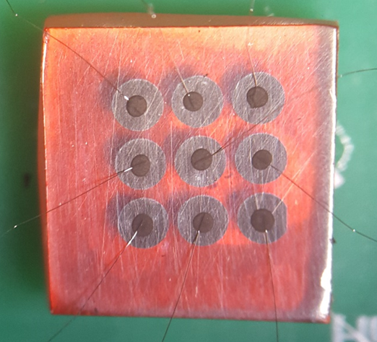
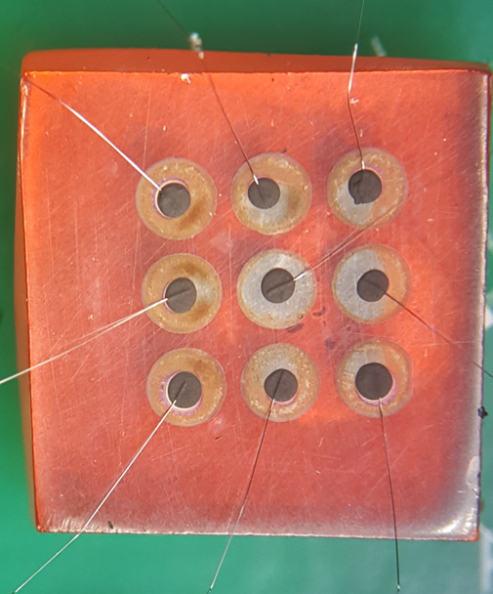
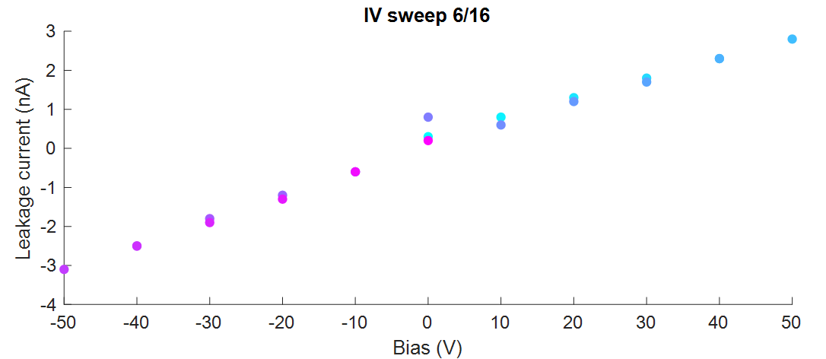
Solution Grown Perovskite from Univ. of North Carolina
FA_{0.9}Cs_{0.1}PbBr₃ detector UNC #1, ~1 mm pixel pitch, ~ 3 mm thickness
Au planar electrode, Bi pixel electrodes (opposite to that of Northwestern)
The blocking contact behavior disappeared a week later?
Strongly blocking contact (I-V curve ) at the beginning
We are interested in collaborating with you on perovskite semiconductor gamma-ray detectors
Notes:
Note: FA
Note #2: Jinsong said on Nov. - Page 7, I remember the device was under continuous bias for two weeks at a high voltage. The corrosion of Bi electrode should be caused by the lacking of encapsulation. Bi is known not to react with perovskites, reported by many research groups.

Slide 12
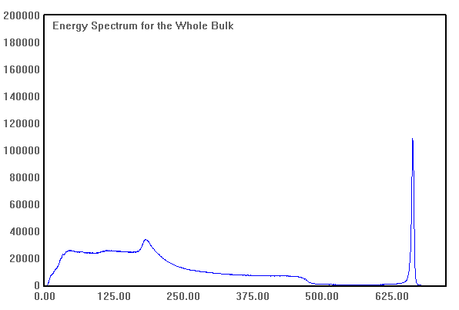
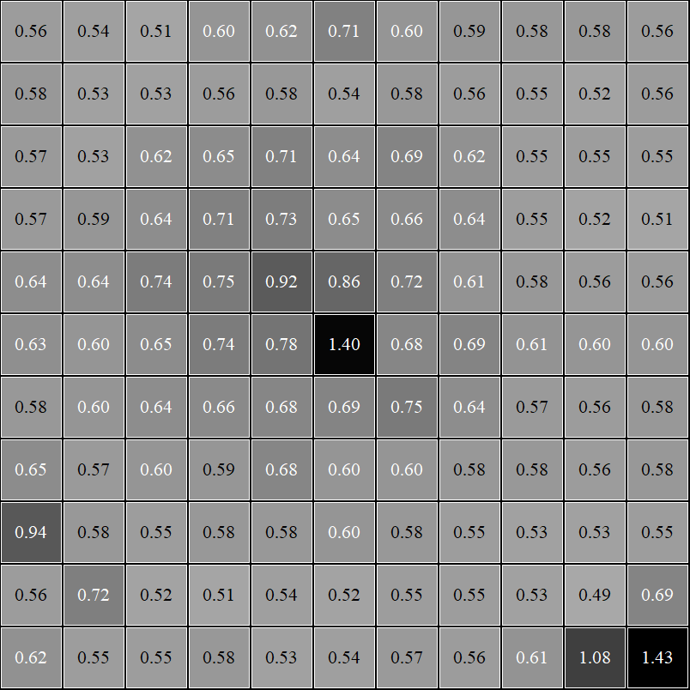
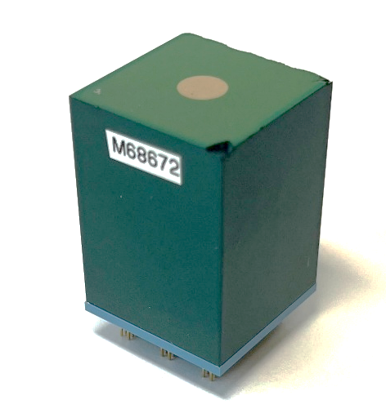
Latest 3-cm Thick CZTs at Univ. of Michigan
All Events ΔE/E = 1.00%
ASIC: VAD_UM2.2
Cathode: -3kV
Sampling: 5 MHz
Dynamic Range: 700 keV
2.2 cm
2.2 cm
¹³⁷Cs
Counts
3 cm
0.60 %
FWHM
CZT #11R2
Energy (keV)
Notes:
With subpixel resolution, we will be able to recover some energy resolution loss as shown here.
However, at lower biases, the diffusion will become larger, subpixel resolution will become poorer, and correction will become less and less effective.
Still at -400V, the subpixel calibration can bring lots of improvement.

Slide 13
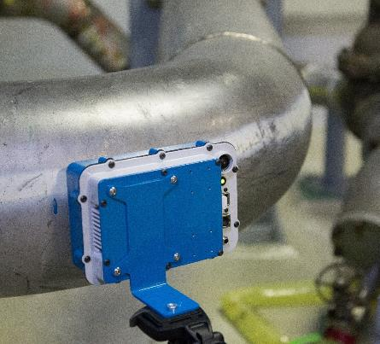
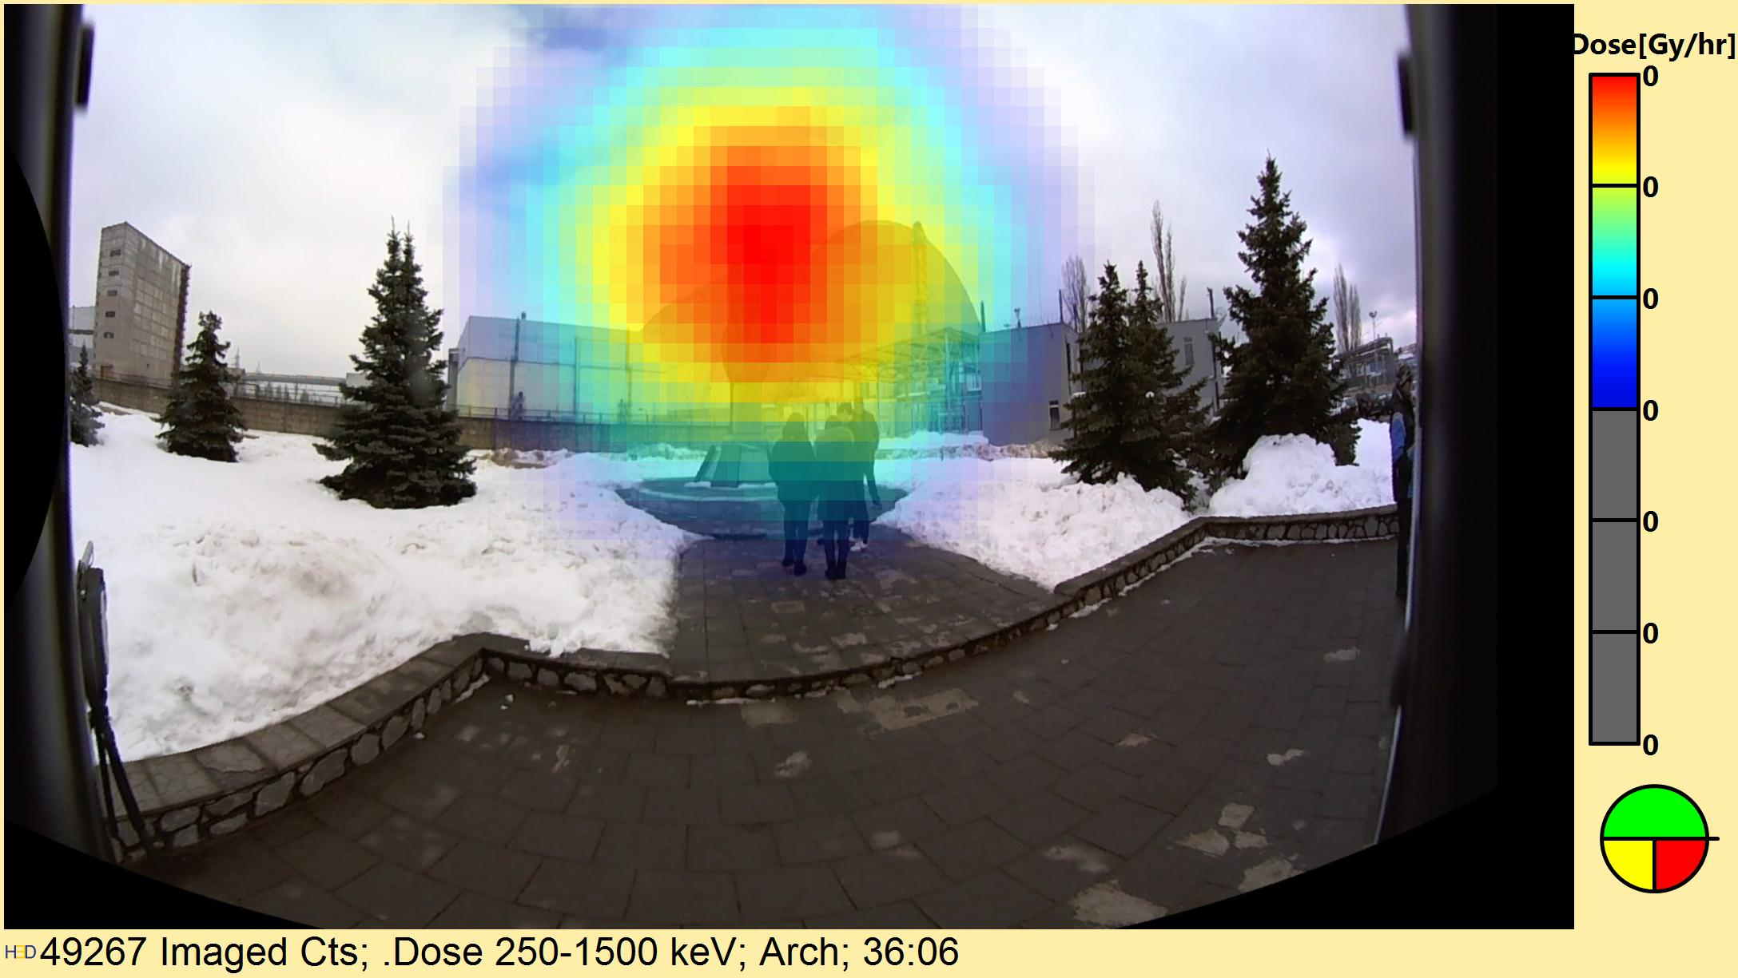
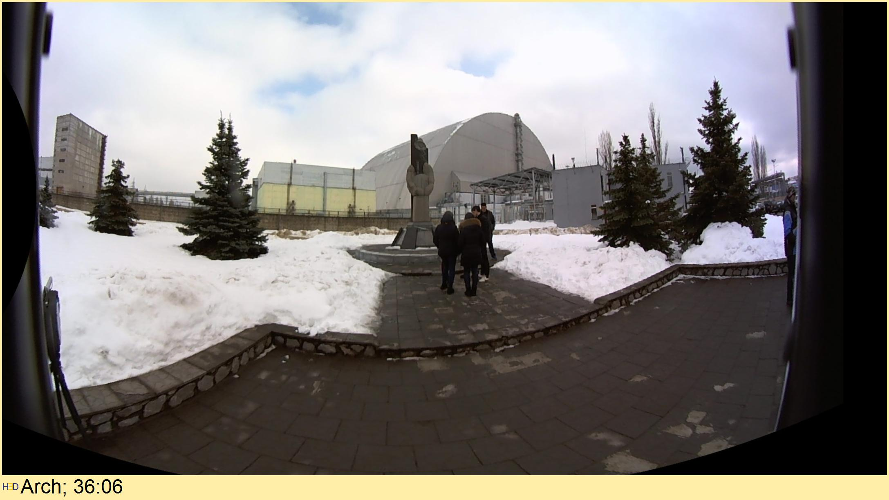
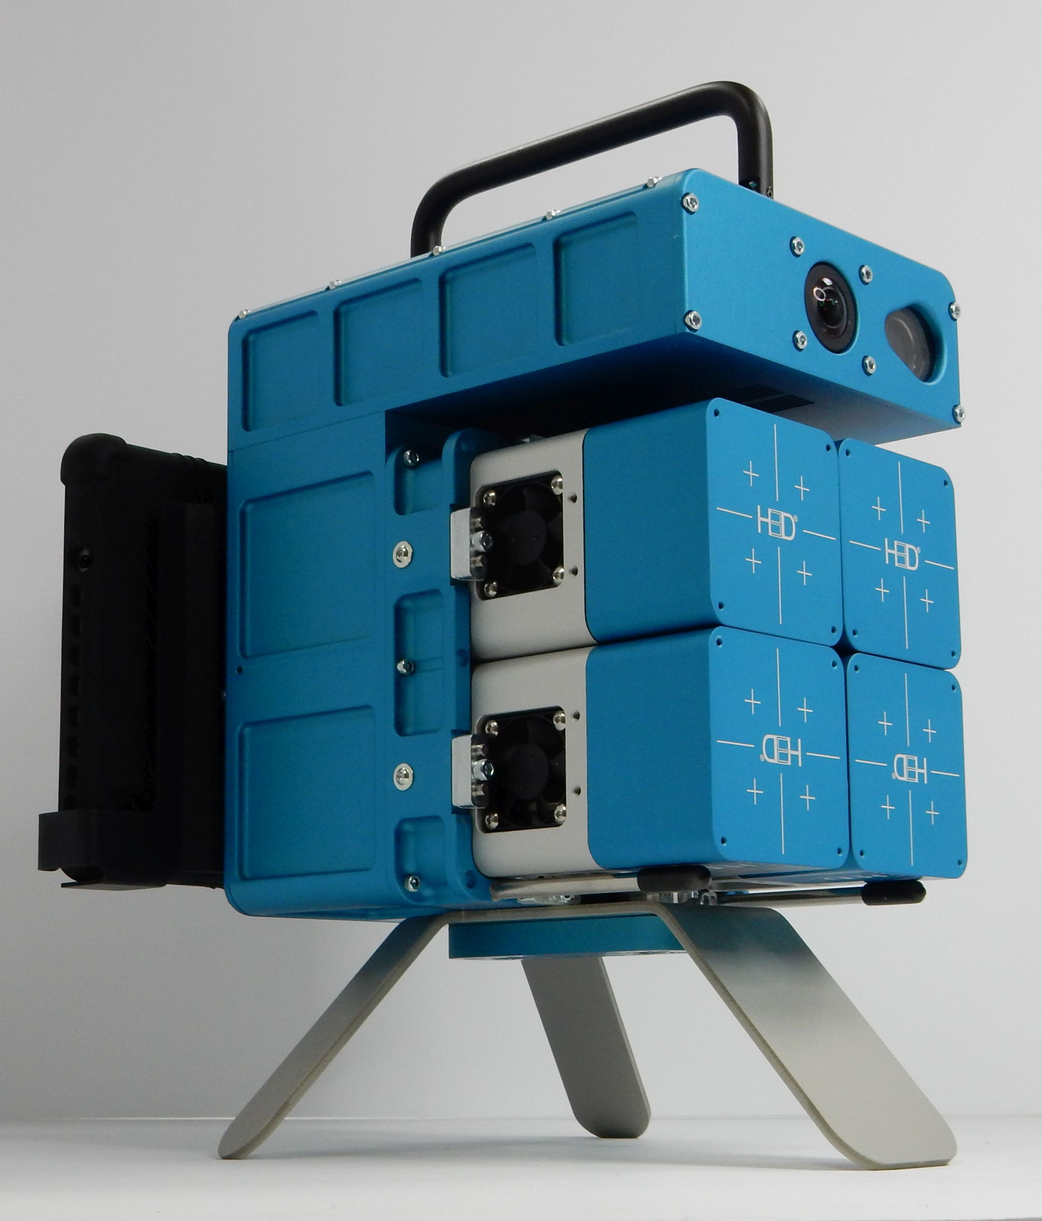
Applications through H3D Inc.
(https://www.h3dgamma.com)
Chernobyl Arch by Dr. Willy Kaye of H3D
(2019)

Slide 14
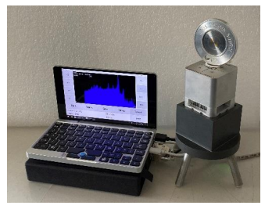
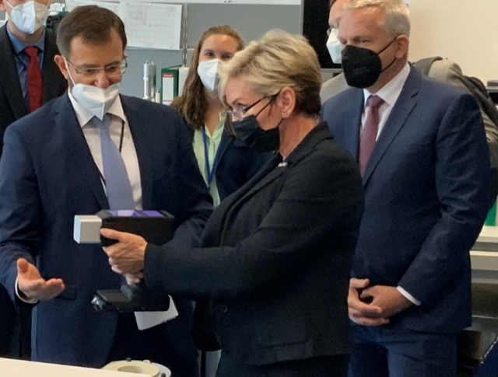
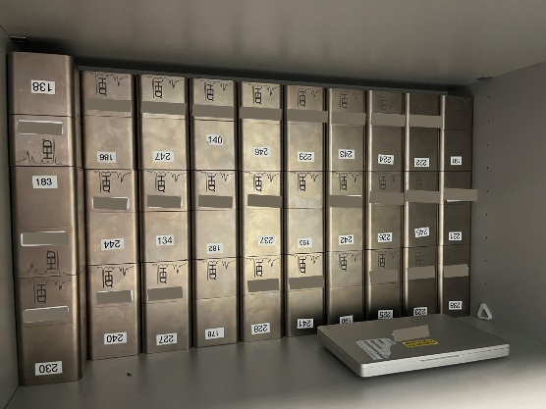
IAEA Demonstrated Gun-Shaped-M400 to Former U.S. Secretary of Energy
IAEA, Fall 2024
September 2021
H3D M400

Slide 15
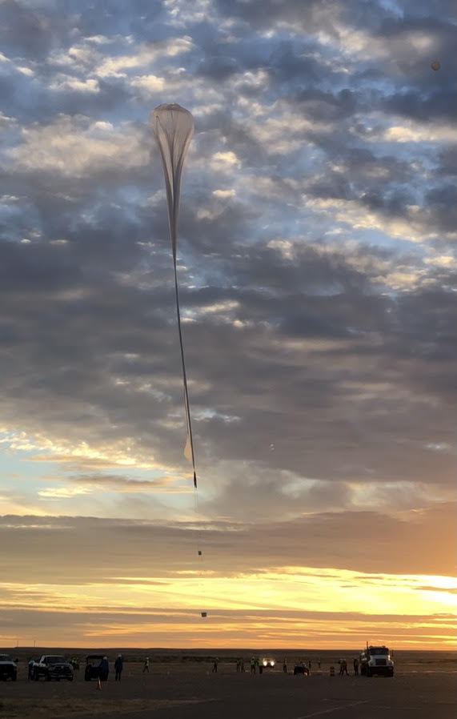
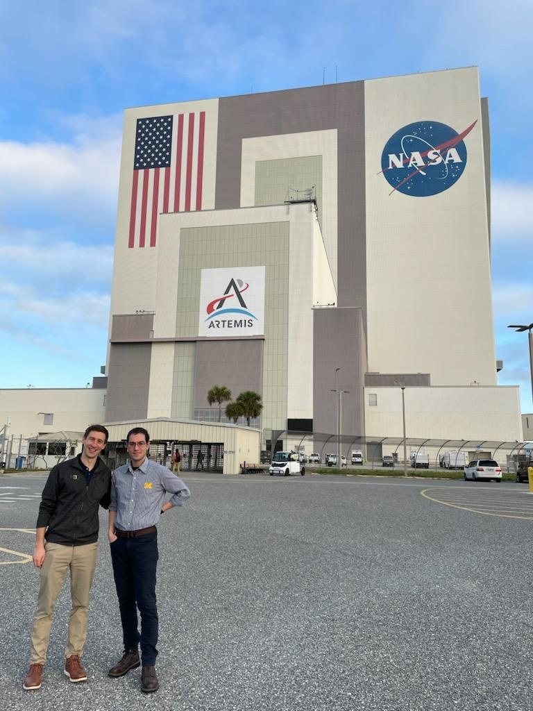
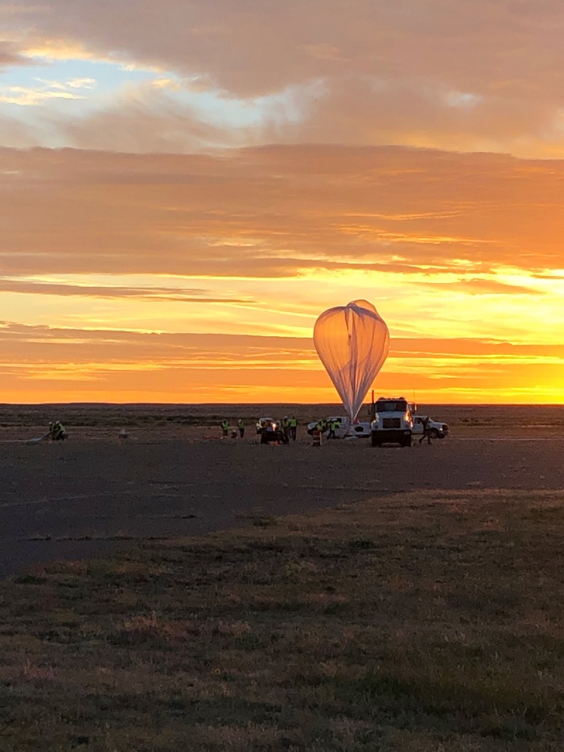
Space Applications
Kennedy Space Flight Center, Feb. 10, 2025
Before balloon launch at NASA CSBF in Fort Sumner,
NM (up ~ 24 – 25 miles), Sept.26th, 2021 (UM Eagle)
TERI (Four 4x4x1.5 cm³ CZTs) is scheduled to be launched by SpaceX CRS-32 in April

Slide 16
Thank you !

