Slide 1
Entanglement between pair-created universes bridged by a Euclidean wormhole
Chen, Hu and DY, 1611.08468
Chen and DY, 1706.07784
Chen, Lin and DY, 1707.01471
Tumurtushaa and DY, 1808.01103
Brahma and DY, 1808.01744
Brahma and DY, 1810.10211
Chen, Yeh and DY, 1903.12045
Chen, Ro and DY, 1904.00199
Chew, Tumurtushaa and DY, 2006.04344
Chen, Lin, Lin and DY, 2404.15450
Chen, Lin, Lin and DY, 2505.02807
Dong-han Yeom 염동한
Pusan National University (main) / University of Waterloo (sabbatical leave)
2025. 7. 7.

Slide 2
Euclidean wormhole is not a new topic.

Slide 5
However, what if Euclidean wormholes
can be an origin of our universe?

Slide 6
A short review on Euclidean path integral

Slide 7

Wheeler-DeWitt equation
$$\hat{H}Ψ=0$$
The Wheeler-DeWitt equation is the conservative approach to canonically quantize the spacetime.
The wave function of the Universe gives a probability distribution for a certain stage of our universe, e.g., a probability before inflation.

Slide 8

Boundary condition problem
$$\hat{H}Ψ=0$$
The problem is, how to give a boundary condition for this (functional) partial differential equation.

Slide 9
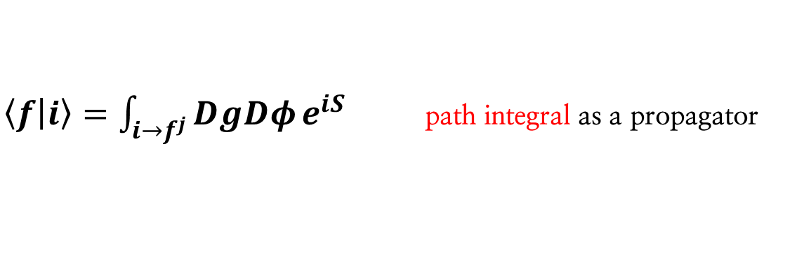

Euclidean path integral approach
(Hartle and Hawking, 1983)
$$|f⟩=\sum_{j}{a_{j}|f^{j}⟩}$$
$\left\langle f | i\right\rangle =\int_{i→f^{j}}^{ }{DgDφ}e^{iS}$ path integral as a propagator

Slide 10
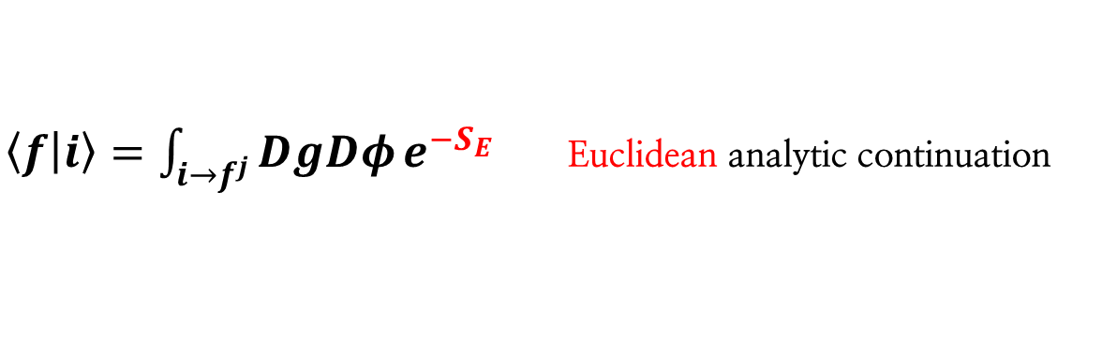
Euclidean path integral approach
(Hartle and Hawking, 1983)
$$|f⟩=\sum_{j}{a_{j}|f^{j}⟩}$$
$\left\langle f | i\right\rangle =\int_{i→f^{j}}^{ }{DgDφ}e^{−S_{E}}$ Euclidean analytic continuation

Slide 11

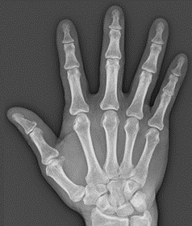
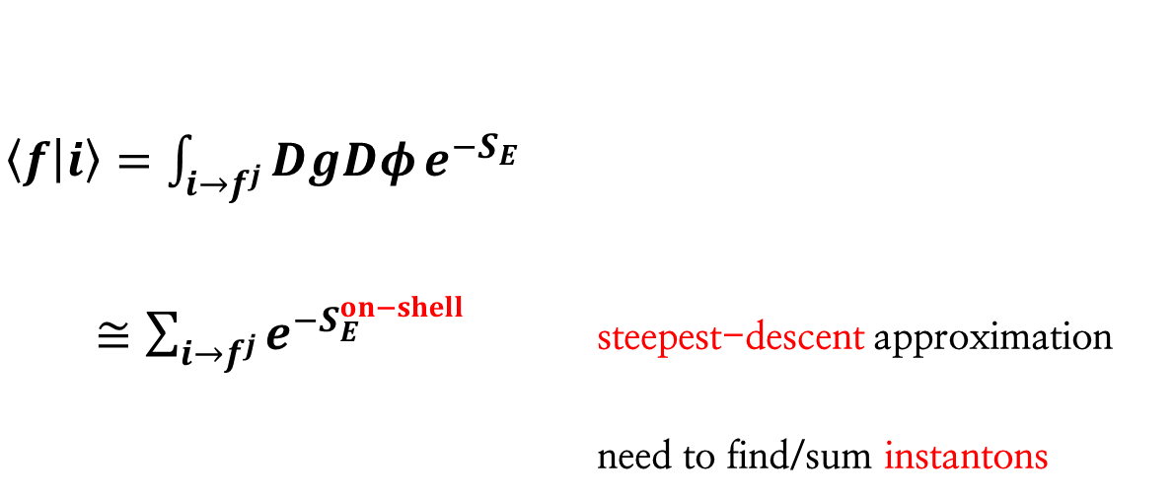
Euclidean path integral approach
(Hartle and Hawking, 1983)
$$|f⟩=\sum_{j}{a_{j}|f^{j}⟩}$$
$\left\langle f | i\right\rangle =\int_{i→f^{j}}^{ }{DgDφ}e^{−S_{E}}$
$≅\sum_{i→f^{j}}^{ }{e^{−S_{E}^{on−shell}}}$ steepest-descent approximation
need to find/sum instantons

Slide 12


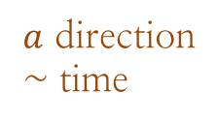
Wave function of Universe
$$Ψ[a,φ]$$
$φ$ direction ~ different initial condition
$a$ direction
~ time

Slide 13
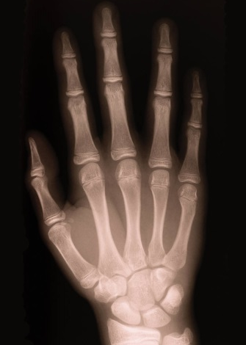
Steepest-descent approximation

Slide 14
Steepest-descent approximation
~ sum-over instantons
Alternative histories:
many-world interpretation

Slide 15

Present universe:
we want to know
the probability of here.
initial singularity → wave function

Slide 16


$$t→t−iτ$$

Slide 17

big-bang singularity

Slide 18




Lorentzian dS
$$a\left(t\right)=\frac{1}{H_{0}}\cosh{H_{0}t}$$
Wick-rotation
$$τ=\frac{π}{{2H}_{0}}+it$$
regular Euclidean boundary
Euclidean on-shell solution
$$a\left(τ\right)=\frac{1}{H_{0}}\sin{H_{0}τ}$$

Slide 19
Euclidean wormholes in dS
Pure dS model: Chen, Hu and DY, 1611.08468
Embedding inflation: Chen and DY, 1706.07784
Large e-folding issue: Chen, Ro and DY, 1904.00199

Slide 20
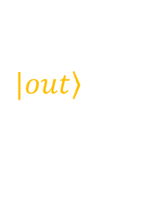

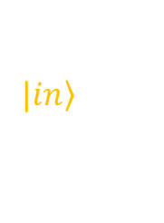
$$|\left.out\right\rangle$$
disconnected
$$\left\langle out | in\right\rangle$$
$$|\left.in\right\rangle$$

Slide 21

$$|\left.out\right\rangle$$
$$\left\langle out | 0\right\rangle$$
no-boundary proposal

Slide 22
$$|\left.out\right\rangle$$
disconnected
$$\left\langle out | in\right\rangle$$
$$|\left.in\right\rangle$$

Slide 23
What if connected?

Slide 24

$${\dot{a}}^{2}=1−\frac{Λ}{3}a^{2}−\frac{C}{a^{n}}$$
If there exists this correction term,
then we can obtain a wormhole.

Slide 25
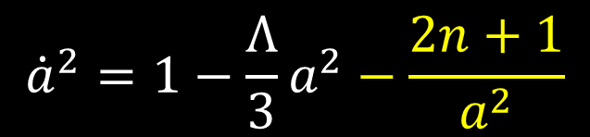
Several candidates
1. Quantum gravity: quantum excitation of WDW equation
$${\dot{a}}^{2}=1−\frac{Λ}{3}a^{2}−\frac{2n+1}{a^{2}}$$

Slide 26

Several candidates
1. Quantum gravity: quantum excitation of WDW equation
$${\dot{a}}^{2}=1−\frac{Λ}{3}a^{2}−\frac{2n+1}{a^{2}}$$
2. String theory: axion induced model
$${\dot{a}}^{2}=1−\frac{C}{a^{4}}$$

Slide 27
Several candidates
1. Quantum gravity: quantum excitation of WDW equation
$${\dot{a}}^{2}=1−\frac{Λ}{3}a^{2}−\frac{2n+1}{a^{2}}$$
2. String theory: axion induced model
$${\dot{a}}^{2}=1−\frac{C}{a^{4}}$$
3. Modified gravity: Gauss-Bonnet-dilaton gravity, loop quantum gravity, etc.

Slide 28

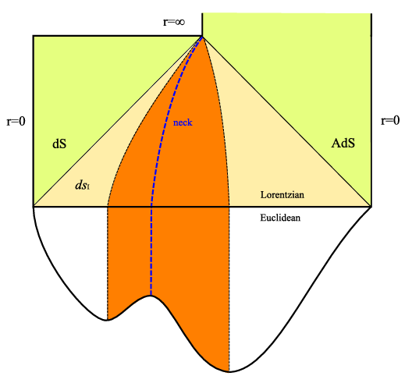
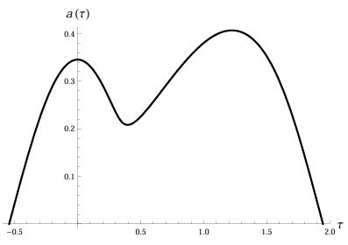
Gauss-Bonnet-dilaton gravity may explain Euclidean wormholes;
this solution might be analytically continued even inhomogenously.
Tumurtushaa and DY, 1808.01103
Chew, Tumurtushaa and DY, 2006.04344

Slide 29
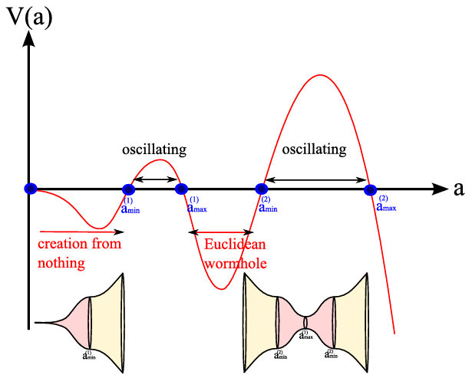

Loop quantum gravity may explain Euclidean wormholes, too.
Brahma and DY, 1808.01744
Brahma and DY, 1810.10211

Slide 30
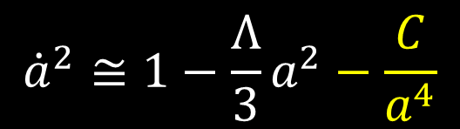
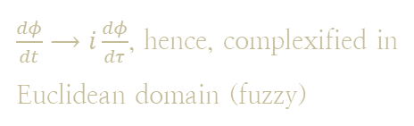
Several candidates
4. Fuzzy Euclidean wormholes: kinetic term of a scalar field
$${\dot{a}}^{2}≅1−\frac{Λ}{3}a^{2}−\frac{C}{a^{4}}$$
$\frac{dφ}{dt}⟶i\frac{dφ}{dτ}$, hence, complexified in
Euclidean domain (fuzzy)

Slide 32
Planck data prefers a concave inflaton potential.
But, why?

Slide 33

One can show that
Euclidean wormholes can only be generated
at the concave part.
$$φ$$
Chen and DY, 1706.07784

Slide 34
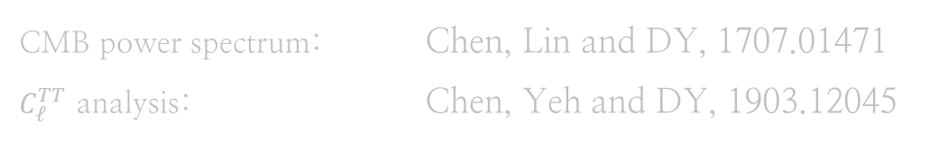
What are the observable consequences?
CMB power spectrum: Chen, Lin and DY, 1707.01471
$C_{ℓ}^{TT}$ analysis: Chen, Yeh and DY, 1903.12045

Slide 35
Halliwell and Hawking’s construction
Turn on perturbations!

Slide 36
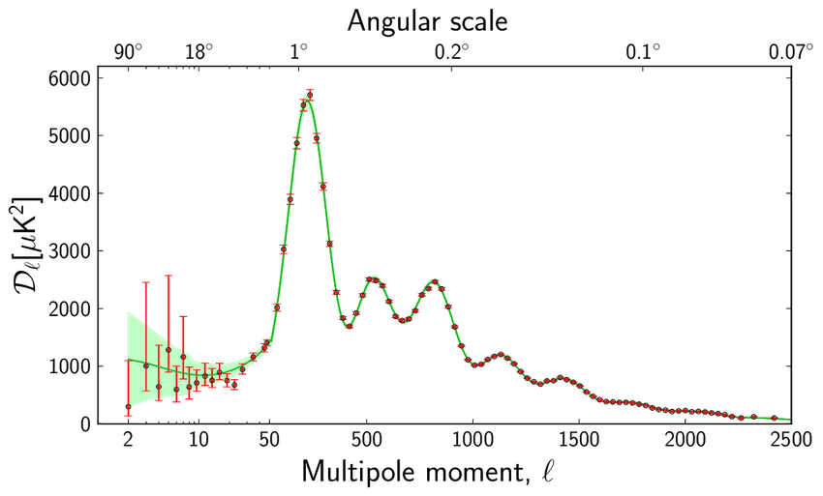
Summary of cosmological observables
We need curvature perturbations to compute
various observational consequences.

Slide 37
Summary of cosmological observables
To compute this,
we need power spectrum of scalar perturbations.

Slide 38
Summary of cosmological observables
To compute this,
we need power spectrum of scalar perturbations.
The power spectrum is nothing but
the expectation value of perturbations.

Slide 39
Summary of cosmological observables
To compute this,
we need power spectrum of scalar perturbations.
The power spectrum is nothing but
the expectation value of perturbations.
Good! Then, how can we compute the expectation values?

Slide 40
Summary of cosmological observables
To compute the expectation value,
we need to specify either quantum states/wave function,
or the vacuum (= quantum states annihilated by the annihilation operator).

Slide 41
Summary of cosmological observables
To compute the expectation value,
we need to specify either quantum states/wave function,
or the vacuum (= quantum states annihilated by the annihilation operator).
wave function
vacuum condition
(~ Gaussian)

Slide 42
Now the question is,
what decides the vacuum?

Slide 43
The way to decide the vacuum
The mode functions satisfy the 2nd order linear differential equation.

Slide 44
The way to decide the vacuum
The mode functions satisfy the 2nd order linear differential equation.
So, the solution is a superposition of two modes,
say, (in-going mode) + (out-going mode).

Slide 45
The way to decide the vacuum
The mode functions satisfy the 2nd order linear differential equation.
So, the solution is a superposition of two modes,
say, (in-going mode) + (out-going mode).
If we ignore the in-going mode, then this is so-called the Bunch-Davies state.

Slide 46
The way to decide the vacuum
Interestingly, if we require the regularity condition at the south-pole,
this automatically selects the Bunch-Davies state.
Therefore, the no-boundary state is a geometrical origin of the BD state.

Slide 47
What’s new for Euclidean wormholes?
Non-BD vacuum: Chen, Lin, Lin and DY, 2404.15450
Entanglement creation: Chen, Lin, Lin and DY, 2505.02807

Slide 48
The way to decide the vacuum
On the other hand, if we are considering the Euclidean wormholes,
there is no such a regularity condition.
Therefore, the Euclidean wormhole is a
geometrical origin of the non-BD-vacuum state.

Slide 49
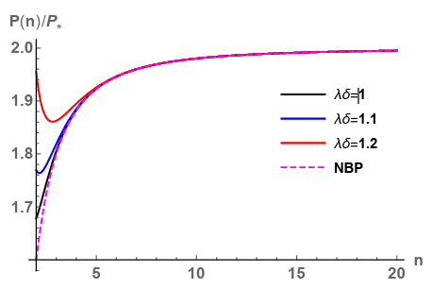
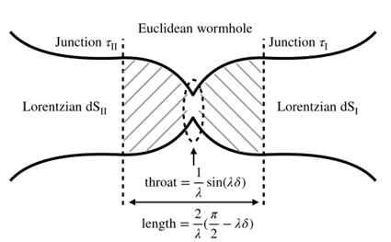
The natural quantum state
For a simple example, one can provide the symmetric conditions.
This explains that two universes are entangled.
This is an interesting example that the Euclidean geometry is time-dependent,
and hence the quantum state is no more a thermofield double.

Slide 50
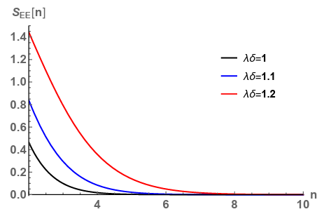
The natural quantum state
A non-BD-vacuum can be explained by Euclidean wormholes.
Euclidean wormholes indicate that our universe is not a pure state.
If we believe in the Euclidean path integral as our boundary condition,
and if we find an evidence that we are in the non-BD-state,
one can believe that our universe is a mixed state.

Slide 51
Future topics
- Can this result be generalized to generic Euclidean wormhole models?
- What are the implications to CMB, gravitational waves, etc.?
- Can this explain an explicit CPT violation?
- What happens if we apply for AdS?

Slide 52
Thank you very much

