Slide 1
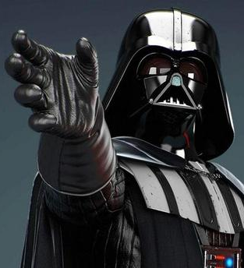
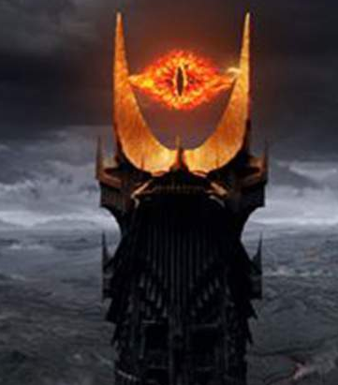





Solid State Detectors for Low-Mass Dark Matter Searches
Prof Miriam Diamond
Dark Side of the Universe, July 2025

Slide 2
Come to the (Solid) Dark Side
What are we looking for?
How are we looking for it?
Solid program of solid-state detectors
  Overview of channels & technologies
  Backgrounds
  Cryogenic crystals
  Some fun R&D stuff
Recent results
  Low Energy Excess

Slide 3
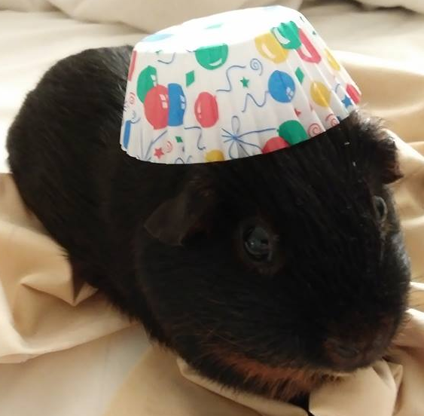
“What are we looking for?”
?

Slide 4
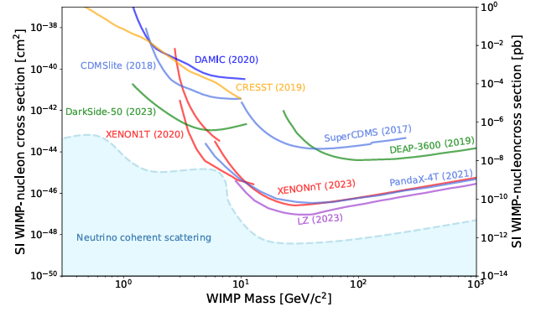
WIMPing out?
Lots of “theoretically motivated” WIMPy candidates
  But… searches where we most expected to find WIMPs haven’t found them!
PDG 2024, Ch. 27 “Dark Matter”
weak scale

Slide 5
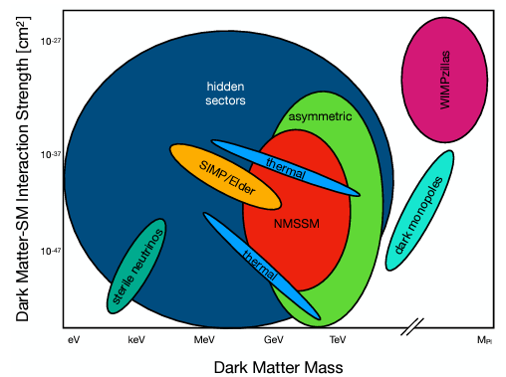
Now what?
arxiv.org/abs/2209.07426

Slide 6



My Favourite Park in the Particle Zoo
too hot
“Light DM”
WIMP DM
too much
CMB/BBN
“Light WIMP-like DM” requires new, low-mass “dark mediators” (dark force carriers)
e.g. “Hidden Valley” / “Mirror Universe” models with “dark photons”
Look for the sub-GeV DM and also the mediators

Slide 7
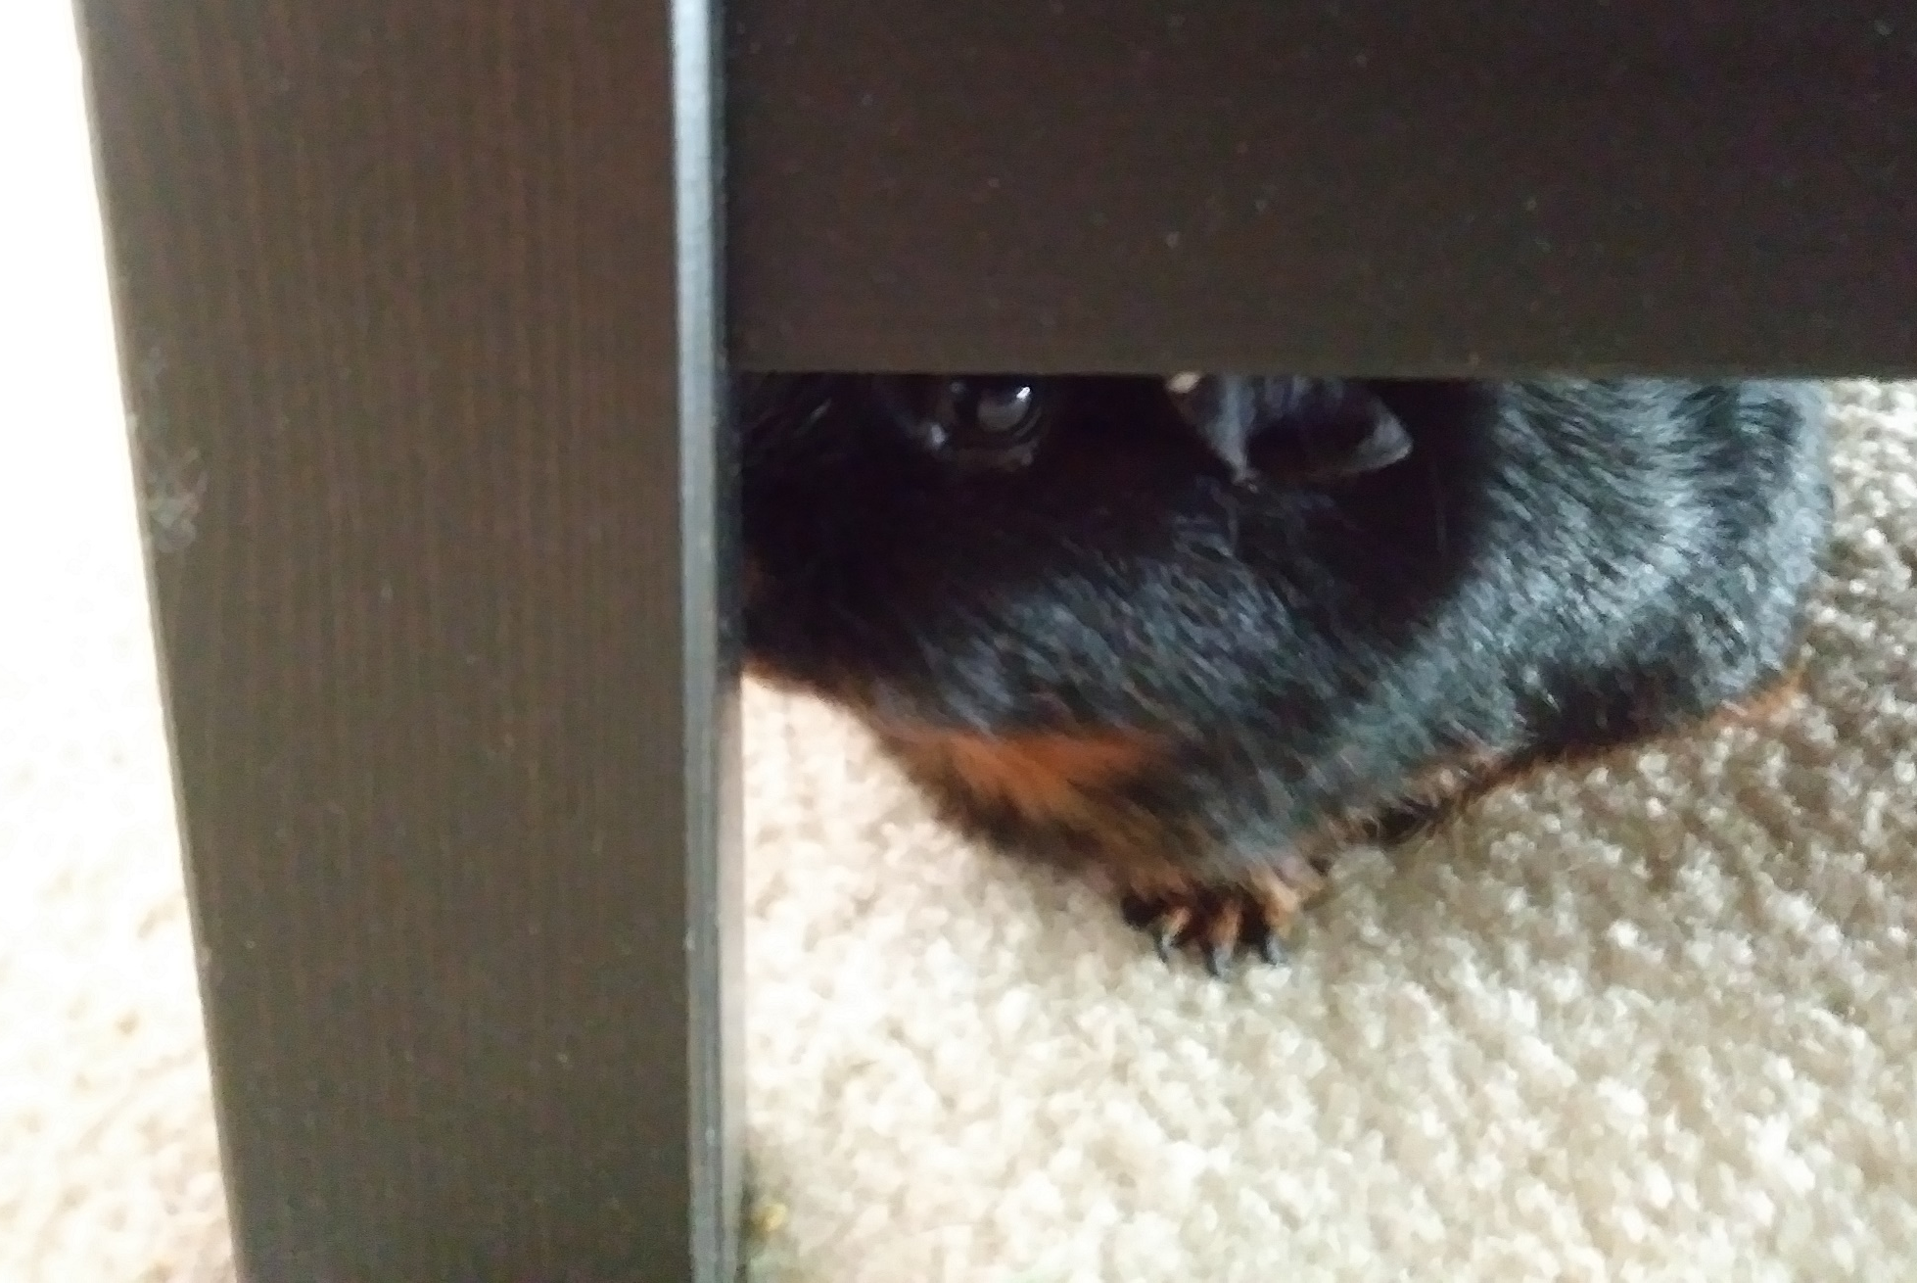
“How are we looking for it?”

Slide 8
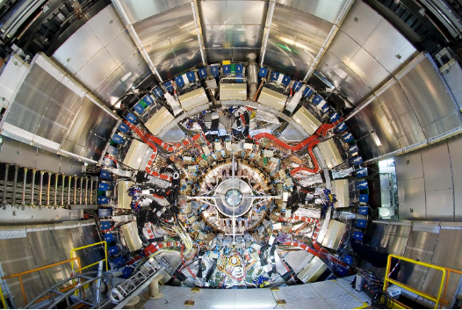
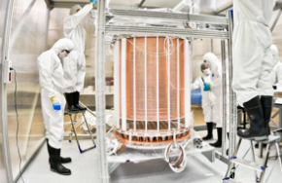
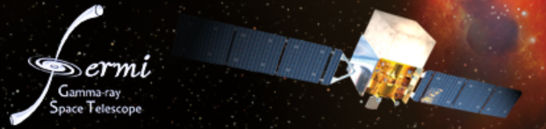
Search Strategies
Complementarity between experiments
Collider
Direct
χ
Indirect
SM
χ
χ
χ
SM
SM
χ
SM
SM
χ
SM

Slide 9
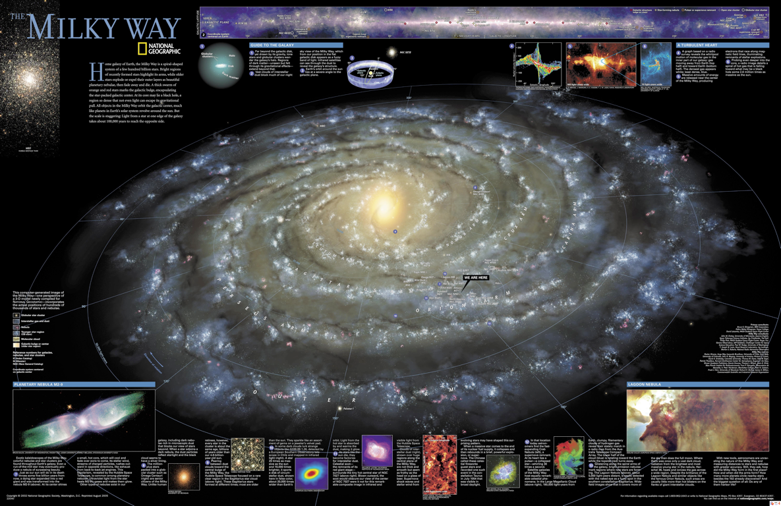
Direct Detection
  Galactic DM collisions with SM particles in detector on Earth
v ~ 270 km/s

Slide 10
Direct Detection
  DM particles collide with SM particles in detector “target” and are absorbed, or cause nuclear and/or electronic recoils
Nuclear Recoil Electron Recoil

Slide 11
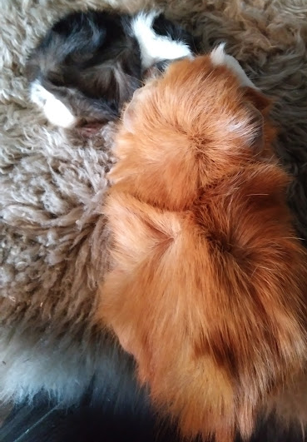
The GeV-Scale & Sub-GeV Detection Challenge
Light DM (~2me) stretches traditional WIMPy direct detection techniques, which rely extensively on inelastic nuclear recoil
Not enough energy transfer
R. Essig
Can’t see recoil of nucleus
proton
mass
11

Slide 12
The GeV-Scale & Sub-GeV Detection Challenge
For ~meV – keV dark mediators, need absorption searches
electron
mass
proton
mass
BRN for DM Small Projects New Initiatives https://www.osti.gov/servlets/purl/1659757
12

Slide 13
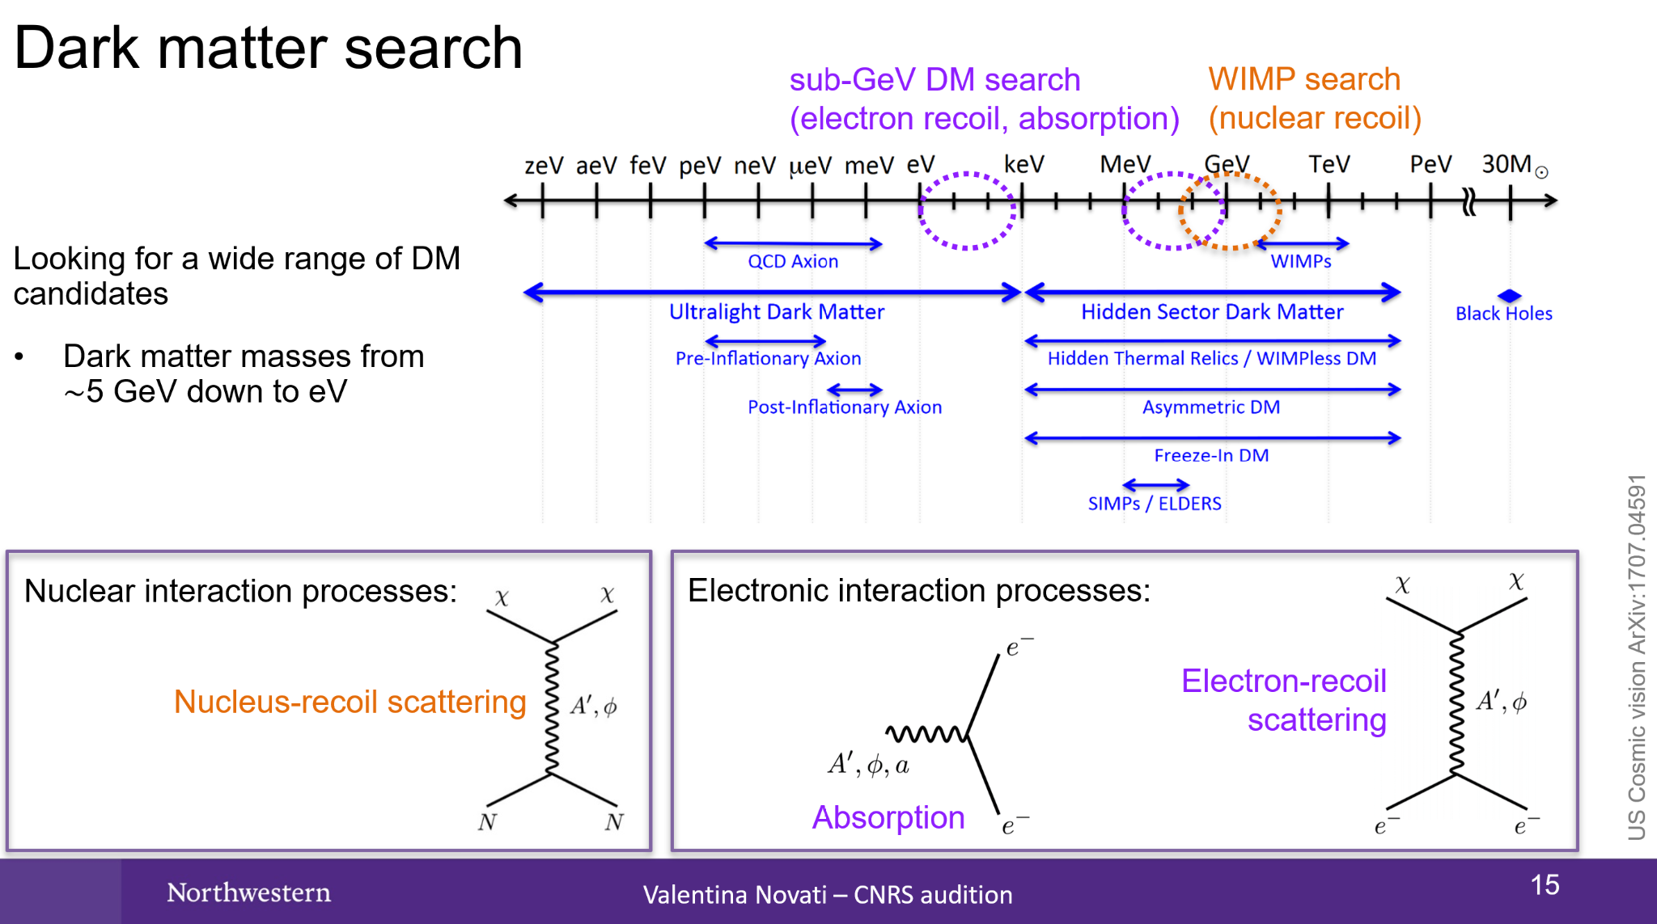
The GeV-Scale & Sub-GeV Detection Challenge
arxiv.org/abs/1707.04591
13

Slide 14
The GeV-Scale & Sub-GeV Detection Challenge
  Lowering mass and/or interaction thresholds
BRN for DM Small Projects New Initiatives https://www.osti.gov/servlets/purl/1659757

Slide 15
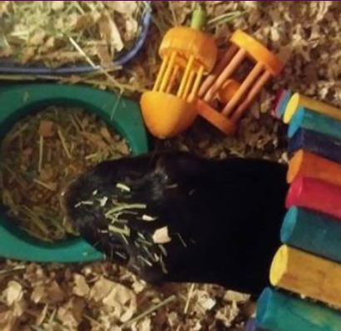
Solid-State Detectors

Slide 16
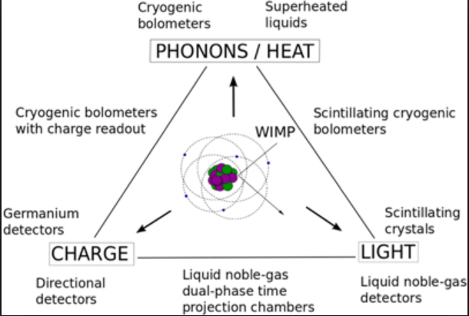
3 Channels for Next-Generation Detectors
Low thresholds
DM
ER vs NR discrimination
https://arxiv.org/abs/1509.08767

Slide 17
Many Next-Generation Detectors are Solid-State
DM
https://arxiv.org/abs/1509.08767

Slide 18
Many Next-Generation Detectors are Solid-State
Categorized by electron recoil energy (ΔE) and m_{DM} detectable:
…
(R&D) (speculative “exotic”)
R. Essig

Slide 19
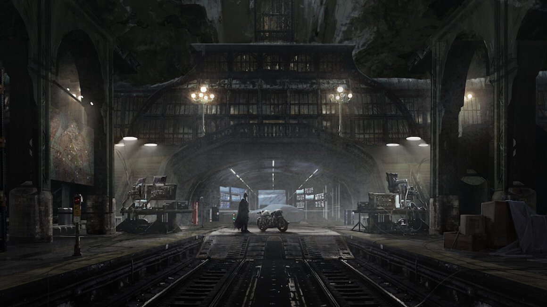
Underground Shielded Secret Lairs
Hide the detectors in shielding and bury them in an underground clean-room.
Why?

Slide 20
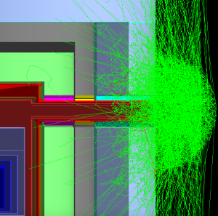
Underground Shielded Secret Lairs
Backgrounds, backgrounds, backgrounds!
Cosmogenic
Cosmic ray muons
Spallation neutrons
Activated materials
Environmental
Airborne radon & daughters
Radio-impurities in materials

Slide 21
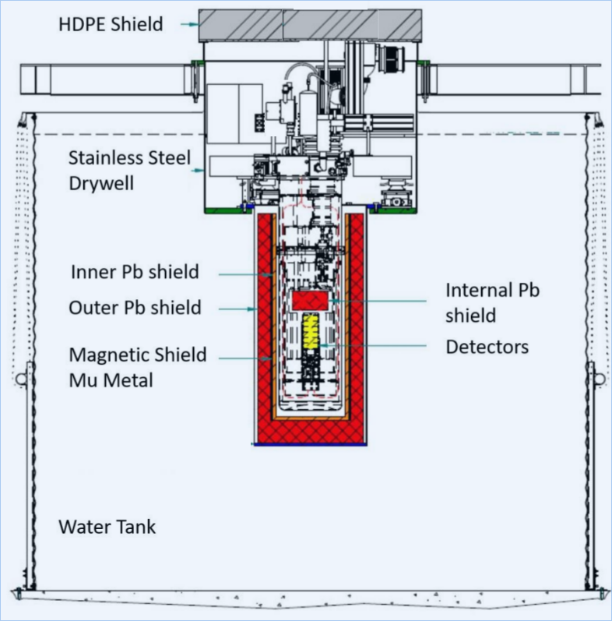
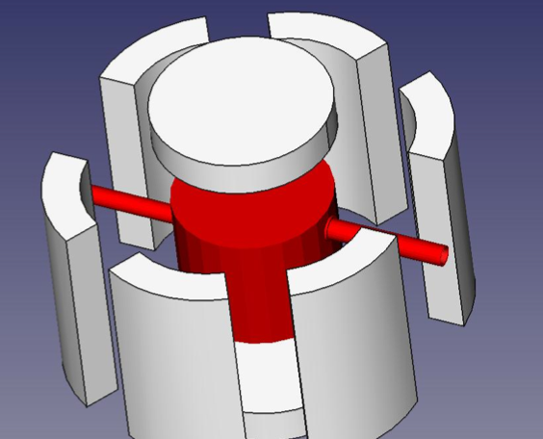
Backgrounds, Backgrounds, Backgrounds…
Often required:
Multiple shielding layers for various backgrounds
Passive
Active, a.k.a. vetoes
…
n
Cryogenic Underground Test (CUTE) facility @ SNOLAB

Slide 22
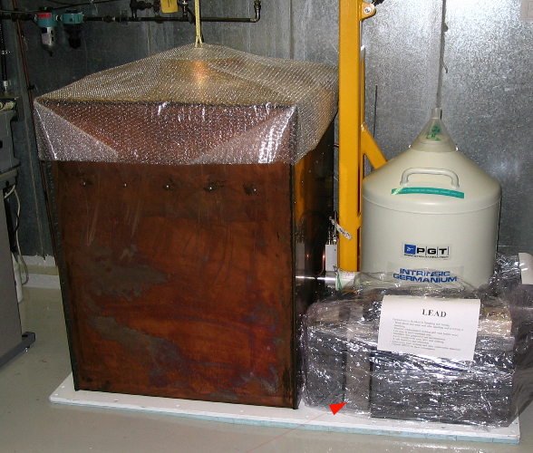
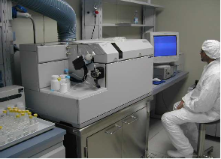
Backgrounds, Backgrounds, Backgrounds…
Often required:
Multiple shielding layers for various backgrounds
Simulations and/or material assays
  Measuring isotope contamination at ppb level is challenging
  Simulating sufficient statistics of particles traversing all the shielding is time-consuming, e.g. importance biasing techniques in GEANT4 (arXiv:2503.00585)
HP Ge detector at SNOLAB
ICP Mass Spectrometer at LNGS

Slide 23
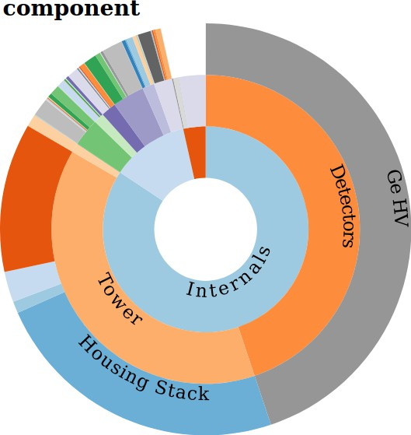
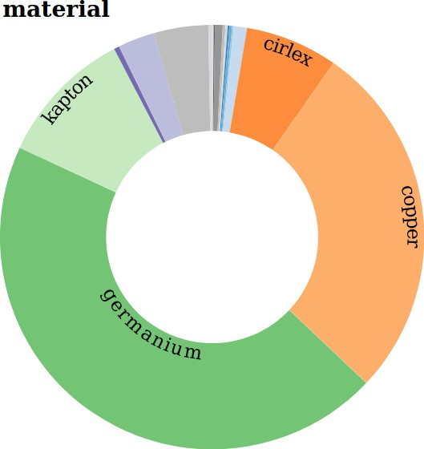

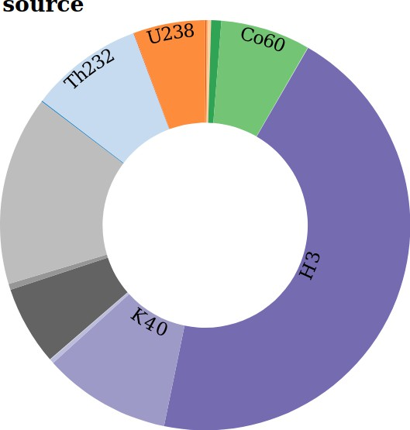
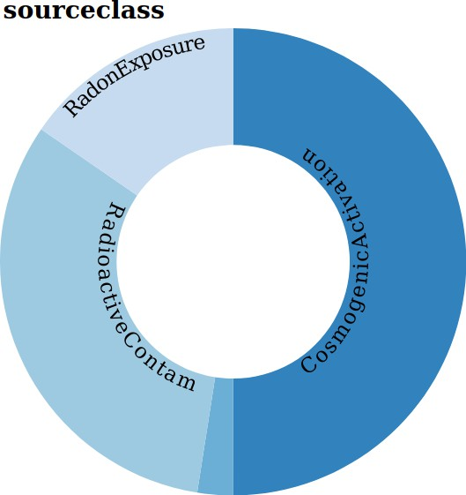
Backgrounds, Backgrounds, Backgrounds…
Often required:
Multiple shielding layers for various backgrounds
Simulations and/or material assays
Backgrounds tracking/estimations system
e.g.
https://github.com/bloer/bgexplorer
Creates bg estimate based on material assay & simulation results
Visualizes bg contributions in pie charts, spectra, tables
Enables easy identification of dominating BGs

Slide 24
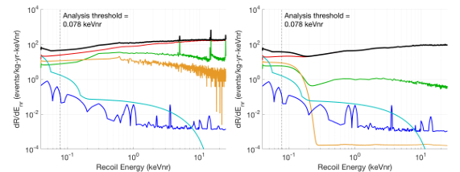
Backgrounds, Backgrounds, Backgrounds…
Often required:
Multiple shielding layers for various backgrounds
Simulations and/or material assays
Backgrounds tracking/estimation system
Set of event selection criteria
e.g. SuperCDMS HV Si detectors, before / after analysis cuts
Black: total projected bg spectrum
Red: electron recoils from Compton gamma-rays, H, Si
Green: surface betas
Orange: surface Pb recoils
Blue: neutrons
Cyan: CEvNS

Slide 25
Charge-Coupled Devices (Semiconductor Pixels)
Take a photo of DM interactions, like with your cellphone camera!
Ionization events induced by DM (instead of photons) in bulk Si of CCD pixels
See talk by Ana Martina Botti:
https://indico.global/event/551/contributions/129399/
DAMIC (Dark Matter in CCDs)
SENSEI (Sub-Electron-Noise Skipper-CCD Experimental Instrument)
OSCURA (Observatory of Skipper CCDs Unveiling Recoiling Atoms)

Slide 26
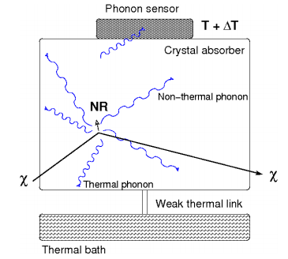
Cryogenic Crystals
Calorimetry rather than tracking/imaging
Operated at a few or tens of mK
Collect phonons…
https://arxiv.org/abs/1509.08767

Slide 27
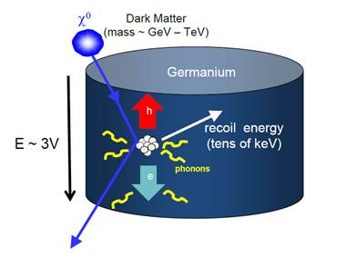
Cryogenic Crystals
Calorimetry rather than tracking/imaging
Operated at a few or tens of mK
Collect phonons… plus possibly electrons or photons
Reflective & scintillating housing
Phonon sensors + electrodes
OR
E
light sensors
phonon sensors
https://arxiv.org/abs/1904.00498

Slide 28
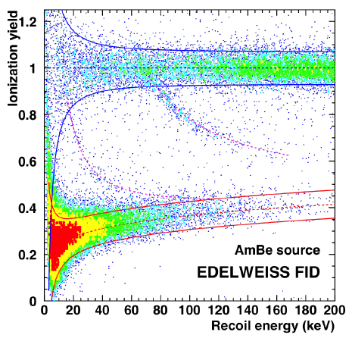
Cryogenic Semiconductor Crystals
Ratio of energy in phonon vs ionization channels allows NR vs ER discrimination
e.g. Si or Ge crystals, using Transition Edge Sensors or Neutron Transmutation Doped Sensors + High Electron Mobility Transistors
ER
NR
EDELWEISS (Expérience pour Detecter Les WIMPs En Site Souterrain) @ Modane
SuperCDMS “iZIP”
https://arxiv.org/abs/1706.01070

Slide 29
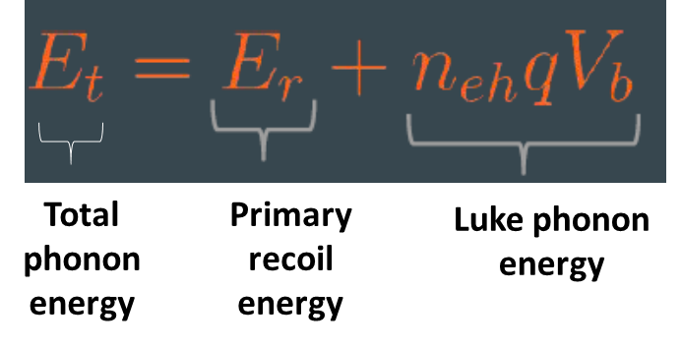
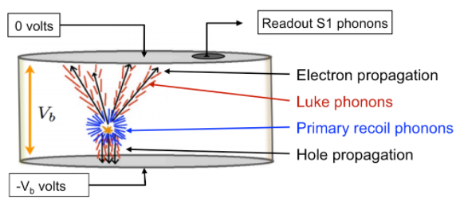
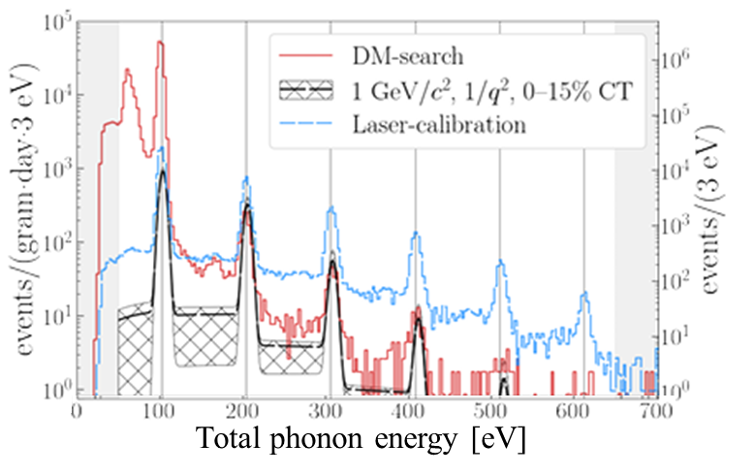
Cryogenic Semiconductor Crystals: Charge Amplification
Drifting charges across a V_{b} generates cascade of “Luke phonons”
Lowers recoil energy threshold
With few eV phonon resolution, see single e⁻-hole pairs
But “true calorimetry” and NR vs ER discrimination lost
Si / Ge
See talk by Matt Stukel:
https://indico.global/event/551/contributions/130120/
SuperCDMS “HV” & “HVeV”
https://arxiv.org/abs/2005.14067

Slide 30
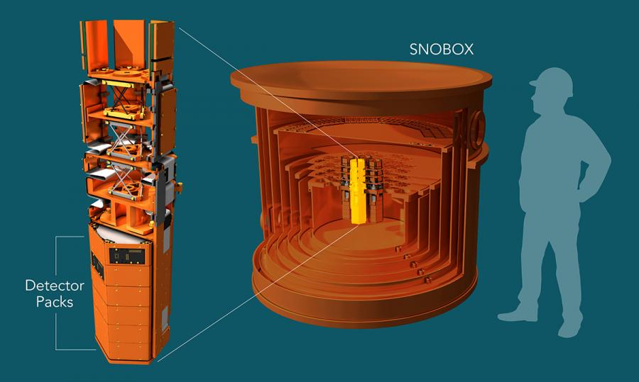
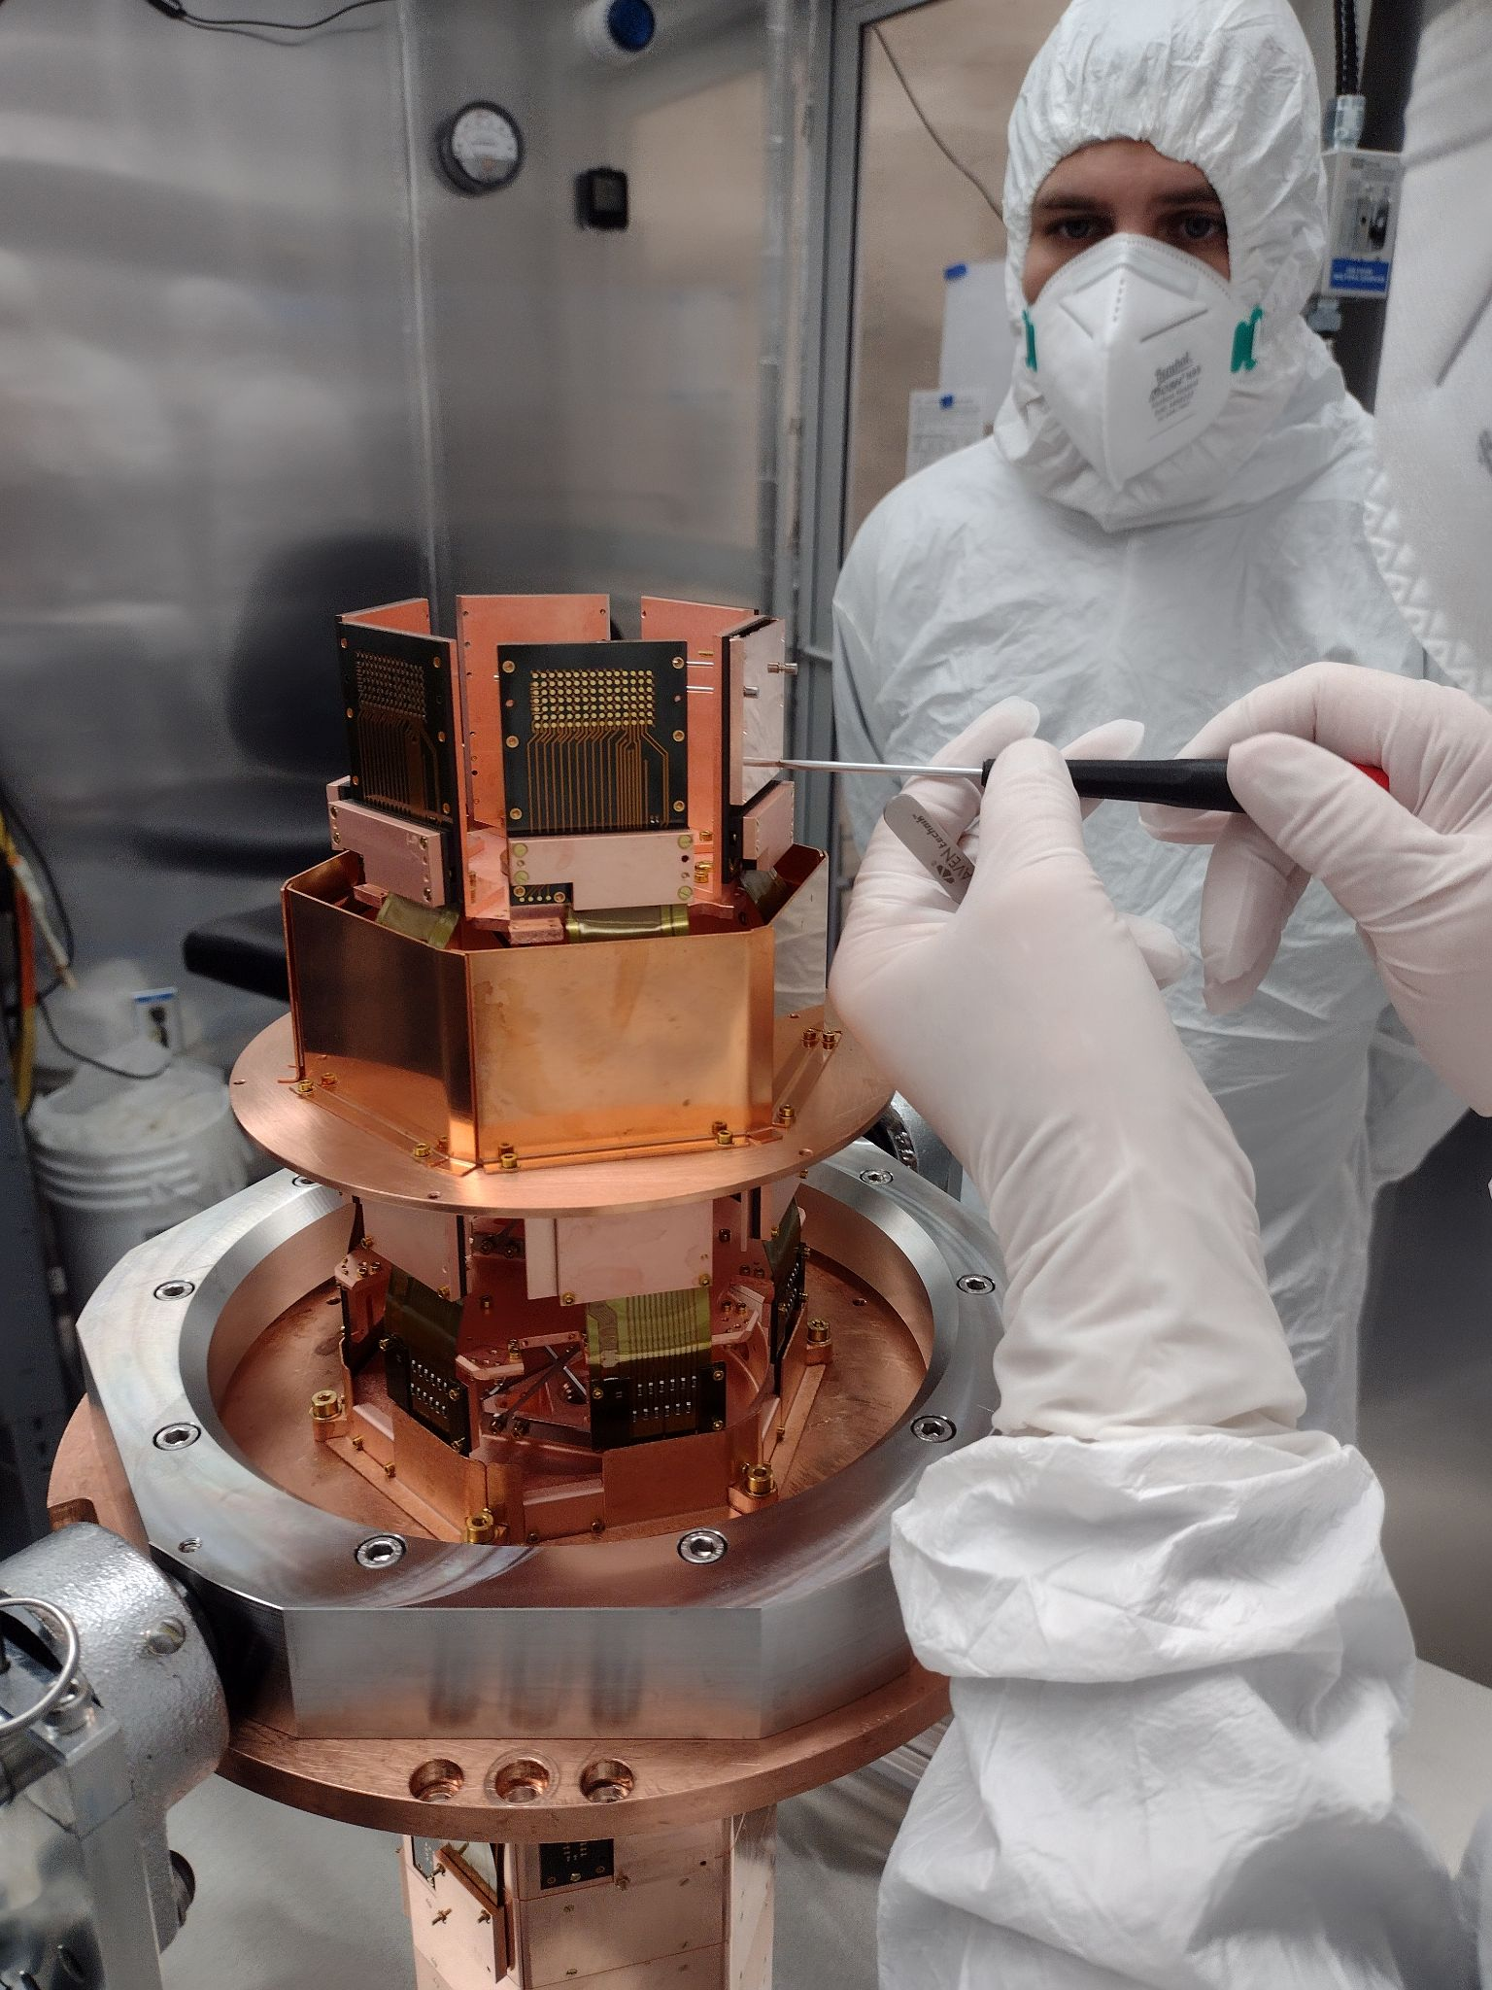
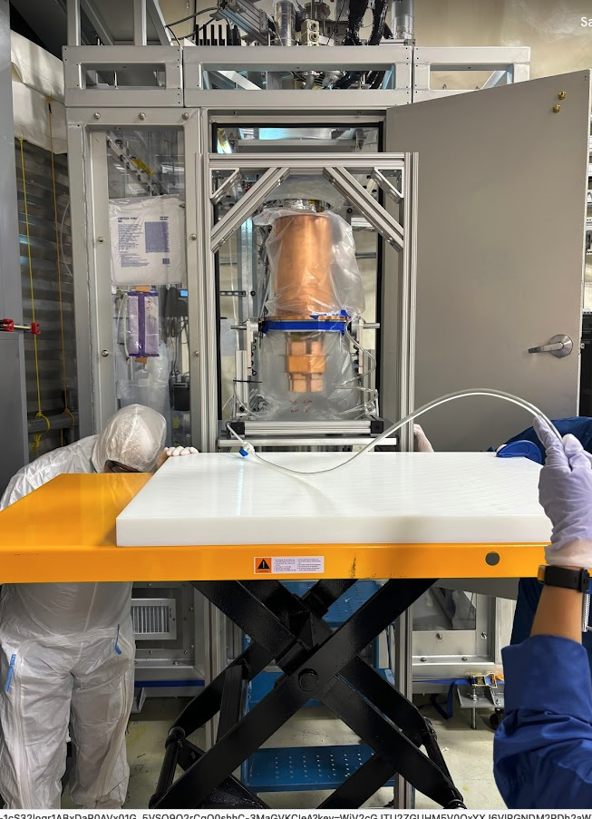
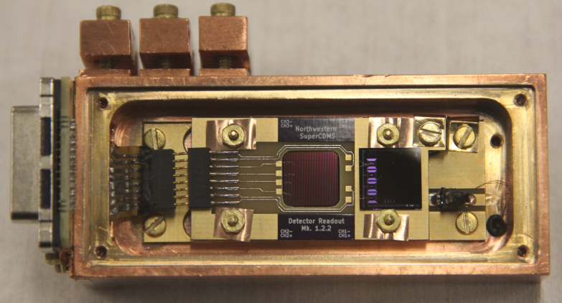
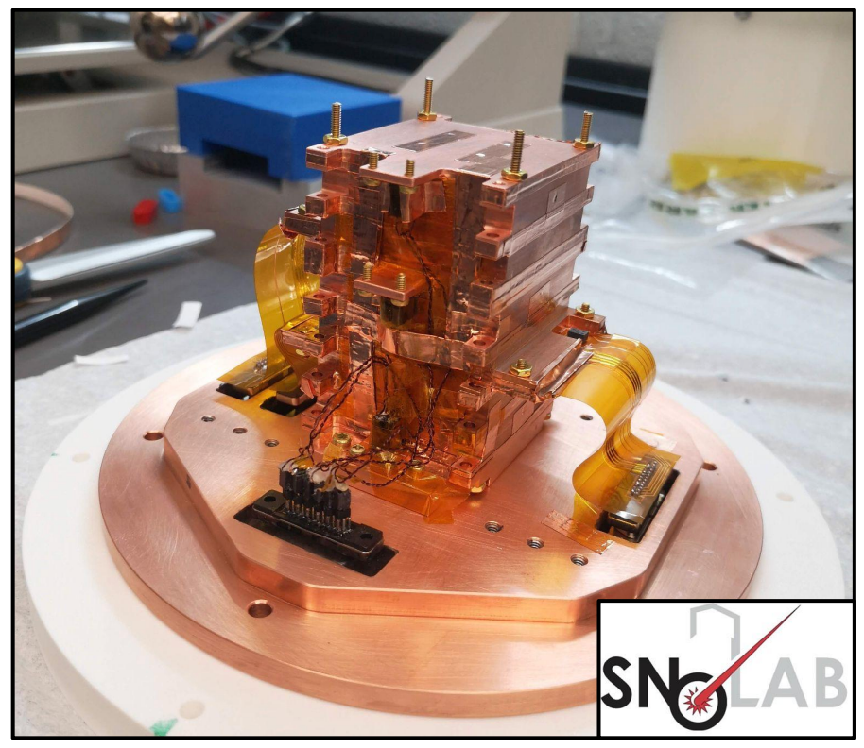
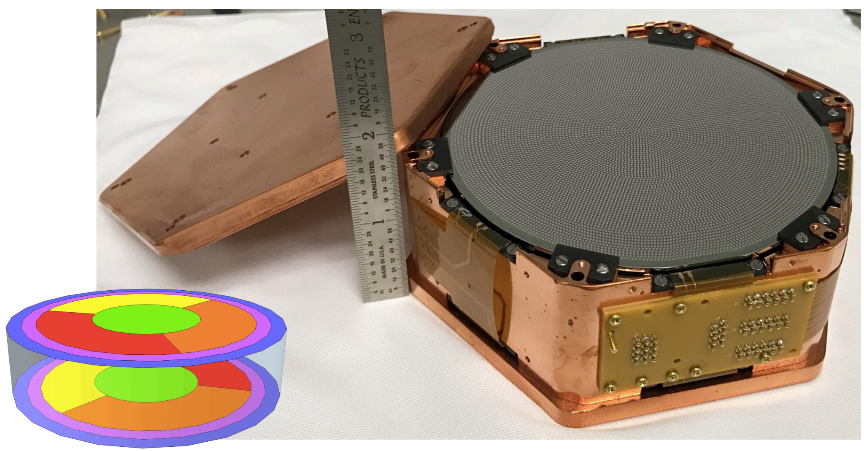
Cryogenic Semiconductor Crystals: Charge Amplification
“HV” Si & Ge: kg-scale devices
“CPD”, “HVeV” Si: gram-scale “prototype” devices
See talk by Matt Stukel:
https://indico.global/event/551/contributions/130120/

Slide 31
Cryogenic Scintillating Crystals
Ratio of energy in phonon vs light channels allows ER & gammas vs NR discrimination
e.g. CaWO₄ crystals
See talk by Colin Moore:
https://indico.global/event/551/contributions/125319/
β/γ
NR oxygen
NR tungsten
CRESST-III (Cryogenic Rare Event Search with Superconducting Thermometers) @LNGS
https://arxiv.org/abs/1904.00498

Slide 32

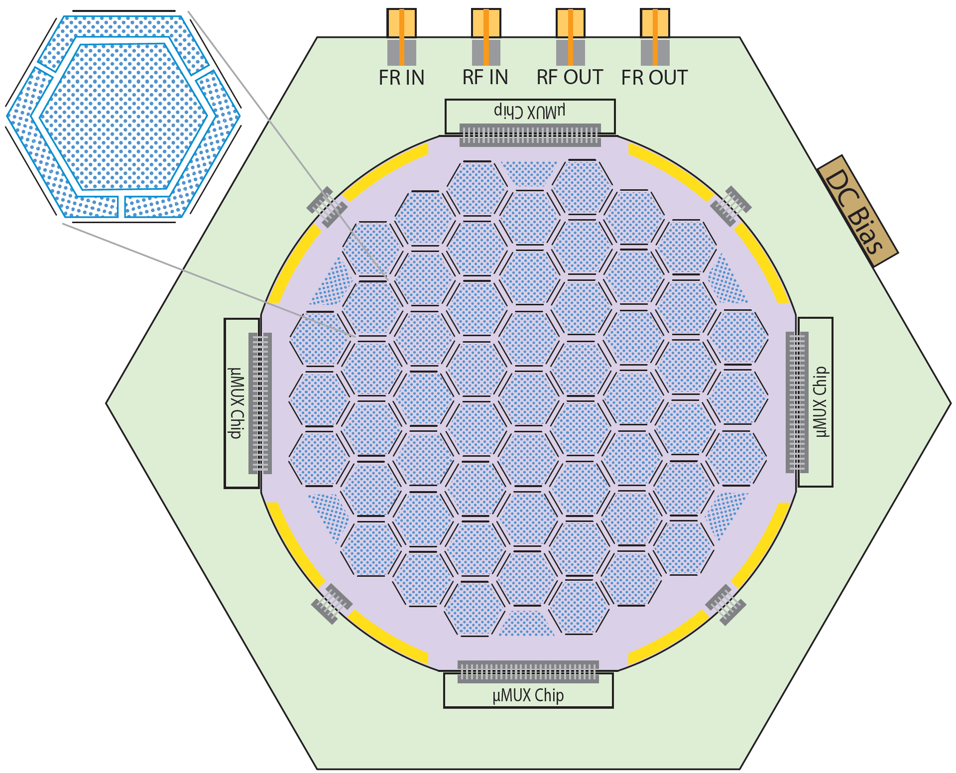
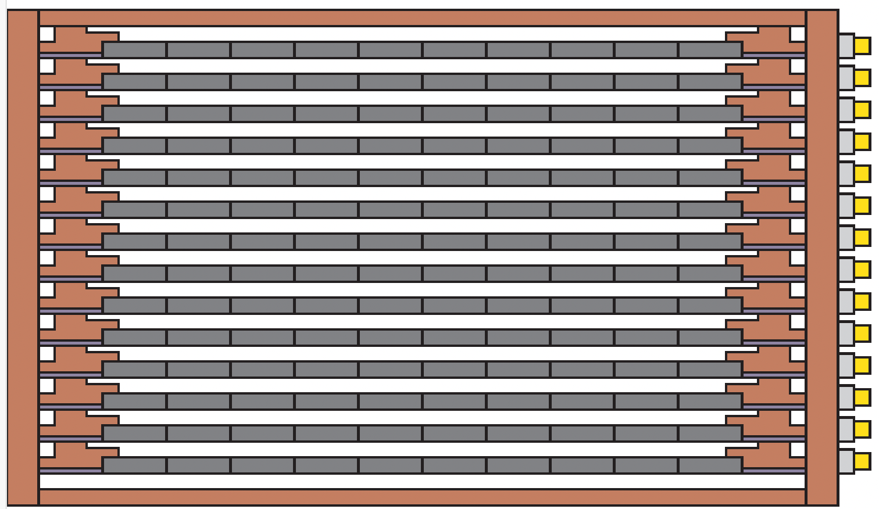
Examples of R&D Underway
Si HVeV with SiO₂ surface layer
HVeV with Ge, SiC, diamond, …
Scaled-up HVeV with upgraded fabrication & readout
Multiple HVeVs together on “wafer”, separated by Deep Reactive Ion Etching trenches
Multiplexing readout with multi-stage cryogenic amplifiers
Stacking wafers for “active vetoing” of each other, ~10 kg payload
“Honeycomb” Proposal
32

Slide 33
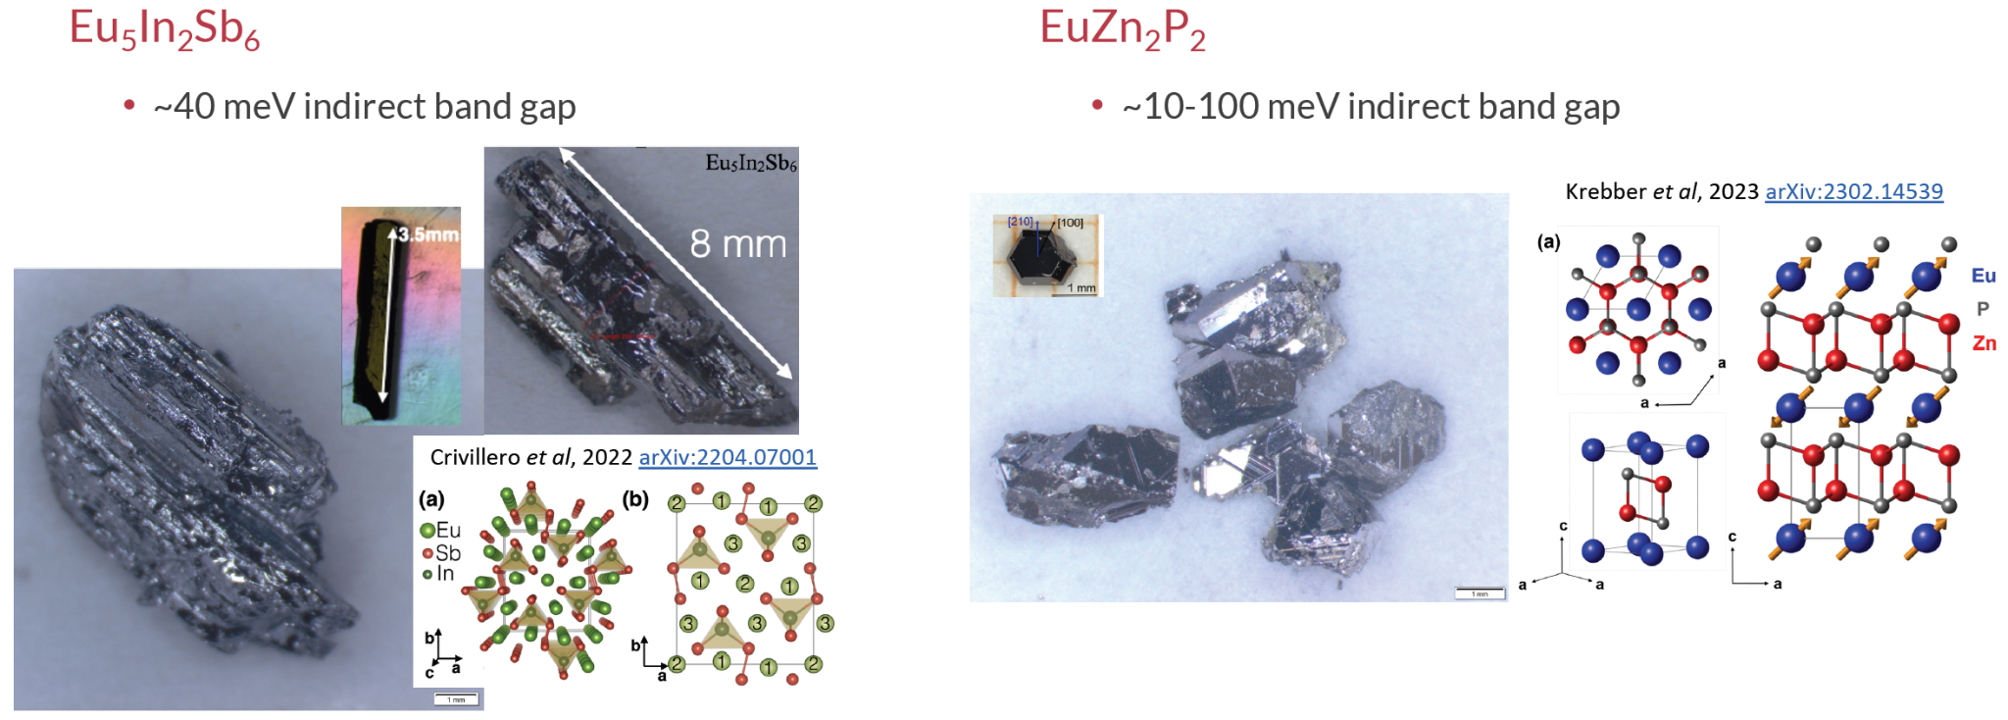
Examples of R&D Underway
Anisotropic crystals for directional discrimination
“Splendor” (Search for Particles of Light dark matter with Narrow-gap Semiconductors) proposal
arXiv:2311.02229

Slide 34
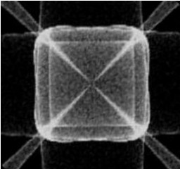
Some Notable Challenges
Simulating detector response
  e.g. G4CMP (Geant4 Condensed Matter Physics, arXiv:1403.4984) package for charge carrier & phonon production/transport in cryogenic crystals
Vibrational isolation
  e.g. suspension system to decoupling cryostat from fridge pulse tubes
  e.g. seismic platform
Electronics readout noise
Remote operations
  Reliable connections to underground equipment
  Alarms for failures that put the “cry” in “cryogenics”
Keeping everything clean
  Sourcing components from radiopure materials (e.g. radiopurity.org)
  Dust & radon control measures required? Underground cleanroom?
Calibrations
  Placing sources inside or outside cryostat
  Activating detectors during calibration runs?
  How to handle very low energies?

Slide 35
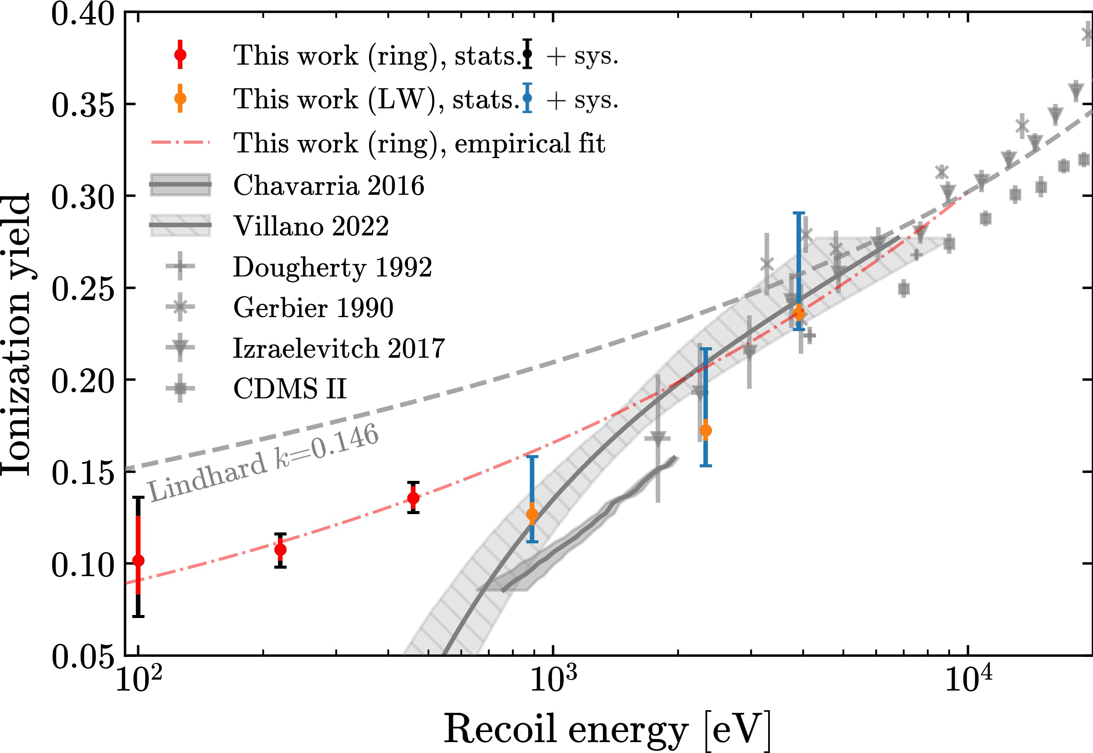
Some Notable Challenges
Ionization yield in low-energy nuclear recoils
  e.g. IMPACT for silicon (arXiv:2303.02196) found significant deviations from Lindhard Model
E_{t} = E_{r} + (N_{eh} · e · V_{b} )
= E_{r} · (1 + e · V_{b} /𝜀_{pair} · Y (E_{r} ))

Slide 36
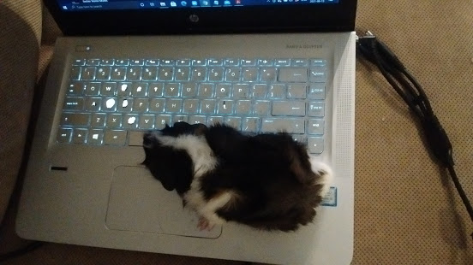
Recent Results

Slide 37
Trying to Shed Light on Low-Energy Backgrounds
Low-energy background events, of unknown origin, observed in:
  XENON1T, DarkSide-50 (liquid nobles)
  SENSEI, DAMIC, SuperCDMS, EDELWEISS, CRESST-III (solid-state)
EXCESS workshop series (2021 -)
Possible explanations in solid-state detectors include:
Cherenkov / transition radiation
Cracking/micro-fracturing of crystals, stress from holders
Luminescence & phonons from recombination
https://arxiv.org/abs/2011.13939

Slide 38
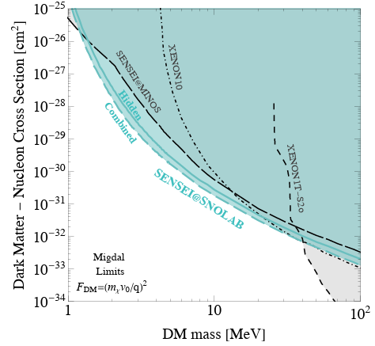
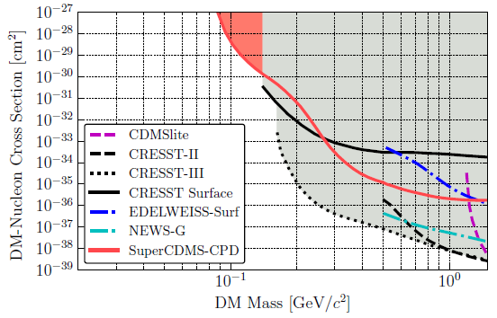
Nuclear Recoil Limits
https://arxiv.org/abs/2007.14289
https://arxiv.org/abs/2312.13342

Slide 39
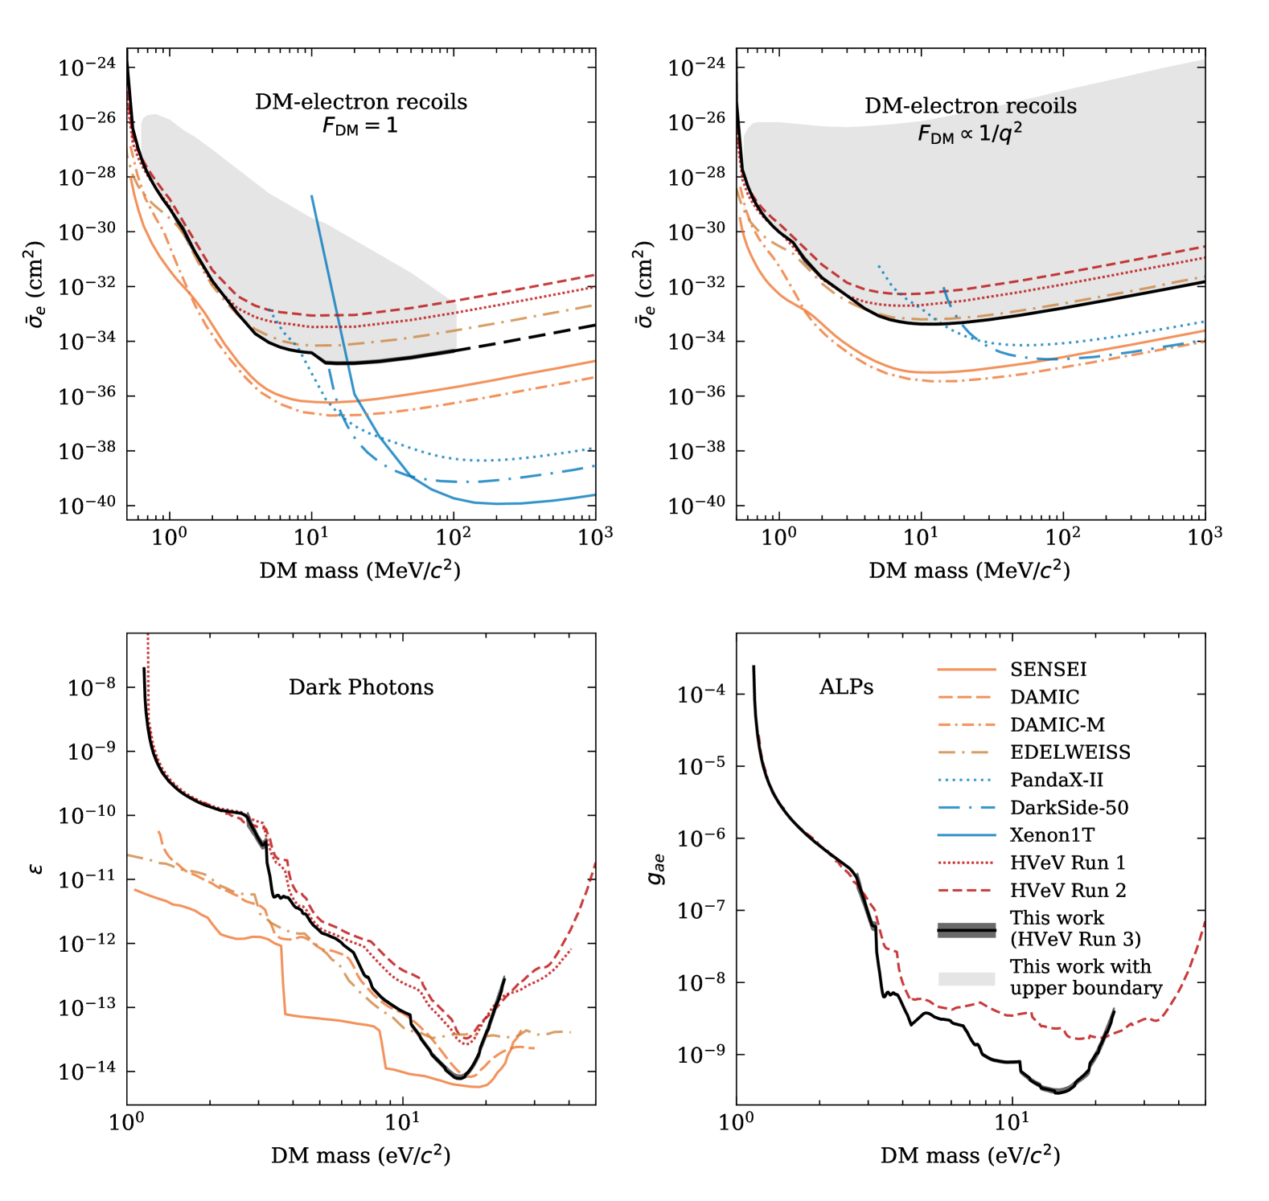
Electron Recoil Limits
kinetic mixing
https://arxiv.org/abs/2407.08085

Slide 40
Dark Absorption
See talk by Matt Stukel:
https://indico.global/event/551/contributions/130120/
kinetic mixing
https://arxiv.org/abs/2407.08085

Slide 41
Come to the (Solid) Dark Side, We Have Chocolate Cookies
Direct detection of WIMP-like DM at GeV- and sub-GeV scale, through nuclear and/or electron recoils, is a well-motivated challenge
Especially when accompanied by searches for low-mass mediators, at eV - keV scale, through dark absorption
Solid-state technologies, including charge-coupled devices and cryogenic semiconductor / scintillating crystals, provide many advantages for such searches …
… As demonstrated in recent world-leading limits on low-mass NR, ER, dark photons, axion-like particles, …
Including prototype and R&D devices, promising further discovery potential in the near future

Slide 42
BACKUP

Slide 43
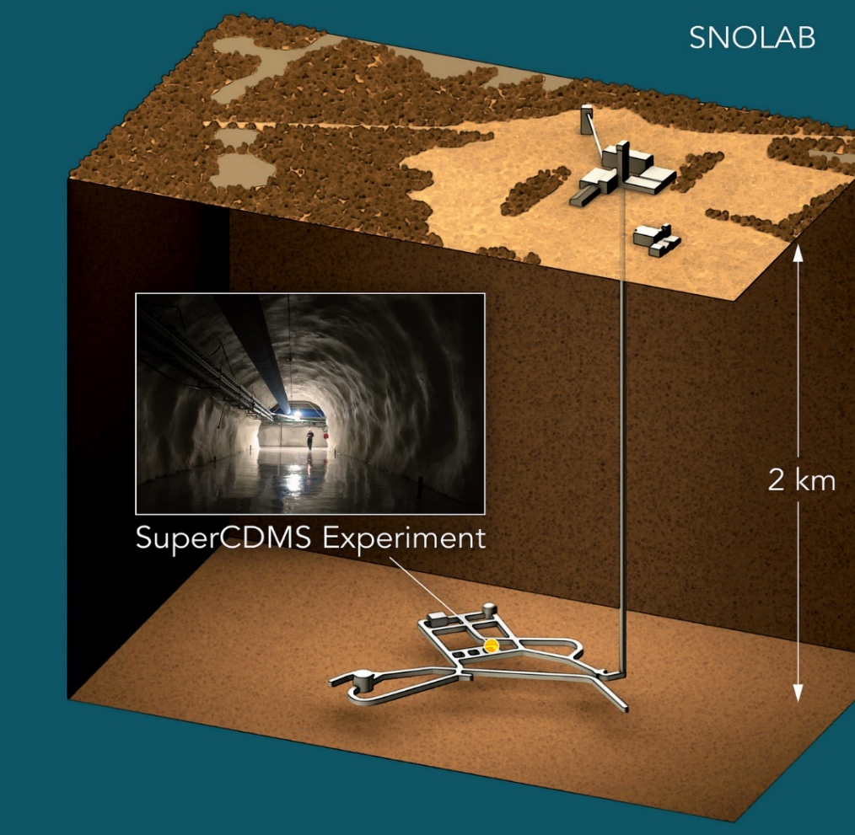
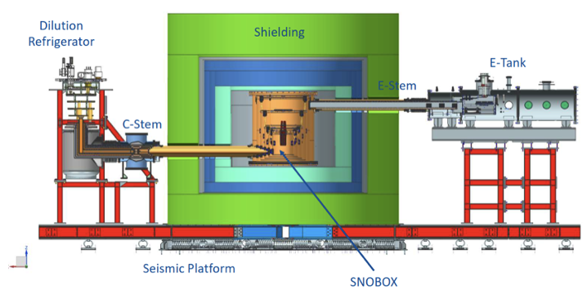

SuperCDMS (Super Cryogenic Dark Matter Search)
Operated in a Soudan, Minnesota underground lab until 2015
More powerful version now being constructed in Canada’s world-leading astroparticle physics facility, 2 km underground in the Vale Creighton Mine near Sudbury

Slide 44
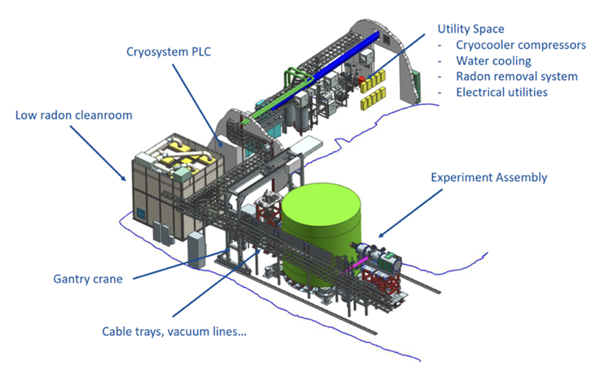
SuperCDMS (Super Cryogenic Dark Matter Search)
Operated in a Soudan, Minnesota underground lab until 2015
More powerful version now being constructed in Canada’s world-leading astroparticle physics facility, 2 km underground in the Vale Creighton Mine near Sudbury

Slide 45
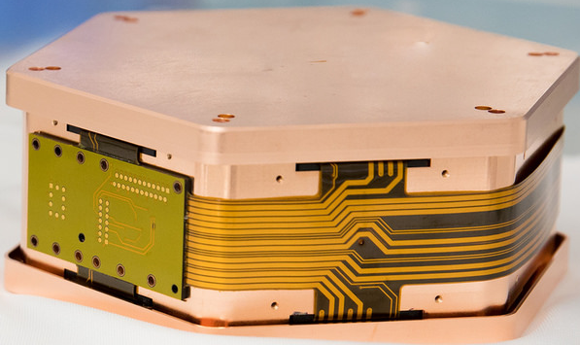
SuperCDMS@SNOLAB
kg-scale Si and Ge detector modules
6 modules per “tower”, 4 “towers” in cryostat

Slide 46




Cryogenic Semiconductor Crystals
SuperCDMS

Slide 47

Charge Channels: High Electron Mobility Transistors
Low-noise amplifiers to read out small ionization signals
Ge or Si

Slide 48
Phonon Channels: Transition Edge Sensors + SQUIDs
Phonon energy deposits cause TESs operated near critical temp to transition from superconducting to normal state
Signal amplification by Superconducting Quantum Interference Devices

Slide 49
New in SuperCDMS: Phonon Signal Amplification
Drifting charges across a V_{b} generates cascade of “Luke phonons”
Lowers recoil energy threshold
But “true calorimetry” and NR vs ER discrimination lost
Si / Ge
Total phonon energy
Primary recoil energy
Luke phonon energy

Slide 50

CUTE (Cryogenic Underground TEst) Facility @SNOLAB
One tower now being tested in CUTE user facility
Calibrations
Detector response
Background measurements
“Early science data”!
https://arxiv.org/abs/2310.07930

Slide 51

SuperCDMS@SNOLAB Sensitivity Projections
Spin-independent nucleon-coupled DM
Already
excluded
Projection for setup under construction
Possible with near-term upgrades
Possible with longer-term upgrades
Neutrino fog
arxiv.org/abs/2203.08463

Slide 52

SuperCDMS@SNOLAB Sensitivity Projections
Dark Photon Axion-Like Particle DM
Already
excluded
Already
excluded
arxiv.org/abs/2203.08463

