Slide 1
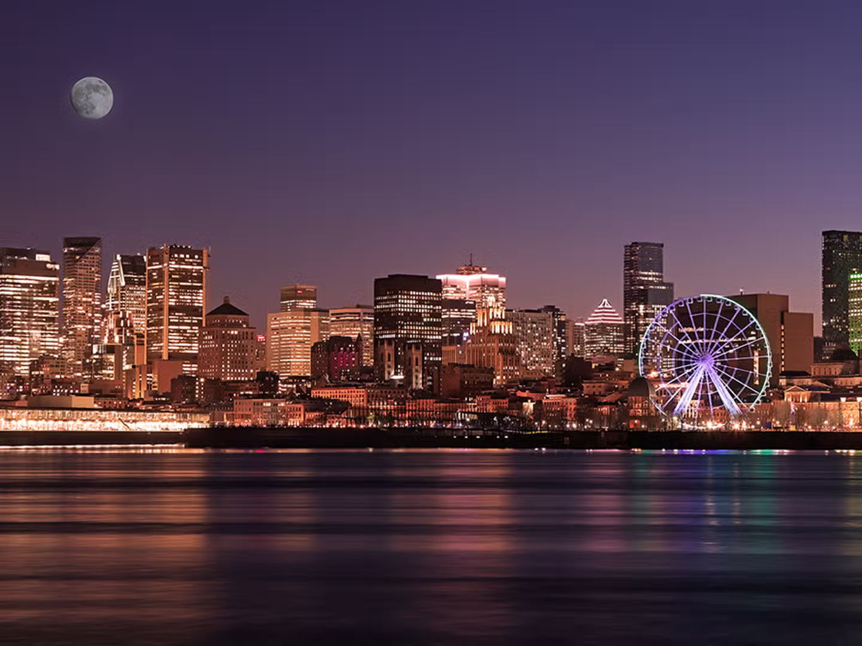
Listening to the Dark Universe:
Experimental Searches for Axion Dark Matter
Dark Side of the Universe 2025
2025. 07. 11. University of Montreal
SungWoo YOUN
Dark Matter Axion Group (DMAG)
Institute for Basic Science (IBS)

Slide 2

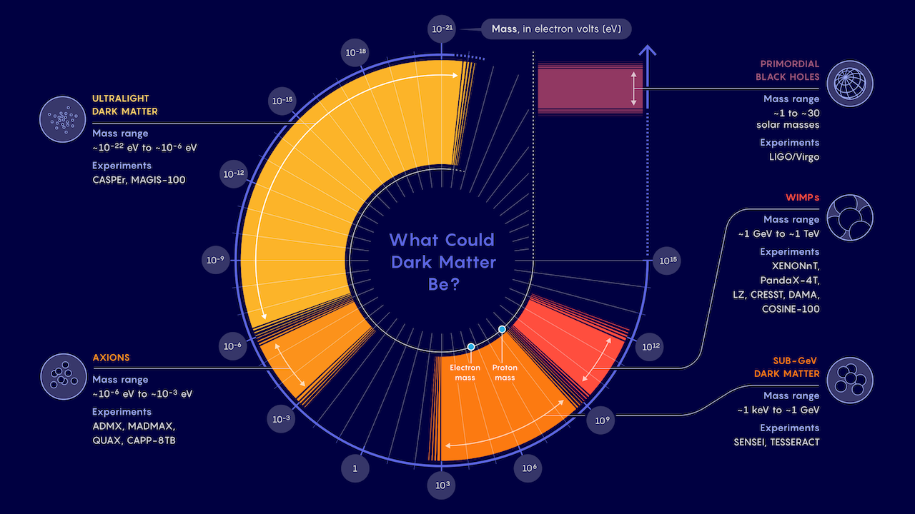
Dark matter business is expanding
WIMPs may be down, but not out
Strong CP problem
&
Dark Matter
Samuel Velasco/Quanta Magazine

Slide 3
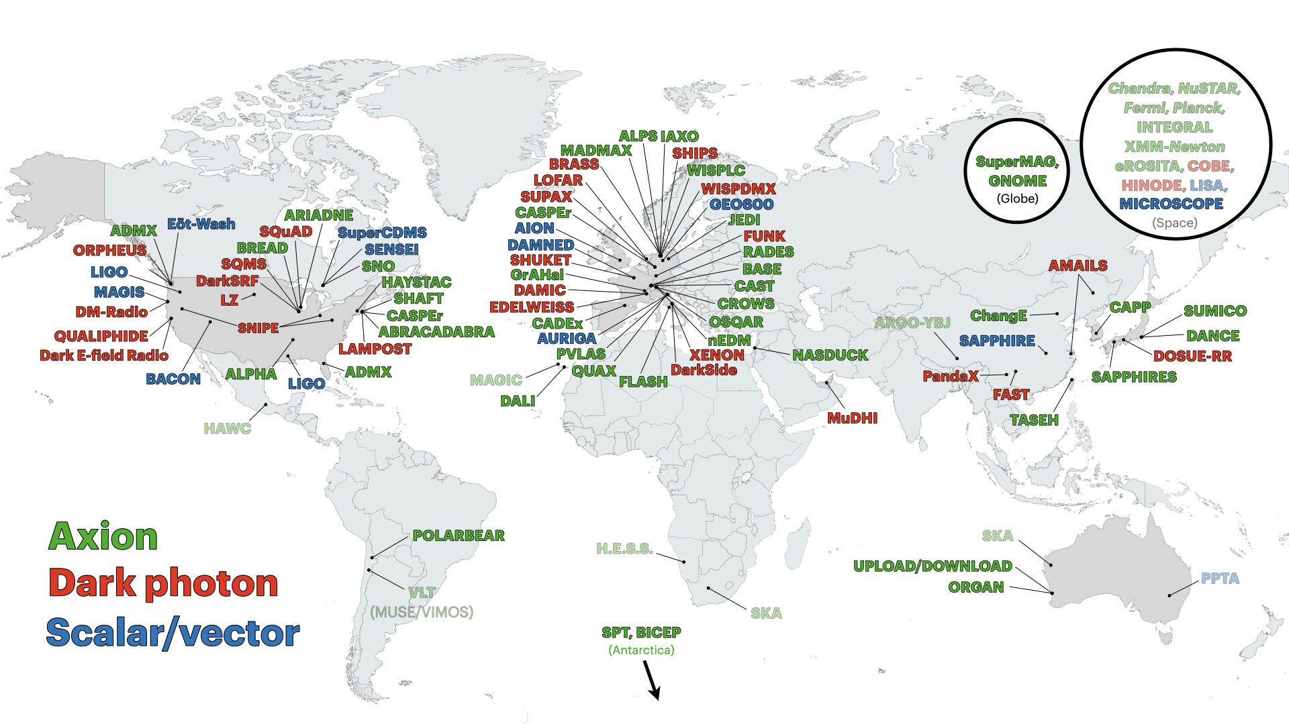
Experiment map
C. O’Hare (2020)

Slide 4
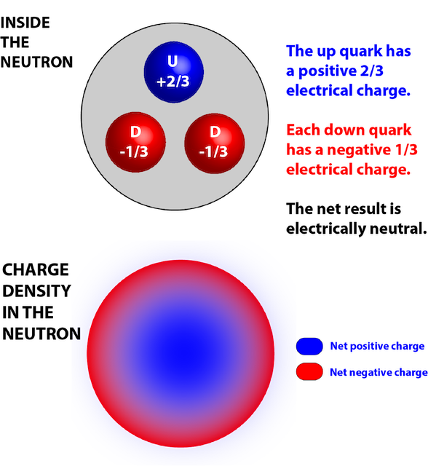
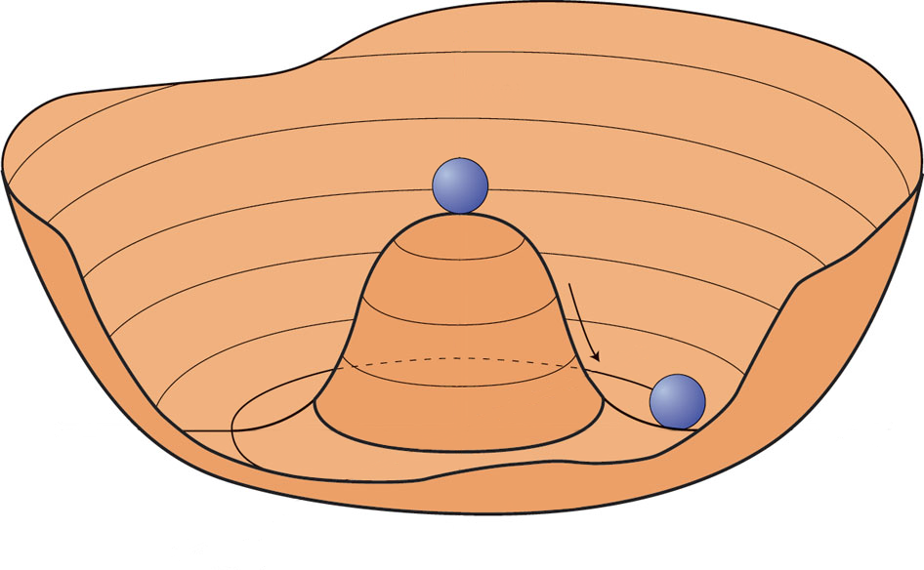
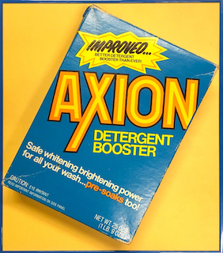
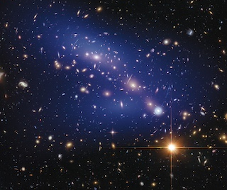

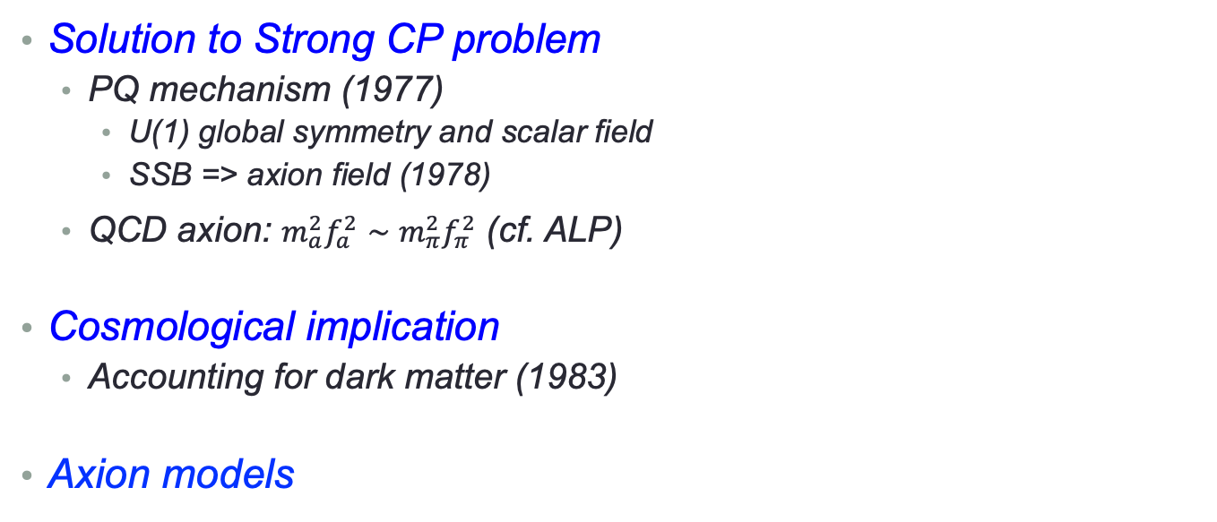
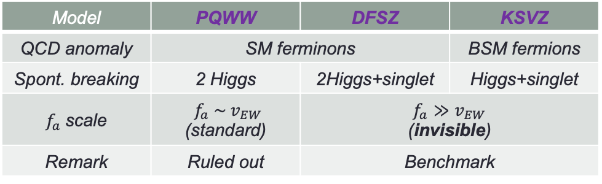

Axion
Absence of nEDM
Solution to Strong CP problem
  PQ mechanism (1977)
    U(1) global symmetry and scalar field
    SSB => axion field (1978)
  QCD axion: $m_{a}^{2}f_{a}^{2}∼m_{π}^{2}f_{π}^{2}$ (cf. ALP)
Cosmological implication
  Accounting for dark matter (1983)
Axion models
vs.
$$L_{QCD}∋θ\frac{α_{s}}{32π}G\tilde{G}$$
$$⟹ \left[θ−\frac{a(x)}{f_{a}}\right]\frac{α_{s}}{32π}G\tilde{G}$$
Spontaneous Symmetry Breaking & Axion
Goldstone boson
$a(x)=θ×fa$ at minimum
Model | PQWW | DFSZ | KSVZ
QCD anomaly | SM ferminons |  | BSM fermions
Spont. breaking | 2 Higgs | 2Higgs+singlet | Higgs+singlet
$f_{a}$scale | $f_{a} \sim v_{EW}$ (standard) | $$f_{a}≫v_{EW}$$ (invisible)
Remark | Ruled out | Benchmark

Slide 5
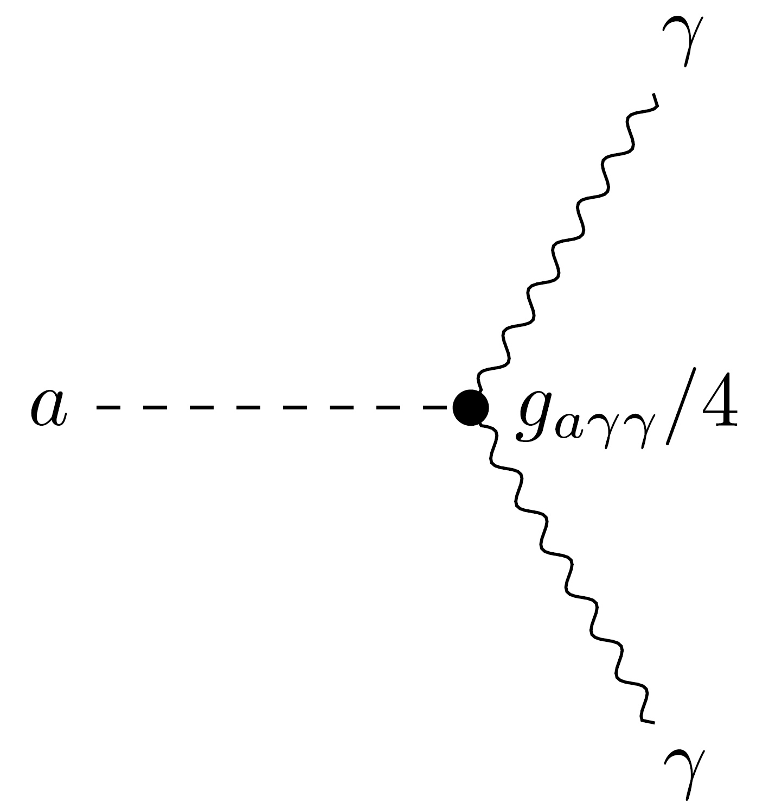
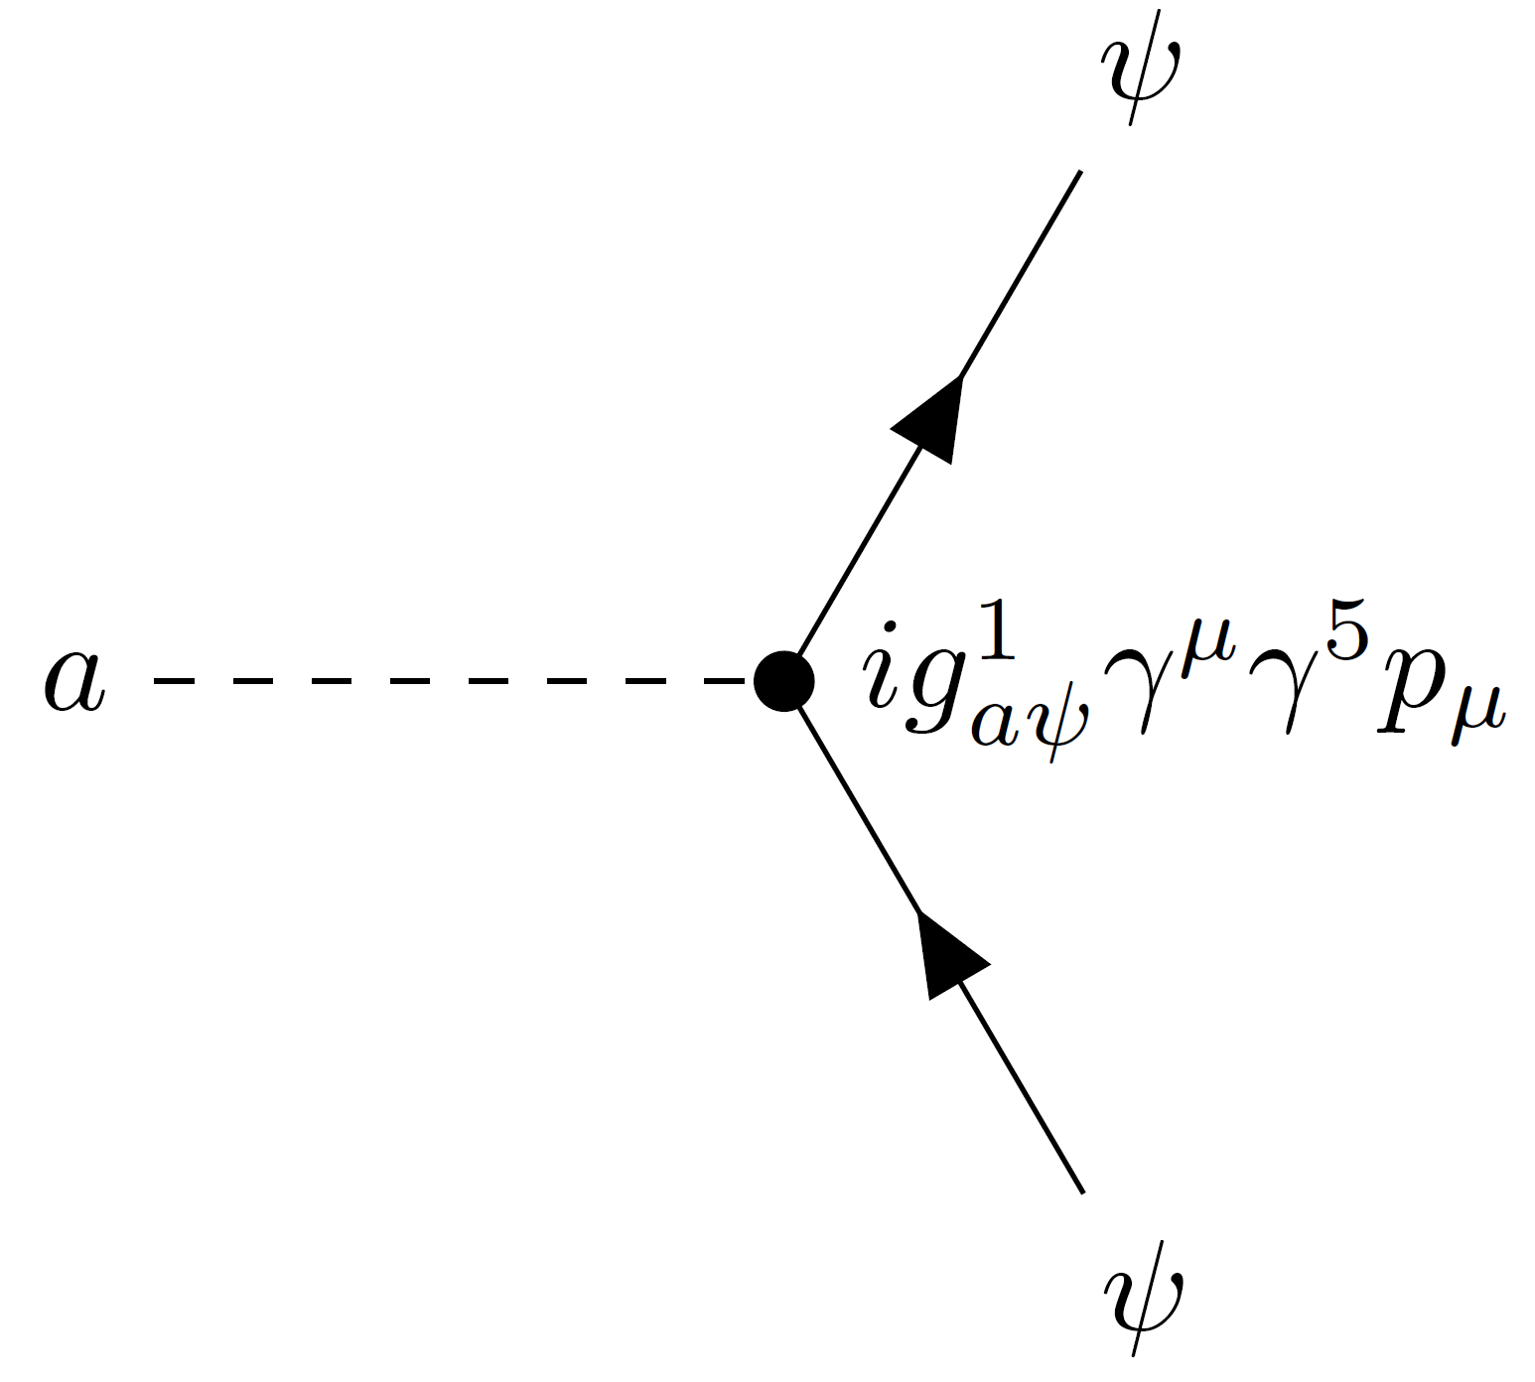
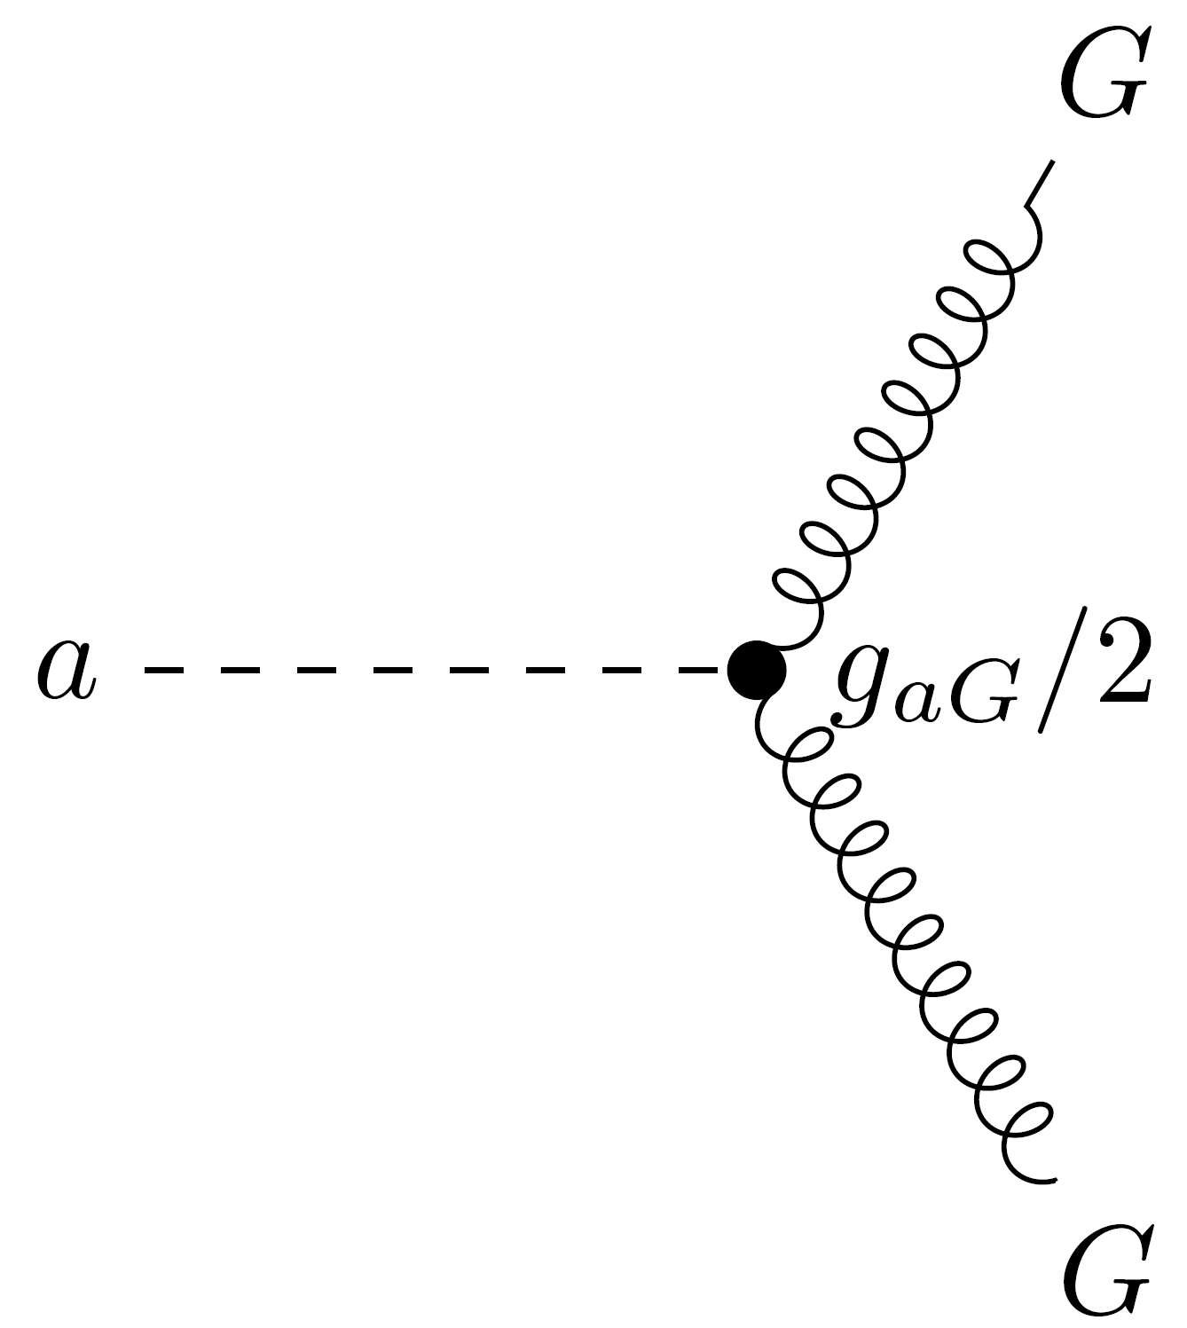
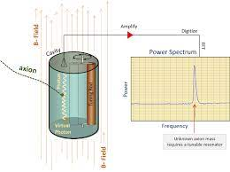
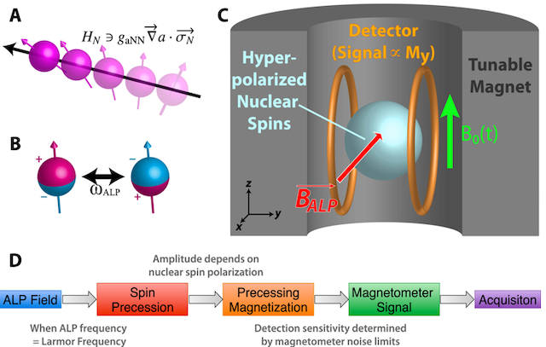
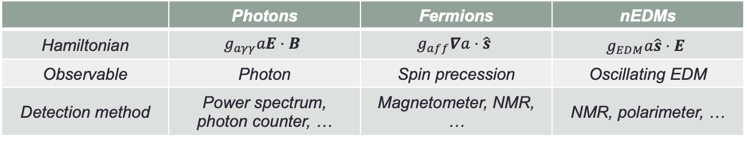
Interaction and detection
Axion coupling
 | Photons | Fermions | nEDMs
Hamiltonian | $$g_{aγγ}aE⋅B$$ | $$g_{aff}∇a⋅\hat{s}$$ | $$g_{EDM}a\hat{s}⋅E$$
Observable | Photon | Spin precession | Oscillating EDM
Detection method | Power spectrum, photon counter, … | Magnetometer, NMR, … | NMR, polarimeter, …

Slide 6
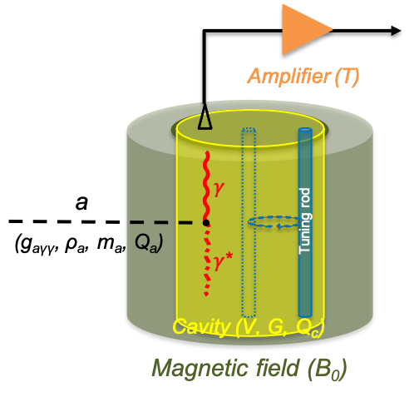
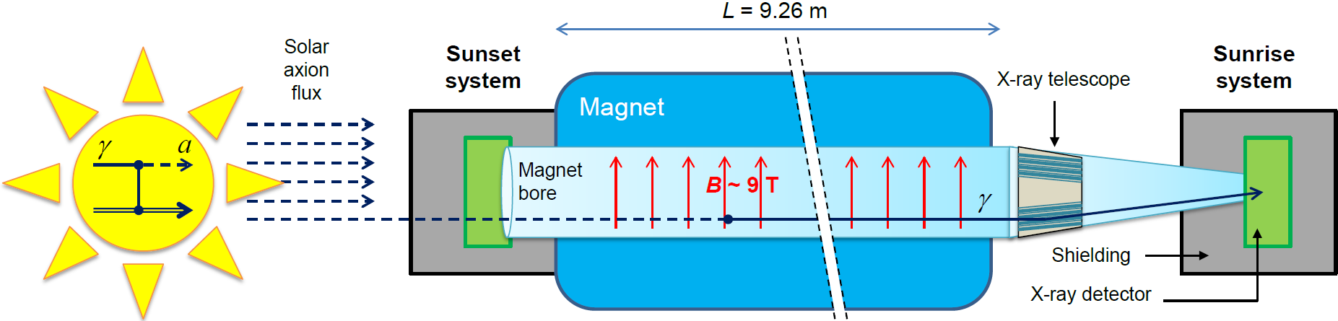
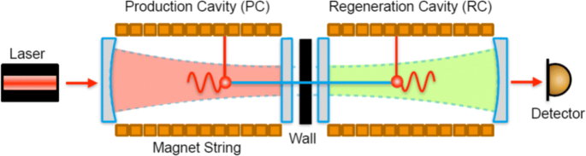
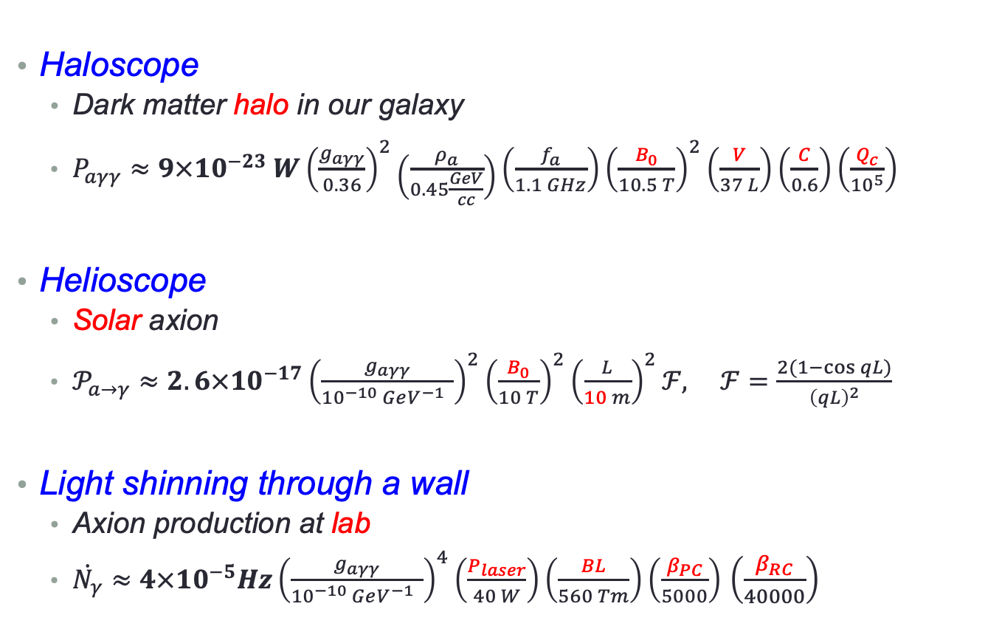
Search strategies
Haloscope
  Dark matter halo in our galaxy
  $P_{aγγ}≈9×{10}^{−23} W{\left(\frac{g_{aγγ}}{0.36}\right)}^{2}\left(\frac{ρ_{a}}{0.45\frac{GeV}{cc}}\right)\left(\frac{f_{a}}{1.1 GHz}\right){\left(\frac{B_{0}}{10.5 T}\right)}^{2}\left(\frac{V}{37 L}\right)\left(\frac{C}{0.6}\right)\left(\frac{Q_{c}}{{10}^{5}}\right)$
Helioscope
  Solar axion
  $𝒫_{a→γ}≈2.6×{10}^{−17}{\left(\frac{g_{aγγ}}{{10}^{−10} GeV^{−1} }\right)}^{2}{\left(\frac{B_{0}}{10 T}\right)}^{2}{\left(\frac{L}{10 m}\right)}^{2}ℱ, ℱ=\frac{2(1−\cos{qL})}{{\left(qL\right)}^{2}}$
Light shinning through a wall
  Axion production at lab
  $\dot{N_{γ}}≈4×{10}^{−5}Hz{\left(\frac{g_{aγγ}}{{10}^{−10} GeV^{−1} }\right)}^{4}\left(\frac{P_{laser}}{40 W}\right)\left(\frac{BL}{560 Tm}\right)\left(\frac{β_{PC}}{5000}\right)$ $\left(\frac{β_{RC}}{40000}\right)$
~100 photons/sec
~10 photons/day
~1 photons/day

Slide 7
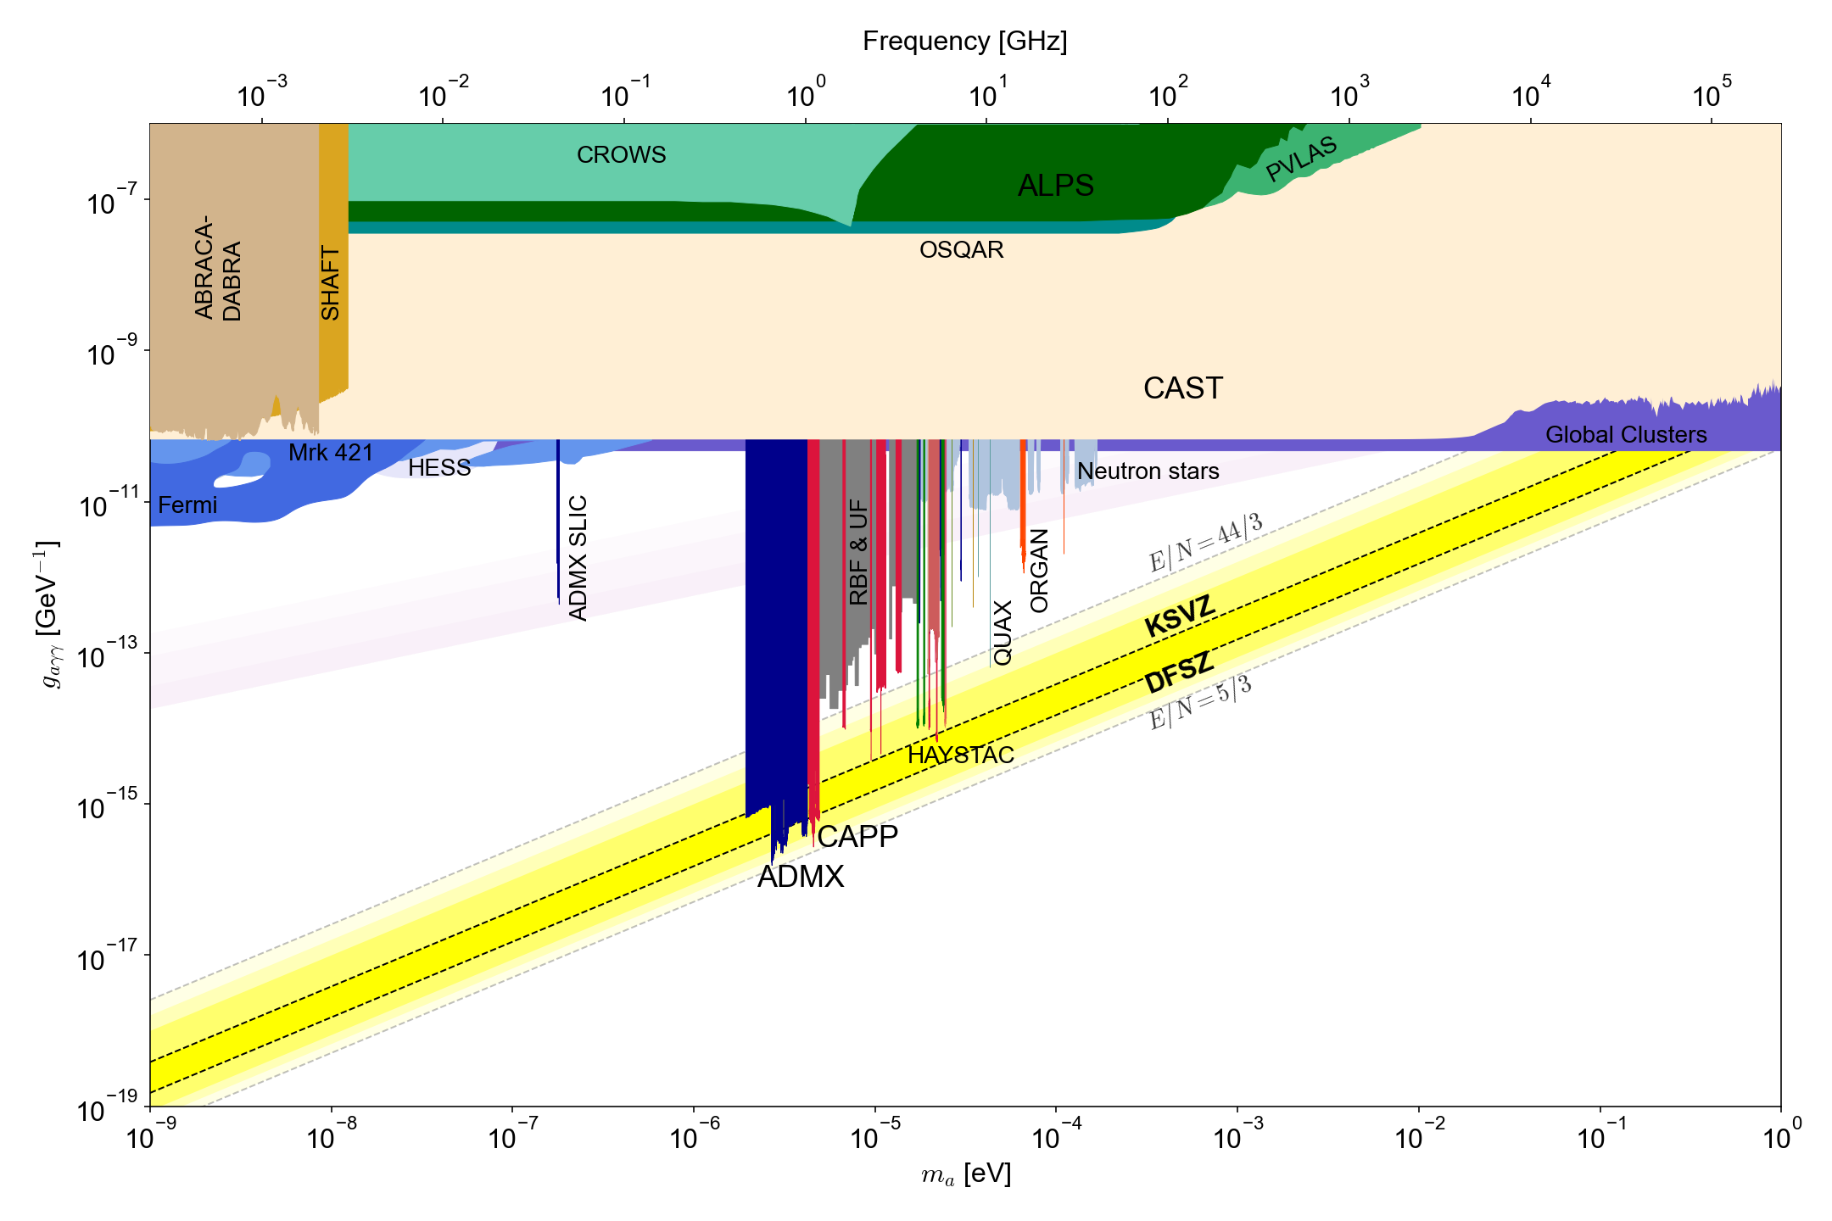
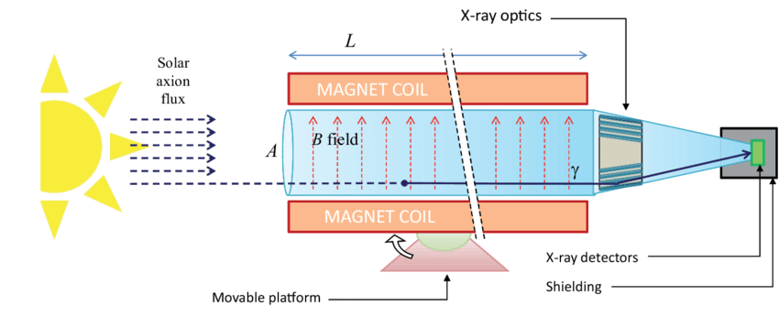
Current status
1 GHz = 4.2 ueV
Helioscope (solar axion)
LSW (axion at lab)
Haloscope (DM axion)

Slide 8
Haloscopes

Slide 9


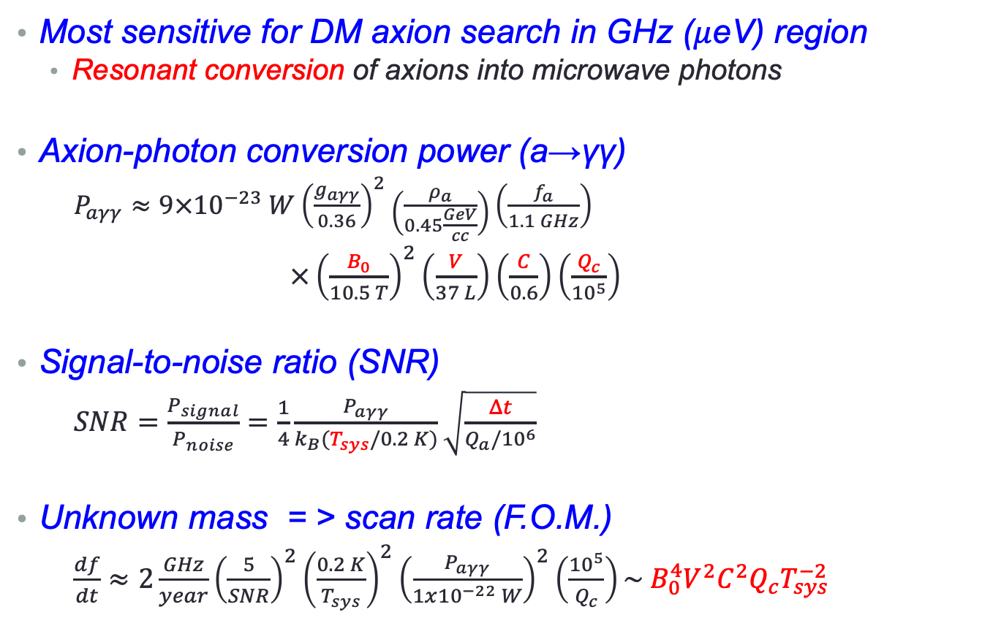
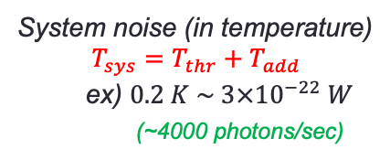
Cavity haloscope
1 GHz = 4.2 $μ$eV
Most sensitive for DM axion search in GHz ($μ$eV) region
  Resonant conversion of axions into microwave photons
Axion-photon conversion power (a→γγ)
  $P_{aγγ}≈9×{10}^{−23} W{\left(\frac{g_{aγγ}}{0.36}\right)}^{2}\left(\frac{ρ_{a}}{0.45\frac{GeV}{cc}}\right)\left(\frac{f_{a}}{1.1 GHz}\right)$
  $×{\left(\frac{B_{0}}{10.5 T}\right)}^{2}\left(\frac{V}{37 L}\right)\left(\frac{C}{0.6}\right)\left(\frac{Q_{c}}{{10}^{5}}\right)$
Signal-to-noise ratio (SNR)
  $SNR=\frac{P_{signal}}{P_{noise}}=\frac{1}{4}\frac{P_{aγγ}}{k_{B}(T_{sys}/0.2 K)}\sqrt{\frac{Δt}{Q_{a}/{10}^{6}}}$
Unknown mass = > scan rate (F.O.M.)
  $\frac{df}{dt}≈2\frac{GHz}{year}{\left(\frac{5}{SNR}\right)}^{2}{\left(\frac{0.2 K}{T_{sys}}\right)}^{2}{\left(\frac{P_{aγγ}}{1x{10}^{−22} W}\right)}^{2}\left(\frac{{10}^{5}}{Q_{c}}\right)\sim B_{0}^{4}V^{2}C^{2}Q_{c}T_{sys}^{−2}$
(~100 photons/sec)
System noise (in temperature)
$$T_{sys}=T_{thr}+T_{add}$$
ex) $0.2 K \sim 3×{10}^{−22} W$
(~4000 photons/sec)

Slide 10
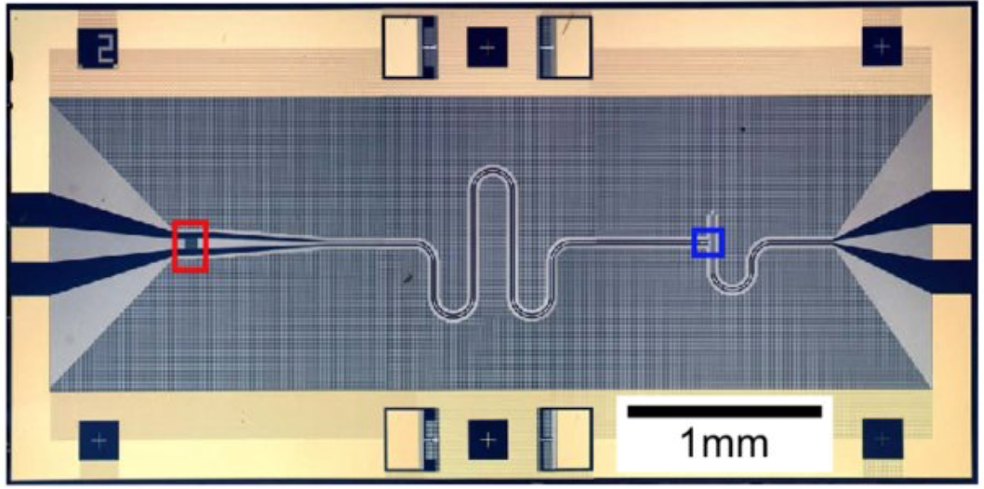
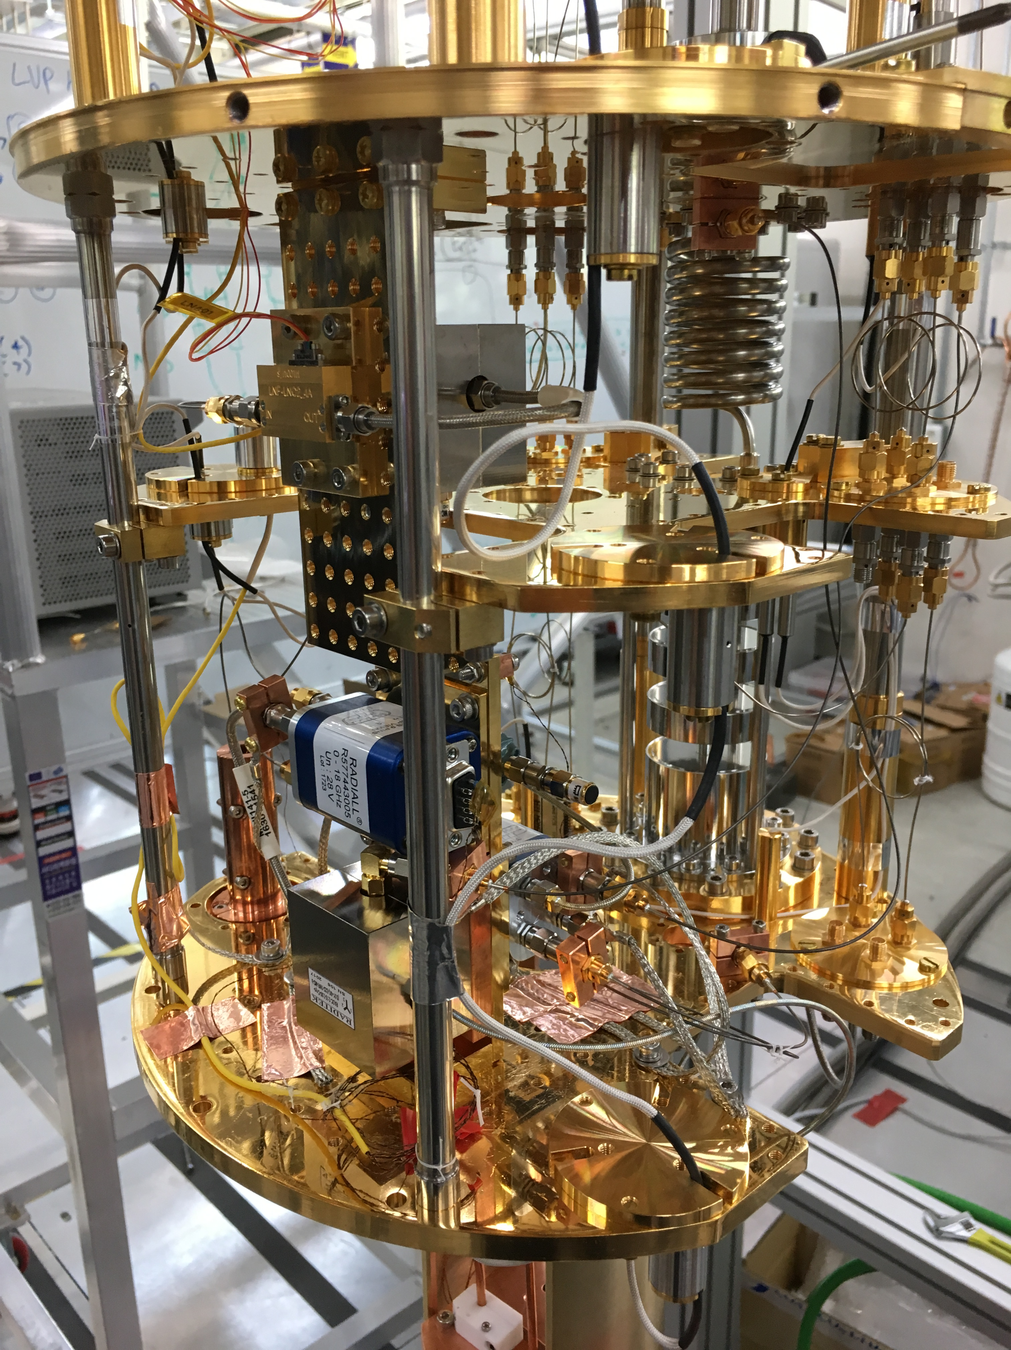
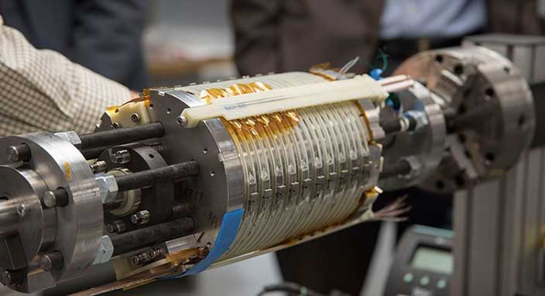
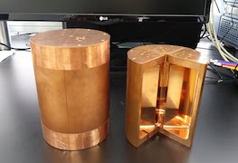




Cavity haloscope – in a nutshell
Most sensitive for microwave photons
Quantum noise limited amplifier T
Cryogenics T
$$P_{aγγ}\sim {10}^{−23} W$$
Signal amplification w/ minimal noise added
Lowering thermal noise
$$a$$
$$γ$$
Tunable High-Q resonator
V, Q, C, Δf
High field Magnet B
$γ$*
Interdisciplinary research !
Boosting a→γγ conversion rate
Resonant frequency tuning

Slide 11
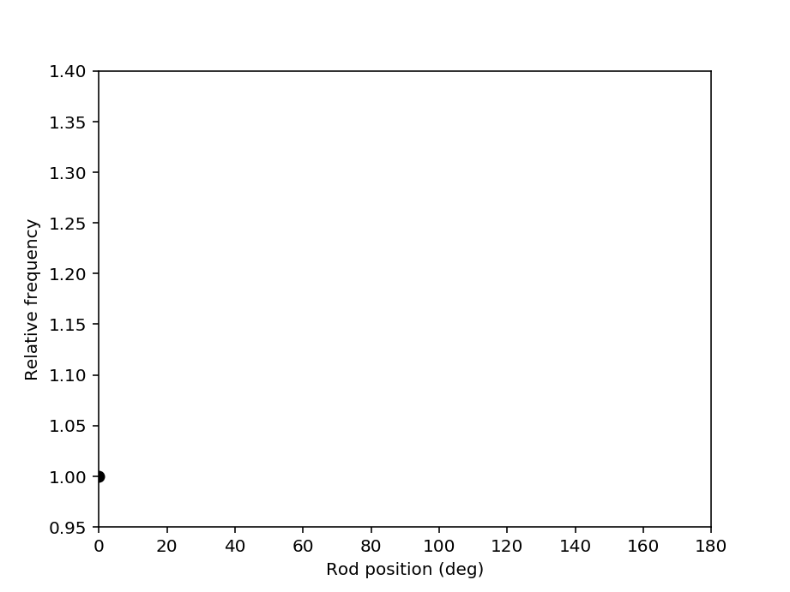
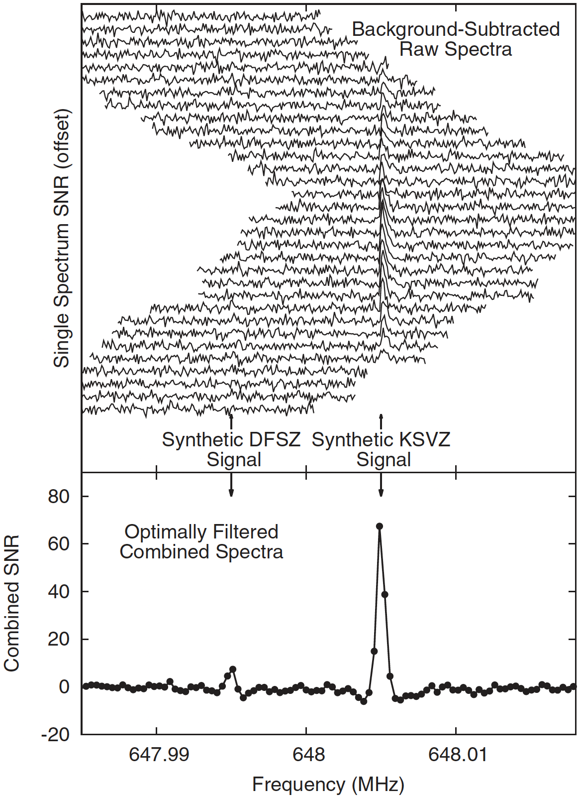

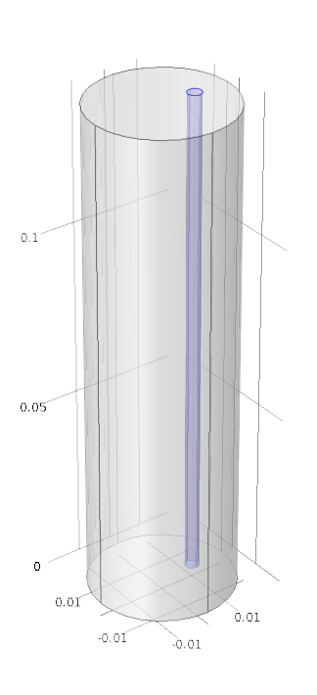
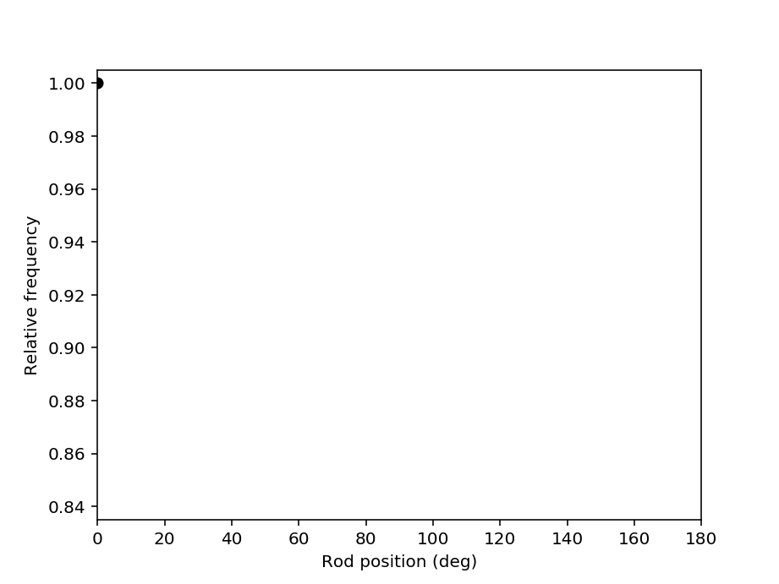

Cavity tuning (TM₀₁₀) and signal
Conductor
Dielectric

Slide 12
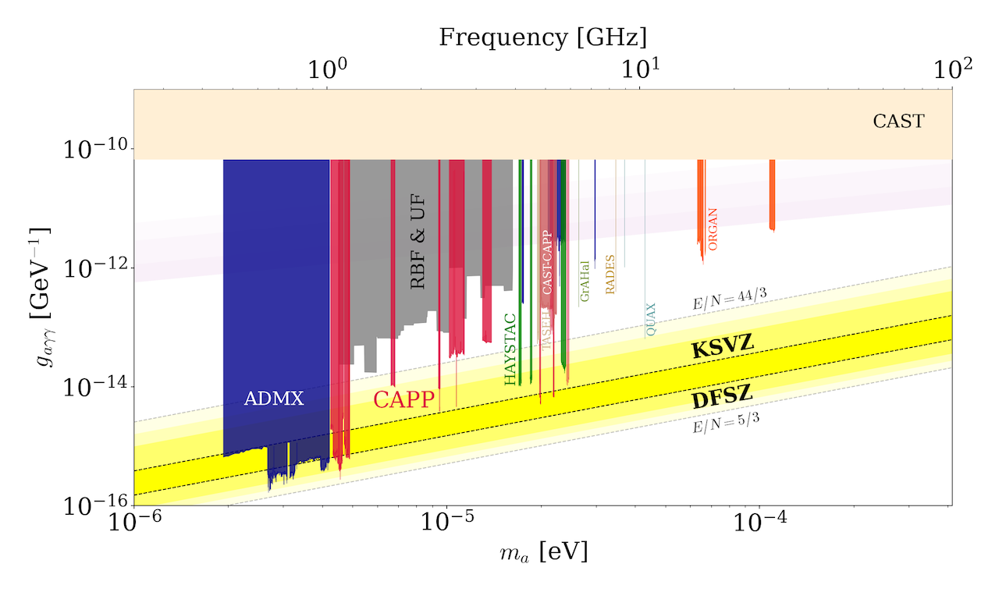
Haloscope searches

Slide 13
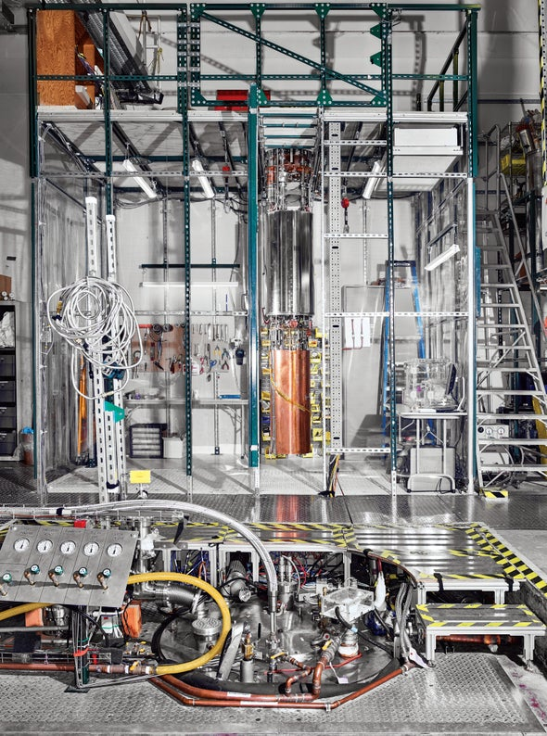
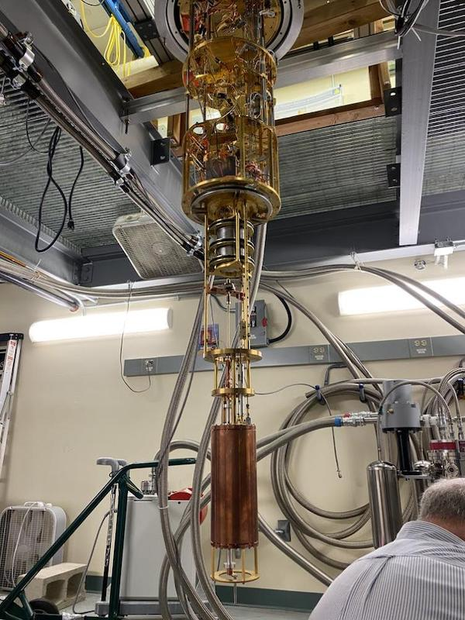
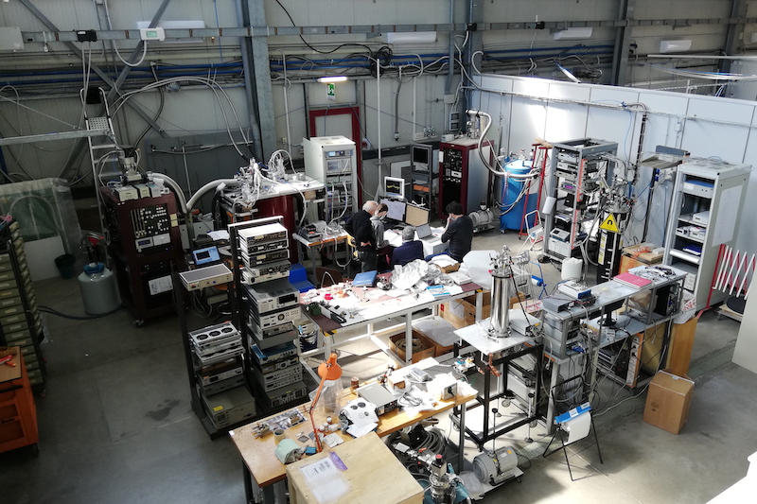
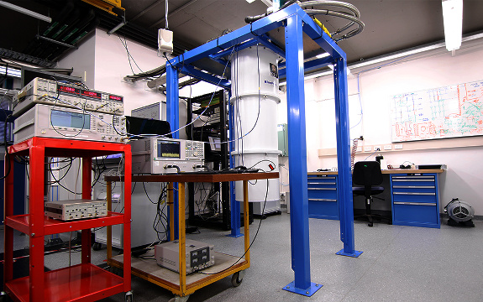
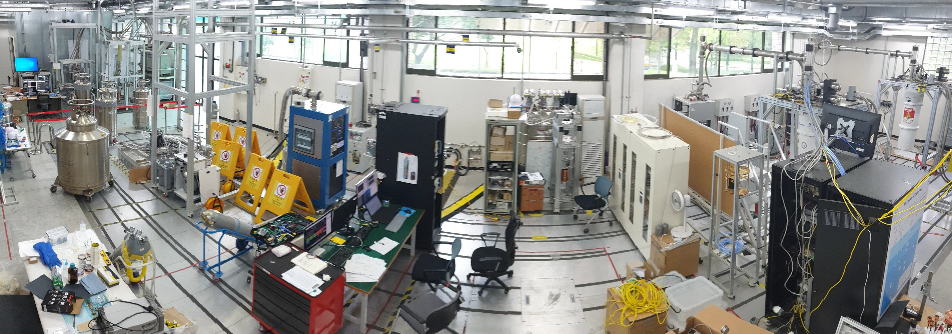
Cavity haloscopes
ADMX
HAYSTAC
QUAX
ORGAN
CAPP

Slide 14
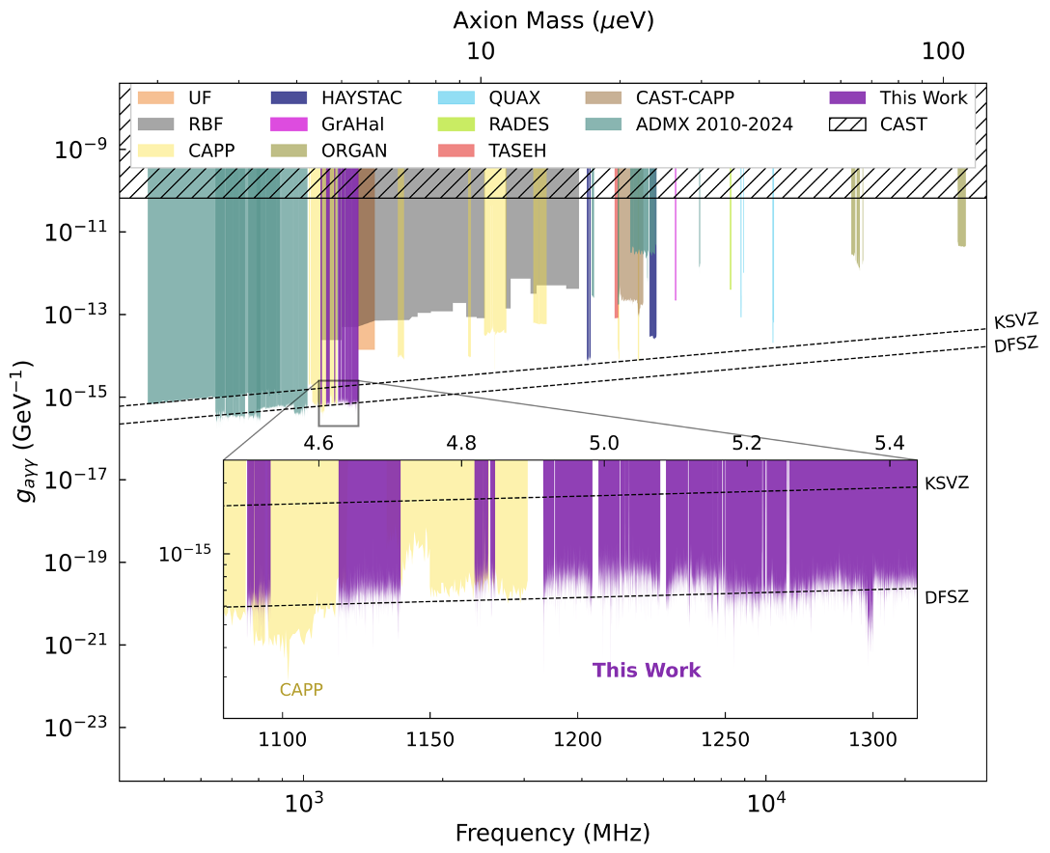
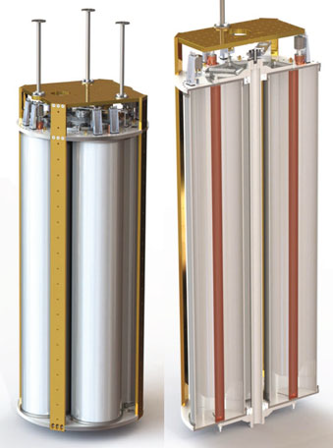
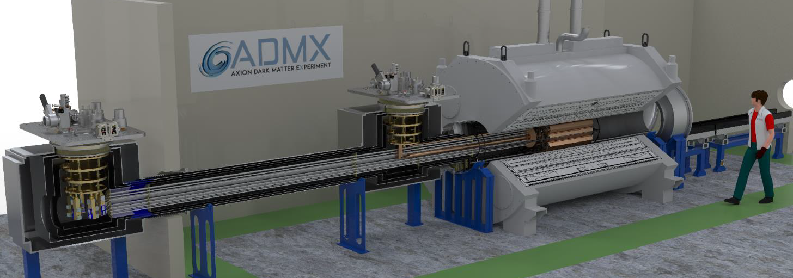
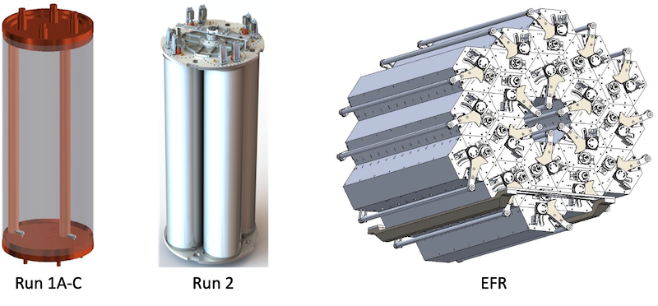
ADMX
ADMX
arXiv:2504.07279
ADMX-EFR
MRI (9.8T, 80cm)

Slide 15
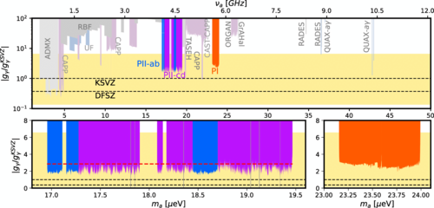
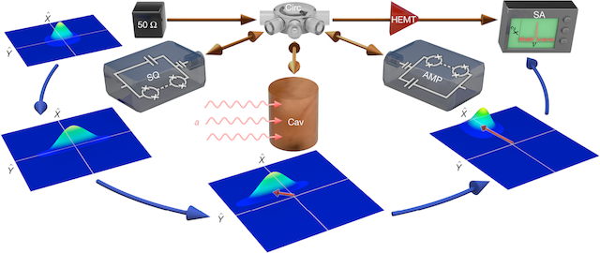
HAYSTAC
HAYSTAC
PRD 107 072007 (2023)
PRL 134 151006 (2025)
Nature 590 238 (2021)
Quantum squeezing (T_{N} < T_{SQL} )
w/ Josephson parametric amplfier (JPA)

Slide 16
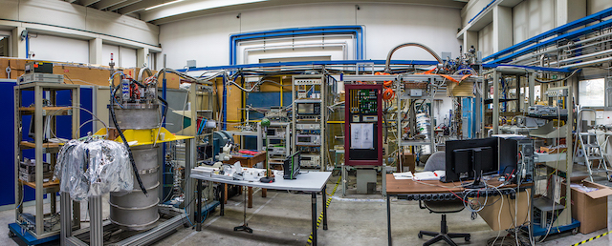
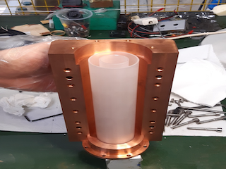
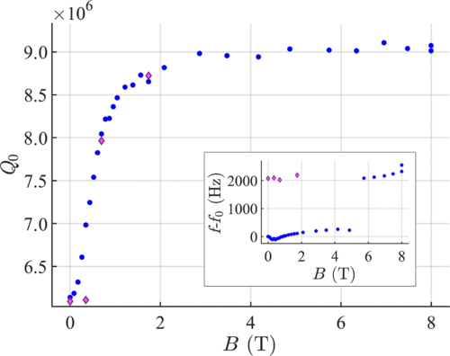
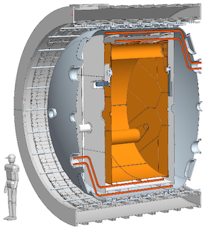
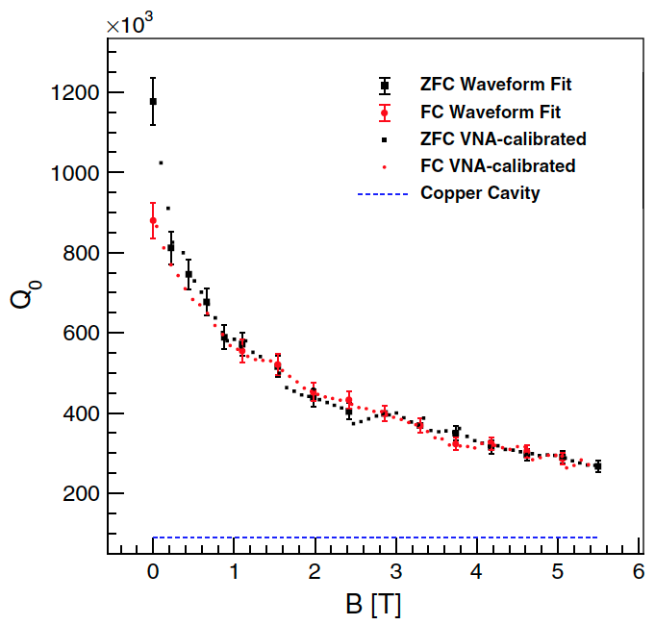
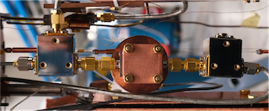
QUAX
QUAX (LNL)
QUAX (LNF)
Dielectric cavity
PRApplied 17 054013 (2022)
FINUDA
B = 1.1 T
R = 1.4 m
PRD 99 101101 (2019)
TWPA
PRD 108 062005 (2023)
SC (NbTi) cavity
FLASH

Slide 17
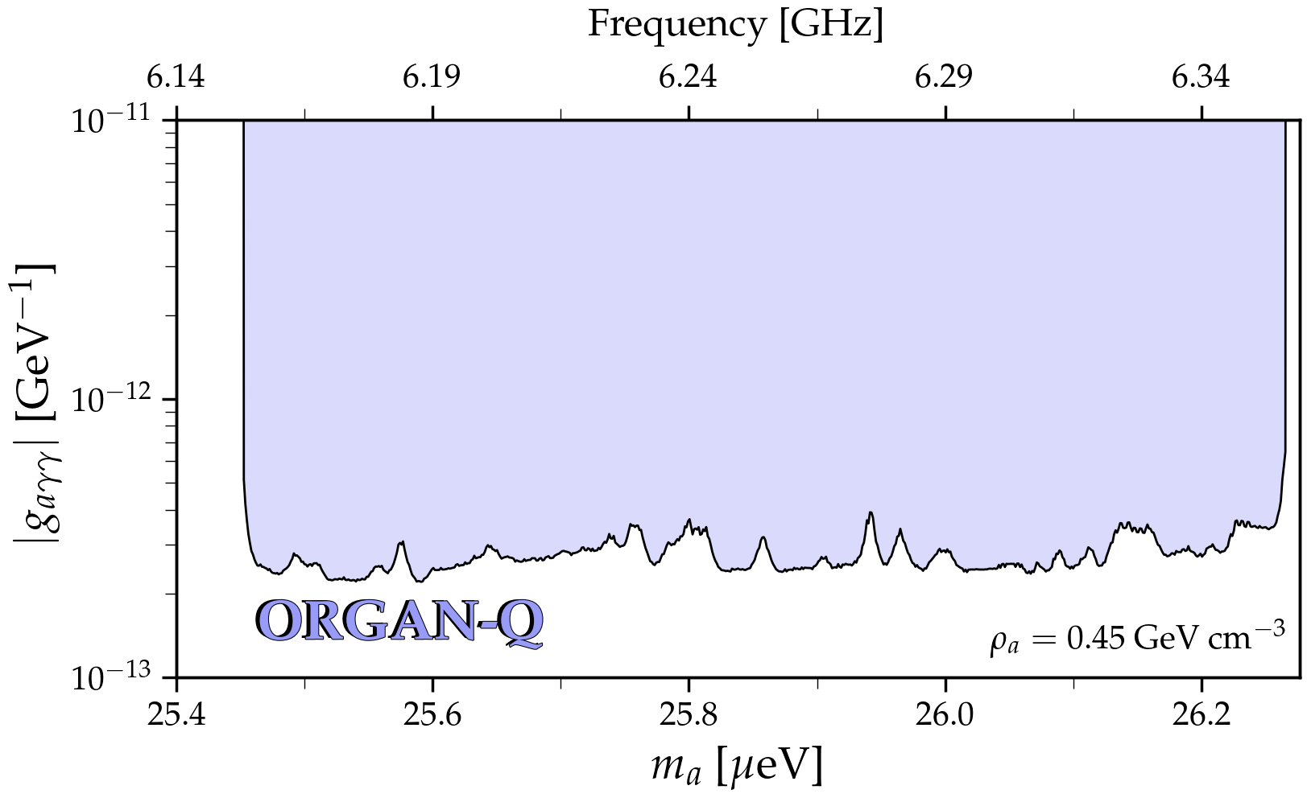



ORGAN
JPA run
PRD 111 095007 (2024)
ORGAN
Sci. Adv. 8 abq3765 (2022)
ALP genesis + SMASH

Slide 18






IBS-CAPP => IBS-DMAG
CAPP-9T
CAPP-12TB
CAPP-12T
CAPP-8T
CAPP-8TB

Slide 19












IBS-CAPP => IBS-DMAG
CAPP-8T
(8T/125mm)
HTS SC cavity + JPA
(2.3 GHz, Q ~ 3.5 M)
AQN search
Paper in preparation
CAPP-8TB
(8T/165mm)
8-cell + JPA
(5.9 GHz, 400 mK)
Near KSVZ sensitivity
arXiv:2507.04344
CAPP-12TB
(12T/320mm)
f > 1 GHz, V = 37 L, T_{sys} < 250 mK
df/dt ~ 2 MHz/day @ DFSZ
PRL 130 071002 (2023)
Extended scan ($∆f$~120 MHz)
PRX 14 031023 (2024)
Ready for 300-MHz run w/ SC cavity
CAPP-12T
(12T/96m)
3-cell + JPA
(5.3 GHz, 400 mK)
KSVZ sensitivity
NM algorithm
PRL 133 211803 (2024)

Slide 20
Cavity haloscopes
ADMX
HAYSTAC
QUAX
ORGAN
CAPP

Slide 21


Searches vs. predictions
$$f<10 GHz$$

Slide 22






MADMAX
Dielectric power booster PRL 118 091801 (2017)
Proof-of-concept
5 disks
Morpurgo (1.6T)
3 disks
Suitable for 10~100 GHz
Prototype (2024)
Full scale design
PRL 134 151004 (2025)

Slide 23











ALPHA
Plasma haloscope PRL 123 141802 (2019)
  Wire metamaterial => bulk plasmon
    Resonant conversion when $m_{a}=ω_{p}$
$ωp2=\frac{2πc^{2}}{a2\log{(\frac{a}{2r})}}$
$ωp$ independent of the detector size
Large conversion volume at high frequencies
Stockholm
Yale

Slide 24





DM Radio
Lumped element haloscope
  Broadband low mass (<1 ueV) search
  Sensitive to pre-inflationary scenario
DM Radio-m³
Solenoidal goemetry
PRD 106 103008 (2022)
$$j_{eff}=g_{aγ}\sqrt{2ρ_{a}}\cos{(m_{a}t)}B$$
ABRACADABRA-10cm
PRL 127 081801 (2021)
DM Radio-50L
Toroidal goemetry
(under construction)
arXiv:2210.07215

Slide 25
Other haloscopes
Recent
  CAST-CAPP: phase-matched cavities, ~20 ueV
  RADES: microwave fiber, ~34 ueV
  Grenoble Axion Haloscope
    14T/52mm magnet, ~26 ueV
  Taiwan Axion Search Experiment with Haloscope
    4.7 GHz, 11 x g_{arr}^{KSVZ}
  Broadband Reflector Experiment for Axion Detection
    Parabolic reflector, THz region
Proposed
  Canfranc Axion Detection Experiment
    90 GHz (W-band), Kinetic inductance detectors
  Superconducting axion search
    SC (NbN) cavity, 14T, 8.4 GHz
  GrAHal-CAPP
    9T/800mm magnet, SC cavity, 1~3 ueV
Nat. Comm. 13, 6180 (2022)
JHEP 2021 75 (2021)
arXiv:2110.14406
PRL 129 111802 (2022)
PRL 132 131004 (2024)
JCAP 11 044 (2022)
arXiv:2505.07541
Front. Phys. 12:1358810 (2024)

Slide 26





Local dark matter density
$ρ_{axion}=0.45 GeV/cm^{3}$ (cf. $ρ_{WIMP}=0.3 GeV/cm^{3}$)
Circular velocity curve of MW
Gaia DR3 and APOGEE DR17
Phase space distribution of 6M stars (Gaia DR3)
Unsupervised machine learning
Mon. Not. R. Astron. Soc. 528 693 (2024)
JCAP01 021 (2025)
$$ρ_{DM,local}=0.447±0.004 GeV/cm^{3}$$
$$ρ_{DM,local}=0.47±0.05 GeV/cm^{3}$$

Slide 27
Helioscope / LSW

Slide 28



Helioscope
Solar axion telescope
  $𝒫_{a→γ}≈2.6×{10}^{−17}{\left(\frac{g_{aγγ}}{{10}^{−10} GeV^{−1} }\right)}^{2}{\left(\frac{B_{0}}{10 T}\right)}^{2}{\left(\frac{L}{10 m}\right)}^{2}ℱ, ℱ=\frac{2(1−\cos{qL})}{{\left(qL\right)}^{2}}$
  History
    BNL => SUMICO => CAST => IAXO
Photon (keV) to axion
in
dense stellar plasma
Conversion into X-ray
in
laboratory B fields
~10 photons/day
arXiv:2406.16840
CAST, CERN
Decommissioned in 2021

Slide 29




IAXO
Full IAXO
International AXion Observatory
  Large toroidal helioscope
    8 dipoles (5.4 T, 20 m x $Φ$600 mm)
  Diverse physics over wide range
    Axions / ALP miracle / Astrophysical hints
  Goal : $g_{aγ} \sim {10}^{−12} GeV^{−1}$
Baby-IAXO arXiv:2010:12076
  Approved in 2020 (DESY)
  First step towards full IAXO
    4 T / 10 m long => 10 x MFOM_{CAST}
Baby-IAXO

Slide 30




Light shining through a wall
Axion-production/photon-regeneration at the lab
  Model independent search
    No need of cosmo./astrophys. source
    Pure axion-photon coupling
  History
    BFRT => OSQAR => ALPS => ALPS II
  Goal: $g_{aγγ} \sim {10}^{−11} GeV^{−1}$ below 0.1 eV
$$\dot{N_{γ}}≈4×{10}^{−5}Hz{\left(\frac{g_{aγγ}}{{10}^{−10} GeV^{−1} }\right)}^{4}$$
  $\left(\frac{P_{laser}}{40 W}\right)\left(\frac{BL}{560 Tm}\right)\left(\frac{β_{PC}}{5000}\right)$ $\left(\frac{β_{RC}}{40000}\right)$
~1 photons/day
ALPS II, DESY

Slide 31



ALPS II
Any Light Particle Search II
40 W
HET/TES
10⁻⁵~10⁻⁶ Hz
First science run (30 x ALPS)
3 orders of magnitude w/ HPL & PC

Slide 32


Axion searches – present
Axion searches – future
Most parameter space will be explored within the next few decades!
Most parameter space is unexplored

Slide 33


Summary
C. O’Hare (2020)
Axion is theoretically well-motivated
but experimentally very challenging
Tremdous efforts duing the past decades
Axion community is getting larger
Next few decades must be crucial/exciting

Slide 35


WISP zoo
Pseudo-scalar
WISP
Axion
  PQ solution to strong CP problem (1977)
  $$m_{a}f_{a}\sim Λ_{QCD}$$
  Invisible axion (1979)
  Dark matter candidate (1983)
Mili-chaged particle
.
.
.
J^{p} = 0–
J^{p} = 0⁺
Axion-Like Particle (ALP)
  Generic axion w/o solving the strong CP problem
  $$m_{a}f_{a}≁Λ_{QCD}$$
ALP
Chameleon
Axion
J = 1
Scalar
  Chameleon (2003)
  Dark energy candidate
Hidden photon
Vector
  Hidden photon
  Gauge field in hidden sector
Others
  Mili-charged particle, …

Slide 36




Form factor
Geometry and mode dependent
  Cavity mode and external field
TM₀₁₀
TM₁₁₀
For cylindrical cavities
z-direction for TM modes
φ-direction for TE modes
TM₀₁₀ mode
Maximum form factor
Typical cavity mode for axion haloscopes
E_{c} field
B₀
E_{c} profile
C₀₁₀ = 0.69
C₁₁₀ = 0

Slide 37








Magnet
CAPP (12T/320mm)
CAPP (18T/70mm)
Grenoble (43T/34mm)
ADMX (8T/600mm)
YBCO pancakes
CERN (1.6T)
UIC (9.4T/800mm)
DESY (10T, dipole)

Slide 38





Cavity
arXiv: 2203.14923
PRD 99 101101 (2019)
9 GHz
PRL 125 221302 (2020)
PRD 107 015012 (2022)
NIM 985 164641 (2021)
10.9 GHz
5.4 GHz
Q₀ > 10⁷

Slide 39





Microwave photon detector
Power detection
(w/ amplifiers)
vs. photon counting
(w/ single photon detector)
HEMT
Transistor-based
(T_{N} ~ K)
f = 10 GHz
JPA
Quantum limited
(T_{SQL} ~ 50 mK x f [GHz])
Game changer
at high freq. and low temp.
Nature 590 238 (2021)
IEEE TASC 2850019 (2018)
PRL 126 141302 (2021)
Quantum squeezing (T_{N} < T_{SQL} )
Single photon counting (T_{N} << T_{SQL})

Slide 40








High-Q cavities
$$\frac{df}{dt}\sim B^{4}V^{2}C^{2}Q_{L}T_{syst}^{−2}$$
Under strong magnetic fields
ReBCO HTS
  Biaxially-textured 2D tapes (commercially available)
f
Normal state
High critical field B_{C2}
&
High depinning frequency f_{dp}
Vortex depinning
(high dissipation)
f_{dp}
Vortex state
↓↓
ReBCO-based
High-Temperature Superconductor (HTS)
Vortex pinning
(low dissipation)
Meissner state
H
H_{m}
Stabilizer (Cu) 20 um
Protection layer (Ag) 2 um
Superconducting
layer (GdBCO) 2 um
Buffer layer (MgO) 0.7 um
Substrate (Hastelloy) 50 um
GdBCO HTS tape
Tapes on 2D pieces
Assembly
3D SC cavity

Slide 41






HTS cavities
$$\frac{df}{dt}\sim B^{4}V^{2}C^{2}Q_{L}T_{syst}^{−2}$$
Material
Manufacturer
Volume [L]
Freq. [GHz]
Q @ 8 T
Application
1st Gen.
YBCO
AMSC
0.3
6.9
0.33 M
Demostration
2nd Gen.
GdBCO
Theva
1.5
2.3
0.5 M
Axion search
3rd Gen.
EuBCO + APC
Fujikura
1.5 | 0.2
2.2 | 5.4
3.5 M | 13 M
AQN search | Axion search
4th Gen.
EuBCO + APC
Fujikura
37
1.2
1.1 M
Axion search

Slide 42







QNL amplification
$$\frac{df}{dt}\sim B^{4}V^{2}C^{2}Q_{L}T_{syst}^{−2}$$
Flux-driven Josephson parametric amplifiers (JPAs)
Parallel-Serial configuration
SST 34 085013 (2021)
Best performance!
Frequency tuning
Pump
Parametric amplification
SQUID
(nonlinear inductance)
Standard quantum limit
U. of Tokyo & RIKEN

Slide 43










HF approach
$$\frac{df}{dt}\sim B^{4}V^{2}C^{2}Q_{L}T_{syst}^{−2}$$
Multiple-cell (pizza)
Higher-mode (wheel)
Photonic crystal
PLB 777 412 (2018)
Mode | f_{rel} | Q_{rel} | V_{rel} | C_{abs}
TM₀₁₀ | 1 | 1 | 1 | 0.69
TM₀₂₀ | 2.3 | 1.5 | 1 | 0.13
TM₀₃₀ | 3.6 | 1.9 | 1 | 0.05
PRD 107 015012 (2022)
JPG 47 035203 (2020)
vs.
Larger volume
Simpler receiver chain
~4 x f_{TM010}
f $∝$ spacing
~10 x f_{TM010}
Kirigami tuning

Slide 44
Axion-fermion coupling

Slide 45





Electron spin
QUAX-ae
  Ferromagnetic haloscope
  Axion-magnon interaction
    Series of YIG spheres
    $B_{ext}$ => magnon at $ω_{L}$
    Axion => magnon excitation
    Relaxation => RF photon
    Cavity resonance (TM₁₁₀)
  $ω_{a}=ω_{L}=ω_{c}$
  Best limit near m_{a} ~ 43 $μ$eV
LACME
  Axion Chiral Magnetic Effect
  Axion => axial chemical potential => helicity imbalance => AC current
$$μ_{5}=g_{ae}\sqrt{2ρ_{a}}\cos{(m_{a}t)}$$
PRL 124 171801 (2020)
Chiral medium
PRD 110 055036 (2024)

Slide 46





Nuclear spin
GNOME
  Topological defects
    Axion domain walls, axion stars
  $$H_{a}=\frac{ℏ}{c}\hat{s}⋅∇a(\vec{r})$$
  Optical magnetometers
    Axion-atomic spin
    Alkali atoms (Rb, K)
  Global network
    > dozen stations
    Correlated signals with GPS time
ARIADNE
  Fifth-force experiment
    Axion-mediated spin-dependent
    $$U_{sp}\left(r\right)=\frac{ℏ^{2}g_{s}^{N}g_{p}^{N}}{8πm_{f}}\left(\frac{1}{λ_{a}r}+\frac{1}{r^{2}}\right)e^{−\frac{r}{λ_{a}}}\left(\hat{σ}⋅\hat{r}\right)$$
  $$≡μ{⋅B}_{eff}$$
    Rotating source mass (g_{s}) and polarized ³He spins (g_{p})
    NMR technique
  Potential probe for 0.1~10 meV
    Complementary method
Nature Phys. 17 1396 (2021)

Slide 47



Nuclear spin/EDM
Cosmic Axion Spin Precession Experiment
  NMR experiment
  CASPEr-Gradient
    $H_{spin}=g_{aNN}∇a⋅\hat{s}⟹τ_{spin}=μ_{N}×B_{a}$
    Dark matter axion
  CASPEr-Electric
    $d_{N}=g_{aGG}a\left(t\right)\hat{s}⟹τ_{EDM}=d_{N}×E$
    QCD axion

