Slide 1
Fast Times at
SIDM High(-Resolution)
Annika Peter
The Ohio State University
Focused largely on papers led by:
Carton Zeng (postdoc @TAMU)
Charlie Mace (hire him this fall!)

Slide 2
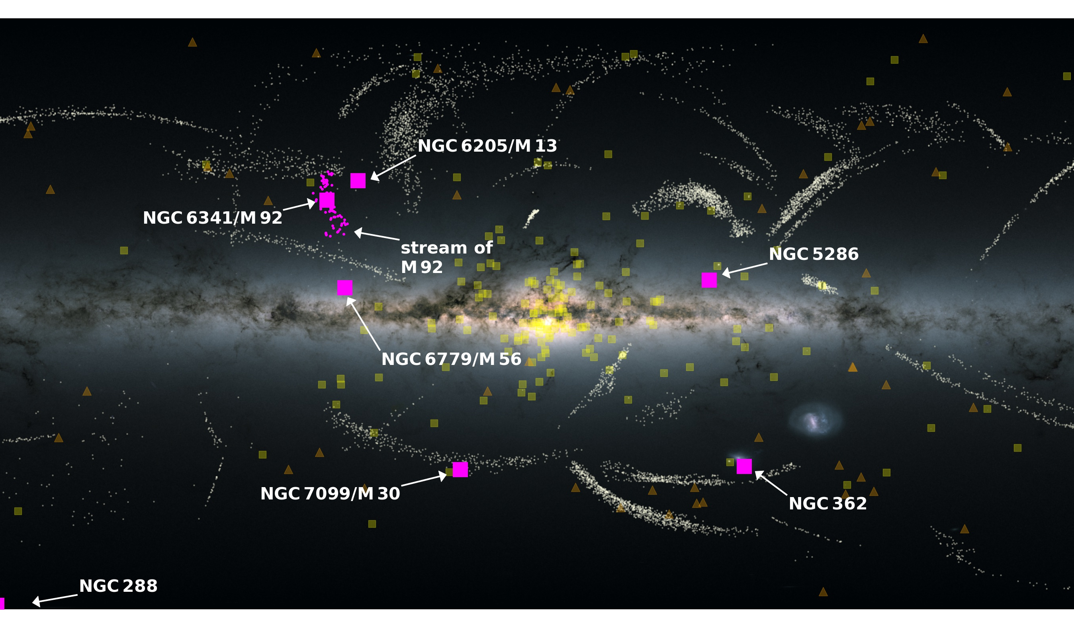
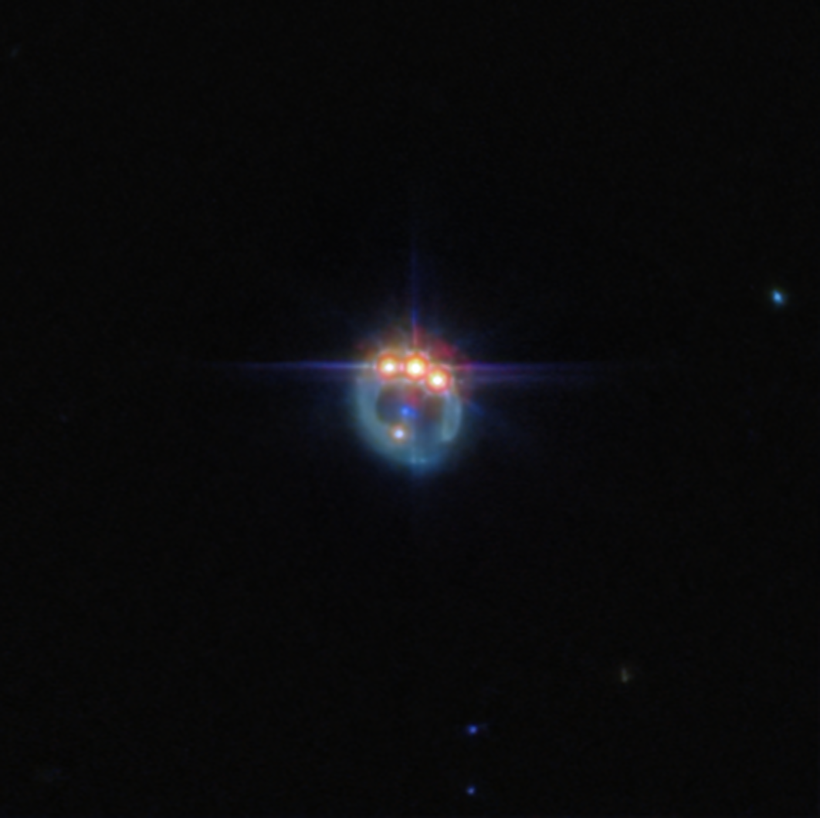
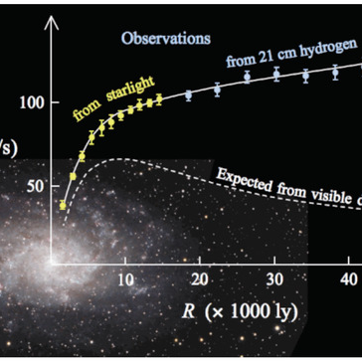
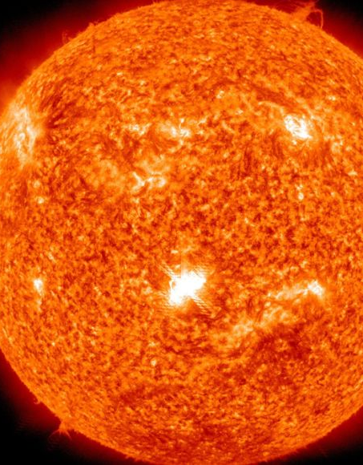
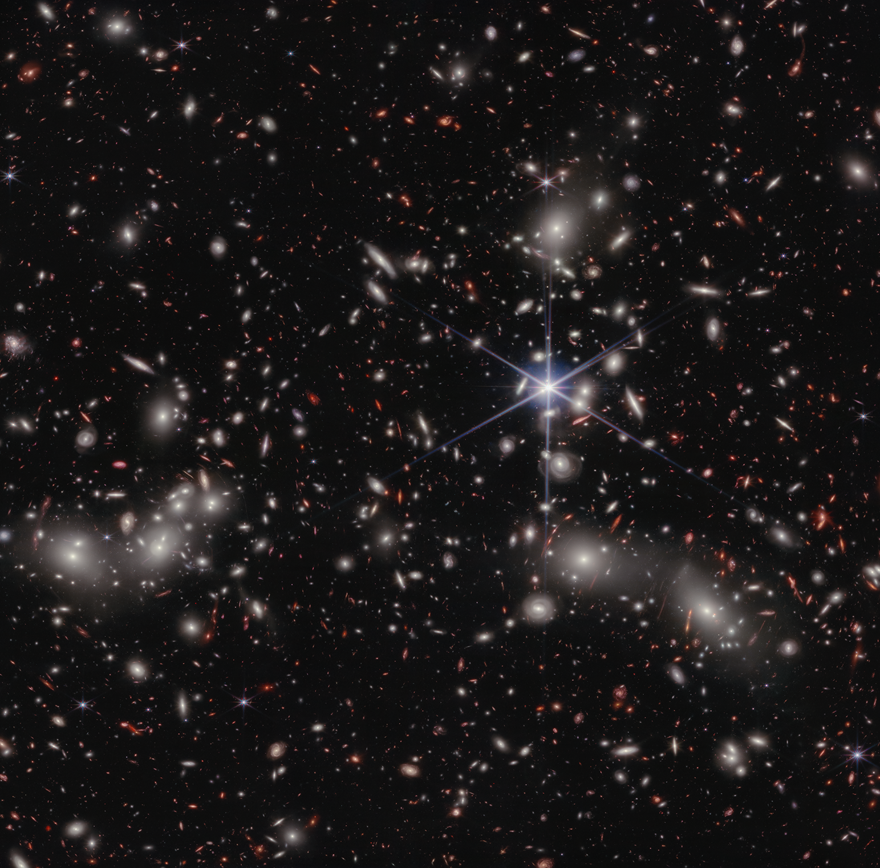
Many probes of dark matter in the cosmos
Notes:
References:
https://education.nationalgeographic.org/resource/sun/ (Sun)
https://www.esa.int/ESA_Multimedia/Images/2022/02/Gaia_reveals_a_new_member_of_the_Milky_Way_family (Gaia; Malhan+ 2022)
https://www.esa.int/ESA_Multimedia/Images/2024/07/Webb_admires_bejewelled_ring (JWST; A. Nierenberg)
https://www.nasa.gov/wp-content/uploads/2023/02/stsci-01gqqfcdz3j7arc9f8qdxe0f7z.png (JWST Pandora’s cluster)
https://www.mdpi.com/2218-1997/7/9/344 (M33; Salucci & di Paolo 2021)

Slide 3
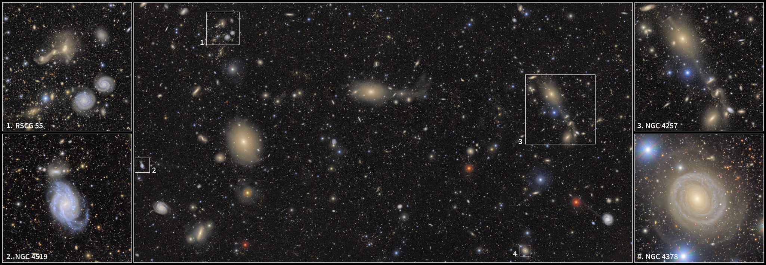
The firehose of data is here!
Rubin First Look
Credit: NSF–DOE Vera C. Rubin Observatory

Slide 4
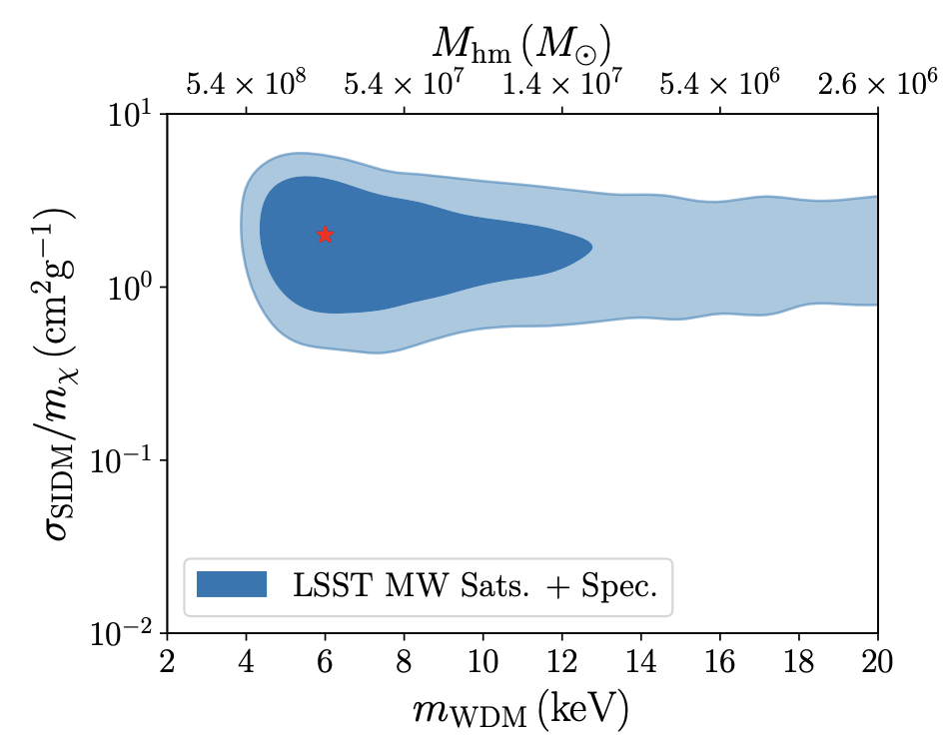
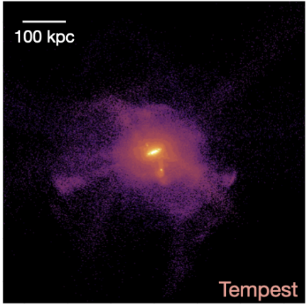
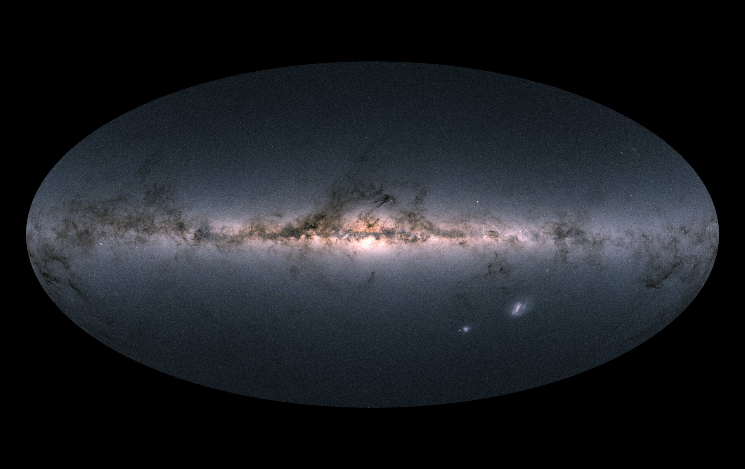
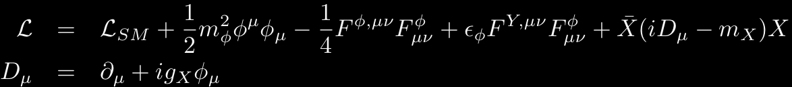
From 𝓛agrangian to 𝓛ikelihood & back again
Lagrangian
Parameter Constraints
Wright+ 2024
Simulation
Drlica-Wagner+ 2019
Observation
Gaia

Slide 5
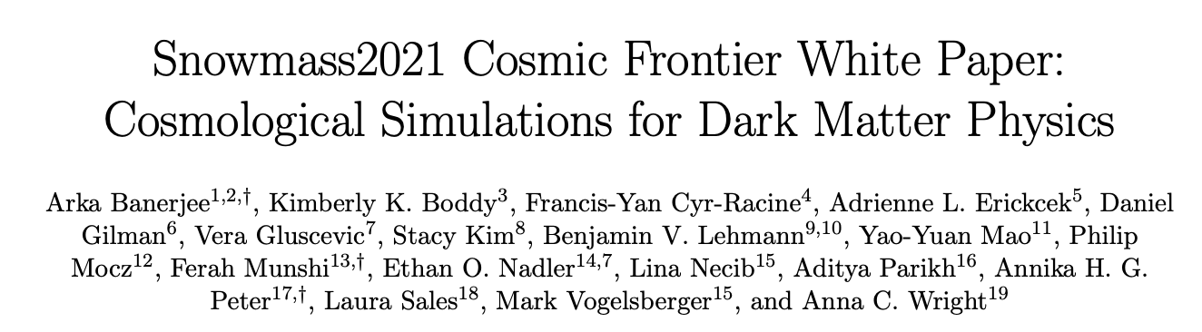
Strategy
A process in six parts, following this white Snowmass white paper:

Slide 6
Strategy
Close collaboration between simulators and particle theorists.
Algorithm development and code comparison tests.
Performing simulations with full hydrodynamics with validated subgrid models and numerical resolution.
Analysis of outputs in the realm of observations.
Fast realizations of observables for inference of DM properties.
Identifying novel signatures from simulations and guidance to observers.

Slide 7
Strategy
Close collaboration between simulators and particle theorists.
Algorithm development and code comparison tests.
Performing simulations with full hydrodynamics with validated subgrid models and numerical resolution.
Analysis of outputs in the realm of observations.
Fast realizations of observables for inference of DM properties.
Identifying novel signatures from simulations and guidance to observers.
Focus on Self-Interacting Dark Matter

Slide 8
What Is Self-Interacting Dark Matter?
Umbrella term for models that incorporate a large non-gravitational DM-DM cross section
Elastic
Atomic
Metastable/exothermic/endothermic

Slide 9
Why Self-Interacting Dark Matter?
It allows for more varied cosmological phenomenology than cold dark matter (CDM).
Interactions are generic predictions of Beyond Standard Model theories of dark matter.
It’s fun! (certainly more fun than collisionless particles)
See Tulin & Yu 2018, Adhikari+ in press, review articles

Slide 10
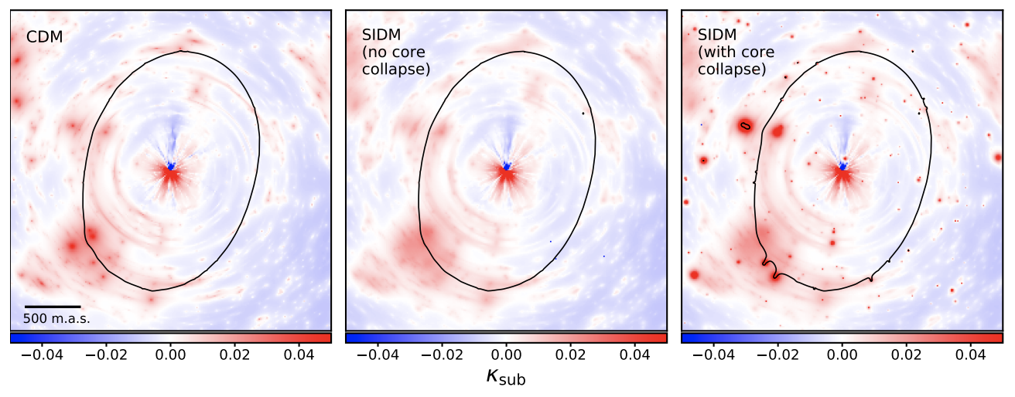
Why Self-Interacting Dark Matter?
Rebirth of idea ~5 years ago
Gliman+ 2021
Convergence maps

Slide 11
Why Self-Interacting Dark Matter?
It allows for more varied cosmological phenomenology than cold dark matter (CDM).
Interactions are generic predictions of Beyond Standard Model theories of dark matter.
It’s fun! (certainly more fun than collisionless particles)
Motivations for SIDM that are no longer valid:
Missing satellites problem (see, e.g., Kim, AP, Hargis 2018; Kim & AP 2021, Esteban, AP, Kim 2024 and HIRE STACY KIM)
Cusp/core problem
If I were really going to start a fight, I would argue that the “diversity problem” is no longer so much of a motivation (see a forthcoming paper by AKAXIA CRUZ (and hire her!))
See Tulin & Yu 2018, Adhikari+ in press, review articles

Slide 12
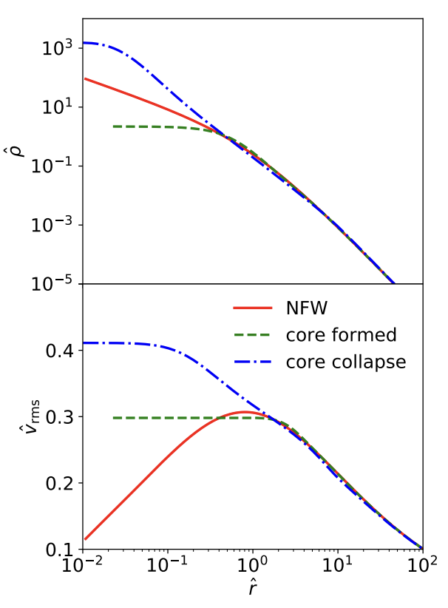
What is the problem with SIDM predictions?
They are computationally expensive, especially when you get into the core-collapse regime.
  (This is an especially big problem when you have a diversity of scales, e.g., you care about small satellites of massive systems.)
  (And it’s especially bad for inference problems.)
Simulations are not nearly as well-tested/calibrated as CDM, nor are the analysis tools.
Baryons add additional layers of complexity along many axes.
Yang+ 2022

Slide 13
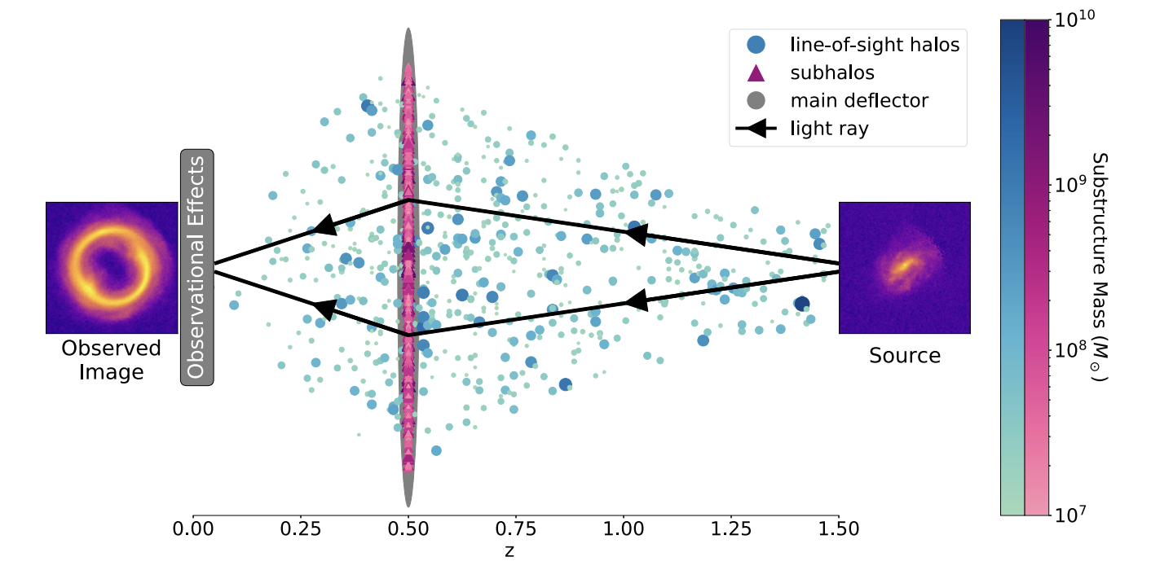

Example for the range of scales
$$∼{10}^{\left\{13−14\right\}}M_{⊙}$$
Need ~10⁵ particles to resolve
Beautiful plot from Wagner-Carena+ 2022

Slide 14
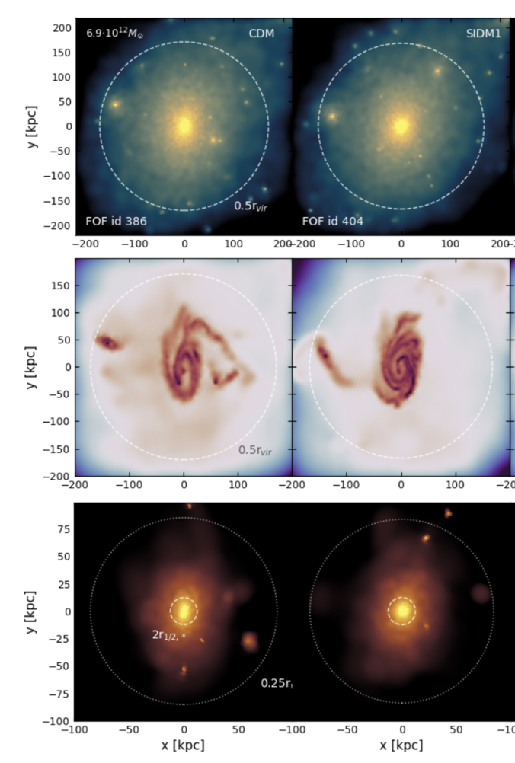
Approaches
AIDA-SIDM/Despali+ 2025
Full-on cosmological simulations.
For dark-matter-only, see Nadler+ 2025

Slide 15
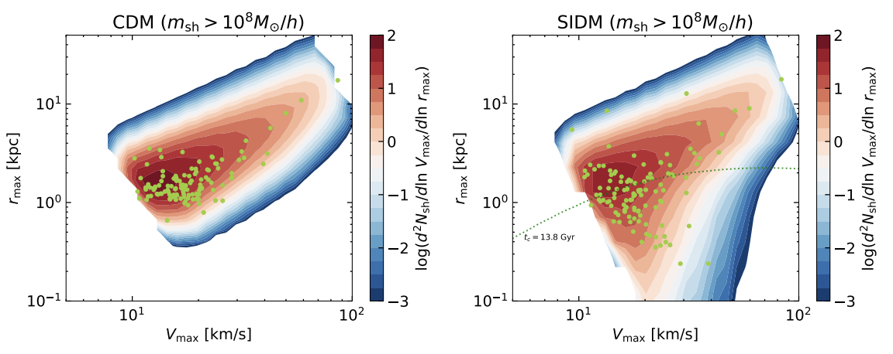
Approaches
AIDA-SIDM/Despali+ 2025
Full-on cosmological simulations.
Semi-analytic models.
SASHIMI-SIDM/Ando+ 2024

Slide 16
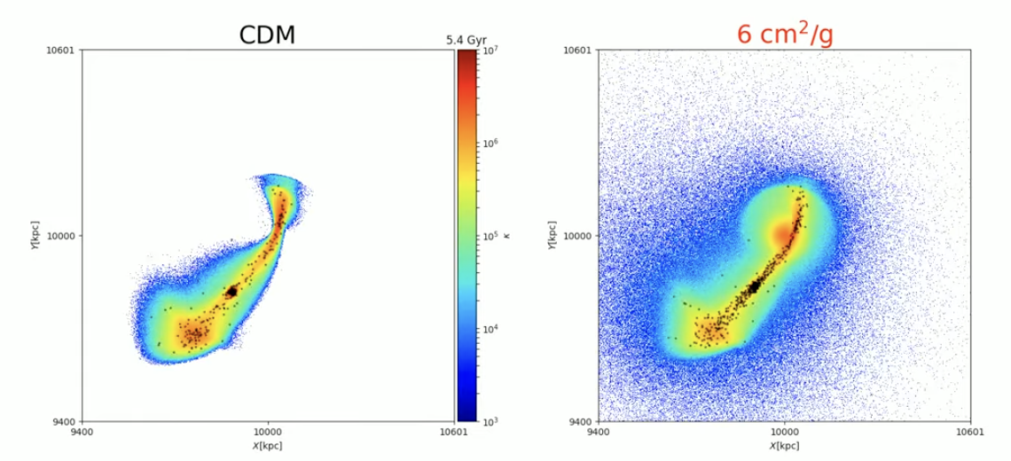
Approaches
AIDA-SIDM/Despali+ 2025
Full-on cosmological simulations.
Semi-analytic models.
Idealized simulations.
Zeng+ 2024
SASHIMI-SIDM/Ando+ 2024

Slide 17
Approaches
Gravothermal fluid/Yang+ 2022
AIDA-SIDM/Despali+ 2025
Full-on cosmological simulations.
Semi-analytic models.
Idealized simulations.
Gravothermal fluid.
Zeng+ 2024
SASHIMI-SIDM/Ando+ 2024

Slide 18
Idealized simulations
Satellite
Analytic host
Satellites
Satellites

Slide 19
Idealized simulations
Satellite
(all resolution elements here)
Innovations (Zeng+ 2023, 2024,2025)
Grow the analytic host w/a merger tree & SIDM evolution.
``Pseudo-particle” scatter between host and satellite particles.
Simulate ensembles of satellites w/varying infall times, generated via merger trees, that allows for a similar # of particles in each subhalo regardless of mass.
Analytic host
Satellites
Satellites
Limitations
Best for quiescent merger histories.
Several aspects would need significant rethinking for major mergers.

Slide 20
Application: “diversity problem”
Zeng, AP+ 2023

Slide 21
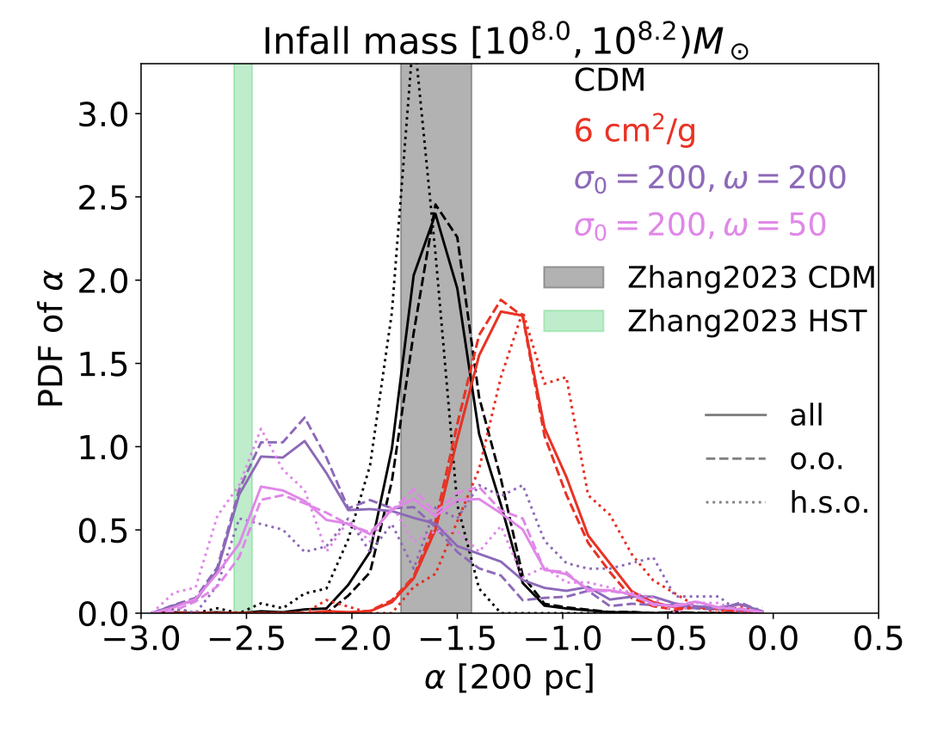
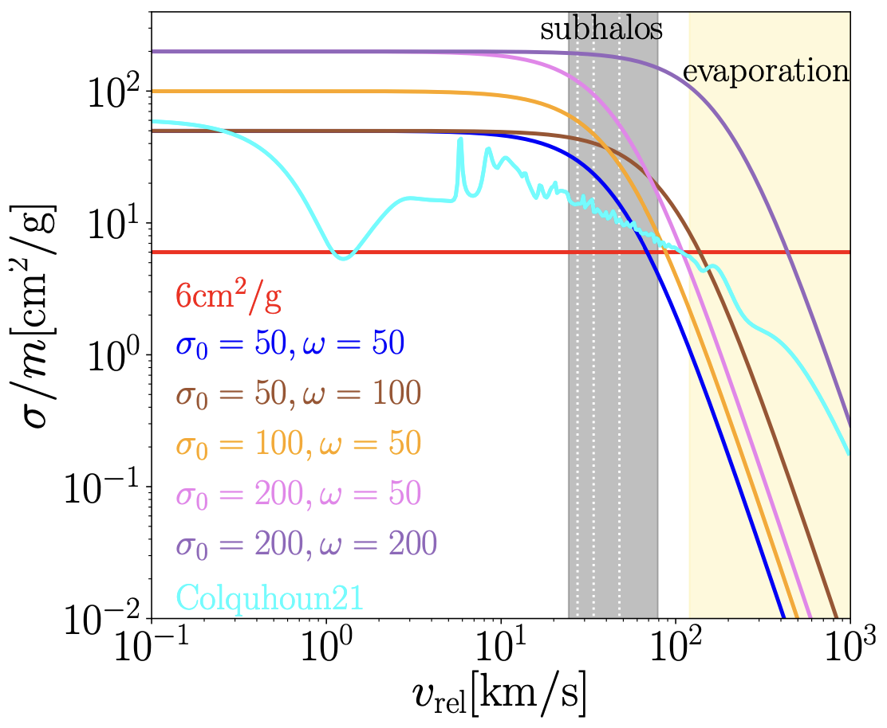

Application: subhalo populations for strong lensing
$$ρ∼r^{α}$$
Zeng+ 2025

Slide 22
Application: stellar response to subhalo evolution
Zeng+ 2024
Core collapse
Core expansion
Special case

Slide 23
Tidal tracks! (speeds up semi-analytic models)

Slide 24
Switching gears…

Slide 25
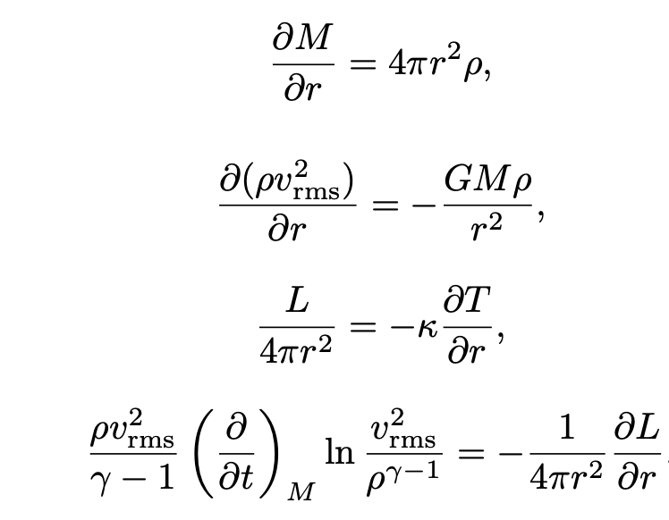
Gravothermal fluid
Based on the treatment of globular clusters in the middle of the last century; Lynden-Bell & Eggleton 1980
Mass conservation
Hydrostatic equilibrium
Thermal conductivity
1st law of thermodynamics
Yang+ 2023

Slide 26
Gravothermal fluid
Based on the treatment of globular clusters in the middle of the last century; Lynden-Bell & Eggleton 1980
Mass conservation
Hydrostatic equilibrium
Thermal conductivity
1st law of thermodynamics
Yang+ 2023

Slide 27
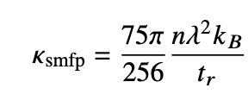
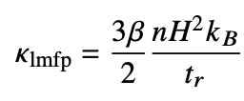
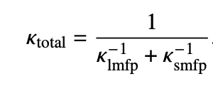
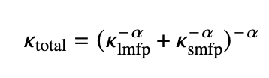
Calibrating conductivity
Old result from Chapman-Enskog theory
Scaling argument from Lynden-Bell & Eggleton 1980 for globular clusters
Standard assumption to bridge the regimes.
More general form for bridging the regimes that we are testing in Mace+ 2025b.
See Outmezguine+ 2023, Yang+ 2023 for a more general discussion of mapping cross sections to conductivities.

Slide 28
First, calibrate the simulations*
Mace+ 2025a
(see also Palubski+ 2024, Fischer+ 2024, 2025)
Notes:
*means that we tested these for isolated halos, but we don’t know what works for subhalos, and Frank has given us reasons to be cautious.

Slide 29
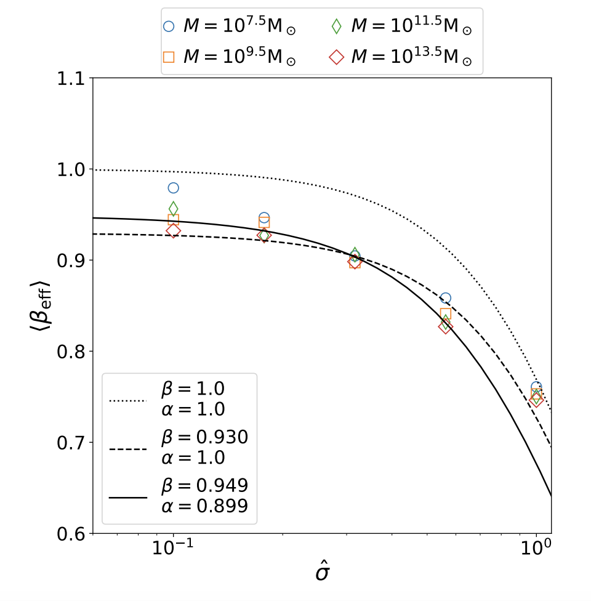

Beta blocking
Takeaways:
$β$ is independent of cross section, halo initial conditions. Here, $β_{eff}$is the effective fudge factor if you treat the halo as being in the pure LMFP regime and fit $β$ to that.
$α≈1$, as is the standard assumption.

Slide 30
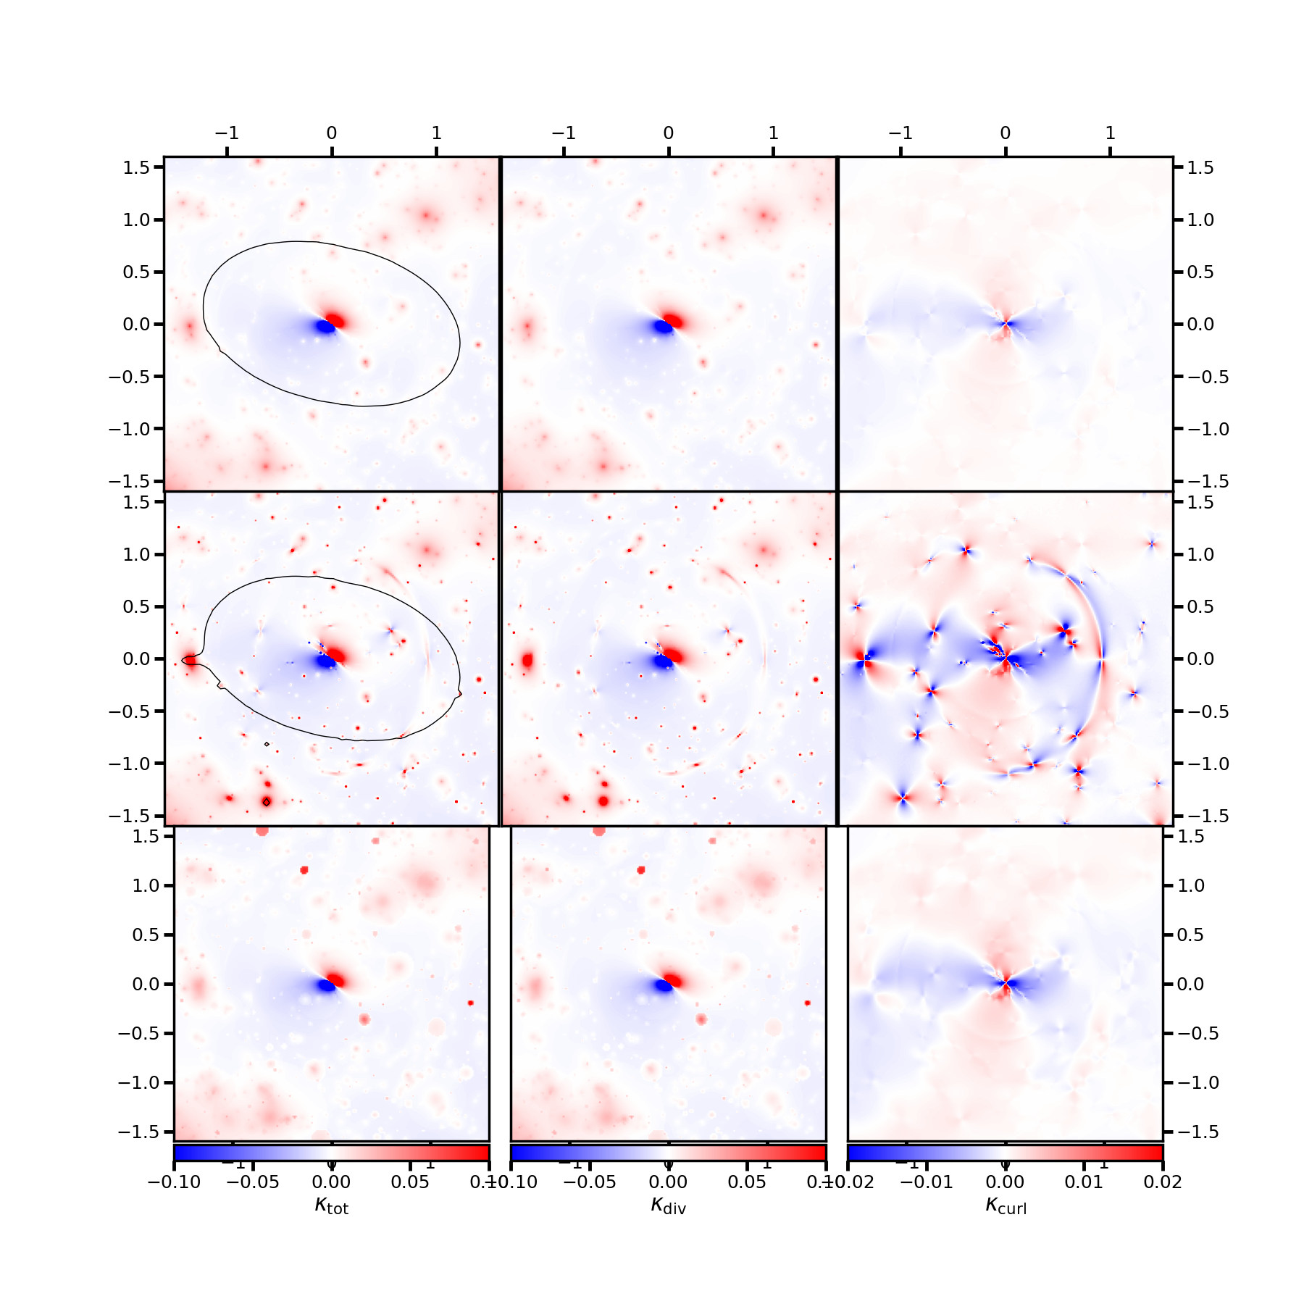
Application: faster substructure lensing maps
CDM
Simple core collapse implementation
Beta (haha) implementation of fast gravothermal model
Mace+ in prep

Slide 31
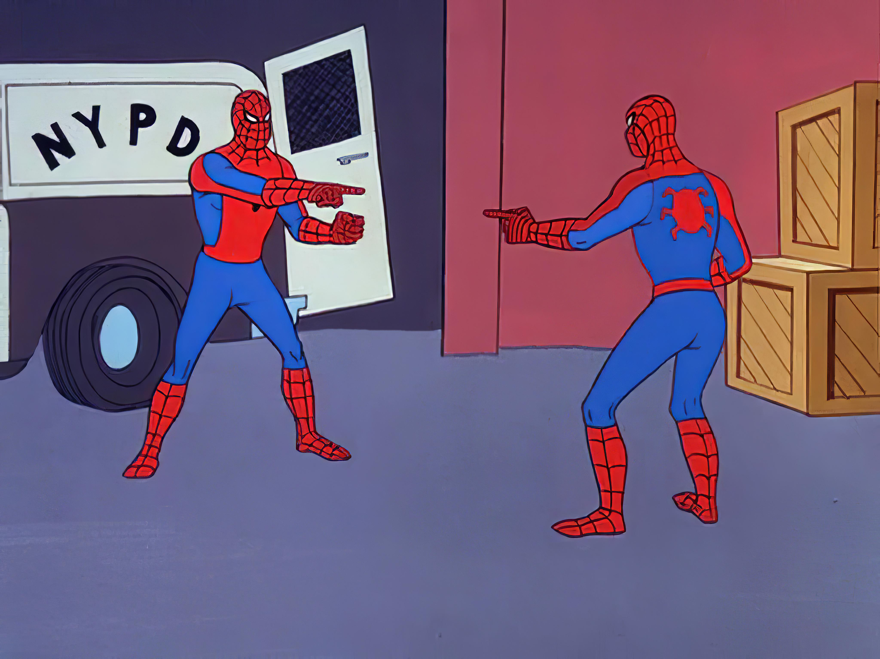
Conclusions
SIDM
sims
speed
accuracy

Slide 32
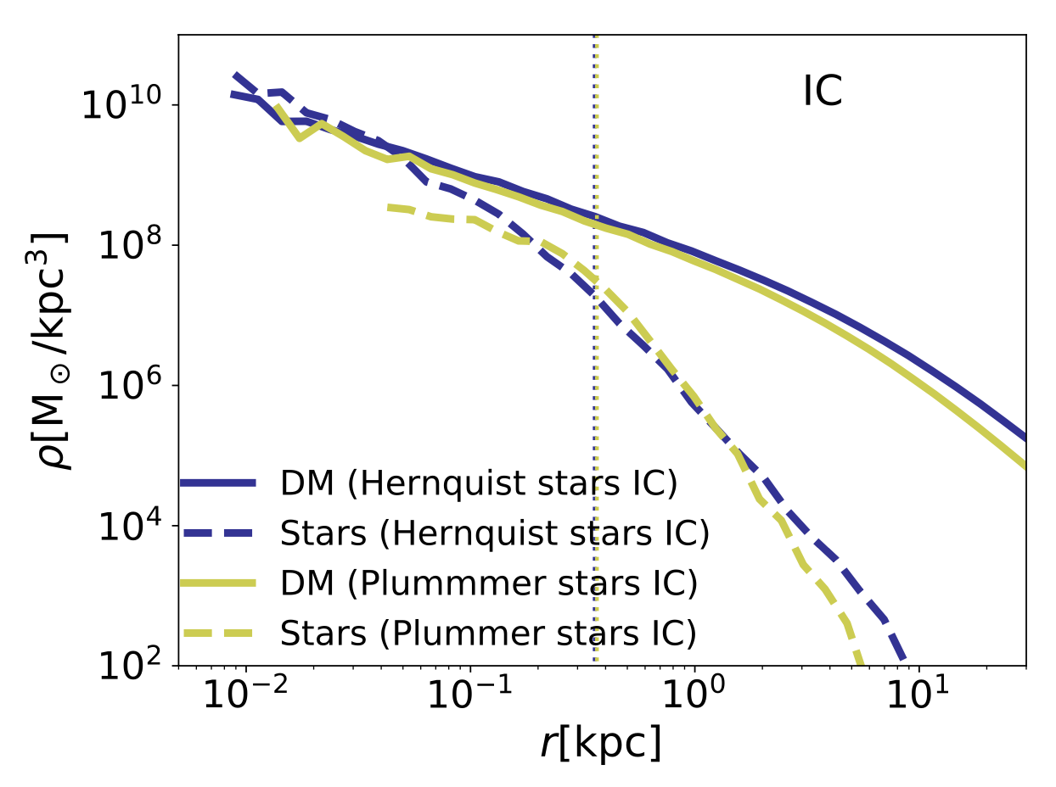
Staged simulations
Zeng+ 2412.14621
Fornax-mass dwarf (inspiration was the “galaxies without dark matter”), initialized with properties consistent w/M*-M_{h} and size-mass relations
Stars are dynamically important
10⁷ particles, star and DM particles have the same mass
Galaxy is either isolated, or on one of four, ever more eccentric, orbits in a group-scale system
Full evaporation modeling!
https://www.youtube.com/watch?v=4kOeuhtVzhc
Notes:
Carton is now a postdoc at TAMU. We drew inspiration from Jorge’s papers from ~15 years go. Used both Hernquist and Plummer ICs for the stars (note issue w/initial conditions for Plummer) because massive dwarfs and lower mass ones can have different stellar distributions

Slide 33
1. Galaxy size tracks core collapse*

Slide 34
1. Galaxy size tracks core collapse*
*Except when it doesn’t

Slide 35
2. Evaporation matters
Depends on cross section model, orbits, etc. especially on the evaporation end.

Slide 36
4. Only cuspy galaxies with initially small M/L can yield dark matter-free galaxies for any length of time
Plummer
Hernquist
Can form DM-free galaxies w/Plummer stellar profiles under some conditions, but it’s a transient state.

