Slide 1

The CRESST Experiment
Status and Outlook
Colin Moore | Max-Planck-Institut für Physik
on behalf of the CRESST collaboration

Slide 2
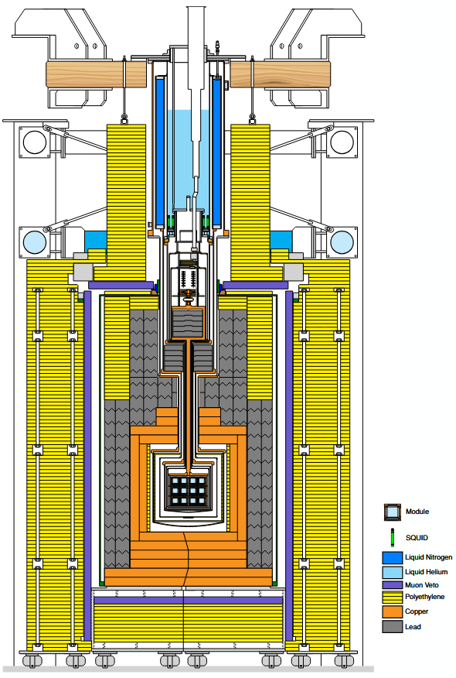
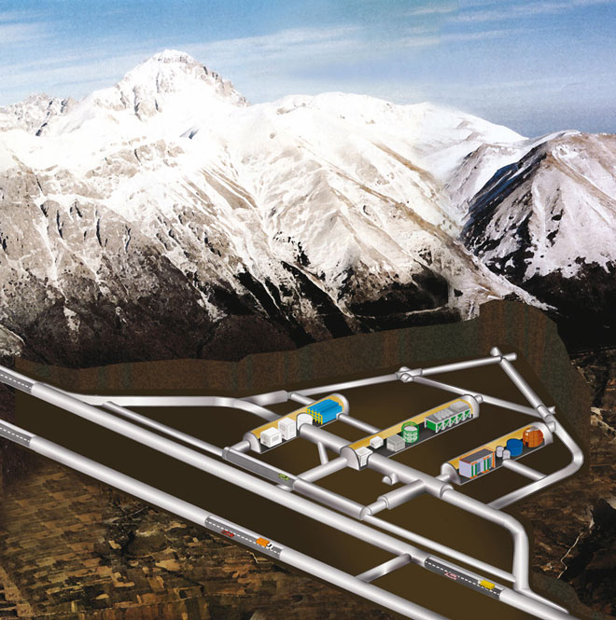










CRESST
~60 collaborators | 9 Institutions | 5 countries

Slide 3
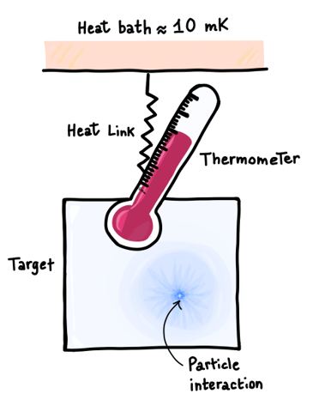
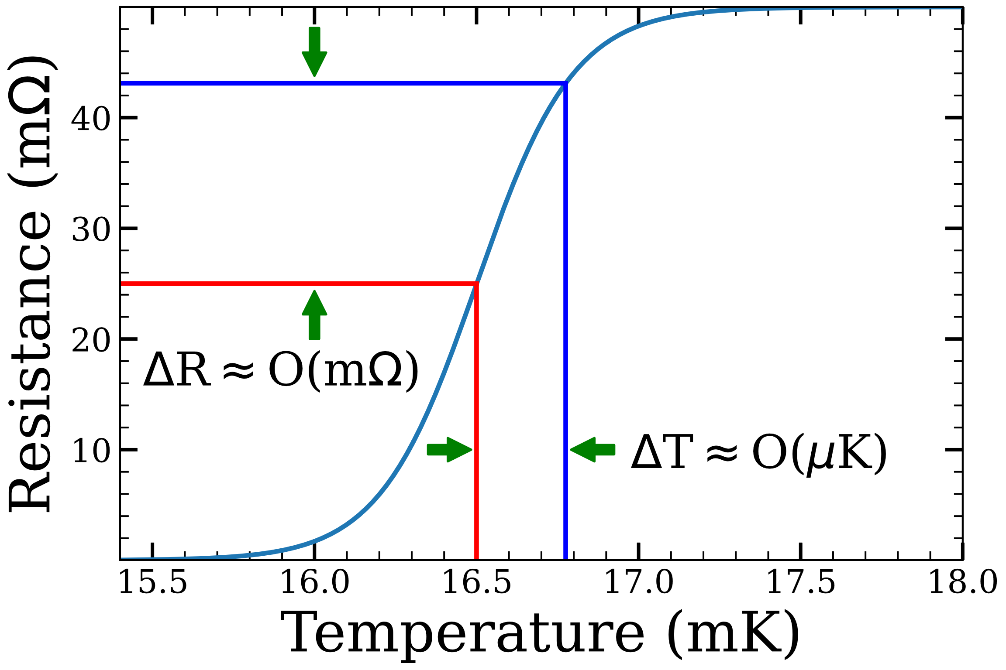
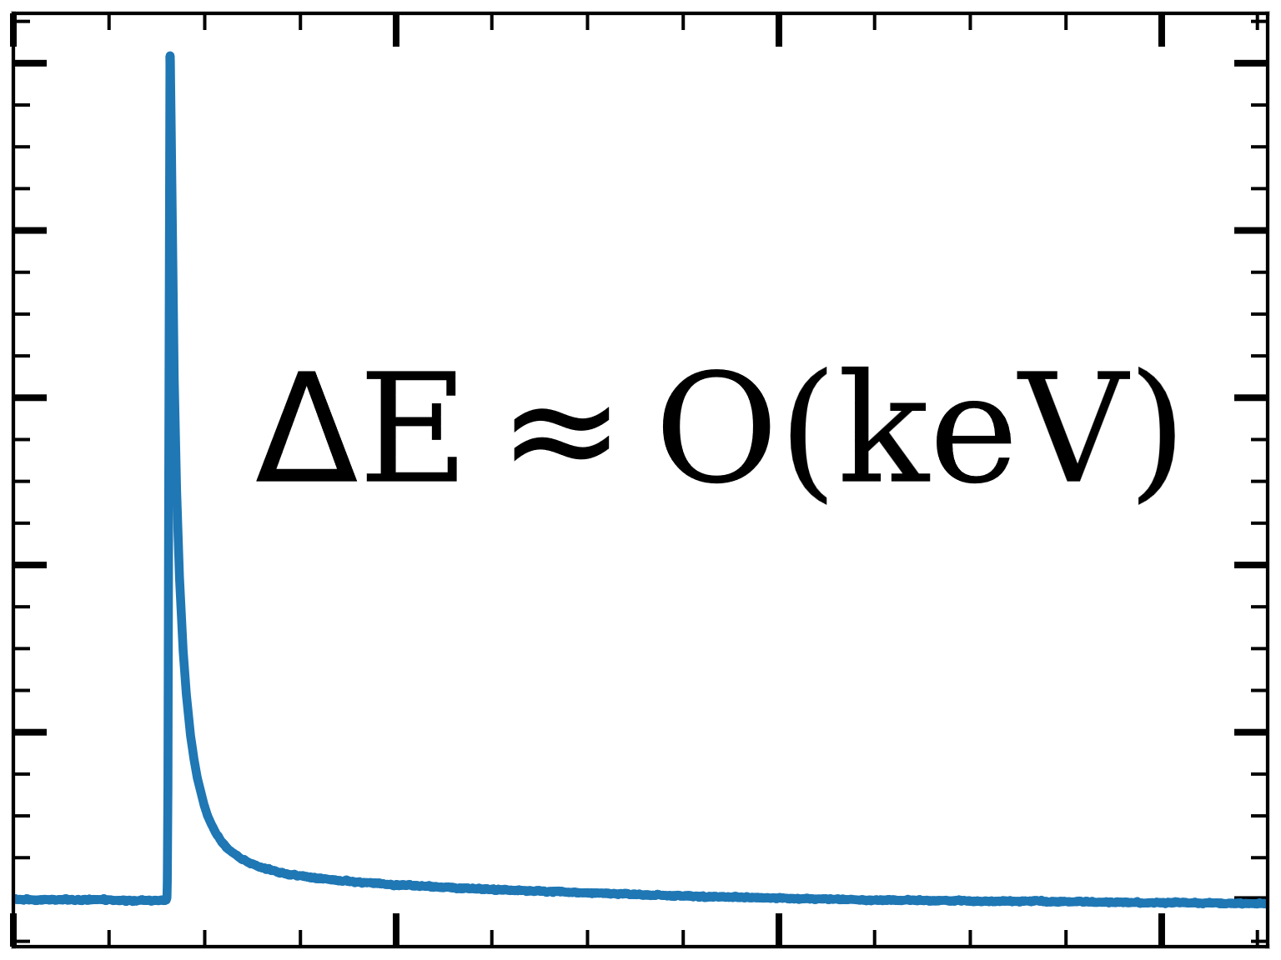
Transition Edge Sensors
Thin tungsten film maintained in superconducting transition
Small change in temperature of crystal produces measurable change in resistance
Aluminum fins increase phonon collection area
Operating point maintained via gold resistive heater
TES
Heater
W
Al
Au
Notes:
Add energy range
Add TES schematic

Slide 4
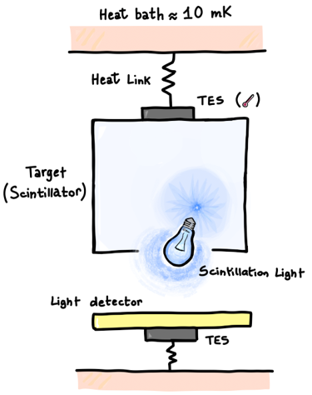
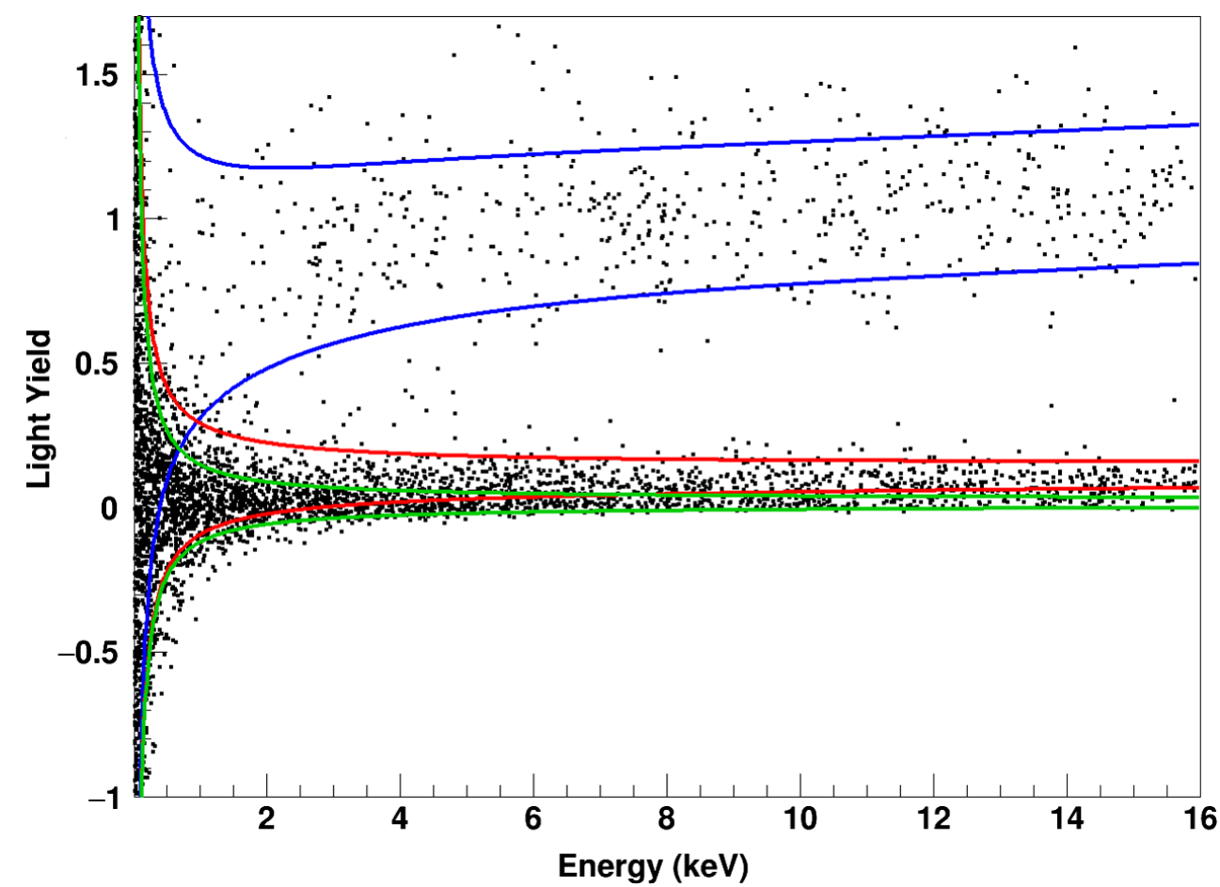
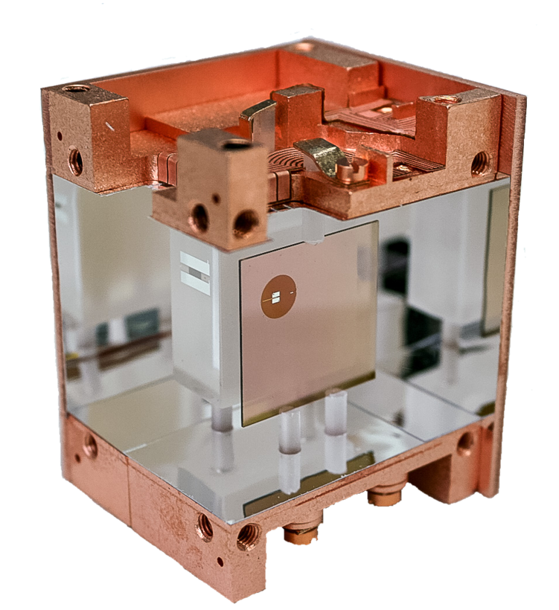
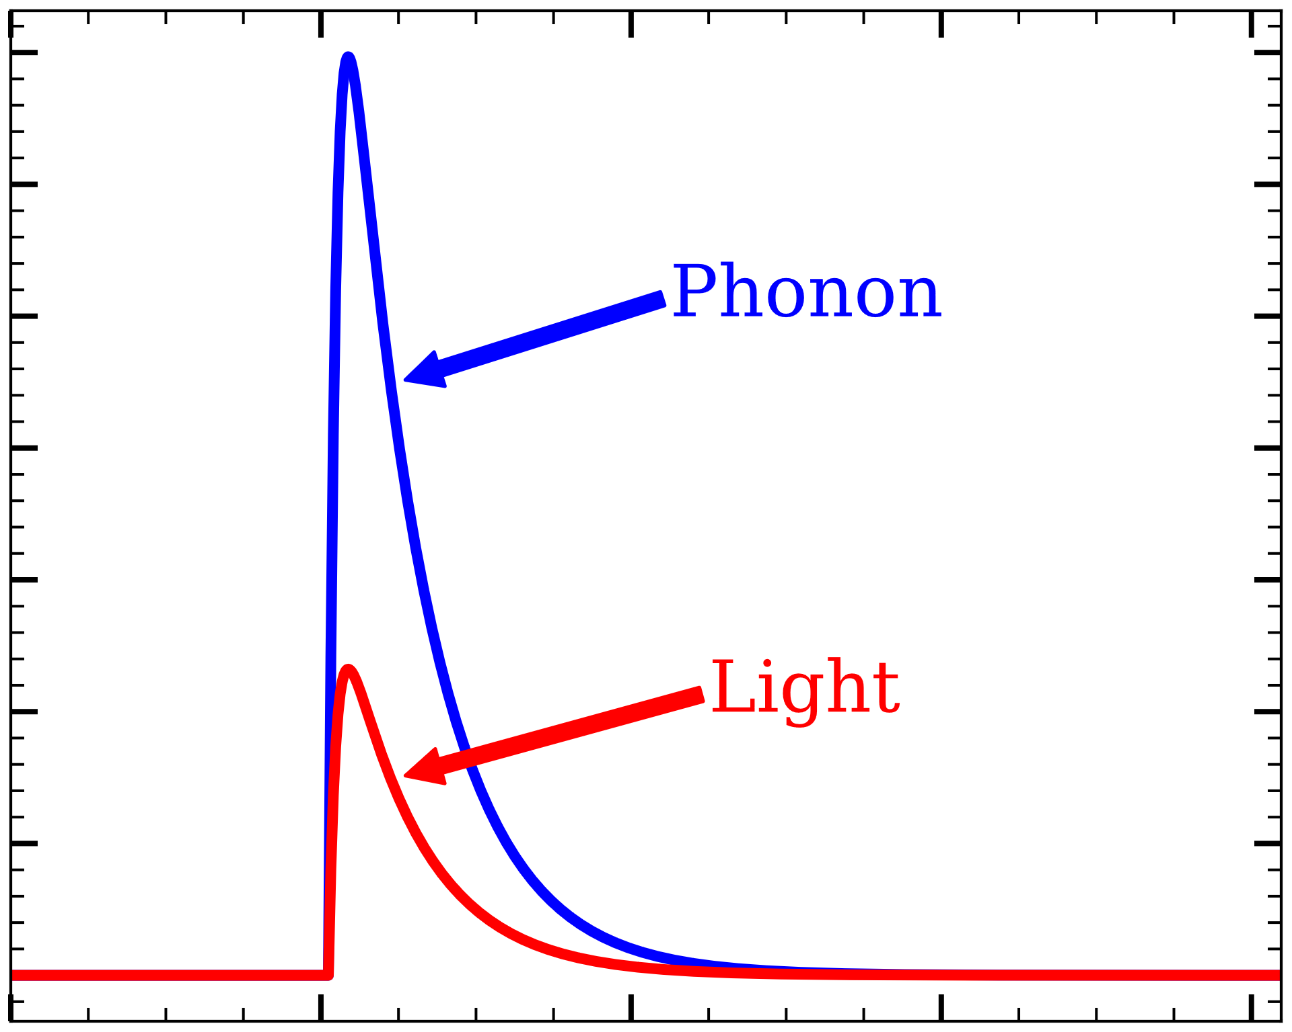
Transition Edge Sensors
10.1103/PhysRevD.100.102002
Two Modes:
Phonon
> 90% deposited energy
Independent of particle type
Light
< 10% deposited energy
Dependent on particle (quenching)
ER
NR
Absorber
Light Detector

Slide 5
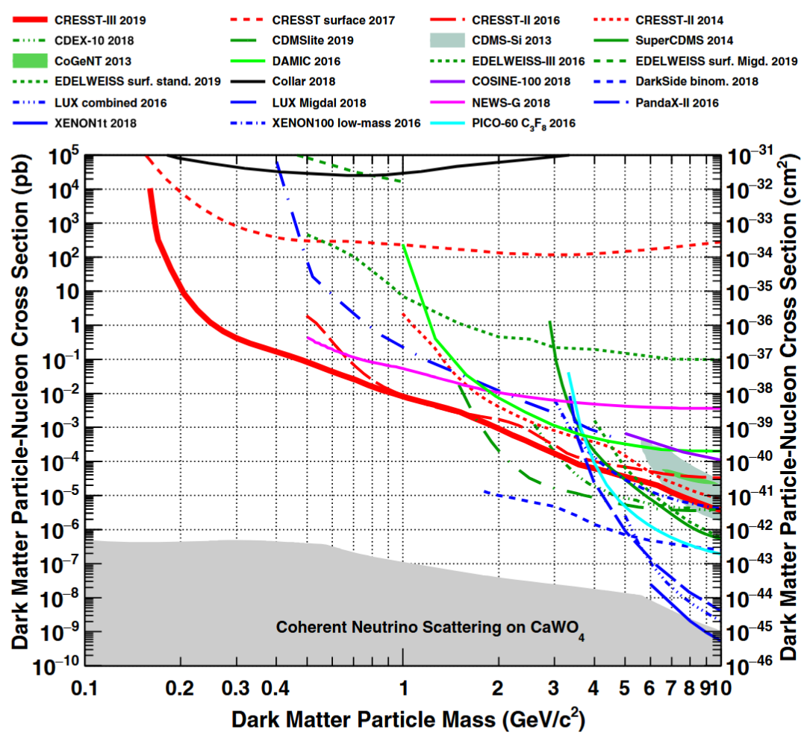
CRESST-III 2019 Results
World-leading 0.16 < m_{χ} < 1.2 GeV
10.1103/PhysRevD.100.102002

Slide 6
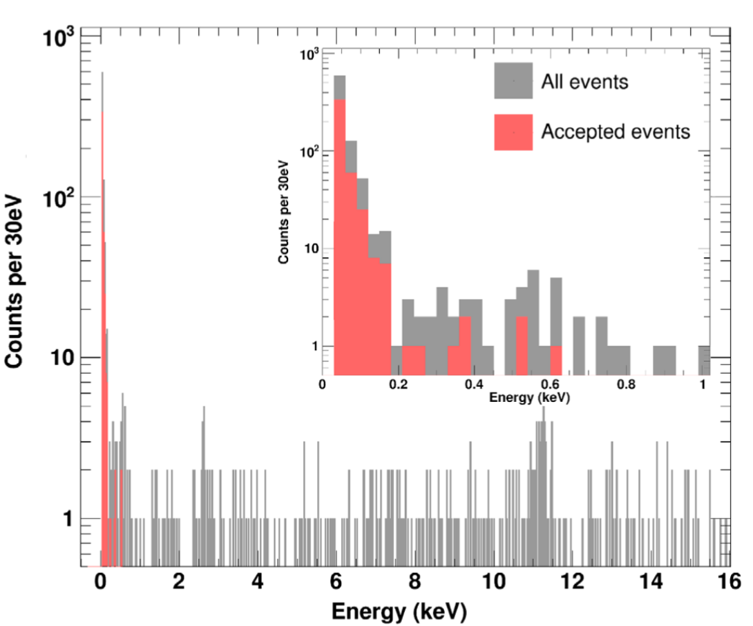
CRESST-III 2019 Results
World-leading 0.16 < m_{χ} < 1.2 GeV
BUT
Unknown background below ~200 eV
“Low Energy Excess” (LEE)
10.1103/PhysRevD.100.102002

Slide 7
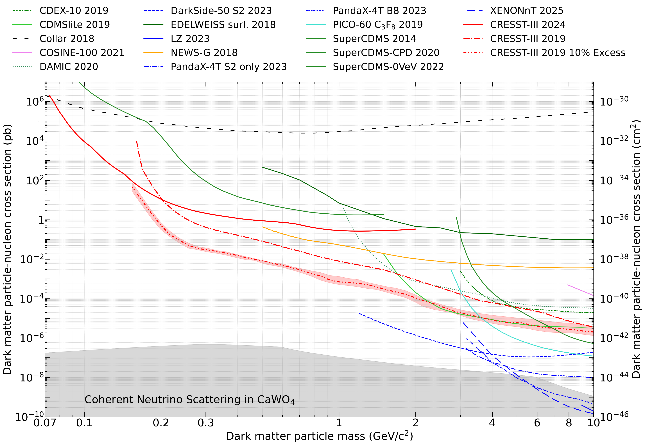
Effect of LEE on Dark Matter Search
Notes:
Update slides from Felix

Slide 8
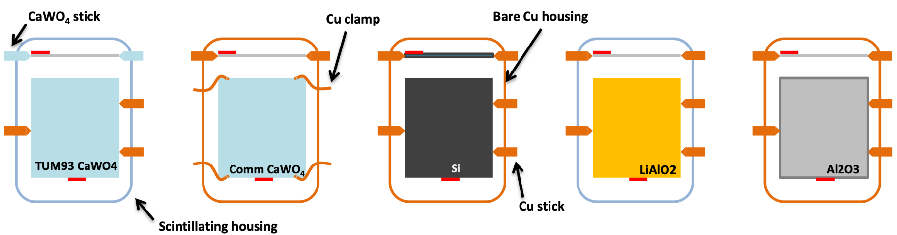
Attempts to Mitigate LEE
Exchange target material
Compare commercial and self-grown crystals
Removed scintillating material from housing
Replaced scintillating sticks with clamps
Different target geometries
Notes:
Not grav assist

Slide 9
Attempts to Mitigate LEE
Exchange target material
Compare commercial and self-grown crystals
Removed scintillating material from housing
Replaced scintillating sticks with clamps
Different target geometries
Exchange target material
Compare commercial and self-grown crystals
Removed scintillating material from housing
Replaced scintillating sticks with clamps
Different target geometries
Notes:
Not grav assist

Slide 10
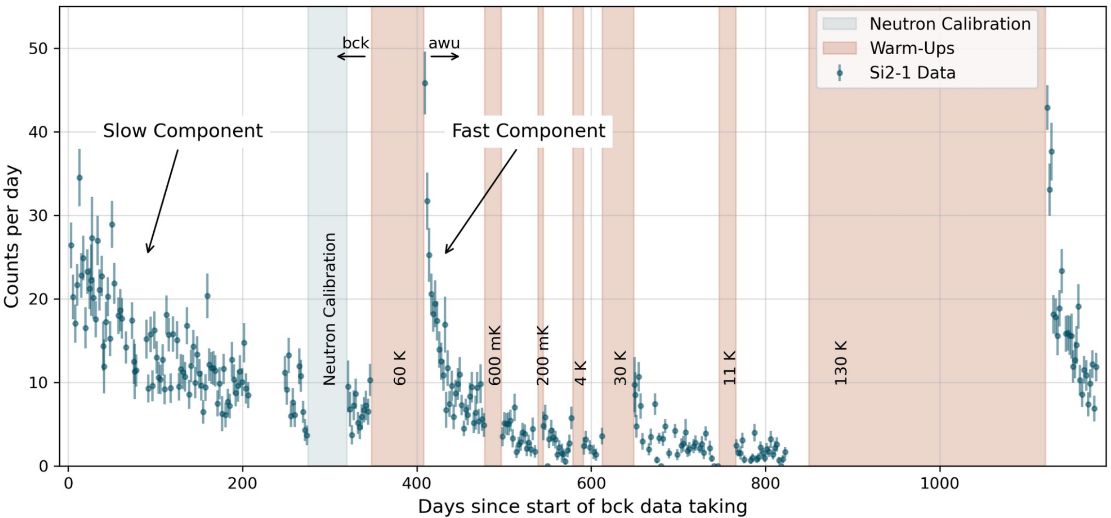
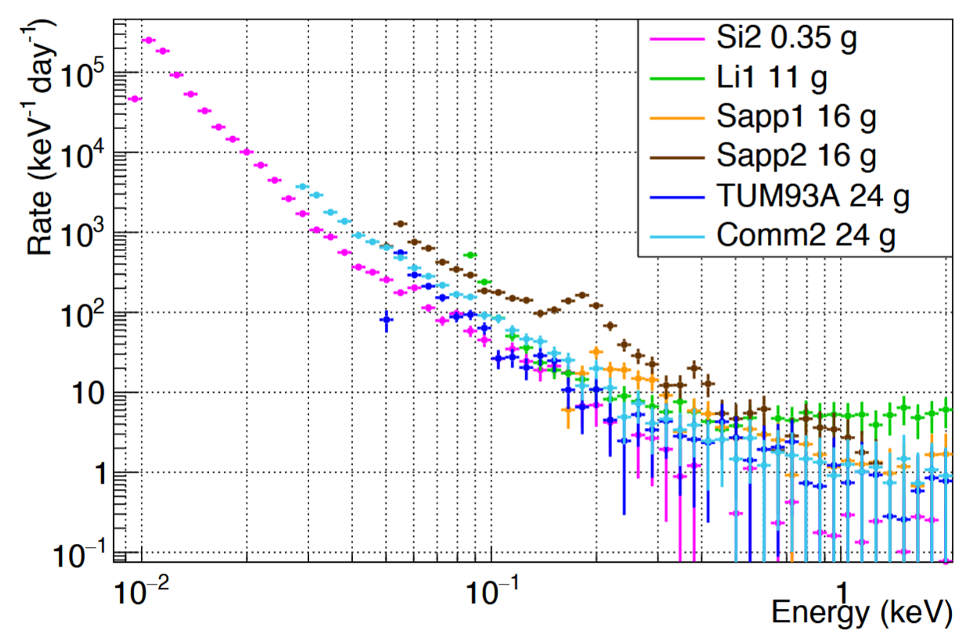
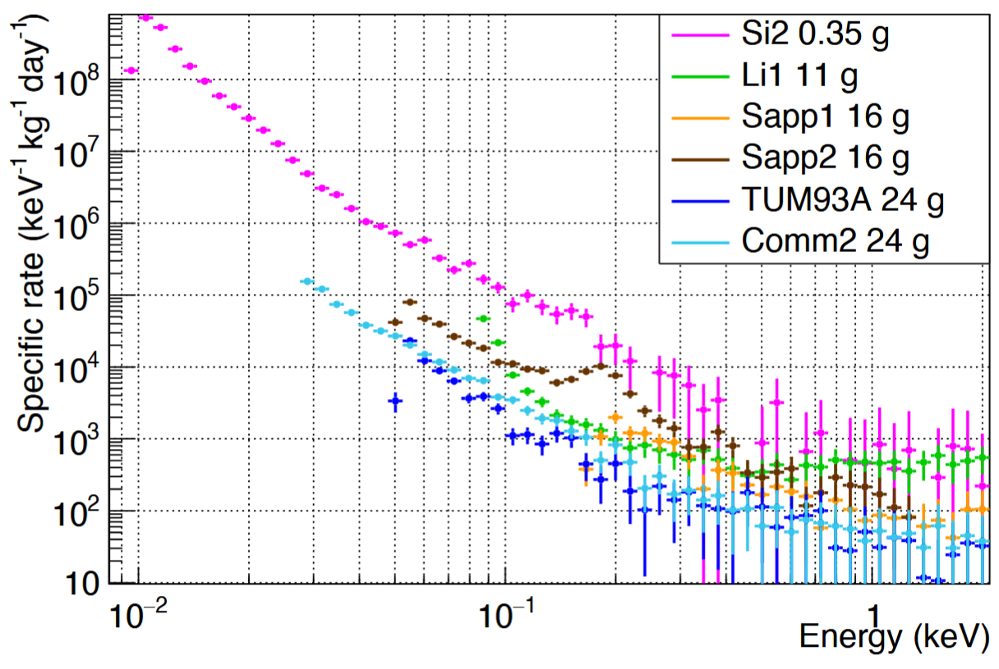
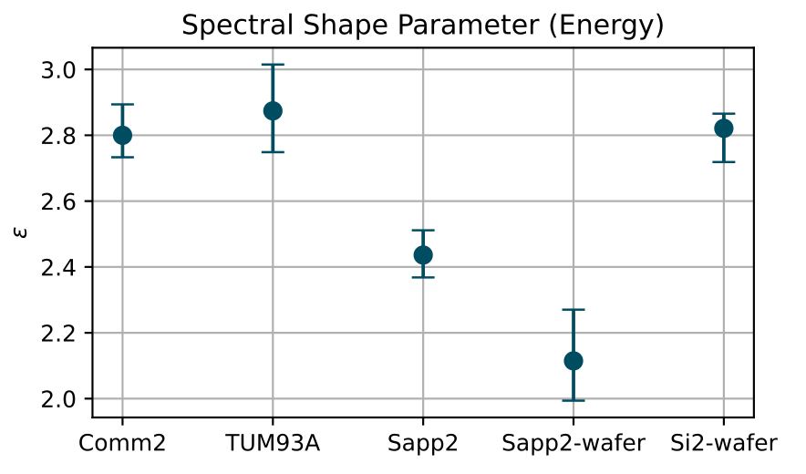
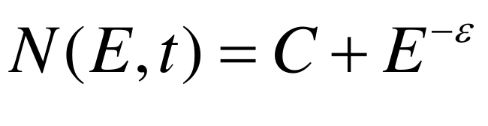
What We’ve Learned
Decays over time:
  Fast decay time ~10 days
  Slow decay time ~250 days
Fast component can be reset
with thermal cycles
Calibrations do not affect LEE
Shape definable by power law,
but different between detectors
→not DM, radiological in origin
10.1140/epjc/s10052-024-13282-8
Notes:
Non-identical spectral shape
Well defined by power law

Slide 11
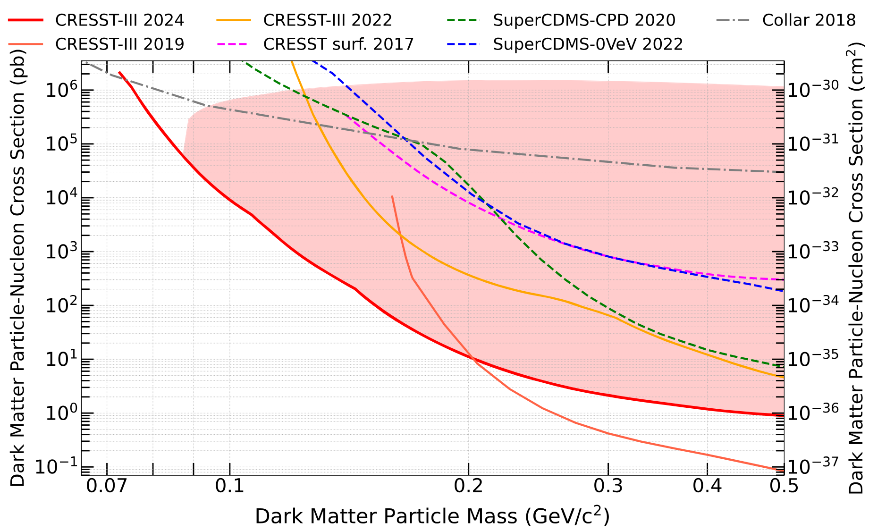
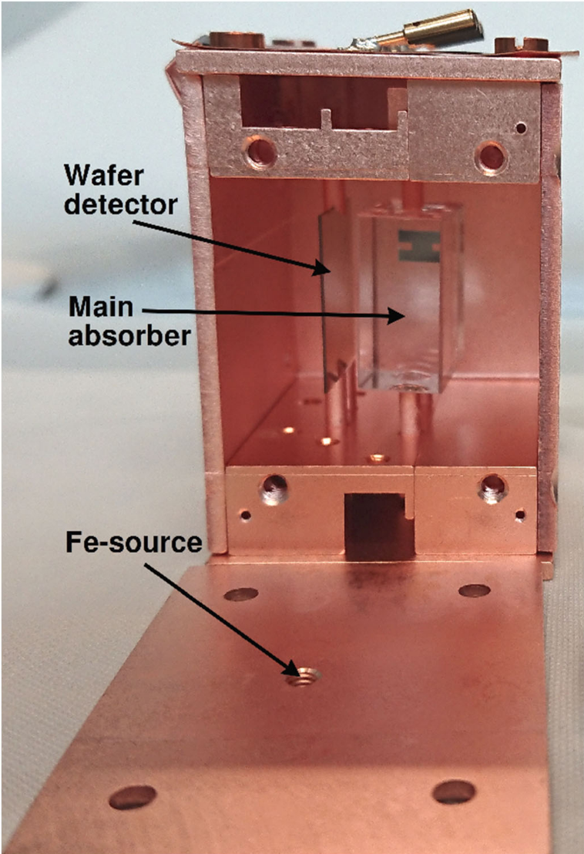
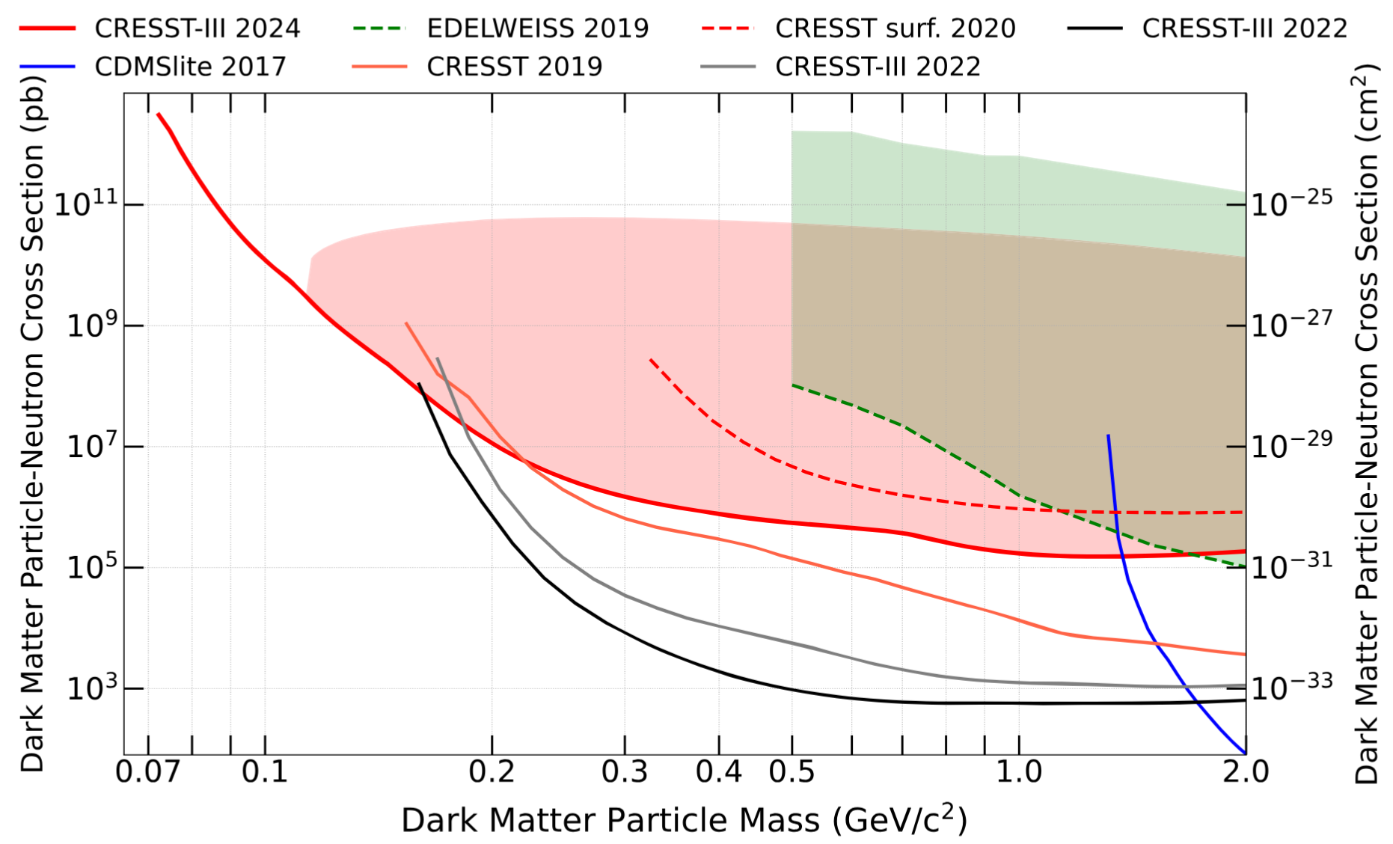
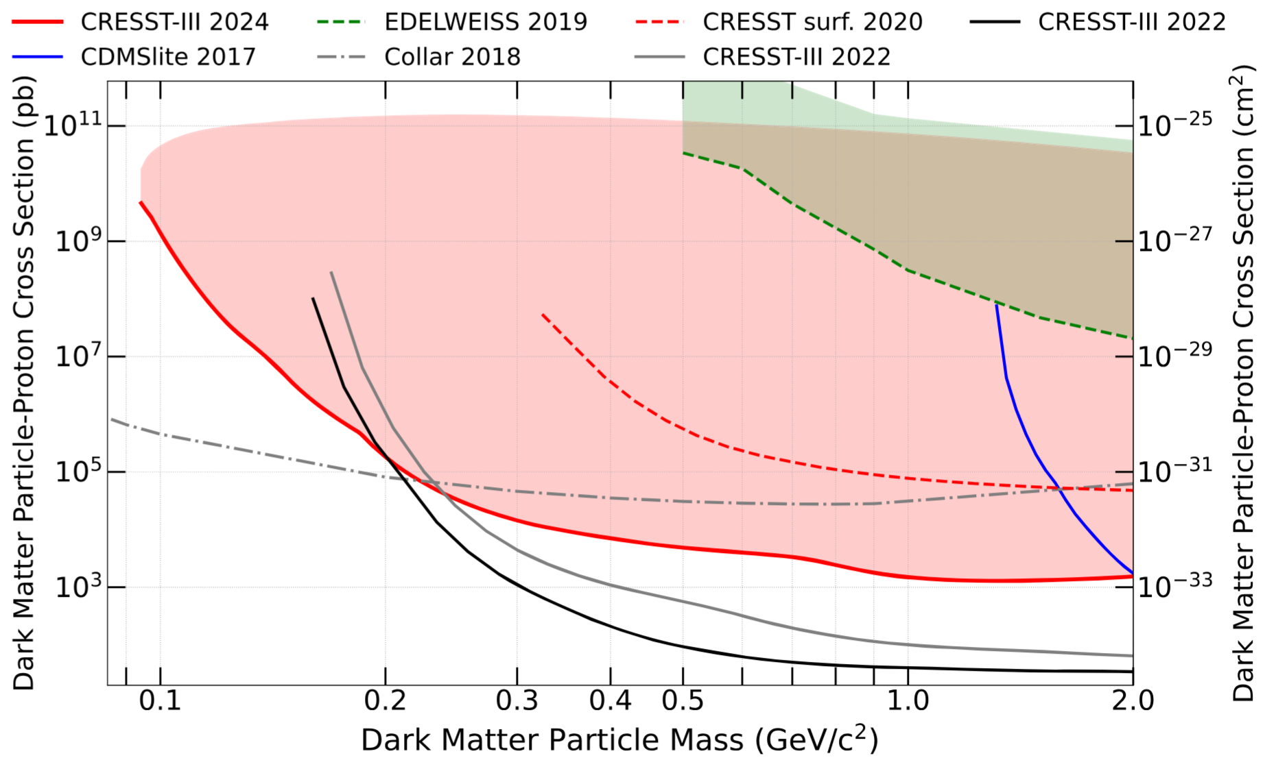
Low-threshold Dark Matter Results
10.1103/PhysRevD.110.083038
Light detector analysed for dark matter limit
Material: Al₂O₃
Mass: 0.6 g
Exposure: 138 g ∙ days
Resolution: 1 eV
Threshold: 6.7 eV_{nr}
SI
SD_{n}
SD_{p}
Notes:
Check Collar
Also black/grey lines are from same CRESST run

Slide 12
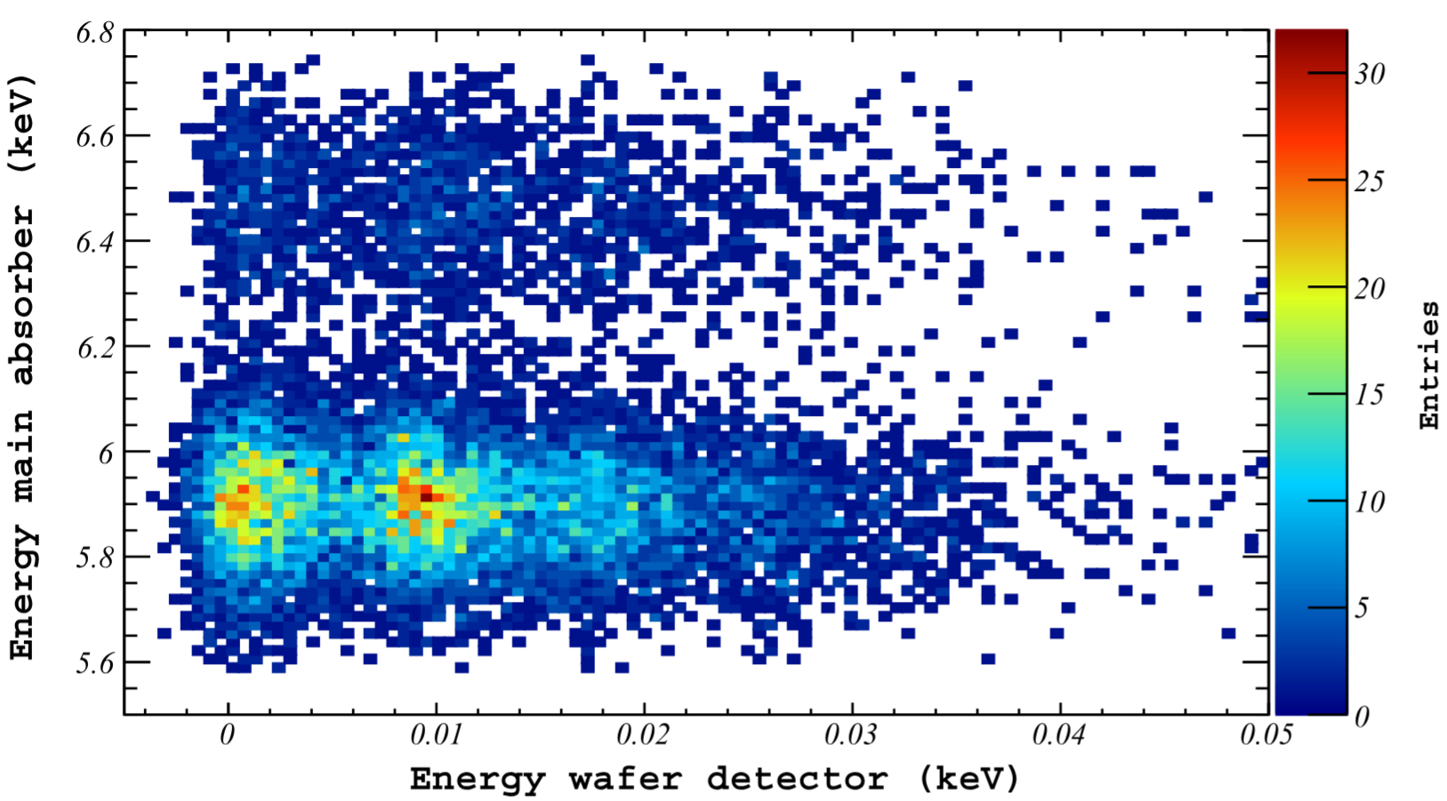
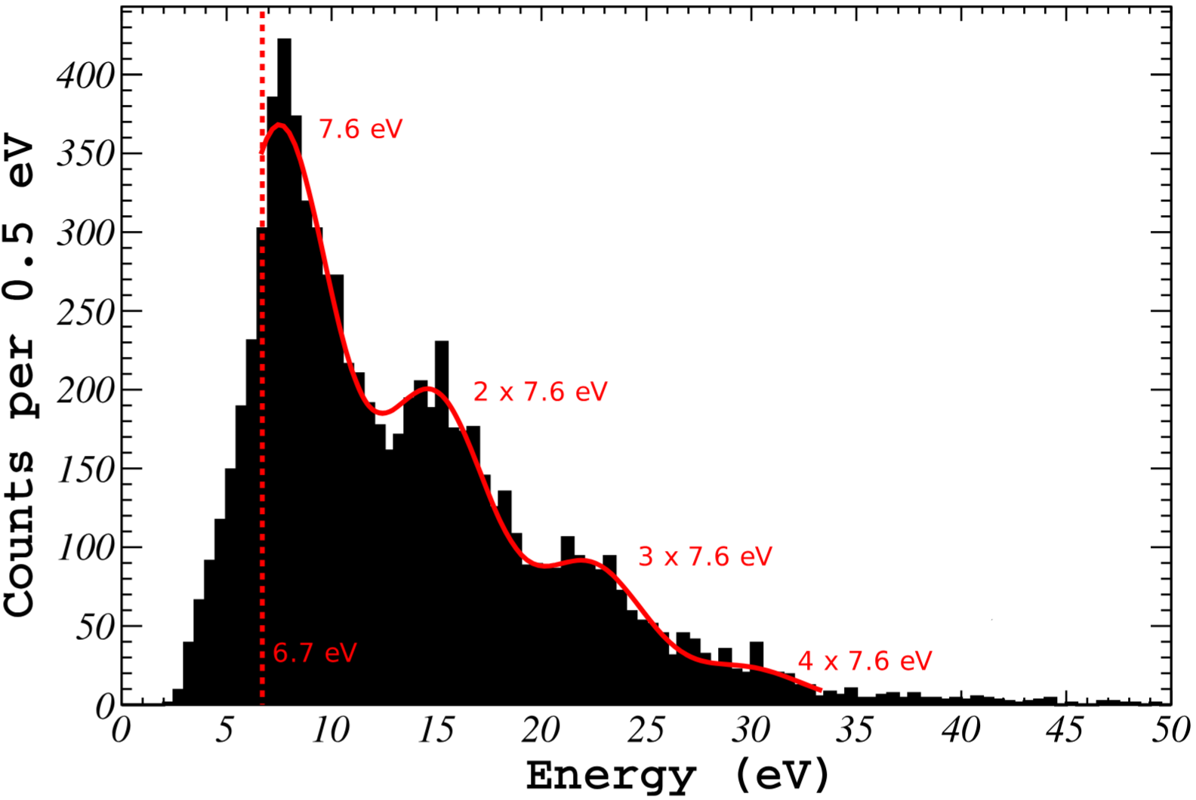
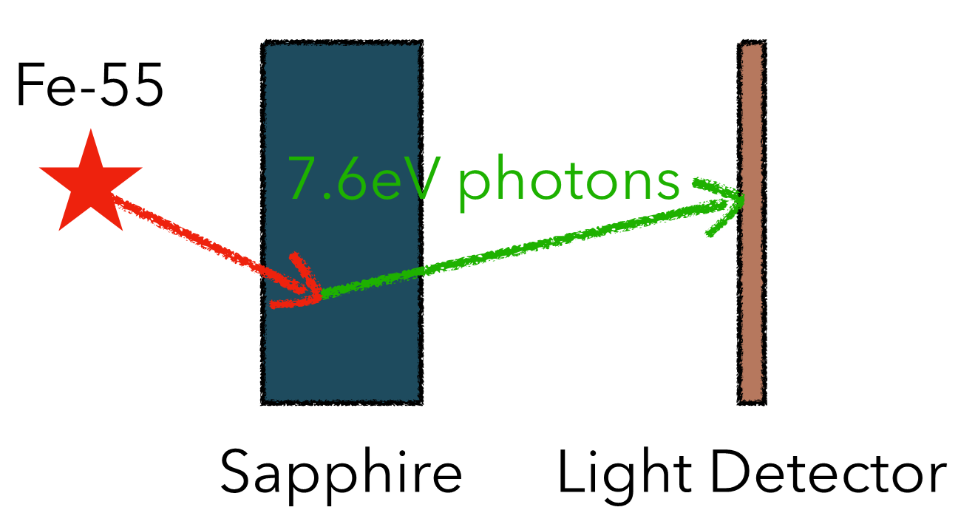
Low-threshold Dark Matter Results
First observation of single photons with CRESST detector
10.1103/PhysRevD.110.083038

Slide 13
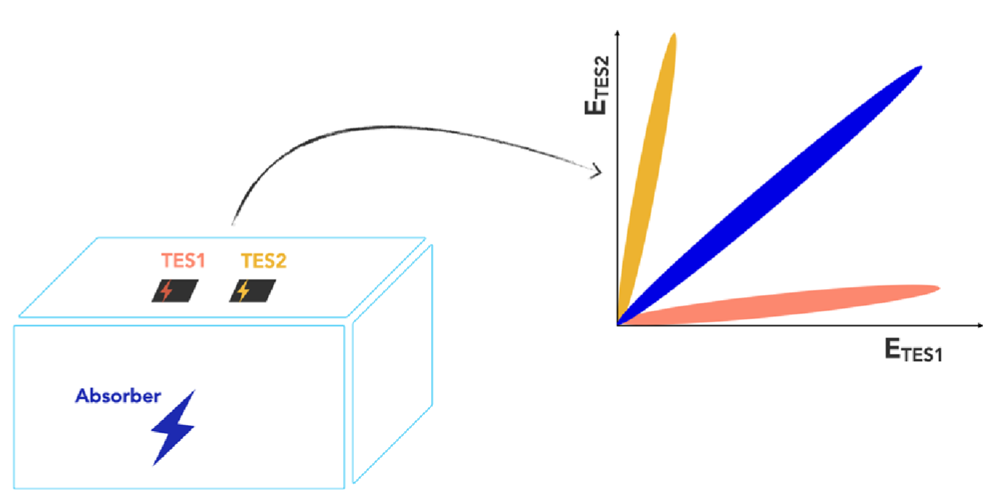
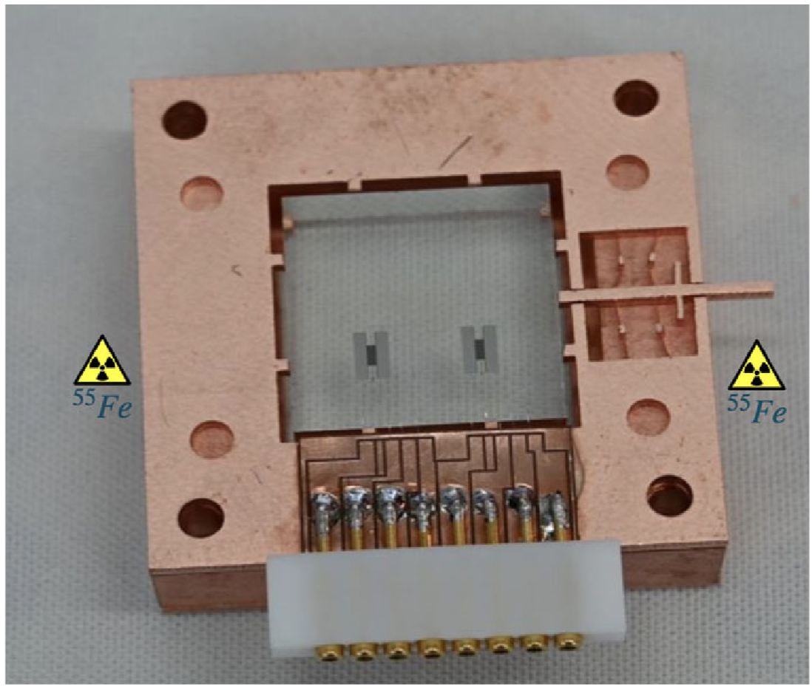
DoubleTES Detectors
Can LEE be attributed to sensor? If so, with a second TES:
  Events in single sensor are vetoed by second
  → singles
  Events in bulk are observed in both sensors
  → shared

Slide 14
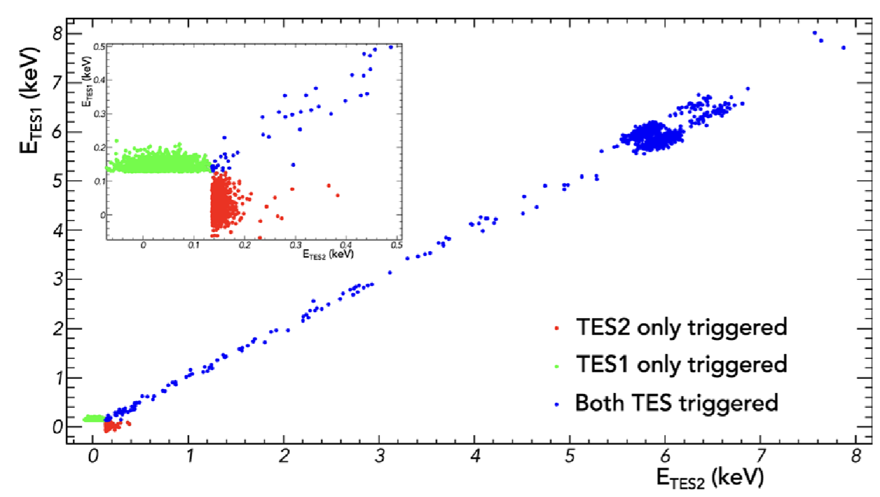
DoubleTES Detectors
Can LEE be attributed to sensor? If so, with a second TES:
  Events in single sensor are vetoed by second
  → singles
  Events in bulk are observed in both sensors
  → shared
10.1140/epjc/s10052-024-13282-8
Does not eliminate LEE, but greatly reduced

Slide 15
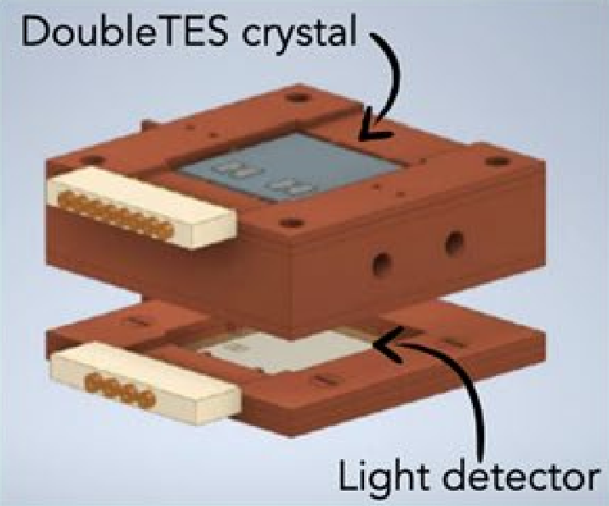
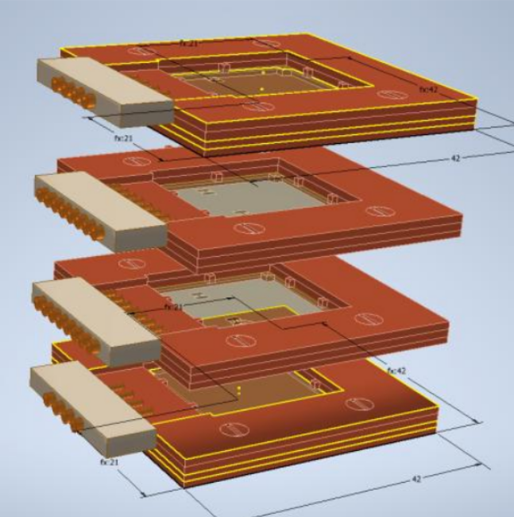
CRESST-III Current Status
5x Standard DoubleTES:
  CaWO₄, 20x20x10 mm³
  Instrumented with two TES
  Standard light detector
DoubleTES Stack:
  4x Silicon-on-Sapphire, 20x20x0.4 mm³
  Instrumented with two TES

Slide 16
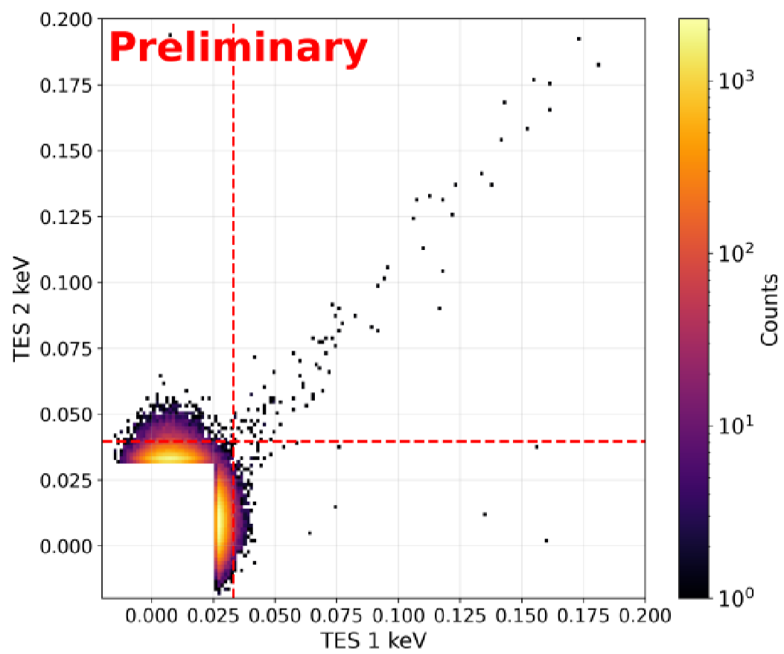
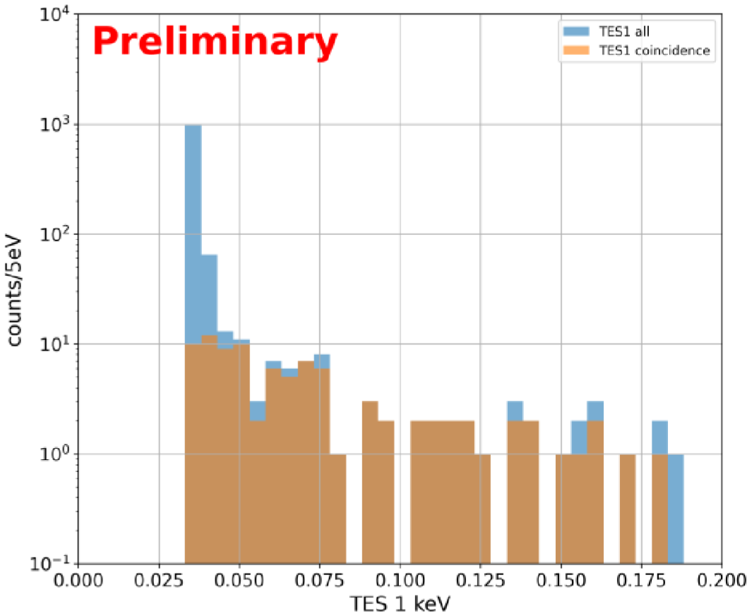
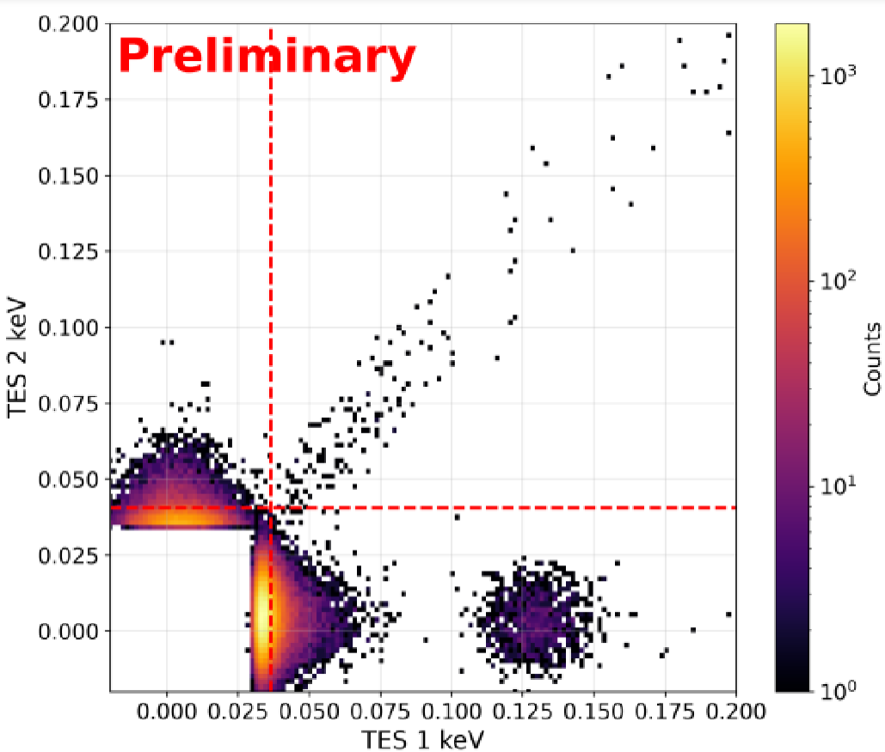
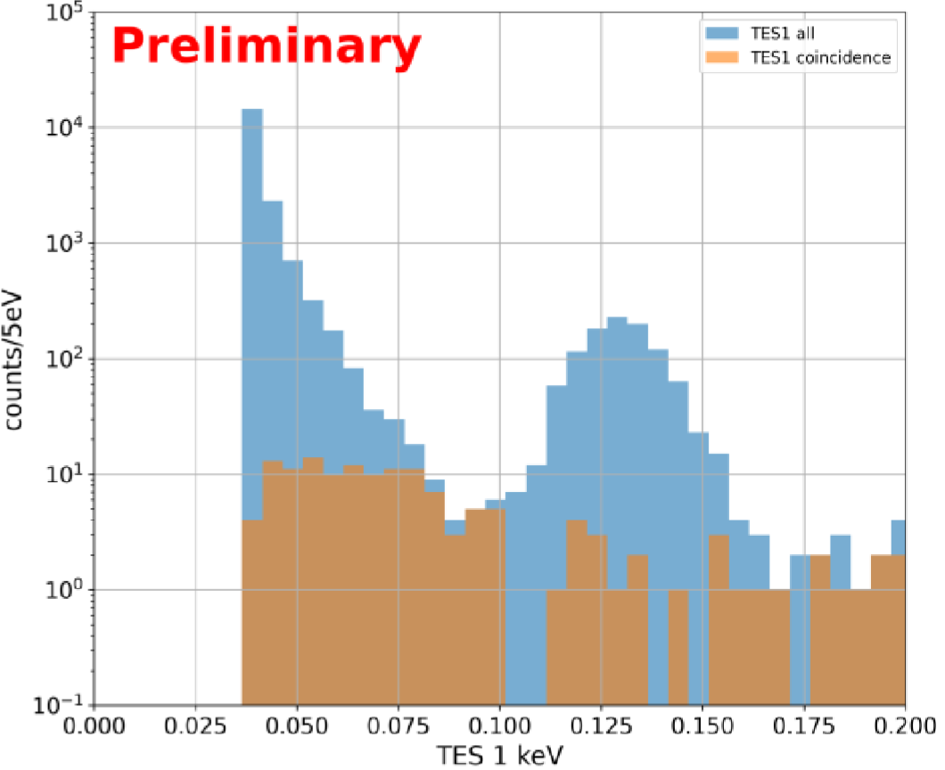
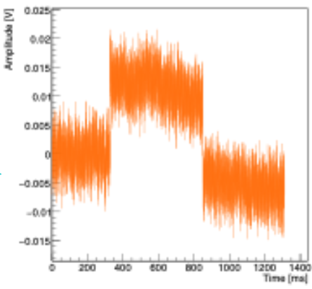
Preliminary Results – CaWO₄
Module | Baseline Res TES1 (eV) | Baseline Res TES2 (eV)
1 | 16 | -
2 | 5 | 5
3 | 10 | -
4 | - | 9
5 | 8 | 7
All modules have at least one working TES
Good baseline resolutions
3 TES detectors failed before data collection
Data collection on hold for He liquefier upgrade
→ Maintenance of affected modules

Slide 17
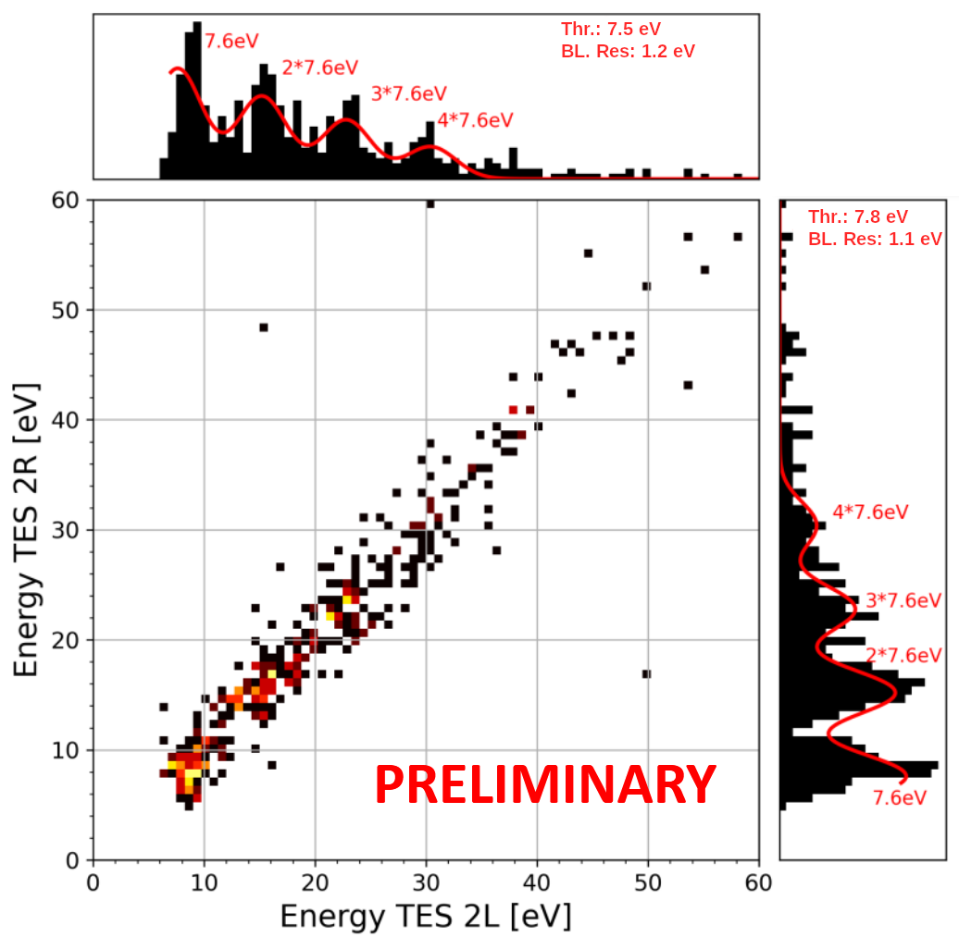
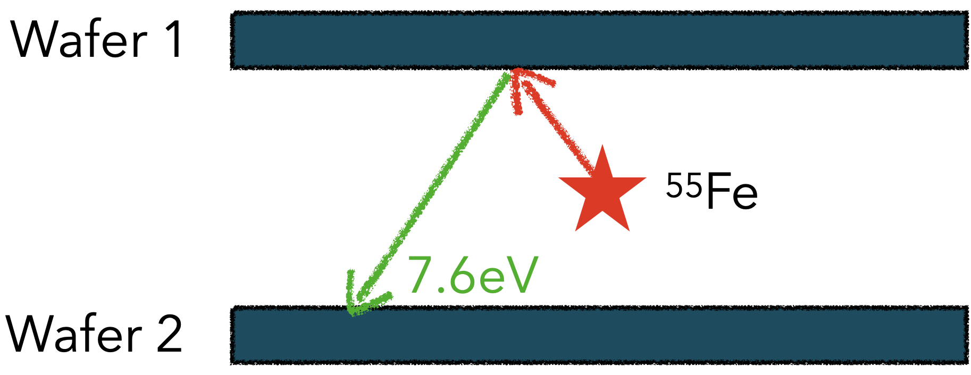
Preliminary Results – Wafer Stack
Stack | Baseline Res TES1 (eV) | Baseline Res TES2 (eV)
1 | 1.4 | 1.1
2 | 1.2 | 1.0
3 | 2.6 | 1.7
4 | 1.5 | 3.9

Slide 18
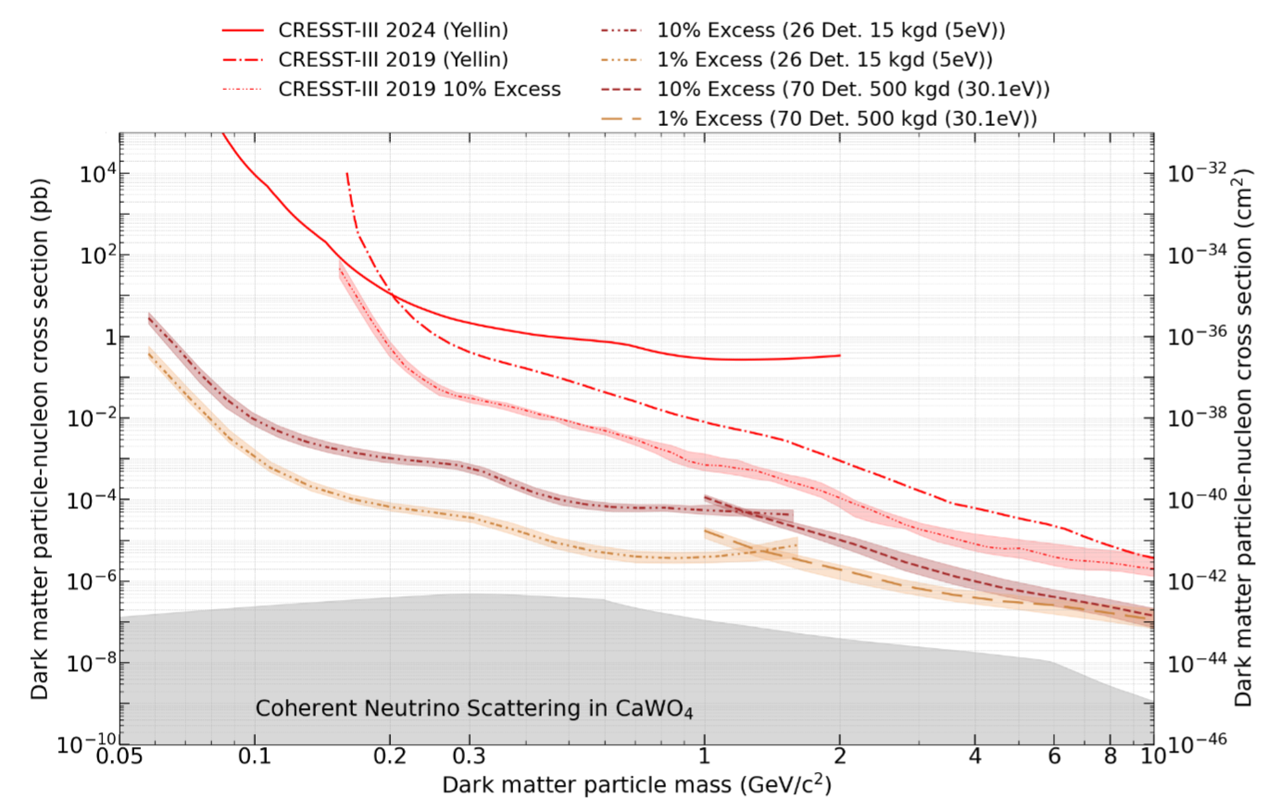
Next Steps for CRESST
Upgrade aging electronics to accommodate increased number of detectors:
Readout channels: | ~32 | 288
Active modules: | O(10) | O(100)
Notes:
Will start after current scientific campaign

Slide 19
Summary
CRESST operates cryogenic calorimeters in the search for sub-GeV dark matter, with world-leading limits below ~1.2 GeV
The LEE currently limits the sensitivity, but progress is being made
The forthcoming upgrade promises up to 3 orders of magnitude improvement in sensitivity

Slide 20

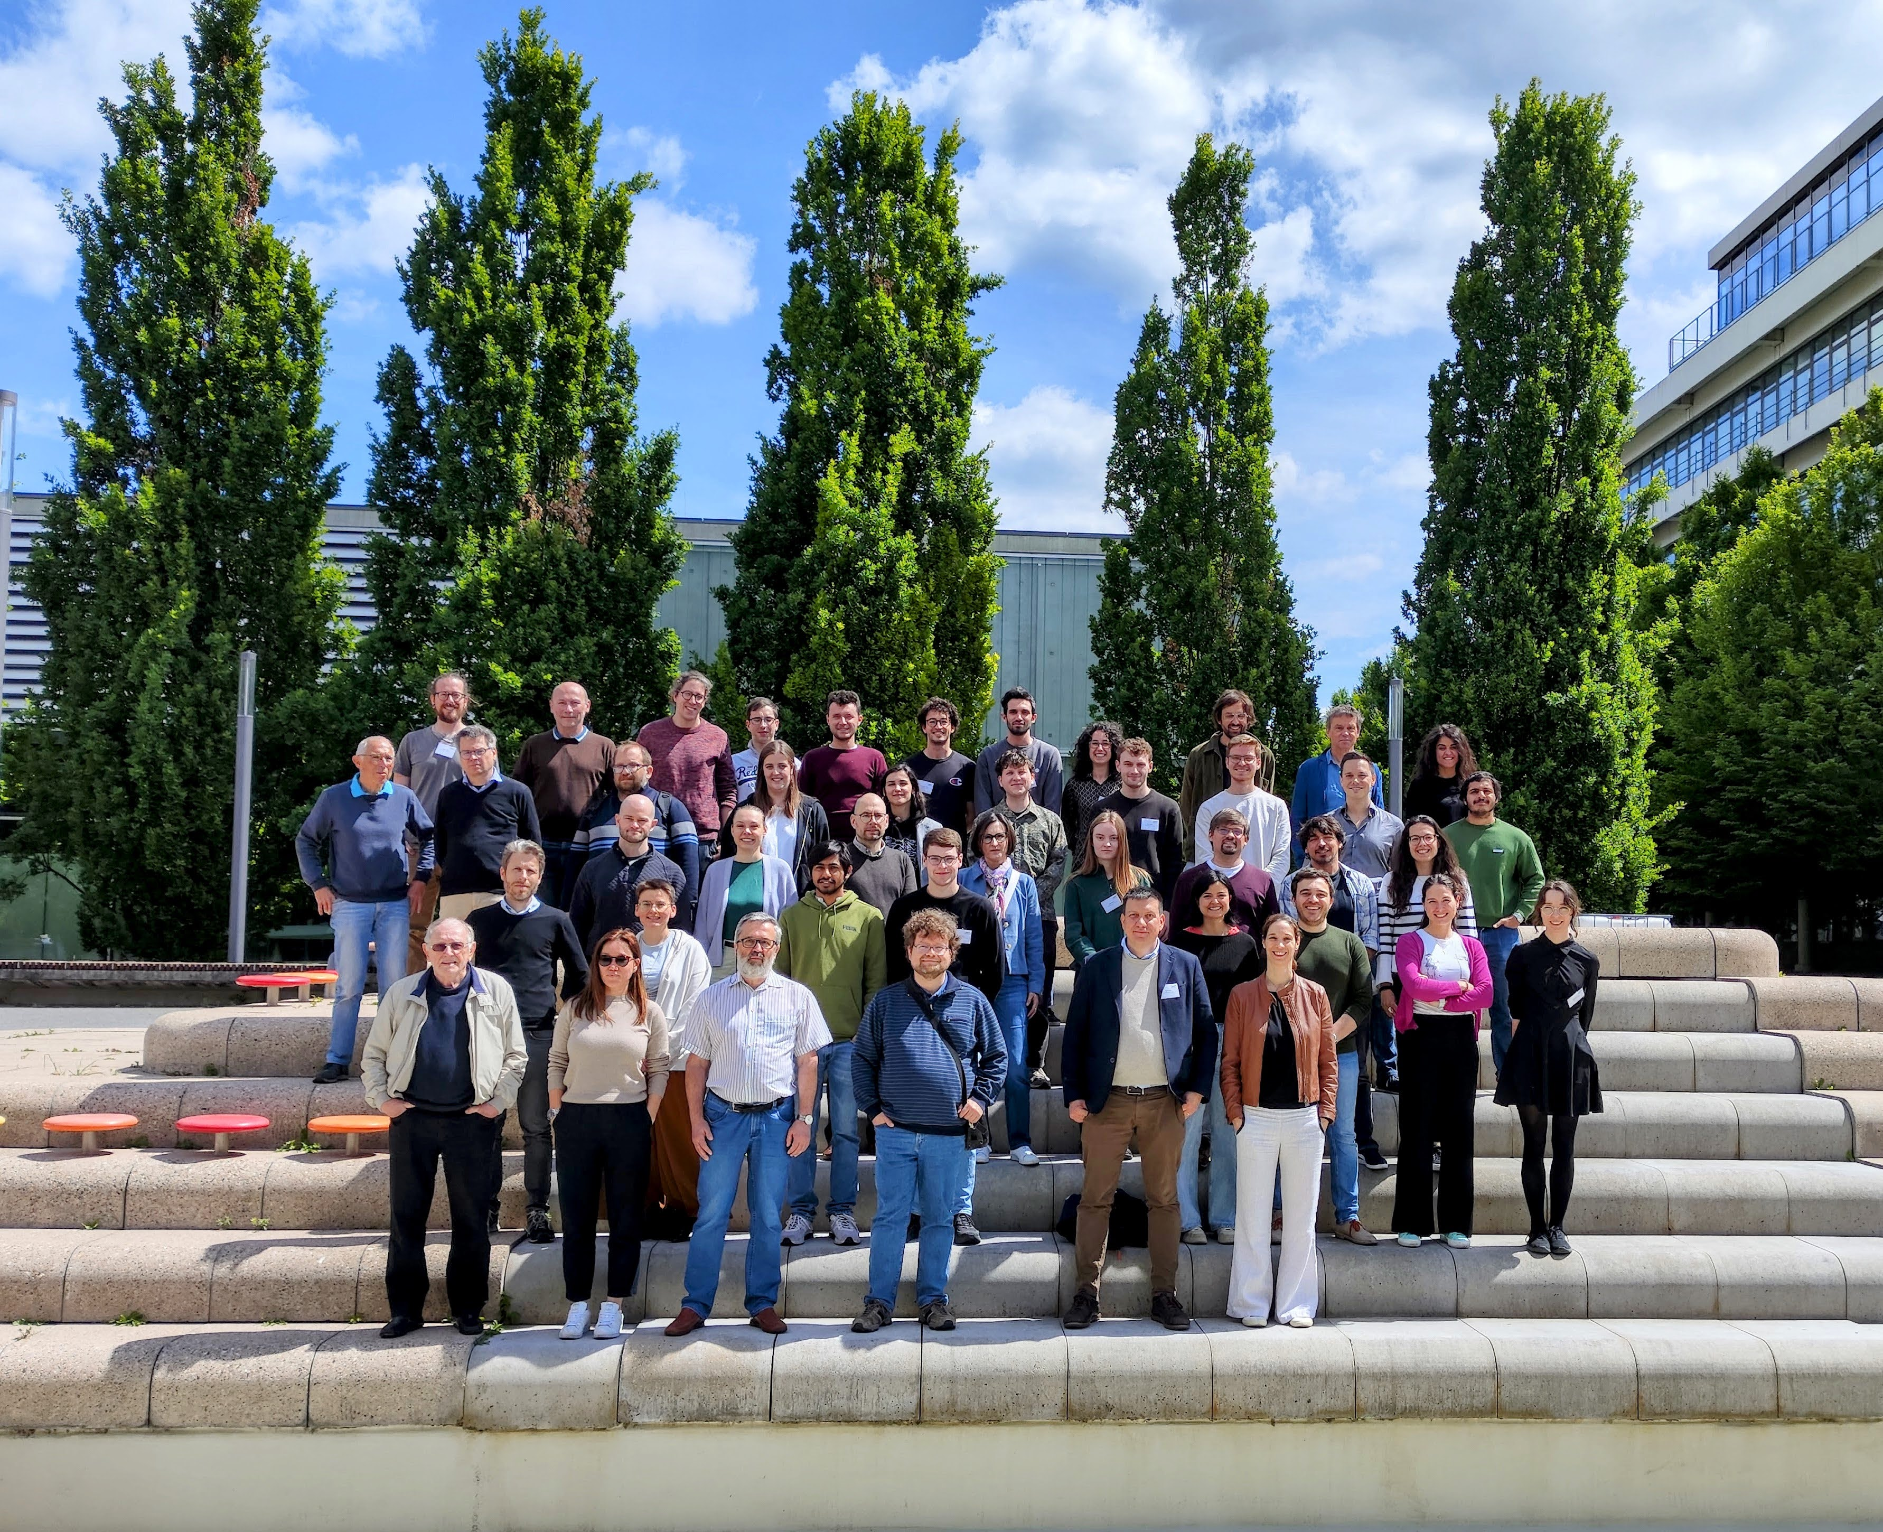

Slide 21
Backup

Slide 22
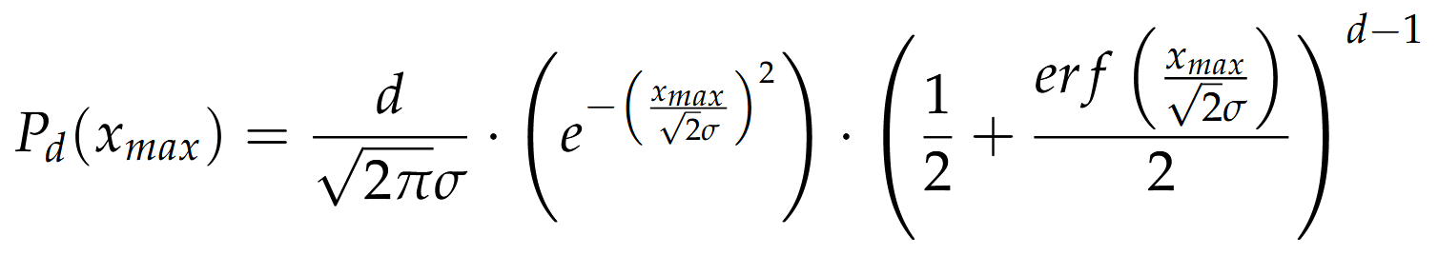
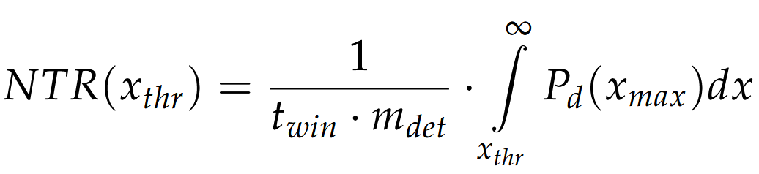
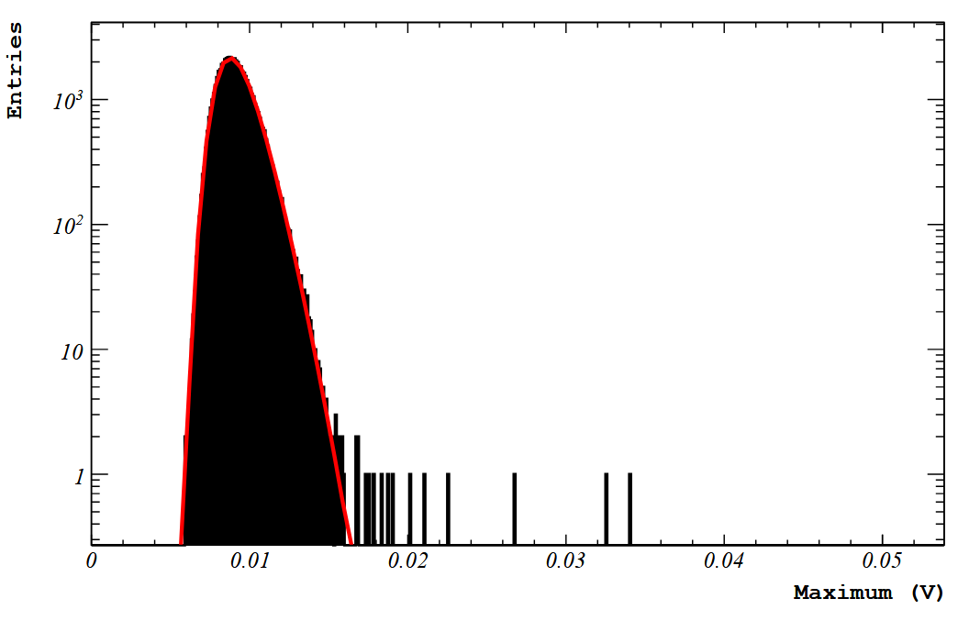
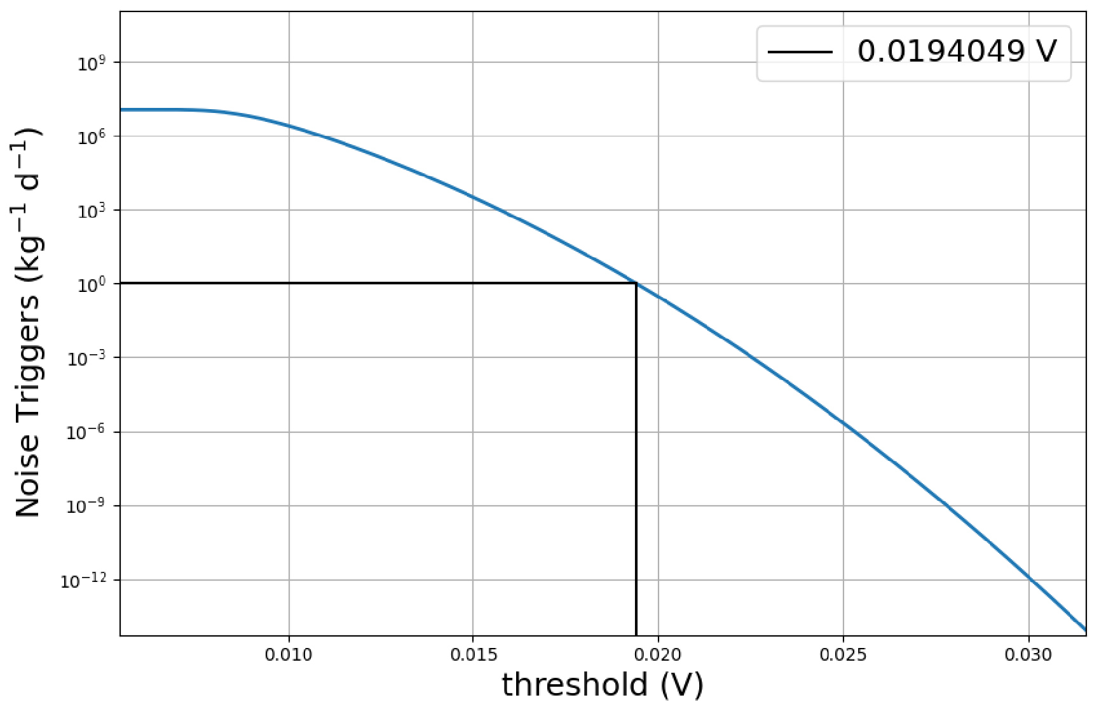
Threshold
Fuchs, D. (2023) nbn-resolving.org/urn:nbn:de:bvb:91-diss-20231004-1709800-1-3

