Slide 1
Capture, thermalisation and annihilation of Dark Matter in Compact Objects
Montreal, Dark Side of the Universe, 08/07/2025

Slide 2
MOTIVATIONS
Our works on Capture in compact stars:
Neutron Stars:
  JCAP 09 (2018) 018 (1807.02840)
  JCAP 06 (2019) 054 (1904.09803)
  JCAP 09 (2020) 028 (2004.14888)
  JCAP 03 (2021) 086 (2010.13257)
  Phys.Rev.Lett. 127 (2021) 11, 111803 (2012.08918)
  JCAP 11 (2021) 056 (2108.02525)
  JCAP 04 (2024) 006 (2312.11892)
White Dwarfs:
  JCAP 10 (2021) 083 (2104.14367)
  JCAP 07 (2024) 051 (2404.16272)

Slide 3
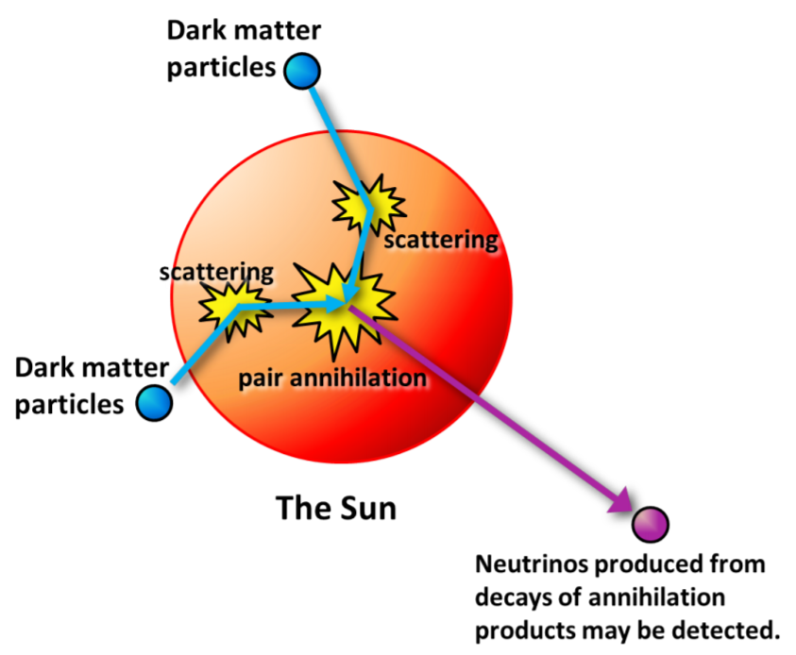
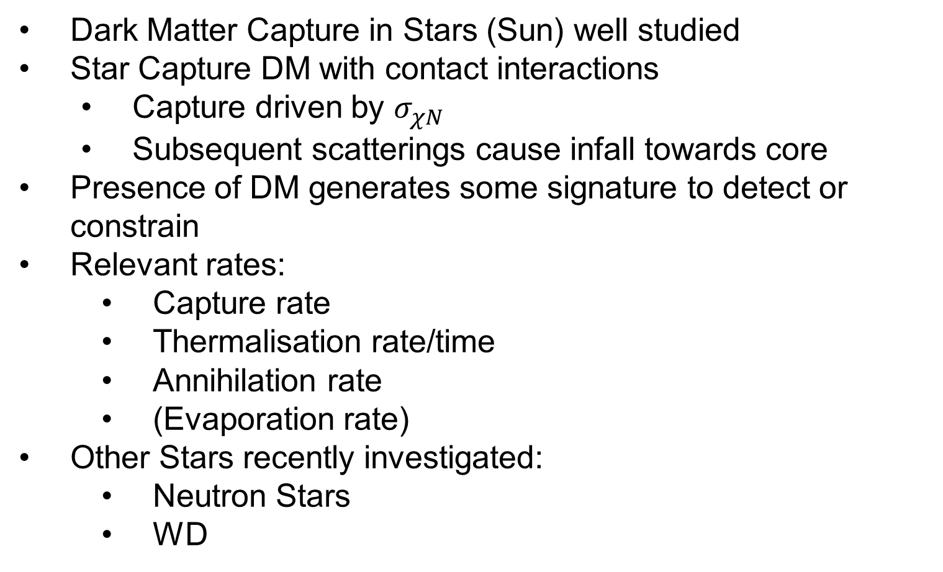
DM capture in stars
Dark Matter Capture in Stars (Sun) well studied
Star Capture DM with contact interactions
  Capture driven by $σ_{χN}$
  Subsequent scatterings cause infall towards core
Presence of DM generates some signature to detect or constrain
Relevant rates:
  Capture rate
  Thermalisation rate/time
  Annihilation rate
  (Evaporation rate)
Other Stars recently investigated:
  Neutron Stars
  WD
Sun and Convective Stars: Aaron talk on 07/07
Exoplanets and BD: Aidan talk on 10/07
Pop III stars: Walter talk on 10/07

Slide 4
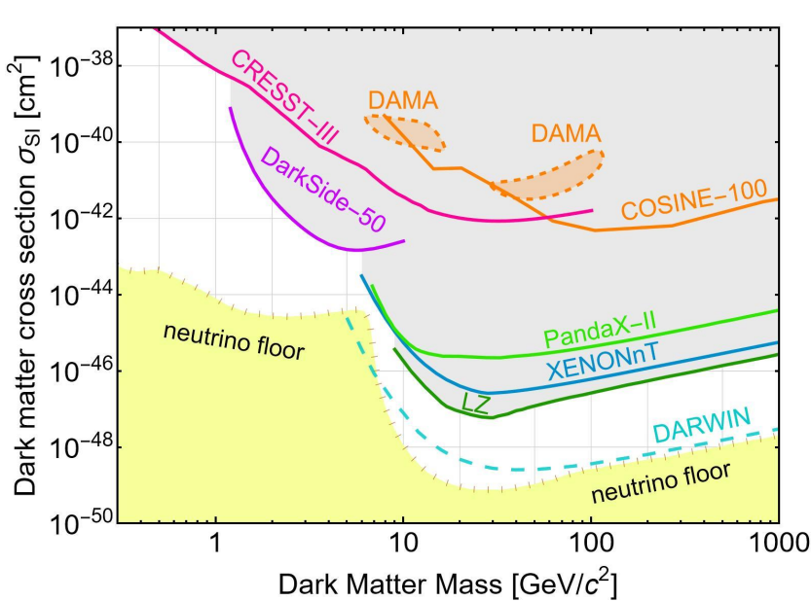

MOTIVATIONS
NS made of degenerate matter
  Neutrons
  Protons
  Electrons
  Muons
  Exotic hadrons?
WD made of Ions and degenerate electrons
Capture rate will be driven by $σ_{χN}$
  Parameter space is same as Direct Detection

Slide 5
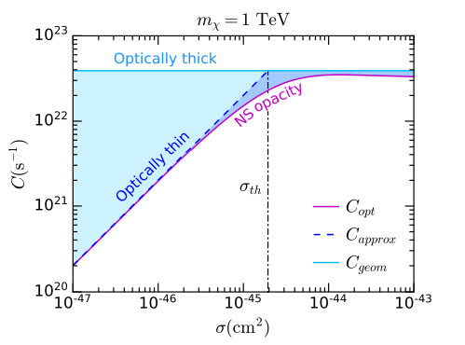
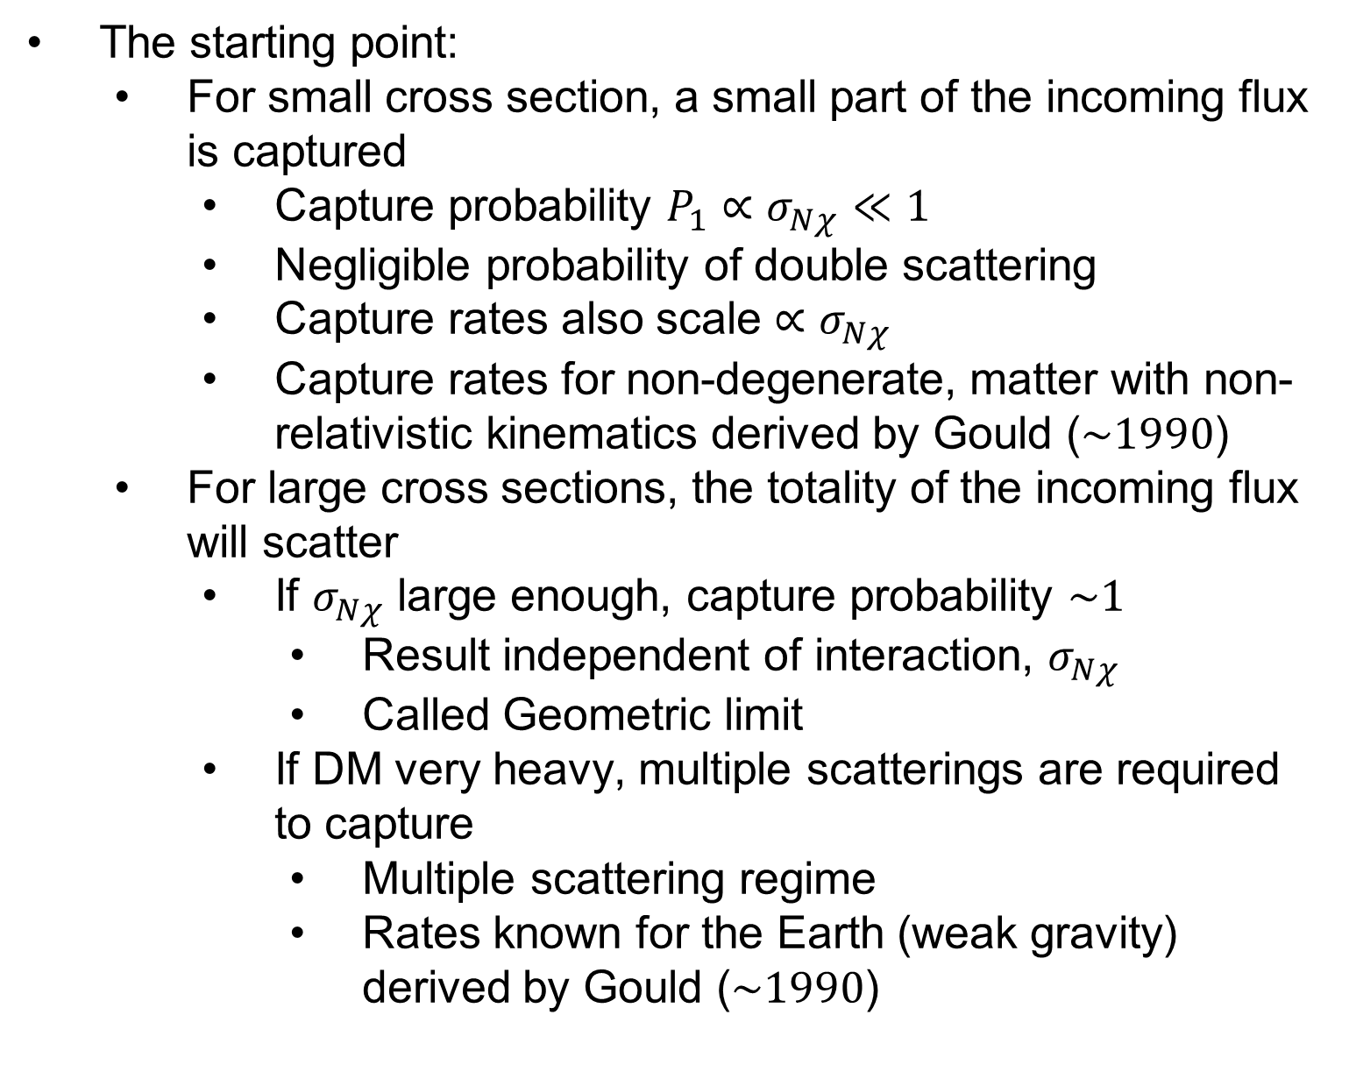
DM capture in stars
The starting point:
  For small cross section, a small part of the incoming flux is captured
    Capture probability $P_{1}∝σ_{Nχ}≪1$
    Negligible probability of double scattering
    Capture rates also scale $∝σ_{Nχ}$
    Capture rates for non-degenerate, matter with non-relativistic kinematics derived by Gould ($\sim 1990$)
  For large cross sections, the totality of the incoming flux will scatter
    If $σ_{Nχ}$ large enough, capture probability $\sim 1$
      Result independent of interaction, $σ_{Nχ}$
      Called Geometric limit
    If DM very heavy, multiple scatterings are required to capture
      Multiple scattering regime
      Rates known for the Earth (weak gravity) derived by Gould ($\sim 1990$)

Slide 6
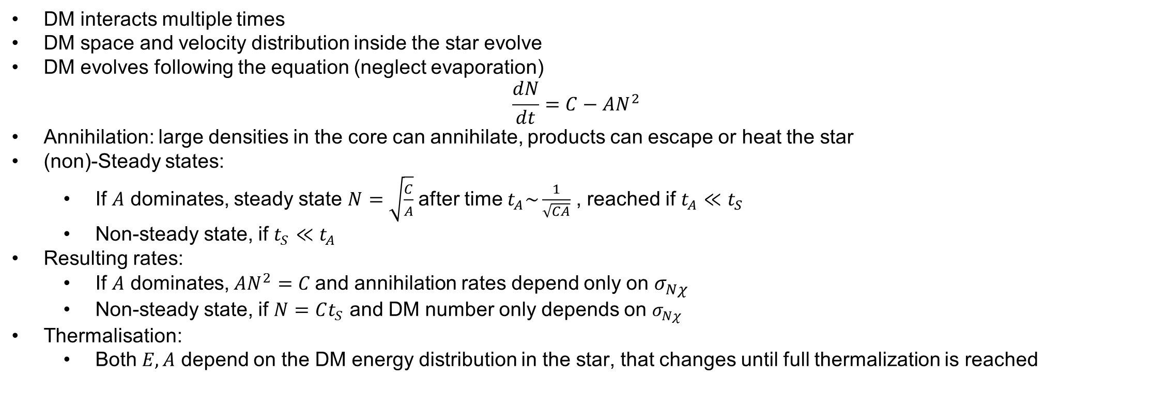
What happens after capture?
DM interacts multiple times
DM space and velocity distribution inside the star evolve
DM evolves following the equation (neglect evaporation)
$$\frac{dN}{dt}=C−AN^{2}$$
Annihilation: large densities in the core can annihilate, products can escape or heat the star
(non)-Steady states:
  If $A$ dominates, steady state $N=\sqrt{\frac{C}{A}}$after time $t_{A}\sim \frac{1}{\sqrt{CA}}$ , reached if $t_{A}≪t_{S}$
  Non-steady state, if $t_{S}≪t_{A}$
Resulting rates:
  If $A$ dominates, $AN^{2}=C$and annihilation rates depend only on $σ_{Nχ}$
  Non-steady state, if $N=Ct_{S}$ and DM number only depends on $σ_{Nχ}$
Thermalisation:
  Both $E,A$ depend on the DM energy distribution in the star, that changes until full thermalization is reached
Age of the star
Many works assume DM is thermalized and steady state is reached
Need to compute A using the time-evolved space/energy distribution
Need to use A to check if stead state is reached

Slide 7
DM capture in neutron stars/ White dwarfs
Neutron Stars
NS collapse to BH
NS merger waveform
Minimum NS temperature
White Dwarfs
Luminosity
Collapse

Slide 8
DM capture in neutron stars/ White dwarfs
Neutron Stars
NS collapse to BH
NS merger waveform
Minimum NS temperature
White Dwarfs
Luminosity
Collapse
Collapse usually requires very heavy DM to form a large over-density at the center

Slide 9
DM capture in neutron stars/ White dwarfs
Neutron Stars
NS collapse to BH
NS merger waveform
Minimum NS temperature
White Dwarfs
Luminosity
Collapse
This is applicable on a large mass range

Slide 10
DM capture in neutron stars/ White dwarfs
Neutron Stars
NS collapse to BH
NS merger waveform
Minimum NS temperature
White Dwarfs
Luminosity
Collapse

Slide 11
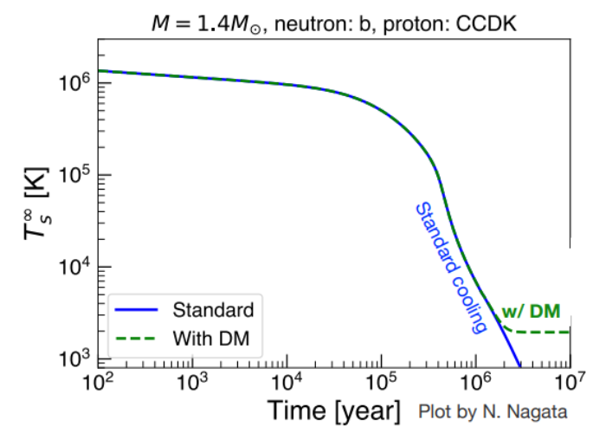
Minimum NS temperature
High density, extreme condition, highly favourable to accumulation of large DM quantities
Powerful probe to test and constrain dark matter (DM)
This generally involves the accumulation of DM particles
  Increase in their temperature
  DM-triggered black hole formation
  Modified EOS/Gravitational wave signal

Slide 12
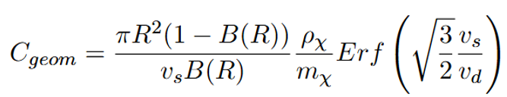
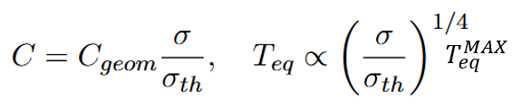
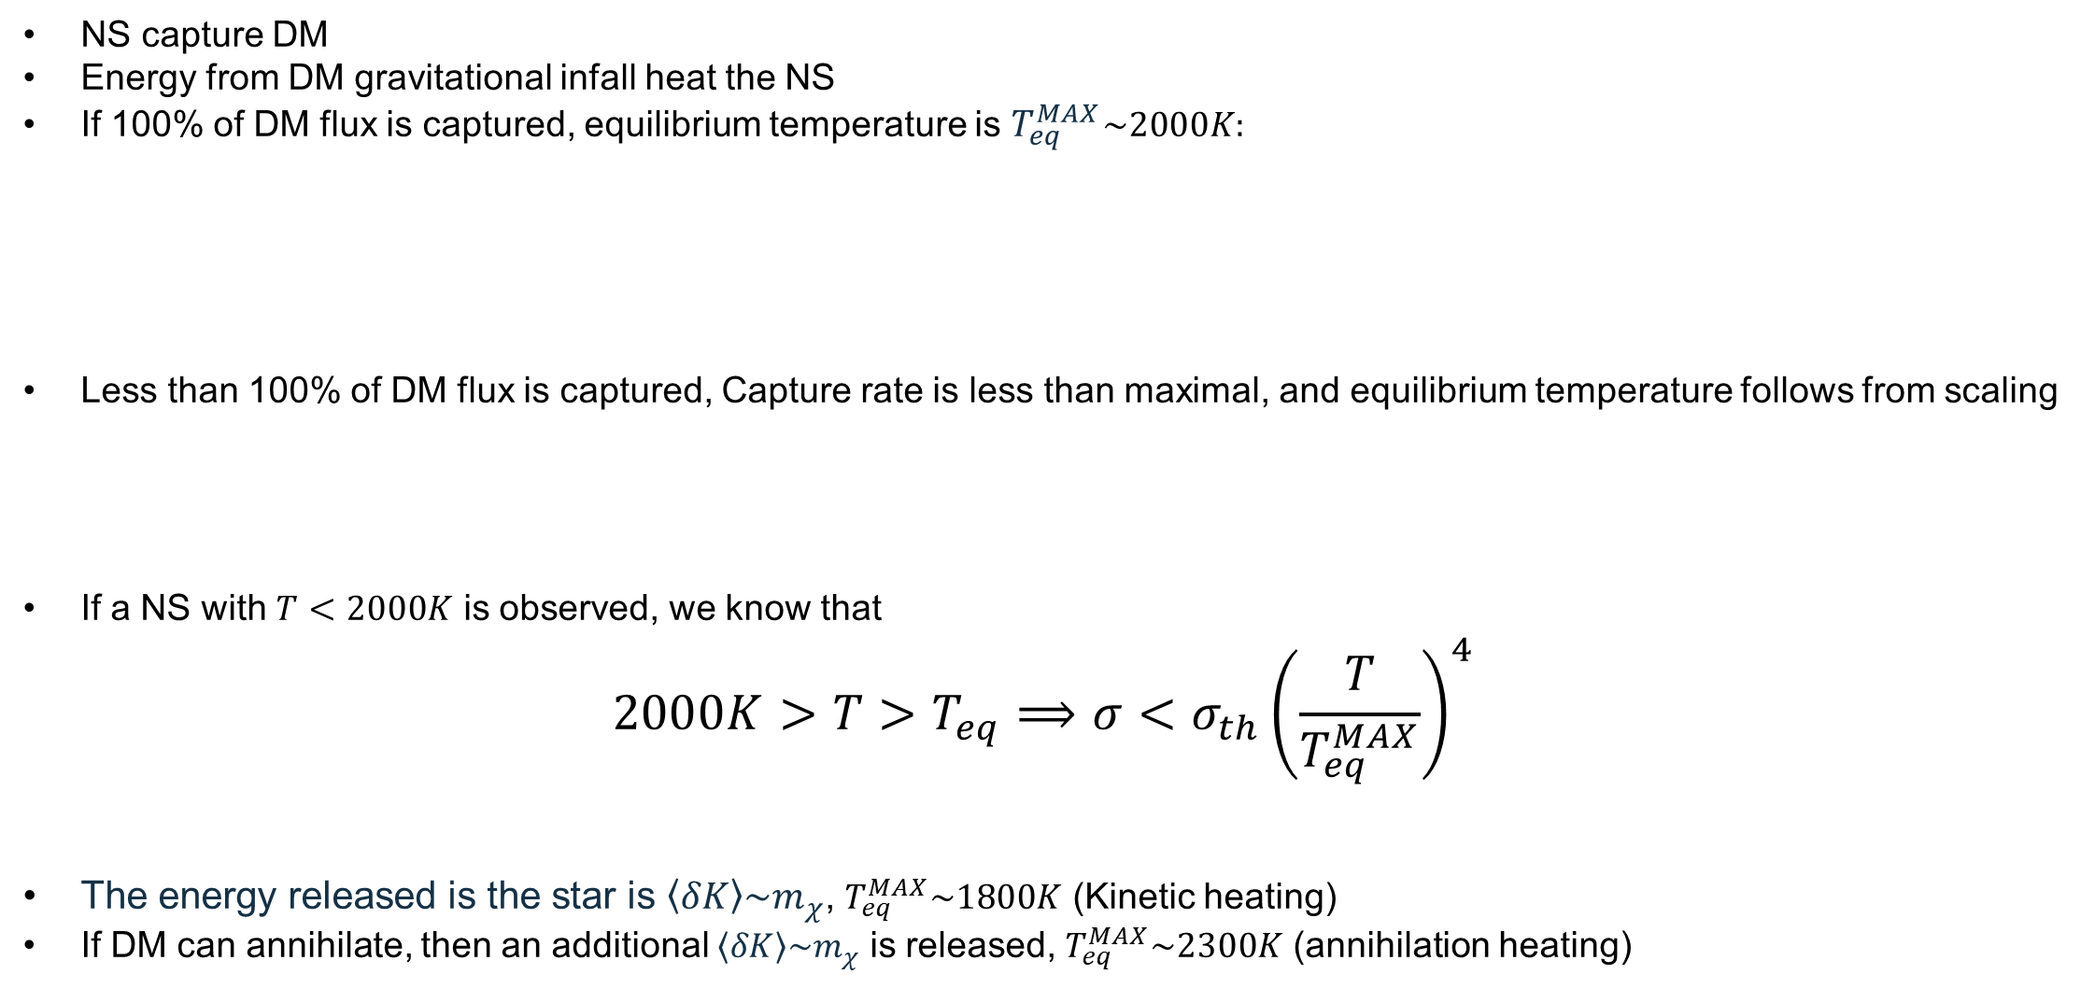
Bounds from ns temperature
NS capture DM
Energy from DM gravitational infall heat the NS
If 100% of DM flux is captured, equilibrium temperature is $T_{eq}^{MAX}\sim 2000K:$
Less than 100% of DM flux is captured, Capture rate is less than maximal, and equilibrium temperature follows from scaling
If a NS with $T<2000K$ is observed, we know that
$$2000K>T>T_{eq}⟹σ<σ_{th}{\left(\frac{T}{T_{eq}^{MAX}}\right)}^{4}$$
The energy released is the star is $\left\langle δK\right\rangle \sim m_{χ}$, $T_{eq}^{MAX}\sim 1800K$ (Kinetic heating)
If DM can annihilate, then an additional $\left\langle δK\right\rangle \sim m_{χ}$ is released, $T_{eq}^{MAX}\sim 2300K$ (annihilation heating)
This assumes energy transfer happens fast enough
$$C_{geom}\left\langle δK\right\rangle =σ_{SB}{\left(T_{eq}^{MAX}\right)}^{4}πR^{2}$$
This assumes C/A equilibrium

Slide 13
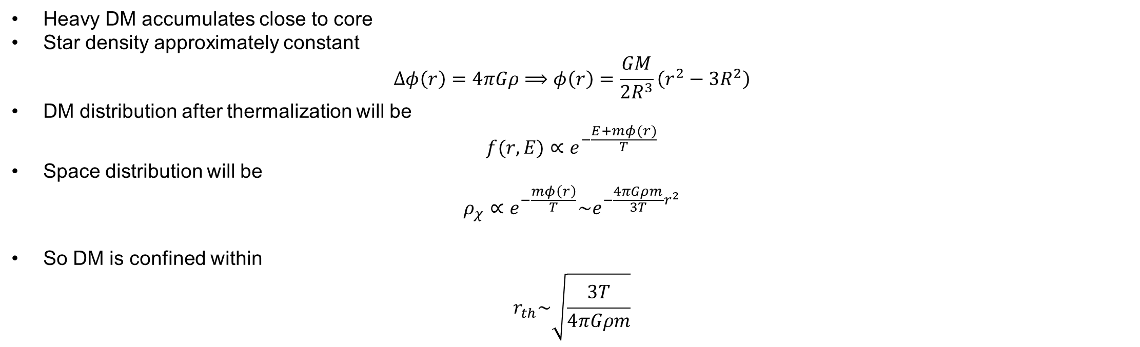
NS/WD collapse
Heavy DM accumulates close to core
Star density approximately constant
$$Δφ\left(r\right)=4πGρ⟹φ\left(r\right)=\frac{GM}{2R^{3}}\left(r^{2}−3R^{2}\right)$$
DM distribution after thermalization will be
$$f(r,E)∝e^{−\frac{E+mφ(r)}{T}}$$
Space distribution will be
$$ρ_{χ}∝e^{−\frac{mφ\left(r\right)}{T}}\sim e^{−\frac{4πGρm}{3T}r^{2}}$$
So DM is confined within
$$r_{th}\sim \sqrt{\frac{3T}{4πGρm}}$$
Here we assume DM is thermalised
The colder and heavier, the larger the central density

Slide 14


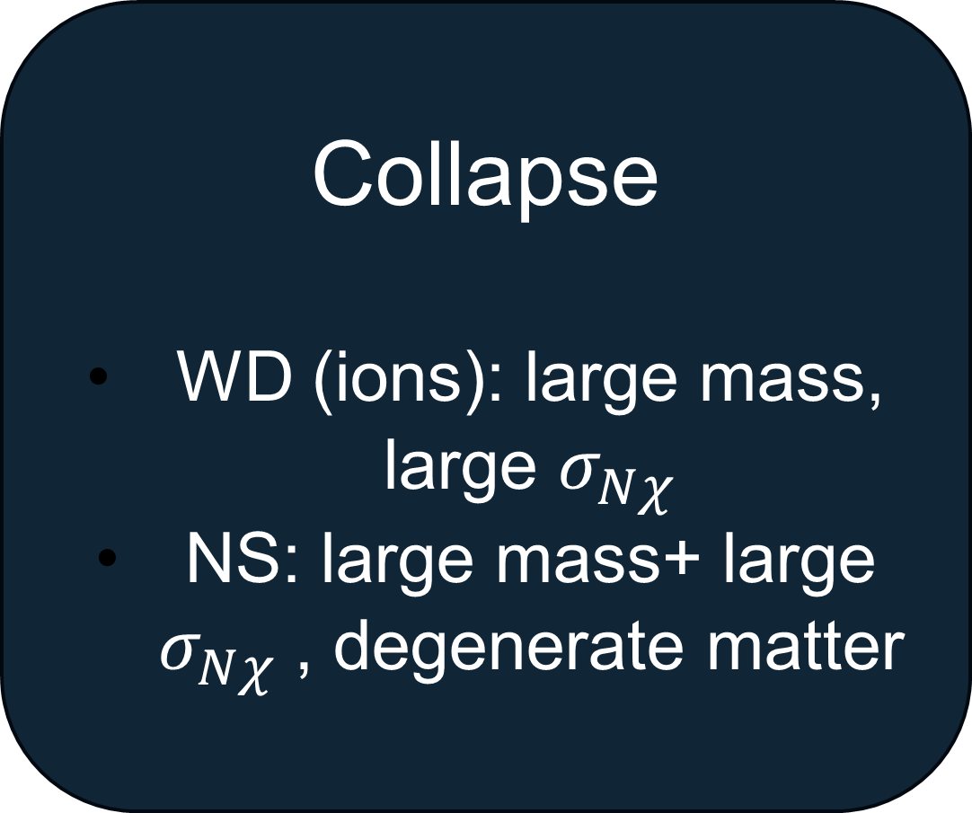
DM capture in neutron stars/ White dwarfs
Minimum NS temperature/WD luminosity
NS/WD electrons: degenerate matter
NS: strong gravity
WD ions: similar to the Sun
Collapse
WD (ions): large mass, large $σ_{Nχ}$
NS: large mass+ large $σ_{Nχ}$, degenerate matter

Slide 15
CAPTURE (NS)
DM Capture in NS usually based on Gould seminal work for Capture in the Sun/Earth.
Need to use/include:
          Schwarzschild metric, star structure (EOS)
          Relativistic kinematics
          Pauli blocking
          Capture probability/average energy transfer (for multiple scattering/heavy DM)
          Hadronic Form Factors
          Target effective mass due to self-interactions
  JCAP 09 (2020) 028 (2004.14888)
  JCAP 03 (2021) 086 (2010.13257)
  Phys.Rev.Lett. 127 (2021) 11, 111803 (2012.08918)
  JCAP 11 (2021) 056 (2108.02525)

Slide 16
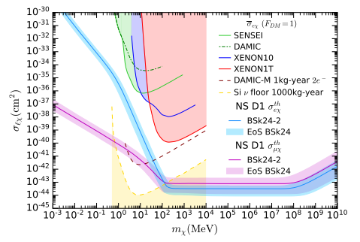
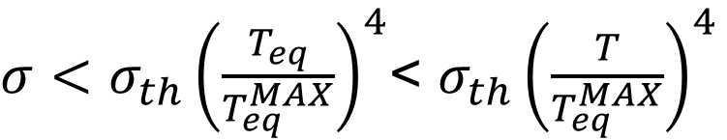
CAPTURE (NS)
Need to use/include:
          Schwarzschild metric
          Relativistic kinematics
          Pauli blocking
          Capture probability/average energy transfer (for multiple scattering/heavy DM)
          Hadronic Form Factors
          Target effective mass due to self-interactions
$σ<σ_{th}{\left(\frac{T_{eq}}{T_{eq}^{MAX}}\right)}^{4}$< $σ_{th}{\left(\frac{T}{T_{eq}^{MAX}}\right)}^{4}$

Slide 17
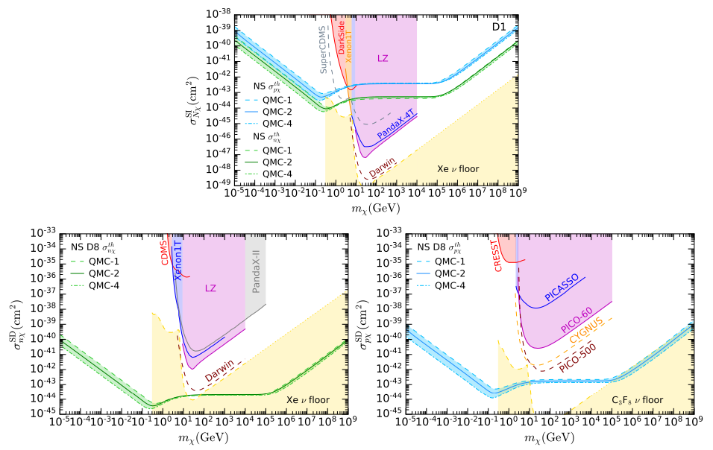
CAPTURE (NS)

Slide 18
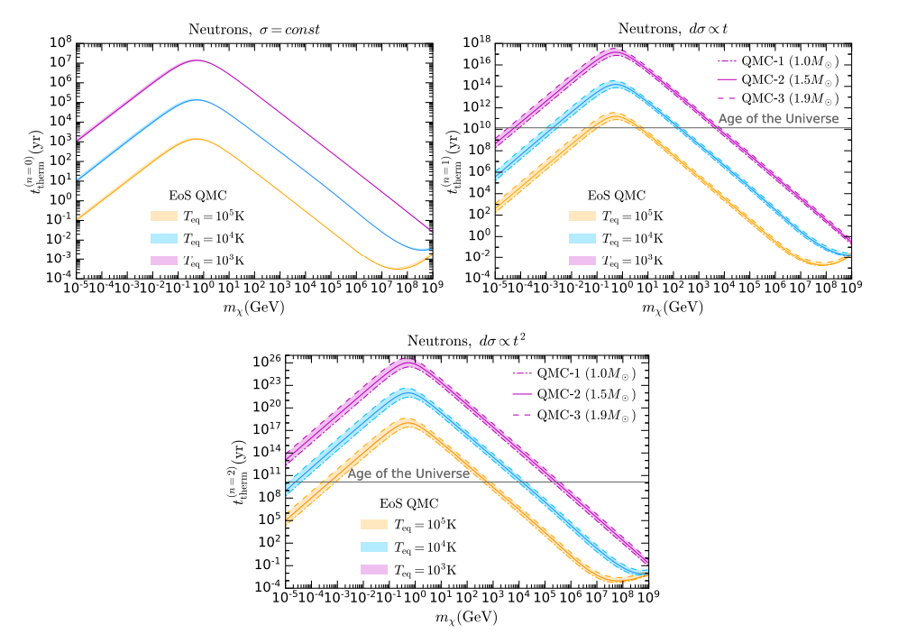
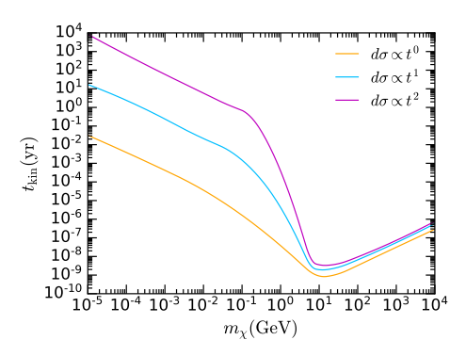
Thermalisation (NS)
JCAP 04 (2024) 006
  Most energy is transferred in a very short timeframe Kinetic heating always happens
  Thermalisation time driven by the last few scatterings
  Unless DM mass very large, last scatterings are Pauli suppressed

Slide 19
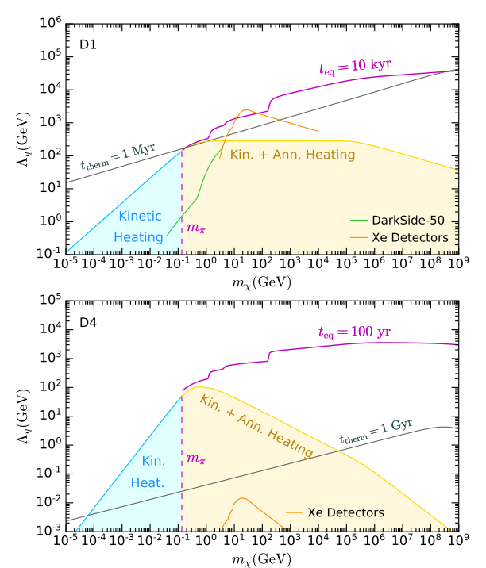
Thermalisation (NS)
Ultimate goal: is DM energy released in the star on a timescale smaller than the star lifetime (1Gy)?
  What about annihilation heating?
If DM thermalizes within star lifetime:
  Use DM temperature to compute annihilation rate
  Use Annihilation rate to compute the Capture-Annihilation equilibrium timescale
  Check that it is smaller than star age
If DM DOES NOT thermalize within star lifetime:
  Find DM average energy
  Use average energy to compute annihilation rate
  Use Annihilation rate to compute the Capture-Annihilation equilibrium timescale
  Check that it is smaller than star age
Result: Capture-Annihilation equilibrium is always reached if DM annihilation channels kinematically open

Slide 20
MULTIPLE SCATTERING (WD)
JCAP 07 (2024) 051
DM Capture usually based on Gould seminal work for Capture in the Earth:
(i) DM trajectories are unaffected by collisions
(ii) Constant escape velocity
(iii) Constant iron (target) density
(iv) DM follows linear trajectories outside and inside the Earth’s core, thereby neglecting gravitational focusing/gravity effects
Assumptions (ii-iv) are actually unnecessary
We will see that the rate can be calculated (nearly) exactly

Slide 21

MULTIPLE SCATTERING
Additional approximations usually made:
  Optical depth inside the star $Rn_{T}σ$, equal to the value at the center, for any point inside the star
  Differential cross section on target $dσ/dcosθ\sim$constant
What we do:
  Only assume (i) DM trajectories are unaffected by collisions
  Optical depth inside star depends on interaction rate
    Same interaction rate used for Capture for consistency
    Optical depth depends on the point in the star
    Need to average over all trajectories
  Cross section very suppressed at large $E_{R}$ (realistic)
    $σ_{χp}\sim const→σ_{χT}∝e^{−E_{R}/E_{0}}$

Slide 22
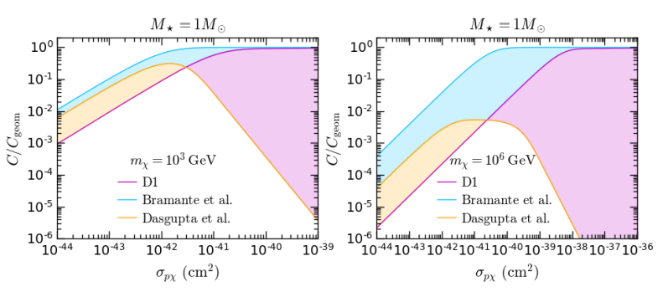
multiple scattering

Slide 23
Thermalisation (WD)
JCAP 07 (2024) 051
Two approximations are possible, they require 2 different assumptions
  The relative speed is dominated by either DM or Target
  For large DM mass, the Target speed is small
Zero temperature approximation (high energy DM)
  Appropriate for capture
  Both approximations can be applied
Large mass approximation
  Appropriate for Thermalisation of very heavy DM
    Thermalisation time driven by last part where DM speed very low
  Only one assumption is verified

Slide 24
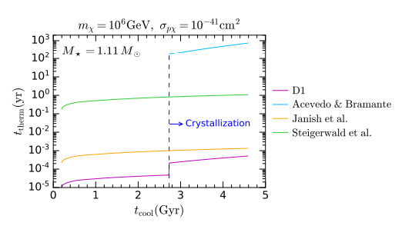
thermalisation

Slide 25
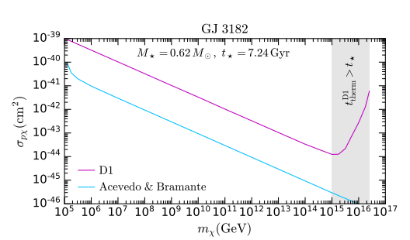
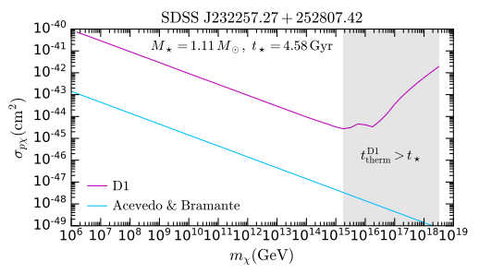
Self gravitation
3 orders of magnitude

Slide 26
Conclusions
NS and WD are interesting probe for DM
  Capture, thermalisation (and annihilation) rates necessary to predict observables
  Typical observables (NS): BH collapse, modified GW, heating
  Typical observables (WD): luminosity, DM triggered collapse/Supernova
(Potential) limits highly competitive with DD
  For NS heating, outperforming DD for SD
  For WD, SN constraint very strong at large mass
DM-induced WD collapse revisited using updates rates
  Cross section required up to 3 orders of magnitude larger

Slide 27

Thank you

Slide 28
Backup

Slide 29

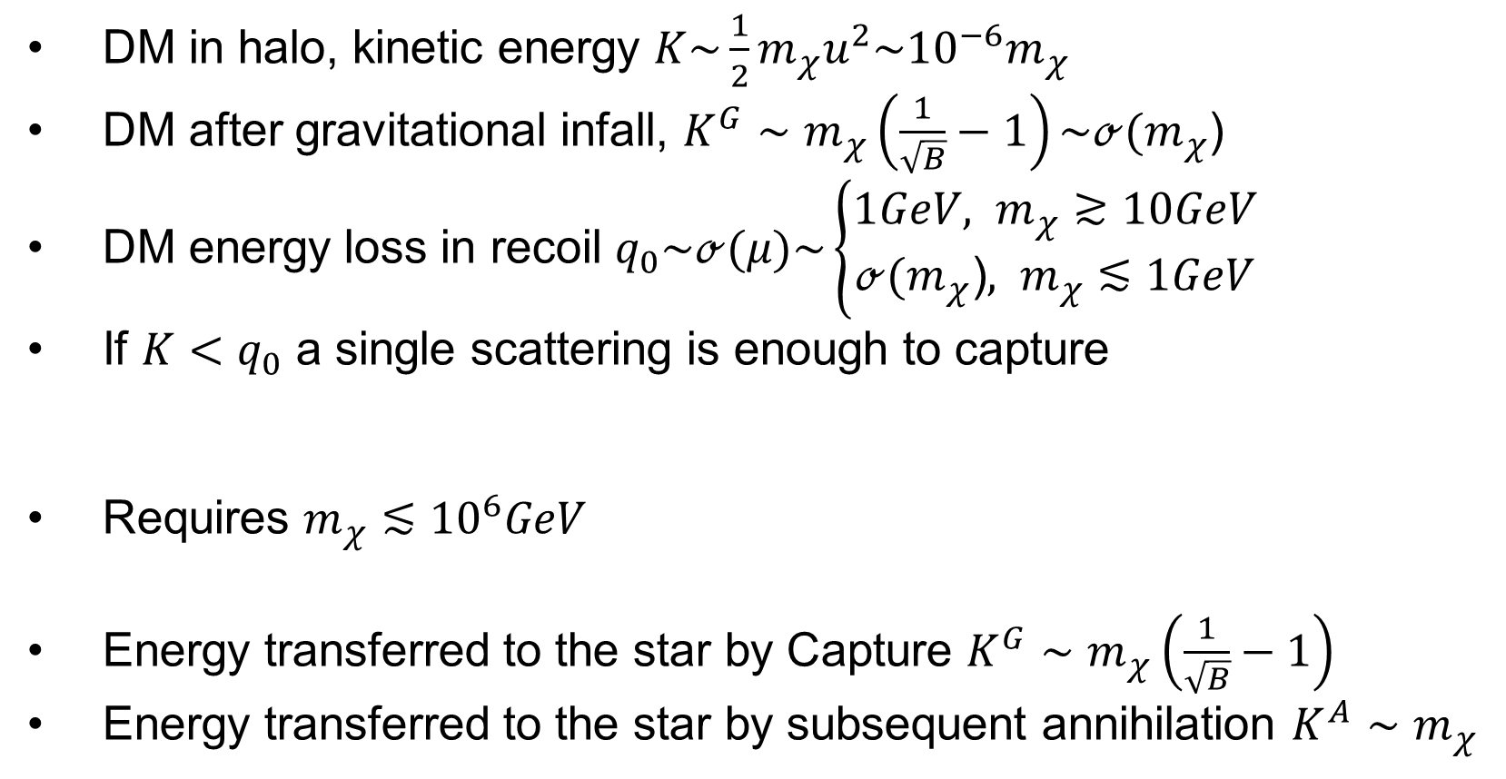


DM Capture kinematics in ns
DM speed in halo $u\sim 300km/s$
DM in halo, kinetic energy $K\sim \frac{1}{2}m_{χ}u^{2}\sim {10}^{−6}m_{χ}$
DM after gravitational infall, $K^{G}∼m_{χ}\left(\frac{1}{\sqrt{B}}−1\right)\sim ℴ(m_{χ}$)
DM energy loss in recoil $q_{0}\sim ℴ(μ)\sim \left\{\begin{aligned}1GeV, m_{χ}≳10GeV \\ ℴ(m_{χ}\text{)}, m_{χ}≲1GeV\end{aligned}\right.$
If $K<q_{0}$ a single scattering is enough to capture
Requires $m_{χ}≲{10}^{6}GeV$
Energy transferred to the star by Capture $K^{G}∼m_{χ}\left(\frac{1}{\sqrt{B}}−1\right)$
Energy transferred to the star by subsequent annihilation $K^{A}∼m_{χ}$
$$T_{eq}^{MAX}\sim 1800K$$
(Kinetic Heating)
$$T_{eq}^{MAX}\sim 2300K$$
(Kinetic + Annihilation Heating)
This assumes CA equilibrium reached

Slide 30
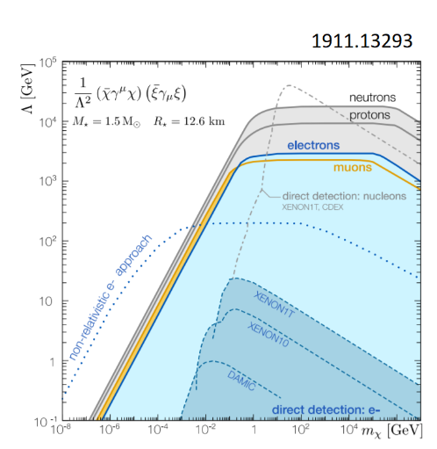
CAPTURE (NS)
02
Need to use/include:
          Schwarzschild metric
          Relativistic kinematics
          Pauli blocking
          Capture probability/average energy transfer (for multiple scattering/heavy DM)
          Hadronic Form Factors
          Target effective mass due to self-interactions
Non-relativistic kinematics vs relativistic kinematics

Slide 31
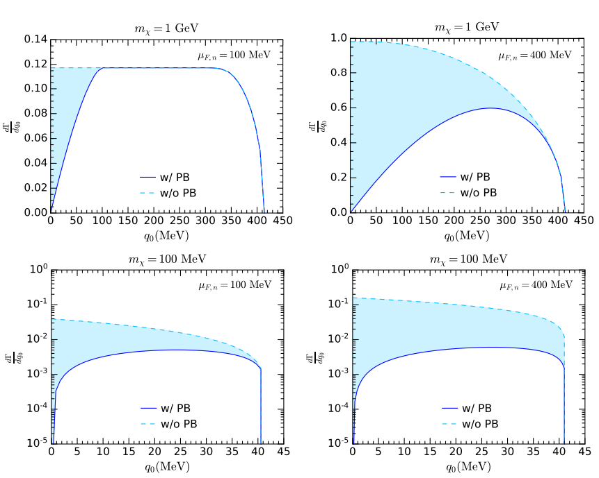
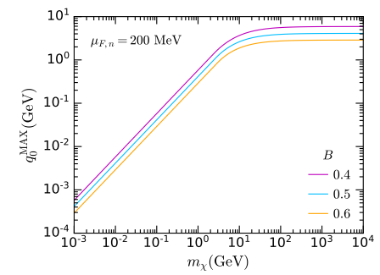
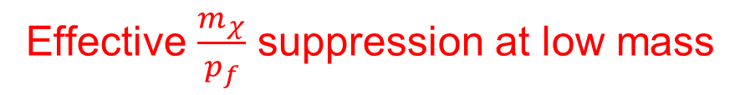
CAPTURE (NS)
02
Need to use/include:
          Schwarzschild metric
          Relativistic kinematics
          Pauli blocking
          Capture probability/average energy transfer (for multiple scattering/heavy DM)
          Hadronic Form Factors
          Target effective mass due to self-interactions
Effective $\frac{m_{χ}}{p_{f}}$ suppression at low mass

Slide 32
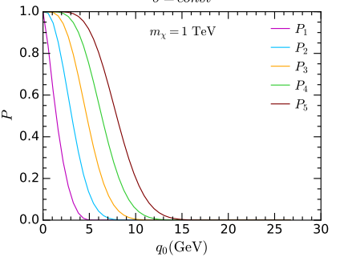

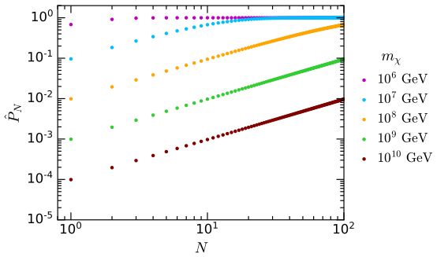

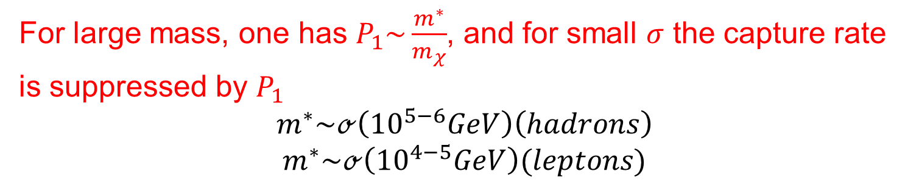
CAPTURE (NS)
02
Need to use/include:
          Schwarzschild metric
          Relativistic kinematics
          Pauli blocking
          Capture probability/average energy transfer (for multiple scattering/heavy DM)
          Hadronic Form Factors
          Target effective mass due to self-interactions
For large mass, one has $P_{1}\sim \frac{m^{∗}}{m_{χ}}$, and for small $σ$ the capture rate is suppressed by $P_{1}$
$$m^{∗}\sim ℴ\left({10}^{5−6}GeV\right)\left(hadrons\right)$$
$$m^{∗}\sim ℴ\left({10}^{4−5}GeV\right)(leptons)$$

Slide 33





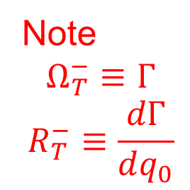
Thermalisation (WD)
03
Thermalisation time give by
Interaction rate
Large number of scatterings
Energy loss per unit time
Note
$$Ω_{T}^{−}≡Γ$$
$$R_{T}^{−}≡\frac{dΓ}{dq_{0}}$$

Slide 34
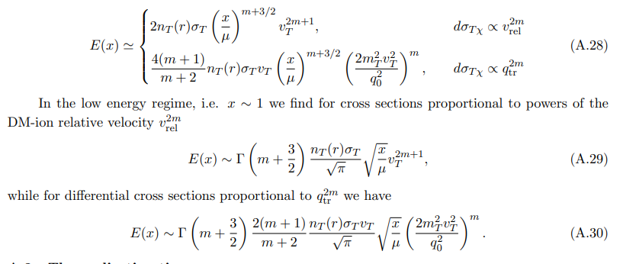
thermalisation
03
In the large energy limit/zero temperature approx.:

Slide 35



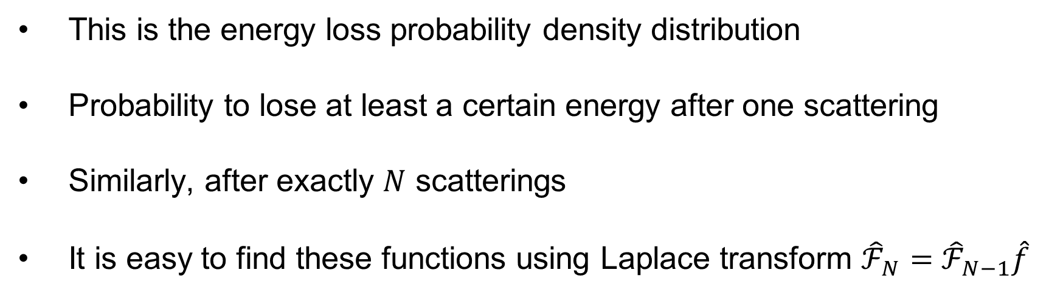
multiple scattering
03
This is the energy loss probability density distribution
Probability to lose at least a certain energy after one scattering
Similarly, after exactly $N$ scatterings
It is easy to find these functions using Laplace transform ${\hat{ℱ}}_{N}=$ ${\hat{ℱ}}_{N−1}\hat{f}$

Slide 36
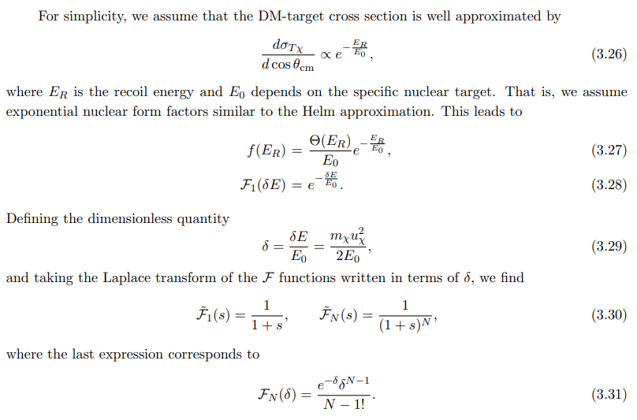
multiple scattering
03

Slide 37

multiple scattering
03
Probability to have interacted already N times is given by Poisson distribution
The Capture rate for exactly N scatterings can be obtained as

Slide 38
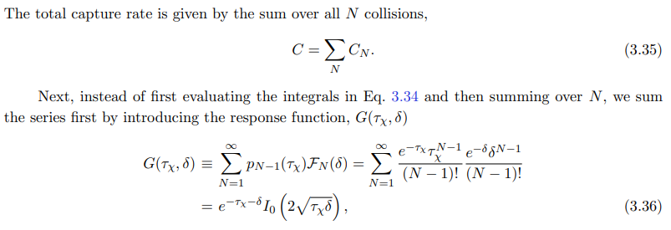

multiple scattering
03
The resulting total Capture rate is

Slide 39
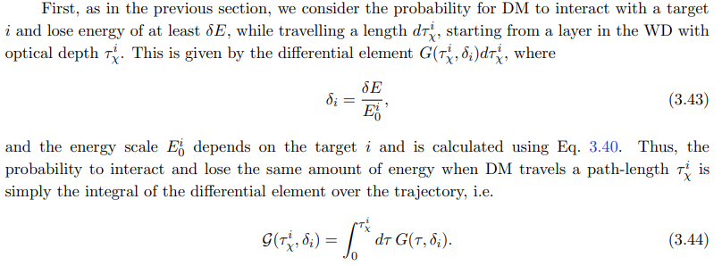
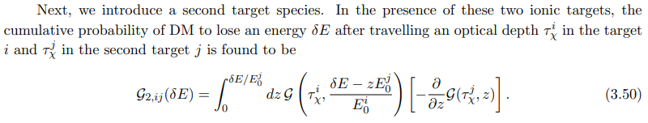
multiple scattering
03
Can expand the formalism to include multiple types of targets

Slide 40
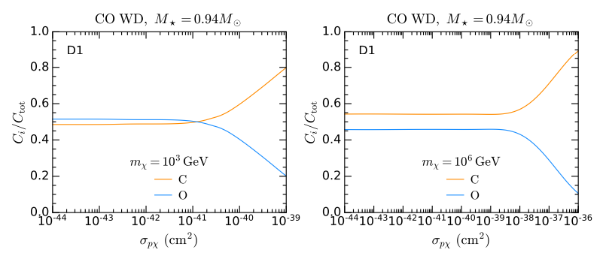
multiple scattering
03

Slide 41


Self gravitation
No DM self-repulsive forces
DM collapses to isothermal sphere of radius
Gravitational field due to DM at center can reach same order of magnitude of the one generated by ordinary matter
  Requires
Star develops an instability and Core-Collapse is triggered

