Slide 1

Reconstructing PTA measurements via early seeded SMBHs
Sohan Ghodla
Colgate University
In collaboration with Cosmin Ilie
DSU-2025 Montréal
July 9, 2025
Based on arXiv:2507.06163

Slide 2
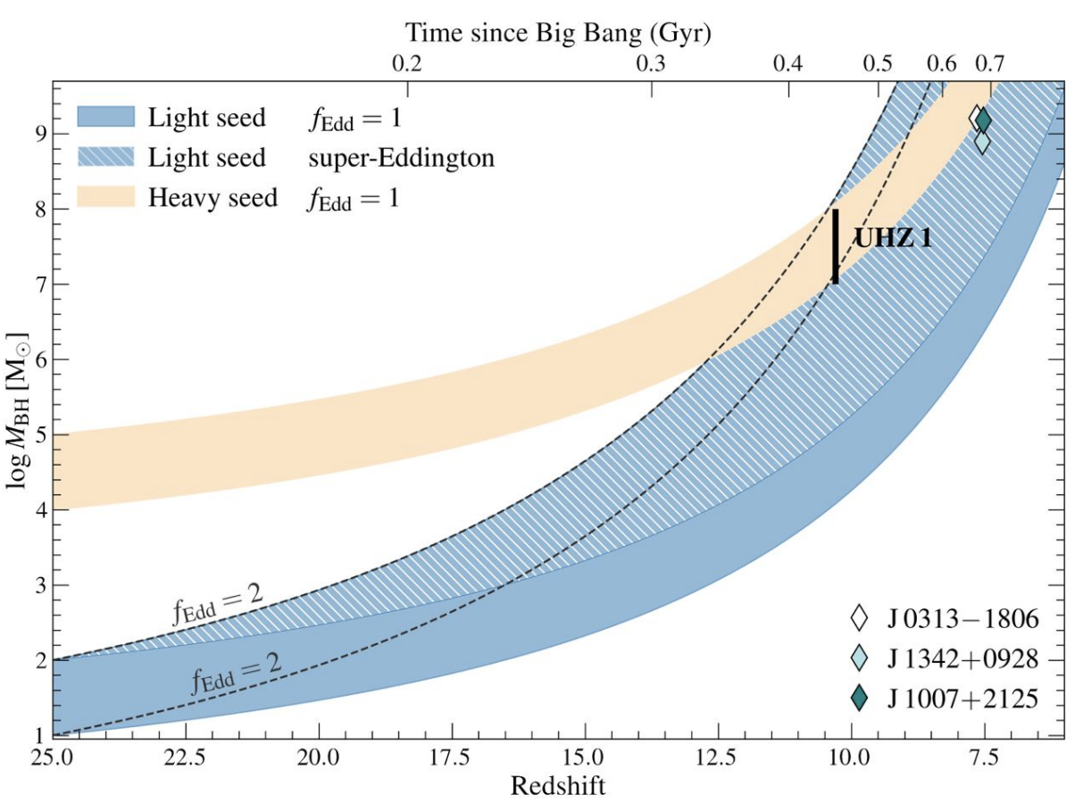
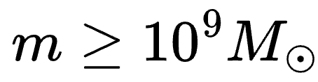
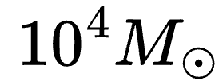
SMBHs in the early Universe
Existence of high redshift SMBHs ( ) imply at least some can grow very massive early (e.g., Yang+ 2020, Wang+ 2021)
Early seed formation at z ∼ 25, for Eddington-limited accretion requires a seed mass of ~ .
Simulations indicate that sustained super-Eddington accretion can be impacted by star formation feedback (e.g. Jeon+ 2023)
Bogdán+ 2023

Slide 3
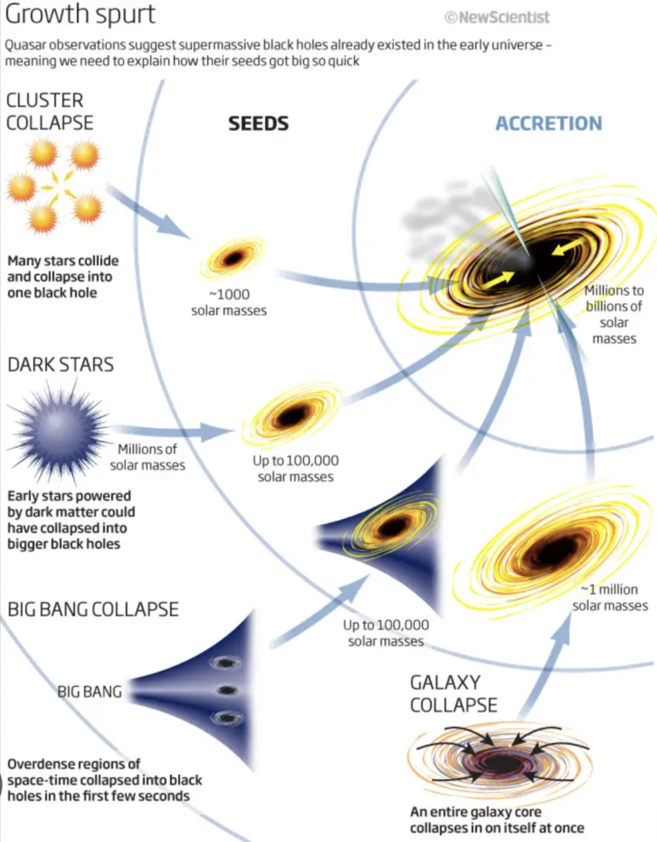
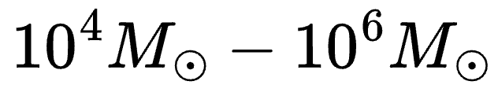
Need for seeds
This motivates the need for massive seeds -
A few seeding mechanisms:
  Direct collapse black holes
  WIMP powered supermassive dark stars, e.g., Spolyar+ 2009
  IMBHs formed in dense Pop III star clusters
  Massive PBHs
  Collapse of self-interacting dark matter halos

Slide 4
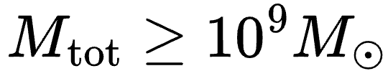
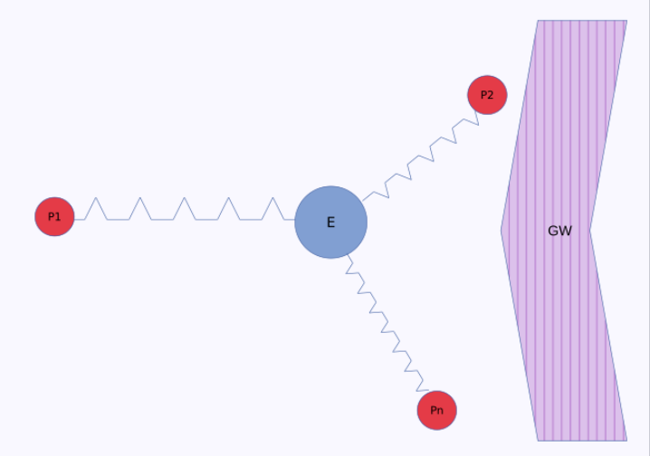
Can early seeded SMBHs be source of PTA signal?
PTA signal could be dominated by SMBH binaries with (NANOGrav 2023, EPTA 2023, Ellis+ 2023).
The early massive seeds could result in big SMBHs at late times.
Could it be that PTA is seeing these SMBHs?
Answer requires a population level study.
PTAs
Pulsars

Slide 5
Approach
Method: We need to create a population of seeds that are distributed throughout the early universe. These then grow and some eventually merge, featuring in the PTA band.
Assumptions:
  Need an efficient SMBH seeding mechanism.
  By z ~ 10, most SMBH seeds have formed.
  Seeds have a log-normal mass distribution ranging (at z = 10).
  Seeds then grow via baryonic accretion.
The halos experience mergers. The SMBH descendants of these seeds eventually merge producing GWs.

Slide 6
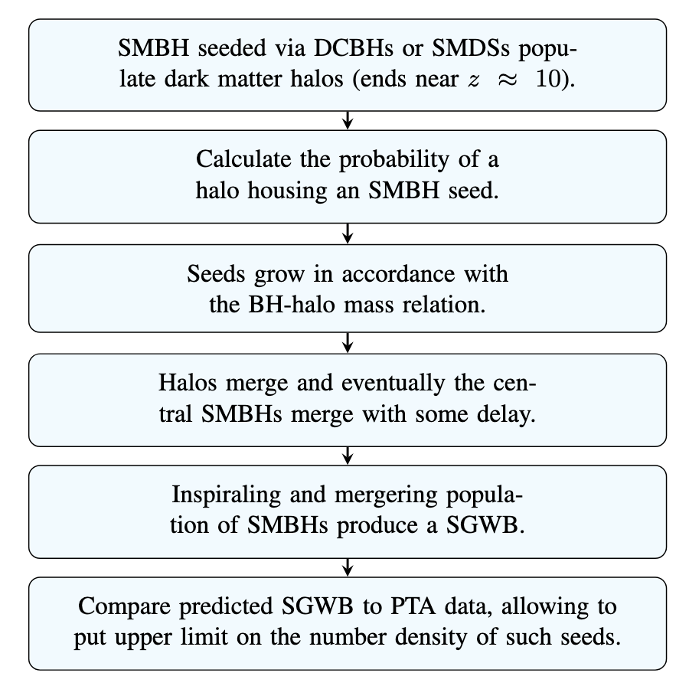
Pick an efficient SMBH seeding mechanism

Slide 7
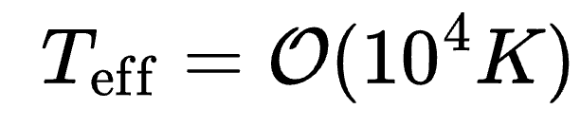
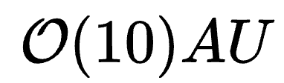
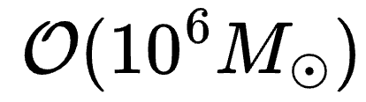
What are dark stars stars?
First stars formed near the center of their halo in pristine atomic gas from BBN
WIMP annihilation within the star provides an efficient source of energy.
Remain cool with surface temperature and puffy with sizes
This allows them to efficiently accrete baryons growing to mass
They eventually collapse to form SMBH seeds.
Darks stars can seed SMBHs efficiently.

Slide 8
Seed occupation probability
Seed growth model
Gravitational waves
Compare to observations

Slide 9
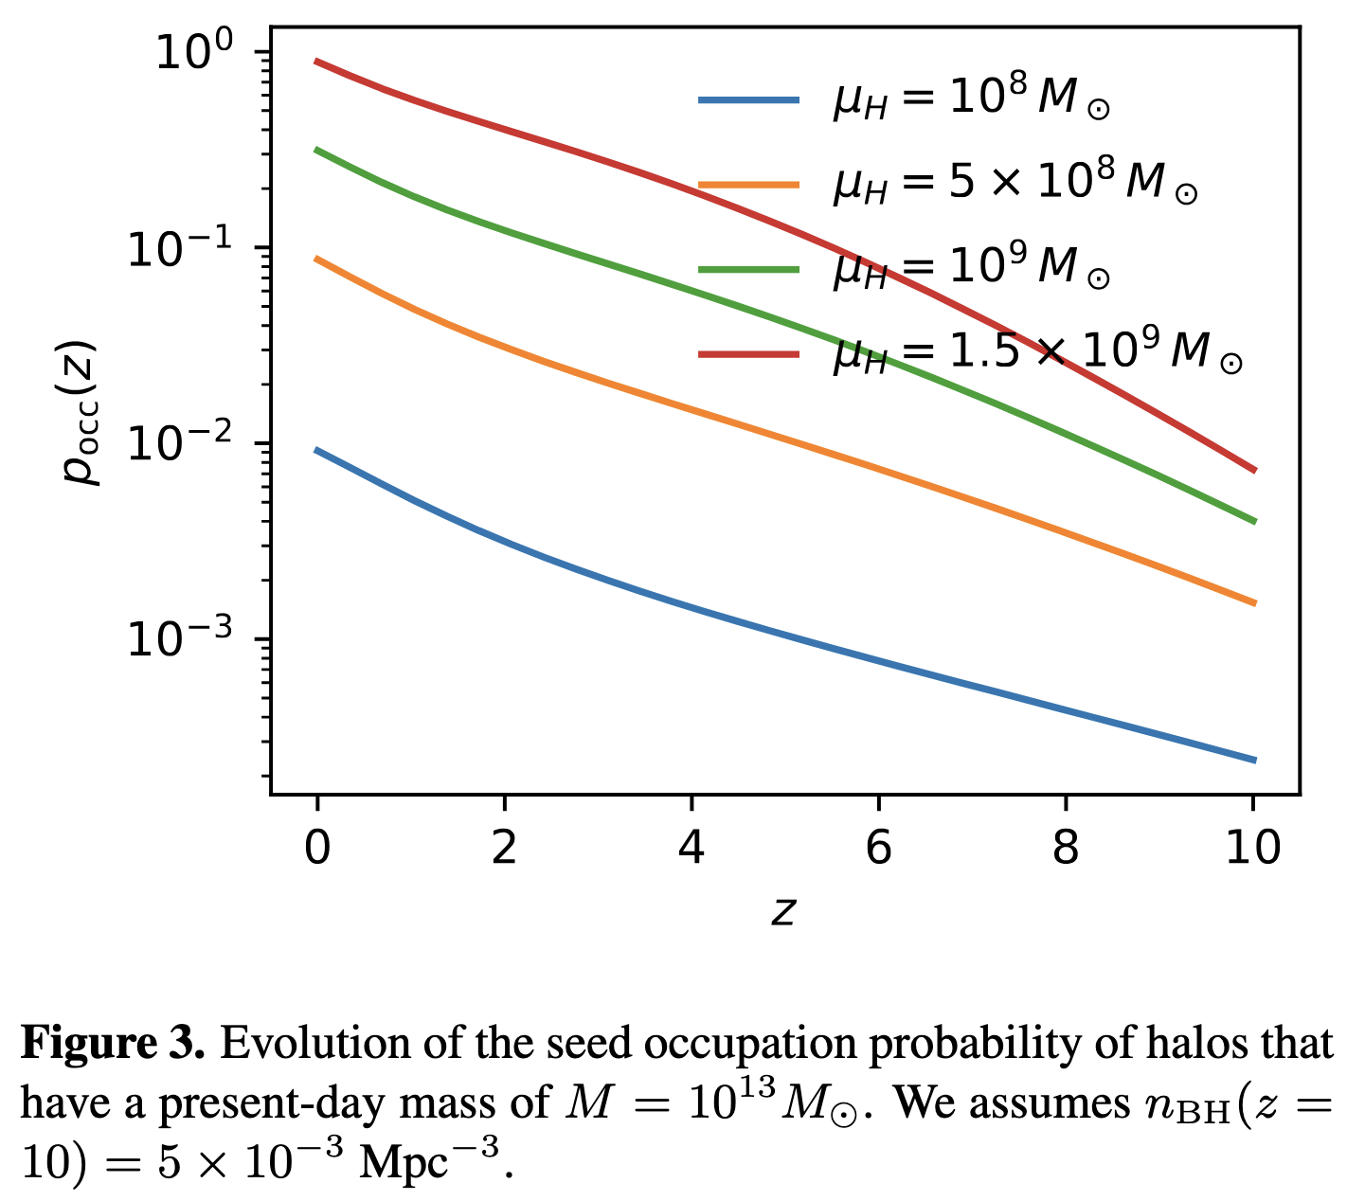
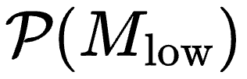


Halo occupation probability
Assume that the threshold mass M_{low} for a halo to host a seed at z ≤ 10 obeys a truncated (from below) log-normal probability density distribution
represents the mean mass of the untruncated distribution

Slide 10
Seed growth model
Gravitational waves
Compare to observations

Slide 11
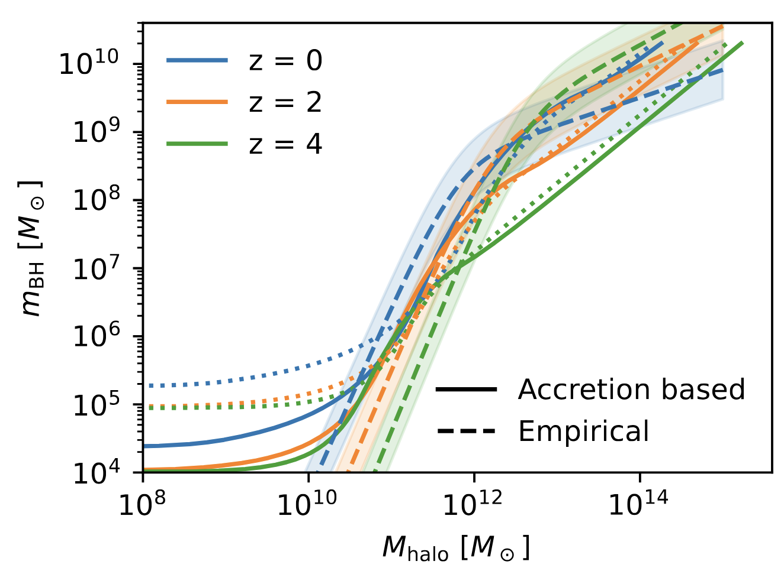


Growth model for black holes
Assume gas accretion to be the primary way these seeds grow.
SMBH growth model tuned to the empirical BH-halo relation from Girelli+ 2020; Reines and Volonteri 2015.
Relation diverges at lower masses because we assume massive seeds to begin with.

Slide 12
Merger rate of SMBHs
Gravitational waves
Compare to observations

Slide 13
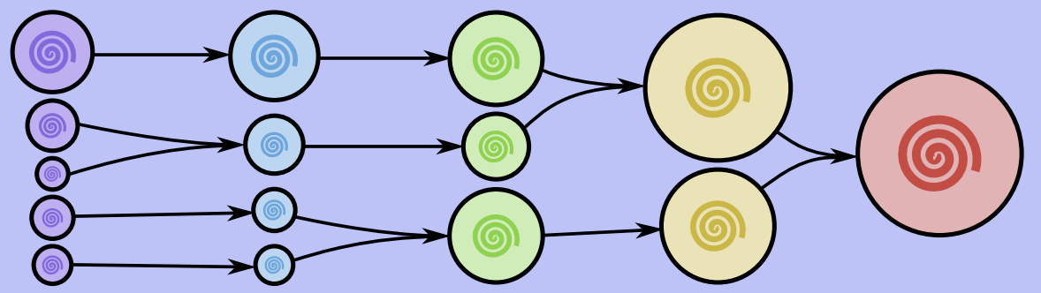
Halo merger tree
Follow the halo merger tree via the Extended Press–Schechter formalism.
Less massive halos (more numerous)
More massive halos (less numerous)
Credit: Behroozi, Wechsler, & Conroy 2013
time

Slide 14
From halo to SMBH merger
Follow the halo merger tree via the Extended Press–Schechter formalism.
Potential source for PTAs
Credit: Behroozi, Wechsler, & Conroy 2013
time

Slide 15
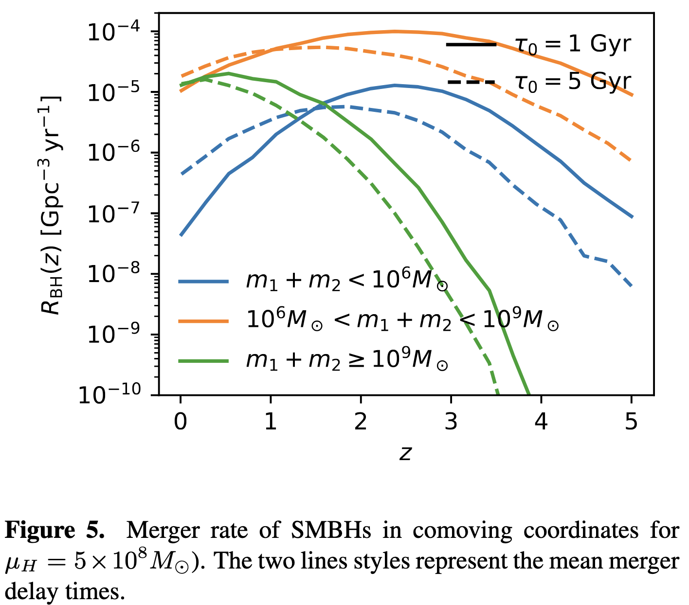
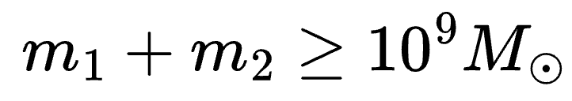
Black hole merger rate
The merger of halos might not result instantaneous mergers of their host SMBHs
Assume a log-normal merger delay time distribution.
SMBHs with experience a late peak in merger time.
These are the ones that most strongly influence PTAs signal

Slide 16
Gravitational waves
Compare to observations

Slide 17
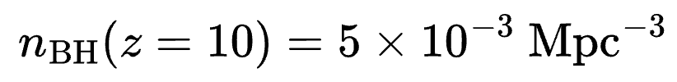
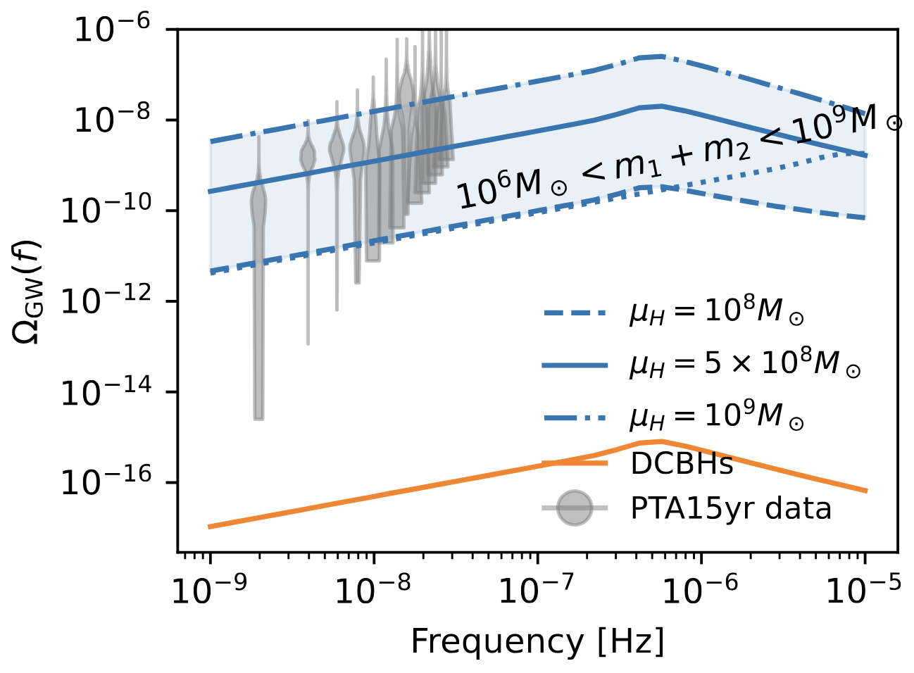


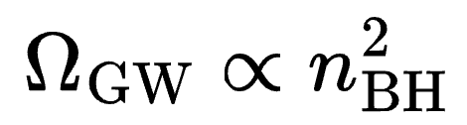
Implication for a stochastic gravitational wave background
We contrast SGWB from dark stars to that from DCBHs.
Due to the lower number density of DCBHs, their contribution to the PTAs SGWB is minimal ( )
At dark stars could be the dominant source in the PTA band.
Within the context of our analysis, is unlikely as that could result in inconsistency with the PTA observation.
Mean halo mass at z = 10

Slide 18
Summary
We calculated the expected SGWB resulting from the inspiral and merger of the descendants of early produced SMBHs
We showed that these SMBHs could dominate the PTA band in the low redshift Universe if produced with the number density
We contrasted two SMBH seeding mechanisms namely seeding from the collapse of dar stars and DCBHs and showed that the observed PTA data implies an upper limit of the number density of such seeds.
Moreover, DCBHs contribute minimally to the observed SGWB.
arXiv:2507.06163
Thank you!

