Slide 1



eRD104: Regulator Design for Serial Powering
28/03/2023
Notes:
The abstract pattern can be removed or repositioned if required. Be careful to ‘Send to Back’ so that it does not obscure any important information.

Slide 2


System Level Background
Notes:
The abstract pattern can be removed or repositioned if required. Be careful to ‘Send to Back’ so that it does not obscure any important information.

Slide 3
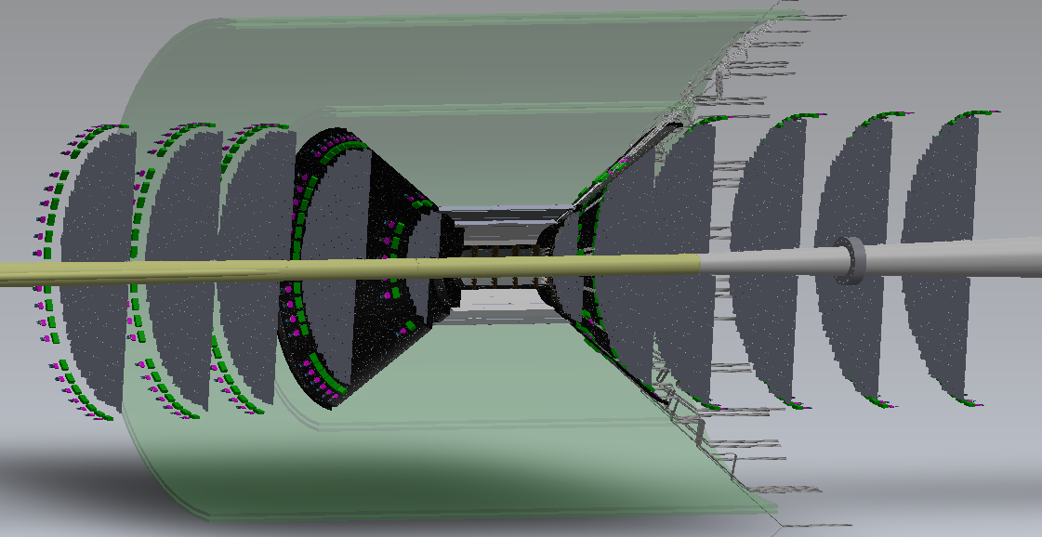
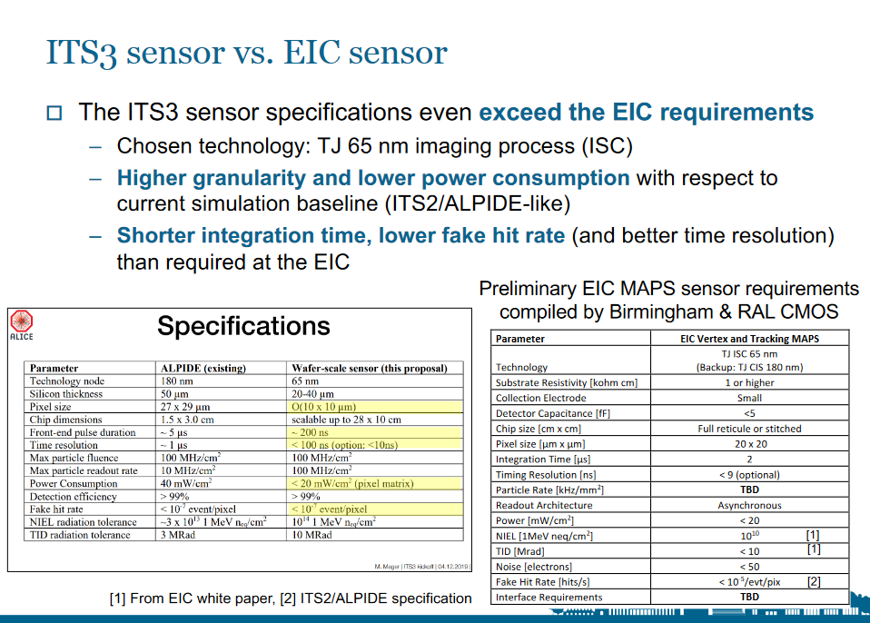
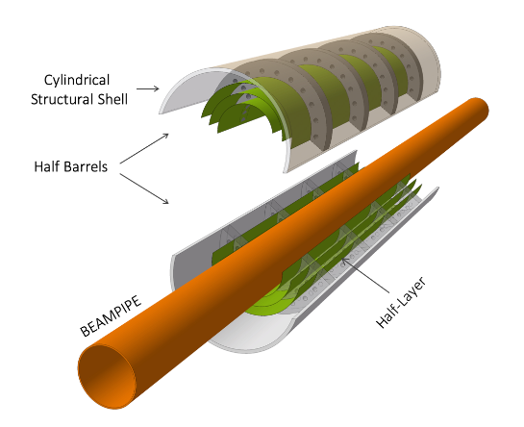
EIC-ITS3 Synergies
Similarities and Differences
  EIC and ITS3 have key similarities in design requirements
  Specifically pixel pitch and power density (driven by material budget)
  Key difference is silicon area to cover (but possible stepping stone to ALICE3…)

Slide 4

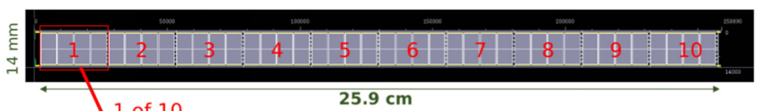
Stitching
Development of a Stitched Monolithic Pixel Sensor, https://iopscience.iop.org/article/10.1088/1748-0221/18/01/C01044/pdf

Slide 5
Practical Impact
EIC-ITS3 Practicalities
  On a practical level, this means that the two detectors could share a vertex chip
  However, the EIC will require something different for the stave and disc layers
  This could be as simple as the vertexing chip with a different stitching plan or something more complex might be needed
  This will have implications for the sort of agreements that will be needed

Slide 6
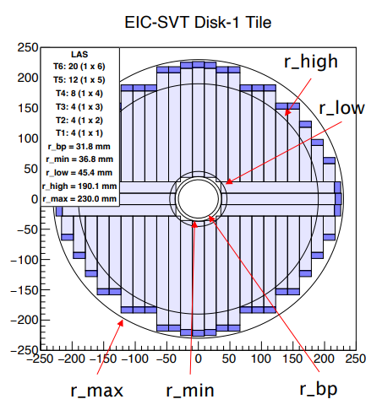
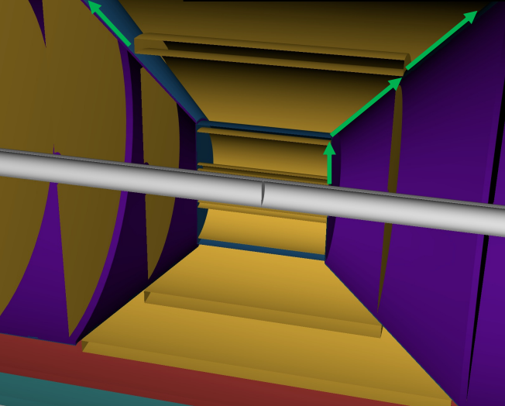
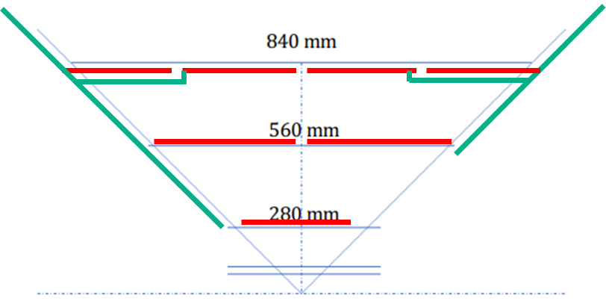
Practical Impact
ePIC SVT configuration, L. Gonella, Nov 7, 2022 - https://indico.bnl.gov/event/17713/contributions/70439/attachments/44360/74847/20221107-ePIC-SVT-cfg-v0.0.pdf
One Chip, Multiple Locations
  ITS3 in the vertex detectors
  Re-sized device in the staves, discs
Some engineering challenges with the EPIC SVT design, N. Apadula, Nov 7, 2022 - https://indico.bnl.gov/event/17713/contributions/70440/attachments/44407/74938/Apadula_EICSC_11_7_22.pdf

Slide 7
Towards Serial Powering
Services and Material
  Minimum possible material is desirable
  Serial powering is an option for this in layers with more than two sensors
First ideas on serial powering for the ePIC SVT, L. Gonella, Jan 30, 2023 - https://indico.bnl.gov/event/18202/contributions/72542/attachments/45762/77268/ePIC-SVT-SP.pdf

Slide 8
Towards Serial Powering
Pixel Array
Periphery
Implementation – 65nm or 180nm
  Integrated SLDO ideal
  But requires edits to ITS3 – not yet agreed
  Also few 65nm submissions
  180nm backup
65nm SLDO
Support
180nm SLDO
Power Path
Integrated 65nm
180nm/65nm

Slide 9
Technical Details
Notes:
The abstract pattern can be removed or repositioned if required. Be careful to ‘Send to Back’ so that it does not obscure any important information.

Slide 10
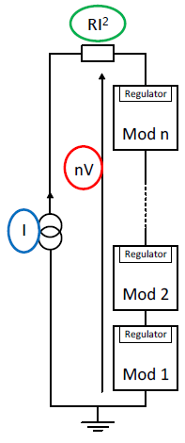
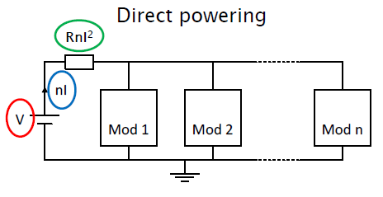
Serial Powering
Serial powering is a current based powering scheme, where modules are powered in series by a constant current. Current to voltage conversion is done by regulators on module.
In a serial powering chain made of n modules, transmitted current is only the current needed by one module.
The voltage across the chain is nV, where V is the voltage on a module. Each module sits on a different ground potential.
Higher power efficiency and reduced cable volume.
Serial powering

Slide 11
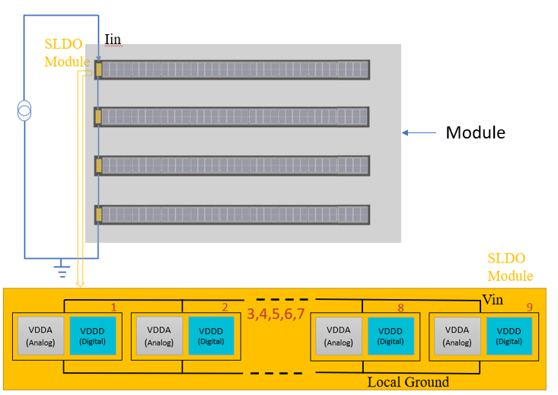
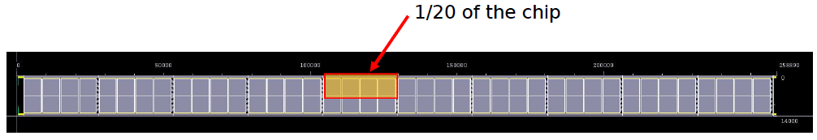
Proposed Powering scheme for EIC L3 disc
Four Sensors per module
One SLDO module per sensor
ITS3 stitched sensor modules has many power domains
ITS3 module has an option of switching off 1/20th
of the sensor (each sensor has 10 reticles)
For the proposed EIC sensor, there will be 9 reticles and
will have the option to switch off 1/18 of the sensor
This means ,9 SLDO’s for Analog + 9 SLDO’s for Digital
Total 18 SLDO’s per Sensor which will be
connected in parallel
ITS3 module
Proposed EIC module (sensor+SLDO)
Development of a Stitched Monolithic Pixel Sensor prototype (MOSS chip) towards the ITS3 upgrade of the ALICE Inner Tracking system
P. Vicente Leitao et al 2023 JINST 18 C01044
pdf (iop.org)

Slide 12
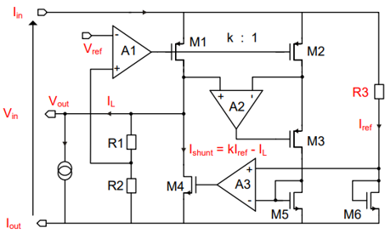
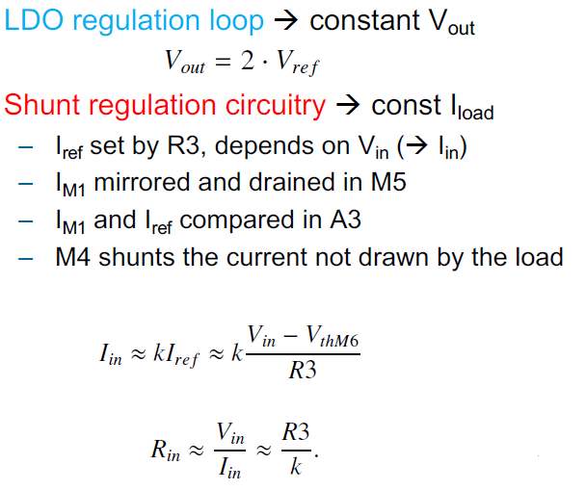
Shunt LDO
Combining the Shunt Regulator and LDO design.
SLDO has an ohmic characteristic which generates
Vin when constant Iin is supplied to the module
Simplified SLDO Diagram
Design Specifications of SLDO
Parameter(Nominal)
Shunt Current | 400mA
Input voltage(for each module) | 2V
Output voltage | 1.2V
Reference input | 0.6V
Load current | 200mA
M. Karagounis, D. Arutinov, M. Barbero et al. ‘An Integrated Shunt-LDO Regulator
for Serial Powered Systems’. In: Proc. of the European Solid-State Device Conference,
ESSCIRC 2009 (2009), pp. 276–279. doi: 10.1109/ESSCIRC.2009.5325974.
https://indico.cern.ch/event/879686/contributions/3706455/attachments
/1975390/3287622/SLDO_RD53B_Features.pdf

Slide 13
Features of SLDO
Over Voltage Protection:
Protects the circuitry in case of over voltage, for e.g., Failure of one/multiple module.
Operated in parallel to SLDO
Takes all excess current in case Vin =>2v
Under shunt Protection:
Protects the regulator from exceeding load currents
High load current reduces shunt current
• In under shunt current situation, Vref is reduced and current to the output is reduced.
Configurable Offset Voltage
To improve the shunt current accuracy
Start Up circuits
Reference current can’t reach the desired value during power up, a further current is added to increase reference values.
This additional current is only active for small supply currents.
As soon as the preregular bandgap is activated, startup circuit is switched off.

Slide 14
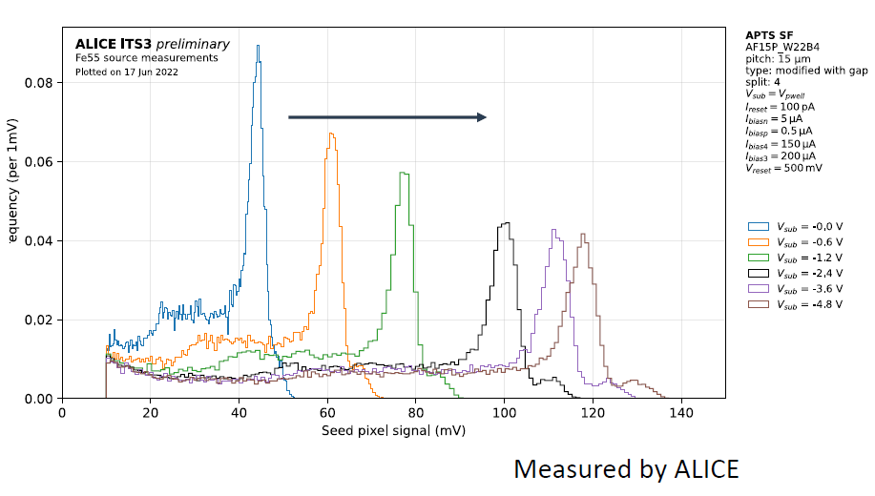
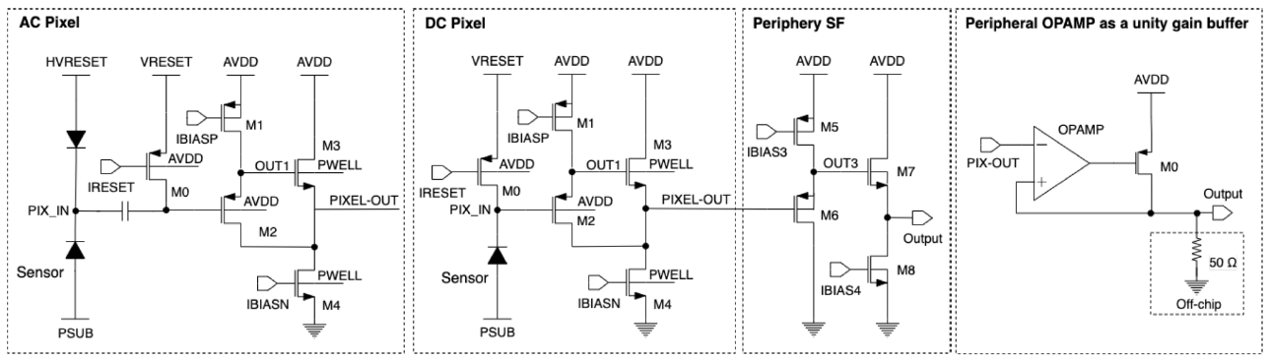
Implications and Challenges of Serial powering
AC coupled read out circuitry : Since each module ground is at different potential, readout needs to be ac coupled.
Requires various protection circuits :Circuits to address over-voltage, under-shunt scenarios.
Noise in the system: Noise on the power line caused by the malfunctioning of one module can be distributed to every module.
Distribution of biases : It was observed in the ITS3 MLR1 measurements that p+ substrate(bulk) bias voltage influences the charge collection. In serial powering each sensor sees different bulk voltage because of the different module ground potential.(Fig.1)
These are APTS and DPTS pixels(Fig.2). There should be HVRESET,VRESET,PSUB,IRESET,IBIASP connections have to be made.
Fig.2
Fig.1
There is a spread of signal amplitude w.r.t bulk voltage
https://indico.cern.ch/event/1127562/contributions/4914054/attachments/2512365/4318759/TWEPP_APTS_bk.pdf

Slide 15


Notes:
The abstract pattern can be removed or repositioned if required. Be careful to ‘Send to Back’ so that it does not obscure any important information.

