Slide 1

Improved Nuclear Matrix Elements for Neutrinoless Double-Beta Decay
Lotta Jokiniemi (she/her)
Postdoctoral Fellow, Theory Department, TRIUMF
McDonald Institute Annual National Meeting,
Queen’s University, Kingston
08/08/2024

Slide 2
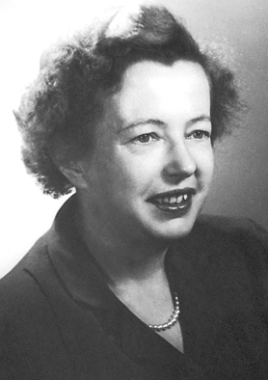
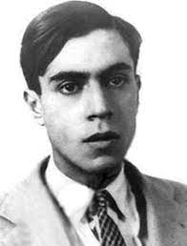
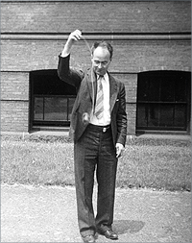
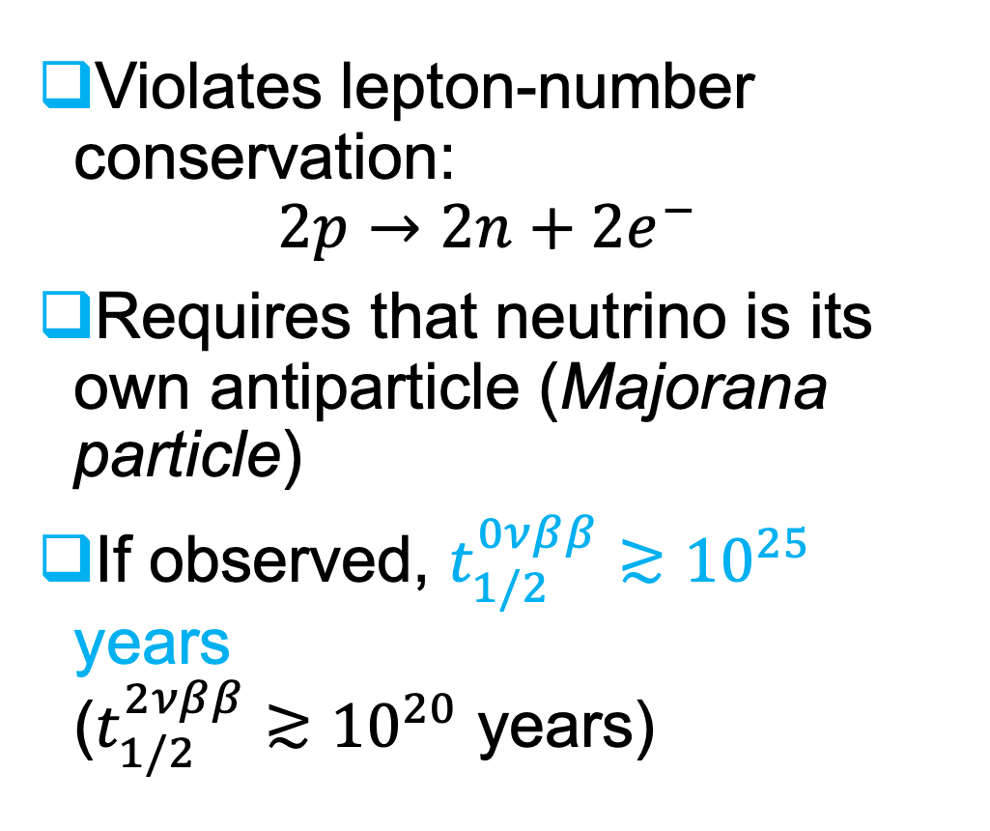
Neutrinoless double-beta ($0νββ$) decay
Violates lepton-number conservation:
$2p→2n+{2e}^{−}$
Requires that neutrino is its own antiparticle (Majorana particle)
If observed, $t_{1/2}^{0νββ}≳{10}^{25}$ years
($t_{1/2}^{2νββ}≳{10}^{20}$ years)
1935
1937
1939
M. Göppert Mayer
E. Majorana
W. Furry

Slide 3
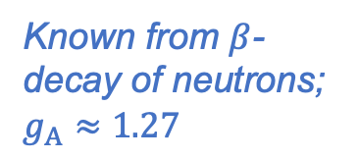
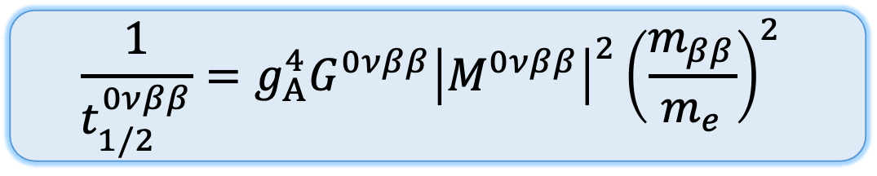
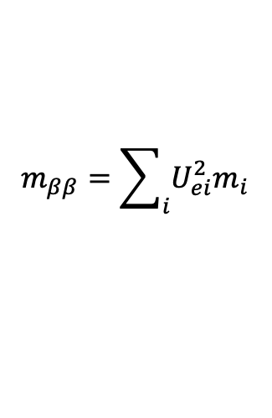
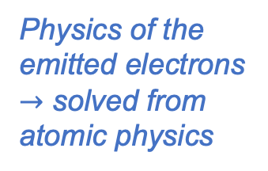
Half-life of neutrinoless double-beta decay
$$\frac{1}{t_{1/2}^{0νββ}}=g_{A}^{4}G^{0νββ}{\left|M^{0νββ}\right|}^{2}{\left(\frac{m_{ββ}}{m_{e}}\right)}^{2}$$
Half-life
Majorana mass
Axial-vector coupling
Phase-space factor
Nuclear matrix element (NME)
Observable to be measured
$$m_{ββ}=\sum_{i}{U_{ei}^{2}m_{i}}$$
Known from $β$-decay of neutrons; $g_{A}≈1.27$
Physics of the emitted electrons
$→$ solved from atomic physics
New physics we want to extract
From nuclear theory

Slide 4
Nuclear matrix elements currently poorly known
M. Agostini et al., Rev. Mod. Phys. 95, 025002 (2023)

Slide 5
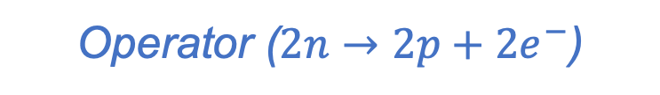

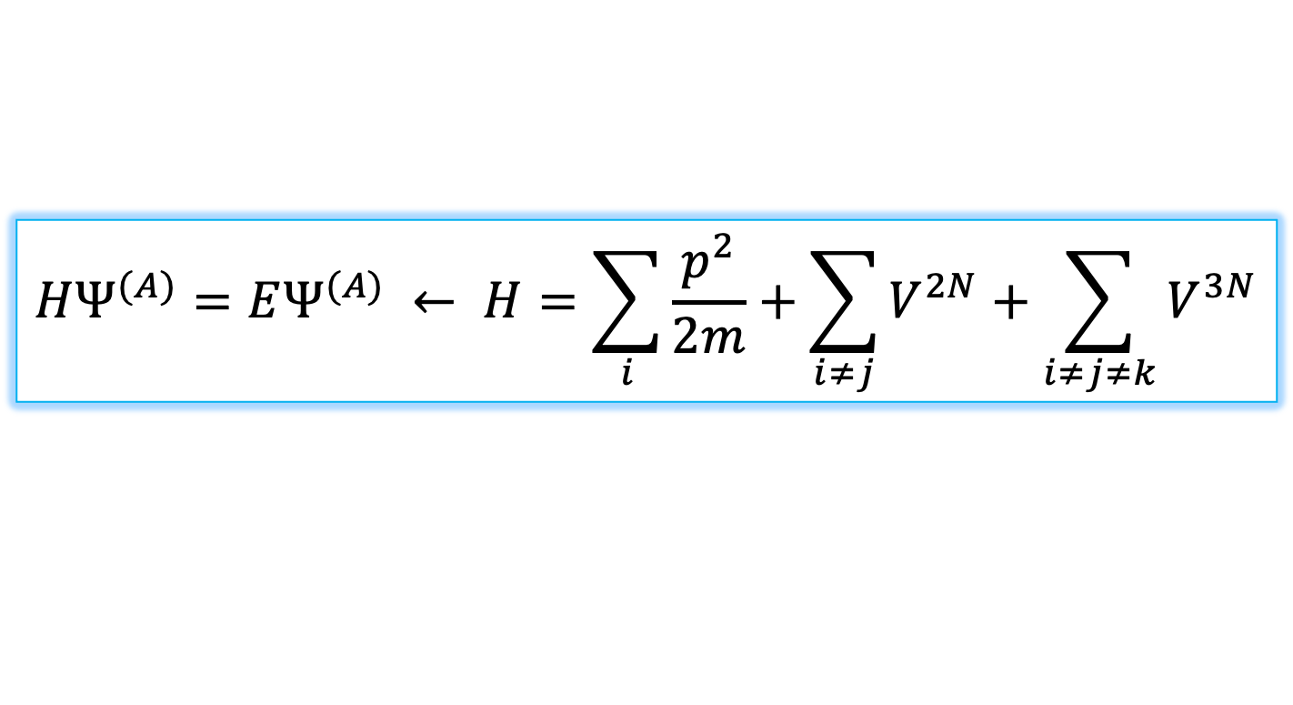
Nuclear matrix element
Operator ($2n→2p+2e^{−}$)
$$M^{0νββ}=\left\langle 0_{f}^{+}‖𝒪^{0νββ}‖0_{i}^{+}\right\rangle$$
Final state nuclear wave function
Initial state nuclear wave function
$$HΨ^{(A)}=EΨ^{(A)} ← H=\sum_{i}{\frac{p^{2}}{2m}+\sum_{i≠j}{V^{2N}+\sum_{i≠j≠k}{V^{3N}}}}$$

Slide 6


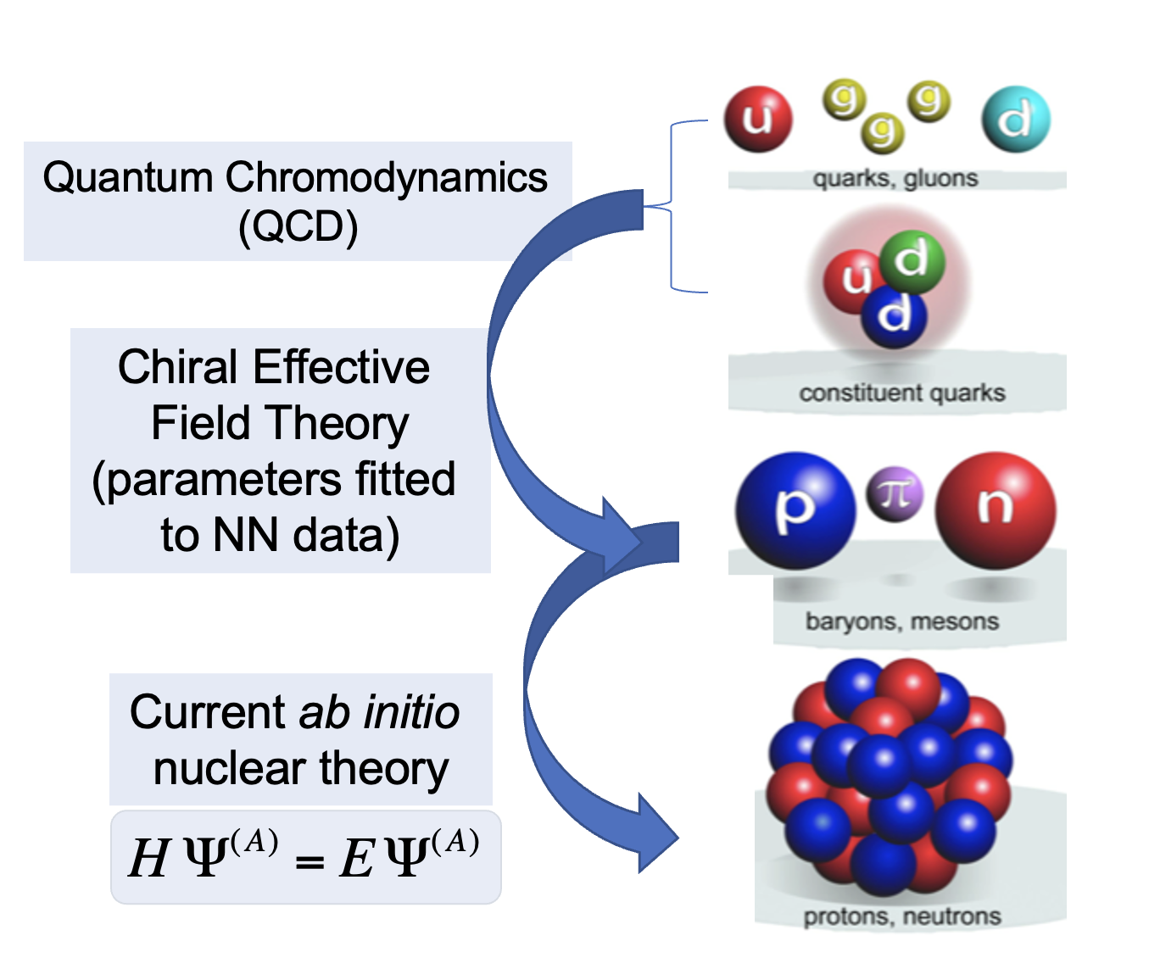
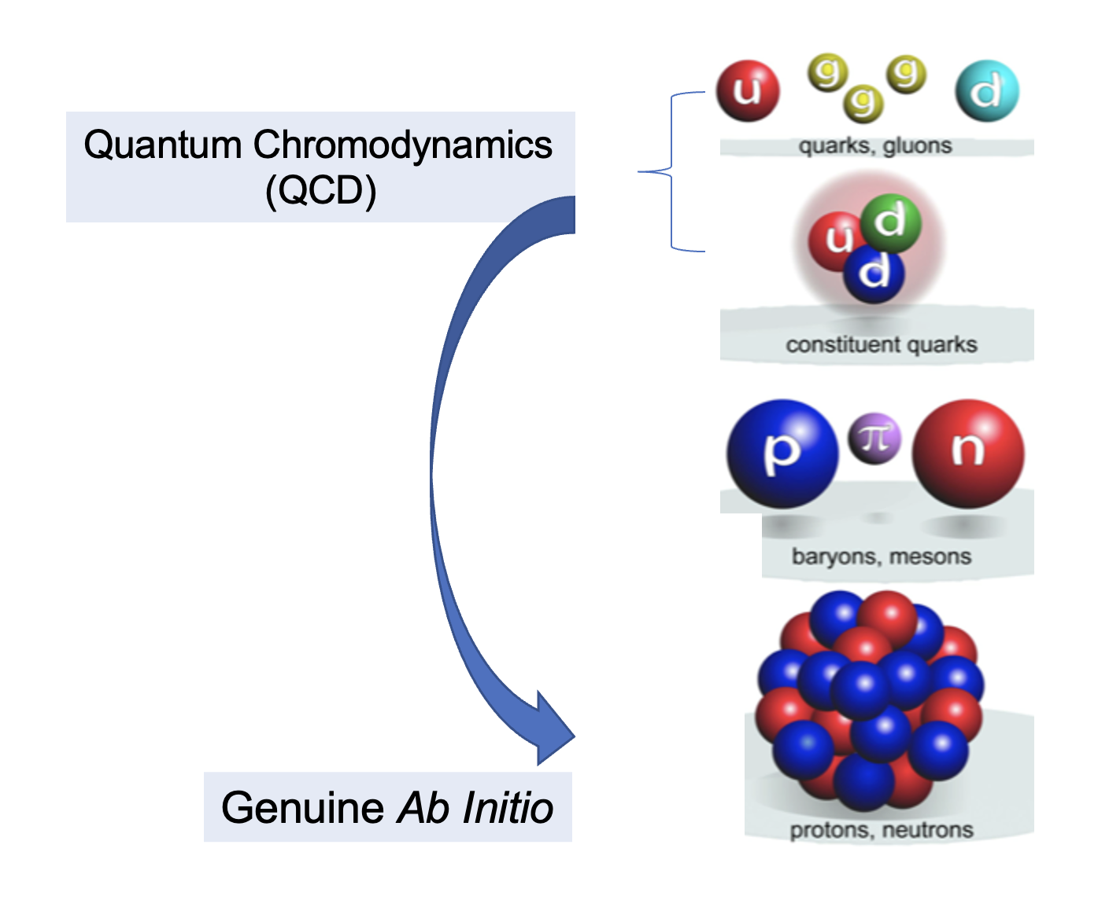

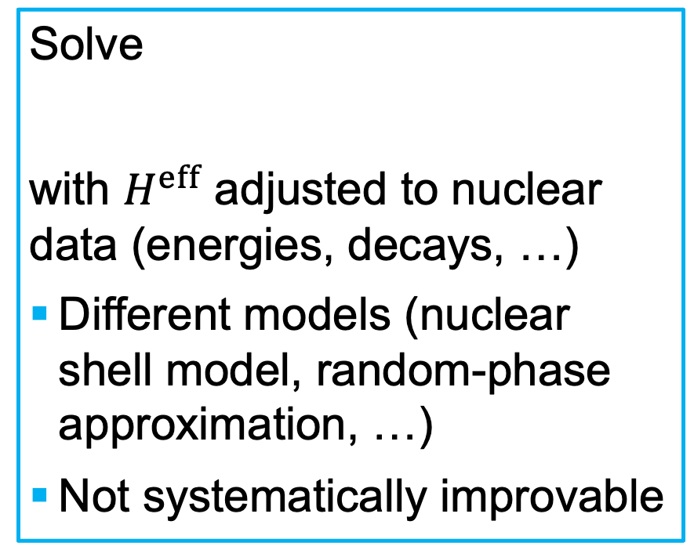
Ab initio vs. phenomenological nuclear methods
Ab initio (lat. ‘from the beginning’)
Phenomenological
Solve
with $H^{eff}$ adjusted to nuclear data (energies, decays, …)
Different models (nuclear shell model, random-phase approximation, …)
Not systematically improvable
$$H^{eff}Ψ^{(A)}=EΨ^{\left(A\right)}$$
Notes:
Highlight that ab initio methods are systematically improvable

Slide 7
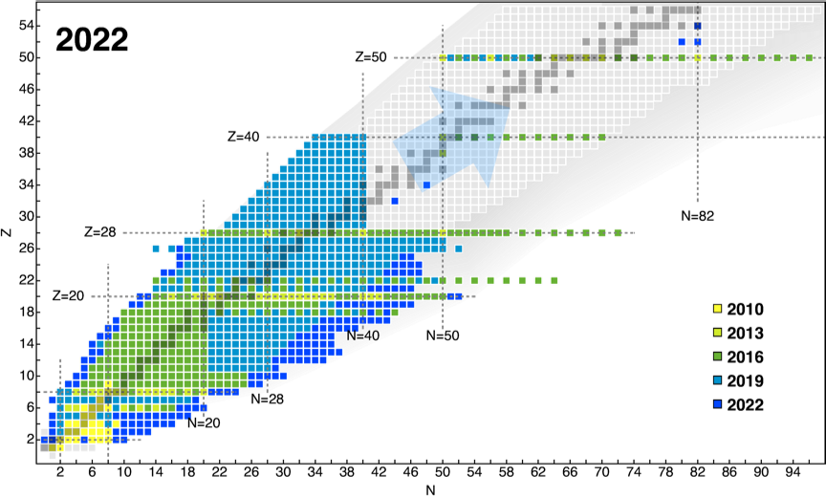
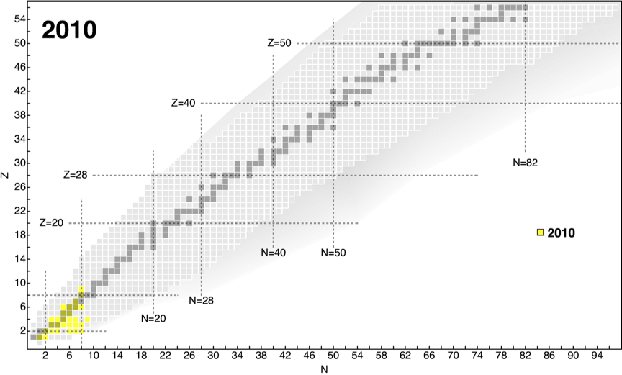
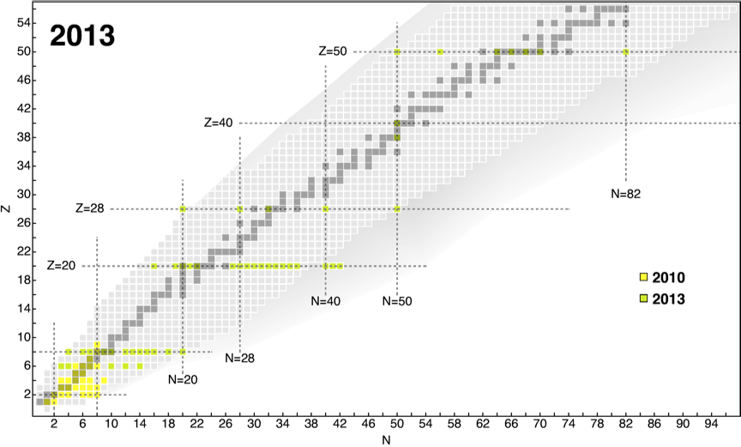
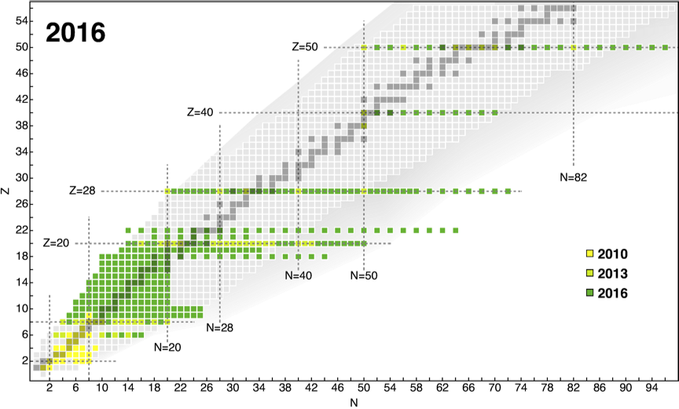
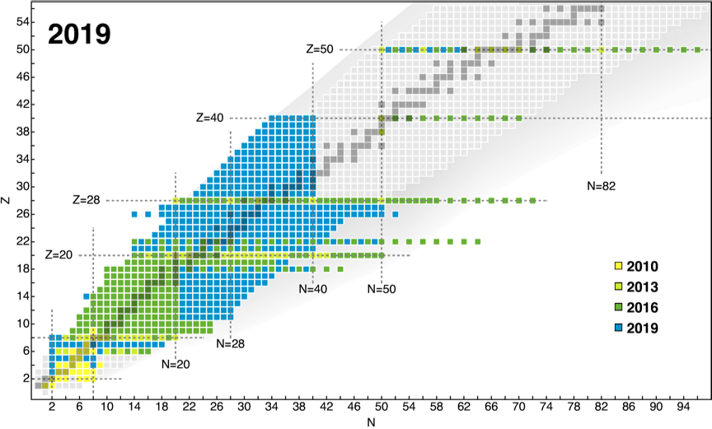
What can we do with ab initio methods?
Polynomially scaling methods (coupled cluster, IMSRG)
Polynomially scaling valence-space methods (VS-IMSRG, IM-GCM)
Exponentially scaling methods (NCSM, quantum Monte Carlo, …)
Figure courtesy of A. Belley, (adapted from H. Hergert, Front. Phys. 8 (2020))

Slide 8
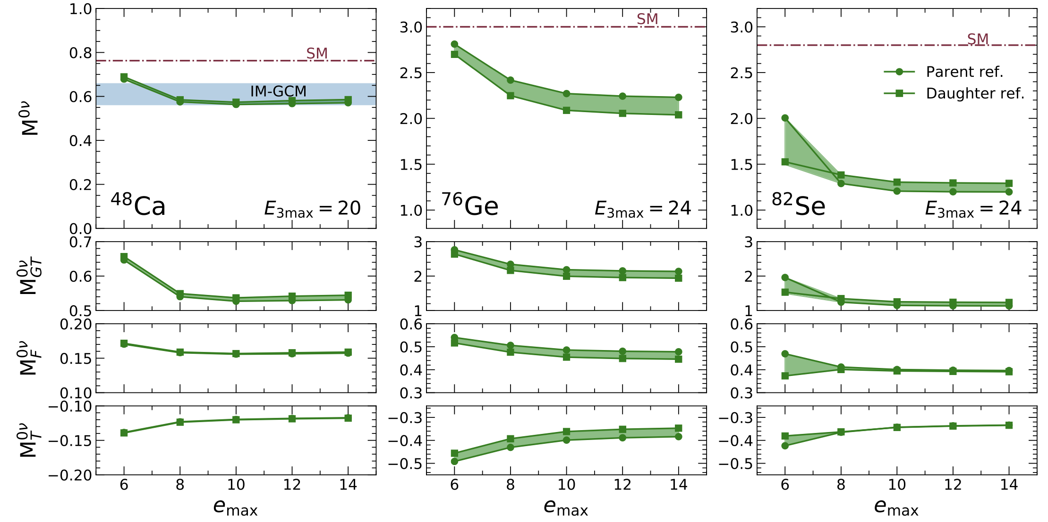
Ab initio $0νββ$-decay NMEs for ${}_{}^{48}{Ca}, {}_{}^{76}{Ge}$ and ${}_{}^{82}{Se}$
A. Belley et al., Phys. Rev. Lett. 126, 042502 (2021)

Slide 9
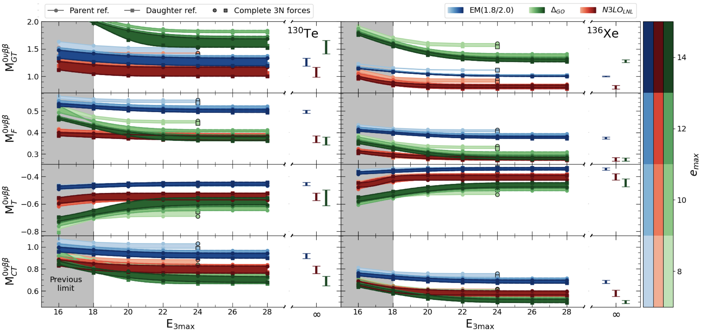
Ab initio $0νββ$-decay NMEs for ${}_{}^{130}{Te}$ and ${}_{}^{136}{Xe}$
A. Belley, T. Miyagi, S.R. Stroberg, and J. D. Holt, arXiv:2307.15156

Slide 10
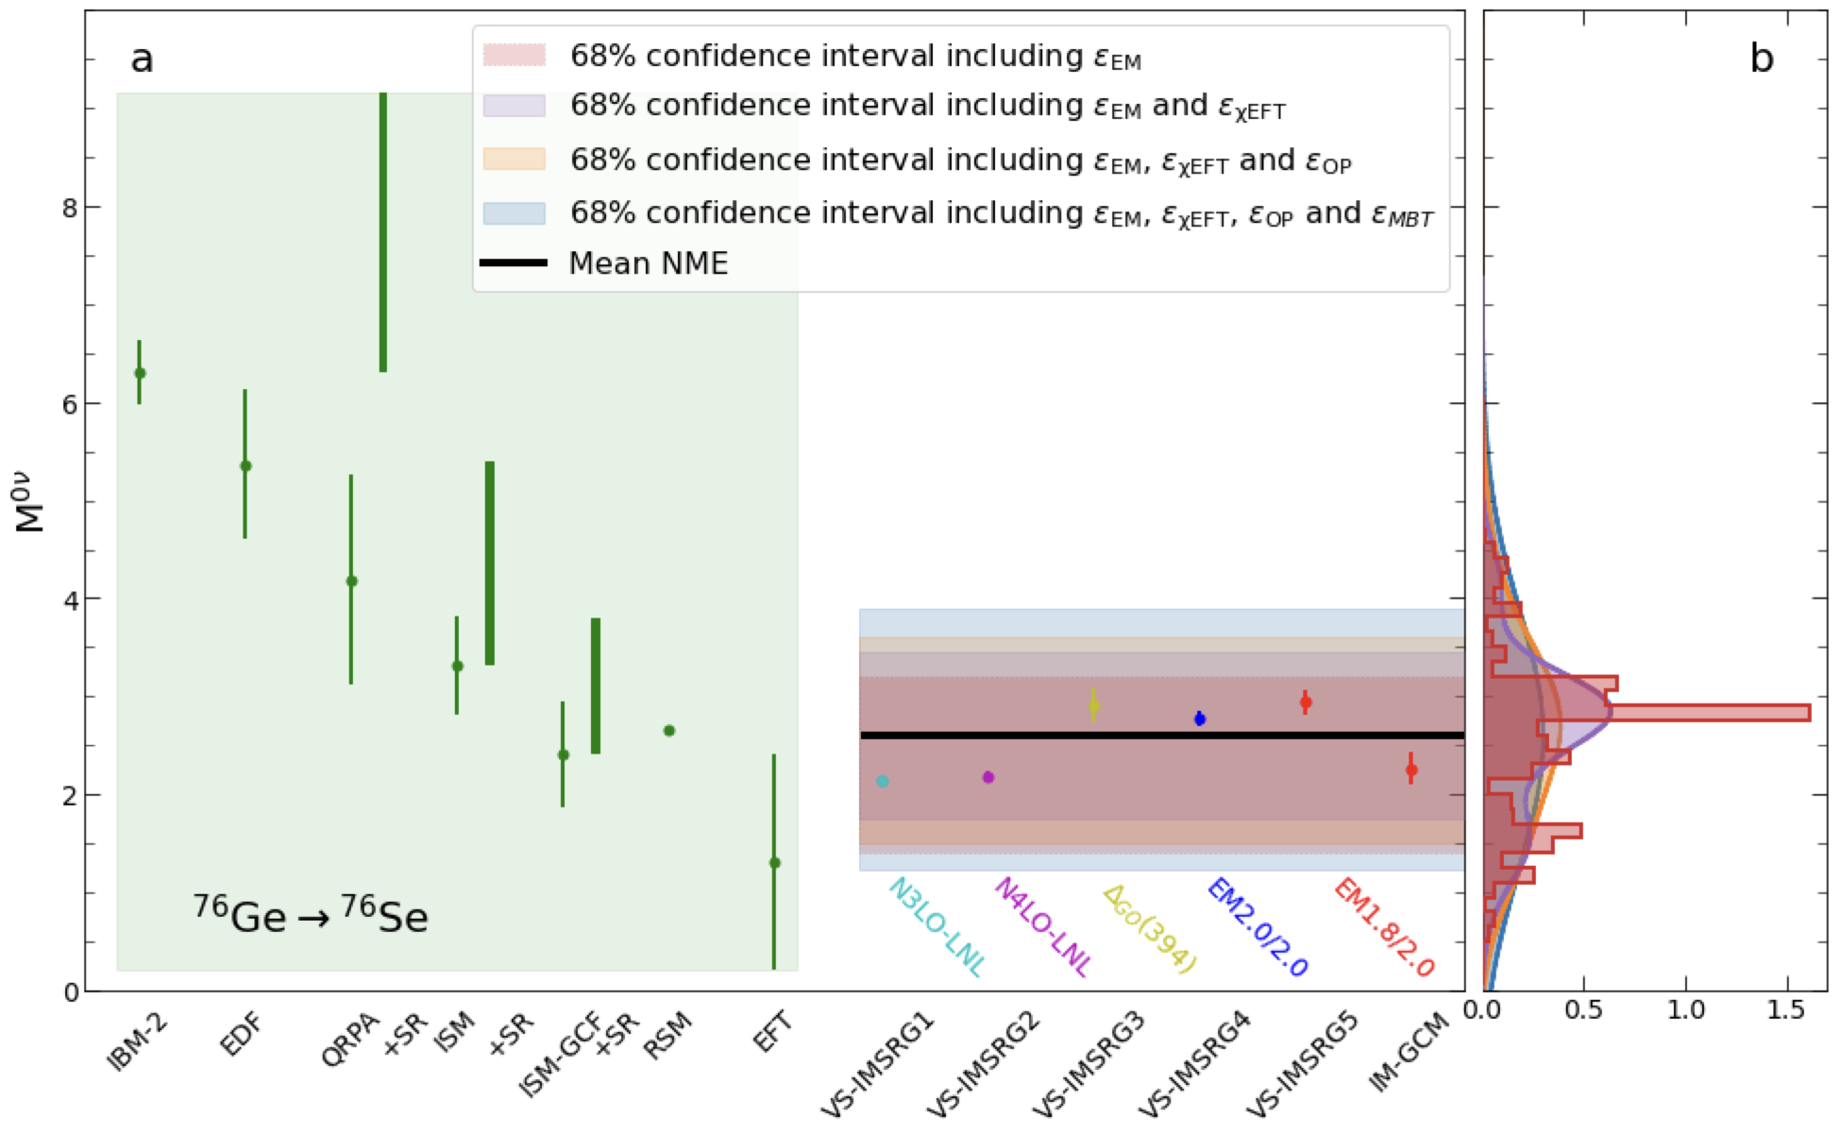
Uncertainty quantification of $0νββ$ decay of ${}_{}^{76}{Ge}$
Ab initio + machine learning + Bayesian statistics
A. Belley et al., Phys. Rev. Lett. 132, 182502 (2024)

Slide 11
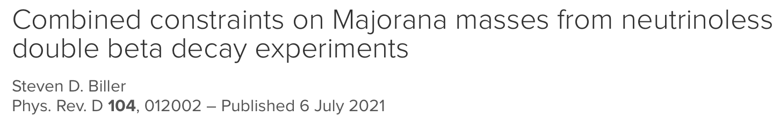

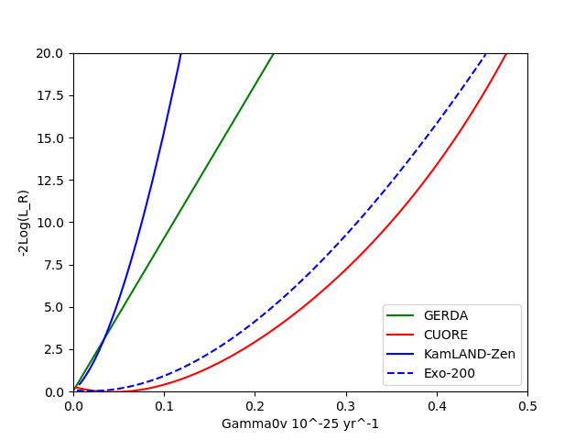
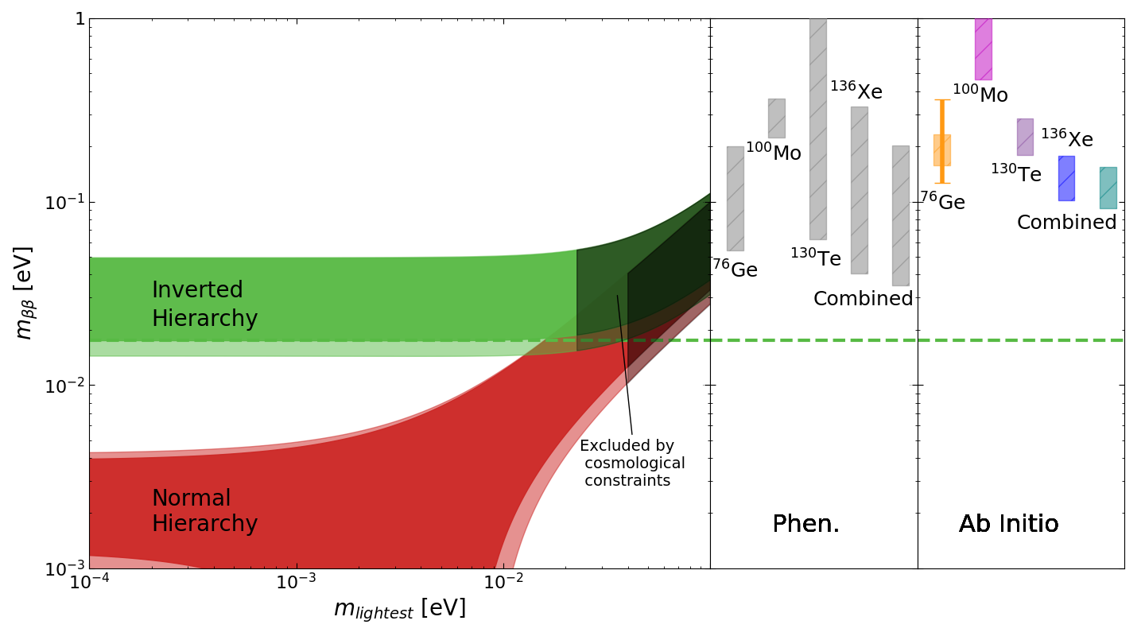
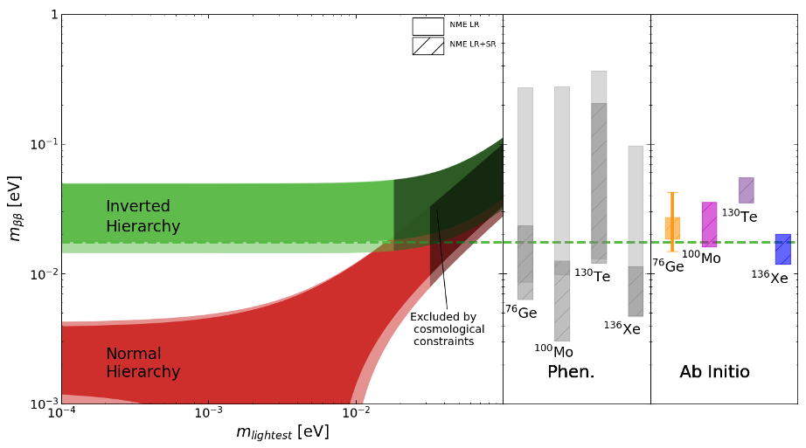

Combined constraints for Majorana masses
T. Shickele, LJ, A. Belley, et al., in progress.
GERDA: PRL 125, 252502 (2020)
CUORE: arXiv:2404.04453
KamLAND-Zen: arXiv:2406.11438
EXO-200: PRL 123, 161802 (2019)
Constraints for heavy neutrinos (A. Todd)
Constraints for next-generation experiments

Slide 12
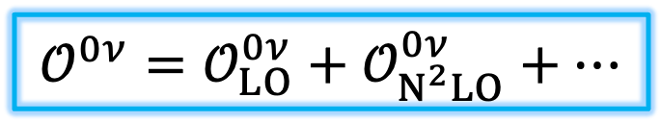
Improvements to the operator of $0νββ$ decay
$$𝒪^{0ν}=𝒪_{LO}^{0ν}+𝒪_{N^{2}LO}^{0ν}+…$$
What is normally included
What needs to be included
Leading order
Next-to-next-to-leading order
V. Cirigliano et al., Phys. Rev. Lett. 120, 202001 (2018), Phys. Rev. C 100, 055504 (2019)

Slide 13
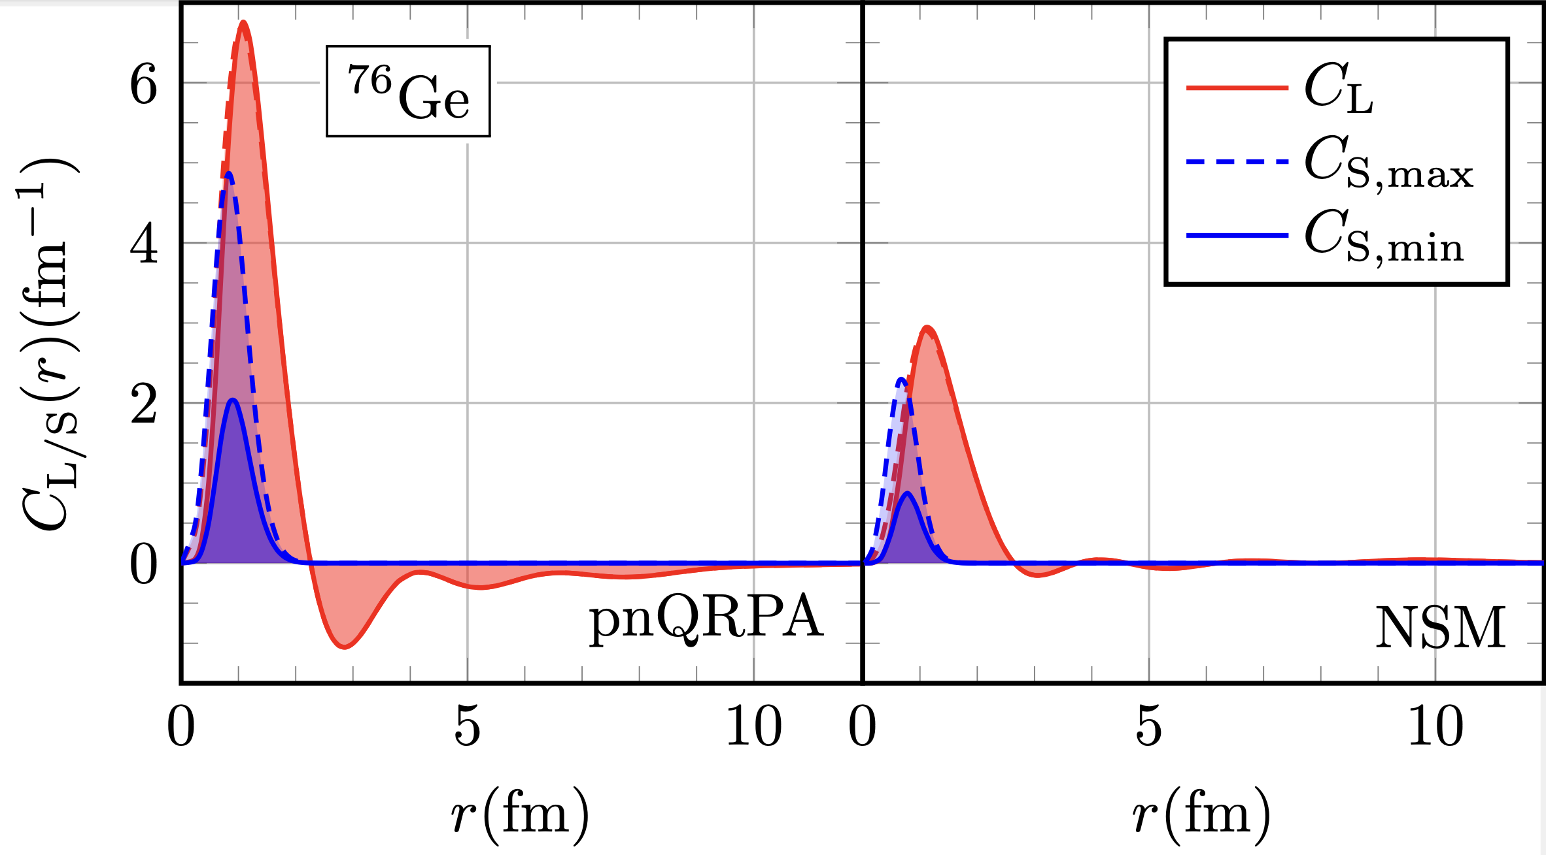
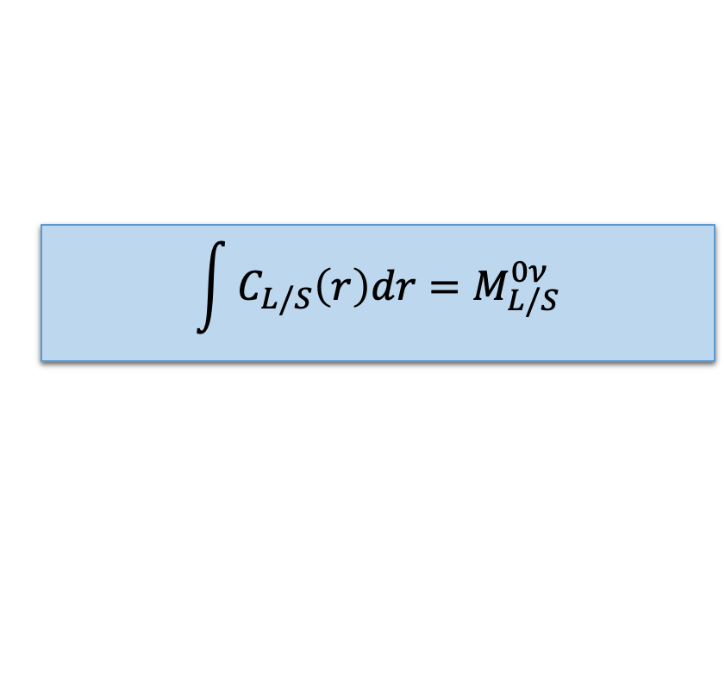
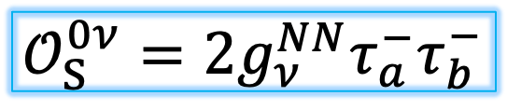
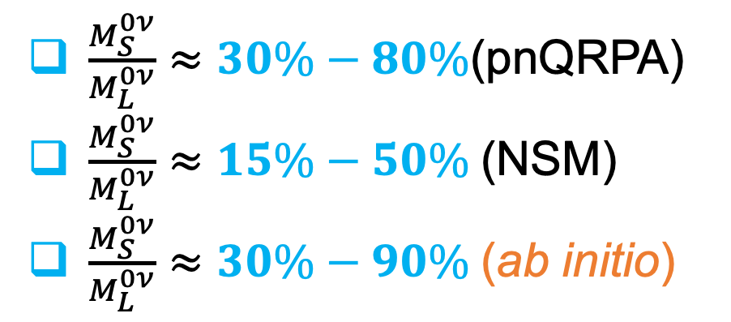
Contact term in pnQRPA and nuclear shell model (NSM)
$$\int{C_{L/S}\left(r\right)dr=M_{L/S}^{0ν}}$$
$$𝒪_{S}^{0ν}=2g_{ν}^{NN}τ_{a}^{−}τ_{b}^{−}$$
$\frac{M_{S}^{0ν}}{M_{L}^{0ν}}≈30\%−80\%$(pnQRPA)
$\frac{M_{S}^{0ν}}{M_{L}^{0ν}}≈15\%−50\%$(NSM)
$\frac{M_{S}^{0ν}}{M_{L}^{0ν}}≈30\%−90\%$(ab initio)
R. Wirth et al., PRL 127, 242502 (2021)
A. Belley et al., PRL 132, 182502 (2024)
A. Belley et al., arXiv:2307.15156
LJ, P. Soriano, J. Menéndez, Phys. Lett. B 823, 136720 (2021)

Slide 14
Effective-field theory corrections to the operator
$$𝒪^{0ν}=𝒪_{LO}^{0ν}+𝒪_{N^{2}LO}^{0ν}+…$$
What is normally included
What needs to be included
Leading order
Next-to-next-to-leading order
How about these?
V. Cirigliano et al., Phys. Rev. Lett. 120, 202001 (2018), Phys. Rev. C 100, 055504 (2019)

Slide 15
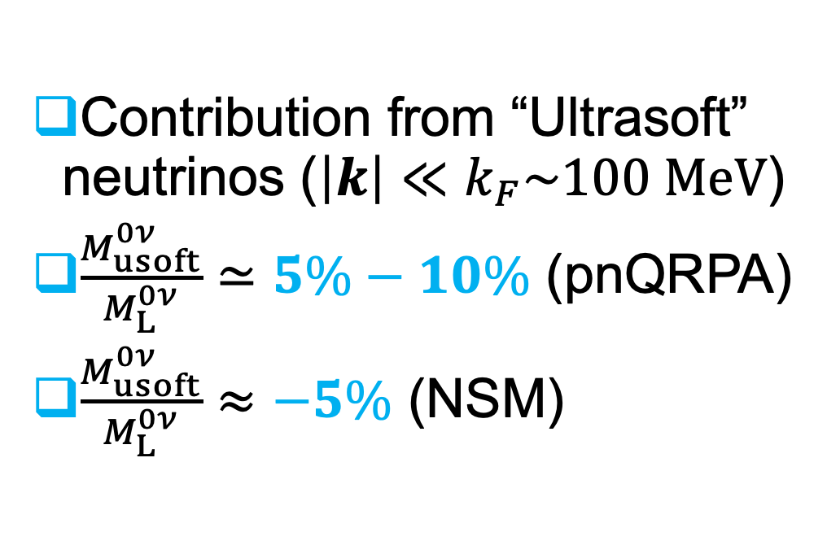
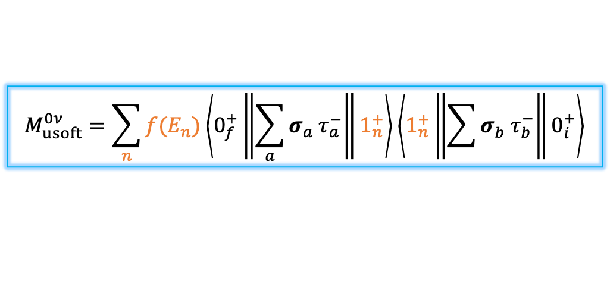
The ultrasoft-neutrino term
$$M_{usoft}^{0ν}=\sum_{n}{f(E_{n})\left\langle 0_{f}^{+}\left\|\sum_{a}{σ_{a}^{}τ_{a}^{−}}\right\|1_{n}^{+}\right\rangle \left\langle 1_{n}^{+}\left\|\sum{σ_{b}^{}τ_{b}^{−}}\right\|0_{i}^{+}\right\rangle }$$
Contribution from “Ultrasoft” neutrinos ($\left|k\right|≪k_{F}\sim 100 MeV$)
$\frac{M_{usoft}^{0ν}}{M_{L}^{0ν}}≃5\%−10\%$ (pnQRPA)
$\frac{M_{usoft}^{0ν}}{M_{L}^{0ν}}≈−5\%$ (NSM)
D. Castillo, LJ, P. Soriano, J. Menéndez, arXiv:2408:03373

Slide 16
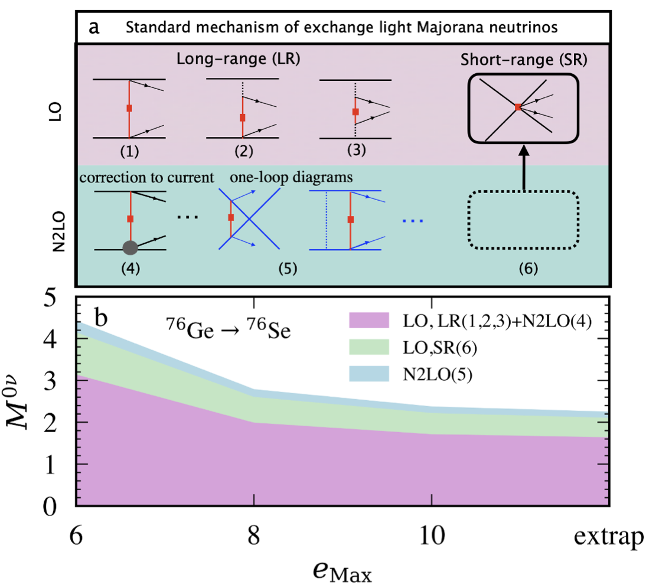
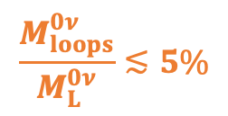
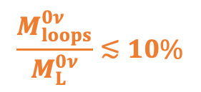

$N^{2}LO$ loop corrections
$$𝒪_{loops}^{0ν}={e^{−q^{2}/(2Λ^{2})}(𝒪}_{VV}^{(m,n)}+𝒪_{AA}^{(m,n)}+𝒪_{US}^{(m,n)}+𝒪_{CT}^{(m,n)})$$
$$\sim 5\%$$
$$\frac{M_{loops}^{0ν}}{M_{L}^{0ν}}≲10\%$$
$$\frac{M_{loops}^{0ν}}{M_{L}^{0ν}}≲5\%$$
A Belley et al., Phys. Rev. Lett. 132, 182502 (2024)
D. Castillo, LJ, P. Soriano, J. Menéndez, arXiv:2408:03373

Slide 17
Combined $N^{2}LO$ corrections
D. Castillo, LJ, P. Soriano, J. Menéndez, arXiv:2408:03373
$→$The N2LO corrections should be included in any $0νββ$ calculations

Slide 18
Could We Learn from Other Nuclear Processes?

Slide 19


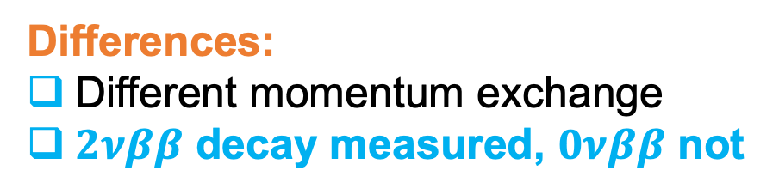
Probing $0νββ$ decay by $2νββ$ decay
Similarities:
Same initial and final nuclei
Weak-interaction processes
Differences:
Different momentum exchange
$2νββ$ decay measured, $0νββ$ not
$q_{2νββ}≈2$ MeV
$q_{0νββ}≈100$ MeV

Slide 20
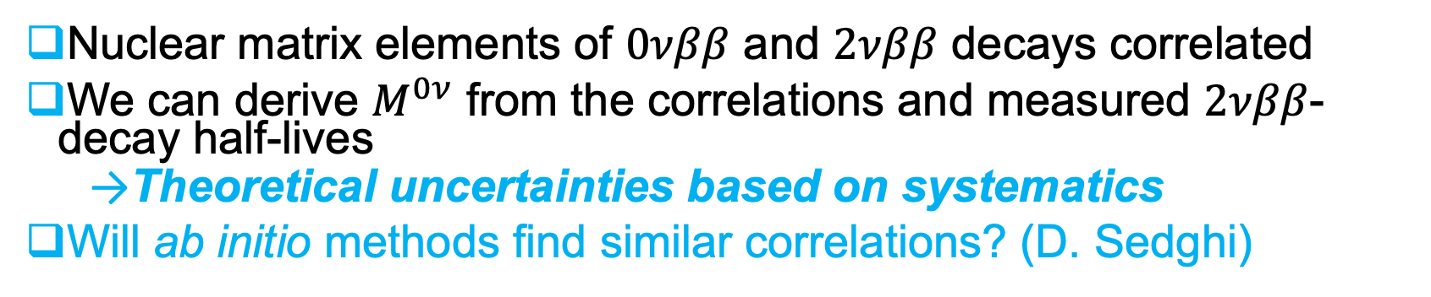
Probing $0νββ$ decay by $2νββ$ decay
Nuclear matrix elements of $0νββ$ and $2νββ$ decays correlated
We can derive $M^{0ν}$ from the correlations and measured $2νββ$-decay half-lives
  Theoretical uncertainties based on systematics
Will ab initio methods find similar correlations? (D. Sedghi)
LJ, B. Romeo, P. Soriano, J. Menéndez, Phys. Rev. C 107, 044305 (2023)

Slide 21
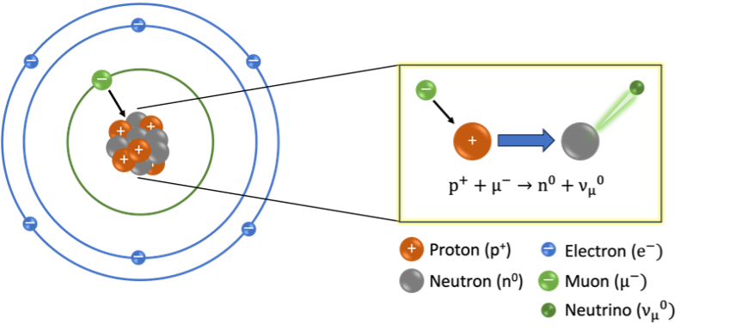
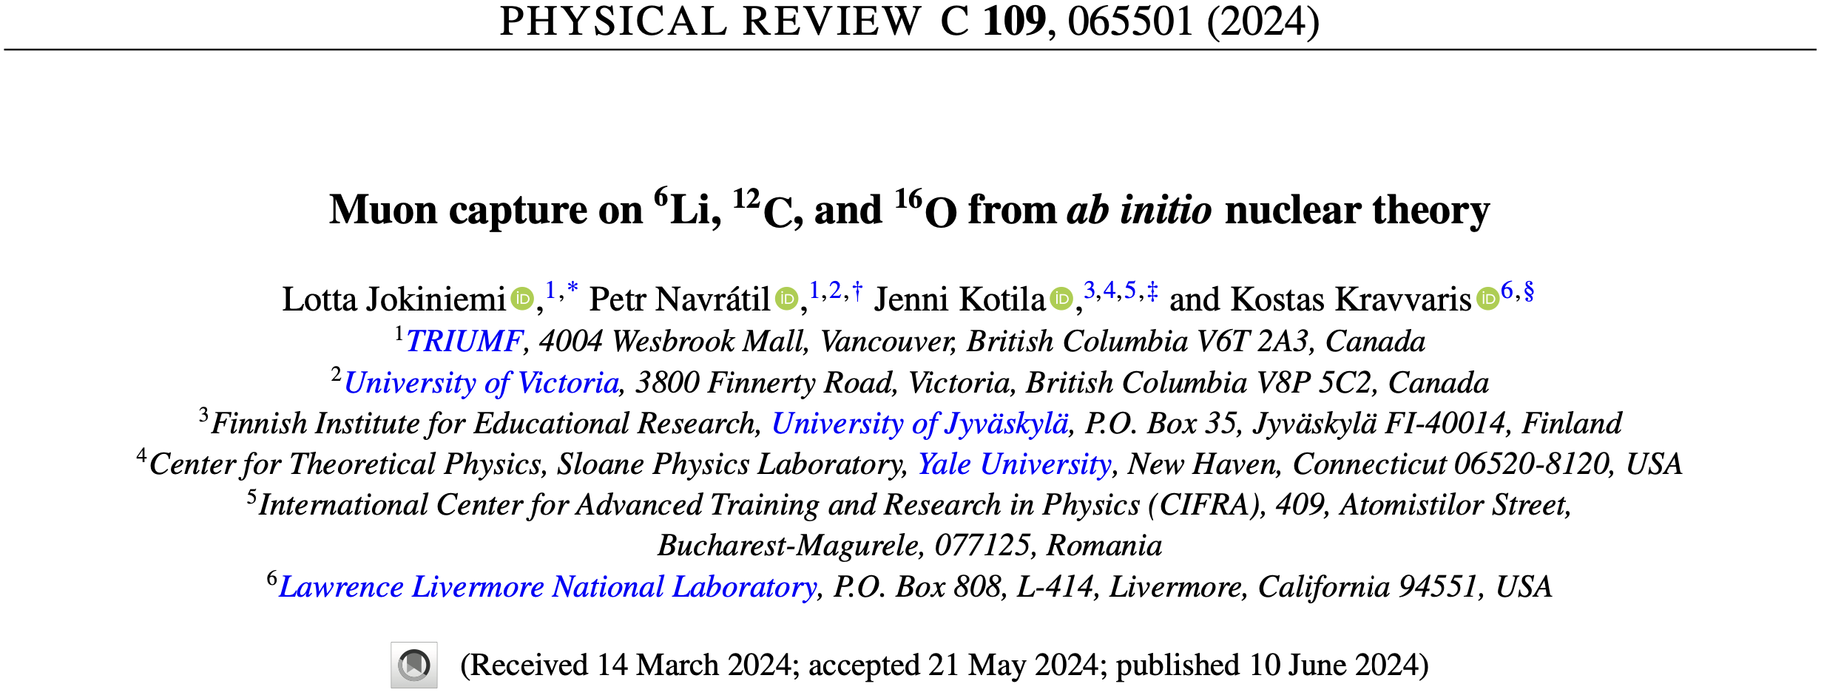
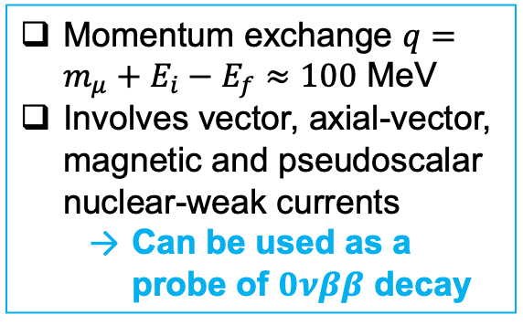
Muon capture on ${}_{}^{6}{Li}$, ${}_{}^{12}C$, ${}_{}^{16}N$ from ab initio nuclear theory
Momentum exchange $q=m_{μ}+E_{i}−E_{f}≈100$ MeV
Involves vector, axial-vector, magnetic and pseudoscalar nuclear-weak currents
  Can be used as a probe of $0νββ$ decay
Ab initio no-core shell-model calculations in good agreement with experiments

Slide 22
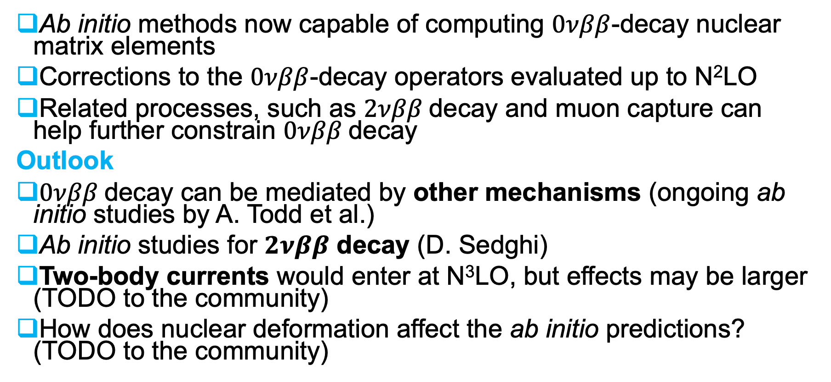
Summary and Outlook
Ab initio methods now capable of computing $0νββ$-decay nuclear matrix elements
Corrections to the $0νββ$-decay operators evaluated up to N²LO
Related processes, such as $2νββ$decay and muon capture can help further constrain $0νββ$decay
Outlook
$0νββ$decay can be mediated by other mechanisms (ongoing ab initio studies by A. Todd et al.)
Ab initio studies for $2νββ$ decay (D. Sedghi)
Two-body currents would enter at N³LO, but effects may be larger (TODO to the community)
How does nuclear deformation affect the ab initio predictions? (TODO to the community)

Slide 23

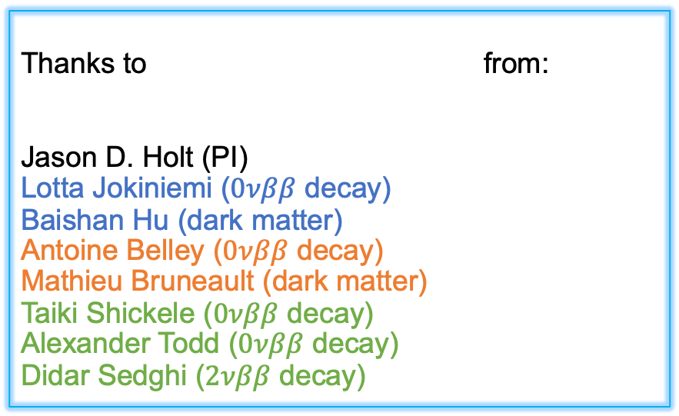
Thank you
Merci
ljokiniemi@triumf.ca
Thanks to from:
Jason D. Holt (PI)
Lotta Jokiniemi ($0νββ$ decay)
Baishan Hu (dark matter)
Antoine Belley ($0νββ$ decay)
Mathieu Bruneault (dark matter)
Taiki Shickele ($0νββ$ decay)
Alexander Todd ($0νββ$ decay)
Didar Sedghi ($2νββ$ decay)

Slide 24
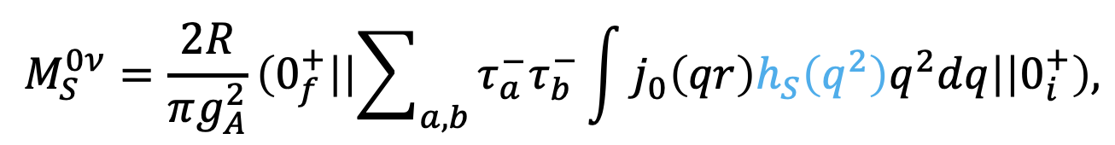
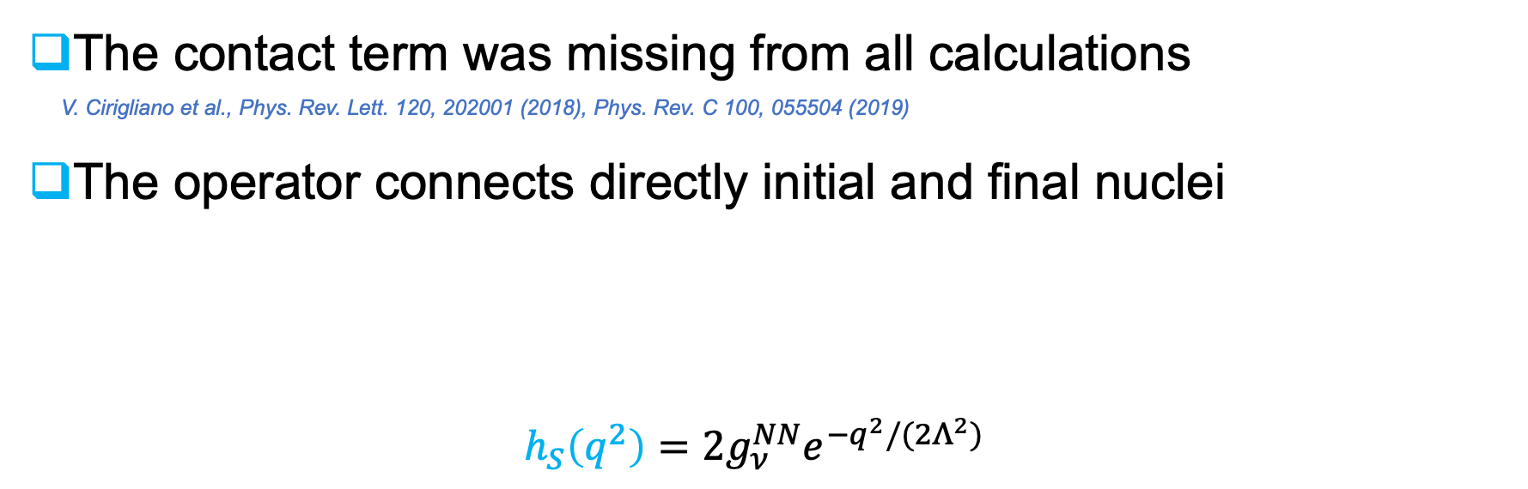
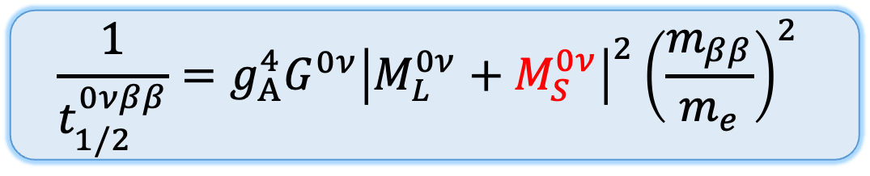
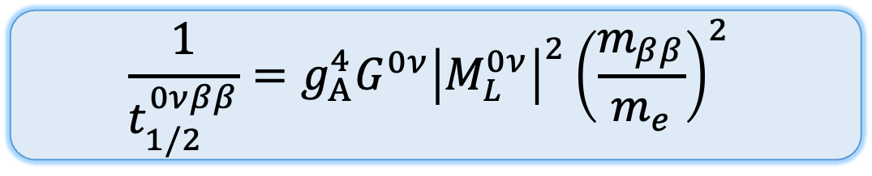
New leading order short-range nuclear matrix element
$$\frac{1}{t_{1/2}^{0νββ}}=g_{A}^{4}G^{0ν}{\left|M_{L}^{0ν}+M_{S}^{0ν}\right|}^{2}{\left(\frac{m_{ββ}}{m_{e}}\right)}^{2}$$
$$\frac{1}{t_{1/2}^{0νββ}}=g_{A}^{4}G^{0ν}{\left|M_{L}^{0ν}\right|}^{2}{\left(\frac{m_{ββ}}{m_{e}}\right)}^{2}$$
The contact term was missing from all calculations
V. Cirigliano et al., Phys. Rev. Lett. 120, 202001 (2018), Phys. Rev. C 100, 055504 (2019)
The operator connects directly initial and final nuclei
$h_{S}\left(q^{2}\right)=2g_{ν}^{NN}e^{−q^{2}/(2Λ^{2})}$
Unknown

