Slide 1



Industrialization
Realizing applied opportunities
Fabrice Retiere (TRIUMF) with major inputs from Serge Charlebois (Sherbrooke)

Slide 2
Outline
Motivation
Jargon
Examples of opportunities
Roadblocks and breakthroughs
You

Slide 3
Motivation – value/goal mapping – 20 years ago when I moved to Canada
Value
Creativity
Achievement
Independence
Belonging
Goals
Develop experimental solutions for discovery physics
Integrate in Canadian SAP community
Ski

Slide 4
Motivation – value/goal mapping - now
Value
Creativity
Achievement
Concern for Environment
Responsibility
Goals
Develop experimental solutions for mitigating climate change and astro-particle physics
Develop effective technology resource management solutions

Slide 5
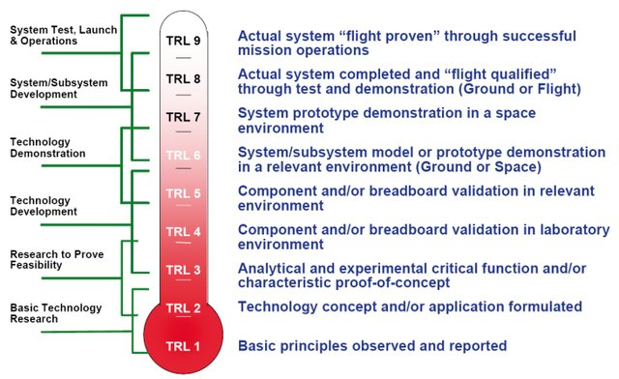
Technology Readiness Level

Slide 6
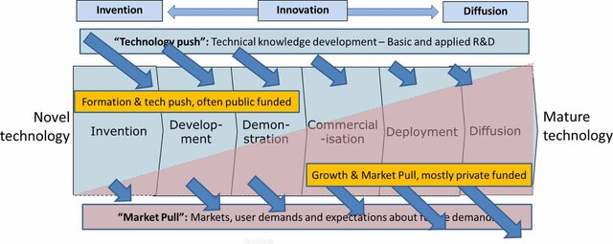
Push – Pull technology

Slide 7
Photon to Digital Converter ++
Push – TRL 1 to 8
p+
p
p-epi
p-epi
n+
n
Poly
SiO2
100-500 um
Electron trajectories
Geiger mode avalanche
Hole trajectories
Linear avalanche
VUV – Blue photon
Charged particle
Neutron or dark matter
5-50um
Un-depleted
depleted
Photon to Digital Converter
80um
5-20um
CMOS
CMOS
CMOS
CMOS
Ultra-thick
Front side avalanche diode
Back side avalanche diode
Extended
7

Slide 8
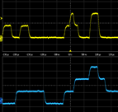

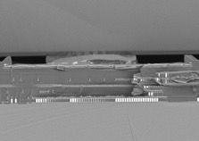

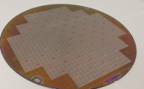

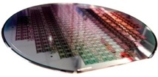
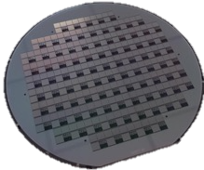

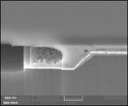
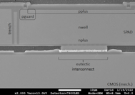
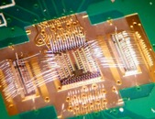
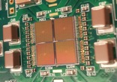
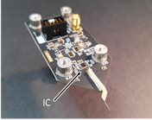
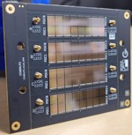
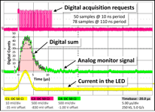
Development timeline and update – All critical gates passed (but the last…)
2D SPADs
and
Wafer level
bonding
1st 3D SPAD
wafer
(on fake CMOS)
…
2018
2019
2020-21
2022
2023
2024
Start
at TDSI
1st CMOS
readout
2nd CMOS
readout
wafer run
Bonding on
real CMOS
demonstrated
Complete
PDC
Photon detection layer
(SPAD array) and 3D
integration
Geiger mode
testing with
active probe
Large tile
8×8
dev.
System and
scaling up
challenges
2019
2020
2021
2022
2023
2024
Electronics layer
(CMOS)
Geiger mode
testing during
SPAD dev.
First functional
2×2 tile
Wafer level
SPAD
testing
Notes:
Two axis of development:
Top arrow - The PDC itself including both the readout electronics (top of top arrow) and the detector (bottom of top arrow)
Bottom arrow – developing the SPAD and PDC test capabilities (left most part) to system level integration in increasingly large systems

Slide 9
Made possible by the astroparticle physics community
Definite need for a new photon detection technology
  High sensitivity and sensitive area, Low power consumption, Scalable to large area
Past Current Future Leverage
First CFI support through Carleton U. for ARGO and nEXO 1.2 M$
  Completed PDC process development and completing first production run
Engineering support from MI 437 k$
nEXO CFI grand 1.2 M$
  Maturing the PDC, producing silicon low radiation tile substrate (interposer)
Other partners: TRIUMF, UofA ~250 k$
Oak Ridge National Lab. project 902 k$ ~1.6 M$ 2.6 M$
  HEP direct support to Teledyne DALSA 350 k$
ARGO’s next CFI proposal 600 k$
Institut national d’optique / Defense R&D Canada ~1 M$
Total 6.4 M$ ~3 M$

Slide 10
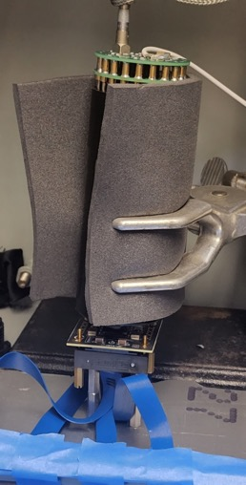
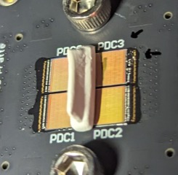
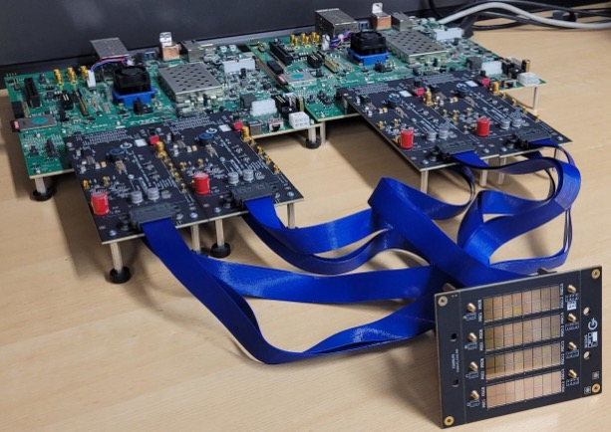
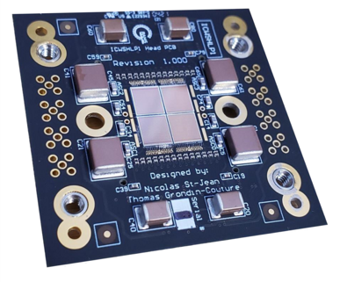
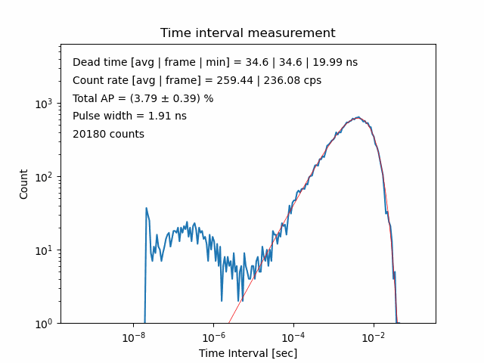
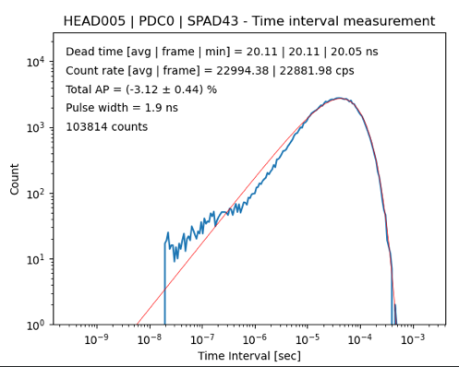
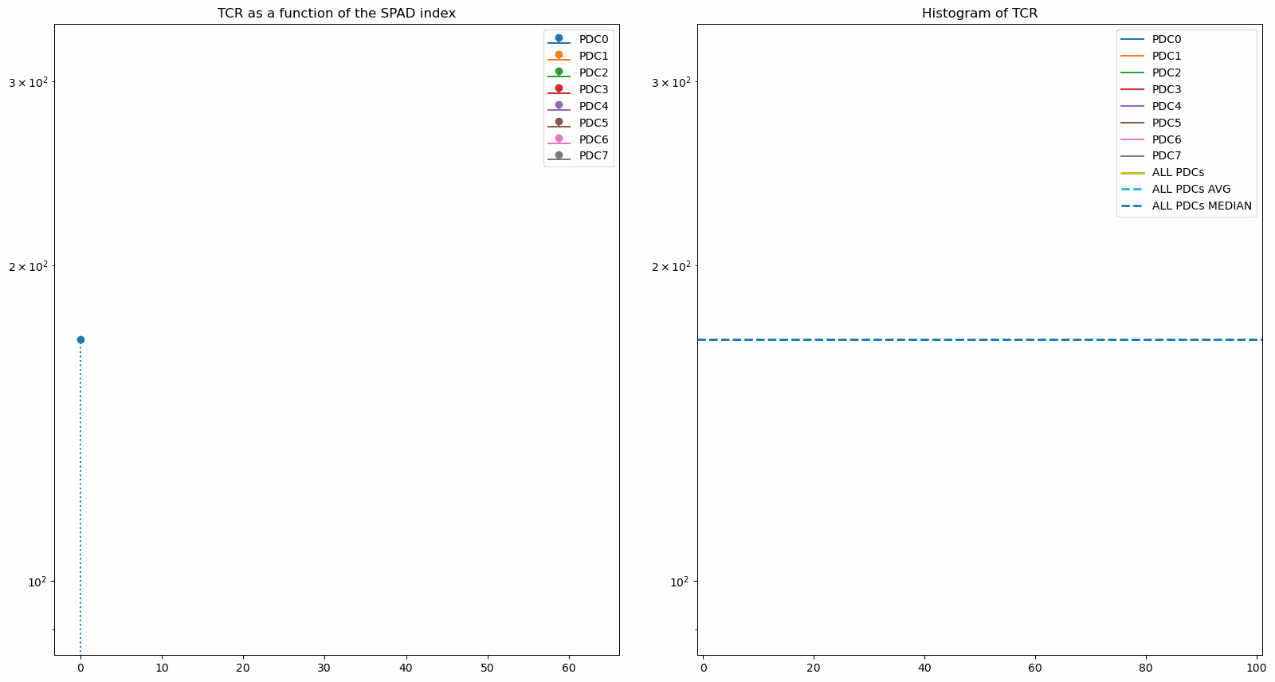
Dissimination of PDC: Creating a community of first users
Single and small PDC arrays to larger PDC tiles
2×2 PDCs
Top
50 mm
50 mm
Exploring (strange) properties of some to performances from large ensemble of SPADs

Slide 11
A wide range of (potential) applications
Large cryogenic experiments
  nEXO, ARGO, …
Medical imaging
  Time-of-flight positron emission tomography – ToF PET
  Time-of-flight computed tomography – ToF CT
  Photon counting X-ray imaging
  Single gamma imaging
Neutron imaging
  Project with Oak Ridge NL
  Project with General Fusion
Muon imaging
Quantum information sciences
  Quantum key distribution – leverages embedded signal processing
  Future entangled photons work
LIDAR
  Ranging is a crowded field (we don’t do)
  Free space air analysis - Time-of-flight with wavelength information
Digital Single photon counting
  Enclosed air analysis for Forest fire surveillance and beyond
  Space telecommunication

Slide 12
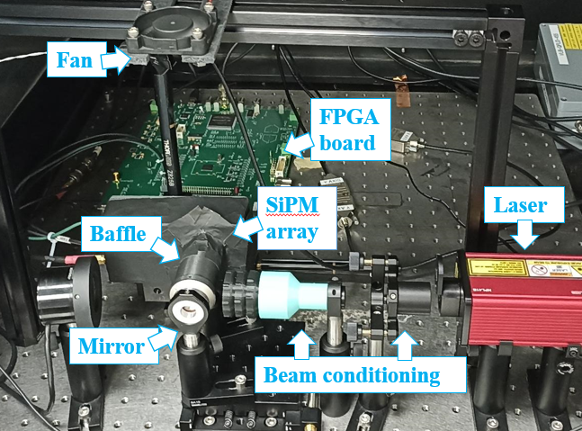
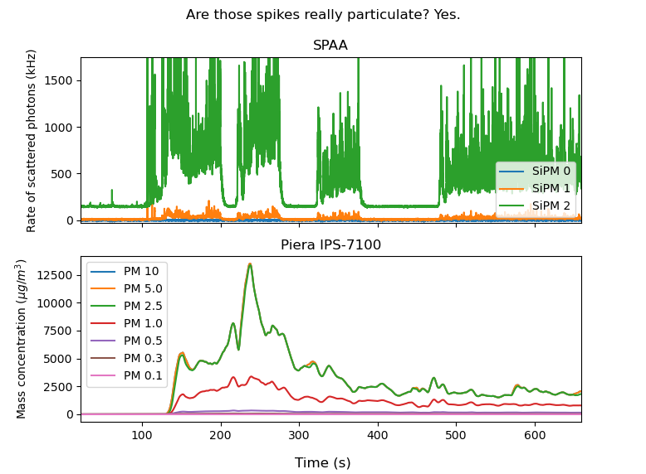
Push – Single Photon Air Analyser
Push – TRL 4 to 8

Slide 13
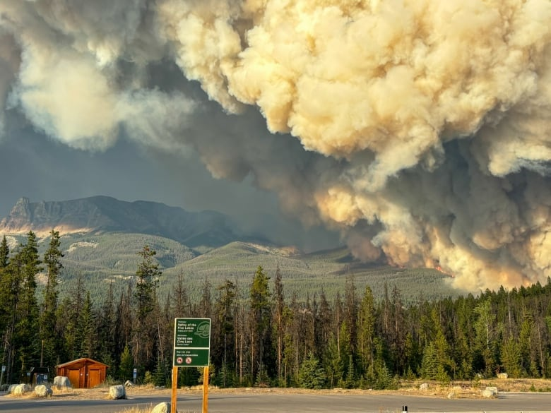
Forest fire
Pull – TRL 3 to 9
It is a huge growing problem in Canada
Why isn’t there a consortium tackling this problem from all angles?
  Forestry, detection, suppression (firefighting), AI,….
  Nothing to do with astro-particle physics but has to be done!
Applying to a variety of grants
  NFRF exploration coming up

Slide 14
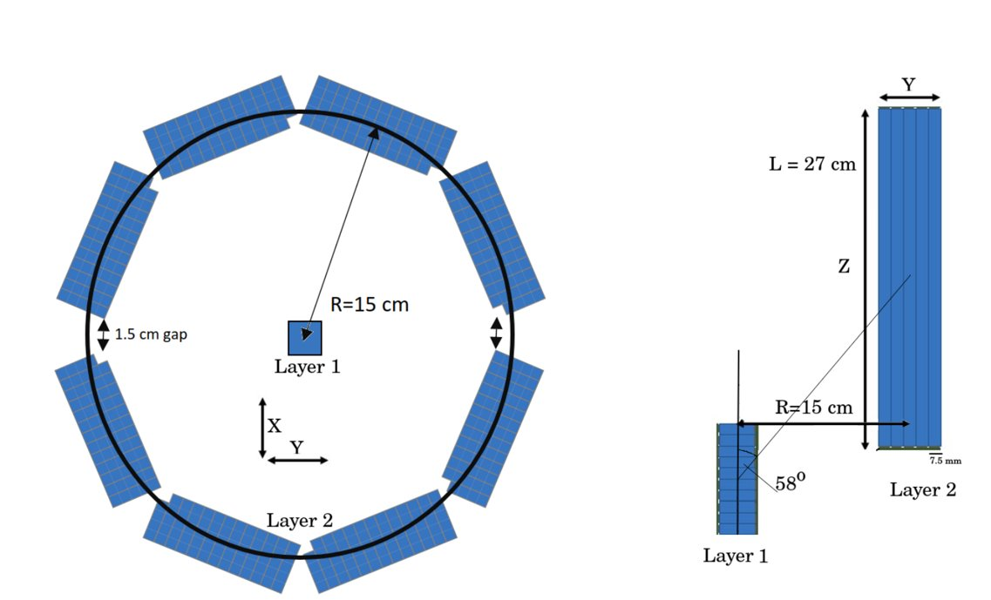
Neutron time of flight spectrometry for General Fusion
Pull – TRL 3 to 8
Challenge: GHz neutron flux for 10us or so – High rate, high efficiency needed - TRL
Technology: Plastic scintillator + SiPM / PDC
Funding: MITACS Elevate for R. Underwood (former SuperCDMS PhD) and NSERC ALLIANCE (1,200k$ for 4 years)
Neutron
Fusion

Slide 15
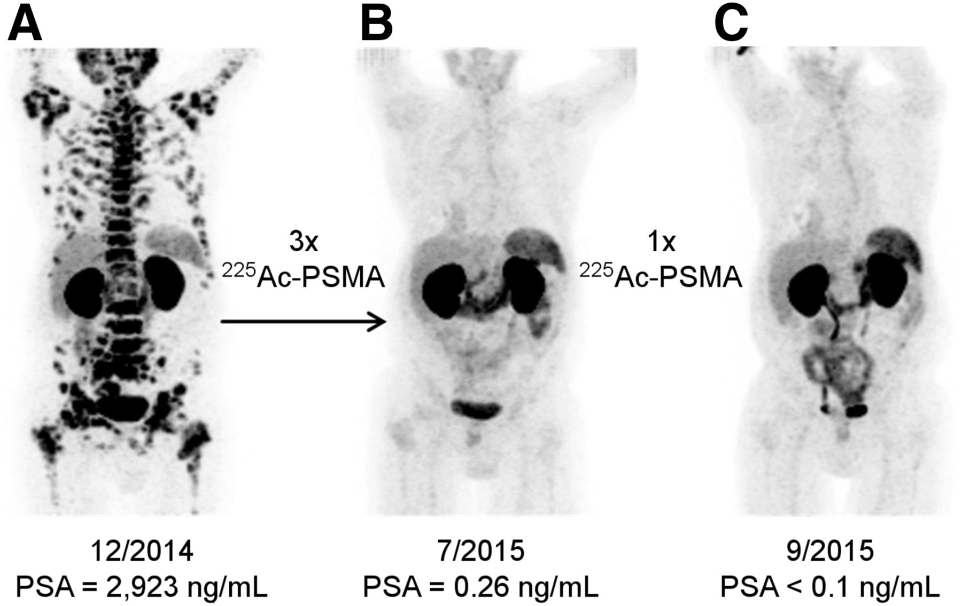
TIIGR, Therapeutic Isotope Imager with Gamma Rays
Push – TRL 2 to 7
²²⁵Ac decay into gamma rays
Isotope parent | Energy | Time scale | Intensity
²²¹Fr | 218 keV | 4.9 min | 11 %
²¹³Bi | 440 keV | 4.9 min + 46 min | 25 %
²⁰⁹Tl | 117 keV | 4.9 min + 46 min + 2.2 min | 1.6 %
²⁰⁹Tl | 465 keV | 4.9 min + 46 min + 2.2 min | 2 %
²⁰⁹Tl | 1,567 keV | 4.9 min + 46 min + 2.2 min | 2.1 %
Challenge is the detection of single gamma at low rate - this is not SPECT
Our (TRIUMF + Korea) aim is to identify a compelling detection scheme by the end of 2024
If successful move towards a staged construction scheme with industrial partners

Slide 16
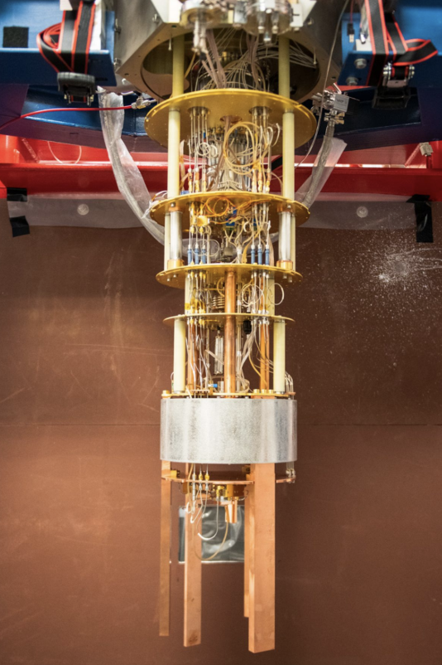
Pull – Qbit decoherence
Pull – TRL 3 to 5
Key issue for (most) quantum computers
Ionizing radiation (primarily from cosmic ray) affects the coherence of qubits and causes correlated errors.
Work at SNOLAB in CUTE to characterize cosmic ray impact
Emerging work on developing cosmic ray tag in cryostat
  UK – Canada grant application led by Giampa (MI/TRIUMF) and Monroe (Oxford)

Slide 17
Roadblocks
Technology transfer offices – Too far from basic research
  We are not selling ice cream. The requirement of doing market assessments does not always make sense, though some grants require it (NSERC I2I, Korea)
  Risk adverse – building trust is needed but should it?
Academic administration – lack of strategic thinking
  Intellectual property - Disconnect between potential IP and “money making” IP. Most IP don’t make money and IP protection requires strategic thinking
  Research security – ad-hoc vetting for companies, more formalized for research institute but still piecemeal
  Too many grants – what should we do?
We need startup…

Slide 18
Breakthrough
Cutting-edge technology are often compelling solutions for applied problem
  Moving technology through the TRL scale is absolutely worth doing
  Be strategic - don’t push a solution without studying the competing solutions
  Don’t worry about being “wrong”. Venture capitalist say that your drive and team is more important than your starting idea. Ability to pivot is key
Advertising our expertise is key
  Let companies come to us for solutions
  Advertisement through Linkedin and websites but also networking – Tech transfer people do a great job at that.
Many grants available though most require commercial partner matching
Drive enables technical and scientific breakthrough … And startup

Slide 19
The end / Fin
Two related questions for all:
Should we do this, can we establish a vicious circle between basic research and applications without losing our soul?
At what TRL should we start working (not an industrialization question)?

Slide 20
Single Photon Air Analyzer – enclosed
Side view
Top view
Beam dump
Beam dump
Air flow
Laser diode
Laser diode
SPAD array
SPAD array
Three modalities in one unit:
Scattering for smoke detection – Same wavelength as light source
Fluorescence for many molecule detection – Select wavelength
Fluorescence of specific film that react to the presence of specifc gases – select wavelength

Slide 21
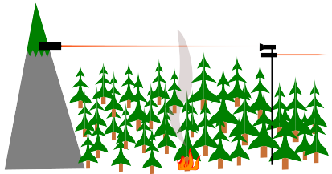
Single photon air analyser – open path
Fire laser in open air
  Backscattered light – smoke
    LIDAR for distance
  Fluorescence
    “LIDAR” for distance
  Attenuation
    For conventional attenuation SPAD not so good because high flux required
    Quantum scheme with entangled photons may reduce photon flux requirement

Slide 22
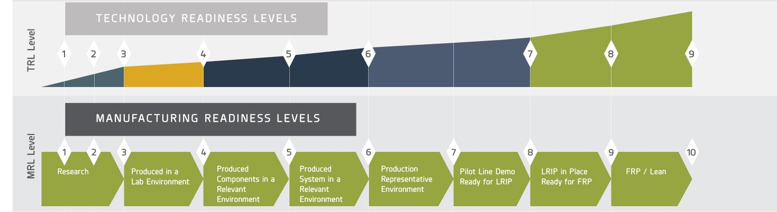
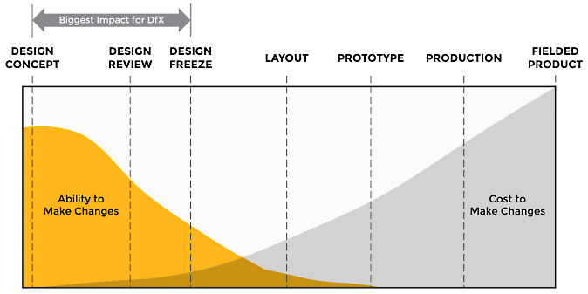
Comparison between TRL and MRL and relevance
Plexus, https://www.plexus.com/en-us/current/articles/manufacturing-readiness-levels-aerospace-defense , 2024-08
ANSYS, https://www.ansys.com/blog/what-is-dfx, 2024-08

Slide 23
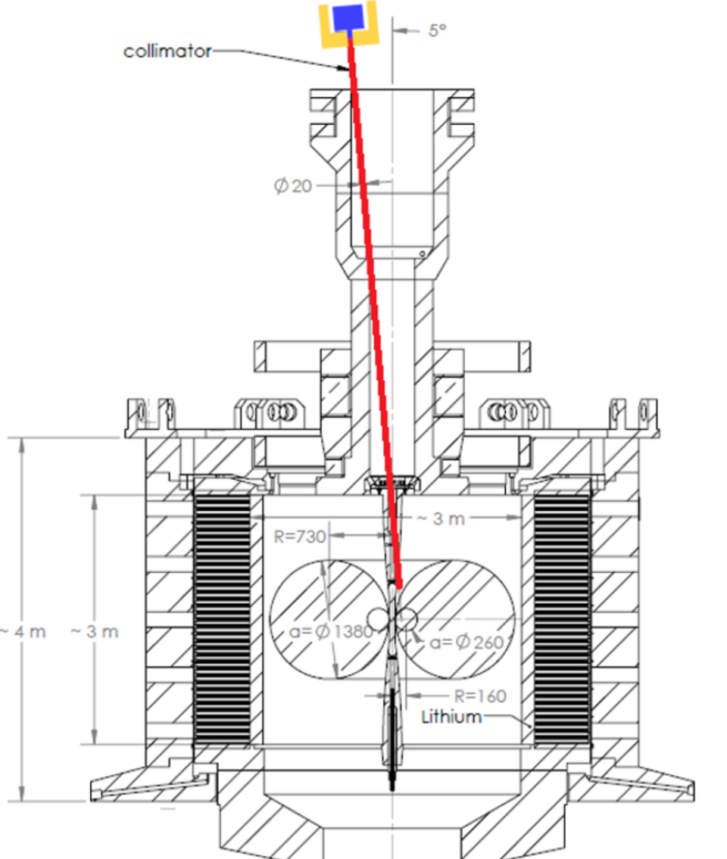
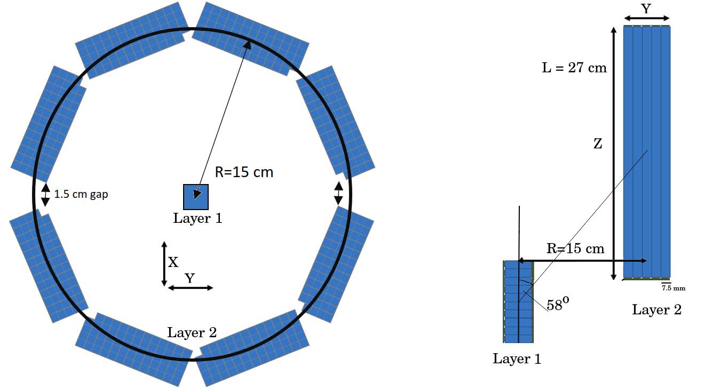
Supporting General Fusion
General Fusion is a company headquarter in Richmond BC (suburb of Vancouver)
Expected to produce 1GHz of neutrons (in pipe) during 10us
Extremely high rate that is very hard to deal with with analog SiPM
Fusion zone
Neutrons

Slide 24
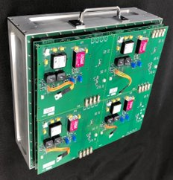
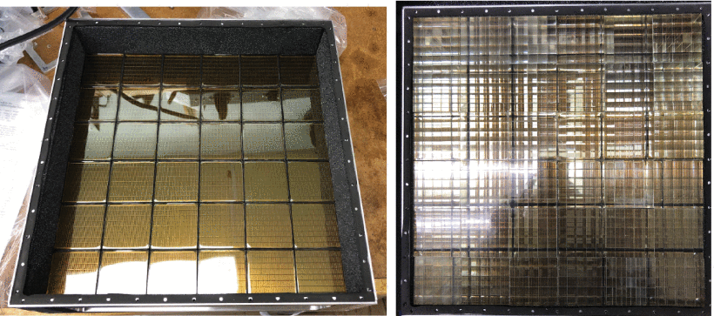
Assisted particle imaging neutron radiography
Existing solution developed by
Oak Ridge National Lab.
  Multi-Anode PMT-based panel array.
  2304 pixels over 30 x 30 cm².
  Eijen EJ-299 PSD pixelated plastic scintillators.
  100s of Watts.
30 cm
30 cm
M. R. Heath et al., “Development of a Portable Pixelated Fast-Neutron Imaging Panel”, DOI:10.1109/TNS.2021.3136344.
ORNL Portable Pixelated Fast-Neutron Imaging Panel [1]
Left: Multi-Anode PMT | Right: Pixelated scintillators

Slide 25
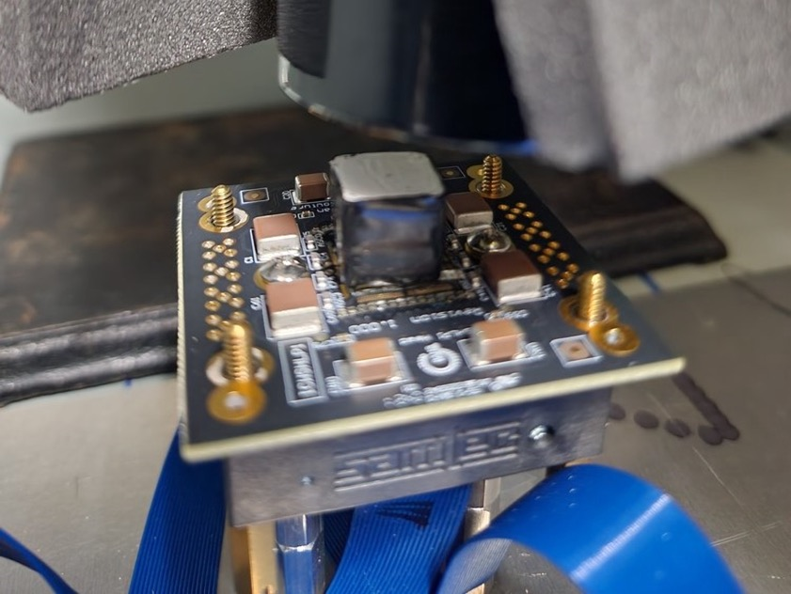

From small demonstrator to Large tiles
Gamma detection demonstration
2×2 tile with scintillator and PMT
Development of a 8×8 tile
PMT R9779 Hamamatsu
Plastic Scint.
PDCs
Eu-152 (10 µCi), EJ-200 Plastic Scintillator
FPGA-based controller to setup and gather data

Slide 26
Outside radiation instrumentation
Quantum information sciences
  Quantum key distribution – leverages embedded signal processing
Spectral LIDAR
  Time-of-flight with wavelength information
      Remote sensing of pollutants
      Remote sensing of threats
Single photon counting and high sensitivity
  Forest fire surveillance
  Space telecommunication
Few words on conventional LIDAR:
Use short infrared wavelength
for eye savety
Can use low sensitivity detectors (<15%)
because repeated high intensity
laser source
Major industrials in this race with
highly dedicated sensor design

Slide 27
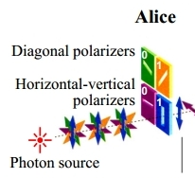
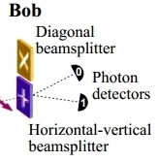


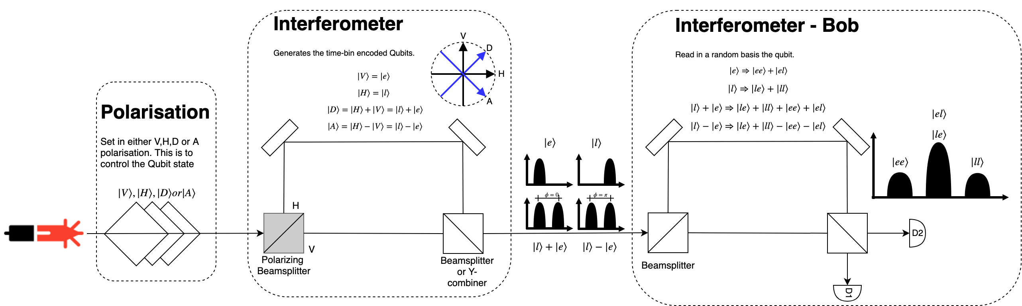
Time-bin Quantum Key Distribution
Interferometer convert polarisation states into time-of-arrival quantum states
What our detectors read
What is transmitted

Slide 28
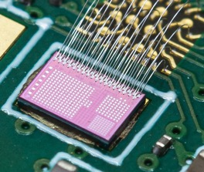
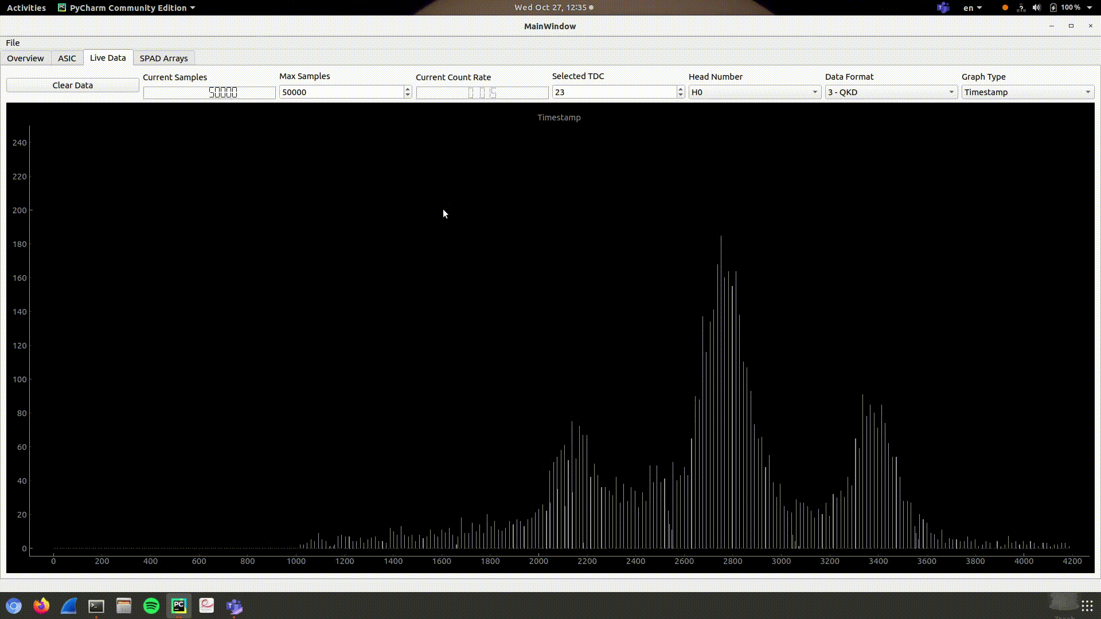
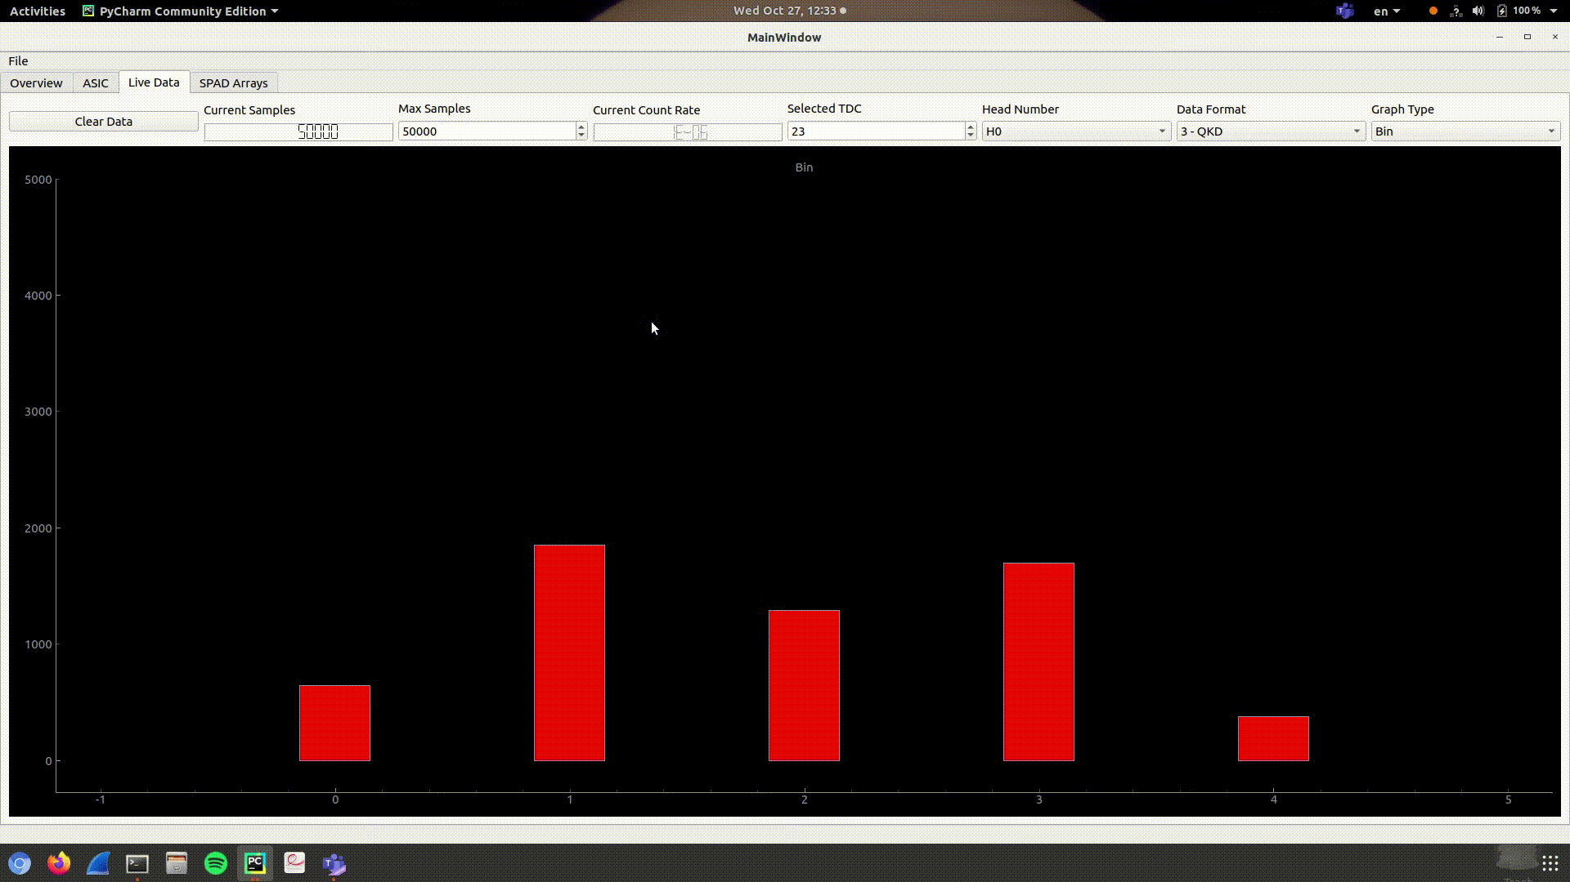
Time stamp classification: the power of embedded processing
Raw time stamp data
Classified time-bins
Each photon is timestamped in the chip
~20ps resolution and precision
Timestamps are transmitted to the computer
The histogram shows 3 modes to the distribution corresponding to the projection of the 4 states of the qubit onto the time base (center bin holds 2 states)
Timestamps are classified
inside the chip into 5 bins
Two bins for out-of-range values
Programmable bins
The provides effective data compression limiting to a 2-3 bits only the relevant information about each qubit
The two graphs show different measurements.
Time variations are due to slow tuning of an interferometer for the purpose of this demonstration.

