Slide 1
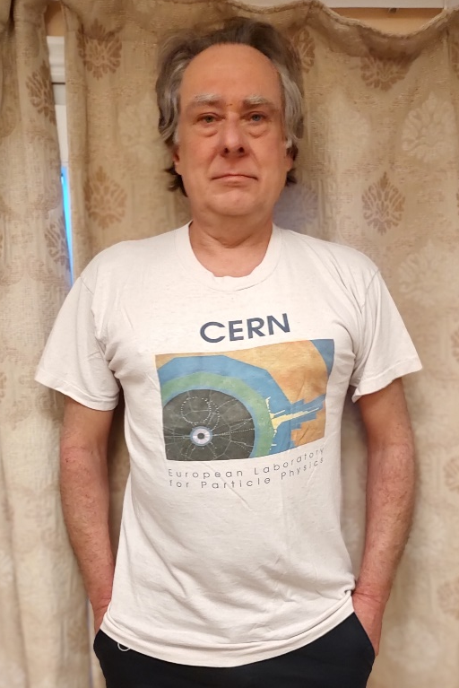
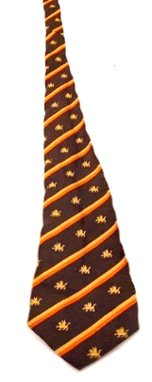
A Career in T-Shirts
(and some Ties)
And a huge thank you for everyone who made it all possible an especially those who have helped make today such a memorable and fun occasion

Slide 2
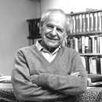
Preamble
When I left school, while working at Harwell Labs looking for cracks in PWRs (and train wheels, glue joints on airplanes, clay pigeons, ….), I became fascinated in philosophy.
“I, however, believe that there is at least one philosophical problem in which all thinking people are interested. It is the problem of cosmology: the problem of understanding the world – including ourselves, and our knowledge, as part of the world. All science is cosmology, I believe, and for me the interest of philosophy, no less than of science, lies solely in the contributions which it has made to it.”
Preface : The Logic of Scientific Discovery: Karl R. Popper
My reading of the historical development of modern science also convinced me of the impermanence of the foundation of theoretical physics so, despite studying the theory option at Imperial College, I opted for experimental fundamental physics.
However, while starting off wanting to simply contribute to our knowledge of the workings of the Universe – things that are independent of whether humanity exists or not - increasingly what has motivated me is the wonderful community of colleagues engaged in the same pursuit and the desire to do my small part in support of this joint endeavour.

Slide 3
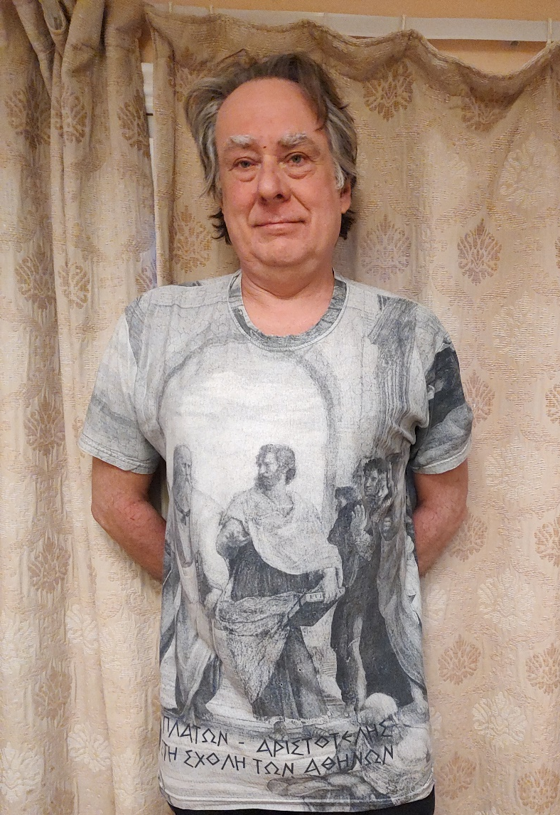
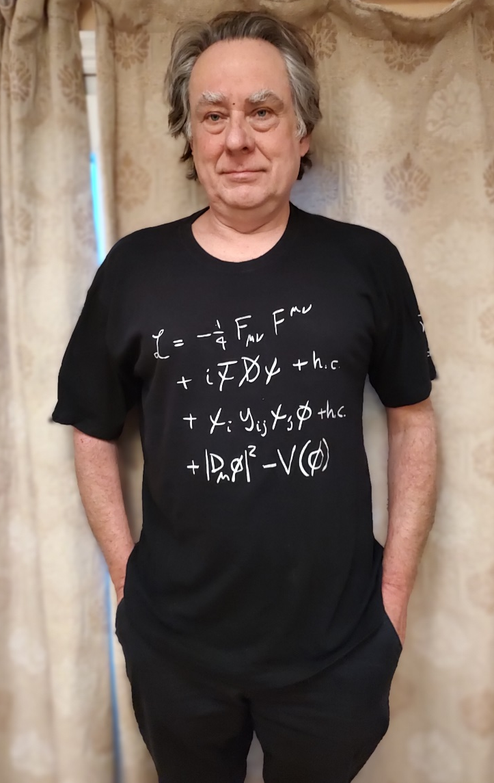
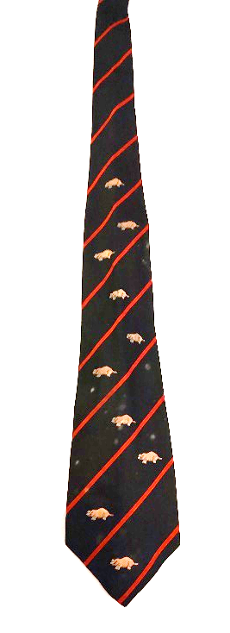
Imperial College:
The formative years

Slide 4
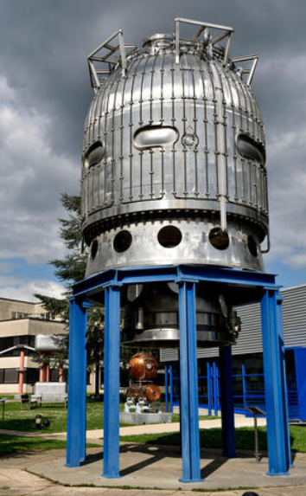
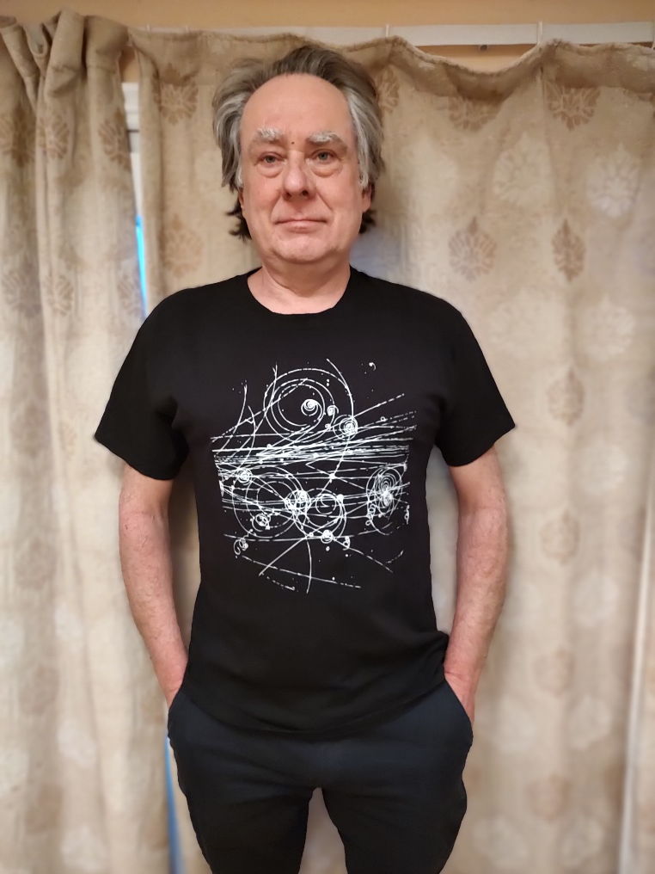
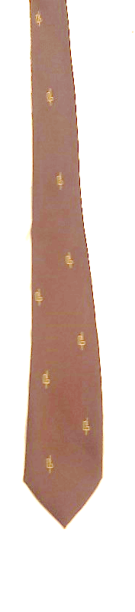
Oxford and Wolfson College:
Starting off as a “bubble-head” (and ending up as a museum piece)

Slide 5
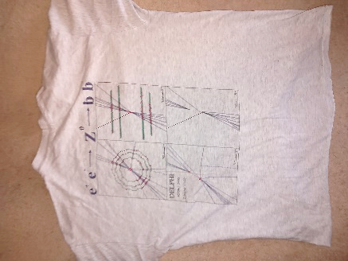
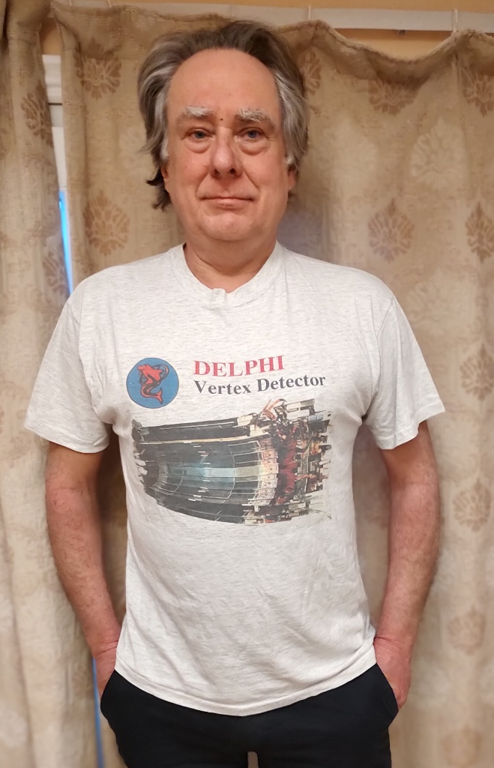
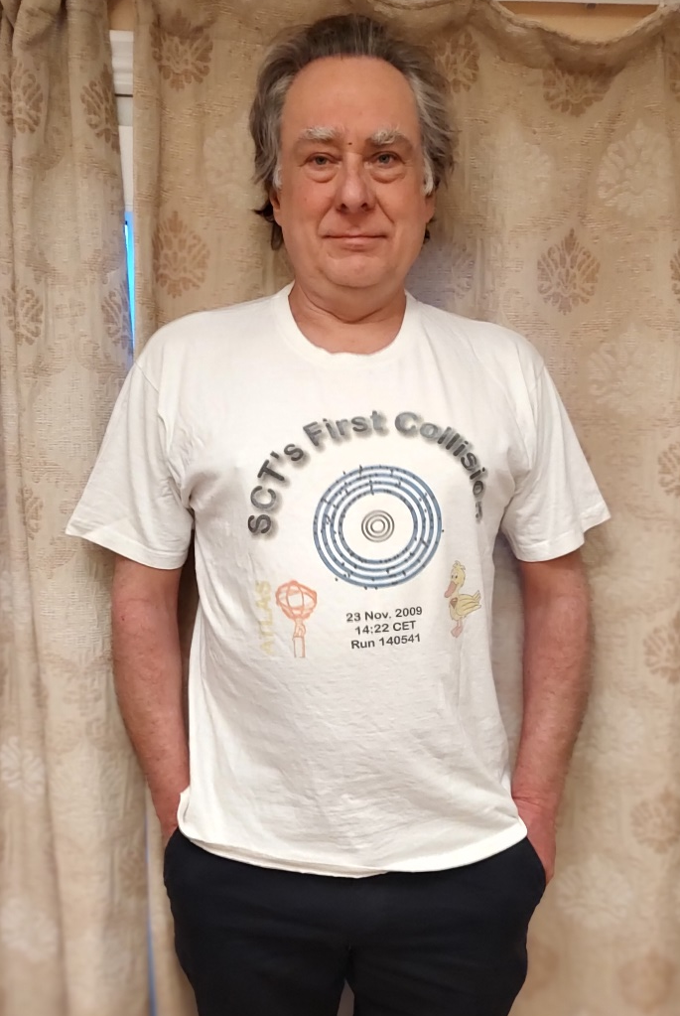

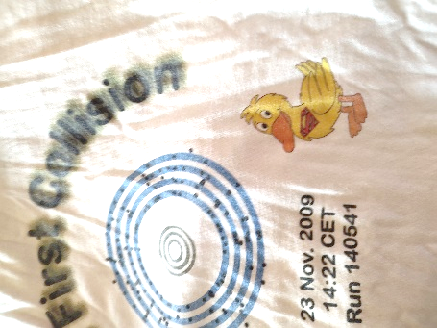
Silicon Strip Detectors:
From a few hundred cm² to many hundreds of thousands of cm²
Why the duck?

Slide 6
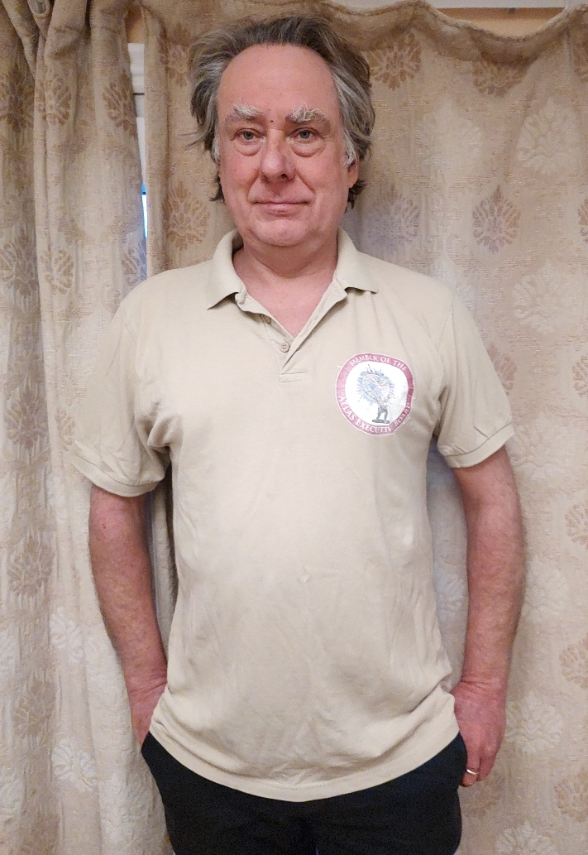
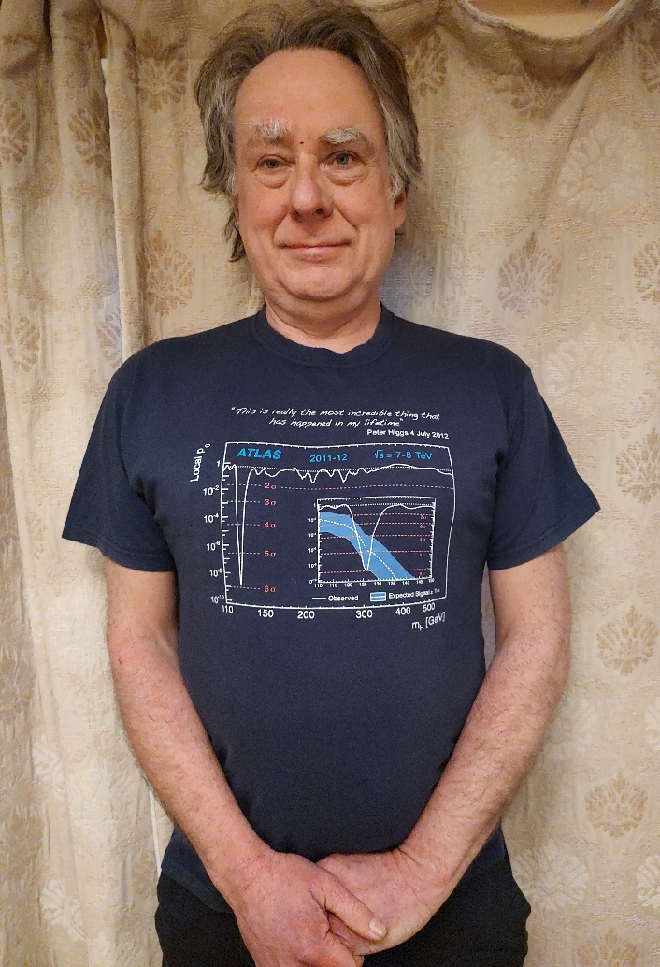
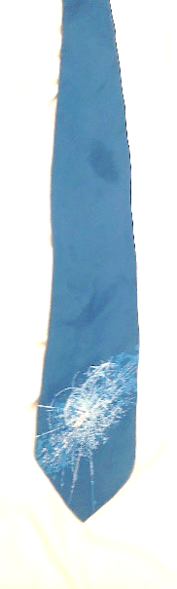
ATLAS Upgrade and Executive Board:
… been there, done that and all I got were these ***** T-shirts

Slide 7
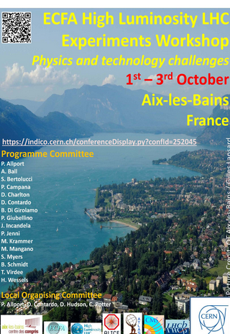
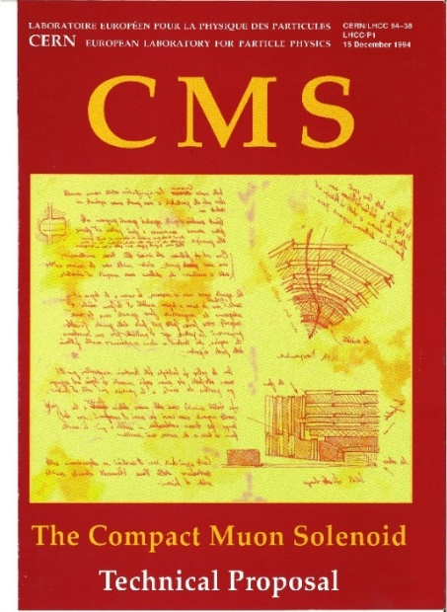
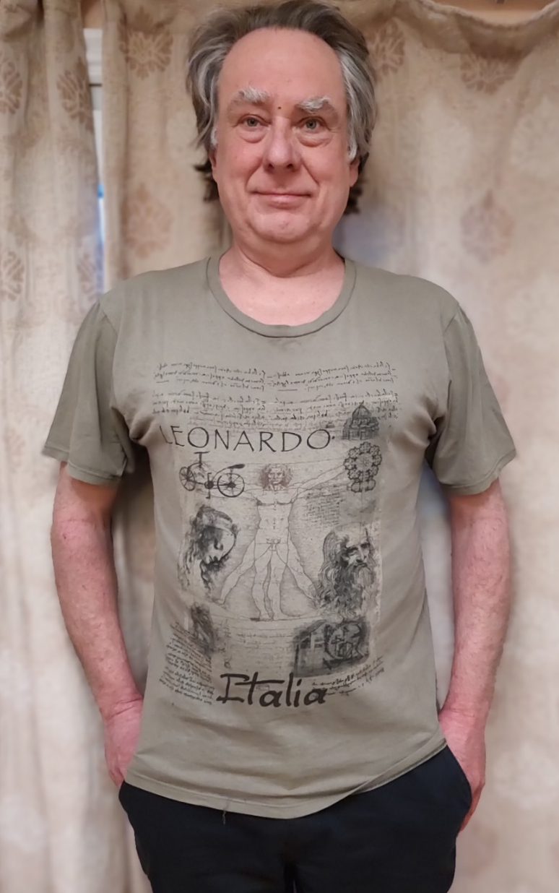
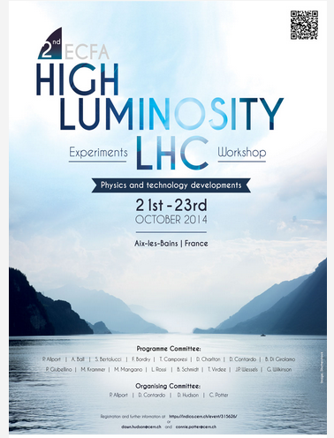
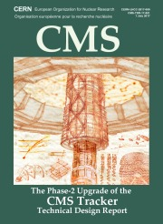
The ECFA HL-LHC Experiments Workshops:
Moonlighting with the competition?

Slide 8
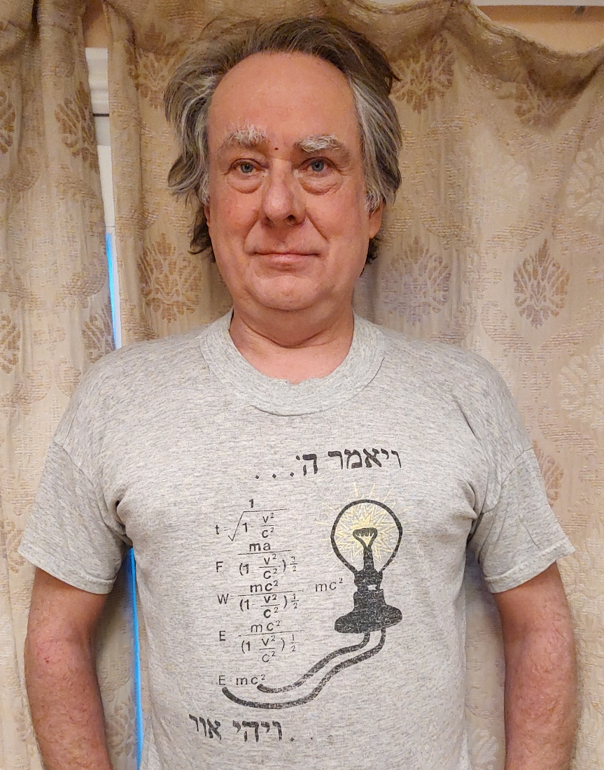
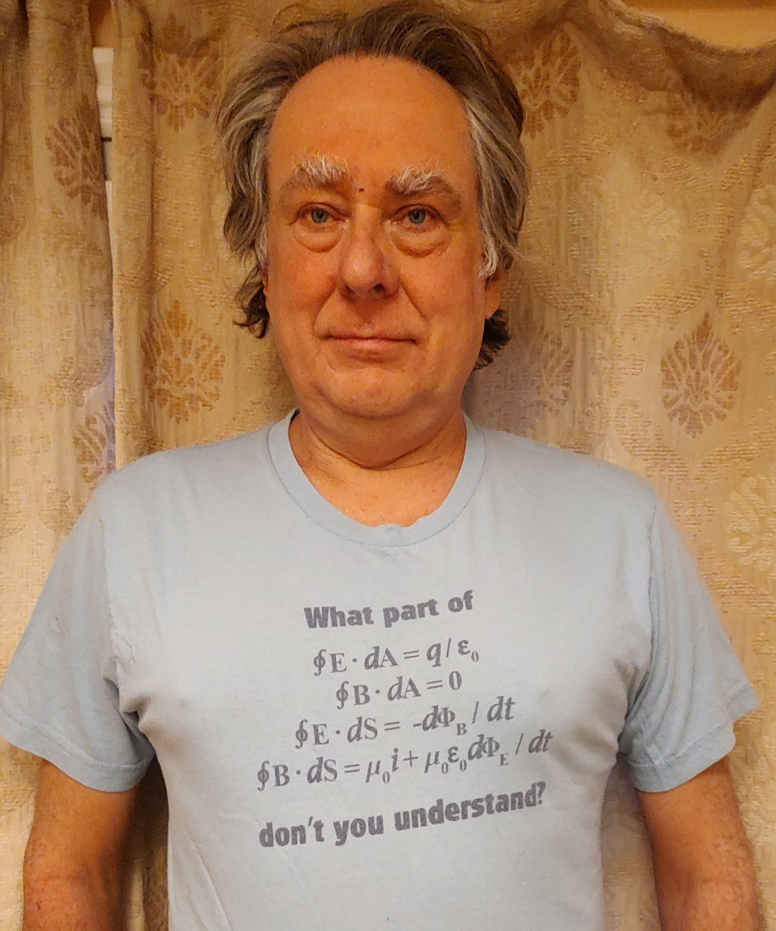

Teaching:
… a combination of dodgy derivations and utter audience incomprehension

Slide 9
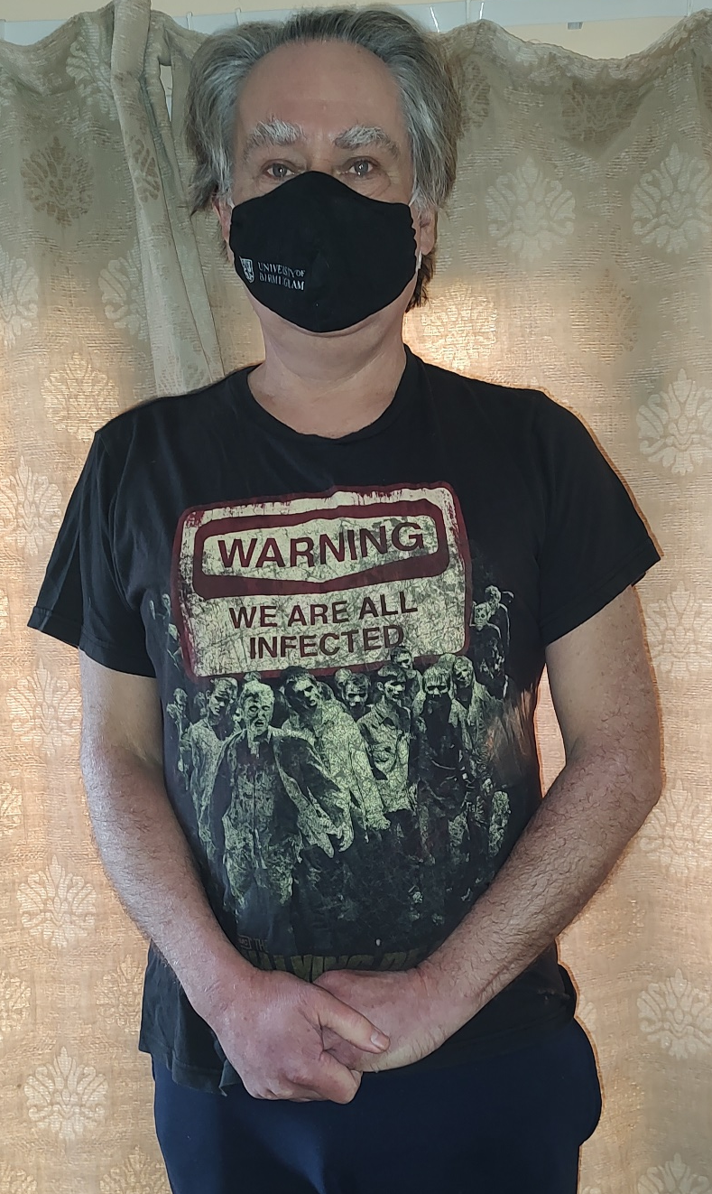
Surviving some tough years …

Slide 10
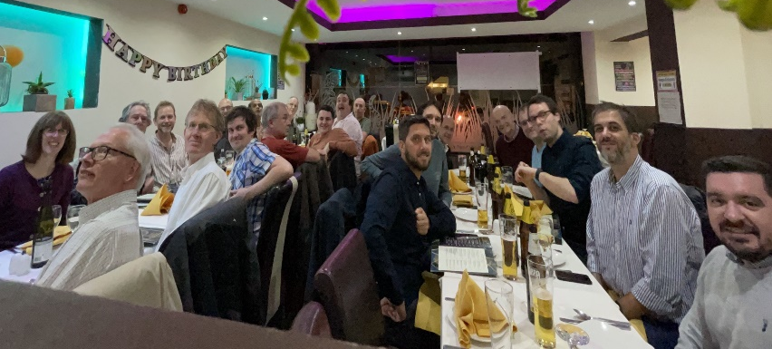
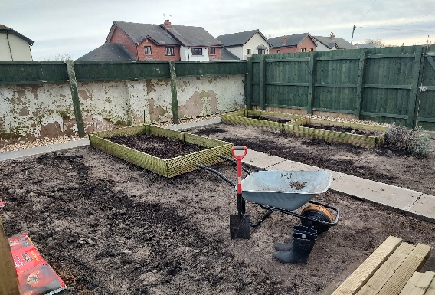
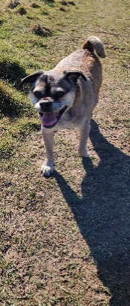
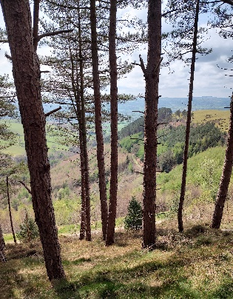
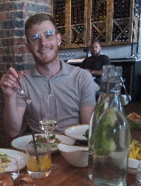
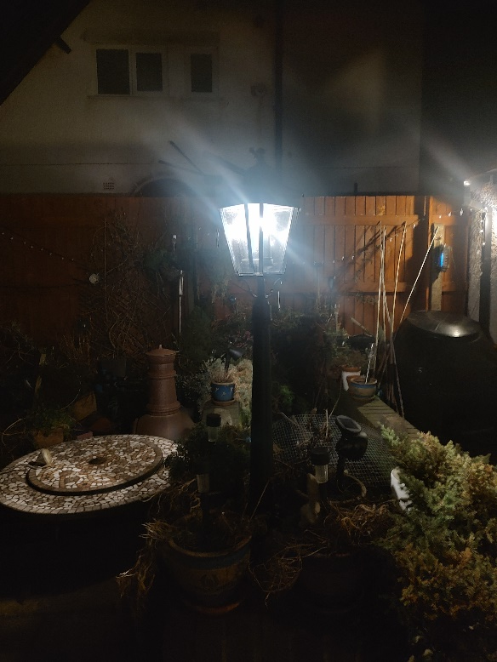
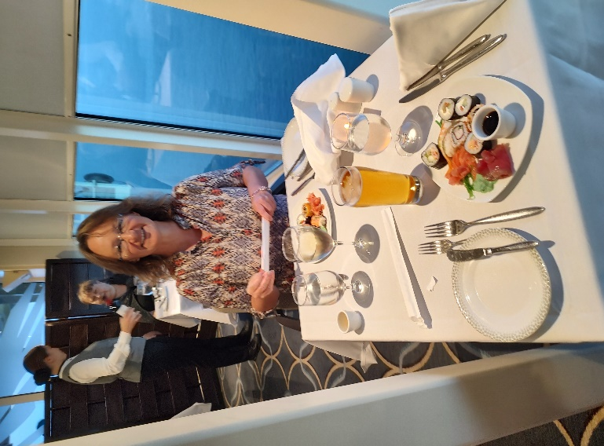
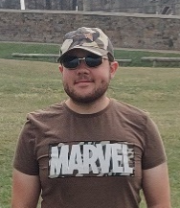
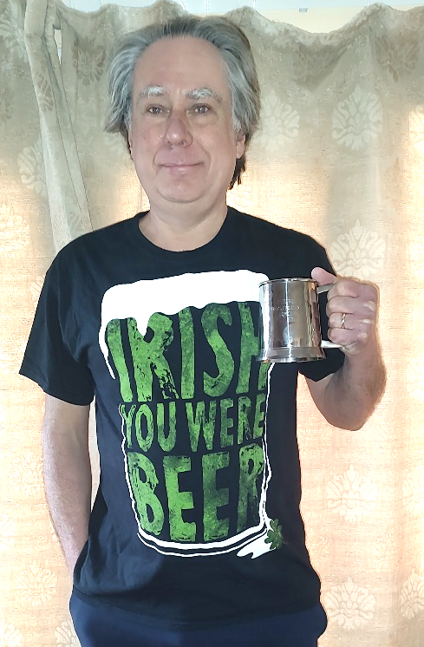
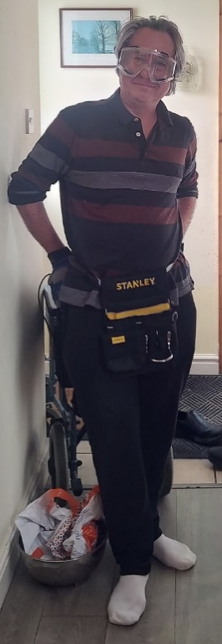
… to a happy ever after ending

Slide 11
… to a happy ever after ending
My profound gratitude to all the family, friends and colleagues who are present, joined remotely or have sent their good wishes.

