Slide 1
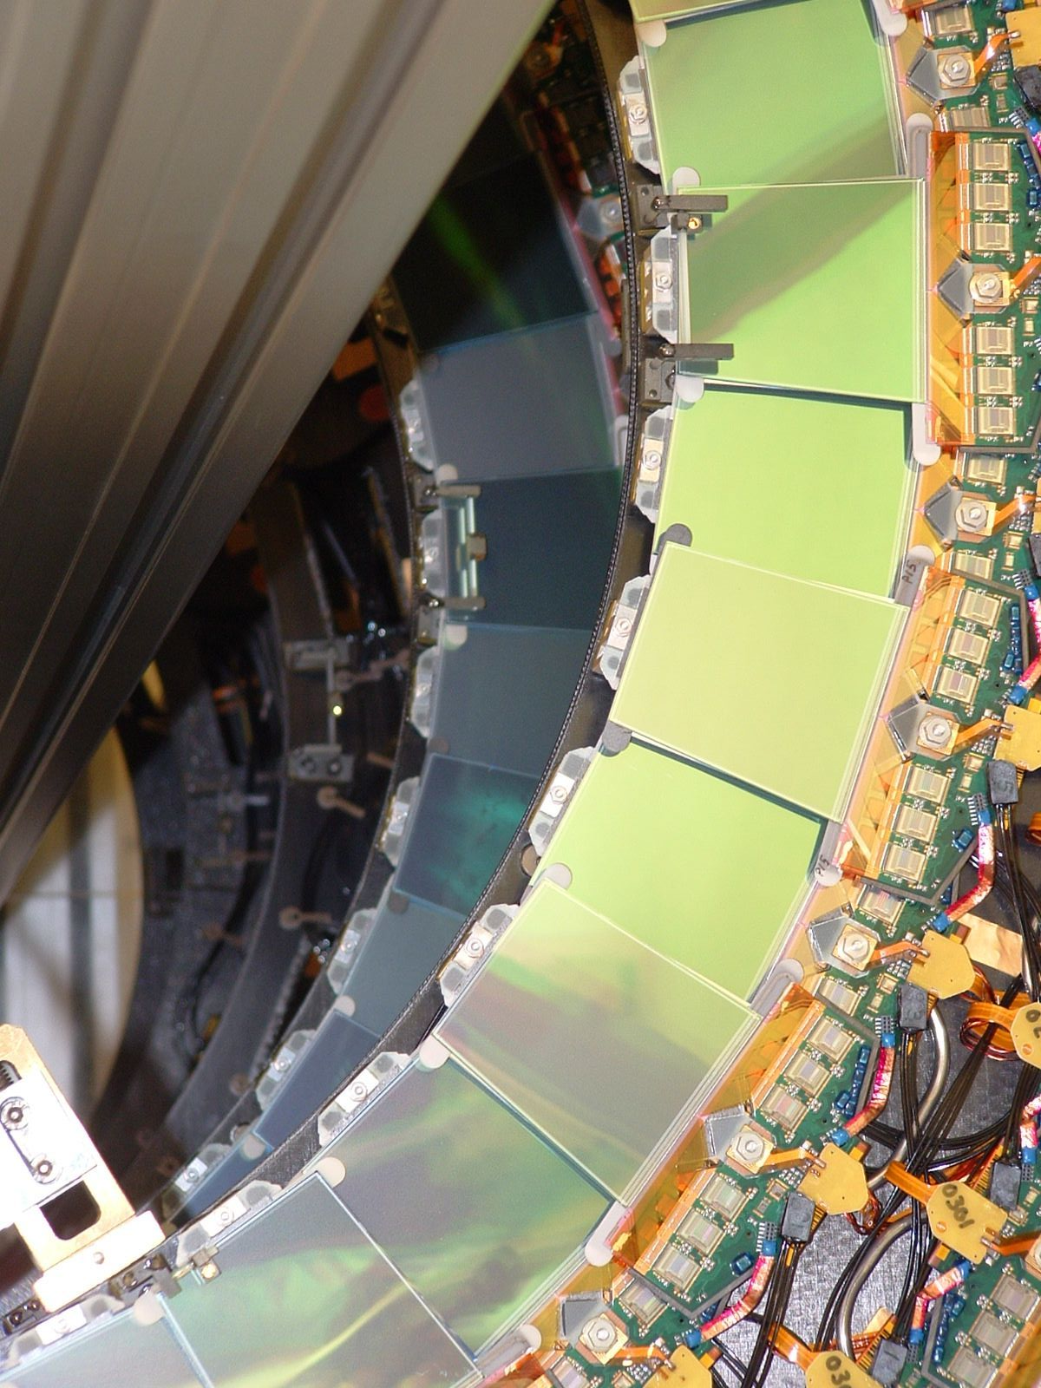

Joost Vossebeld
Phil Allport Fest
The ATLAS SCT and the Liverpool LSDC

Slide 2
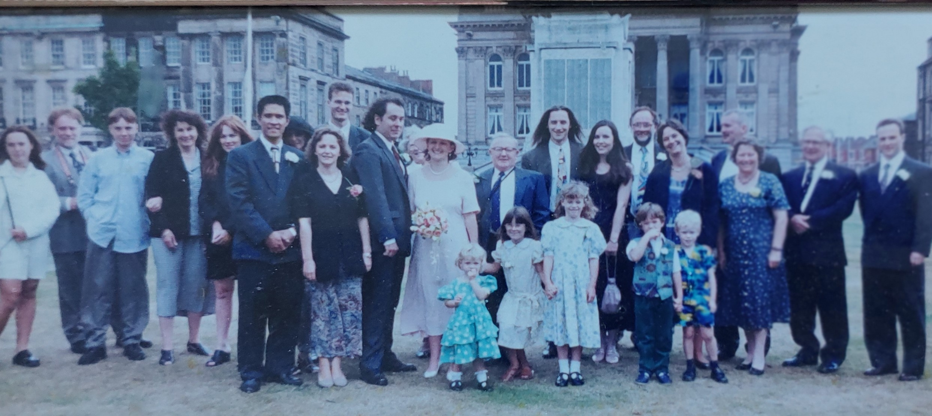
Phil in Liverpool: 1993 - 2015
Phil joined the Liverpool Particle Physics group in 1993. The link came about through having worked with the then Liverpool team on Delphi, then led by Prof Paul Booth.
Initial work was on Delphi and on early silicon R&D for future hadron colliders (SSC and LHC). Soon R&D work became focussed on sensor development for ATLAS, which led to the Liverpool involvement in the construction of the ATLAS SCT.
Phil has made a major impact on the Liverpool Particle Physics group, through his work on silicon R&D, the ATLAS SCT and ITk upgrade and as director of the LSDC and Head of the Particle Physics cluster and many other things…!
Phil’s job interview in Liverpool itself had a major
impact on his life …
Phil met Karol (apparently, buying a suit for Phil’s interview was the start of a their life together)

Slide 3
Silicon Detectors for the Large Hadron Collider
Tracking at the LHC would require small feature size and fast readout as well as ability to sustain radiation.
Early silicon detector R&D was done through the RD20 collaboration. Phil, first at Cambridge, and then in Liverpool, played a central part from these early day.
Focus of R&D
understanding and modelling the effects of radiation (and annealing!) on the performance of sensors
and on how to design and operate sensors to minimise these effects.
  Capacitive readout strips
  Guard rings for high bias voltage
  Design for cold operation and avoiding thermal run-away

Slide 4
Early ATLAS proposal: competing technologies
Micro strip gas detectors (MSGCs) and silicon detectors both offered the required small feature sizes and fast readout
Liverpool had a strong gas detector group and was actively involved in the proposal to use MSGCs, but Phil and others saw a brighter future in silicon.
Early on, the main concerns with silicon were:
Cost/Complexity → to cover larger areas with expensive and complex Silicon modules
Material → silicon sensors require local readout electronics
ATLAS technical proposal 1994, silicon pixels and strips, MSGCs and straws.
ATLAS technical design report 1997

Slide 5
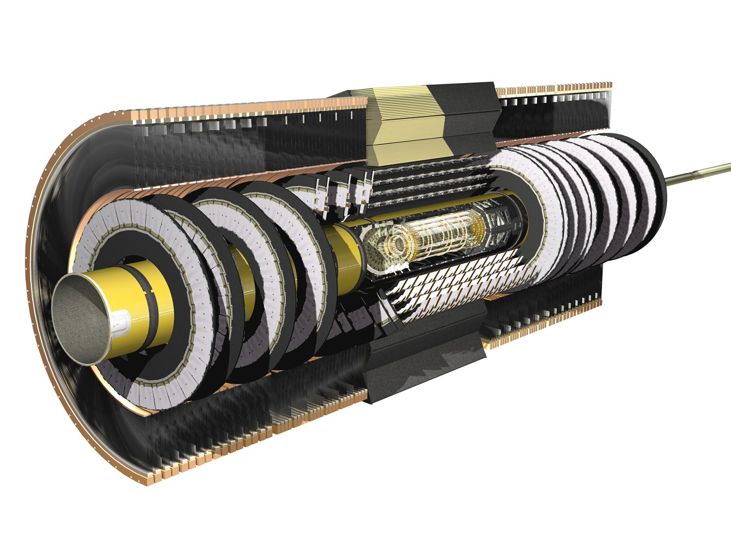
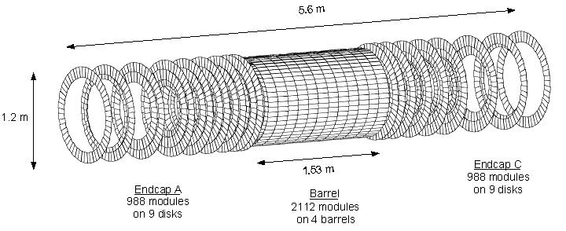
The ATLAS Semi-Conductor Tracker (SCT) detector
UK proposed a major involvement in the construction of the SCT detector.
A joint project involving UK, Poland, Spain, Sweden, Germany, Japan, Netherlands, Norway, Australia, US, Czech Republic.
UK contributions to:
sensor and module development,
module production
service and support structure engineering
the assembly of SCT barrels and endcap-C disks.
Liverpool developed a major role in the construction of the forward STC endcap-C
Large silicon microstrip tracker with over 4000 silicon modules, 60 m² of silicon and 6.3 million electronic channels.

Slide 6
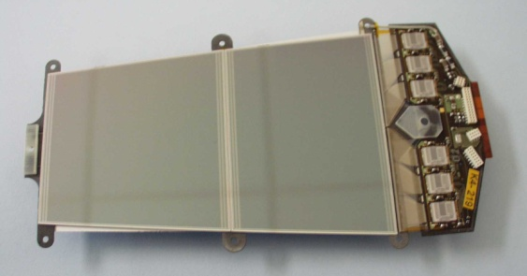
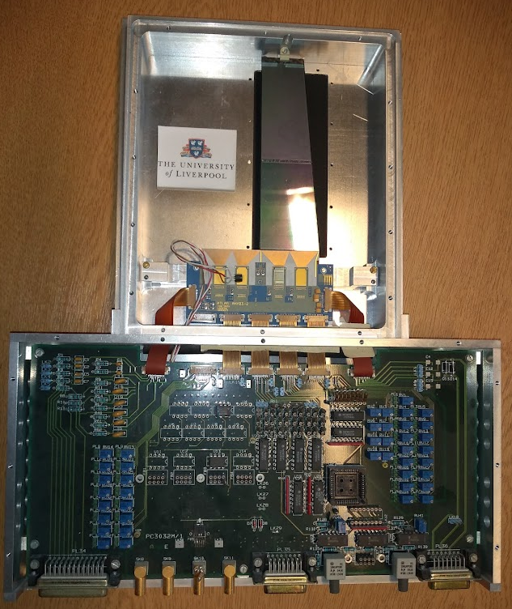
Development of the forward SCT module
Key challenges:
Layout of wedge shaped detectors
Design of the compact readout flex circuit.
Thermal separation sensor and electronics
Design suitable for mass production
Evaluation
demonstration of the wedge strip sensors
Manufacture and testing of first sensor prototypes
Module concept
thermolithic pyro graphite spine
Early wedge detector with readout board
Endcap module prototype

Slide 7
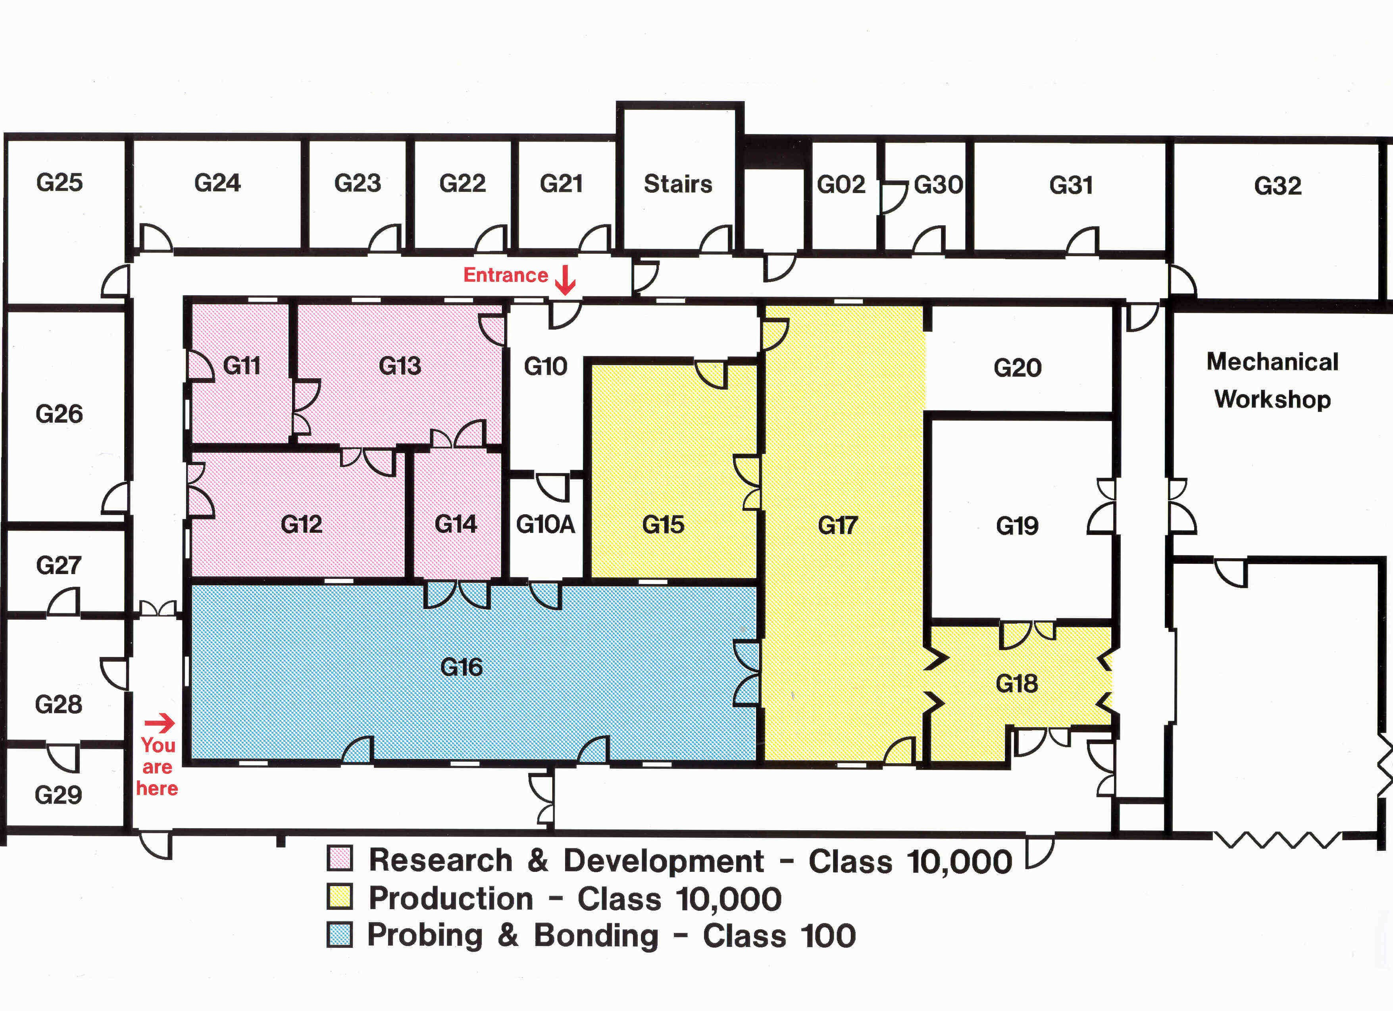
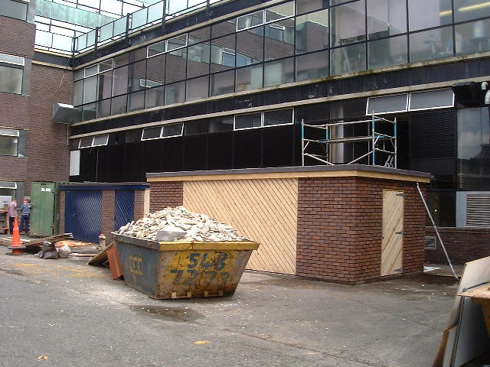
The Liverpool Semi-Conductor Centre - LSDC
The construction of large are silicon arrays for the LHC required an investment in state-of-the-art facilities.
In 1998, the University of Liverpool won £3.1M funding from the Joint Infrastructure Fund to establish build a 450m² clean room facility equipped with state-of-the-art wire-bonding, wafer-probing and metrology equipment.
JIF was a call for transformative bids the working environment, and enhance the research capability of the UK research community by creating a flexible scheme that can respond to the real needs of the academic research community.
LSDC floorplan
Oliver lodge ground floor from courtyard concept

Slide 8
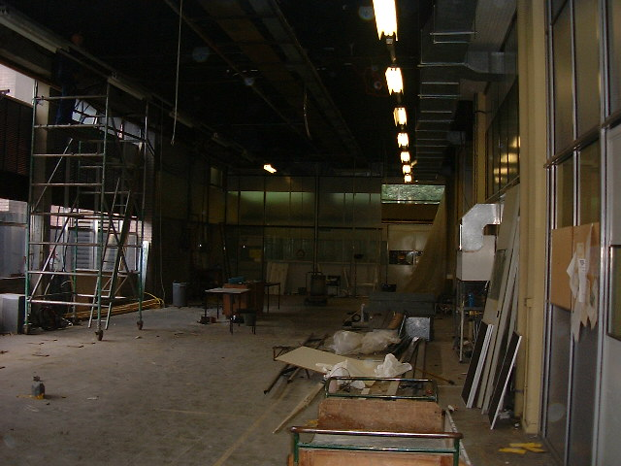
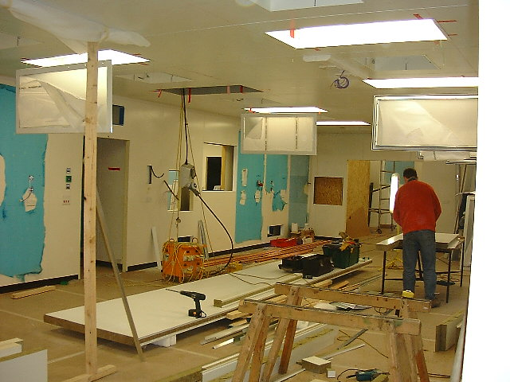
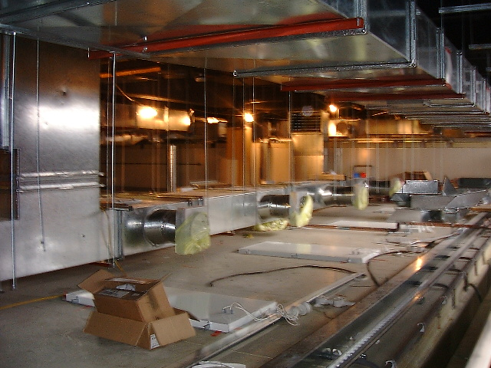
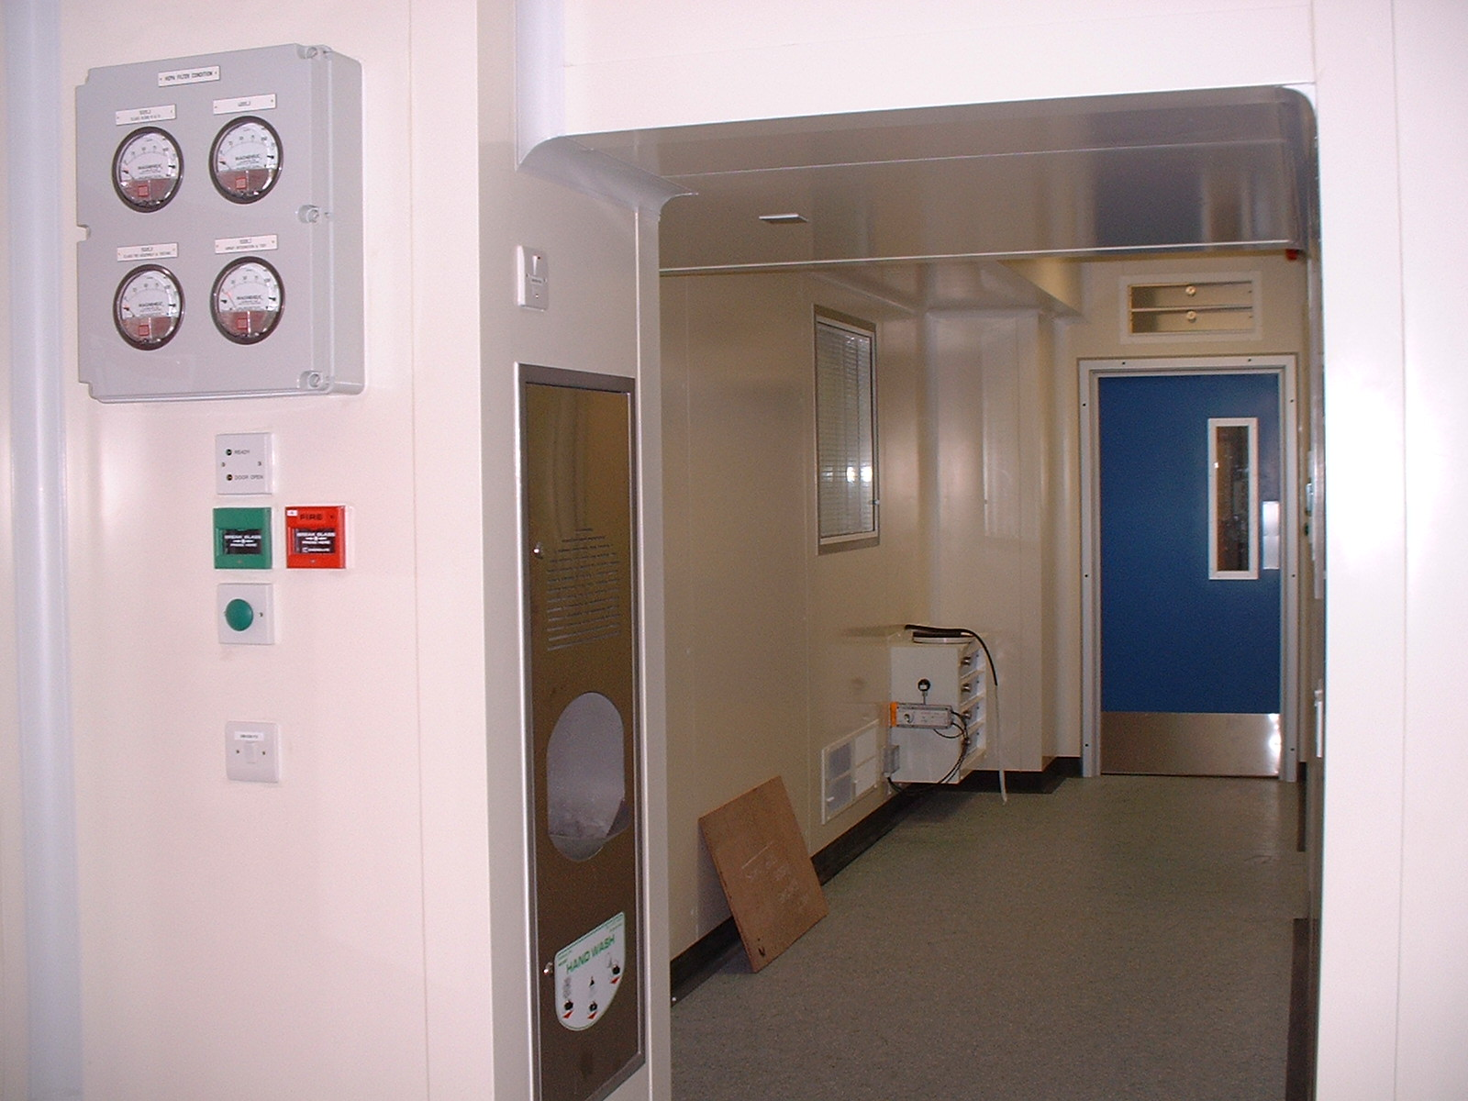
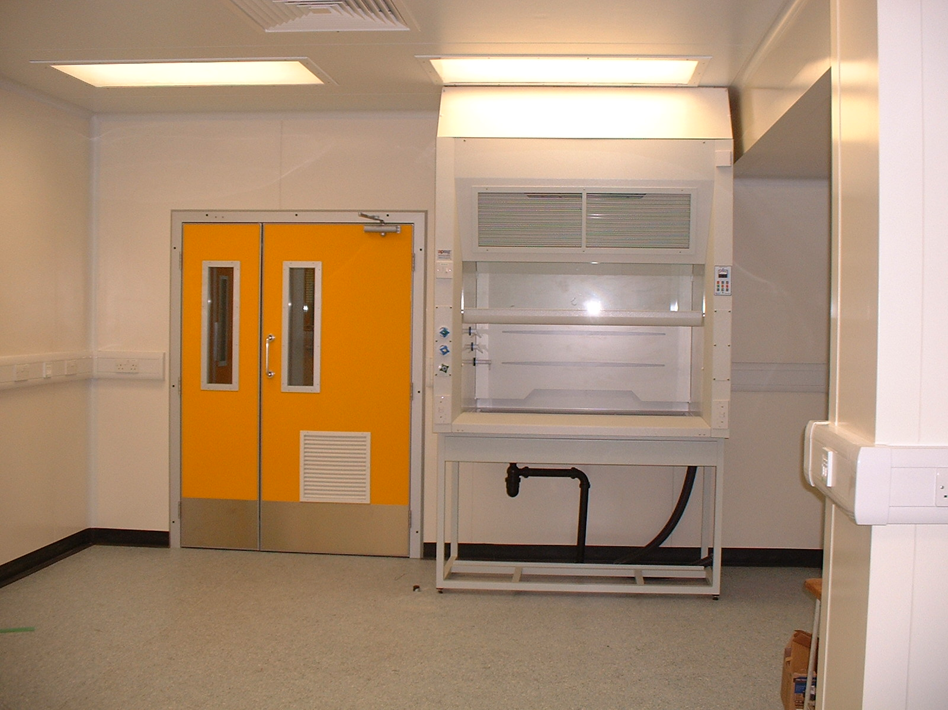
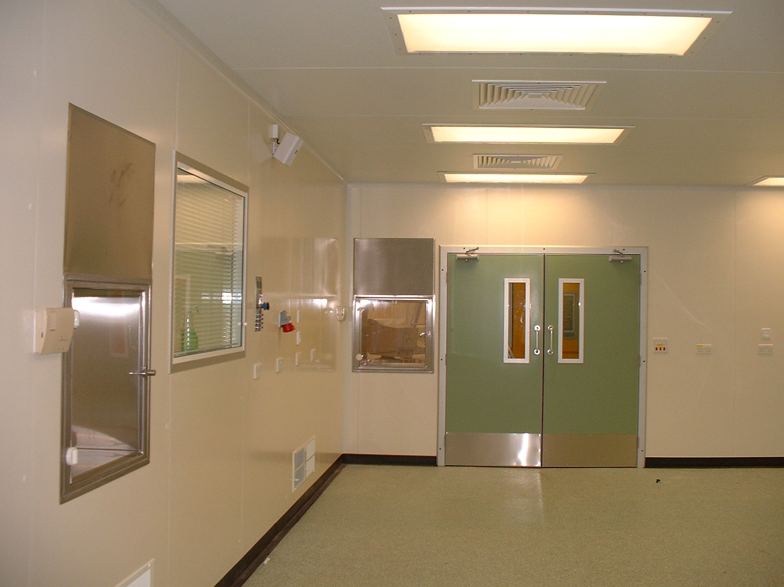
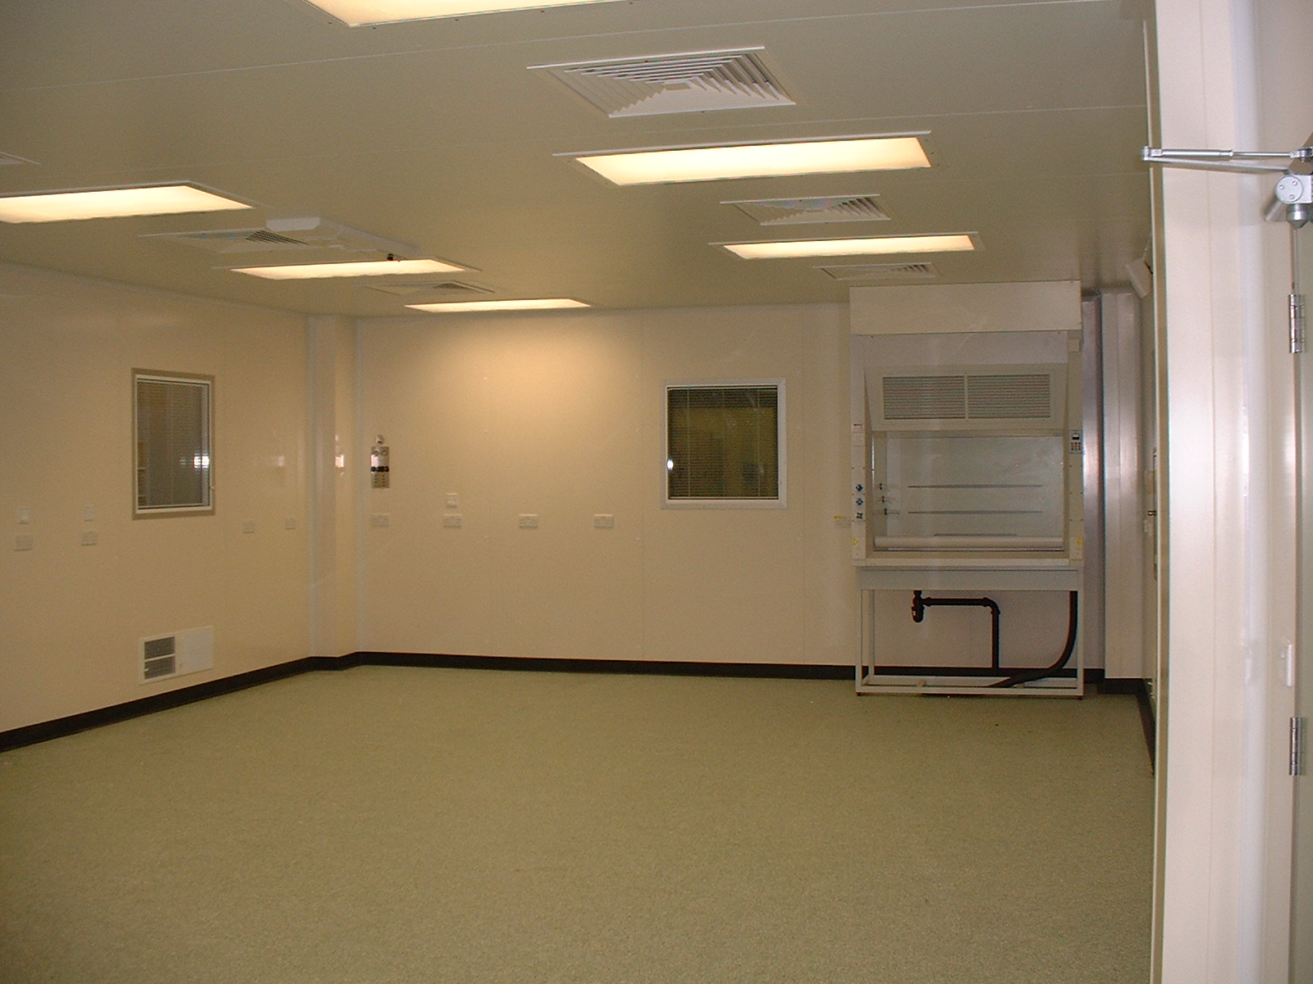
Construction of the LSDC
Different stages of LSDC construction project

Slide 9
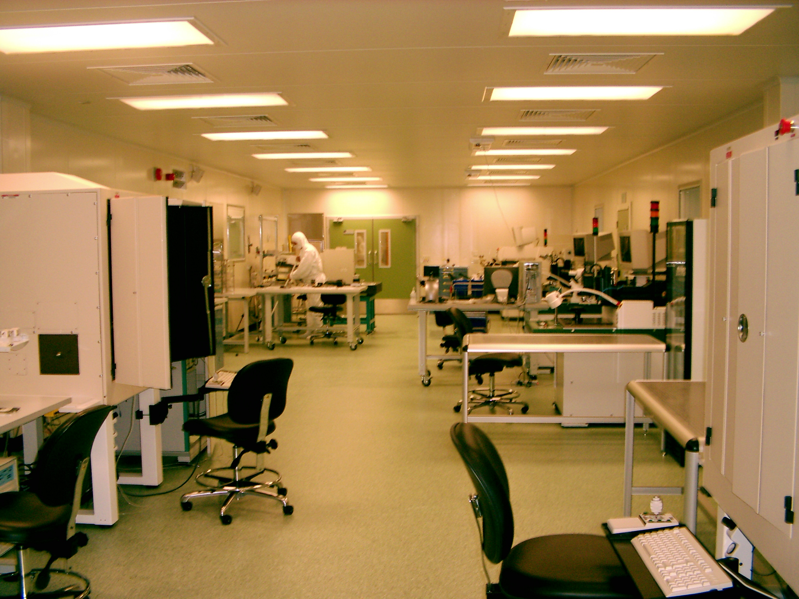
Official opening
Officially opened on 11th September 2003 by Sir David King, the government's Chief Scientific Advisor.
LSDC “class 100” area in 2003
Professor Phil Allport, director of the new centre, reports:
"The Semiconductor Detector Centre is equipped with state of the art microelectronics assembly equipment. It makes possible the construction and testing of detector systems of areas of many square metres, built from hundreds of individual sensors, measuring with a spatial resolution of typically a few thousandths of a millimetre."

Slide 10
The UK construction of the SCT
Within the UK the SCT detector as proposed as one of the major contributions to the construction of the ATLAS experiment with module production across the UK, endcap-C disk assembly in Liverpool and barrels in Oxford.
For the endcap-C, following the completion of the LSDC facilities, a decision was taken to do the full endcap assembly in Liverpool → a very important decision for Liverpool.

Slide 11
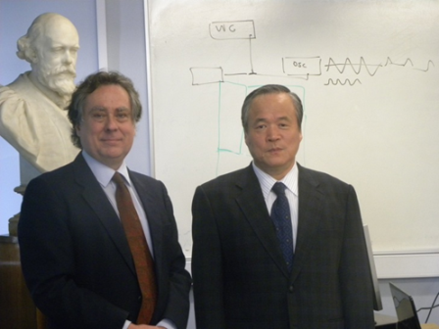
The forward SCT modules
SCT forward long, middle and short modules
The construction of the SCT endcaps required the manufacture and qualification of ~2,500 forward modules (4 variants)
Phil, together with Carlos Lacasta (Valencia), coordinated this major effort from early qualification, through pre-production and production.
Qualifying sensor suppliers and coordination of the procurement process.
Coordinating module production across multiple production sites (Glasgow, Liverpool, Valencia, MPI, Melbourne, NIKHEF, Geneva, Prague)
Quality control during production (next slide)
Phil also spent a sabbatical in Valencia working with the team there to set up for module production at IFIC.
Phil with Hamamatsu CEO
Yamamoto

Slide 12
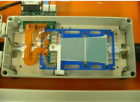
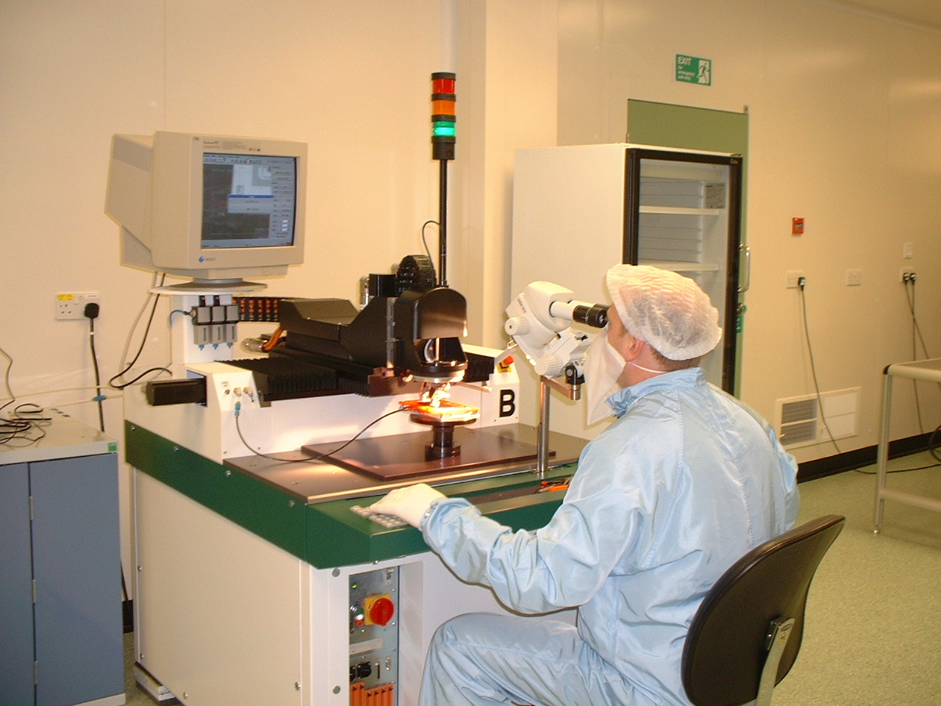
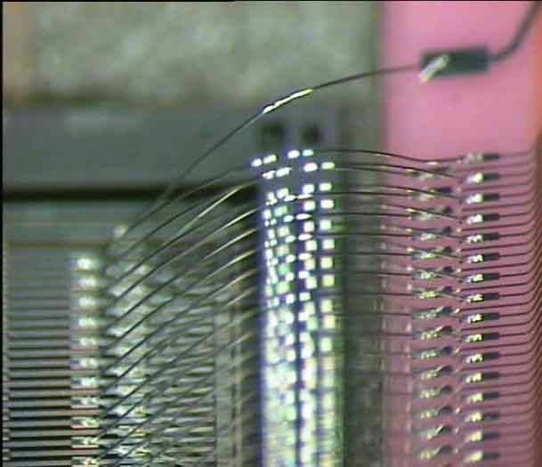
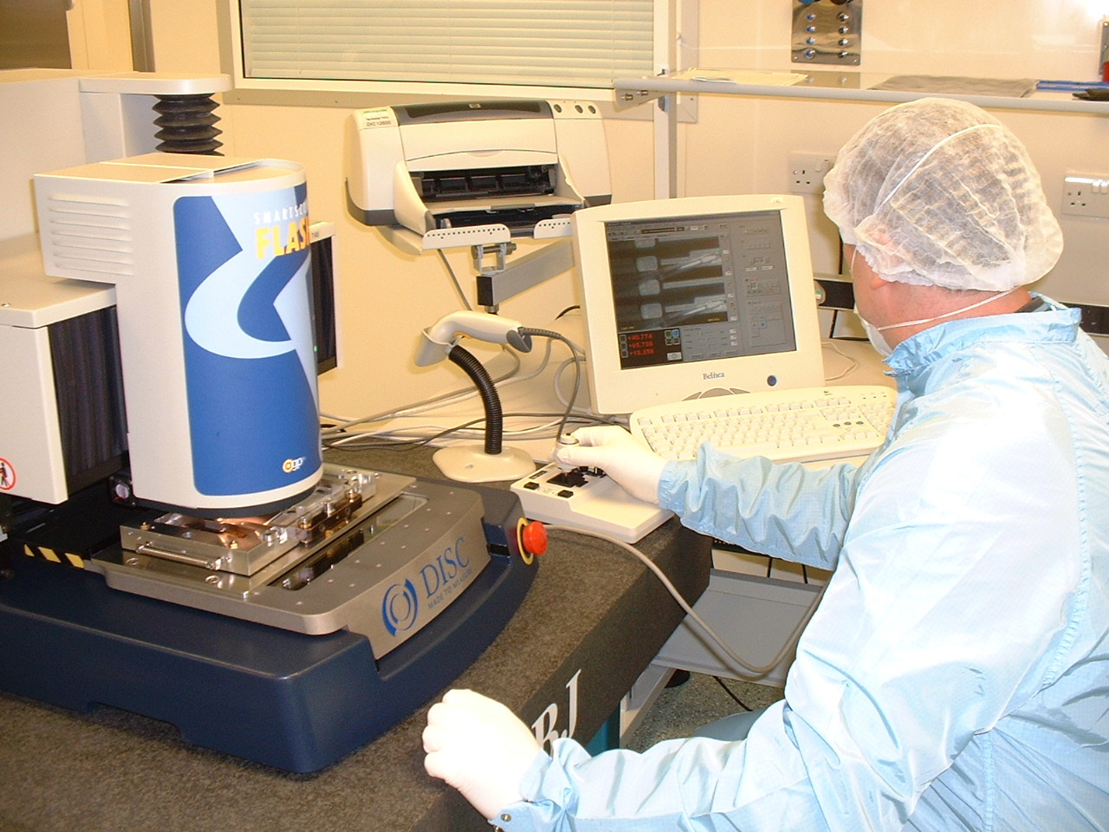
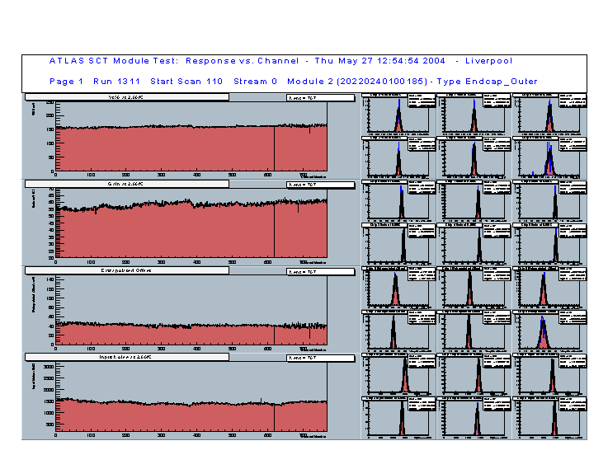
Module production and quality control in Liverpool
Module wire bonding
(~5,000 bonds per module
Module metrology
In Liverpool 300 modules were built and 1,000 modules were tested.
Detailed electronic testing
The SCT was specified to operate for 10 years at the LHC without intervention. Ensuring high quality was key to the future success of the SCT and ATLAS.
The failure rate today, at the module level, is still only a fraction of a percent, nearly 20 years after module production was completed.

Slide 13
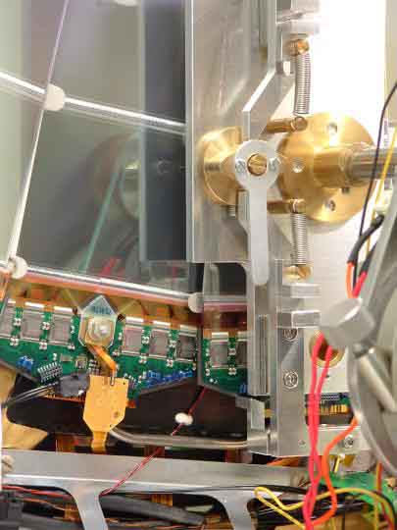
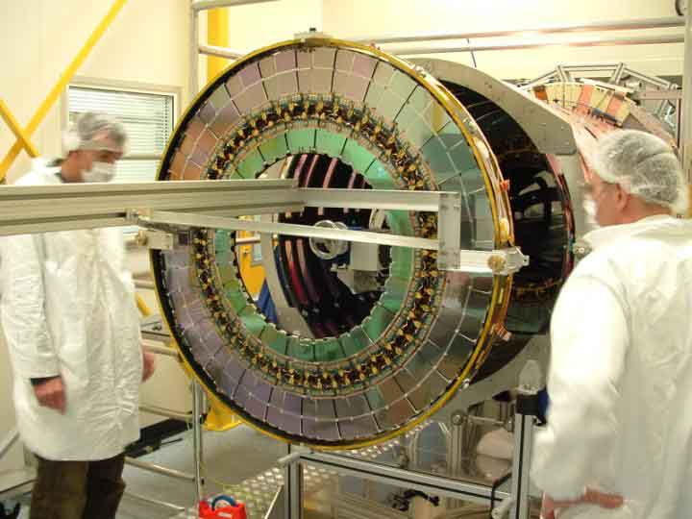
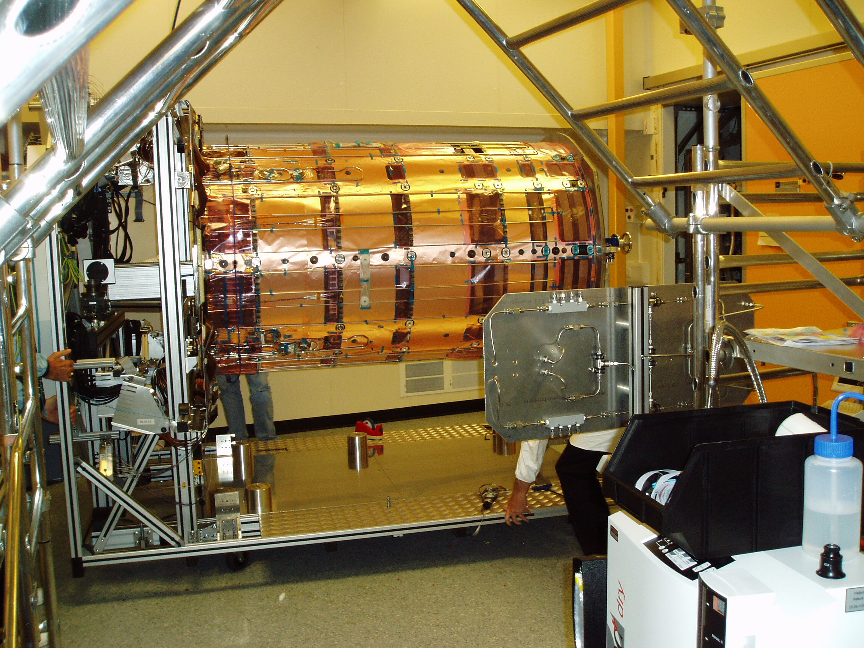
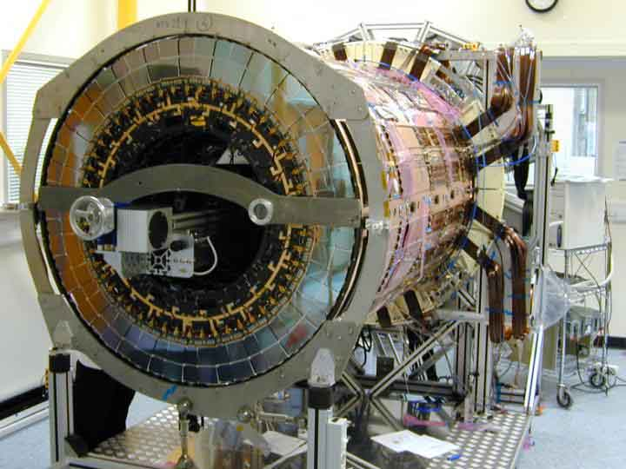
The construction of Endcap-C
Following the completion of the LSDC facilities, a decision was taken to do the full endcap assembly in Liverpool → a very important decision for Liverpool.
9 disks were assembled, mounting up to 132 silicon modules each and connected these to electrical services and cooling.
Each disk was mounted into the endcap cylinder and connected to the on-cylinder services
Extensive cooling and read-out infrastructure was set up in the LSDC to fully test all disk after installation.
Module assembly to disk
Disk installation
Connecting and testing
endcap-C completion
The assembly of the SCT Endcap-C in Liverpool completed was in 2004!

Slide 14
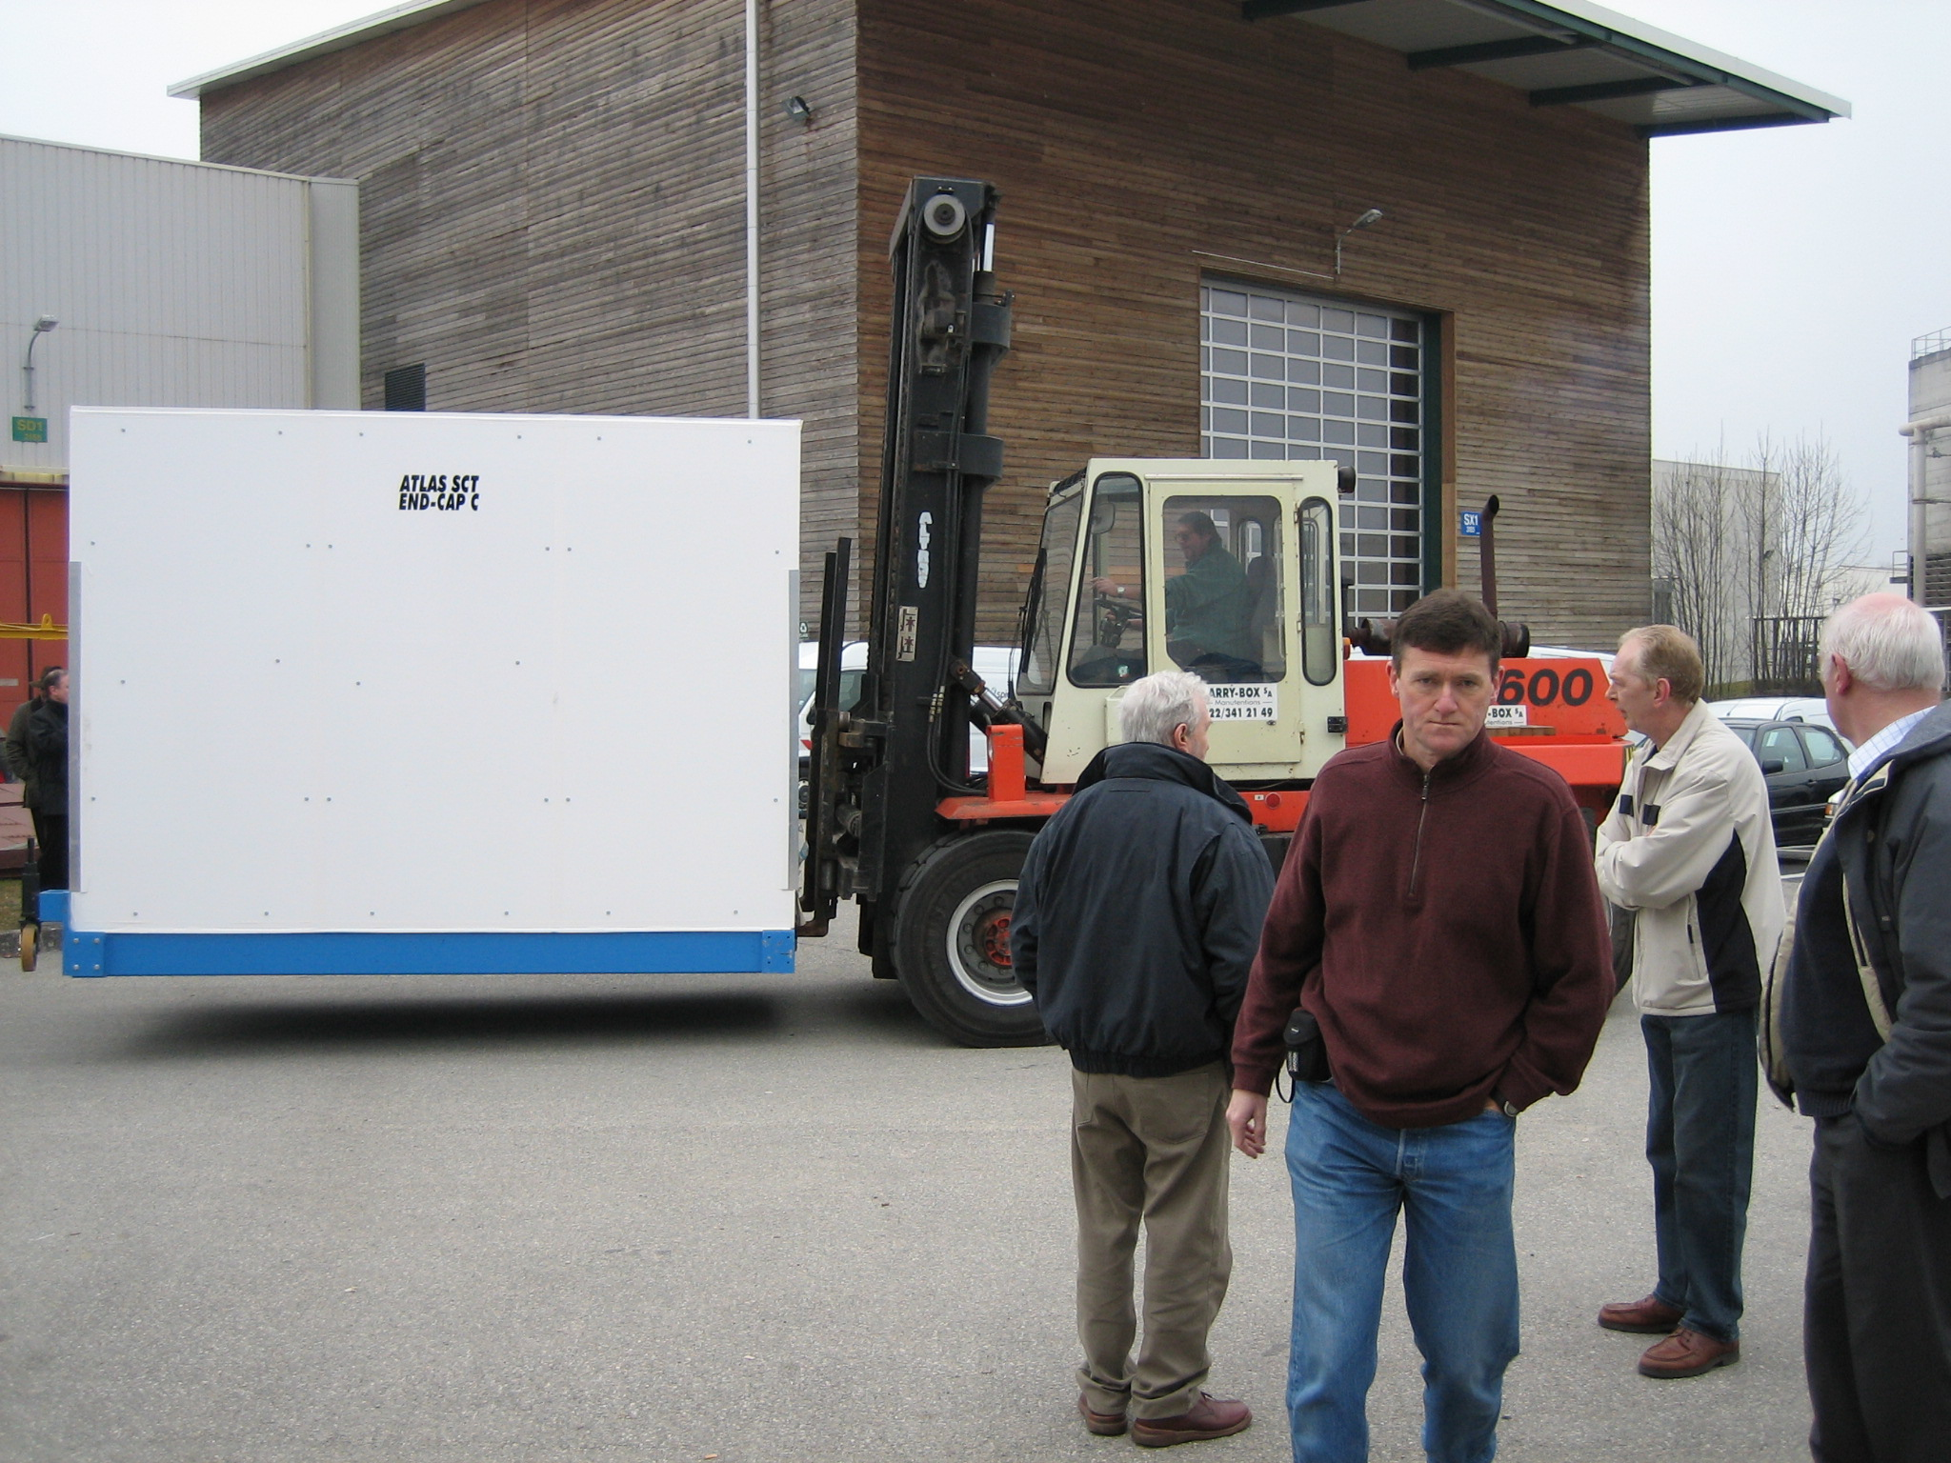
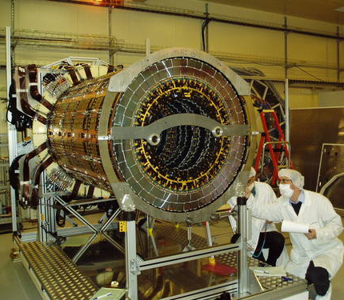
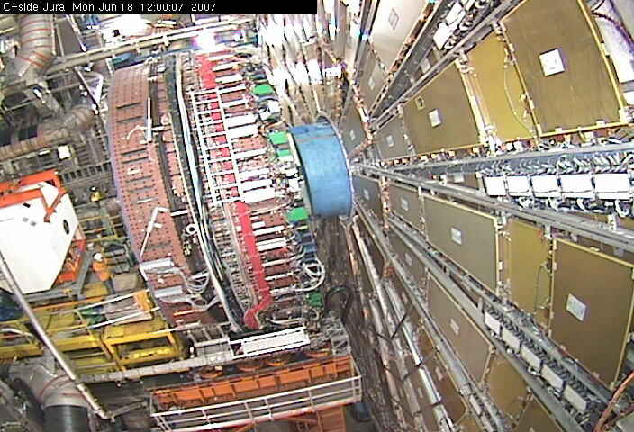
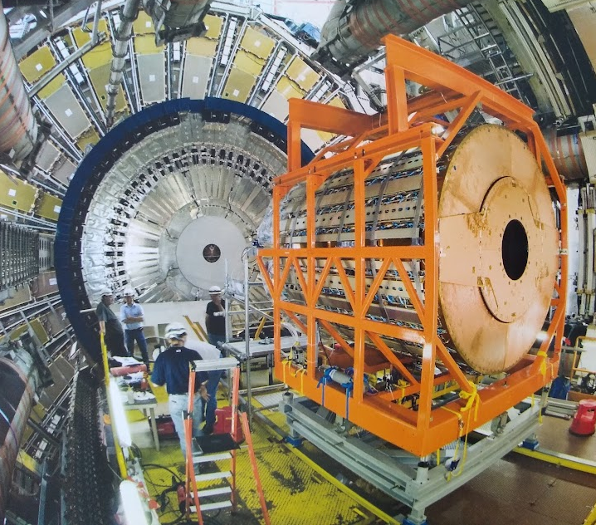
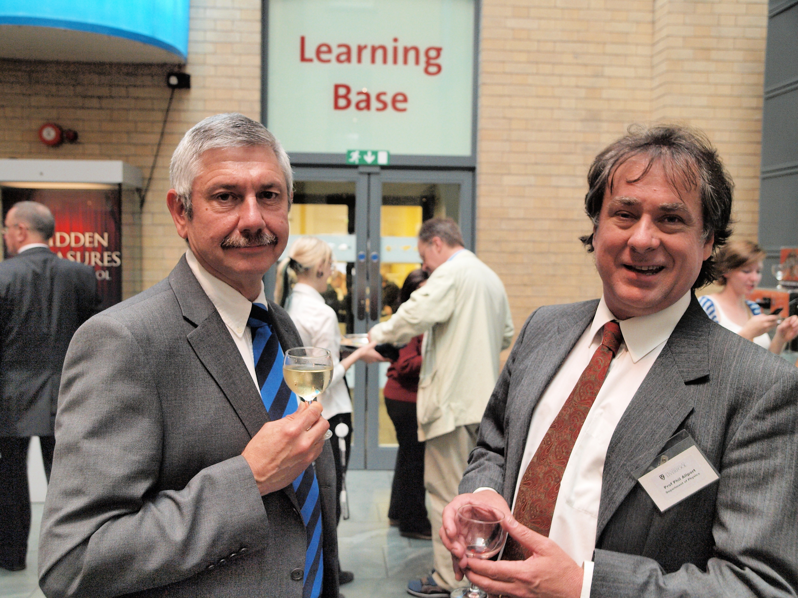
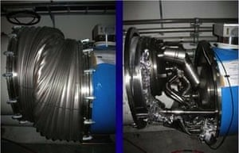
Delivery to CERN, installation and start up
Arrival at CERN
Endcap-C in CERN clean room
Installation in ATLAS
LHC start-up 10/9/08
but followed by this a few days later…!
First particles seen in SCT on day 1
Celebrations in Liverpool (with pro-VC Steve Holloway)

Slide 15
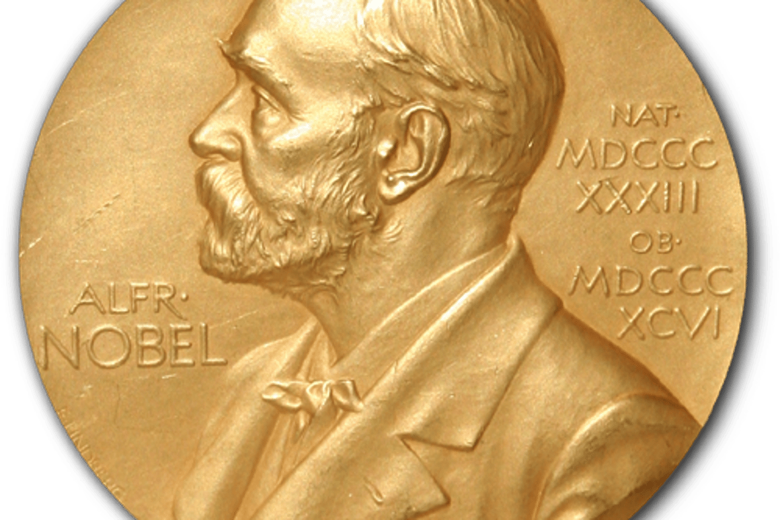
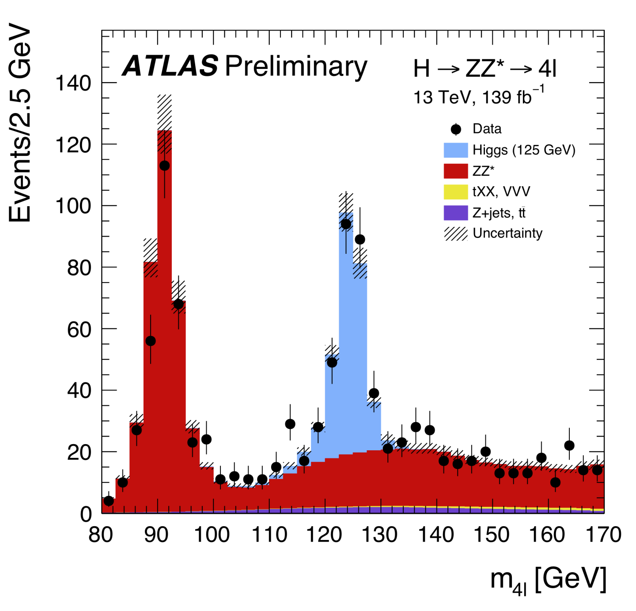
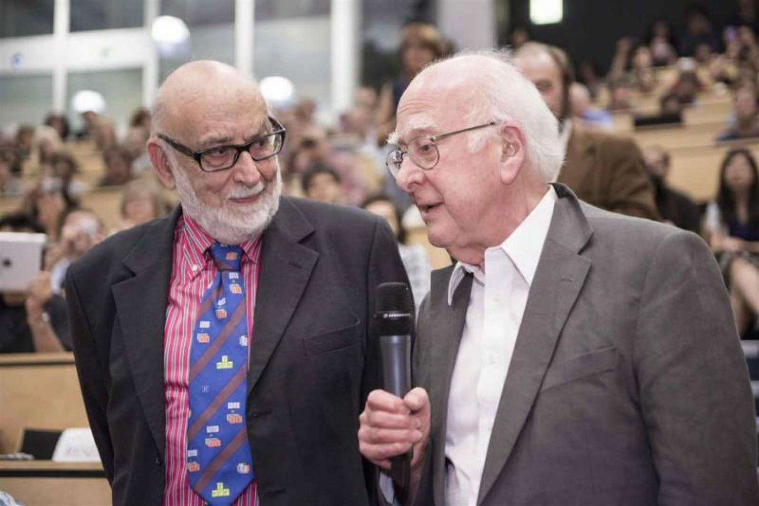

Delivery to CERN, installation and start up
Arrival at CERN
Endcap-C in CERN clean room
Installation in ATLAS
LHC start-up 10/9/08
.., but luckily in the end got much better..
First particles seen in SCT on day 1
Celebrations in Liverpool

Slide 16
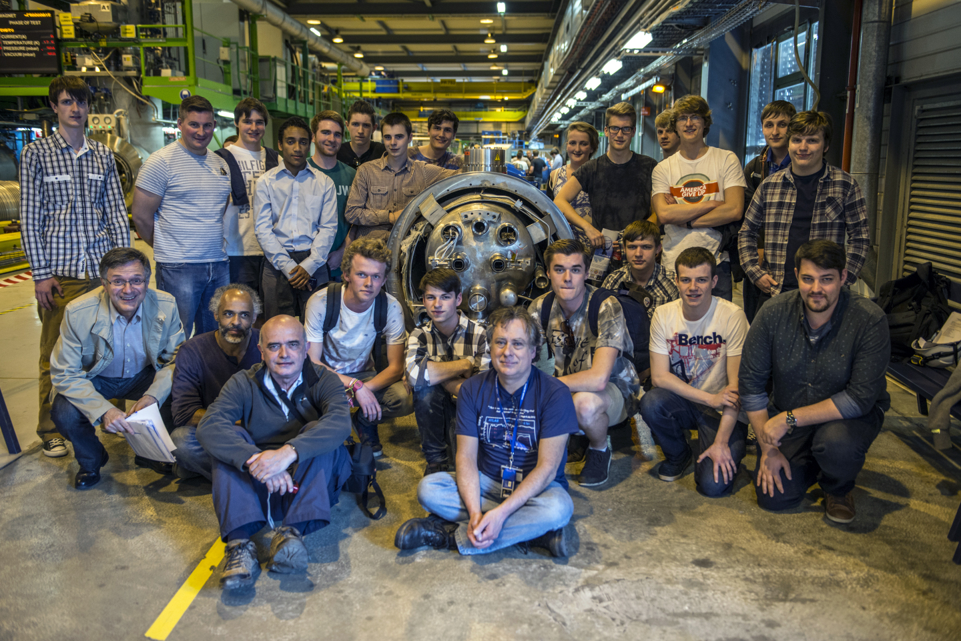
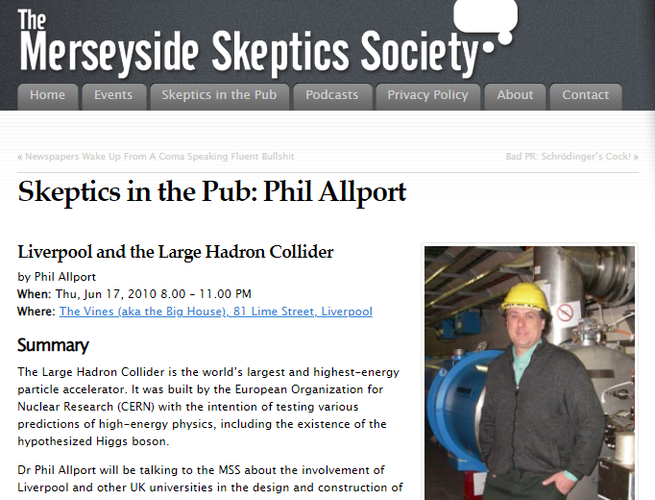
Promoting Science and inspiring people
Phil & Karol jointly organised many Neston High School trips to CERN.
Major impact on many young people
many students went on to do physics degrees
some are today working in particle physics!
Neston High School visit to CERN
Talks to the wider audience on many occasions.

Slide 17
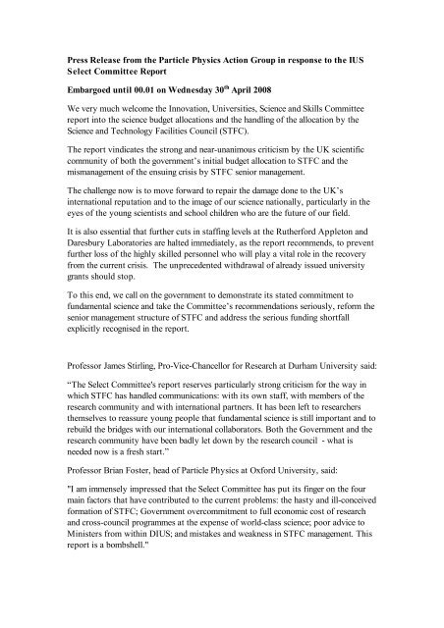
The not so good times…
As head of Liverpool Particle Physics group:
Severe funding crisis in PP following merger of PPARC and CCLRC into STFC.
The UK withdrew from the ILC and even looked at a possible withdrawal from CERN.
PP groups faced funding being removed from already active grants.
Very painful situations where research activities were abruptly ended and contracts to some staff could not be honoured.
Phil worked incredibly hard to help achieve ensure the best possible outcome for all involved.
As head of Liverpool PP and also chair of the IOP high energy particle physics section Phil co-organised the community campaign to fight against these severe cuts.
Particle Physics Action Group (2009-2011): Phil Allport, Brian Cox, Mark Lancaster, Brian Foster (with support from James Stirling)
Particle Physics is still here!

Slide 18
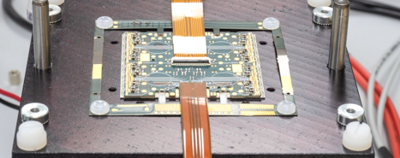
The legacy of the work on the SCT
Building detectors like the SCT to the highest possible standard has been key to the physics successes of the LHC → more than a thousand published physics papers from ATLAS alone!
The R&D and expertise gained established silicon detectors as the leading technology option a for vertex and tracking detectors for may future experiments and upgrades.
Sensor R&D from early 2000s R&D focussed on the upgrades of the ATLAS detector for the super-LHC (HL-LHC)
Collaborative R&D found a new home in RD50
n-in-p sensors: with others in Liverpool, Phil focussed on developing radiation tolerant n-in-p silicon sensors -- now the baseline technology choice for the HL-LHC tracker upgrades.
Monolithic pixel sensors: discussions with Phil and others around 2012 to join a new R&D on High Voltage monolithic CMOS sensors, a technology we are now deploying in Mu3e for the first time.
ATLAS HL-LHC Tracker upgrade The ITk proposal was built on the expertise gained and construction infrastructure developed for the SCT and similar projects.
Very soon after delivering the SCT, Phil initiated in Liverpool the work starting to develop the detector solutions for the ATLAS ITk tracker upgrade:
Large project on ITk strip barrels and pixel endcap in the UK.
Leadership Phil of the International ITk project
charge collection vs fluence at 700V
ITk strip barrel module
ITk quad pixel module

Slide 19
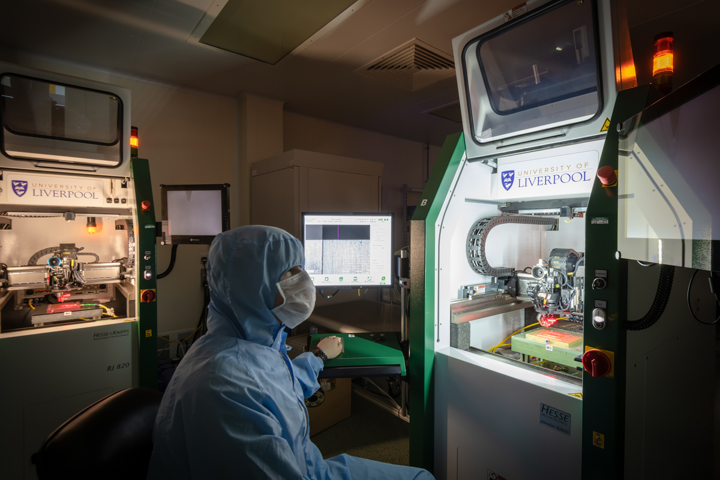
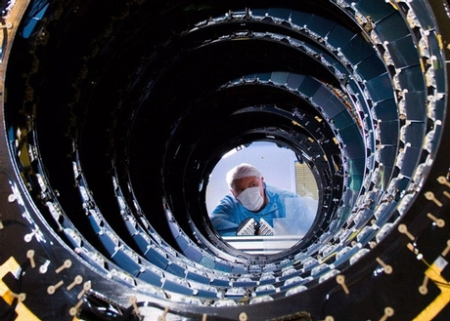
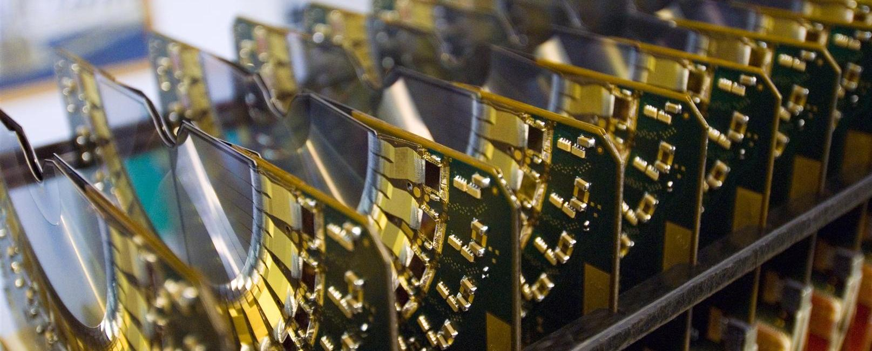
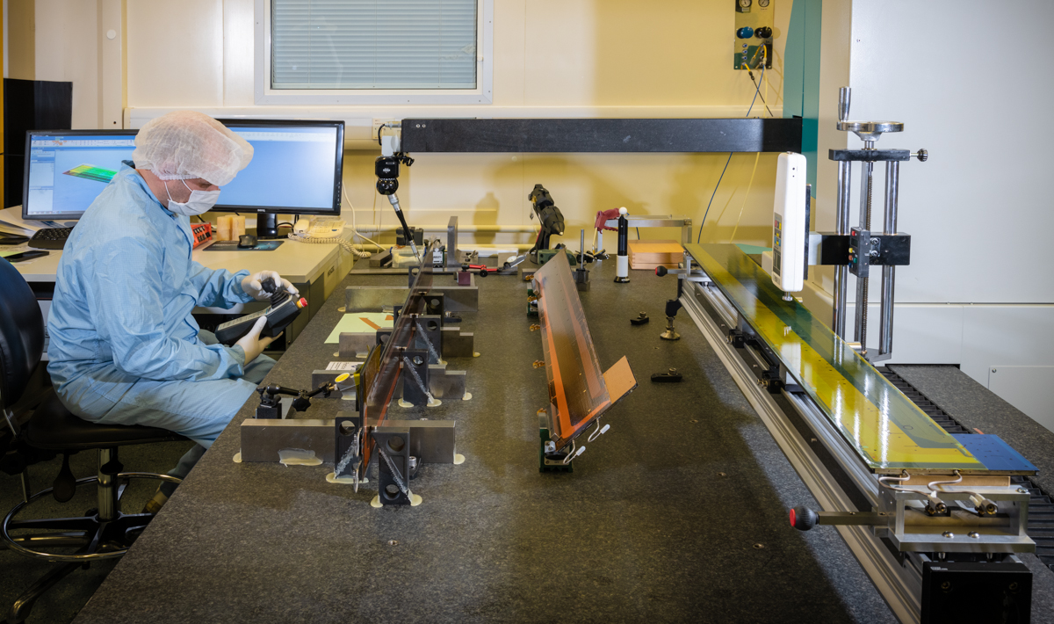
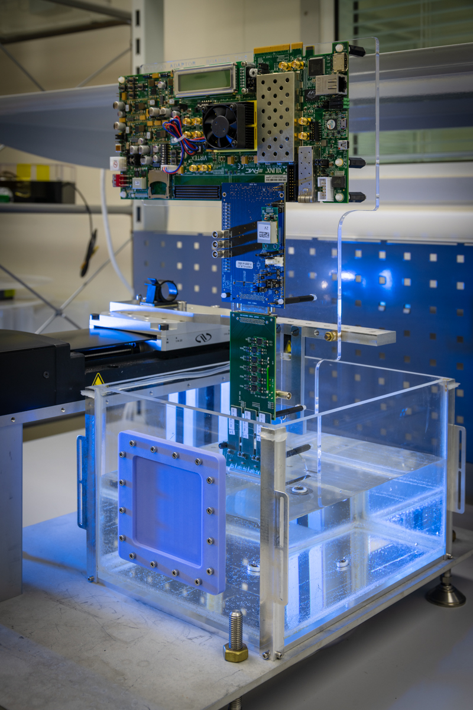
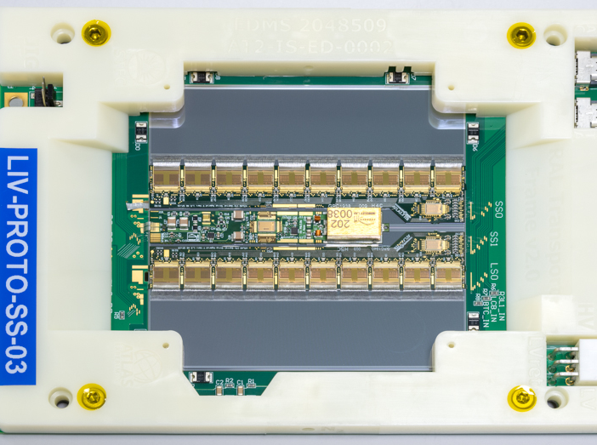
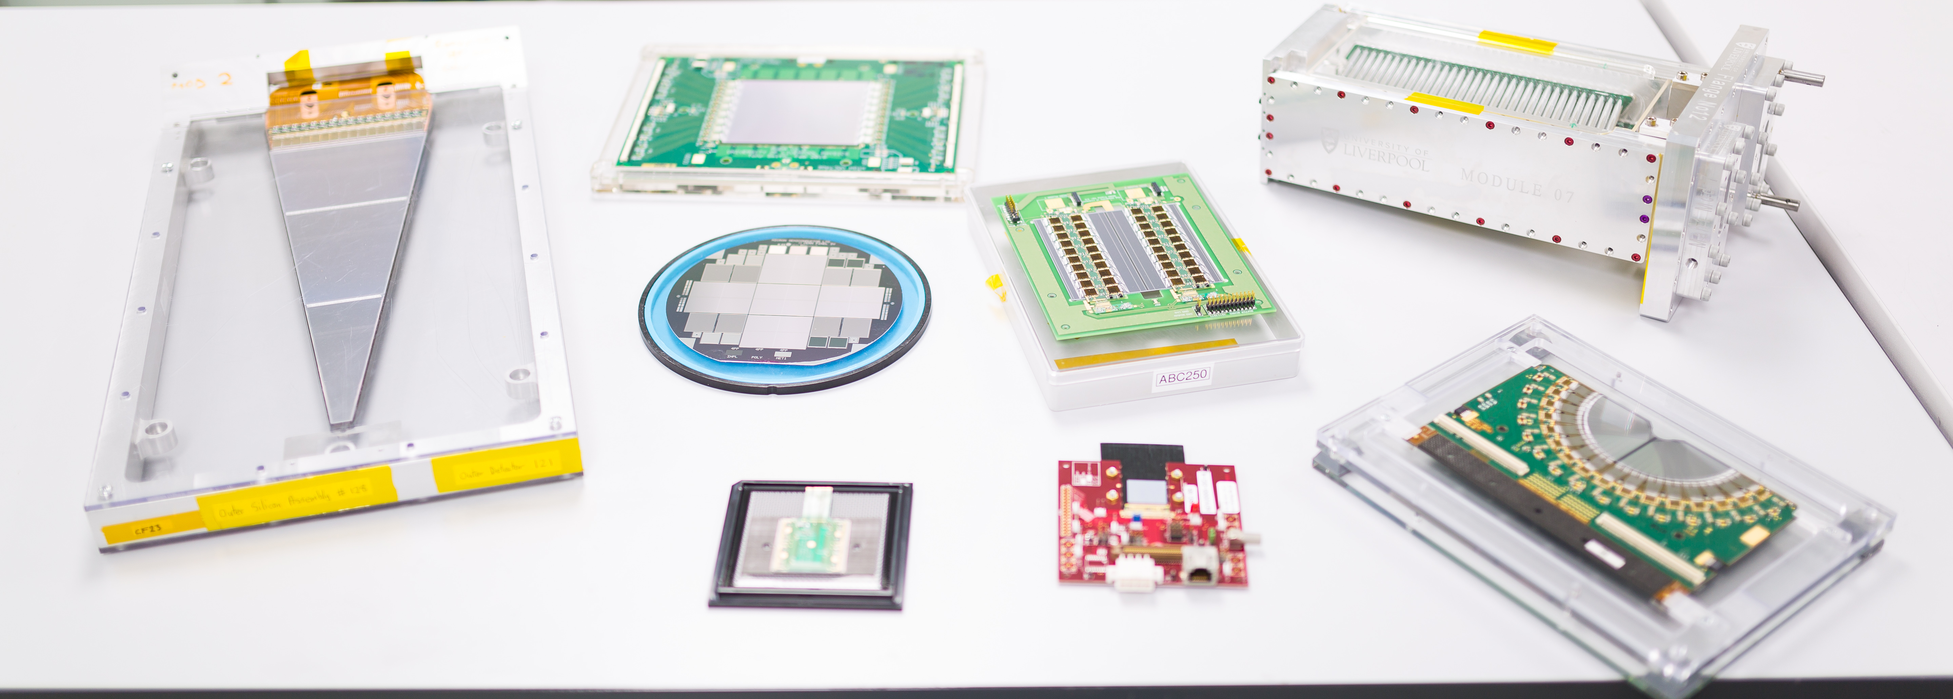
The LSDC today
The SCT was the first major project hosted in the facility.
Extensive expertise and infrastructure was developed under Phil’s lead
and was grown and kept up-to-date since then, through the hosting many projects including Liverpool ITk work.
Over the 20 years since it was established the LSDC hosted:
ATLAS: SCT, ITk strip barrel and ITk pixel endcap, LHC-b: Vertex Locator and Velo pixel upgrade, T2K/ND280: ECAL, g-2: straw tracker, LZ: optical calibration system, SBND: Cathode planes, Mu3e: HV-MAPS Tracker, DarkSide20k: SiPM tiles, NP: ALICE: ITS and the ALPHA, R3B and HI-ISOLDE silicon detectors
Silicon R&D: radiation tolerance, HV-MAPS, Proton therapy applications
Calorimetry: MODEs-SNM security and VIDAR reactor monitoring
Lar R&D: ARIADNE
Much of the work on these projects could not have been done in Liverpool without the LSDC and the work on the SCT.

Slide 20
SCT team on completion SCT Endcap-C in 2004
A big thank you, Phil, for the major impact you have had on the Liverpool PP group!

