Slide 1



Avalanche diode update
From SiPM to Dark Matter search and beyond
Fabrice Retiere
Instrumentation for Physics discovery and beyond

Slide 2
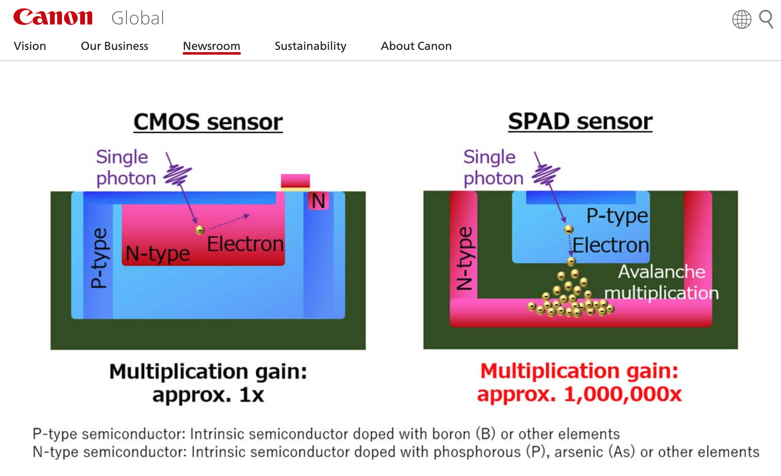
Single Photon Avalanche Diode

Slide 3
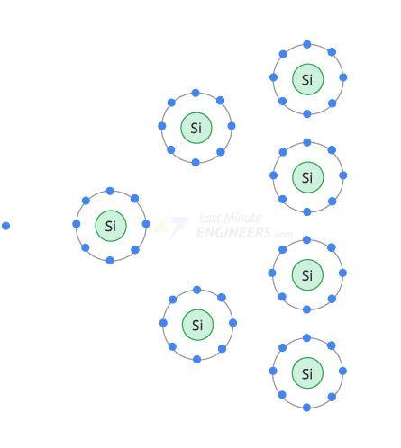
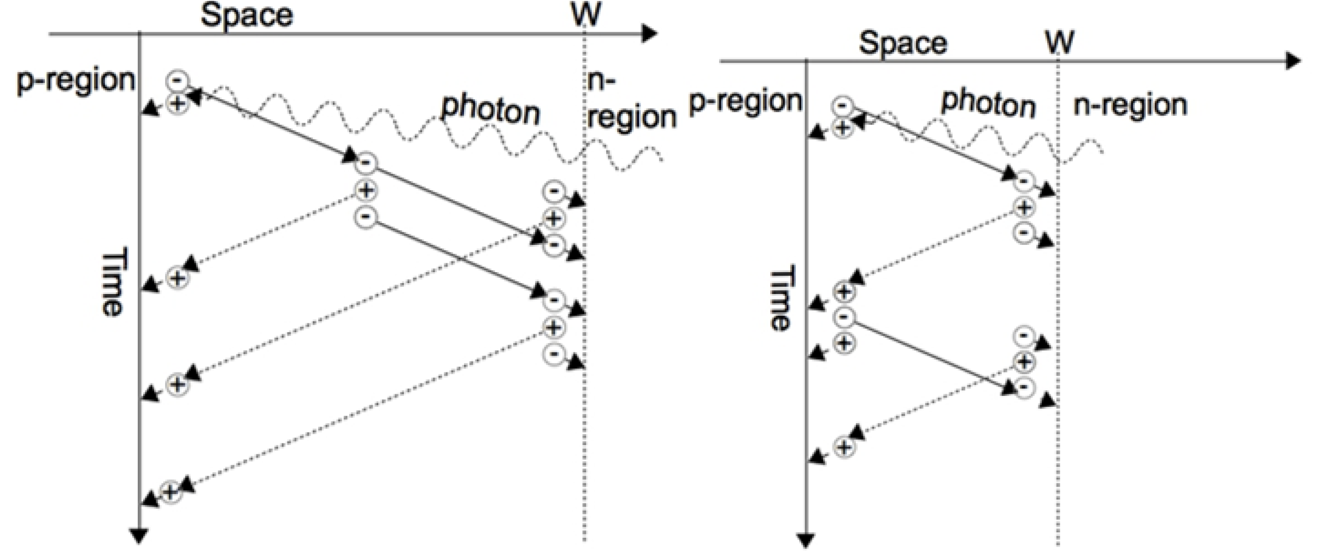
Breaking down
Limited avalanche
Breakdown
https://www.intechopen.com/chapters/49261

Slide 4
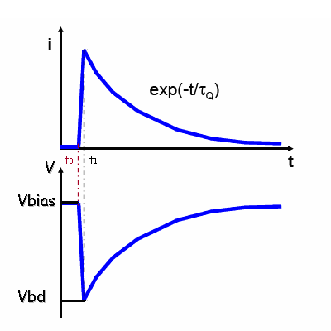
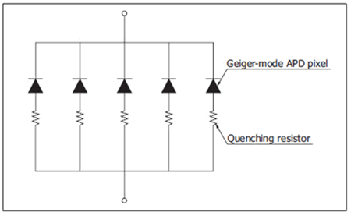
Passive quenching with resistor
Quenching resistor for stopping breakdown
https://physicsopenlab.org/2016/02/16/silicon-photomultiplier-sipm/

Slide 5
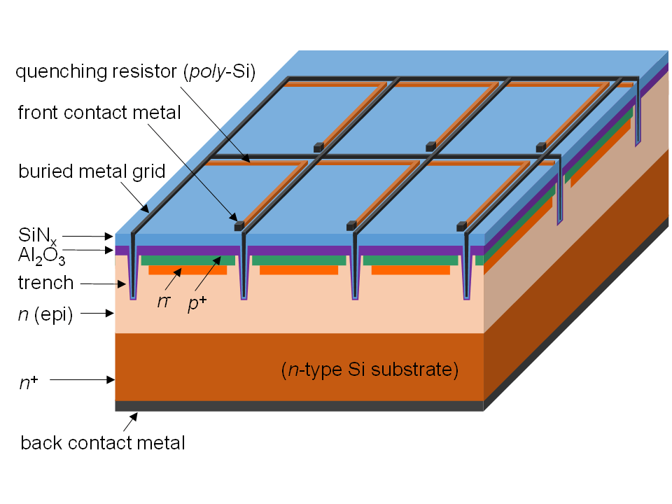
Many SPAD in parallel – aka SiPMs
https://sites.gatech.edu/lanns/research/silicon-photomultipliers/

Slide 6
Moving away from DS analog scheme?
Bias
Photon
Amplifier
Need power
to buffer
capacitance
Analog to Digital
Conversion
Comparator (more power)
Waveform digitizer
Photon search engine
In software or firmware
Timing performance
Limited by size
Large pulse very messy
~0.1nF/mm²
Photon time stamp
Bias
Photon
AQ
Active
Quench
Photon time stamp
Tag for every photon
Or some simpler aggregate
Digital processing

Slide 7
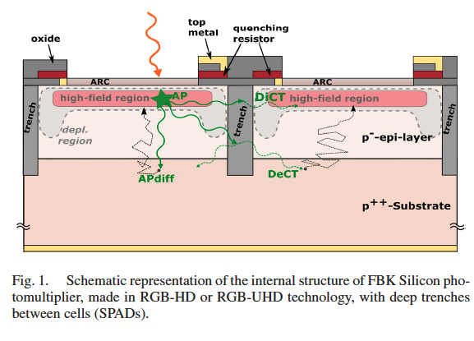
SPAD nuisances
Dark noise
  Thermal. At room temperature ~100kHz/mm²
Carrier trap and release => after-pulsing
Light emission during avalanche
  Direct cross-talk
  Delayed cross-talk
  External cross-talk, aka hit another SiPM

Slide 8
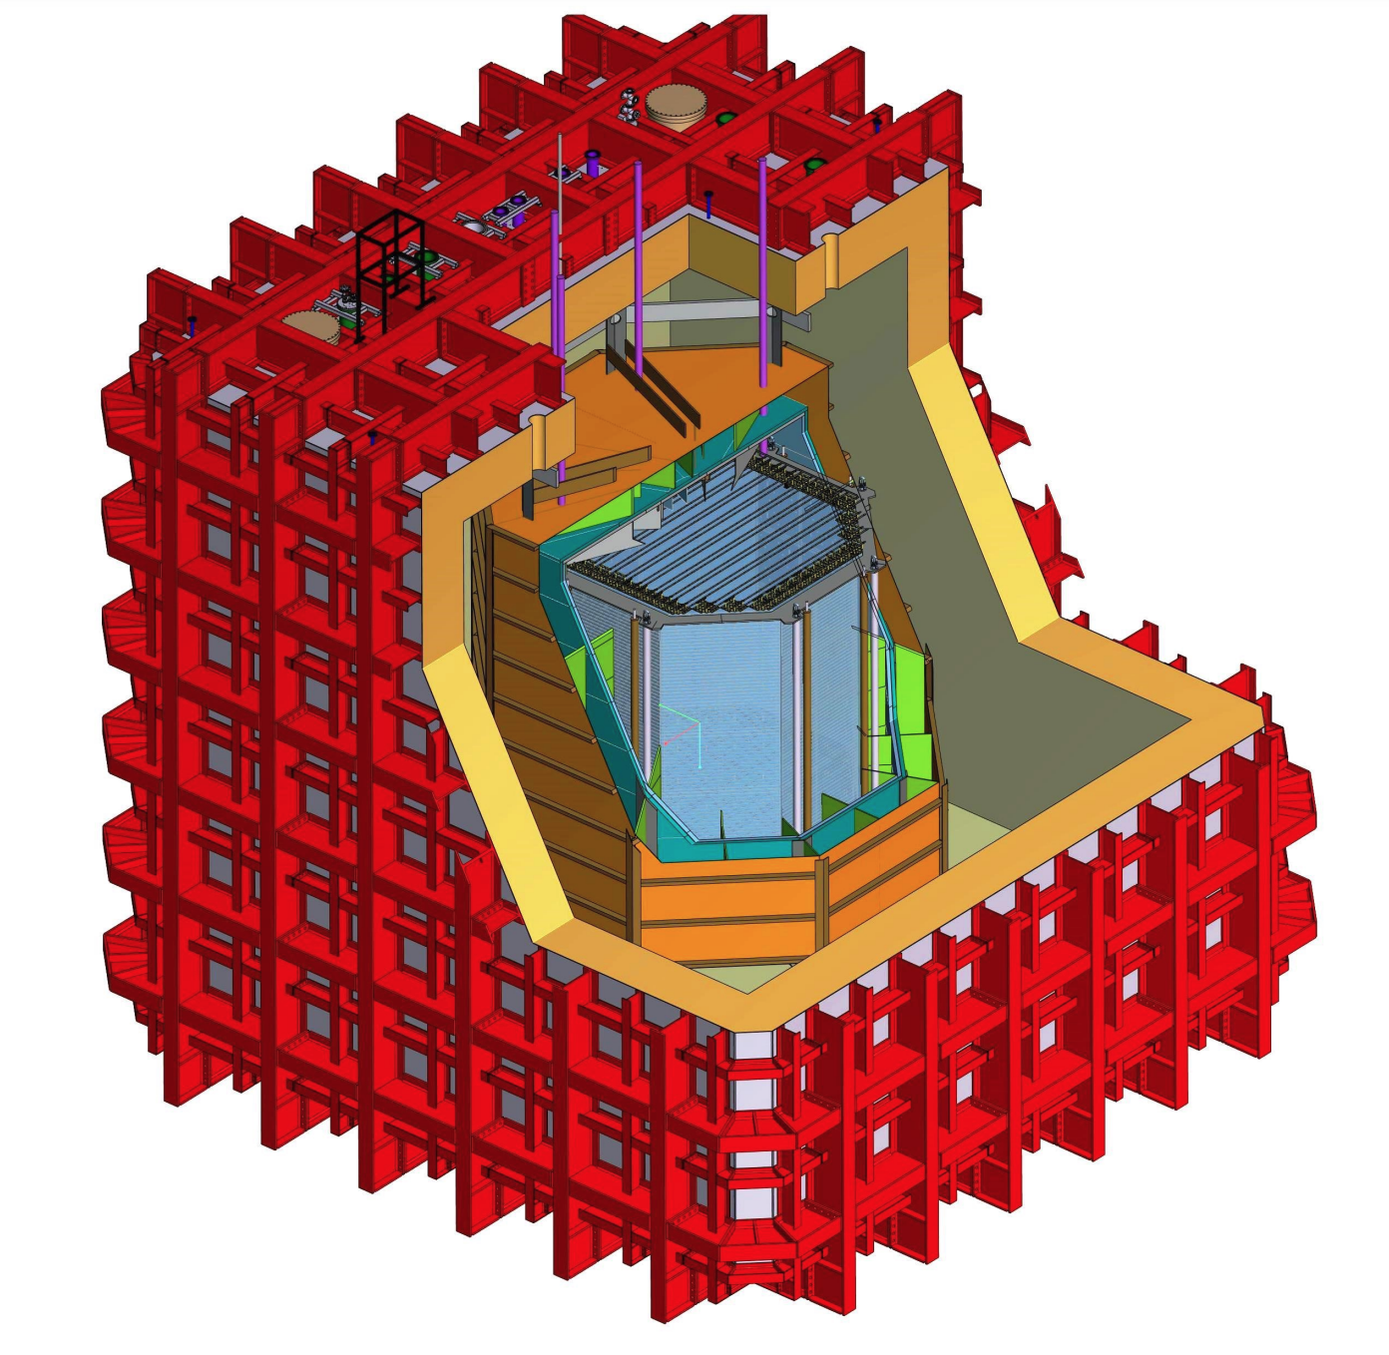
DarkSide-20k
30 tons of (depleted) liquid Argon
Construction on-going
Start physics running in 2027?

Slide 9
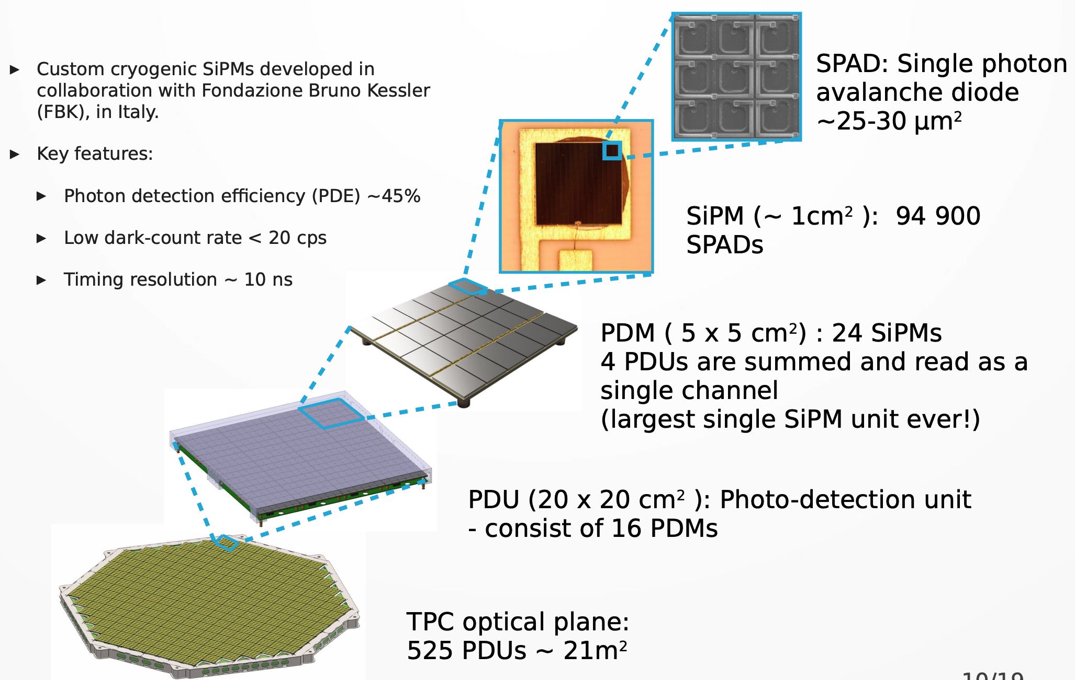
DarkSide-20k photon detection
Taken from Rafał Wojaczyński (Astrocent)

Slide 10
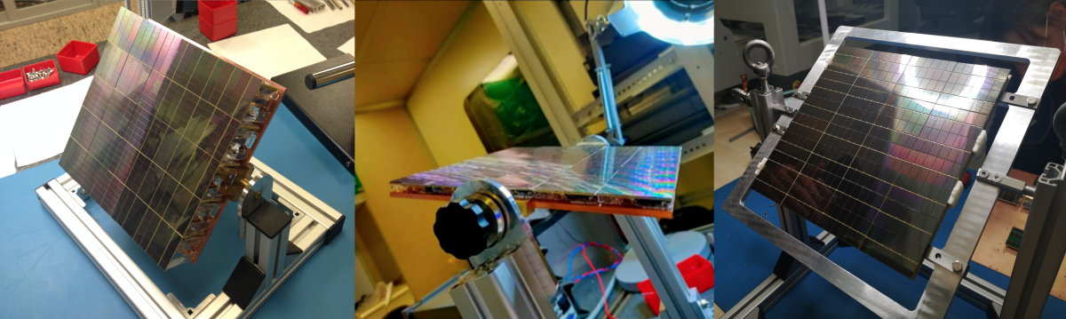
Photon Detection Unit

Slide 11
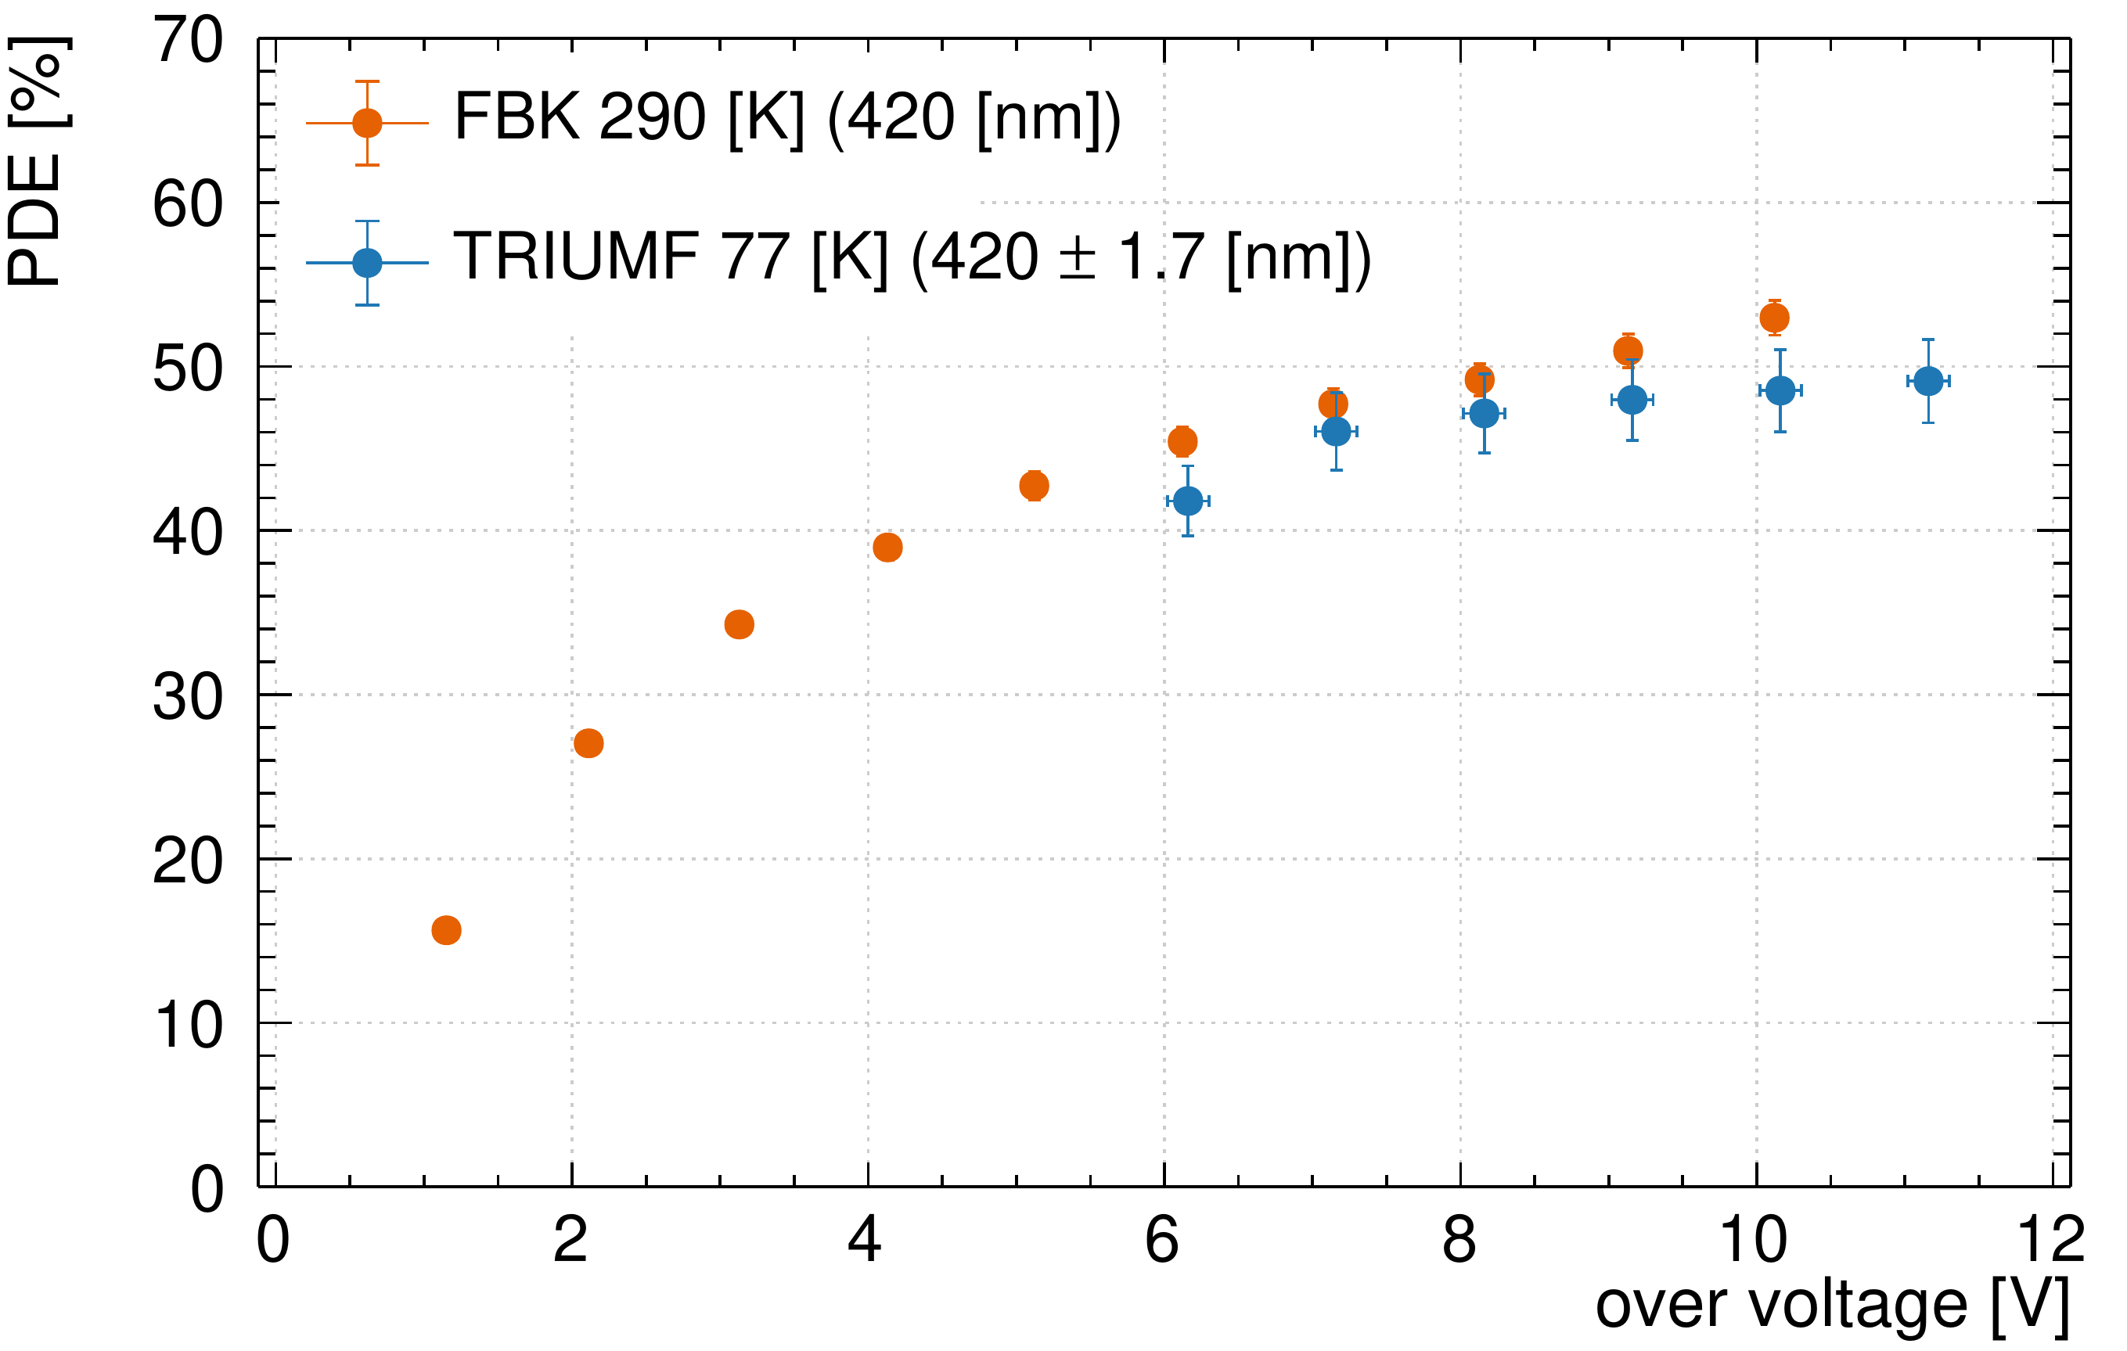
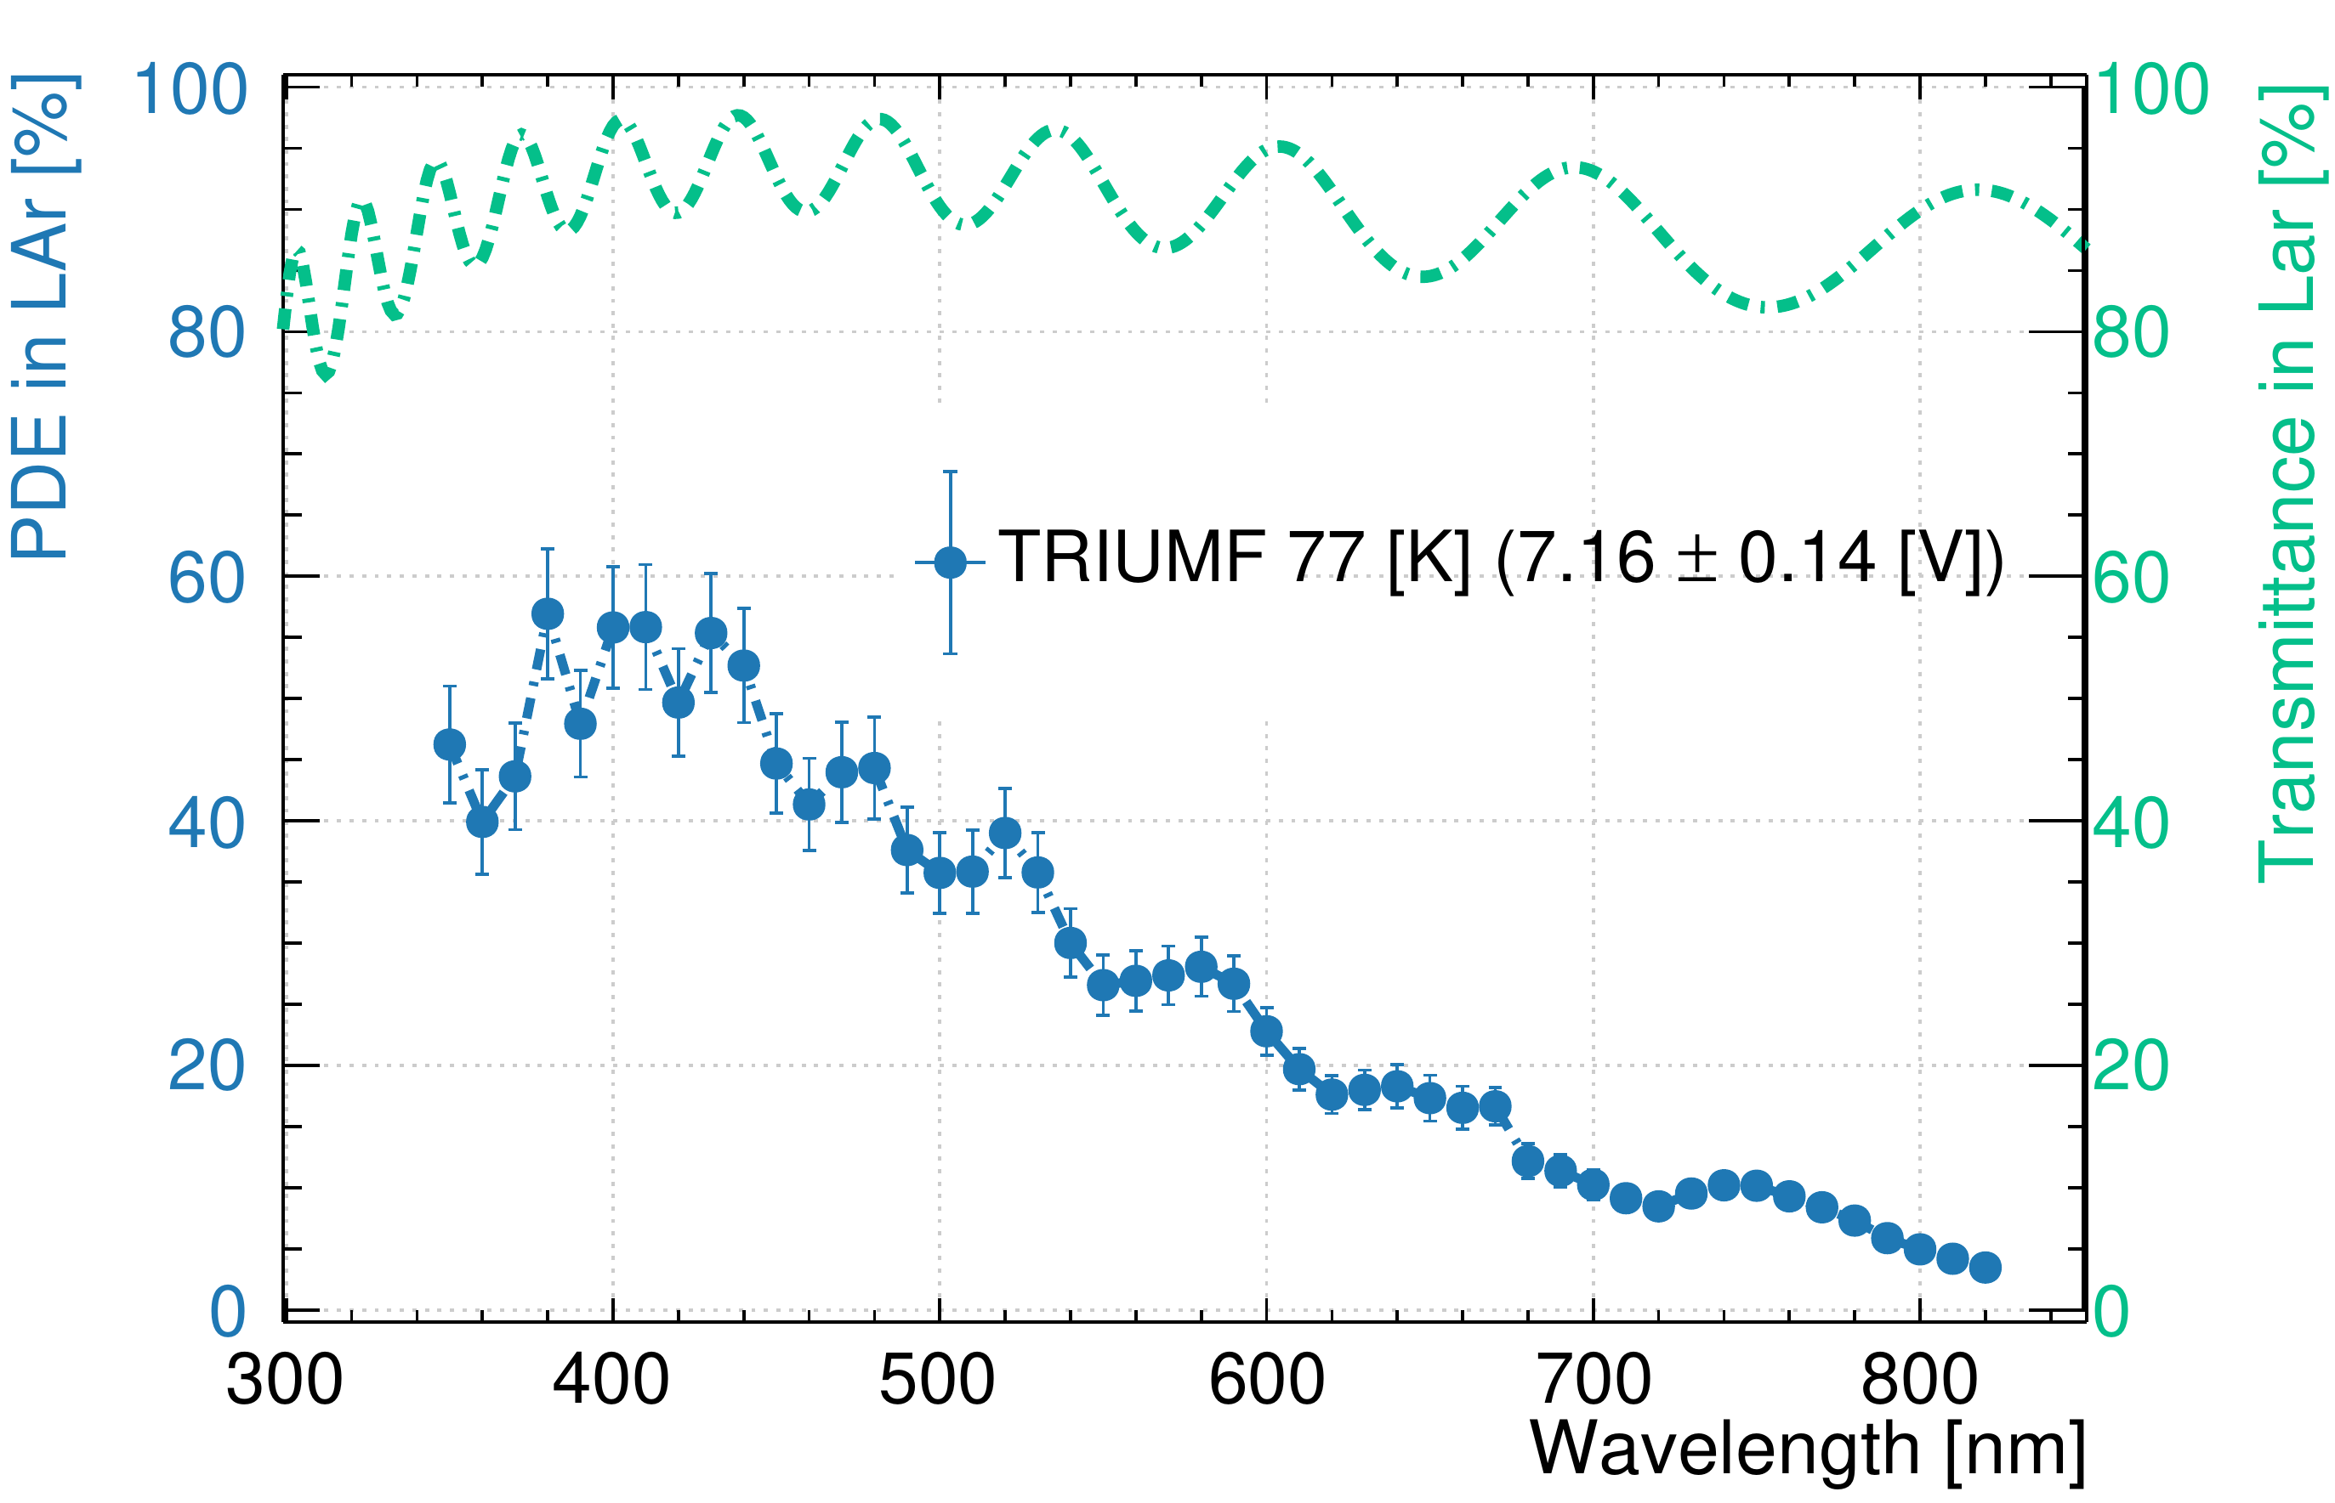
Efficiency requirements are exceeded

Slide 12
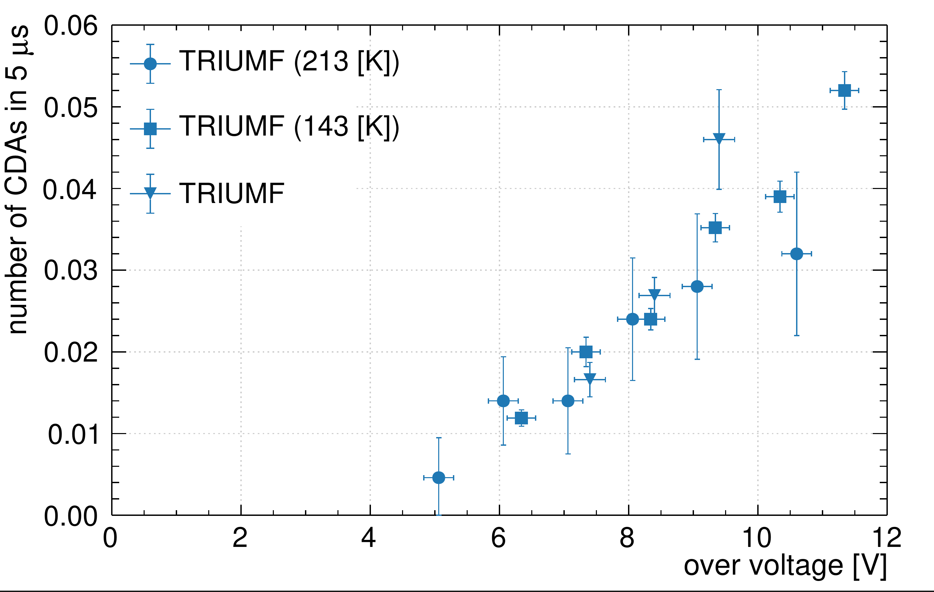
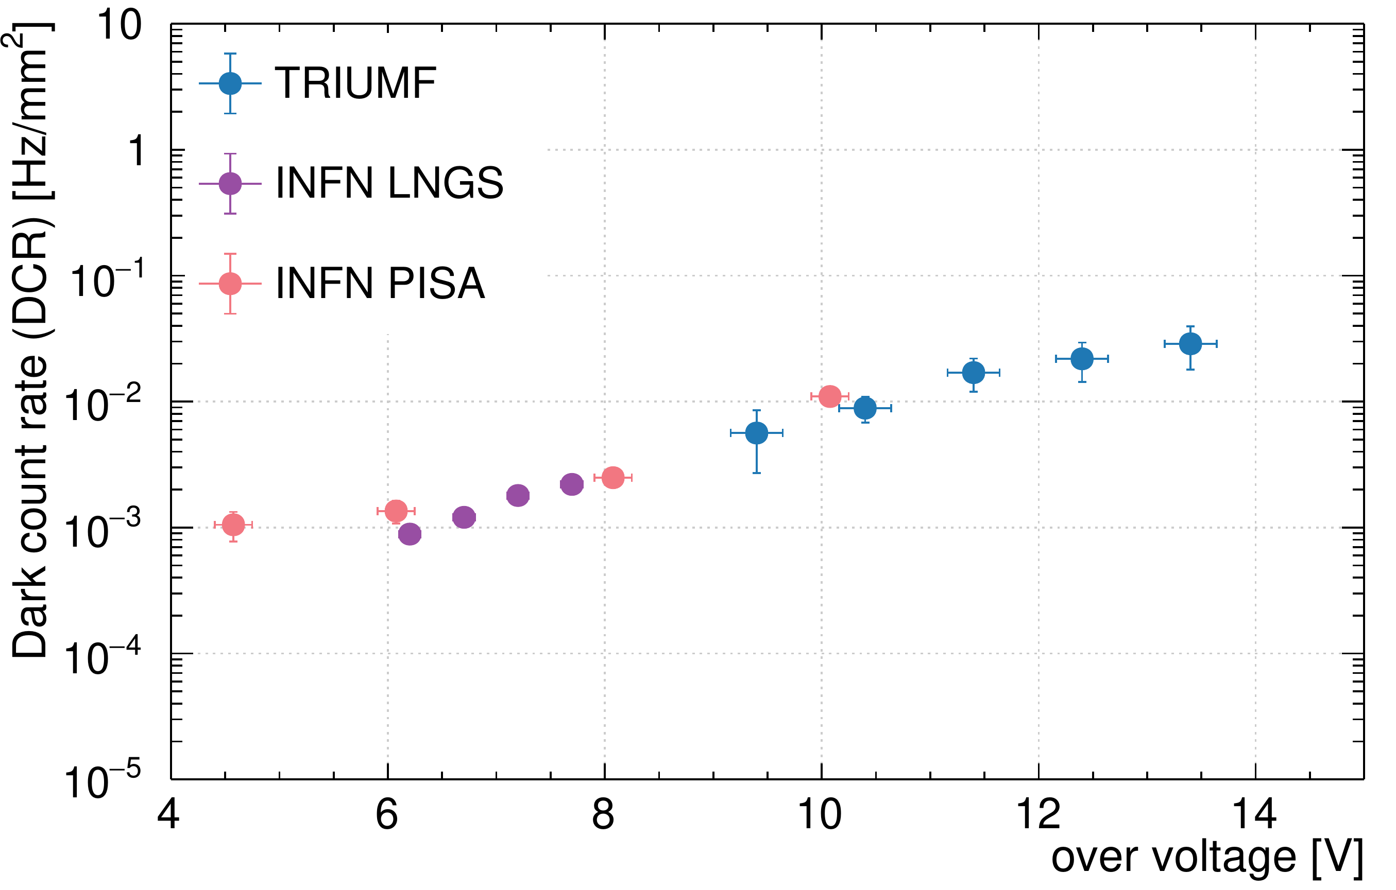
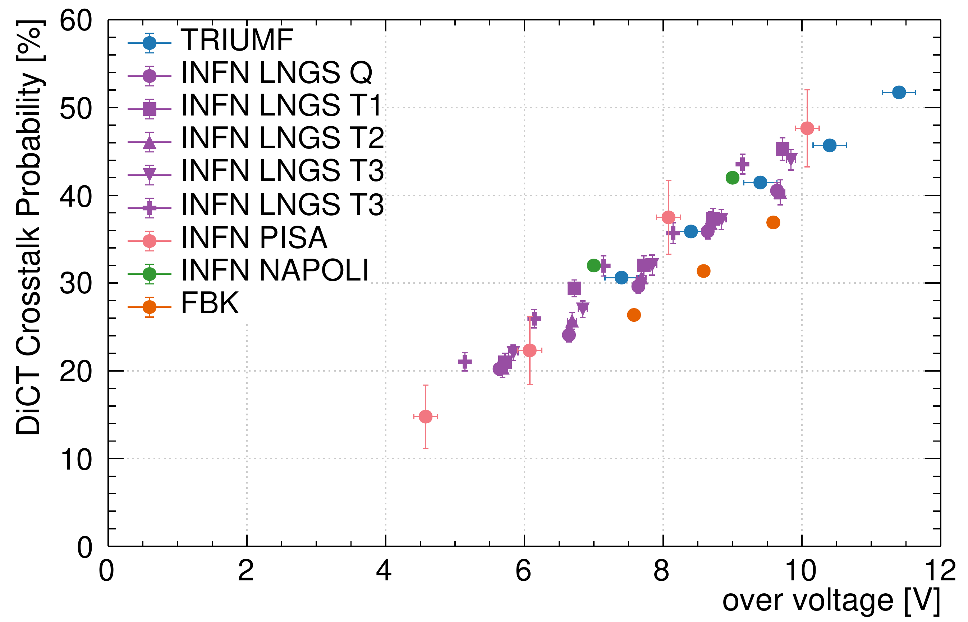
Nuisances are under-control

Slide 13
Photon detection in nEXO
Energy resolution dominated by light
  Need 3% efficiency of detecting scintillation photons for 1 % energy resolution
  With negligible noise for light detection
Need at least 4 m² of detection area
Need reflective electrodes

Slide 14
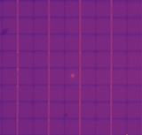
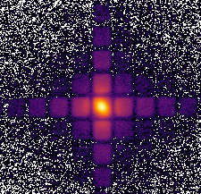
Imaging re-emitted light
Technical detour: SPAD light emission
FBK VUV-HD3
Reflected light
Re-emitted light

Slide 15
Spectra
Acceptance:
Objective NA=0.45, i.e. θ< 26.7°
Simulation shows that acceptance is about 10% of total
Preliminary
Preliminary

Slide 16
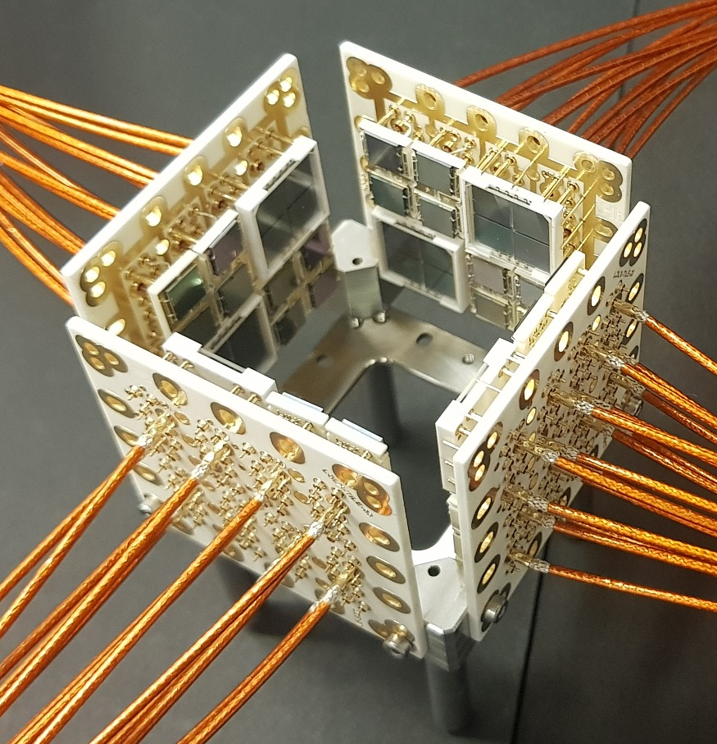
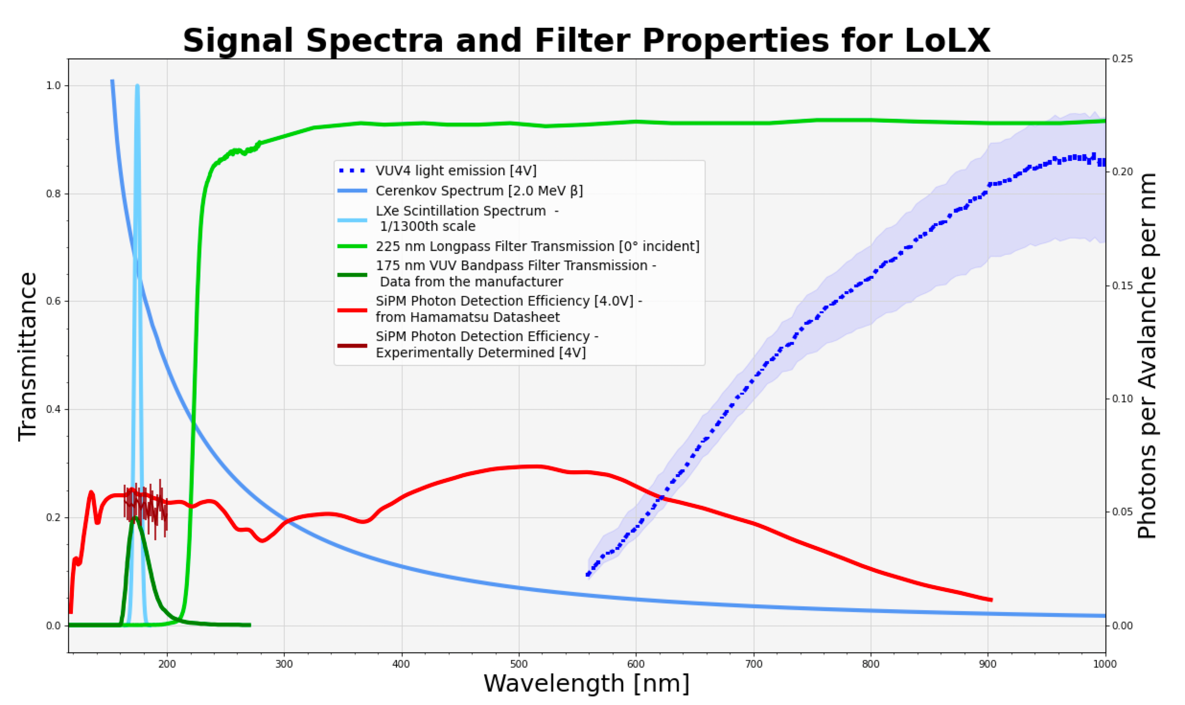
All processes in Lxe probed by the light only liquid Xenon experiment

Slide 17
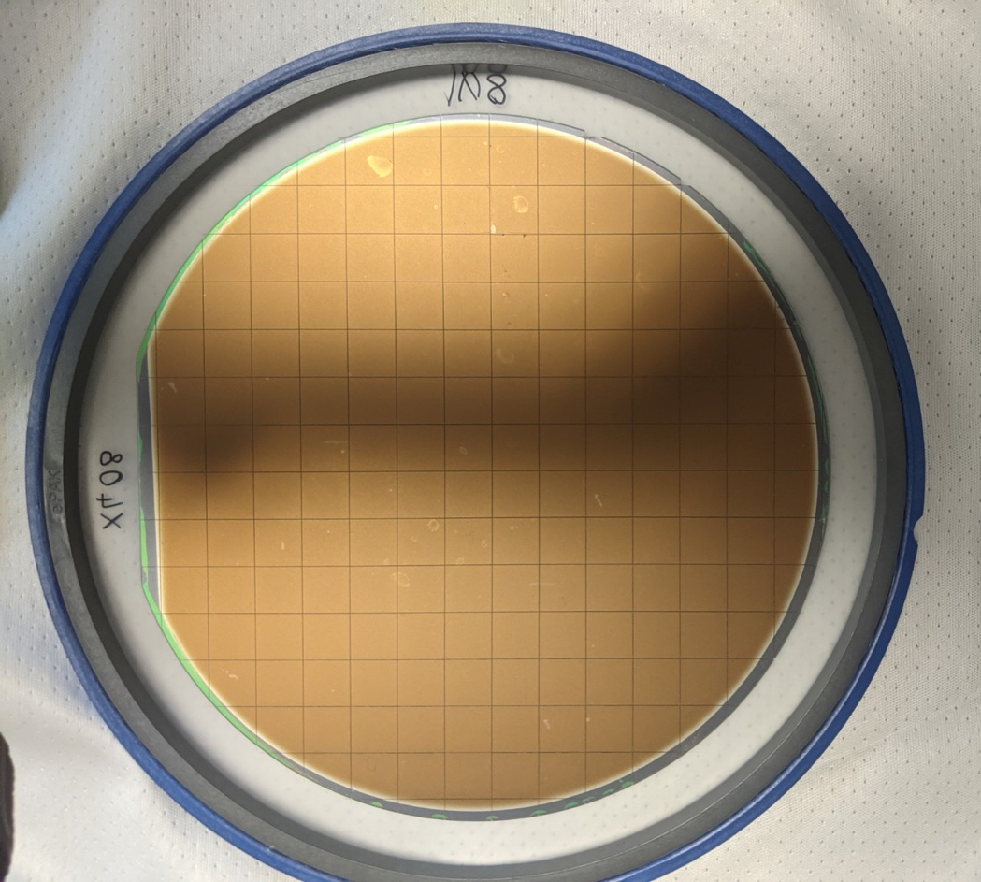
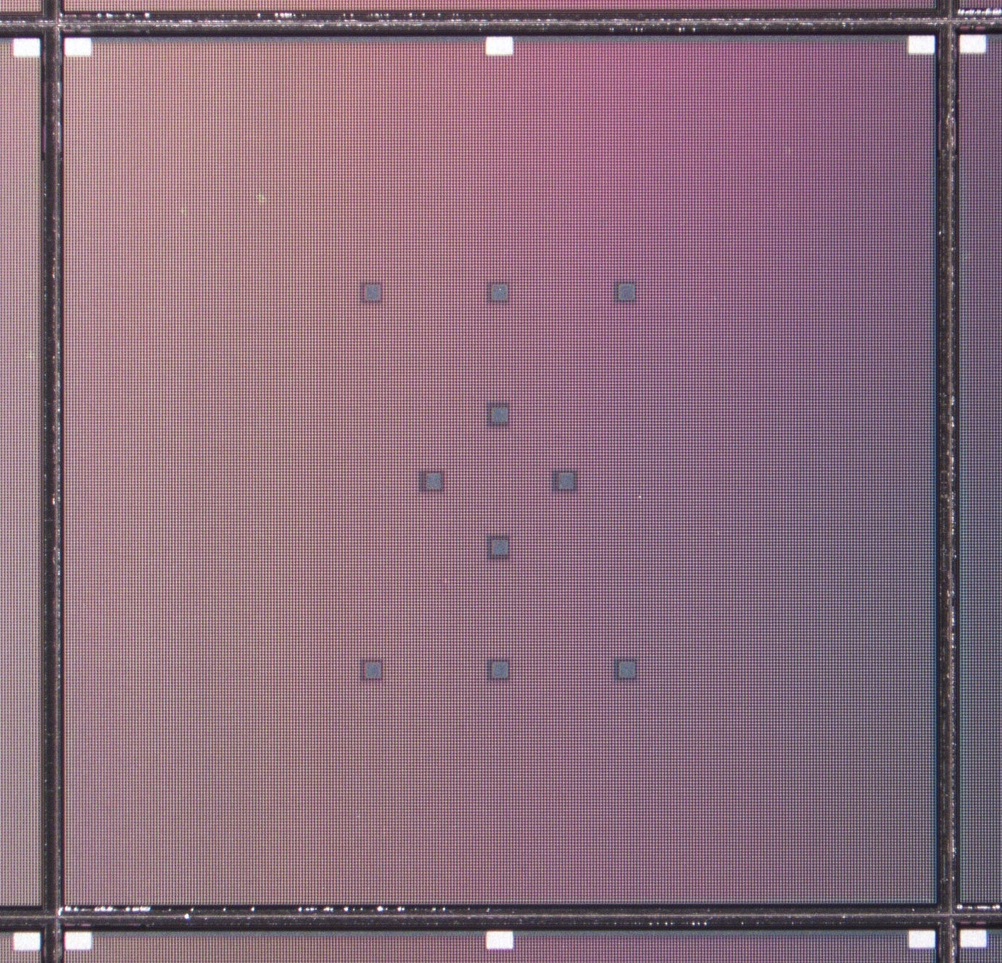
New FBK production for nEXO and SBC
1x1cm2 but most SiPMs don’t work…

Slide 18
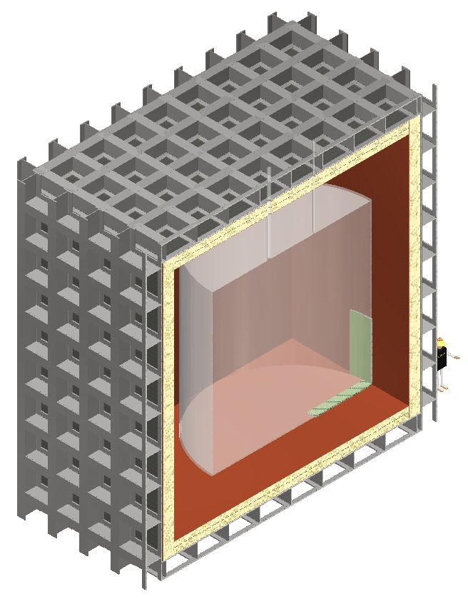
ARGO beyond DarkSide-20k
300 tons of LAr
R&D ongoing
Key challenge is light readout over huge area
Foreseen at SNOLAB in the 2030s era
Outer cryostat
Liquid argon buffer
Ultrapure acrylic vessel
(7m diameter and height)
400 tonnes low-radioactivity
argon within acrylic vessel
250 m² of single photon detectors
covering full acrylic vessel surface

Slide 19
ARGO photon detection requirements
 | DarkSide-20k | ARGO minimum | ARGO desirable
Surface Area | 40 m² | 250 m² | 250 m²
Efficiency at 420 nm | >40% | >50% | >60%
Efficiency at 128 nm | 0 | 0 | >20%
Dark noise rate at 86K | < 1kHz/m² | < 1kHz/m² | < 0.1kHz/m²
Correlated prompt avalanche (cross-talk) | <50% | <50% | <10%
Correlated delayed avalanche (after pulsing) | <5% | <5% | <1%
External cross-talk | Unknown | <50% | <10%
Single Photon Timing resolution | 20ns | 1ns | 0.1ns
Granularity | 25cm² | 1 m² | 10 cm²
Radioactive content | Very low | Very low | Ultra low

Slide 20

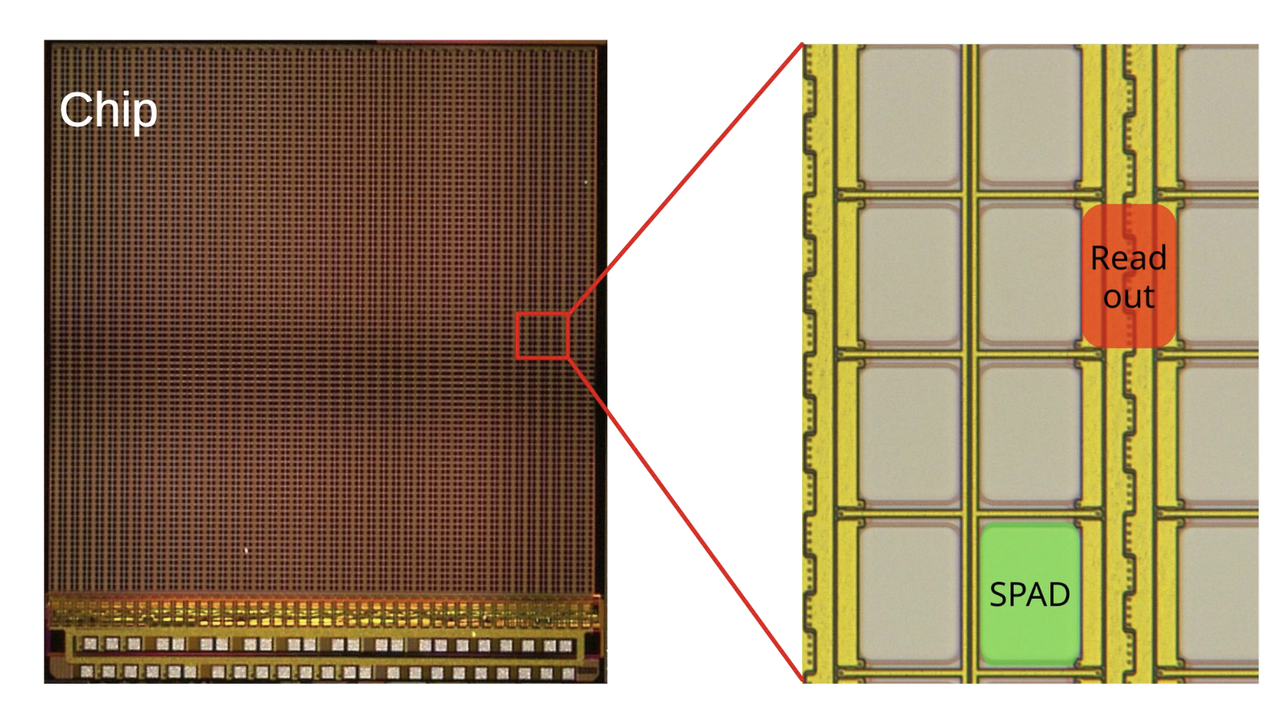
The future is digital!
2D SPAD @ Heidelberg
2D SPAD array designed by Heidelberg built by Fraunhofer IMS
The good
  Single chip doing everything
  Dark noise rate of 0.02 Hz/mm²
The bad
  Some loss of active area
  No VUV sensitivity… yet

Slide 21
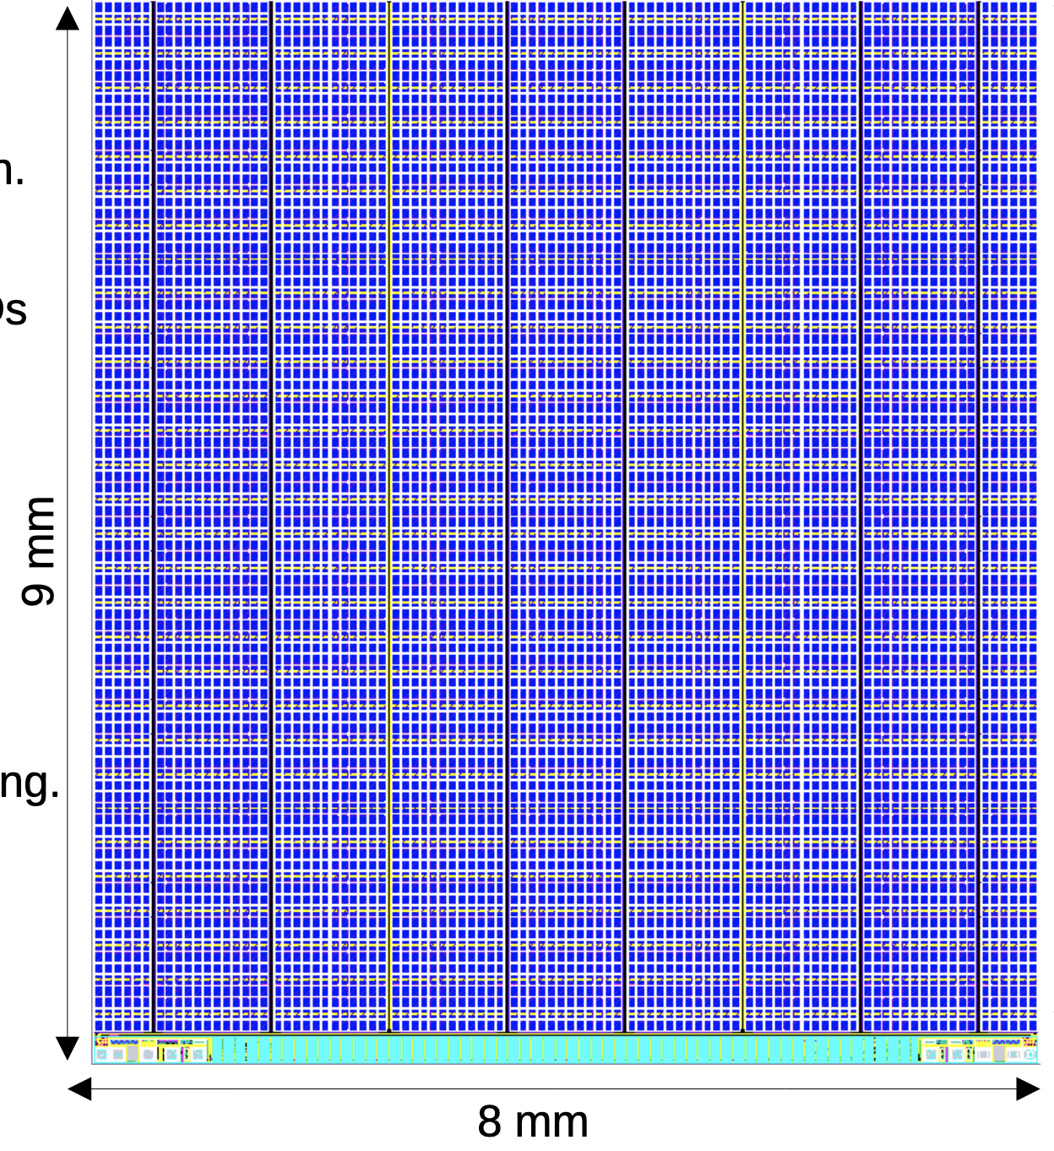
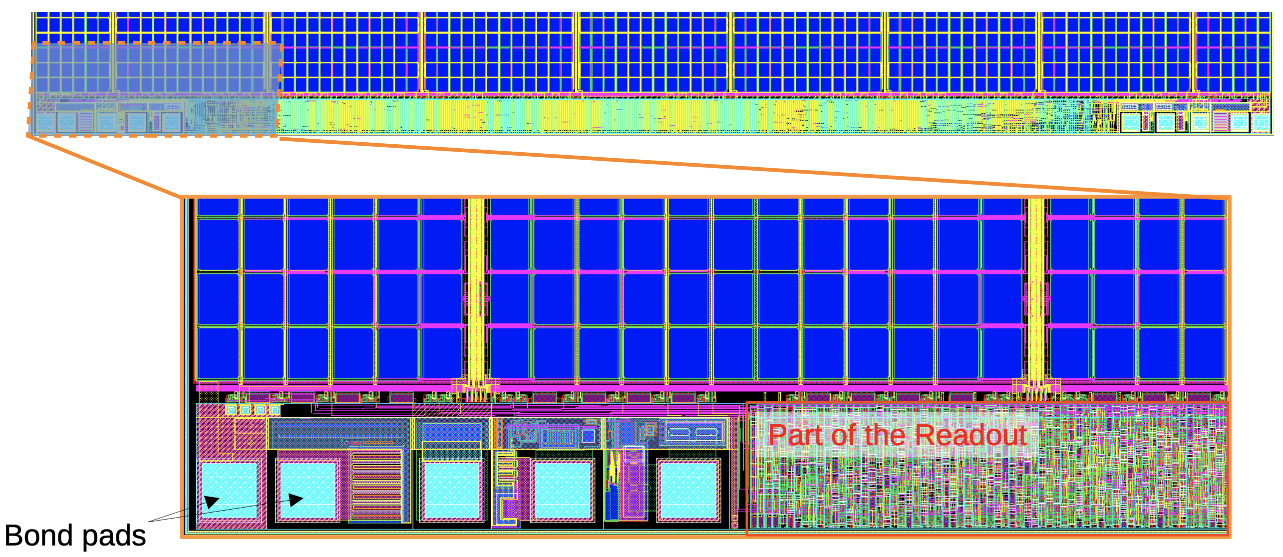
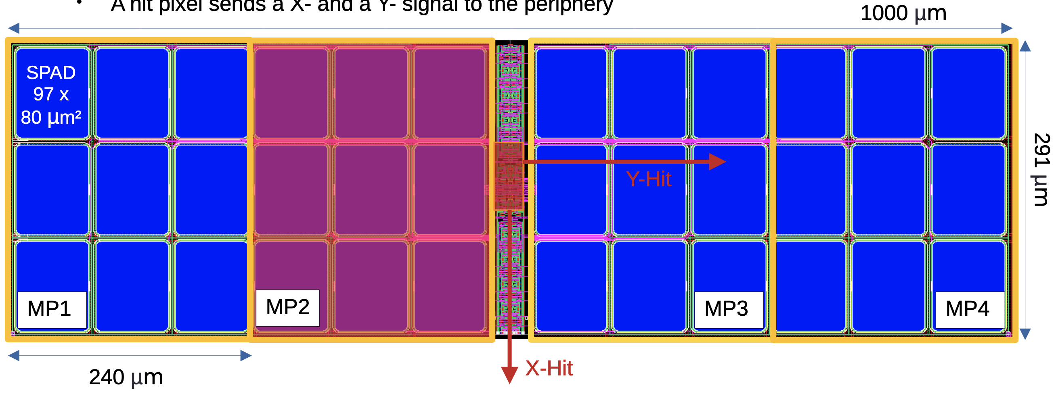
2D SPAD array for DARWIN

Slide 22
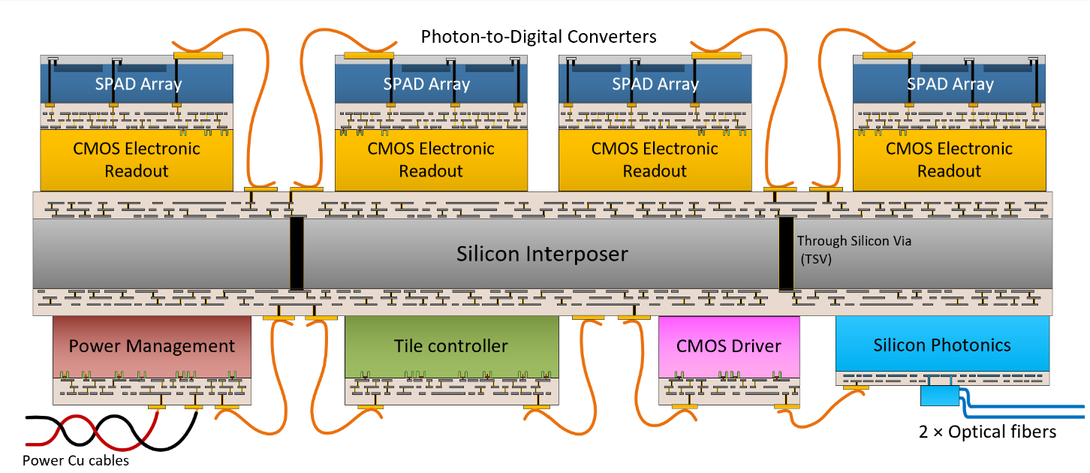


Photon to Digital Converter – Canadian tech.

Slide 23
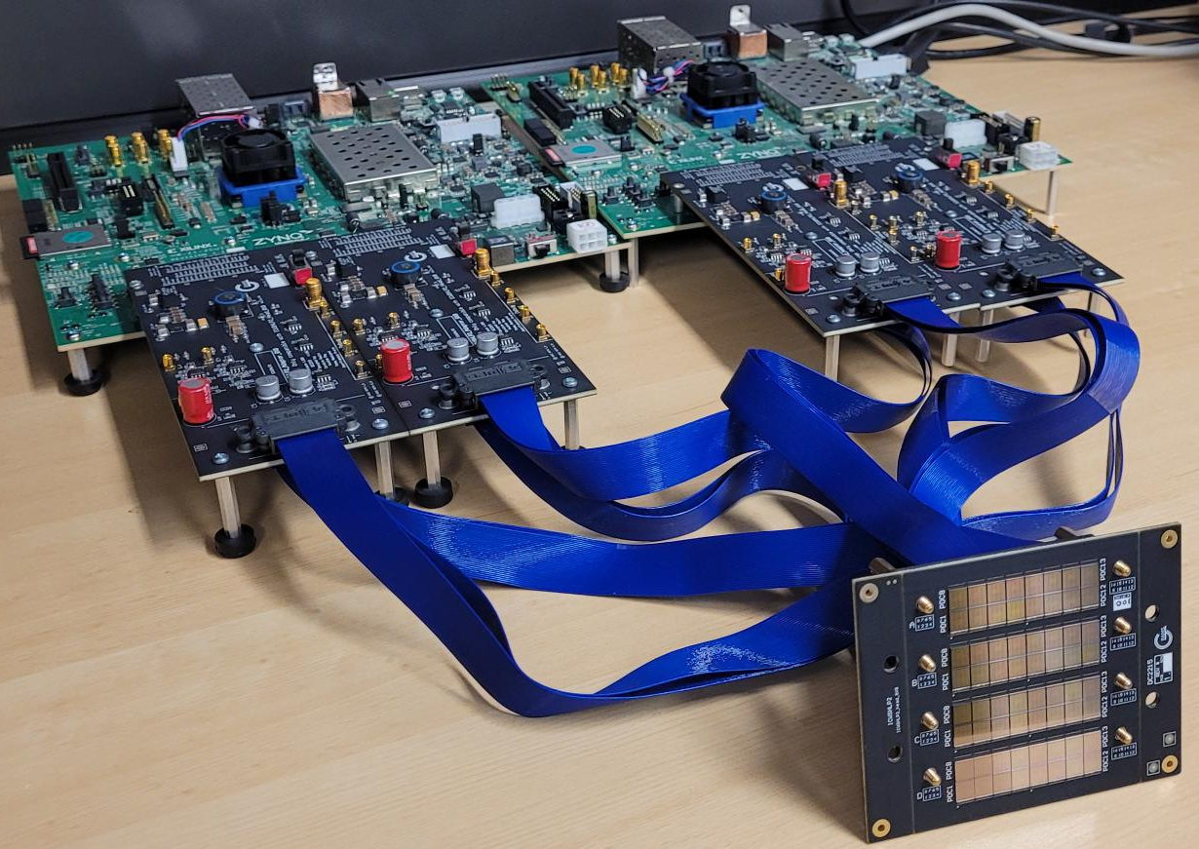
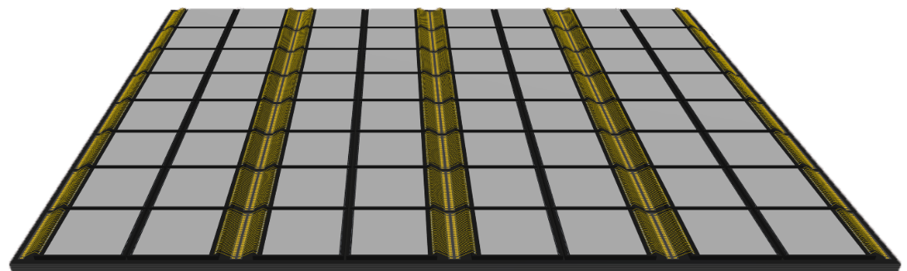
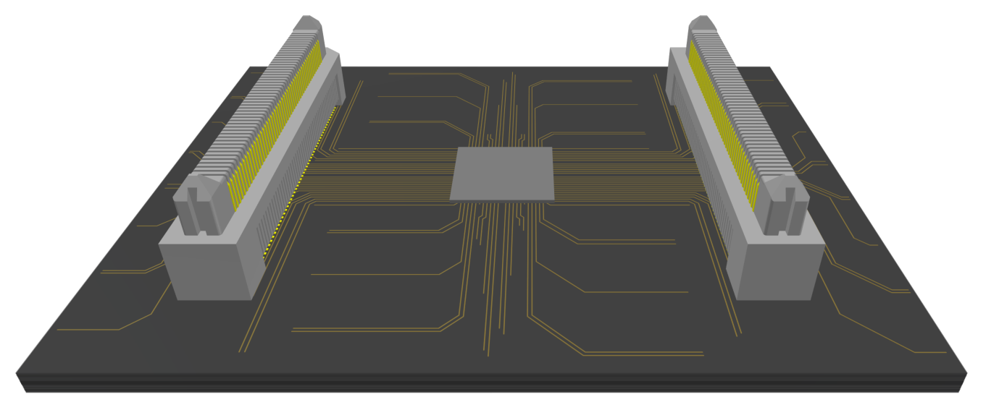
Current development state
FPGA-based Controller
ASIC-based Controller
  TOP
  BOT
45 mm
57 mm

Slide 24
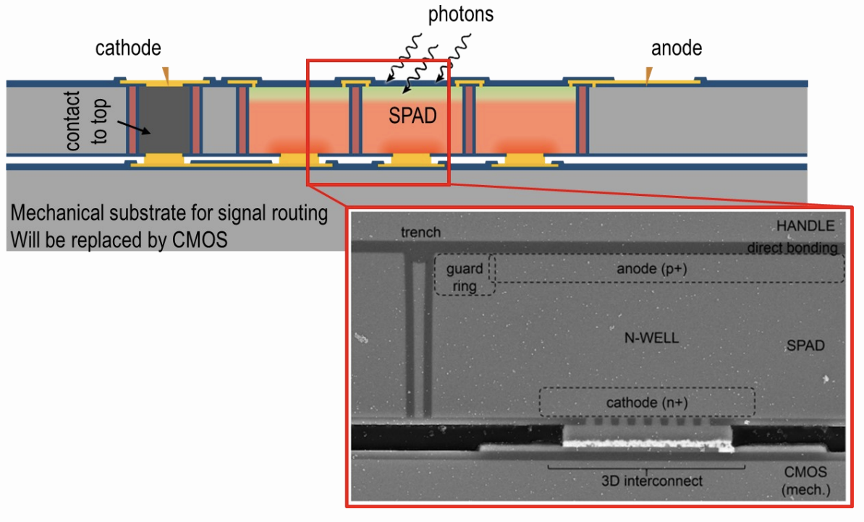
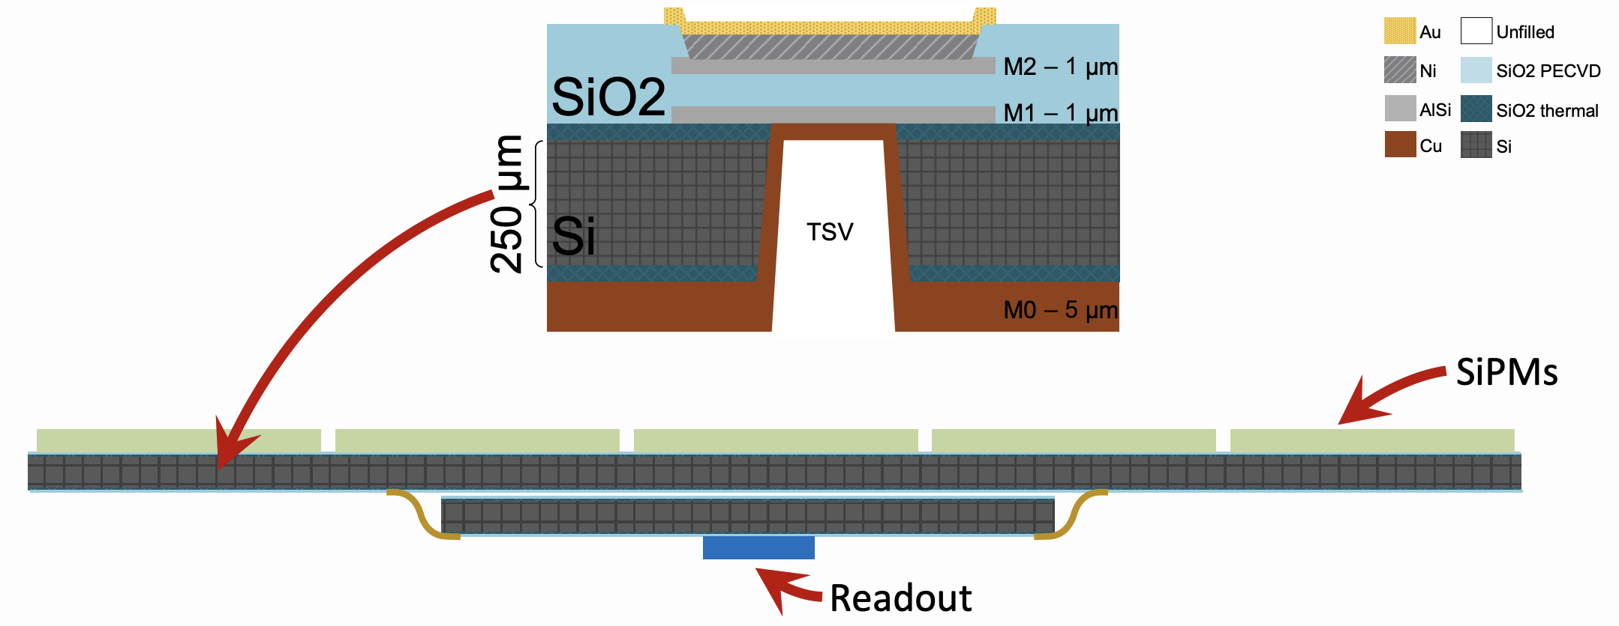
Prototyping progress by Sherbrooke’s group
PDC 3D integration
Silicon interposer

Slide 25
PDC ++?
Front Side illumination (ala Sherbrooke)
photon
Thin passivation ~100nm
Ultra-thin contact 1-5nm
e⁻
Low drift field region
h
e⁻
Drift field region
Front side: best for <500nm wavelength
  Electron produced in high field region for optimum timing
  Drawbacks: Efficiency, higher manufacturing complexity
Back side illuminated: versatile
  Adjust thickness for desired thickness
  CMOS/CCD BSI sensors are now common
Avalanche region
Molecular bonding
CMOS
Aka. electronics
Back side illumination
photon
Thin passivation ~100nm
Ultra-thin contact 1-5nm
Low drift field region
e⁻
e⁻
Drift field region
Avalanche region
Molecular bonding
CMOS
Aka. electronics

Slide 26
Photo-detector performance comparison
Issue to scale up to 1cm². Impacting SBC and nEXO
Parameters at LXe temperature for cm² scale channel size | Hamamatsu PMTª | FBK family ^{b} | Hamamatsu family^{b} | Heidelberg 2D SPAD array | Sherbrooke 3D SPAD array
Efficiency at 128nm (LAr) | 0% | % | 10% | 0 | 0
Efficiency at 175nm (Lxe) | 34% | 24.4±1.4%→? | 20.5±1.1%→? | 0→25%→? | 0→25%→?
Efficiency at 420nm | 35% | 60% | 50% | 50% | 15%→?
Single avalanche charge resolution | 25% | 5%^{c} | 5%^{d} | N/A | N/A
Dark noise rate (Hz/cm²) in LXe | 0.23 ± 0.07 | 19 ± 1 | 35 ± 1 | 2 | 1000
# correlated avalanche in 1 μs | 0.02 ± 0.005 | 0.23 ± 0.06 | 0.06 ± 0.02 | AP=0, XT=? | AP=0, XT=?
# Photons emitted per avalanche | N/A | 1 ± 0.5 | 1 ± 0.5 | ? | ?
Single photon timing resolution | 3.9 ± 0.6ns | ~10 ns^{c} | ~100 ns^{d} | 100ps | 100ps
Radiopurity per active area | ~mBq/cm² | Medium ^{c} | < 10 nBq/cm^{2 d} | ~nBq/cm² | ~nBq/cm²
Power consumption in LXe | 0.13 mW/cm² | 2 mW/cm² ^{c} | 2 mW/cm^{2 d} | < 1mW/cm² | < 1mW/cm²
ª Massaged from P. Barrow et al., https://arxiv.org/pdf/1609.01654.pdf
^{b} G.Gallina et al., https://arxiv.org/pdf/2209.07765.pdf
^{c} DarkSide-20k readout scheme for 25cm² channel size
^{d} nEXO readout scheme for 6cm² channel size (can be applied to FBK)

Slide 27
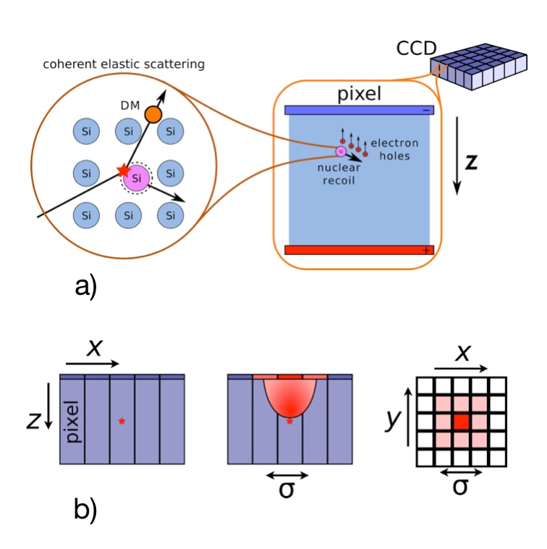
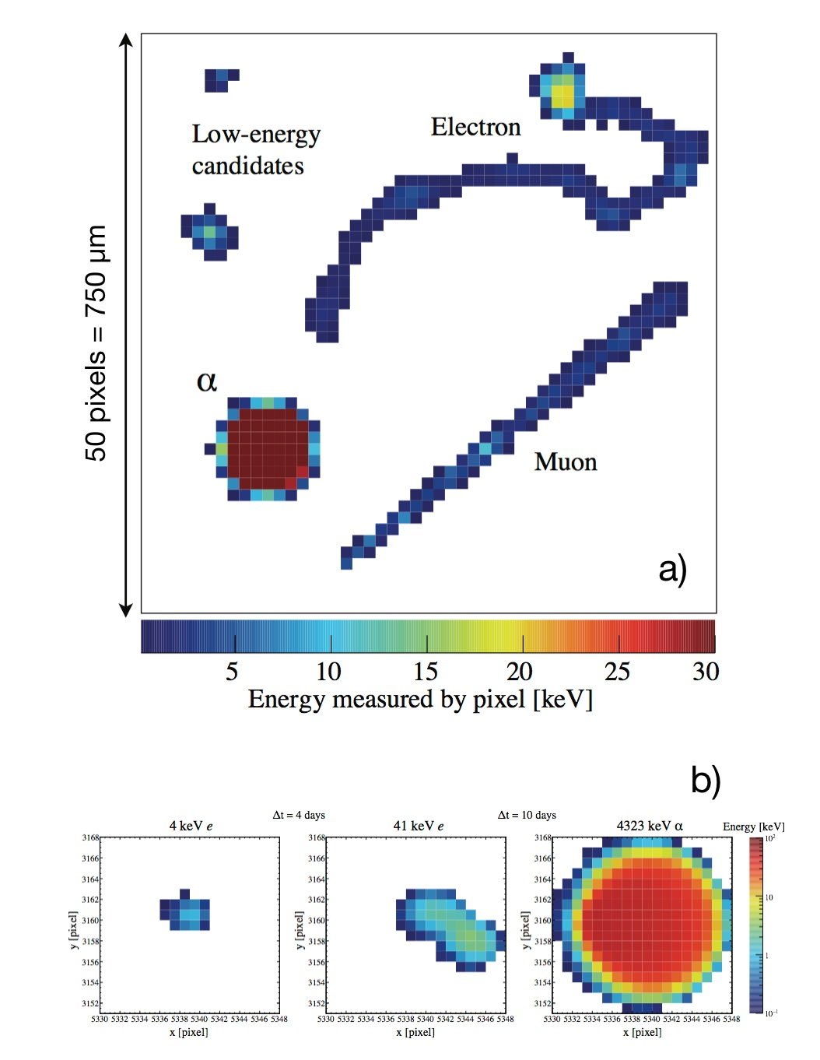
Dark matter search with CCD detour…
DAMIC and SENSEI experiments

Slide 28
Direct DM search with avalanche diode
Reflective coating
Thick contact: few um
Block external photons
Using timing coincidence to reject background
  May operate at shallow depth
1-1000 e⁻
Low drift field region
Drift field region
Avalanche region
Molecular bonding
CMOS
Aka. electronics

Slide 29
Adding timing
Reflective coating
Thick contact: few um
e⁻
e⁻
e⁻
e⁻
e⁻
e⁻
e⁻
CCD readout once every ~12h
Avalanche diode coincidence: ns possible
Remove correlated background
e⁻
e⁻
e⁻
Cerenkov photon
e⁻
e⁻
e⁻
e⁻
e⁻
e⁻
Isolated
electron
e⁻
Cosmic muon
e⁻
e⁻
e⁻
e⁻
e⁻
e⁻
e⁻
Low drift field region
e⁻
e⁻
e⁻
e⁻
e⁻
e⁻
e⁻
CMOS
Aka. electronics

Slide 30
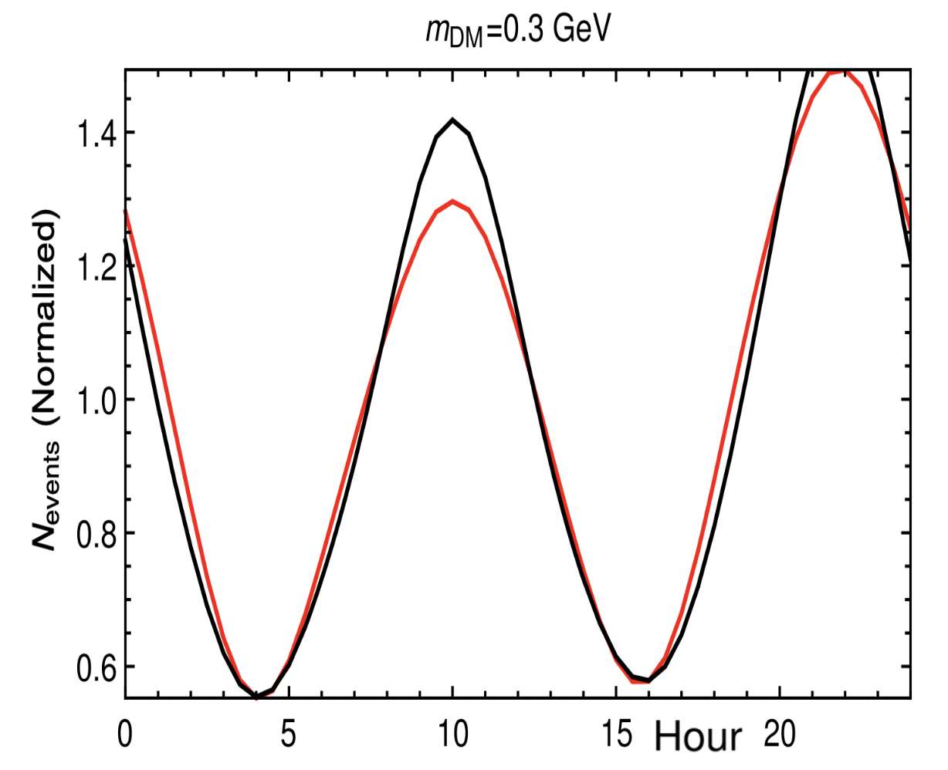
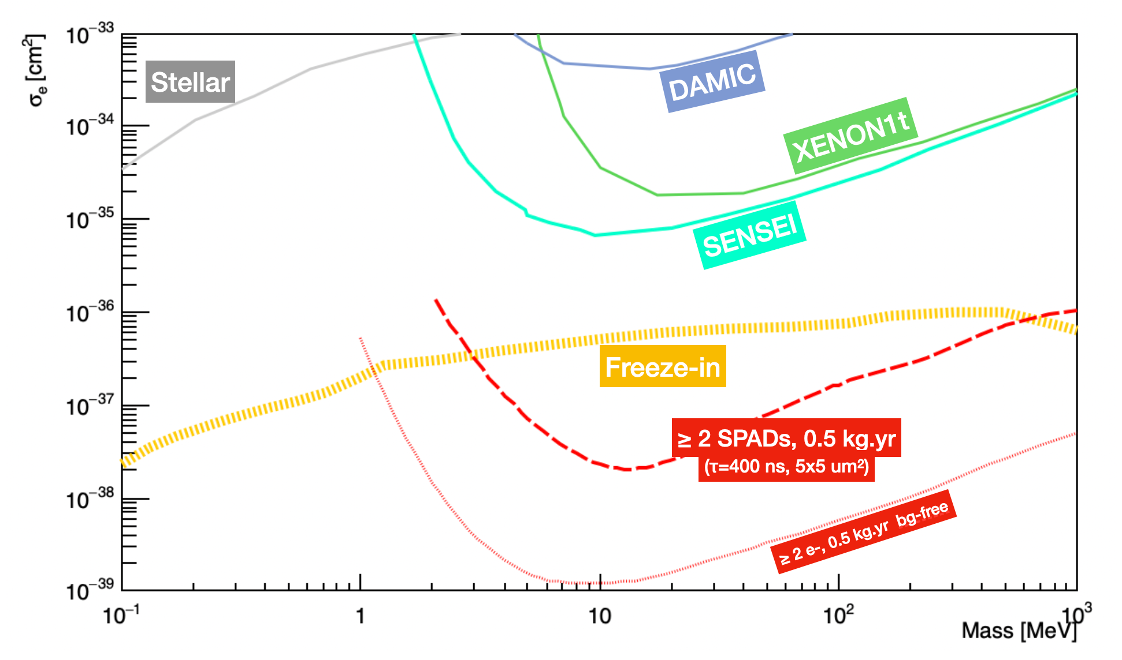
Performances expectations
Work done by GSSI (Agnes) and RHUL (Monroe)’s group

Slide 31
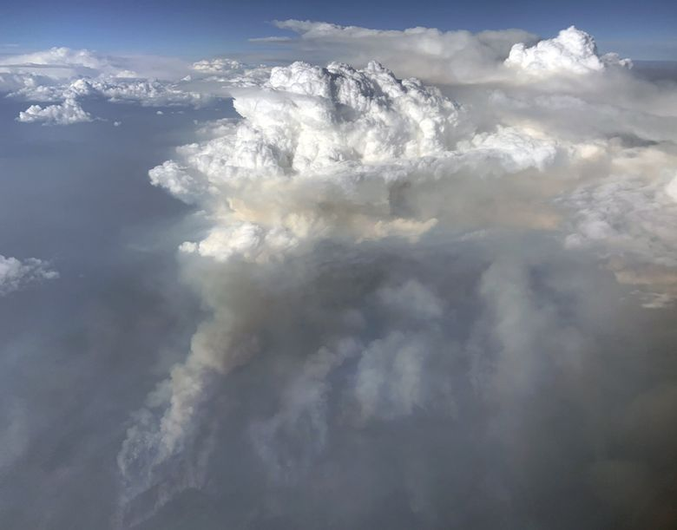
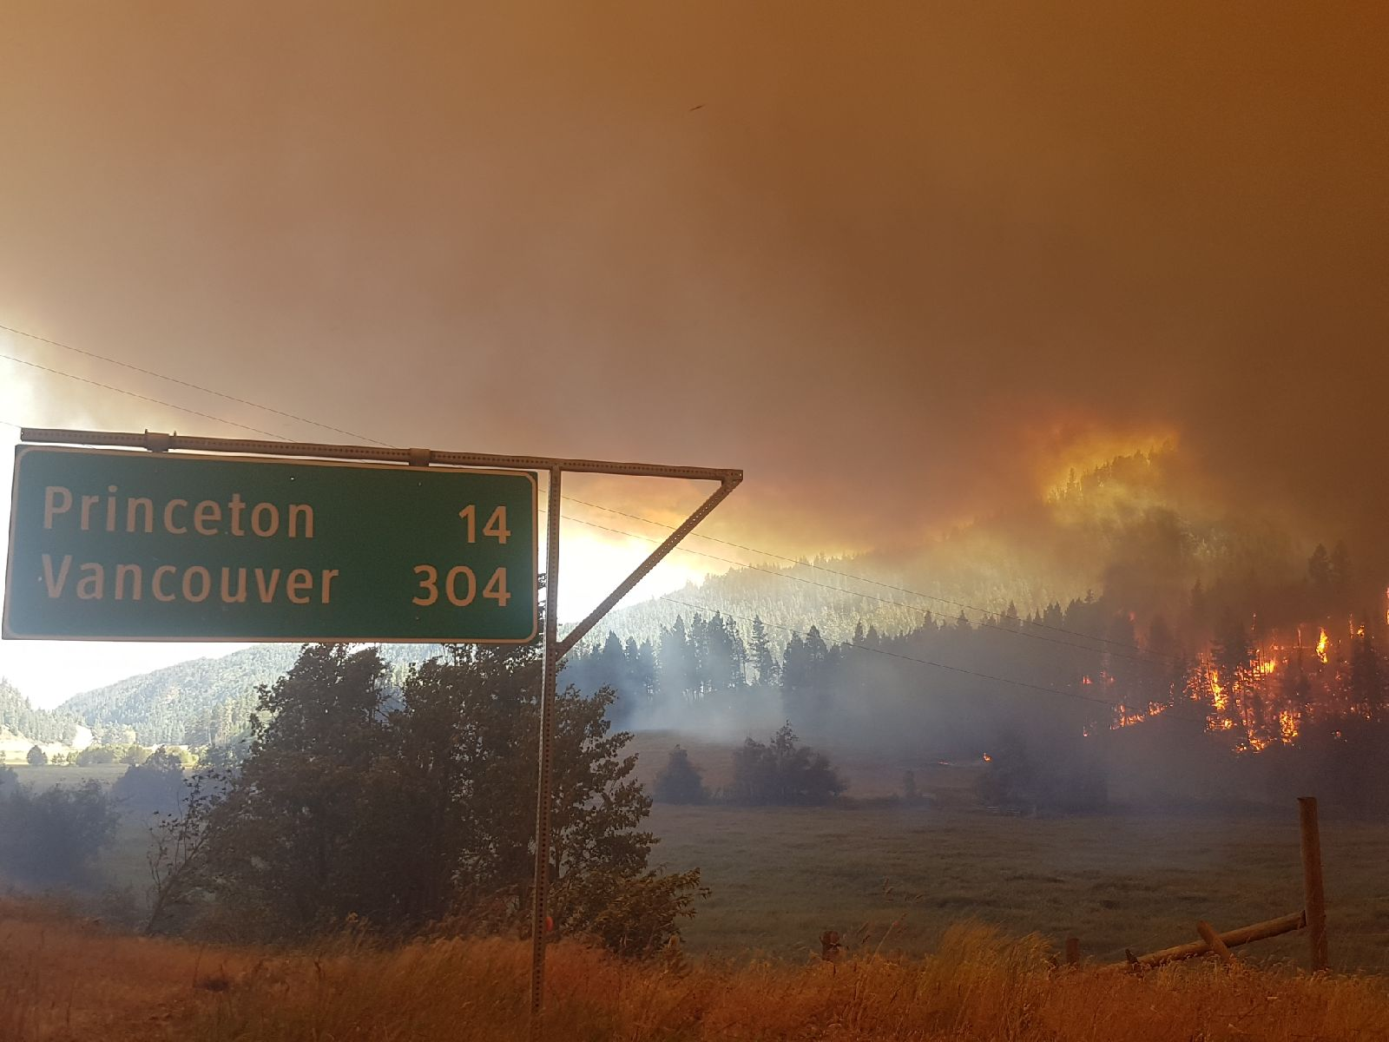
Beyond Dark Matter search

Slide 32
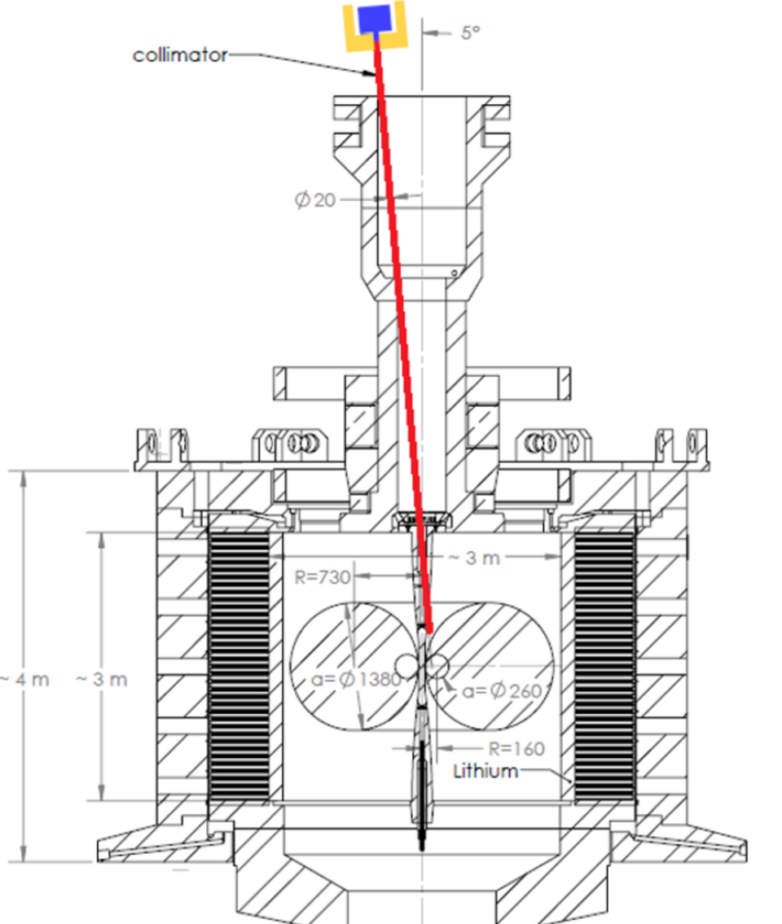
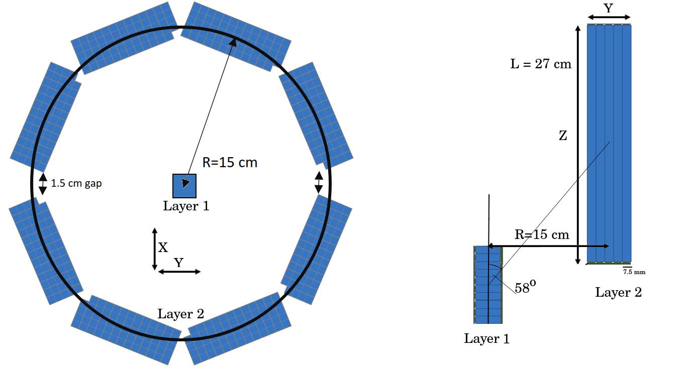
Supporting General Fusion
General Fusion is a company headquarter in Richmond BC
TRIUMF proposed a concept for neutron spectrometry
NSERC ALLIANCE grant being written
Fusion zone
Neutrons

Slide 33
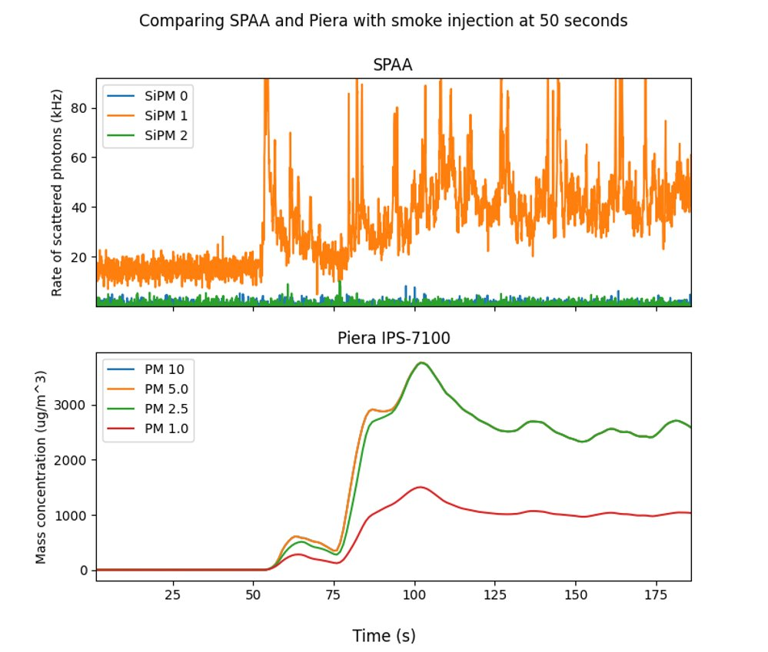
Working using SiPM to detect smoke
Demonstrated over the summer 2022
Photon counting is compelling
New design coming. Easier to build
Smoke injection

Slide 34
“Outlook” – the 3D integrated revolution that SAPES did not fund…
+ Digital Hybrid Photodetector
With Juan Pablo Yanez (Alberta)

Slide 35

The end

Slide 36
Back-side conceptual issue: light emission?
SiO2 (passivation)
p++
Delayed x-talk?
p substrate
e⁻
Trenches
p epi
Direct cross-talk?
gain
n
n
Electronics (CMOS)

Slide 37
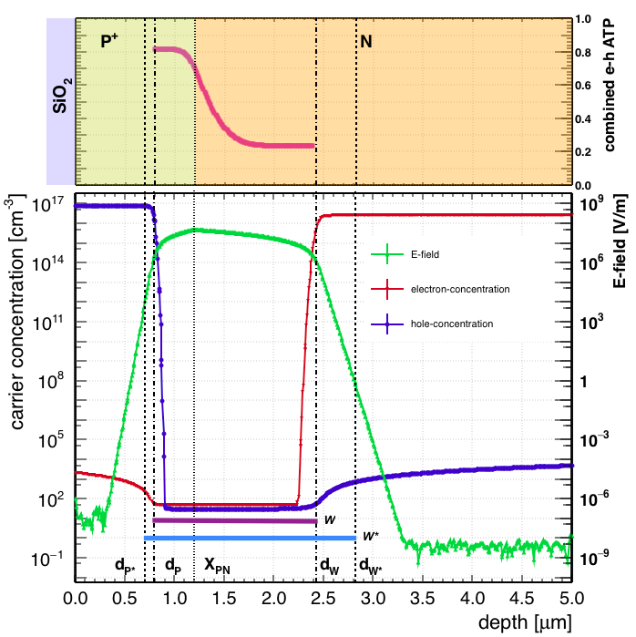
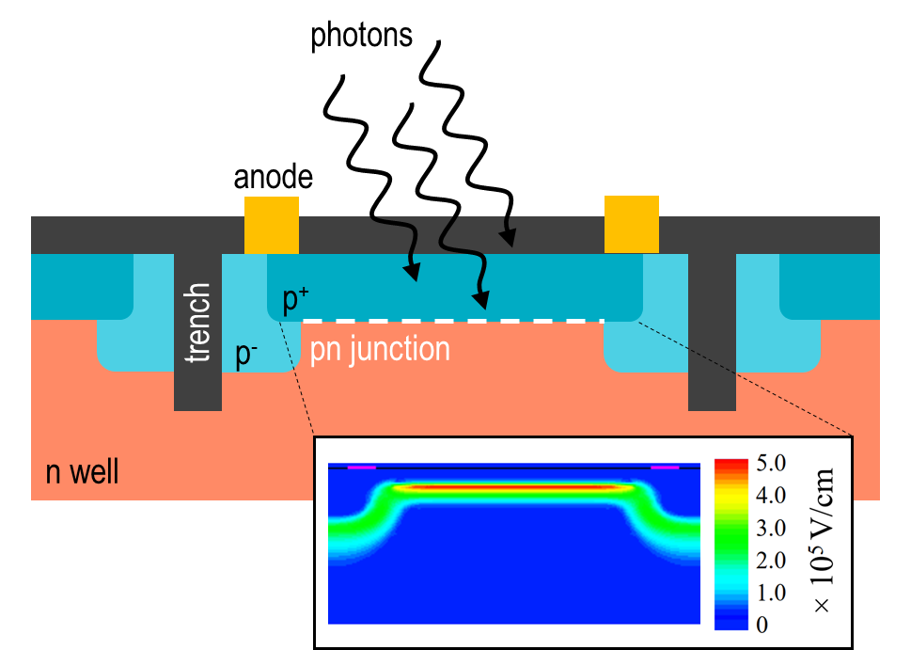
Triggering an avalanche
holes
Diffusion
Electrons
Diffusion
Easier for electrons to start an avalanche than for holes
Only a limited region of silicon is active

Slide 38
Detecting photons
holes
Diffusion
Electrons
Diffusion
38

Slide 39
VUV focus
holes
Diffusion
Electrons
Diffusion
39

Slide 40

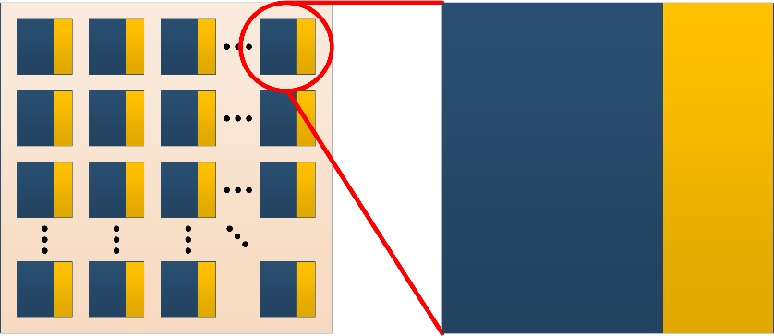
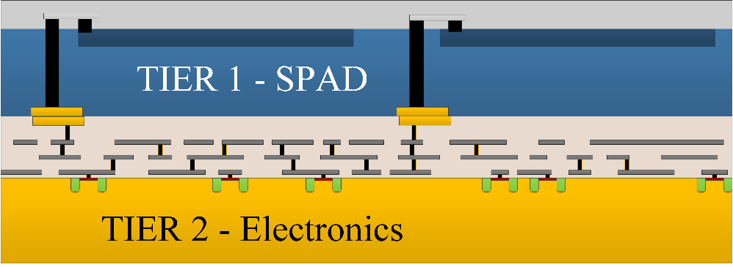
3D vs 2D digital option
SPAD
SPAD
Electronics
Electronics
2D - trade-off between photon detection and electronics performances
3D vertical integration – Complexity

Slide 41
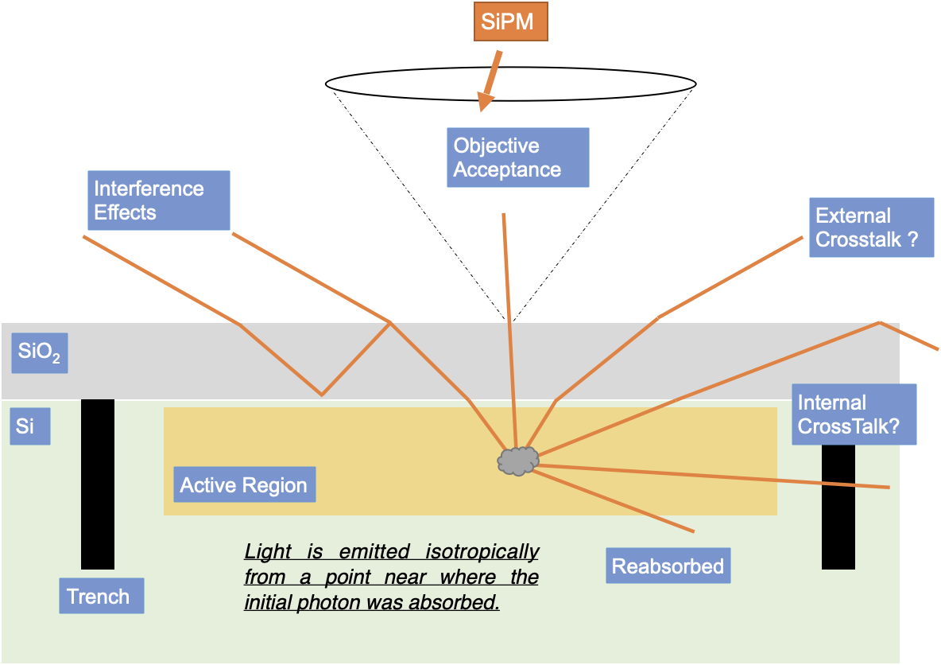
Or are they? What about light emission into the detector?
Light emission assumptions:
  At p-n junction – maximum field
  Isotropic
External cross-talk
  Photon escaping the SiPM surface
Internal cross-talk
  Photons being absorbed in a neighboring SPAD
We measure photons escaping with objective acceptance

Slide 42
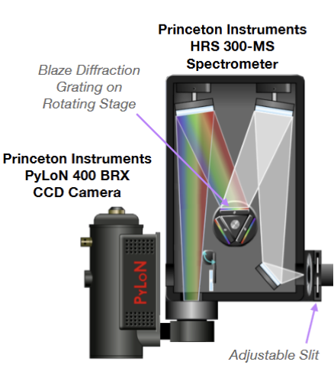
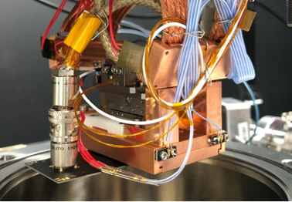

Microscope for the Injection and Emission of Light
Technical dtour: SPAD light emission
Cryogenic stage: 80-290K
Laser injection at 405nm
Record SiPM signal with waveform digitizer
  Assess the probability that the laser trigger an avalanche
Objective
Dichroic
mirror
405nm
laser
Longpass
filter
Olympus inverted
microscope

Slide 43

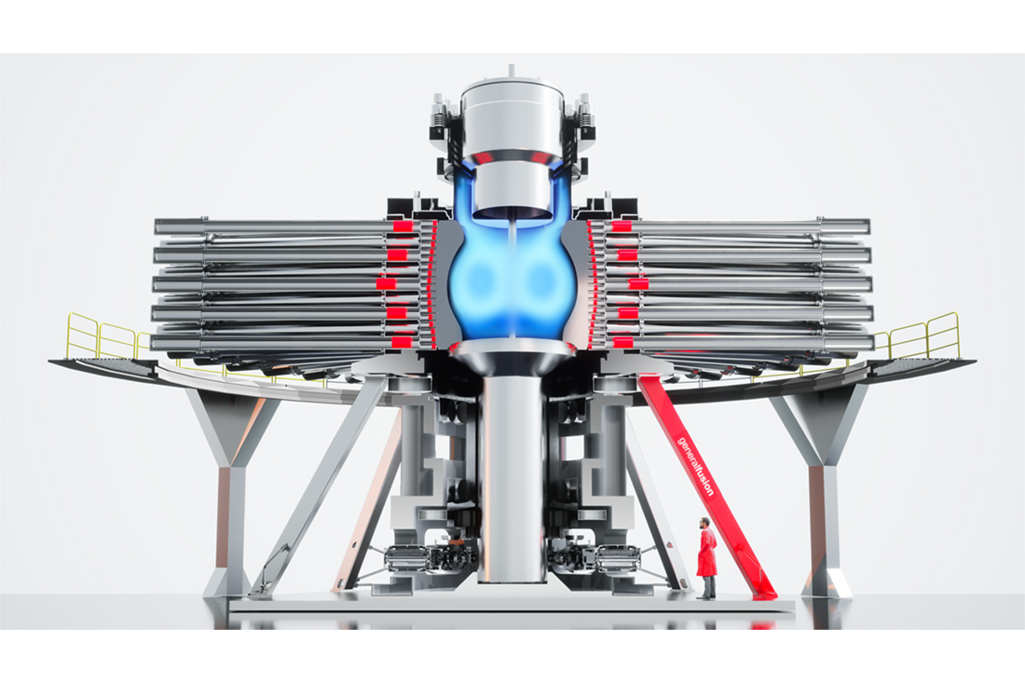
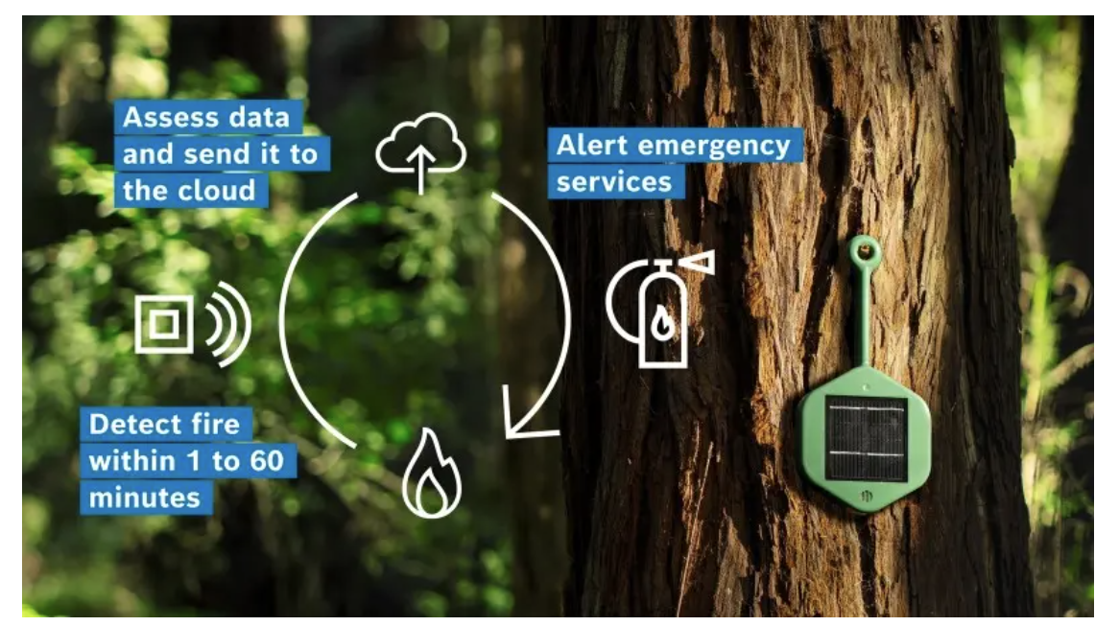
Can we, particle physicists, help mitigate the impact of climate change?
Early forest fire detection
Supporting emergence of clean energy sources

Slide 44


Characterizing smoke by detecting particulate scattering
Based on a single photo-diode
Low noise electronics in an ASIC + AI
Designed primarily in Mississauga, ON
80$/unit

Slide 45

Core Single Photon Detection technology
PDC developed for Astro-particle physics
“Front-side” illuminated single photon detector
Designed at U.Sherbrooke (QC, Canada)
Built at Teledyne-DALSA (QC, Canada)
Parent, Samuel, et al. "Single photon avalanche diodes and vertical integration process for a 3D digital SiPM using industrial semiconductor technologies." 2018 IEEE Nuclear Science Symposium and Medical Imaging Conference Proceedings (NSS/MIC). IEEE, 2018.

Slide 46
(single SPAD) Photo-detection efficiency in 2022
15% @ 810 nm
*all measurements done at 20°C, V_{ov} = 25%, t_{ho} = 545 ns, typical.
Notes:
PDE vs wavelength: 3D ~ 2D. Mostly the same p+n junction => peaks in blue. Different oscillations are due to different SiO2 top layer thicknesses (2D = 1280nm. 3D = 1775nm. see backup slide, where SiO2 transmission matches PDE). See increase in red spectrum for 3D.

Slide 47


TDC integrated in each Single Photon Avalanche Diode (SPAD)

Slide 48

Photon to digital converter in the dark
Technical detour: SPAD light emission
Sherbrooke’s 2D SPAD

Slide 49
keV e- for Digital Hybrid Photo-Detector
Photo-cathode
Beat down dark noise by firing multiple SPADs Diffusion layer
  Photocathode thermal noise at room temperature ~1Hz/mm²
  SPAD thermal noise at room temperature ~100kHz/mm²
keV e-
Thin passivation ~100nm
Ultra-thin contact 1-5nm
e⁻
e⁻
e⁻
e⁻
Zero field region
Drift field region
Avalanche region
Molecular bonding
CMOS
Aka. electronics

