Slide 1



Searches for Ultra Long-Lived Particles with
Mi annual meeting
August 2023
Miriam diamond
Assistant professor

Slide 2


Canadian MATHUSLA Team
(partially funded by NSERC Discovery grant)
UVic
Faculty
Heather Russell
Postdoc
Caleb Miller
Summer Students
Branden Aitken
Sarah Alshamaily
UofA
Faculty
Steven Robertson
UofT
Faculty
Miriam Diamond
David Curtin
Postdoc
Runze Tom Ren
Grad Students
Jaipratap Grewal (finishing)
Jared Barron (finishing)
Caleb Gemmel
Gabriel Owh
Undergrad Students
Jason Yuan (fall 2022/winter 2023)
Yongqi Wang (fall 2022/winter 2023)
Simran Hiranandi (summer 2023)
Alex Lau (fall 2023 – summer 2024)
HQPiggies
Quark
Qubit

Slide 3
Outline
An Update to the Letter of Intent for MATHUSLA: Search for Long-Lived Particles at the HL-LHC (arXiv:2009.01693)
Recent Progress and Next Steps for the MATHUSLA LLP Detector [SNOWMASS] (arXiv:2203.08126)
Basic Concept
    Backgrounds
    Identifying LLPs
LLP Sensitivity
Cosmic Ray Telescope
Detector Design
Geometry simulations
Trackers
DAQ
Vertex Reconstruction
Simulations for rate estimates
Test stands
https://mathusla-experiment.web.cern.ch/

Slide 4
Basic Concept

Slide 5
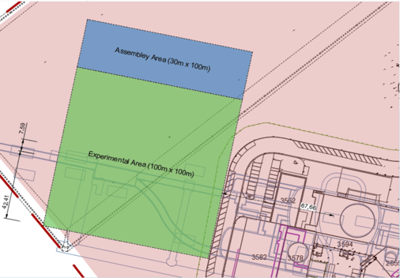
An External LLP Detector for HL-LHC
Dedicated detector sensitive to neutral long-lived particles that have lifetime up to the Big Bang Nucleosynthesis (BBN) limit (10⁷ – 10⁸ m)
Proposed large area surface detector located above CMS with robust tracking and background rejection
Can run standalone or “combined” to CMS
Construction & operation will not interfere with any other LHC experiments
Beam line
CMS IP

Slide 6
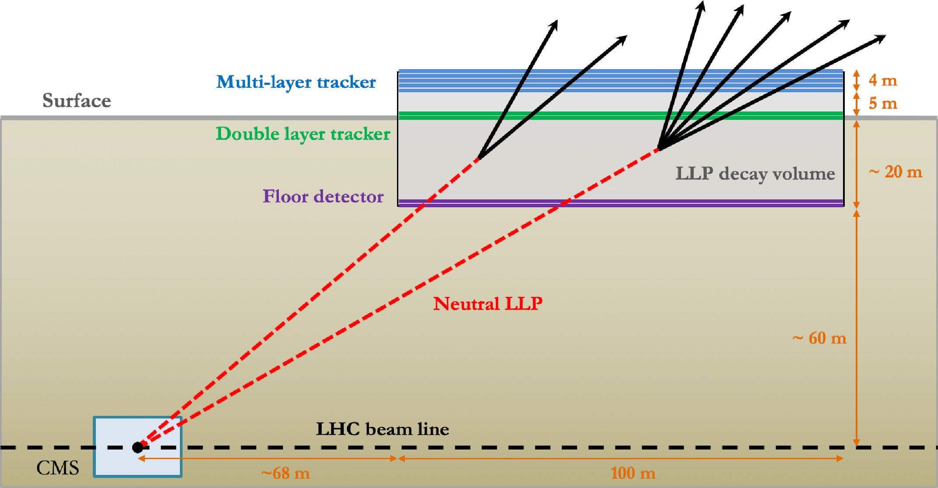
An External LLP Detector for HL-LHC
NOT TO SCALE
~100m x 100m x 25m decay volume
Displacement from IP: ~70m horizontally, 60m vertically

Slide 7
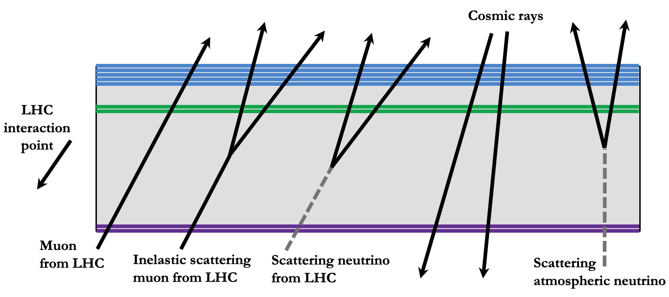
Backgrounds
LLP displaced vertex (DV) signal has to satisfy many stringent geometrical and timing requirements (“4D vertexing” with cm/ns precision)
These requirements, plus a few extra geometry & timing cuts, provide “near-zero background” (< 1 event per year) for neutral LLP decays!

Slide 8
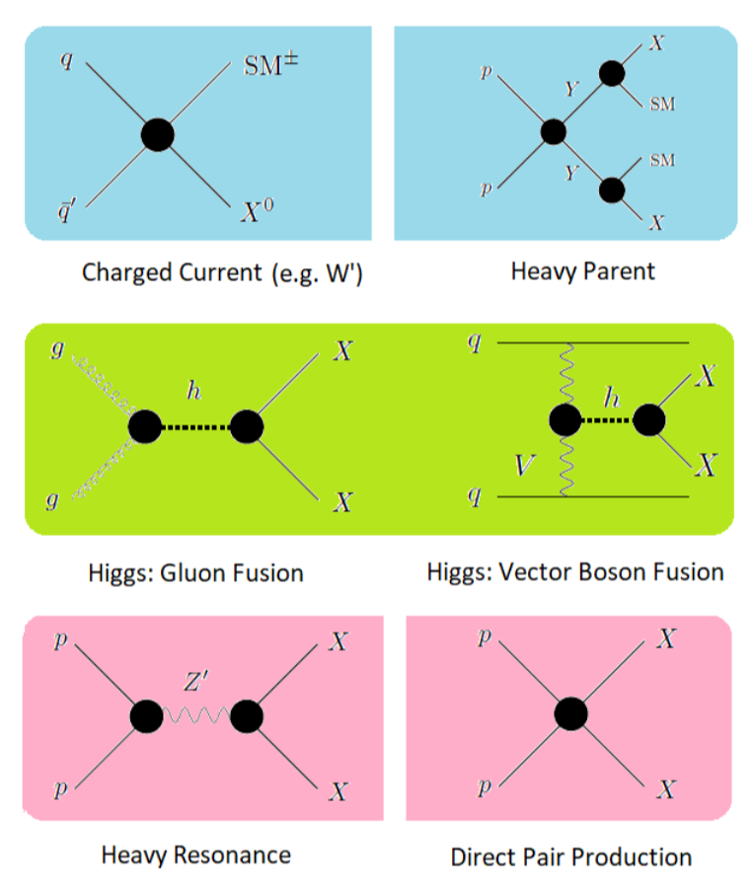
Identifying LLPs
🍁
Incorporate MATHUSLA into CMS L1 Trigger
Correlate event info off-line → determine LLP production mode
MATHUSLA can’t measure particle momentum or energy, but:
track geometry → measure of LLP boost event-by-event
leptons
LLP
hadrons
arXiv:1705.06327

Slide 9
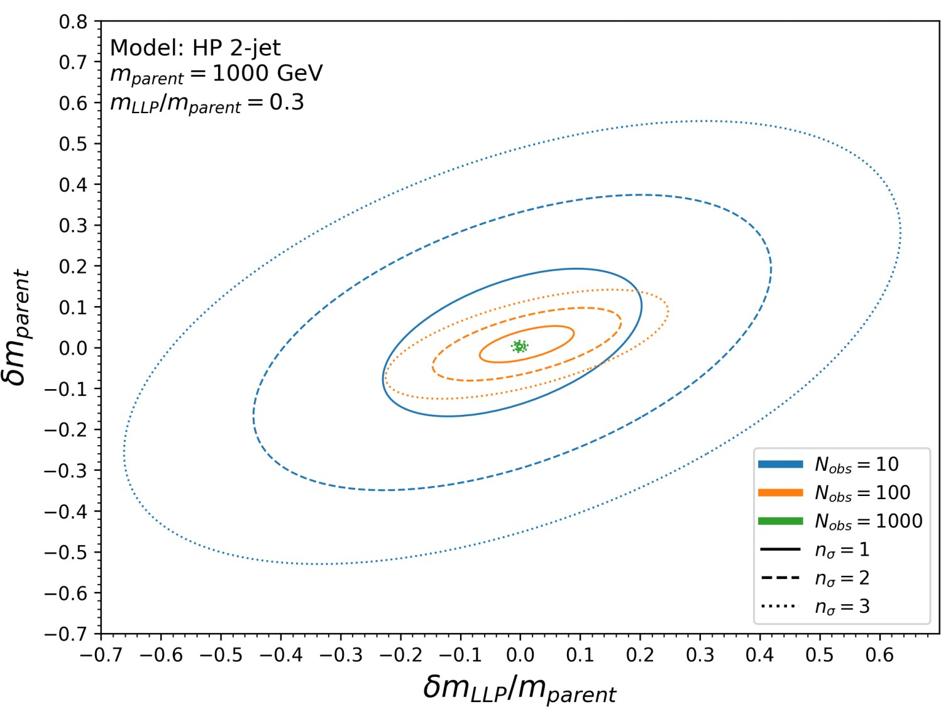
Identifying LLPs
🍁
If production mode is known: Boost distribution → LLP mass
If LLP mass is known: Track multiplicity → LLP decay mode
MATHUSLA + CMS analysis will reveal model parameters (parent mass, LLP mass) with just ~ 100 observed LLP events!
arXiv:2007.05538 , 1809.01683

Slide 10
LLP Sensitivity
More benchmark models can be found in Physics Beyond Colliders at CERN: Beyond the Standard Model Working Group Report arXiv:1901.09966

Slide 11
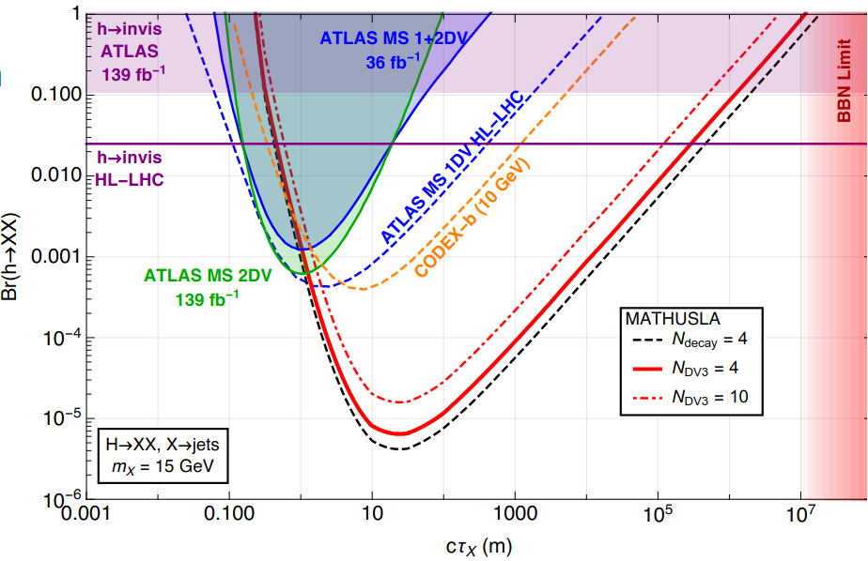
LLP Sensitivity: Weak- to TeV- Scale
🍁
Up to 1000x better sensitivity than LHC main detectors
e.g. hadronically-decaying LLPs in exotic Higgs decay
DV3: 3+ observable charged particles from LLP decay intersect 4+ detector layers
Any LLP production process with σ > fb can give signal in MATHUSLA
arXiv:2001.04750

Slide 12
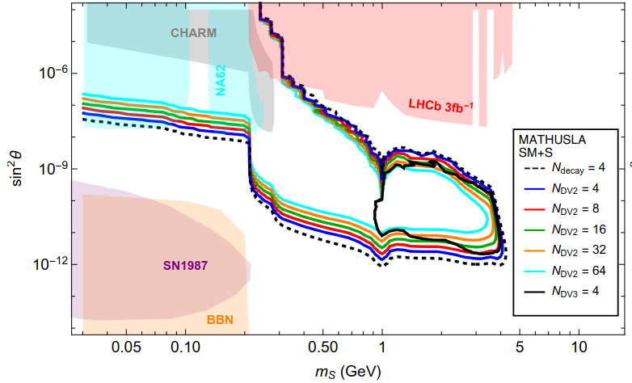
LLP Sensitivity: GeV-Scale
🍁
For scenarios where the long-lifetime limit (>100m) is accessible, MATHUSLA is complementary to other planned experiments
e.g. singlet dark scalar S, mixing angle θ with SM Higgs

Slide 13
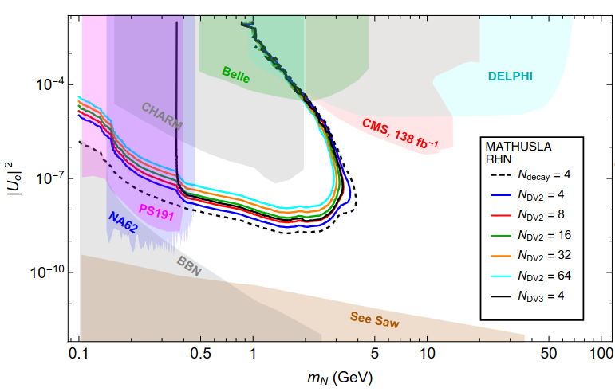
LLP Sensitivity: GeV-Scale
🍁
Reach for heavy neutral leptons
e.g. sterile neutrino N, whose largest mixing angle U_{e} is with υ_{e}

Slide 14
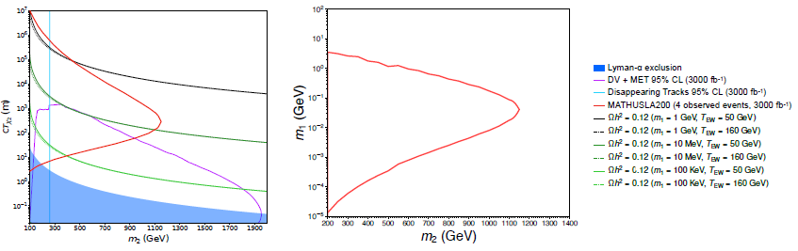
LLP Sensitivity: DM
🍁
Scenarios where LLP → DM + SM decay is the only way to see the DM
e.g. Freeze-In Dark Matter: BSM mass eigenstates χ₁ (DM) and χ₂ (LLP), where χ₂ was in thermal equilibrium with primordial plasma

Slide 15
Cosmic Ray Telescope

Slide 16
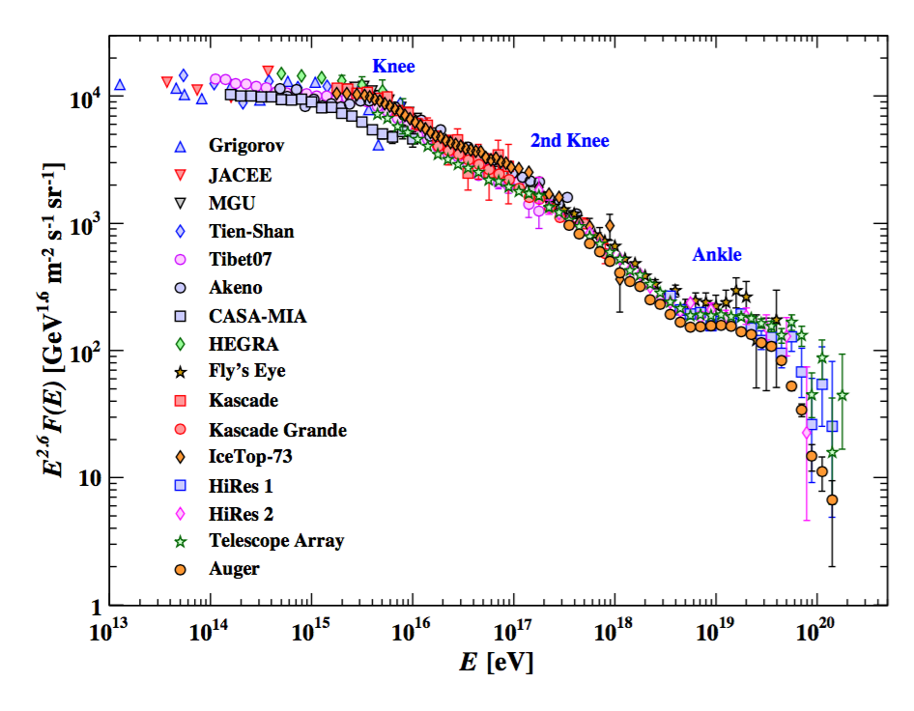
MATHUSLA as a Cosmic Ray Telescope
Relevant abilities in CR experimental ecosystem (precise resolution, directionality, large-area coverage, interesting region CR energy spectrum)
https://indico.cern.ch/event/980853/contributions/4361206/attachments/2251261/3819144/CRMathusla_LLP_25May2021_JC.pdf

Slide 17
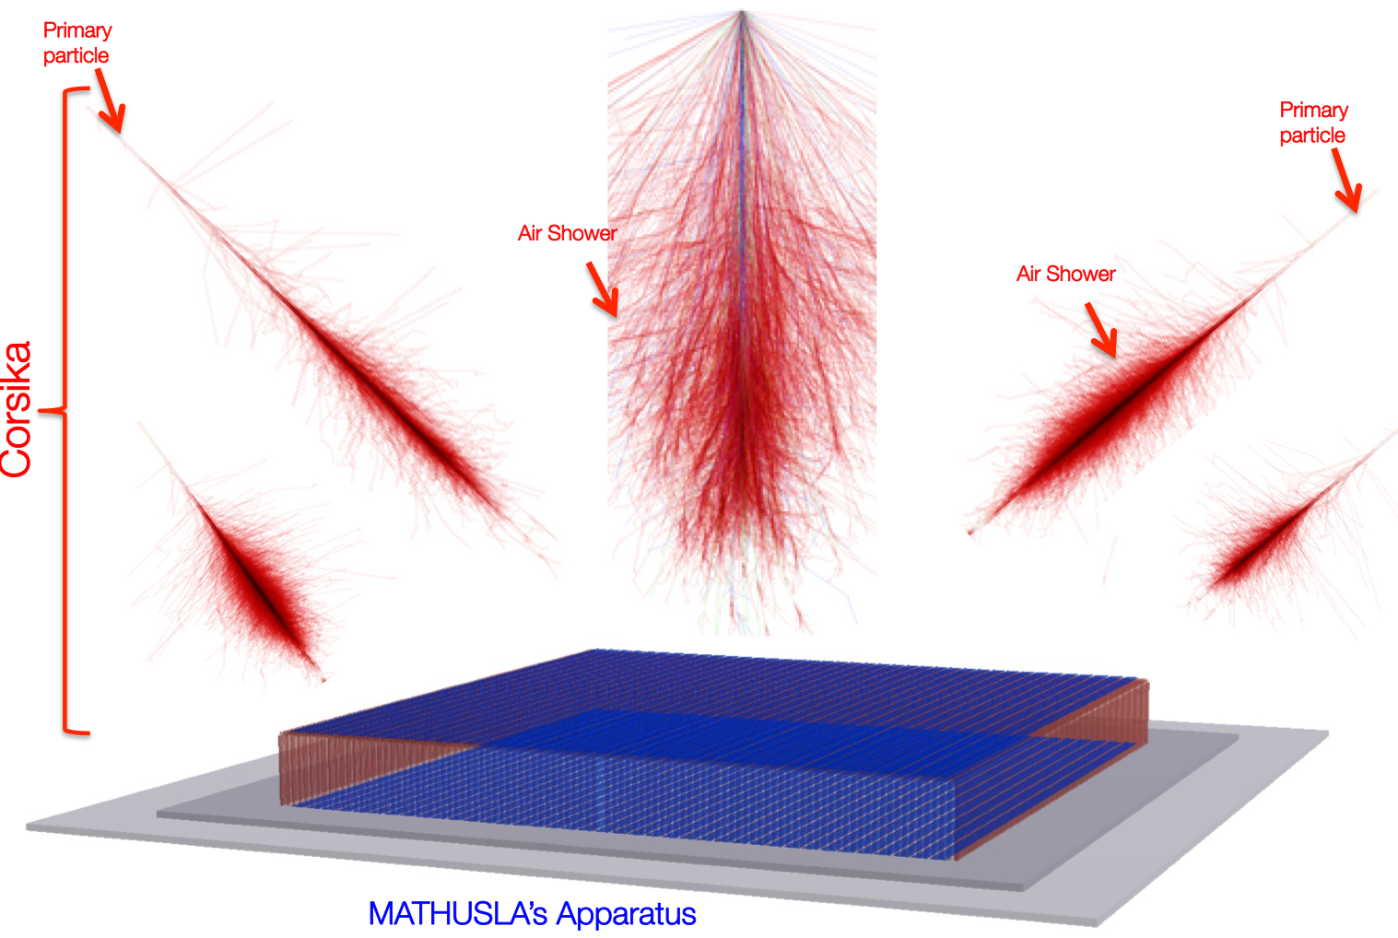
MATHUSLA as a Cosmic Ray Telescope
Reconstruction of shower core, direction, total # charged particles, slope of radial particle density distribution
MC simulations using CORSIKA (https://www.iap.kit.edu/corsika/)

Slide 18
Detector Design

Slide 19
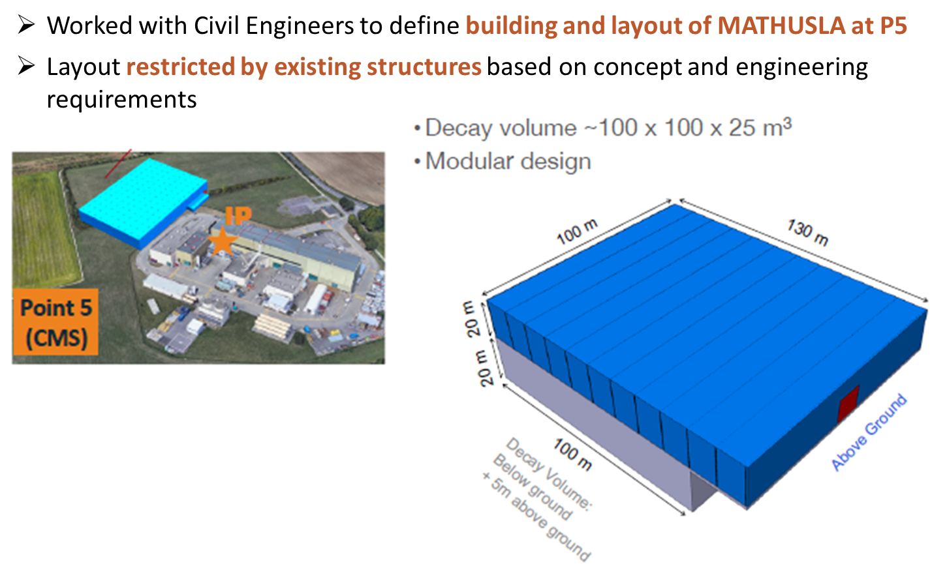
Detector Design

Slide 20
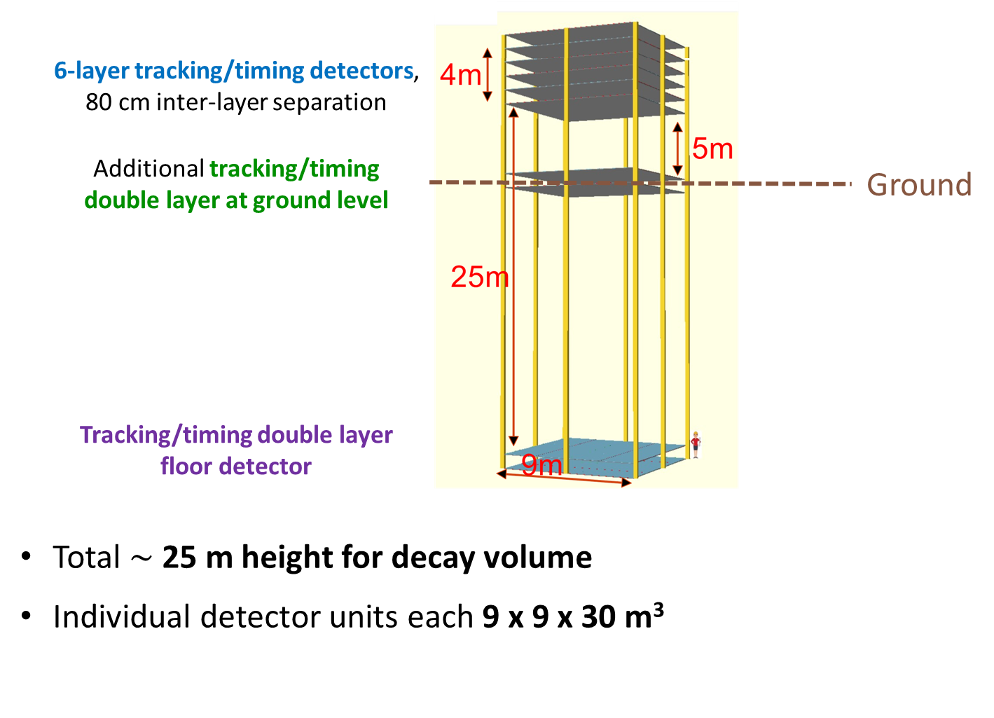
Detector Design

Slide 21
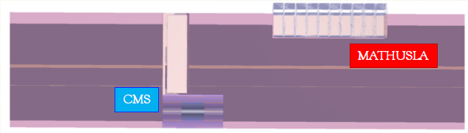
Geometry Simulations
🍁
Cavern, access shaft, CMS, rock, and detector all modeled in GEANT4
  Rock model is from a geological survey
Backgrounds under detailed study:
  Upward-going muons from collisions (Pythia8)
  Backscatter (to upwards going V⁰) from downward-going cosmic rays (Parma)
  Neutrino interactions (Genie3)
Exploring background rejection power of adding a high-coverage floor veto, [partially]- instrumented walls

Slide 22
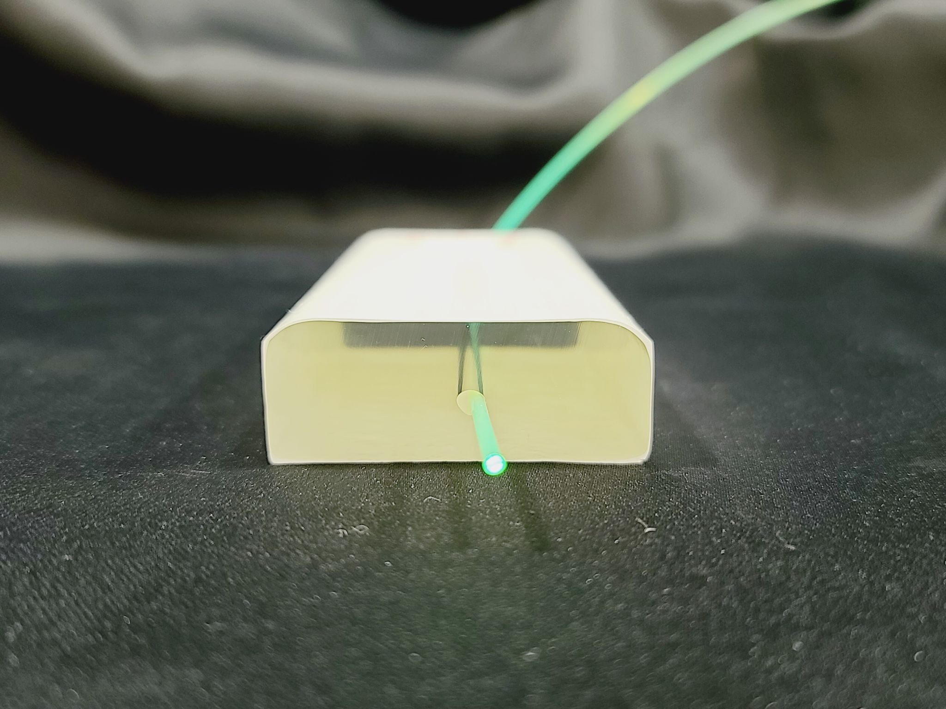
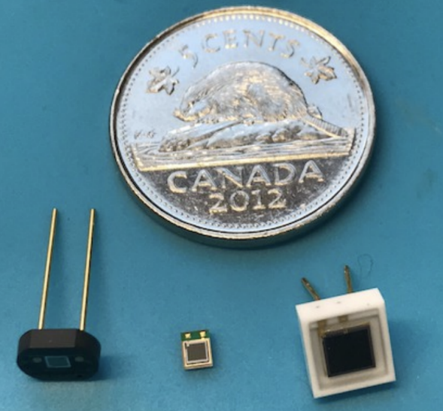
Trackers
Tracker layers: Composed of extruded scintillator bars with WLSFs (wavelength-shifting fibers) coupled to SiPMs (Silicon Photomultipliers)
  Extrusion facilities in FNAL used for several experiments (e.g. Belle muon trigger upgrade, Mu2e)

Slide 23
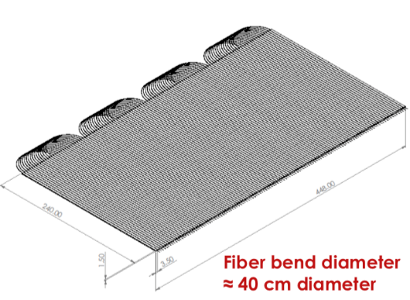
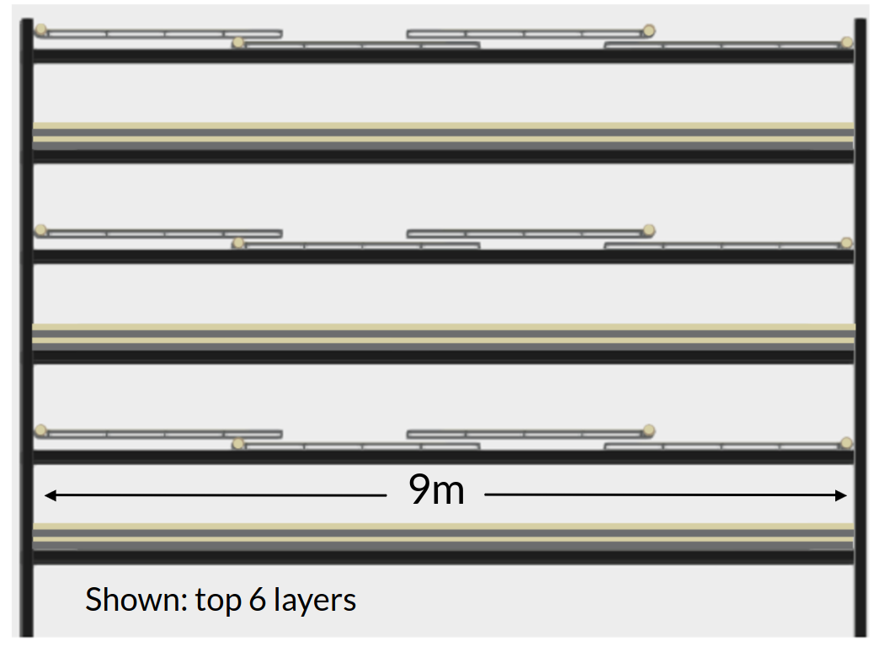
Trackers
🍁
MRS engineering support for layout
Considering readout at both ends of each scintillator bar, or looped fiber for readout at one end
  Transverse resolution depends on bar width
  Δt between two ends gives longitudinal resolution
  Nominal layer design: 256 bars, each 2.5 m long
  Each layer segmented into 4 sheets of bars
  Overlapping sheets, and alternating layer orientation, ensures no gaps in coverage

Slide 24
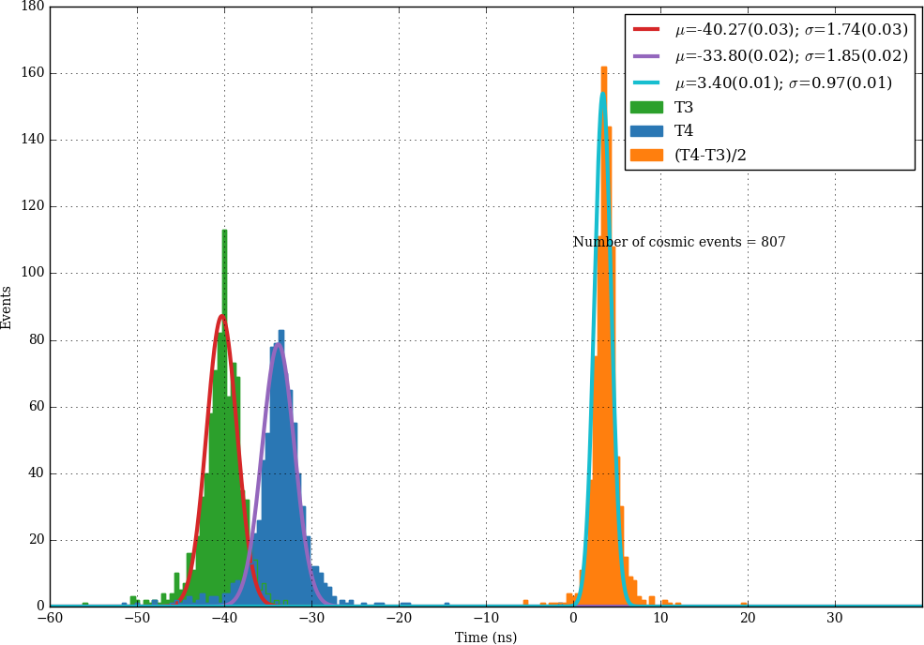
Trackers
To reconstruct hit position along scintillator bar: use difference in arrival time between separate measurements at two ends
or
Target timing resolution ~1 ns
T1 T2
SiPM 1
SiPM 2

Slide 25
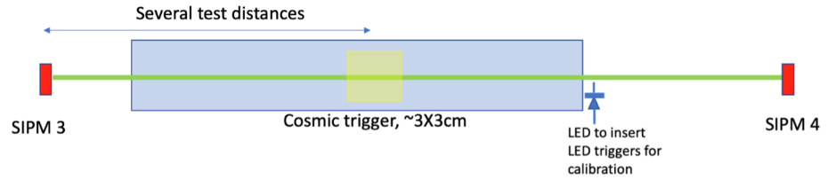
Trackers
🍁
Precise timing resolution is a critical feature of the detector design
  Separates downward- from upward-going tracks
  Rejects low-β particles from neutrino quasi-inelastic scattering
  “4D” tracking and vertexing reduces fakes/combinatorics
Ongoing characterization studies using small dark-box setups indicate 1 ns timing resolution goal is achievable
D1 D2
WLSF

Slide 26
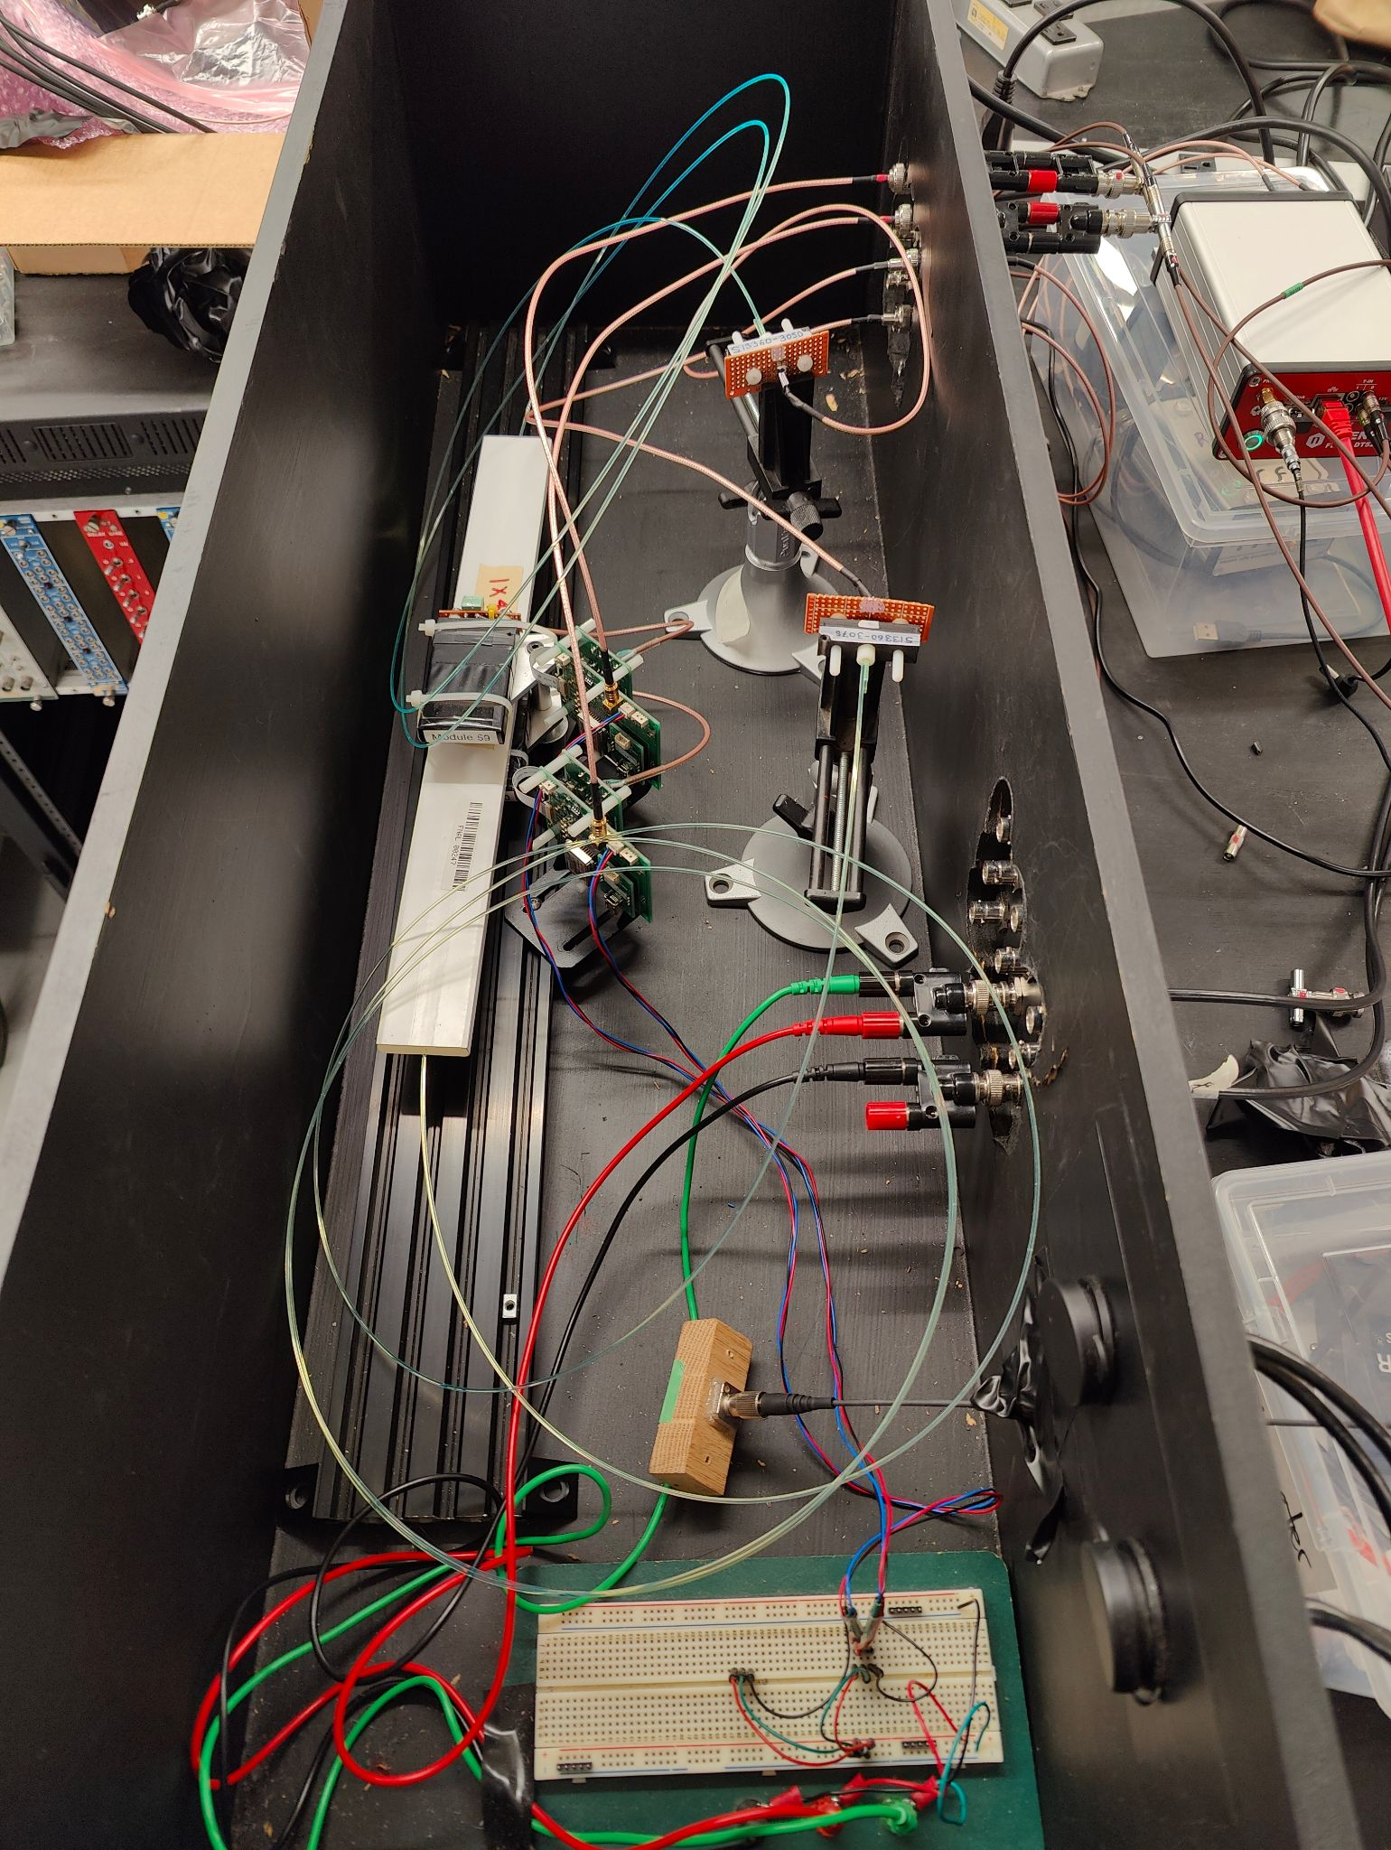
Trackers
🍁
Currently under investigation in dark-box setups at UToronto & UVic with different vendors/models of scintillator, WLSF, SiPM:
Optimizing timing (position) resolution
Light yield
Light leakage and fiber stress
Temperature effects, e.g. on SiPM dark current

Slide 27
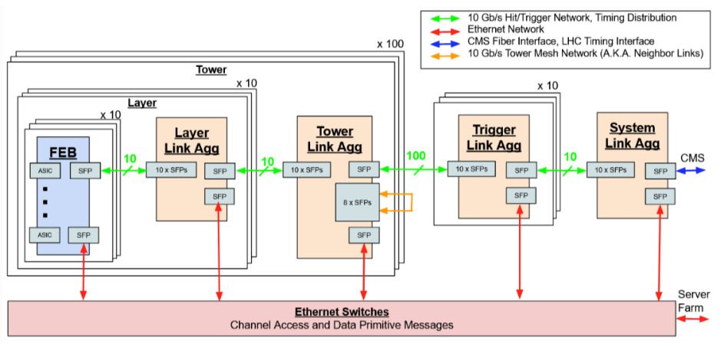
  Modular design of FEBs and link aggregation boards
DAQ
MATHUSLA Trigger
  Tower agg module triggers on upward-going tracks within 3x3 tower volume
  Selects data from buffer for permanent storage
Trigger to CMS
  Upward-going vertex forms trigger to CMS
  Trigger latency estimates appear compatible with CMS L1 latency budget
Data rate well within COTS servers

Slide 28
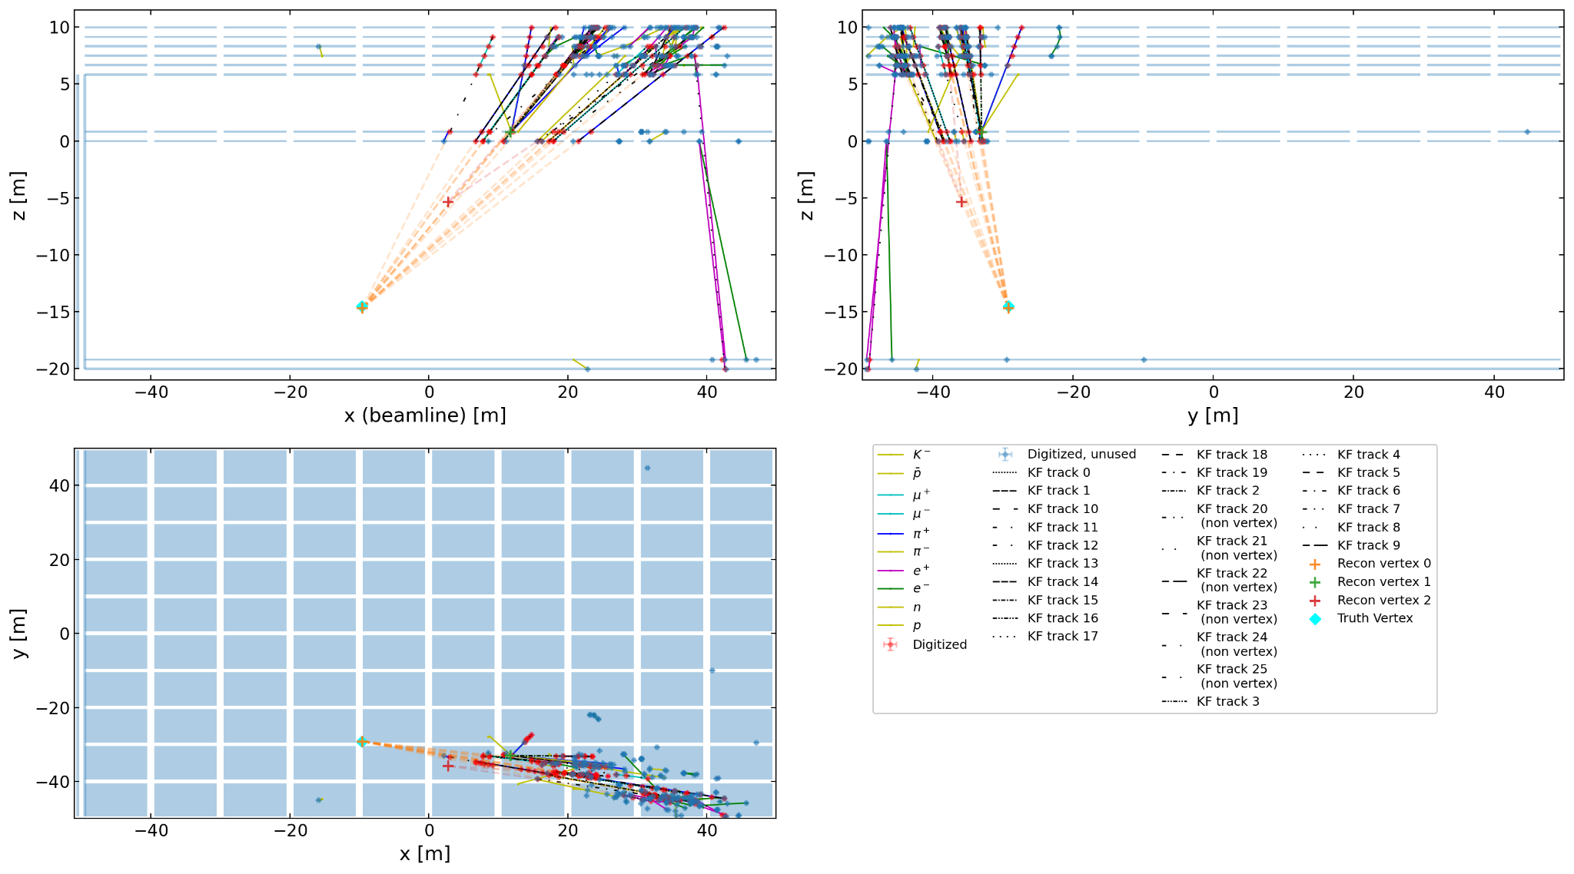
Vertex Reconstruction
🍁
Implementation of custom tracking algorithms (based on Kalman filtering) + “4D” vertex formation, to achieve high LLP reconstruction efficiency for low-multiplicity LLP final states in MATHUSLA’s unique environment
e.g. scalar LLP X
pp → h →XX, X → bb
m_{X} = 20 GeV, cτ_{X} = 1000 m

Slide 29
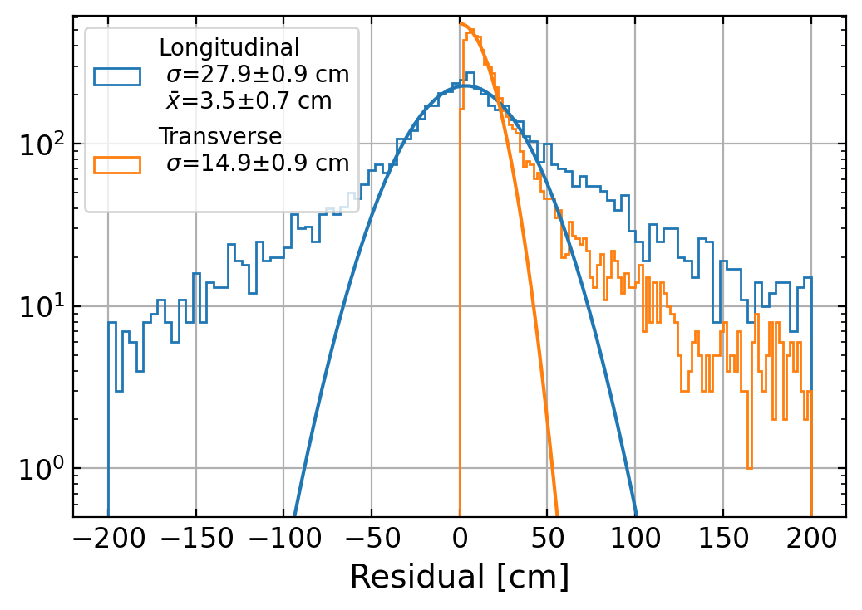
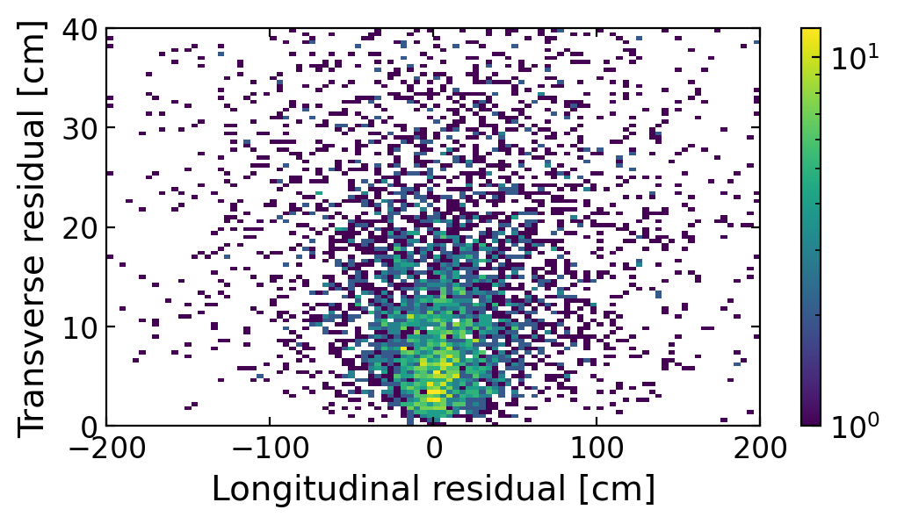
Vertex Reconstruction
🍁
Validated using GEANT4 simulated events
e.g. scalar LLP X
pp → h →XX, X → bb
m_{X} = 20 GeV, cτ_{X} = 1000 m
10000 events simulated
Geometric acceptance 73%
Vertex identification efficiency 98%

Slide 30
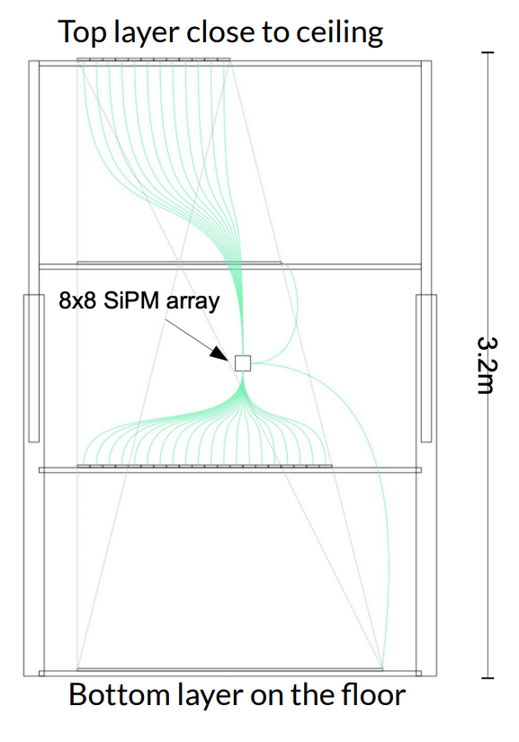
🍁
Test Stand @ UVic
Constructing 64-channel “mini-module” of 4 layers, ~1m x 1.5m each
Potential studies include:
Mechanical structure
Basic track reconstruction with cosmics (validation, performance)
Basic triggering
Hit efficiencies, effects of gaps between bars
Comparisons with simulations

Slide 31
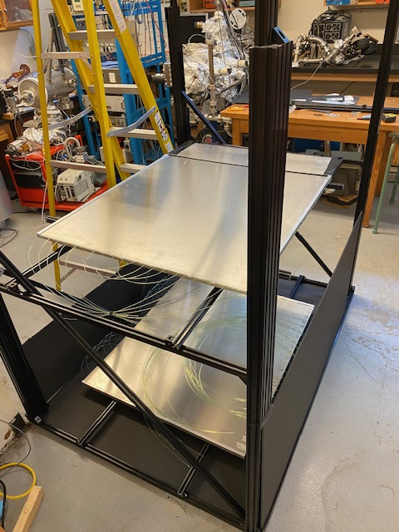
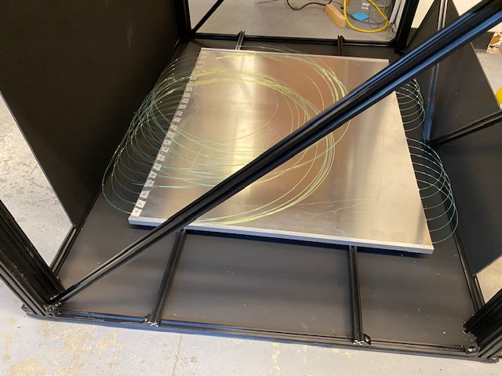
🍁
Test Stand @ UVic

Slide 32
🍁
Test Stand @ UToronto
Constructing 120-channel “mini-module” of 5 layers, ~1m x 1m each
More advanced features include:
PCBs (with pre-amps) to carry SiPM signals to readout boards
Compression-fitting mounting apparatus to keep each SiPM in place
Layers [re]moveable and height-adjustable individually
Potential studies include:
PCB design optimization
“Large angle” tracking
Modelling interfaces between modules

Slide 33


The MATHUSLA Collaboration
https://mathusla-experiment.web.cern.ch/

Slide 34
Conclusions
MATHUSLA is a planned external LLP detector for the HL-LHC that can probe deep into LLP parameter space in a variety of BSM scenarios
Canadian groups highly active in multiple aspects
  Sensitivity projections for various BSM models
  Detector simulations of rare backgrounds
  Layout of tracker layers
  Scintillator/fiber/SiPM characterizations
  Vertex reconstruction software
  Test stands
  Excellent training-ground for HQP
  Conceptual Design Report to be published soon, followed by prototype module and full detector for HL-LHC
  New collaborators always welcome!

Slide 35
References
Alpigiani et al. Recent Progress and Next Steps for the MATHUSLA LLP Detector”. Proceedings of the US Community Study on the Future of Particle Physics (Snowmass), March 2022, arXiv:2203.08126.
John Paul Chou, David Curtin, and H.J. Lubatti. New detectors to explore the lifetime frontier. Physics Letters B, 767:29–36, Apr 2017, arXiv: 1606.06298.
Cristiano Alpigiani et al. A Letter of Intent for MATHUSLA: a dedicated displaced vertex detector above ATLAS or CMS, 2018, arXiv:1811.00927.
David Curtin and Michael E. Peskin. Analysis of long-lived particle decays with the MATHUSLA detector. Physical Review D, 97(1), Jan 2018.
David Curtin et al. Long-lived particles at the energy frontier: the MATHUSLA physics case. Reports on Progress in Physics, 82(11):116201, Oct 2019, arXiv:1806.07396.
Imran Alkhatib. Geometric Optimization of the MATHUSLA Detector, 2019, arXiv:1909.05896.
Henry Lubatti et al. MATHUSLA: A Detector Proposal to Explore the Lifetime Frontier at the HL-LHC, 2019, arXiv:1901.04040.
Cristiano Alpigiani. Exploring the lifetime and cosmic frontier with the MATHUSLA detector, 2020, arXiv: 2006.00788.
Jared Barron and David Curtin, On the Origin of Long-Lived Particles, 2020, arXiv:2007.05538.
Cristiano Alpigiani et al. An Update to the Letter of Intent for MATHUSLA: Search for Long-Lived Particles at the HL-LHC, 2020, arXiv:2009.01693.
M. Alidra et al. The MATHUSLA Test Stand. NIMA, 985:164661, 2021, arXiv:2005.02018.

Slide 36
BACKUP

Slide 37
LLPs at the [HL-]LHC
Seeking to go Beyond the Standard Model (BSM) motivates the possibility of so-far-undiscovered LLPs
"Top-down": Various BSM theories (e.g. supersymmetry) constructed to explain the “fundamental mysteries” naturally include new LLPs
"Bottom-up": LLPs occur in the SM (e.g. muons), and can occur via similar mechanisms when adding new particles to the model
The problem of long lifetimes: LHC could be making LLPs that are invisible to its main detectors!
If the LLP has c ∙ lifetime >> detector size, most escape the detector
Even LLPs that decay in the detector, but a significant distance away from the Interaction Point, are difficult to spot
If the LLPs decay in the detector with only a tiny rate, they get swamped by backgrounds

Slide 38
Backgrounds
Cosmic rays
          Calibrations performed using Test Stand measurements (taken above ATLAS IP in 2018) arXiv: 2005.02018
          Downward-going events ~3 x 10¹⁴ over entire HL-LHC run, distinguished from LLPs using timing cuts
          Upward-going events ~2 x 10¹⁰ : inelastic backscatter from CRs hitting the floor, or decay of stopped muons in floor. Only tiny fraction (estimates underway) produce fake DV, via decay to 3 charged tracks
          Rare production of K⁰_{L} harder to estimate; work underway on veto strategies
Rare decays of muons originating from HL-LHC collisions
Upward-going events ~2 x 10⁸ , mostly from W and bbar production
Work underway for optimal rejection strategies
Charged particles from neutrino scattering in decay volume
Neutrinos from HL-LHC collisions << 1 “fake” DV/year
Atmospheric neutrinos ~30 “fake” DV/year, reduced to < 1 with cuts

Slide 39
Backgrounds: Recent Refined Estimates
Cosmic rays
          Calibrations performed using Test Stand measurements (taken above ATLAS IP in 2018) arXiv: 2005.02018
          Simulated using PARMA 4.0 + GEANT4
          Downward-going events ~3 x 10¹⁴ over entire HL-LHC run, distinguished from LLPs using timing cuts
          Upward-going events ~2 x 10¹⁰ , produced through inelastic backscatter from CRs that hit the floor, or through decay of stopped muons in floor. Tiny fraction can produce fake DV, via decay to 3 charged tracks
          Rare production of K⁰_{L} harder to estimate; veto strategies are available. Currently working on precise estimates and studying rejection

Slide 40
Backgrounds: Recent Refined Estimates
Rare decays of muons originating from HL-LHC collisions
Expect ~2 x 10⁸ upward-going muons over entire HL-LHC run, mostly from W and bbar production
Simulated using MadGraph & Pythia8
Full study underway to demonstrate optimal rejection while maintaining high LLP signal eﬃciency; test-bed for custom tracking algorithms in unique MATHUSLA environment
Charged particles from neutrino scattering in decay volume
Simulated using GENIE
Neutrinos from HL-LHC collisions: using LHC minimum-bias samples, estimate << 1 “fake” DV/year
Atmospheric neutrinos: using flux measurements from Frejus experiment, estimate ~30 “fake” DV/year, reduced to < 1 with cuts

Slide 41
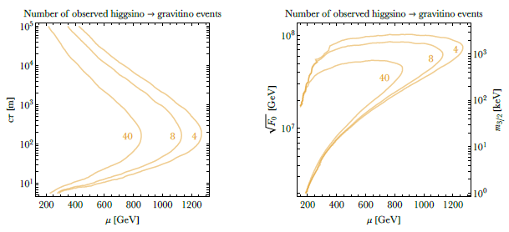
LLP Sensitivity: TeV-Scale
Any LLP production process with σ > fb can give signal.
e.g. meta-stable Higgsinos

Slide 42
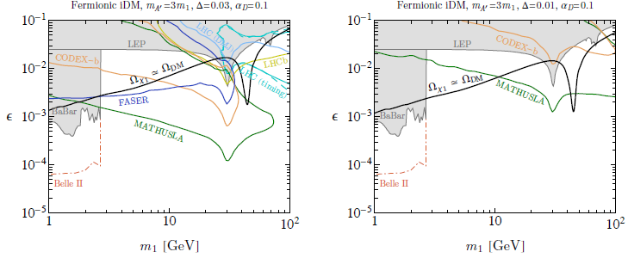
LLP Sensitivity: DM
Scenarios where LLP → DM + SM decay is the only way to see the DM
e.g. Inelastic Dark Matter: BSM mass eigenstates χ₁ (DM) and χ₂ (LLP) with mass splitting Δ , dark photon A’ with mixing ϵ with SM photon
Black curve: thermal o-annihilations yield observed DM relic density

Slide 43
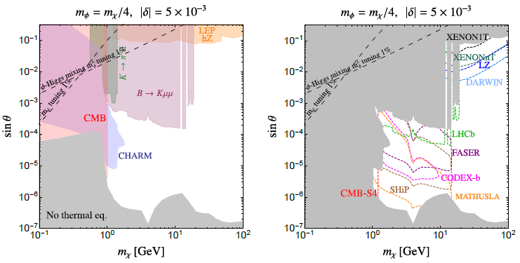
LLP Sensitivity: DM
Scenarios where DM model requires existence of LLP, but LLP signature does not involve the DM particle directly
e.g. Co-Annihilating DM: BSM χ and χ₂ with mass splitting δ, χ χ₂ → ϕϕ where scalar ϕ has mixing angle θ with SM Higgs

Slide 44
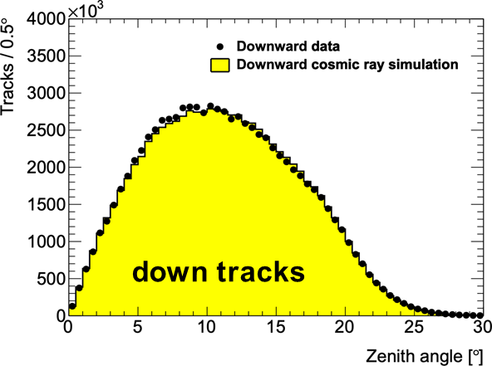
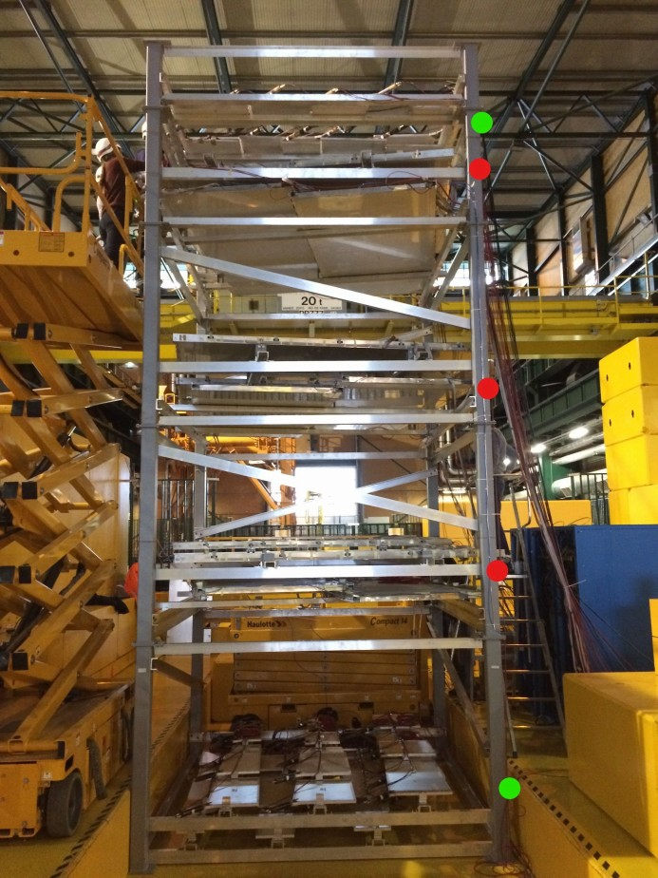
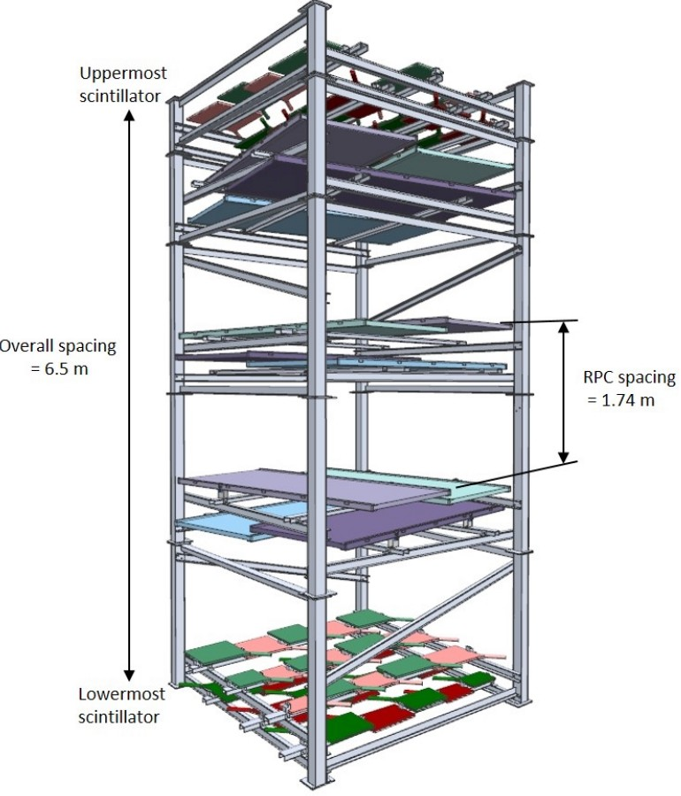
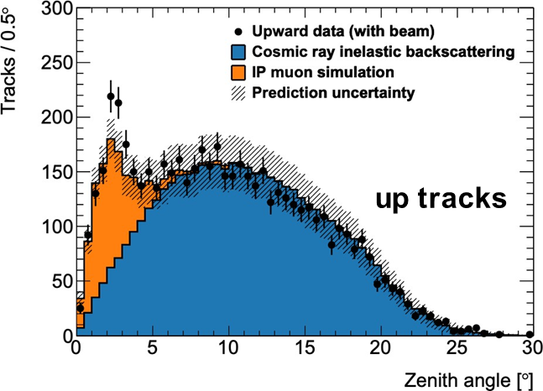
MATHUSLA Test Stand
Operated above ATLAS in 2018
Downward cosmic rays, upward LHC muons and upward CR backscatter well described by simulations
6

Slide 45
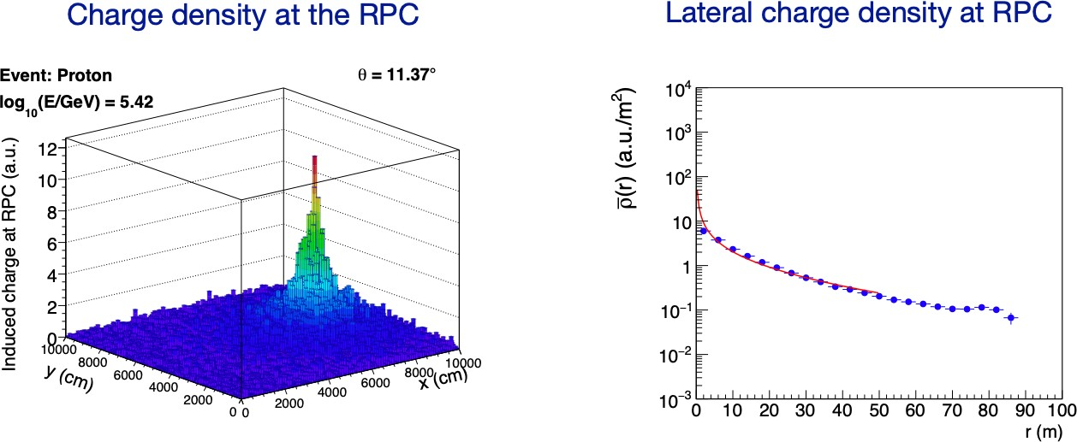
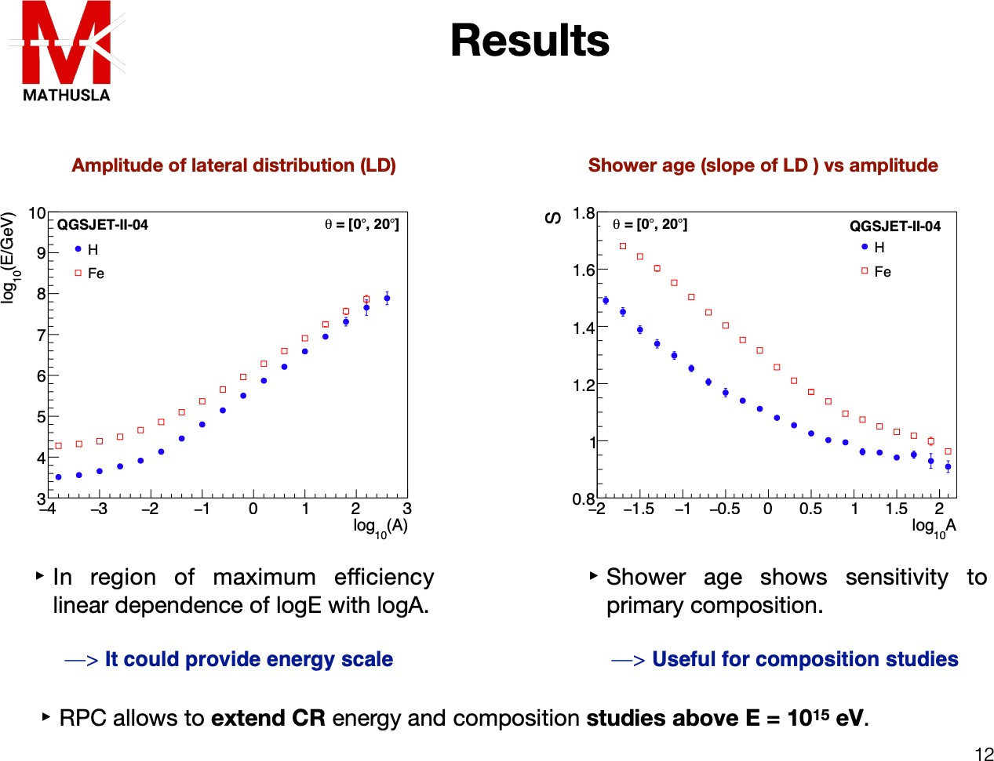
MATHUSLA as a Cosmic Ray Telescope
CR physics reach would be greatly enhanced by adding an analog RPC layer, due to scintillator saturation effects
https://indico.cern.ch/event/980853/contributions/4361206/attachments/2251261/3819144/CRMathusla_LLP_25May2021_JC.pdf

