Slide 1
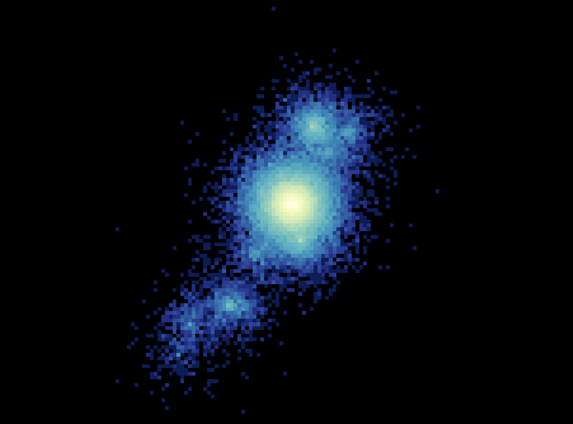
LiquidO
Seeing through the fog to find new physics
Mark Chen
Queen’s University and the Canadian Institute for Advanced Research
Summer Particle Astrophysics Workshop 2024

Slide 2
What is LiquidO? → O is for “Opaque”
R&D towards a novel liquid scintillator detection technique that uses an opaque medium

Slide 3
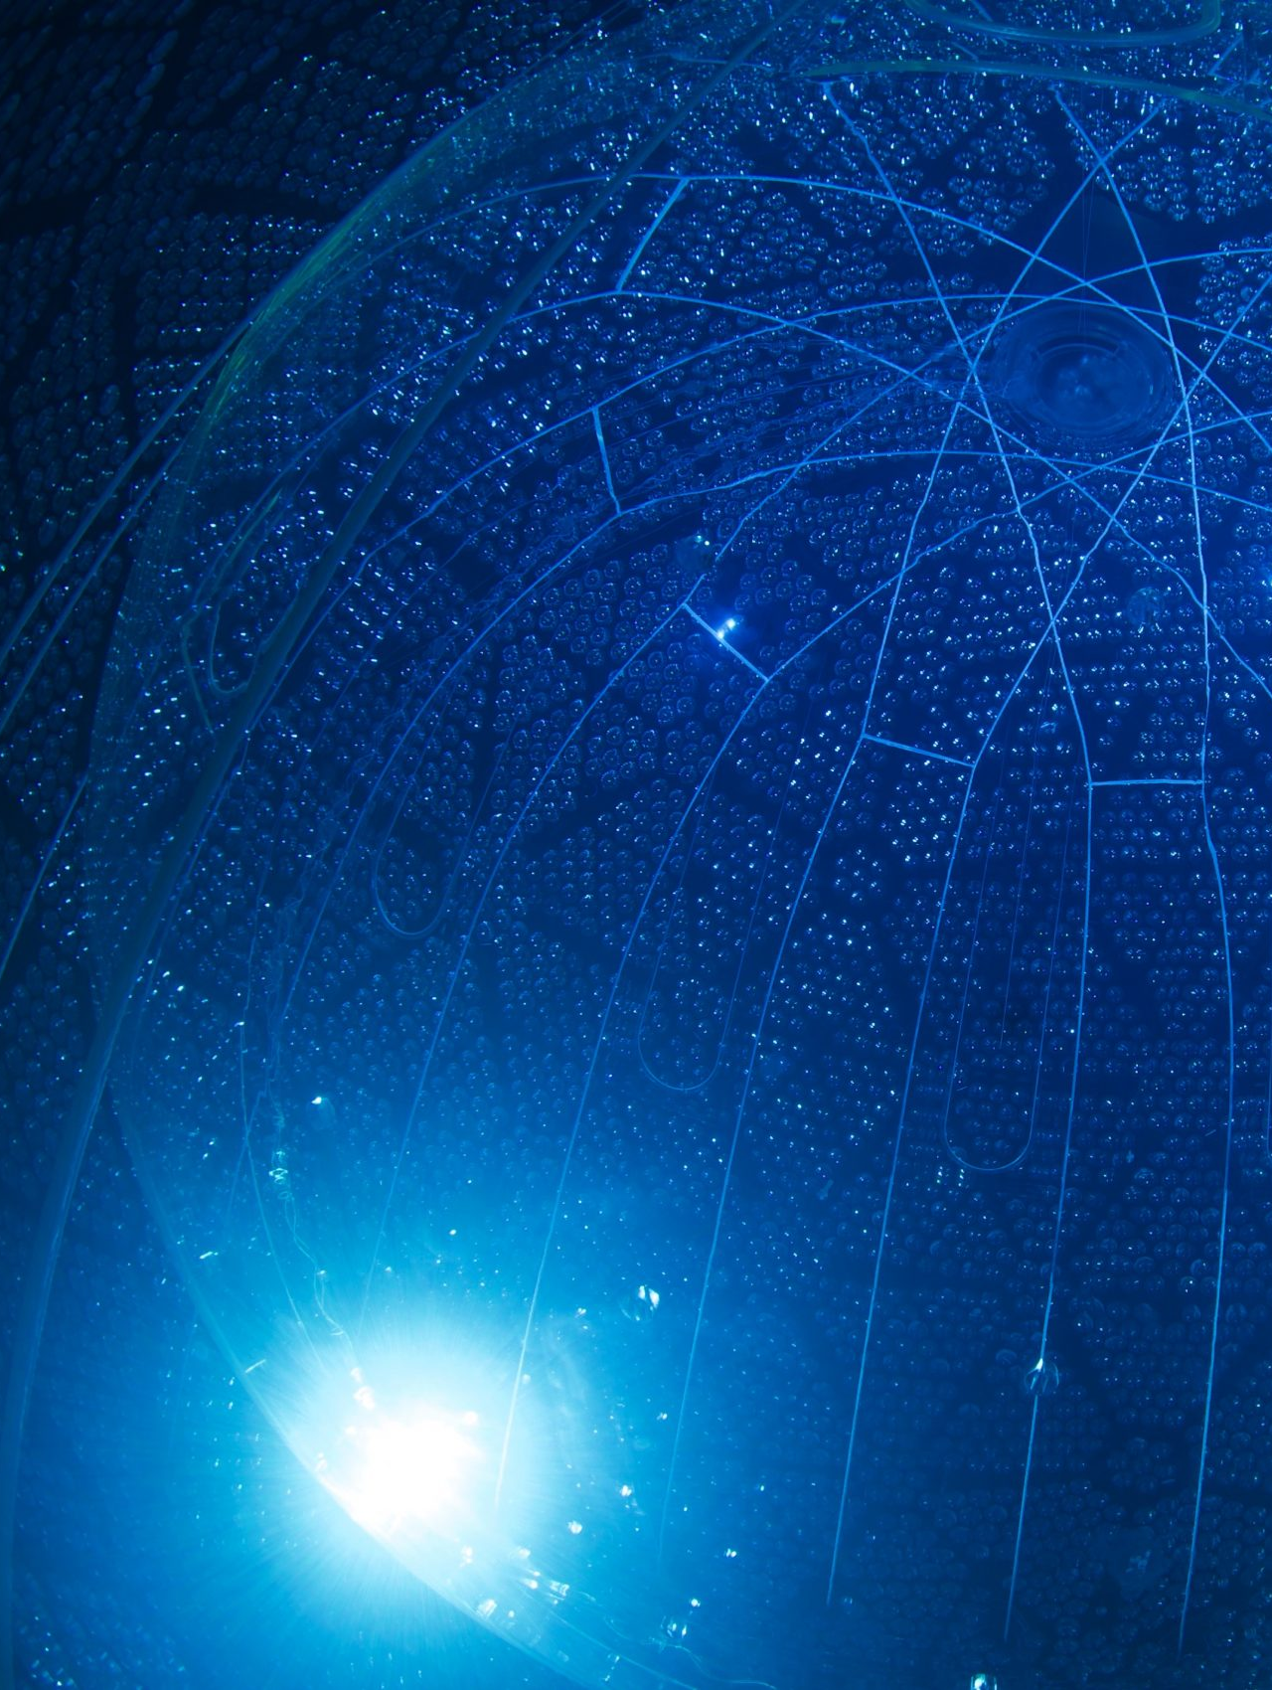
What is a Liquid Scintillator?
It’s a material that gives off light when excited by particles/radiation
inorganic crystals, organic liquids, noble gases and liquids, plastic scintillators
Right: the SNO+ neutrino detector is filled with liquid scintillator; light is detected by photomultipliers (PMTs)

Slide 4
Light Confinement using high scattering medium (with low absorption) to preserve energy deposition information

Slide 5
How to readout an “opaque” scintillator?
grid of wavelength-shifting fibres
X, Y info: ~1-cm fibre grid spacing (~mm imaging)
Z info: timing along fibre (~cm resolution)
SiPM fibre readout (photon counting)
(everybody ❤️ SiPMs these days)
It’s like a light TPC or photon drift chamber!
Image: CDF central tracker

Slide 6
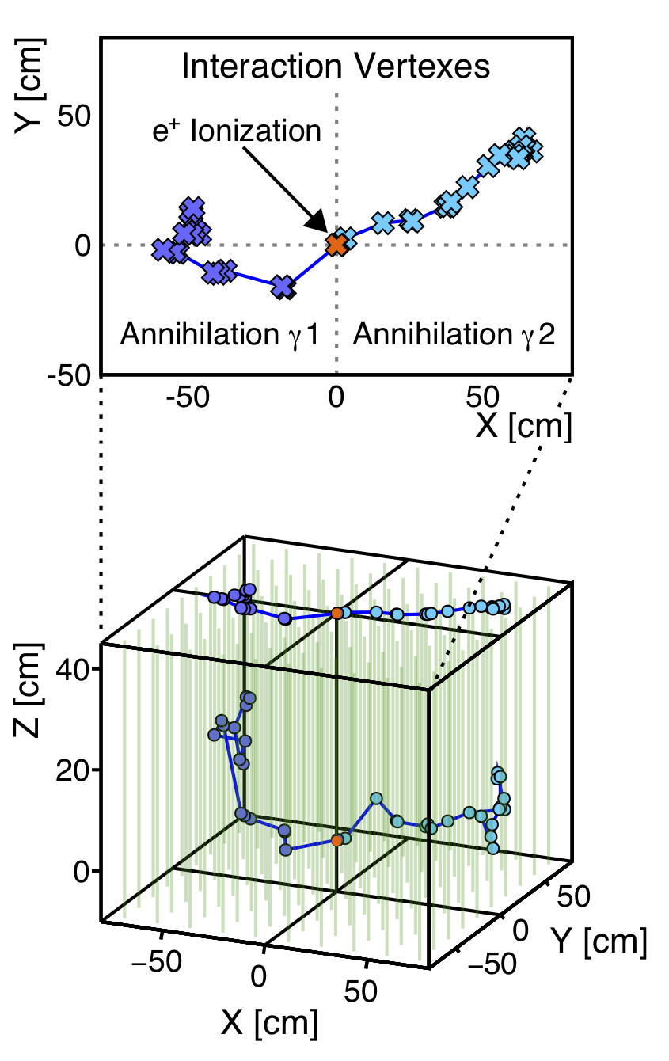
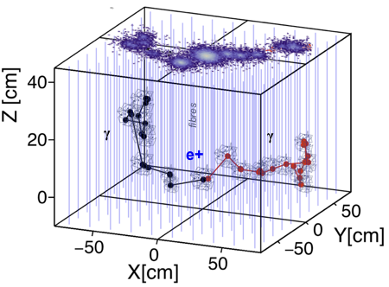
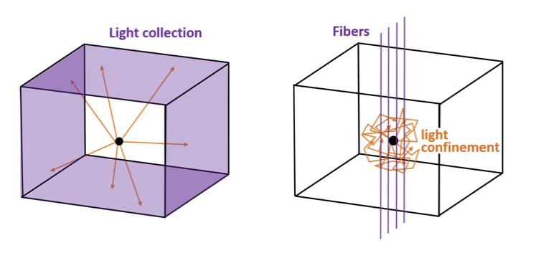
Scintillation light from energy deposition is confined stochastically… scattering enables imaging!
Fibres
6

Slide 7
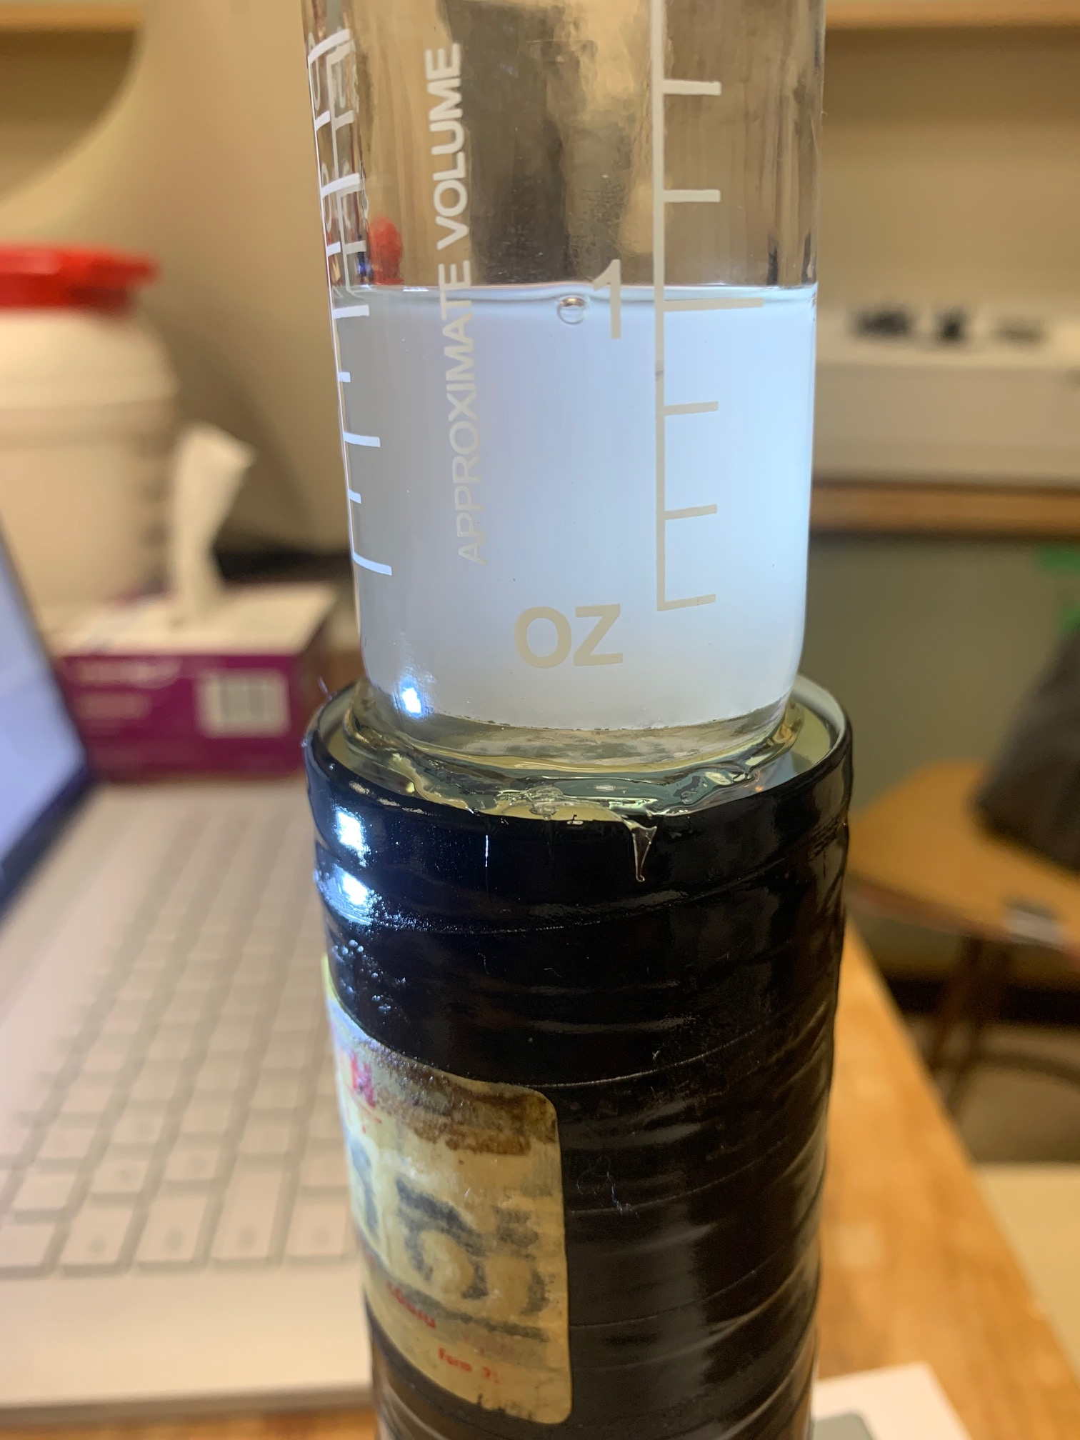
LiquidO Features & Advantages
spatial and temporal event ID and pattern information → powerful background rejection
relaxing the scintillator transparency requirement opens many doors for liquid scintillator design options

Slide 8
Event Identification
@MeV energies
Single Site (electrons, alphas, proton recoils)
Multi Site (gammas)
Positrons!
4 3 2 1
γ

Slide 9
LiquidO Simulations – 2 MeV
In contrast: how do PMTs from far away see such events?
…as mostly indistinguishable large balls of light!

Slide 10
“Energy Flow” – Time Information
LS

Slide 11
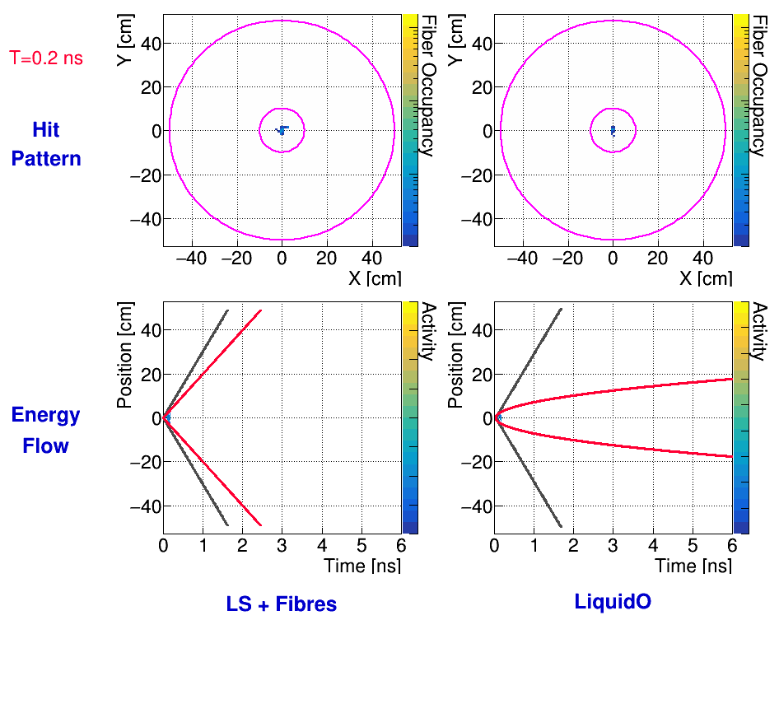
Light “confinement” establishes strong space-time event pattern

Slide 12
Does stochastic light confinement work? YES! μ-LiquidO
electron beam from SuperNEMO R&D

Slide 13
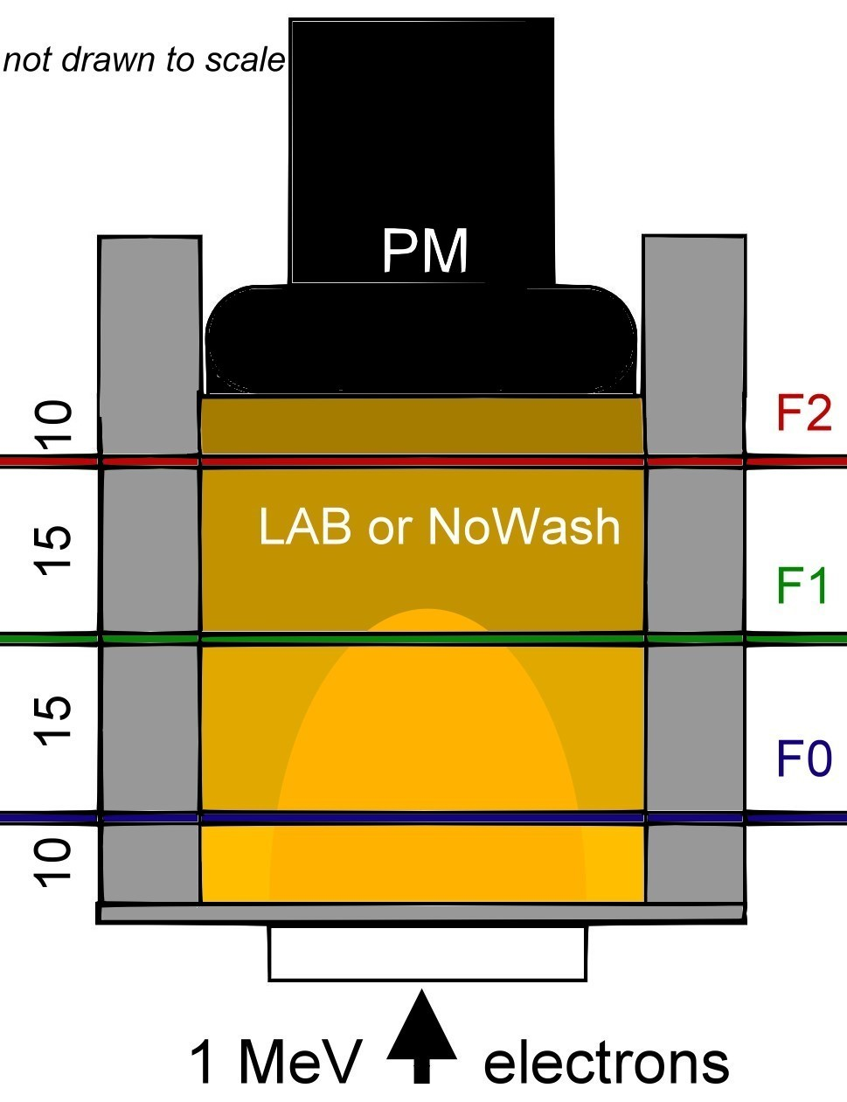
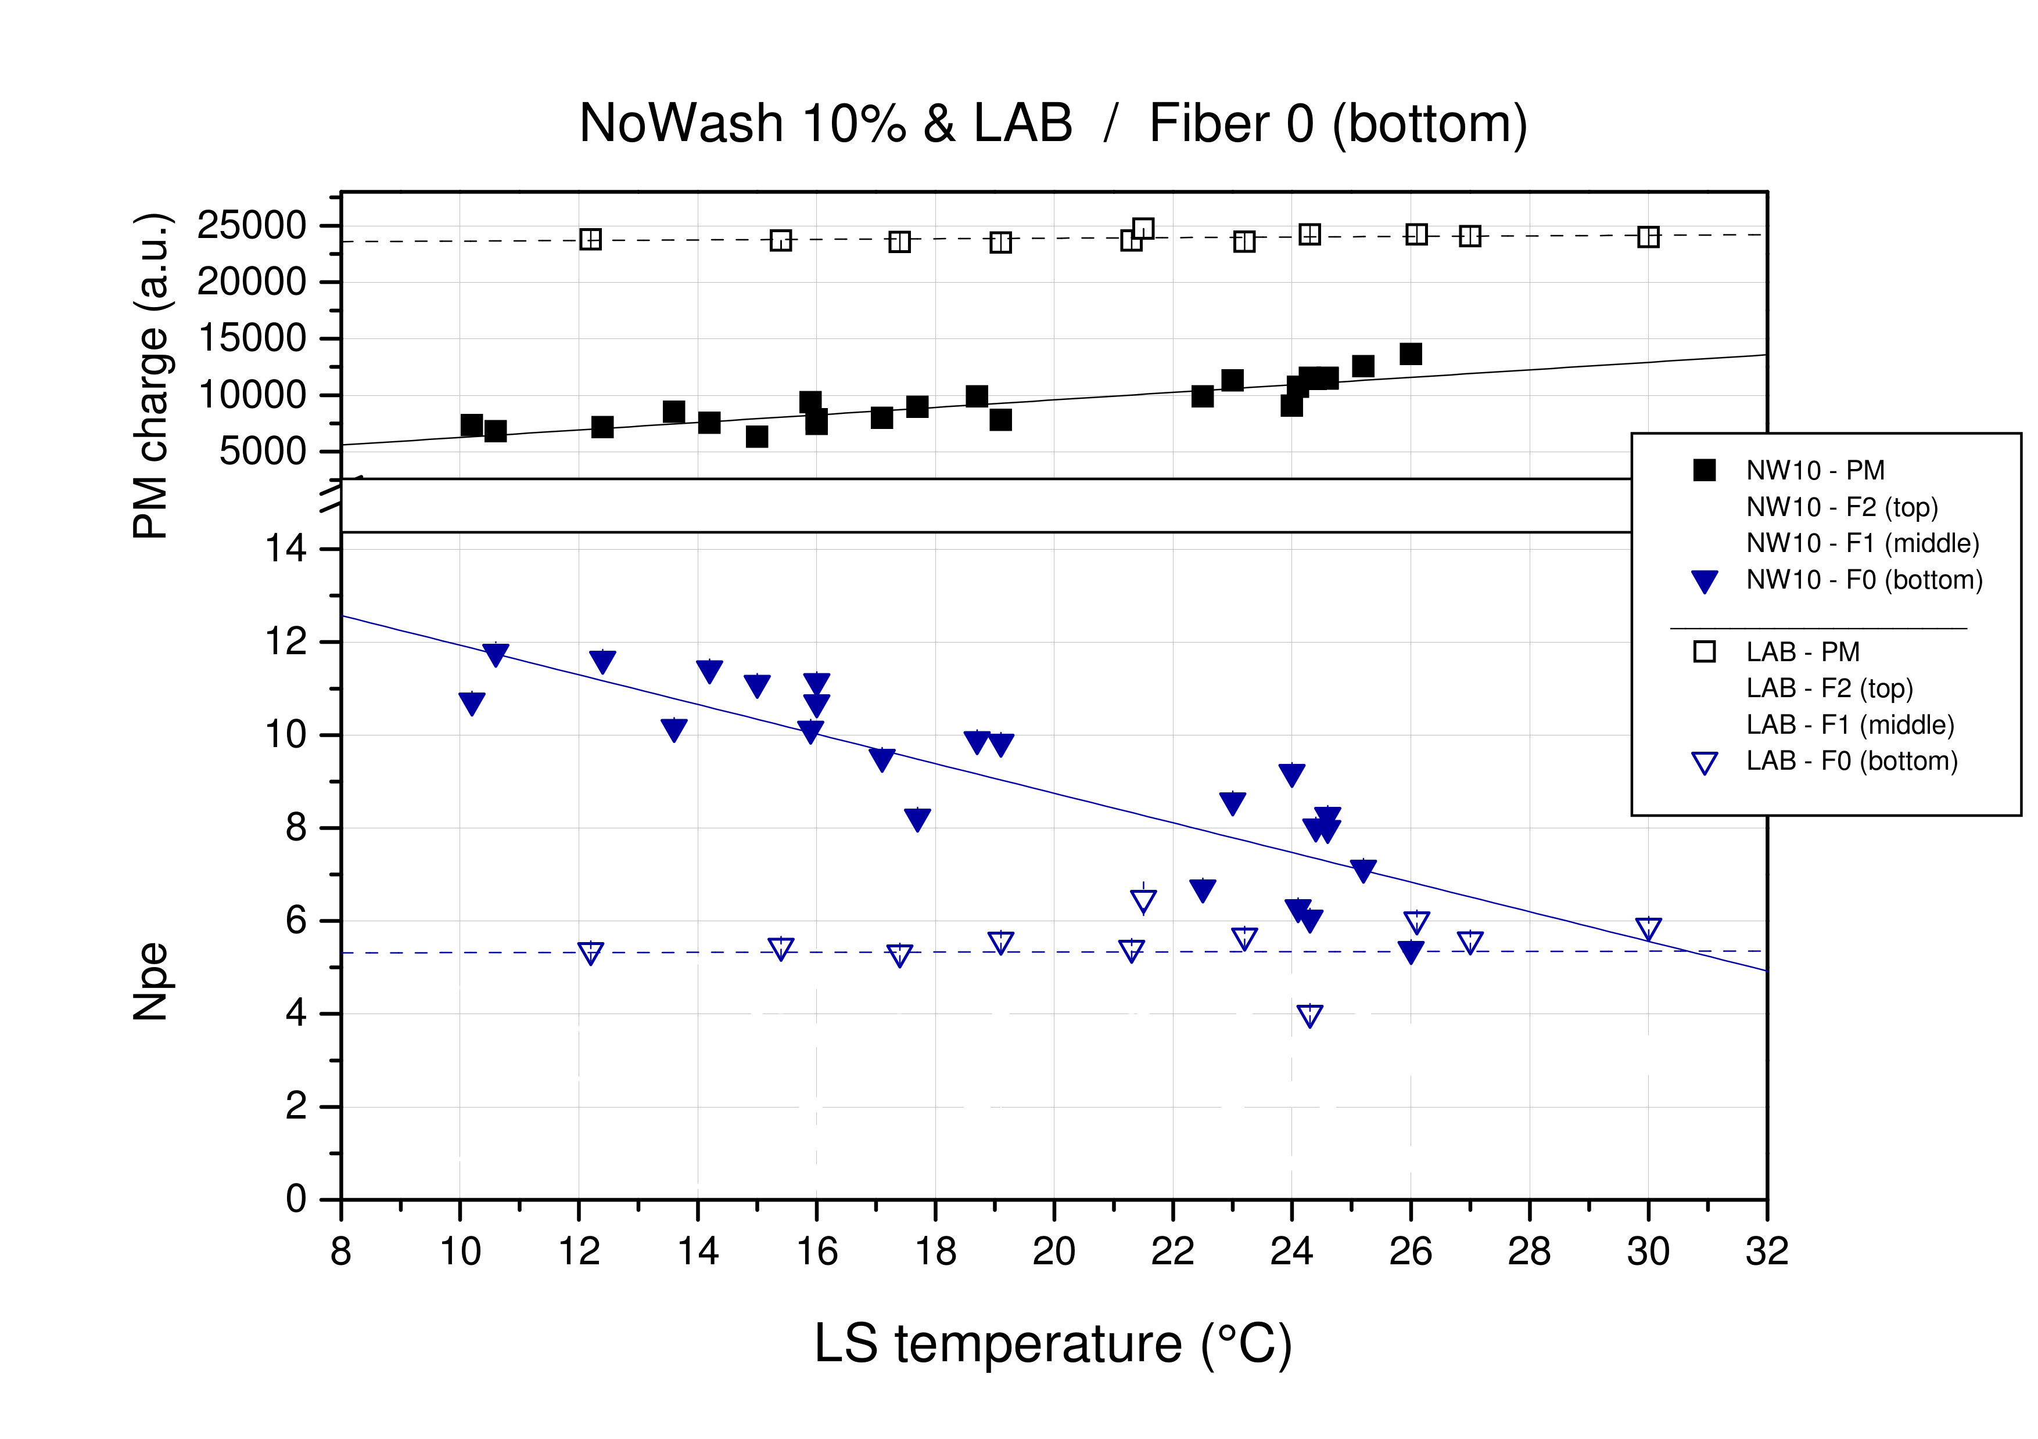
:4 :2
X2.5 X1
translucent
transparent

Slide 14
:4 :2
X2.5 X1
translucent
transparent

Slide 15
Summary of μ-LiquidO demonstration of
opacity light confinement
in Nature’s Communications Physics (2021) 4:273

Slide 16
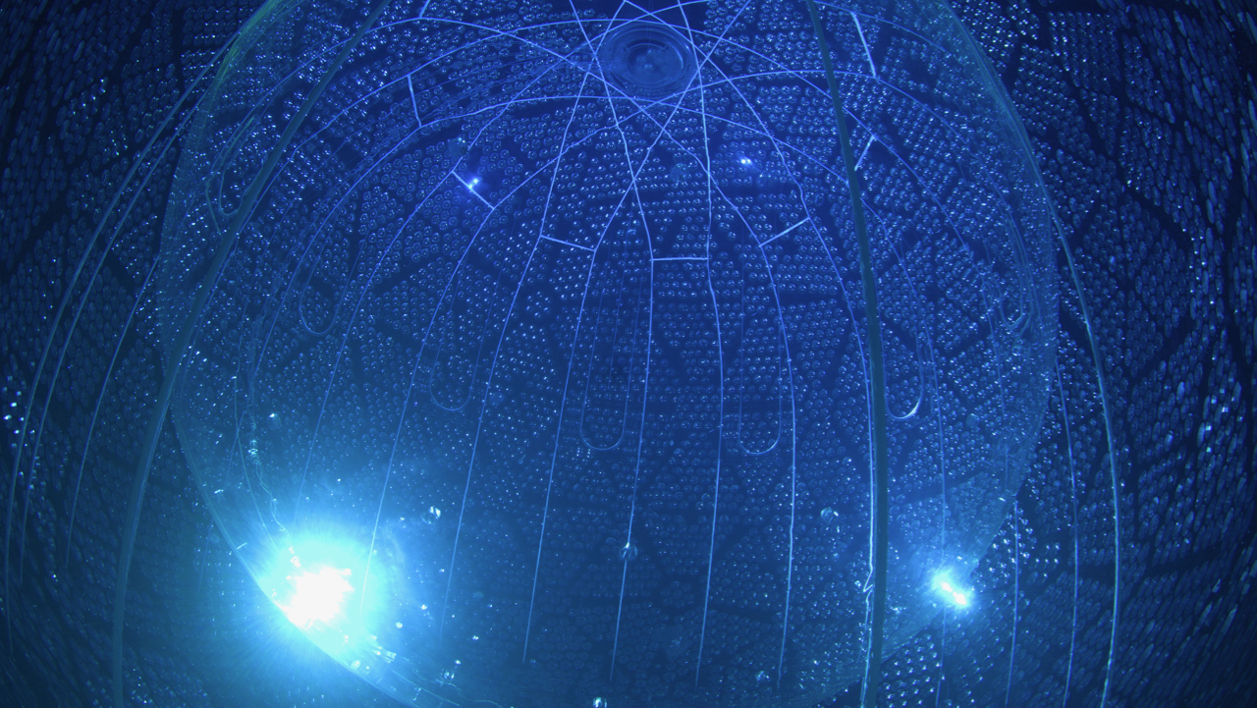
Advantages of Large Volume Liquid Scintillator viewed by PMTs far away
Review
Homogeneous volume
Low background
Fiducial volume cut to reduce external backgrounds
Passive buffer volume needed to shield from PMT radioactivity
Image: SNO+
negatives in pink

Slide 17
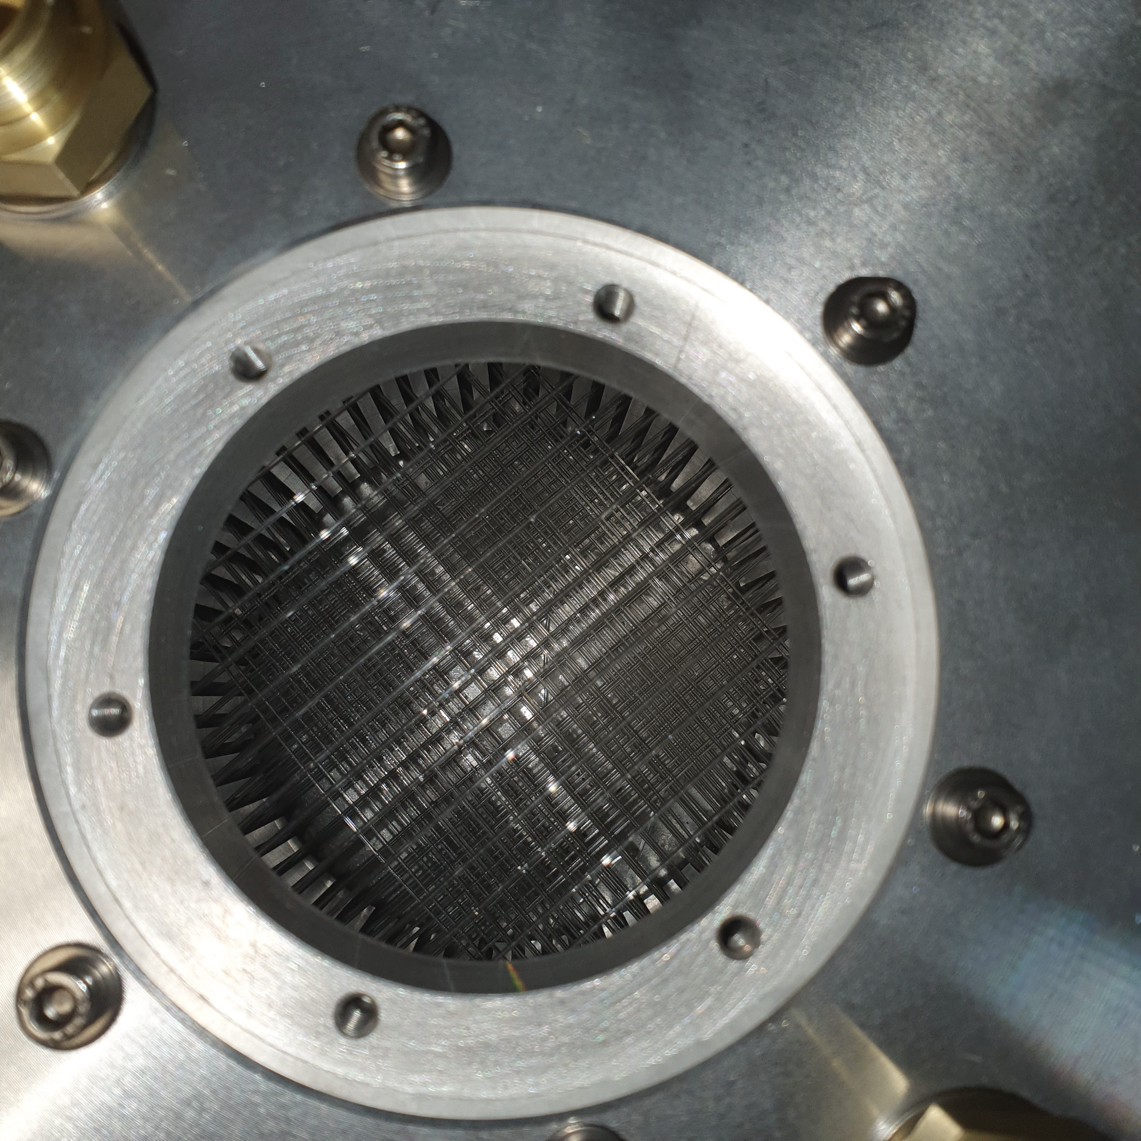
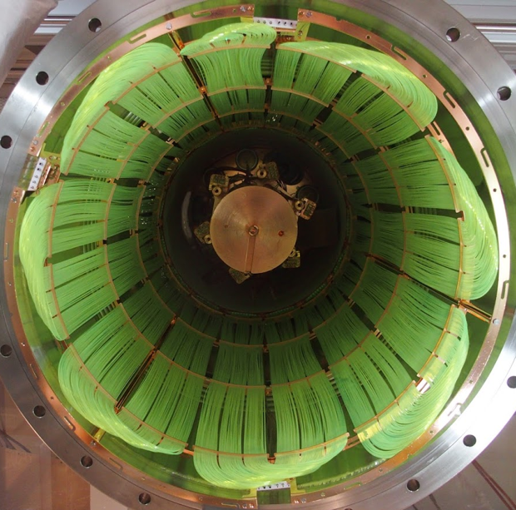
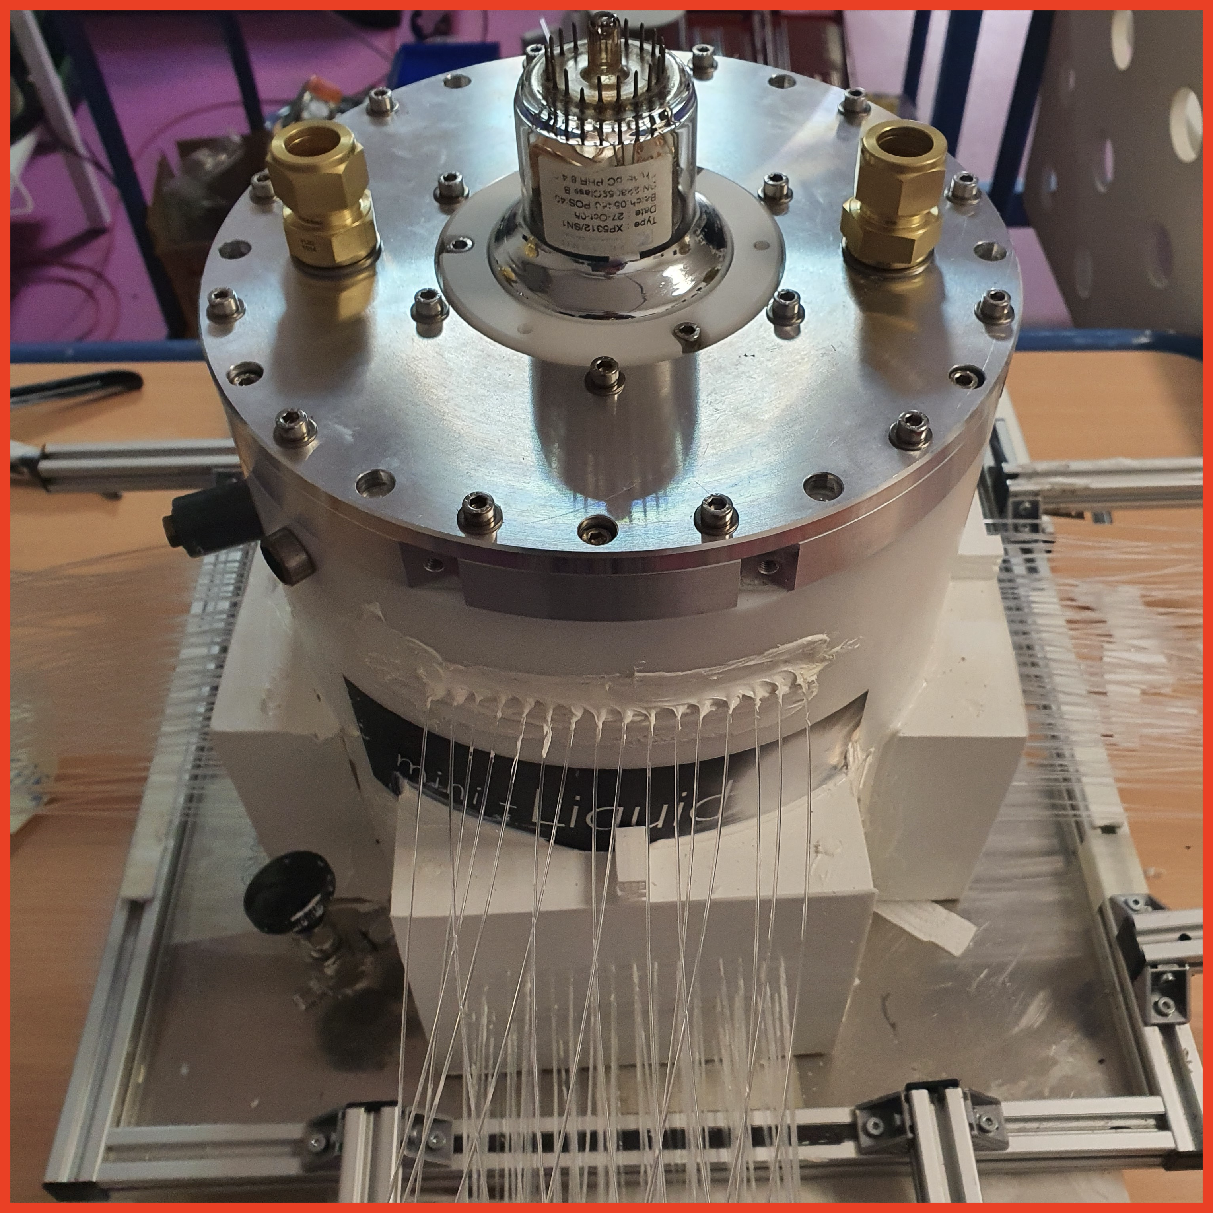
Advantages of LiquidO Technique readout by fibres+SiPMs
Review
Scintillating, wavelength-shifting fibres
can be radiopure and are active
GERDA fibre curtain as an example
Active background rejection
Powerful single-site/multi-site discrimination
External SiPMs don’t require passive buffer
Fiducial cut includes active detector rejection of external backgrounds
Liquid scintillator can still be low background
Added background component: fibres
Image: GERDA fibre curtain
negatives in pink
Images: Mini-LiquidO

Slide 18
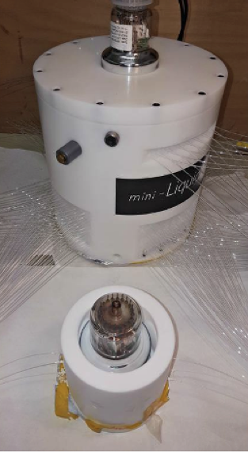
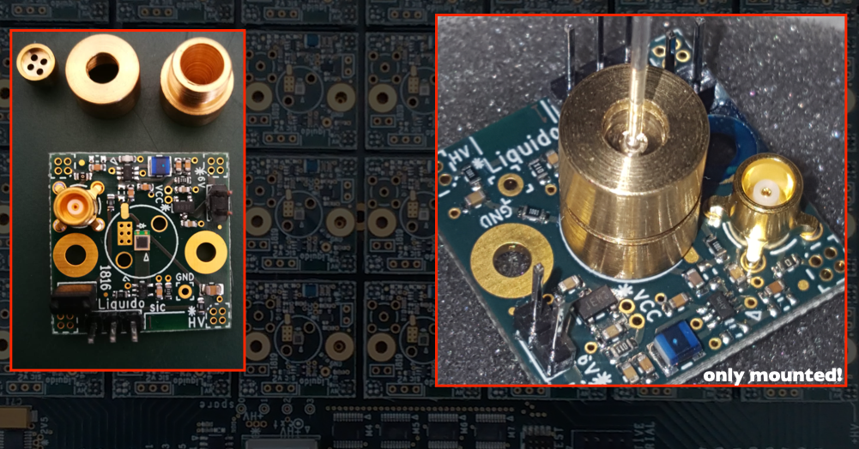
Next Steps for LiquidO
Mini-LiquidO
(has taken data)
w/fast SiPM electronics readout

Slide 19
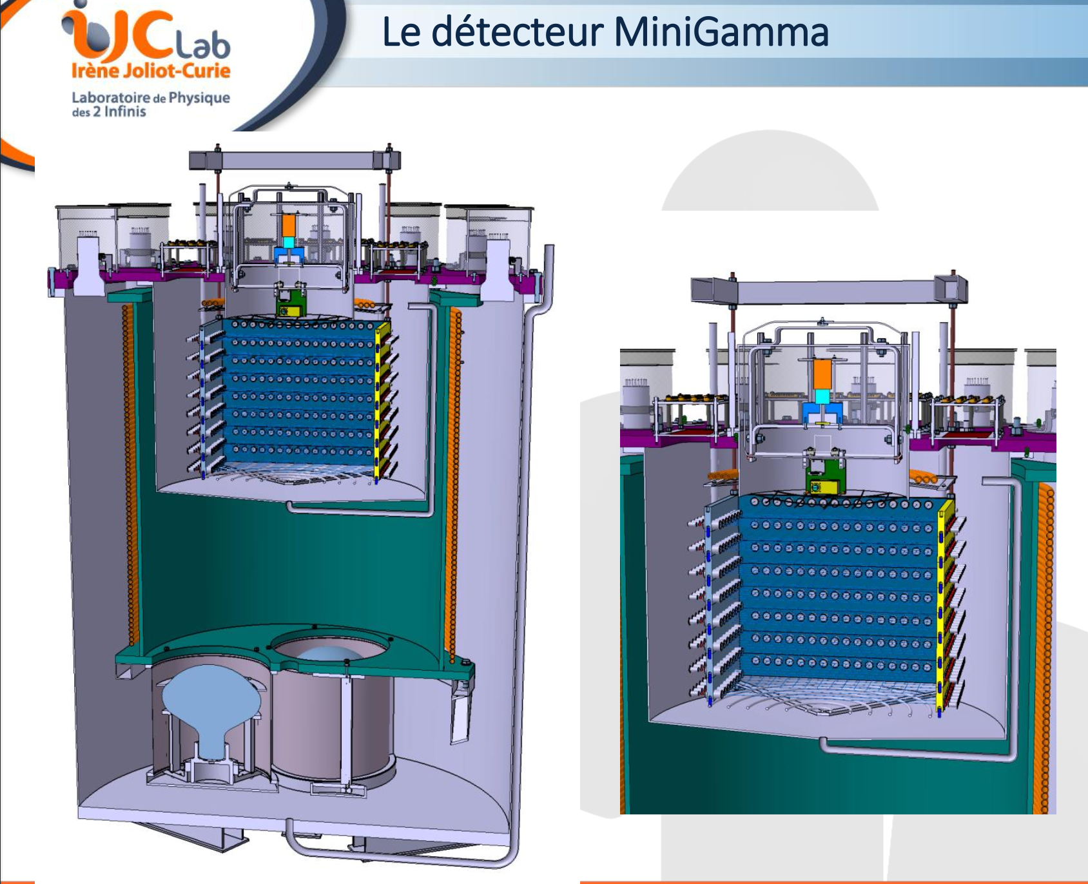
Mini-gamma
161 L opaque LS
1021 L transparent LS

Slide 20
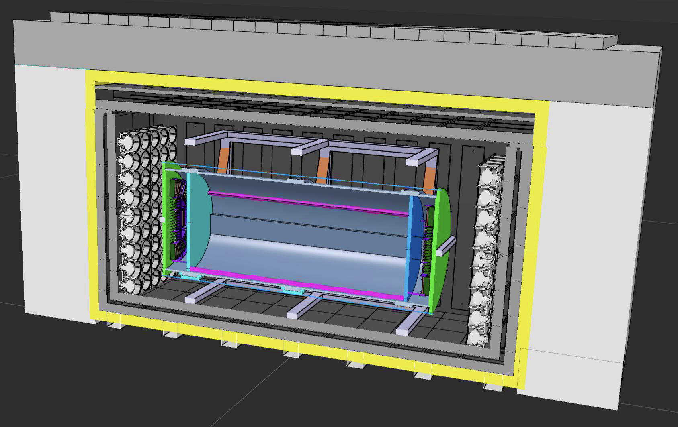
~10-ton LiquidO at Chooz
~10,000 fibres+SiPM readout channels (GHz waveforms)
fully funded EIC project

Slide 21
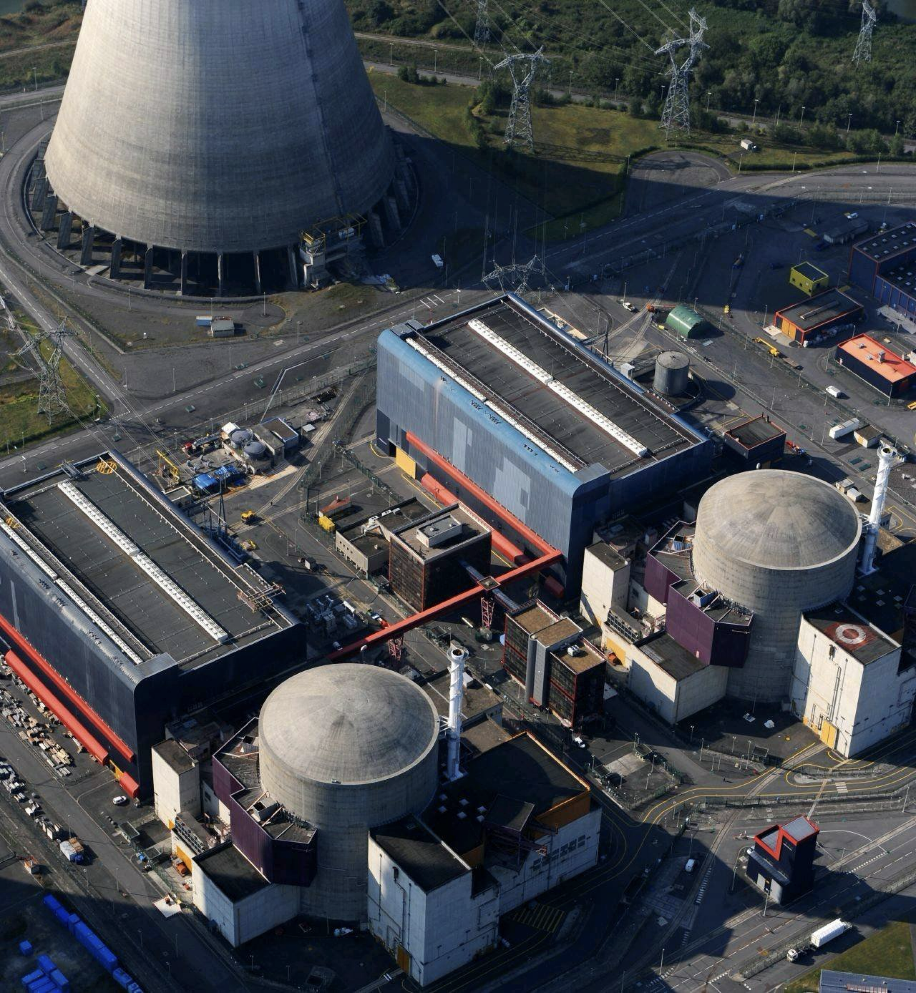



CLOUD
Chooz LiquidO Ultra-near Detector
Baseline: ~30 m
Overburden: ~3 mwe
IBD antineutrino rate:
~15 events/minute

Slide 22
Summary
LiquidO is a novel approach for liquid scintillator neutrino detection
Exciting neutrino physics potential
EVENT ID ⊕ RELAXED LS REQUIREMENTS
Thanks!

