Slide 1


An Introduction to C++
from if statements, functions, classes, libraries, to building your own interactive story driven game.
Remington Hill
Contact Info: remington.hill@queensu.ca
Supervisor: Dr. Stephen Sekula
Queen’s University
May 8th, 2024

Slide 2

Outline
Introduction.
Formatting.
Compiler(s).
Libraries.
Namespaces.
Control statements (if, else, while, etc.).
Functions.
Classes.
Vectors
Zork project

Slide 3
What is and what isn’t this talk?
This is not a formal lecture on C++.
  I am not a computer scientist.
I assume that each of you have no experience coding in C++.
  If you have experience in C++, there is a 85% chance I put you to sleep.
My hope is that after today, you have enough of the basics to do the following:
  Understand collaboration analysis tools and write code in the existing framework.
  Run Geant4 simulations (or other equivalent C++ simulations).
A couple of questions before we get started:
  How many of you have taken a computer science course before?
  How many of you have written software in C++ before?
    Be honest! No judgement. I am using this to gauge pace.
  Who has written in Python before?

Slide 4


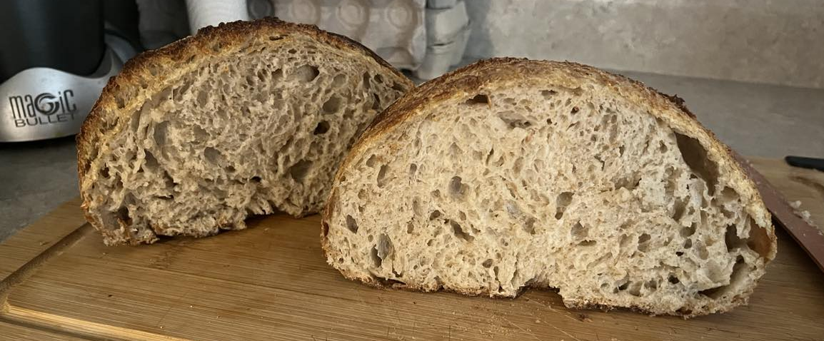
Introduction
My name is Remington W. Hill.
First year PhD Student at Queen’s University (Sept. 2023).
  Supervisor: Dr. S. Sekula.
  Working on commissioning PICO-500 and analyzing PICO-40L data.
I did my MSc at Laurentian University.
  Supernova neutrino detection (Supervisor: Dr. C. Virtue).
You can find me in Sudbury at SNOLAB (2nd floor cubical space, C15).
Hobbies:
  Baking and cooking .
  Reading (sci-fi/fantasy, history, etc.).
  Walking my dog on the local trails in Sudbury.
  I enjoy playing and watching chess (the most recent candidates was spectacular).

Slide 5
Some general remarks
Don’t be afraid to ask for help!
  Can always speak to your coworkers, supervisor, etc.
  If you need help, I can be reached at remington.hill@queensu.ca or at C-15 on the 2nd floor at SNOLAB (for those who are on site this summer).
You are going to make mistakes; learn from them.
  Here are my highlights:
    2018: Undeclared variable I assumed was out of scope, turned out to be spelt wrong.
    2019: Insufficient memory storage resulting in me creating 4-5 TBs of data and crashing my simulation.
Make sure you keep a good reference handy.
  I use “C++: How to program” by Deitel and Deitel (in fact, most examples in this talk are largely inspired by this textbook, as well as last years talk by J. Hucker).
Understanding the limits of googling and using someone else's code.
  Stack overflow is an asset. However, do not just copy the code without understanding why it is written the way that it is.
  This will make you a better programmer. Will also help with readability; whomever takes over your code will thank you.

Slide 6
C++ structure
* Here, when we say every line, we exclude control operators such as if, else, while, etc. Classes, structs (see later slides), will require semi-colons.
Every line must be ended with a semi-colon* (;).
Variable types need to be specified upon declaration.
  Is it an int, double, float, TFile, TTree, G4int? You need to tell the compiler.
Indentation is optional; however, please respect your fellow programmers.
  When entering a conditional statement, class, struct, etc. it is good practice to increase the indentation by 1 tab or 4 spaces.
Make sure you leave useful comments.
  Each of you will work on code that someone else will then use (potentially).
  Do not make them pull there hair out.
  For today only, I am breaking this rule to avoid clutter.
Choose appropriate variable names.
  Do not store an energy value in a float called “temp”.
    This means nothing.
  Suppose you were looking to store both the electrical charge of an electron, and the permittivity of free space, what would be a good name for each?

Slide 7
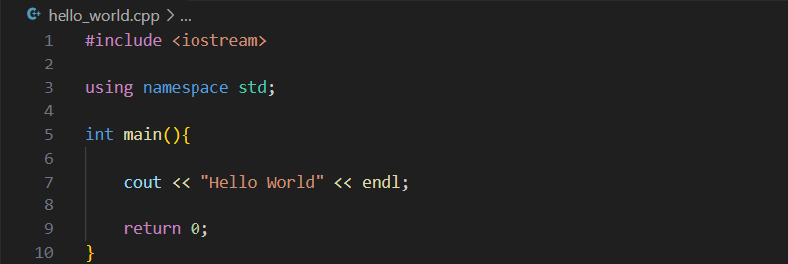
A classic example
The first thing you, as a programmer, will typically do in a new language is print the classic, “Hello World”.
  What does this look like in C++?

Slide 8
A classic example
The first thing you, as a programmer, will typically do in a new language is print the classic, “Hello World”.
  What does this look like in C++?
The method to include standard libraries or your files.
If enclosed by < >, compiler will look in your path for the library.
If included by double quotes (i.e. #include “experiments.h”), local directories are checked.

Slide 9
A classic example
The first thing you, as a programmer, will typically do in a new language is print the classic, “Hello World”.
  What does this look like in C++?
Tells the compiler which namespace is being used throughout program.
For example, cout and endl belong to the std namespace.
This line allows us to use these two functions without specifying their namespace.
Without this line, all calls to functions of this namespace need to include std::

Slide 10
A classic example
The first thing you, as a programmer, will typically do in a new language is print the classic, “Hello World”.
  What does this look like in C++?
This is the main function; it is the entry point for your C++ program.
Every function will have its arguments defined in (), and be closed by {}.
Function definitions before this will not be called or used unless called within the main() function.
int tells the compiler that this function returns an int value when it exits.
Can return any type (double, int, vector<int>, etc.).

Slide 11
A classic example
The first thing you, as a programmer, will typically do in a new language is print the classic, “Hello World”.
  What does this look like in C++?
Print to the terminal the string “Hello World”.
cout and endl are objects from std; more on this later (see Namespaces).
cout stands for ‘character output’. endl ends the current line.

Slide 12
A classic example
The first thing you, as a programmer, will typically do in a new language is print the classic, “Hello World”.
  What does this look like in C++?
Return value of the function.
Returning zero tells the compiler that main exited without issue.
Any other value is some error status you need to identify.
User defined functions return whatever the user provides and

Slide 13
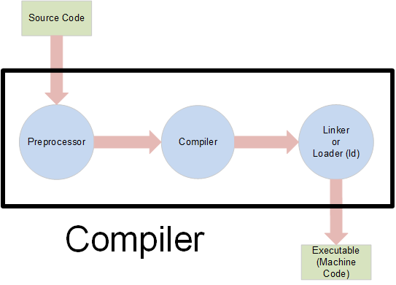
Compiling
How do we run this code?
  Will need to convert this from human readable to machine readable.
Right now, we have what is often referred to as the source code.
  For most daily applications, you don’t have access to this (i.e. whatever video games you are playing right now).
To get the machine readable file, also called the executable, we must look to compiling this C++ script.
Preprocessor: process all statements with #; copies C++ statements to temp. files.
Compiler: translates source code to machine code.
Linker: will link together object code files (headers, more on this later).
Courtesy of icarus.cs.weber.edu.

Slide 14
Compiling pt. 2
Here, we are going to use the command line and g++ (on LINUX).
To compile, run:
This will yield an executable of the name “Hello_World”.
  It is fairly standard to use the same source code name, but drop the file extension.
  If no name is supplied, default is a.out.
There are other arguments that can be included:
  You will most certainly use –I/path/to/headers/, which tells the compiler to include the supplied directory.
To run this file, simply put:
If you do not have access to the command line and g++ today (or a windows compiler), can use this: https://www.programiz.com/cpp-programming/online-compiler/
  A temporary solution; you should seek access to a permanent solution.
For large files or projects, I encourage you to use ‘make’ (or GNUmake).
  Will automatically check which parts of the code need updating.
  i.e. unchanged files are not recompiled.
  You can find documentation here: https://www.gnu.org/software/make/manual/make.html.

Slide 15
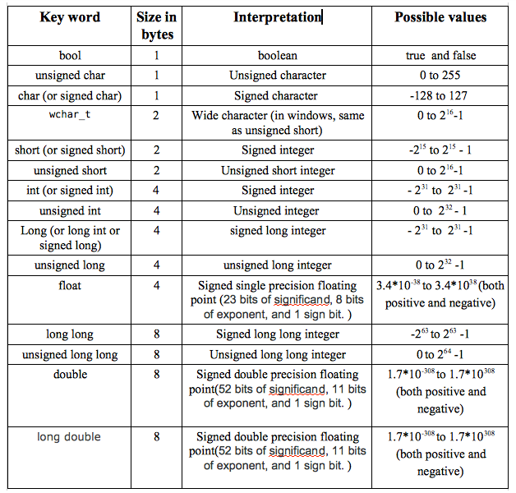
Data types
C++ requires you to be exact when defining variables.
  You must tell the machine what it is handling.
So what are they?
Declaration: this is telling the compiler what the name and data type of your variable is.
Initialization: This is supplying an initial value to the variable.
Courtesy of go4expert.

Slide 16
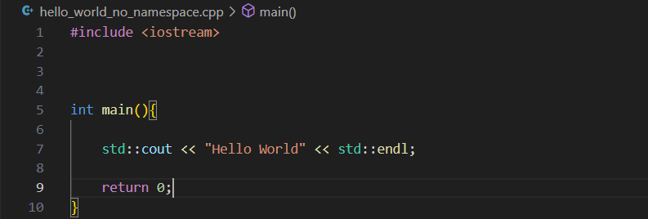
Namespaces
What are namespaces?
  Suppose you include two header files, Alice.h and Bob.h.
  Each are a different namespace.
  They both function within them called person().
  How do we specify which one we are using?
Namespaces: define the scope where global identifiers and global variables are placed.
  I.e. Within the namespace, Alice, access to all identifiers is possible.
To use functions within a namespace, two approach's.
  Specify namespace followed by function or variable name (Alice::person()).
  Or use the namespace (see left).

Slide 17
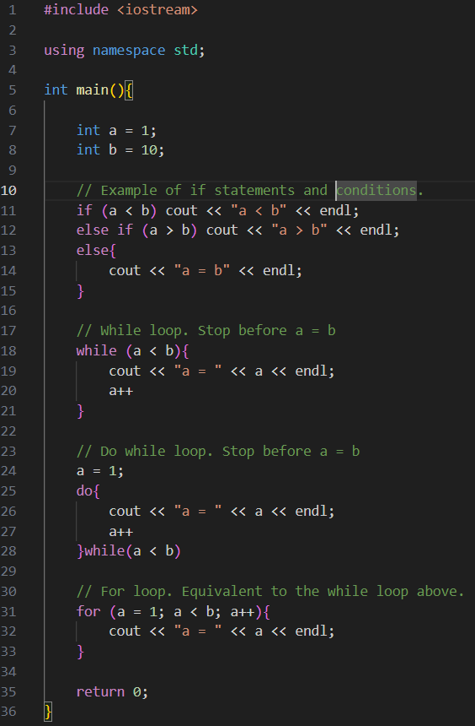

Control statements
Control statements allow you to control where a program will go and what actions it will take.
The most common are:
if (condition){..code..}
else if (condition){..code..}
else{..code..}
for(start; stop; increment){..code..}
while (start/condition){..code..}
do while(condition){..code..}
Examples of each can be found on the right.
  There are critical differences between all of them (lets discuss).

Slide 18
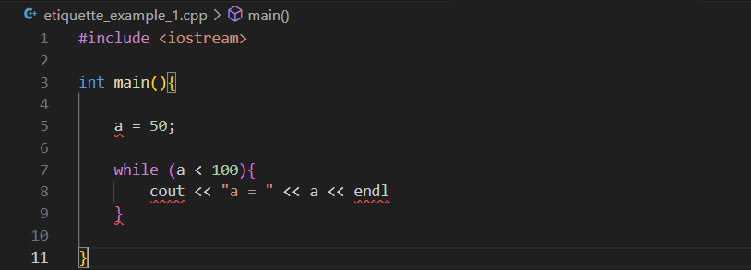
Find the errors!
We should have enough information to now begin to identify errors in the code.
  There are 5/6 errors in the code below.
  Take 1-2 minutes amongst yourself to identify what they are.

Slide 19
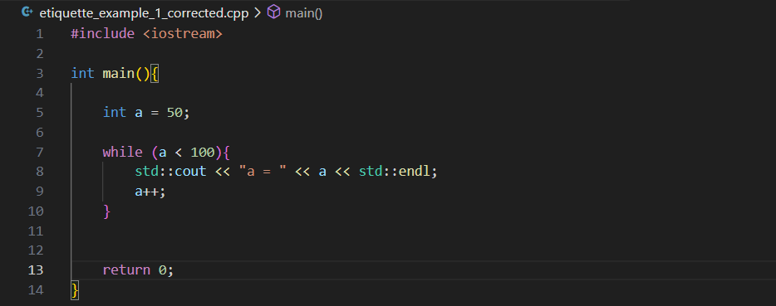
Corrected code
1) Missing variable type in declaration.
2/3) Missing namespace identifier(s).
4) Missing semi-colon at the end of the line.
5) No increment resulting in infinite loop.
6) Missing return statement.
(This technically won’t give an error message, but good practice is to always return a value for non-void functions)

Slide 20
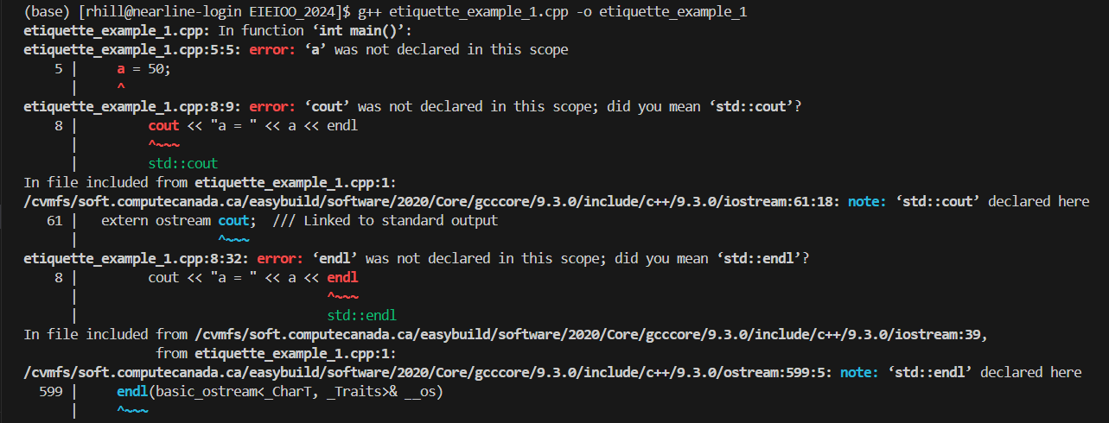
Listen to your compiler!
Listen to your compiler.
  If the compiler encounters an error, it will be very explicit on where it is.
Let us look at the log from our previous example.
  Some things it won’t catch (i.e. infinite loop; that is your responsibility!).

Slide 21


Command Line / User Inputs
Yesterday, you would have learned how to navigate the command line at Mark’s talk.
  I will assume you are familiar with the basics.
Suppose I wanted to check which two numbers, $a$ and $b$, was smaller.
  Can I avoid having to recompile each time? Yes.
  Two solutions we will cover:
    Command line arguments
    User input during execution (cin).
For command line arguments, modify the main function to include two arguments (which we will talk about later):

Slide 22
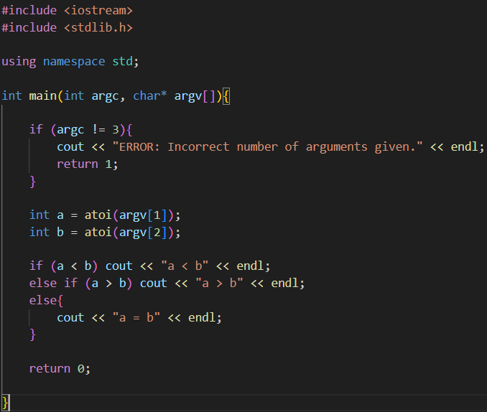
Command line (cont.)
The code on the right will take two integers as inputs.
It then uses three conditional statements to check if:
  a < b
  a > b
  a == b
The pointer to the array of argv[] needs to be converted to the appropriate type.
  atoi() for ints.
  atof() for doubles.
argv[0] is the filename of the executable.

Slide 23
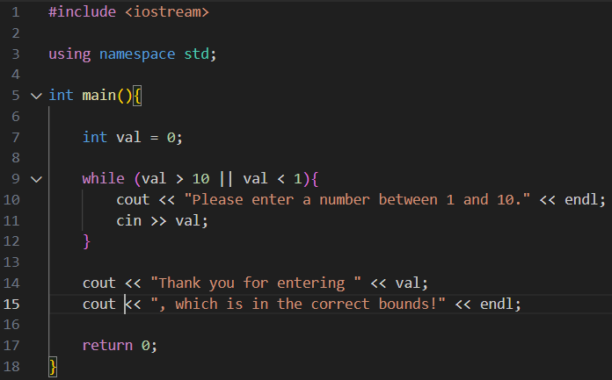
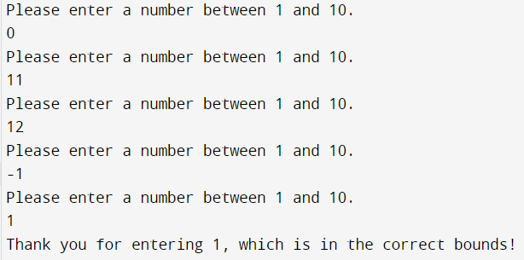

Character inputs
Another variation of this program is character input.
  Called cin; opposite of cout.
  Like cout, it is apart of the iostream header.
This asks the user for input during execution.
The general structure is to declare some variable of a given type, then use the overloaded cin operator to store it
Let us see this in action.

Slide 24
Exercise (basic intro.)
Take the next 5 minutes to do the following:
  Write a program that asks the user for two numbers.
    Stipulate that the one number must be greater than the other.
  Loop over the range that these two numbers span (incrementing by 1 at each step).
  At each point, compute the product of the increment and upper bound and output the information to the terminal to update the user.
  BONUS: Instead of printing the product, cout the division and the remainder for the two numbers. For the remainder, you will need to use the % operator.

Slide 25
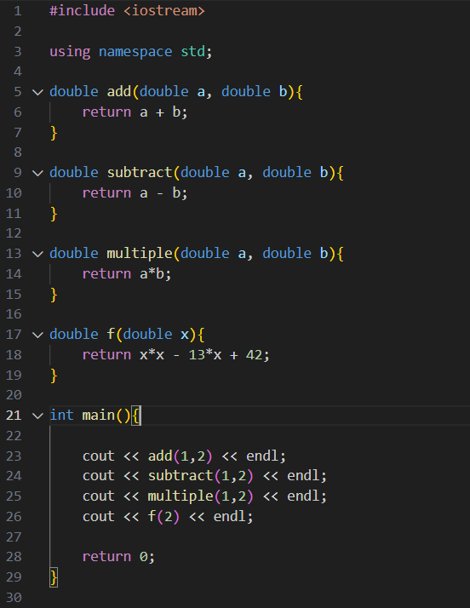
Functions
Thus far, we have made use of functions from the standard library.
  You are free to create your own.
As is the case with our main, our custom functions will have the following format:
  type function_name(args){}
type: Denotes the type of value returned by the function.
function_name: The name you give to the function.
args: the arguments supplied to the function (types must be specified and separated by commas).
Lets talk about some of the examples on the right.

Slide 26
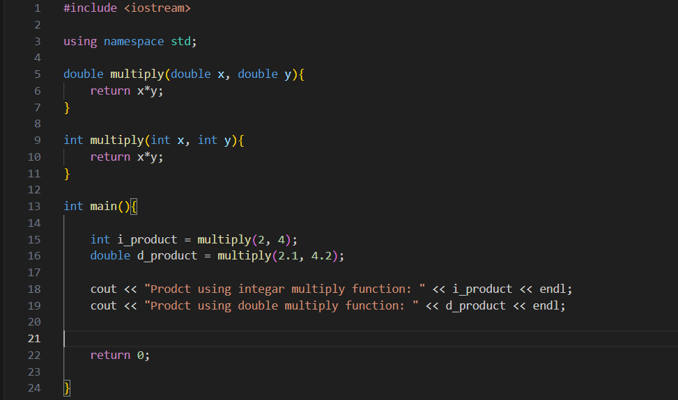
Question time!
NO!
Will the following code give me an error during compilation?

Slide 27
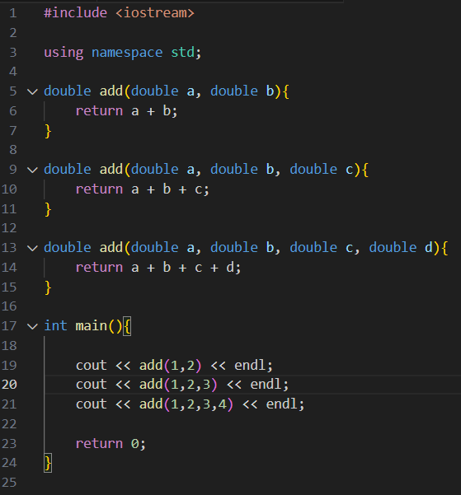
Function overloading
Function overloading is a method of having the same function name but with different arguments.
This is allowed, if and only if, there arguments are different.
  Compiler will look for appropriate function call.
An unrealistic example is on the right.
  In practice, a sum function for array or vector of length N would be used.
See this in ROOT, Geant4, etc. very often.
  TH1, Tfile, TTree, TBranch.

Slide 28
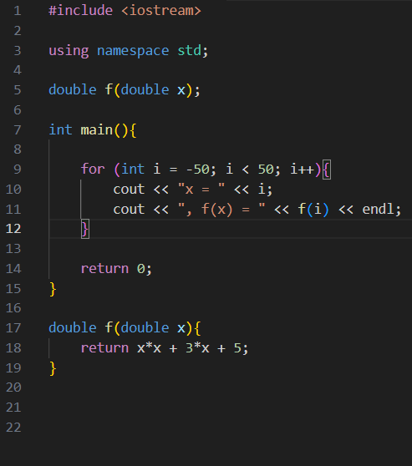
Function prototyping
Something you will encounter when working with classes is function prototyping.
  A method of defining a function and its arguments prior to specifying its operation.
Useful for when functions depend on one another.
  Or for the sake of tidiness, a class is defined in a header file outside the current file.

Slide 29
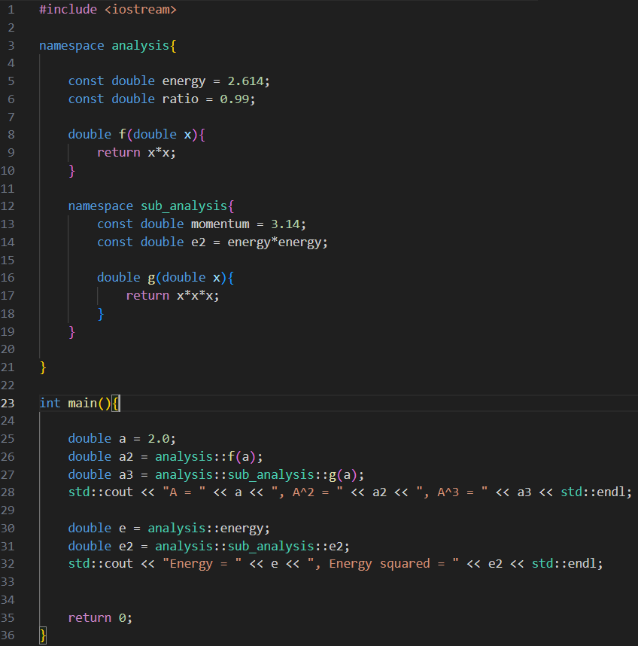
Namespaces pt. 2
Main namespace (analysis).
You can create your own namespace.
Suppose you have a set of custom functions that you use in your analysis.
  Can place these in a header file and include this in future analysis to have access to the functions.
To define a namespace:
namespace nsp_name{..code..}
An example is on the right.
Nested namespace (sub_analysis).
sub_analysis has access to members of analysis.

Slide 30
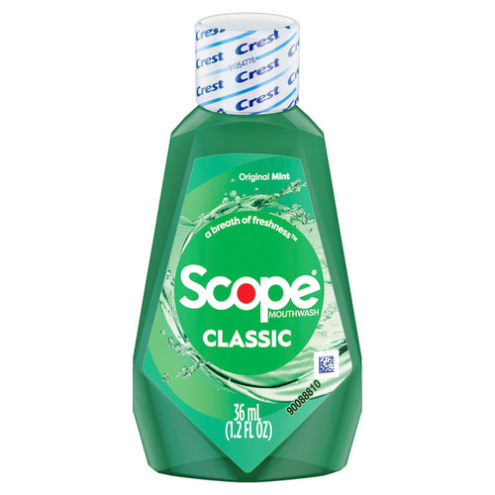
A brief aside on scope
Let’s talk about scope.
You might often hear programmers talk about scope. What does this mean?
Scope tells us where a function, variable, struct, class, is or is not defined.
We saw earlier namespaces, functions:
  The rule of thumb is that when a variable is defined within one of these, it is local to this scope.
  You cannot access it outside of this namespace of function.
It is good practice to avoid global variables.

Slide 31
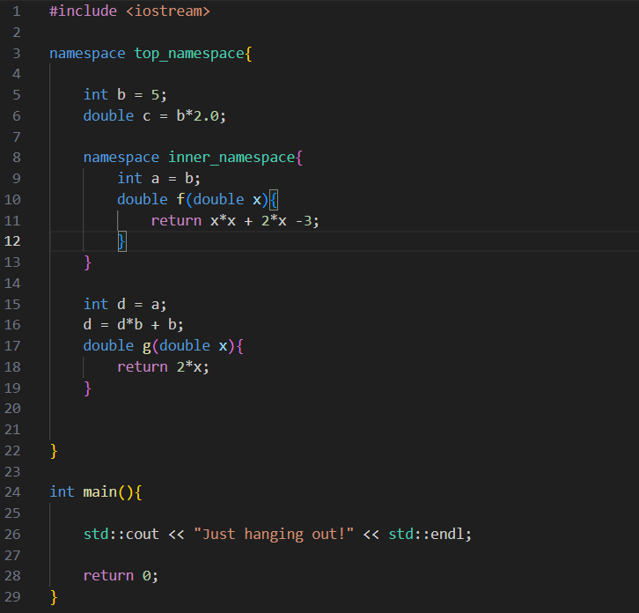
Scope error
Let us take a couple minutes to find the scope error.
Where is the error?
FOUND IT!
If we try to declare that d is equal to a, the compiler will recognize that a is “not declared in this scope”.

Slide 32
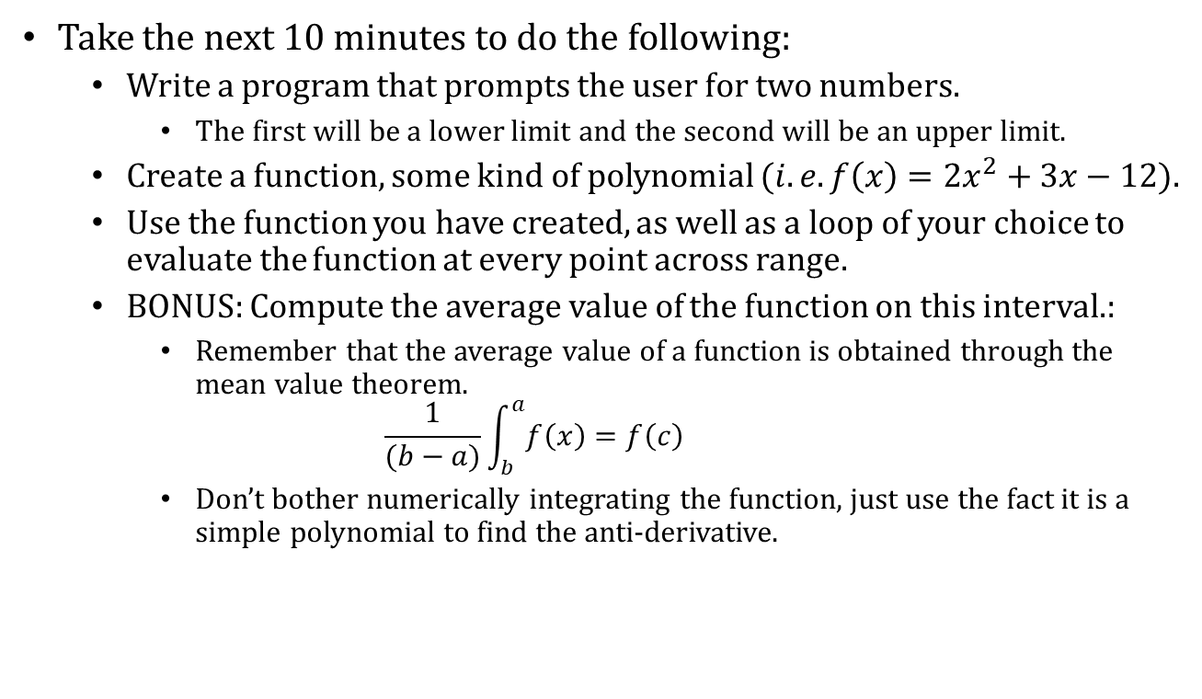
Exercise
Take the next 10 minutes to do the following:
  Write a program that prompts the user for two numbers.
    The first will be a lower limit and the second will be an upper limit.
  Create a function, some kind of polynomial $(i.e. f\left(x\right)=2x^{2}+3x−12$).
  Use the function you have created, as well as a loop of your choice to evaluate the function at every point across range.
  BONUS: Compute the average value of the function on this interval.:
    Remember that the average value of a function is obtained through the mean value theorem.
    $$\frac{1}{(b−a)}\int_{b}^{a}{f\left(x\right)=f\left(c\right)}$$
    Don’t bother numerically integrating the function, just use the fact it is a simple polynomial to find the anti-derivative.

Slide 33
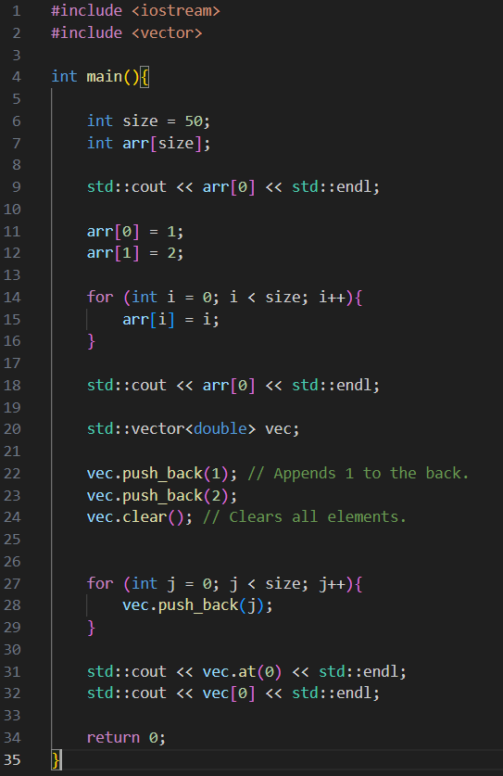
Arrays and vectors
Vectors and arrays serve a similar function. But are vastly different in execution.
  Both can store multiple instances of the same type (i.e. int, double, etc.).
Arrays are static entities (like structs).
  This means that they cannot change size after declaration.
  type array_name[size];
Vectors are dynamically sized entities.
  They can change size after declaration (although, be careful of memory constraints).
  std::vector<type> vector_name;
Each have their own respective functions.
  std::vector reference (https://cplusplus.com/reference/vector/vector/).
  std::array reference (https://en.cppreference.com/w/cpp/container/array).

Slide 34
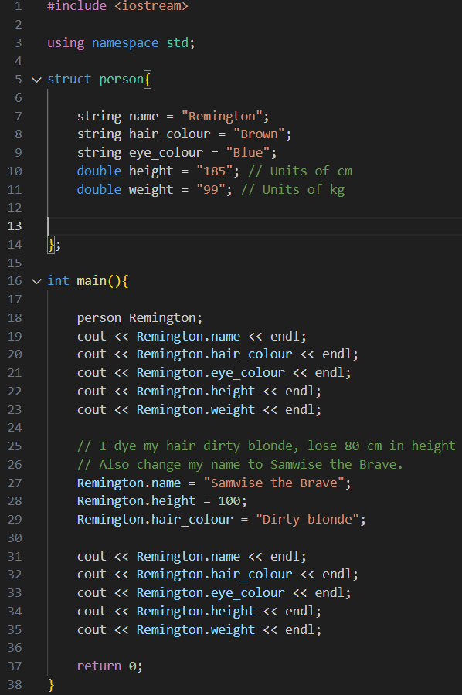
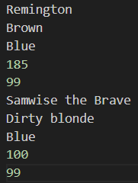
Structs
“Structures are aggregate data types”.
  Another way of saying collection.
What are some examples of ‘structures’ in real life?
  A person.
    Height, name, hair colour, etc.
  A SNOLAB experiment.
    Mass, live time, sensitivity, etc.
  Any others?
General structure for a struct is:
struct struct_name{..code..};
Do not forget the semi-colon!
Let us go through this example.

Slide 35
Classes
Classes are a more complicated struct.
  Very similar construction.
They allow you to privatize or publicize variables and functions.
Like structs, classes have an optional requirement(s):
  Constructor: allows the user to specify what functions are called, variables are set, etc. when the class object is first created.
  Destructor: allows the user to specify what happens to the class variables at the end of the program.
  We won’t talk about this much here.
Let us consider an example:
  Suppose we wanted to create a class that represented each experiment at SNOLAB.
  What sort of variables, functions, etc. would we need?
Let us do this together!

Slide 36

Zork project! (30 minutes)
Ever heard of Zork?
  Text-based adventure game; released back in the 1970s and 80s.
Design a program that includes the following:
  Create a C++ class for the character.
    Include health, attributes, items.
  Create a set of narrative conditions that asks the user to choose what to do.
    Each narrative condition can be represented by a function.
    Use control statements to change to different functions.
  Make sure to ask for user input at each step.
  In the time that you have, try and have at least three prompts; update you character if they take damage, acquire an item, etc.
I will be walking around and helping.
  Feel free to work in groups.

Slide 37
Conclusions
Throughout this talk we have established the basics of how to write in C++.
  We looked at the different data types in C++ and how to perform basic numerical operations on them.
  We established some of the basics for defining your own functions, while also talking about prototyping and overloading.
  Arrays and vectors were introduced to give you an introduction on where each might be more appropriate or better to use.
  We discussed classes and structs that will allow you to interpret more complex C++ code and organize your own analysis work.
I strongly encourage you to all attend the talk by Philippe next week on ROOT.
  Between now and then play around with C++ and see if you can begin to write more complex scripts.
  ROOT is a toolset used by many experiments; it will help to have experience with it.
If you ever have any questions or comments, feel free to stop by my cubical or reach out via email: remington.hill@queensu.ca.

Slide 38
Thank you for listening! Questions?
38

