Slide 1


PICO Collaboration
(Bubble Chambers)
Emily Adams, Michaela Robert
EIEIOO 2024

Slide 2
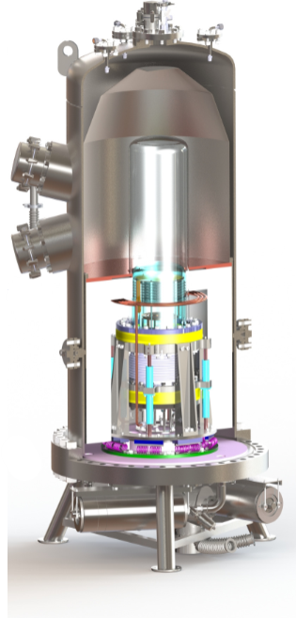
Agenda
Intro to bubble chambers
PICO as a dark matter detector
PICO history
Detector components
Compression cycle
Seitz Model
PICO backgrounds
PICO data
Dark matter search
PICO-40L cross section rendering

Slide 3
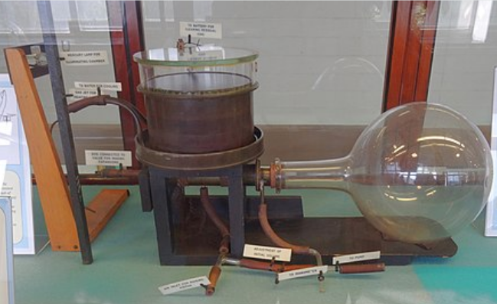
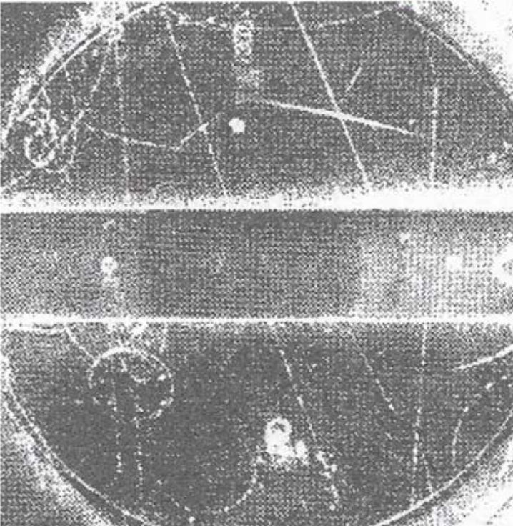



Before the Bubble Chamber…
The Cloud Chamber
1911 → Invented by C. Wilson in 1911
1927 → Awarded Nobel Prize
Incoming particle ionizes supersaturated vapour (usually water or alcohol) inside the chamber
Vapour condenses around the resulting ions, creating misty tracks of liquid droplets
Particles identified by physical characteristics of the tracks
Used to study cosmic rays
  Discovery of positron and muon
  Strange particles (‘pothooks’) first observed → motivation for the bubble chamber!
Original Cloud Chamber - C.T.R. Wilson
$$K^{+}→μ^{+}+ν_{μ}$$
$$K^{+}$$
Kaon Decay
$$μ^{+}$$
Notes:
Alpha – thick and straight
Beta – thin, deflections evident
K+ = up, antistrange

Slide 4
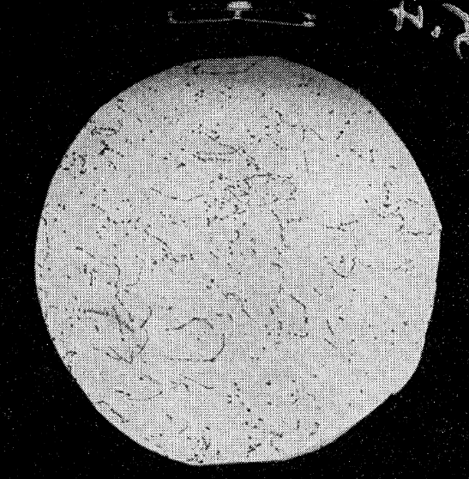
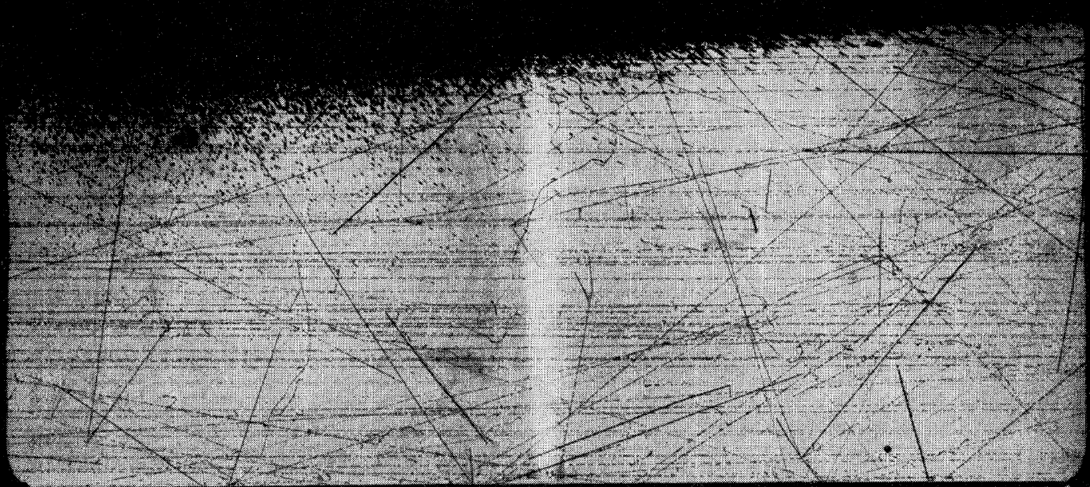
Glaser’s Bubble Chamber
1952 → Invented by D. Glaser in hopes of faster collection of ‘pothook’ events
1960 → Nobel Prize
Large chambers of pressurized liquid which could be expanded to achieve superheated state
Incoming charged particles create ionization tracks in the fluid
Energy deposition causes boiling (bubbles) along the track
Output data were camera images that were printed on thousands of meters of film
Electron tracks in an ether filled bubble chamber (left) and 2 BeV proton tracks in an iso-pentane chamber (right) (Glaser, 1954)
Notes:
https://blog.sciencemuseum.org.uk/the-art-of-boiling-beer-60-years-of-the-bubble-chamber/
Advantages over cloud chambers: can be made bigger and more dense
Used heavily throughout the 1960s to study charged particles and other interactions
Exploited in CERN’s (at that time) brand new and largest accelerator, Proton Synchrotron
(https://cerncourier.com/a/in-the-tracks-of-the-bubble-chamber/)

Slide 5
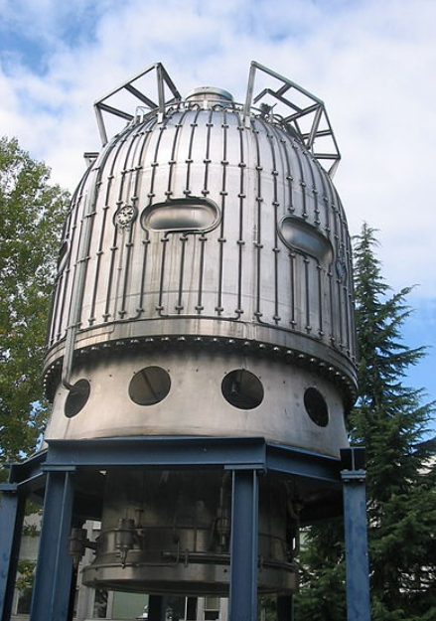
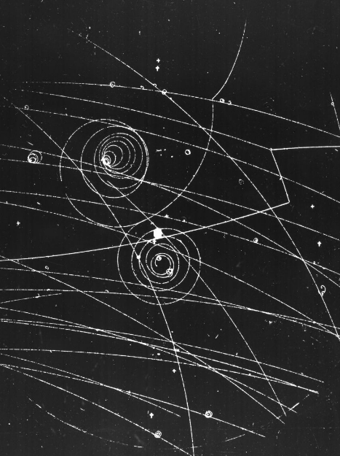
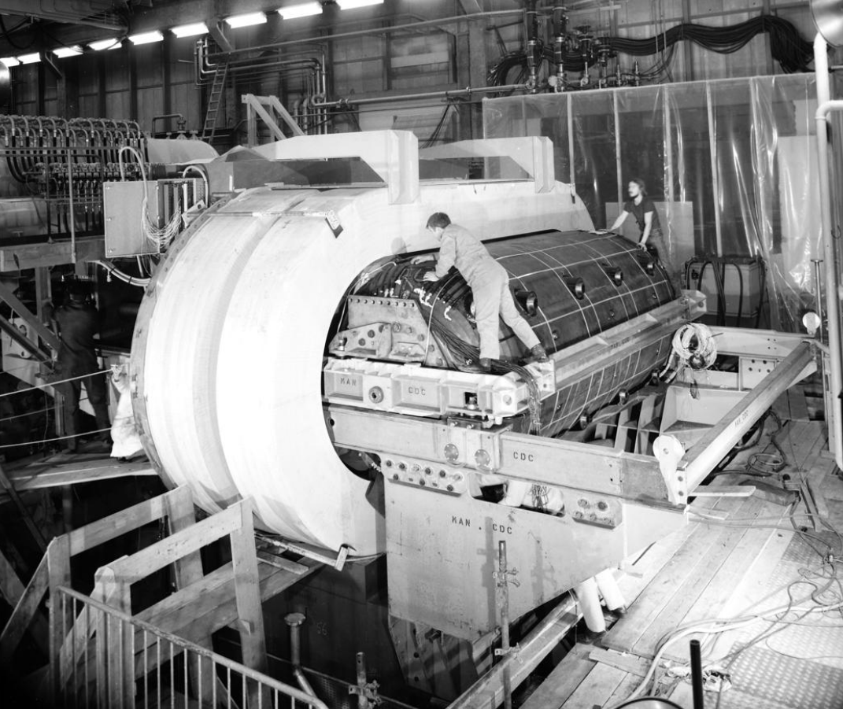
Bubble Chambers
Big European Bubble Chamber
35 cubic metres of liquid hydrogen, deuterium, or neon hydrogen mixture
3.5T magnet
Gargamelle
Designed to detect neutrinos
First evidence of Z⁰ boson
10 tonnes of liquid CF3Br
2T magnet
Notes:
https://blog.sciencemuseum.org.uk/the-art-of-boiling-beer-60-years-of-the-bubble-chamber/
Advantages over cloud chambers: can be made bigger and more dense
Used heavily throughout the 1960s to study charged particles and other interactions
Exploited in CERN’s (at that time) brand new and largest accelerator, Proton Synchrotron
(https://cerncourier.com/a/in-the-tracks-of-the-bubble-chamber/
Gargamelle
Operatued in proton synchrotron muon neutrino beam

Slide 6
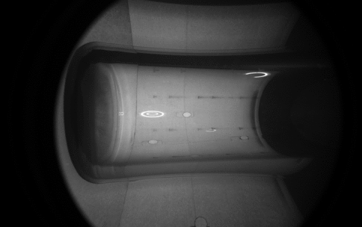


Bubble chambers as WIMP Detectors
WIMPS, neutral particles with tiny cross sections, can be detected in bubble chambers through nuclear recoils:
Kinetic energy is transferred from dark matter to a target nucleus in the superheated fluid through spin-independent or spin-dependent interactions
Resulting signal expected to look like neutron signal
$$χ$$
$$χ$$

Slide 7
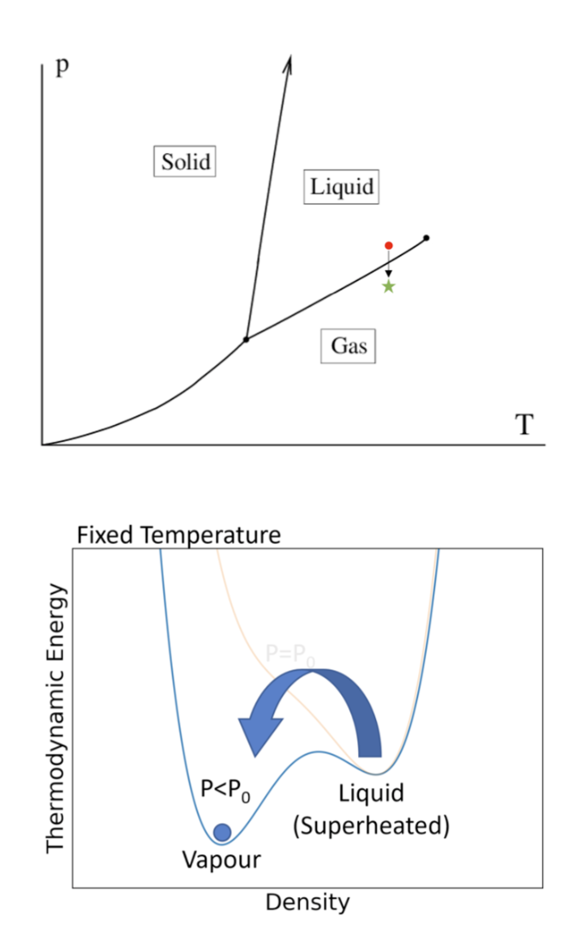
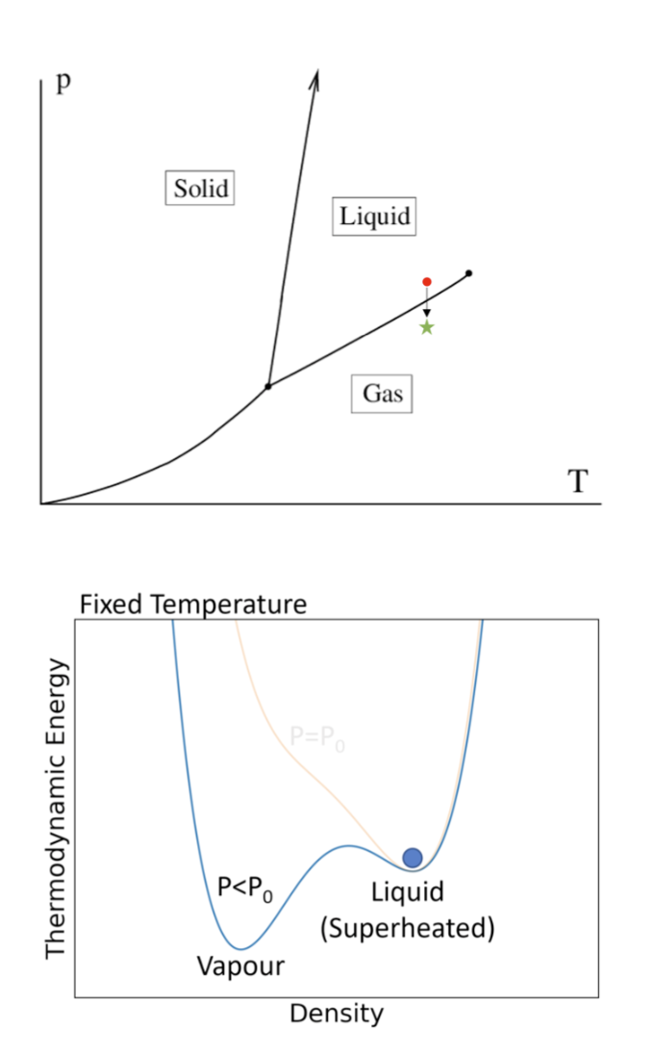
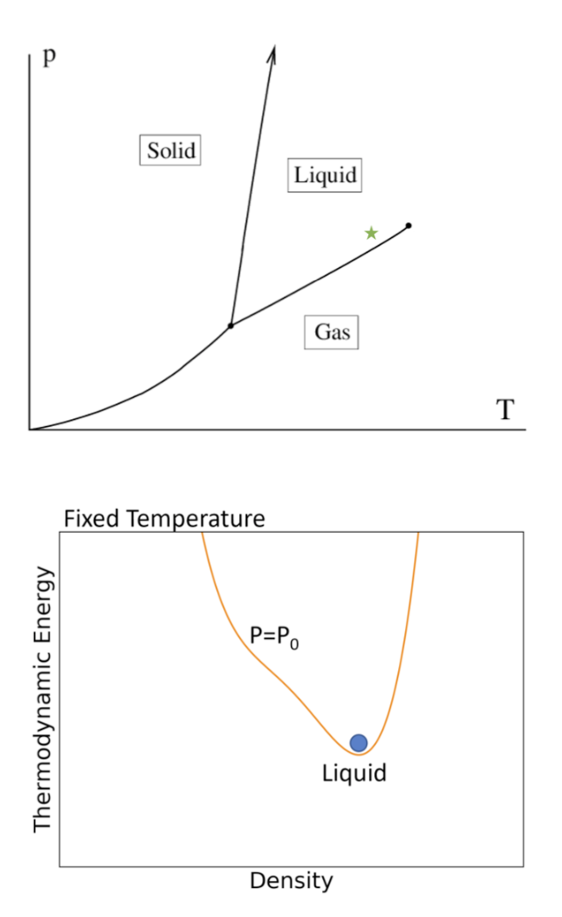
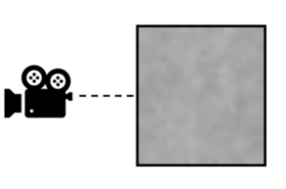
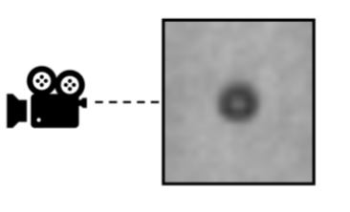
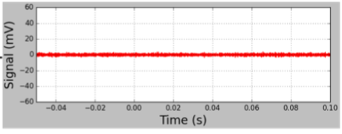
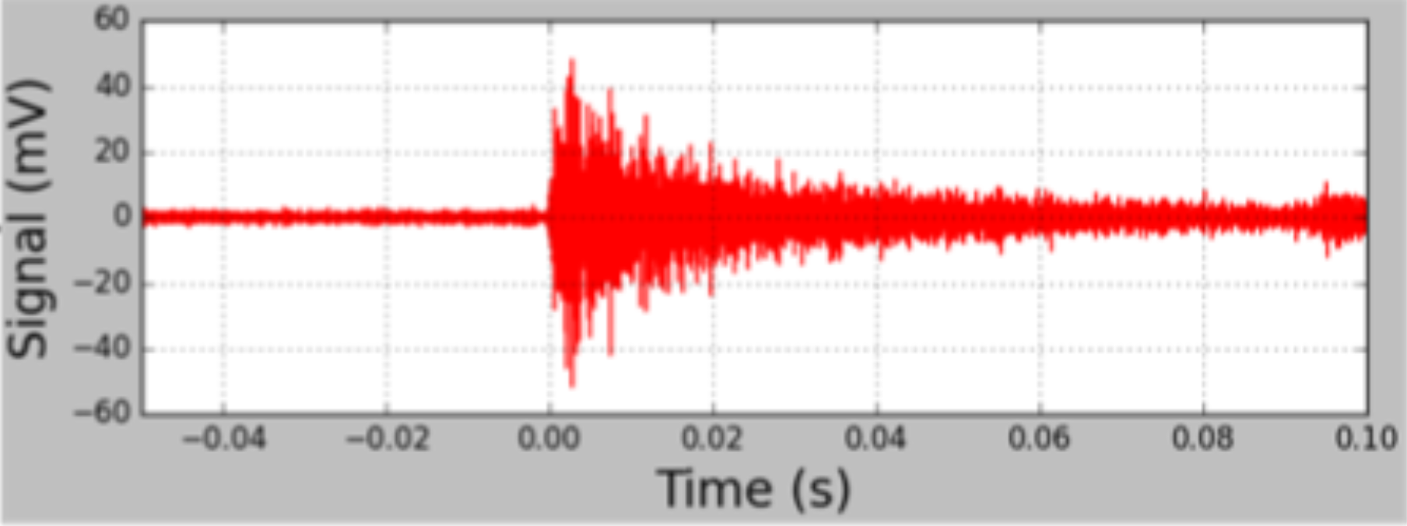

PICO Bubble Chamber Overview
$$E_{R}>Q_{Seitz}$$
Pressure Control
Minya’s cool animation

Slide 8
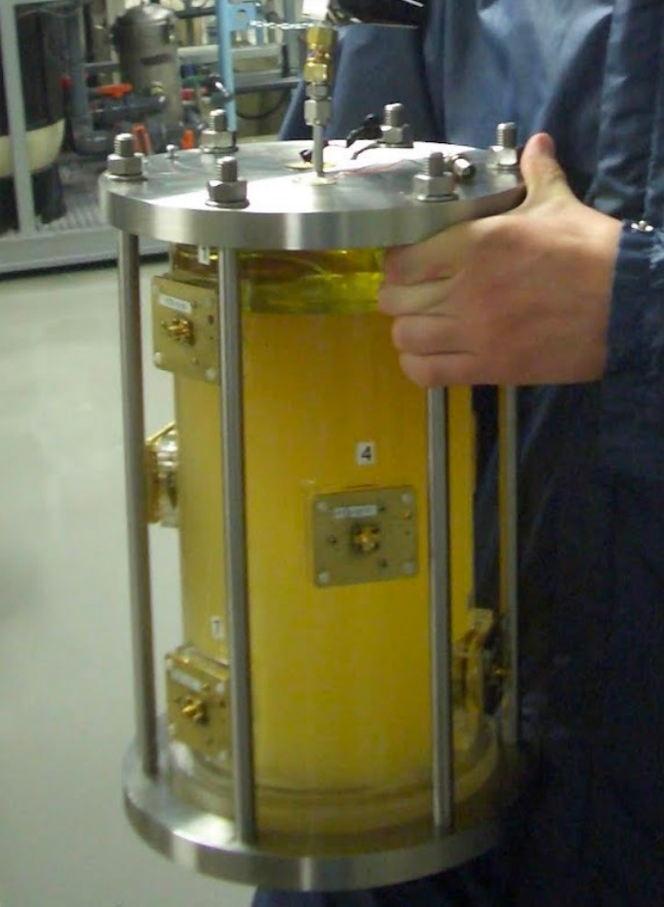
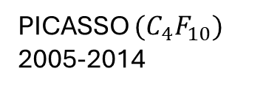
History of PICO Bubble Chambers
PICASSO ${(C}_{4}F_{10})$
2005-2014

Slide 9
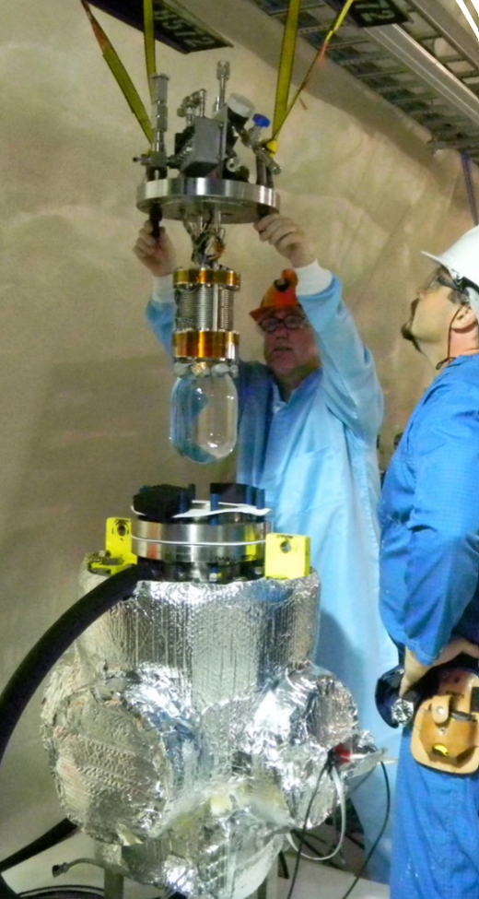
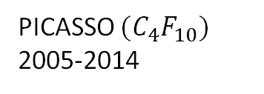
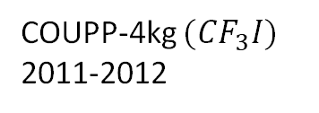
History of PICO Bubble Chambers
PICASSO ${(C}_{4}F_{10})$
2005-2014
COUPP-4kg $(CF_{3}I)$
2011-2012

Slide 10
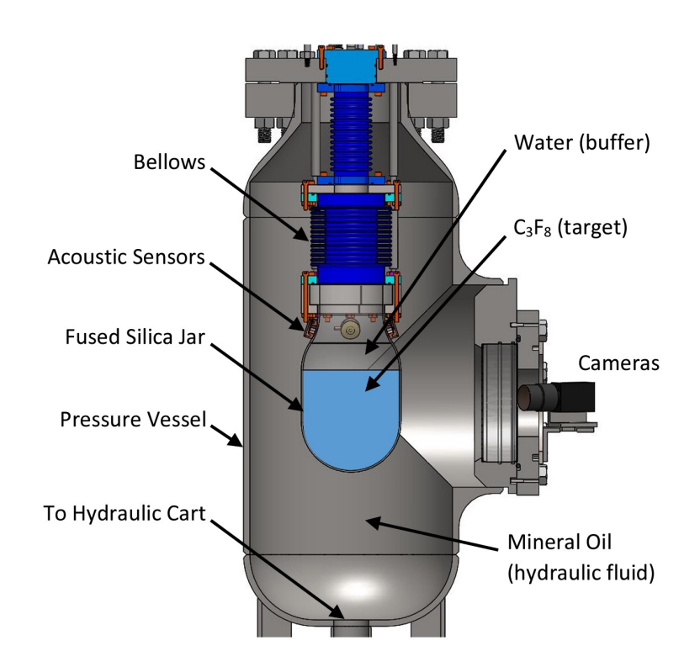
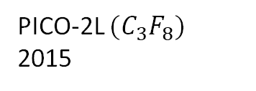
History of PICO Bubble Chambers
+
=
PICASSO ${(C}_{4}F_{10})$
2005-2014
COUPP-4kg $(CF_{3}I)$
2011-2012
PICO-2L ${(C}_{3}F_{8})$
2015

Slide 11
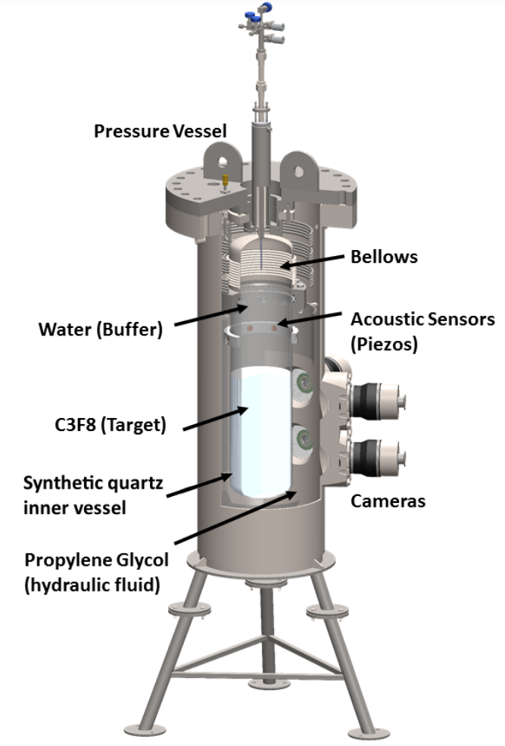
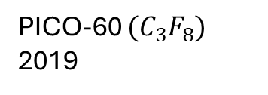
Evolution of PICO Bubble Chambers
PICO-60 ${(C}_{3}F_{8})$
2019

Slide 12
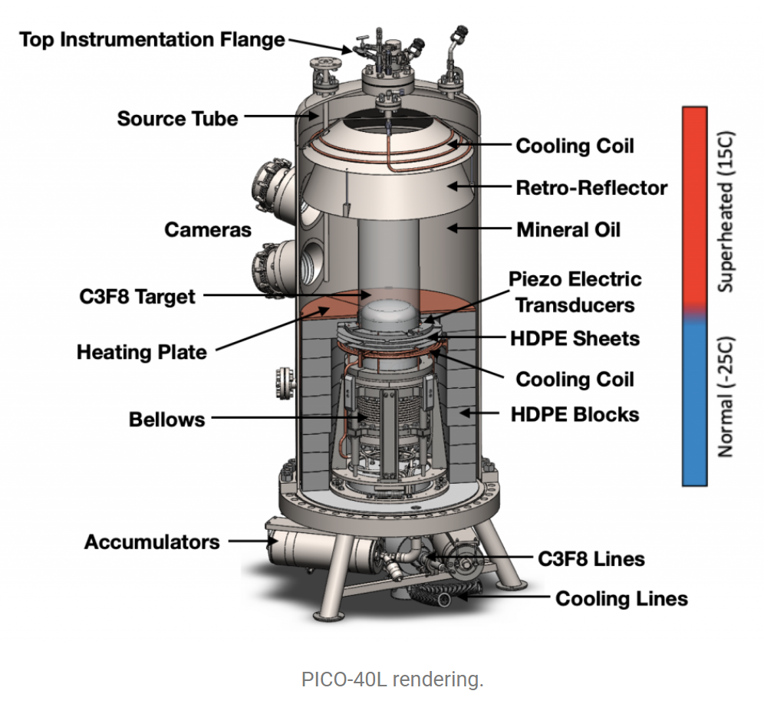
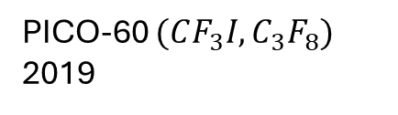
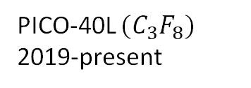
Evolution of PICO Bubble Chambers
PICO-60 ${(CF_{3}I, C}_{3}F_{8})$
2019
PICO-40L ${(C}_{3}F_{8})$
2019-present

Slide 13
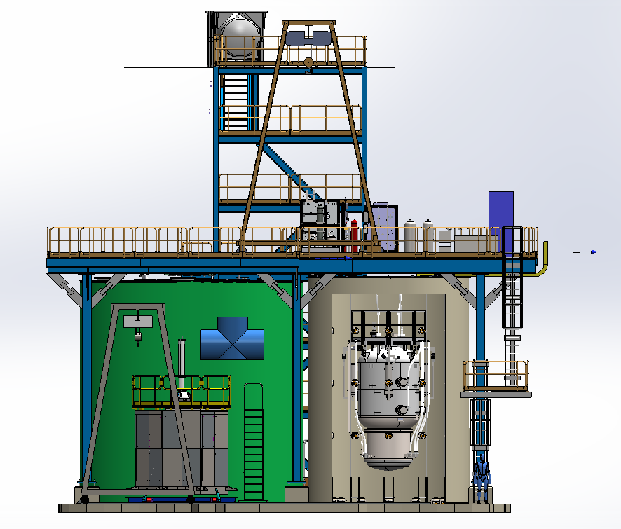
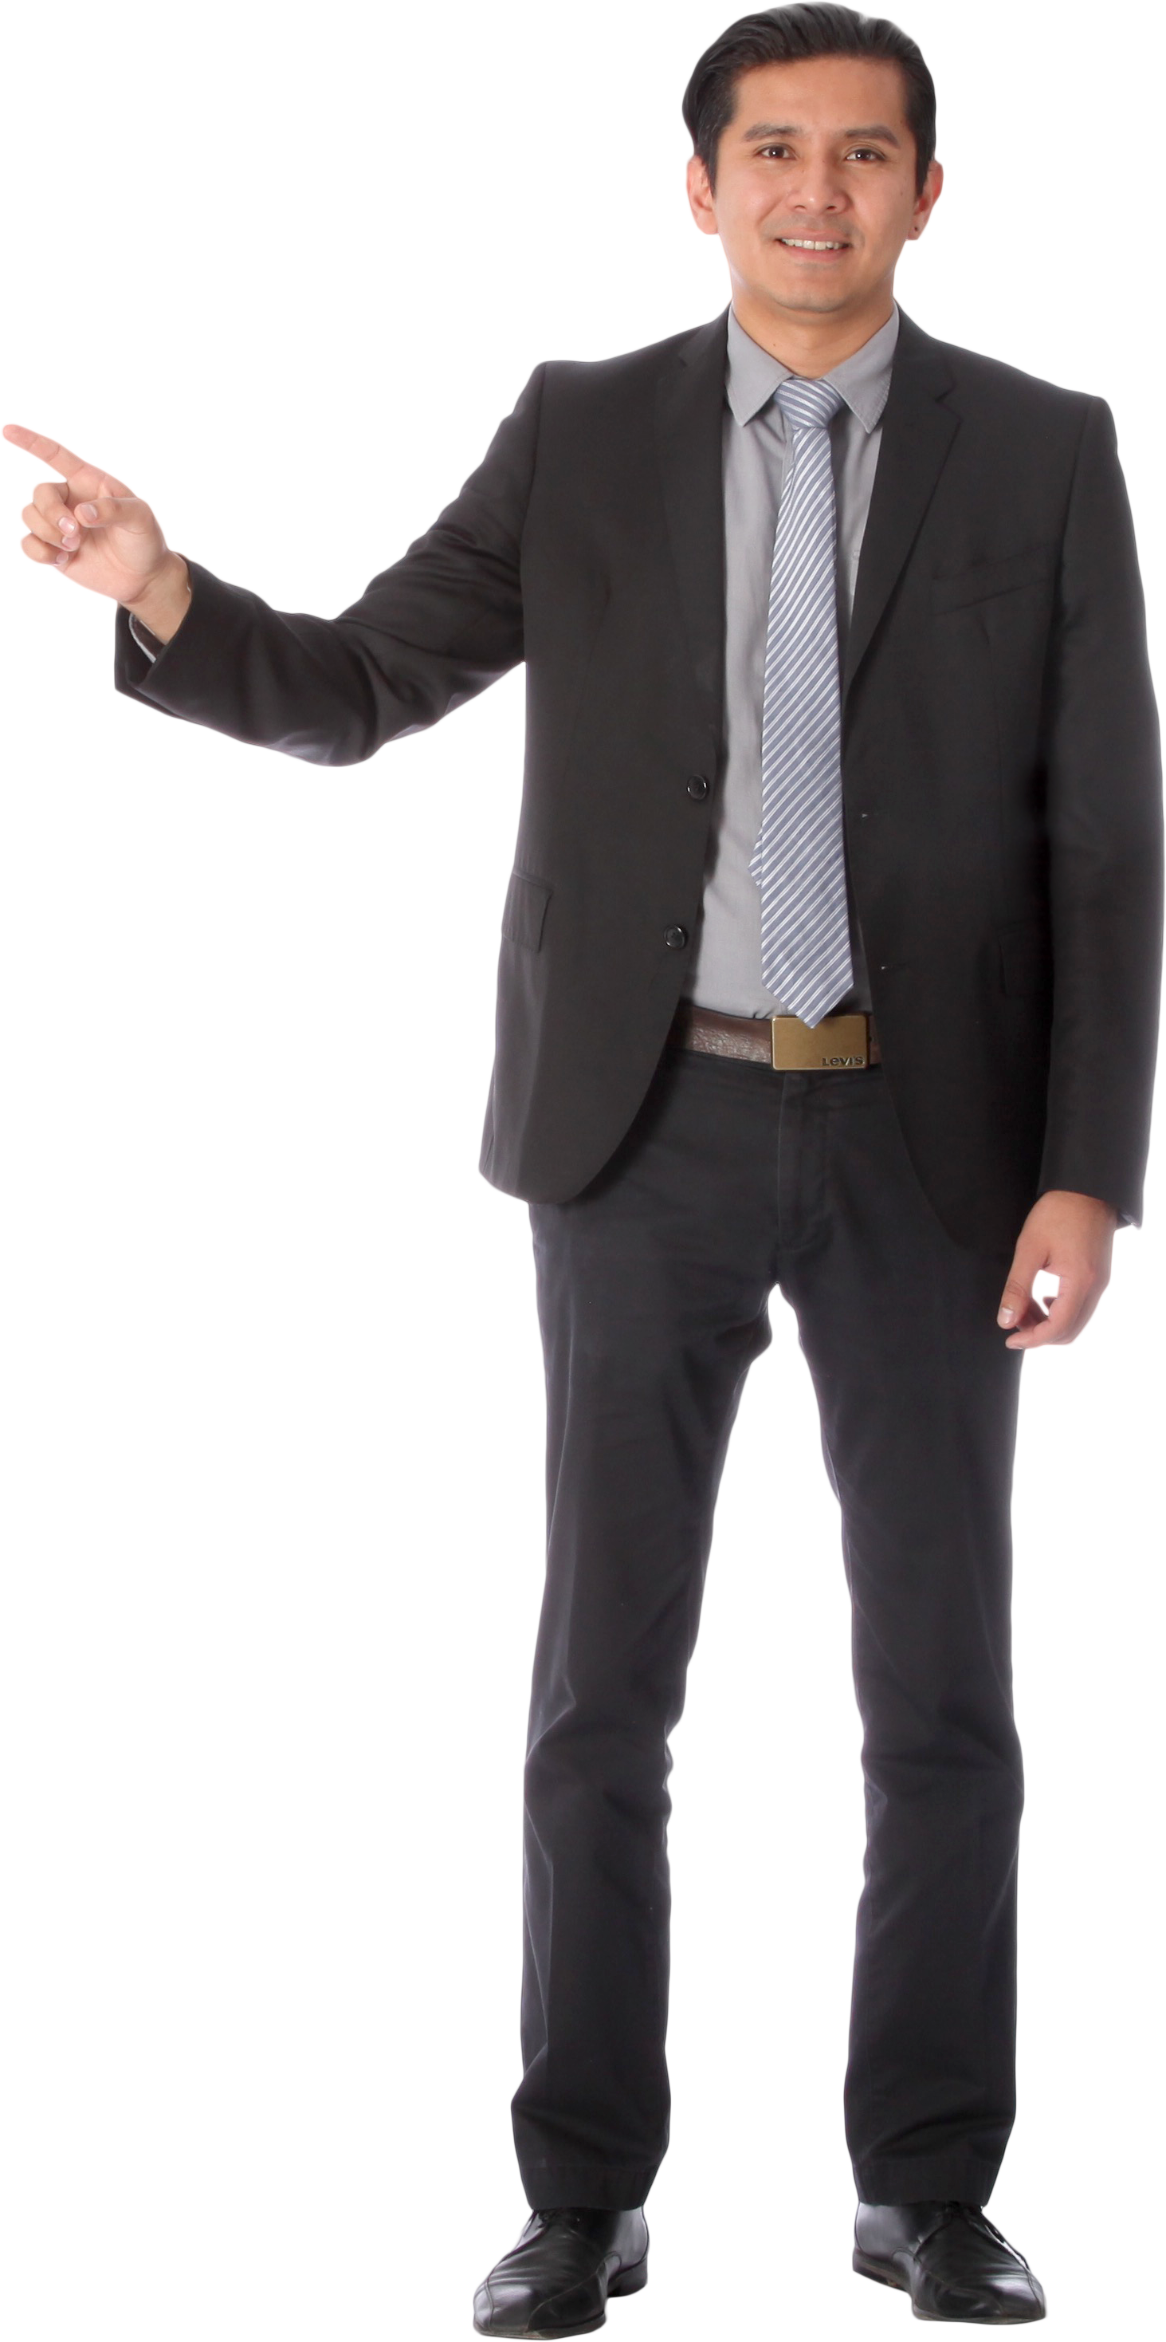
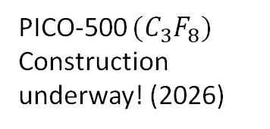
Evolution of PICO Bubble Chambers
PICO-500 ${(C}_{3}F_{8})$
Construction underway! (2026)
PICO-60 ${(CF_{3}I, C}_{3}F_{8})$
2019
PICO-40L ${(C}_{3}F_{8})$
2019-present

Slide 14
Major Components of PICO Chambers

Slide 15
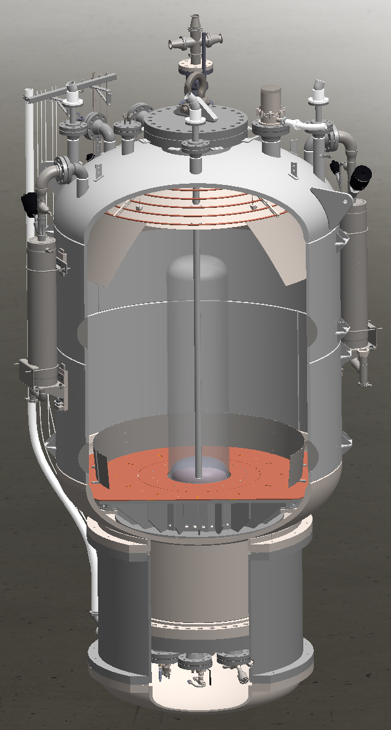
Pressure Vessel (PICO-500)
CRN R8904.5
Function
  Pressure coupled to Inner vessel via bellows
Design Pressure |  | 220 psig (internal) 32 psig (external)
Design Temp |  | +/- 100 C
Capacity |  | 9500 L (2510 gal)
Height |  | 220 in
Diameter |  | 84 in
Wall thickness |  | ¾ in
Mass | Empty | 19,850 lbs
 | Operating (water tank empty) | 50,500 lbs
 | Operating (water tank full) | 23,500 lbs
Material |  | 316L stainless steel

Slide 16
Pressure Vessel (PICO-500)
CRN R8904.5
Function
  Pressure coupled to Inner vessel via bellows
Design Pressure |  | 220 psig (internal) 32 psig (external)
Design Temp |  | +/- 100 C
Capacity |  | 9500 L (2510 gal)
Height |  | 220 in
Diameter |  | 84 in
Wall thickness |  | ¾ in
Mass | Empty | 19,850 lbs
 | Operating (water tank empty) | 50,500 lbs
 | Operating (water tank full) | 23,500 lbs
Material |  | 316L stainless steel

Slide 17
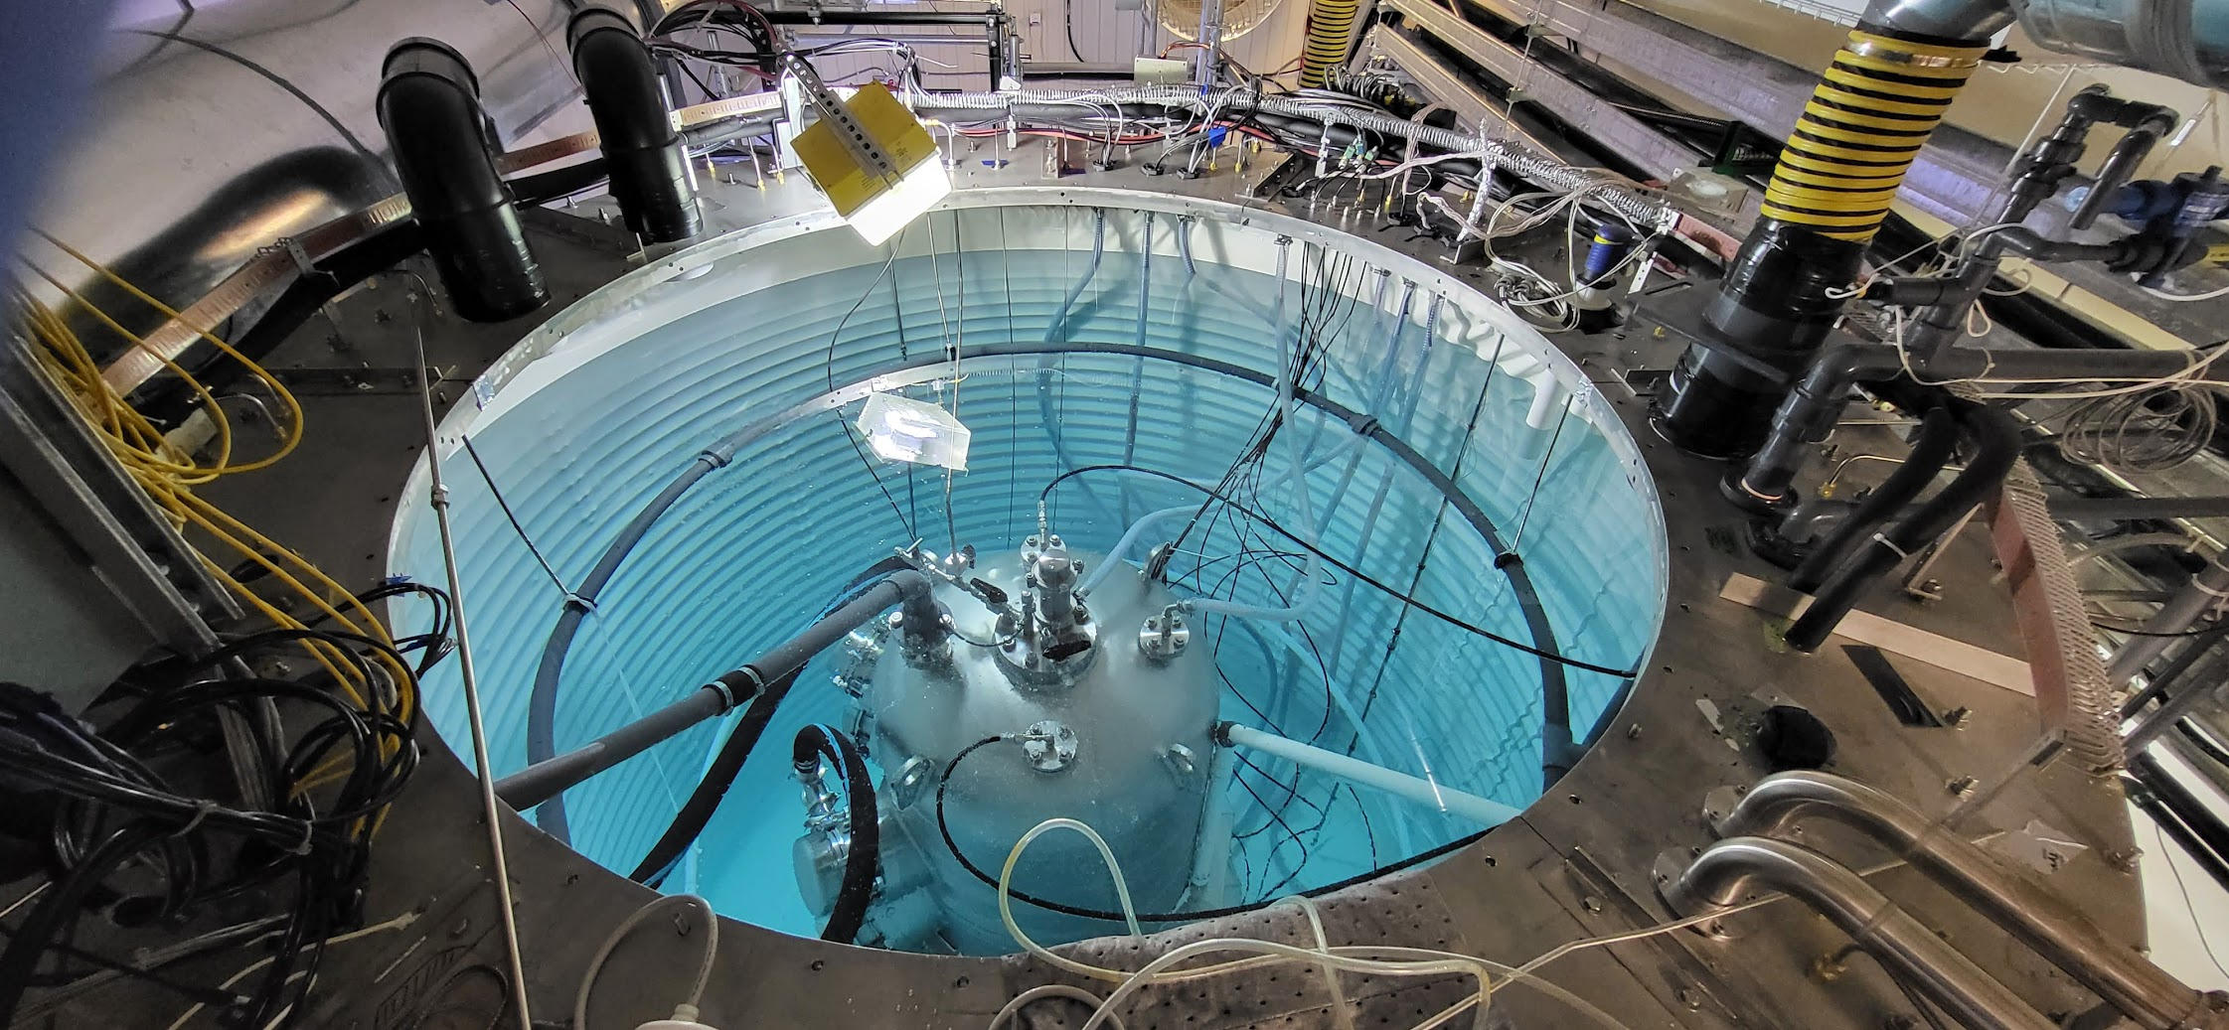
Water Tank (PICO-40L)

Slide 18
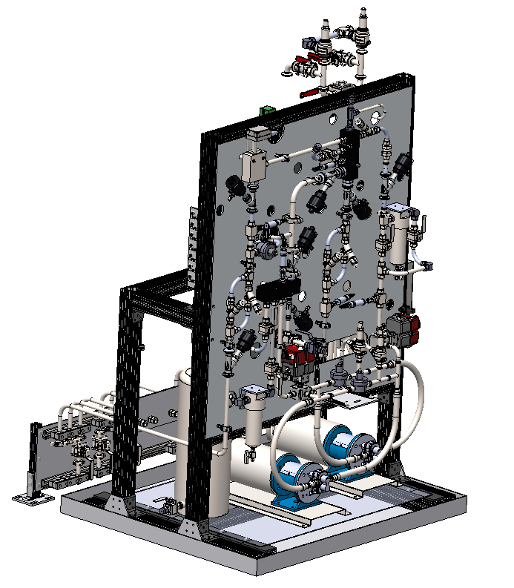
Hydraulic Cart (PICO-500)
‘Contains elements which control the movement of fluid (oil) in the system.’
Operation
Filling
Draining
Power failure, thermal expansion scenario
92.7 in
58.8 in
58.5 in

Slide 19
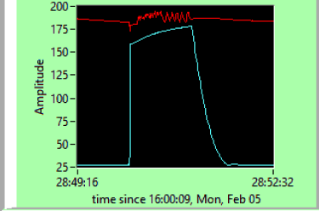
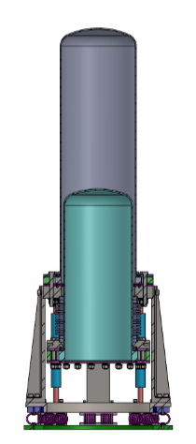
Compression cycle (PICO-40L monitoring)
L to R
Expanded state
Bubble forms
Fast compression
Slow compression
Expansion
Back to Expanded state

Slide 20
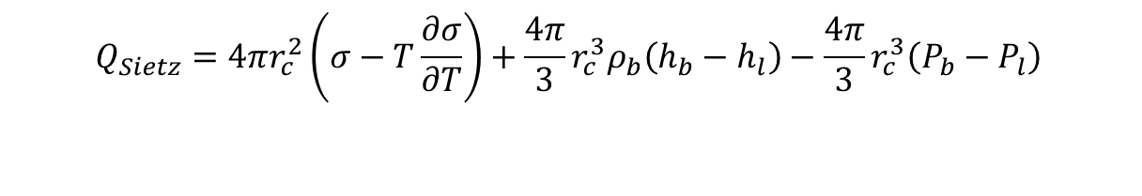
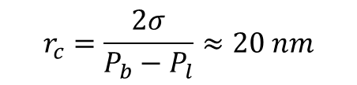
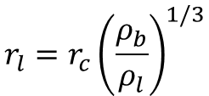
Seitz Bubble Nucleation Model
A critically sized bubble $(r_{c})$ will nucleate and continue to grow if a minimum amount of energy $(Q_{Seitz})$ is deposited within a small radius $(r_{l})$
$$r_{c}=\frac{2σ}{P_{b}−P_{l}}≈20 nm$$
for $C_{3}F_{8}$
$$r_{l}=r_{c}{\left(\frac{ρ_{b}}{ρ_{l}}\right)}^{1/3}$$
$$Q_{Sietz}=4πr_{c}^{2}\left(σ−T\frac{∂σ}{∂T}\right)+\frac{4π}{3}r_{c}^{3}ρ_{b}\left(h_{b}−h_{l}\right)−\frac{4π}{3}r_{c}^{3}\left(P_{b}−P_{l}\right)$$
Surface Tension
Phase Transition
Expansion of Vapour

Slide 21
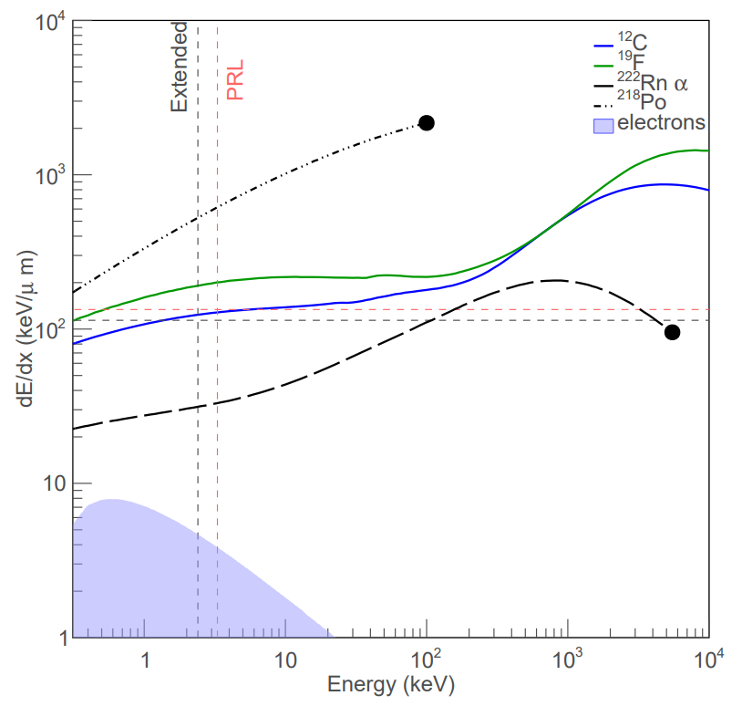
Stopping Power
Particles with higher stopping power are more likely to nucleate bubbles
Major advantage of bubble chambers: electron recoils are extremely inefficient at nucleating bubbles due to low stopping power
Detectors are designed to budget less than 1 gamma event in their dark matter search periods
P. Mitra (2018). PhD thesis
Notes:
Neutrons come from:
Radioactive impurities in detector materials
Induced by high energy gammas emitted after neutron or alpha captures in rock
Induced by cosmic muons – muon spallation, muons start EM showers and photons get absorbed by nuclei causing them to decay, hadronic cascades induced by muon
In order to achieve deposition of the threshold energy within a short enough track, the interacting particle needs to have a high enough stopping power – it must lose a certain amount of energy per unit length. This plot shows the stopping power for various particles of different energies. What we don’t want to see in our detector is gammas or electrons, and one of the main advantages about bubble chambers is that they are intrinsically nearly insensitive to electron recoils because of the low stopping power of electrons. We use a very very hot gamma source to probe those extremely rare electron recoil events to characterize the gamma rejection of the detector, and choose a threshold that is as sensitive as possible to wimps and as insensitive as possible to gammas.
Great, but you might notice we have a problem up here, especially with 222-Rn alphas, given that radon likes to settle to the floor, and we happen to be operating in the deepest underground physics lab on the planet.

Slide 22
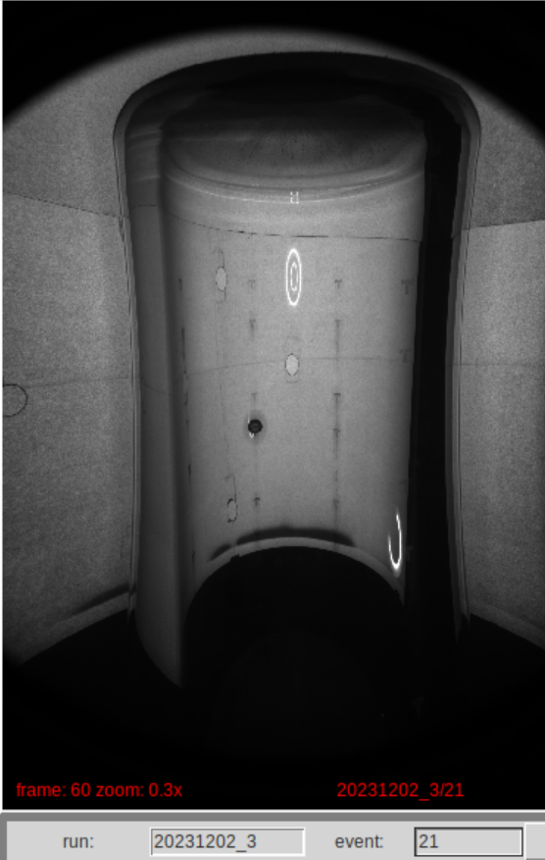
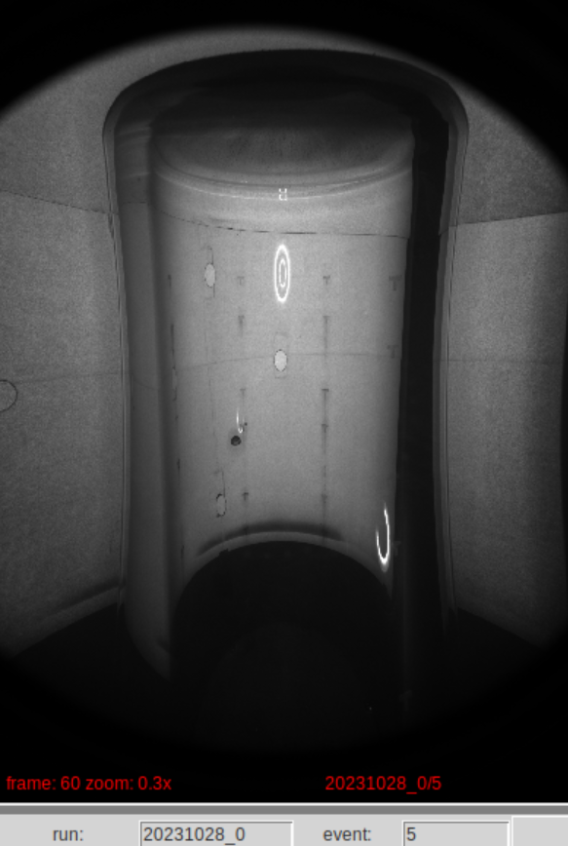
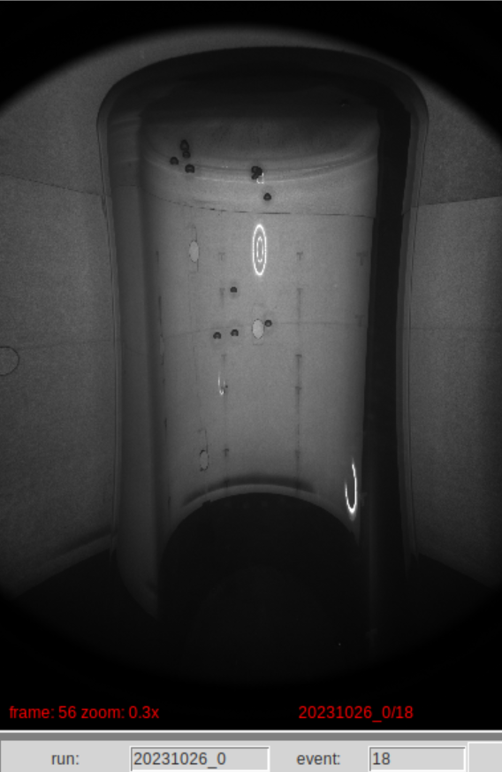
PICO Data: Optics
Alpha
Neutron (single)
Neutron (multiple)

Slide 23
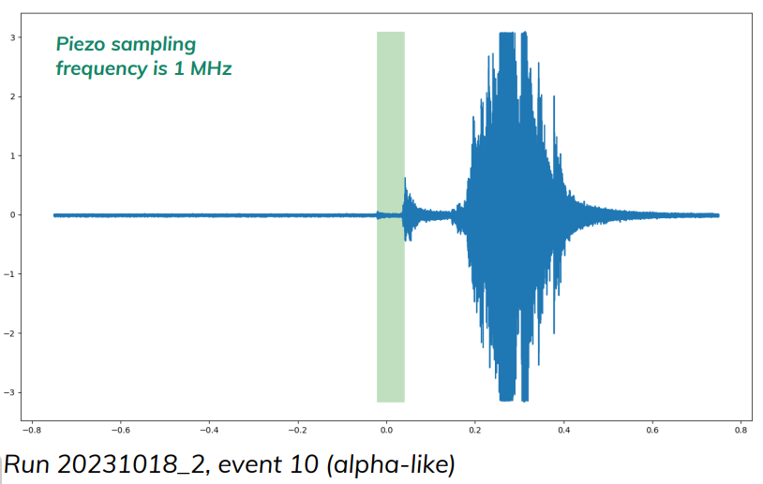
PICO Data: Acoustic Signal
Bubble
Recompression
Instrumentation

Slide 24
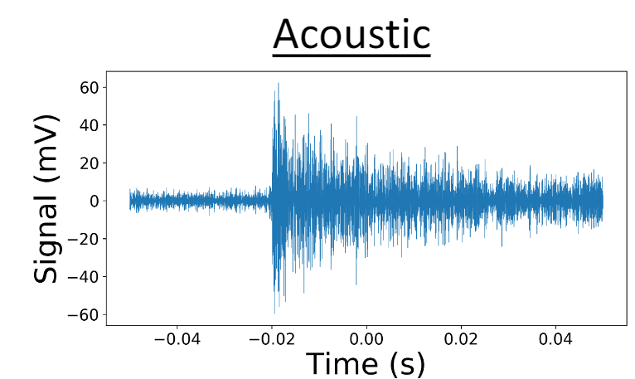
PICO Data: Acoustic Signal
Bubble
Recompression
Instrumentation

Slide 25
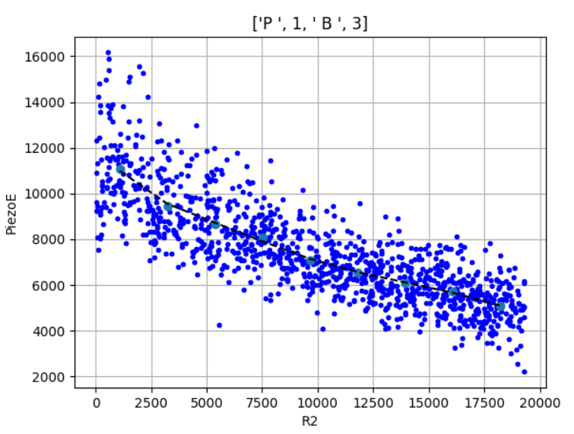
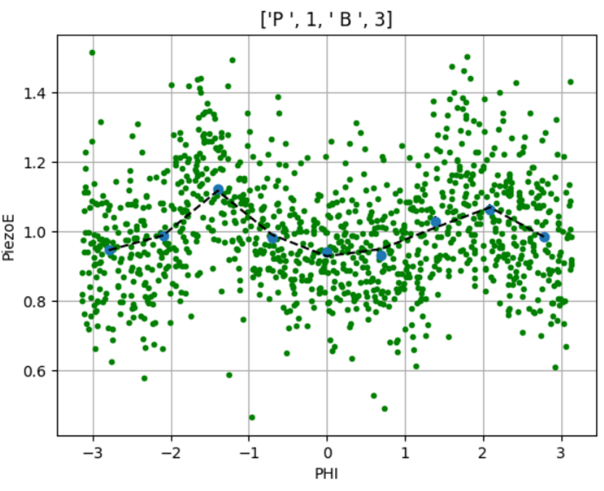
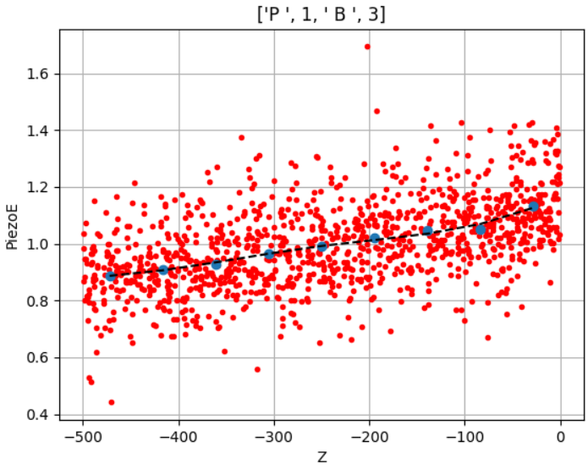
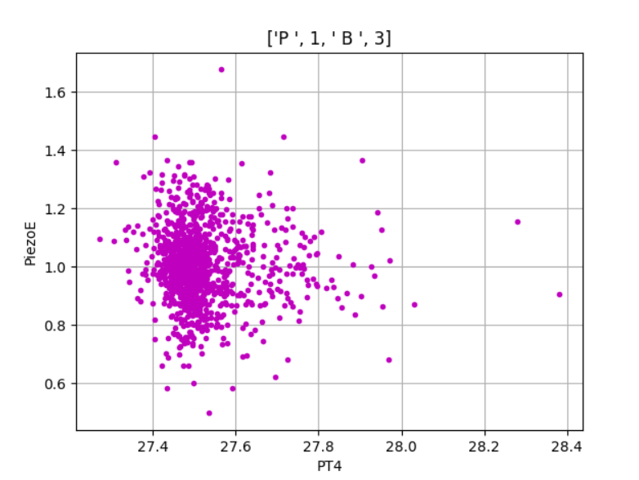
Position Corrections : Optics & Acoustics

Slide 26
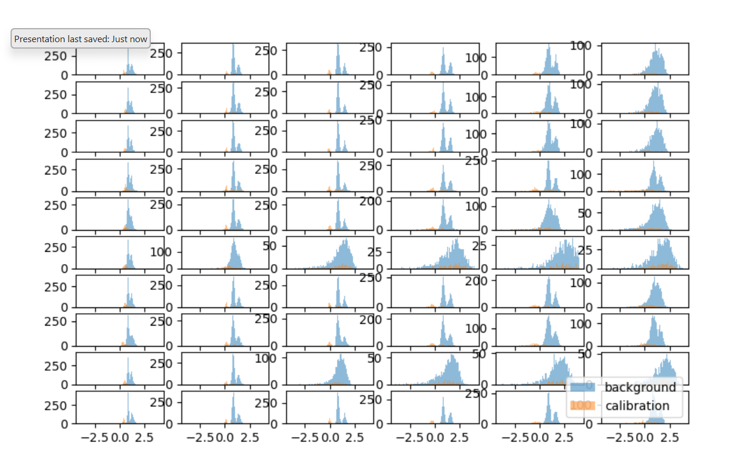
Acoustic Power
Frequency Bands
Piezometers

Slide 27

Particle Discrimination (PICO-60)
Acoustic Power

Slide 28
PICO’s Backgrounds
Alpha
Neutron (single)
Dark Matter (expected)
Optically, bubbles nucleated by alphas and neutrons look the same as we expect a WIMP-nuclear recoil to look

Slide 29

Neutron Multiplicity
Neutron (single)
Neutron (multiple)
Mean free path: average distance travelled by a particle in a medium between collisions
~cm for neutrons in C₃F₈
Statistics to pull single neutron signal out of dark matter search data
Notes:
$$λ=\frac{1}{\sqrt{2}πd^{2}N/V}$$

Slide 30


PICO-60 Complete Exposure
Spin Independent Spin Dependent

Slide 31


PICO Exposure Forecast
Spin-Independent Spin Dependent

Slide 32

Thank you! Any Questions?

Slide 33



Compression 1 (fast)
Notes:
Pneumatically actuated
Fast compression raises freon above P_liquid
0.2 seconds

Slide 34

Compression 2
Pump on
Notes:
Pumps engage to raise to P_compressed

Slide 35

Compression 2
Pump on

Slide 36

Expansion 1 (spontaneous)

Slide 37


Expansion 1 (spontaneous)

Slide 38
Expansion 1 (spontaneous)
CV-7306

Slide 39

Expansion 2 (LPA)

Slide 40

Expansion 2 (LPA)

Slide 41
Expansion 2 (LPA)
PCV-7522

Slide 42

PV Oil Filtration (circulation)
Pump on
Not part of compression cycle
New to PICO-500

Slide 43
PICO Bubble Chambers
Advantages
Disadvantages
Insensitive to electron recoils (depending on active fluid)
Alpha rejection using acoustics
Ability to change active fluid
  Use different nucleus targets
  Current target: Fluorine (SD WIMP-proton)
Variable thresholds
Large deadtime between events
Limited interaction energy information

Slide 44

PICO-500 Parameter Space
Notes:
Expanded state design pressure

Slide 45

Particle Discrimination (PICO-40L)
Counts

Slide 46

Seitz Threshold
$E_{T}=4πr_{c}^{2}\left(σ−T\frac{∂σ}{∂T}\right)+\frac{4π}{3}r_{c}^{3}ρ_{b}\left(h_{b}−h_{l}\right)−\frac{4π}{3}r_{c}^{3}\left(P_{b}−P_{l}\right)$, $P_{b}−P_{l}≥\frac{2σ}{r_{c}}$
where,
  $E_{T}$ = Seitz threshold
  $r_{c}$ = critical bubble radius
  T = temperature
  $ρ_{b}$ = bubble vapor density
  $h_{i}$= specific enthalpy of bubble vapor ($b$) or superheated liquid ($l$)
  $P_{i}$ = Pressure in bubble ($b$) or superheated liquid ($l$)
  $σ$ = surface tension
Bubble surface
Latent heat of vaporization
Expansion of Vapour
E. Behnke et al., First dark matter search results from a 4-kg CF3I bubble chamber operated in a deep underground site DOI: 10.1103/PhysRevD.86.052001
Notes:
Seitz threshold for bubble nucleation
untitled (queensu.ca)
Terms:
Helmholtz free energy of surface and heat absorption from surrounding
Latent heat of vapourization
Work to form bubble surface
r_c when the bubble gas pressure can overcome the surface tension and liquid pressure and depends on the fluid in use

Slide 47

Solar neutrino floor
https://physics.aps.org/articles/v14/96

Slide 48
WIMP-Nucleon Cross Section
$$σ_{OWN}=\frac{4μ_{A}^{2}}{π}{\left[Zf_{p}+\left(A−Z\right)f_{n}\right]}^{2}+\frac{32G_{F}^{2}μ_{A}^{2}}{π} \frac{J+1}{J}{\left(a_{p}\left\langle S_{p}\right\rangle +a_{n}\left\langle S_{n}\right\rangle \right)}^{2}$$
Spin-independent
Spin-dependent

Slide 49
PICO Detector Operation
Gibb’s Potential
C₃F₈ Pressure
Density
Time
Oil
Pressure Vessel
C₃F₈
Outer Jar
Inner Jar
Bellows
Notes:
Let’s look at the structure of these detectors. We need a variable volume vessel to contain our freon, because we need to control its pressure. To do that, we attach a “small” quartz jar to a bellows, which looks a bit like an accordion tube, it can expand and contract its length, and sealing the freon between the inner jar/bellows, and the outer jar. We put that inside of a pressure vessel filled with oil, so that when we pressurize the oil, it pushes the inner jar further into the outer jar, shringking the freon volume, thereby increasing the pressure.

Slide 50
PICO Detector Operation
P₀
1. C₃F₈ is pressurized to stable liquid state
Density
Time
Oil
Pressure Vessel
C₃F₈
Outer Jar
Inner Jar
Bellows
Notes:
Initially we pressurize the freon so that it is in a stable liquid state, and its gibbs potential looks something like this

Slide 51
PICO Detector Operation
P₀
P < P₀
1. C₃F₈ is pressurized to stable liquid state
2. C₃F₈ volume is slowly expanded
Gas
Superheated
Density
Time
Oil
Pressure Vessel
C₃F₈
Outer Jar
Inner Jar
Bellows
Notes:
Then, we carefully expand the volume by decreasing the oil pressure, allowing the C3F8 to push the bellows back down until the C3F8 pressure roughly matches the oil pressure. Now the Gibb’s potential has evolved into something like this, where the freon would be most table as a gas, but its gotten stuck in a local minimum that corresponds to a superheated state.

Slide 52
PICO Detector Operation
P₀
P < P₀
1. C₃F₈ is pressurized to stable liquid state
2. C₃F₈ volume is slowly expanded
3. Detector waits for a bubble in superheated state
Gas
Superheated
Density
Time
Oil
Pressure Vessel
C₃F₈
Outer Jar
Inner Jar
Bellows
Notes:
Now we wait, with cameras and pressure transducers monitoring for signs of a bubble

Slide 53
PICO Detector Operation
P₀
P < P₀
Bubble expansion
1. C₃F₈ is pressurized to stable liquid state
2. C₃F₈ volume is slowly expanded
3. Detector waits for a bubble in superheated state
4. Incoming particle causes a nuclear recoil resulting in a bubble - images, pressure and acoustic data are recorded
Gas
Superheated
Density
Time
Oil
Pressure Vessel
C₃F₈
Outer Jar
Inner Jar
Bellows
Notes:
And eventually, some particle interacts with the freon, causing a nuclear recoil which triggers localized boiling near the interactions site – THE BUBBLE. Images, pressure and acoustkc data of the bubble growth are recorded

Slide 54
PICO Detector Operation
P₀
P < P₀
1. C₃F₈ is pressurized to stable liquid state
2. C₃F₈ volume is slowly expanded
3. Detector waits for a bubble in superheated state
4. Incoming particle causes a nuclear recoil resulting in a bubble - images, pressure and acoustic data are recorded
5. Detector compresses to collapse the bubble and reset for next event
Gas
Superheated
Density
Time
Oil
Pressure Vessel
C₃F₈
Outer Jar
Inner Jar
Bellows
Notes:
The DAQ system recognizes a bubble has formed and starts pumping oil back into the pressure vessel to compress the C3F8 and squeeze the bubble back into liquid form

Slide 55

Thermodynamics
Target volume is a liquid at standard atmospheric conditions
Gibbs free energy: liquid state

Slide 56


Seitz Threshold
Lower the pressure to create a superheated fluid
Gibbs global minimum potential now vapour state
The necessary energy to deposit for bubble formation is given by the Seitz threshold
$$Q_{Sietz}=4πr_{c}^{2}\left(σ−T\frac{∂σ}{∂T}\right)+\frac{4π}{3}r_{c}^{3}ρ_{b}\left(h_{b}−h_{l}\right)−\frac{4π}{3}r_{c}^{3}\left(P_{b}−P_{l}\right)$$
Surface Tension
Phase Transition
Expansion of Vapour

Slide 57

Thermodynamics
Lower the pressure to create a superheated fluid
Gibbs’ potential global minimum now vapour state
critical bubble radius: $r_{c}=\frac{2σ}{P_{b}−P_{l}}$
For $C_{3}F_{8}$: $r_{c}≈20nm$
‘Minimum radius of a bubble that will continue to grow’

