Slide 1
EIEIOO 2023 Machine Learning Session
Noah Rowe
Mark Anderson
Thursday May 11 2023

Slide 2
Session Timeline & Tutorial Setup
Machine learning presentation (Noah)
  ~45 minutes
Machine learning tutorial (Mark)
  ~1 hour
Before I start:
  Set up local environment for ML tutorial
  https://github.com/GePPCLab/NN-PSA-tutorial

Slide 3

Binder Image Error

Slide 4
Tutorial Setup
In terminal:
  git clone git@github.com:GePPCLab/NN-PSA-tutorial.git
  cd NN-PSA-tutorial
  python3 -m venv env
  source env/bin/activate
  python3 -m pip install --upgrade pip
  python3 -m pip install --upgrade setuptools wheel
  python3 -m pip install jupyter jupyterlab
  python3 -m pip install -r requirements.txt
  jupyter notebook

Slide 5
Machine Learning Presentation Outline
Machine learning overview and practices
Specific machine learning examples + use cases
Neural networks for particle physics
Neural networks
Outline notes:
Content is directed towards summer students
Content is very focused, not all-encompassing

Slide 6
What is Machine Learning
Artificial Intelligence
  Designing computer systems to mimic human intelligence
Machine Learning
  Subset of AI that learns from experience and without explicit learning inputs
Deep Learning
  Subset of ML that uses multi-layered neural networks to learn data preprocessing steps
Artificial Intelligence
Machine Learning
Deep Learning

Slide 7
Application of Machine Learning
Machine learning as a predictive technology
  “Is this image of a dog or a cat?”
  “What is the probability of a team winning a hockey game?”
  “What is the location of this signal in the detector?”
Why machine learning?
  Can learn complex and non-intuitive patterns and relationships within the data
    Often these are challenging to code and communicate accurately
  Can analyze large and complex datasets that are difficult to handle with traditional methods

Slide 8
Types of Machine Learning Prediction Problems
Supervised machine learning (defined input-prediction pairs)
  Regression
    Predicting a continuous numerical variable
    “What will the price of a stock be tomorrow”
  Classification
    Predicting a categorical variable
    “Is this email spam or not”
Unsupervised machine learning (no pre-defined classes/values)
  Clustering
    Group similar datapoints together based on inputs
      “Cluster these customers based on purchasing behaviour”
      “Cluster these pulses based on the recorded signal”

Slide 9
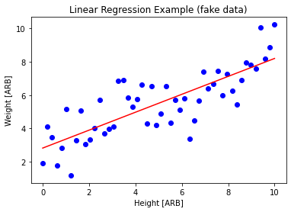

Machine Learning Examples: Linear Regression
Models the relationship between a dependent variable and one or more independent variables using a linear equation
$y=β_{0}+x_{1}∗β_{1}+x_{2}∗β_{2}+…+x_{n}∗β_{n}$

Slide 10
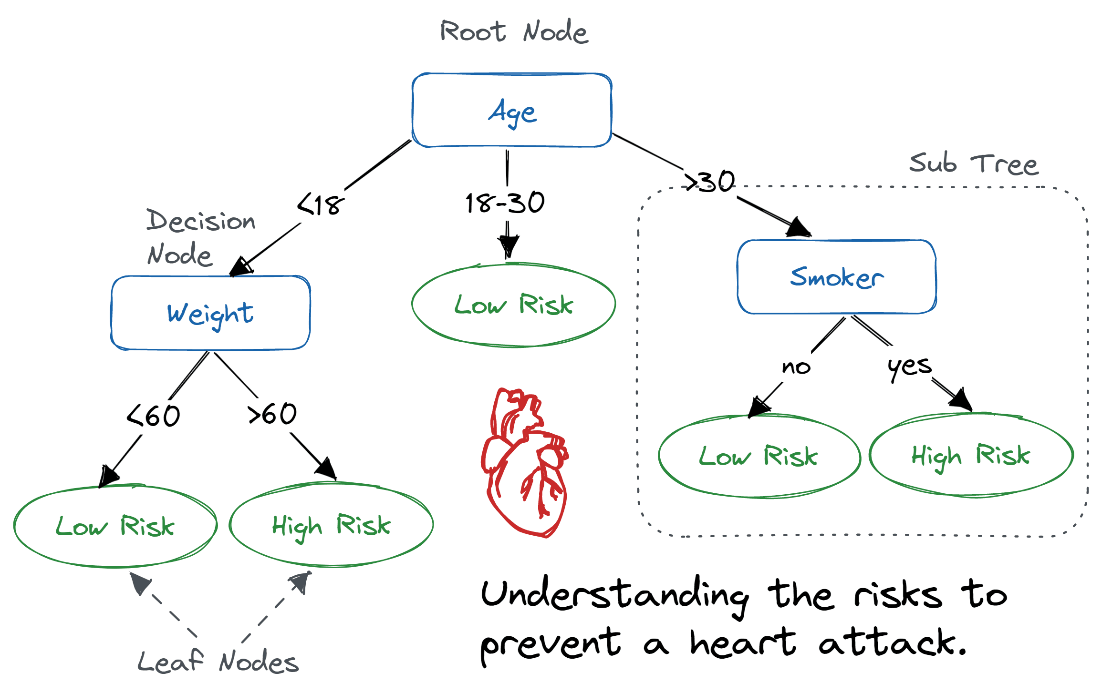
Machine Learning Algorithms: Decision Trees
A tree-based algorithm that recursively splits the data into smaller subset based on binary conditions
Learned parameters:
  Number of nodes/branches
  Node splitting condition
  Final leaf values
Can be used for classification or regression problems
https://www.datacamp.com/tutorial/decision-tree-classification-python

Slide 11
Machine Learning Algorithms: Decision Trees
Benefits:
  Easy to understand and interpret
  Easy to implement
  Low computational demand
Drawbacks:
  Often too simple for complex prediction problems
  Restrictive in how input are processed
  Very prone to overfitting

Slide 12
Note: Overfitting in Machine Learning
Overfitting is a common problem in machine learning
  Every machine learning algorithm can overfit
Occurs when a predictive model is trained too much on the training data
  Example: training a model to predict goals scored in a season by a hockey player
  Will see very good predictive performance on training data and poor performance on testing data
Can only be identified by testing the model on non-training data

Slide 13
Other Common Machine Learning Algorithms
Random forests
  Many decision trees trained in parallel
  Regression or classification
Logistic regression
  Adaptation of linear regression for classification
K-nearest-neighbours
  Calculates a distance metric between prediction input and existing data
  Predicts the value of the k-closest datapoints
  Regression or classification
Neural networks
Not a complete list!!!

Slide 14
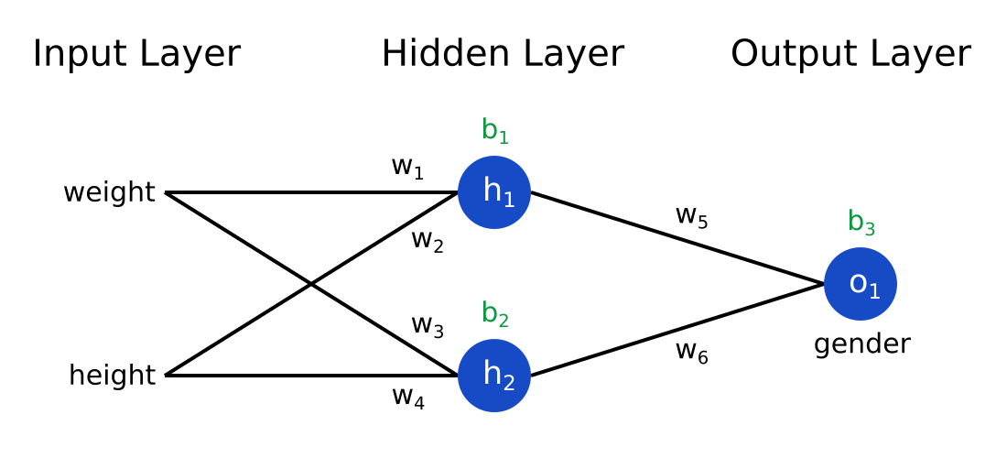
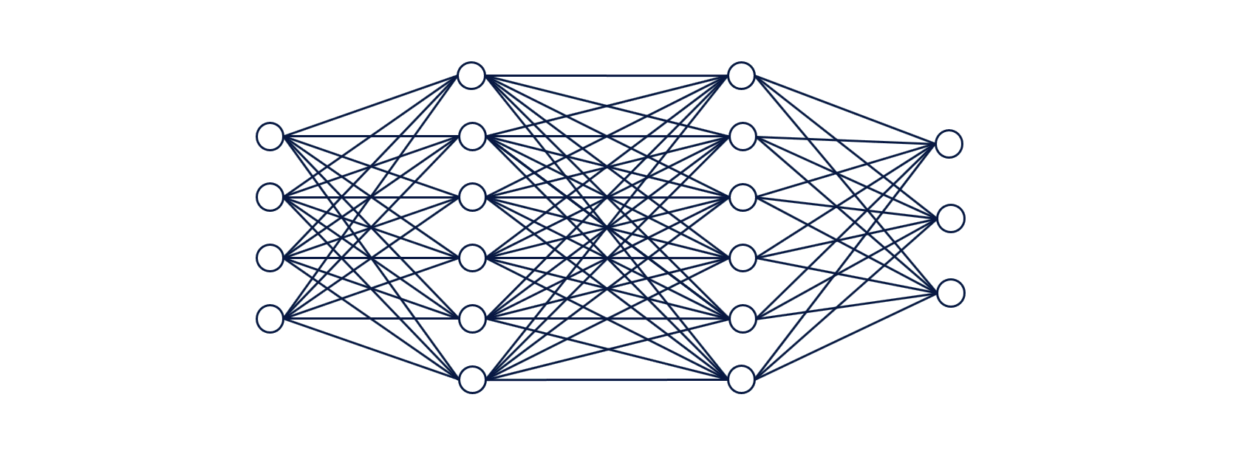
Neural Networks
Type of supervised machine learning algorithm
Modelled after the structure and function of a human brain
NN are defined by layers of nodes and weights that are pass information in the forward direction to arrive at a prediction
Network weights are updated by optimizing a loss function
  Loss function compares predicted values and true values to measure success
https://community.alteryx.com/t5/Data-Science/It-s-a-No-Brainer-An-Introduction-to-Neural-Networks/ba-p/300479
https://victorzhou.com/blog/intro-to-neural-networks/

Slide 15
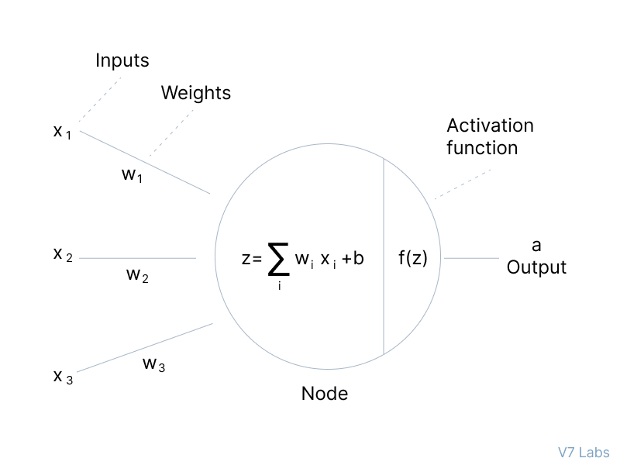
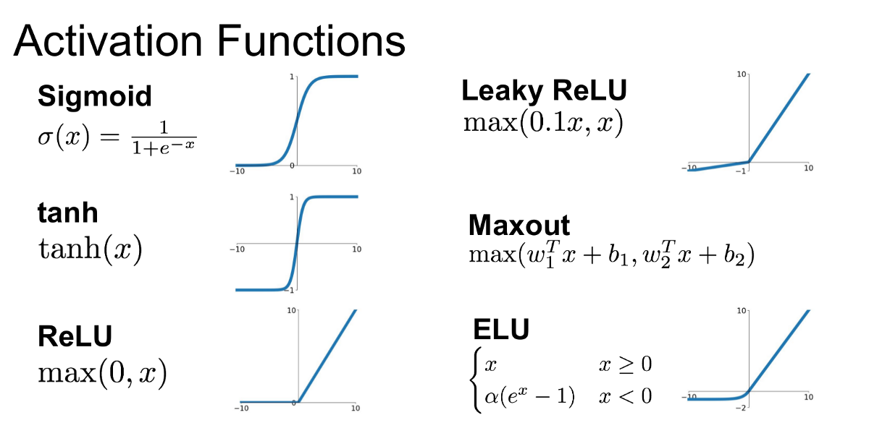
Neural Networks
https://medium.com/@shrutijadon/survey-on-activation-functions-for-deep-learning-9689331ba092
https://www.v7labs.com/blog/neural-networks-activation-functions

Slide 16
Neural Network Design Considerations
What type of input data do you have?
  Data normalization
  Data dimensionality
  Data size
  Data structure
    Text? Images? Time-series?
What are you trying to predict?
  Number of outputs
  Regression or classification
  Definition of success

Slide 17
Types of Neural Networks
Feedforward neural networks
Simplest type of network
Information flows from input layer through hidden layers to the output layer

Slide 18
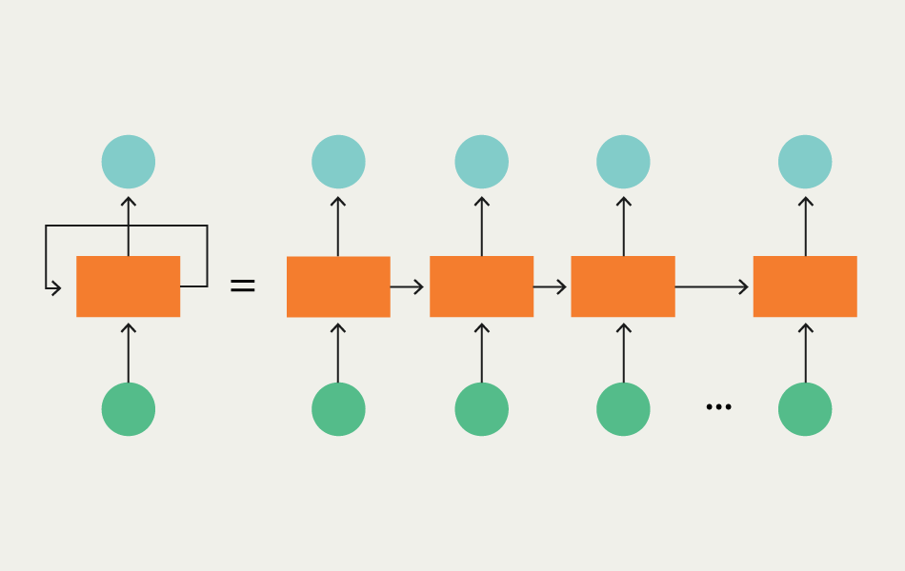
Types of Neural Network
Recurrent neural networks
Used for time-series or sequential data
  Speech recognition
  Stock price forecasting
  Language processing
Hidden layer output from previous datapoint used as input to next datapoint
https://www.v7labs.com/blog/recurrent-neural-networks-guide

Slide 19
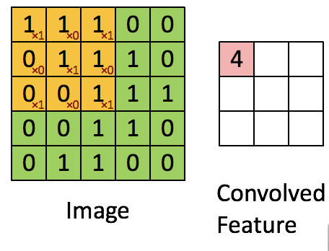
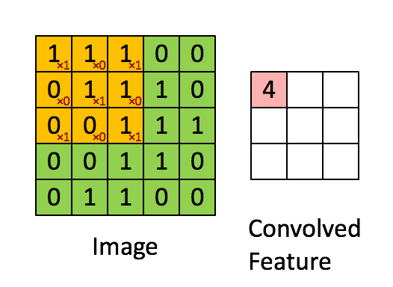
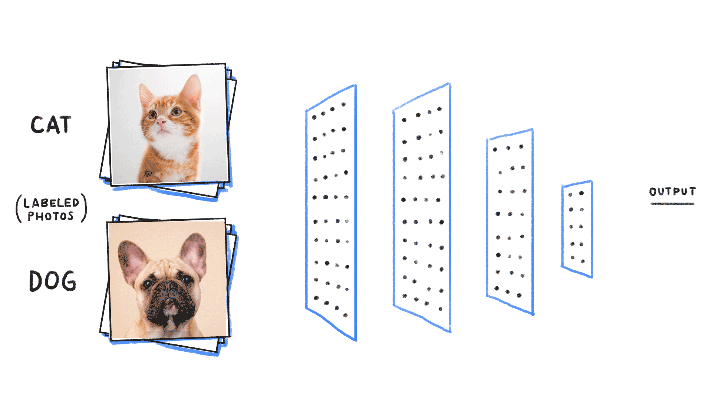
Types of Neural Networks
Convolutional neural networks
Primarily used in image-related applications
  Image/video classification
  Object detection
Use a unique type of network layer: convolutional layer

Slide 20
Question Break!
Covered so far:
Machine learning in general
Different (non-NN) machine learning algorithms
Neural networks
  Methodology
  Design considerations
  FNNs, RNNs, CNNs
Coming up:
Neural networks for particle physics (personal research)

Slide 21
Machine learning applications in NEWS-G
Noah Rowe
EIEIOO 2023

Slide 22
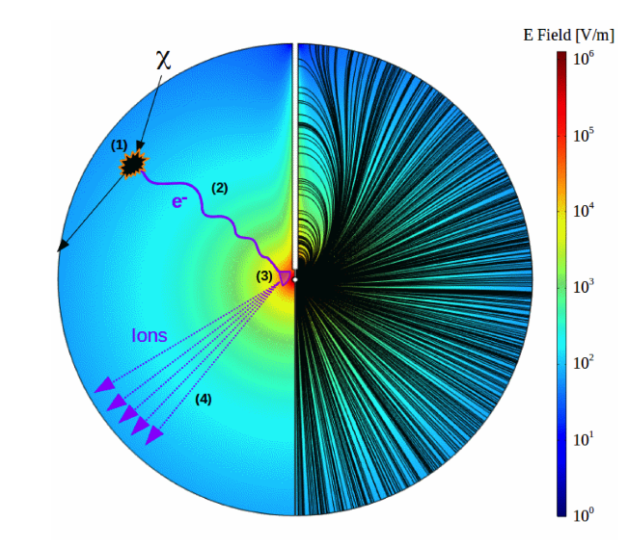
NEWS-G
NEWS-G – Spherical Proportional Counter
Signal Generation:
Primary ionization
Electron drift
Townsend avalanche
Positive ion drift

Slide 23
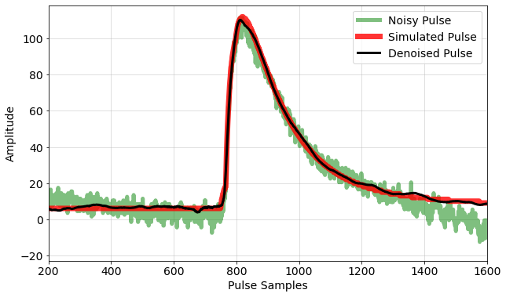
Problem Definition
Goals:
Utilize machine learning methods to remove noise from recorded detector signals
Model implementation should aid in measuring important signal characteristics, such as amplitude and rise-features
22

Slide 24
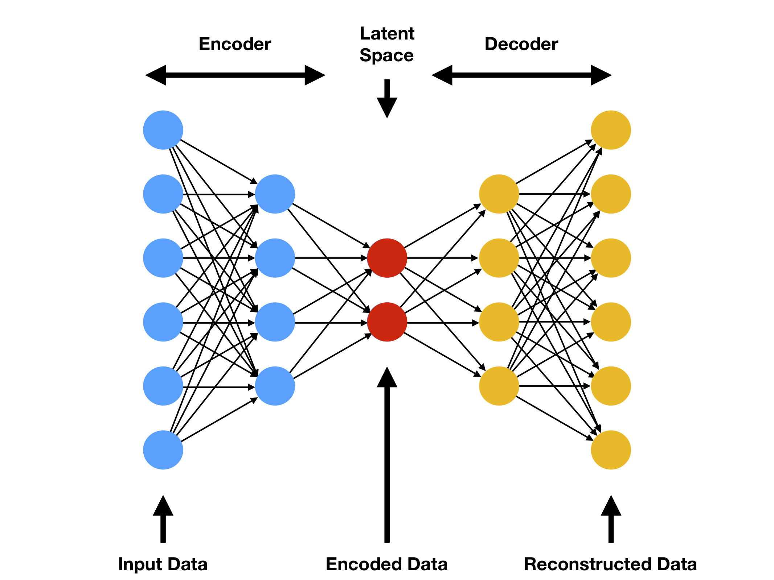
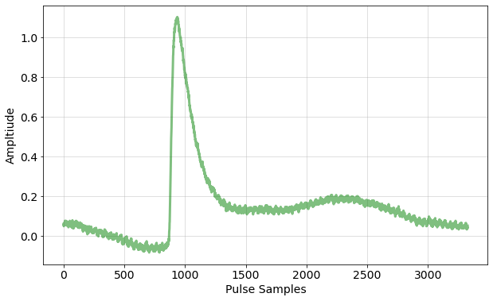
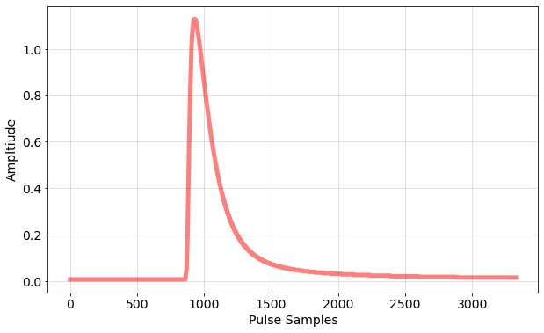
Methods – Model Architecture

Slide 25
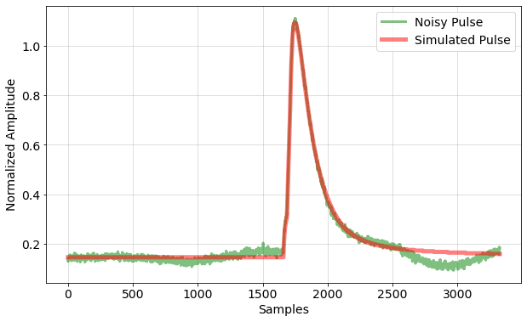
Methods – Model Training
Simulated pulses + real noise
Trained on a simulation-based dataset modeled after our real detector
Simulated pulses
X
Y

Slide 26
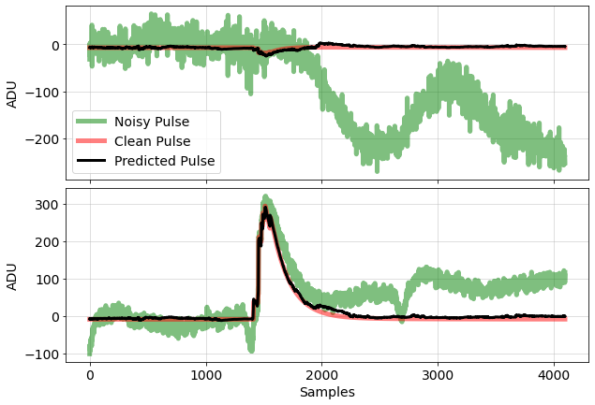
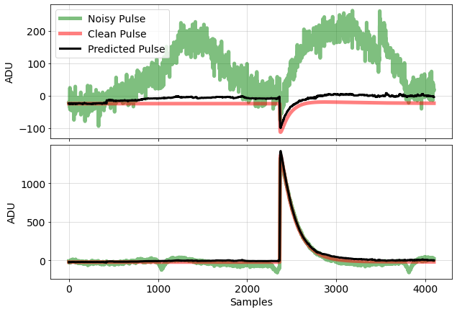
Example Pulses
Energy: ~250eV
Energy: ~330eV

Slide 27
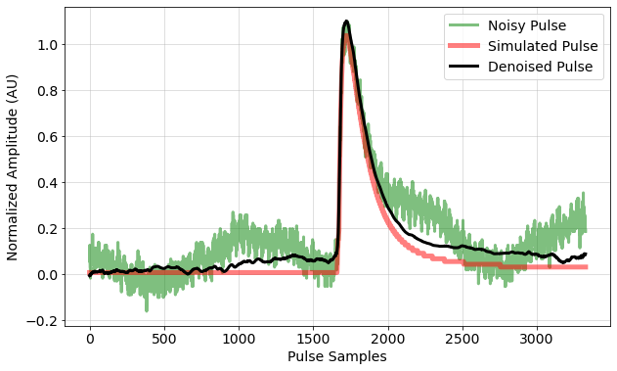
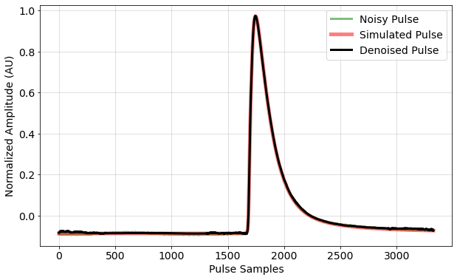
Example Pulses
Energy: ~170eV
Energy: ~1370eV

Slide 28
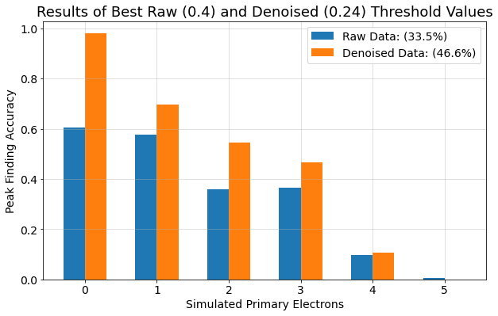
Primary Electron Counting

Slide 29
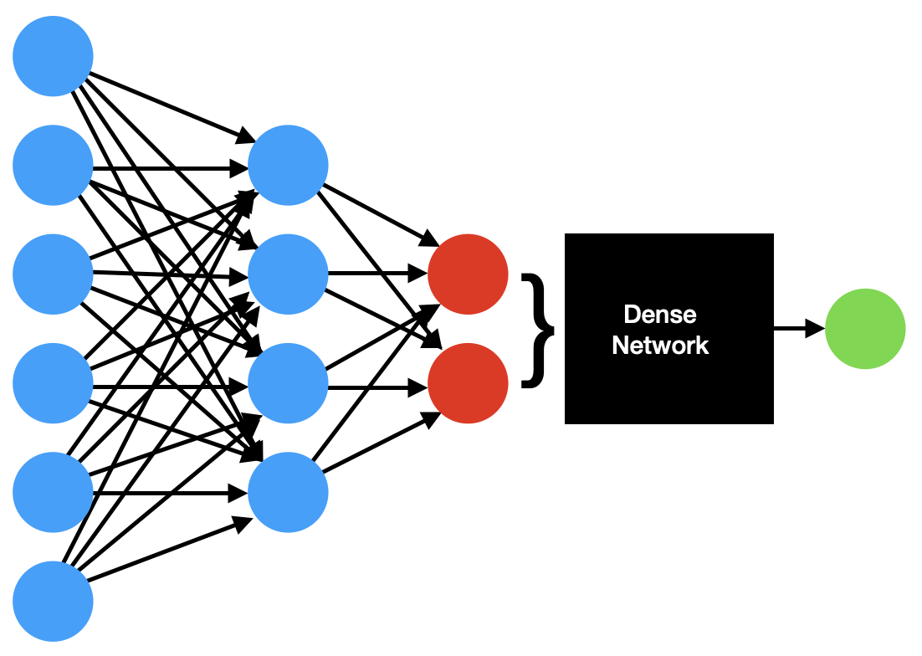

Single Output Model

Slide 30
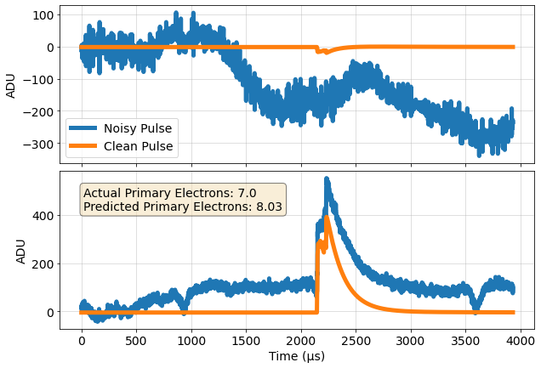
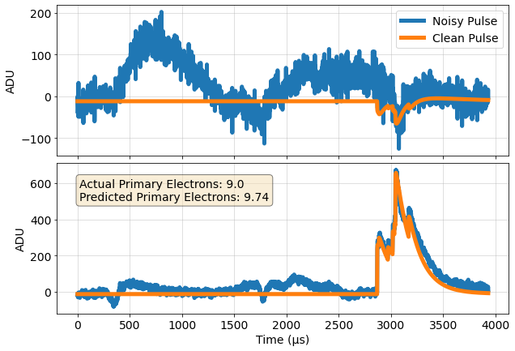
Primary Electron Prediction Examples

Slide 31
Machine Learning Extensions
Other single-output predictions
  Direct energy prediction, pulse shape classification
Double-deconvolution layer implementation
  Explicitly add preprocessing steps to network layers
  Learn to return primary electron arrival times
Different model architectures for improved performance
  Adversarial networks
  Graph-based neural networks

Slide 32
Thank you!

Slide 33
Additional Slides

Slide 34
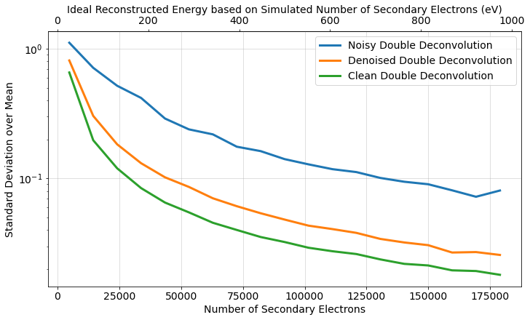
Simulated Energy Resolution Results

Slide 35
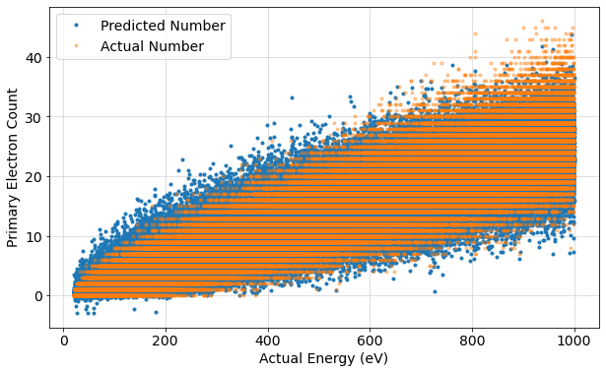
Primary Electron Prediction

Slide 36
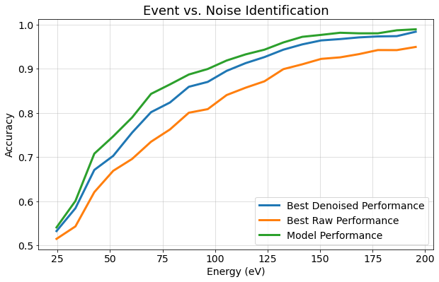
Event Triggering Results
Triggering efficiency test on simulated data
10000 events with a simulated pulse, 10000 noise traces
Modelled electronic triggering
Preliminary results

Slide 37
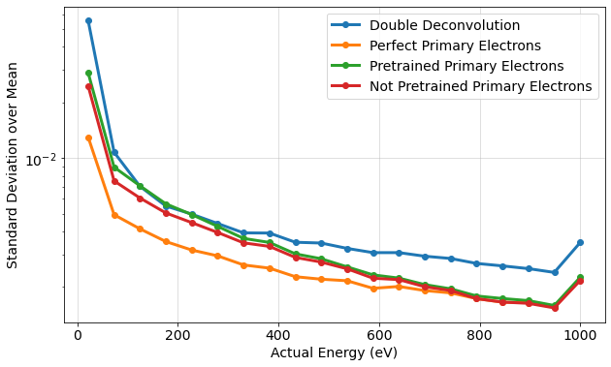
Primary Electron Prediction

Slide 38
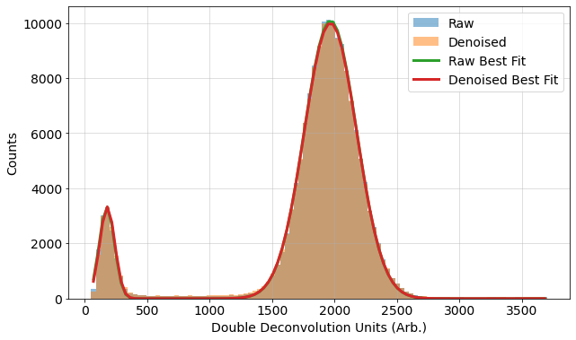
Real Data Energy Spectrum Analysis

Slide 39
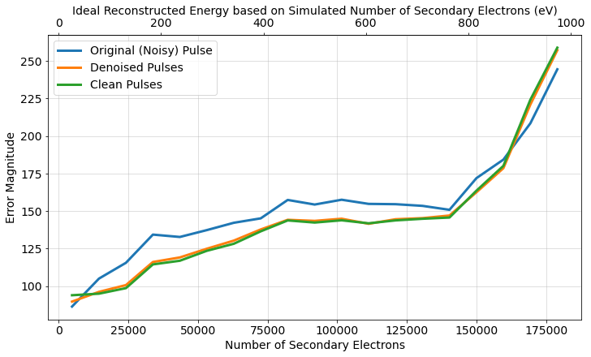
Energy Prediction Error Magnitude

Slide 40
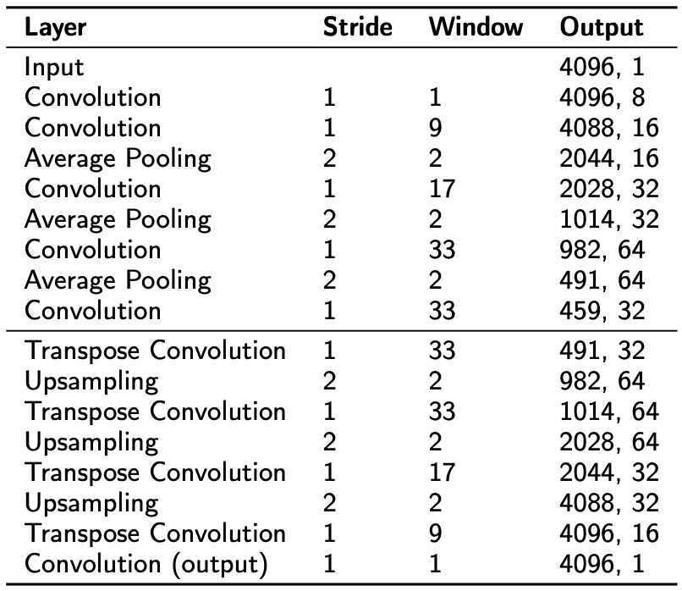
Model Architecture

Slide 41
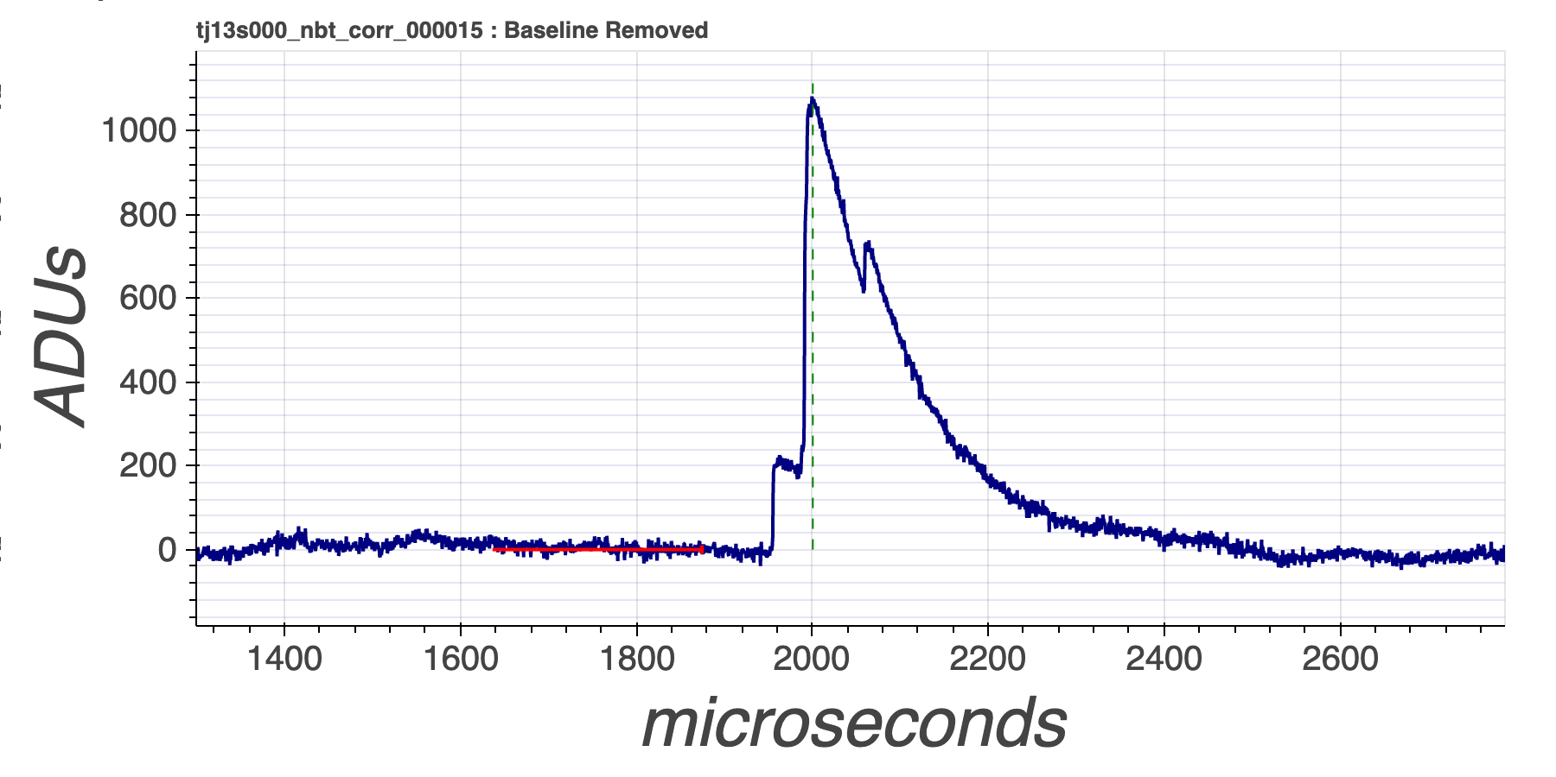
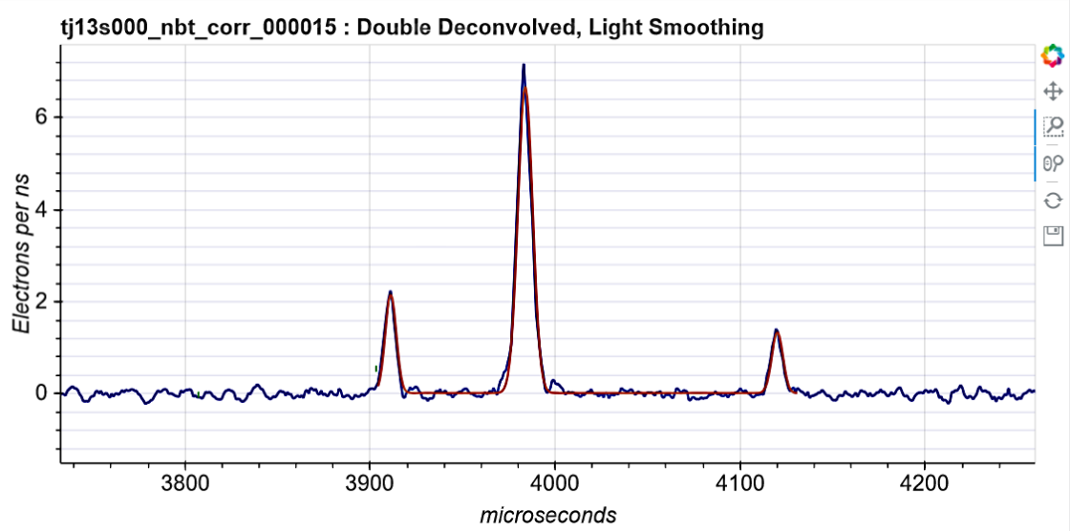
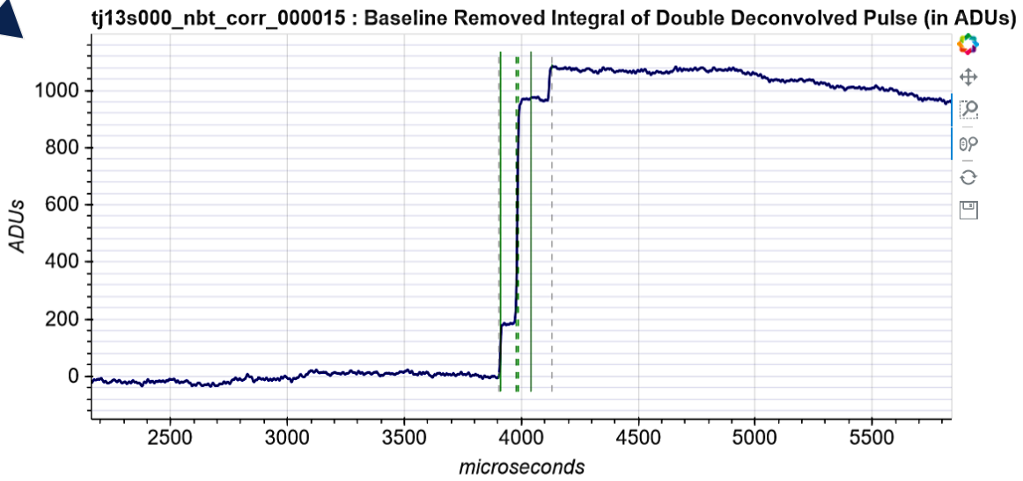
NEWS-G Signal Generation
Integrated Double Deconvolved Pulse
Raw Pulse
Double Deconvolved Pulse
Double Deconvolution Algorithm
Integration
Detector Response

