Slide 1

Bubble Chambers:
The Seitz and Sounds of Dark Matter
Colin Moore
EIEIOO
May 11, 2023

Slide 2
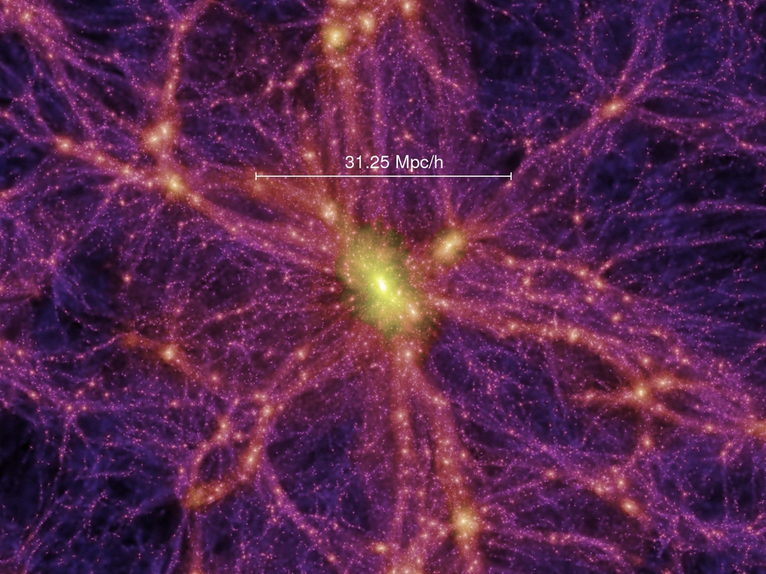
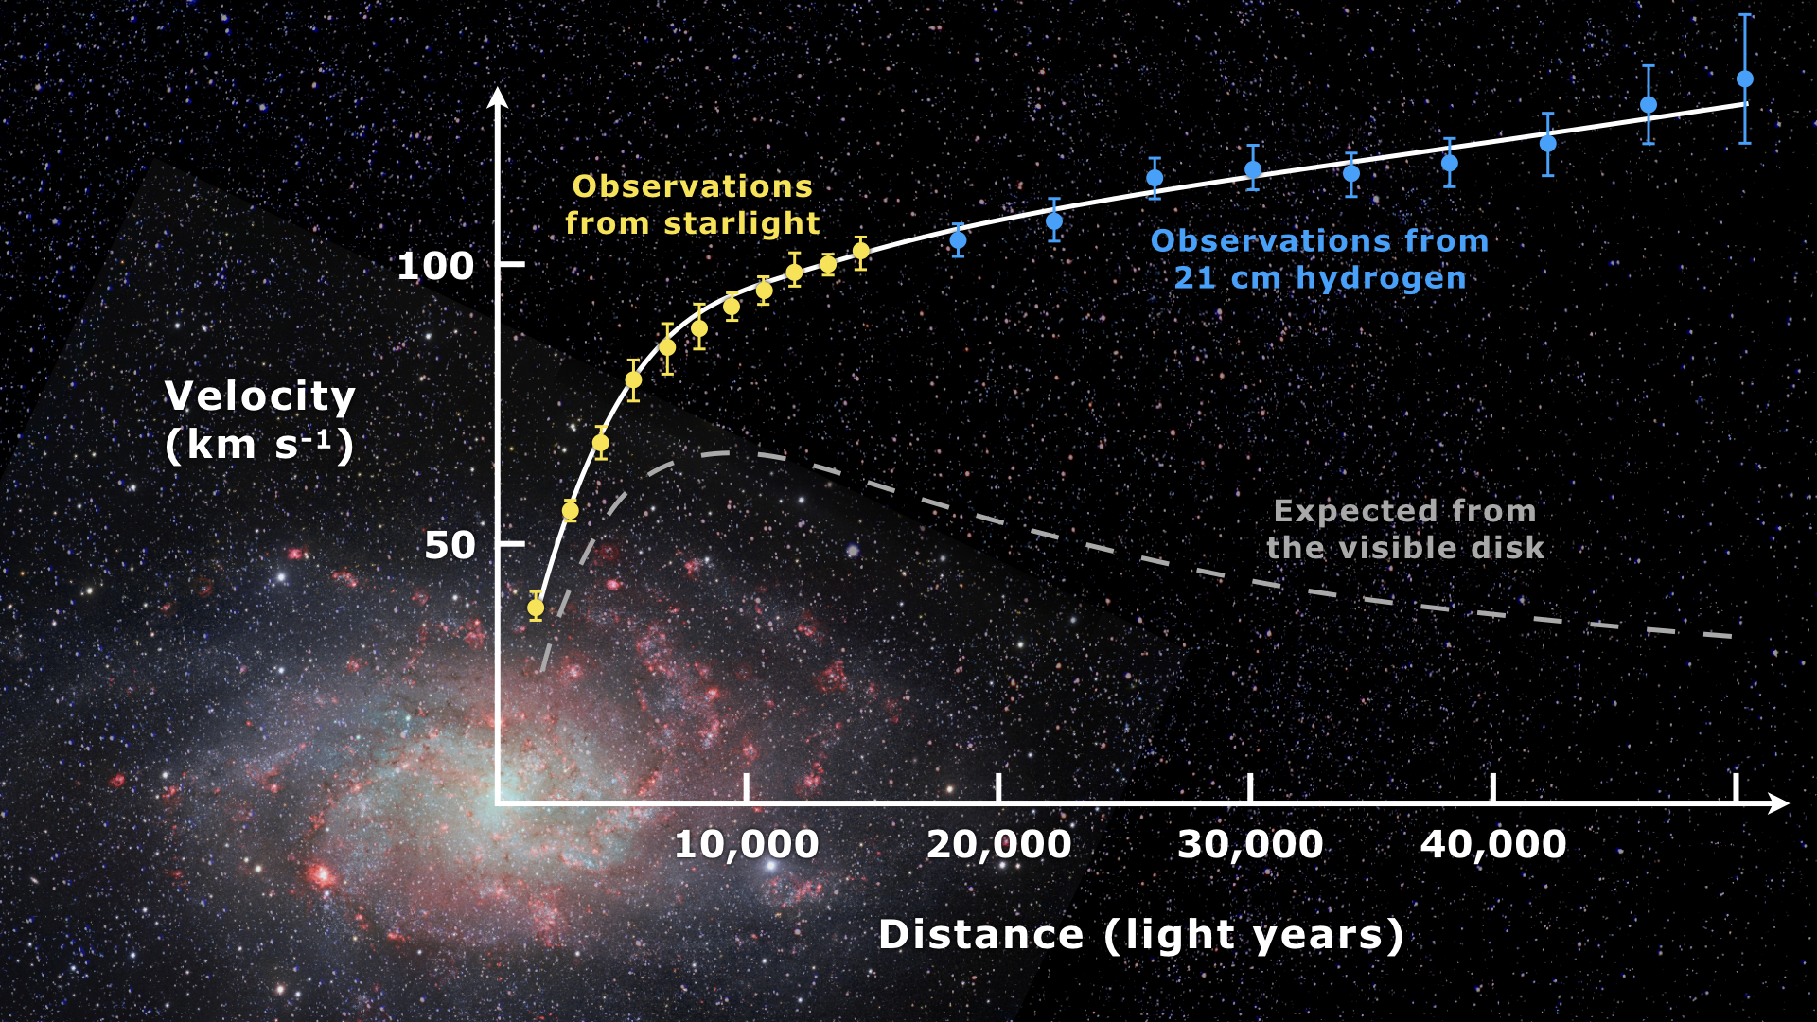
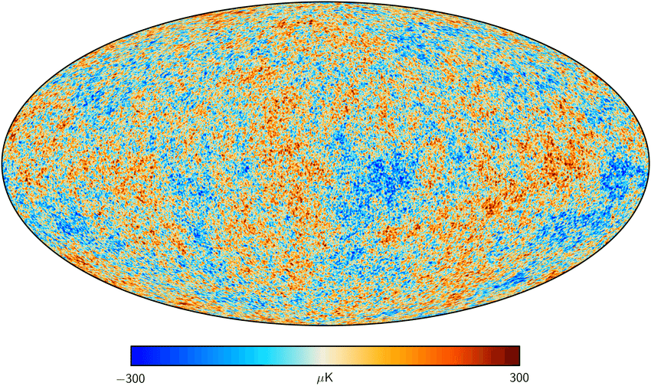
Dark Matter
Tons of evidence!

Slide 3
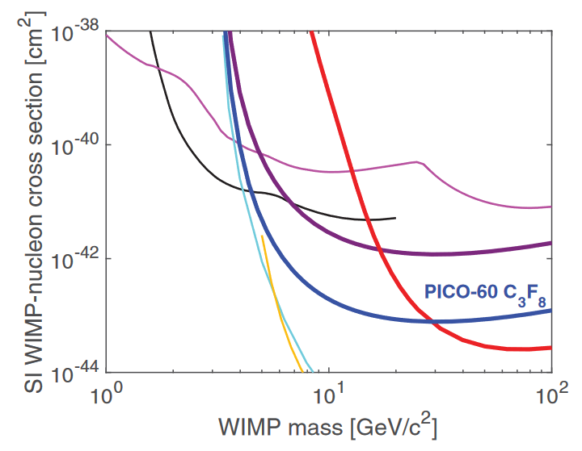
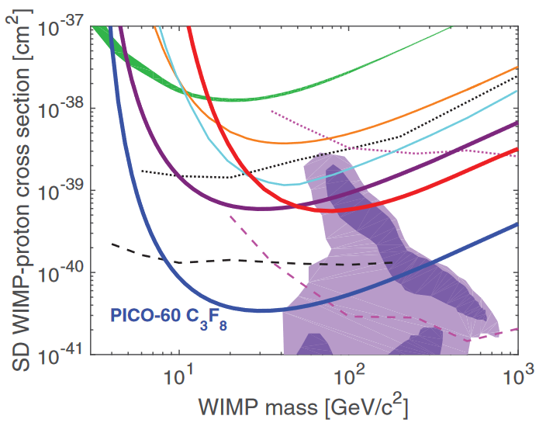
Dark Matter Interactions
Spin-Independent
Spin-Dependent
WIMP-proton and WIMP-neutron coupling equal
Interaction rate grows as square of nucleon number
  Heavier target nuclei = higher expected rate
Common targets: argon, xenon, germanium, etc.
WIMP-proton and WIMP-neutron coupling not equal
  Experiments specify WIMP-proton or -neutron
Interaction rate depends on nuclear response
  Must be calculated on a per-target basis
Common proton targets:
  fluorine (100), sodium (100), iodine (100)
Common neutron targets:
  xenon 129 (25), xenon 131 (21), germanium 73 (7.7)

Slide 4
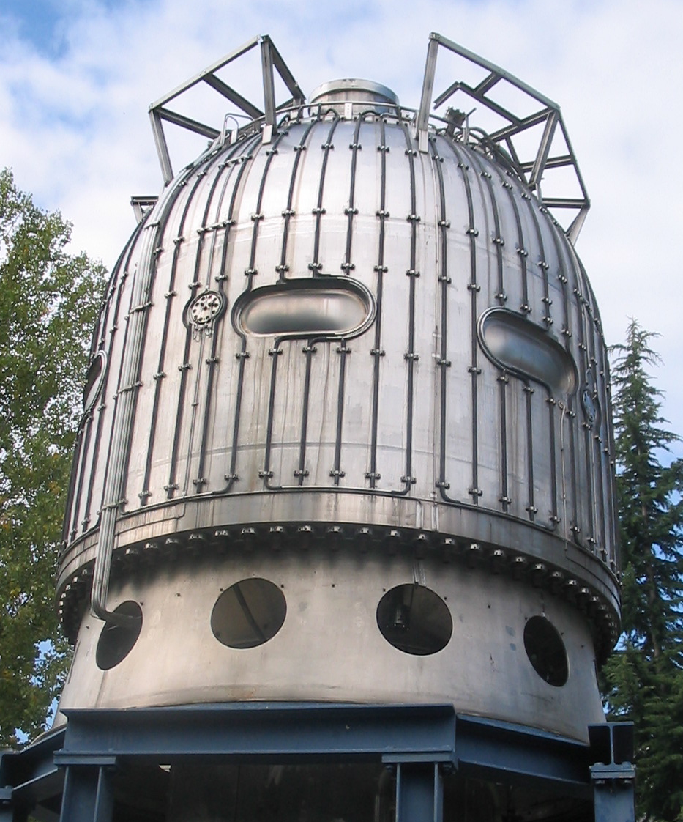
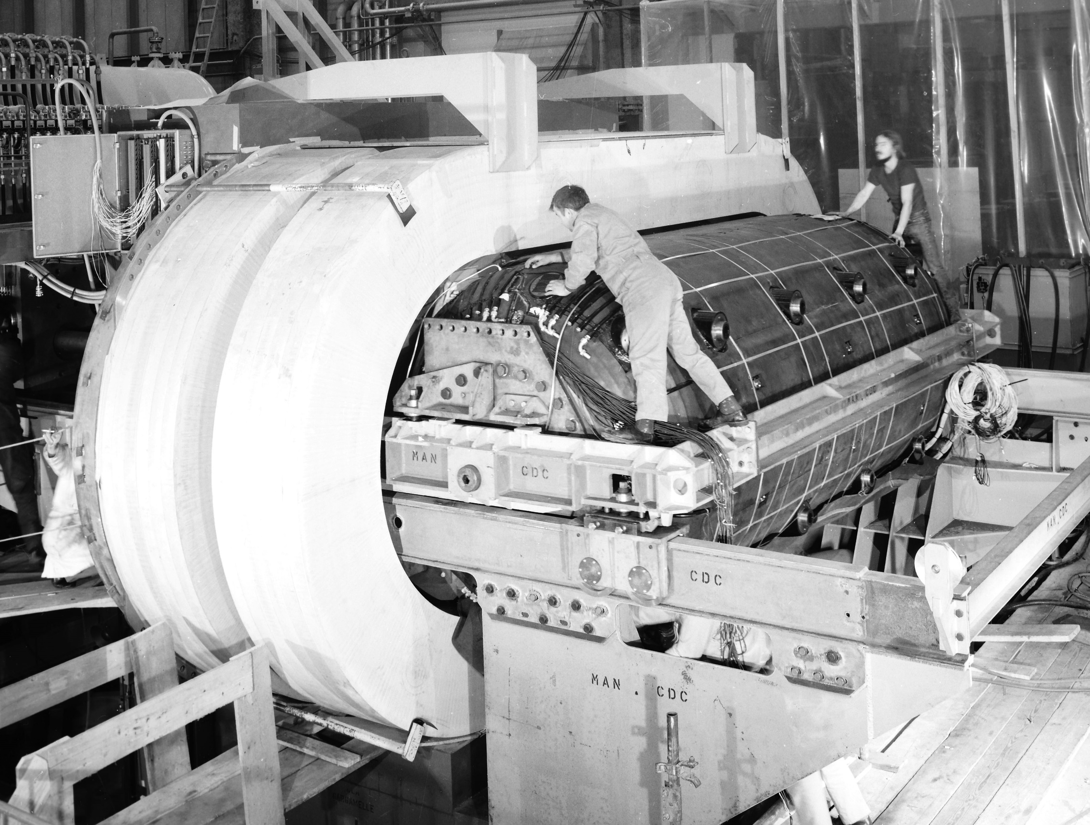
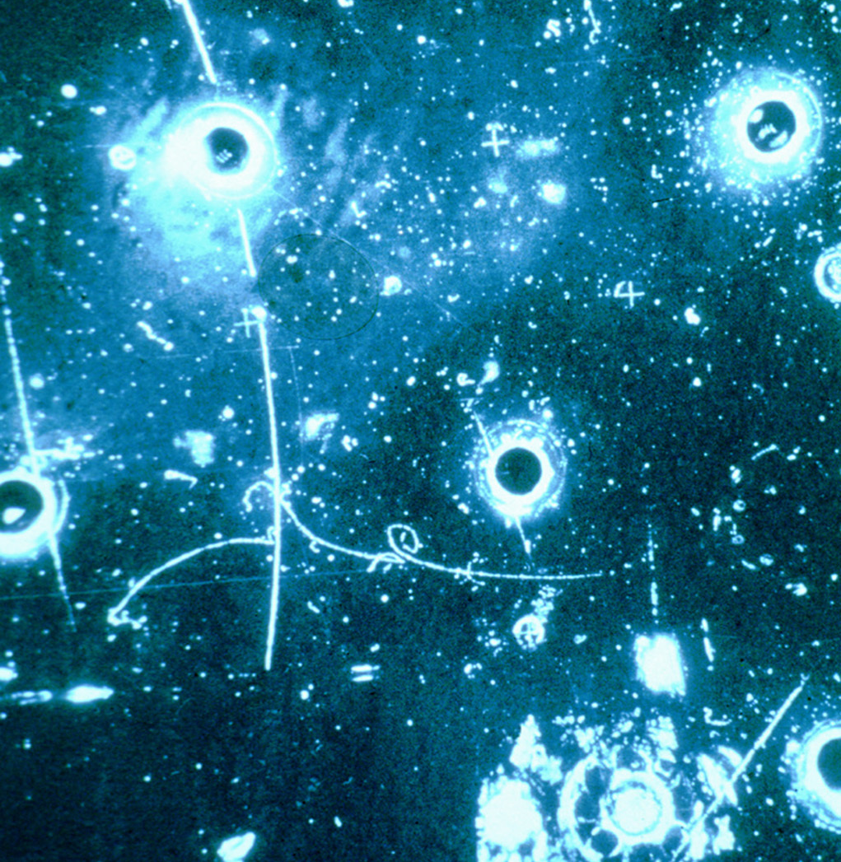
What are Bubble Chambers?
Old technology used to study particles from cosmic rays/accelerators
Pioneered in 1950s, saw use into 1980s
  D. Glaser awarded Nobel Prize in Physics in 1960 for development of bubble chambers
Used in discovery of Z⁰ boson
Superseded by newer technologies
Bubbles caused by energy deposition in superheated liquid
Images of bubbles recorded through windows in pressure vessel
Images, CW from top left:
Big European Bubble Chamber
Gargamelle
Event from Gargamelle

Slide 5
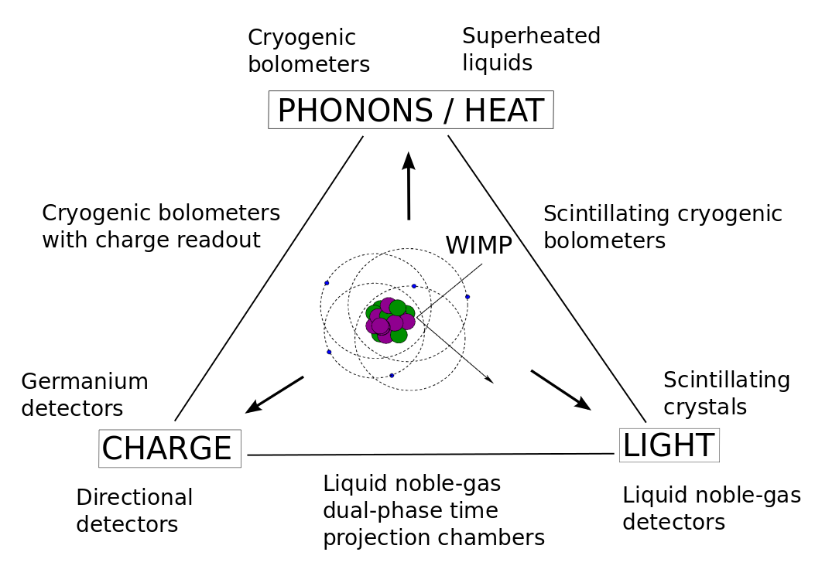
What are Bubble Chambers?

Slide 6
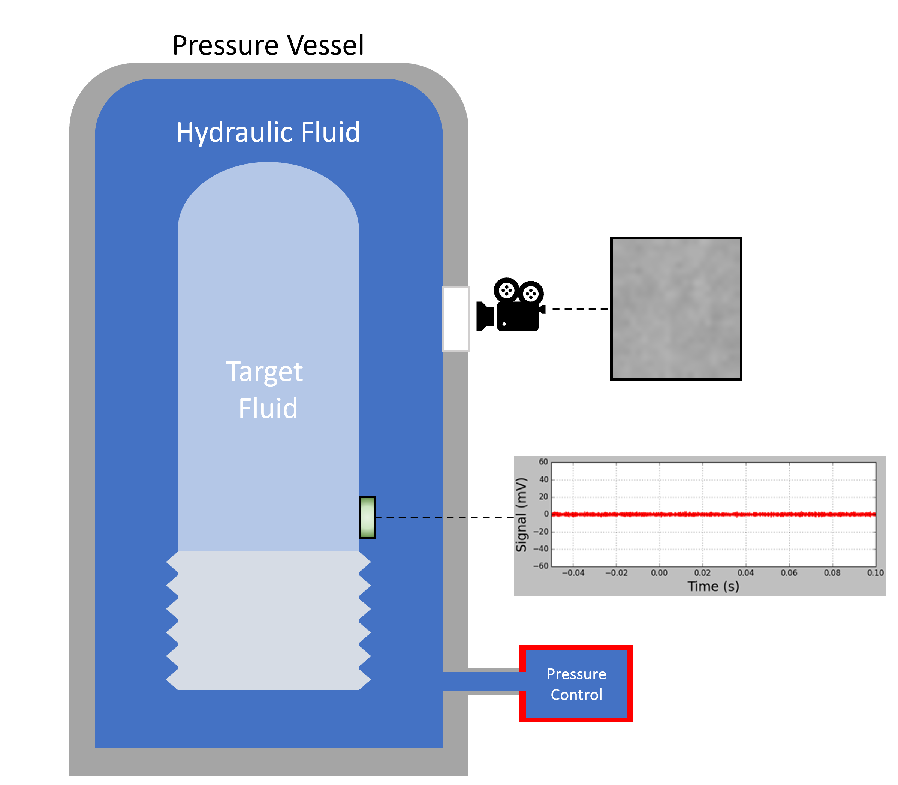
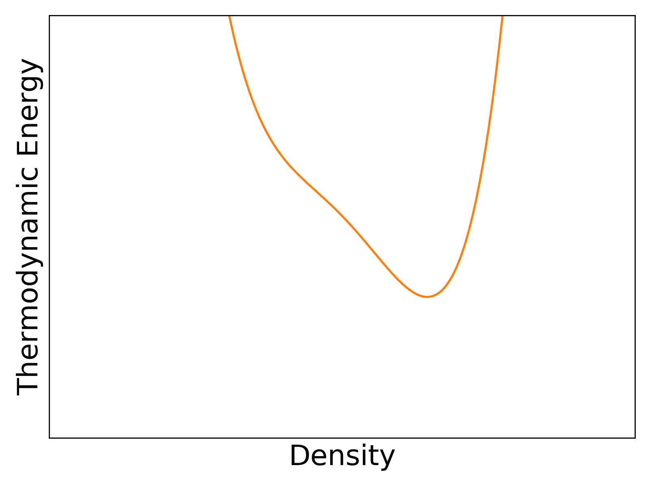
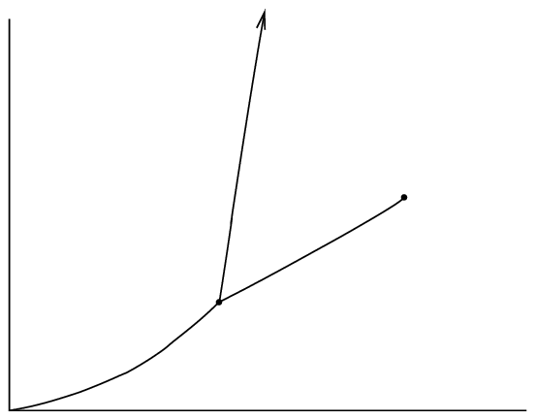
Bubble Chamber Principles
Fixed P, T
P=P₀
Liquid
Pressure
Liquid
Solid
Gas
Temperature

Slide 7
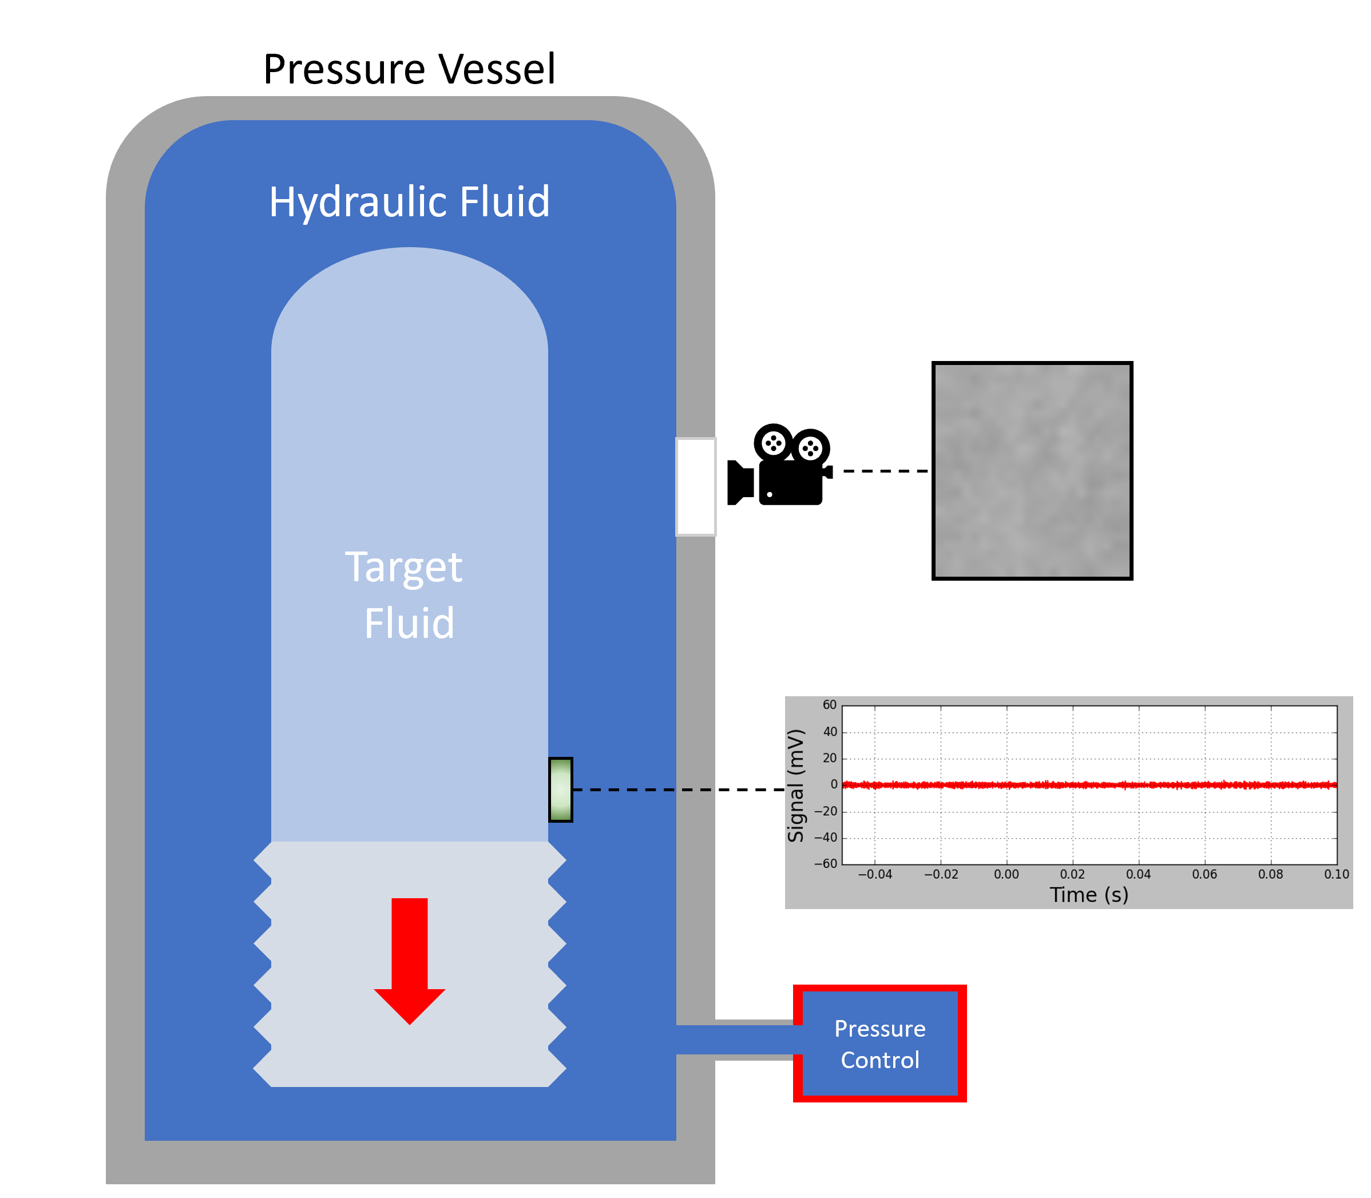
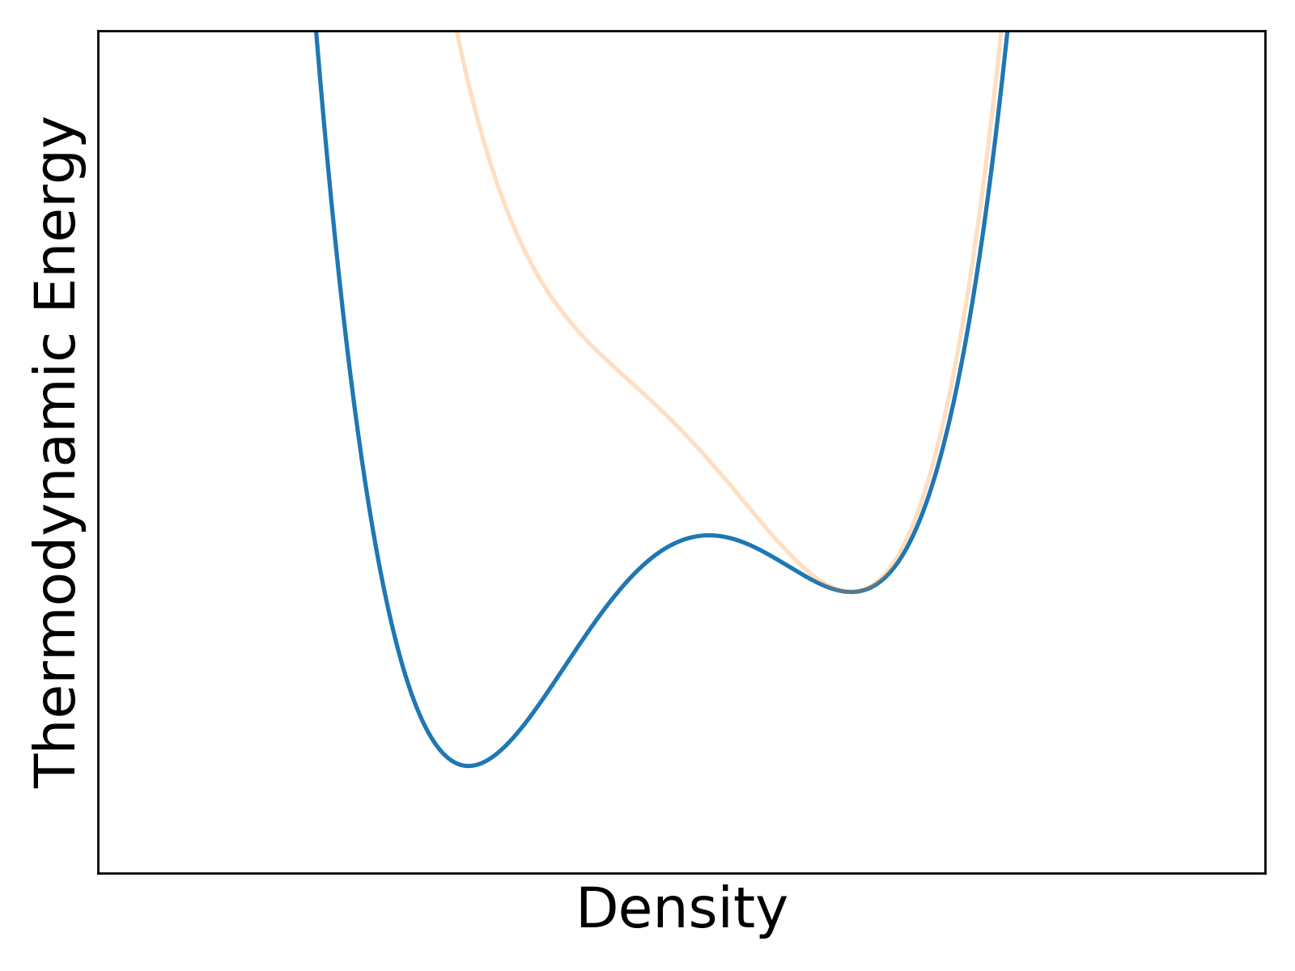
Bubble Chamber Principles
Fixed P, T
P=P₀
P<P₀
Liquid
(Superheated)
Vapour
Pressure
Liquid
Solid
Gas
Temperature

Slide 8
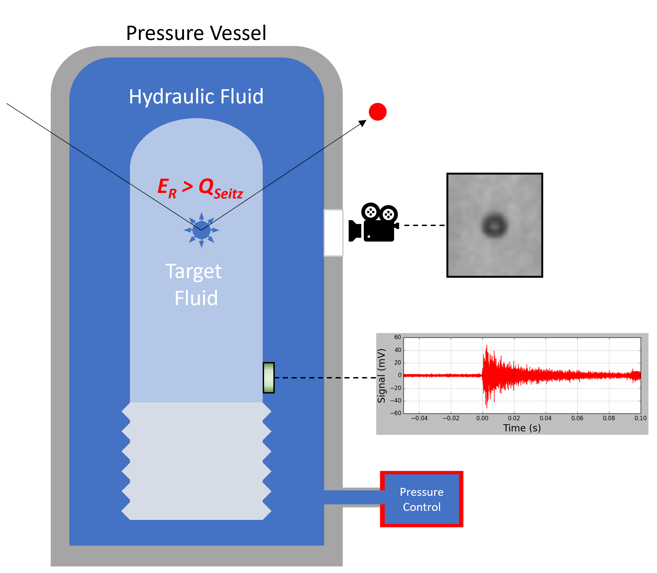
Bubble Chamber Principles
Fixed P, T
P=P₀
P<P₀
Liquid
(Superheated)
Vapour
Pressure
Liquid
Solid
Gas
Temperature

Slide 9
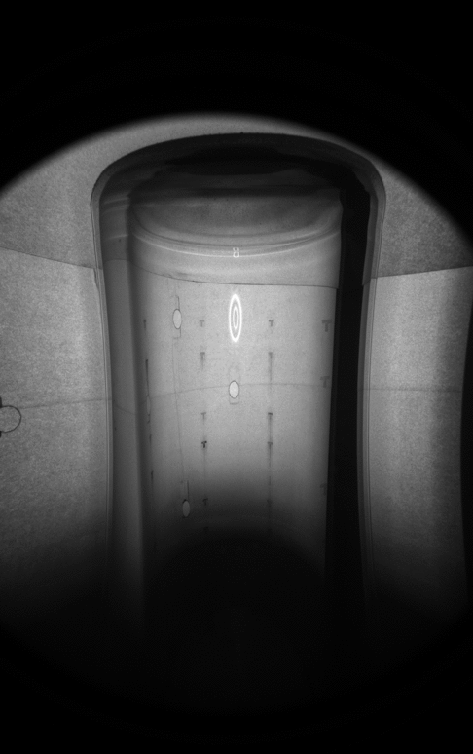
Bubble Chamber Principles
Fixed P, T
P=P₀
P<P₀
Liquid
(Superheated)
Vapour
Pressure
Liquid
Solid
Gas
Temperature

Slide 10

How are Bubbles Formed?
Any bubble larger than the (fluid-specific) critical radius will continue to grow to macroscopic size
  PICO’s active fluid: r_{c} = 20 nm
  How does a bubble grow to the critical radius?
Energy threshold:
Surface tension
Converting liquid to gas
Expansion of vapour
Pressure and temperature define the Seitz threshold for a fluid
Energy deposited causes region to “literally explode into bubbles of larger than critical size”

Slide 11
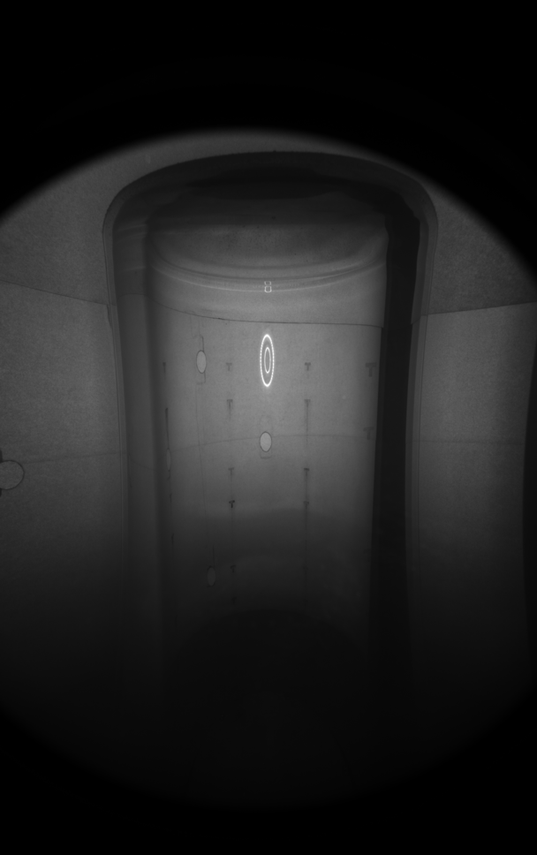

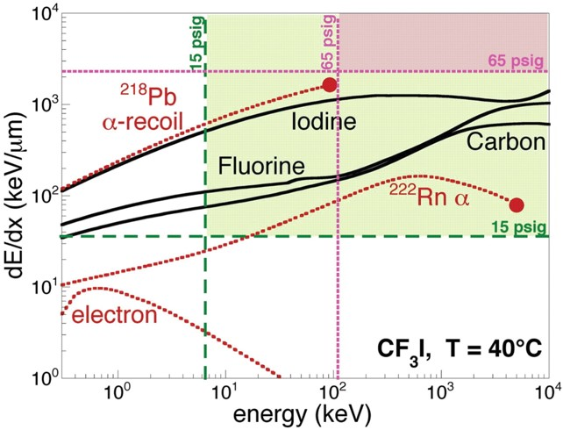
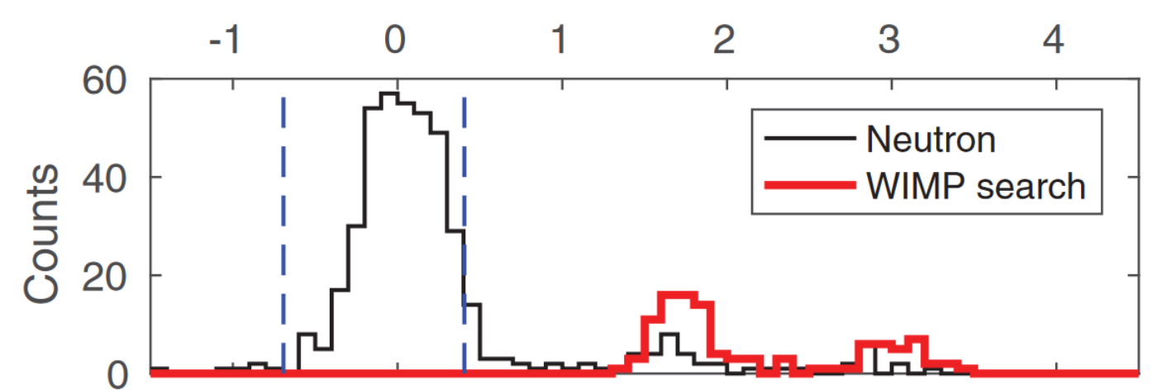
Backgrounds in a Bubble Chamber
Alphas
Nuclear Recoils
Electron Recoils

Slide 12
Advantages of Bubble Chambers
Advantages
Fairly simple design/operation
Inherently insensitive to electron-recoil interactions (depending on active fluid)
Alpha rejection via acoustics
Variable threshold
Ability to change active fluid to exploit different sensitivities
  Fluorine: WIMP-proton SD
  Hydrogen: low-mass WIMPs
  Iodine: spin-independent
Disadvantages
Little energy information
Large deadtime between events

Slide 13
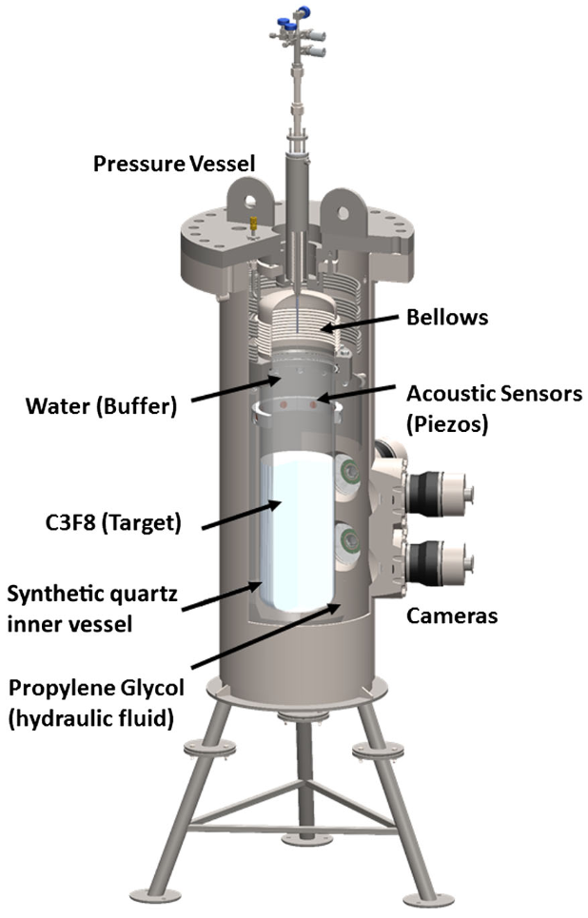
PICO-60
Previous large-scale detector
Active target: C₃F₈
  Spin-dependent sensitivity due to fluorine
Operated at SNOLAB (2016-2017)
Used same design as all previous PICO/COUPP bubble chambers
Produced world-leading WIMP-proton limit
Water buffer and bellows caused issues with spurious nucleation
  Particulate entering active region
  Water and freon mix

Slide 14
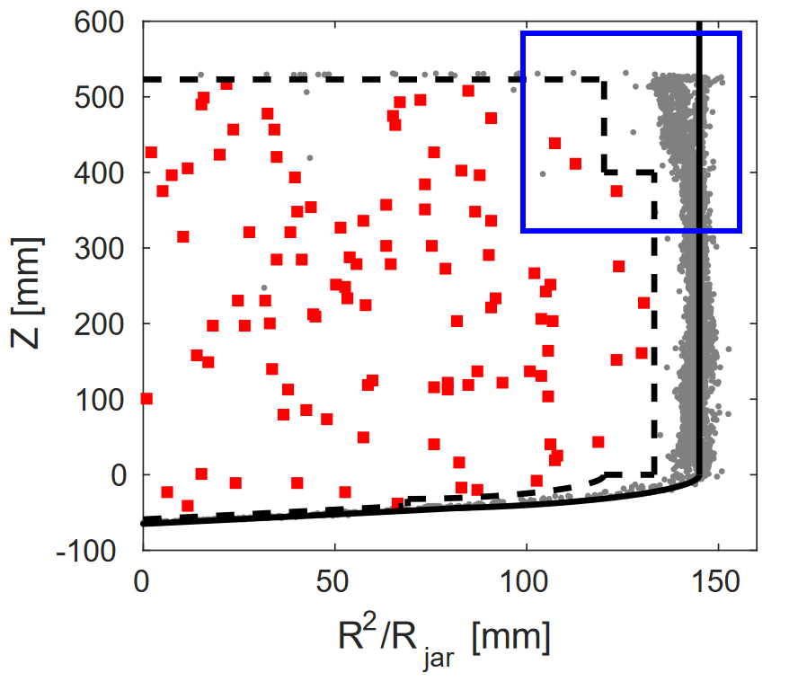
PICO-60

Slide 15
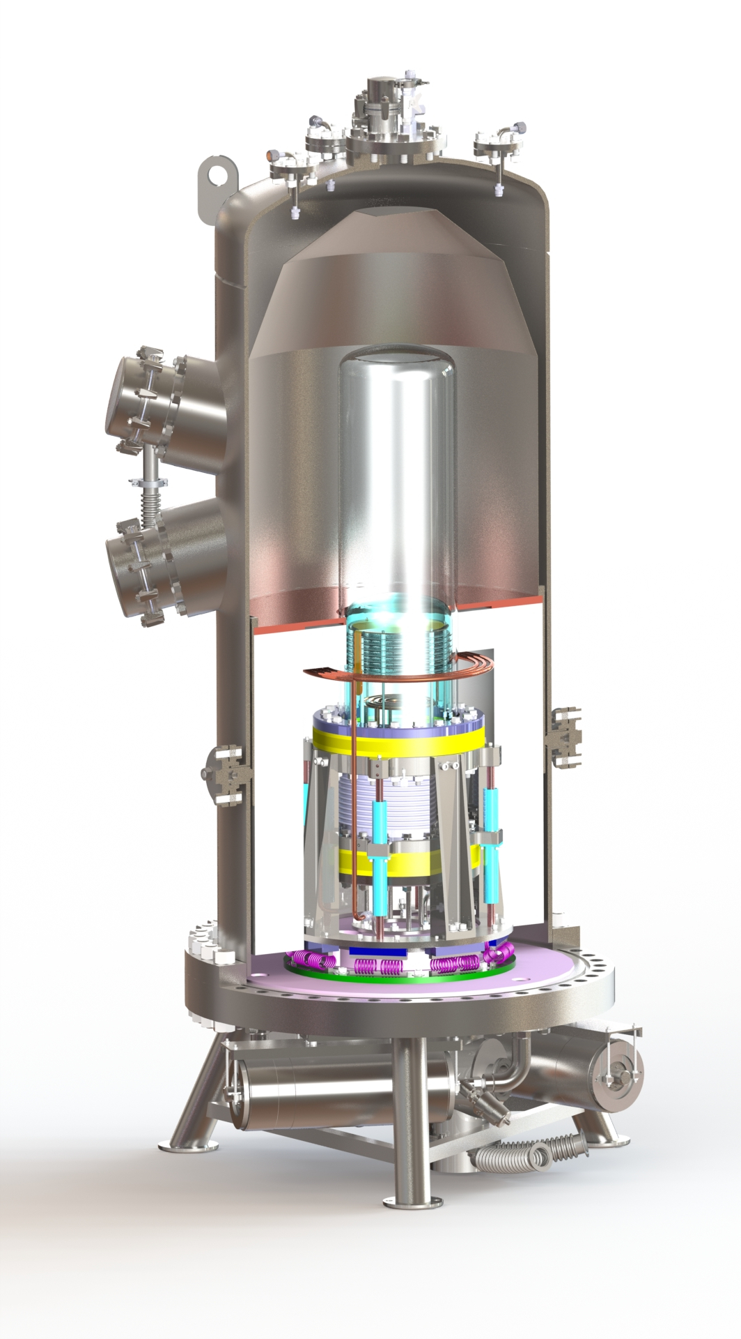
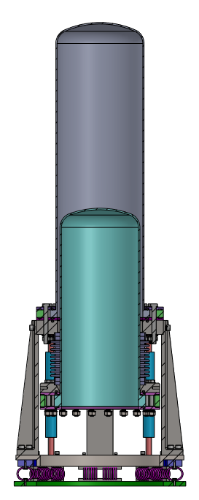
PICO-40L
Uses new “Right-Side-Up” chamber design
Water buffer replaced by second inner jar
Two thermal regions. At 30 psia:
  Warm region (15°C): C₃F₈ is superheated
  Cold Region (-25°C): C₃F₈ is liquid
First large-scale use of RSU design
Proof of concept for PICO-500
Warm
Region
Cold
Region

Slide 16
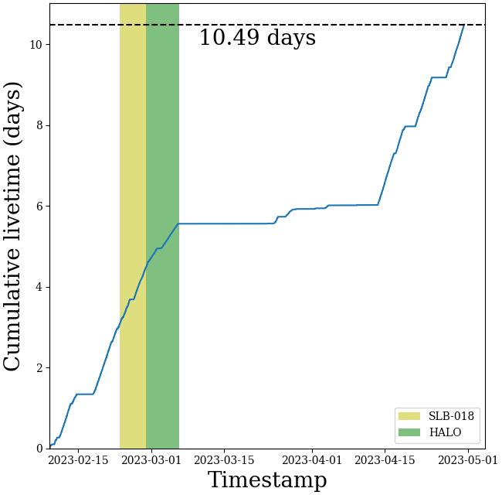
PICO-40L Commissioning

Slide 17
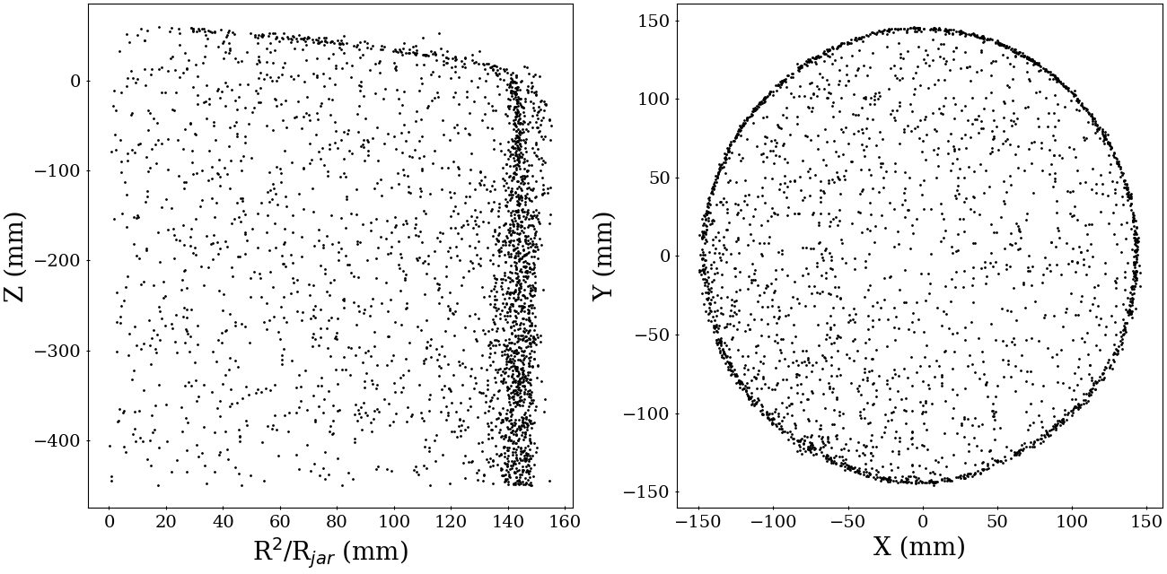
PICO-40L Commissioning

Slide 18
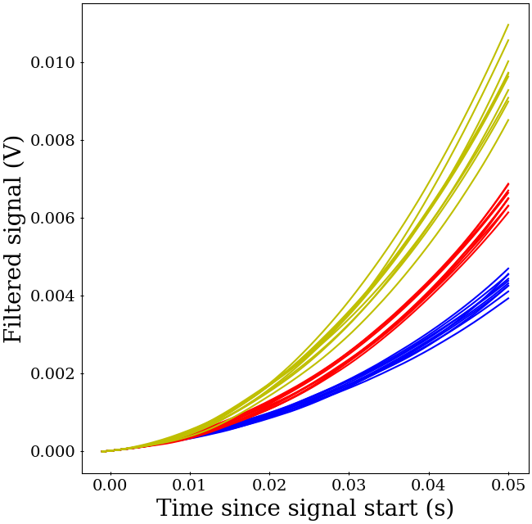
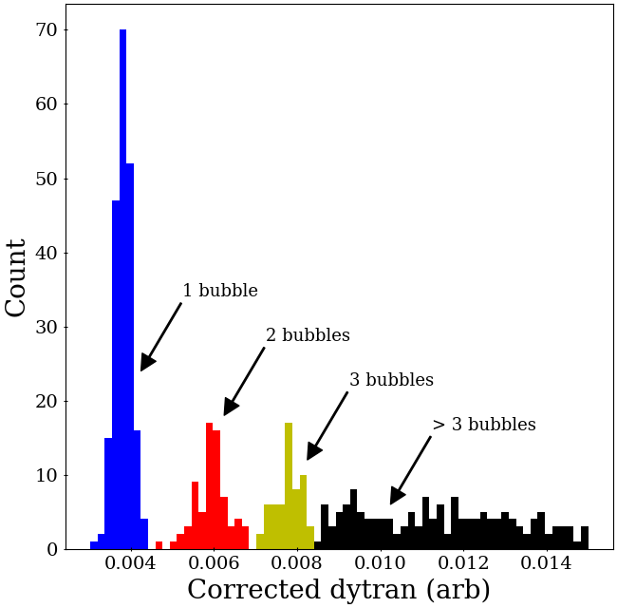
PICO-40L Commissioning

Slide 19
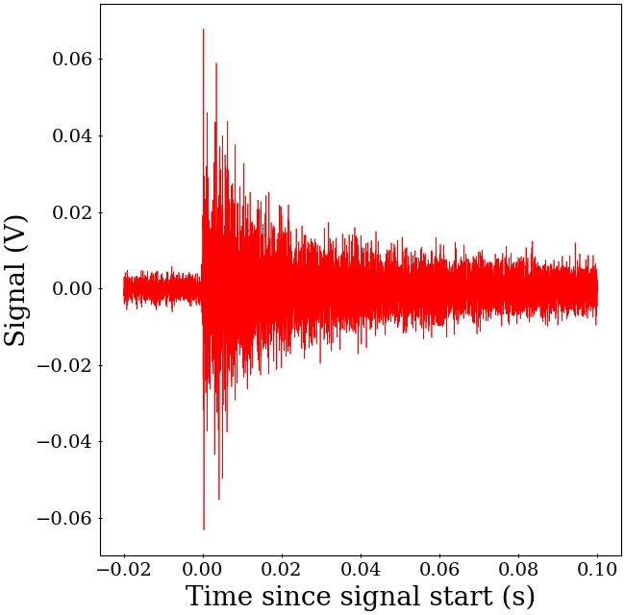
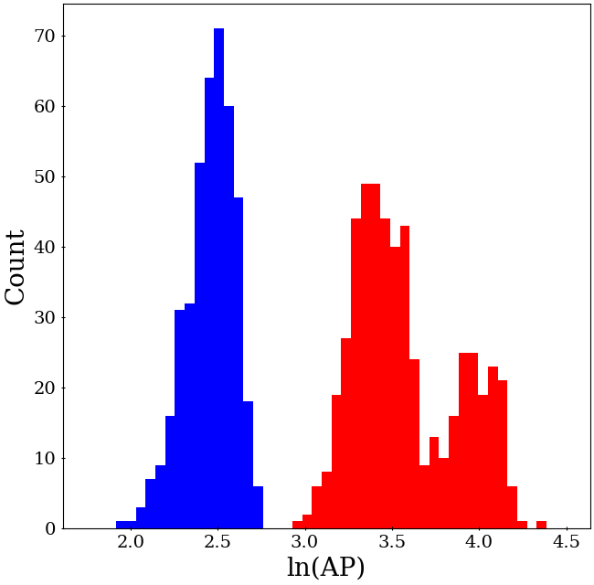
PICO-40L Commissioning

Slide 20

PICO-40L Commissioning

Slide 21
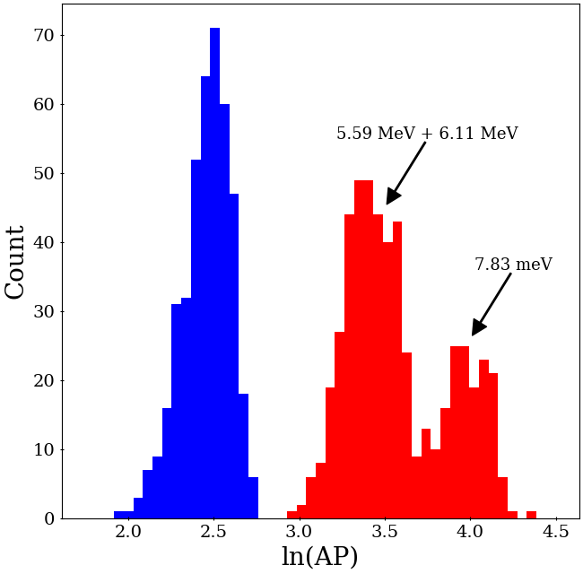
PICO-40L Commissioning

Slide 22
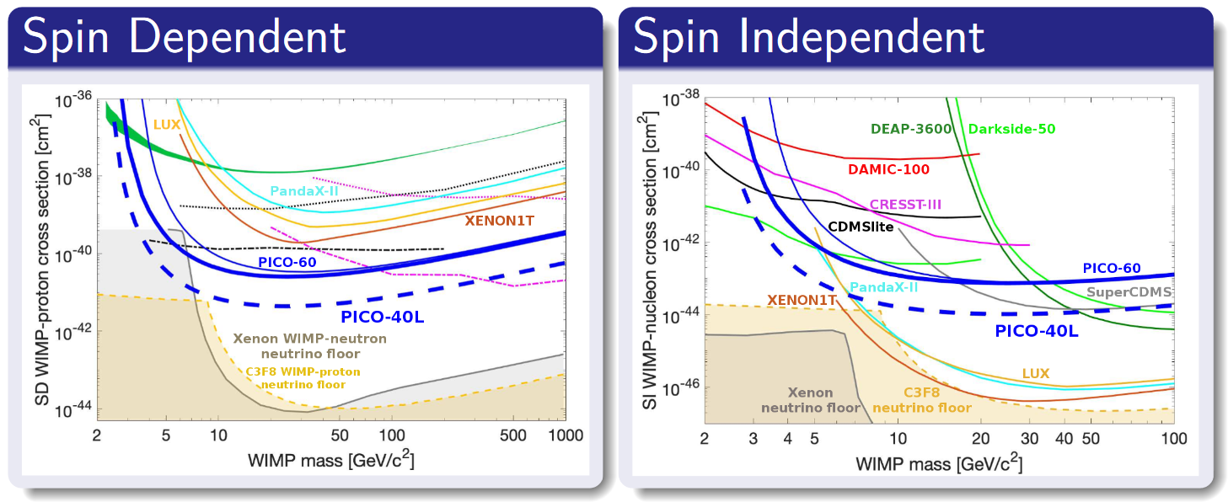
Science goal of PICO-40L
https://arxiv.org/pdf/1905.12522.pdf

Slide 23
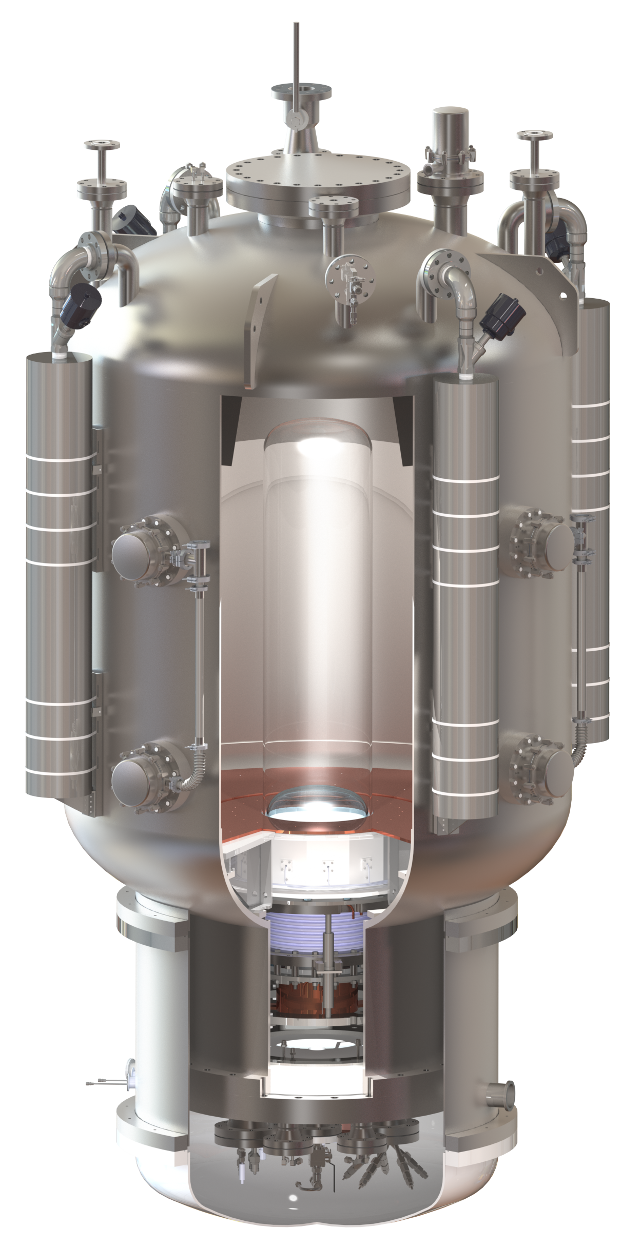
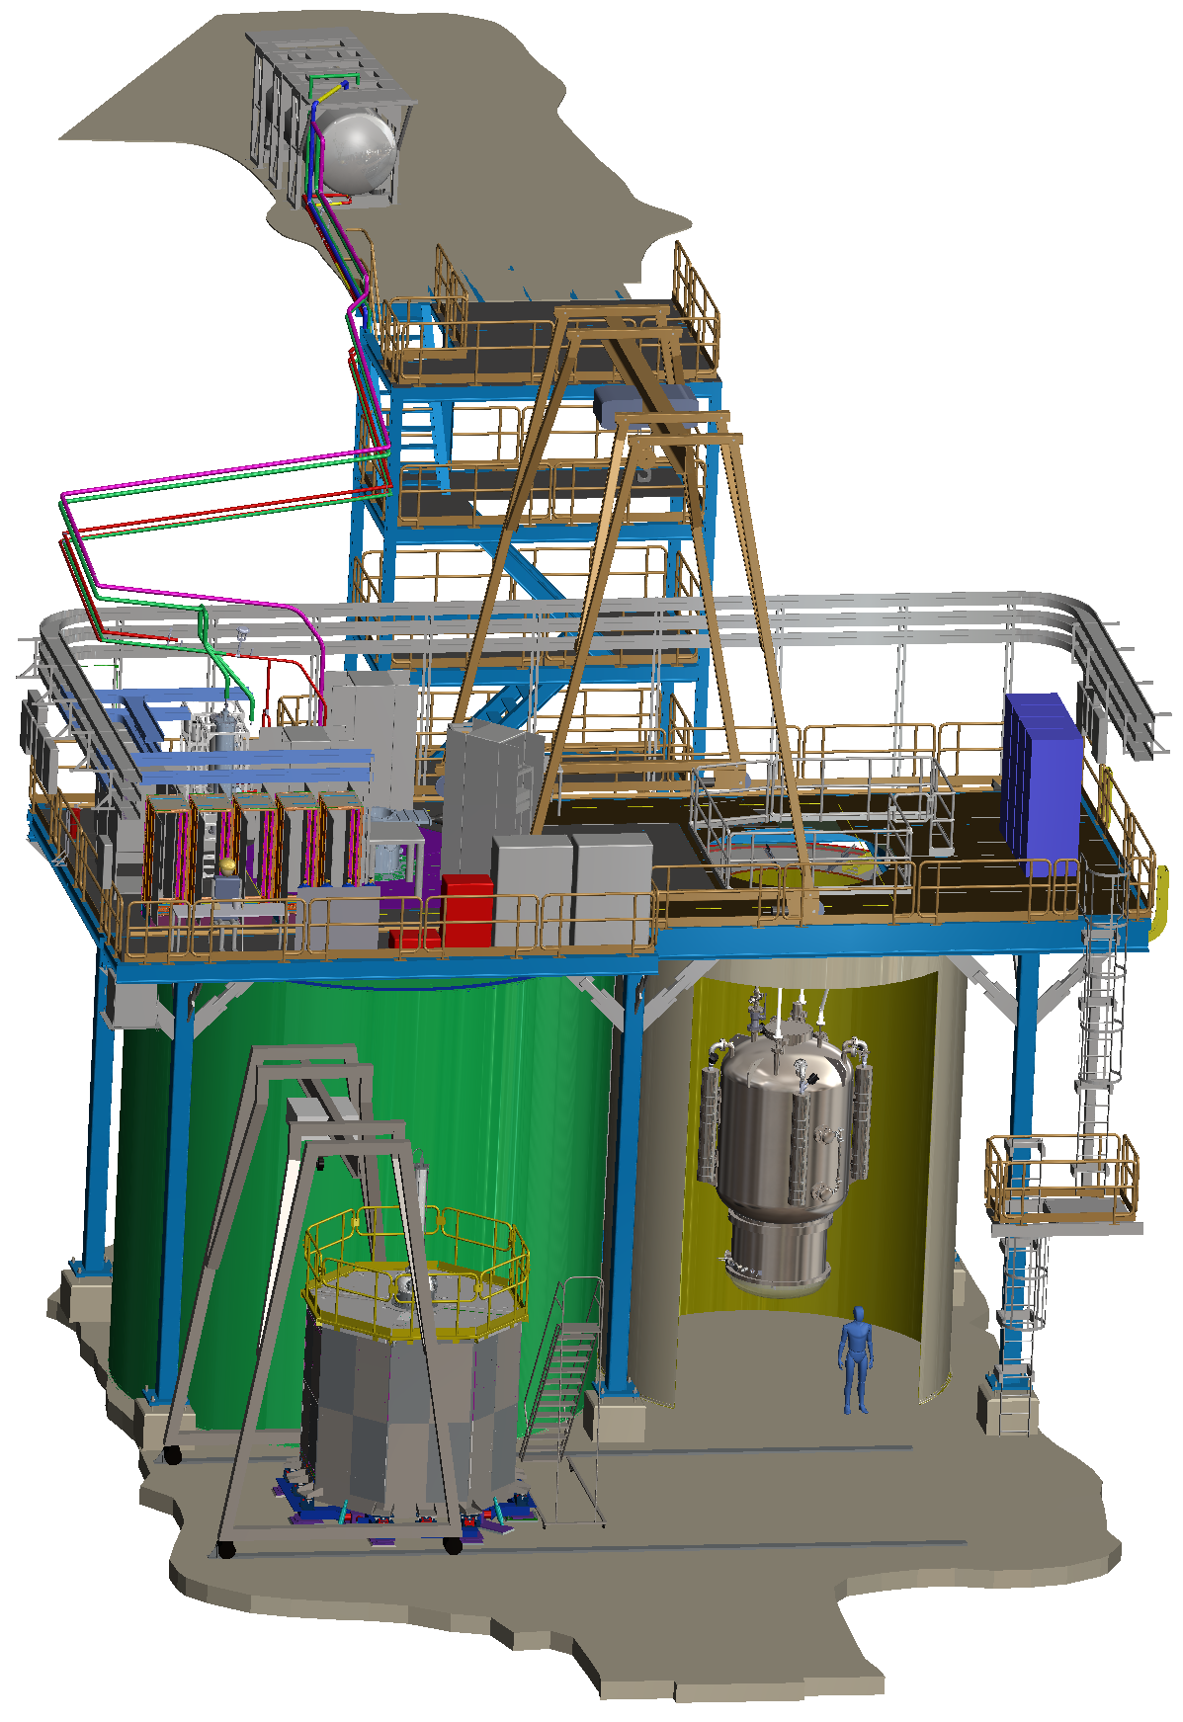
PICO-500
Next-generation, tonne-scale bubble chamber
Housed in SNOLAB cube hall (next to DEAP-3600/News-G)
Design mostly complete
Preparing for assembly
at SNOLAB

Slide 24
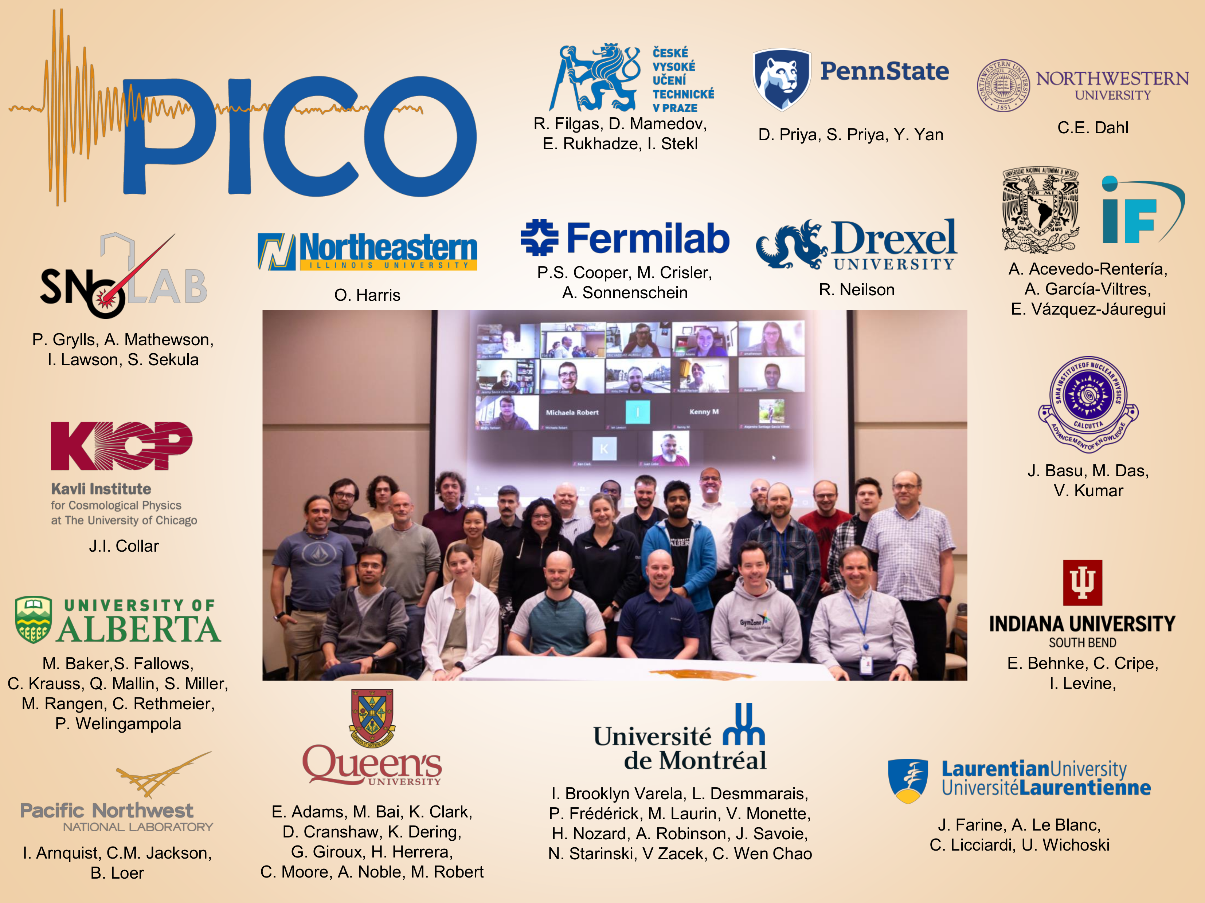
Thanks for listening!

Slide 25
Image Sources
Slide 2:
  Rotation curve: https://commons.wikimedia.org/wiki/File:Rotation_curve_of_spiral_galaxy_Messier_33_(Triangulum).png
  CMB Anisotropies: DOI: 10.13140/RG.2.2.36598.19528
  DM Simulation: Springel, V. et al. Max Planck Institute for Astrophysics, https://wwwmpa.mpa-garching.mpg.de/galform/press/
Slide 3:
  C. Amole et al. (PICO Collaboration), Phys. Rev. Lett. 118, 251301 – Published 23 June 2017
Slide 4:
  Gargamelle: https://en.wikipedia.org/wiki/Gargamelle
  BEBC: https://en.wikipedia.org/wiki/Big_European_Bubble_Chamber
Slide 5:
  DM Triangle: https://www.arxiv-vanity.com/papers/1509.08767/
Slide 6:
  Phase diagram: DOI: 10.1119/1.1399044 (https://www.researchgate.net/figure/Phase-diagram-of-a-simple-substance-in-the-pressure-temperature-plane_fig1_1825860)
Slide 11:
  C. Amole et al. (PICO Collaboration), Phys. Rev. Lett. 118, 251301 – Published 23 June 2017
Slide 13:
  PICO-60 picture: arxiv 1902.04031

Slide 26
Extra slides

Slide 27
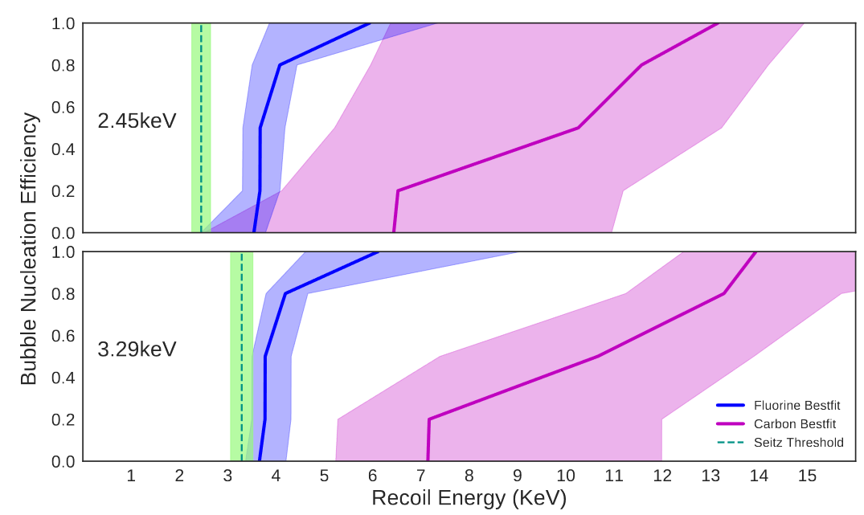
Efficiency curves

Slide 28
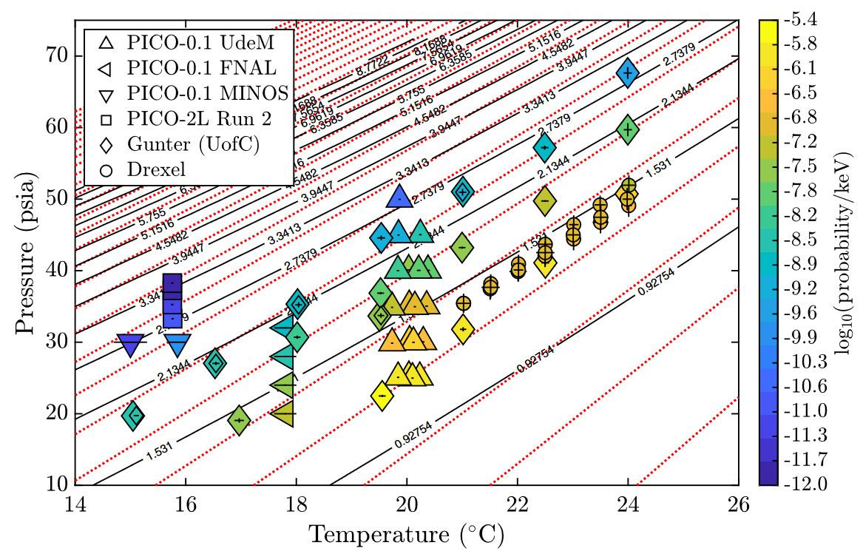
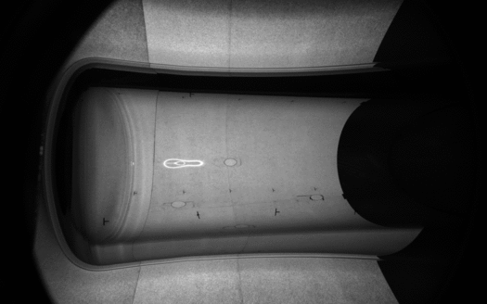
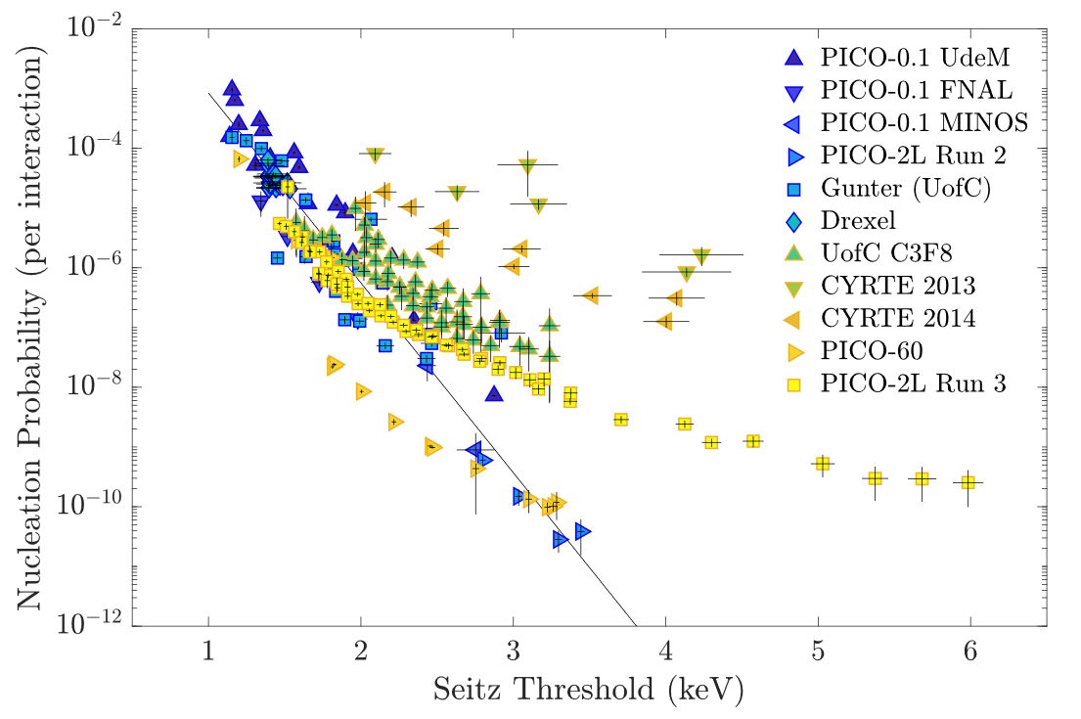
New Physics to Explore

Slide 30
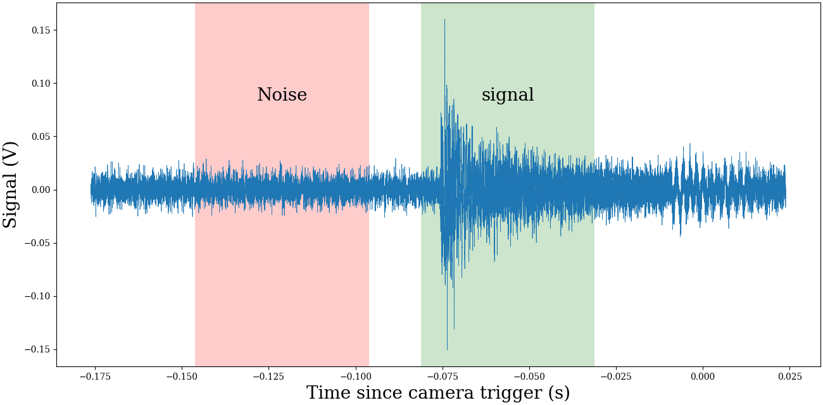
Acoustic Signal

Slide 31
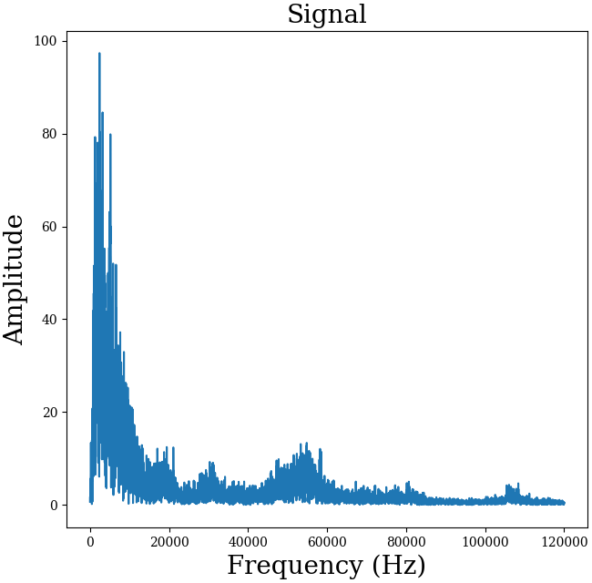
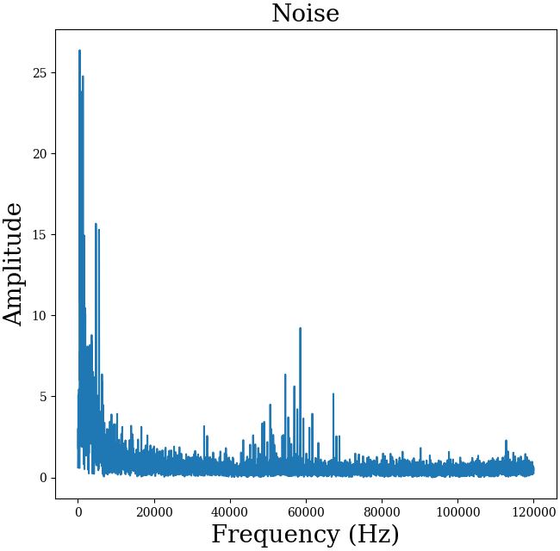
FFT

Slide 32
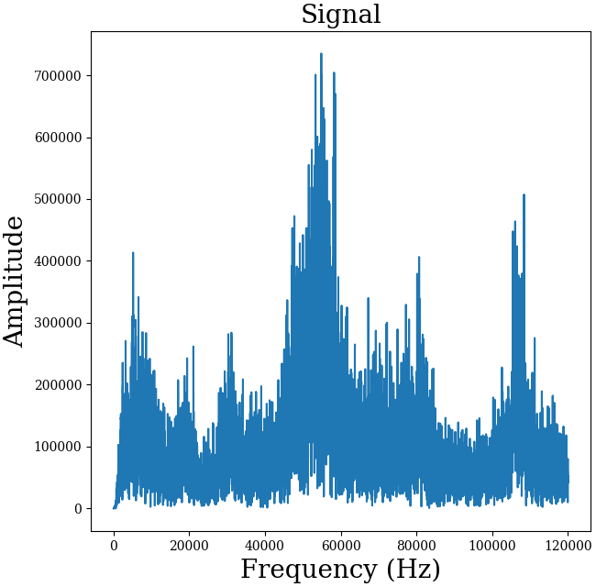
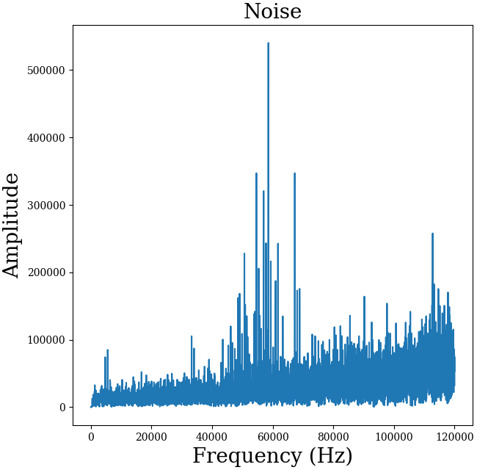

Slide 33



Slide 34
