Slide 1
Exploring the properties of opaque scintillators
LiquidO
By: Spencer Guerin

Slide 2
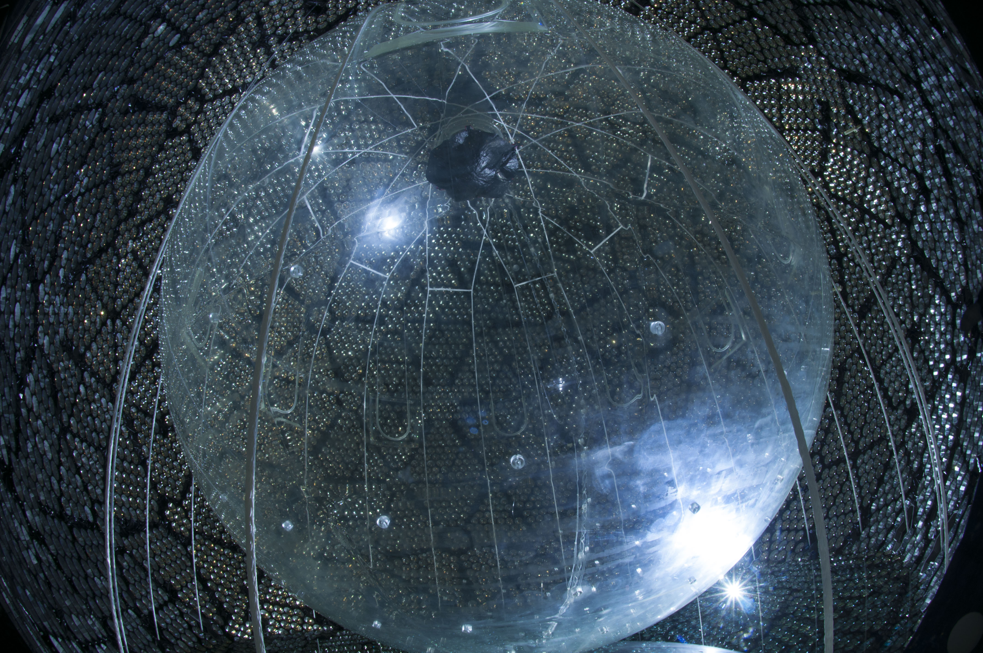
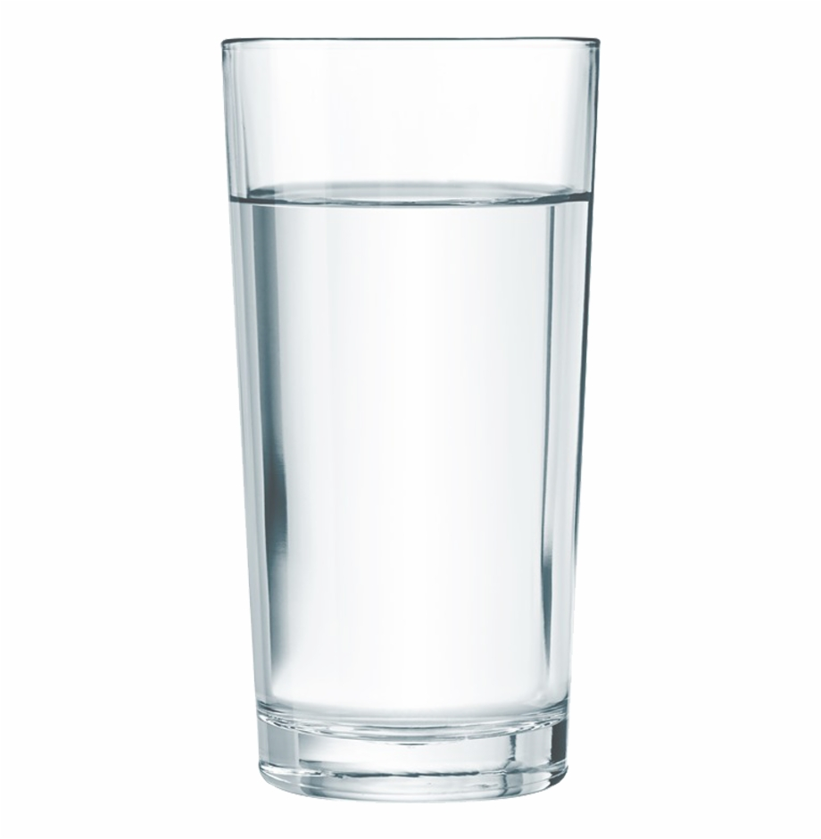
The transparent approach
Transparent liquid scintillator to interact with incoming particles causing scintillation light [1]
Many PMT’s surrounding the scintillator to collect light in the SNO+ detector [2]

Slide 3
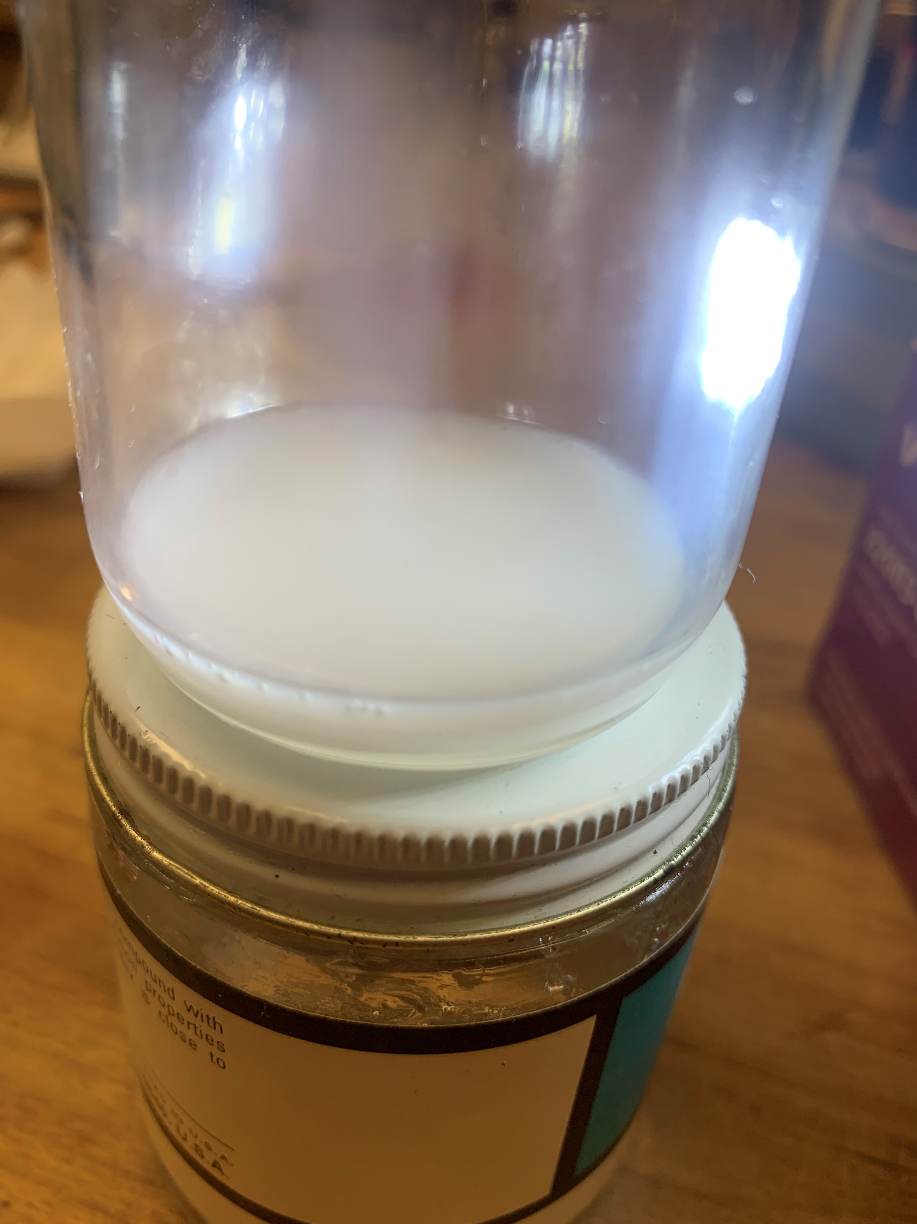
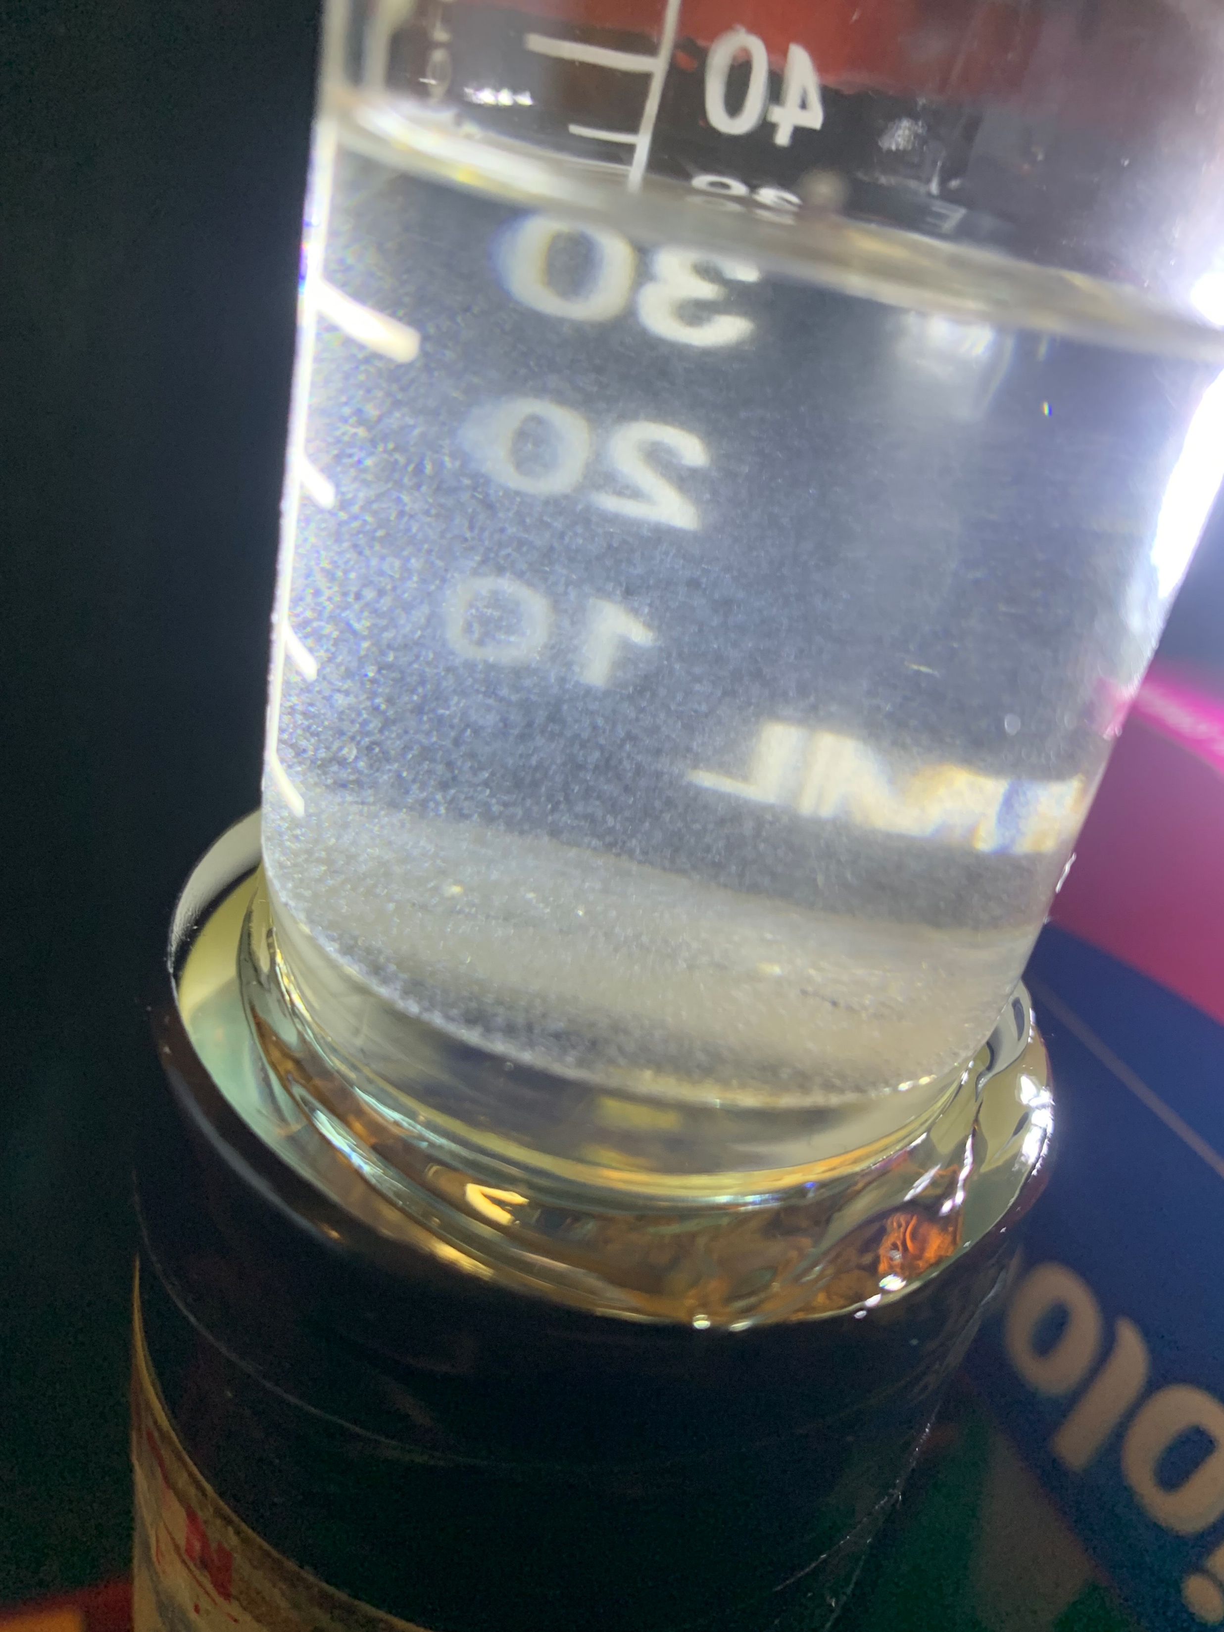
The opaque approach: LiquidO
Differs from the transparent approach in 2 ways:
Make the scintillator opaque
Reason: confine the scintillation light as close as possible to its creation point
Completely opaque sample prepared this summer
Partially opaque sample prepared this summer

Slide 4
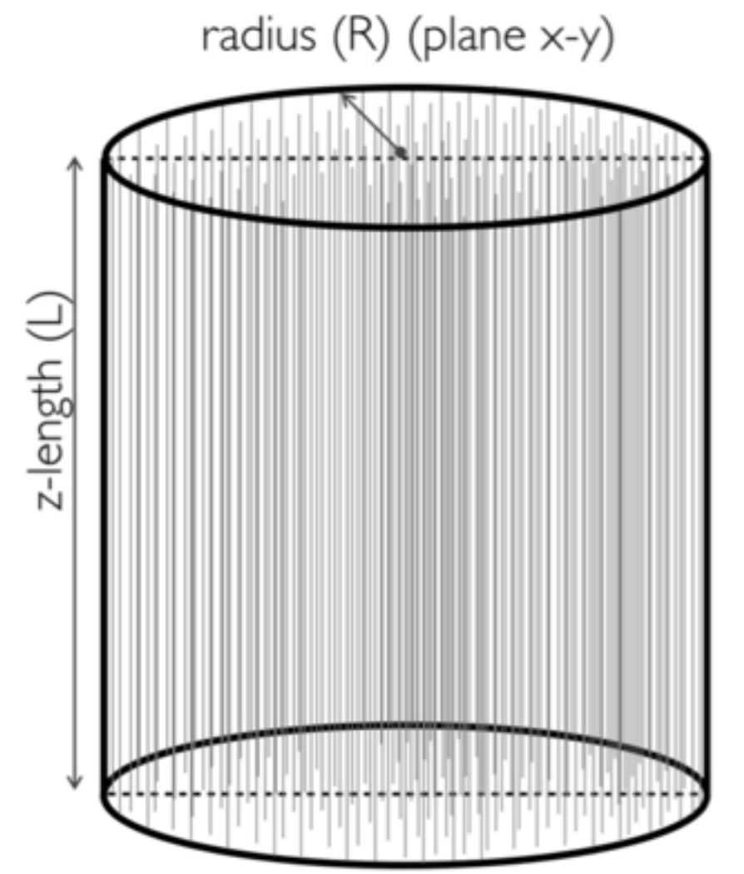
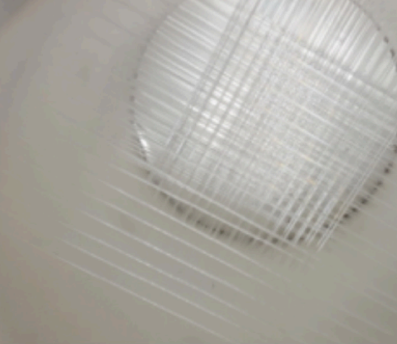
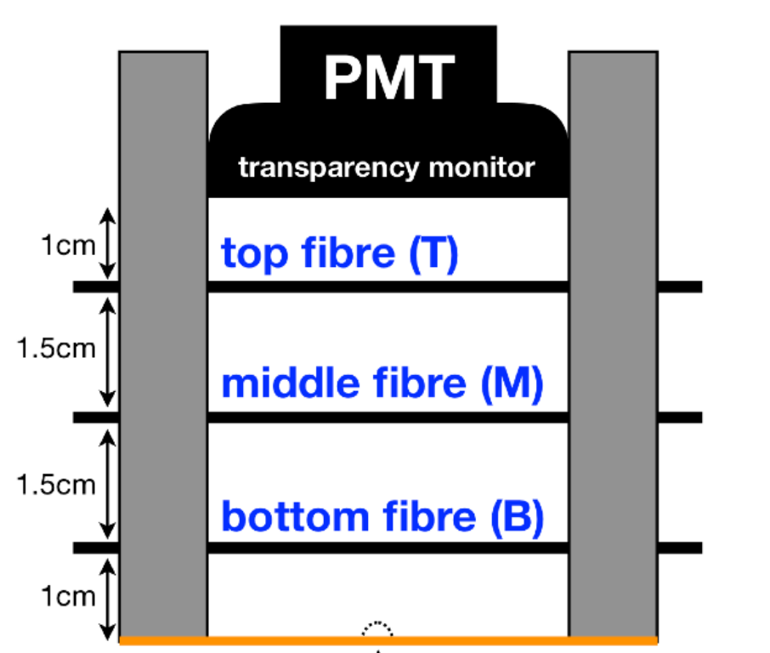
The opaque approach: LiquidO
2) Collect the light with an array of wavelength shifting fibers
Reason: collect the scintillation light as close as possible to its creation point
Placement of wavelength shifting fibers [3]
Theoretical LiquidO detector [3]
Suggested spacing between layers of fibers [3]

Slide 5
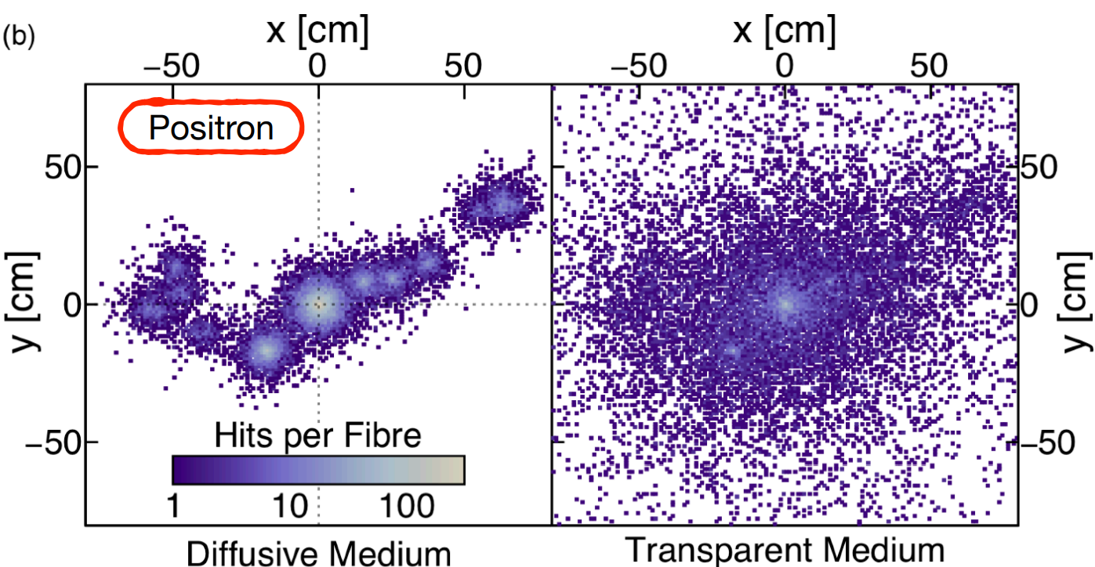
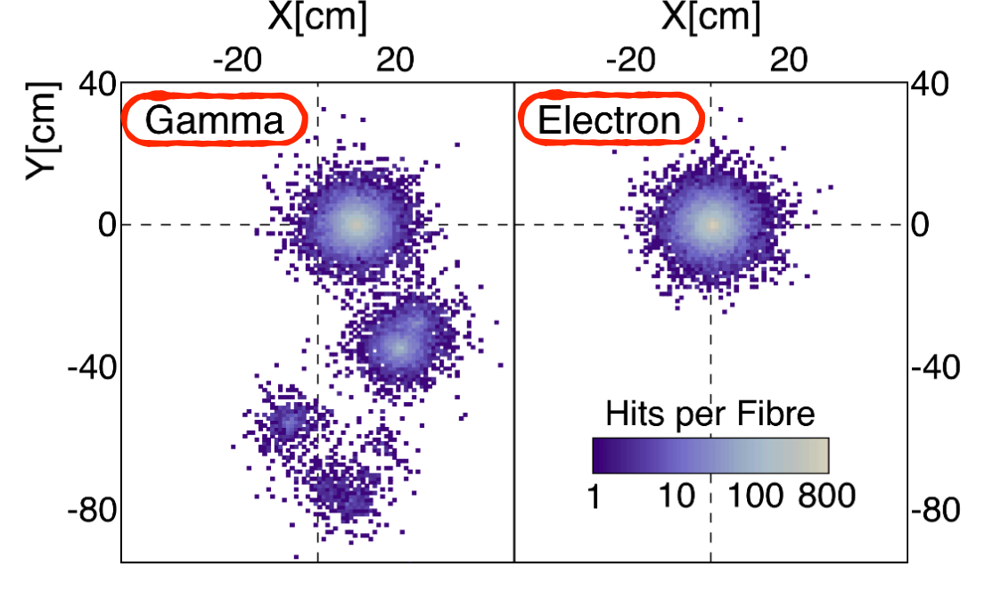
LiquidO enhanced imaging
J. Pedro Ochoa-Ricoux, LiquidO: an introduction [3]
J. Pedro Ochoa-Ricoux, LiquidO: an introduction [3]
Enhanced energy resolution: Positron annihilation in opaque and transparent medium (left)
Differentiation between gammas and electrons individually (right)
Creates 2D energy disposition patterns with incredible accuracy

Slide 6
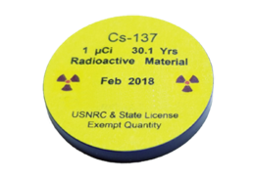
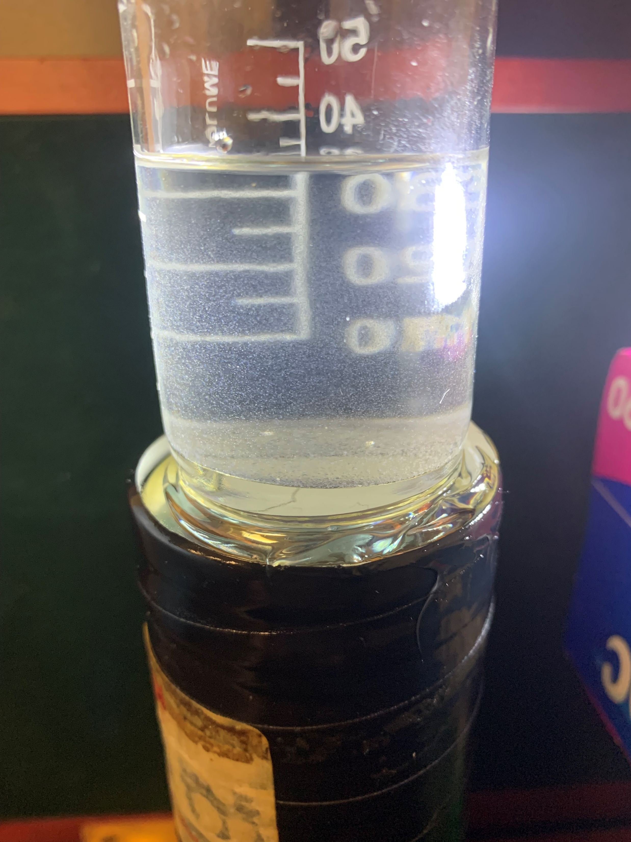
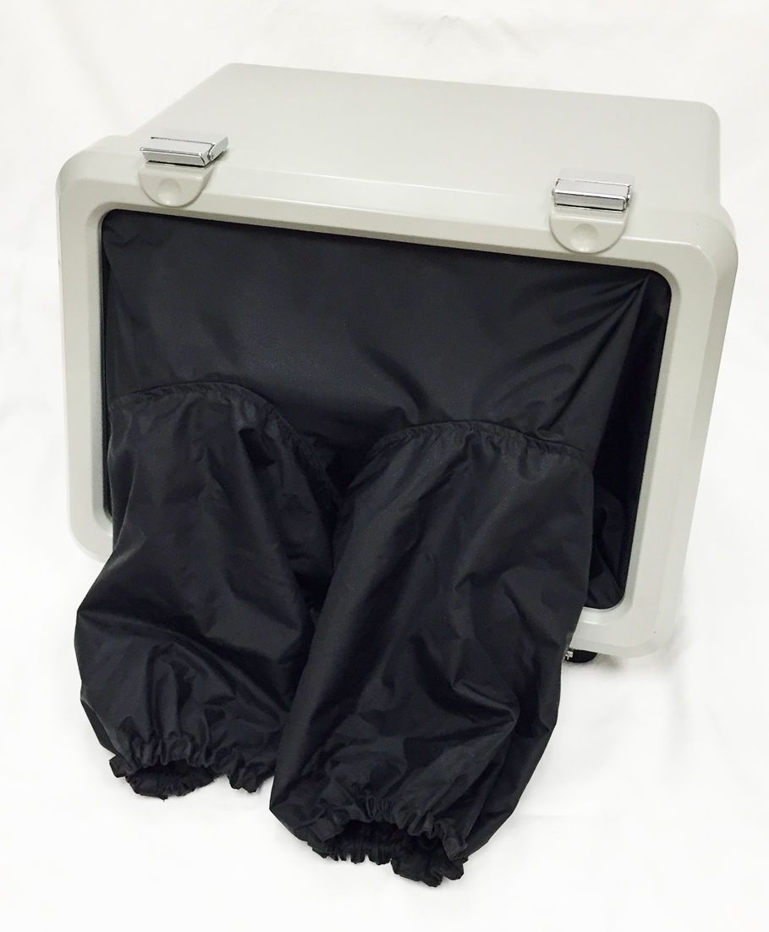
Apparatus
Cesium-137 source
Cylindrical container of opaque scintillator
Photo multiplier tube
All contained in a dark box

Slide 7
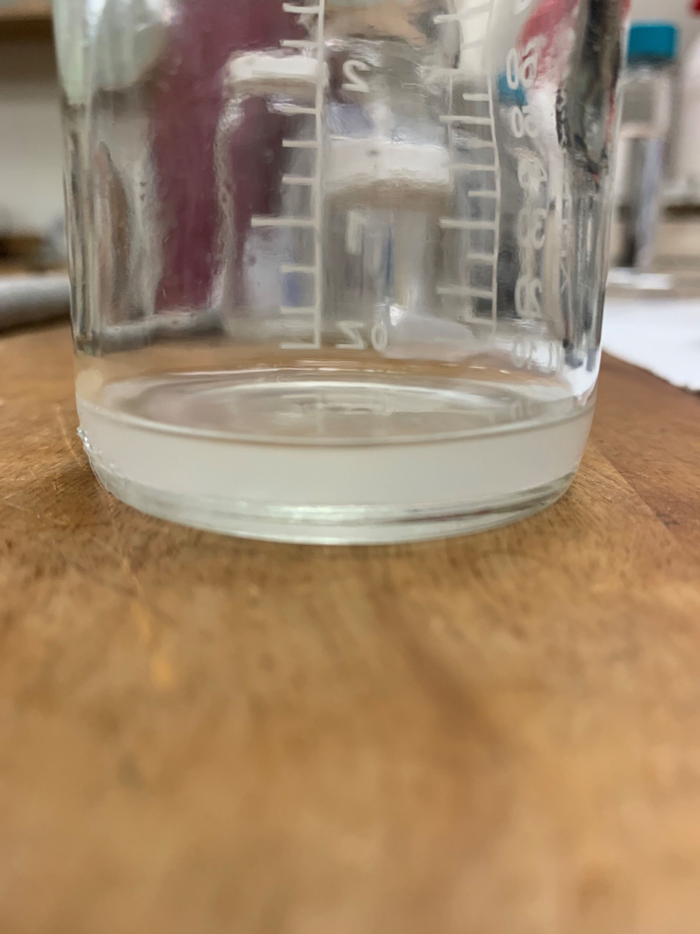
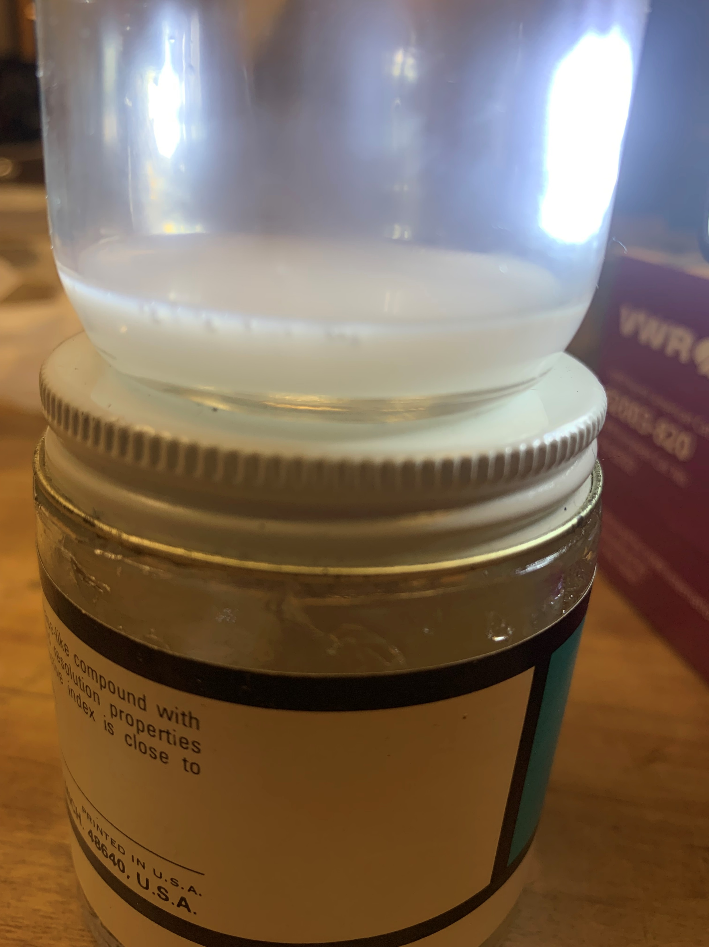
Making an opaque scintillator
The procedure:
1) Start with what we know works:
LAB and PPO according to 2g PPO/L of LAB, as used in SNO+
Transparent
2) Add a surfactant:
Add some PRS to the 2g/L mixture of LAB to PPO, allows the water droplets to mix throughout
Transparent
3) Add water droplets:
The PRS and water droplets undergo an emulsification reaction making it opaque
Opaque

Slide 8
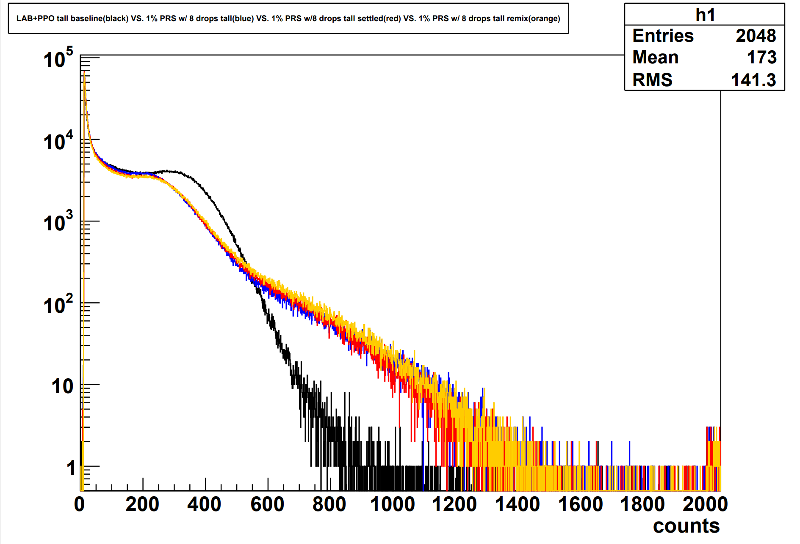
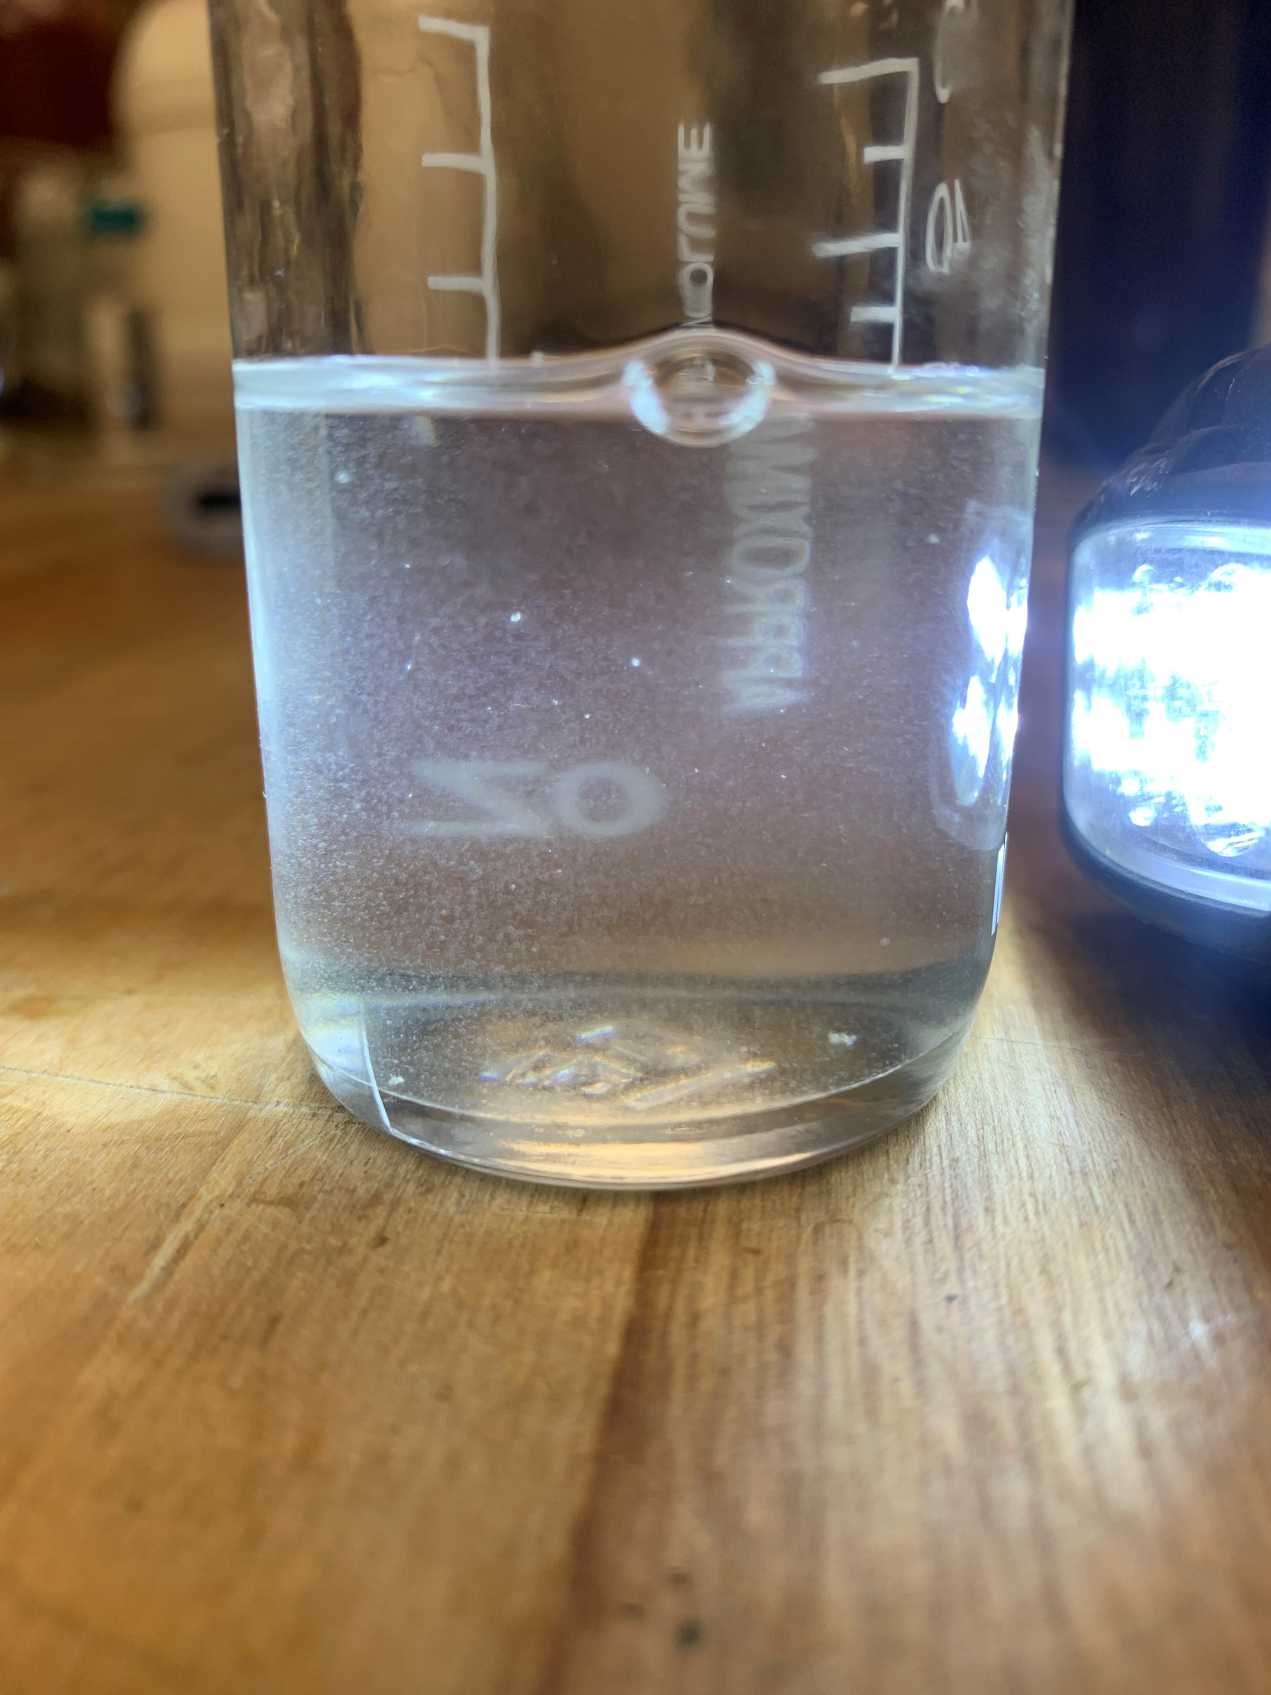
Thick trials
Slightly opaque
sample
35 mL of 1% PRS w/ 0.07g of PPO (2g/L concentration)
8 water droplets added
Cs-137 used as source
Spectra:
Baseline LAB+PPO at 2g/L concentration
1% PRS w/ 8 drops original mix
1% PRS w/ 8 drops once settled
1% PRS w/ 8 drops after remix
Channel Number

Slide 9
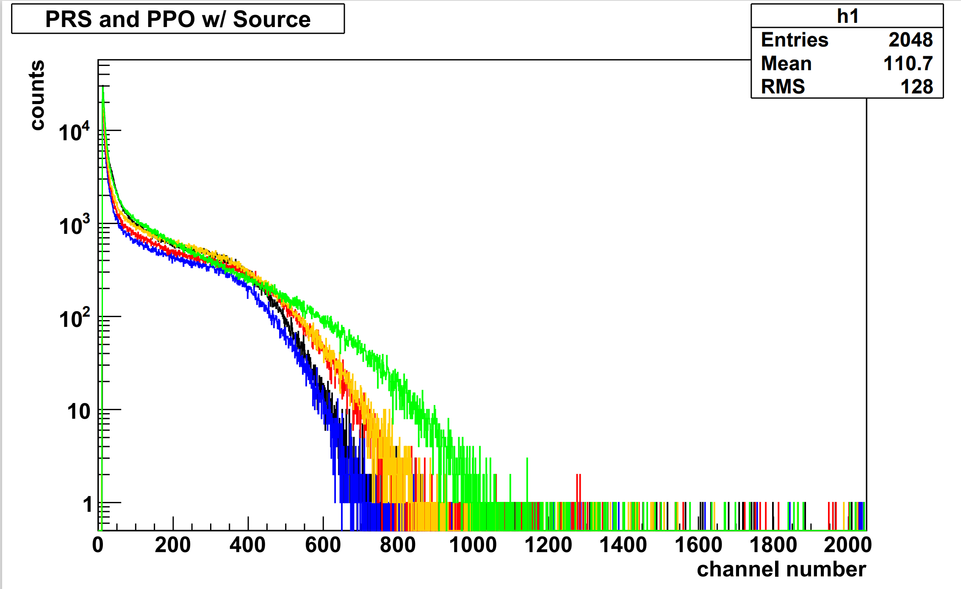

Thin trials
Opaque sample
7.2 mL of 5% PRS w/ 0.0144g of PPO (2g/L concentration)
Water drops added in succession
Cs-137 used as source
Spectra:
Baseline 5% PRS w/ PPO
5 droplets of water added
10 droplets of water added
15 droplets of water added
20 droplets of water added

Slide 10
Summary
Opaque scintillators increase the amount of light detected due to the back scattering of scintillating photons, the so called “fog effect”
For larger volume samples the light is obscured and less are detected, in thinner volumes due to the closeness of the detector more light is detected
Combining the confinement of the photons from the opaque nature of the scintillator with the closeness of the fiber array, LiquidO offers incredibly energy resolution not possible in the transparent approach

Slide 11
[1] - Water Glass Png Pint Glass - Clip Art Library (clipart-library.com)
[2] - OG Group Web (berkeley.edu)
[3]- LiquidO_SnowmassNF01_OchoaRicoux (fnal.gov)
Sources

