Slide 1
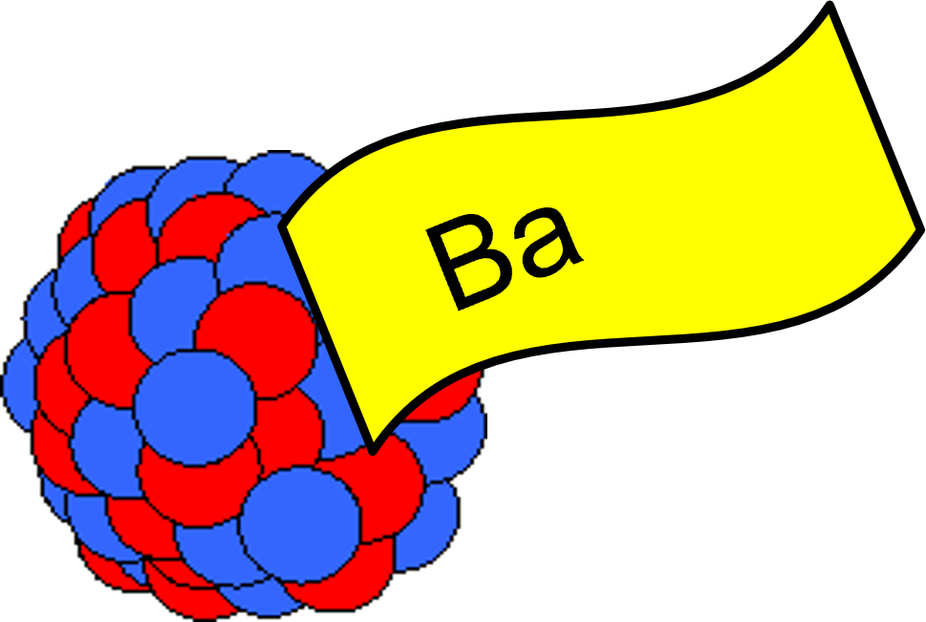


Characterizing an in-gas Laser Ablation Ion Source through SIMION Simulation for Barium-tagging
Katherine Lei
Supervisor: Thomas Brunner
Mcgill University

Slide 2

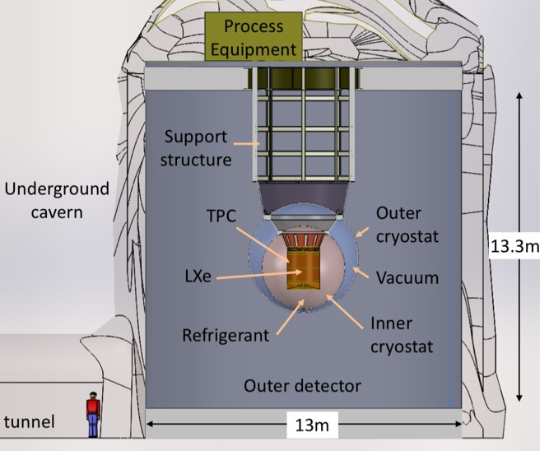
The nEXO Experiment
Proposed experiment searching for neutrinoless double beta decay (0νββ) in ¹³⁶Xe using a 5 tonne liquid Xe (LXe) Time Projection Chamber (TPC)
Positive observation requires the neutrino to be its own anti-particle neutrino is a Majorana particle.
Violates Lepton number conservation physics beyond the Standard Model.
nEXO is expected to reach a half-life sensitivity goal of 1.35 × 10²⁸ yr
nEXO, J. Phys. G: Nucl. Part. Phys. 49, 015104 (2022)
136Xe
136Ba++ + 2e-
Ba-tagging for background elimination!
nEXO pCDR, arXiv:1805.11142

Slide 3
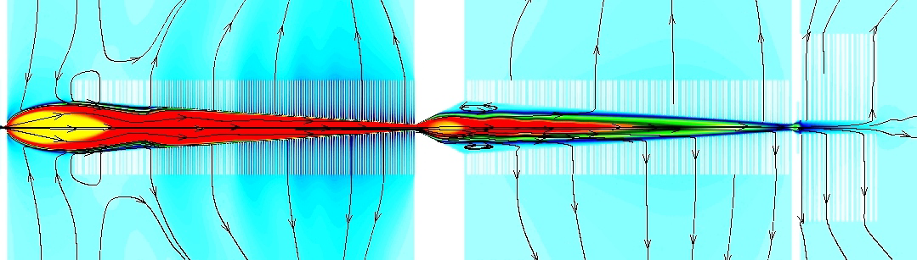
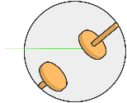

Canadian Ba-tagging Scheme
Xe Gas
Stage2:
RF carpet for efficient transfer of ion from capillary to RF funnel
Stage1:
Extraction of detector volume around the location of the decay to gas phase using a capillary tube.
Stage3:
RF funnel facilitates separation of xenon accompanying the Barium ion.
Laser Ablation
Ion Source in Gas
nEXO TPC
RF Carpet
RF Funnel
Stage5:
Multiple Reflection TOF Spectrometer for systematic studies and determination of ion mass.
Liquid Xe
Xe Gas (~2bar)
High vaccum (~10⁻⁶mbar)
He buffer Gas
High vaccum
Ultra-high vacuum (~10⁻⁸mbar)
(~10⁻²mbar)
(~10-7mbar)
Laser Ablation
Ion Source
Linear Paul Trap
MRTOF
Mass Spectrometer
Quadrupole
mass filter
Stage4:
The Linear Paul trap for detection of barium ion via laser fluorescence
spectroscopy​.
Detector
Laser Spectroscopy
Notes:
“Canadian Effort”
“Review of progress”

Slide 4
Canadian Ba-tagging Scheme
Xe Gas
Stage2:
RF carpet for efficient transfer of ion from capillary to RF funnel
Stage1:
Extraction of detector volume around the location of the decay to gas phase using a capillary tube.
Stage3:
RF funnel facilitates separation of xenon accompanying the Barium ion.
Laser Ablation
Ion Source in Gas
nEXO TPC
RF Carpet
RF Funnel
Stage5:
Multiple Reflection TOF Spectrometer for systematic studies and determination of ion mass.
Liquid Xe
Xe Gas (~2bar)
High vaccum (~10⁻⁶mbar)
He buffer Gas
High vaccum
Ultra-high vacuum (~10⁻⁸mbar)
(~10⁻²mbar)
(~10-7mbar)
Laser Ablation
Ion Source
Linear Paul Trap
MRTOF
Mass Spectrometer
Quadrupole
mass filter
Stage4:
The Linear Paul trap for detection of barium ion via laser fluorescence
spectroscopy​.
Detector
Laser Spectroscopy
Notes:
“Canadian Effort”
“Review of progress”

Slide 5
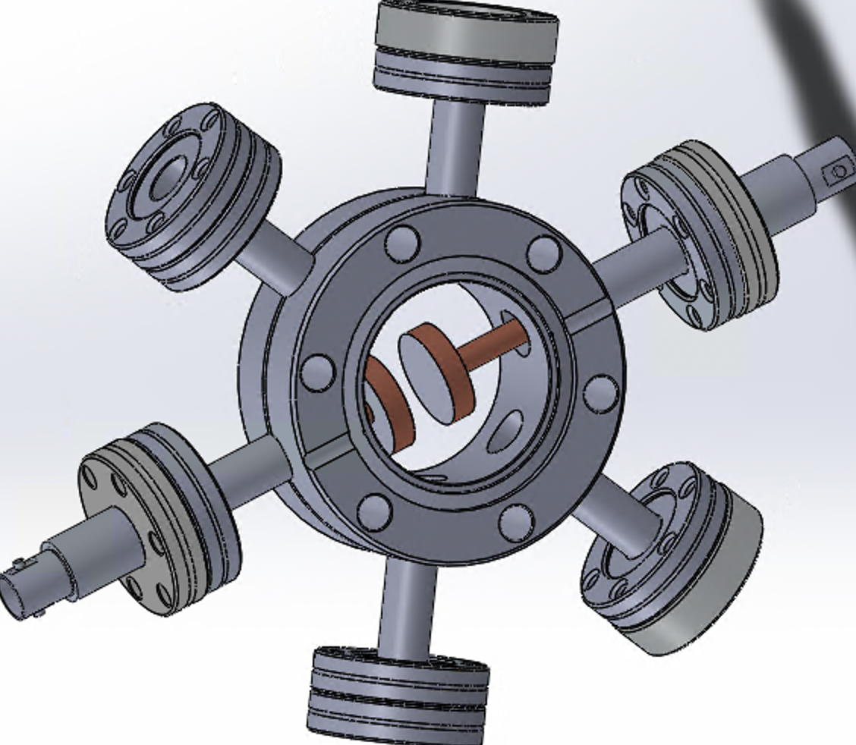
In-gas Laser Ablation Ion Source (IGLAS)
Ion source in a controlled gaseous environment for calibration of the ion identification setup and determine transport efficiency throughout the system
Xe/Ar Gas
Parallel plate geometry, separation ~ 0.9 cm
Focused laser ablating ions off of target surface
Apply +/- voltage bias on target/collector to drift ions toward the collector
Chamber can be at vacuum or filled with Xe/Ar gas at different pressures
Laser
Target
Ion Collector

Slide 6
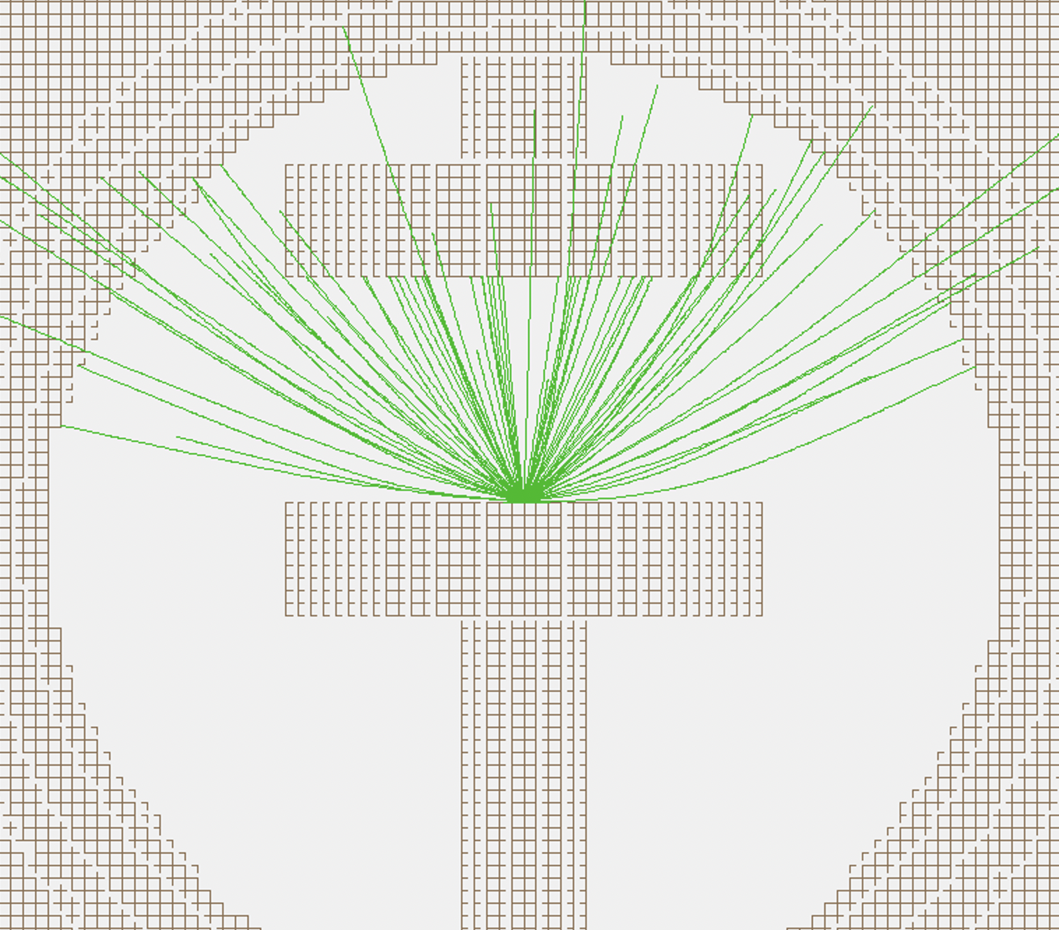


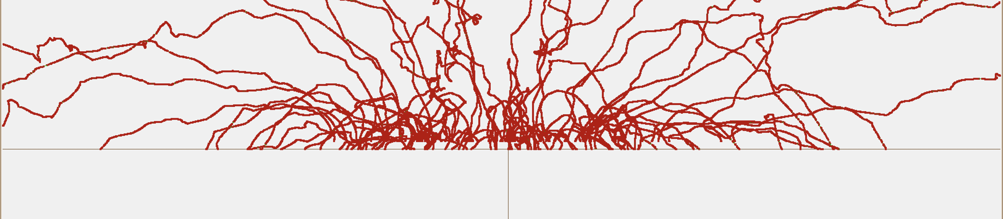
SIMION Simulation
Apply voltage to each of the 3 electrodes, define particle initial conditions, implement hard-sphere collision model with desired parameter values to simulate collisions between Cu+ and Xe or Ar gas
Initial KE: Gaussian distribution centered at 50 eV, FWHM~25 eV
Vacuum
10 Torr Ar
Assigned a total charge ~ 10⁻¹⁰ C (estimated from current measurements and laser repetition rate) to simulate Coulomb repulsion between the ions
Electric field lines

Slide 7
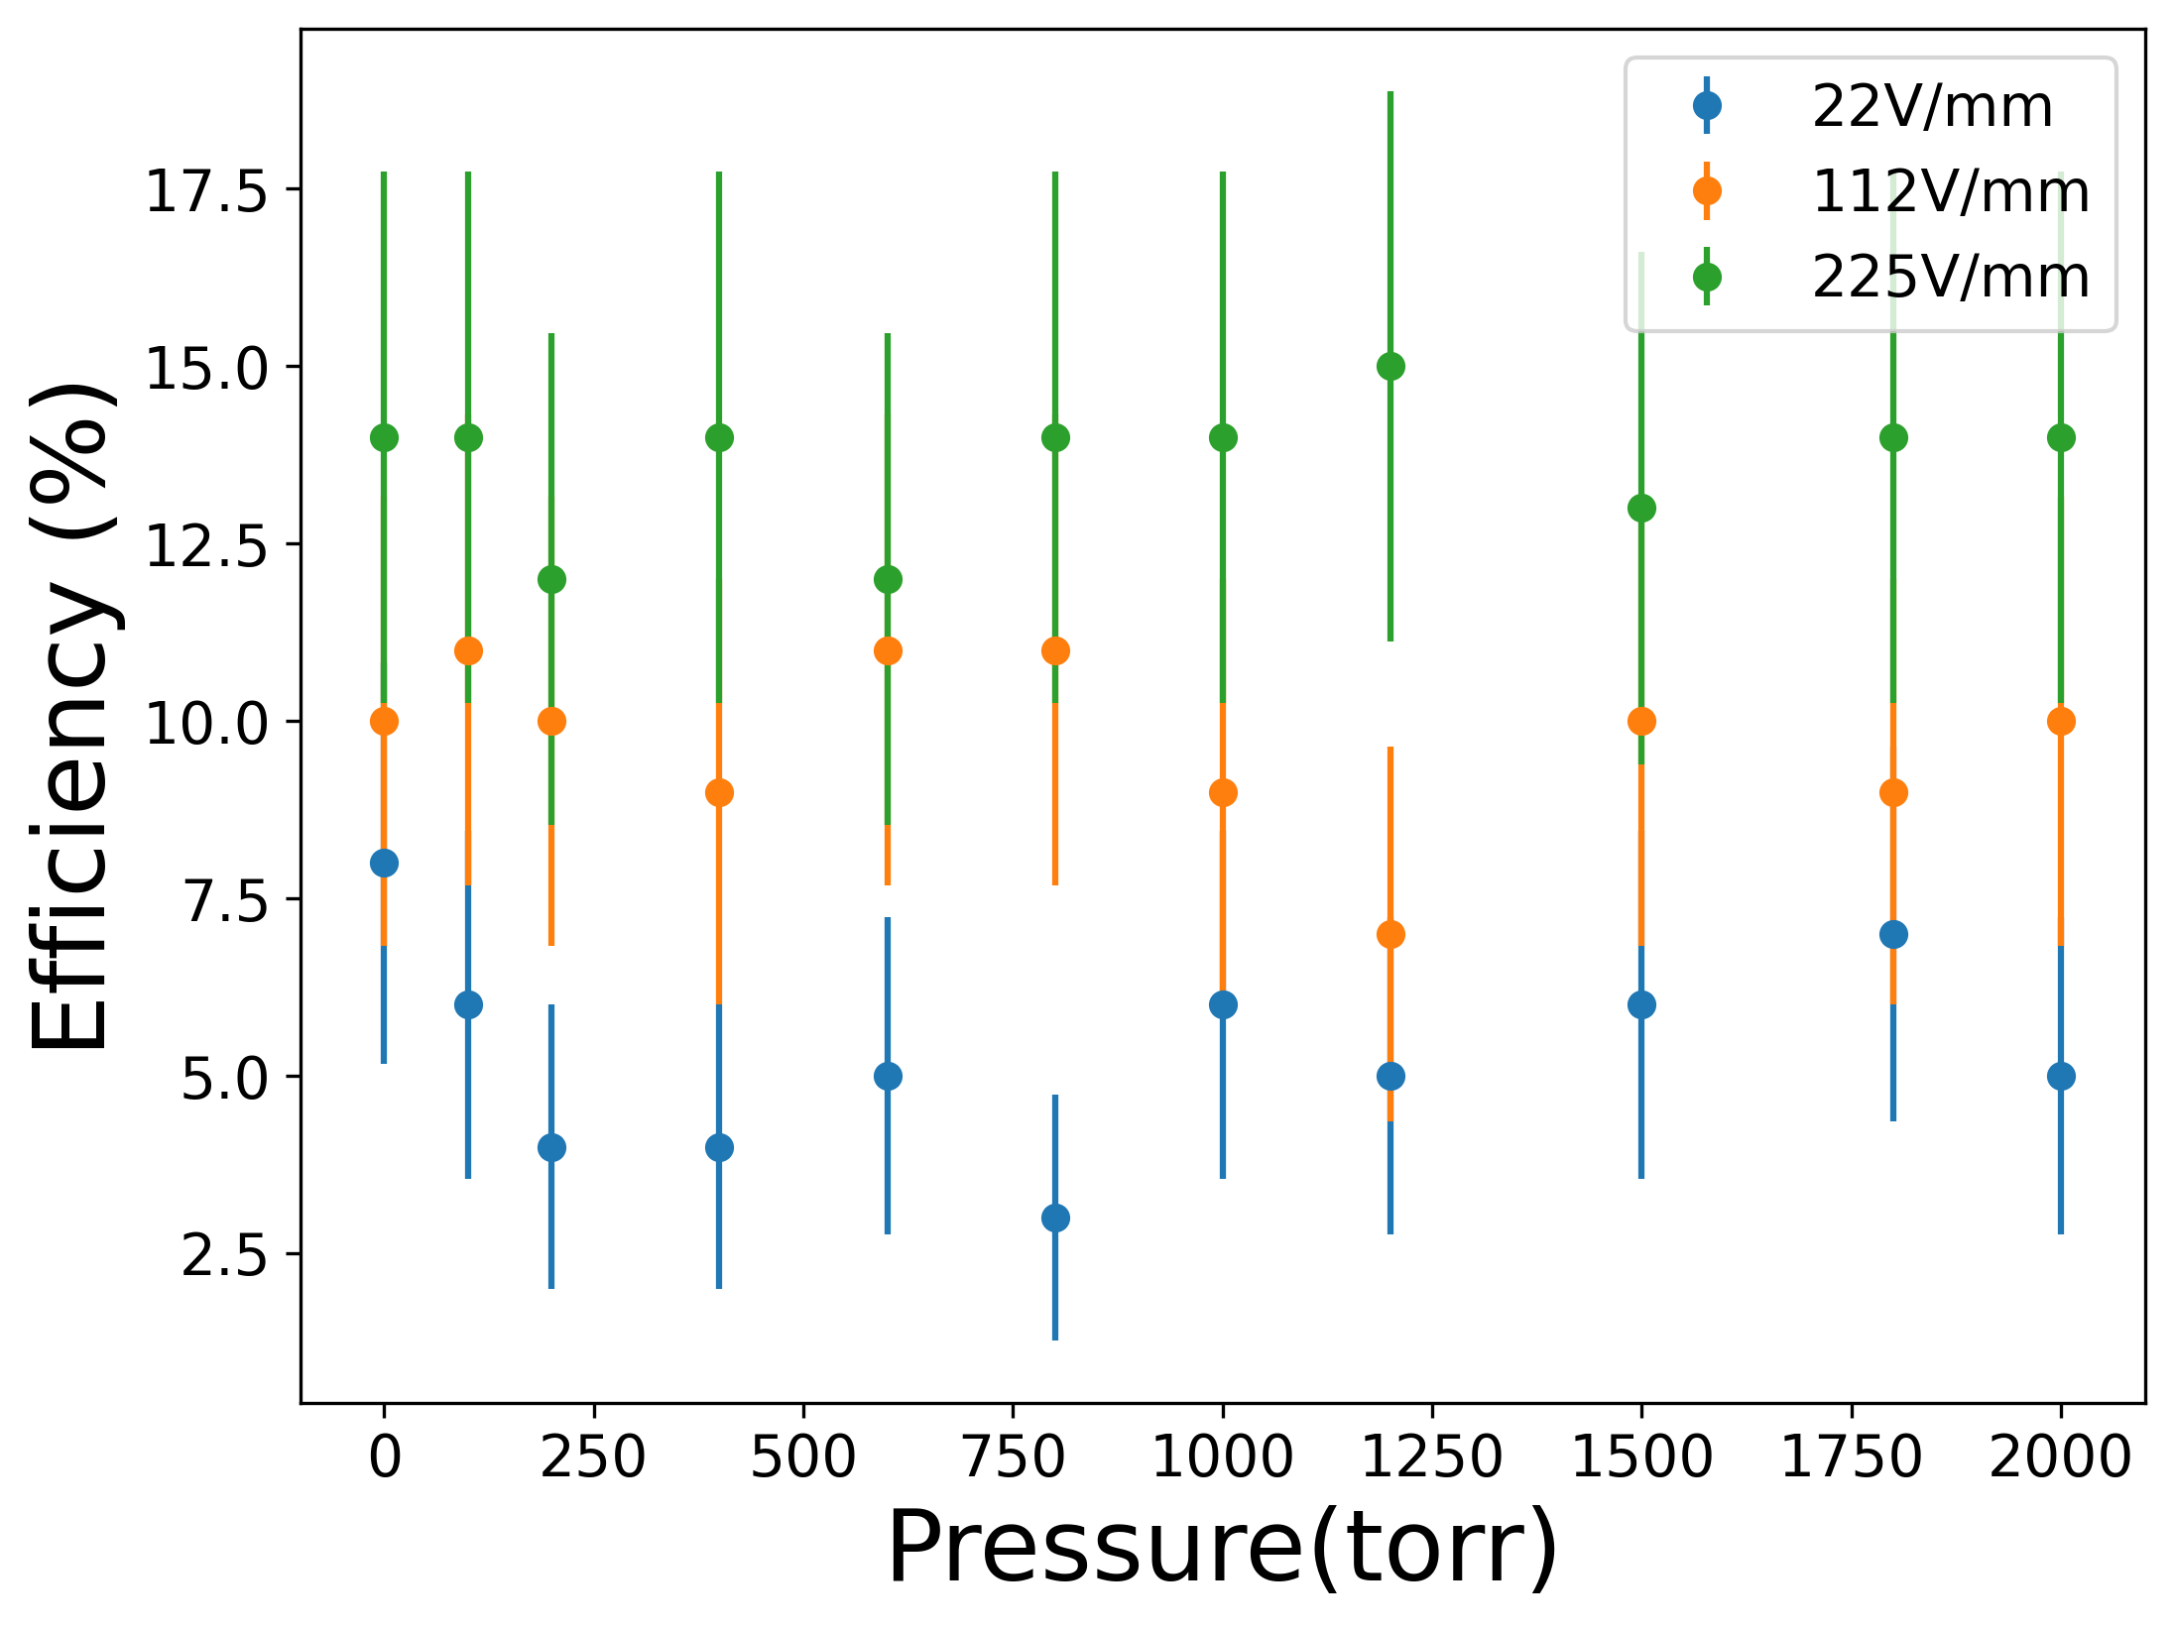
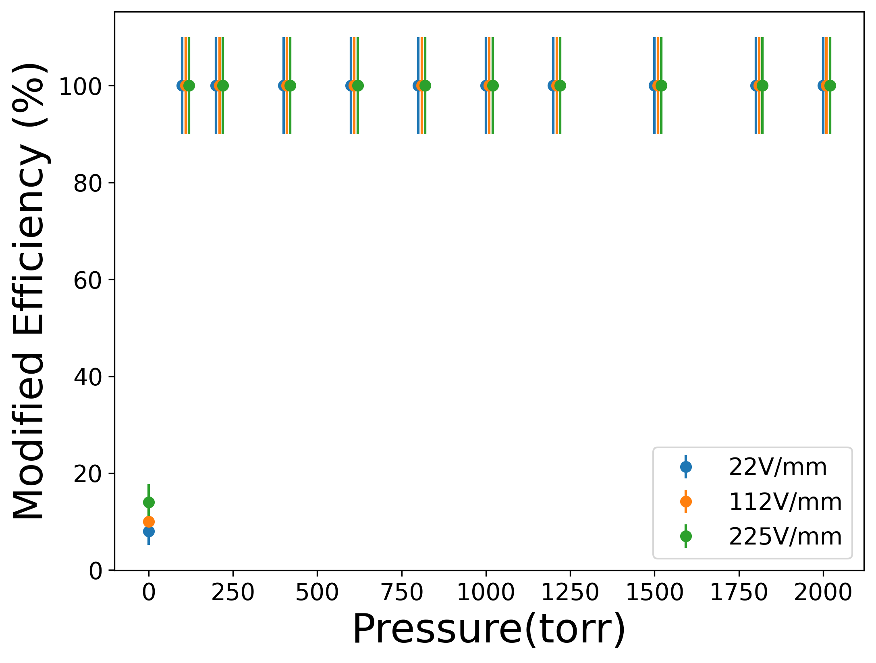
Simulated Ion Transport Efficiency
Efficiency = Ions arriving on collector/Ions created
Simulated in Xe as a function of pressure with varying electric field strengths
Ions that quickly return to the target don’t affect the efficiency in current measurements, excluding them gives the ‘’modified efficiency’’ at 100% except at vacuum.
100% efficiency expected at all pressures away from vacuum

Slide 8
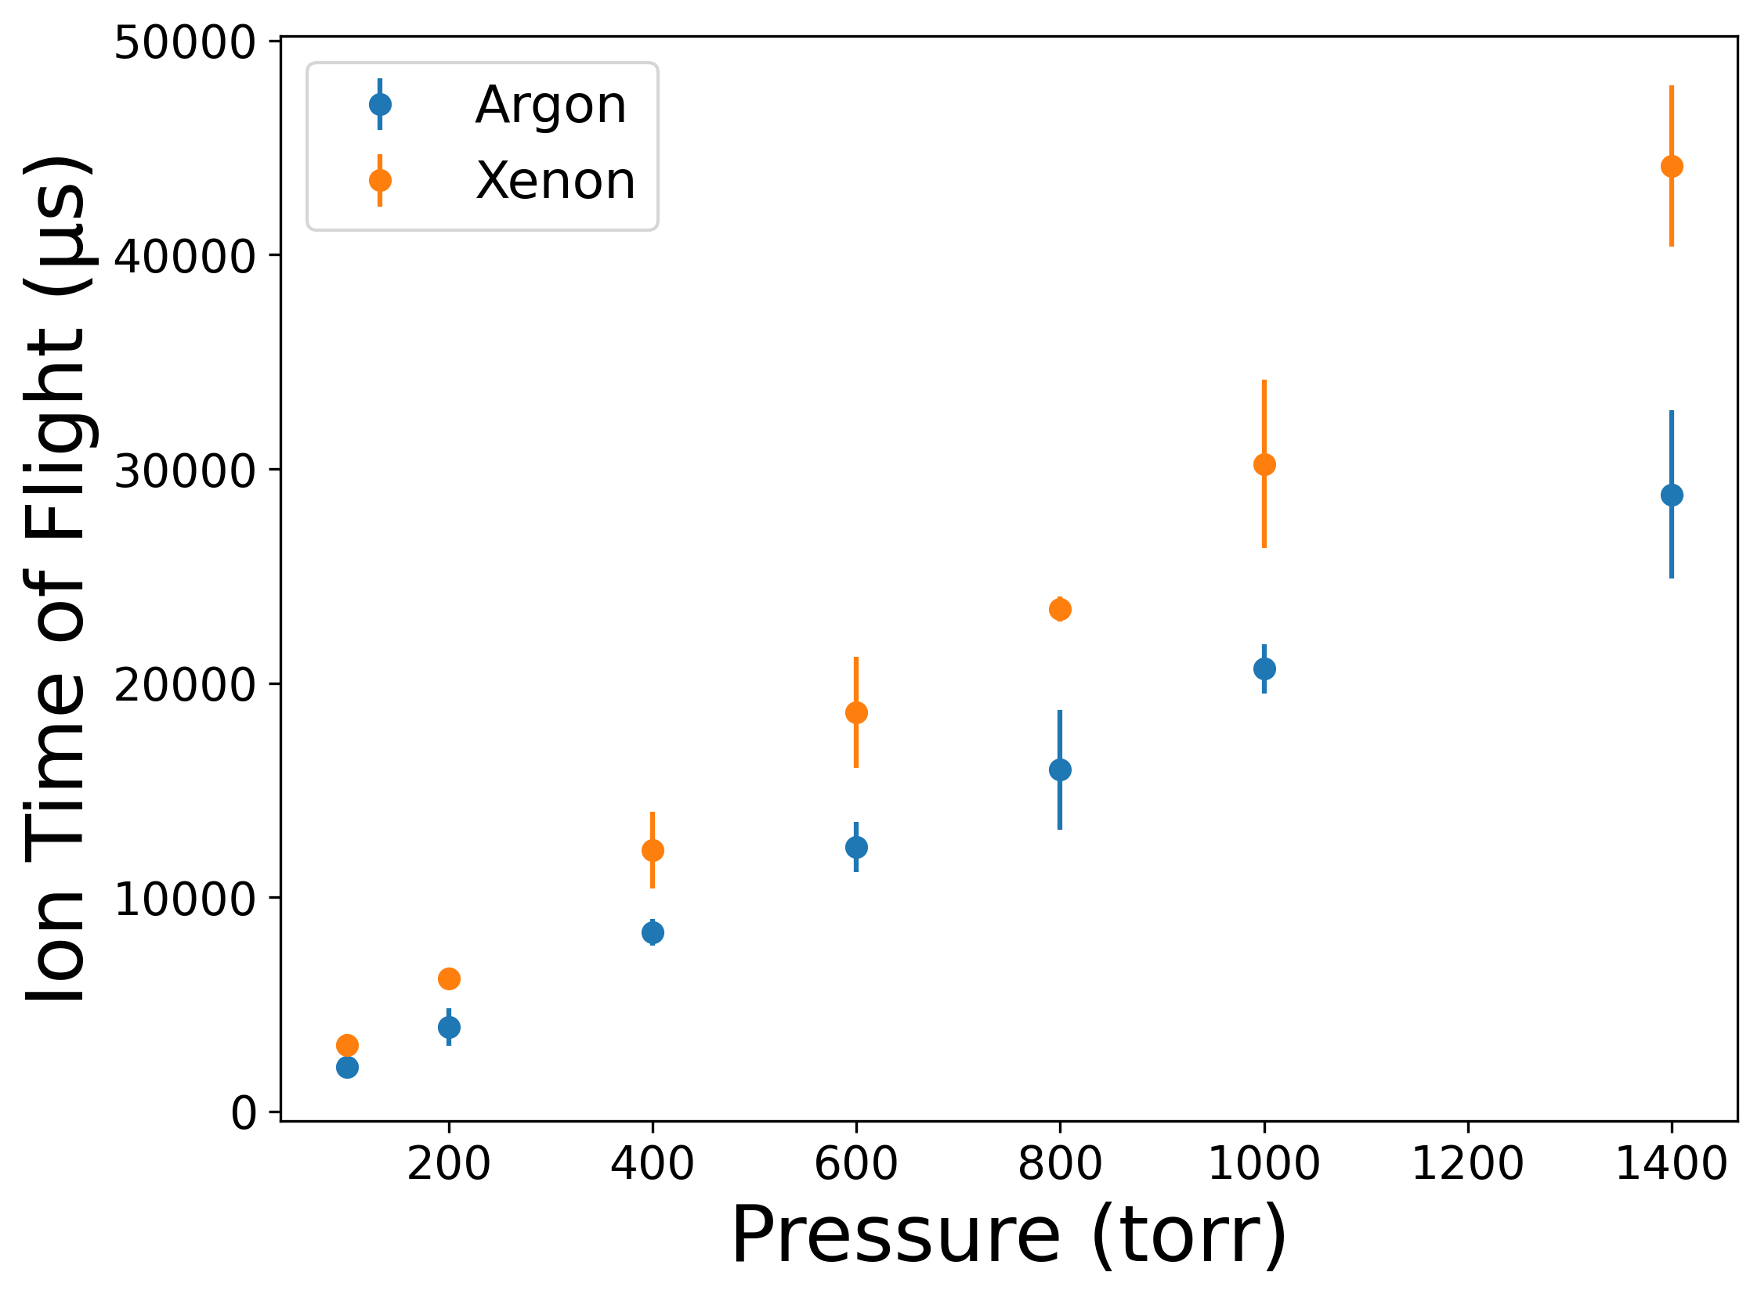
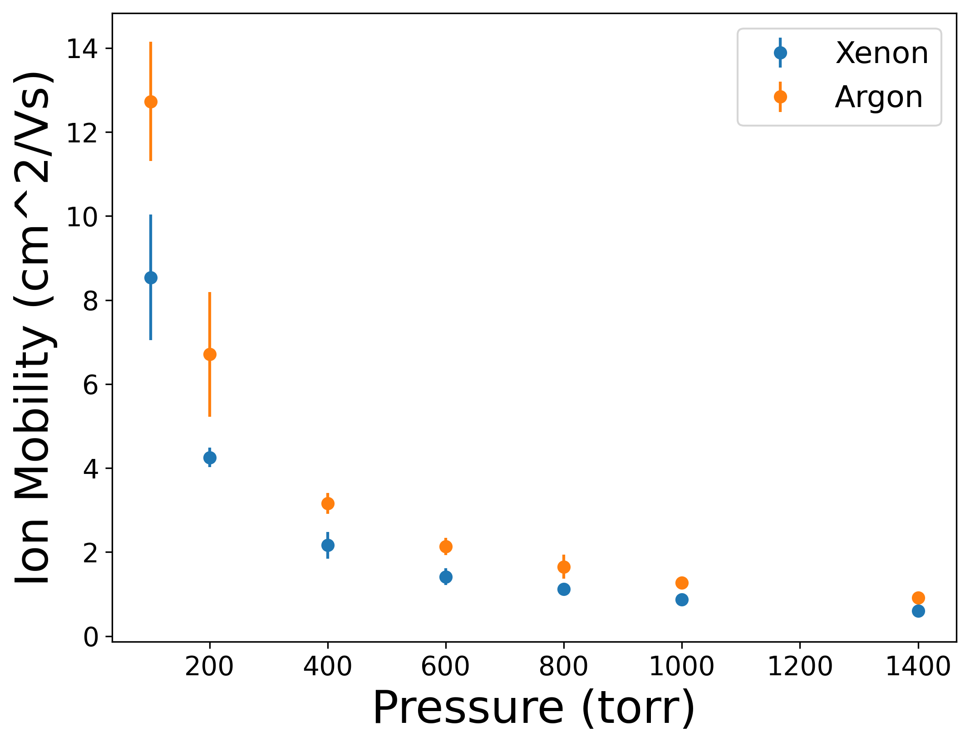
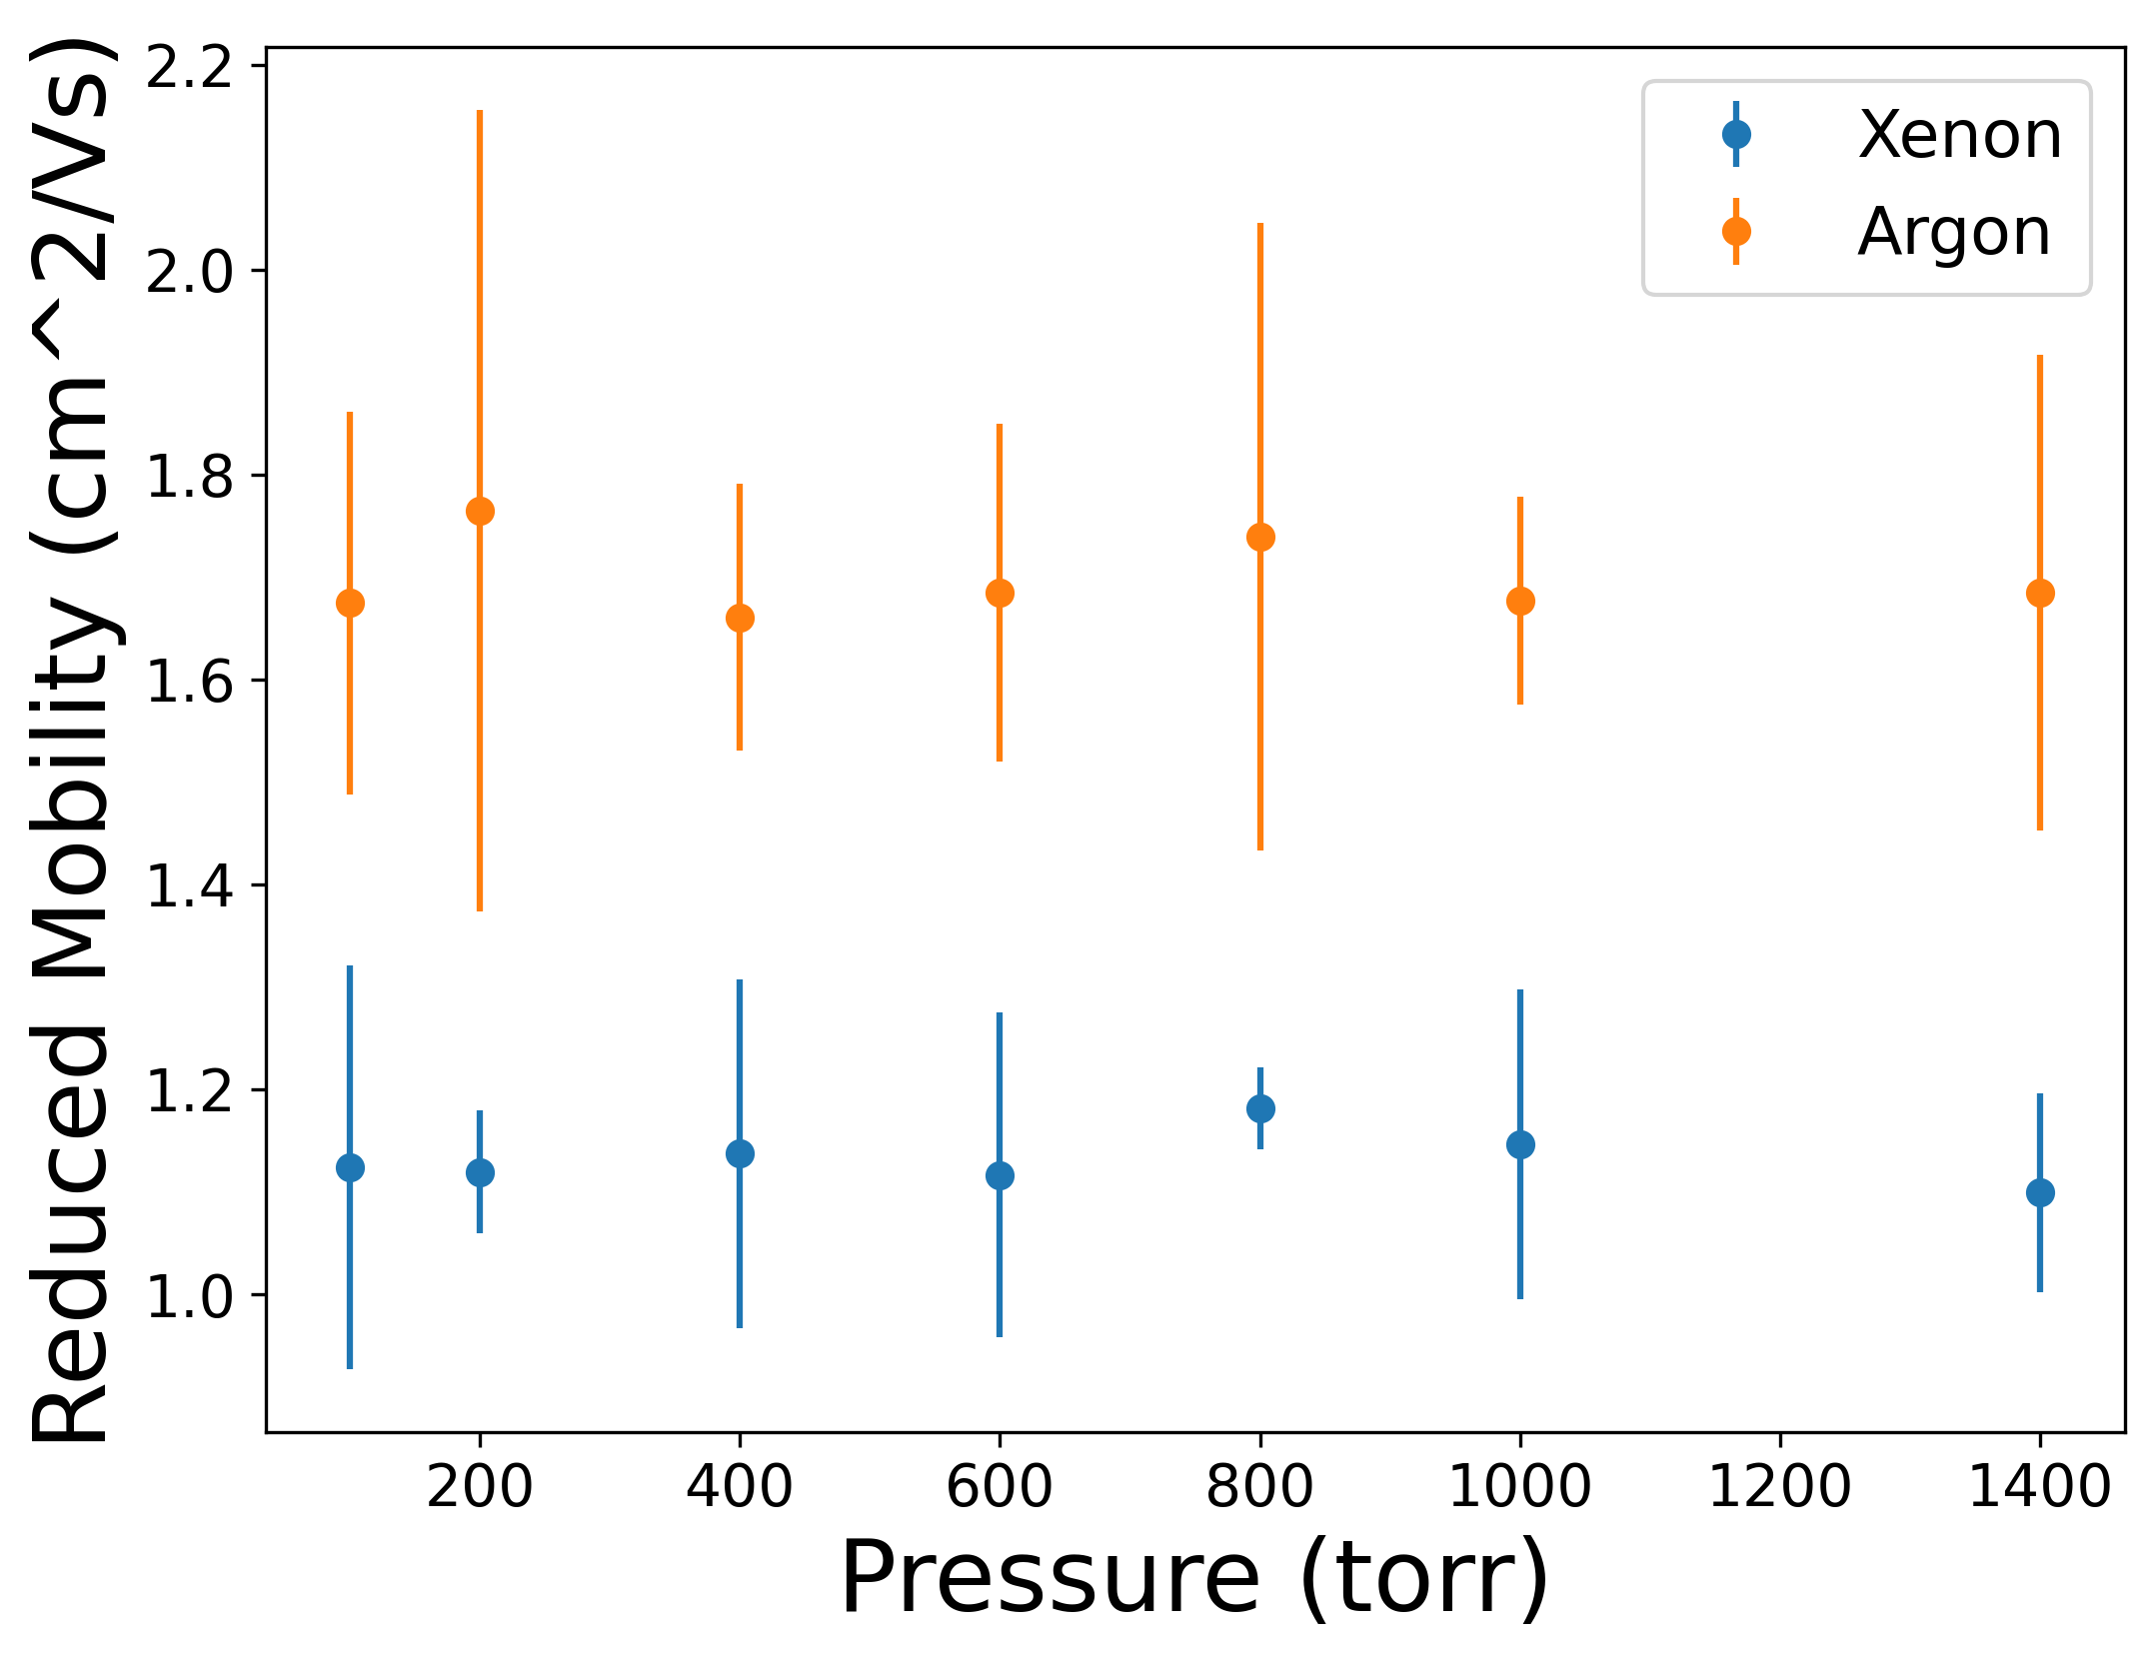
Simulated Ion Time of Flight/Mobility
Ion time of flight as a function of pressure in Xe/Ar
Ion mobility and reduced mobility in Xe/Ar as a function of pressure
3V/mm
Literature values:
2.23 cm²/Vs (in Ar)
1.0987 cm²/Vs (in Xe)
Next: working on measuring these in the lab by using charge-sensitive preamplifiers on both the target and ion collector
Viehland, L.A., Skaist, T., Adhikari, C. et al. Int. J. Ion Mobil. Spec. 20, 1–9 (2017).

Slide 9
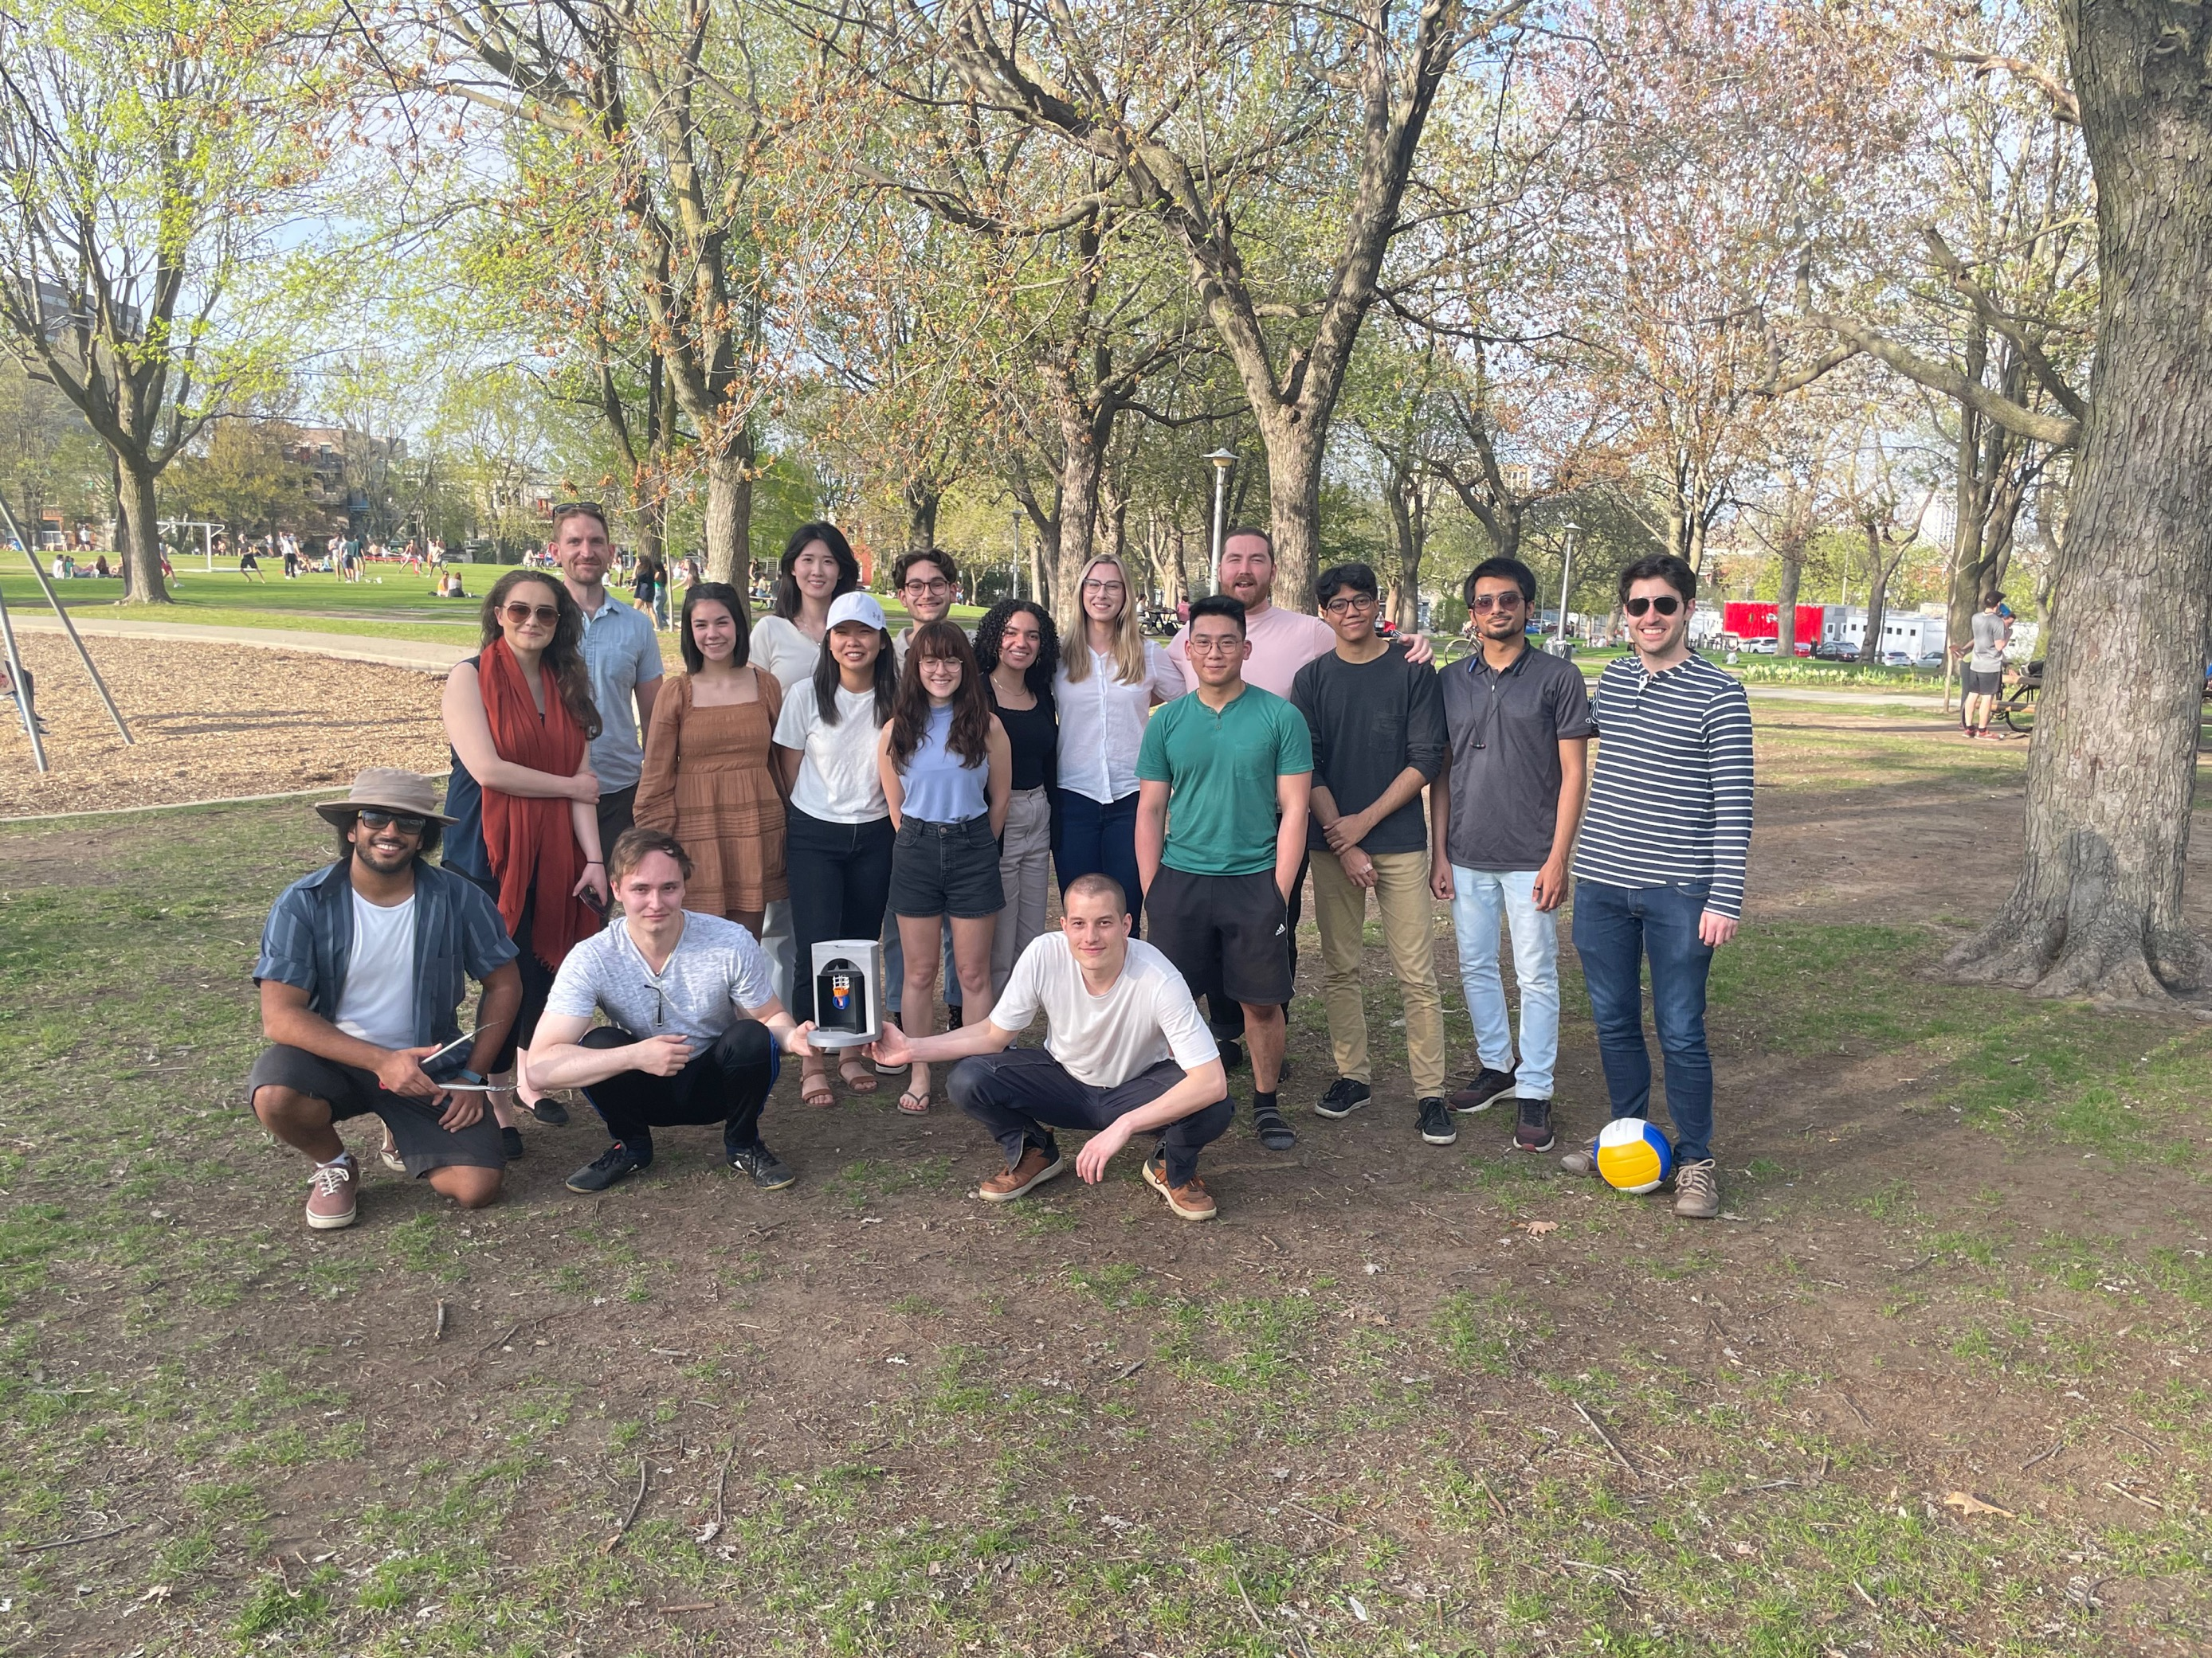
Conclusions
An in-gas laser ablation ion source (IGLAS) is developed to create ions in high pressure gas for calibration and systematic studies of the Ba-tagging setup for the proposed nEXO experiment
Simulations are done in SIMION using the hard-sphere collision model to study transport efficiency, ion time of flight and ion mobility of Cu+ in Xe and Ar gas as a function of pressure
Working towards measuring time of flight using charge-sensitive preamplifiers to compare experimental data to simulation results
Thanks to the lab group at Mcgill!

Slide 10







Acknowledgements
Thank You for Listening!

