Slide 1
Analysis of leaching on Polytetrafluoroethlene (PTFE) shielding through the detection of alpha particle emissions.
2022/08/16
Pranav Sairam – Physics and Astronomy Student at the University of Waterloo
SNOLAB Summer Coop Research Assistant
Supervisor: Dr. Silvia Scorza

Slide 2
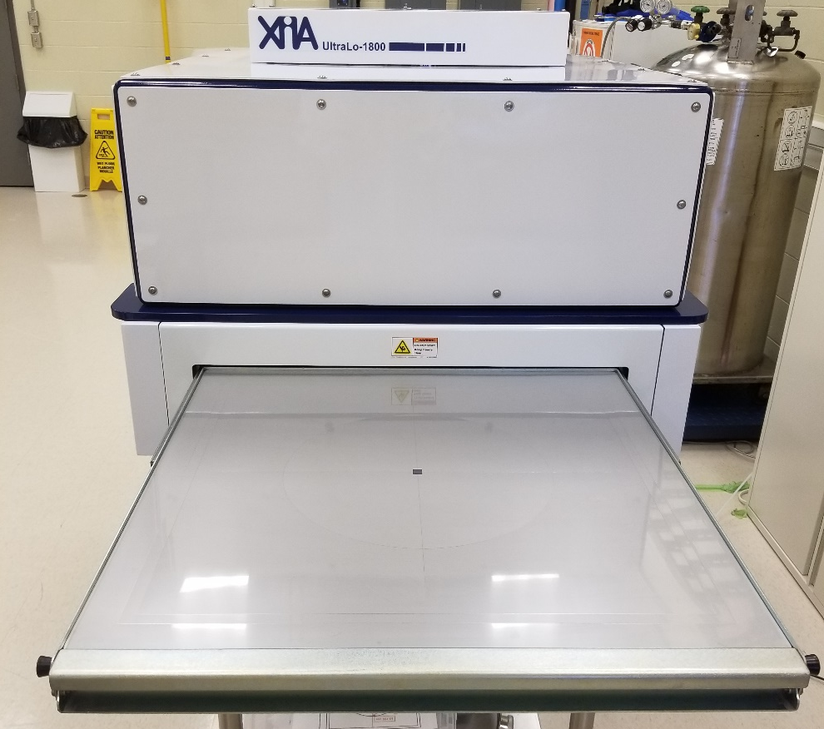
Instrument: XIA Ultra-Lo 1800
Ionization counter filled with liquid argon boil-off
Grounded electrode holds sample (a conductive tray)
Higher pair of counting anodes surrounded by “guard” anode to identify emitted alphas from sidewalls
Potential of 1100 V applied between tray and positive anode, emitted alpha particles ionize Argon gas releasing electrons
Electrons drift upwards to induce currents in anode to lead to a count measurement

Slide 3
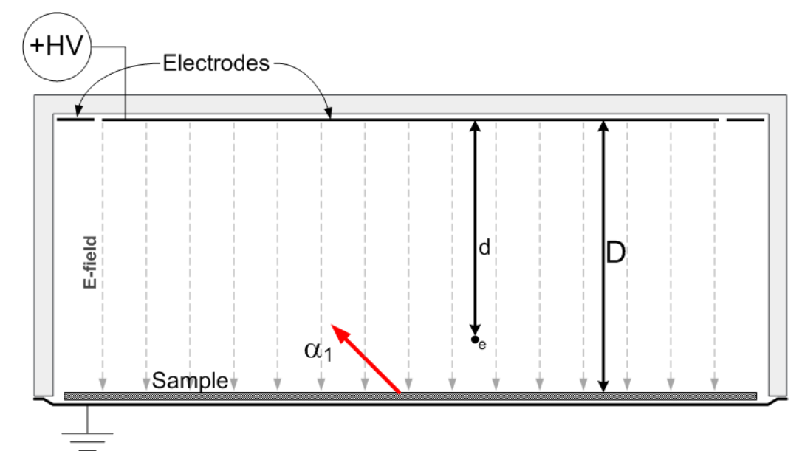
Analysis Information
Pulse-shape discrimination used for energy of particle & rise time of pulse (height above sample tray)
Sample Change: purge of minimum 45 minutes using Argon boil off
Tray background activity taken periodically to account for variability
Efficiency correction due to random nature of alphas counting from their ionization paths

Slide 4
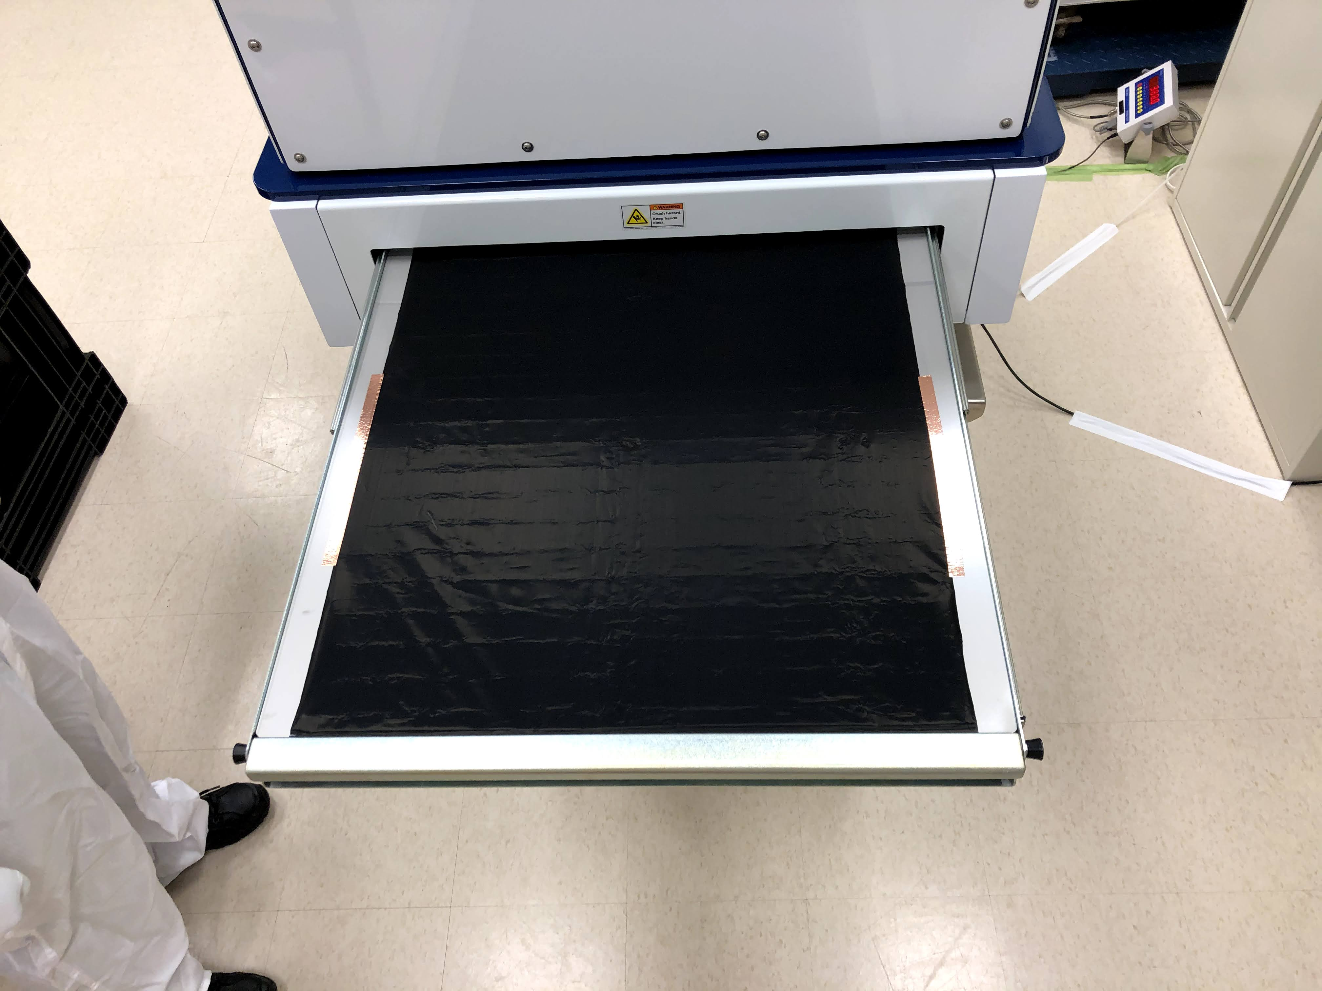
Analysis Pipeline
Identification of alphas via the pulse discrimination
Subtraction of the background contribution due to count gas / interior surface of chamber
  Empty tray readings (Tray Background) have a conductive Teflon liner having lower background rate, scaled by fraction of tray’s exposed surface to counting anode
Subtraction of the Instrumental Background independent of Tray Background, normalized with relation to the runtime (in hours)
  Instrumental Background is independent of sample size, remains constant between runs
XIA UltraLo detector experiences efficiency loss of alpha counting due to random nature of ionization paths, detector efficiency table provided by manufacturer
Notes:
- Mention energy efficiency validated via Th232 energy calibration (4.8 meV)

Slide 5
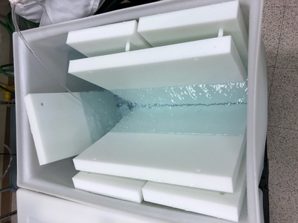
Significance of PTFE Material
Essential to select radiopure shielding materials
  Protect and Minimize background radiation
Polytetrafluoroethlene (PTFE) is the main component of the shielding for the Cryogenic Underground Test Facility (CUTE) neutron source calibration system
  To be installed soon, likely in October 2022
Use the XIA detector to analyze alpha emissions of leached PTFE samples to determine effectiveness of shielding

Slide 6
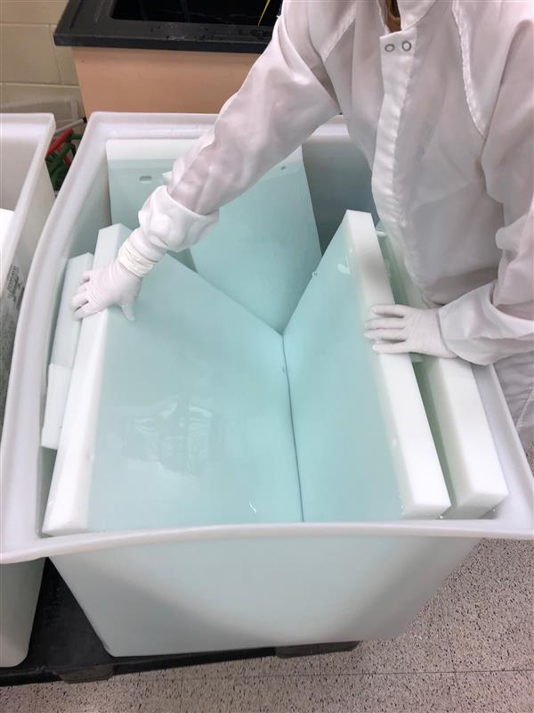
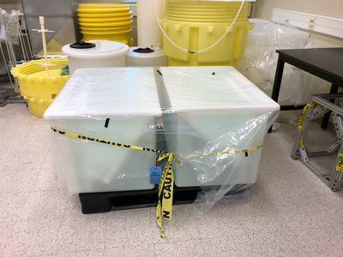
Treatment of PTFE: Leaching Process
February 9th, 2022:
  PTFE plates leached with UPW (Ultra-Pure Water)
February 23rd, 2022:
  The side orientation of the plates were flipped (180-degree vertical flip) for uniform leaching, moved out, rinsed, and water was changed
March 9th, 2022:
  All plates removed
  Smaller plates treated the same as the overall big plates
Notes:
Cleaning process
Feb 09th leached with UPW
Feb 23rd the plates were flipped, move it out, rinse everything, changed water
March 9th all platers were removed
The plates that were treated the same was as the big plates

Slide 7
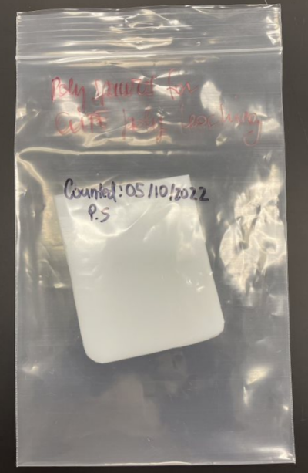
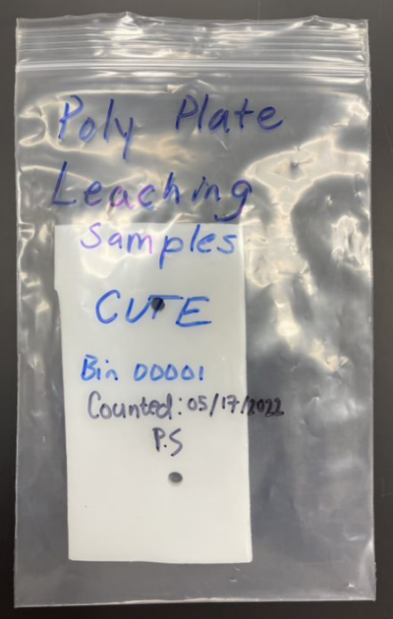
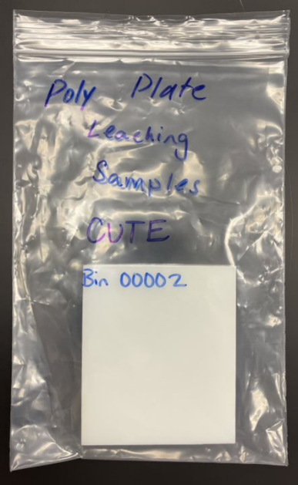
Sample Information
Sample 1
Name: Polyspacer Leaching Baseline
Acquisition Date Range: May 5, 2022 to May 10, 2022
Purge Time: 45 minutes
Total Acquisition Time: 113 hours
Sample Area: 76 cm²
Sample 2
Name: Poly Plate Leaching – Bin 00001
Acquisition Date Range: May 10, 2022 to May 17, 2022
Purge Time: 45 minutes
Total Acquisition Time: 162 hours
Sample Area: 105 cm²
Sample 3
Name: Poly Plate Leaching – Bin 00002
Acquisition Date Range: May 17, 2022 to May 24, 2022
Purge Time: 45 minutes
Total Acquisition Time: 168 hours
Sample Area: 64 cm²

Slide 8
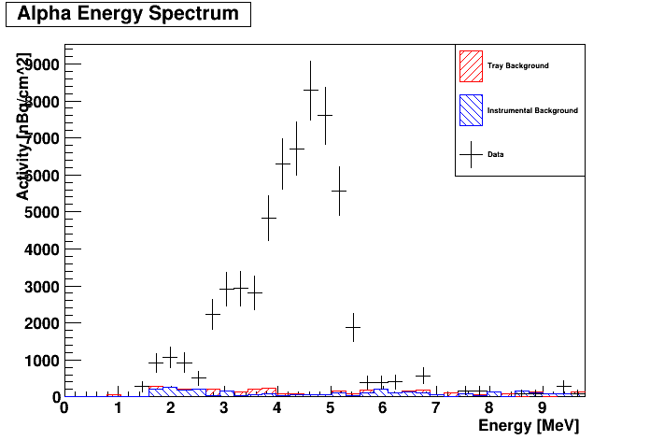
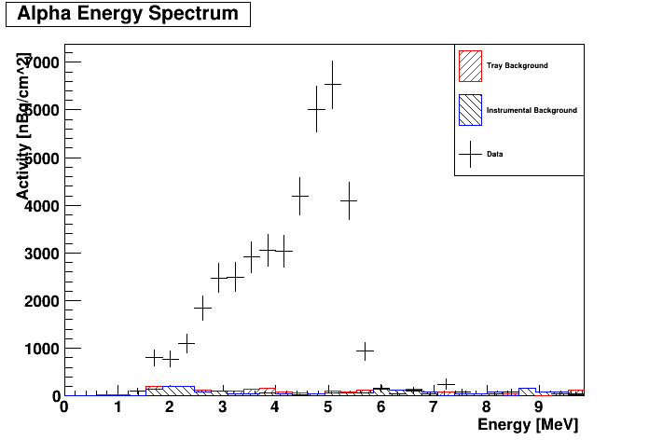
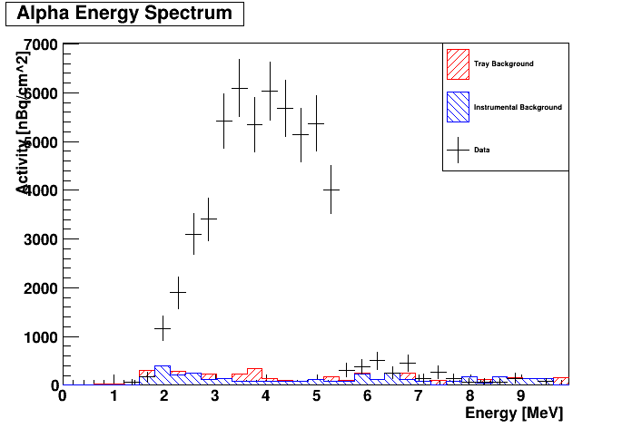
Analysis Results: Energy Spectra
Polyspacer Leaching Baseline Spectrum
Poly Plate Leaching Bin00001 Spectrum
Poly Plate Leaching Bin00002 Spectrum

Slide 9
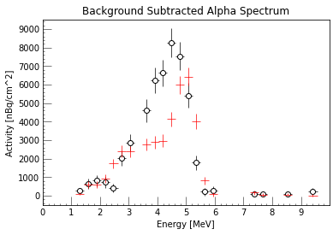
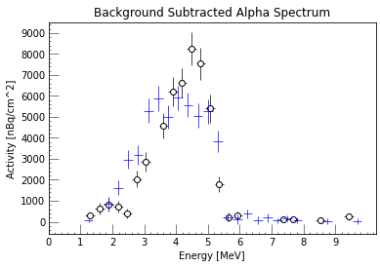

Comparison between Baseline and Leached Samples
Between 3-5 MeV Range, the activity levels were:
  Baseline: 38 611 ± 1700 nBq/cm²
  Bin 00001: 21 106 ± 910 nBq/cm²
  Bin 00002: 32 715 ± 1400 nBq/cm²
Percentage reduction between baseline and samples:
  Bin 00001: 45%
  Bin 00002: 15%
Bin00001 sample sees reduction in area of surface alpha activity (4-6 MeV)
Less bulk and surface level activity
Bin00002 sample maintains agreeability with baseline
Alpha contamination in the bulk and surface regions are statistically compatible
Notes:
Bin 01 shows very small cleaning efficiency due to leaching, reduced by percentage
Bin 02 does not show any reduction in contamination
Bin 02 are statistically compatible within statistical error
Mention: maybe not aggressive enough with leaching as only upw was used, coupled with acid could have better effect
Maybe the time period for the leaching is not enough
Maybe what we are thinking to remove is not

Slide 10
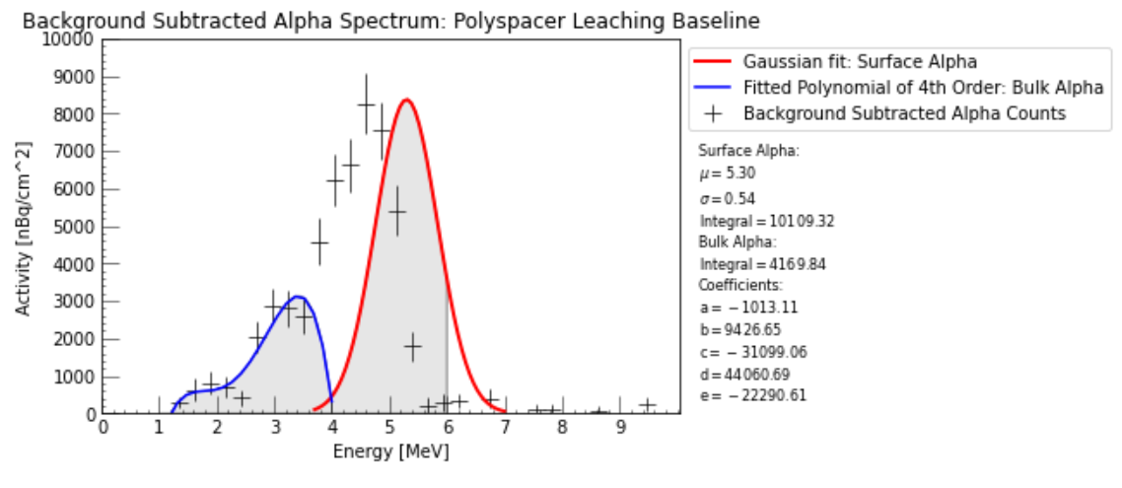
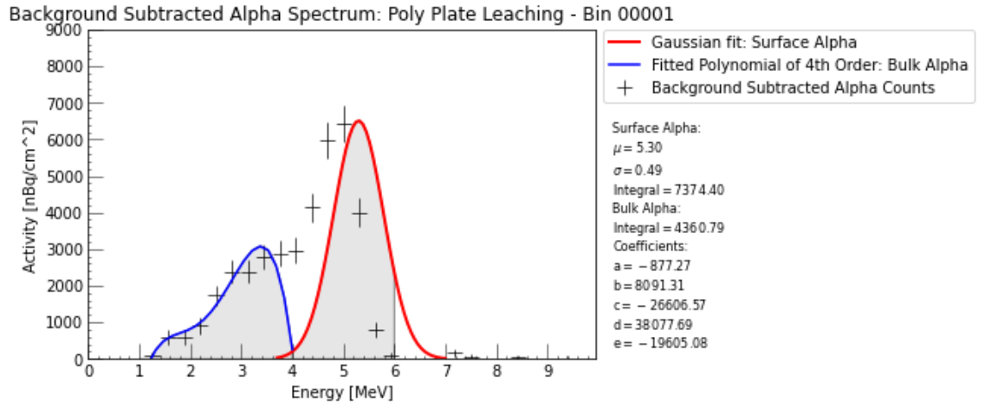
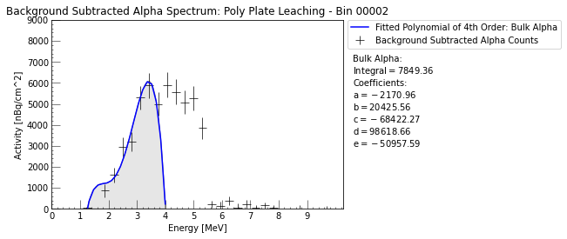
Analysis Results: Fitting Energy Spectra
Overall fitting not as expected
  Fitting first done at 5.3 MeV for Rn-222 Alpha, peak is observed at around 4.8 MeV (Th-232 Exposure)
Notes:
Mention that this is the subtracted data
Consolidate these fits onto one slide for all the samples
Gaussian fit force at 5.3 MeV,
Fit bin 01 with narrower gaussian
Put this in the widescreen format ppt
Bin 02 fit from 1-4 MeV, not gaussian, polynomial
Only background subtracted
If we try to fit data to have better idea of what we expect with a gaussian at 5.3 Mev coming from radon daughter and a bulk with exponential/polynomial, fitting is not very good, although there is a line shifted not at 5.3 like for radon
For bin02, there is a big bulk event, but still compatible with the contamination we had before leaching
If we leave gaussian fitting to its own mean value, we found the mean of the gaussian is a possible surface contamination of 4.8 mev
Add total fit (red + blue), mention
Fit polynomial over entire range for Bin0002
Percentages

Slide 11
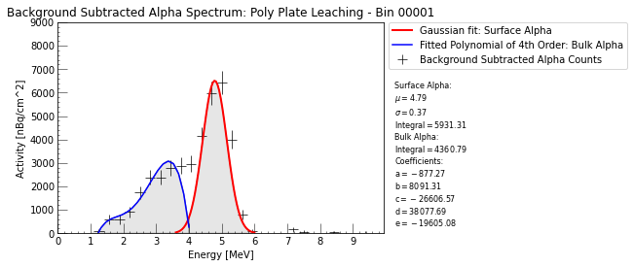
Analysis Results: Bin 00001 Energy Spectra
Fitting comparison conducted at 5.3 MeV for Rn-222 as compared to
4.8 MeV for Th-232
Notes:
Mention that this is the subtracted data
Gaussian fit force at 5.3 MeV,
Fitting was not what we were expecting
Here we leave the fit function as natural mean of about 4.8 MeV, suggesting alpha from Th-232
So if we think that is the surface contamination (previously), this may be surface for Th-232
This may still be statistically compatible with bulk alpha from poly
Quantify reduction for bin 01
Maybe this is a peak for Th-232

Slide 12
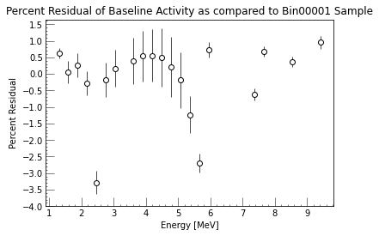
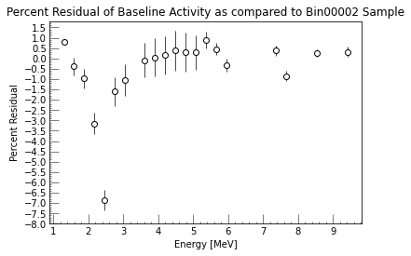
Percent Residual of Surface Activity
3-5 MeV region shows promising level of percentage residual (> 0%) for Bin 00001 sample
Overall percentage residual for Bin 00002 sample shows agreement for the baseline comparison as more negative

Slide 13
Thank you, any questions?
Notes:
Cleaning process
Feb 09th leached with UPW
Feb 23rd the plates were flipped, move it out, rinse everything, changed water
March 9^{th all platers were removed}
The plates that were treated the same was as the big plates
Follow the history of the plates, should be a good reflection of what happened at the

