Slide 1




Scintillating Bubble Chamber
Silicon Photomultiplier Analysis
Queen’s University • Ciaran Byles-Ho • Aug. 12, 2022

Slide 2

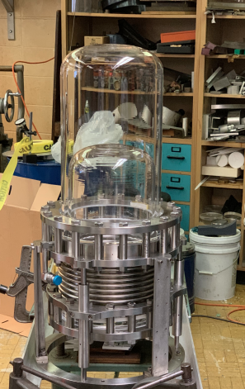
Scintillating Bubble Chamber:
SBC-LAr10
Quasi-background-free Bubble Chamber
10 kg of liquid argon
Aims to hit lower thresholds (100 eV)
2
Snowmass 2021 Scintillating Bubble Chambers: Liquid-noble Bubble Chambers for Dark Matter and CEvNS Detection [https://doi.org/10.48550/arXiv.2207.12400]
Notes:
Liquid argon:
Able to run much lower thresholds than freon bubble chambers while possibly remaining blind to electron recoils

Slide 3
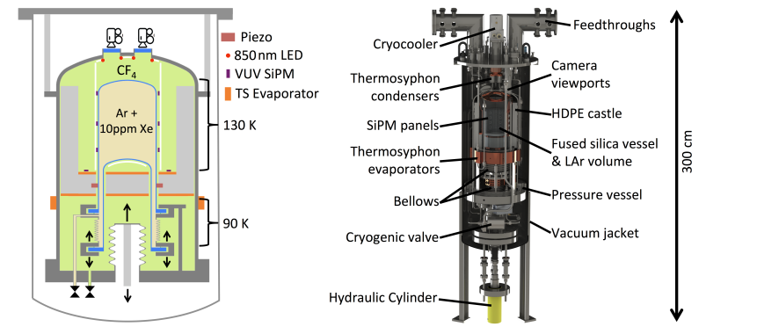

How does SBC work?
Relies on electron recoils to lose energy through scintillation
Bubbles nucleate after small energy depositions
SiPMs detect scintillation light to veto high energy single-bubble events
3
Snowmass 2021 Scintillating Bubble Chambers: Liquid-noble Bubble Chambers for Dark Matter and CEvNS Detection [https://doi.org/10.48550/arXiv.2207.12400]
Notes:
Contains liquid argon in a metastable state to allow the nucleation of bubbles at low energys
Rapid compression allows for

Slide 4

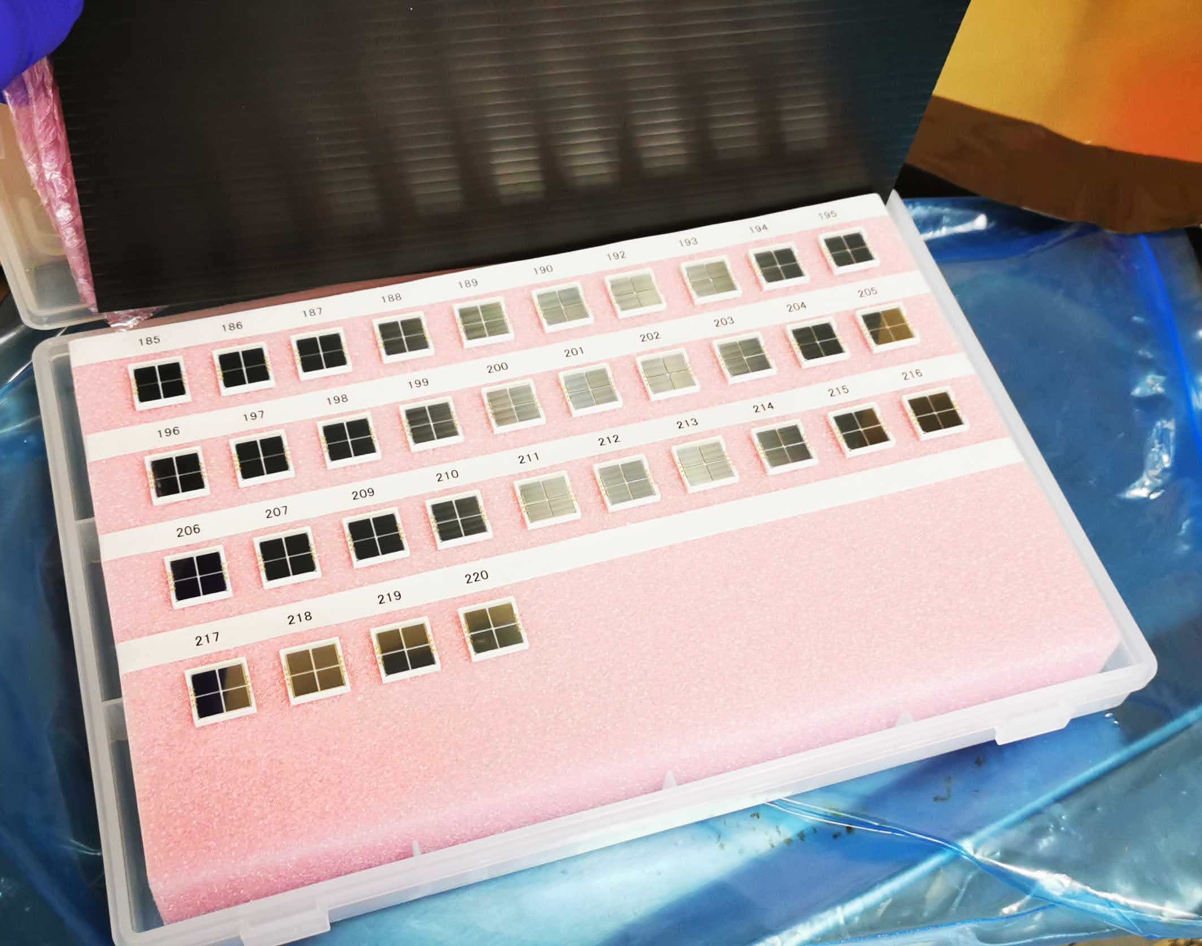
Silicon Photomultipliers (SiPMs)
Detect single photons near UV to near IR
SBC SiPMs detect LAr and LXe UV light
Consists of many single-photon avalanche photodiodes (microcells)
4
Notes:
Recovery time after single photon detection

Slide 5
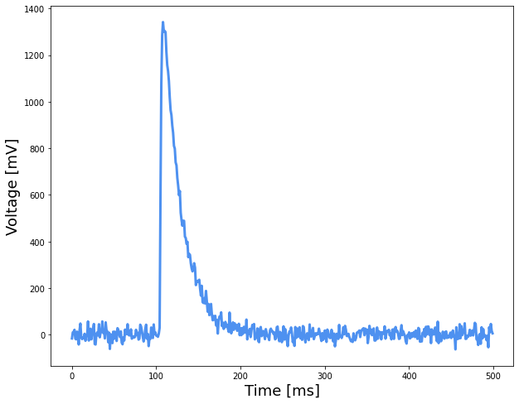
Understanding SiPMs
A microcell drifts towards an avalanche region when a photon hits
The microcell then activates a self-sustaining avalanche
Dark Event: generation of pulse without light
  Crosstalk
  After Pulsing
5

Slide 6
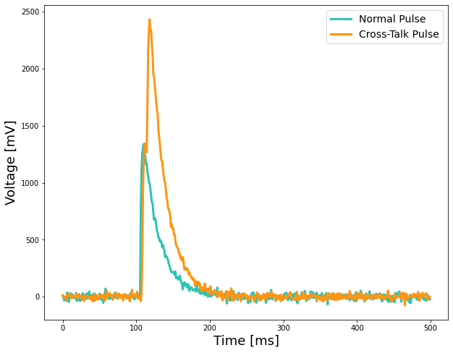
SiPMs Background
Crosstalk
Occurs when primary avalanche in one microcell triggers another in an adjacent cell
Occurs in on top or near initial pulse
Causes increased initial pulse magnitude
May have inflection point
6

Slide 7
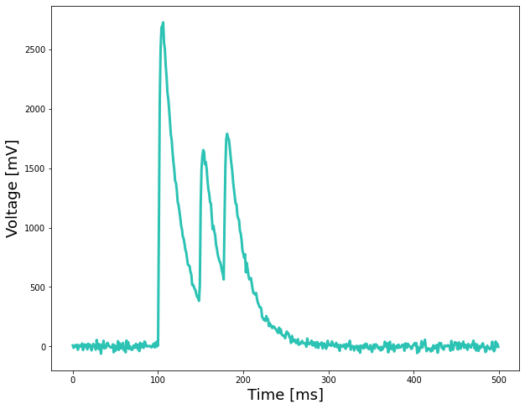
SiPMs Background
After-Pulsing
There is a probability that an adjacent cell may release a delayed pulse
Occurs in recover phase
Lesser magnitude than original if near original
7

Slide 8
Motivation
To explore new methods of determining the dark noise rate and cross talk probability using machine learning methodologies and compare to algorithmic approaches.
8

Slide 9
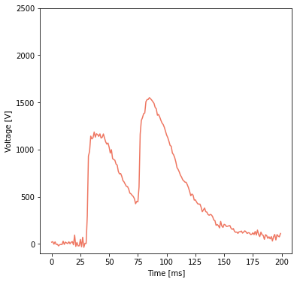
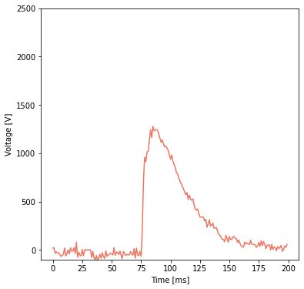
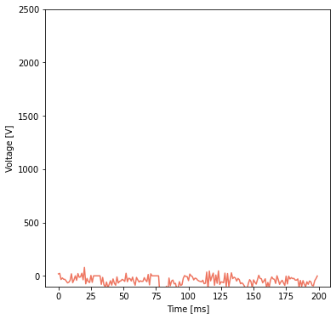
Pulse Counting with Computational Algorithms
VUV-sensitive Silicon Photomultipliers for Xenon Scintillation Light Detection in nEXO
Jamil et al. 2019
9

Slide 10
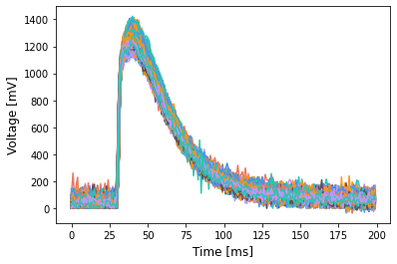
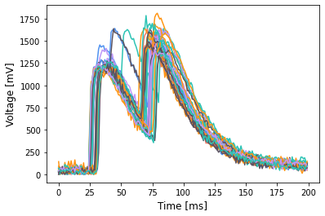
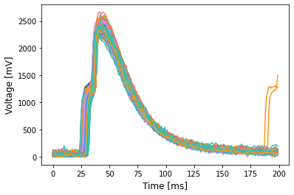
Unsupervised Machine Learning
K-means Clustering
50 Clusters • 10 000 Initial Pulses
Cluster 0
Normal
925 Pulses
Cluster 12
After Pulsing
31 Pulses
Cluster 1
Delayed Crosstalk
160 Pulses
10

Slide 11
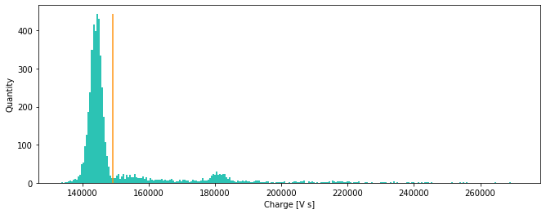
Resulting Algorithm
Data Input
K-means Threshold Determinant
Algorithm
Improved pulse parameter error from 20% to 1% on simulated data
11

Slide 12
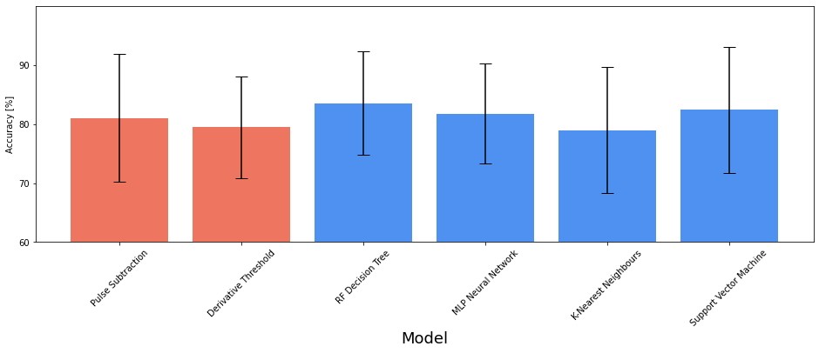
Supervised Machine Learning
~4000 hand-picked labels
Algorithm
Machine Learning
12

Slide 13
Current Results
Traditional Algorithms
Machine Learning
Accurately calculates t0
Calculates charge
Near 100% accuracy on simulated data
Real Dataset
  Near-even distribution of labels
  ~80% accuracy
Trial run
  1000 unseen datapoints
  Uneven distribution of labels
  ~90% Accuracy
13

Slide 14

Conclusion
Unsupervised ML effectively classifies background groups
Supervised ML can be used for pulse analysis
ML can effectively improve current algorithmic approaches
14

Slide 15

Thank you
Ciaran Byles-Ho
ciaran.bylesho@queensu.ca
August 15, 2022
CAAST 2022

