Slide 1
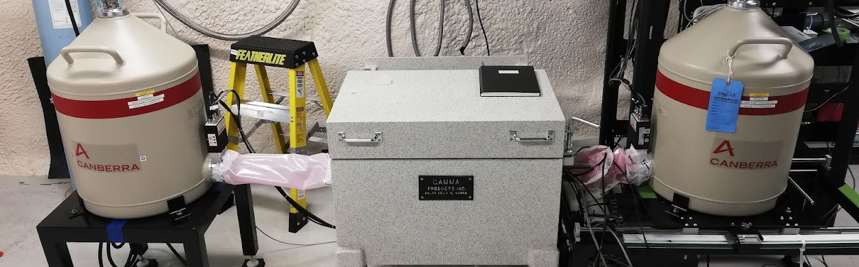
Commissioning a CTBT Coincidence Detector System Underground at SNOLAB
DEREK KONG | SNOLAB | SUMMER 2022

Slide 2
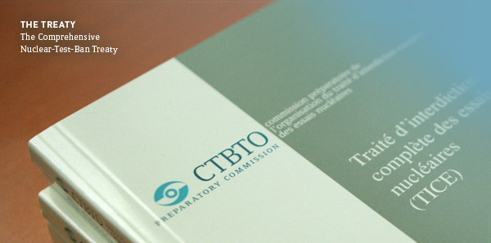
The Comprehensive Nuclear-Test-Ban Treaty (CTBT)
UN General Assembly adopted treaty with basic obligations banning detonation of nuclear explosions
Global radionuclide stations set up to monitor potential nuclear events
Xenon radioisotopes are of interest, as possible products of nuclear detonations
Proposed identification by beta-gamma coincidence detection

Slide 3
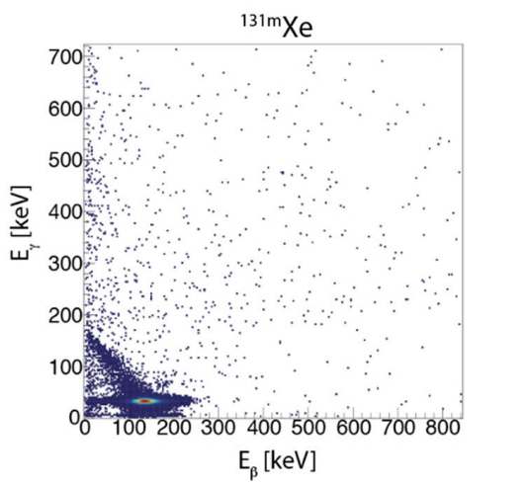
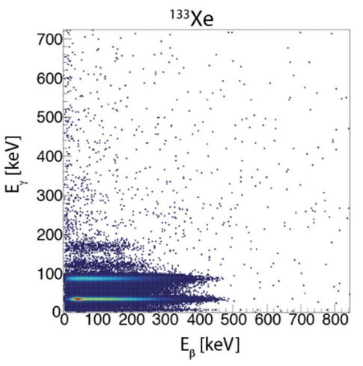
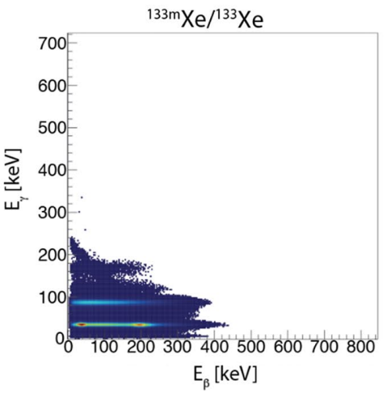
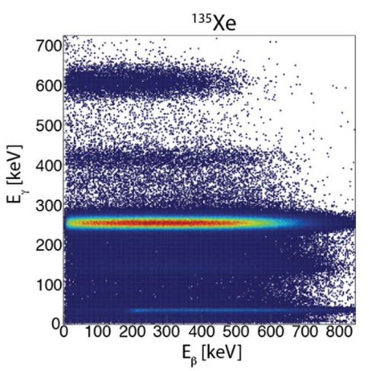
Radioxenon Isotopes
Beta gamma coincidence detection
Four different isotopes
Distinguishing features:
  Horizontal lines (broad beta spectrum)
  Diagonal lines (Compton scattering)
Gamma Energy
Beta Energy
Cooper et al. 2019. Radioxenon net count calculations revisited

Slide 4
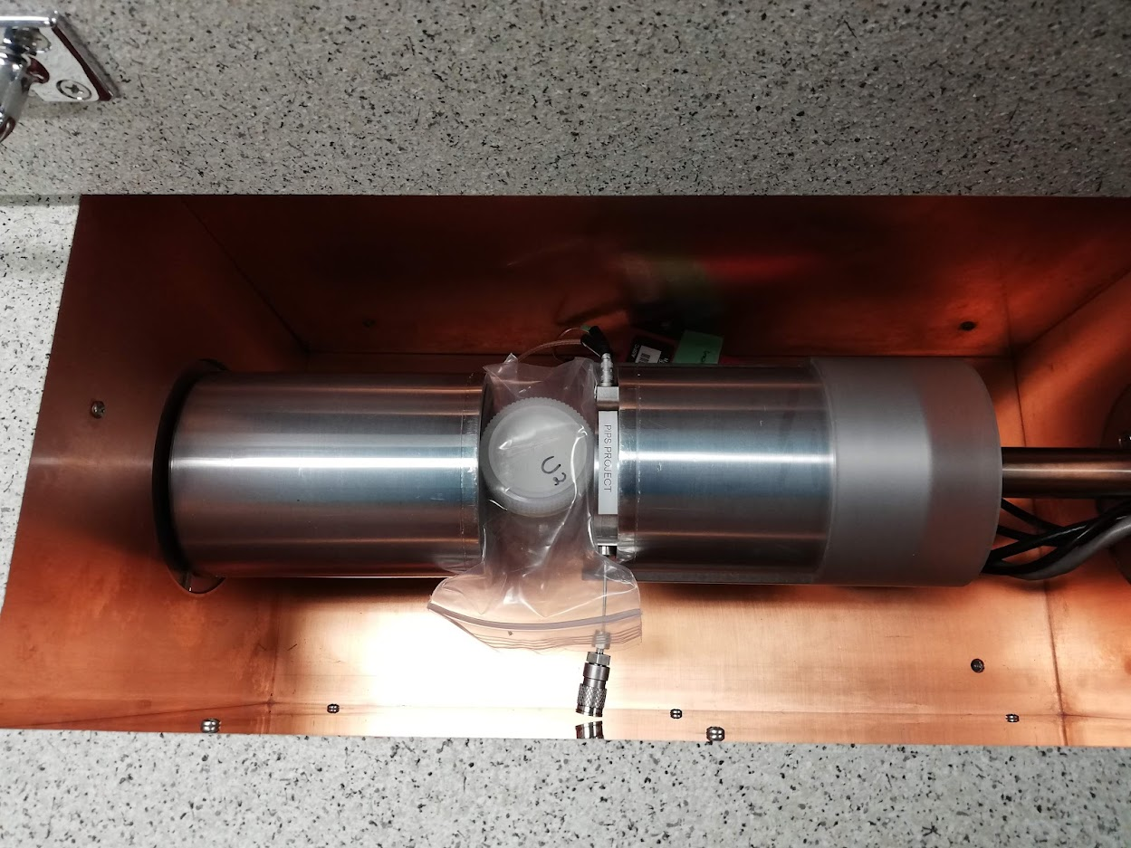

The CTBT System
Beta Detector (PIPS)
Gamma Detector(s) (HPGe)
Housing and auxiliary
Source
Data
Preamplifier
Power
Network/Ethernet
Voltage
LN2 (Liquid Nitrogen)
Lynx MCA

Slide 5
Key Coincidence Patterns
Gamma Energy
Gamma Energy
Gamma Energy
Beta Energy
Beta Energy
Beta Energy
Compton Scattering
Co-60
Full 1st Gamma, Partial 2nd Gamma Energy Deposit
Na-22
Full Beta, Full Gamma Energy Capture
Xe Isotopes

Slide 6
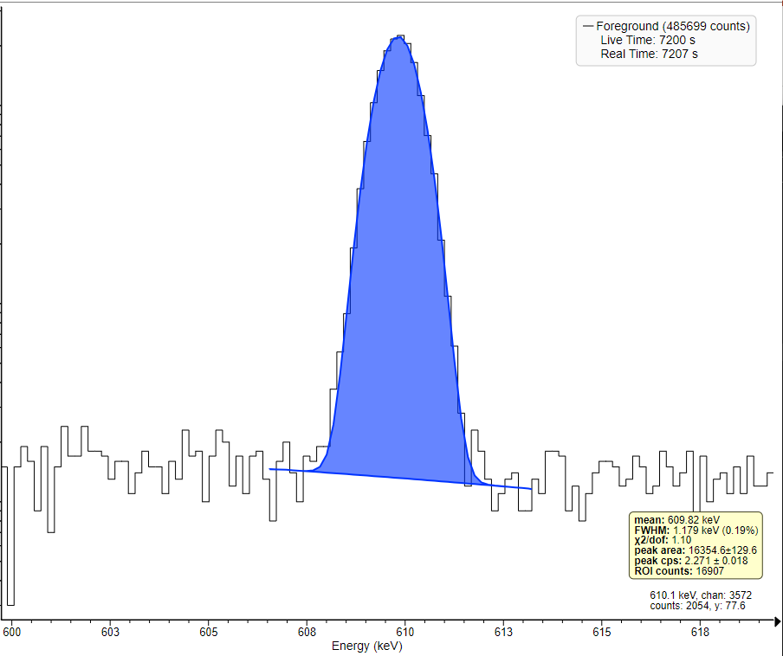
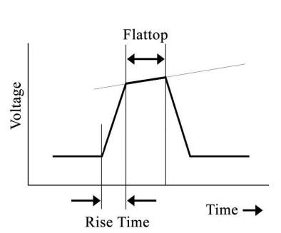

Gamma Detector (HPGe)
HPGe gamma-gamma system already in use underground
Optimizing Lynx MultiChannel Analyzer (MCA) pulse processing
  Low FWHM values constitute accuracy

Slide 7
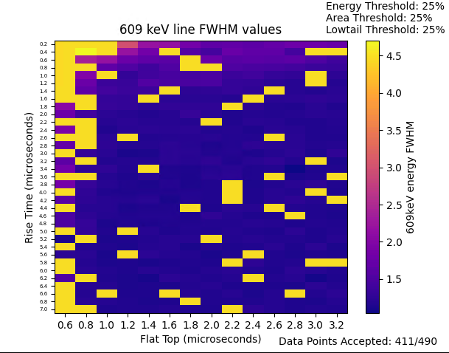
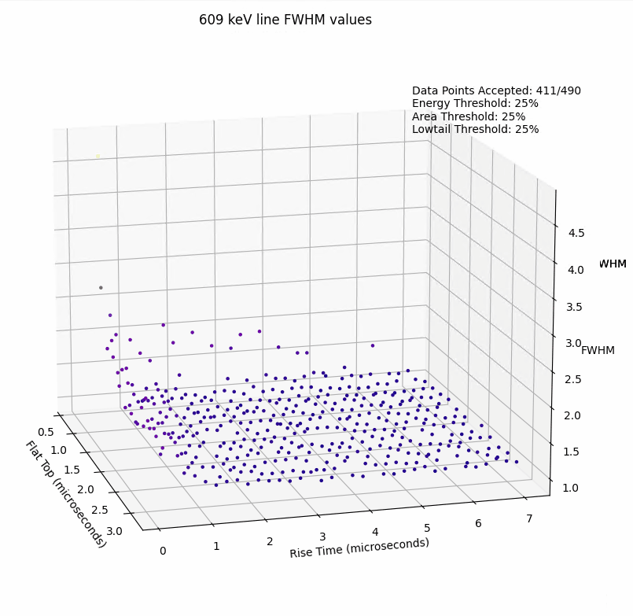
Conclusion: Rise Time set to 4.0μs
Flat Top set to 1.8μs
U238 609 keV FWHM Trend
Heatmap Representation
Scatter Representation

Slide 8
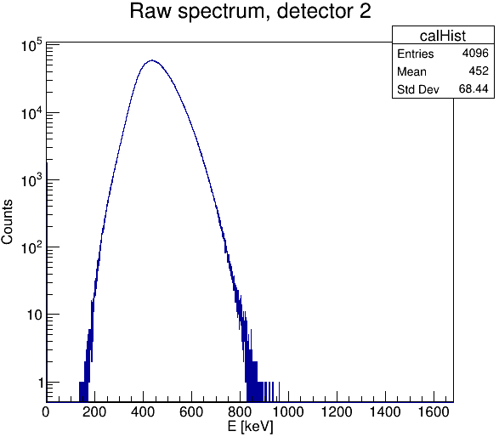
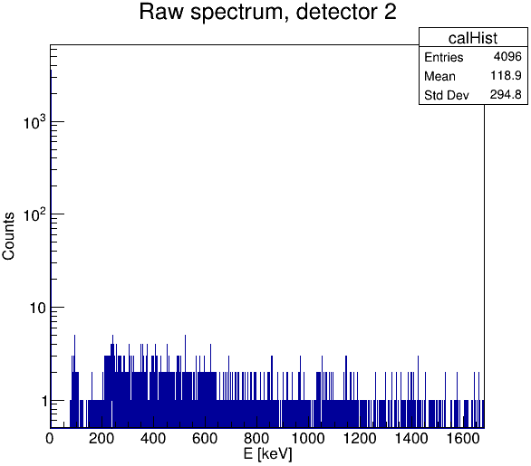
Beta Detector (PIPS)
Provided by Health Canada following use in CTBT system development
PIPS sensitive to electronic noise, reconfiguration necessary
U238 Beta Spectrum
Rewiring/Isolation

Slide 9
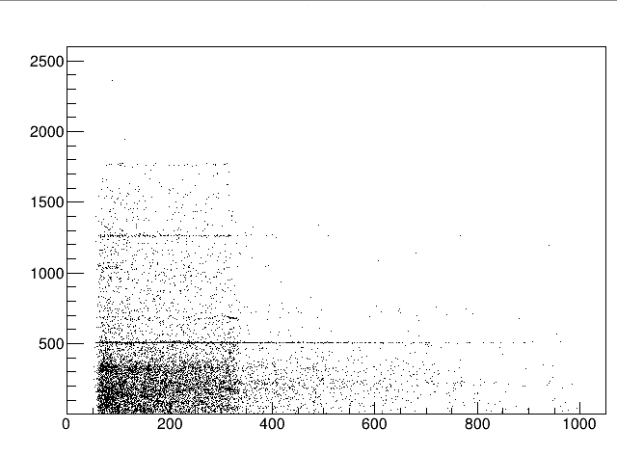
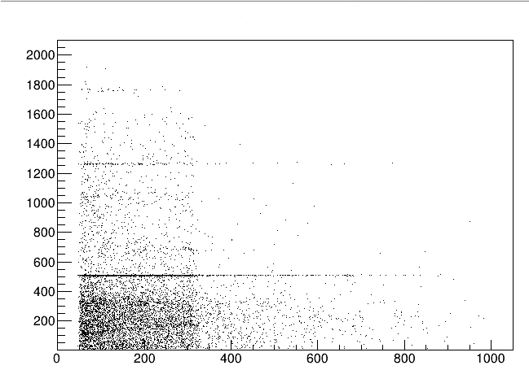
Rise Time Adjustments
Data runs of ~45 minutes of Na-22
511, 1275, and 1786 keV gamma lines well defined on both
Take HC recommendation of “higher” rise time
Na-22 coincidence @ 2.8μs Rise Time
Na-22 coincidence @ 3.8μs Rise Time
Partial 2nd Gamma Deposit
Beta Energy (keV)
Gamma Energy (keV)
Gamma Energy (keV)
Beta Energy (keV)
Beta Energy (keV)

Slide 10
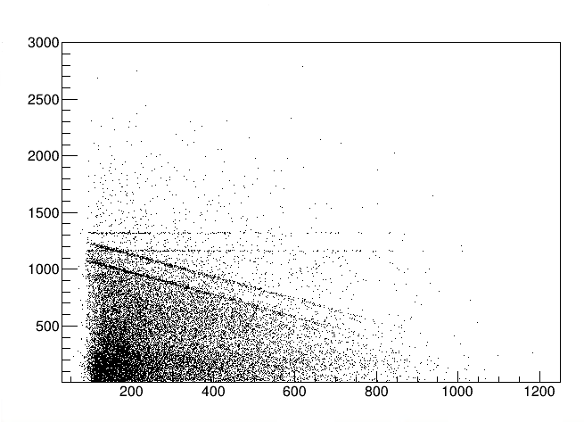
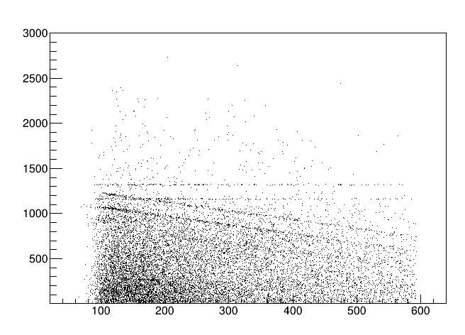
Gain
Recommended gain setting by HC: 11.32
Beta-gamma coincidence showed majority of beta counts at < 600 keV
Co-60 b-g coincidence @ 4 Gain
Co-60 b-g coincidence @ 11.32 Gain
Compton Scattering
Gamma Energy (keV)
Gamma Energy (keV)
Beta Energy (keV)
Beta Energy (keV)

Slide 11
Underground Radon Rates
Rocks and soil surrounding SNOLAB have trace amounts of U-238 and Th-232
Decays lead to higher concentration of Rn gas underground
Interferes with background gamma counts, purged via LN2
Parent
Daughter
Th-232
Rn-220
t_{1⁄2} ~ 55s
U-238
Rn-222
t_{1⁄2} ~ 4d

Slide 12
LN2 Purge Flow Rates
Three LN2 rates tested against U-238 gamma lines
Data ranging from three to seven days
Lower energy lines saw more drastic decreases in counts per second
Settled on 4 L/min
2 L/min
4 L/min
6 L/min

Slide 13
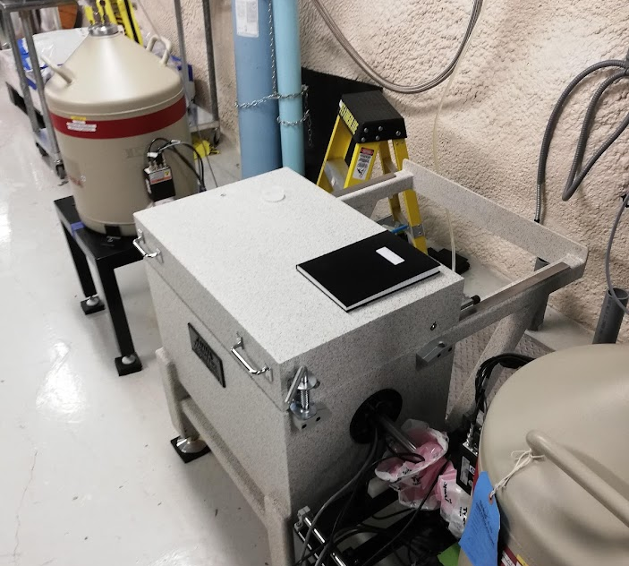
The Future
Further optimization of beta detector settings
A second PIPS detector has been installed
Once up to standard, SNOLAB could become premier location for air sample analysis

Slide 14
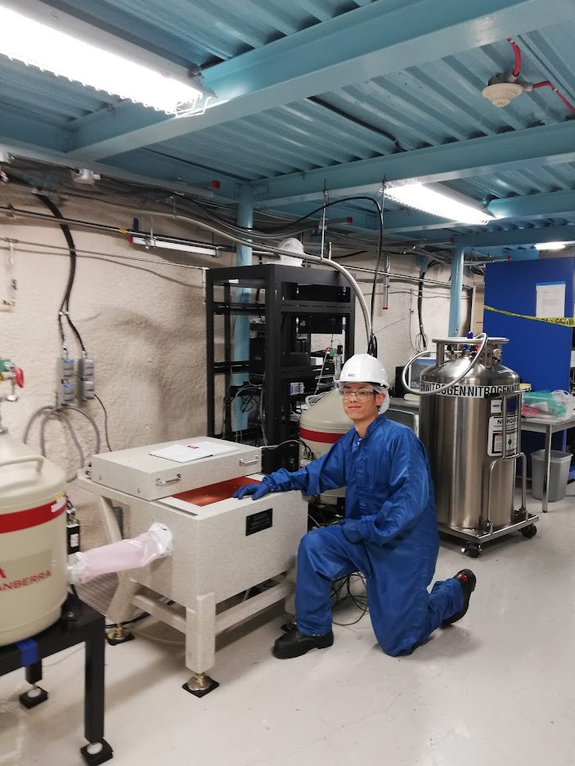
Thank You!

Slide 15
Cooper et al. 2019. Radioxenon net count calculations revisited https://d-nb.info/1201957443/34
Image References

