Slide 1
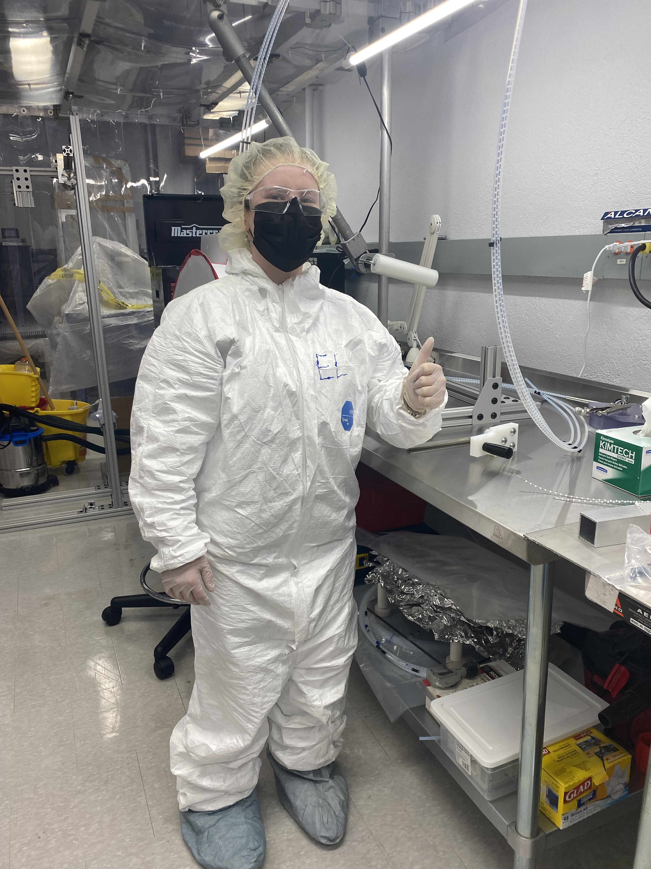
CASST Presentation
August 2022
n
E
X
O
Jacques farine – Supervisor Emily Laxton – 3rd year kinesiology LU
1

Slide 2
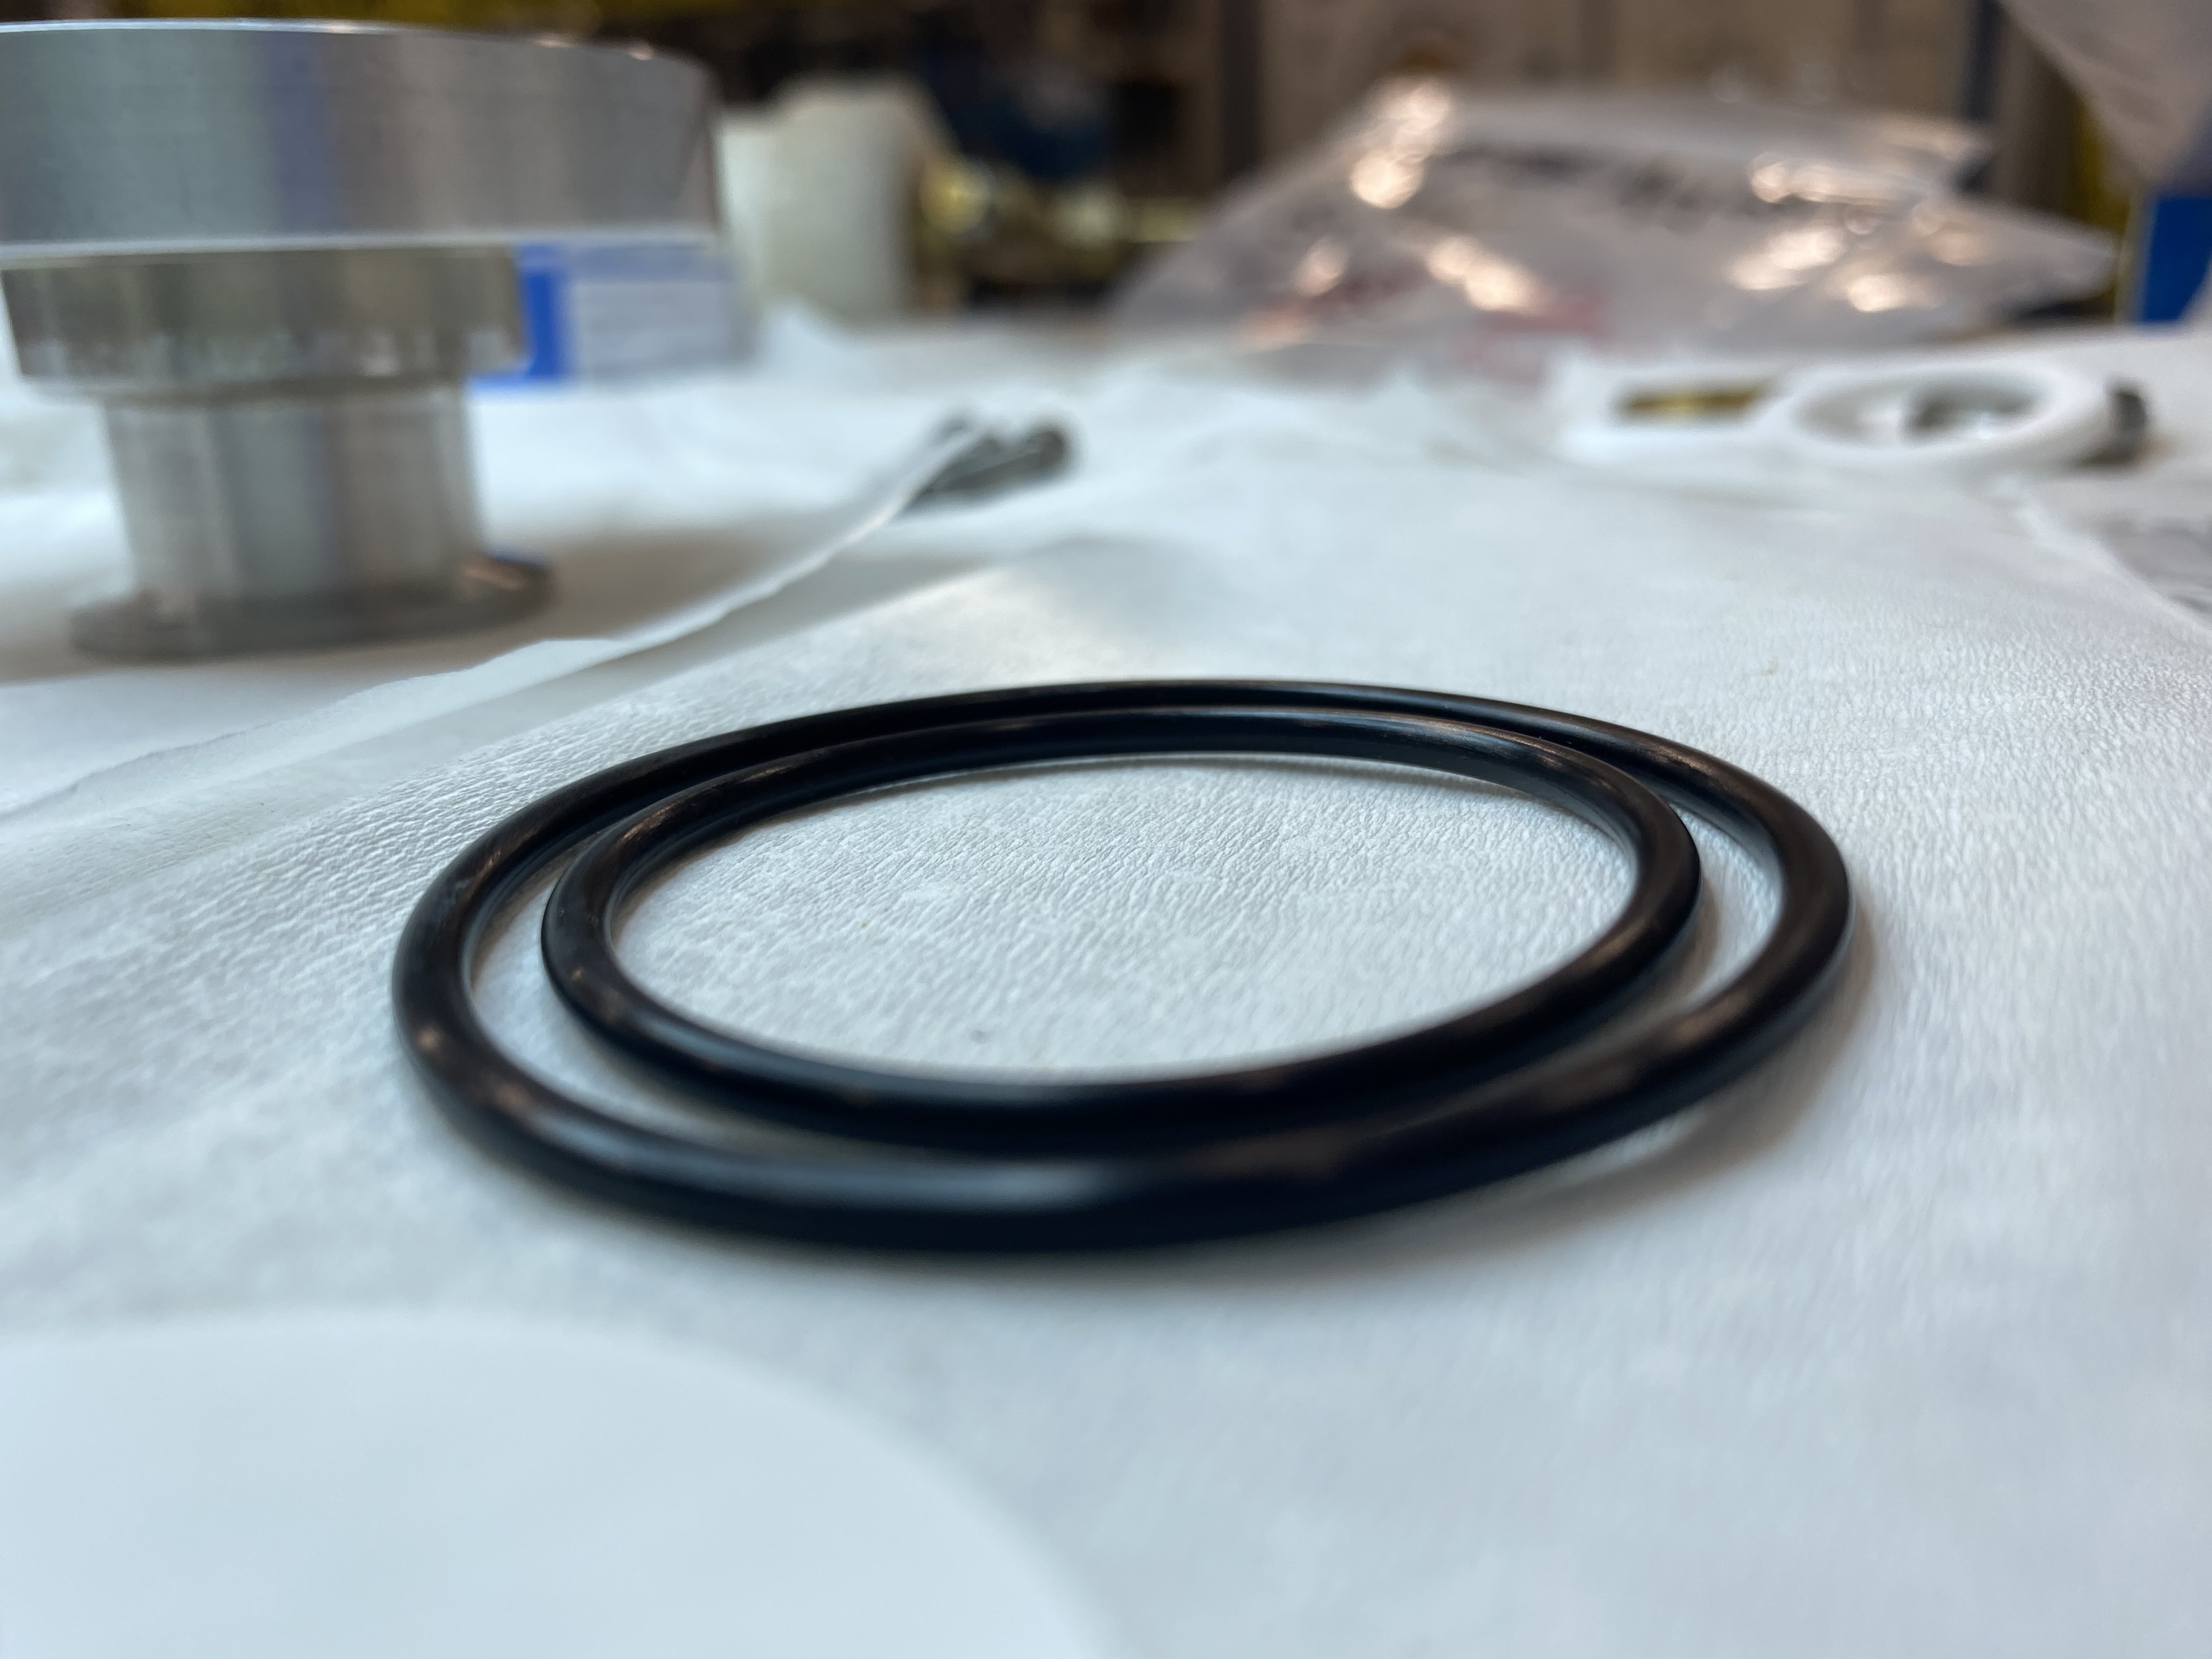
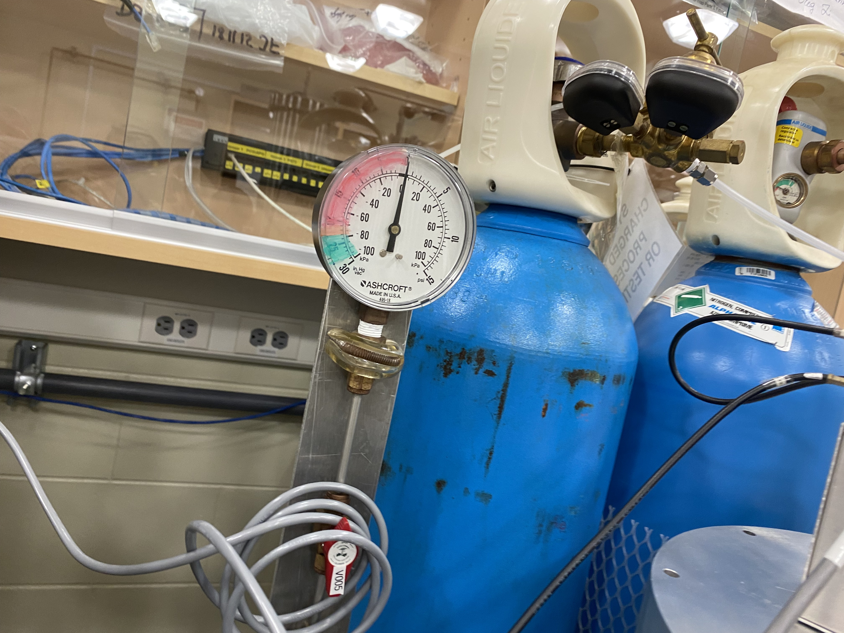
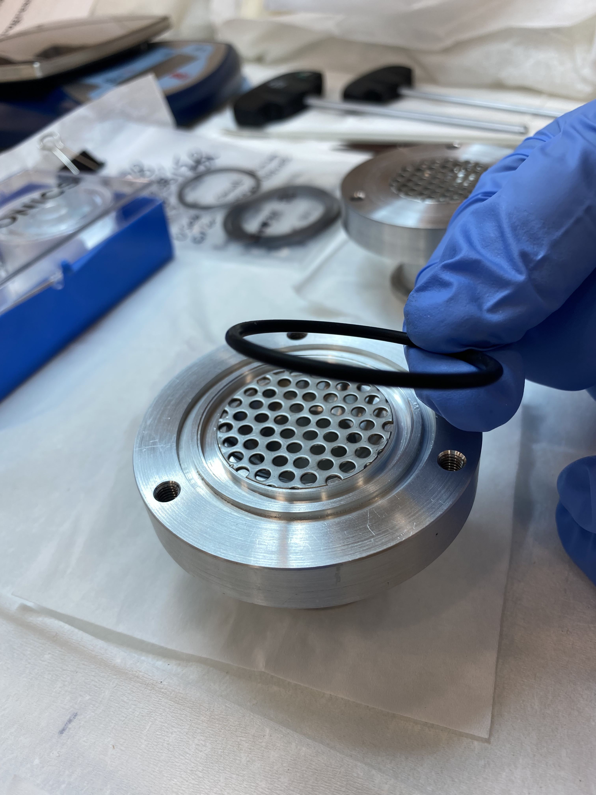
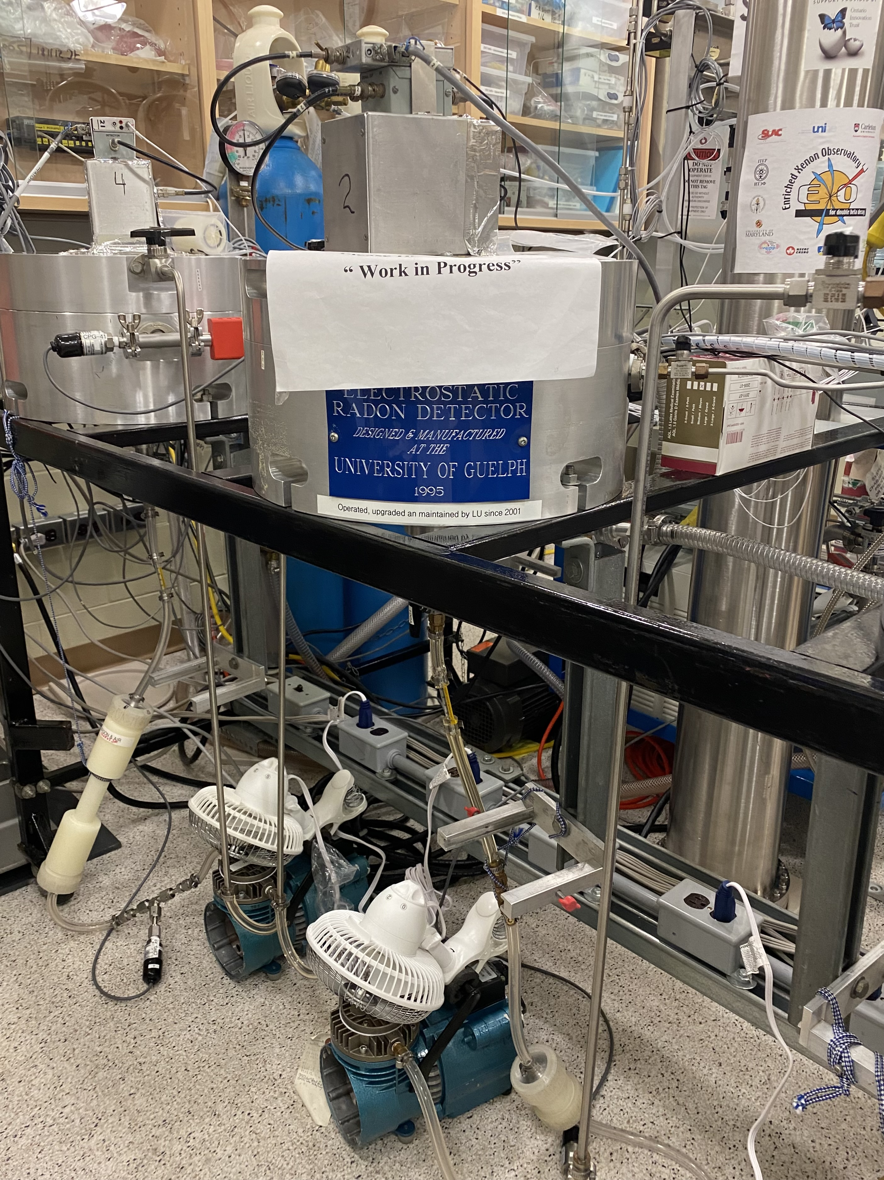
surface lab Learning Experience
ESC Details
Pump
Loop
Chamber
Columns
Diode
New terminology
O-Rings
Becquerel
Ferrules
Computing technology
DOS
Coding
MCA
MT
CPU
Theory
Vacuum
Radioactive Decay Chains
PV=nRT
Flow
2

Slide 3
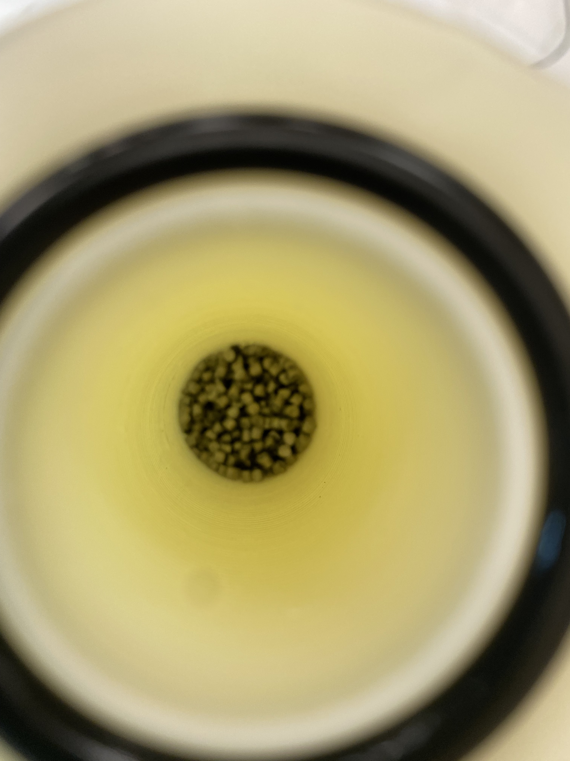
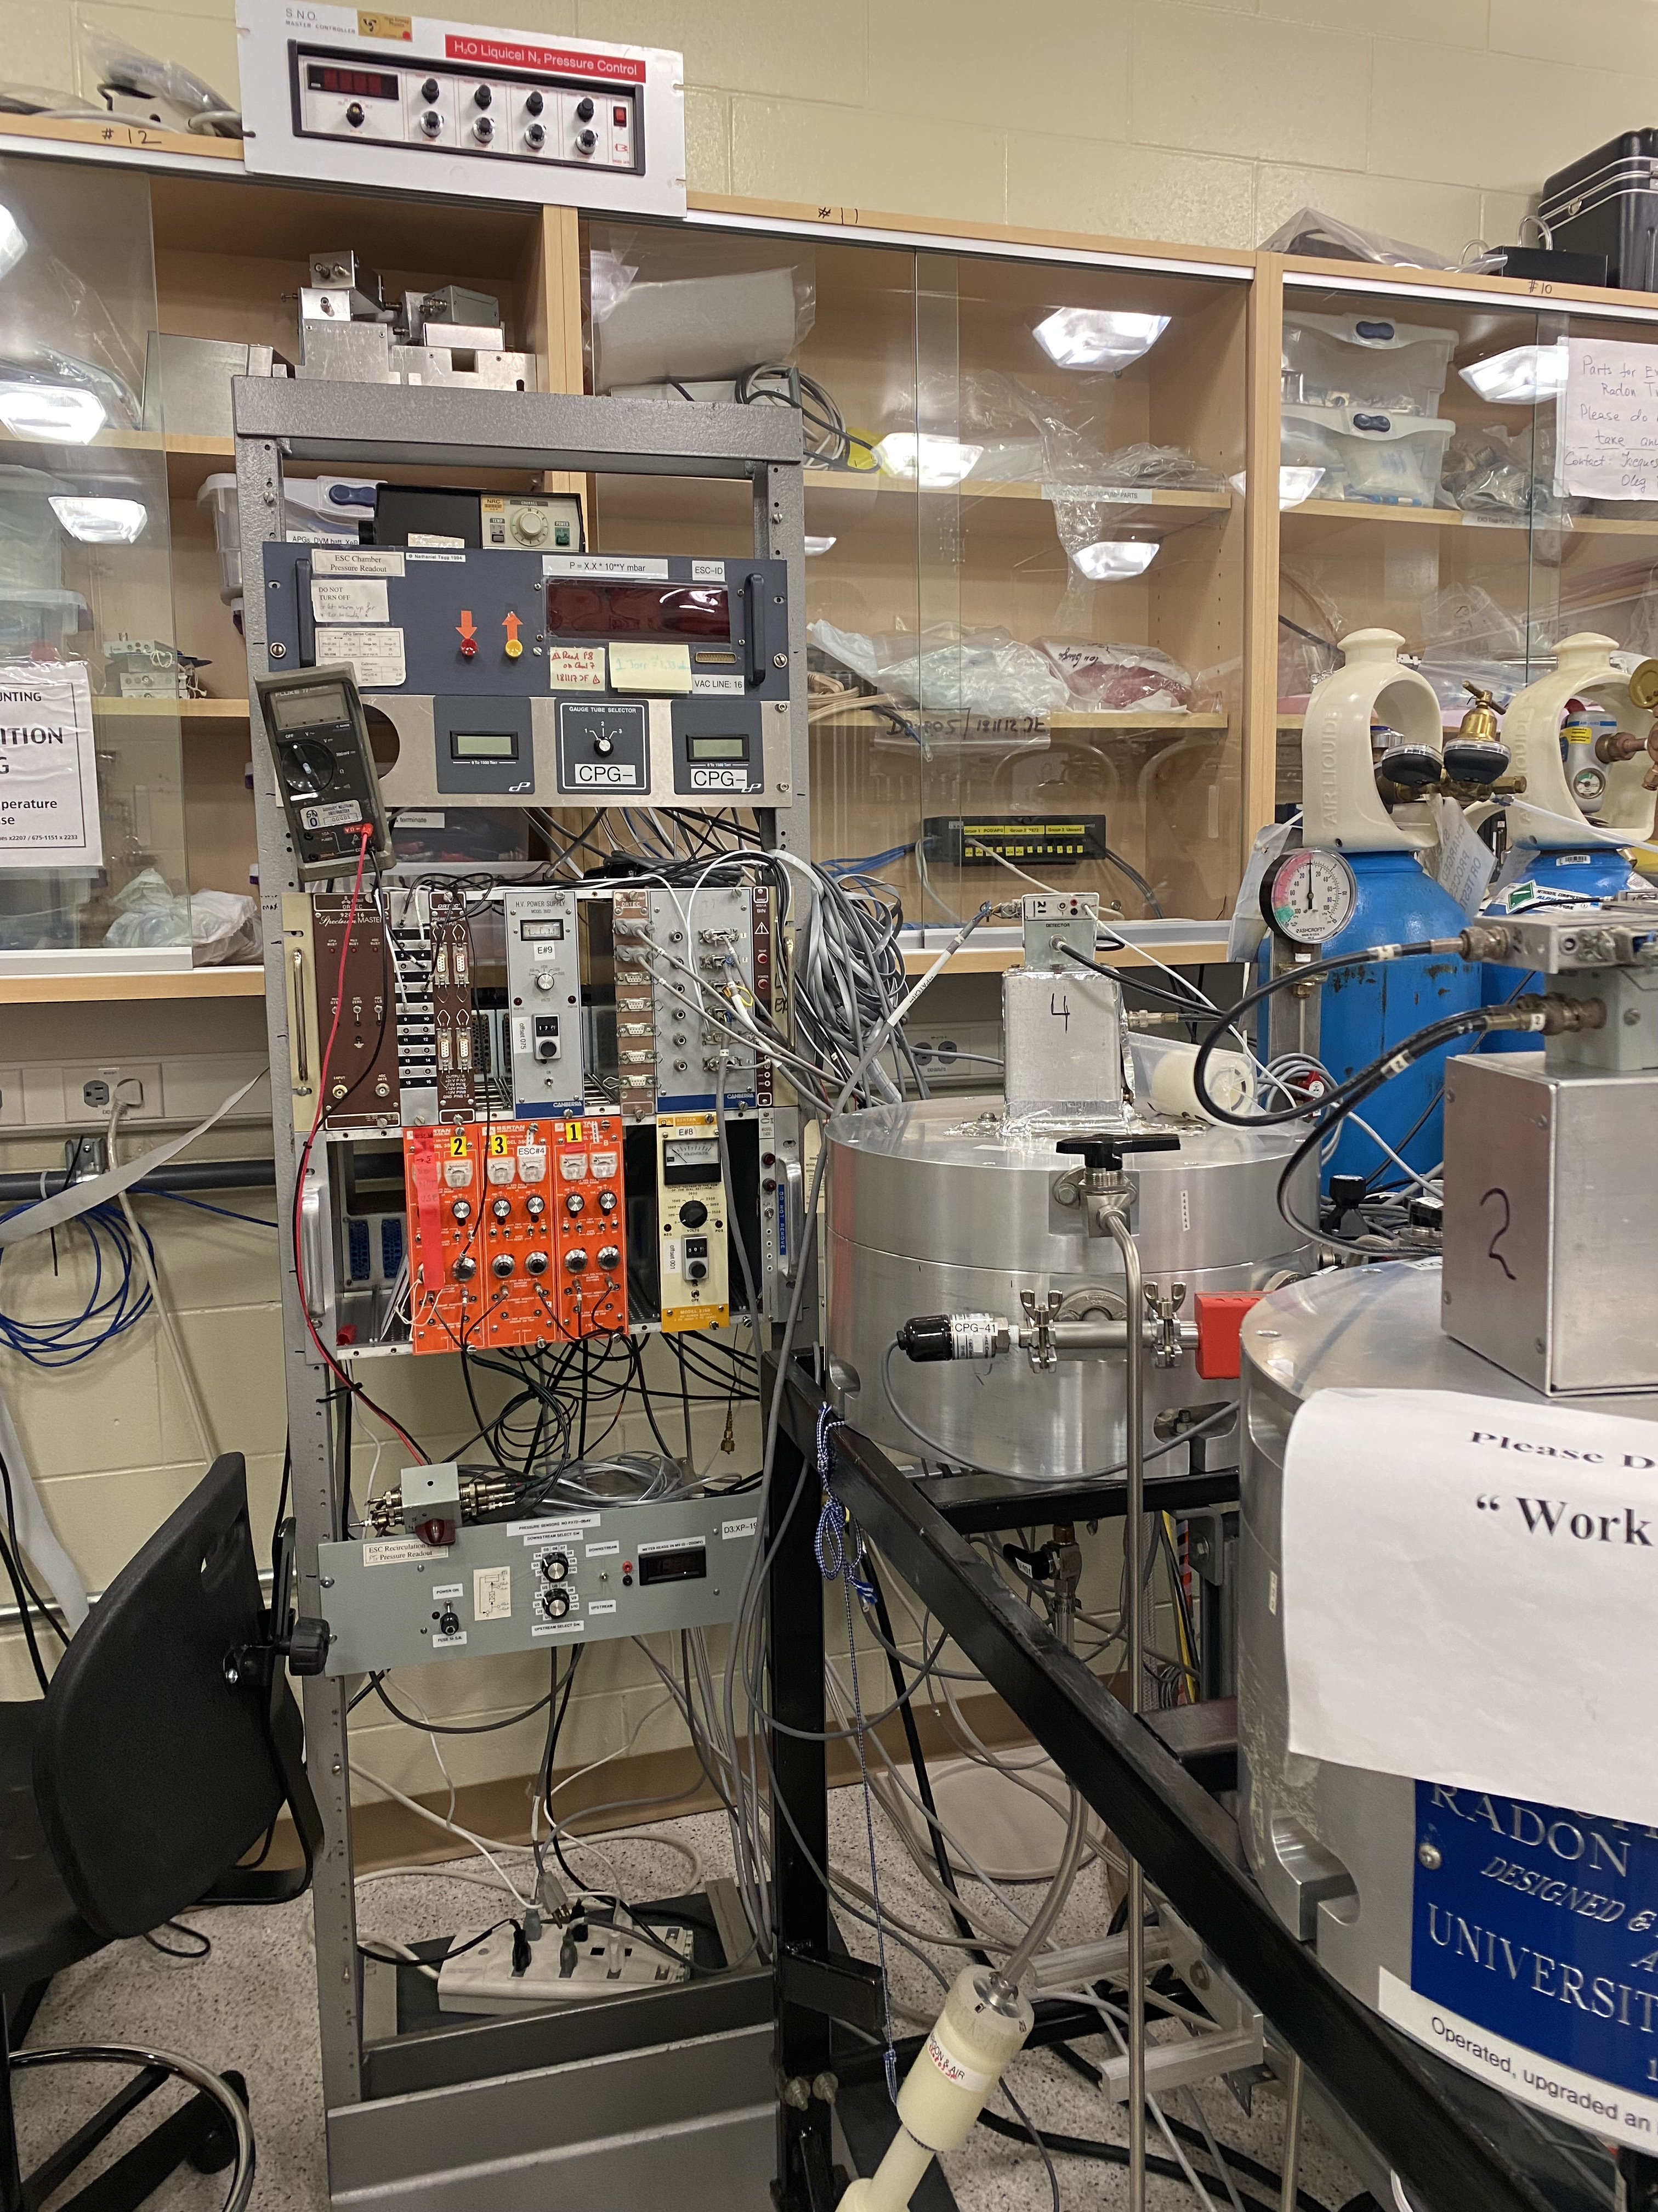
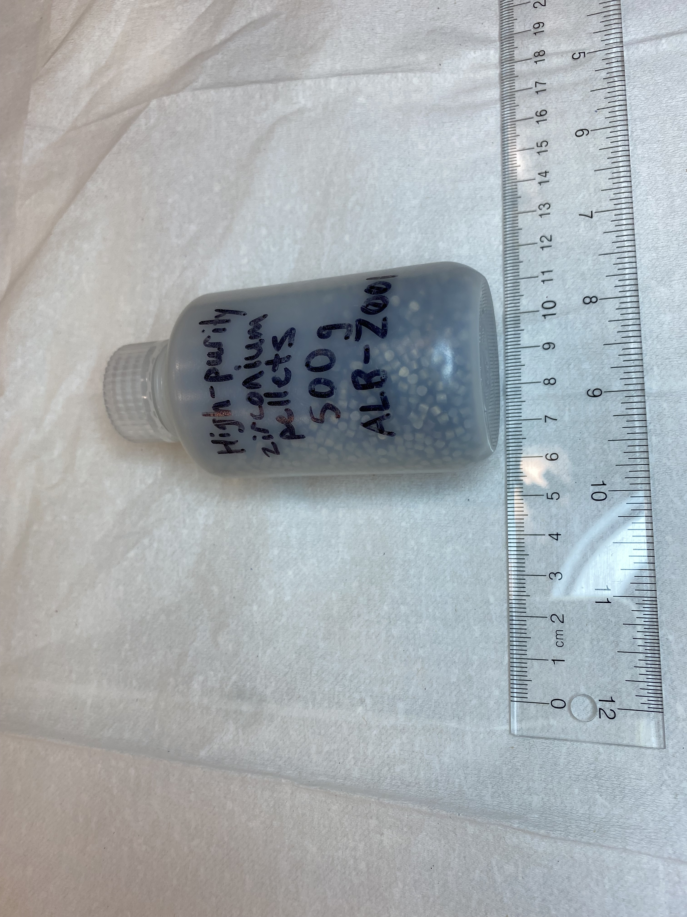
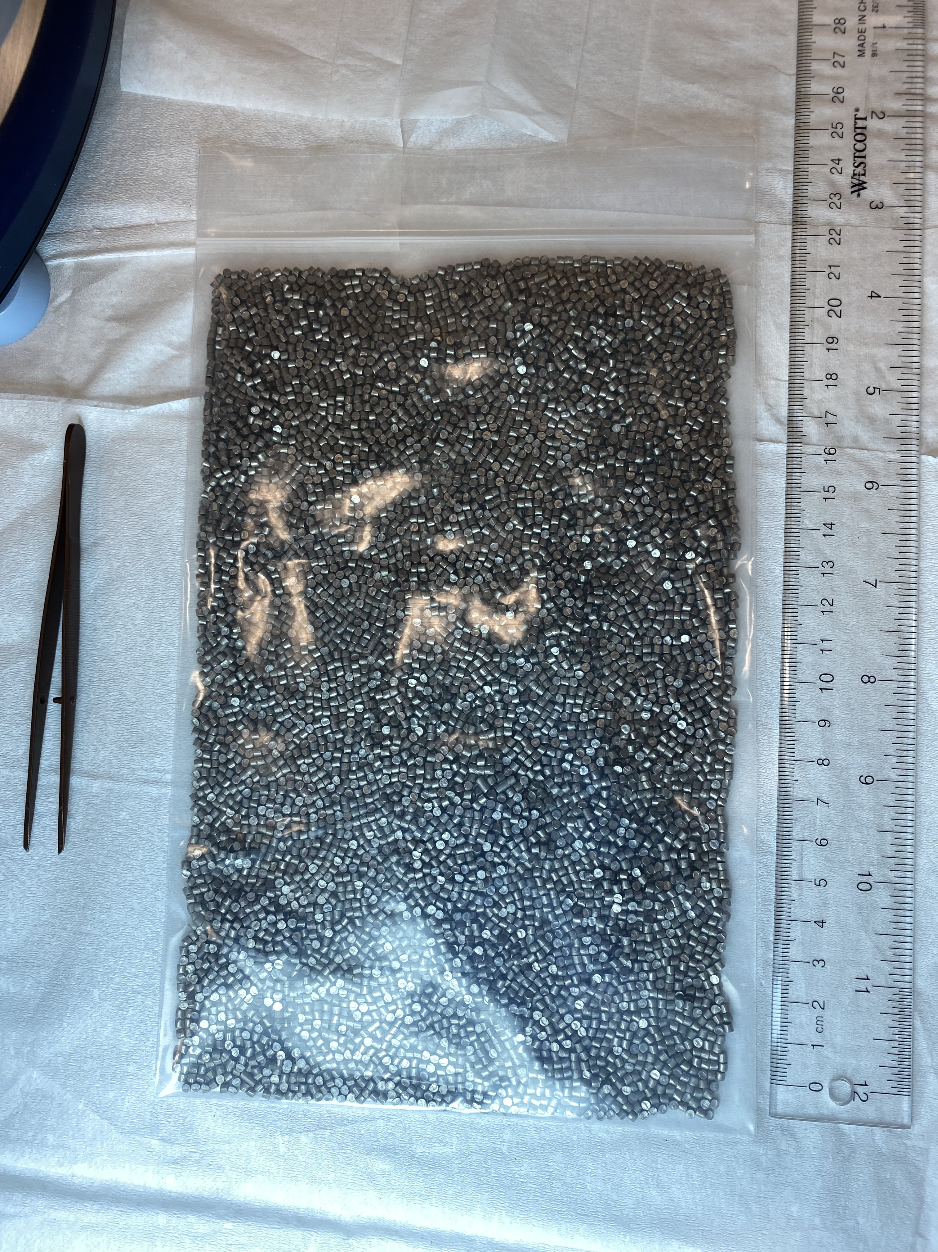
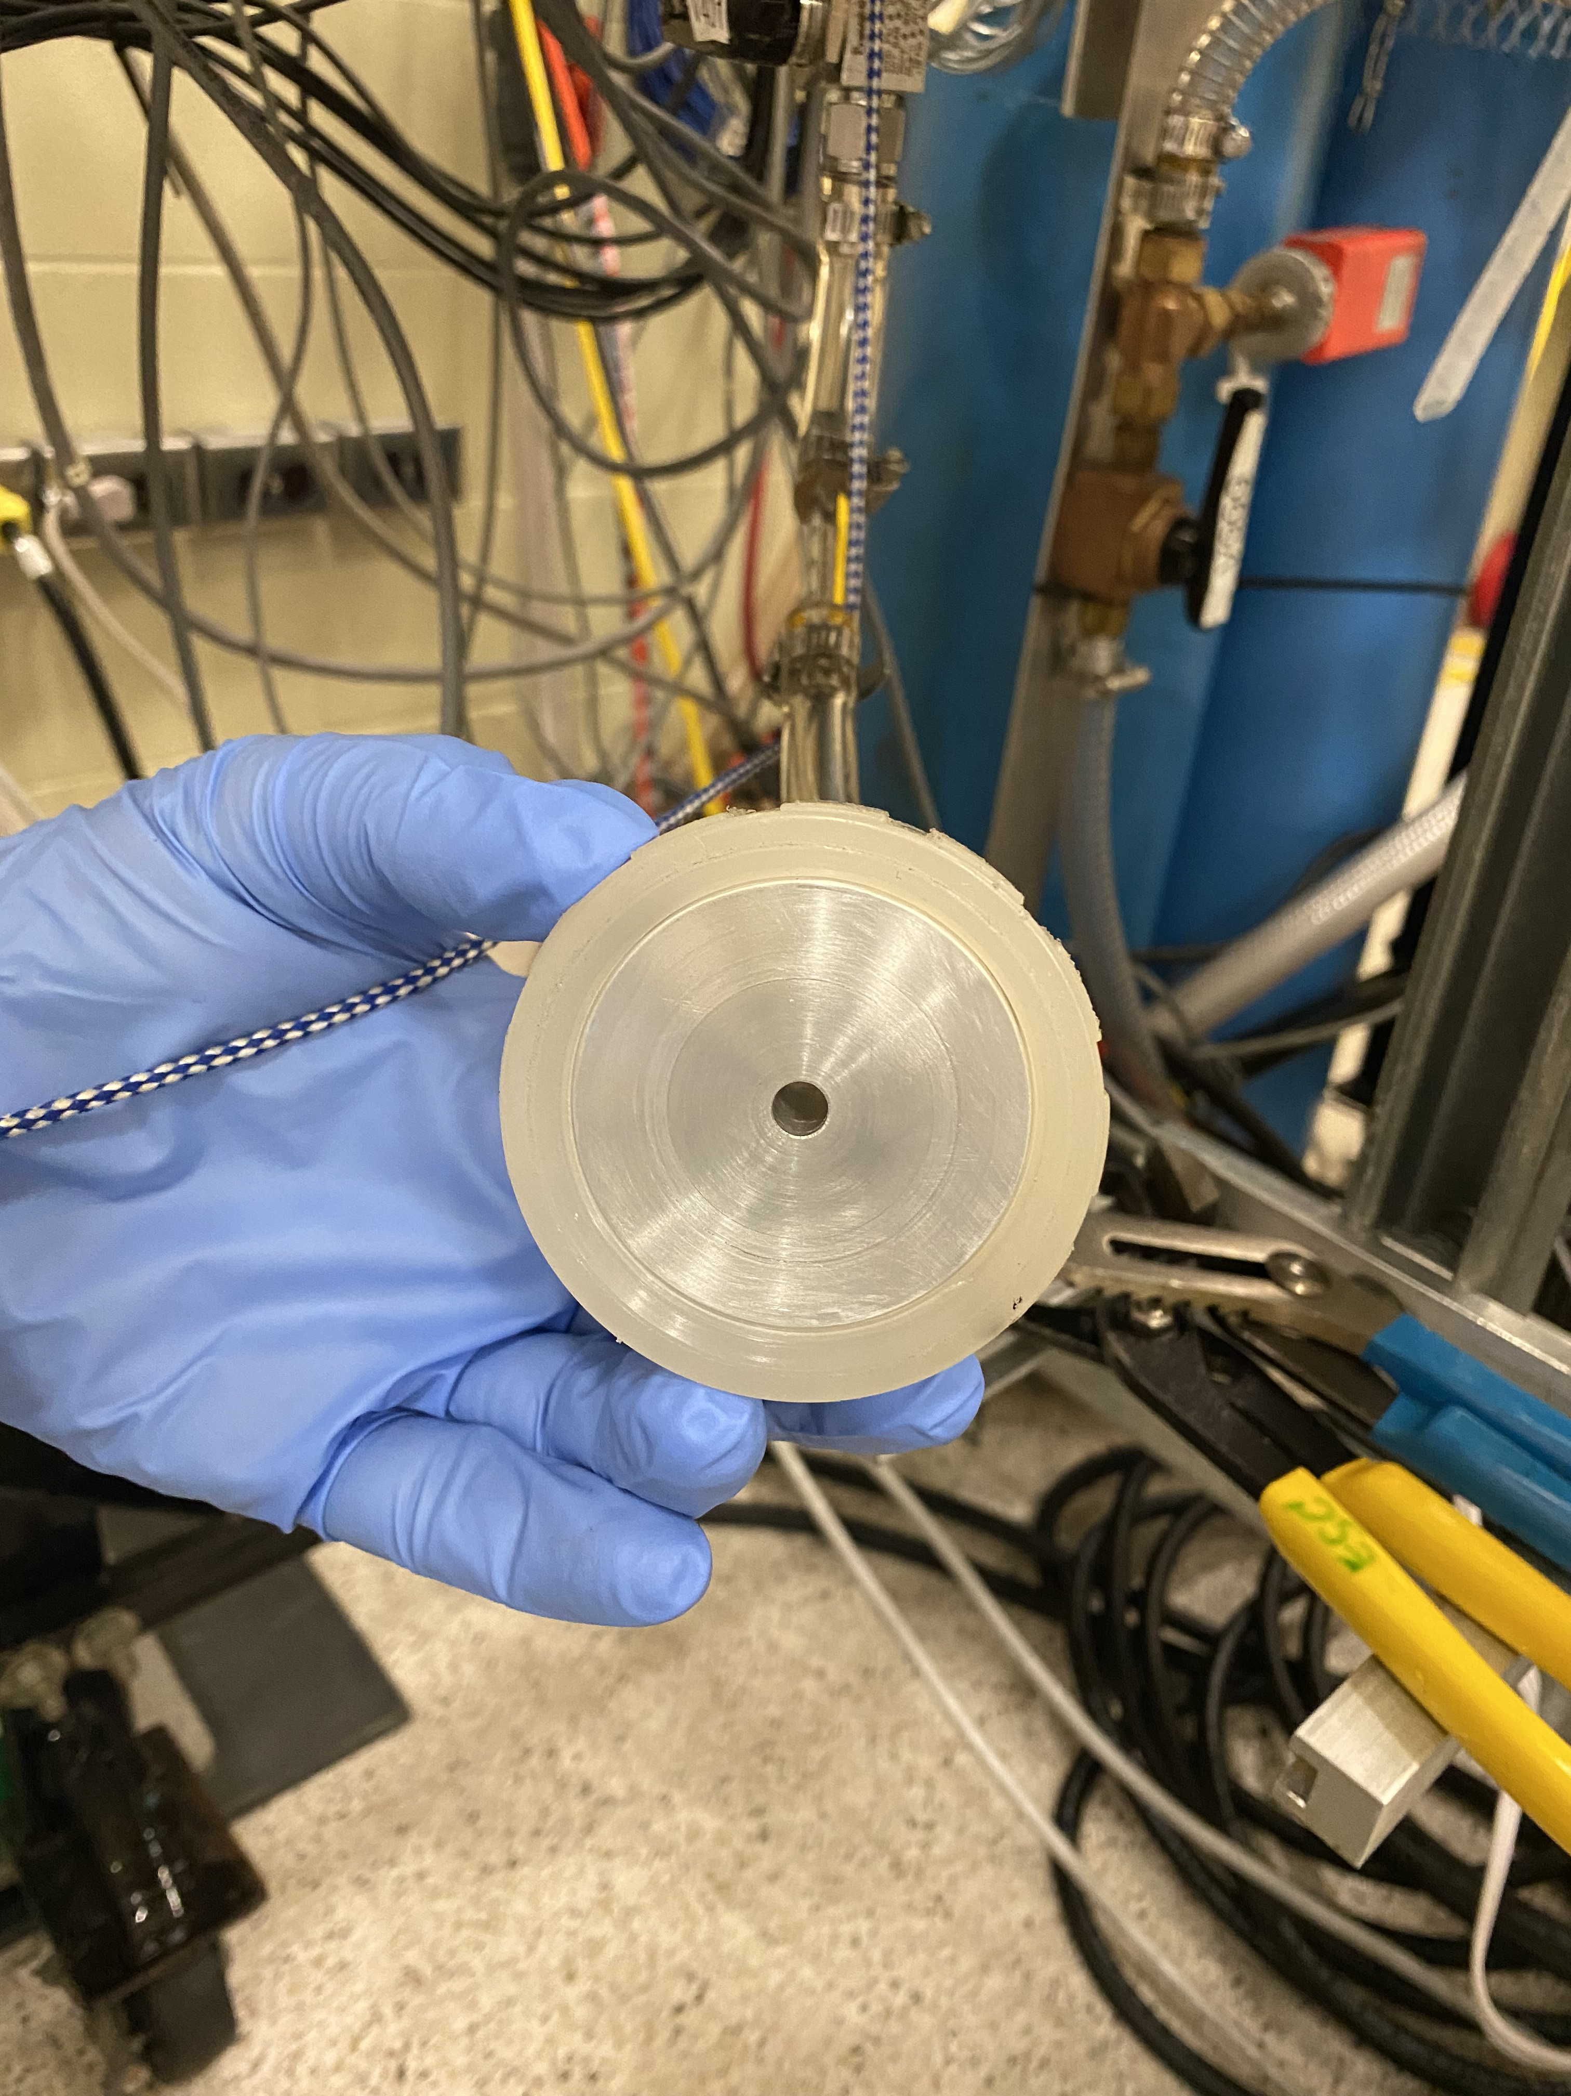
My ESC Competency’s
Emanation Runs:
  Background P & C
  Sample
  Blank
Completed ESC Daily Checks (2-3 times a week)
Handling of Samples:
  Disassembly and Assembly of Columns
  Recovery After Counting
  Sample Documentation
Samples Handled
  Yellow Paint
  Purifier Pellets for Noble Gases
3

Slide 4
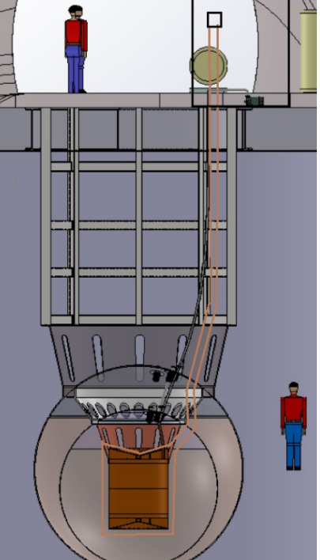
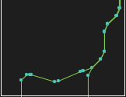
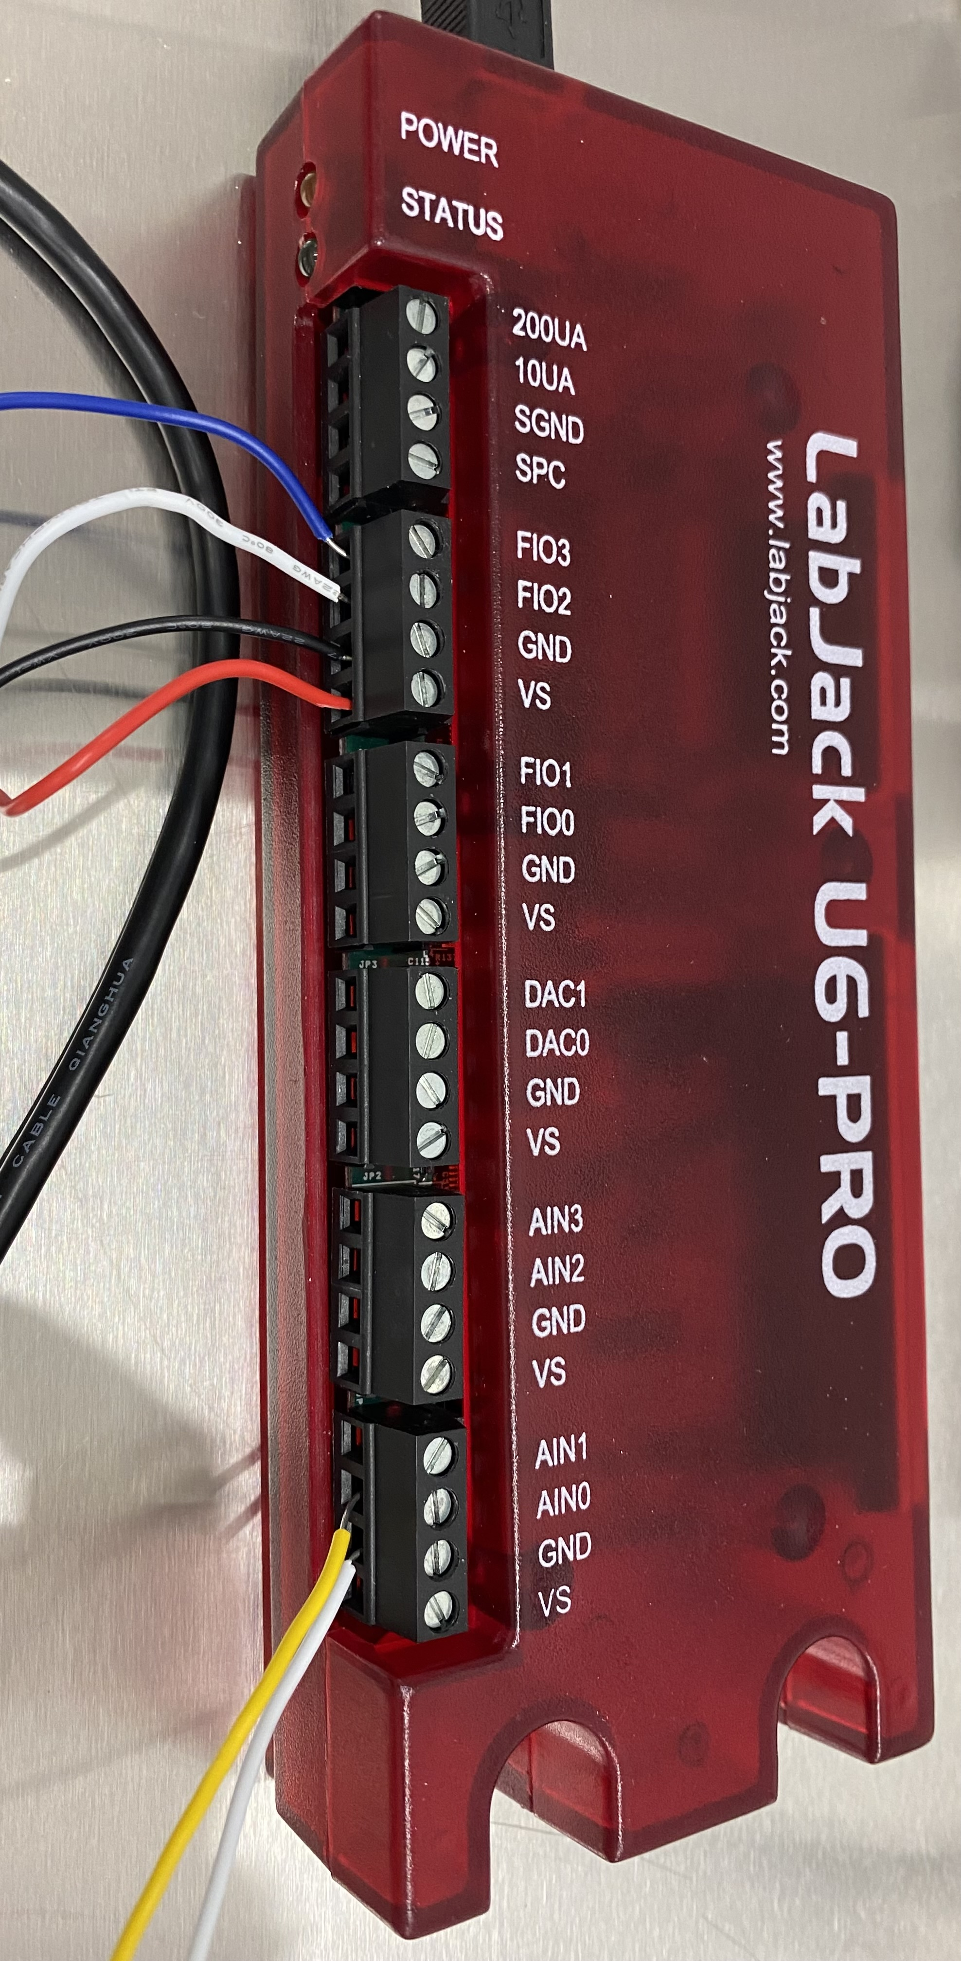
Transition Summary
2020 → 2022
2-D Cartesian centerline coordinates for guide tube design named GT2-02T, adjustments have been made to this design which created GT2-02TKf a slightly modified design to fit in the lab
  different bend radii
  changed bend angles at locations to allow for overlapping sections
DAQ: LabJack and pyGUI for torque
analysis is still able to record torque,
distance and time data
Load Lock
Deck Surface
4

Slide 5
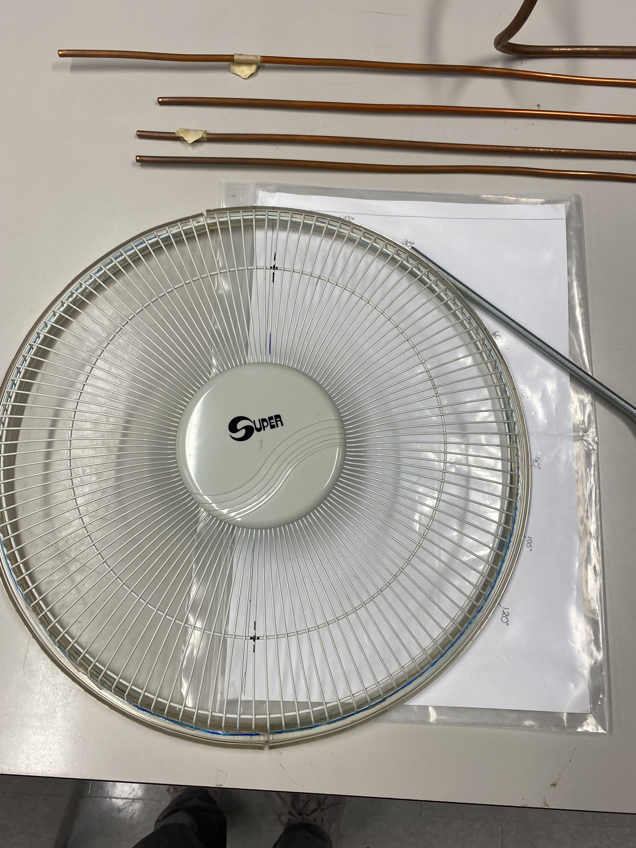
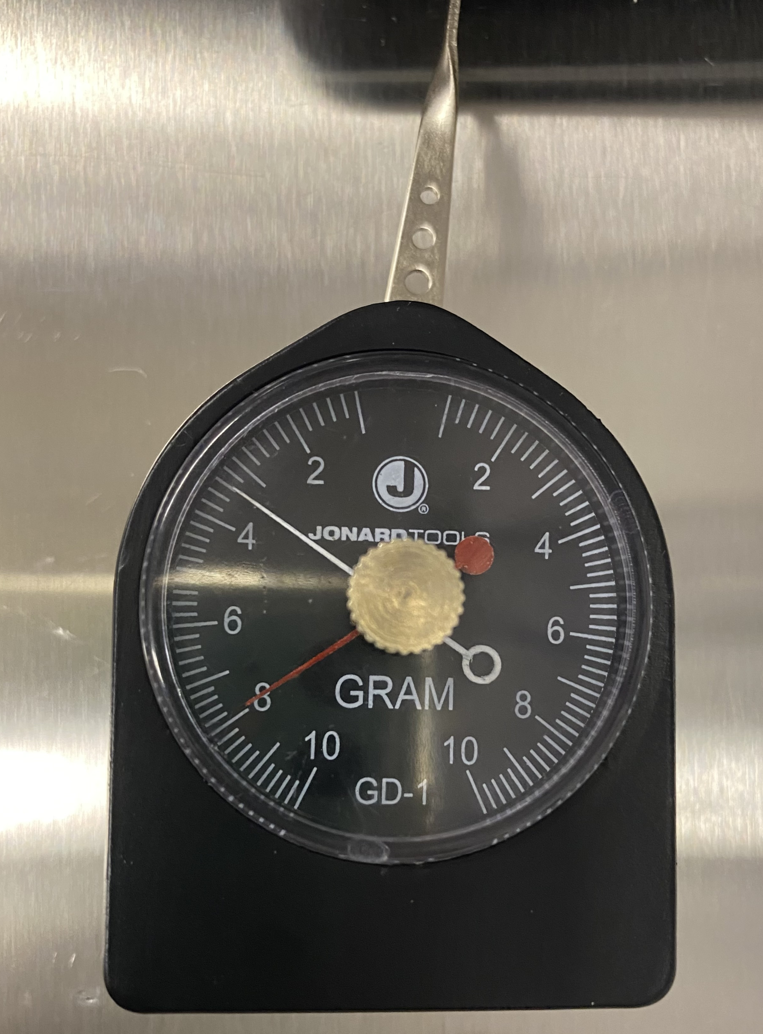
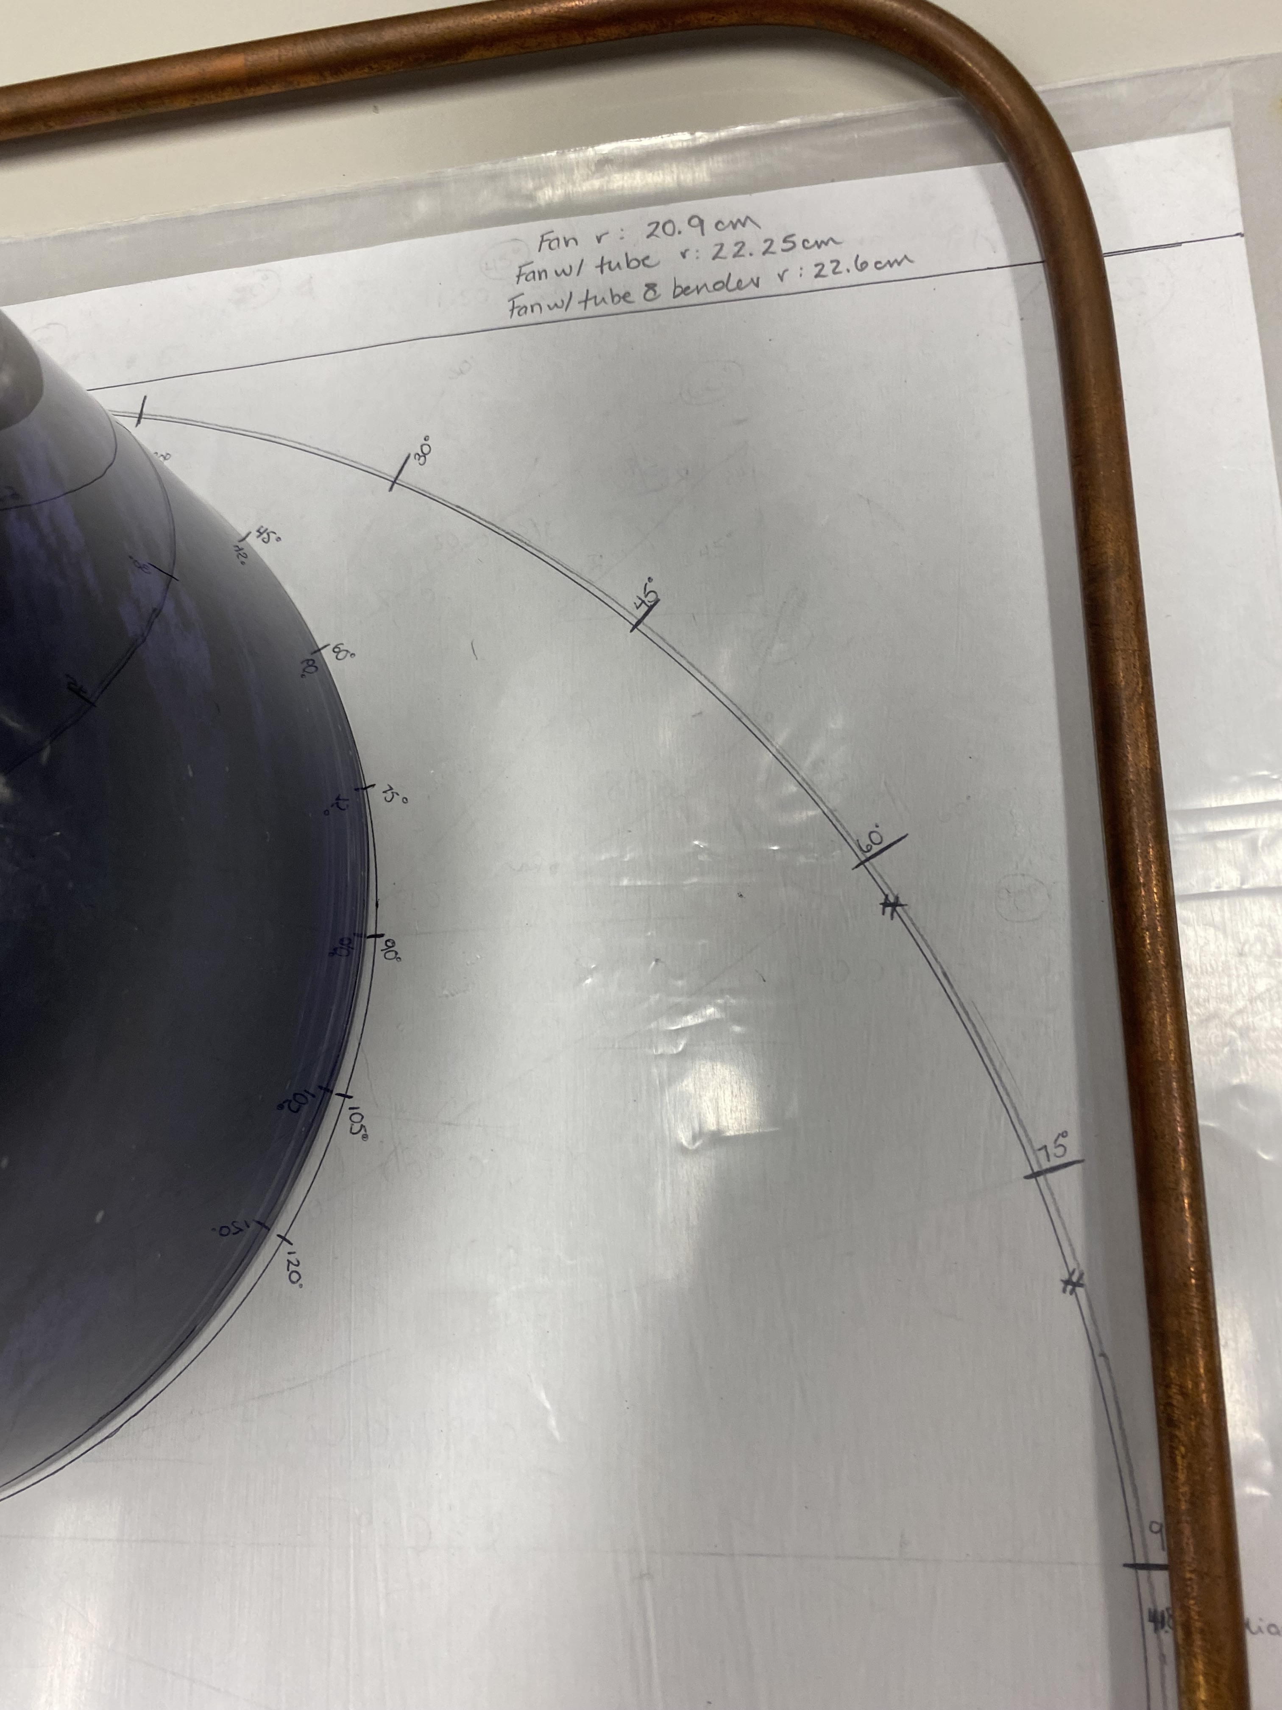
Setting up A Force test
Force Test Goal: to calculate the resultant frictional forces between the crimped source cable with Teflon beads and the copper tubing
To measure force a dynamometer was used
First change to GT2-02T explained: the bend radii for the initial design were either listed as 10 cm or 20 cm, cylindrical objects below were found at Laurentian for tube bending of slightly different radii
fan Radius = 20.9 cm
Fan Radius w/ Tygon Tubing = 22.6 cm
Dynamometer
Curtain Roll radius = 11.1 cm
5

Slide 6
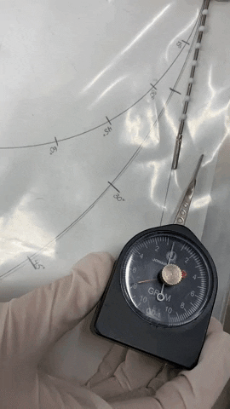
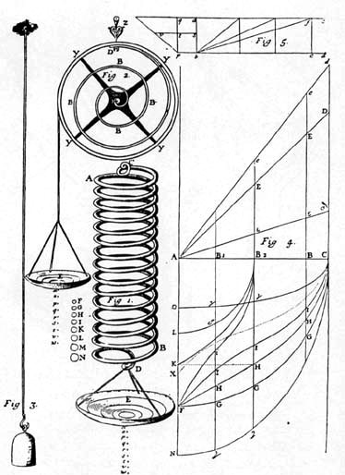
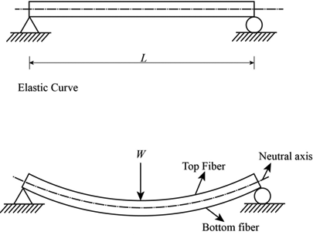


Trial and Error : Force Test
$$E= \frac{F/A}{∆L/L}$$
$$F=kx$$
???
???
Hooke’s law?
Young’s Modulus?
6

Slide 7
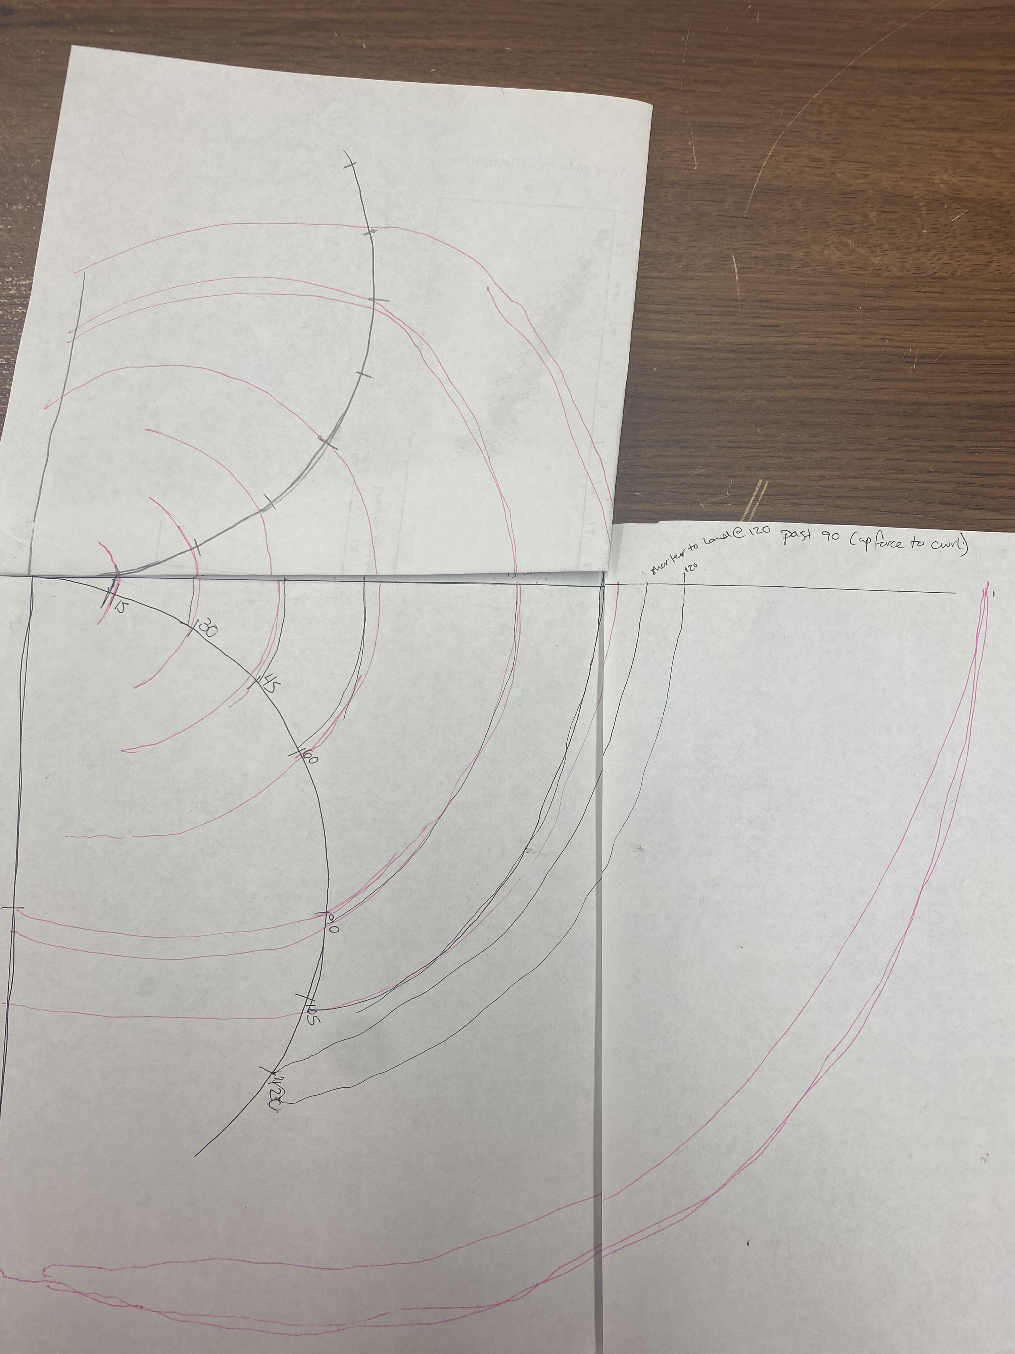
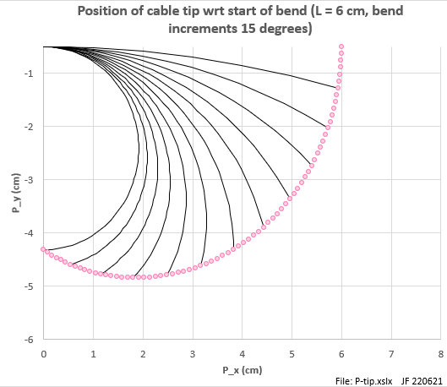
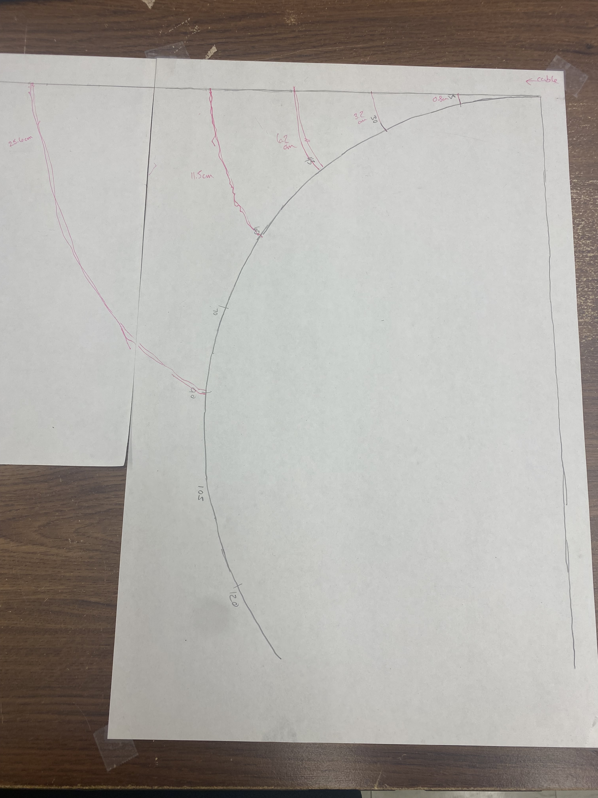
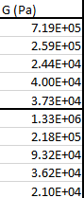
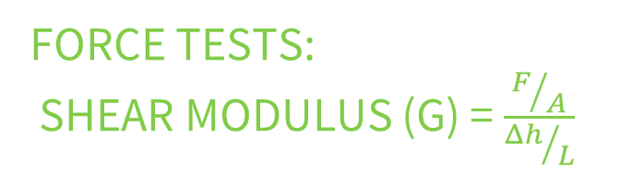


Force Tests:
Shear modulus (G) = $\frac{F/A}{{Δh}/L}$
Experimentation: Δh (cable path distance) - was calculated by the understanding that the cable naturally takes a spiral path
Results: determined that bending of the source cable (sc) does not adhere to the shear force properties of a steel rod
Future: the properties of the rope–like designed source cable may explain its flexibility and low G, but future experimentation awaits to explore this concept
Shear Modulus Results From Force Test:
$$G_{rod}=7.2 x {10}^{10}Pa$$
$$G_{ave. sc}=2.8 x {10}^{5}Pa$$
7

Slide 8
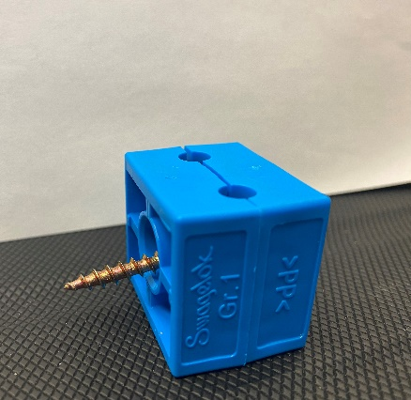
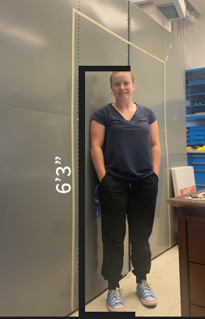
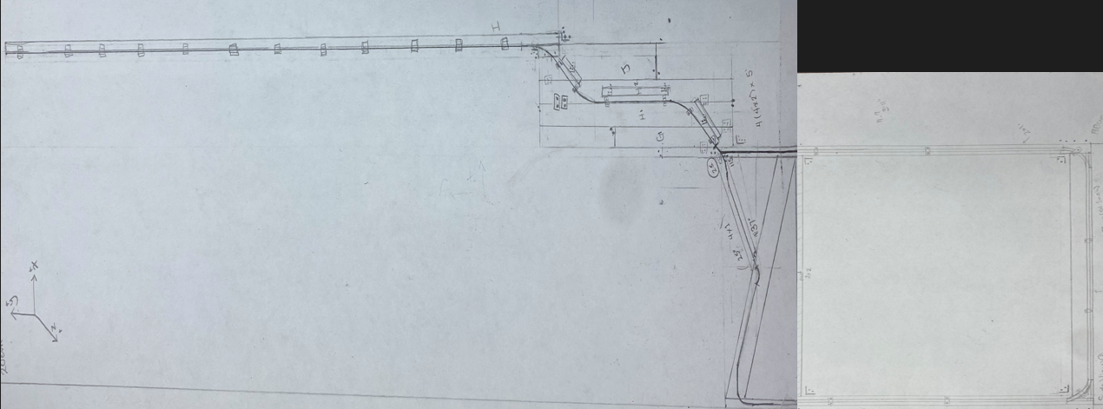
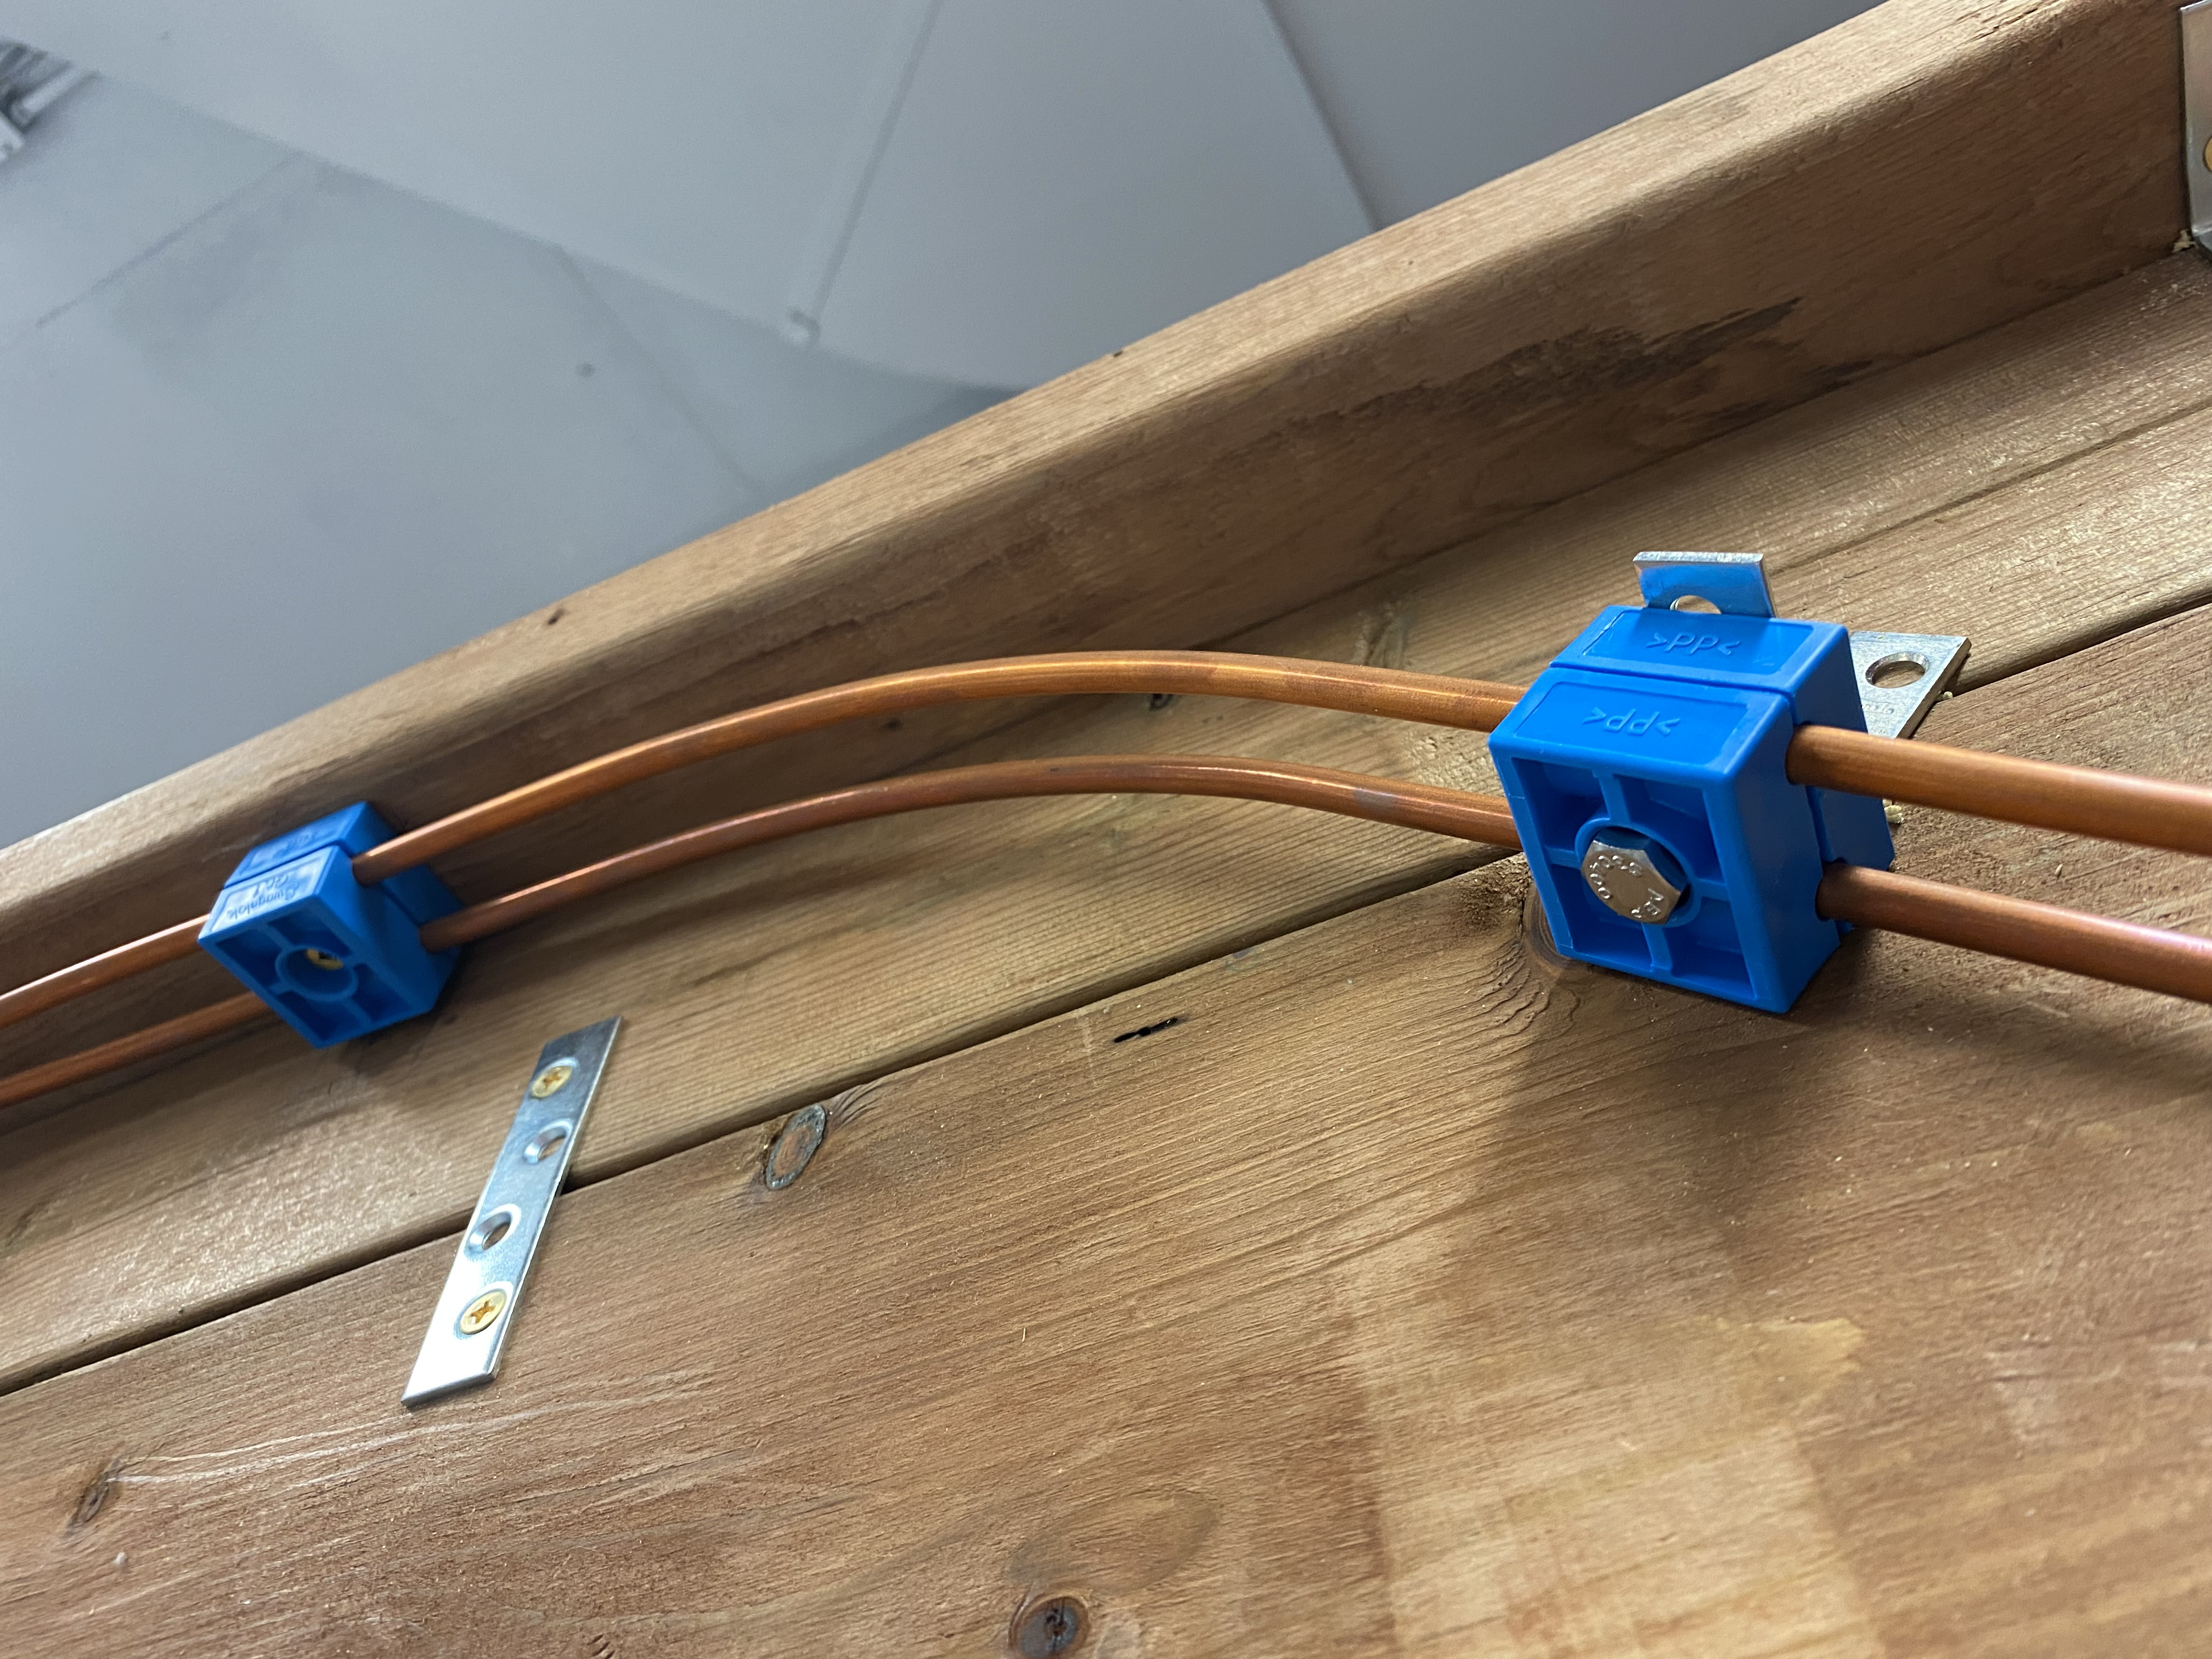
THE Plan: GT2-02TK
Slight change was made to two bend angles in Kurtis’ design GT2-02T to GT2-02TKf to allow for the ascending and descending guide tubing stemming away from the TPC to overlap
Designed a wooden frame to support the integrity of the guide tube path
Next Steps: to build the wooden support frame, bend the copper tubing in accordance with GT2-02TKf, transfer the structure into the clean room with D-140 at Laurentian and start data collection
Fig.5
Fig.6
Fig.7
8

Slide 9
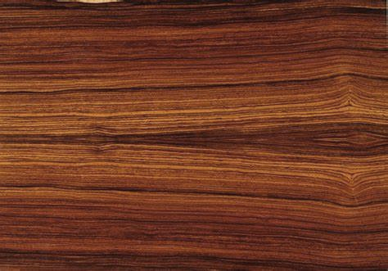
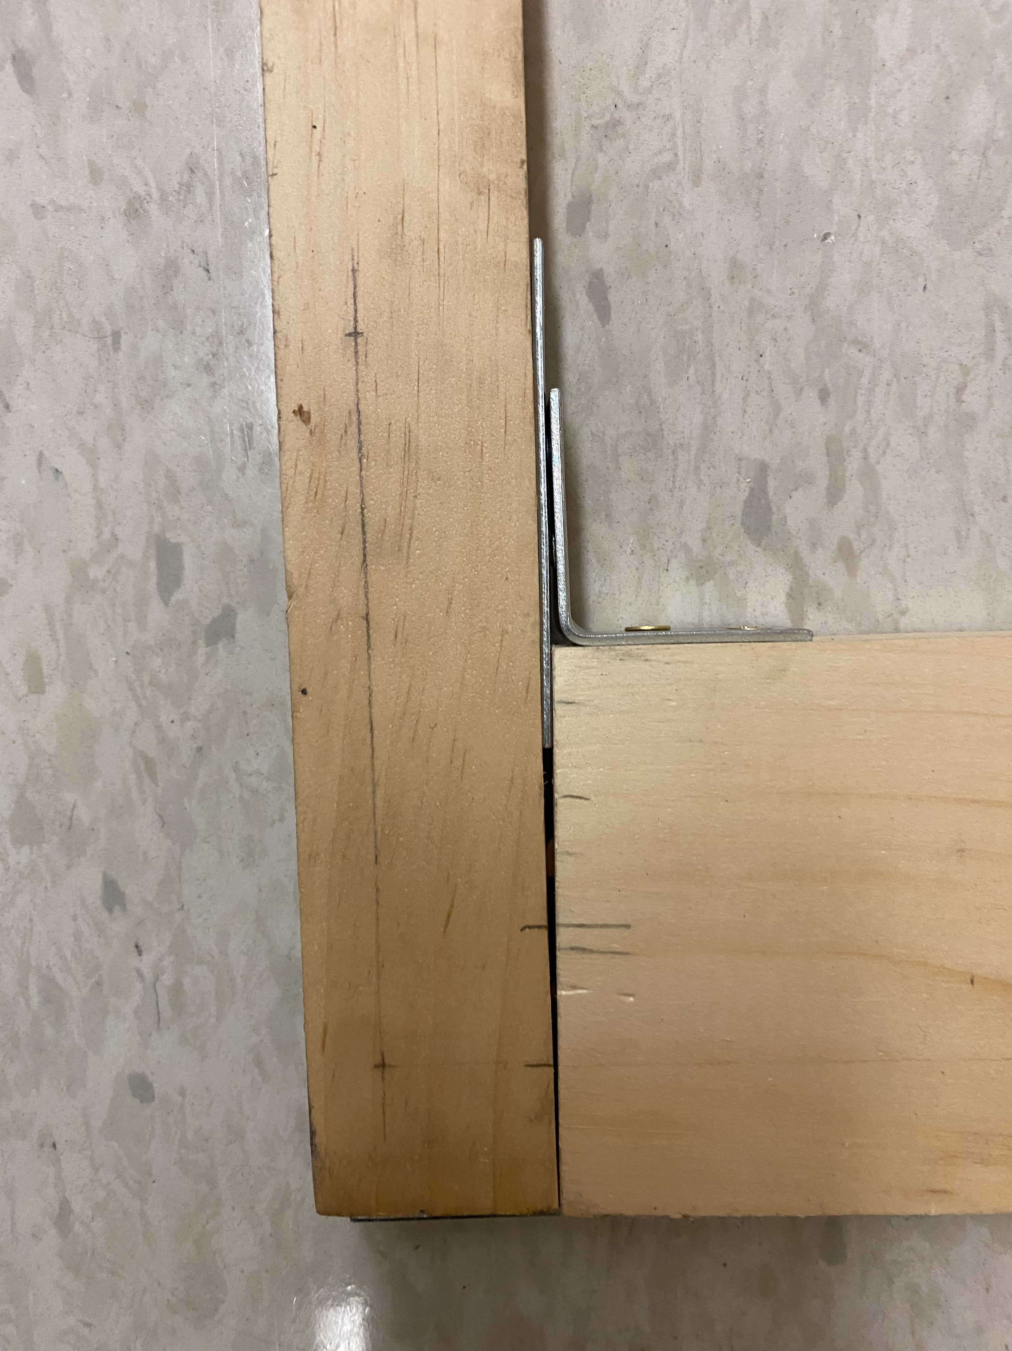
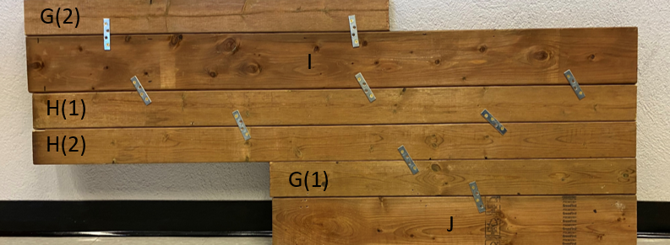
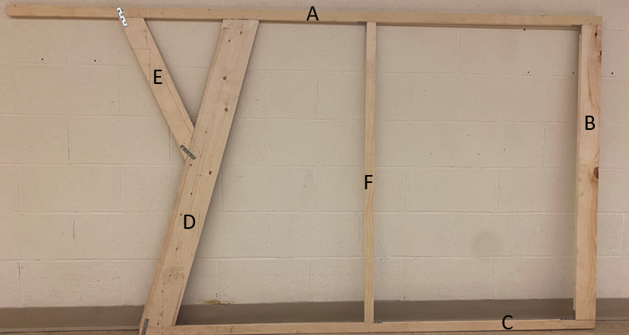
Building the Support Structure
K
D
C
Wood from Pine Hill Lumber and, Hardware (plate-brackets, L-brackets and screws) from McMaster Carr
Assembled the Y-Knot and the Raft separately on 5th floor of Fraser
Straightness was relative to the floor tiles
There are three separate assembled pieces of wooden structures that were all connected in the end, as if connected it would not fit in the elevator
The lumber piece labelled “C” was not straight, solution to fix the misalignment
Fig.7
Fig.6
9

Slide 10
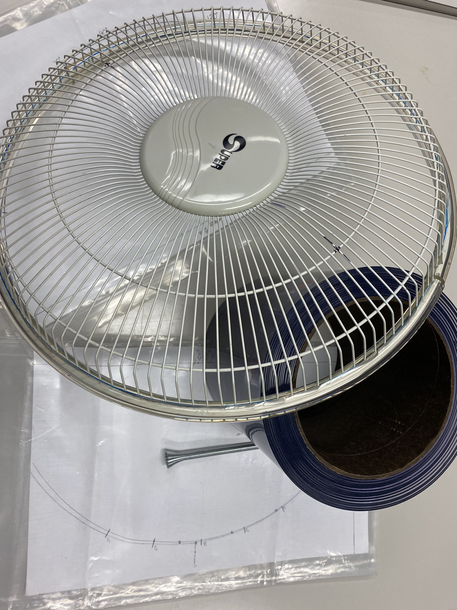
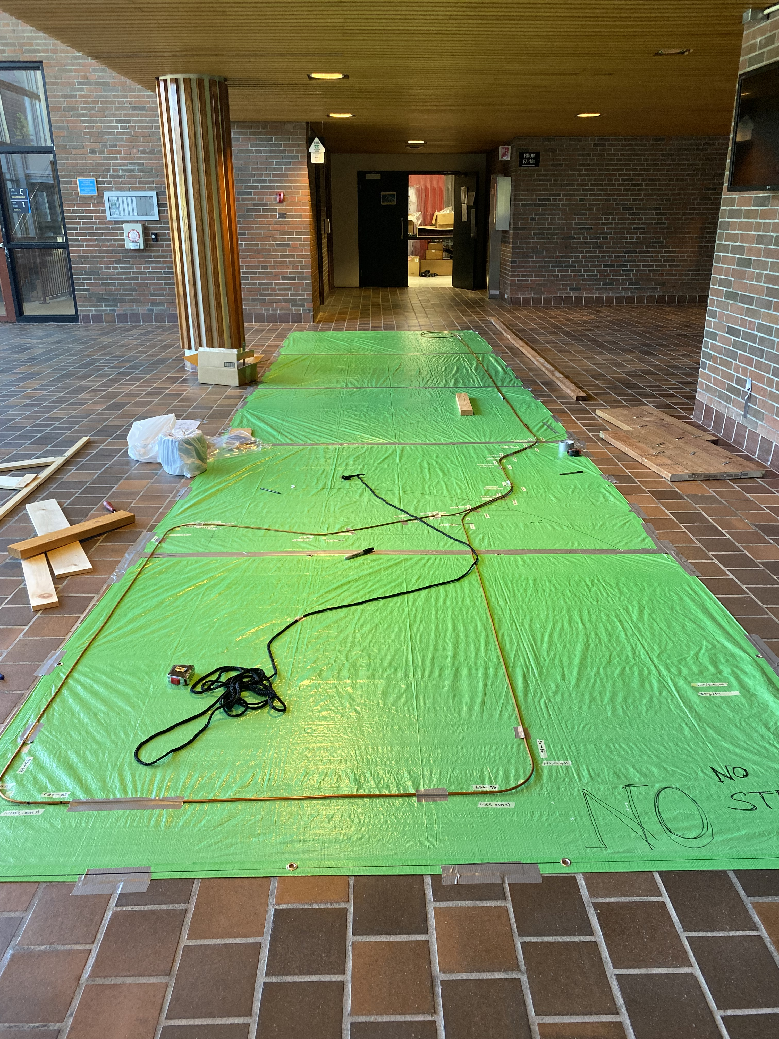
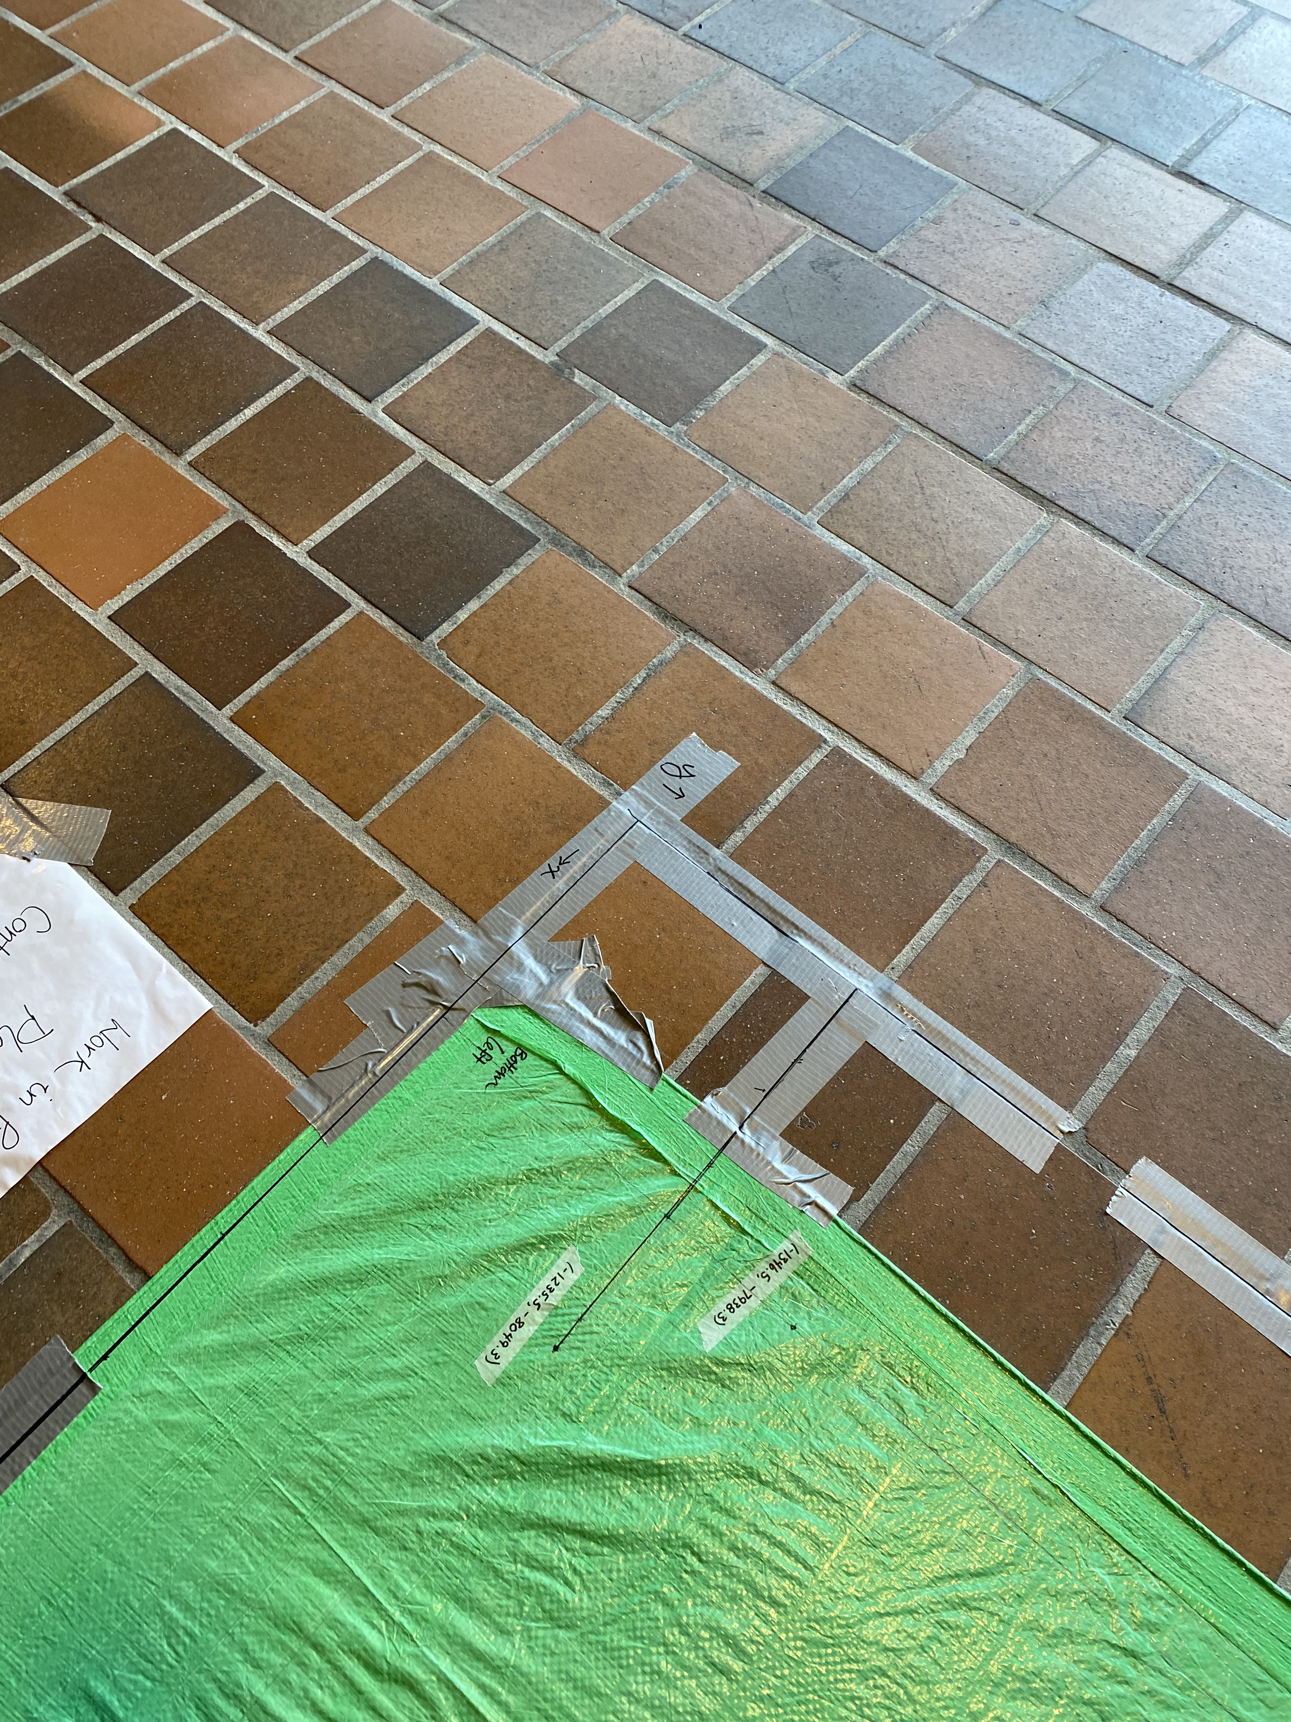
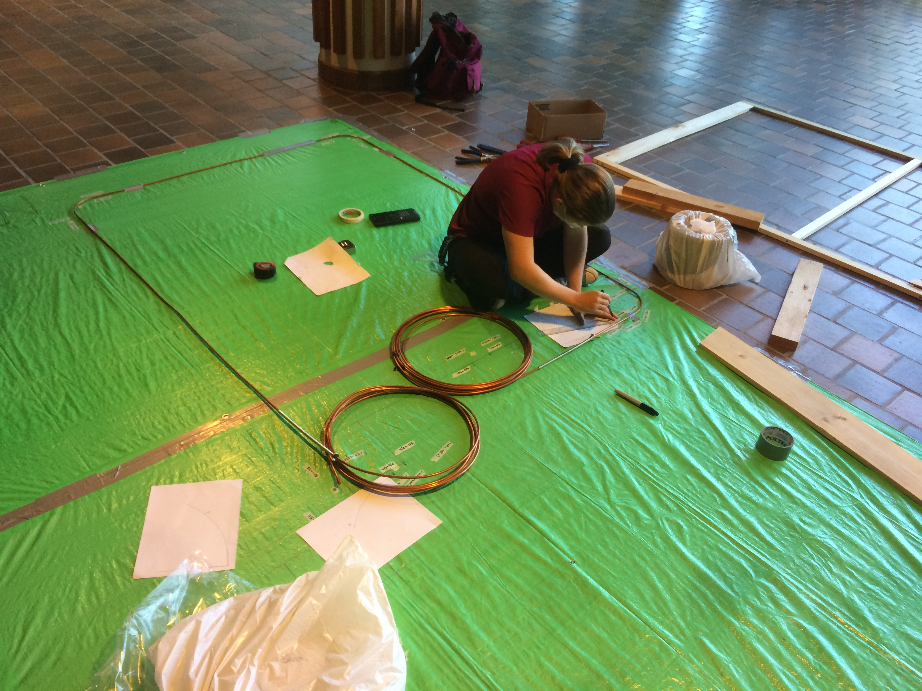
Tube Bending
Used the Fraser Lobby floor tiles as a straight reference for the tarps placement and drawing out the GT2-02TKf design
Bent the copper tubing relative to the coordinate system and used the fan shell and curtain roll for the tubing to bend around
Three separate sections of the wooden frame were connected together
The guide tube was secured onto the wooden frame using brass routing clamps and Swagelok clamp kits
Fig.5
10

Slide 11
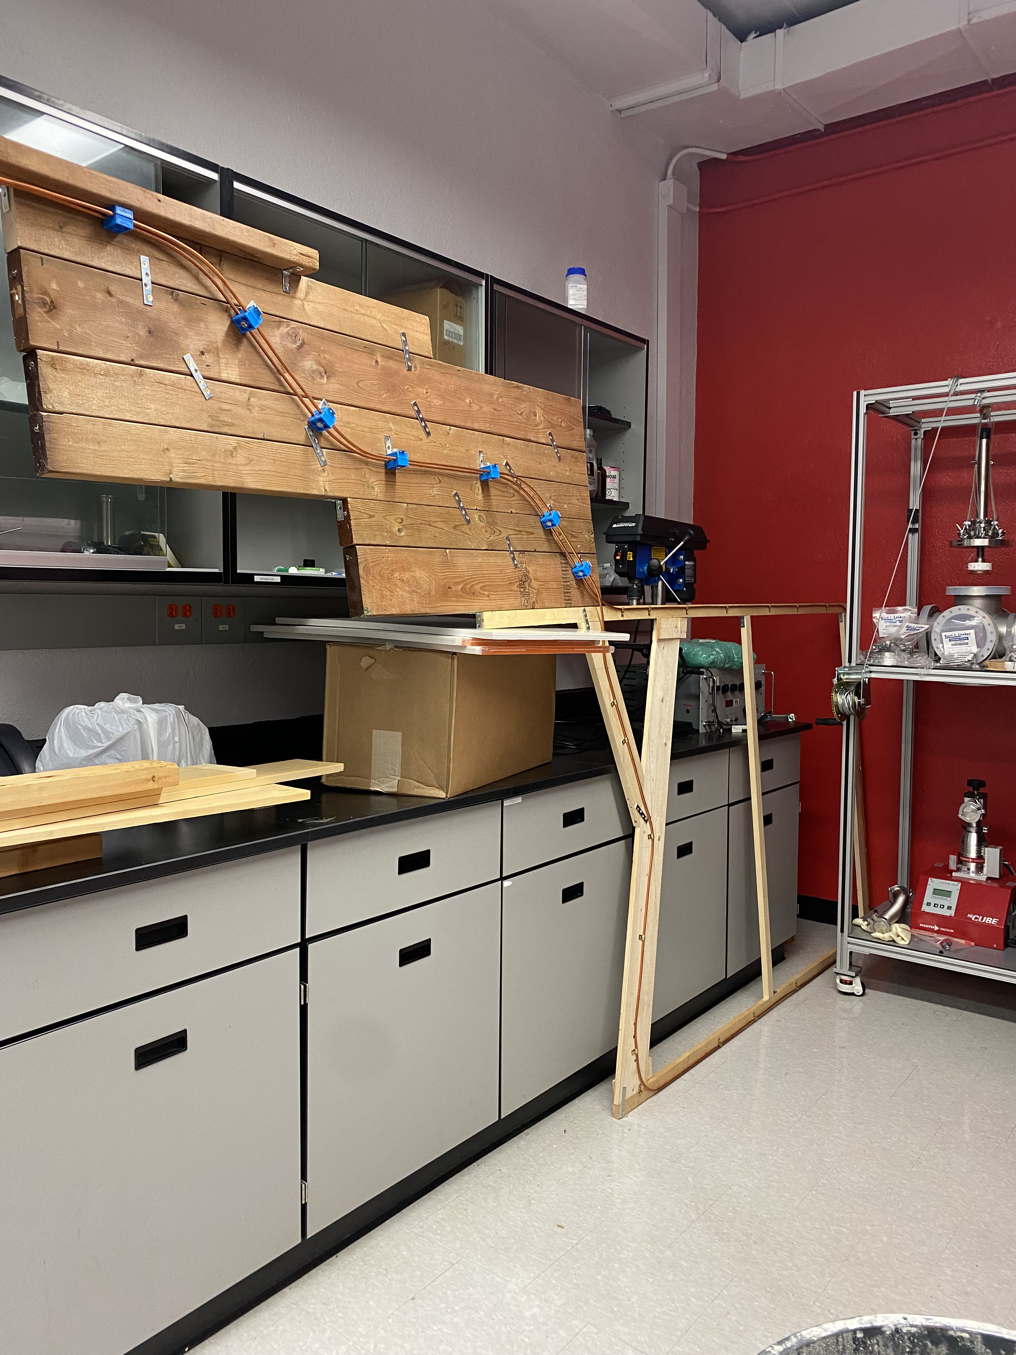
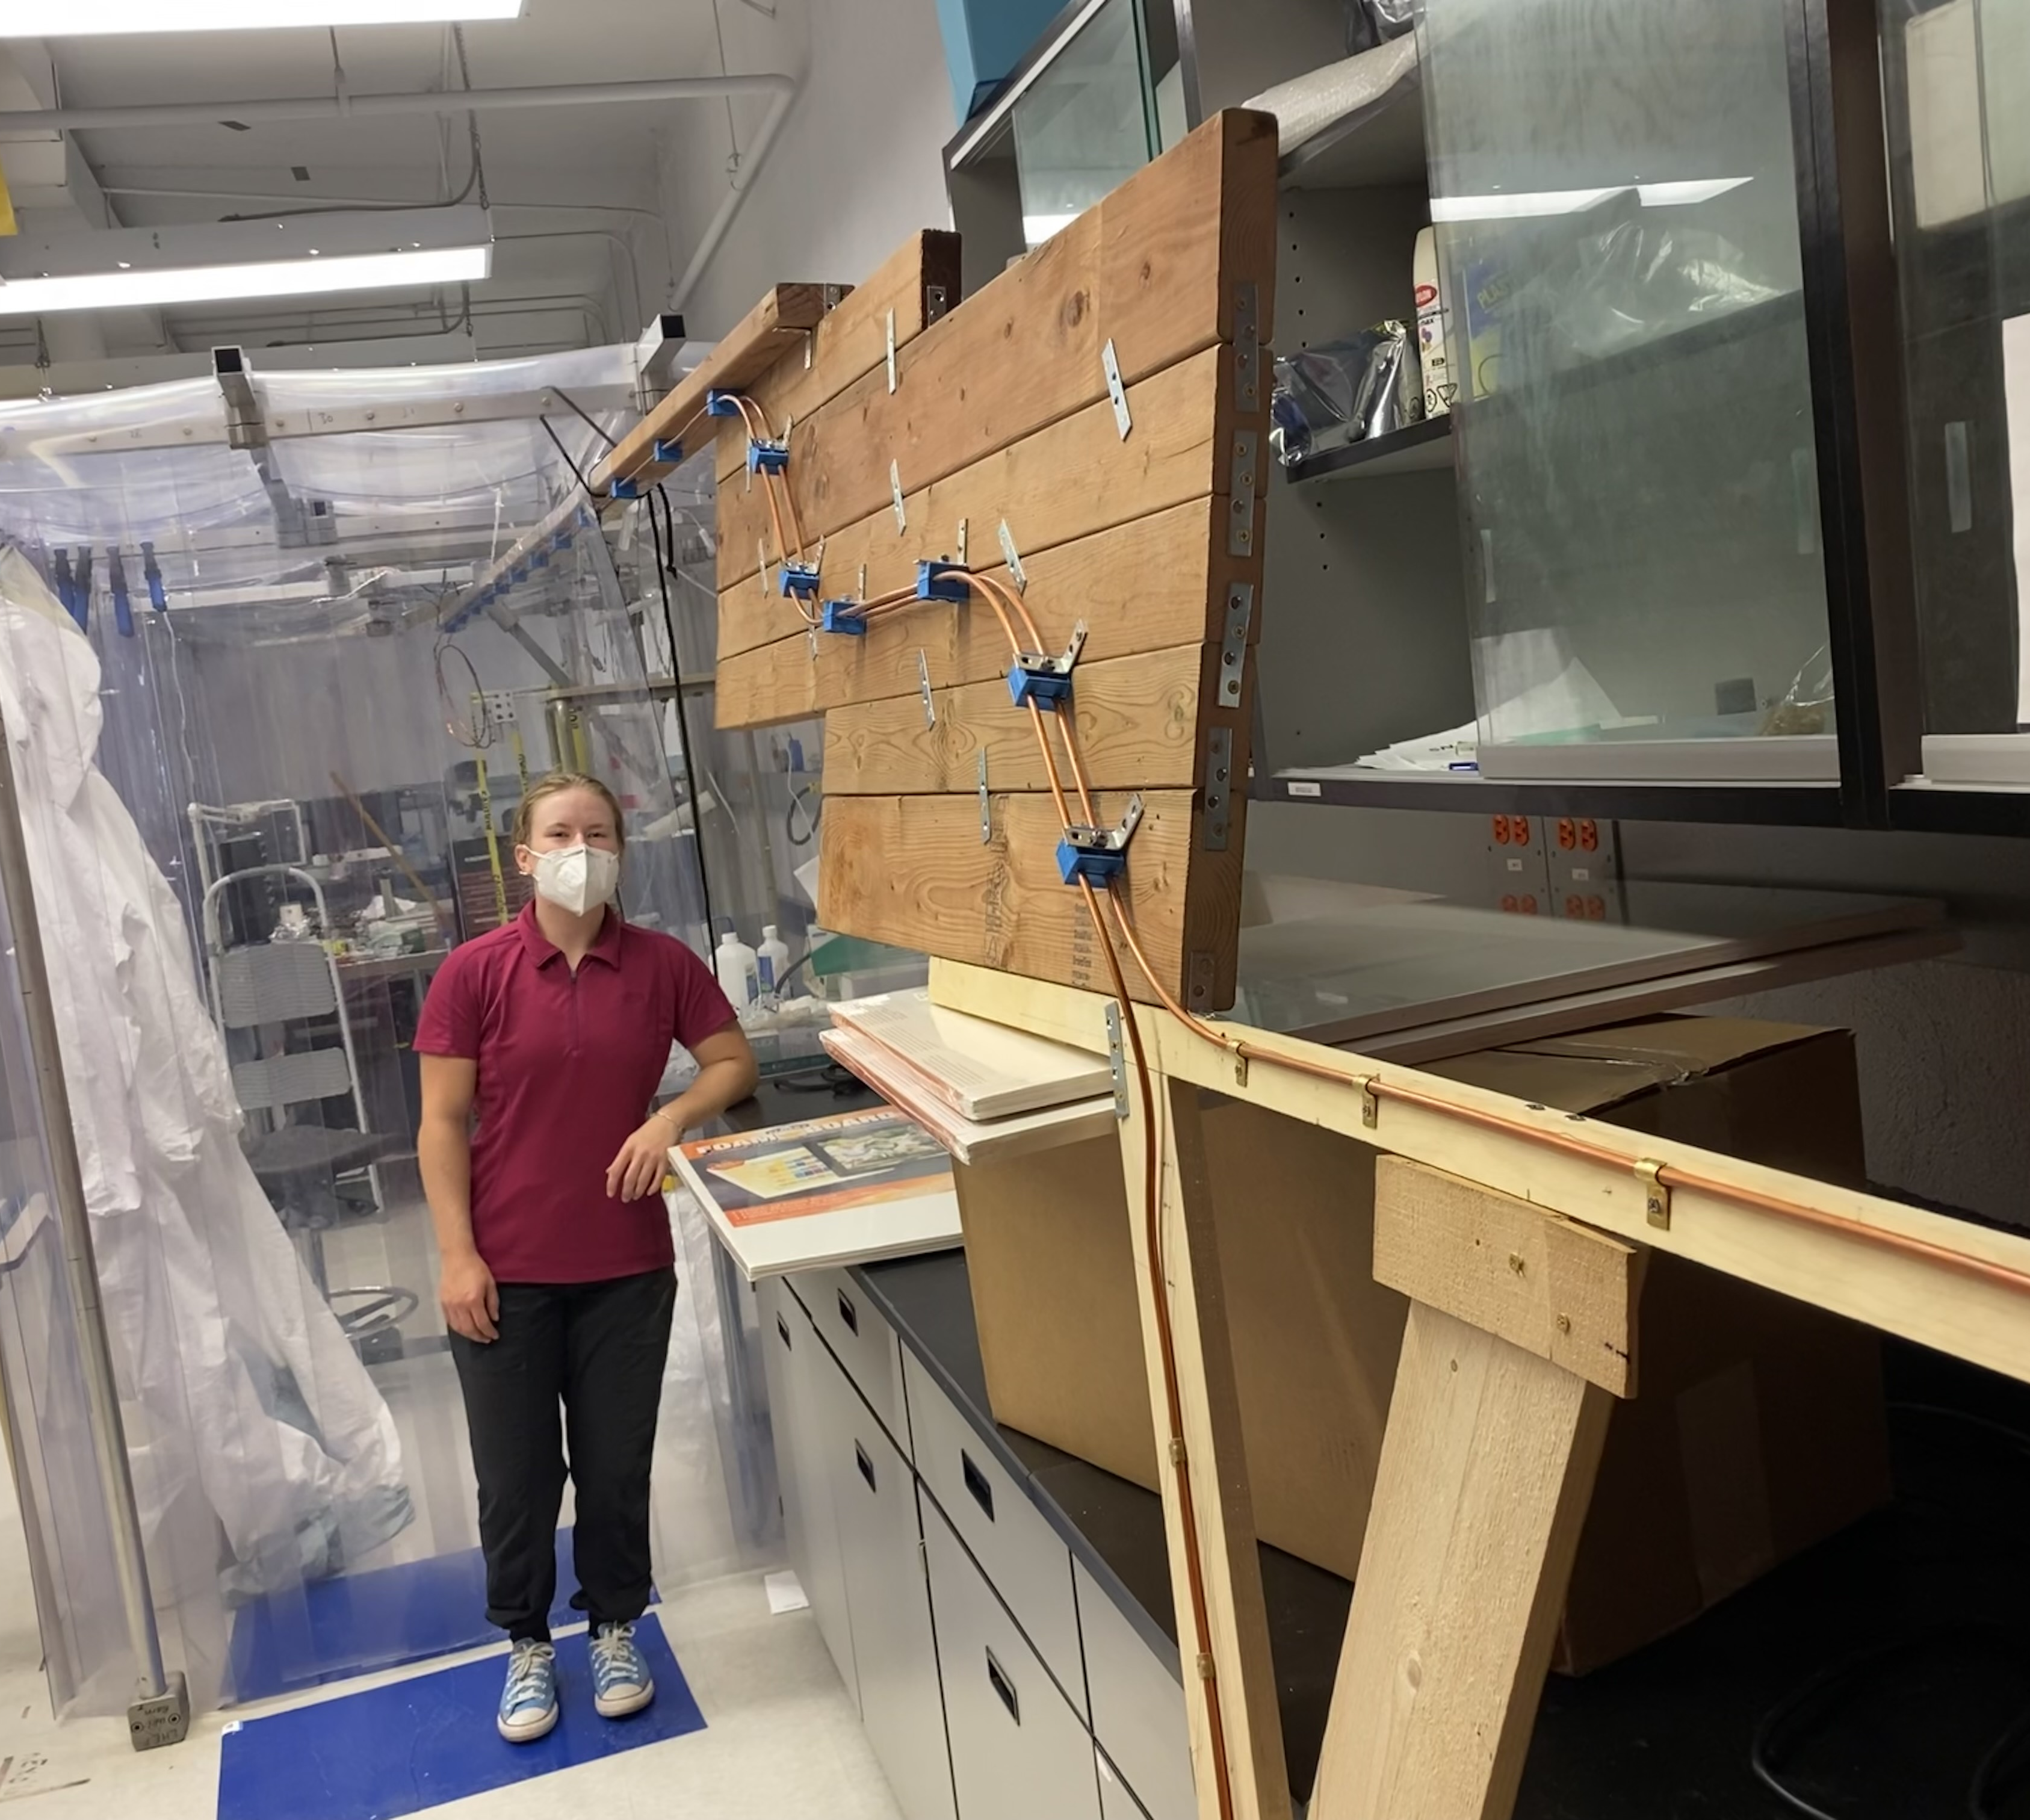
Transferring to D-140
As seen below the large wooden structure with the guide tube which its total length is over 26ft has been safely moved into D-140
Most of the 16ft board is in the clean room which as been cleaned and covered in tape in order to reduce particle emittance
The box was a temporary hold until a stand was built to support the wooden frame
Fig.5
11

Slide 12
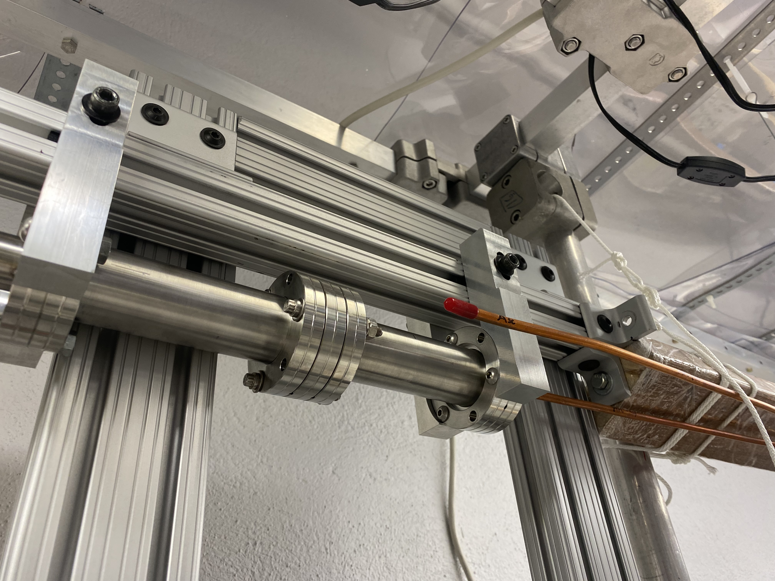
Future Plans
The guide tube is now ready to test the source cables ability to travel through its geometry, setting up the telescope, cassette, torque sensor and LabJack are works in progress
The descending path of GT2-02TKf is assembled to the load-lock
Future Work: to record Torque vs Position data on the source cables journey through the guide tube to determine how smoothly it moves through the bends and straight sections
Fig.5
12

Slide 13
Thank you for Listening

