Slide 1
hetDB
The High-Energy Transients Database

Slide 2
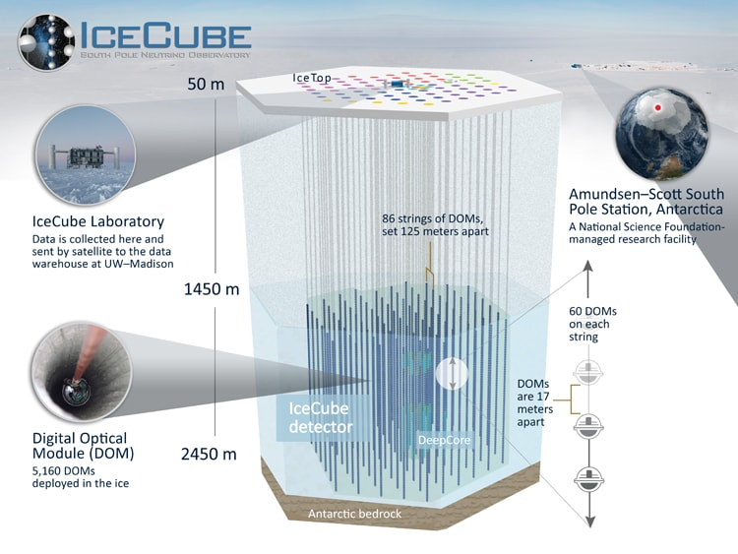
What am I building to?
hetDB is a database of transient observations, that makes data from NASA's GCN easy to analyse
It provides a Python interface to the data it stores
Image provided by the IceCube Collaboration

Slide 3
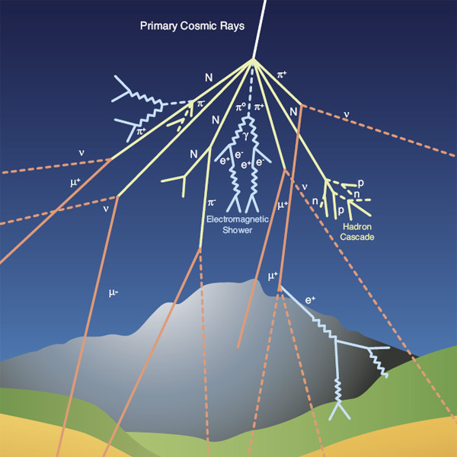
Why do we care?
Cosmic rays are very high energy charged particles: ~10²¹ eV
Neutrinos are not charged, so remain undeflected as they travel
By identifying the emitter of HE neutrinos, we can identify the source of HE cosmic rays
Hypothesis: the source of GRBs is also the source of cosmic rays
  Spatial coincidence!
Image provided by CERN
Notes:
MENTION 2018 BLAZAR GRB NEUTRINO CONFIRMATION – YOU KNOW THE ONE

Slide 4
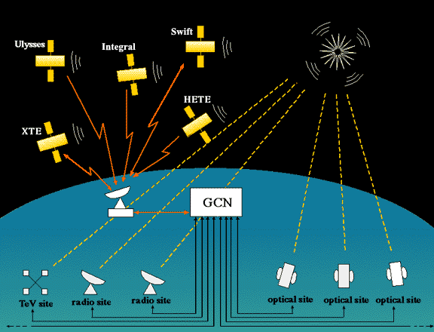
Gamma-ray Coordinates Network
Image provided by NASA
Notes:
The gamma-ray coordinates network was established in 1997. It's goal is to provide a "one stop shopping network" for:
- Information about GRBs and other transients events sent ASAP after detection
- Follow-up observations from other observers in the same region as the initial observation

Slide 5
GCN Notices
//////////////////////////////////////////////////////////////////////
TITLE: GCN/AMON NOTICE
NOTICE_DATE: Mon 08 Aug 22 08:00:42 UT
NOTICE_TYPE: ICECUBE Astrotrack Bronze
STREAM: 25
RUN_NUM: 136918
EVENT_NUM: 45252263
SRC_RA: 132.3328d {+08h 49m 20s} (J2000),
132.5365d {+08h 50m 09s} (current),
131.8824d {+08h 47m 32s} (1950)
SRC_DEC: -42.7168d {-42d 43' 00"} (J2000),
-42.8017d {-42d 48' 05"} (current),
-42.5301d {-42d 31' 47"} (1950)
SRC_ERROR: 39.13 [arcmin radius, stat-only, 90% containment]
SRC_ERROR50: 14.09 [arcmin radius, stat-only, 50% containment]
DISCOVERY_DATE: 19799 TJD; 220 DOY; 22/08/08 (yy/mm/dd)
DISCOVERY_TIME: 28797 SOD {07:59:57.26} UT
REVISION: 0
ENERGY: 5.4853e+01 [TeV]
SIGNALNESS: 3.8646e-01 [dn]
FAR: 1.8772 [yr^-1]
SUN_POSTN: 138.24d {+09h 12m 57s} +16.10d {+16d 06' 17"}
SUN_DIST: 59.14 [deg] Sun_angle= 0.4 [hr] (West of Sun)
MOON_POSTN: 262.81d {+17h 31m 15s} -26.31d {-26d 18' 19"}
MOON_DIST: 97.13 [deg]
GAL_COORDS: 263.16, 0.71 [deg] galactic lon,lat of the event
ECL_COORDS: 155.21,-56.98 [deg] ecliptic lon,lat of the event
COMMENTS: IceCube Bronze event.
COMMENTS: The position error is statistical only, there is
no systematic added.
Custom format
Made for emails
Machine- & Human-readable

Slide 6
GCN Circulars
TITLE: GCN CIRCULAR
NUMBER: 32357
SUBJECT: IceCube-220624A: Classification of AT2022nit as a type Ia supernova and AT2021bei as an AGN
DATE: 22/07/09 11:15:01 GMT
FROM: Simeon Reusch at DESY <simeon.reusch@desy.de>
Robert Stein (Caltech), Jannis Necker, Simeon Reusch (DESY), Shreya Anand, Kaustav Das (Caltech), Jesper Sollerman (Stockholm Uni), Viraj Karambelkar, Mansi Kasliwal (Caltech) and Anna Franckowiak (DESY/Ruhr University Bochum) report:
We observed neutrino IC220624A (Santander et. al, GCN 32260) with the Zwicky Transient Facility (Reusch et al., GCN 32270) as part of our ZTF neutrino follow-up program (Stein et al. 2022). Though no candidates were identified with our initial ToO observation, we continued our regular monitoring of the localisation with additional ToO and serendipitous observations.
As part of these additional observations, we identified the transient ZTF22aaparxg/AT2022nit as a possible optical counterpart. We undertook spectroscopic observations of AT2022nit with the Low Resolution Imaging Spectrometer (LRIS, Oke et al. 95) at the Keck I Observatory.
Using SNID (Blondin et al. 2007), we classify AT2022nit as a type Ia supernova at redshift z=0.16 (see https://www.wis-tns.org/object/2022nit for the full spectrum). Given that type Ia supernovae are not predicted to emit high-energy neutrinos, we therefore exclude AT2022nit as a candidate counterpart to IC220624A.
We also identified ZTF19adgzidh/AT2021bei as another optical counterpart candidate and observed it with ALFOSC on the 2.5m NOT telescope at Roque de los Muchachos Observatory.
Using SNID (Blondin et al. 2007), we classify AT2021bei as flare in an AGN at redshift z=0.48 (see https://www.wis-tns.org/object/2021bei for the full spectrum). Because such flares occur frequently across the sky, we expect to find coincidences between AGN flares and neutrinos by random chance. Given the lack of any exceptional flaring activity in this source, we conclude that AT2021bei is not a promising counterpart to IC220624A.
We have not identified any other candidate optical counterparts with ZTF.
Based on observations made with the Nordic Optical Telescope, owned in collaboration by the University of Turku and Aarhus University, and operated jointly by Aarhus University, the University of Turku and the University of Oslo, representing Denmark, Finland and Norway, the University of Iceland and Stockholm University at the Observatorio del Roque de los Muchachos, La Palma, Spain, of the Instituto de Astrofisica de Canarias.
The data presented herein were obtained at the W. M. Keck Observatory, which is operated as a scientific partnership among the California Institute of Technology, the University of California and the National Aeronautics and Space Administration. The Observatory was made possible by the generous financial support of the W. M. Keck Foundation.
The authors wish to recognize and acknowledge the very significant cultural role and reverence that the summit of Maunakea has always had within the indigenous Hawaiian community. We are most fortunate to have the opportunity to conduct observations from this mountain.
Paragraphs of text
Made for emails
Human-readable, machine-unreadable

Slide 7
hetDB
SQL database of data from GCN alerts
Stores all information contained in GCN notices + circulars
Determines particle messenger, observatory, event
Focused on parsing recent IceCube notices
  ...but can easily be adjusted to work with others
Notes:
ADD BULK STATS

Slide 8
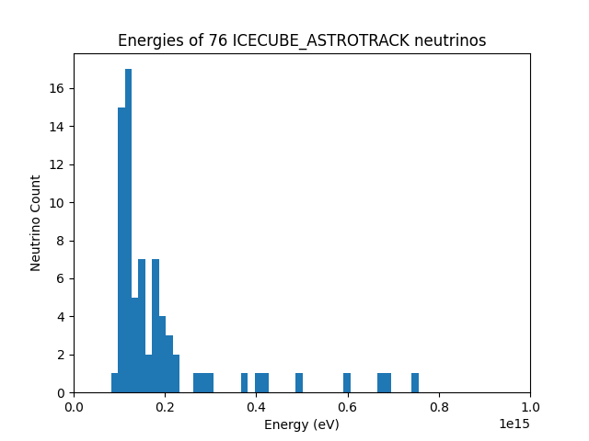
hetDB

Slide 9
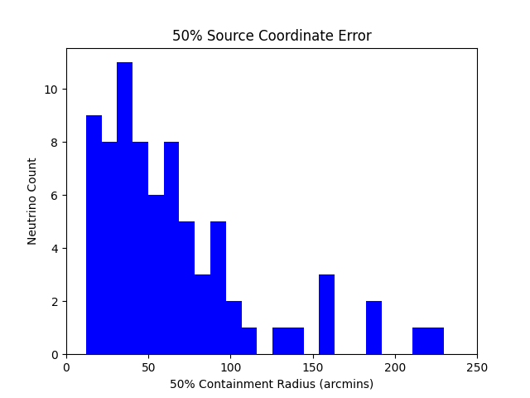
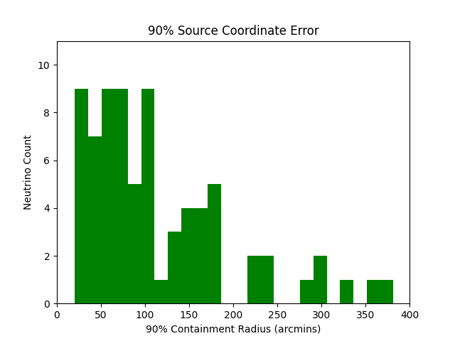
hetDB

Slide 10
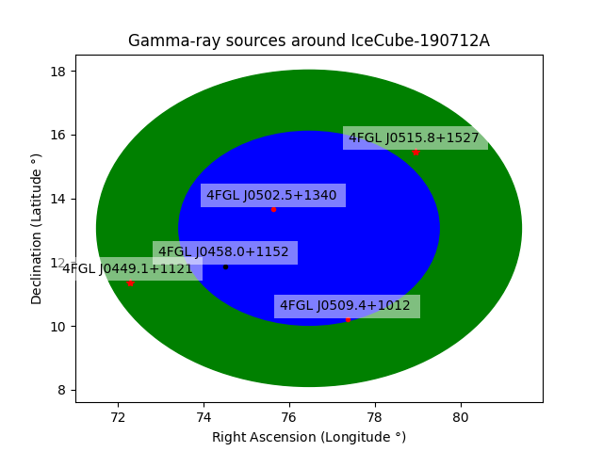
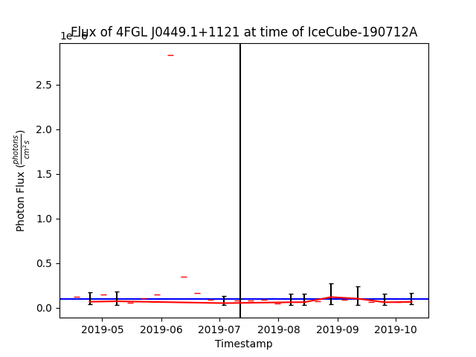
hetDB
Python interface
Integrates data from Fermi catalog
NASA precomputed γ-ray light curves for variable sources

Slide 11
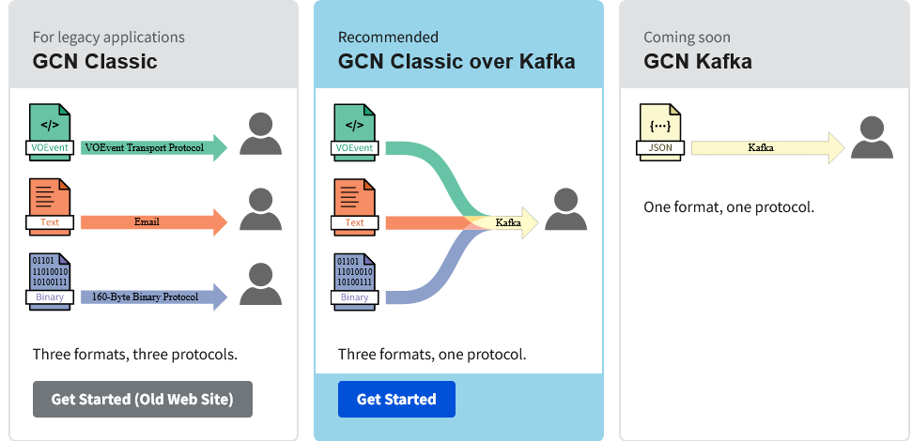
General
Gamma-ray Coordinates Network
New protocol!
New format!
New accounts!
New names!
Old service still operational!
Image provided by NASA GCN

Slide 12
Want to try it out?
Source code available at github.com/queens-lemma/hetDB
  Bootstraps from NASA’s GCN archives
Database instance available on Cedar CC cluster

Slide 13
Special Thanks
Tai Withers
  Coded hetDB’s proof-of-concept.
  All-around swell person
Dr. Nahee Park
  Supervisor, mentor, and an excellent resource
All my McDonald Institute and LEMMA coworkers
  Thanks for helping this summer fly by!

