Slide 1
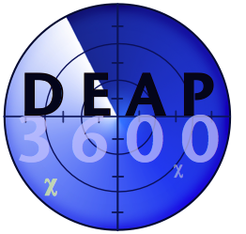

Producing the World’s Cleanest Noble Gas for DEAP-3600
2022/08/16 – CASST
Sarah Rourke
DEAP Summer Student 2022
Notes:
Thank you for your time today. I will be sharing with you how DEAP purifies its argon to obtain leading results in the search for dark matter.

Slide 2
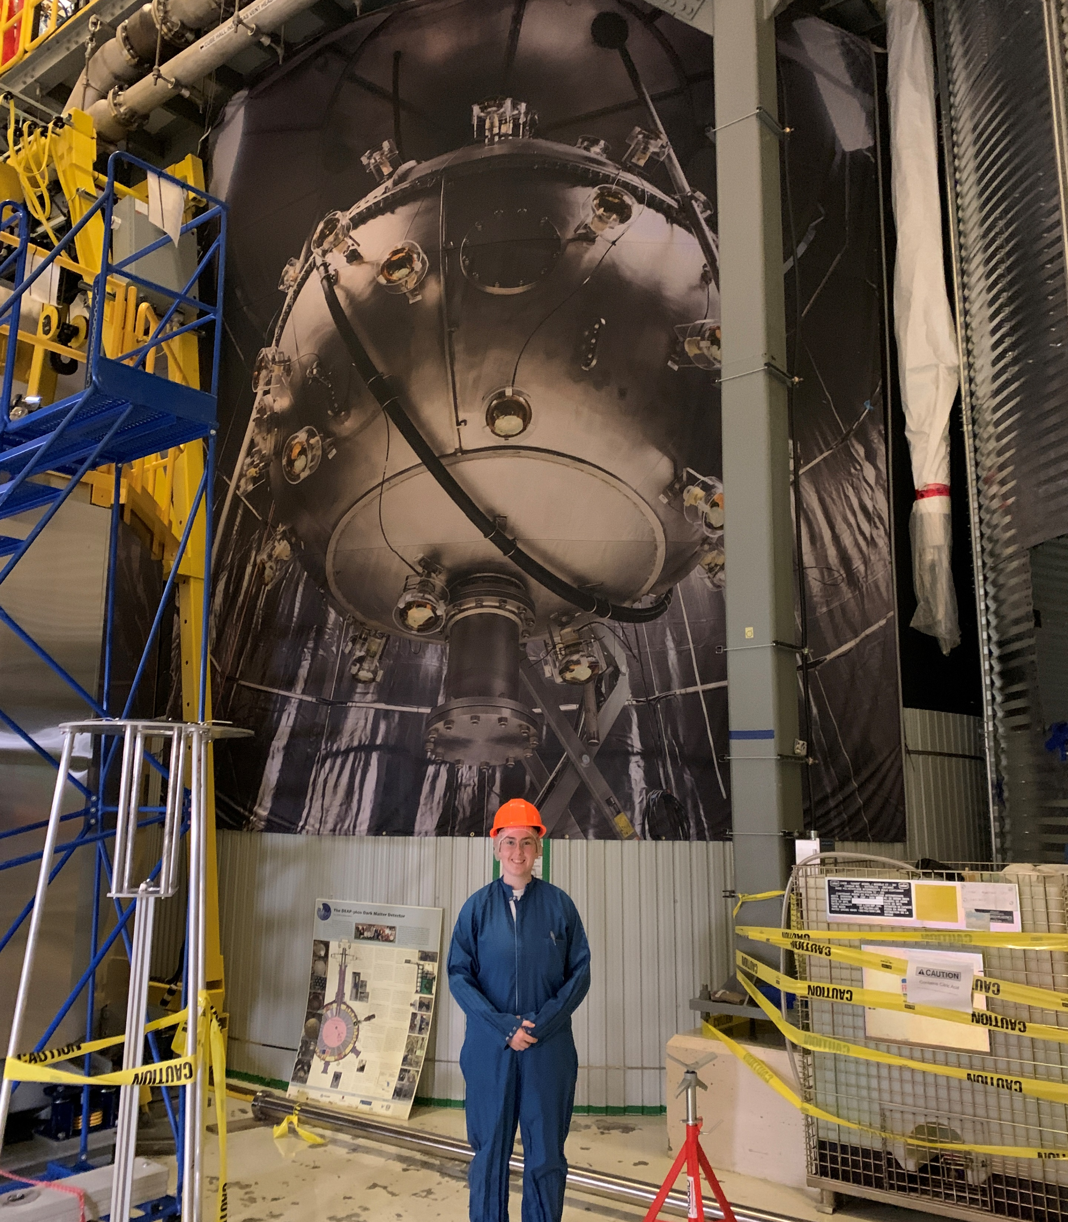
Dark matter Experiment using Argon Pulse-shape discrimination (PSD)
uses 3600 kg of liquid argon (LAr) as a target for the direct detection of Weakly Interacting Massive Particles (WIMPs)
Notes:
DEAP stands for Dark matter Experiment using Argon Pulse-shape discrimination and the 3600 signifies the design amount of liquid argon to be used as a target for the direct detection of Weakly Interacting Massive Particles. Here is a picture of me in front of the steel tank that houses the detector.

Slide 3
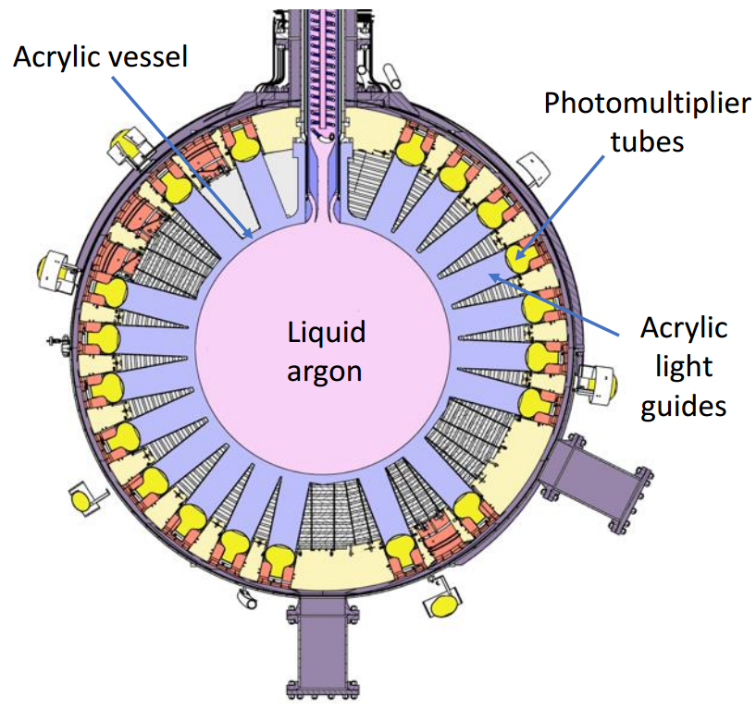
(AV)
The detector was designed to minimize background events
(PMTs)
In its second fill, DEAP minimized the radon activity in the LAr to 153 nBq/kg
The argon must be pure at the part per billion (ppb) level
Notes:
Acrylic vessel (AV) filled with LAr
Acrylic light guides (LGs) couple the AV to photomultiplier tubes (PMTs)
Inner detector is housed in a steel shell and immersed in a steel tank filled with ultra-pure water
In every aspect of its design and construction, DEAP was tailored to minimize background signals. These are from electromagnetic events, radioactivity, neutrons, cosmic rays, and pertinently to this talk, radon and its progeny. This is a diagram of the inner detector, which is composed of an acrylic vessel filled with liquid argon and acrylic light guides that couple the AV to photomultiplier tubes. A steel shell surrounds the inner detector, and it is all immersed in a steel tank filled with ultra-pure water. Results from 2019 state that the radon activity was minimized to 153 nBq/kg of liquid argon.

Slide 4
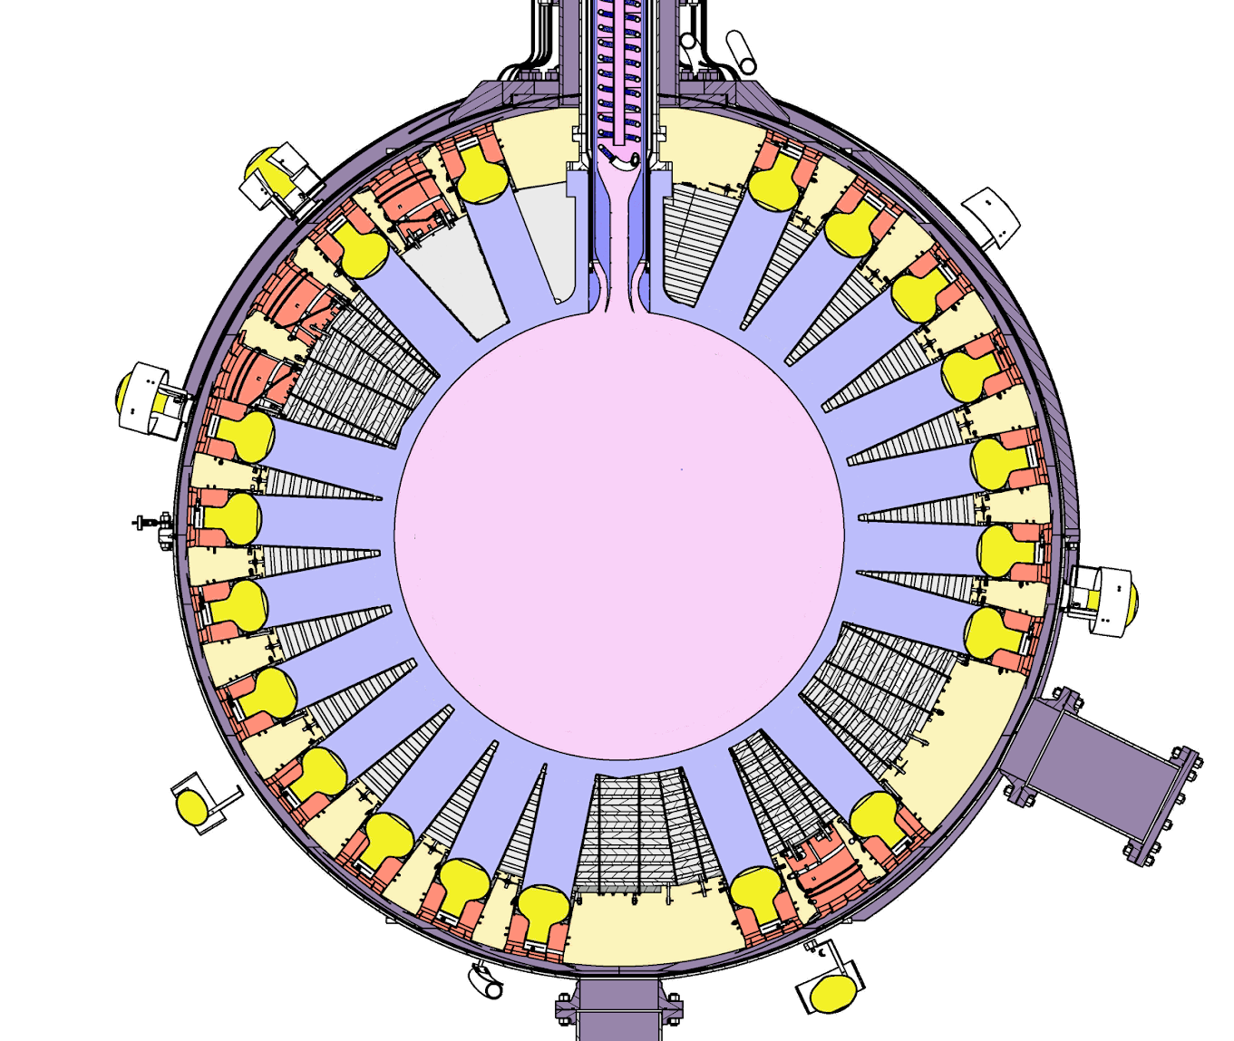
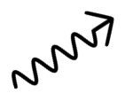
Clean argon is required for PSD resolution
χ
χ’
Nuclear recoils in LAr create unstable Ar dimers and emit scintillation light
Contaminants in Ar lead to collisional deexcitation
Radon and its progeny are important backgrounds to minimize
Ar
γ
Notes:
The detector works by capturing the scintillation light generated by charged particles interacting with the argon in the vessel. This light is shifted into the visible range by a coating on the vessel, then directed to the PMTs by the light guides so that their signals can be measured. Contaminants in the bulk argon would lead to collisional deexcitation, meaning DEAP’s characteristic pulse-shape discrimination models would not work. Radon and its progeny are important to minimize as their energy signals interfere with the PSD resolution and could be mistaken for instances of dark matter particles.

Slide 5
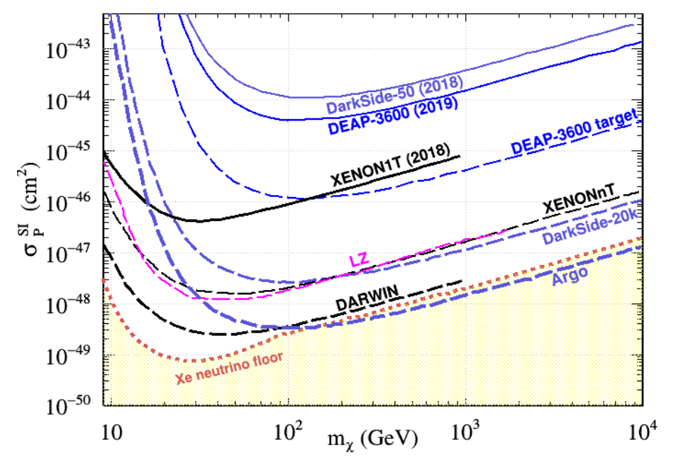
The purpose of the third fill is to
Reach design sensitivity
Prove the background model is correct
Inform future designs
Notes:
Dark matter experiments’ results are typically presented in a plot as shown, which depicts the WIMP-nucleon scattering cross section versus its mass. DEAP’s latest results are from 2019. In 2020, the detector was emptied for the second time to prepare for upgrades. Now, as we prepare it for its third fill, we are seeking to 1. Reach design sensitivity, 2. Prove the background model is correct and demonstrate zero background experiment, and 3. Inform future liquid argon detector designs. By achieving these goals, DEAP hopes to reach its target sensitivity shown in this plot.
- Plot from DEAP funding request

Slide 6
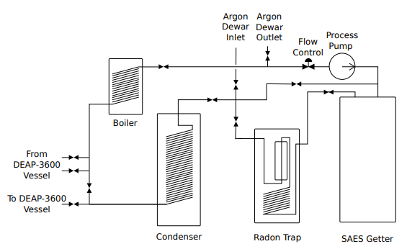
The purification system achieves sub-part per billion levels of impurities and reduces radon levels
Pushes Ar through the system
Vaporizes LAr from AV for recirculation
Hot zirconium getter purifies Ar from ppm to ppb purity
Charcoal trap removes nobles
Liquifies gas before AV
Notes:
In the rest of this talk, I will describe DEAP’s purification system, and how we achieve sub-part per billion levels of impurities and reduce radon levels. This is a simplified diagram of the purification system. Beginning in a storage dewar, argon is then pulled up to the system by the process pump, then passes through a hot zirconium getter, a charcoal trap, and a condenser before entering the acrylic vessel. Coming out of the vessel, it passes through a boiler to vaporize the liquid argon for recirculation.

Slide 7
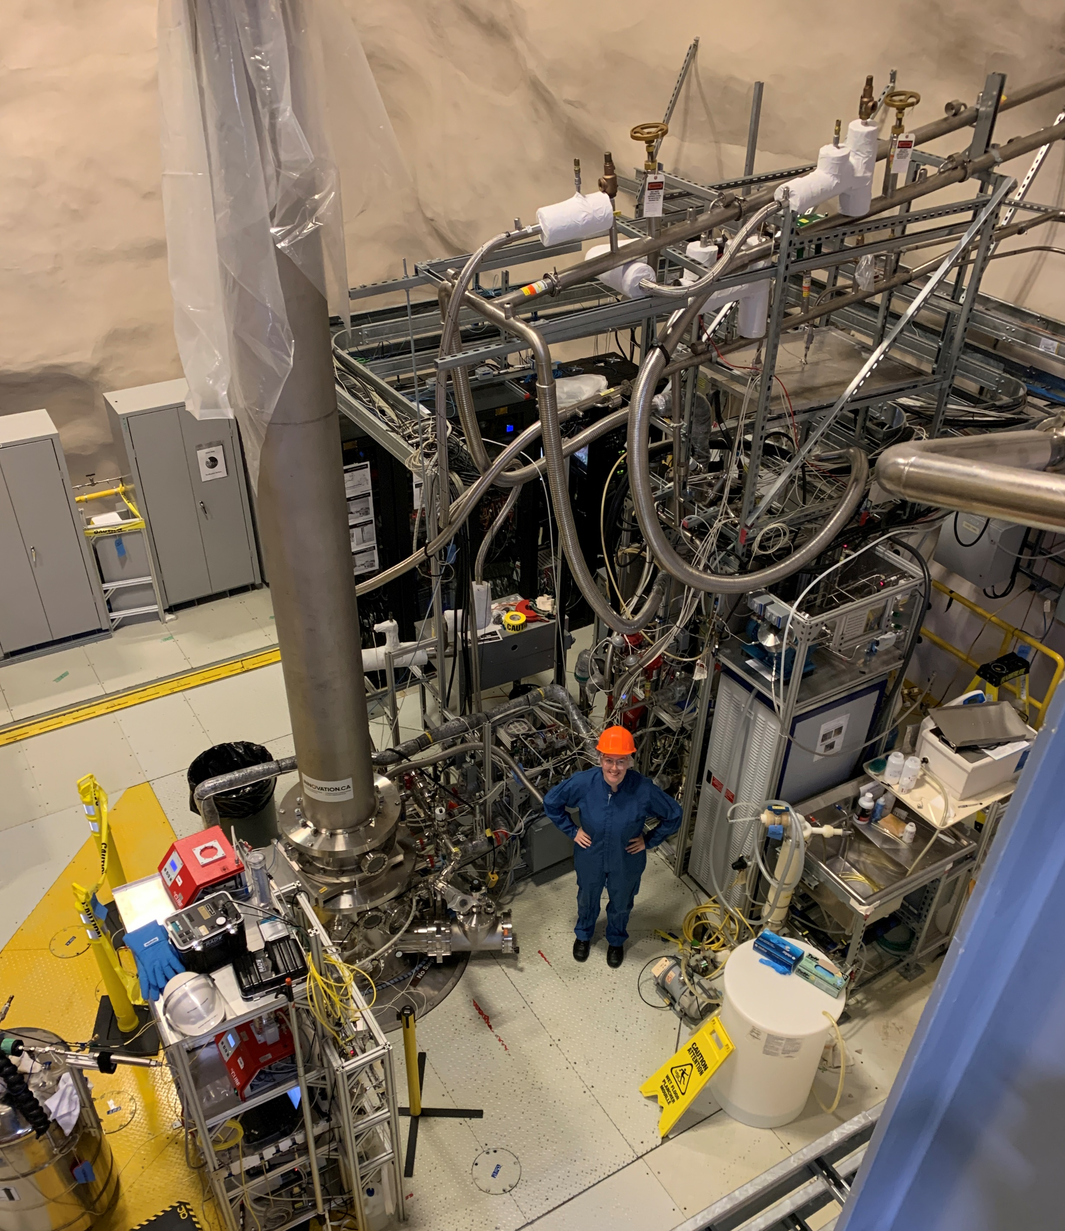
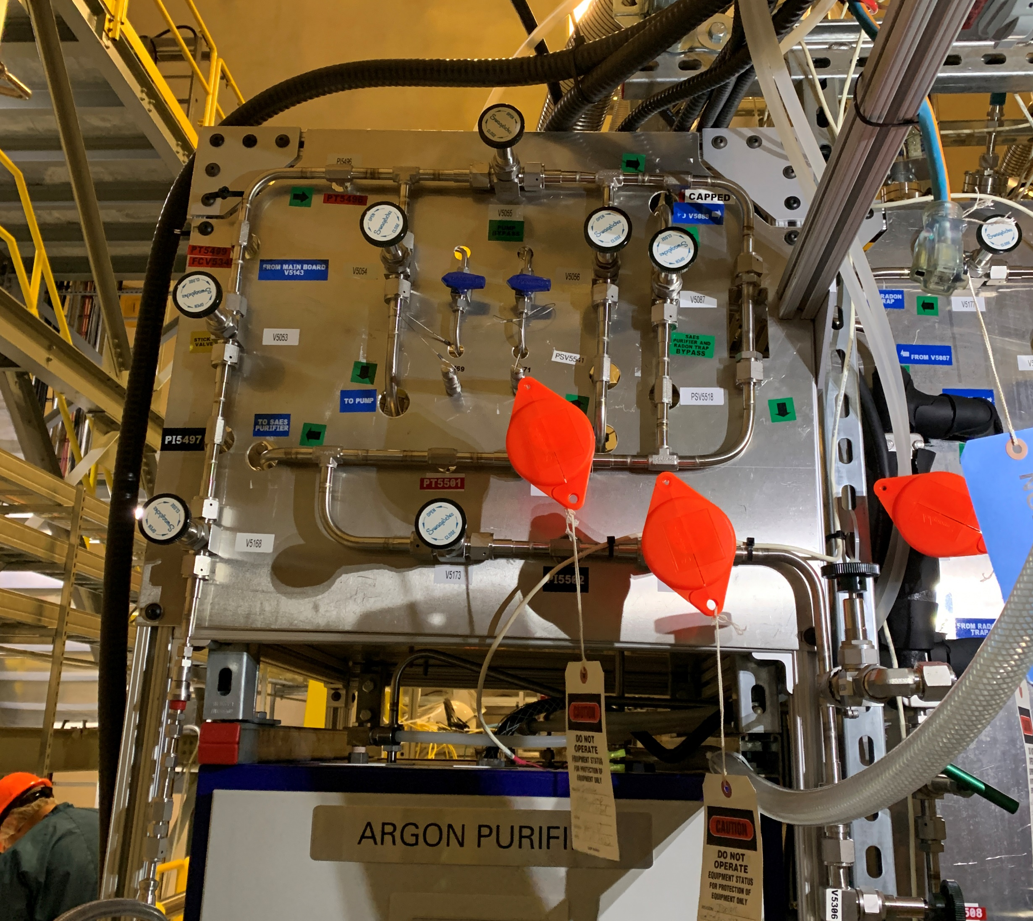
The Purification System
Notes:
In reality, here are what some of the components look like.

Slide 8
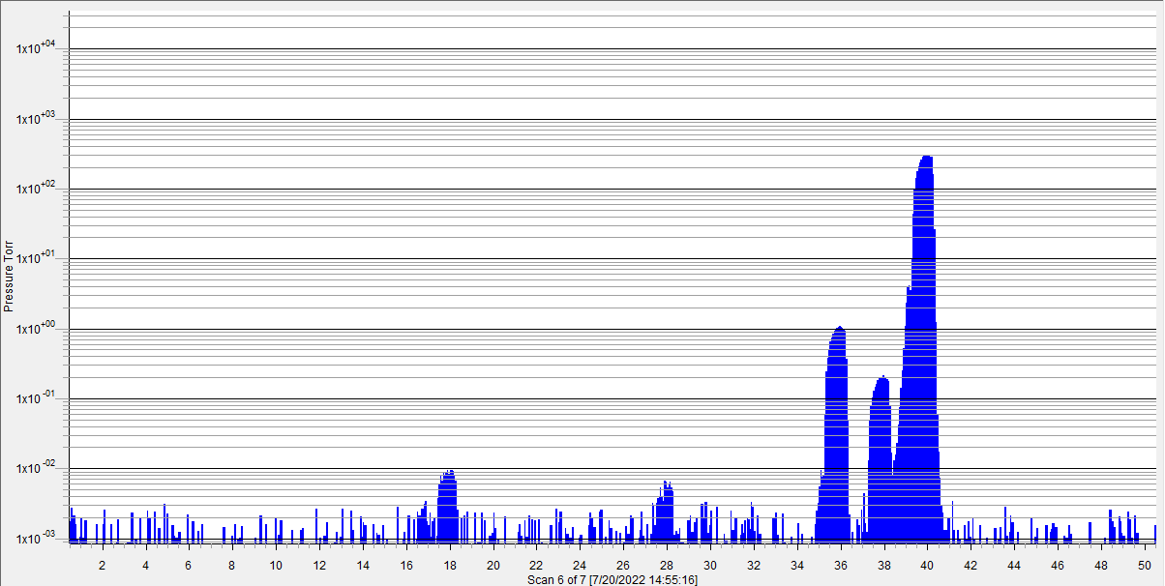
The Cirrus 2 Residual Gas Analyzer (RGA) uses quadrupole mass spectrometry to characterize the gas
Scan of an Ar Cylinder Before Purification
O₂
⁴⁰Ar
PRELIMINARY
N₂
³⁶Ar
H₂O
³⁸Ar
OH
Total Ar Purity 99.9897%
Notes:
Be prepared to explain why the Ar purity from the bottle isn’t 5 9’s: small leaks in manifold, too short of a scan potentially…
One of my main tasks this summer was using a residual gas analyzer to verify the purity of our argon. The Cirrus 2 Atmospheric RGA uses quadrupole mass spectrometry to characterize the sample gas using the ions’ mass-to-charge ratios. Shown here is a scan result directly from a cylinder of argon gas, with partial pressures in Torr versus mass number. By comparing the ratios of the peaks, it is possible to determine the total purity of the gas, as well as the particular contaminants.

Slide 9
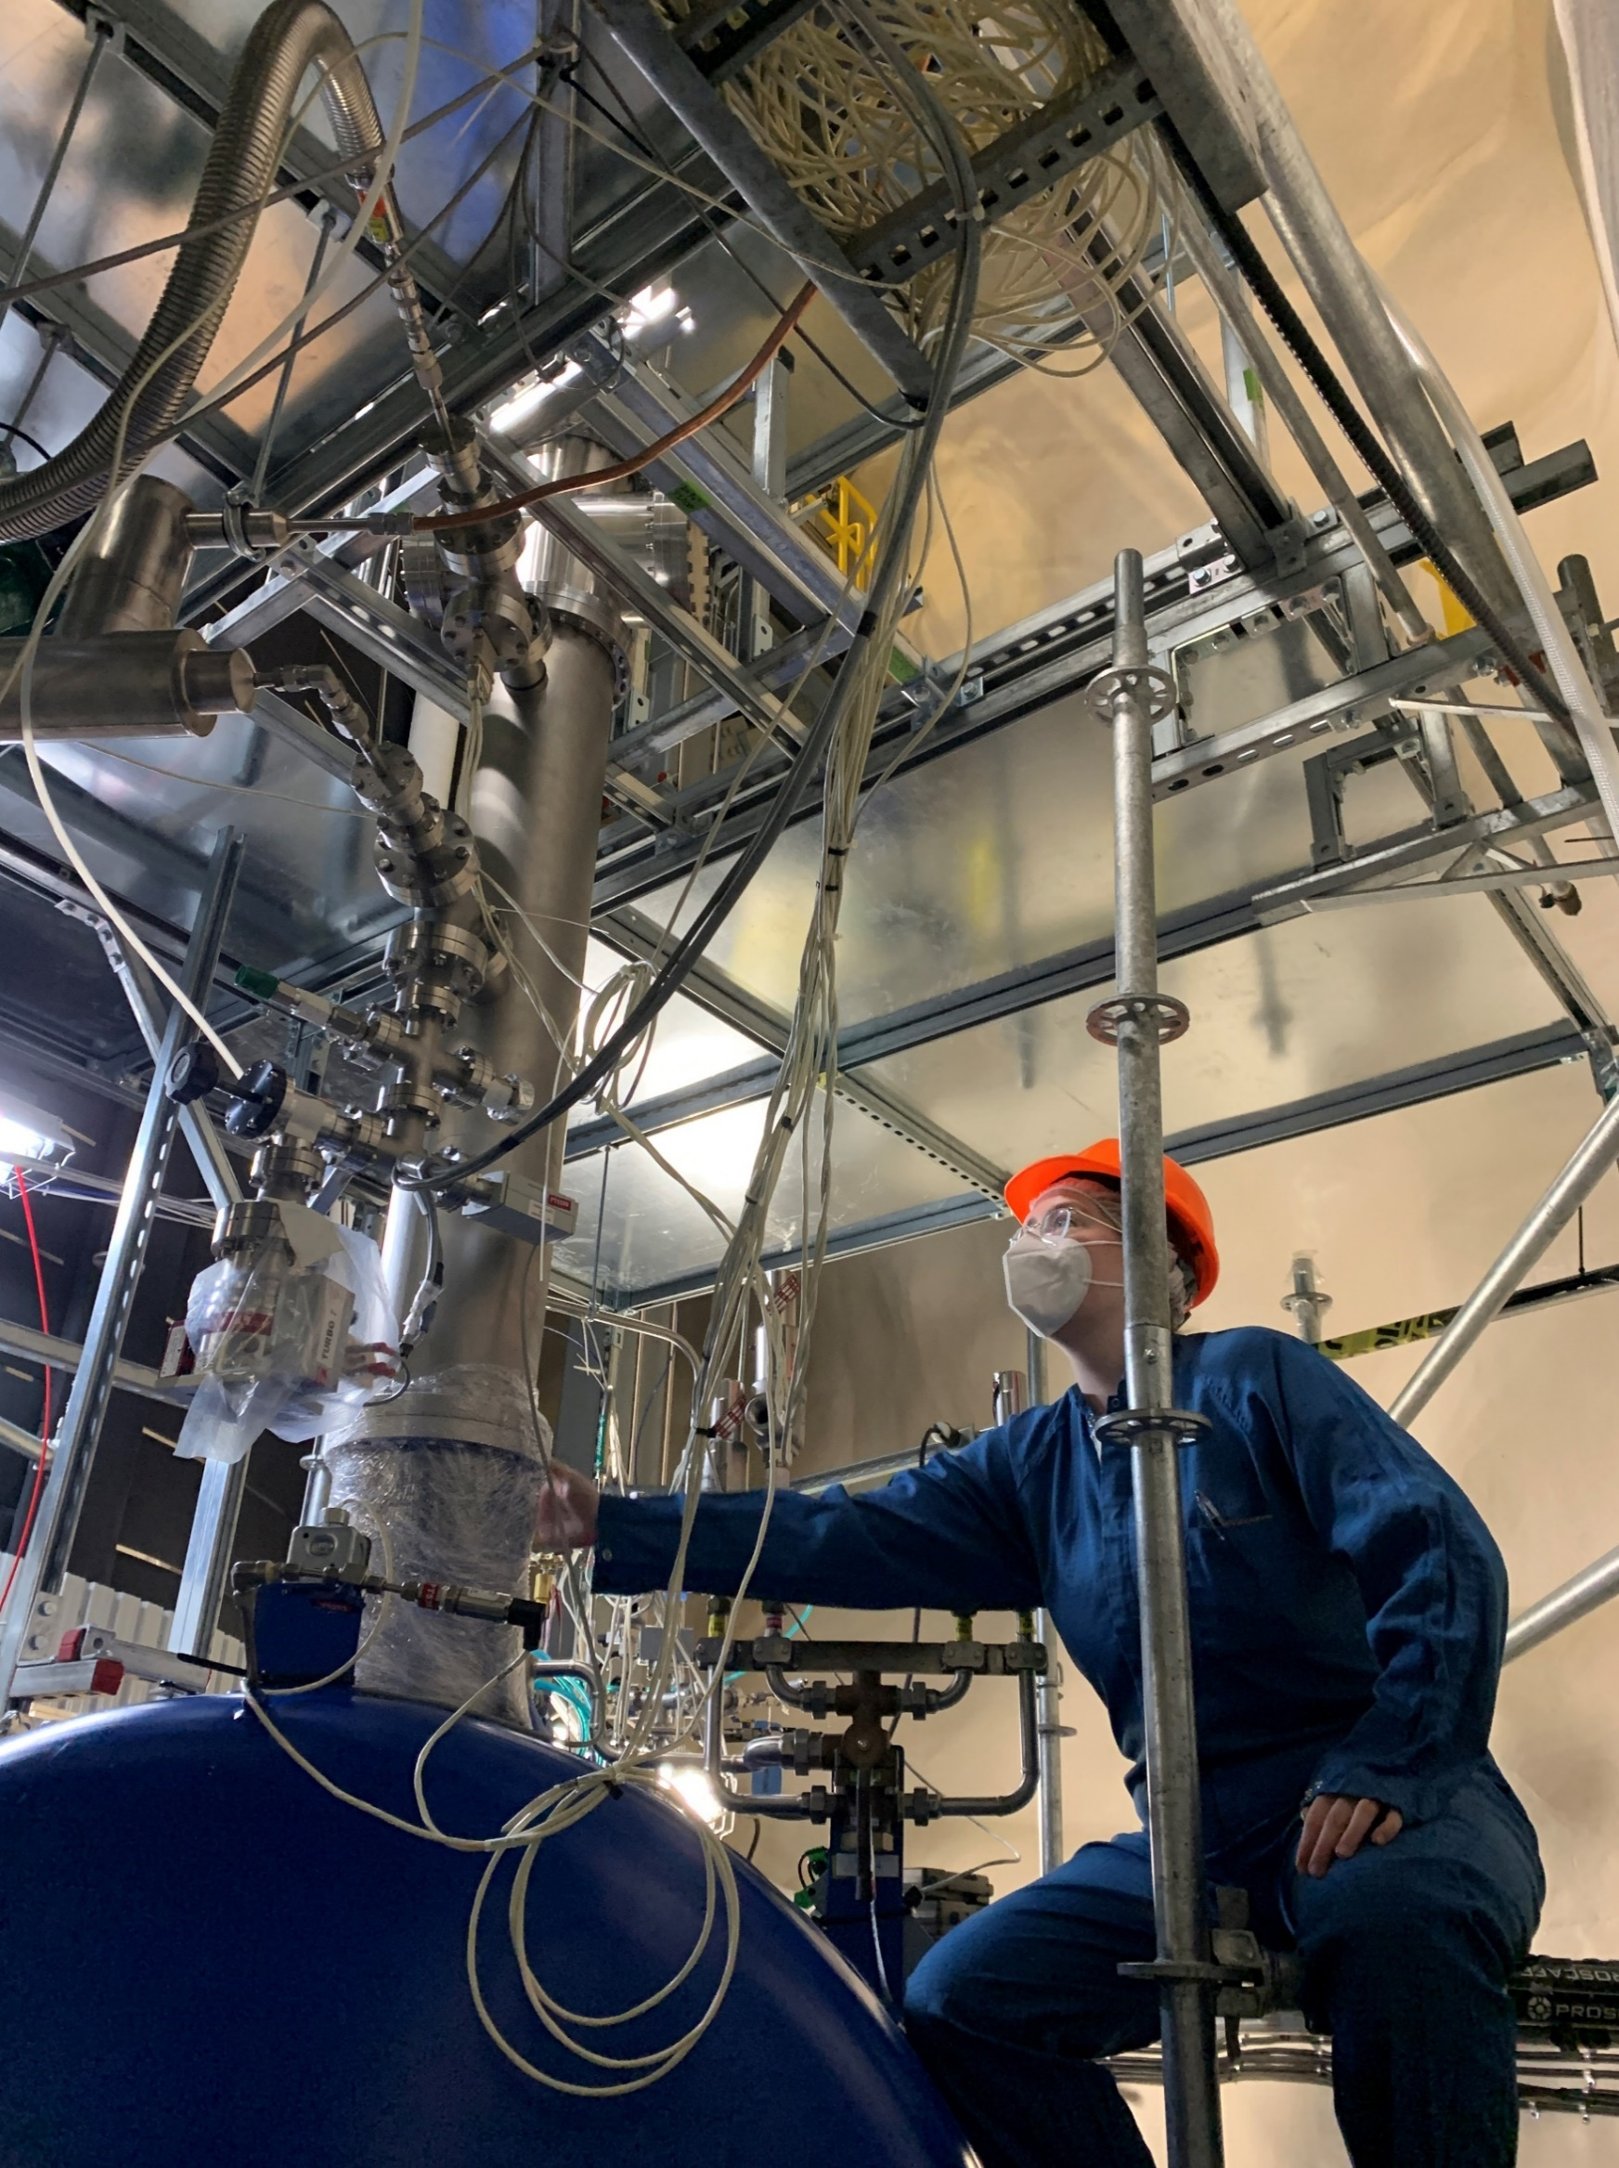
The argon dewar stores ppm-pure Ar
The cooling tower keeps the argon liquid
The dewar holds 3000 L of LAr
This Summer:
Leak checked connections
Commissioned cryocooler and heater
Studied the quality of the argon
Notes:
We start at the argon dewar. It gets filled by cylinders of argon gas, or portable dewars of liquid argon. The cooling tower, shown in the picture, keeps the argon in the dewar in its liquid form by cooling it with liquid nitrogen. It is composed of a cryocooler and a heater. This summer, as part of its recommissioning, we leak checked all connections to the dewar, commissioned the cryocooler, and studied the quality of the argon it held. Recommissioning the cooling tower involved adding the ability to remotely control the cryocooler. Over just the past 2 weeks we have been operating the cryocooler and heater to begin cooling the argon to maintain it in liquid form inside the dewar, and we have proved excellent temperature control.

Slide 10
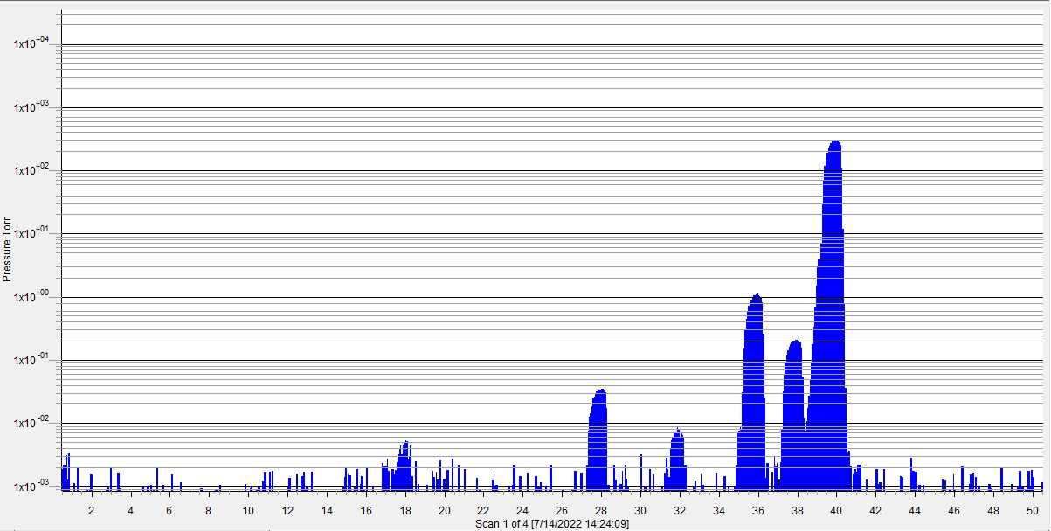
Early Residual Gas Analyzer scans show good but not yet optimal Ar purity in storage dewar
Scan of the Ar Dewar Before Purification
O₂
⁴⁰Ar
PRELIMINARY
N₂
³⁶Ar
H₂O
³⁸Ar
OH
Total Ar Purity 99.9801%
Notes:
Some early RGA scans did not show optimal results, however they are very helpful for identifying possible leaks or contaminants in the dewar. With the recent step of operating the cooling tower, we expect to see improved scans in this week’s commissioning tests.

Slide 11
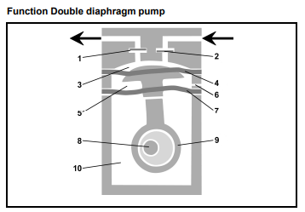
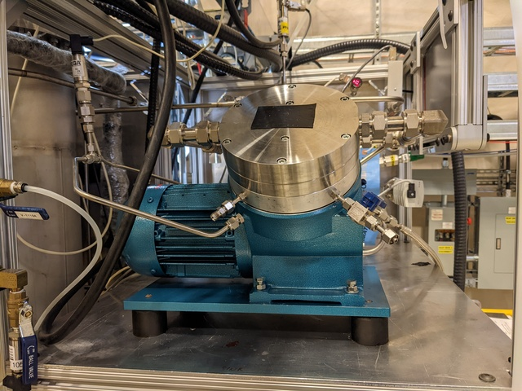
The KNF process pump pushes the argon through the system and protects it from lab air
Working diaphragm
Safety diaphragm
Forward pressure of 30 psig
Notes:
Next, there’s the KNF process pump, which was rebuilt at the beginning of the summer. Inside of the pump, there are two diaphragms to protect the process systems from the lab air at all times. This component was also thoroughly leak checked, as well as monitored to ensure it can maintain the necessary forward pressure of 30 psi gauge to pull argon up from the dewar, and push it through the next component, the getter.

Slide 12
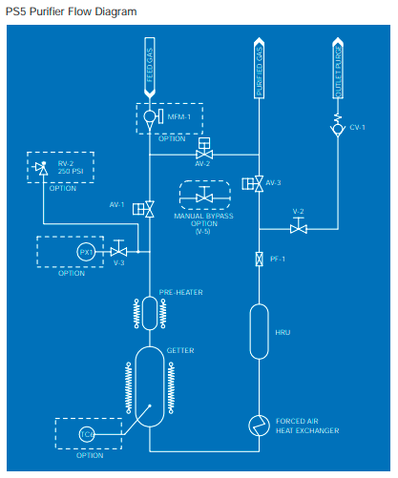
The SAES hot zirconium getter takes in ppm purity and produces ppb
Very effectively removes electronegative impurities
Impurities form irreversible chemical bonds to the getter alloy, zirconium, and thus ppb-pure Ar exits the getter
Soon to be recommissioned
Notes:
The SAES hot zirconium getter is crucial to obtaining part per billion purity of our argon. DEAP’s custom built getter uses zirconium to remove impurities from the argon. The getter material is heated up and reacts with these impurities and condenses on the cooler walls of the device. We then have argon pure at the part per billion level. The getter has not yet been recommissioned for the third fill.

Slide 13
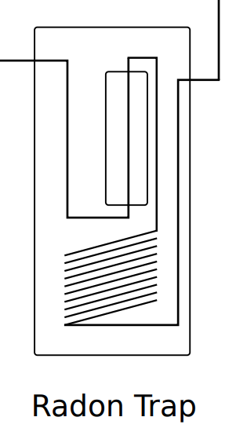
The radon trap further reduces contamination by removing radon
GAr is pre-cooled by liquid nitrogen (LN₂)
Charcoal column absorbs radon and radioactive impurities
Recommissioning started with pumps and purges of the lines with argon, then a bakeout of the heater to remove residual radon
Next step: recommissioning the LN₂ cooling system
Notes:
Next, the argon passes through a charcoal trap to remove other nobles, notably radon. At this point, the argon gas arriving from the getter is at 300 K, and the trap pre-cools it to 100 K using liquid nitrogen. The gas passes through a charcoal column, where radon is absorbed and trapped in the material. The recommissioning of the trap was started by purging the lines of the process system with argon and pumping it out to flush potential impurities. Another step we completed in its recommissioning was by baking out the heater to remove residual radon from the trap. The next step will be to recommission the LN2 system, as this is needed for the full function of the trap.

Slide 14
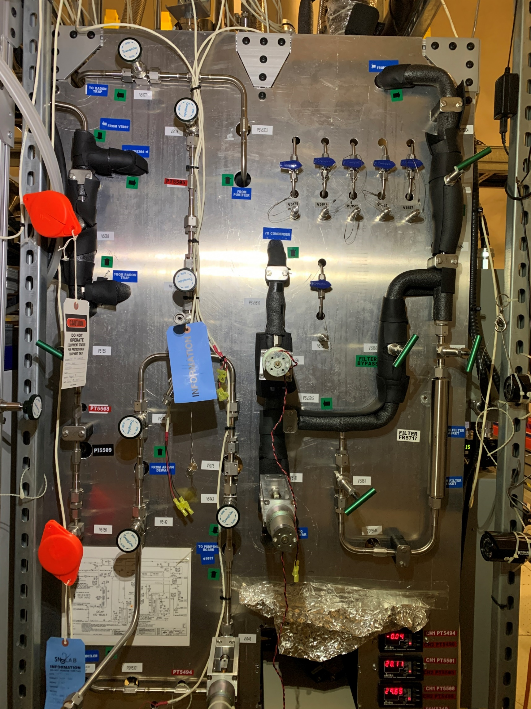
The radon trap further reduces contamination by removing radon
GAr is pre-cooled by liquid nitrogen (LN₂)
Charcoal column absorbs radon and radioactive impurities
Recommissioning started with pumps and purges of the lines with argon, then a bakeout of the heater to remove residual radon
Next step: recommissioning the LN₂ cooling system
New particulate filter installed after the radon trap for third fill
Notes:
One of the upgrades to the purification loop was the installation of a new particulate filter, installed after the radon trap and before the condenser, and it is shown here.

Slide 15
The condenser and the boiler deliver the argon to and from the acrylic vessel
Liquid exiting the AV is vaporized before recirculating in the purification loop
Liquifies the gas to be introduced into the detector
Soon to be recommissioned
Notes:
The gas then passes to the condenser, where the purified argon gas is liquified. The argon travels through a stainless-steel coil immersed in LN2 before entering the acrylic vessel. Gaseous argon can also be introduced to the vessel, it is then liquified by the cooling cool in the neck of the detector. On the outlet of the AV, there is a boiler which can vaporize the liquid argon before reintroducing it to the process pump at the top of the purification loop. It is comprised of a heater wrapped around a stainless-steel flow line. These parts have not yet been recommissioned.

Slide 16
First mode of operation
Dewar
For the stabilization of the purification loop during start-up
Notes:
The first mode of operation of the purification loop involves bypassing the acrylic vessel and circulation the argon from the storage dewar through the purification devices. This allows for the stabilization of the purification before actually filling the vessel.

Slide 17
Second mode of operation
Dewar
Re-purification and re-circulation of argon
Notes:
The second mode of operation flows the argon through the acrylic vessel. Once the vessel has been filled from the dewar, the dewar is sealed off from the process systems. The argon in the vessel can be re-circulated and re-purified by being pulled up through the boiler by the process pump and passed through the purification steps again.

Slide 18
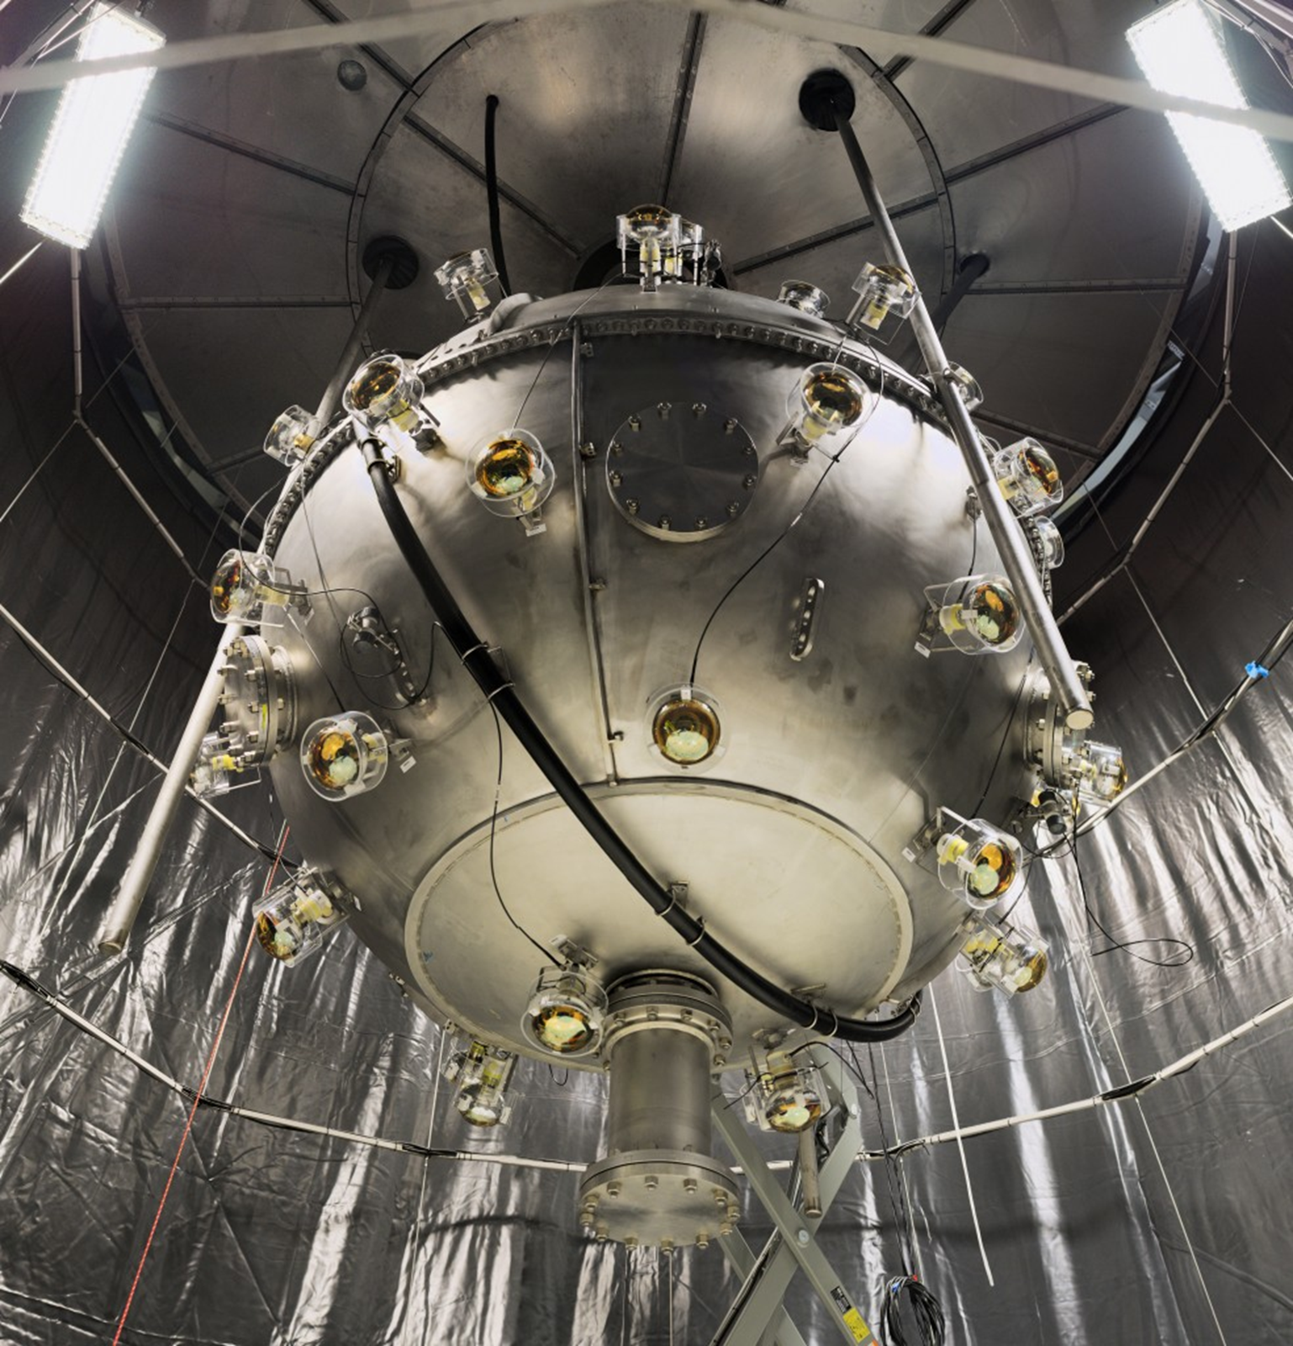
Next Steps
Finish installation and commissioning of new hardware
Begin Third Fill this Winter
  Small fill and drain to remove particulates
  Fill with LAr to previous level to compare results and determine the effect of the hardware upgrades
Notes:
In the coming months, DEAP will be continuing the installation and commissioning of new hardware, as well as recommissioning its existing parts such as the getter, the condenser, and boiler I mentioned. This winter, the vessel will be filled for its third time. They may start by filling and draining a small amount to remove any particles that may have settled during its last empty. There is also a new dust removal system being installed. Next, the vessel will be filled up to its previous level in order to compare to previous results and verify the improvements made by the hardware upgrades.

Slide 19
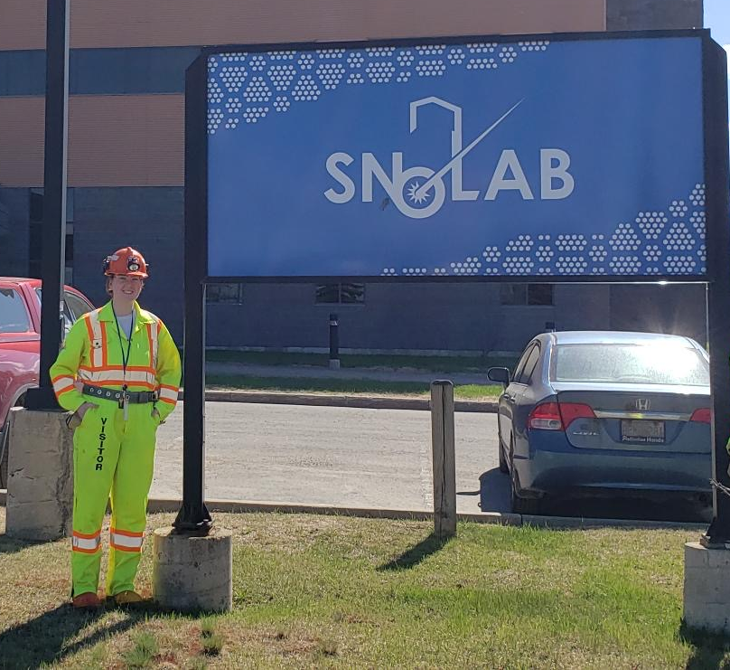
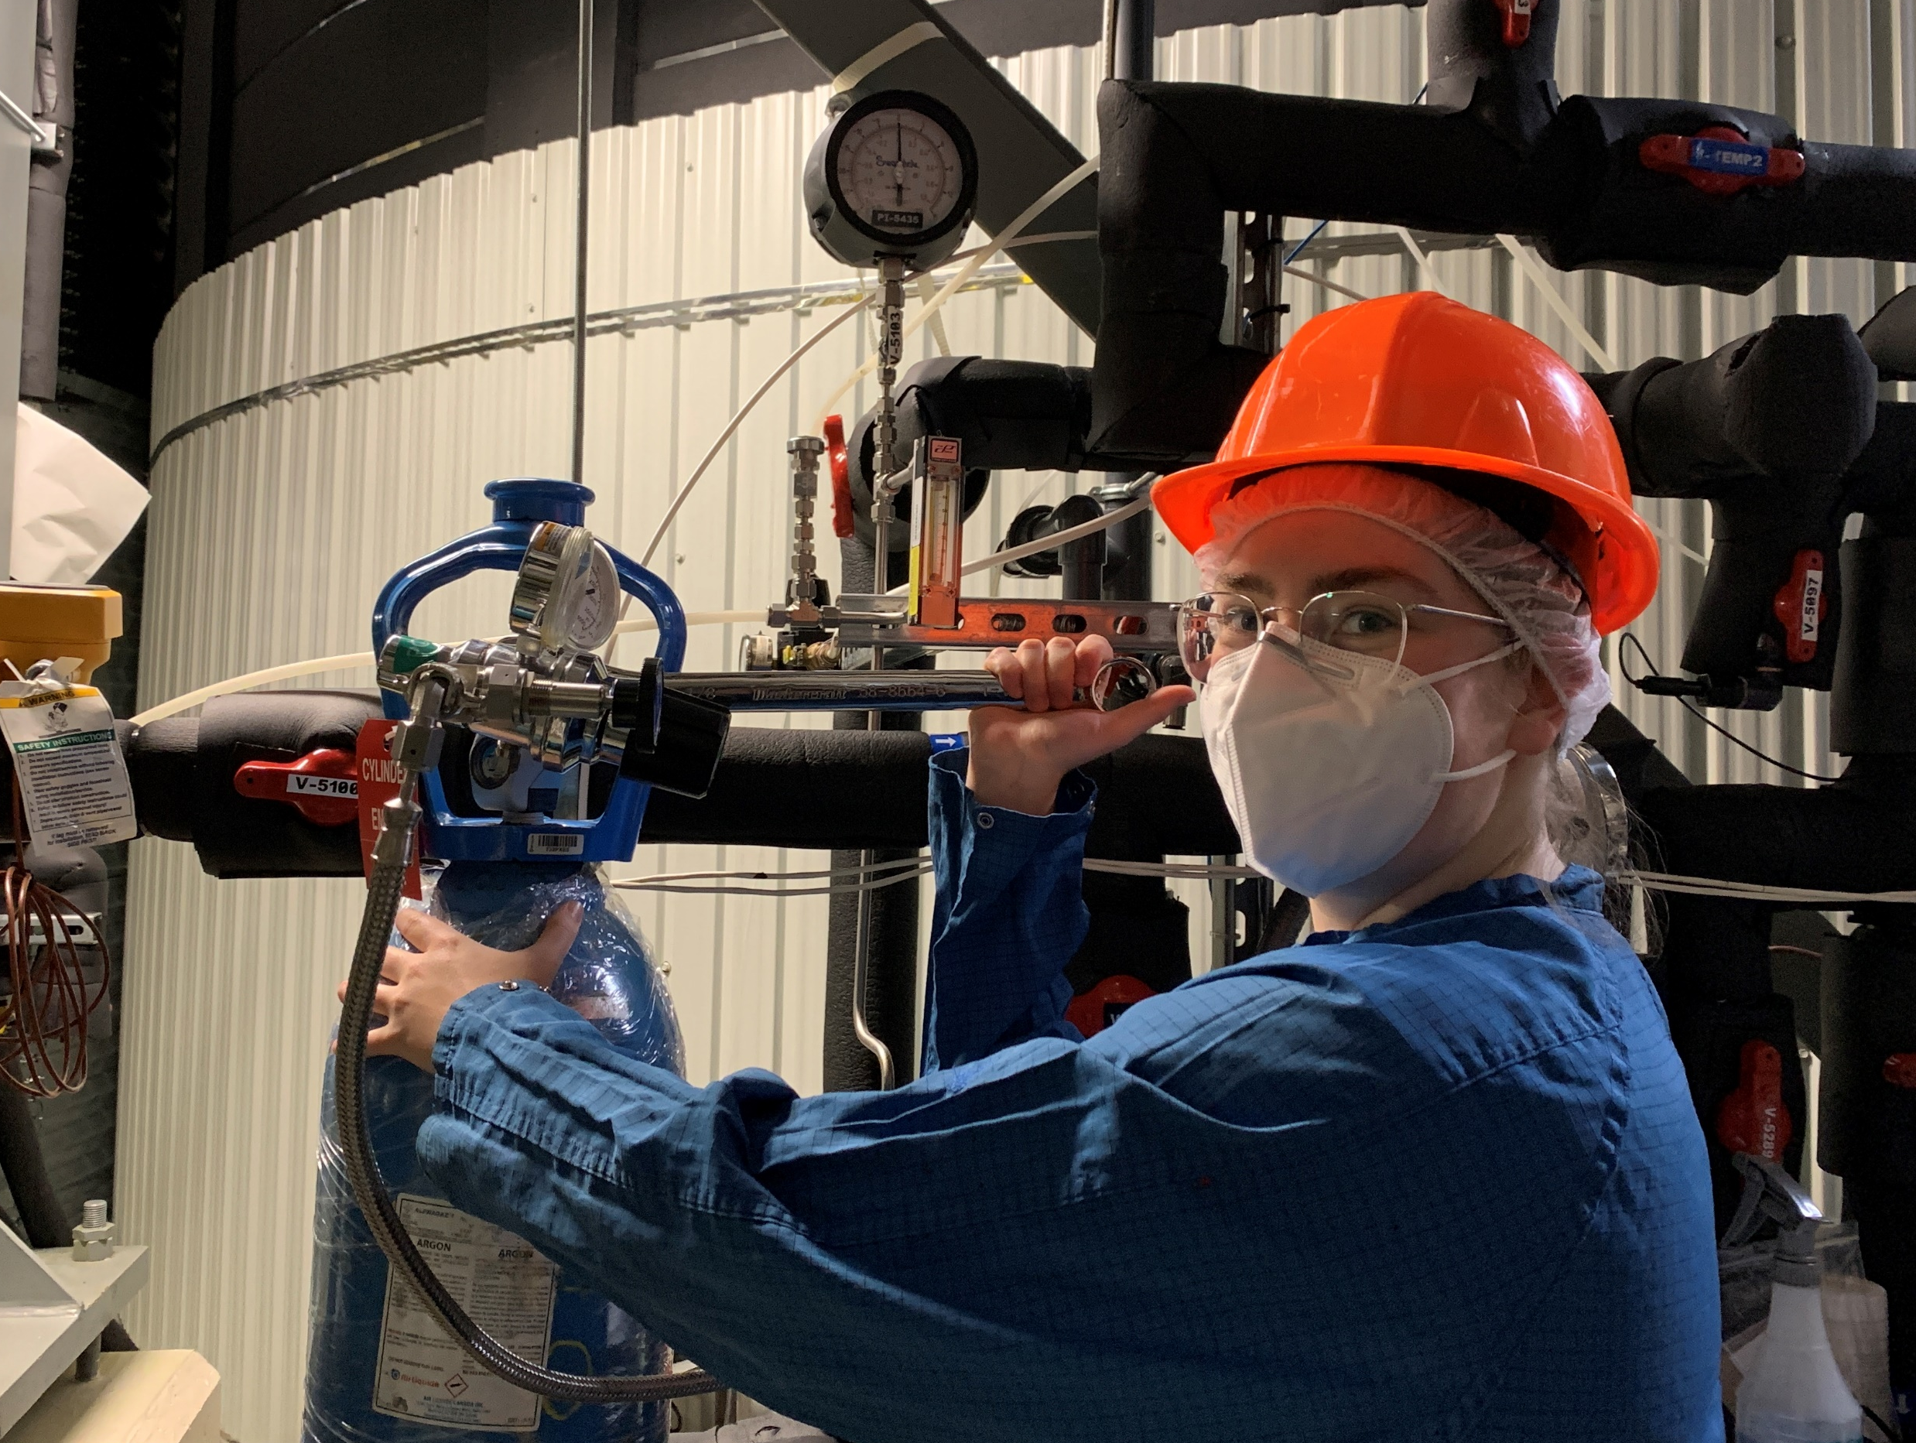
My summer at SNOLAB
250+ hours underground
∼30 flights of stairs per shift
100+ RGA scans
Learned how to:
Assemble and leak check vacuum systems
Operate an RGA and analyze the purity of a gas
Wire connectors to remotely operate hardware underground
And so much more!

Slide 20

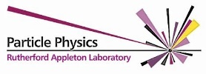















Thank you!
Notes:
Thank you so much for your time and attention today. Thank you to the entire DEAP collaboration, and specifically to Chris Jillings, Sean Daugherty, and Ryan Crampton for welcoming me as a part of this experiment.

