Slide 1
The Current Understanding of Particle Physics:
(Some) Experiments are looking to:
The Standard Model
Probe the.Standard Model
Detect Dark .Matter
EVERYTHING ELSE
(dark matter and dark energy)

Slide 2
A Generic Search Experiment:
How can we measure the light emitted from SiPMs?
SiPMs
(light sensors)
Something that scintillates (Liquid Argon, Liquid Xenon, etc)
An event to cause scintillation

Slide 3

Laser-Driven Photon
Emission in SiPMs with MIEL
CASST Student Talk Competition
Zach Charlesworth
August 2022

Slide 4

How does a SiPM work?
Photon
E-field
p++
e⁻
e⁻
p
Avalanche
n
n+
Notes:
Add arrow for light coming in as well
Add slide numbers

Slide 5

Light Proof Enclosure
MIEL at TRIUMF
SiPM
Olympus
IX83 Microscope
Princeton Instruments
HRS 3OO-MS Spectrometer
Dichroic mirror
Longpass Filter
Princeton Instruments
PyLoN 4OO BRX CCD Camera
Adjustable Slit

Slide 6
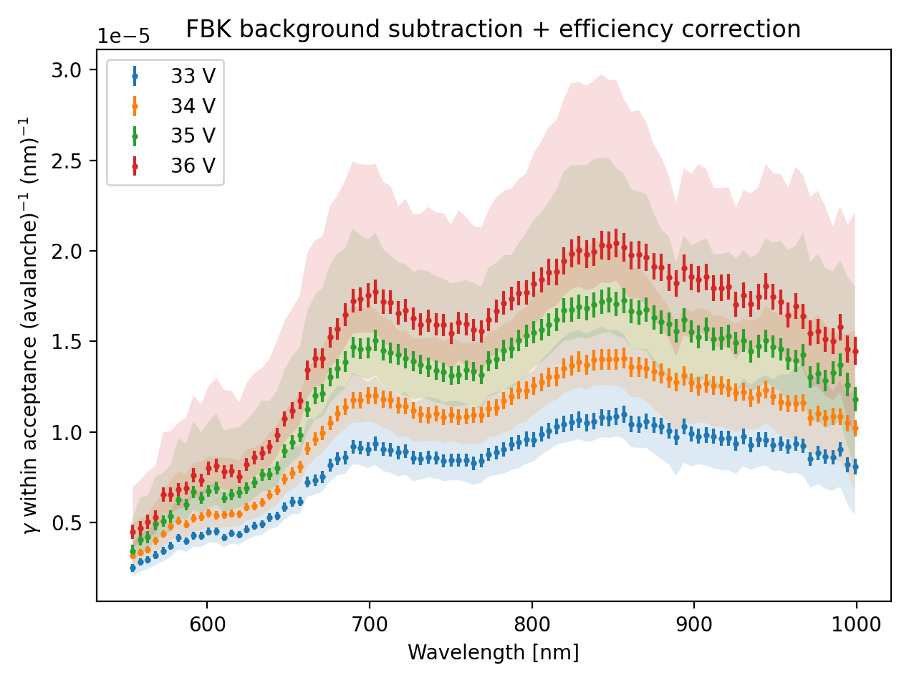
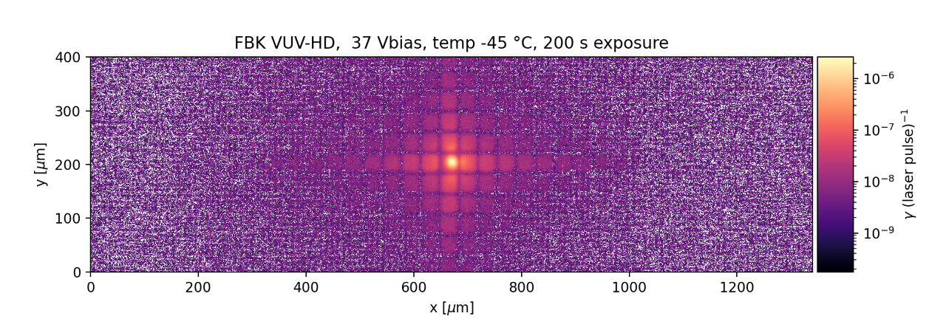
Light Emission Visualized:
SiPM layout:
Preliminary
SPAD
(Single Photon Avalanche Diode)

Slide 7
Charge Readout of a SiPM
Single Photon Avalanche Diode
1 SPAD fires:
(SPAD)
2 SPADs fire:
Resistor
Voltage
Readout
Time
…
10 SPADs fire:
Voltage
-
+
Time

Slide 8
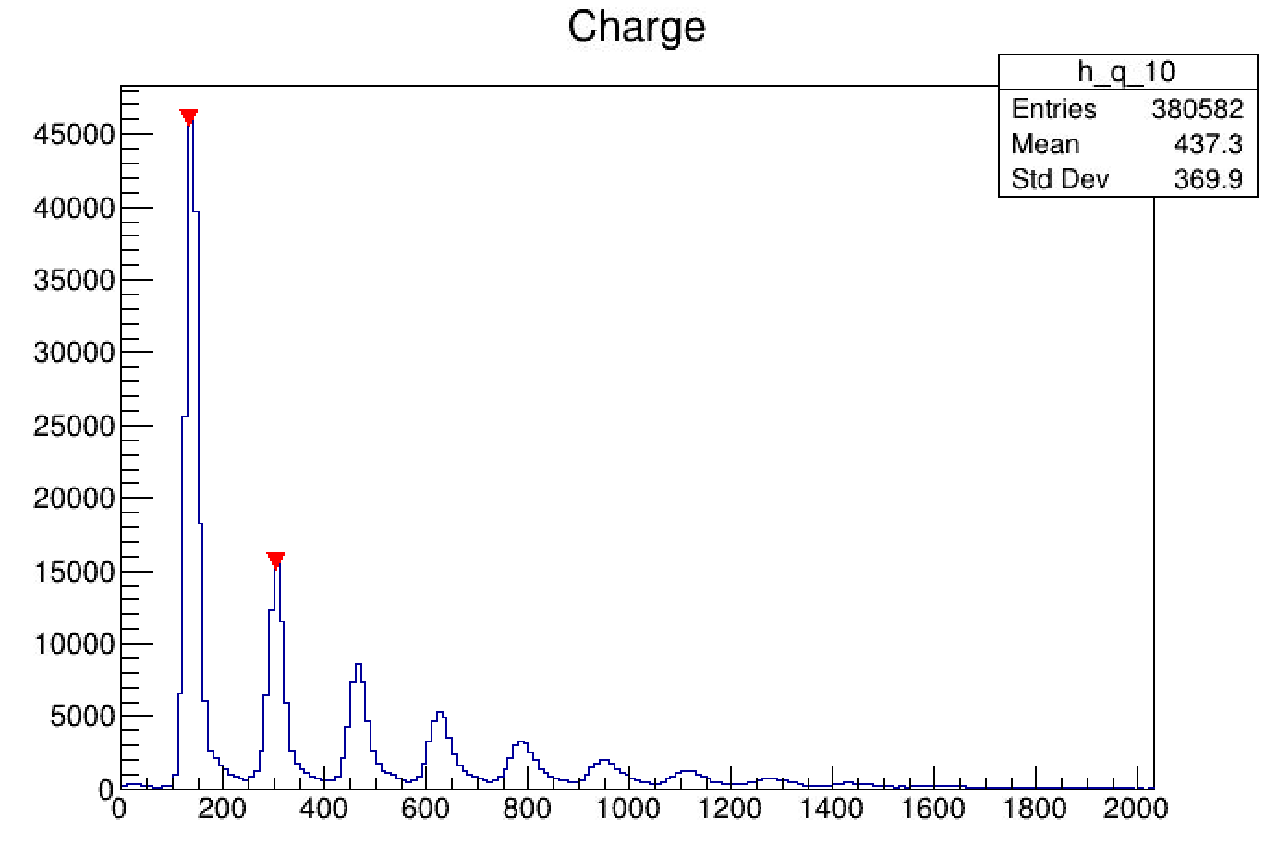
“Finger Plots”
1 SPAD fired
Number of times there’s cross-talk
÷
Number of times the SiPM fires
=
The probability of cross-talk
2 SPADs fired
3 SPADs fired
Counts
4 SPADs fired
…
Charge (ADC*ns)

Slide 9


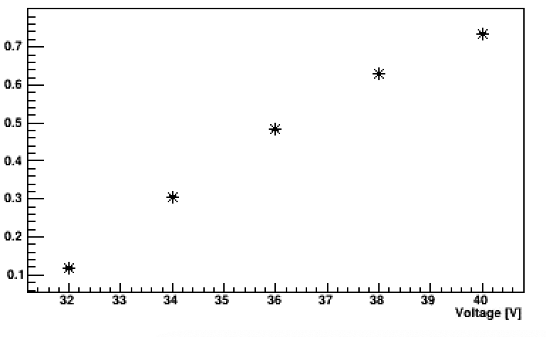
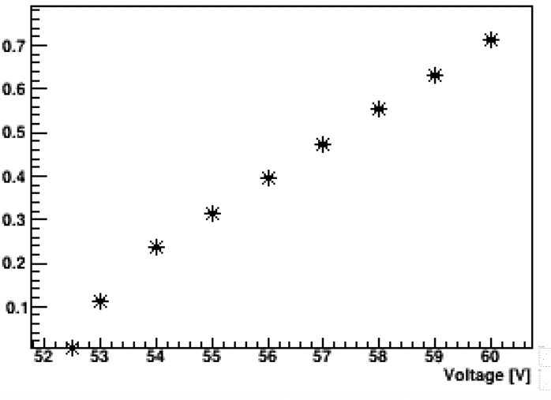
Quantifying Internal Cross-Talk:
V_{BR} = 28.0 +/- 1.6V
V_{BR} = 47.5 +/- 1.5V
Internal Cross-Talk Probability
Internal Cross-Talk Probability
Notes:
Add preliminary label

Slide 10
Recap:
Advances particle physics through rare event searches and dark matter searches
Quantifying and Measuring Internal and External Cross Talk
Better energy resolution and more precise detectors

Slide 11
Acknowledgments:
TRIUMF PHAAR Group:
Fabrice Retière (Head)
Kurtis Raymond
Andrea Capra
Peter Margetak
Austin de St Croix
Duncan McCarthy
Juliette Martin
Mahsa Mahtab
Noah Albano
Ryan Underwood
Byeongguk Min
Seraphim Koulosousas
Maia Henriksson-Ward
Mayur Patel
Nicolas Massacret

Slide 12
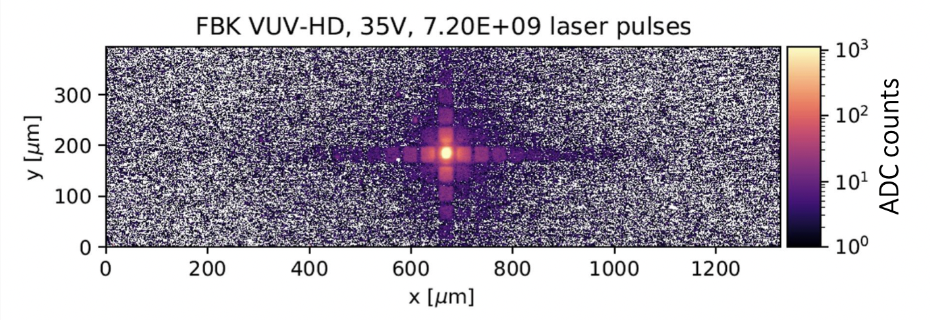
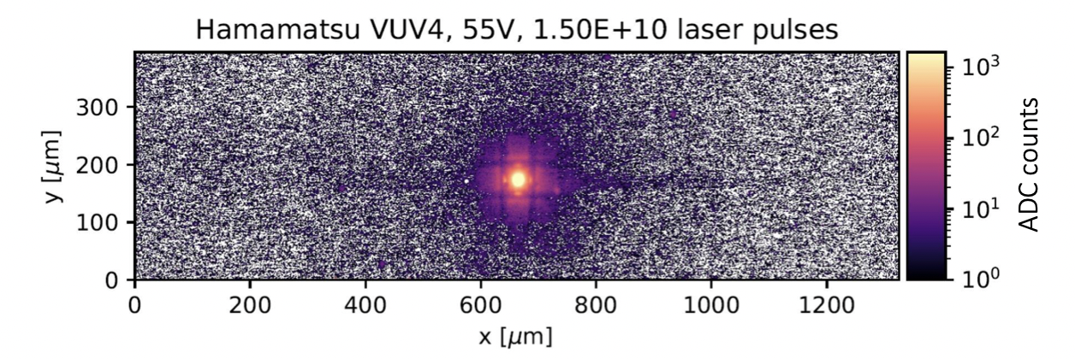
BACKUP:
Polysilicon Trenches
Tungsten Trenches

Slide 13
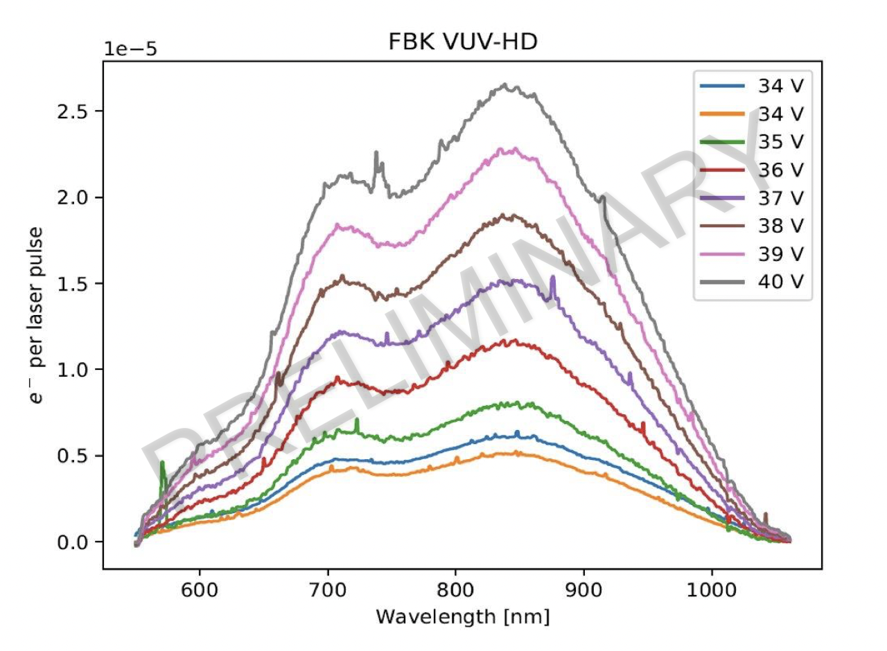
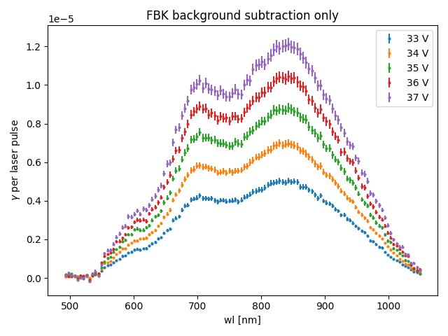
BACKUP:
PRELIMINARY

Slide 14
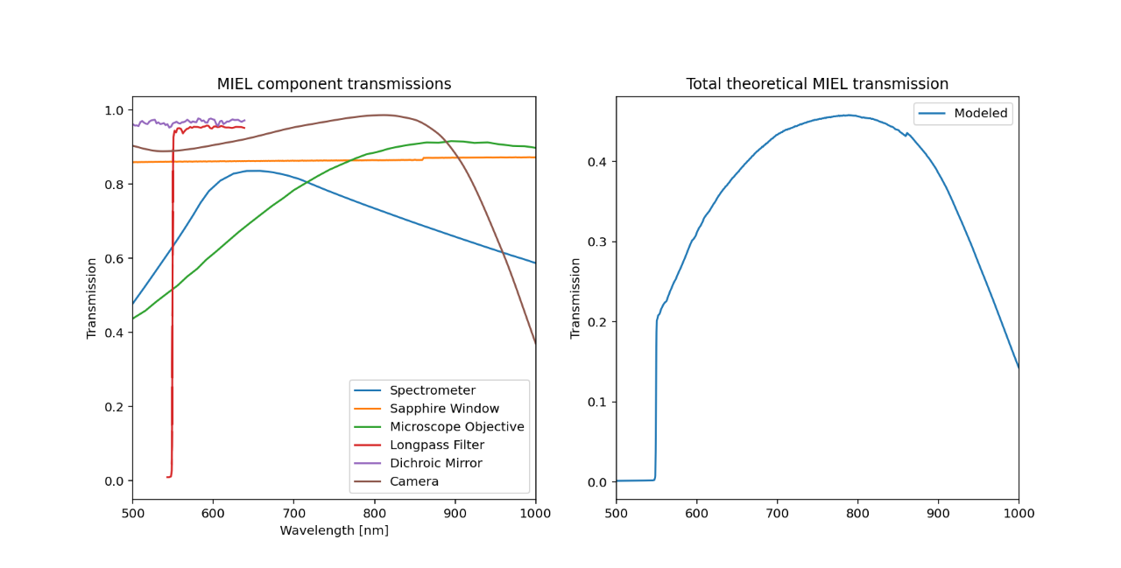
BACKUP:

Slide 15
BACKUP:

Slide 16
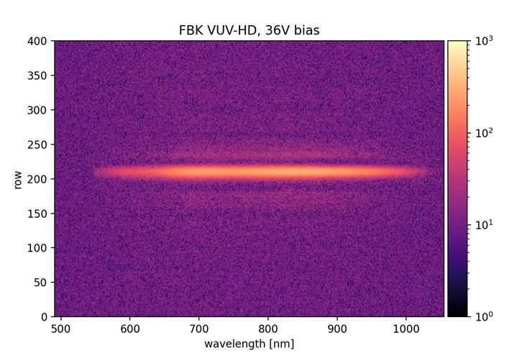
BACKUP:
Cosmic Rays removed

Slide 17
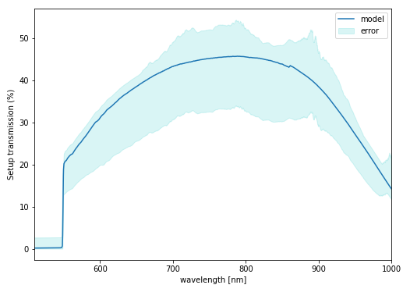
BACKUP:

