Slide 1


Ar2D2 Detector Simulation
Megan Foster

Slide 2
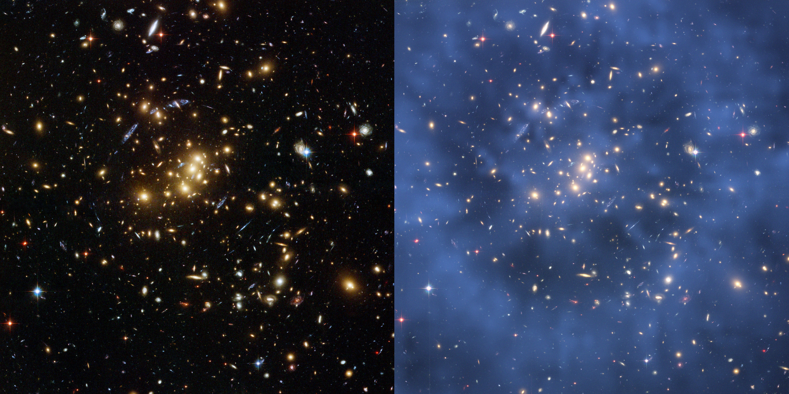
Dark matter – 85% of the universe
Indirect detection
Direct detection
Image credit: NASA (Hubble Telescope), ESA, M.J. Jee and H. Ford (Johns Hopkin’s University)

Slide 3
SCINTILLATING DETECTORS
PMT/
SiPM
Backgrounds
Atmospheric/external radiation
Radiation from detector materials
Ar39
Scintillating material
(Liquid Argon)

Slide 4
The Ar2D2 Detector

Slide 5
Design
Lead
Clean lead
Backgrounds
Outer copper
Atmospheric/external radiation
Radiation from detector materials
Ar39
Inner copper
Acrylic

Slide 6
Materials
Backgrounds
Activity of each layer taken from SNOLAB gamma assays website
Relative abundancies taken from SNOLAB branching percentages website
Simulation used to determine usable geometry and materials
Atmospheric/external radiation
Radiation from detector materials
Ar39
Gamma assays: https://www.snolab.ca/users/services/gamma-assay/HPGe_samples_pub.html
Branching percentages: http://snolab.ca/~tjsonley/HPGE_Test/COAX/180427/

Slide 7
The Simulation

Slide 8

Previous work
Separate simulations for each layer of the detector, SiPMs, and external
Detector partially defined in geometry file
Visualizations complete

Slide 9
Step 1 - Geometry
Actual geometry
Simulated geometry (nested solid volumes)
Create a .geo file containing all components of the detector

Slide 10

Step 2 – Generate Macros
Calculate event counts (N) for each element in decay chain
Specify energy of decay
Specify location of origin (fillshell)
Specify how many times to run simulation (N)
N

Slide 11
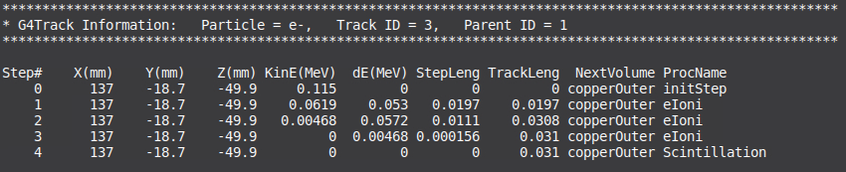
Step 3 – Run Simulation
Submit to nearline
Results are stored in .root files
Position information is stored in RAT logs and ROOT Tree

Slide 12
Results

Slide 13
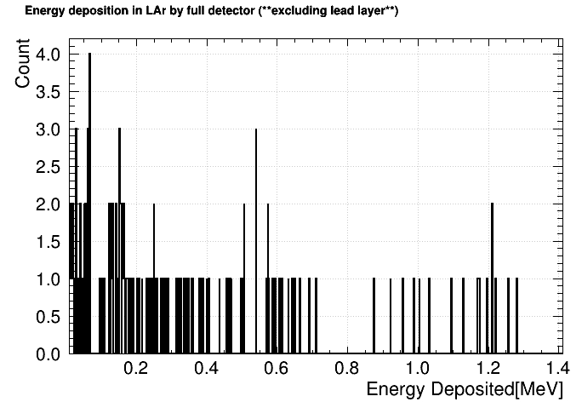
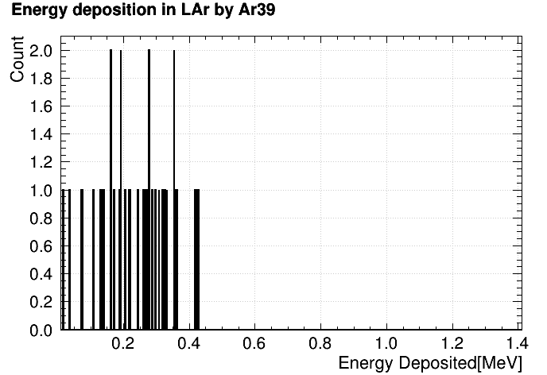
Full Detector Simulation (excluding lead layer)

Slide 14
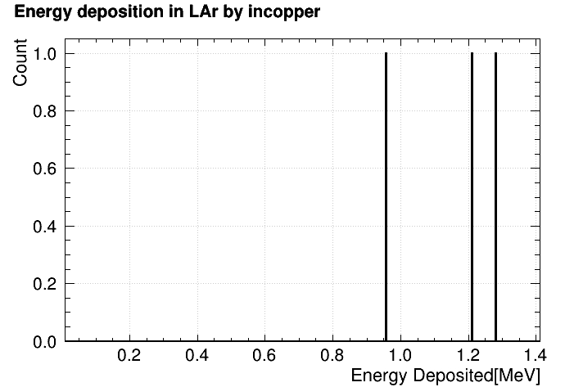
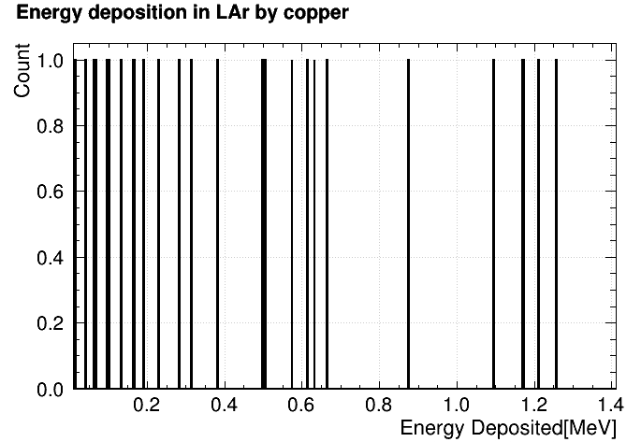
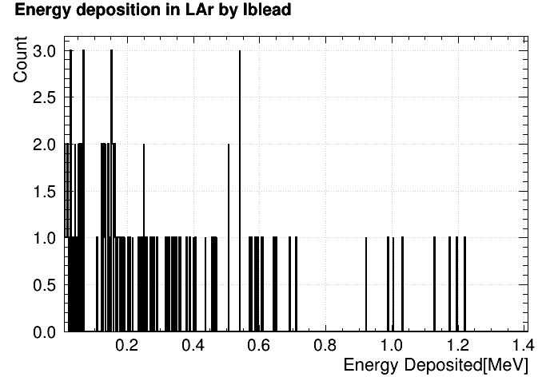

Slide 15
Conclusions & Future work
Layer that contributes most to background in range of interest: clean lead
Future work:
  Run entire simulation with SiPMs and external backgrounds
  Edit detector composition and geometry to mitigate backgrounds from clean lead

Slide 16

Thank you!
Questions?

