Slide 1
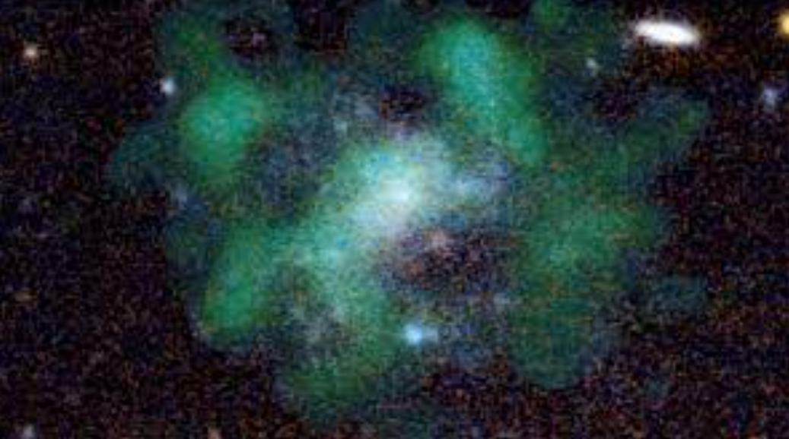
Modelling the Kinematics of an Ultra Diffuse Galaxy to Determine its Dark Matter Content
By: Henry White
For: Canadian Astro-Particle Physics Summer Student Talk Competition 2022
Notes:
Blue is from stellar emission, green is from neutral HI gas which was used to derive kinematic models of the galaxy
Photo from http://www.sci-news.com/astronomy/dark-matter-free-galaxy-10342.html

Slide 2
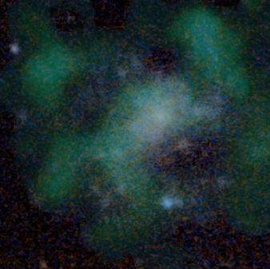
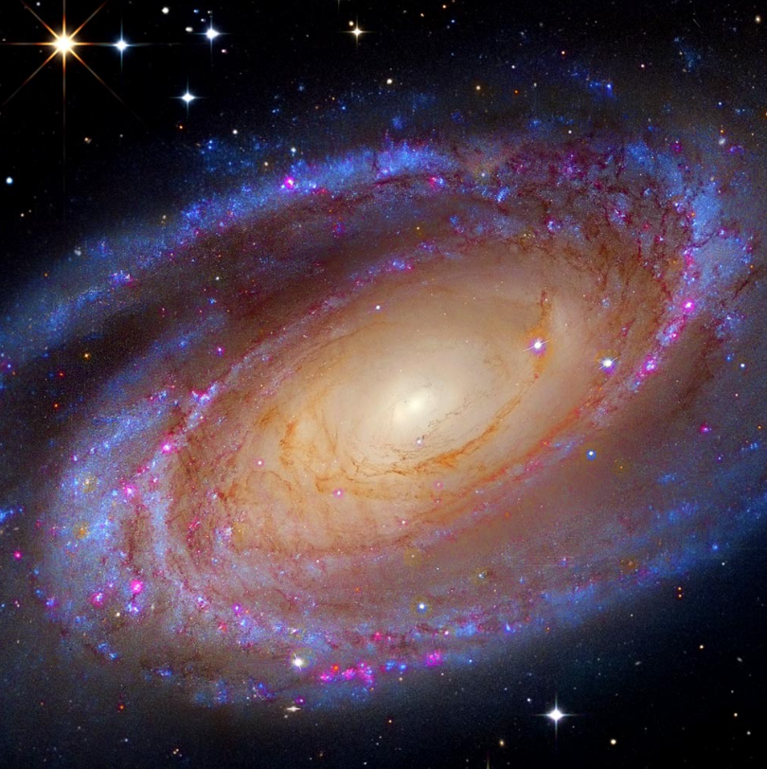
Background Information
An Ultra Diffuse Galaxy (UDG) is a low surface brightness galaxy whose matter content is spread out over a large volume [1].
Imagine a galaxy with a mass thousands of times smaller than the Milky way that occupies a similar amount of space.

Slide 3
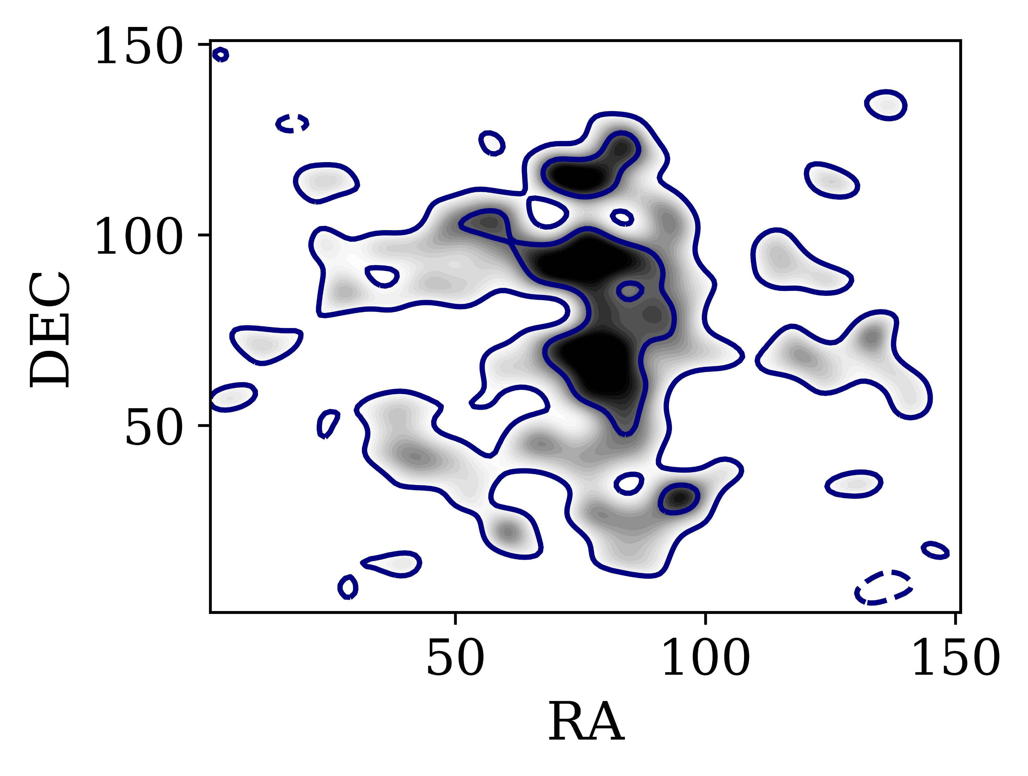
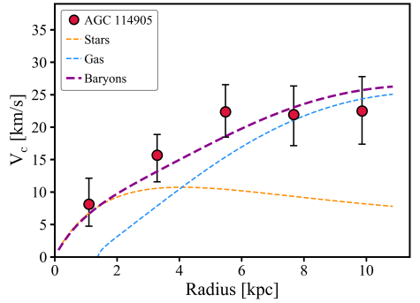
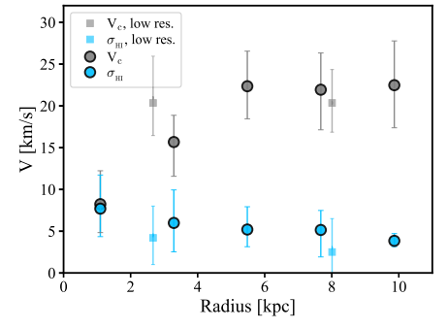
Ultra Diffuse Galaxy: AGC 114905
From analysis of the neutral hydrogen maps of AGC 114905, it has been suggested that AGC 114905 contains little to no dark matter [2] (henceforth MP22).
This claim stems from the rotation curve and velocity dispersion profile of the galaxy which appears to be completely explained by baryonic matter.
Notes:
Velocity Dispersion describes how much the random velocity of gas varies from the mean value at that radius.
Explain dependence on inclination (mention Sellwood paper)!!
Explain how this claim could mean trouble for both current CDM and galaxy formation theories

Slide 4
Scientific Goal
To investigate whether AGC 114905 needs dark matter to explain its kinematics.
I’ve done this by analyzing the reliability of 3D-Barolo, the software used to derive these claims, in the ultra diffuse galaxy regime [3].
3D-Barolo
Notes:
My analysis aimed to help determine if 114905 contained DM or not
This is significant because if it doesn’t, then our theories of CDM, MOND, and galaxy formation are incomplete and if it does contain DM, these theories are supported.
“My analysis aims to study the reliability of 3D-BAROLO, the software used to derive such claims, in the low surface brightness regime to look for sources of uncertainty within this calculation.”
Is 3D-BAROLO systematically inaccurate in a specific way?

Slide 5
Procedure
Create
Create mock observations of galaxies with properties similar to AGC 114905
Model
Model the kinematics of these mock galaxies with 3D-BAROLO software
Compare
Compare results with the known properties of the mock galaxy AND published results in MP22

Slide 6
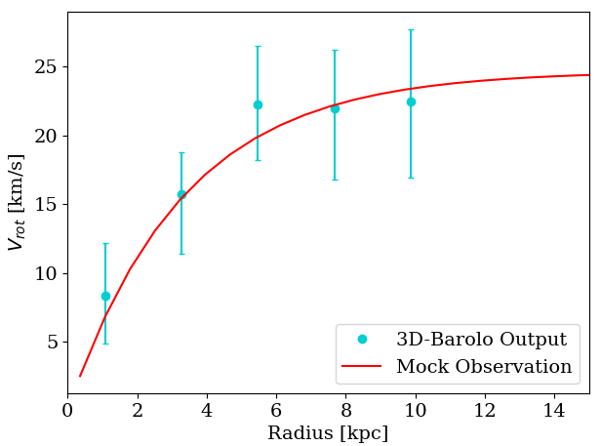
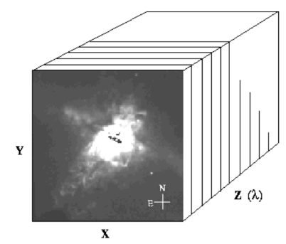
Software Information
Mock Cube Generator (MCG)
  Creates observations of mock galaxies with user specified properties
3D-Barolo
  Extracts the kinematic properties of a galaxy from observations
MCG
3D-Barolo

Slide 7
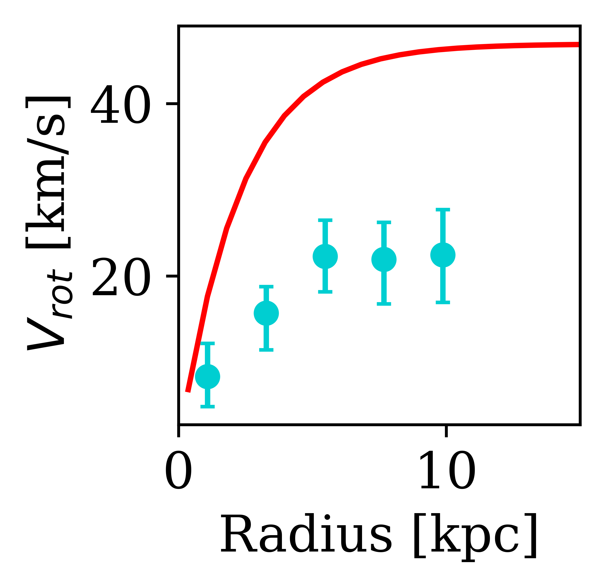
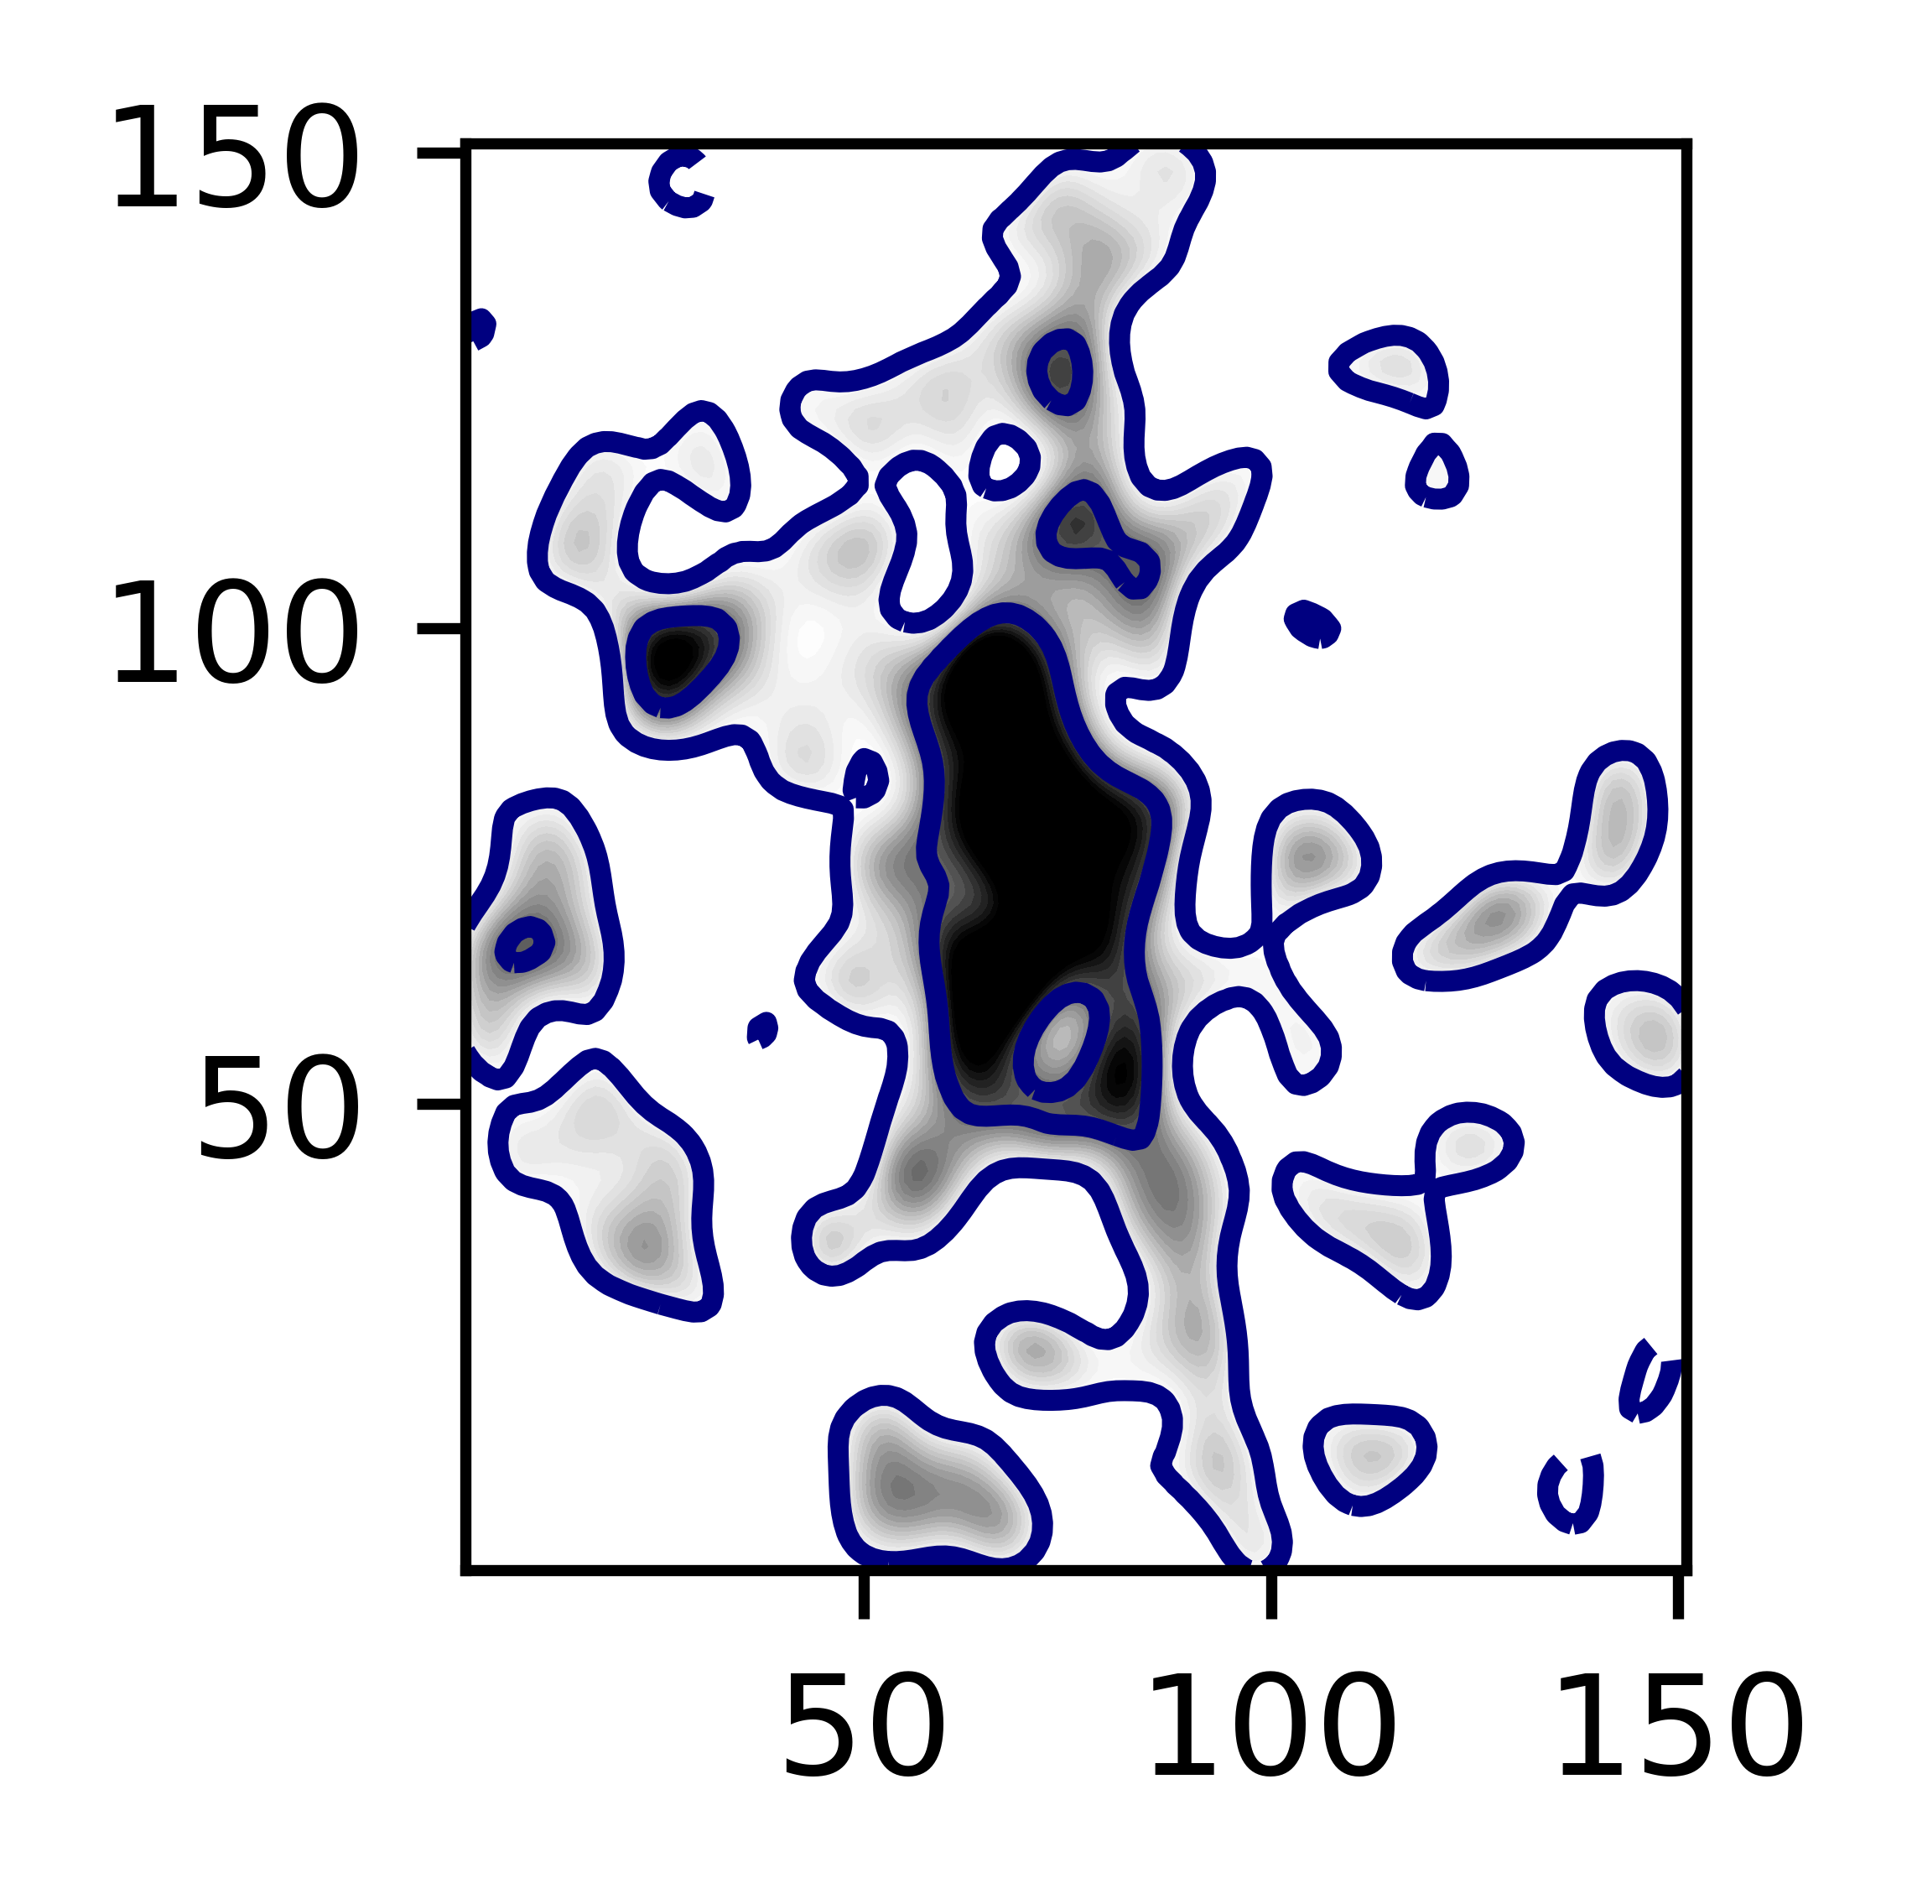
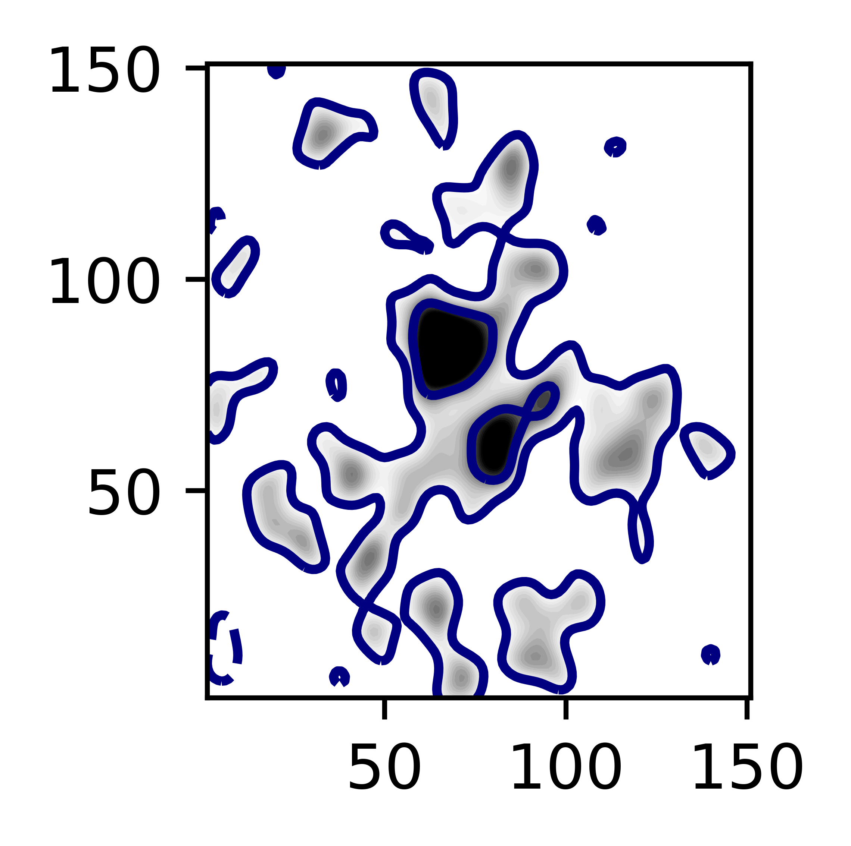
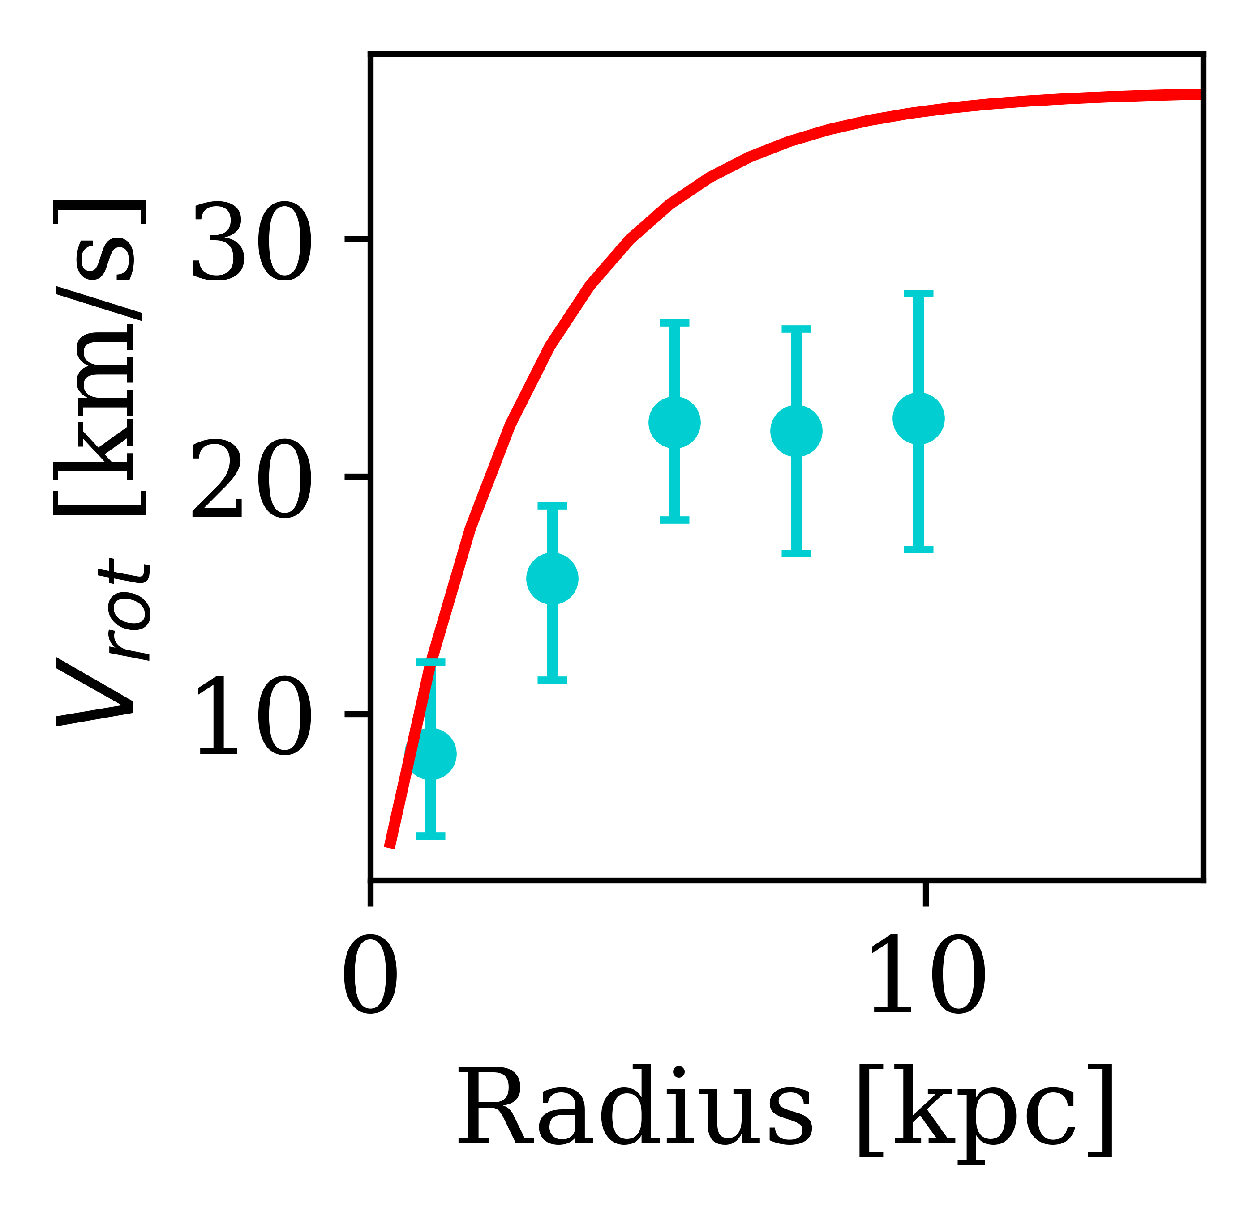
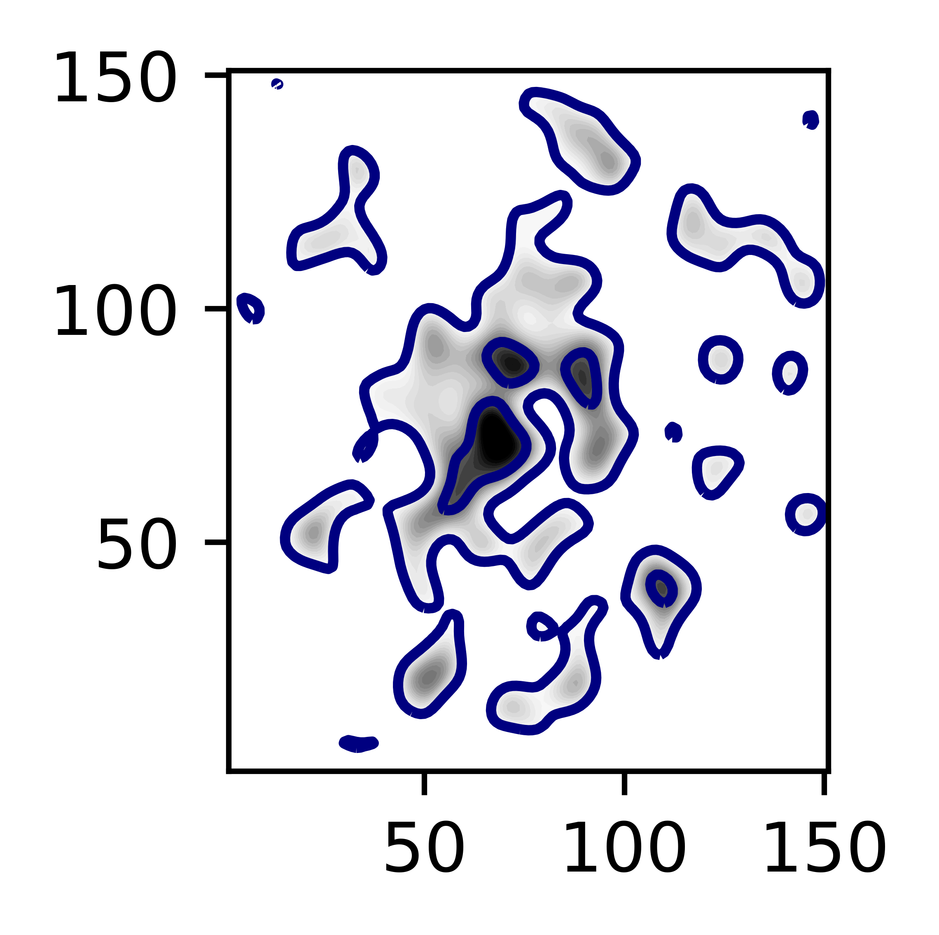
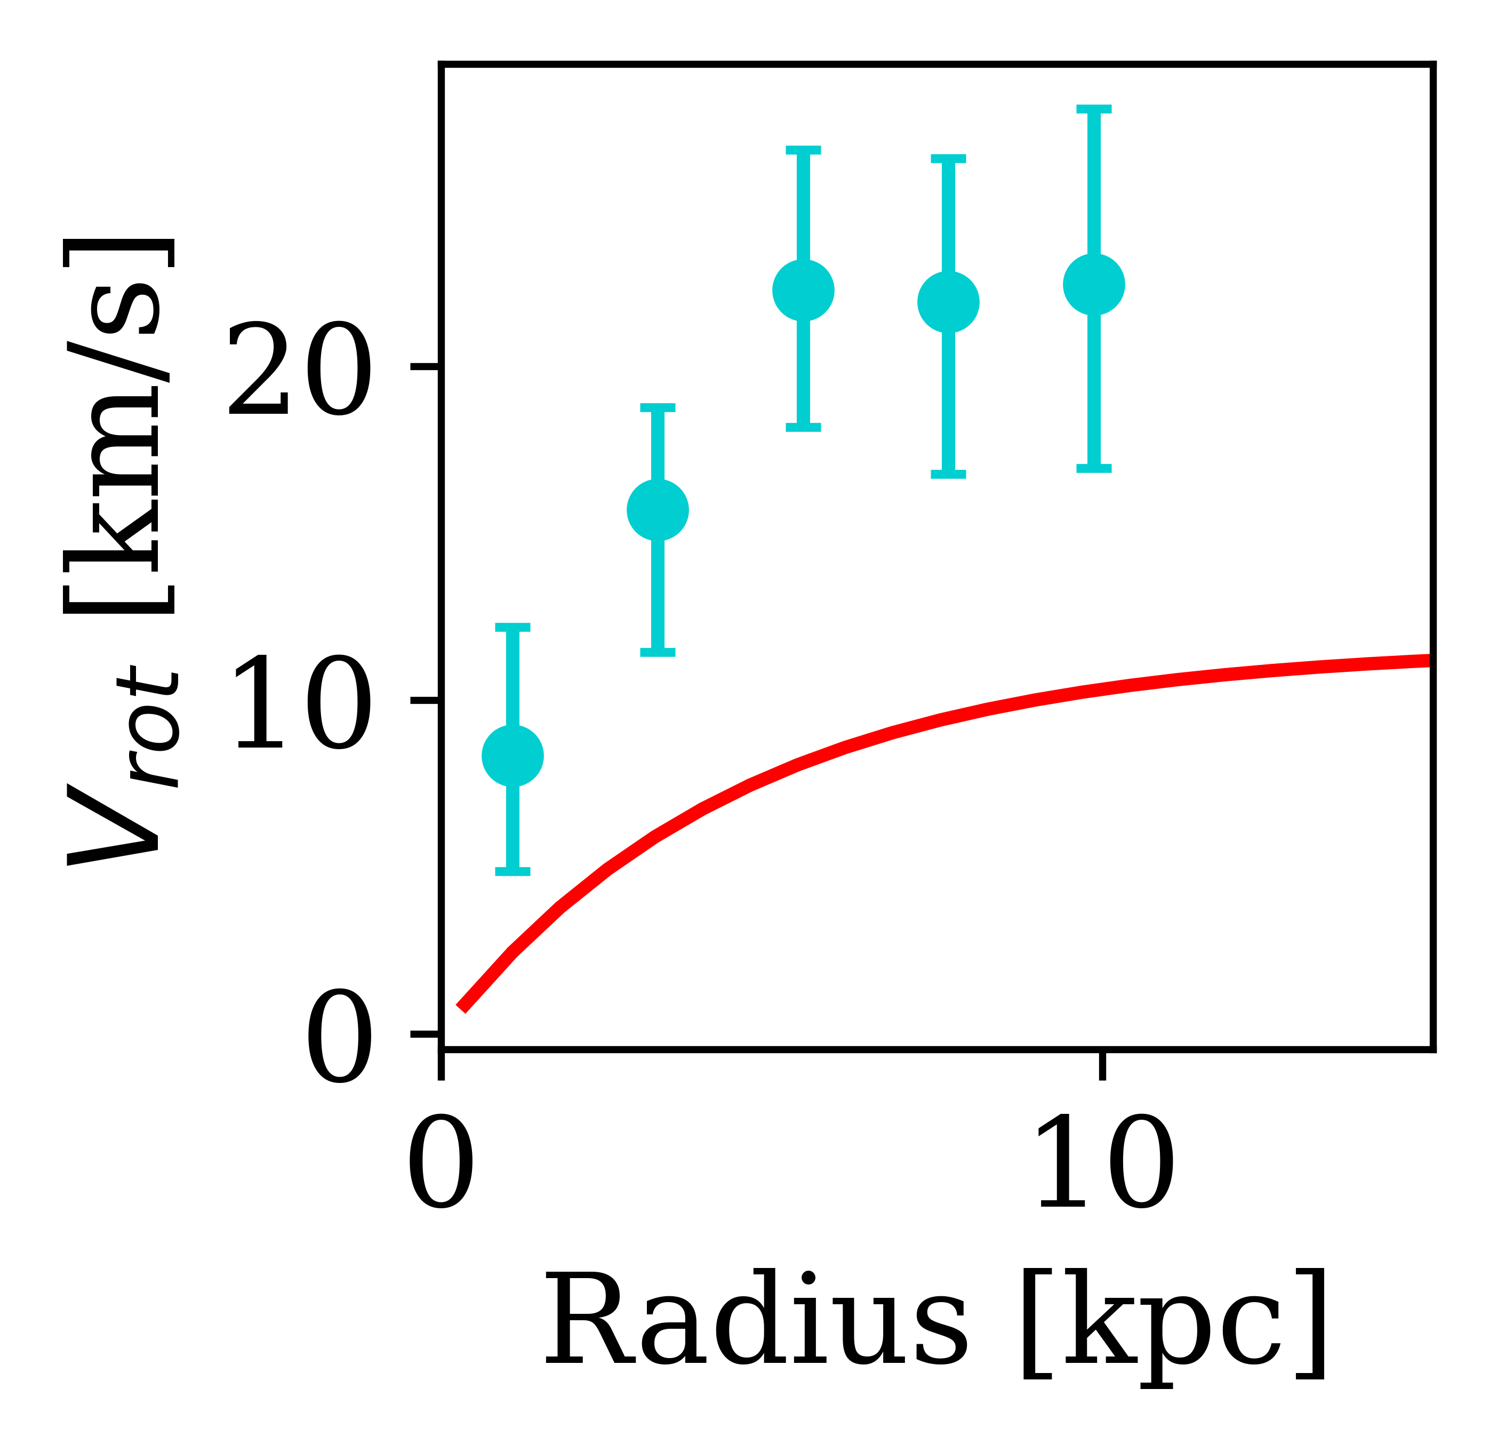
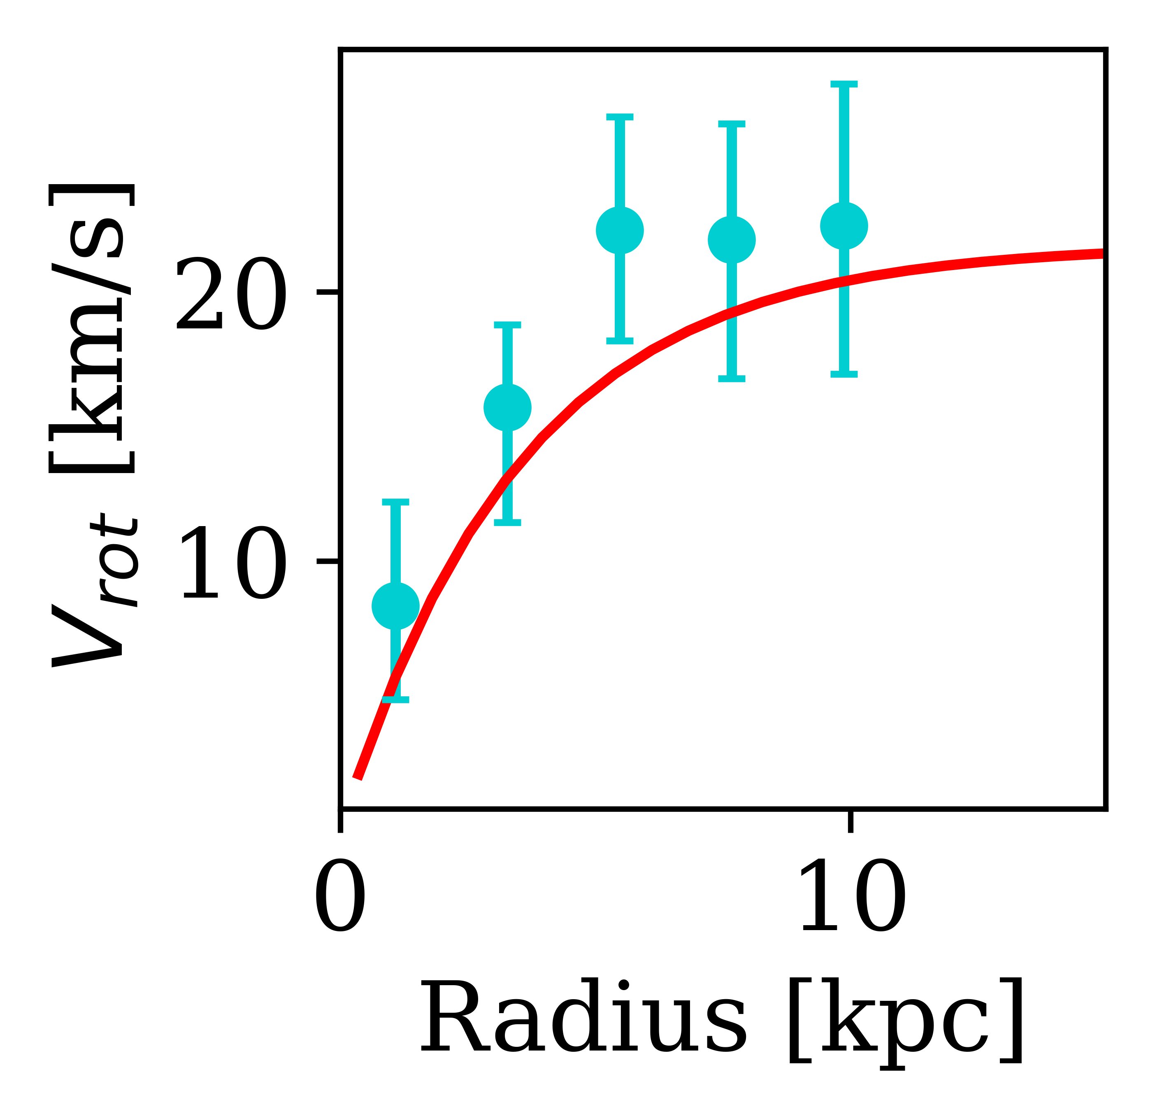
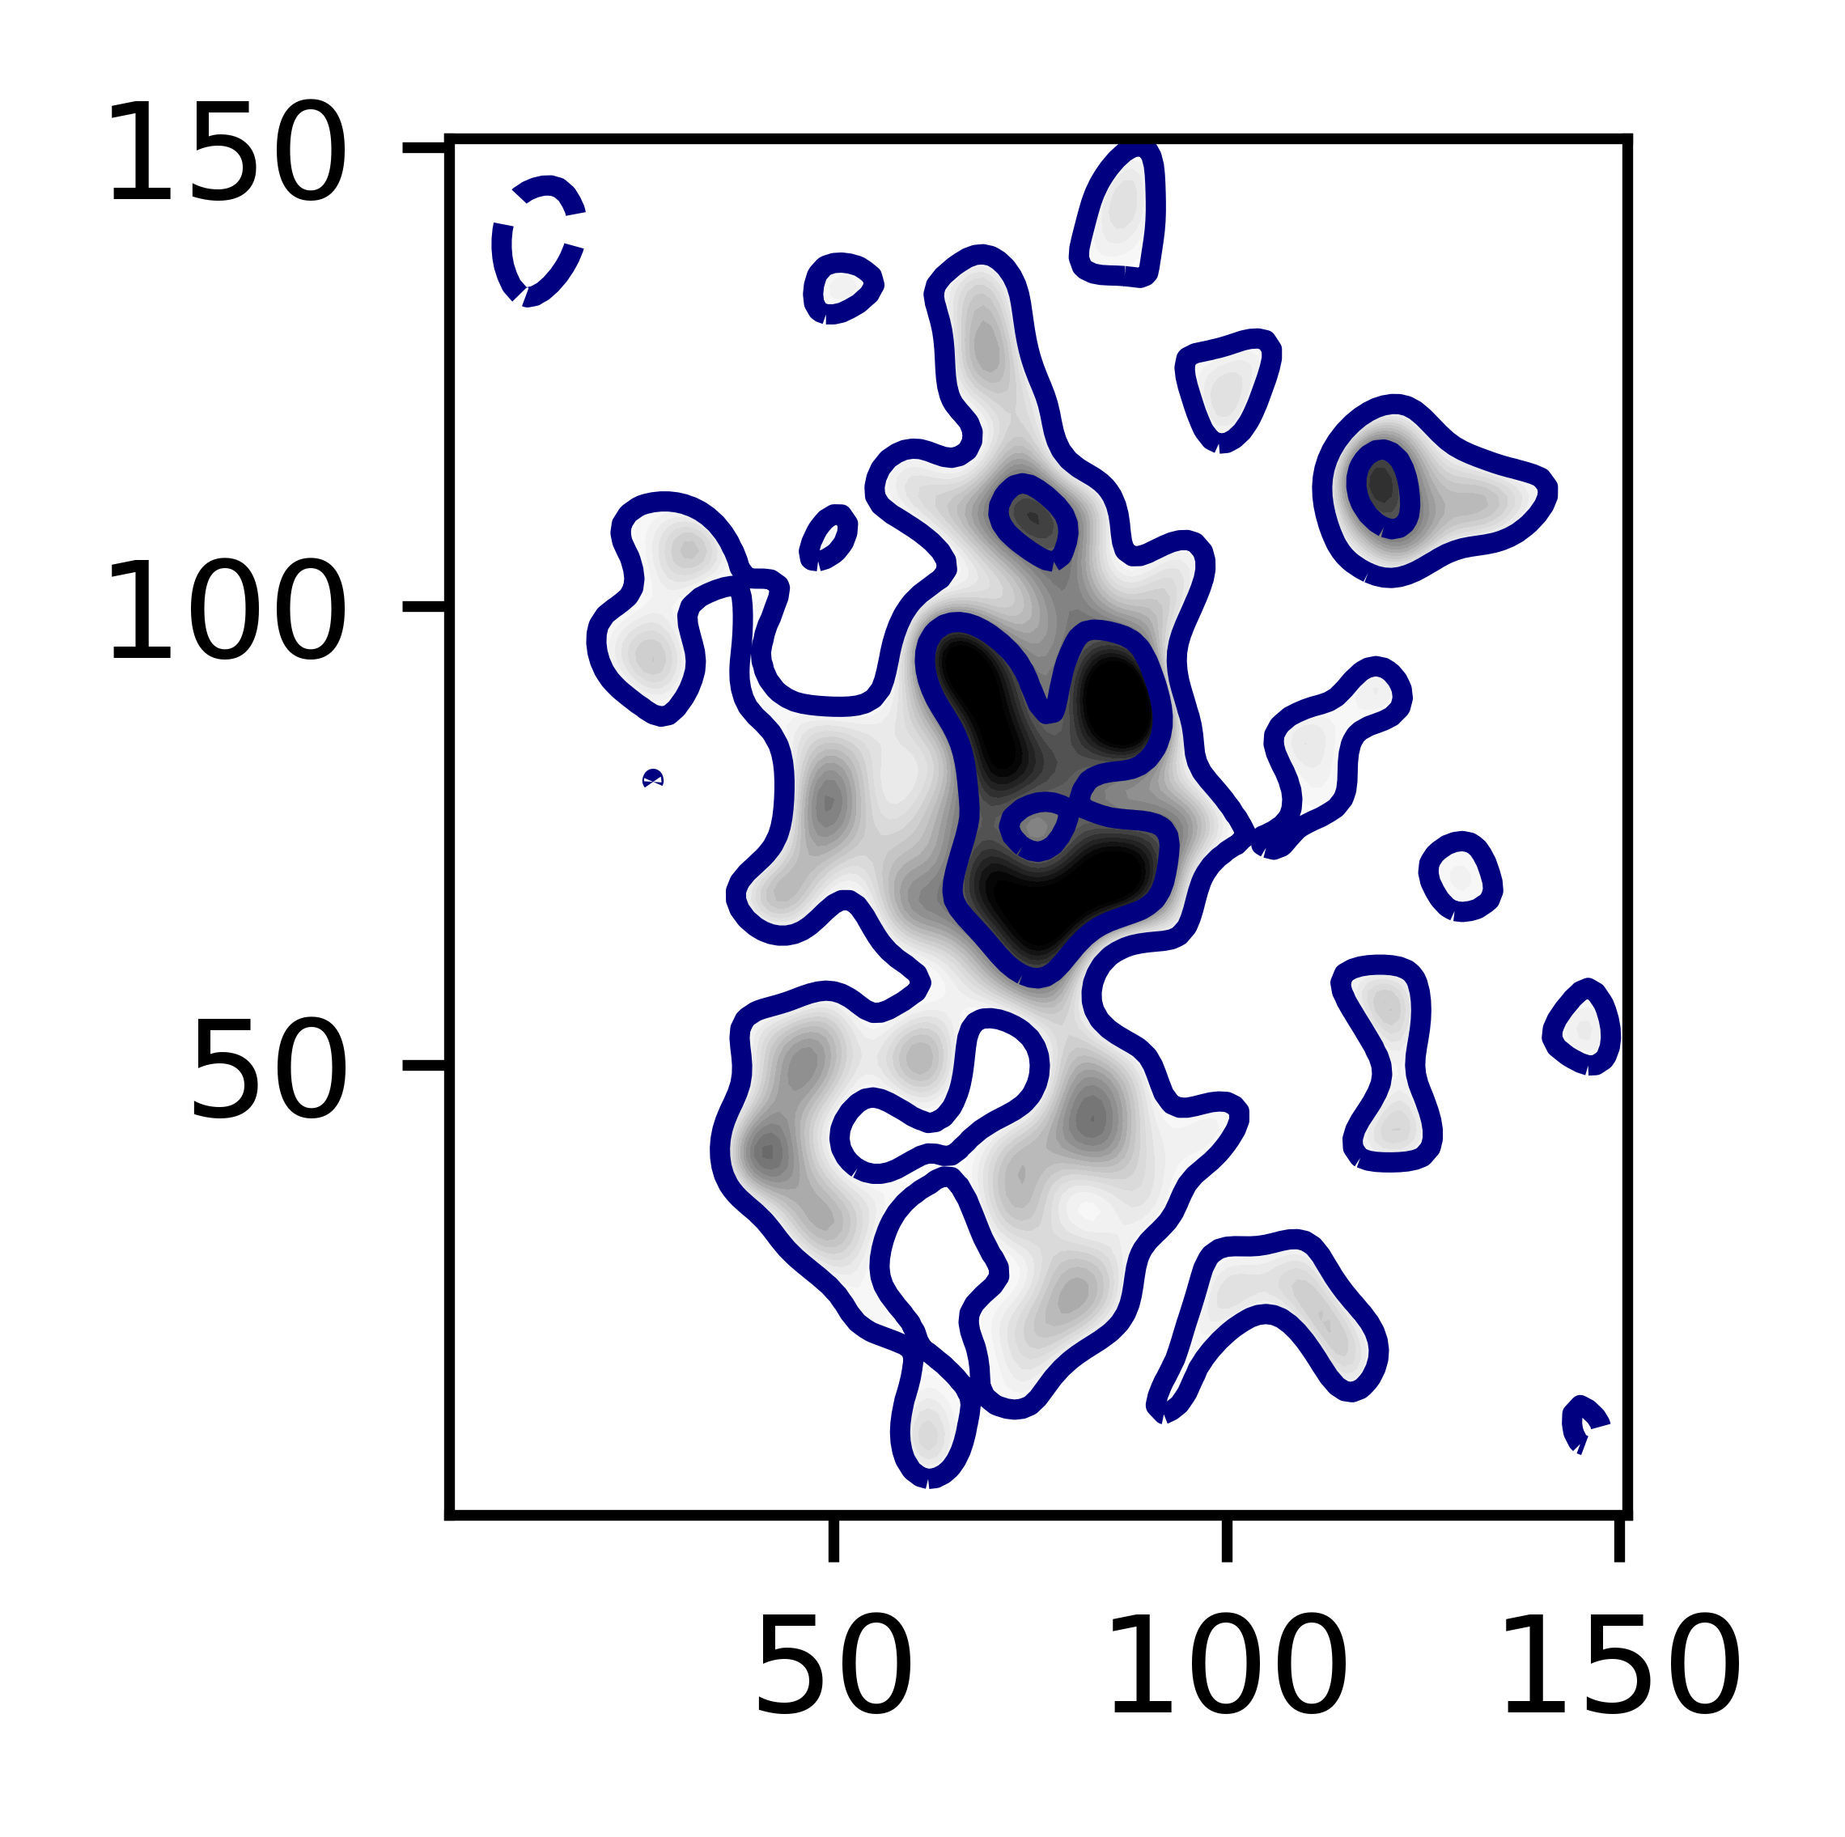
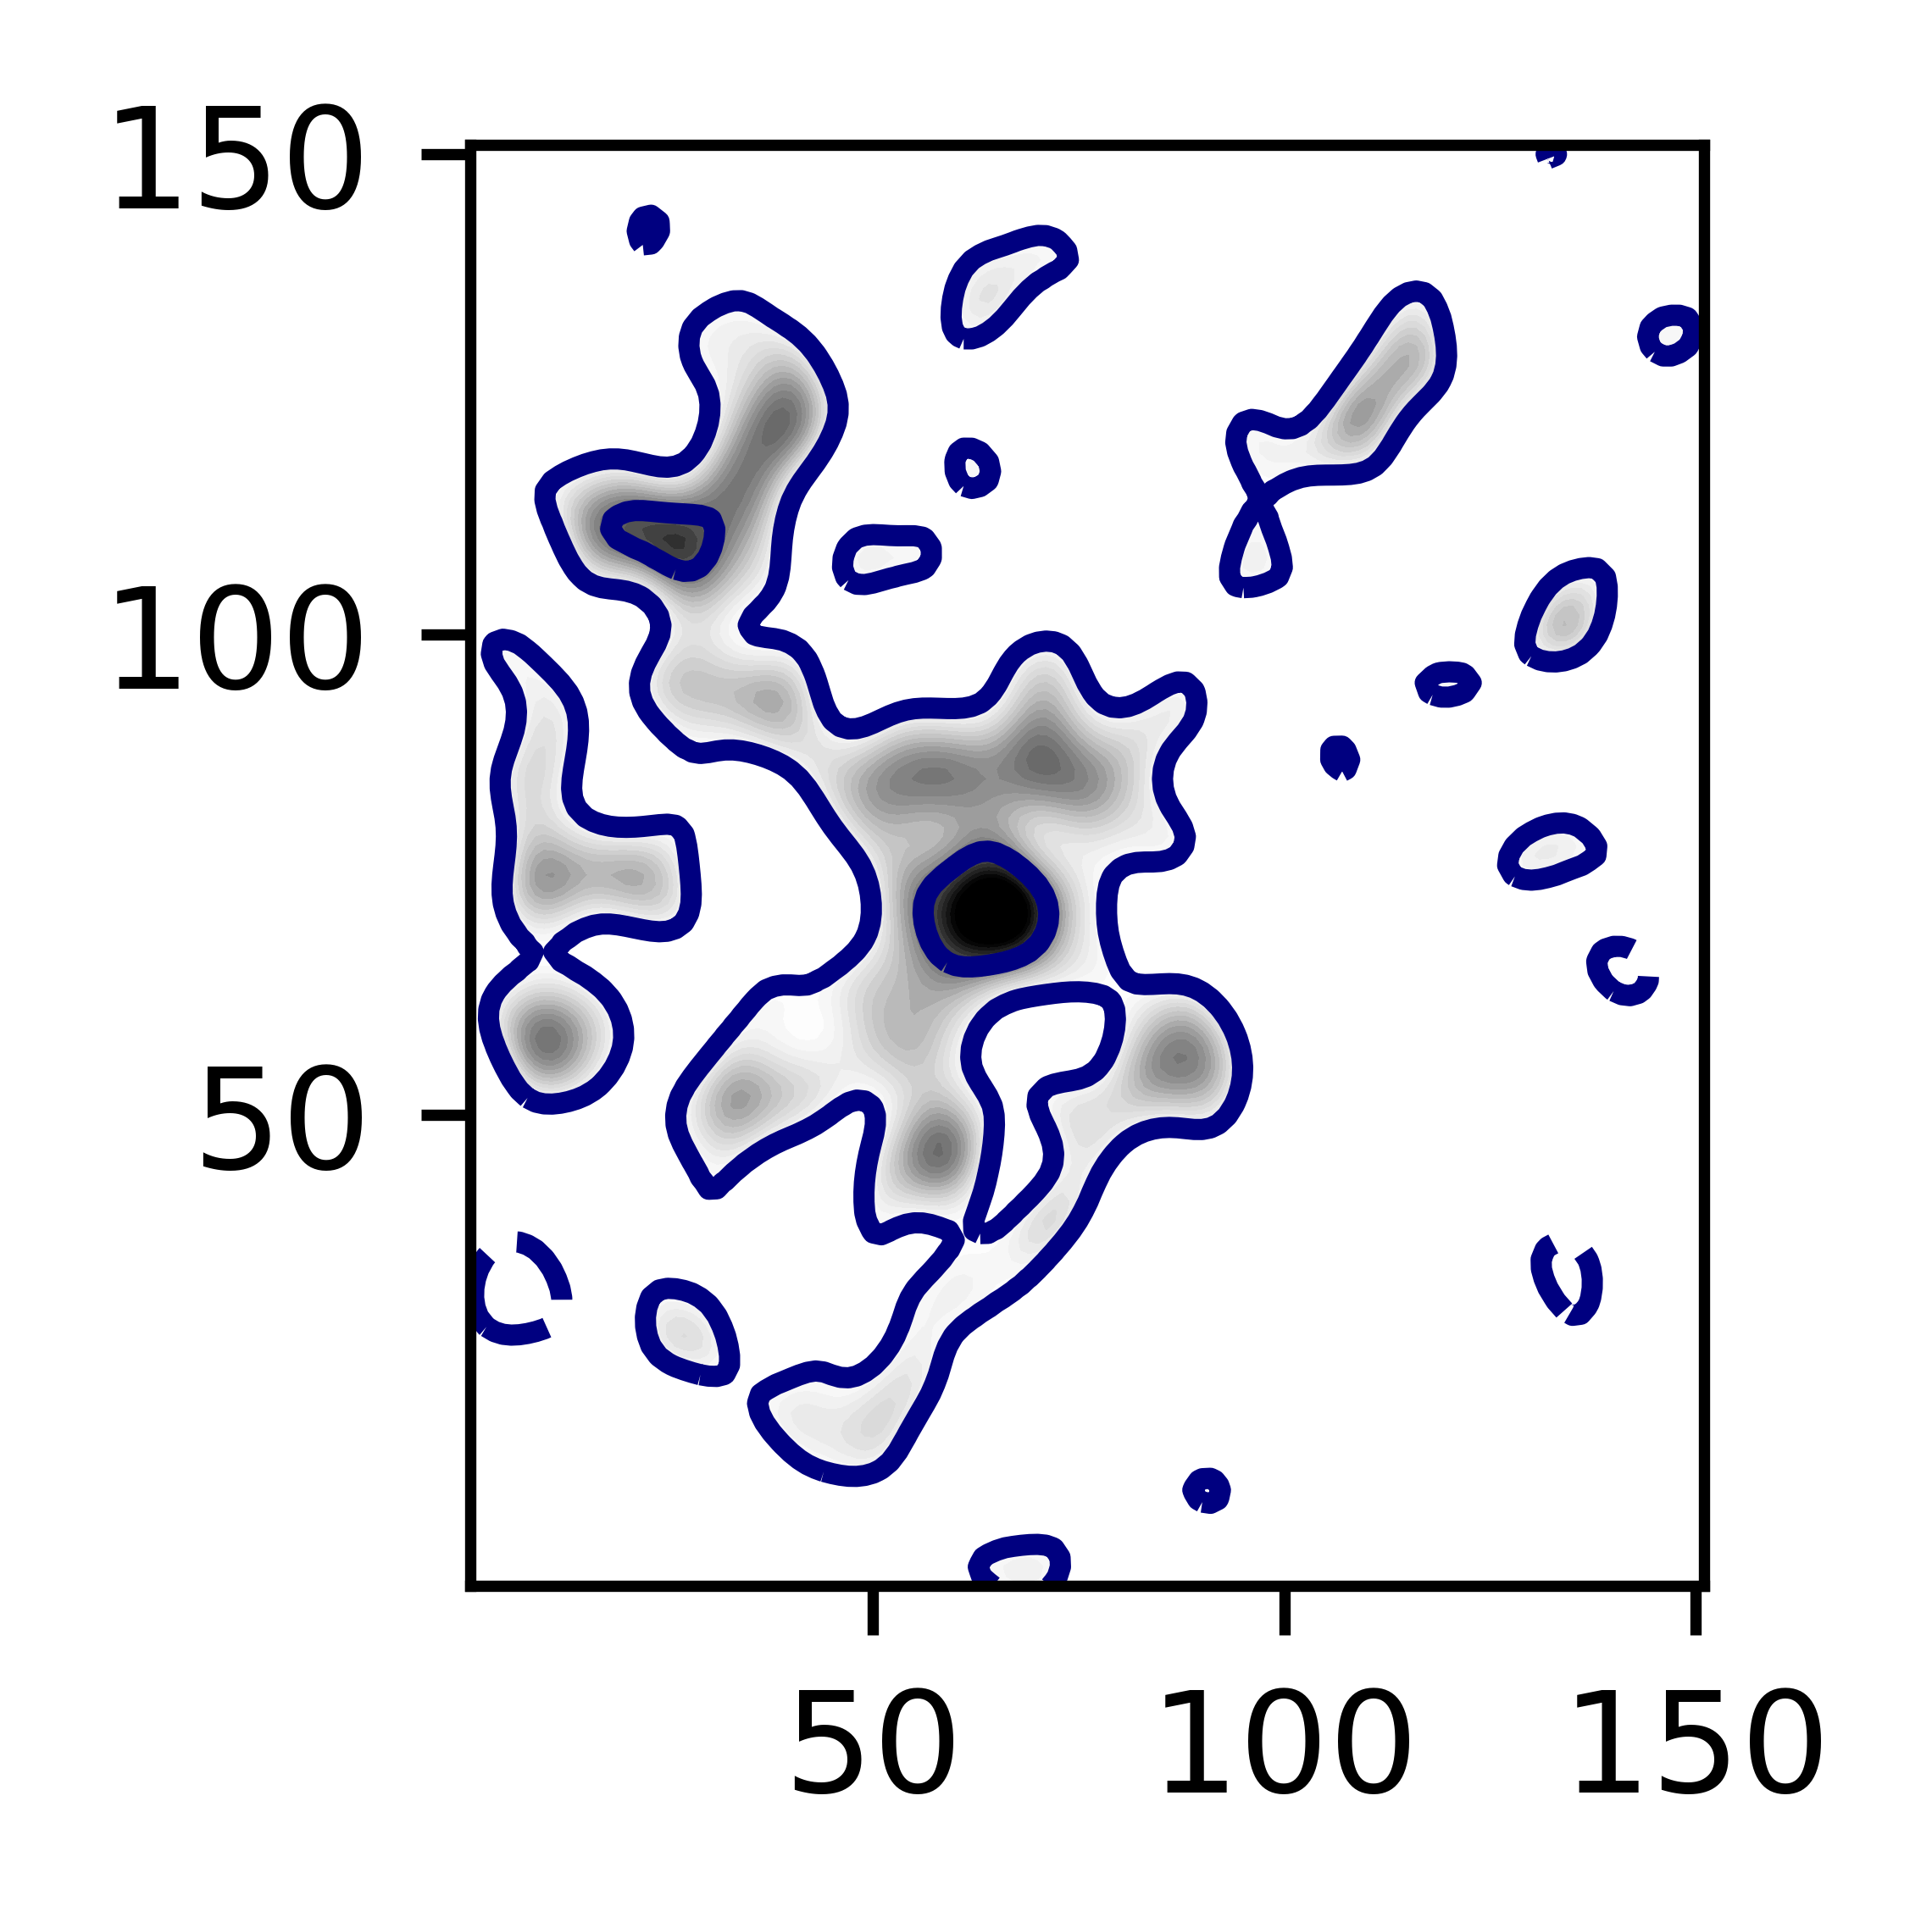
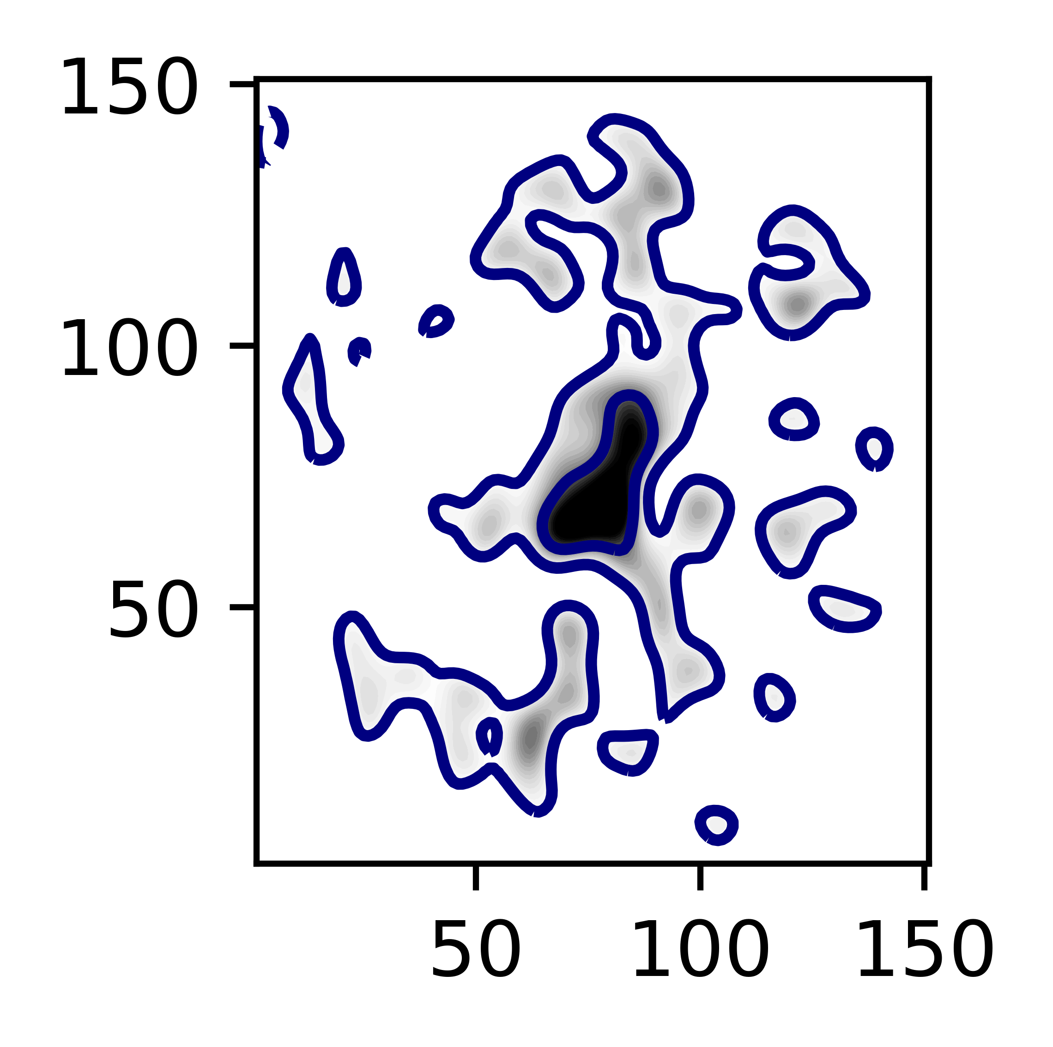
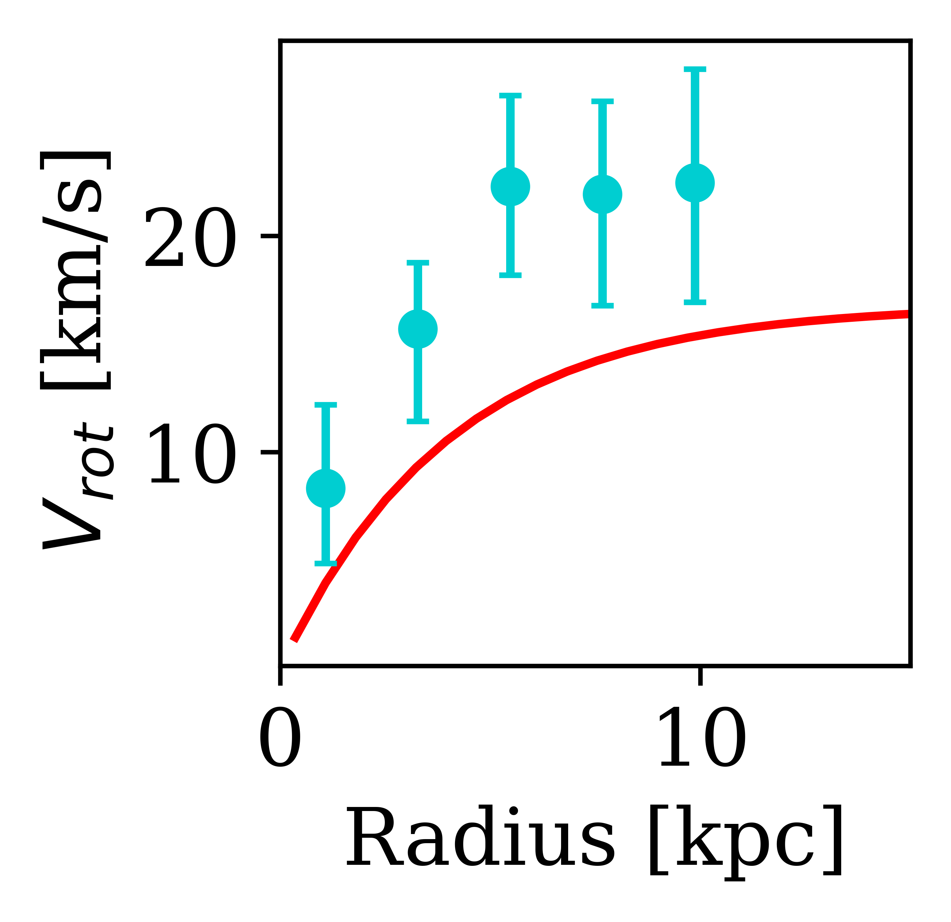
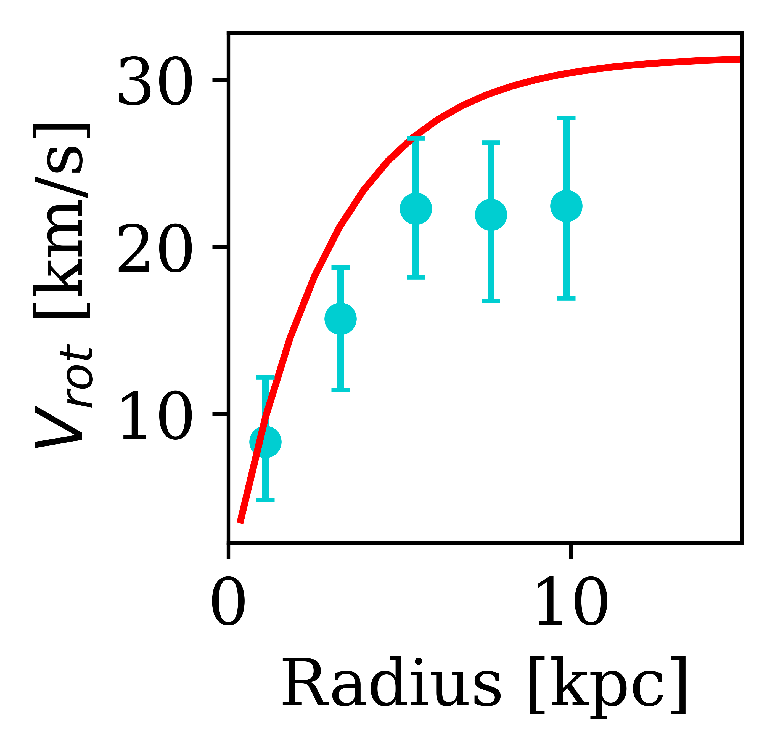
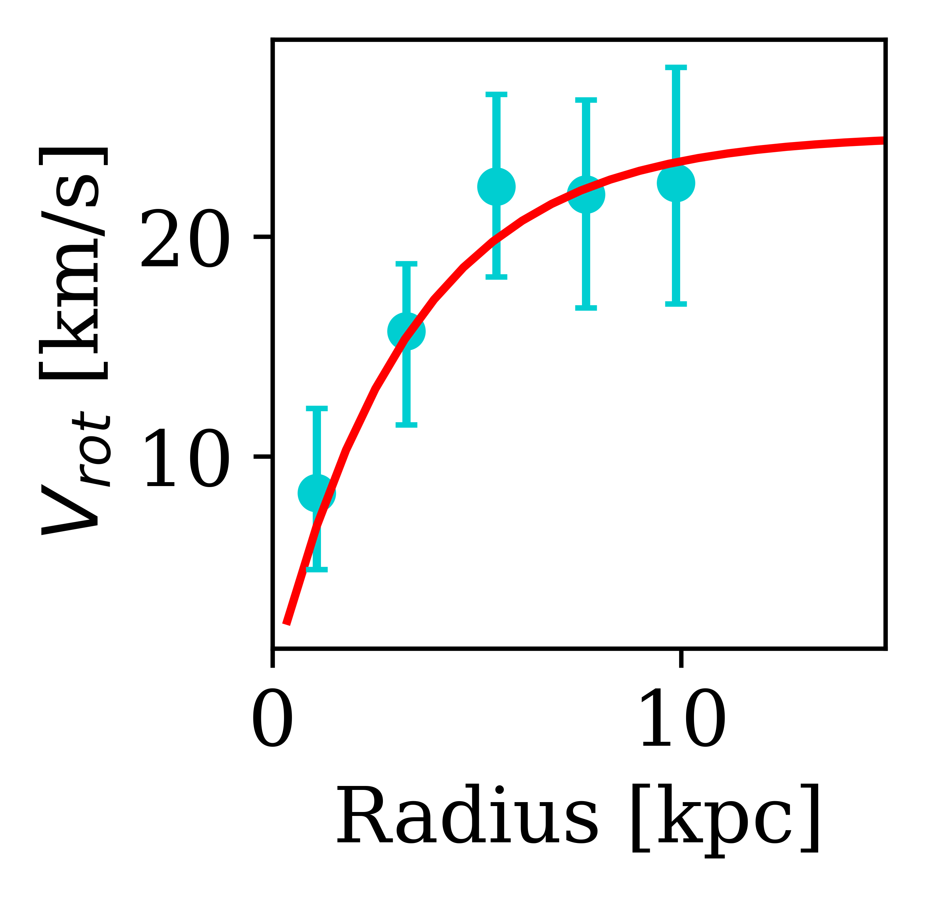
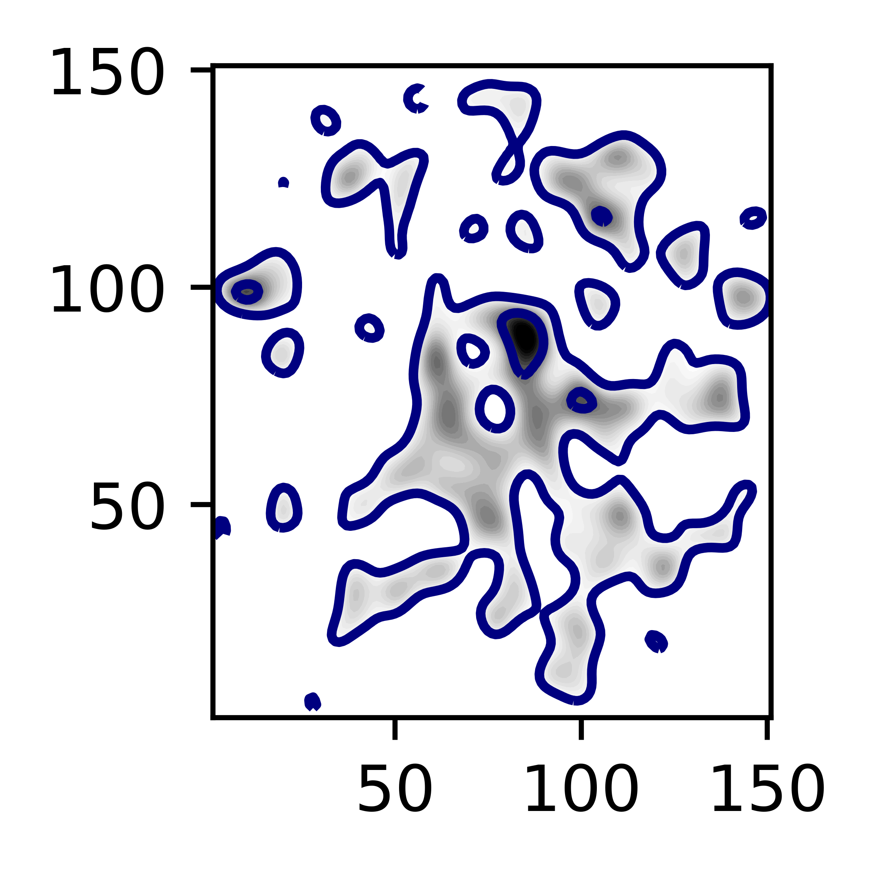
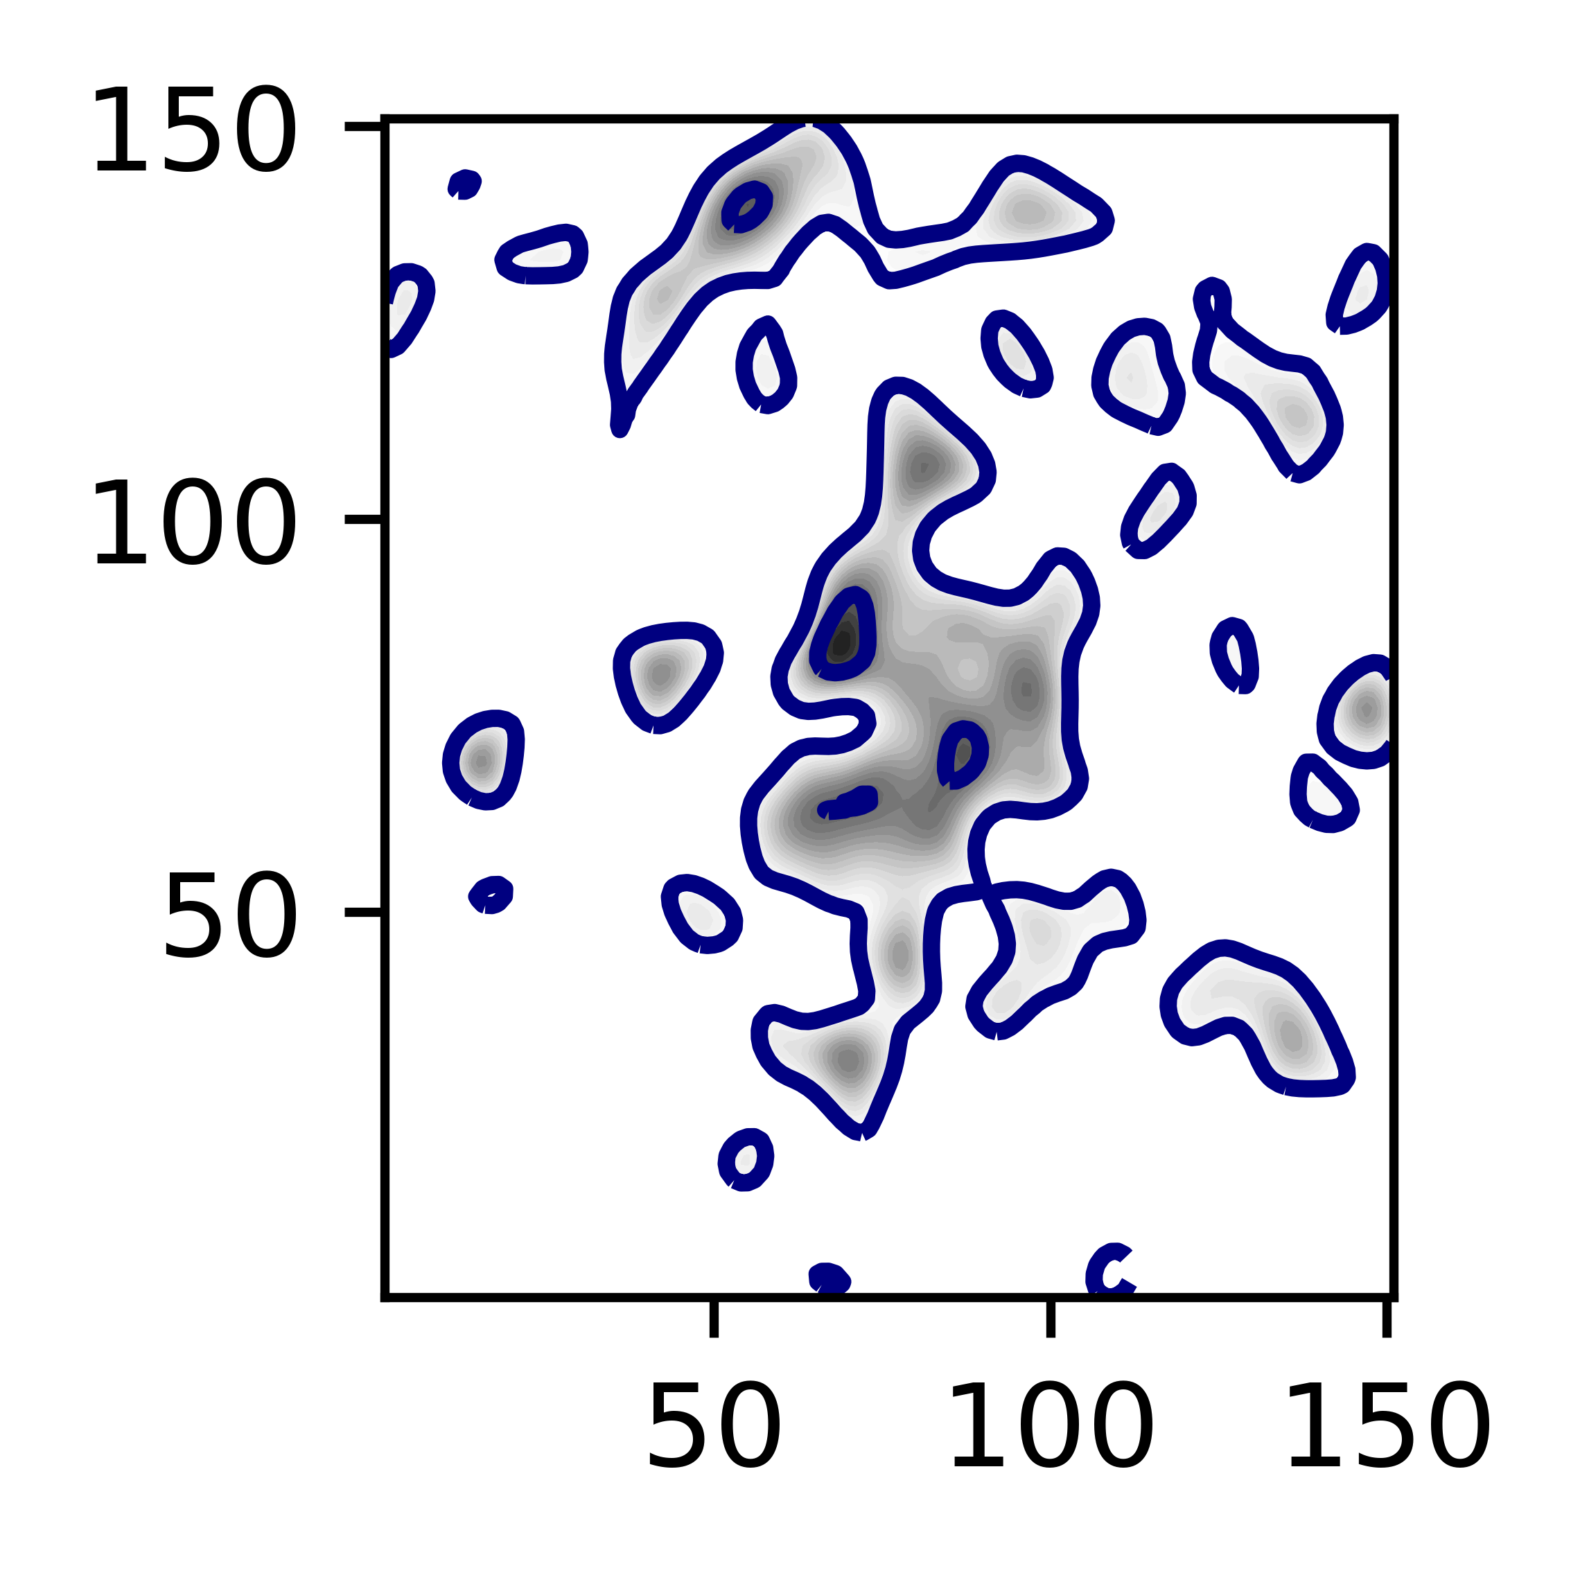
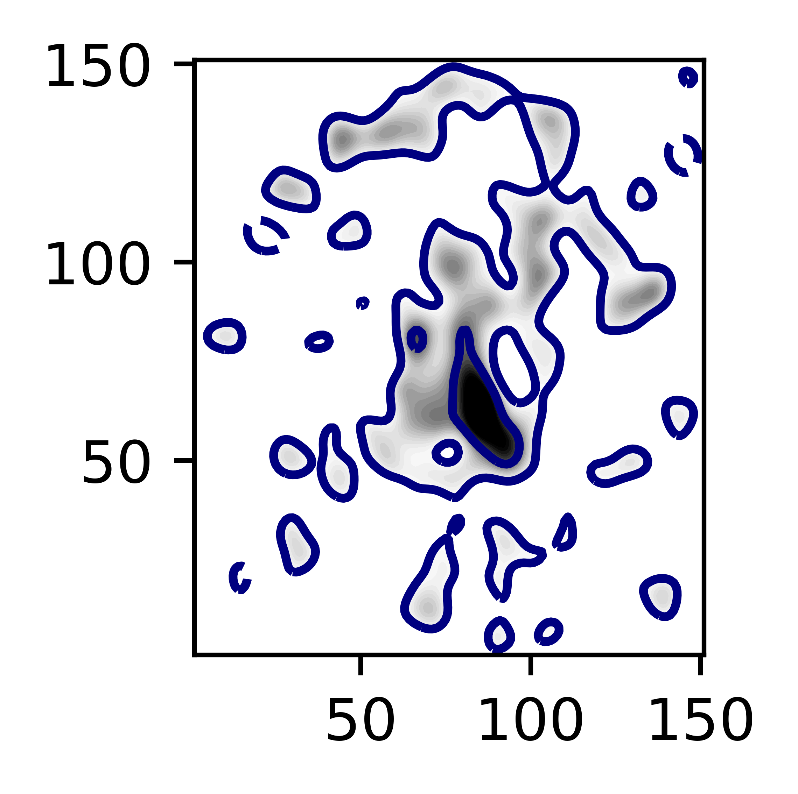
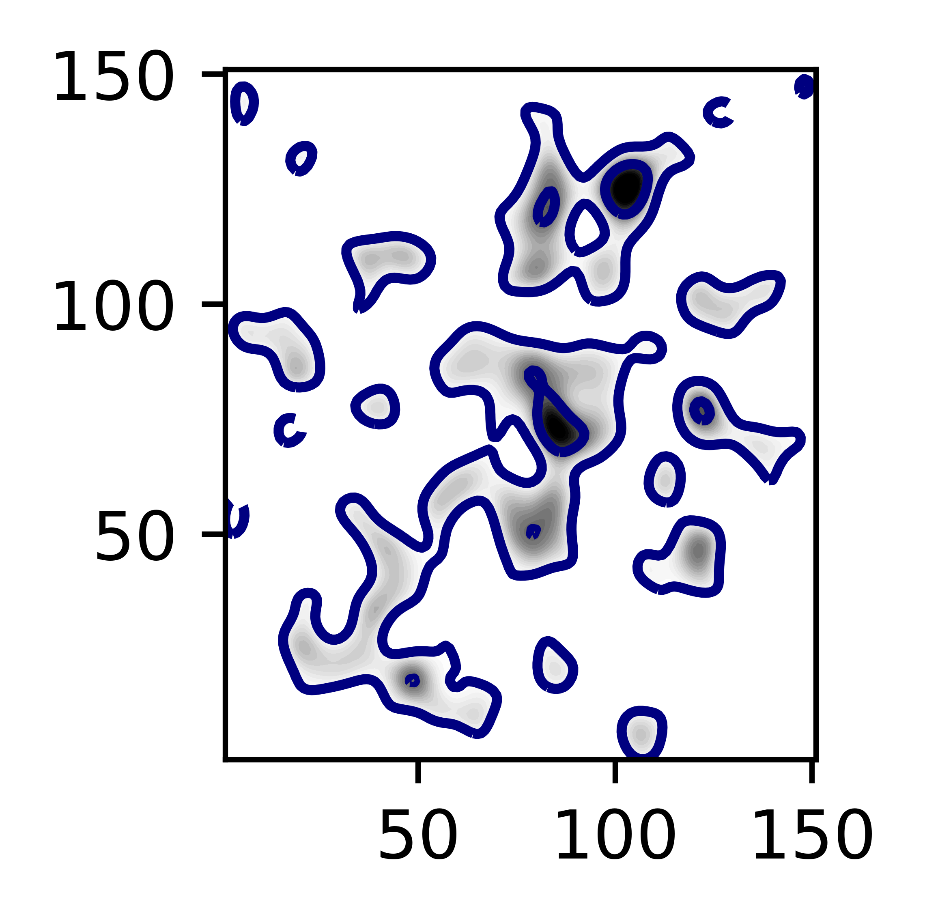
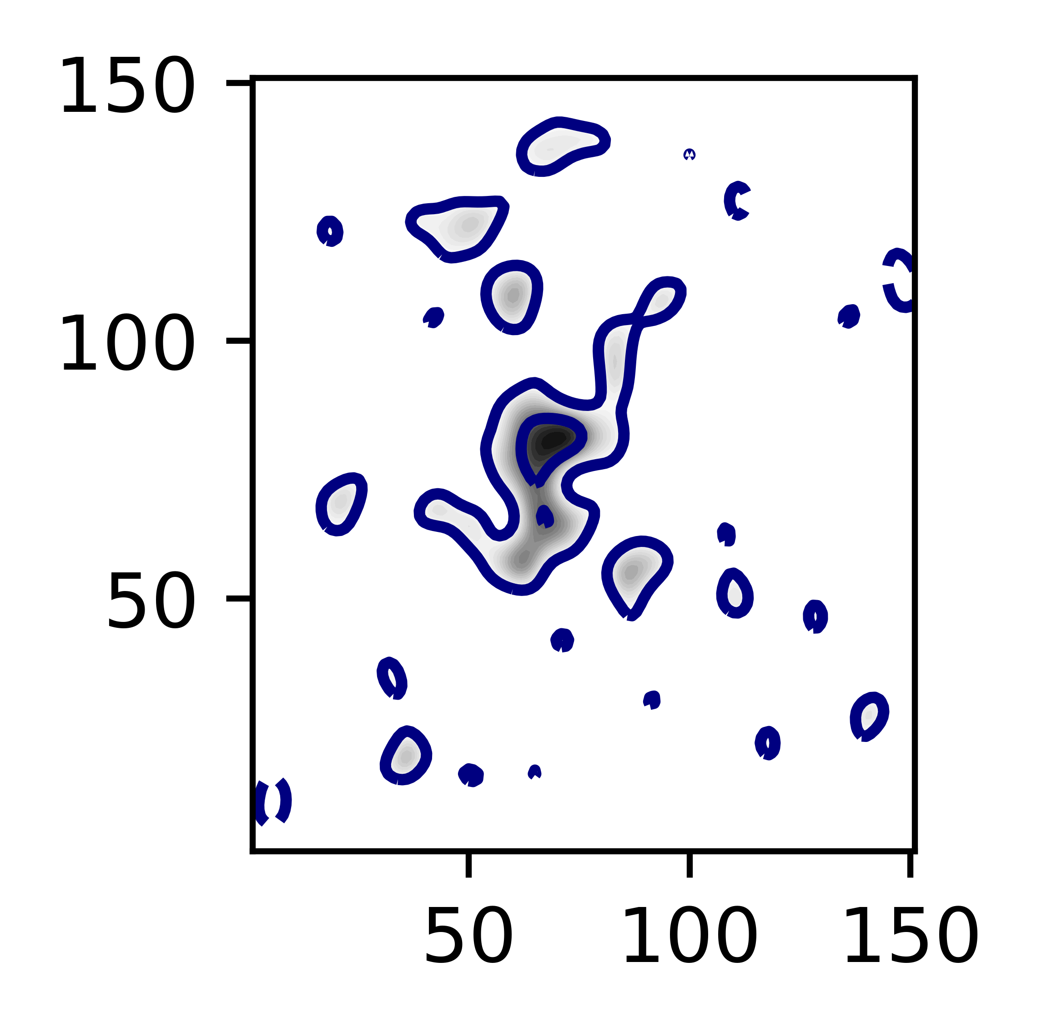
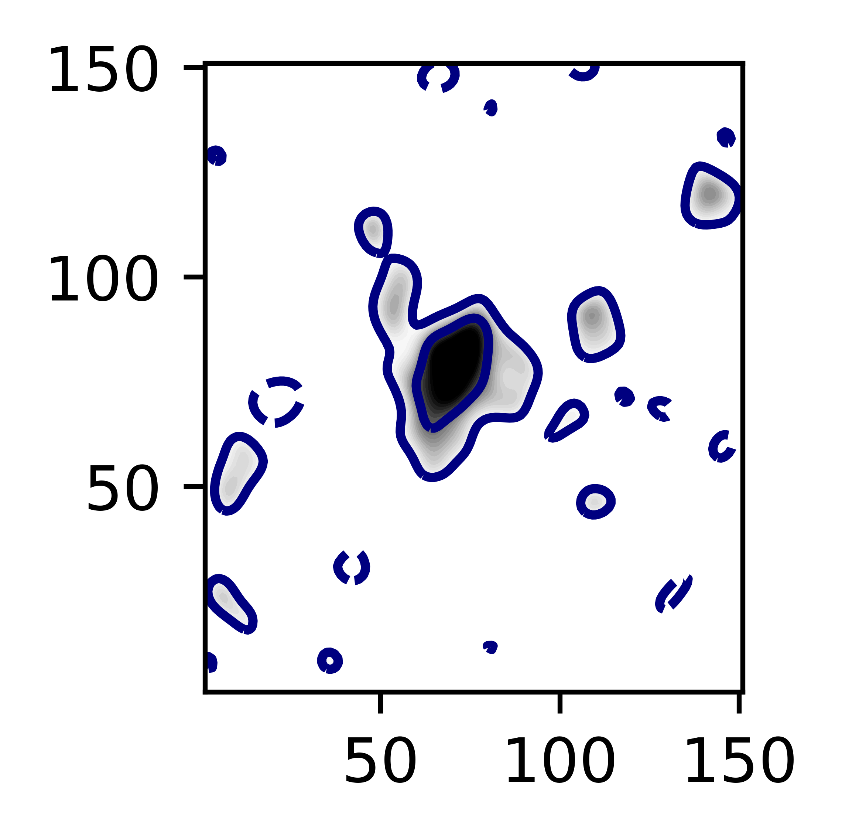
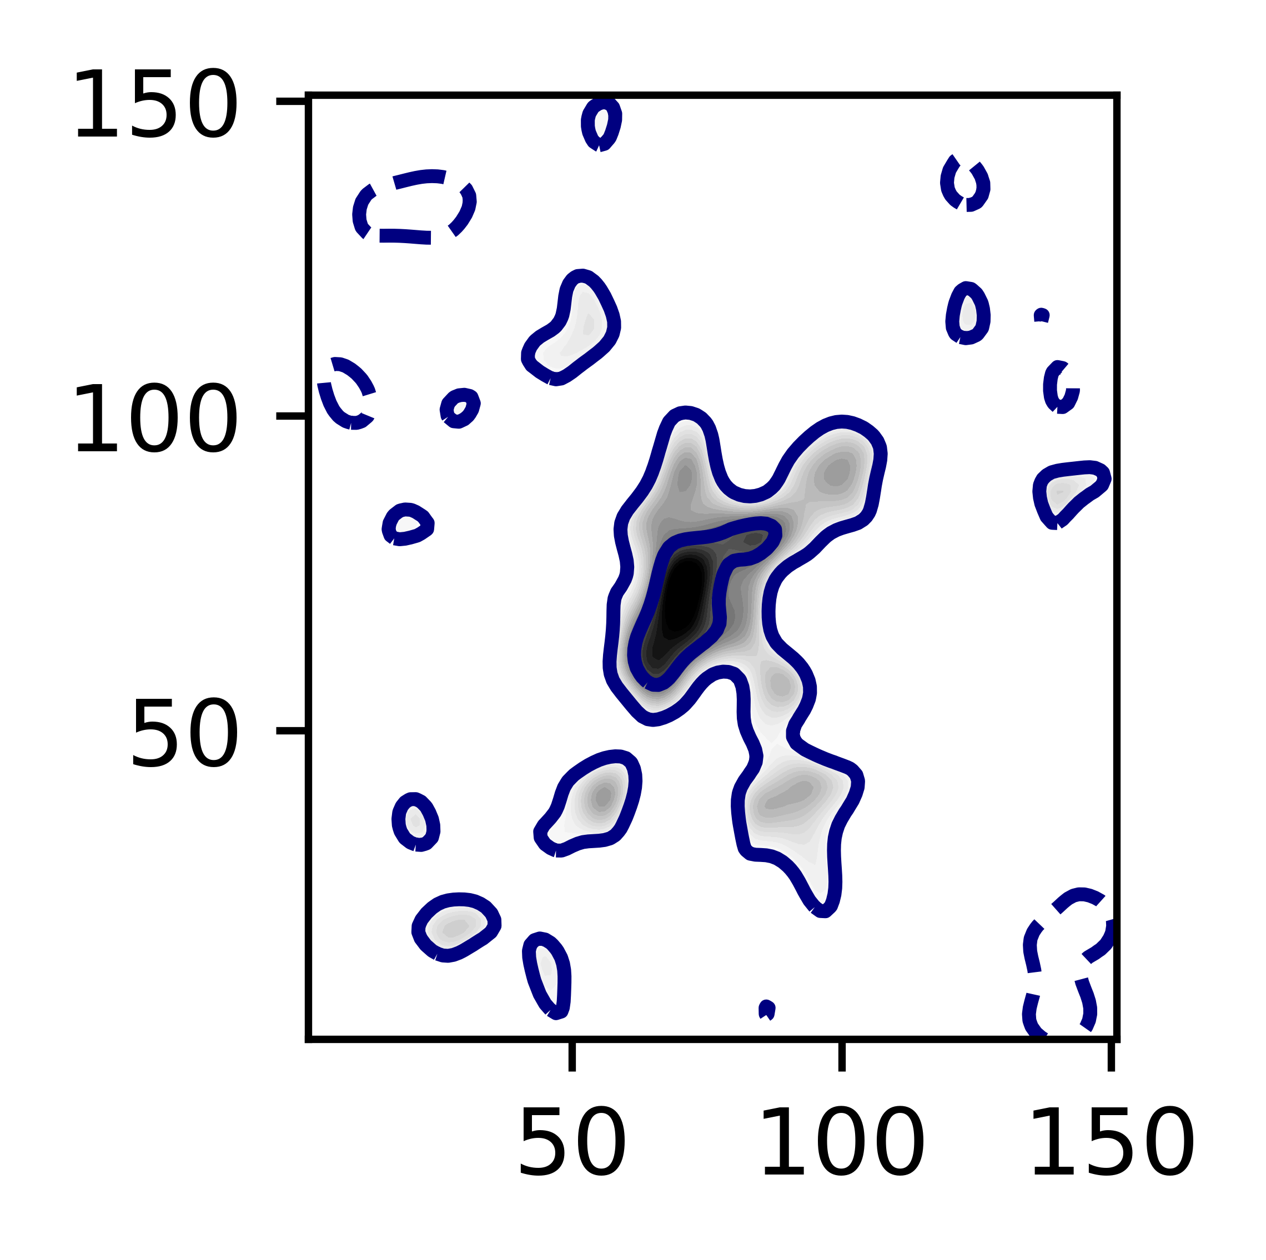
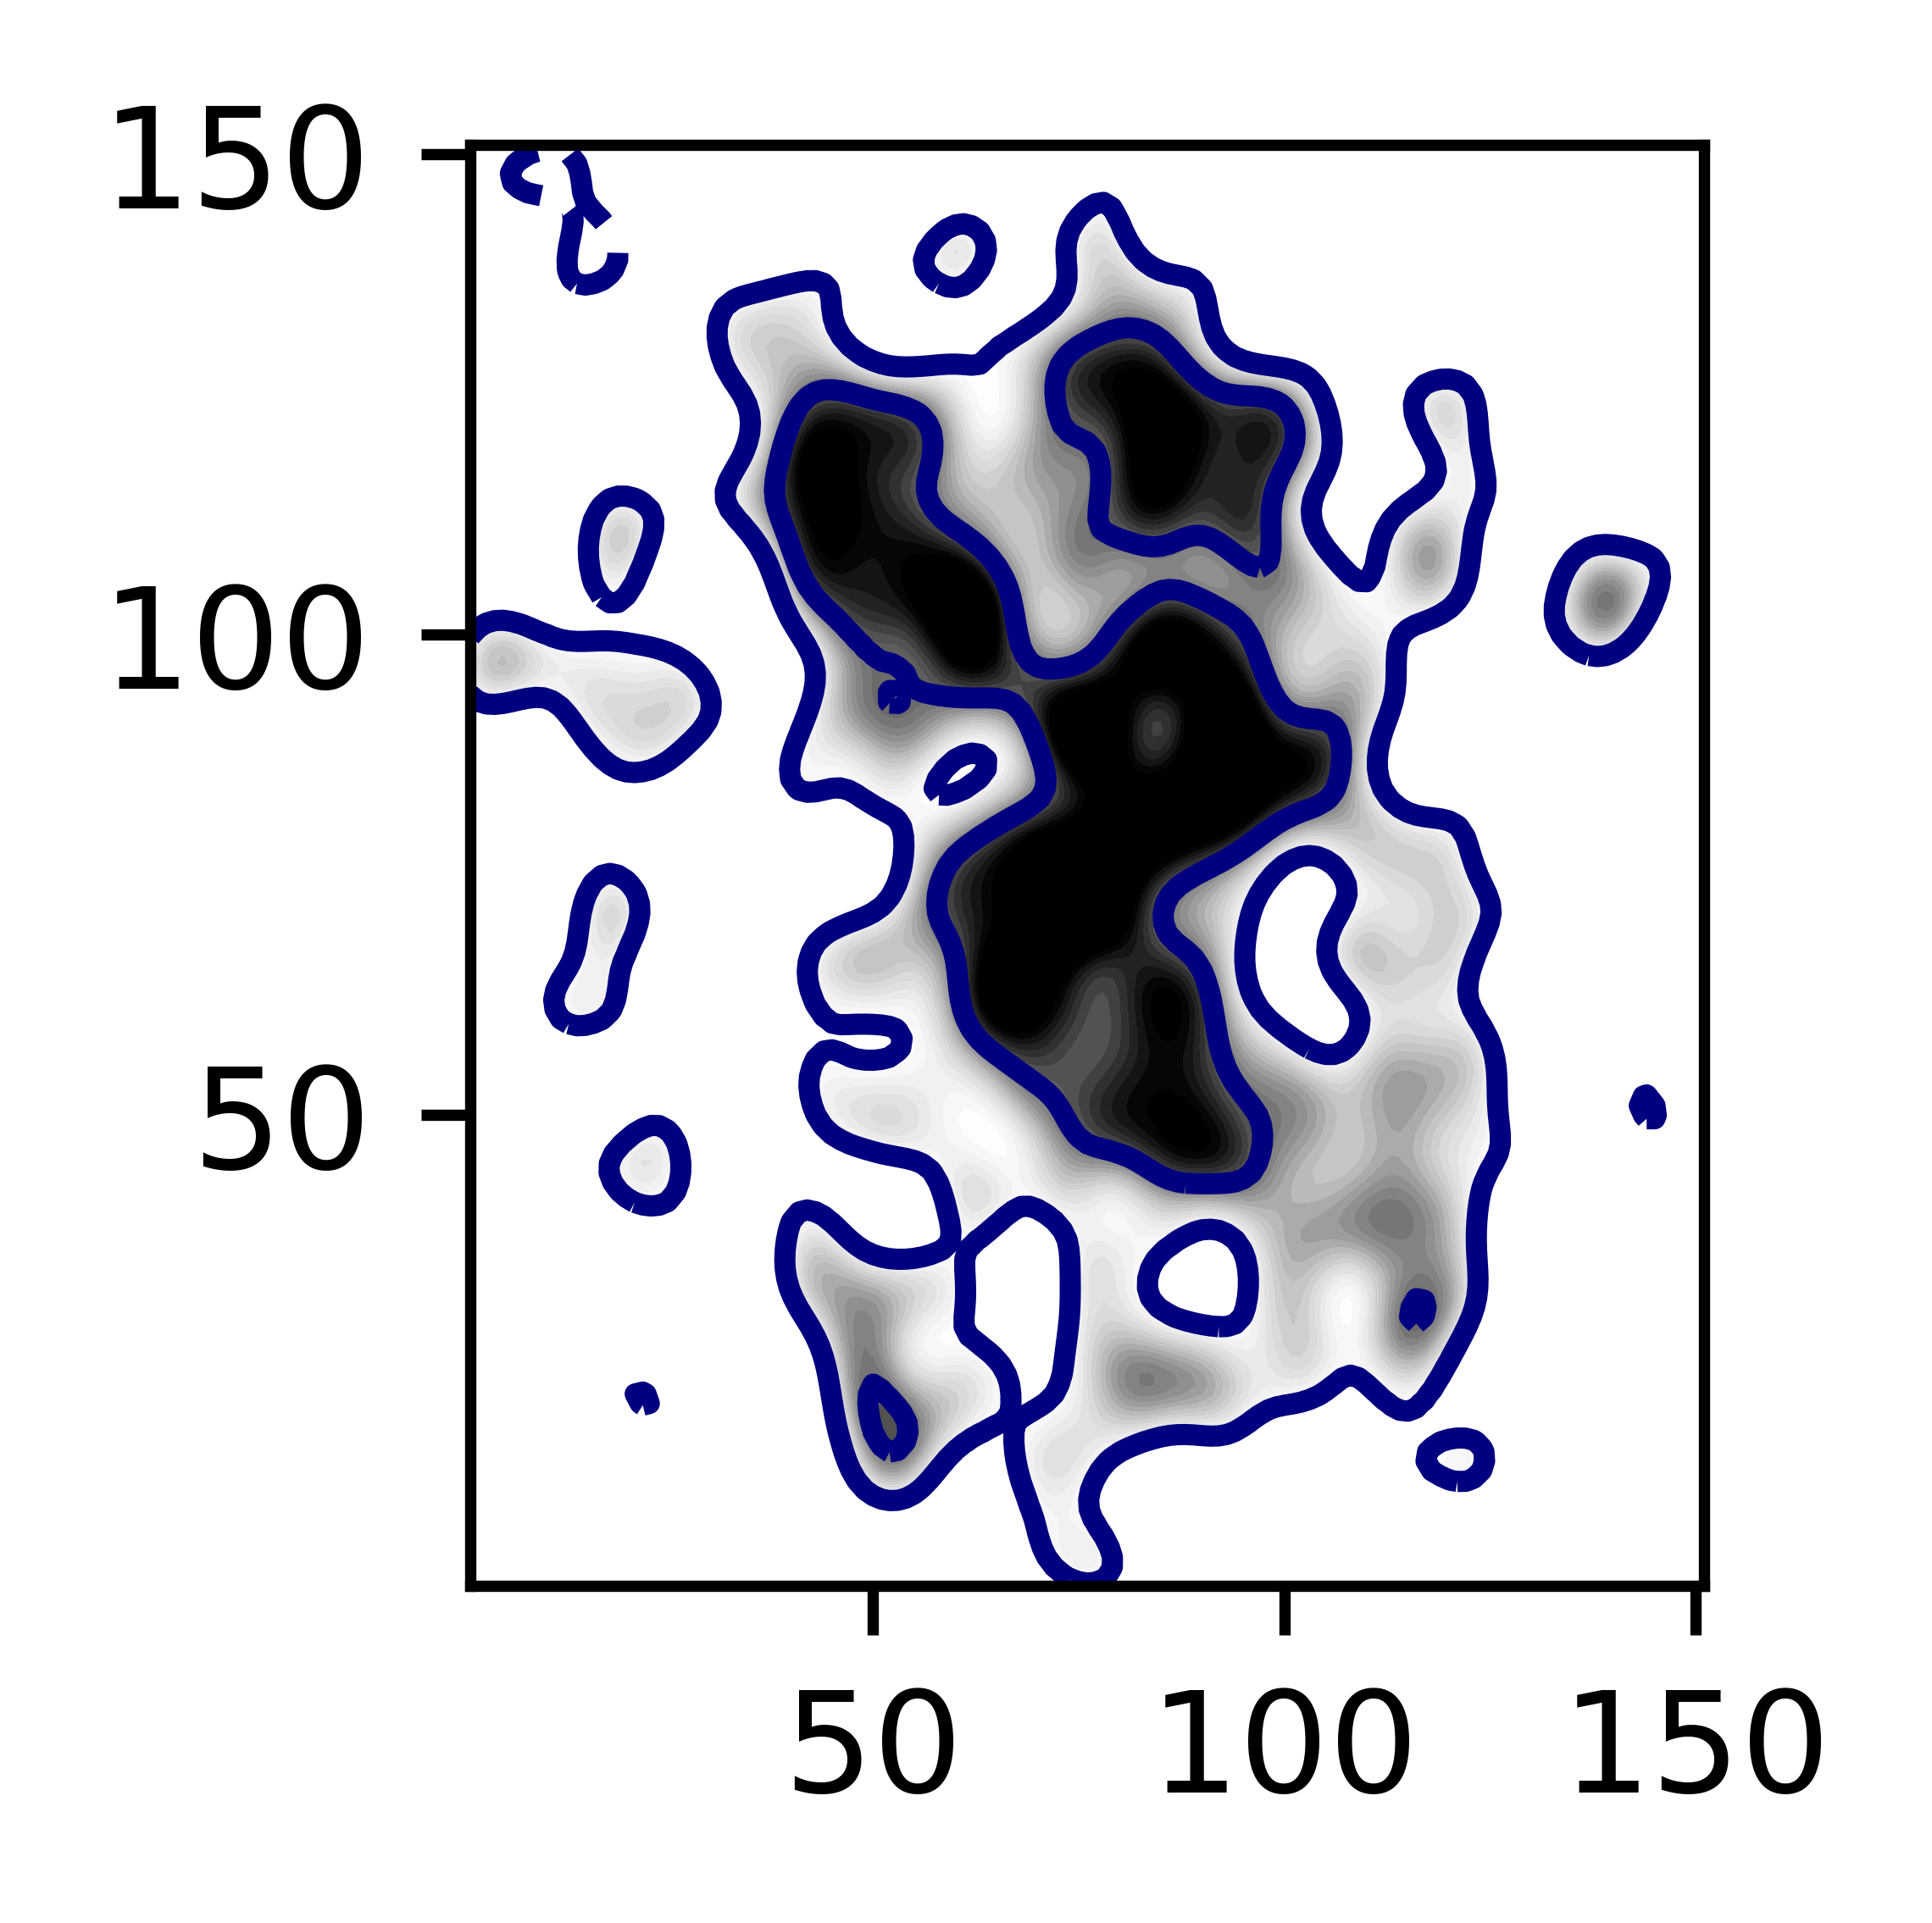
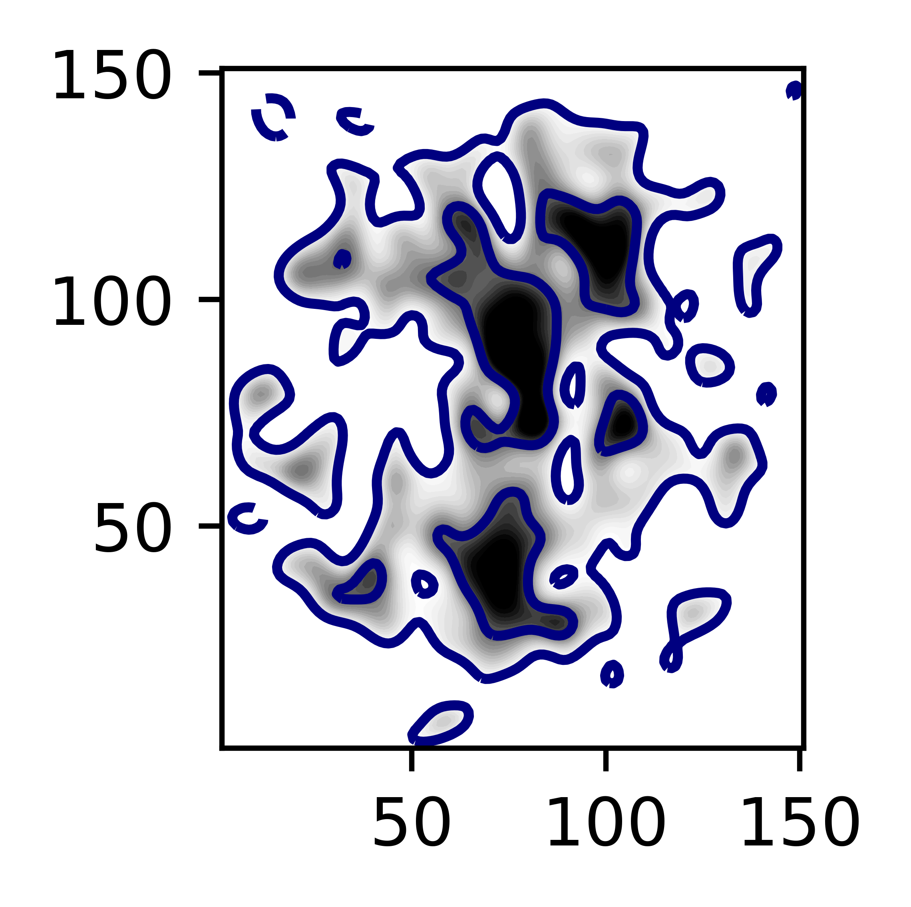
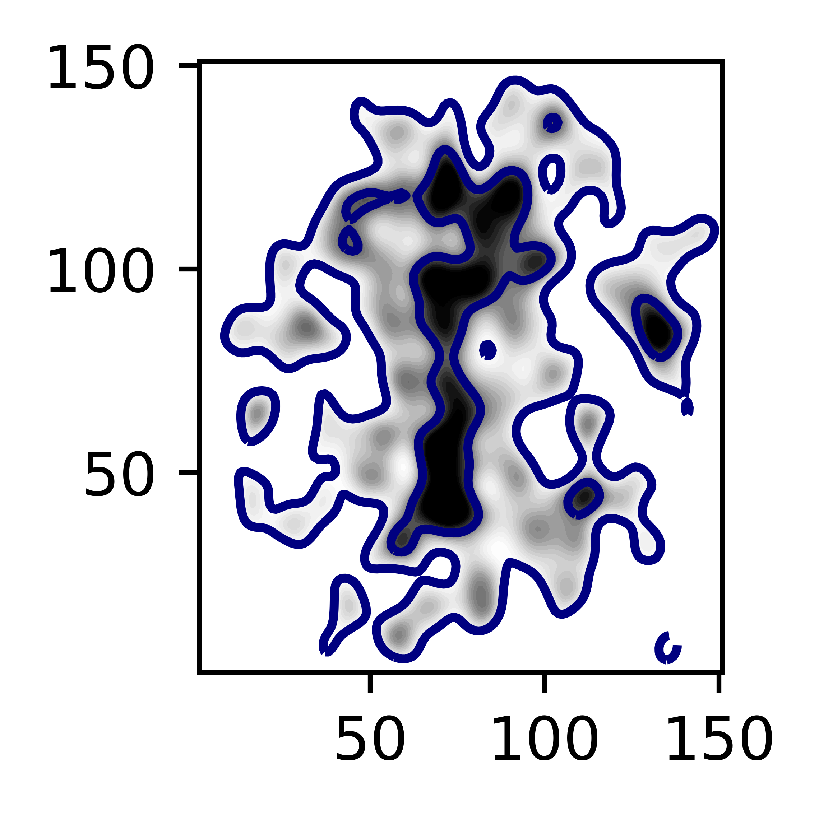
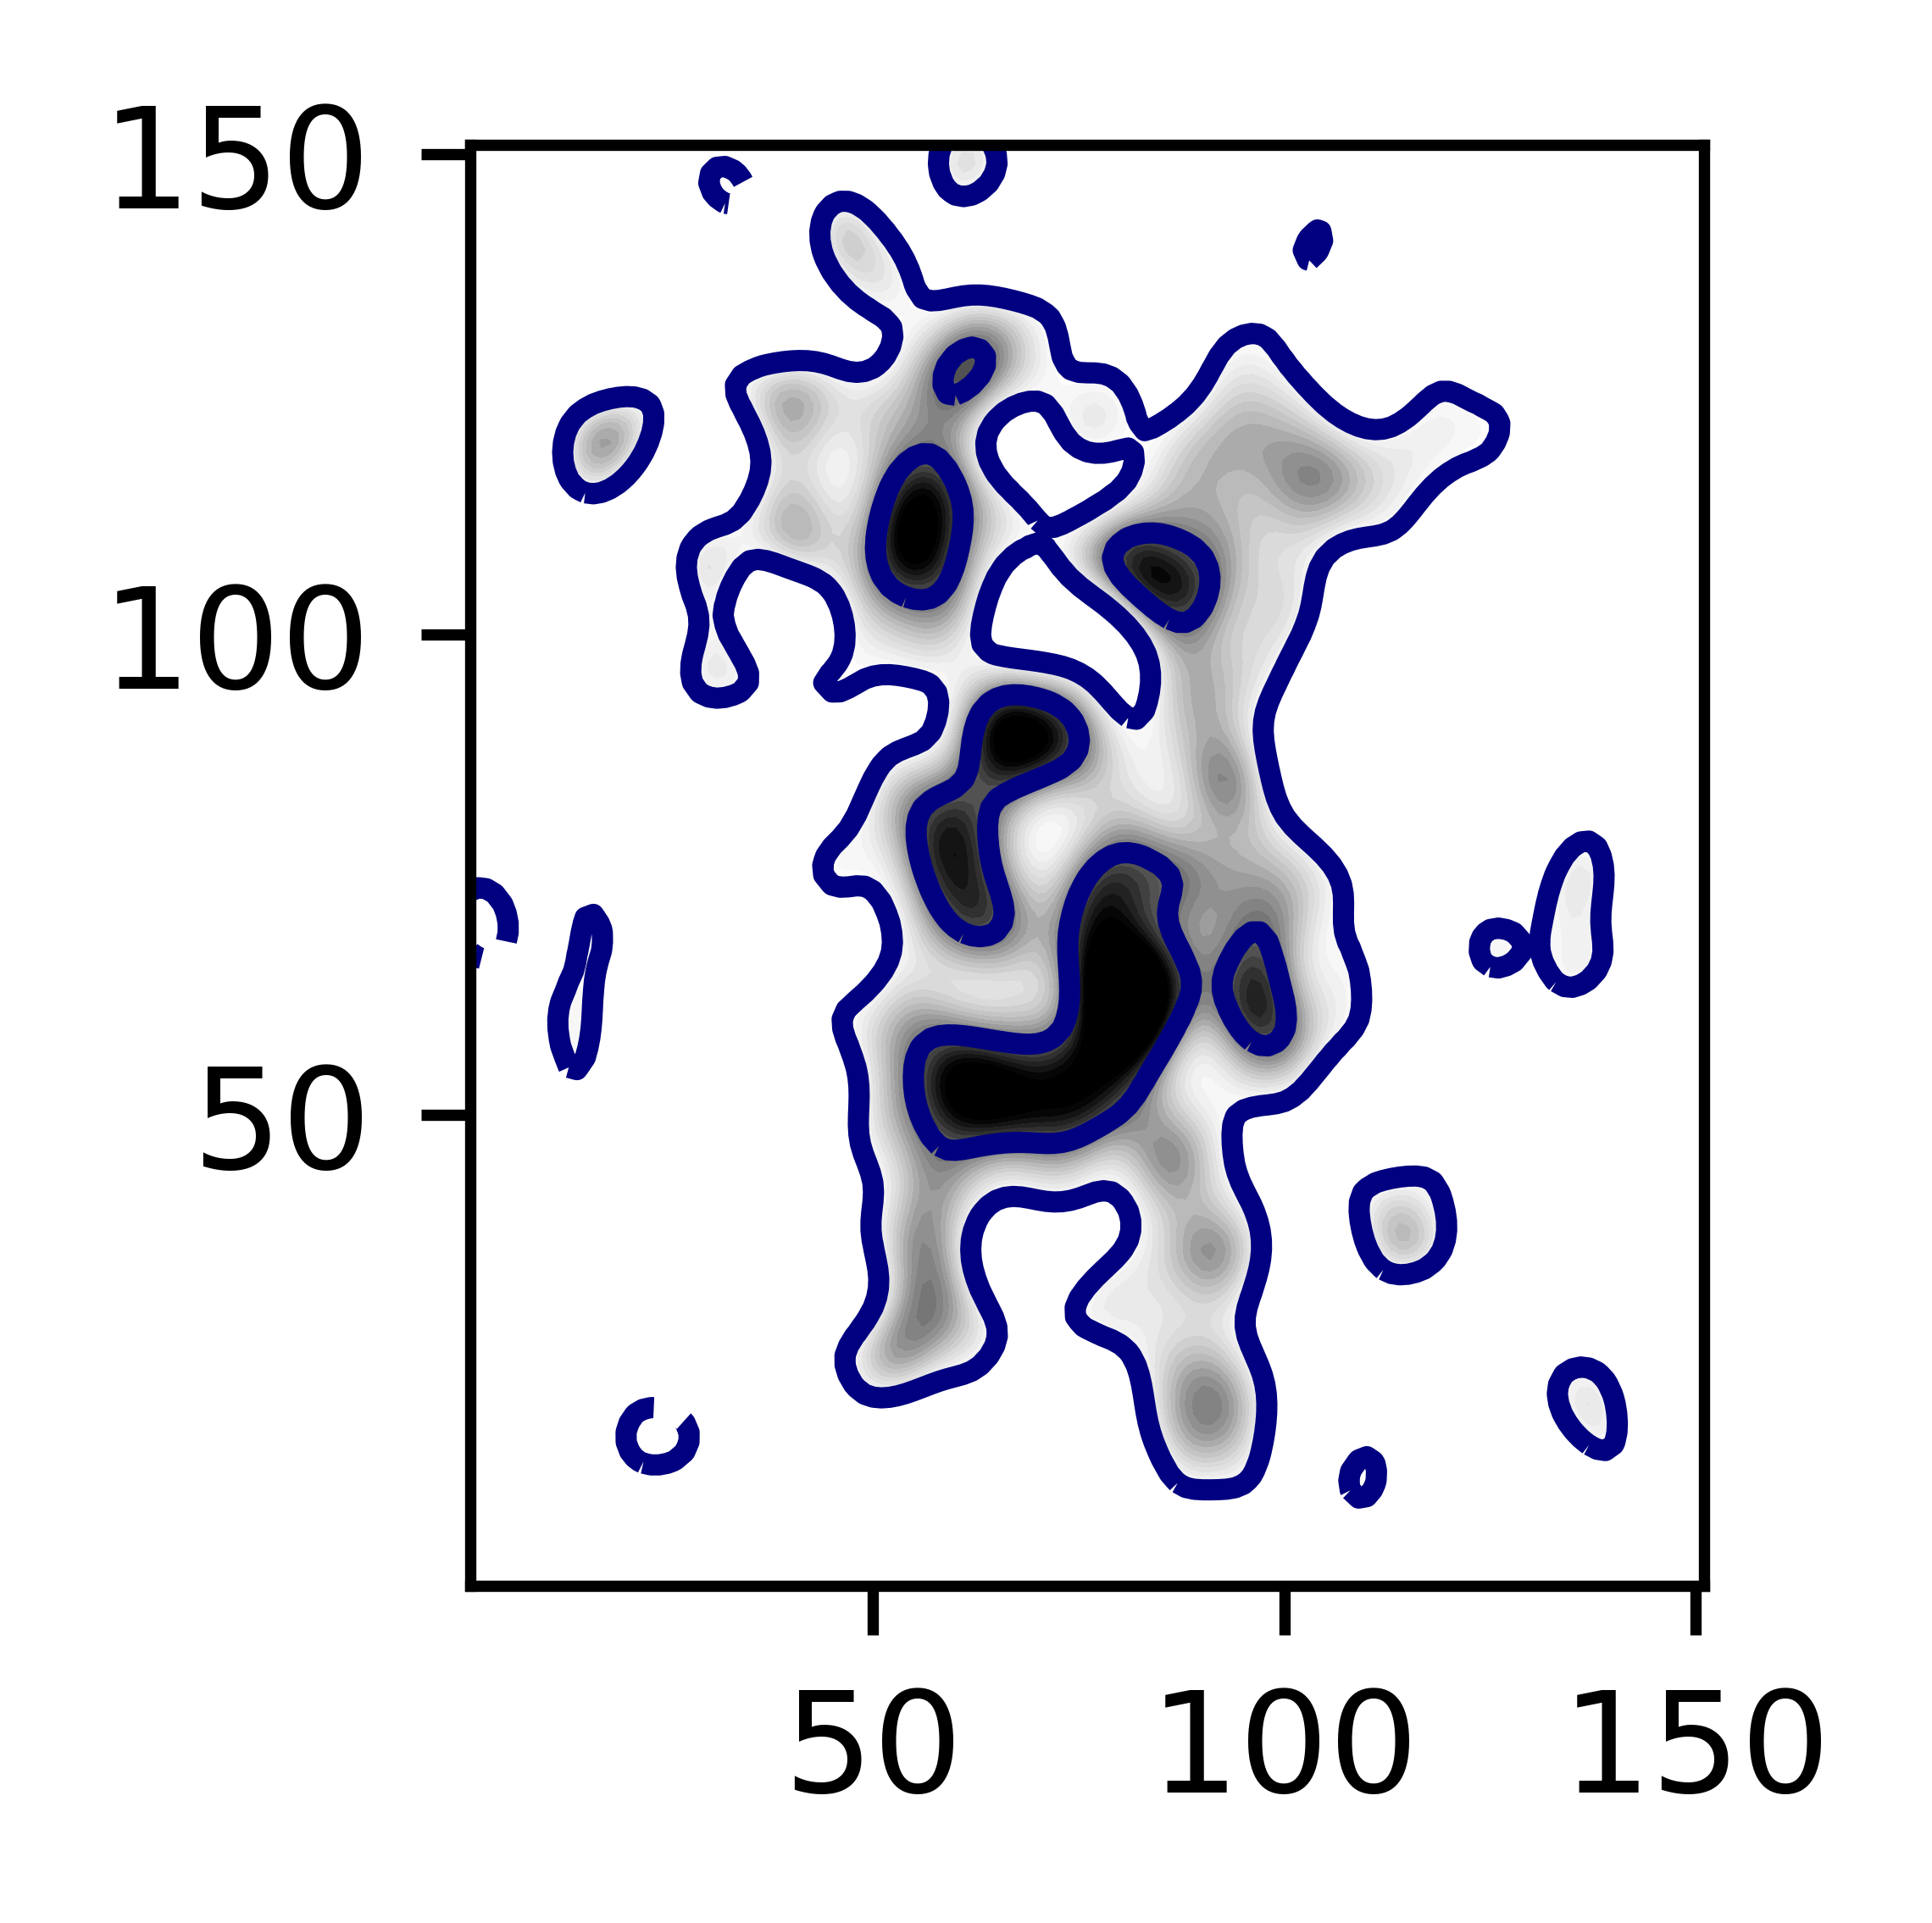
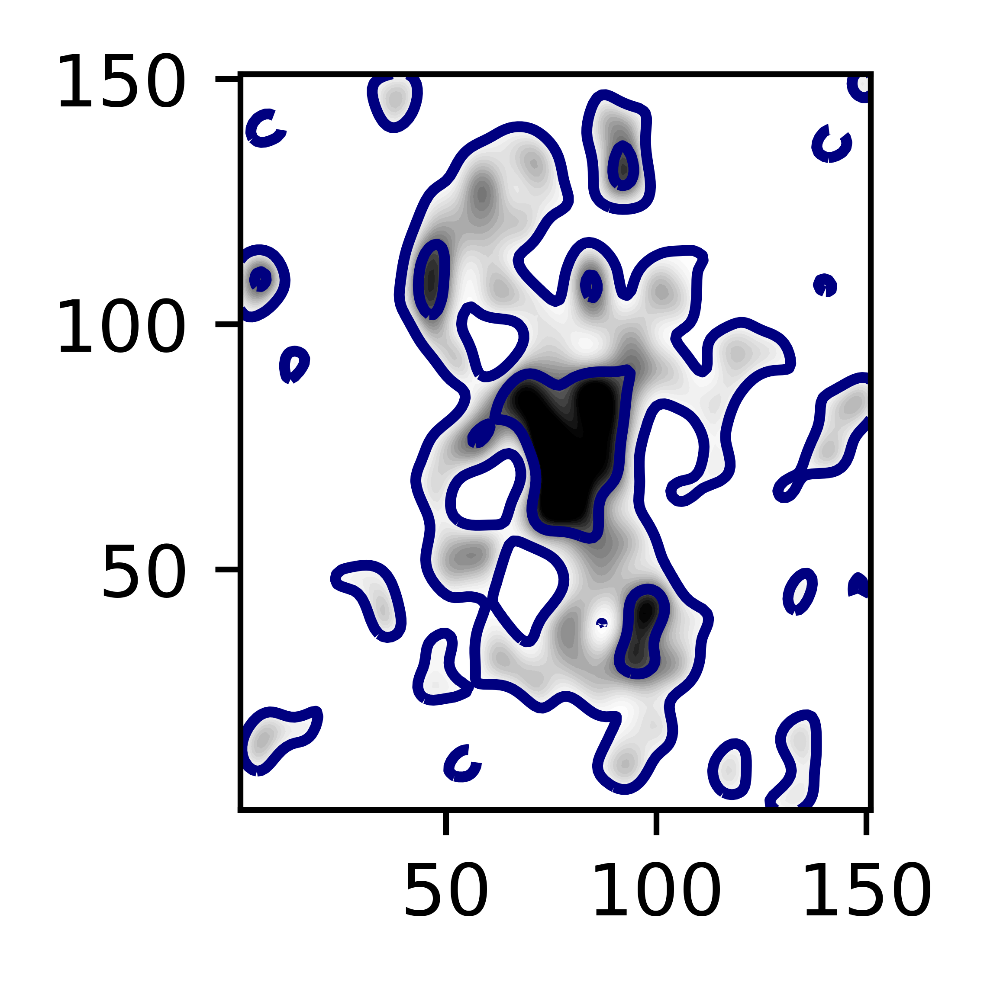
Notes:
Put greater variety of rotation curves in future

Slide 8
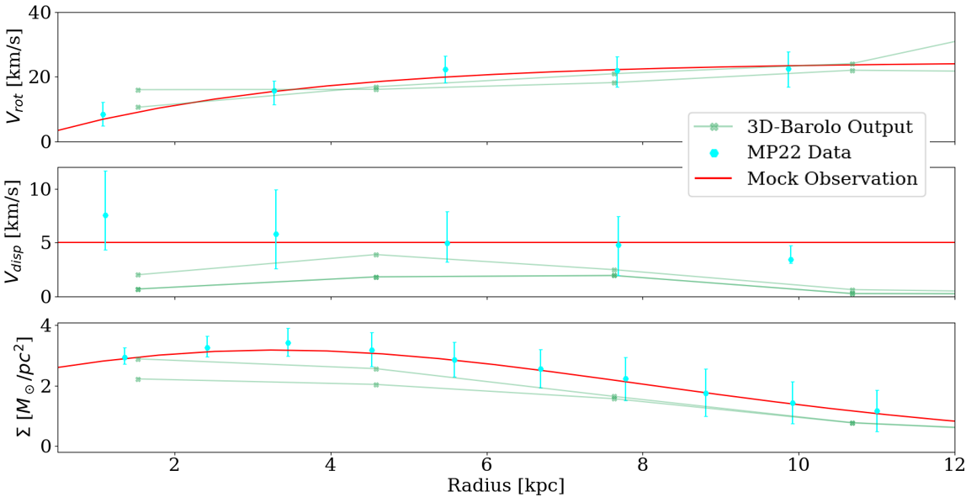
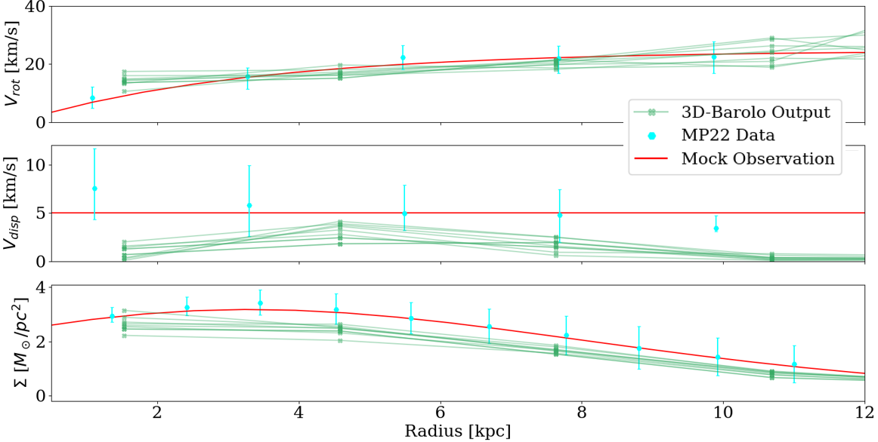
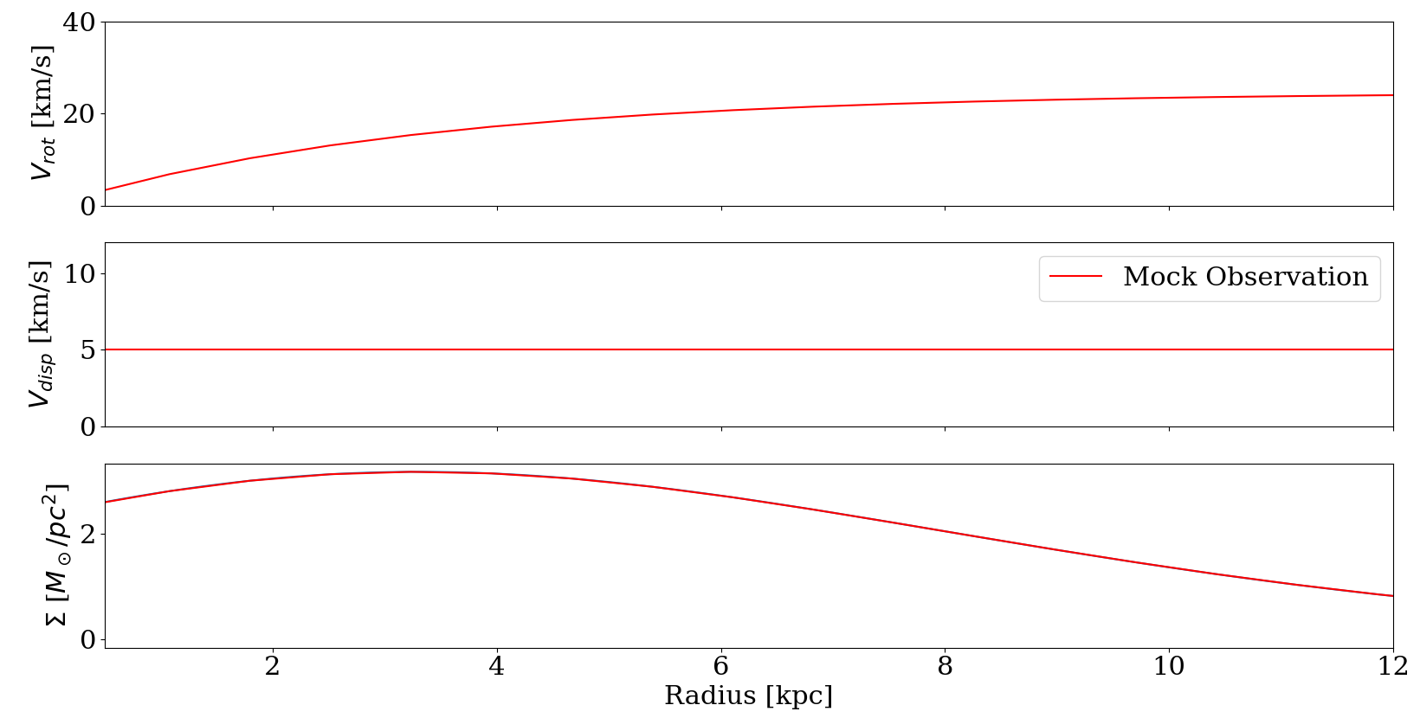
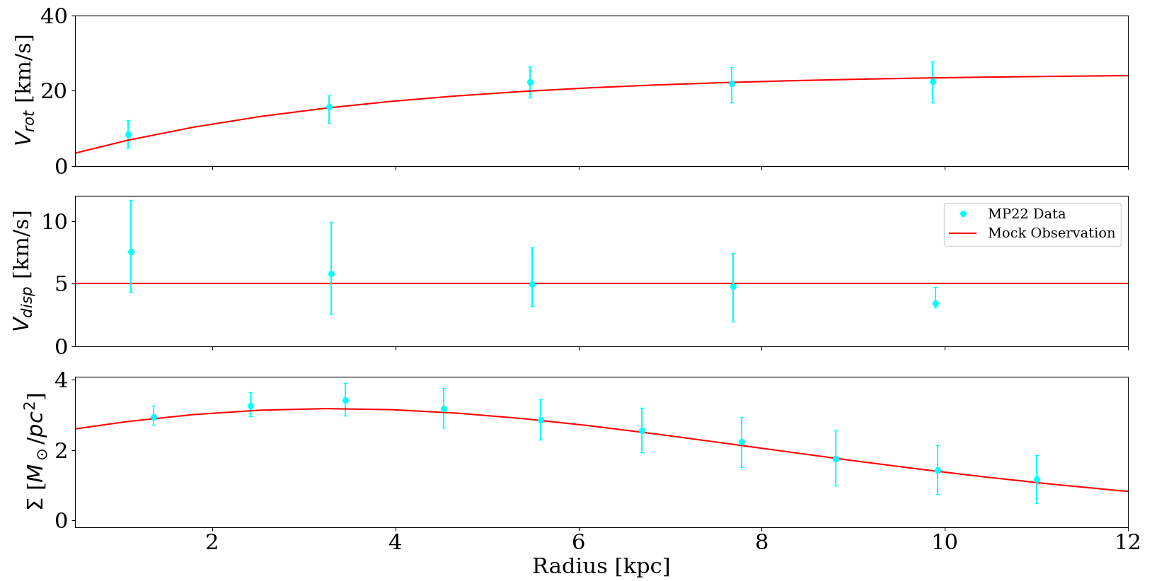
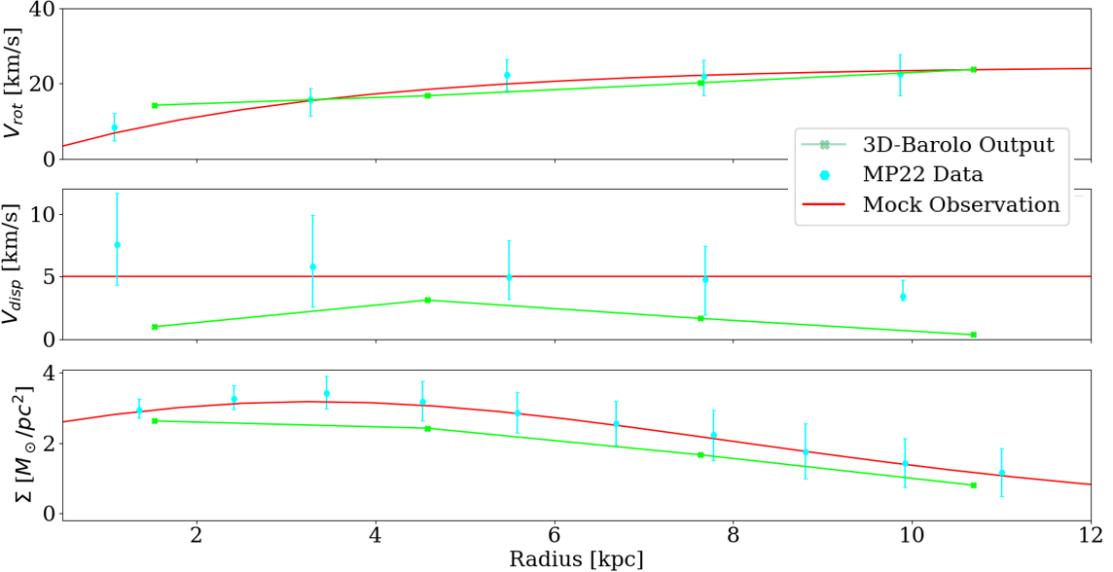
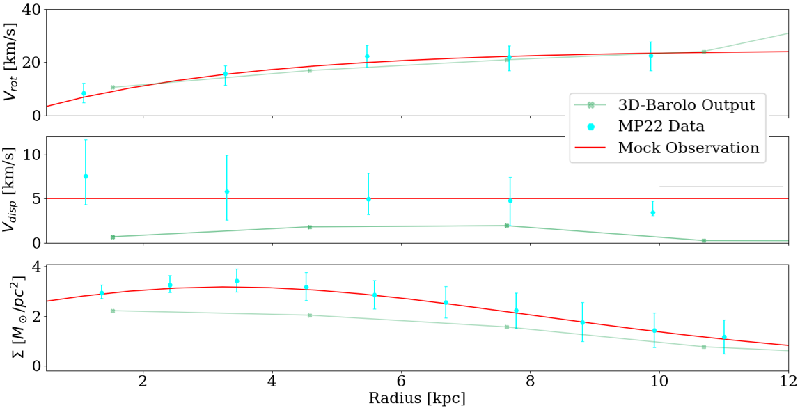


What happens when you put in a MP22-like mock model into 3D-Barolo?
Notes:
Make lines and numbers bigger
Animation Idea:
Starts with plot that shows MP21 data with MCG model for 3 profiles
Then, lines from random seeds begin to appear point by point
Then show median (if time)
Conclusion: The velocity Dispersion is underestimated!

Slide 9
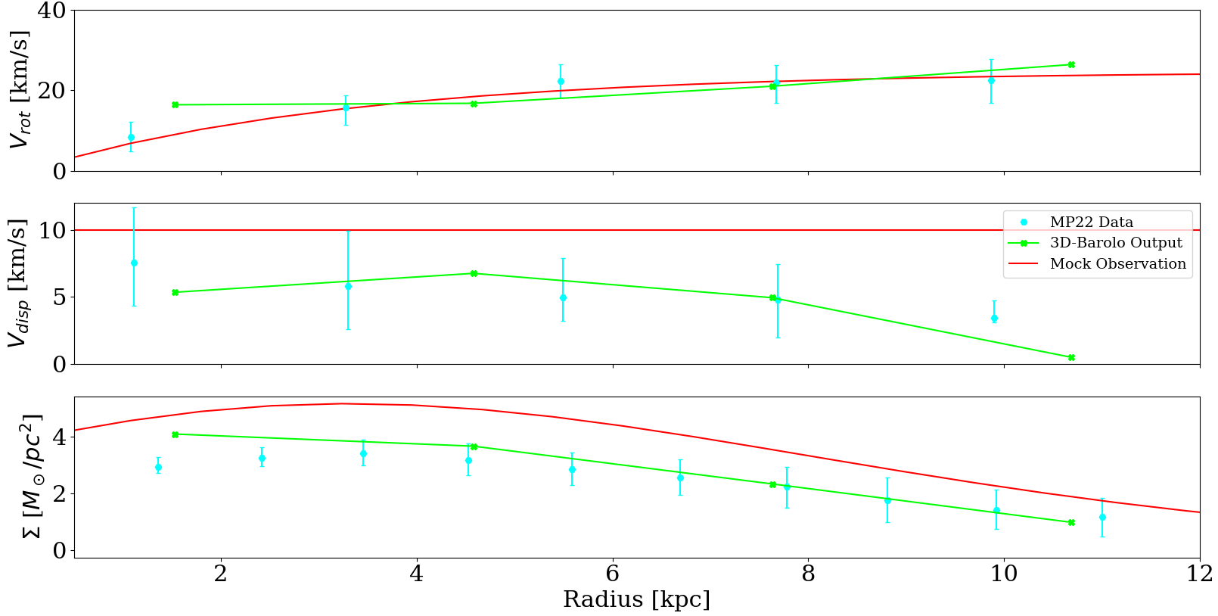
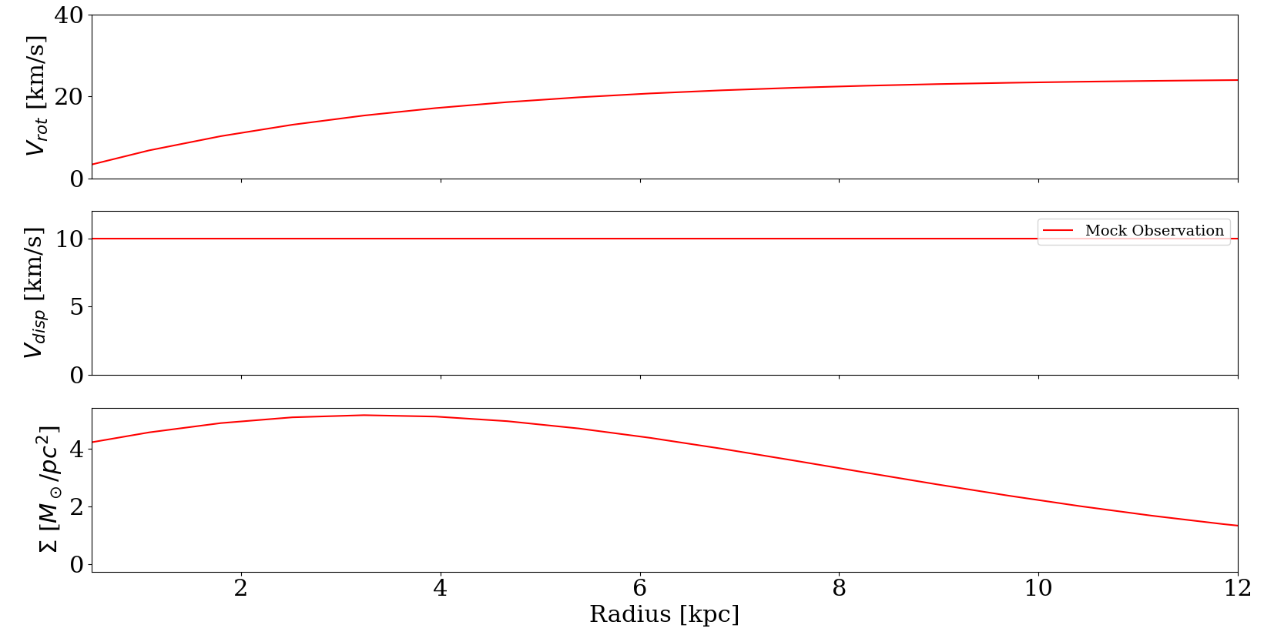
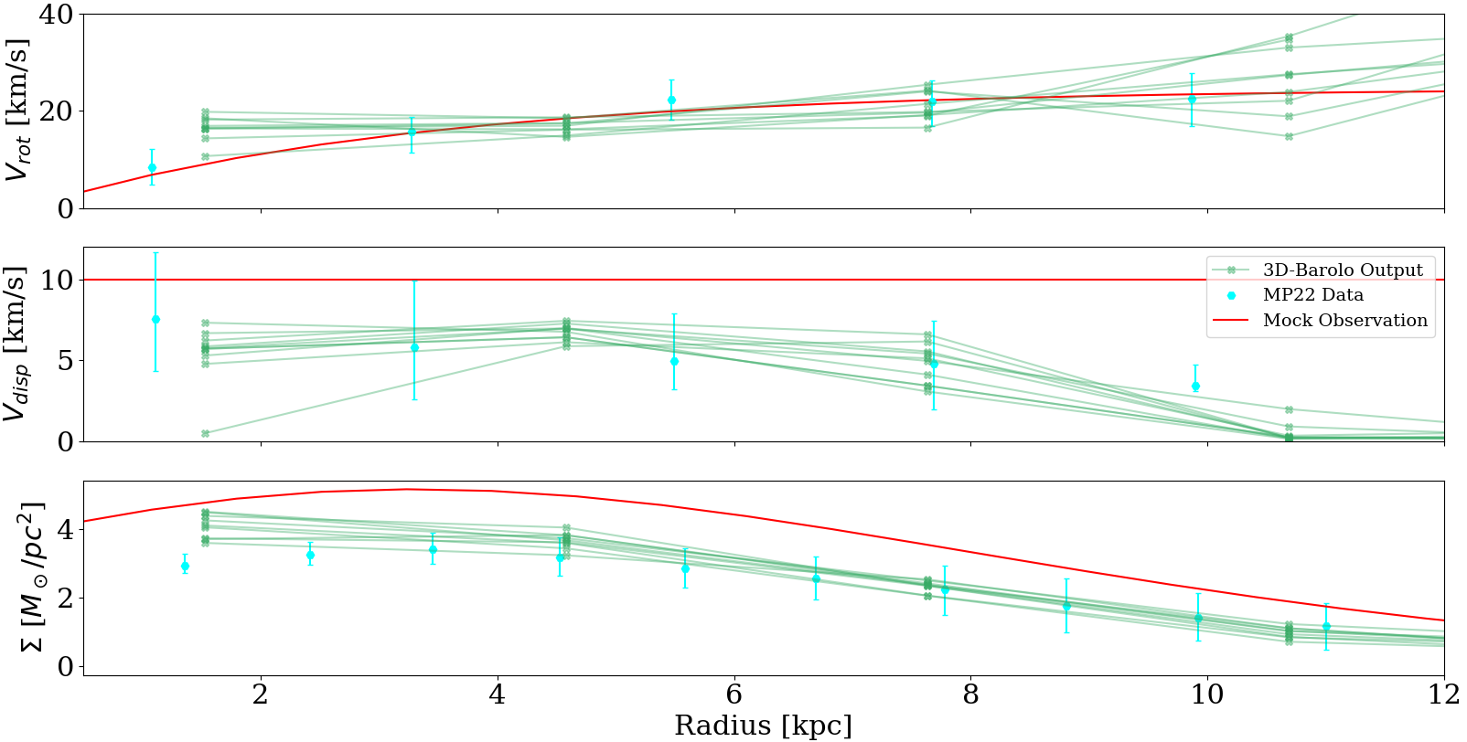
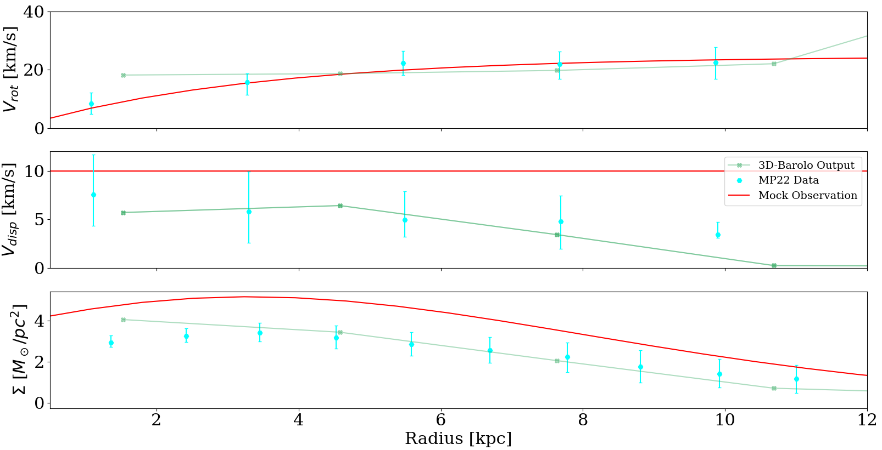
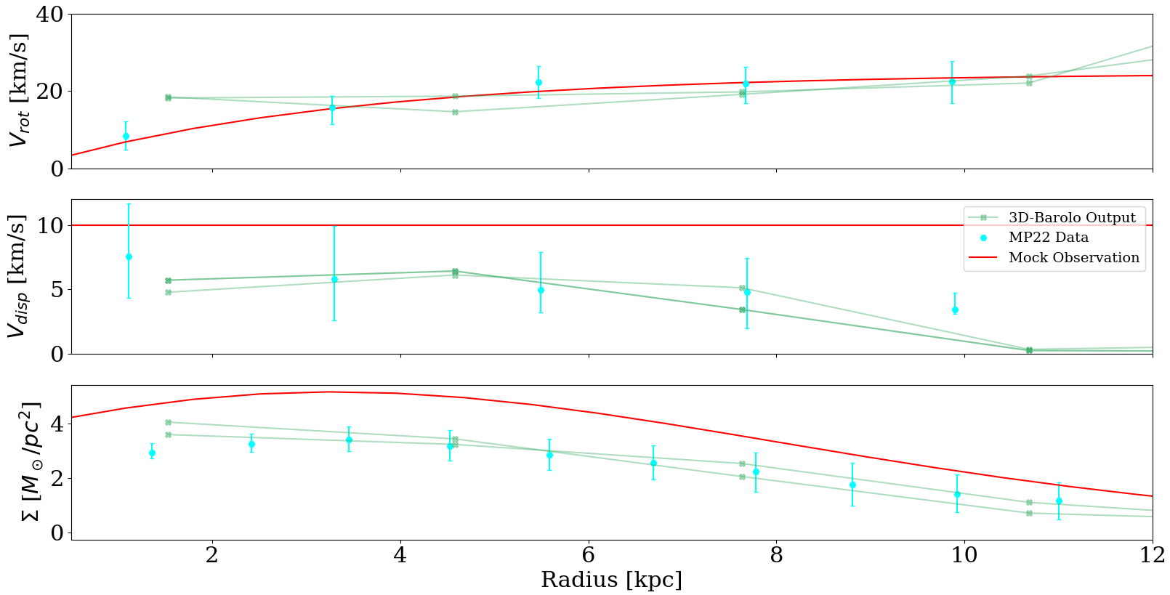
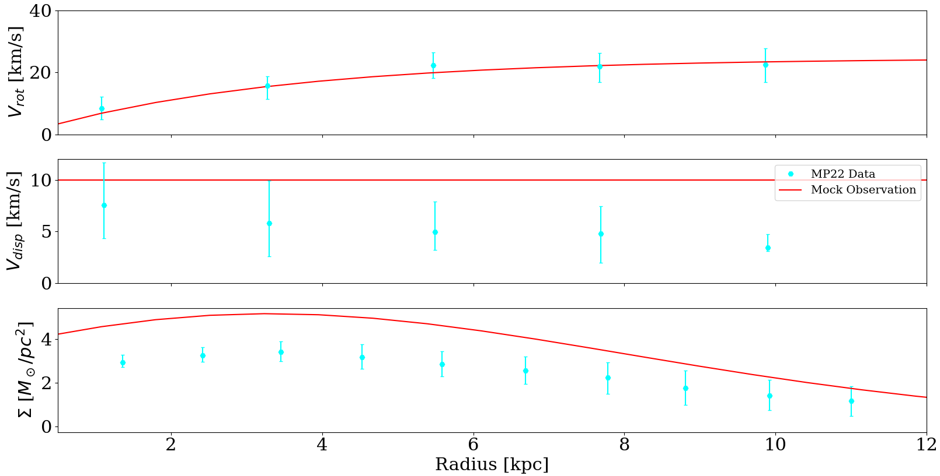
Finding AGC 114905’s Properties
Notes:
Good parts: All 3 fits are looking good
Problem: The integral of the mock model surface density gives 2.5MHI
This is where you summarize the models you made that tried to look like the MP21 plots after being fed into Barolo

Slide 10

Results and Conclusions
By producing mock observations of ultra diffuse galaxies, the accuracy of the kinematics produced by 3D-BAROLO were quantified
The velocity dispersion of AGC 114905 is likely $4.8±0.5 km/s$ higher than what is reported in MP22
Galaxies with higher velocity dispersion tend to have more massive DM halos [4].
Notes:
Velocity Dispersion describes how much the random velocity of gas varies from the mean value at that radius.
4.8 is the mean difference in velocity dispersion between the mock model and the Barolo output. 0.5 is the standard deviation from doing multiple runs.

Slide 11
References
[1] P. G. van Dokkum, R. Abraham, A. Merritt, J. Zhang, M. Geha, and C. Conroy, “FORTY-SEVEN MILKY WAY-SIZED,
EXTREMELY DIFFUSE GALAXIES IN THE COMA CLUSTER,” The Astrophysical Journal, vol. 798, no. 2, p. L45, jan
2015. [Online]. Available: https://arxiv.org/abs/1410.8141
[2] P. E. M. Pi ̃n a, F. Fraternali, T. Oosterloo, E. A. K. Adams, K. A. Oman, and L. Leisman, “No need for dark matter: resolved kinematics of the ultra-diffuse galaxy AGC 114905,” Monthly Notices of the Royal Astronomical Society, vol. 512, no. 3, pp. 3230–3242, dec 2021. [Online]. Available: https://doi.org/10.1093%2Fmnras%2Fstab3491
[3] E. Di Teodoro and F. Fraternali, “3d-barolo: a new 3d algorithm to derive rotation curves of galaxies,” 2015. [Online].
Available: https://arxiv.org/abs/1505.07834
[4] P. J. Elahi, C. Power, C. d. P. Lagos, R. Poulton, and A. S. G. Robotham, “Using velocity dispersion to estimate halo mass: Is the Local Group in tension with CDM?” Monthly Notices of the Royal Astronomical Society, vol. 477, no. 1, pp. 616–623, 03 2018. [Online]. Available: https://doi.org/10.1093/mnras/sty590

Slide 12
Image Credits
AGC 114905: https://earthsky.org/space/dark-matter-missing-from-galaxy-agc-114905/
Milky Way: https://www.amnh.org/explore/ology/astronomy/the-milky-way-galaxy2
Both figures in slide 3 are from ref. [2].
Significance of Results Galaxy: https://astronomy.com/magazine/ask-astro/2017/12/galaxy-rotation
Significance of Results Frisbee: https://commons.wikimedia.org/wiki/File:Frisbee_freestyle_claudio_cigna_2009.jpg
Gravitational Potential Well: https://en.wikipedia.org/wiki/Gravitational_potential
Balloon: https://www.turbosquid.com/3d-models/3d-inflated-balloon/1036754

Slide 13
Key Questions
For a mock galaxy with properties like AGC 114905 in MP22, what do the profiles output by 3D-Barolo look like?
What kind of mock galaxy is needed for 3D-Barolo to output profiles similar to what is seen in MP22?
Notes:
I created mock observations of 114905 and saw how well BAROLO fit these data cubes
Have plots showing how similar your mock models are to 114905 profiles (at inc=32) and channel maps

Slide 14
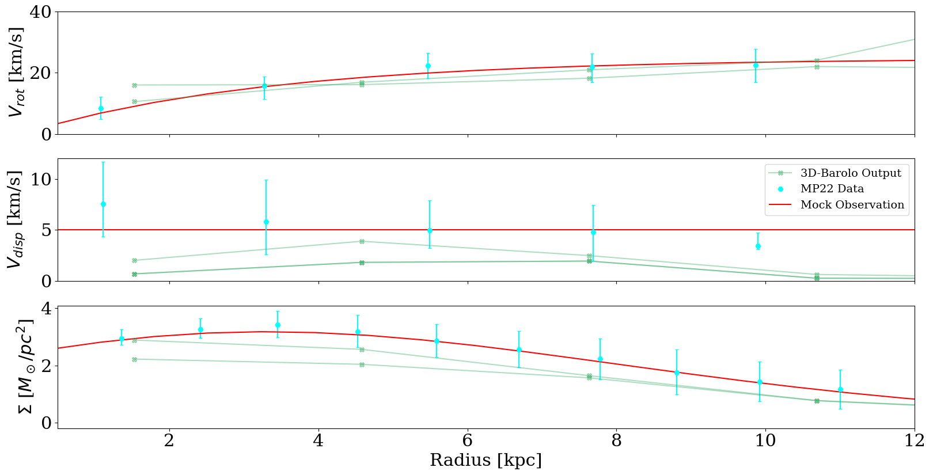
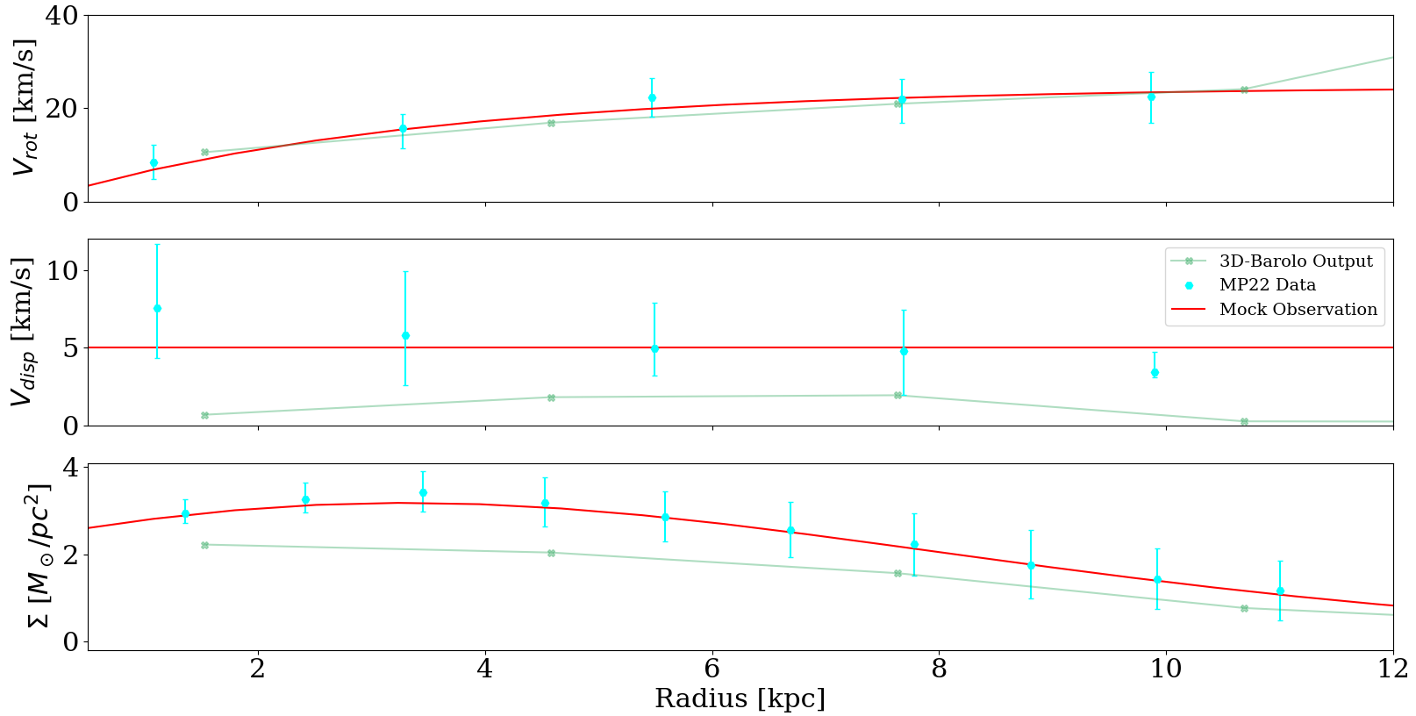
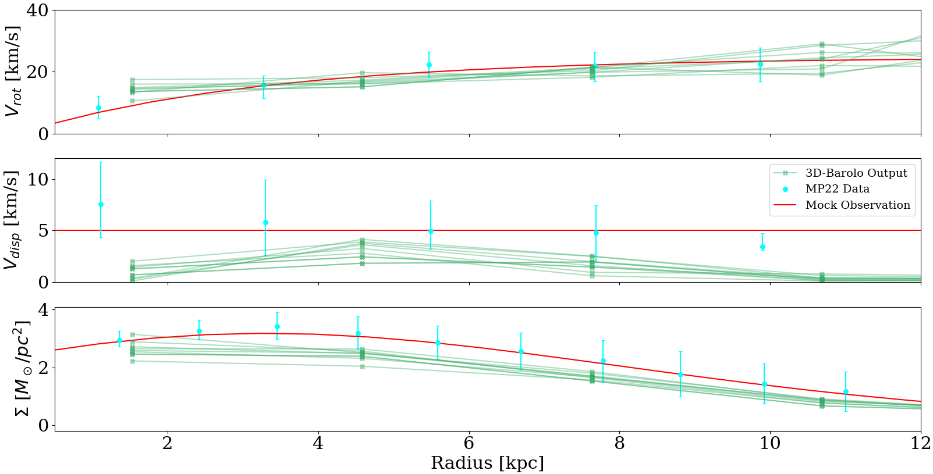
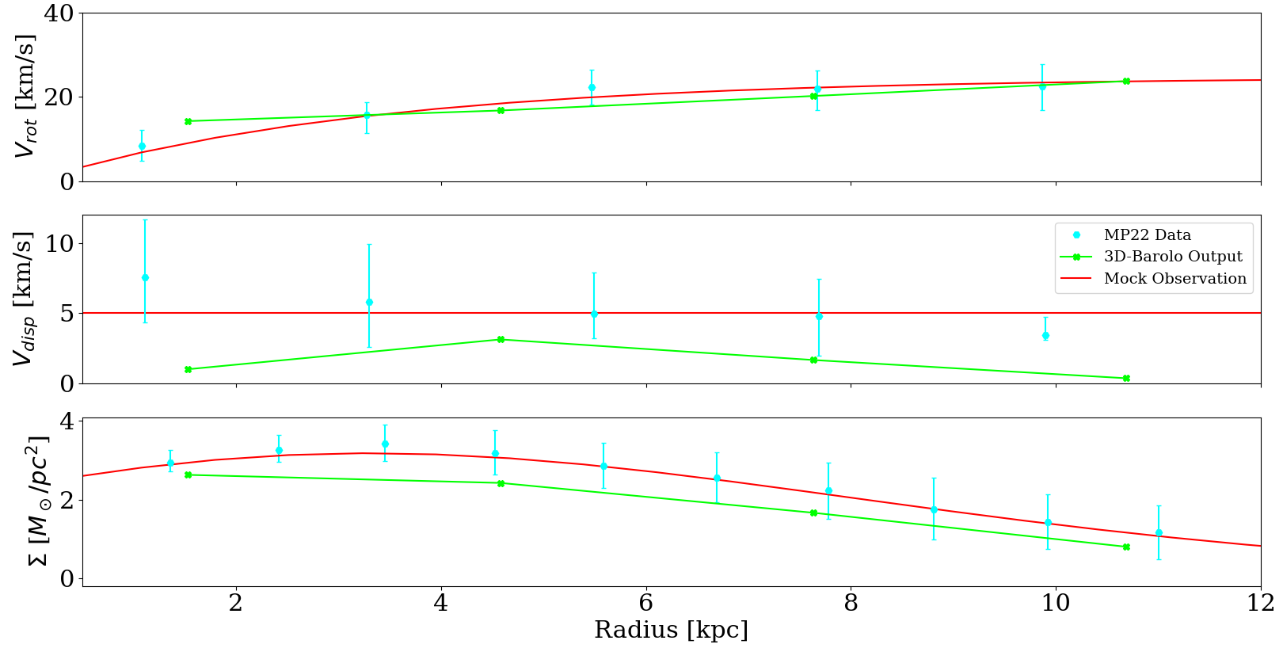

What happens when you put in a MP22-like mock model into 3D-Barolo?
  $V_{disp}$ is underestimated by 2.5 – 4.5 km/s
  Inner Surface density is slightly underestimated
Notes:
Make lines and numbers bigger
Animation Idea:
Starts with plot that shows MP21 data with MCG model for 3 profiles
Then, lines from random seeds begin to appear point by point
Then show median (if time)
Conclusion: The velocity Dispersion is underestimated!

Slide 15

Finding AGC 114905’s Properties
$V_{disp}$ and $Σ\left(r\right)$ are increased within the mock galaxy
The quality of fits between 3D-Barolo and MP22 data increases dramatically
Notes:
Good parts: All 3 fits are looking good
Problem: The integral of the mock model surface density gives 2.5MHI
This is where you summarize the models you made that tried to look like the MP21 plots after being fed into Barolo

Slide 16

Conclusions
The velocity dispersion of AGC 114905 is likely higher than what is published in ref. [2] by $3.5±1$ km/s
This suggests that AGC 114905 could require a DM halo to explain the velocity of matter within it
Notes:
9 minutes and 30s is my quickest run so far
Mention main uncertainties:
MCG produces a very simplified galaxy model
Distance to galaxy is different in MCG than in real life case
Resolution (their data cube has significantly more pixels across)

