Slide 1
Simulating the Capture of Asymmetric Dark Matter in Stars
Madelynn Mast

Slide 2


Slide 3
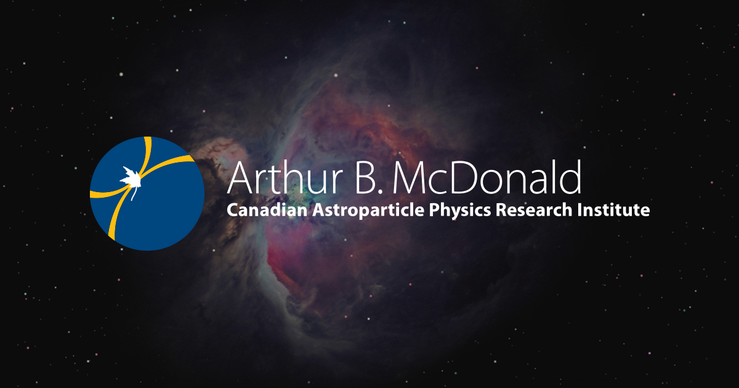
Notes:
This summer I was hired by the Arthur B. McDonald institute as a McDonald Institute Summer Fellow.

Slide 4
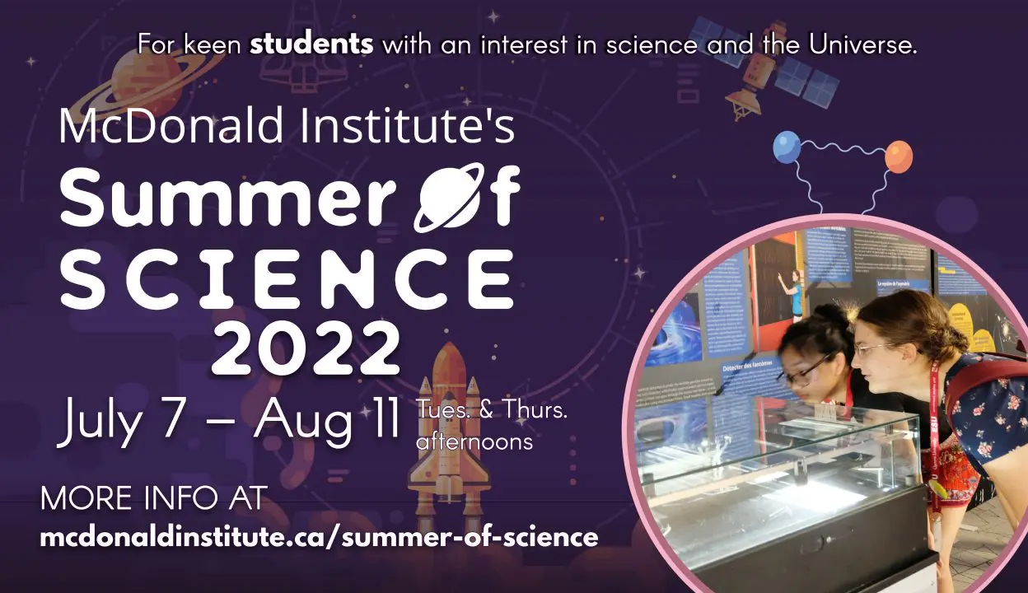
Notes:
Me and the 5 other fellows spent half our summer working on Summer of Science, a summer camp that teaches introductory particle astrophysics to high school and middle school students

Slide 5
The Second Half
Simulating the Capture of Asymmetric Dark Matter in Stars
Notes:
The other half of my summer was spent working with Professor Aaron Vincent on a project to simulate the capture of asymmetric dark matter in stars which is what I'll be talking about today.

Slide 6
The Plan
Notes:
So with introductions out of the way, Let's get into my research plan for the summer.

Slide 7
Look at Stars.
Find Dark Matter.
Notes:
Look at Stars, Find Dark matter

Slide 8
Sounds Simple Right?
Notes:
That’s pretty simple right? Not ambitious at all?

Slide 9
Simulating the capture of asymmetric dark matter in stars.
Notes:
SO what I'm currently doing to achieve that is simulating the capture of asymmetric dark matter in stars. Let's break down that title step by step

Slide 10
Simulating the capture of asymmetric dark matter in stars.
Notes:
First we have the theortical capture of dark matter

Slide 11

Picture from Symmetry Magazine
Notes:
The idea here relies on the theory that dark matter is a WIMP. WIMP stands for weakly interacting massive particle. This would mean that dark matter could interact with standard model particles in some capacity. If this is true, then it can lose enough velocity so that it can no longer escape the gravitational field of the star itself, and be trapped inside.

Slide 12
Simulating the capture of asymmetric dark matter in stars.
Notes:
Next we have the concept of asymmetric dark matter

Slide 13
Asymmetric
No Self Annihilation
No Decay
No Evaporation
Notes:
For sake of time I will not go into the details of asymmetry or symmetry of all particles, but in this case asymmetric refers to the fact that the particle does not self-annihilate, evaporate, or decay. This means that once gravitationally trapped, it does not simply remove itself from the equation when it come into contact with its antiparticle. This would mean that the dark matter stays trapped and continues to act on the matter of the star.

Slide 14
Asymmetric WIMPs
Notes:
So now we have solidified the concept of an asymmetric WIMP as our dark matter candidate. Next,

Slide 15
Simulating the capture of asymmetric dark matter in stars.
Notes:
We can discuss what affect this would have on a star using two new fields

Slide 16
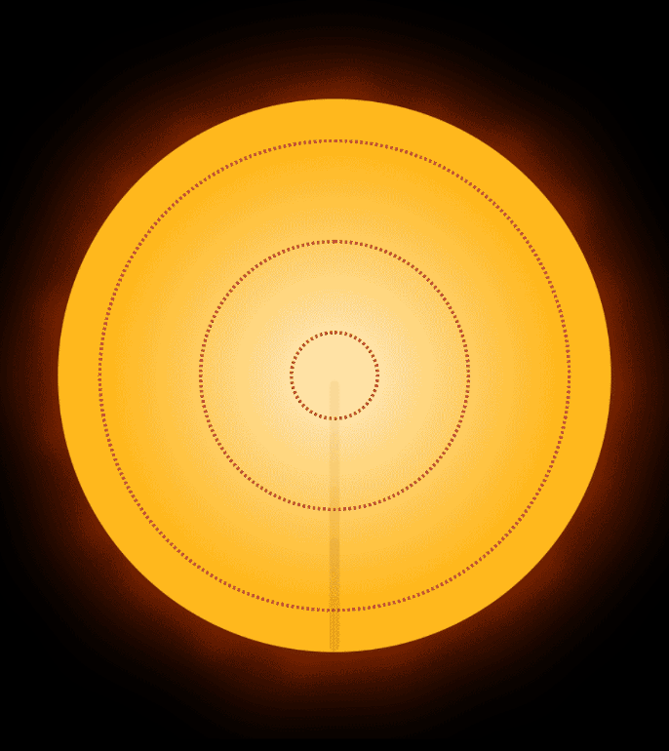
Asteroseismology and Helioseismology
Picture from Sydney Institute for Astronomy
Notes:
Asteroseismology and Helioseismology. Both of the fields rely on studying pressure waves inside stars to interpret the density, temperature, gas motion and other properties of the stellar interior. This leads us to own main problem in the field
We can also use thinks like neutrino flux from for example the sun to cross examine our current models of stars to the actual outputs measured by astronomers

Slide 17
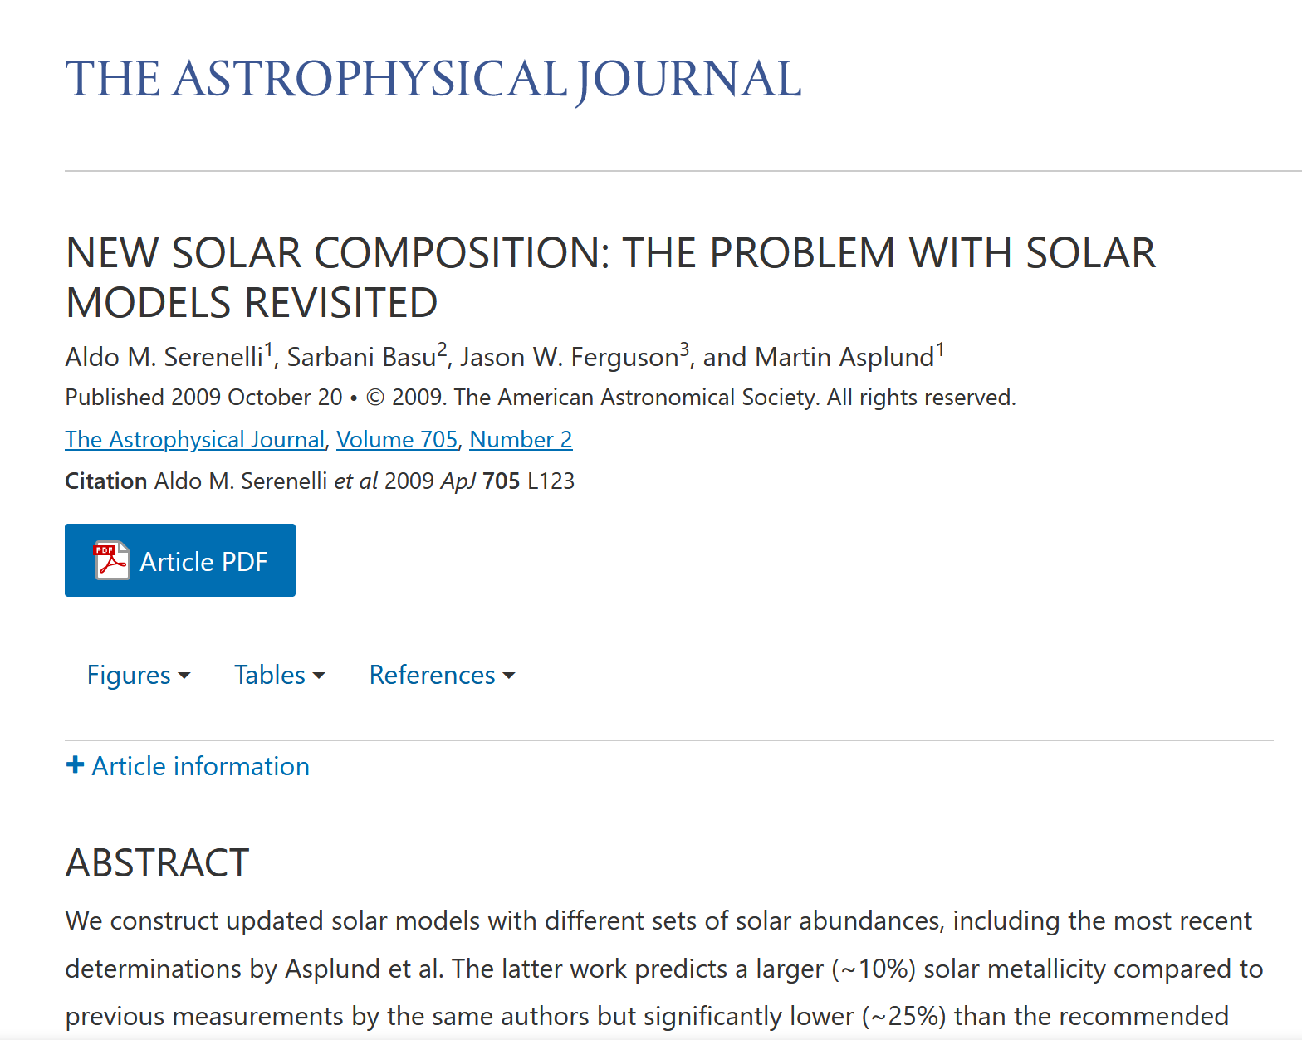
Our Star Models are wrong
Notes:
Many of are Star models are wrong, in the paper pictured here, Serenelli et al, they discuss the issues between our standard solar models and helioseismology readings. The basis of these discrepancies is that readings show that the core of the sun should not be as hot as our models predict. This leads us to Dark Matter.

Slide 18
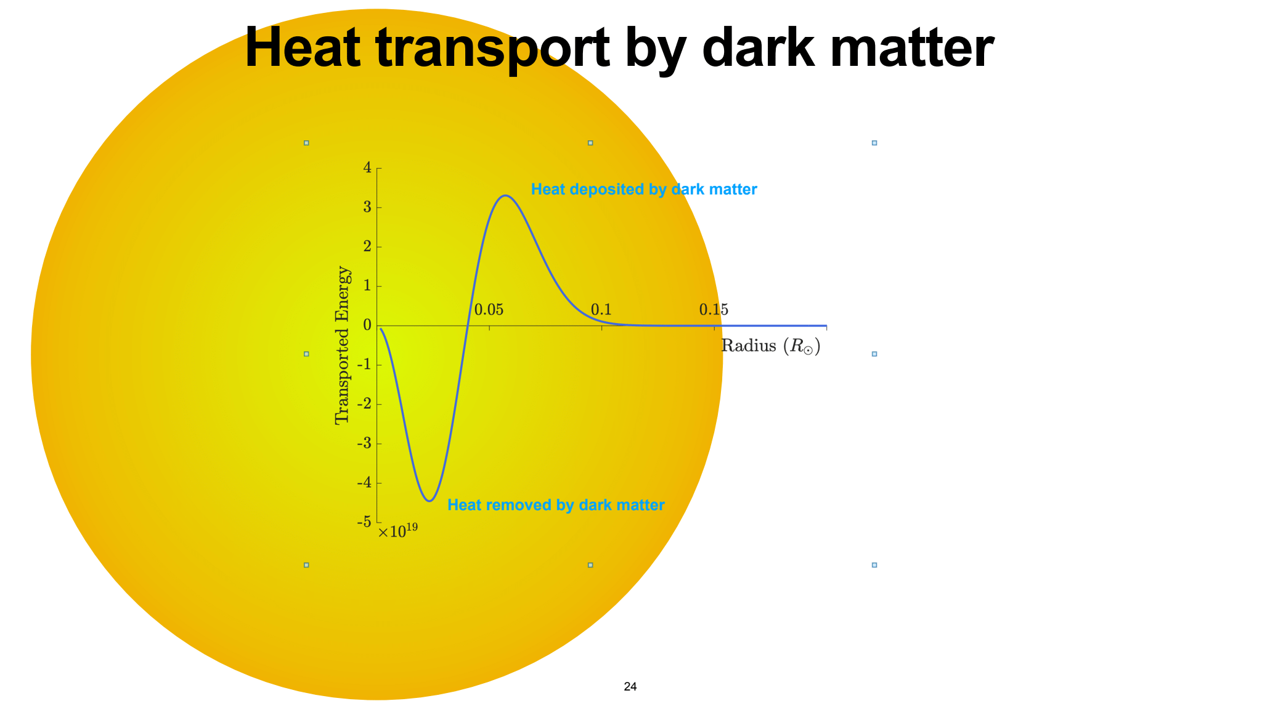
Graphic from Professor Aaron Vincent
Notes:
The theory proposed in my guiding literature is that Dark matter bumping around in the sun can move heat from the inner core and diffuse it outward. This would make the core less hot. And if this can happen in the sun, it could happen in other stars as well

Slide 19
Simulating the capture of asymmetric dark matter in stars.
Notes:
This naturally leads us to wanting to simulate these dark matter interactions in the sun and other stars which is the bulk of my work

Slide 20


Hannah Banks
Siyam Ansari
Pat Scott
Aldo Serenelli
Luke Fraser Leach
Rashaad Reid
Madelynn Mast
Audrey Fung
Neal Avis Kozar
Aaron Vincent
Graphic from Professor Aaron Vincent
Notes:
The team that currently works on this theory as a whole is quite big with particular credit going out to my professor Aaron Vincent and Hannah Banks who are the main writers of the literature I use.

Slide 21
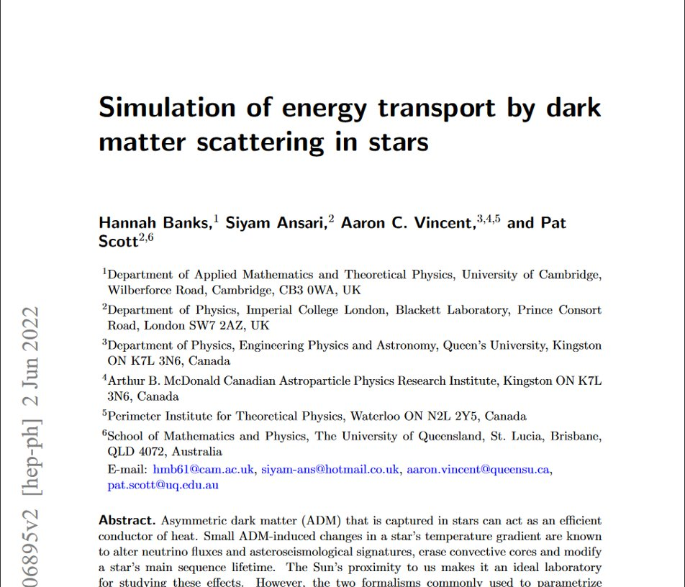
Notes:
My job is help extend the research done by the aforementioned team to be used on a wider scale. The paper I use to base most of my code off of is "Simulation of energy Transport by Dark Matter Scattering in Stars" which I'll refer to as Banks et. al. This paper synthesizes multiple previous theories such as and Gould and Raffelt written in 1990, to create a new recalibrated equation for how the heat is transported through the star by dark matter.

Slide 22
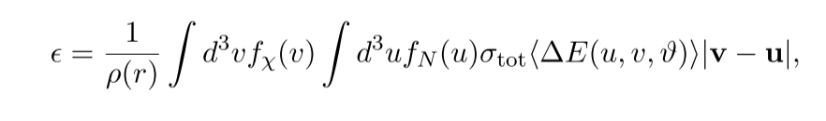
Equations from Banks et. al
Notes:
Their findings from the original research found that the equation from Spergel & Press while theoretically disproven, shows a better fit than the

Slide 23
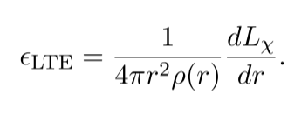
Equations from Banks et. al
Notes:
Gould & Raffelt equation which needs a significant amount of modulation and suppression factors to provide accurate fits.

Slide 24
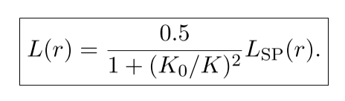
Equations from Banks et. al
Notes:
Because of this our team has decided to use the Spergel and Press equation as the basis, because the correction to fit Monte Carlo simulation results is relatively easy. (correction fix here) This new equation has been proven to work in a snapshot of a star

Slide 25
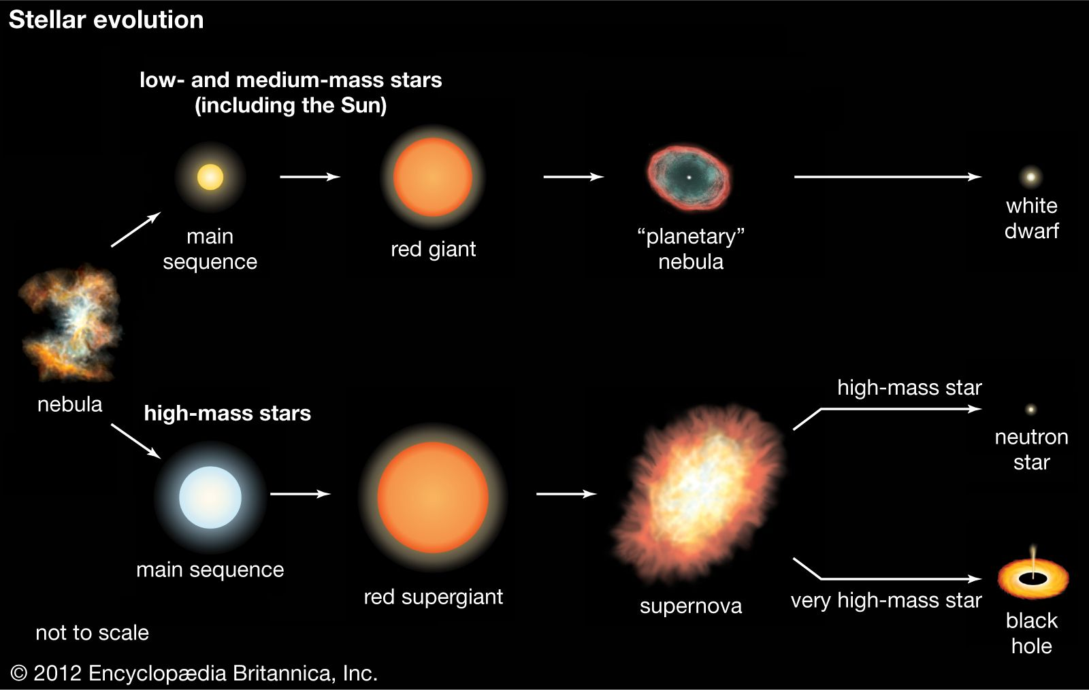
Notes:
But for the theoretical equation to be tested against observable data, we need the heat transport over the evolution of the star. This leads to a very special friend

Slide 26
Fortran
Notes:
A lot of Fortran

Slide 27
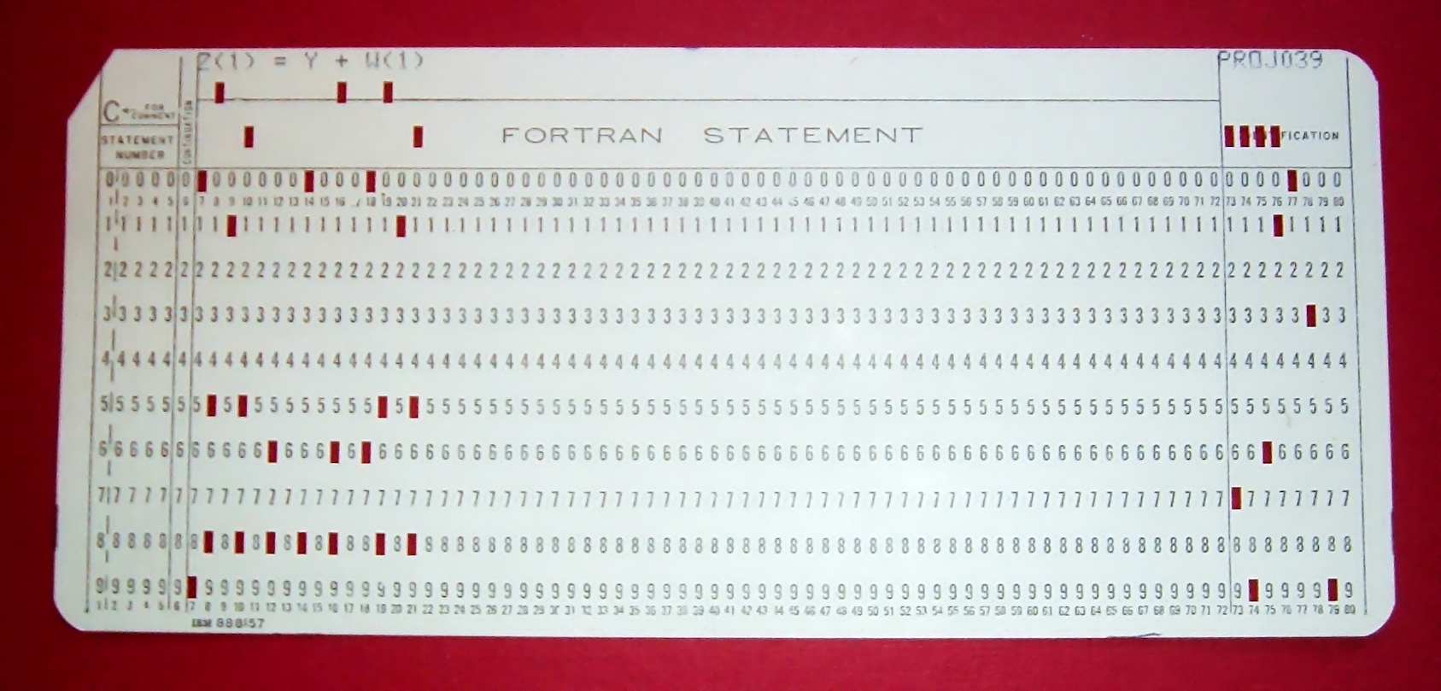
Not this kind of Fortran...
Notes:
Luckily I'm not using punch cards anymore

Slide 28
But I do spend most of my time coding in Fortran 90
Capt’n General
Cosmion
Notes:
The code for Banks et al is done in Matlab, but this is too slow for the amount of data used in stellar evolution models. This means that all the equations need to be transported over to a fortran based repository A large section of code exists already in repositories known as Capt'n General and Cosmion. The Cosmion contains code for the Monte Carlo simulations, but I spend my time working on the code in Capt’n General on the heat transport

Slide 29
Progress
Recalibrated Equation
Higher DM mass
V and Q cross sections
Notes:
Since the beginning of the summer I've added the recalibrated equation for our current understanding of heat transport, updated the code so masses of dark matter above 8 GeV do not cause crashes, and implemented multiple velocity and momentum dependent cross sections for the dark matter interaction.

Slide 30
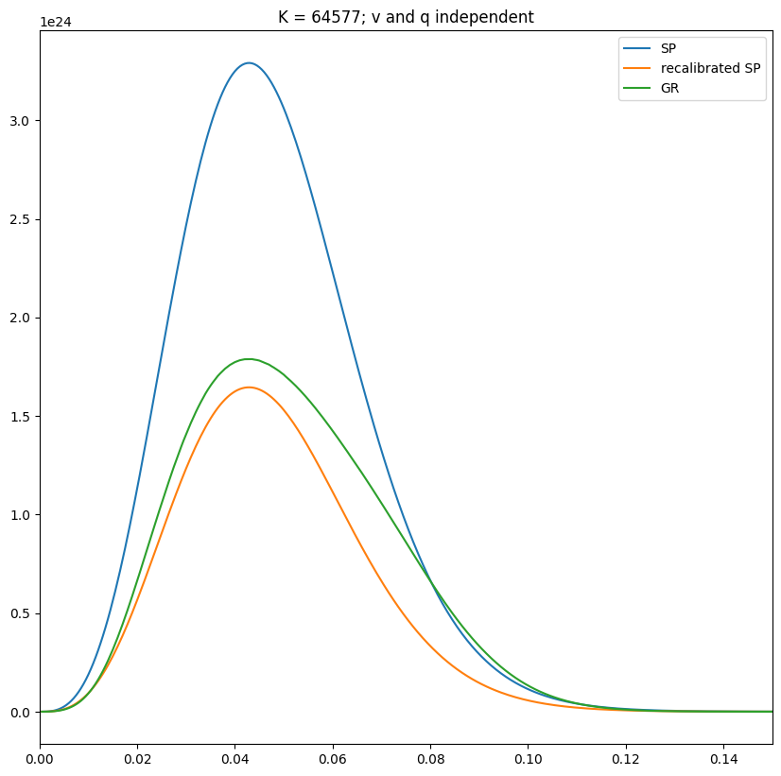
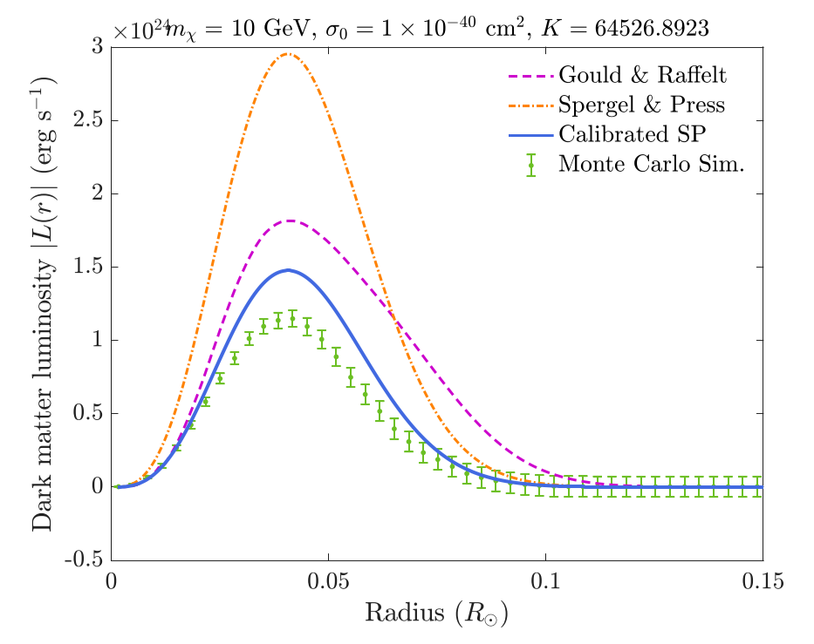
Notes:
To showcase this I've managed to recreate all the Hertzsprung-Russel diagrams from the Banks et al paper using the Fortran code as pictured here. Minor discrepancies remain, but are currently assumed to be from using a slightly different solar model in the Fortran code. I have the graphs for one of the velocity and momentum independent functions shown here.

Slide 31
a LOT of CPU hours
Notes:
The next step in the data analysis process that is ongoing at this moment but not finished enough to present is using a stellar evolution module known as MESA to simulate this transport in multiple stars. This will hopefully lead to data that can be checked against current ongoing Monte Carlo simulations of this same theory and eventually observables.

Slide 32
Future Work
Checking Observable Data
01
Checking Assumptions
02
Notes:
The future work that needs to be done would be checking the theoretical models created in my time here against observed data, as well as checking our current assumptions made in the Banks et. Al paper.

Slide 33
Thank YOU!!

