Slide 1
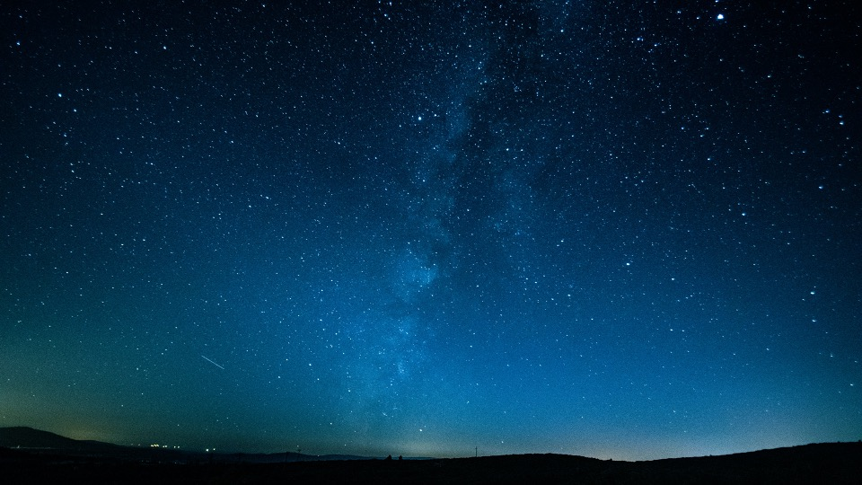
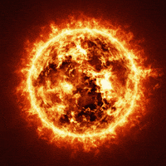
How the Sun Shines
An Educational Content Kit
By Maggie Oxford

Slide 2
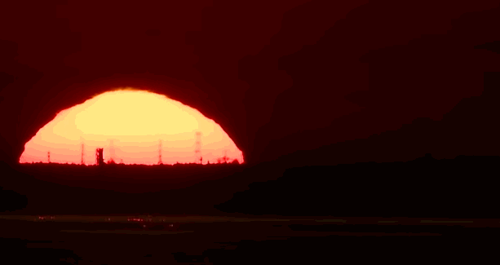
Contents
Main Concepts
Elementary
Middle School
High School
Highlights

Slide 3
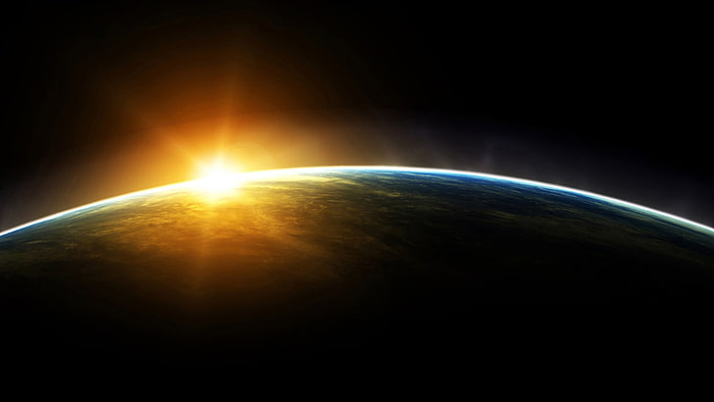
Main Concepts
Particle Physics
Nuclear Fusion
Solar Energy
Solar Neutrino Problem
Power

Slide 4
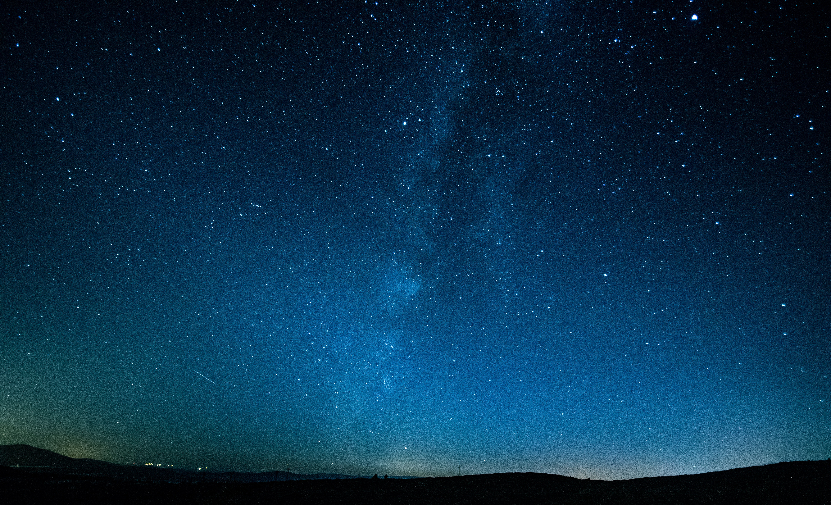

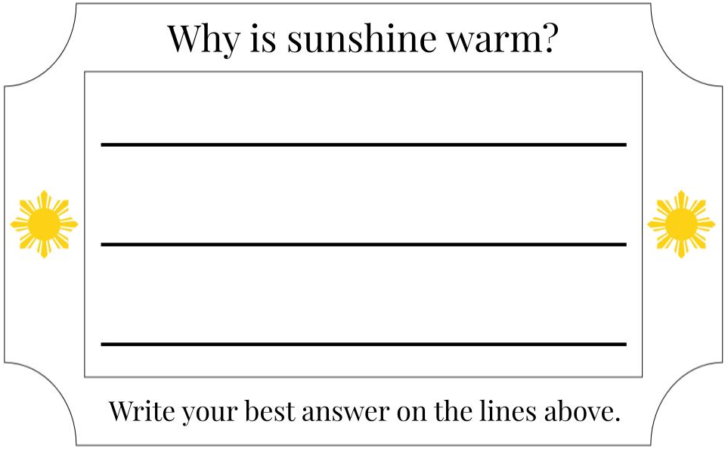


Elementary – A Trip to the Sun

Slide 5
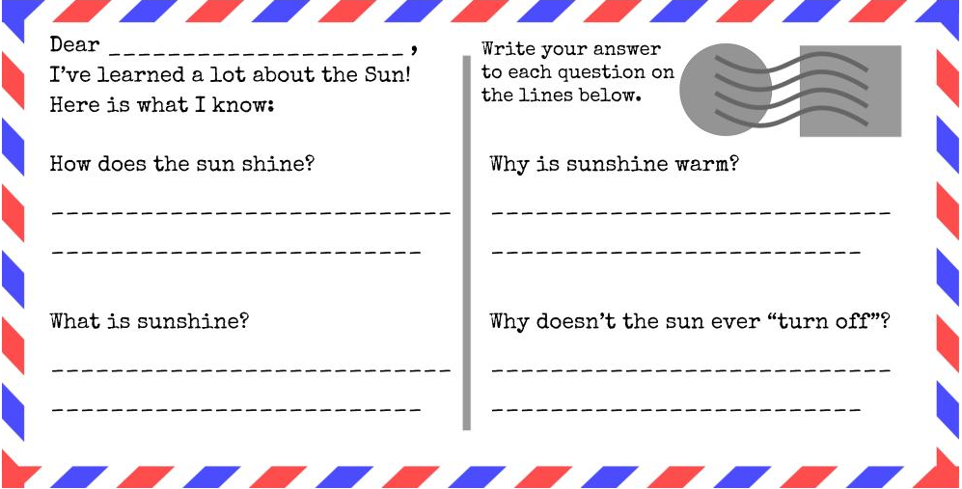

Elementary – A Trip to the Sun

Slide 6
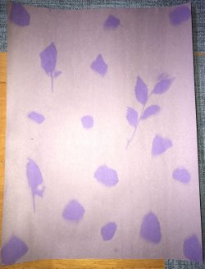

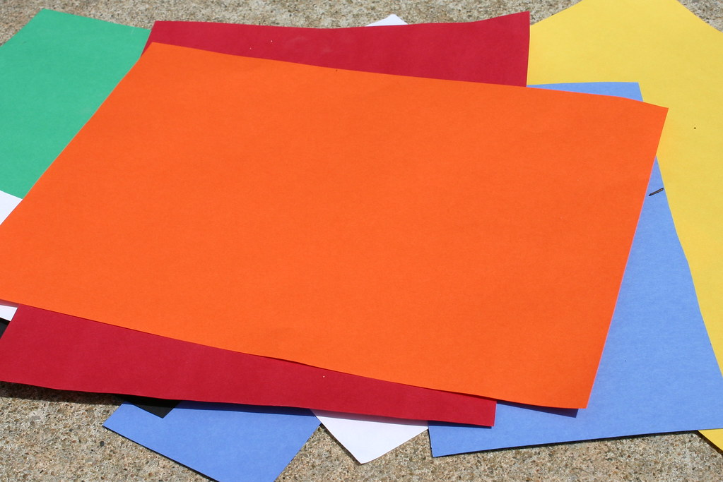
Elementary – Solar Energy
Create art with the power of the Sun!
+
+
=

Slide 7
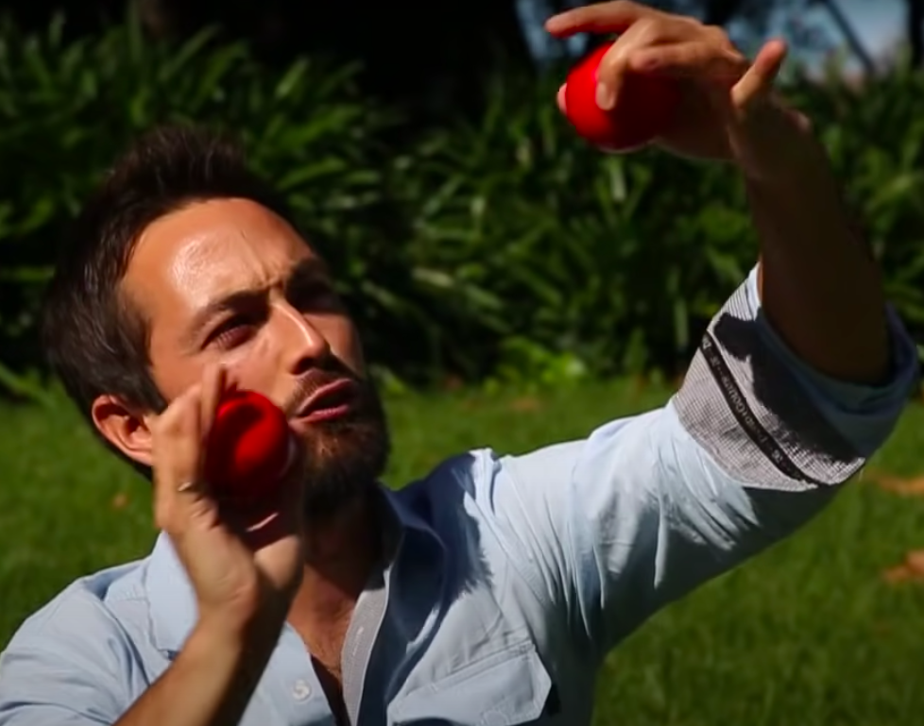
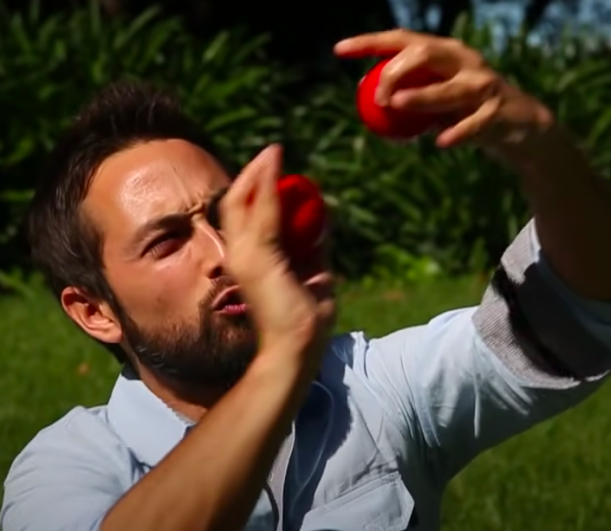
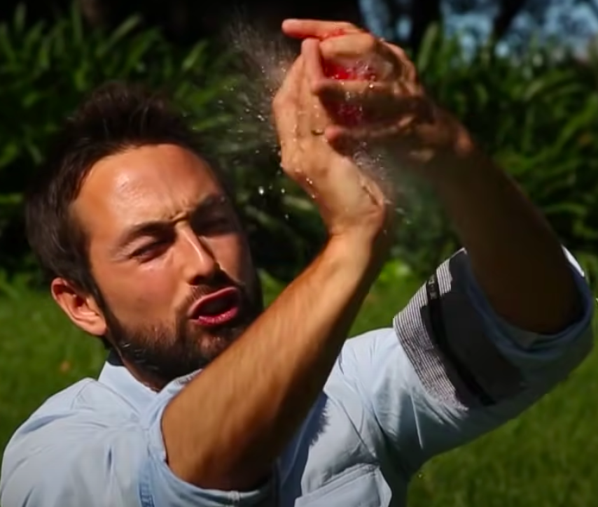
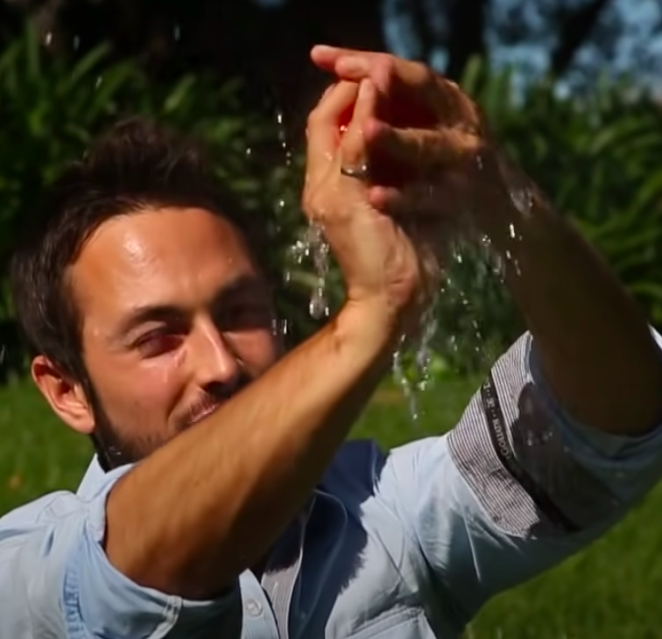
Elementary – Nuclear Fusion
Red Sponge = Hydrogen (Proton)
Water = Energy
Credit: Veritasium

Slide 8
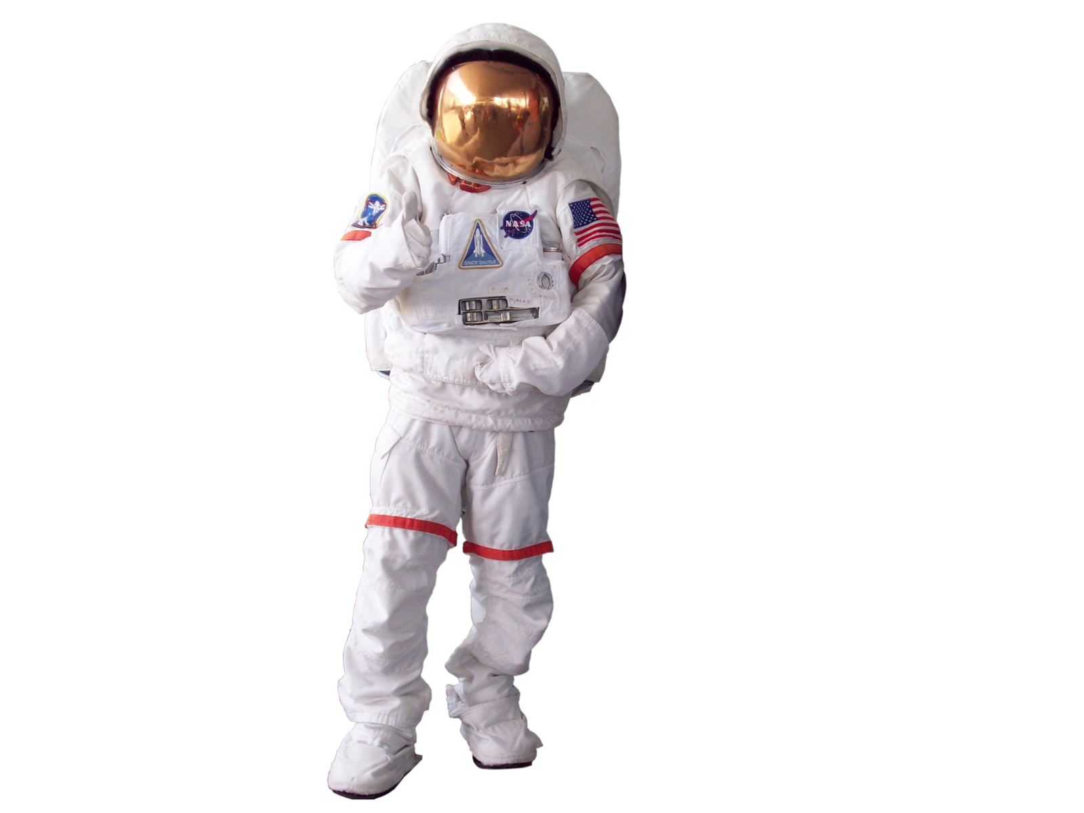
Middle School – Solar Mission
Hey! I’m a scientist on a space mission to research the Sun. I’ve learned a lot, but I’m stuck on a few questions and need YOUR help!
Notes:
`

Slide 9
Middle School – Nuclear Fusion
Red Sponge = Hydrogen (Proton)
Water = Energy
Credit: Veritasium

Slide 10
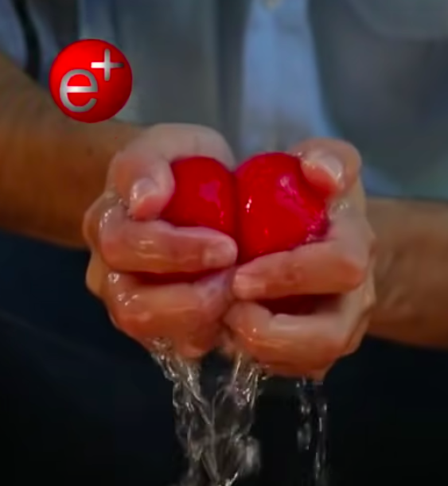
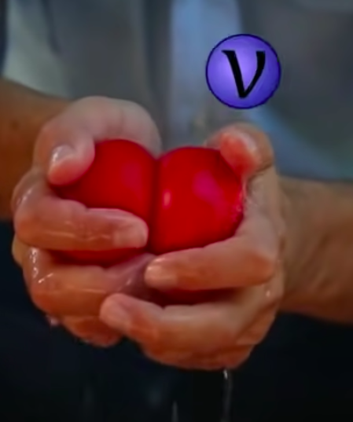
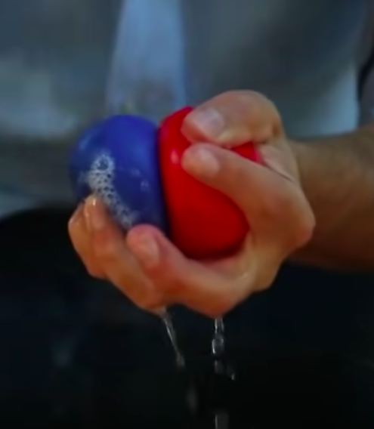
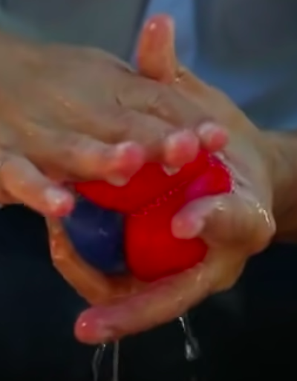
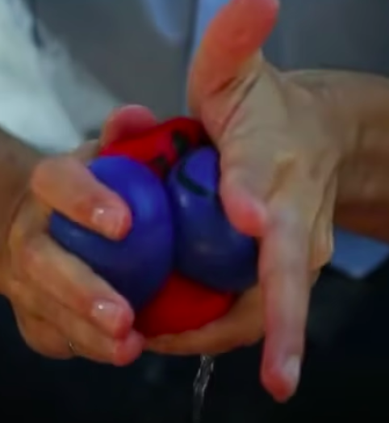
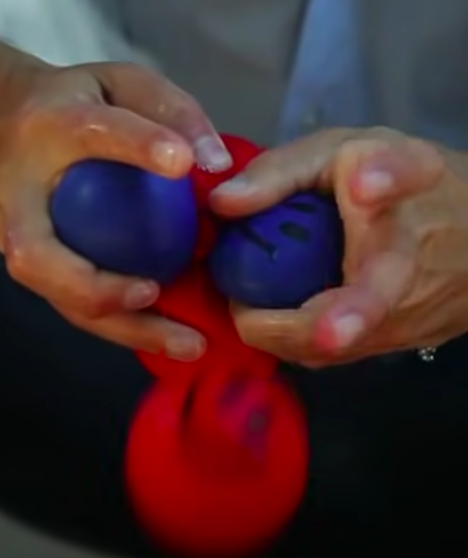
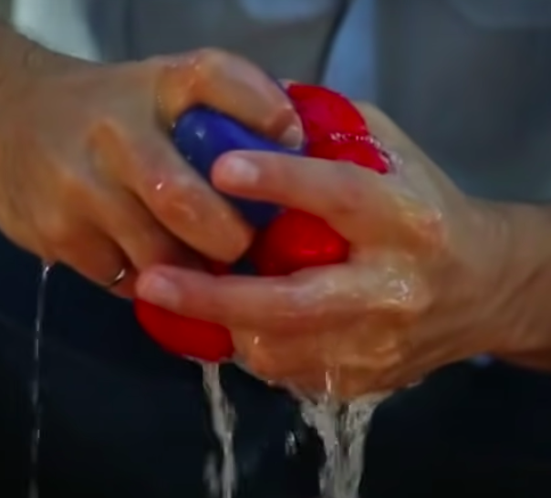
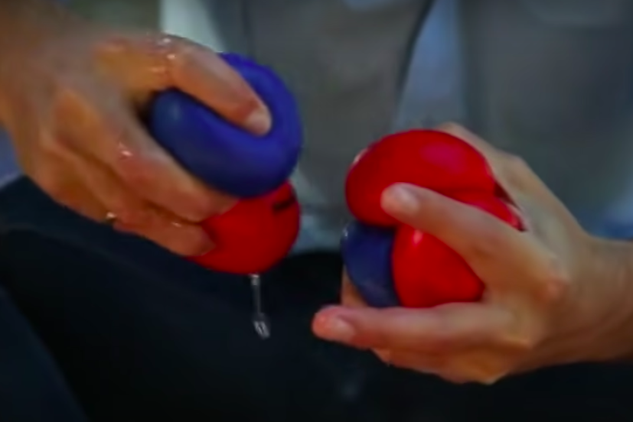
Middle School – Nuclear Fusion
Red Sponge = Proton
Blue Sponge = Neutron
Two Protons + Two Neutrons = Helium Nucleus!
Water = Energy
Credit: Veritasium

Slide 11
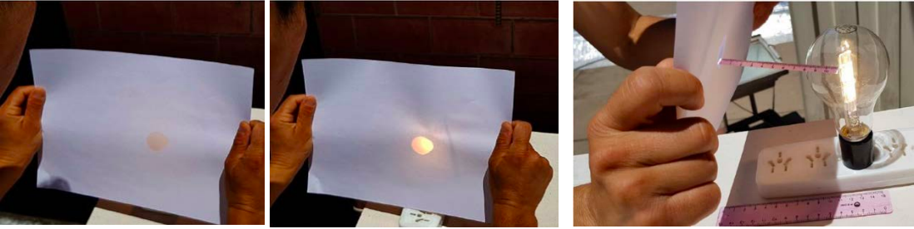
Middle School – Measuring the Power of the Sun
Oil Spot Photometer
Image Credit: The IAU
Notes:
`

Slide 12
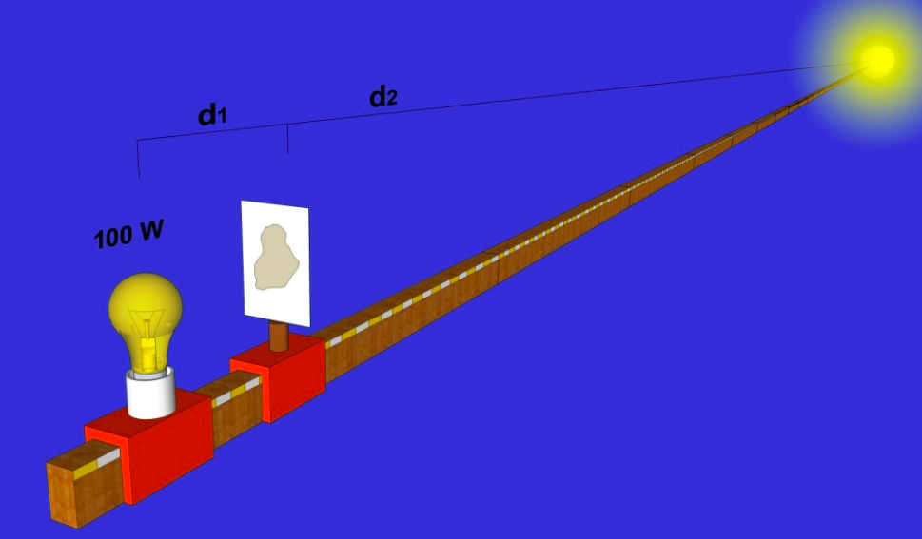
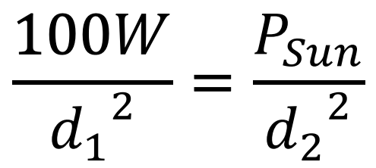
Middle School – Measuring the Power of the Sun
Oil Spot Photometer
Image Credit: The IAU
Notes:
`

Slide 13

Middle School – Lifetime of the Sun
Using the power of the Sun they measured, students calculate the lifetime of the Sun
This can lead into a discussion about the Solar Neutrino Problem
Notes:
`

Slide 14

High School – Is the Sun Dying?
Do we start preparing for an apocalypse??
Are the scientists wrong??

Slide 15
High School – Measuring the Power and Lifetime of the Sun
Oil Spot Photometer
Image Credit: The IAU
Notes:
`

Slide 16
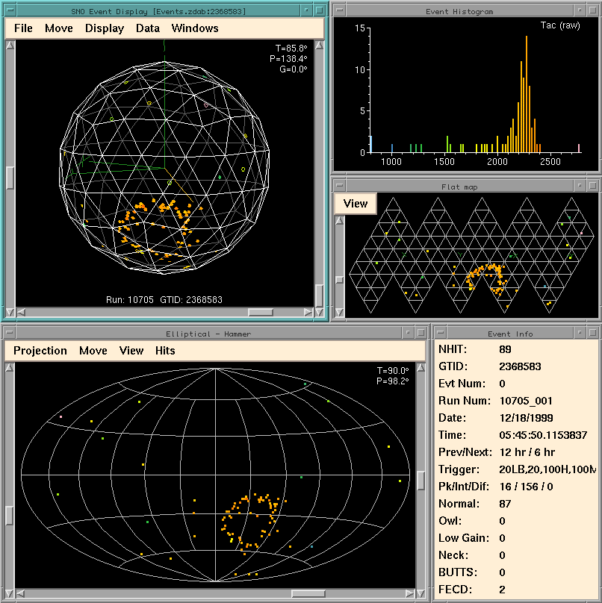
High School – Solar Neutrino Problem
Solution
Problem
Predicted Model
Image Credit: The SNO Experiment, Edited by Chris Kyba

Slide 17
High School – Solar Neutrino Problem
Neutrino Oscillations
Detected Neutrino Flux
Predicted Neutrino Flux
Image Credit: The SNO Experiment, Edited by Chris Kyba

Slide 18
Project Highlights
Enriching Science Classrooms Across Canada
Inspiring an Interest in Physics
Astroparticle Physics for Every Grade Level
Hands–on
Learning Experience
Matches Nobel Prize–winning Science to Curriculum Goals

Slide 19
The End!
Thanks for listening!
Special thanks to Mark Richardson and Charles Woodford for their mentorship and support

