Slide 1
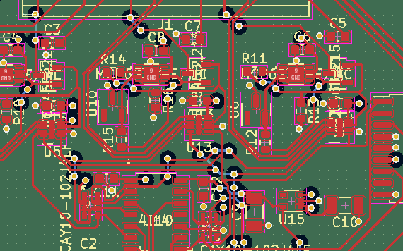
Thermal Control Systems for SBC
A summer research presentation by Ezri Wyman

Slide 2
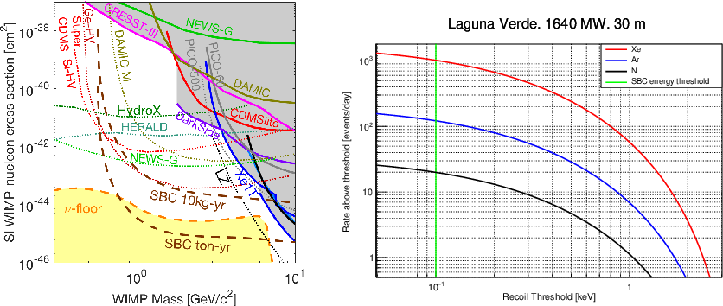
Dark Matter Search
Different experiments probe different types of particle
SBC (in brown) aims to detect both dark matter and CEνNS
Notes:
https://www.semanticscholar.org/paper/The-Scintillating-Bubble-Chamber-(SBC)-Experiment-Giampa/211b170ddbe72a717376e3d7f5858c3de07b8a85

Slide 3
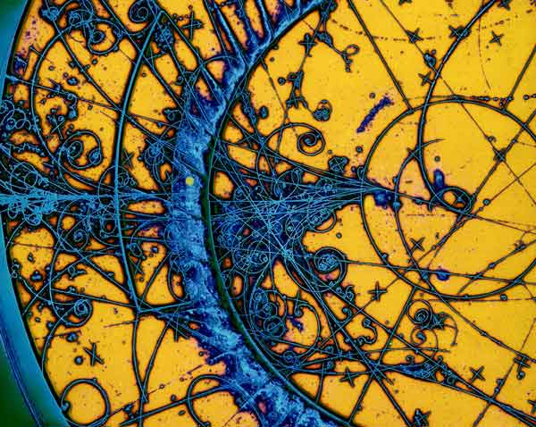
Bubble Chambers
Created in the 1950s to look at charged particles
Function similarly to cloud chambers
Great for dark matter searches
Notes:
https://home.cern/news/news/experiments/seeing-invisible-event-displays-particle-physics

Slide 4
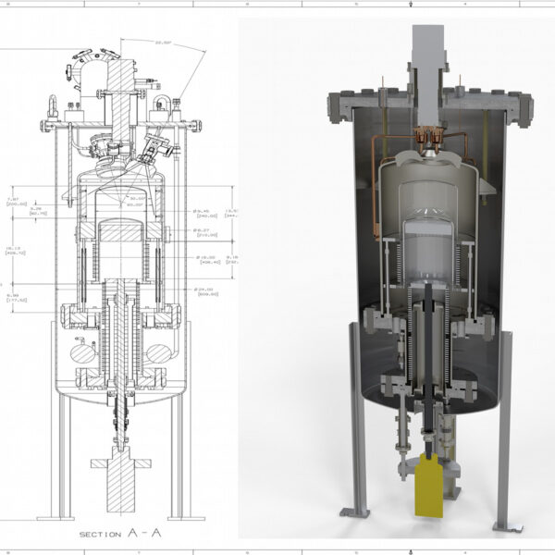
The Scintillating Bubble Chamber Experiment
Superheated liquid makes up the active volume
Particle interactions that input energy nucleate bubbles
Scintillation light gives more information about the interactions
Notes:
https://particlephysics.ca/project/scintillating-bubble-chamber-experiment/?lang=en

Slide 5
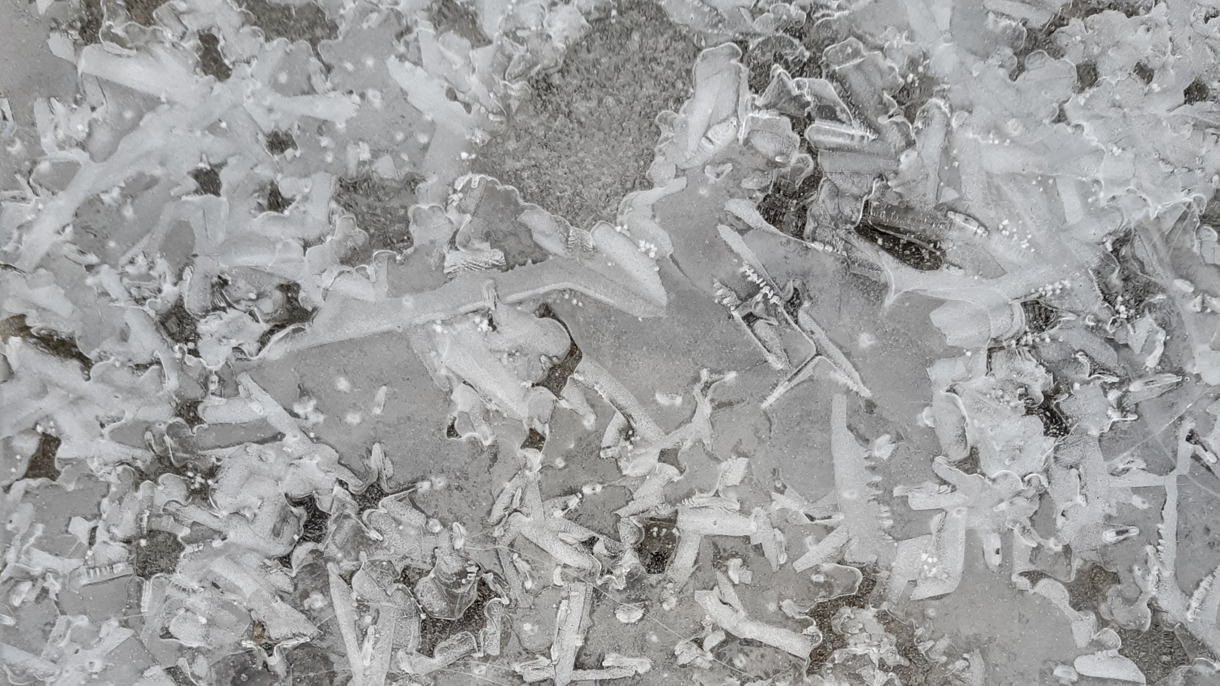
Thermal Control Systems
SBC’s active volume consists of liquid argon and xenon
“Superheated” is still really cold!
Temperature control is vital to understand the nucleation threshold

Slide 6
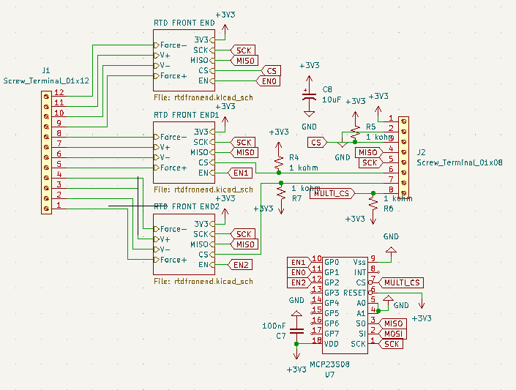
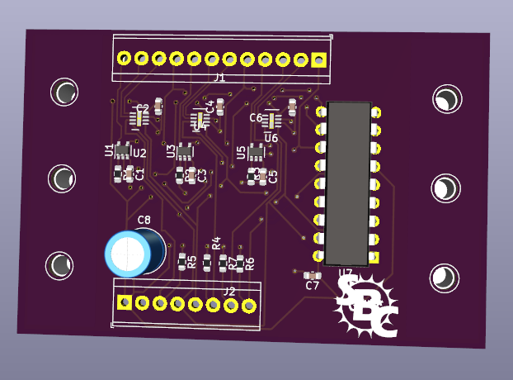
First Prototype

Slide 7
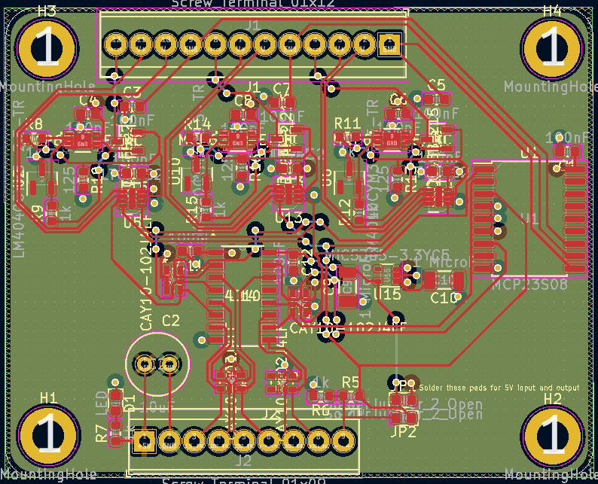
Second Prototype
Upped the voltage of the board (and added relevant step downs)
Changed out components that didn’t work as expected
Condense the board
Added two layers

Slide 8
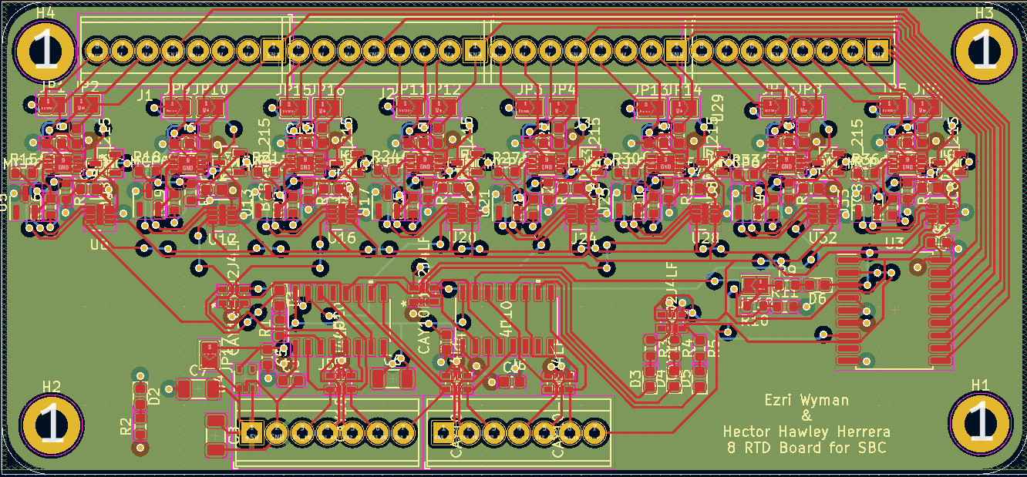
What’s Next?

Slide 9
The Big Picture
Test setup at Queen’s expected to be tested cold in the coming weeks
Experimental construction is in progress
Temperature control will continue to be vital through the construction, testing, and run of the experiment
Notes:
https://particlephysics.ca/project/scintillating-bubble-chamber-experiment/?lang=en

