Slide 1

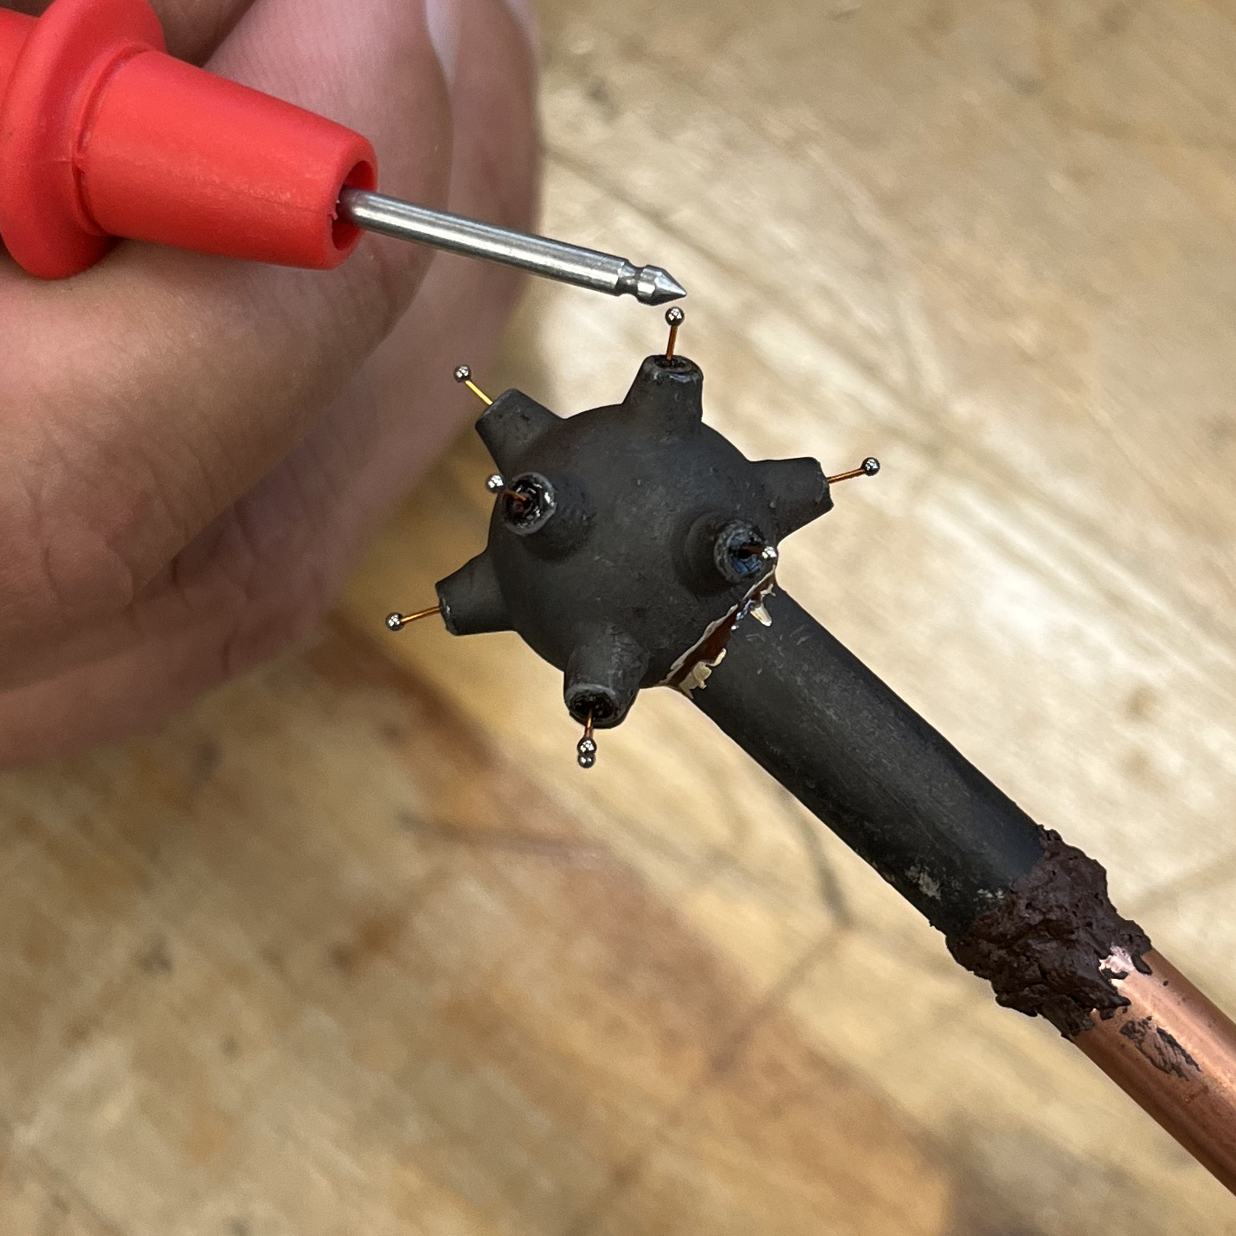
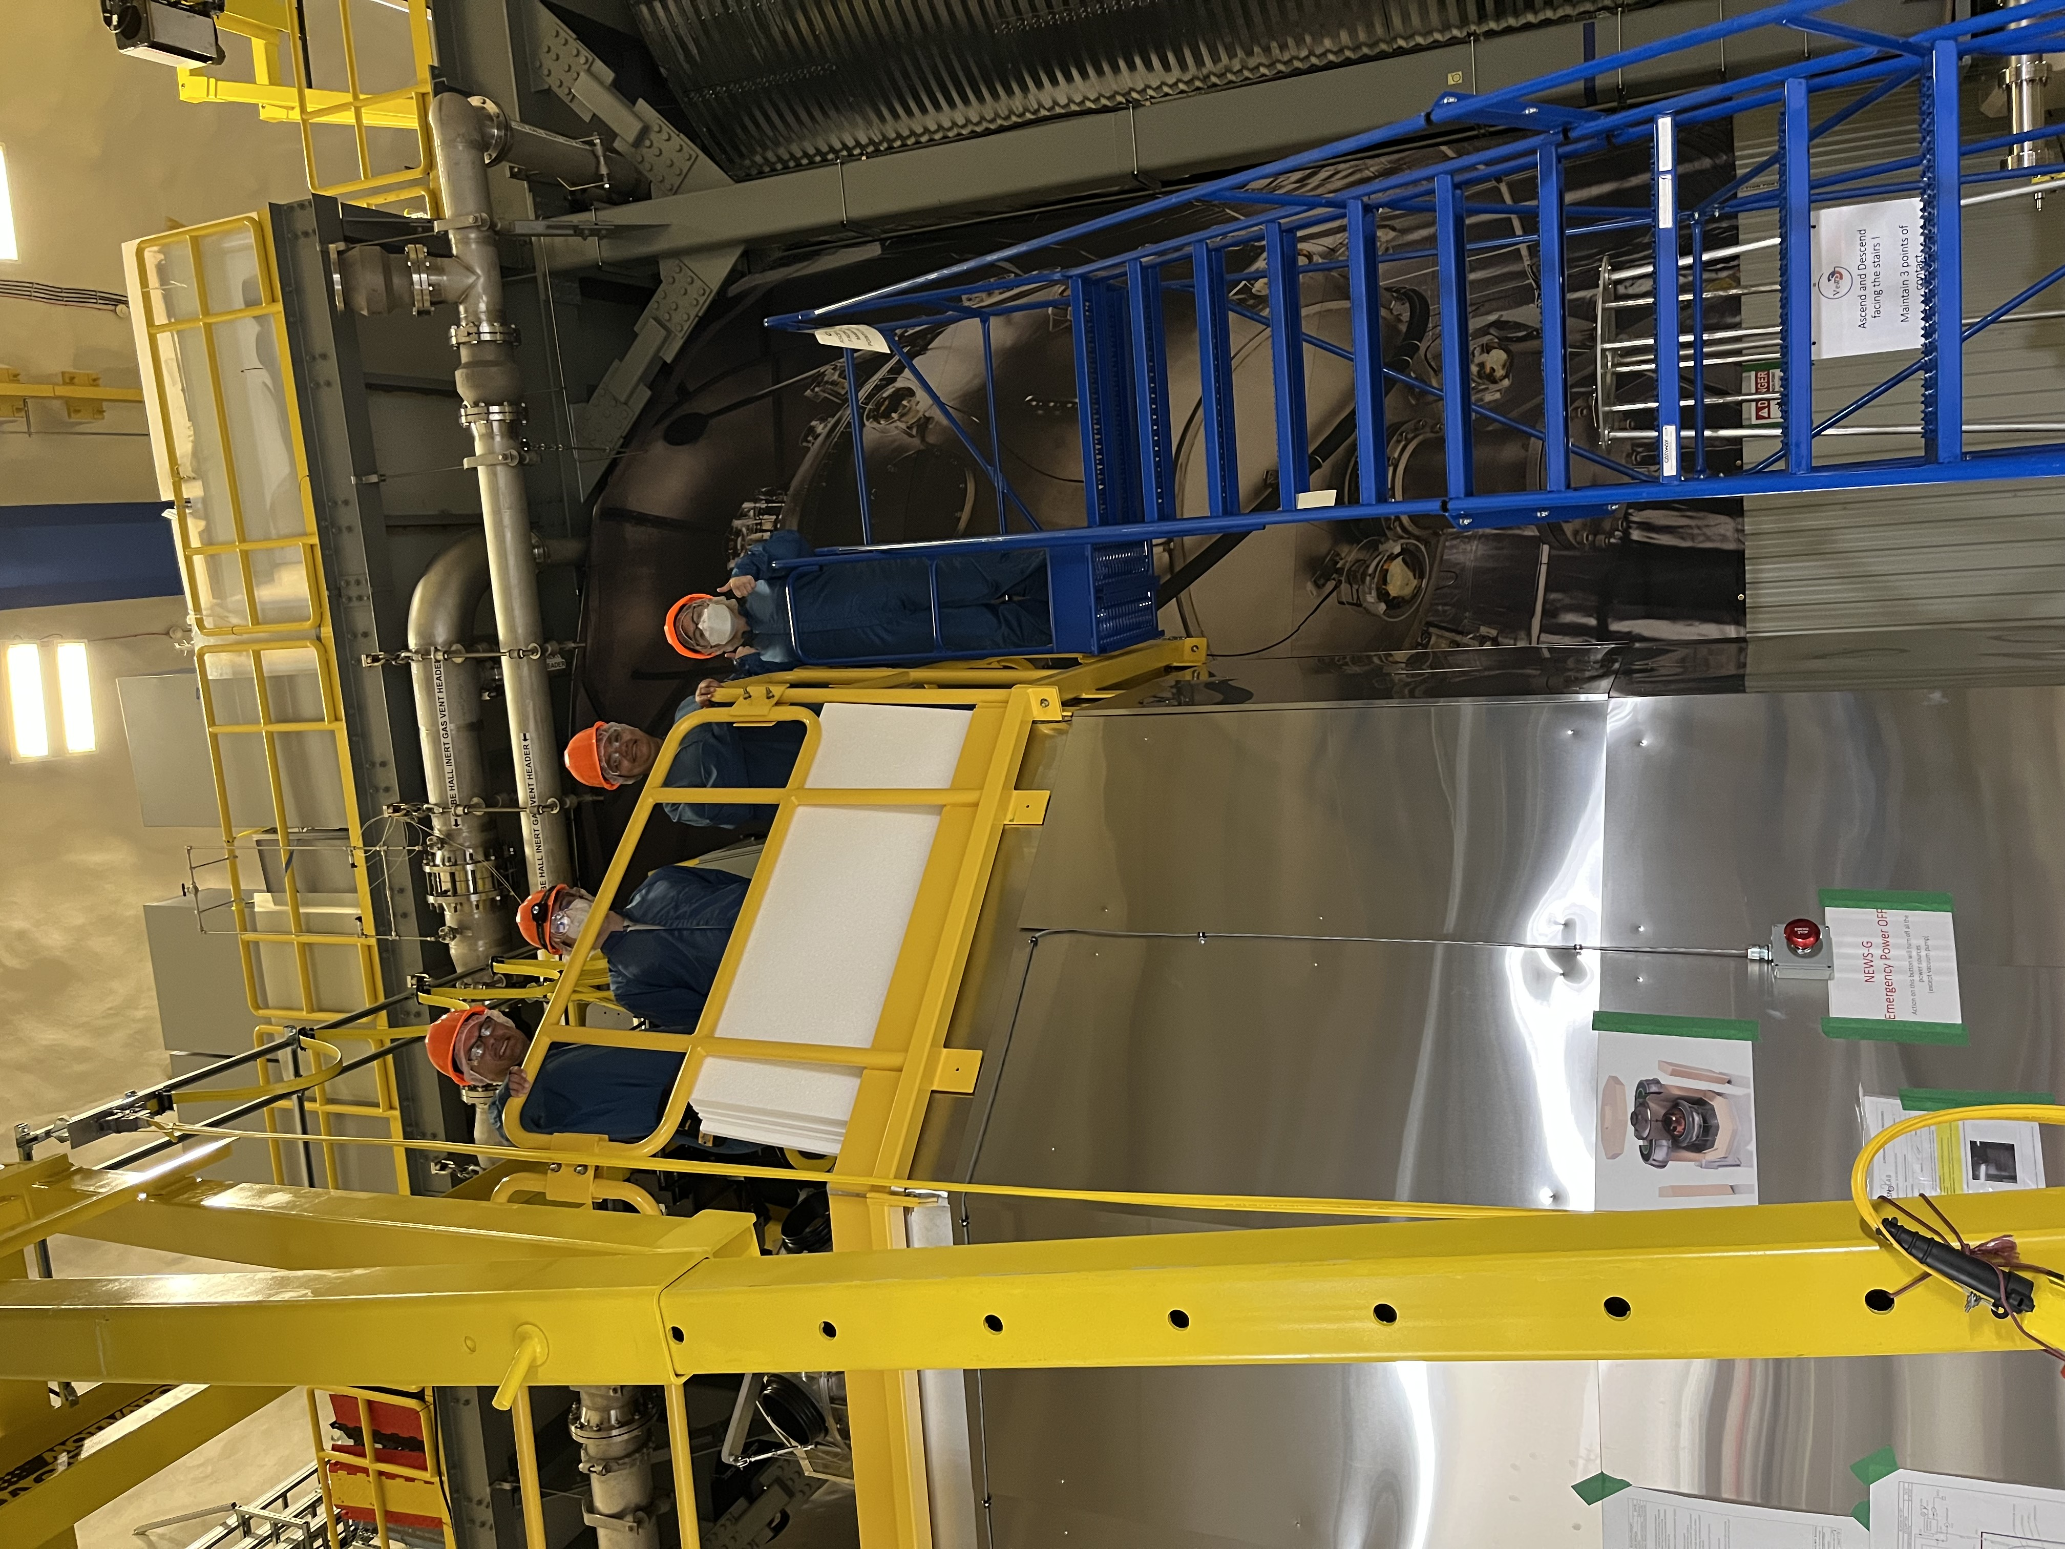
NEWS-G: Detector Calibration
Irina Babayan
CASST 2022

Slide 2
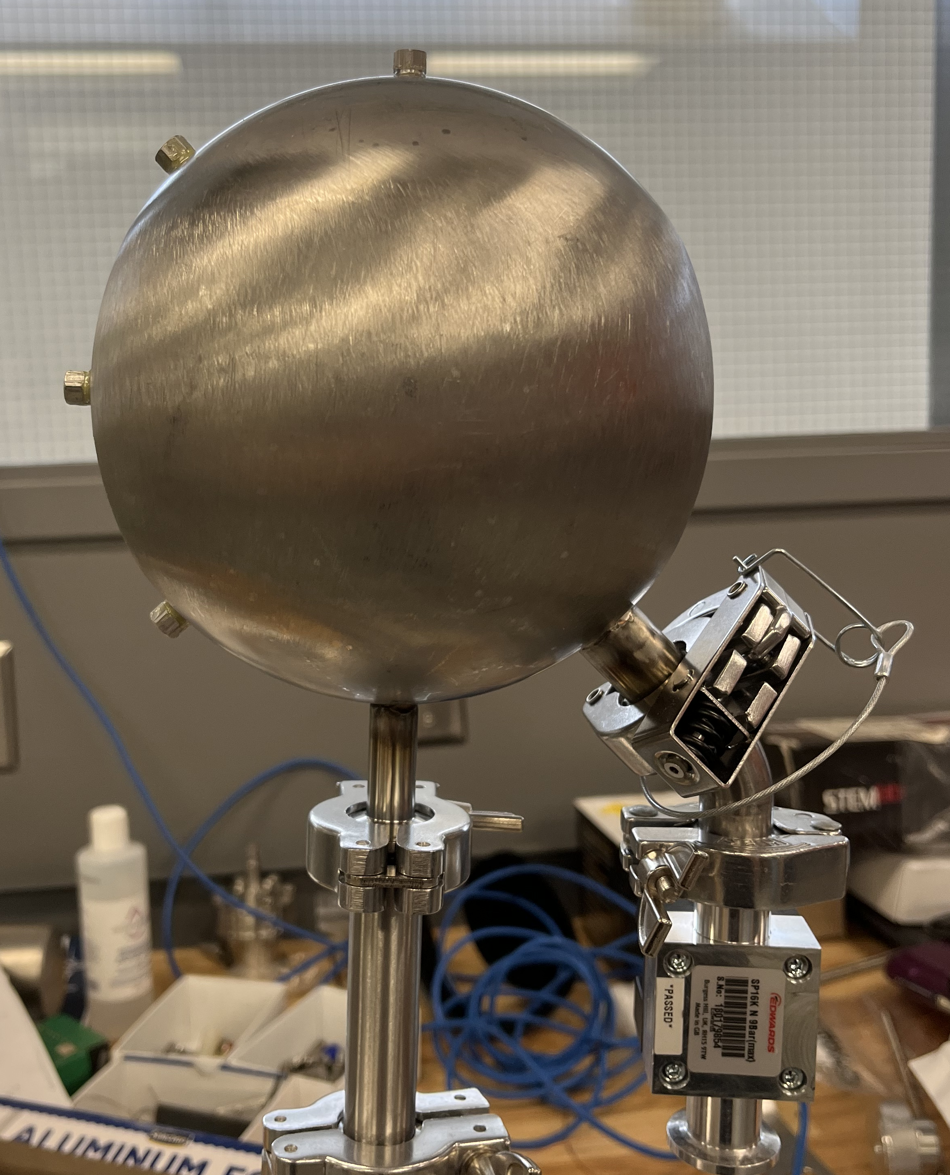
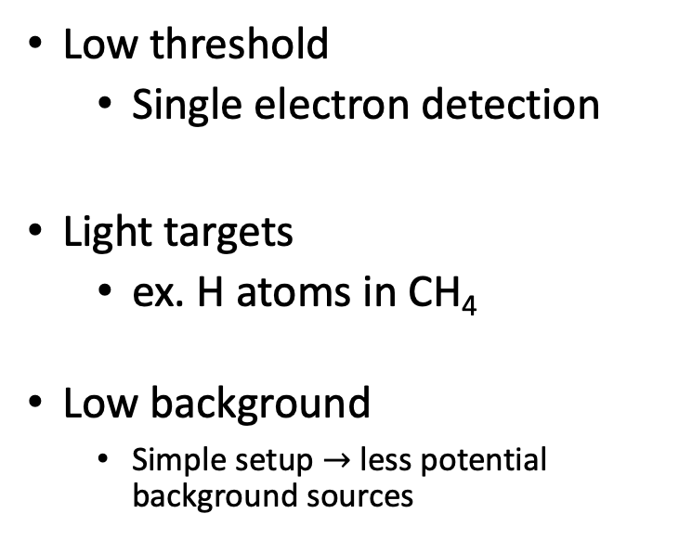
Low-mass dark matter search
Low threshold
  Single electron detection
Light targets
  ex. H atoms in CH₄
Low background
  Simple setup $→$ less potential background sources

Slide 3
Signal generation in an SPC

Slide 4
e⁻
⁺
e⁻
Primary ionization
Electron drifts towards centre
Secondary ionization
  Ion-electron pair generated
Ion movement is detected
e⁻
⁺

Slide 5
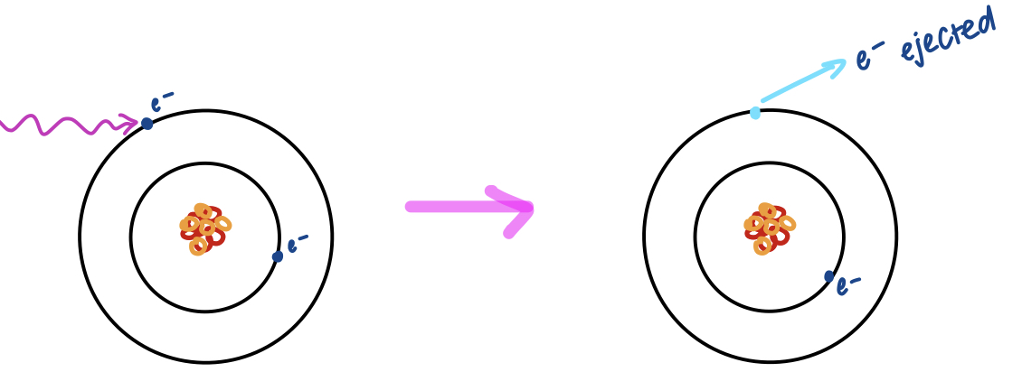
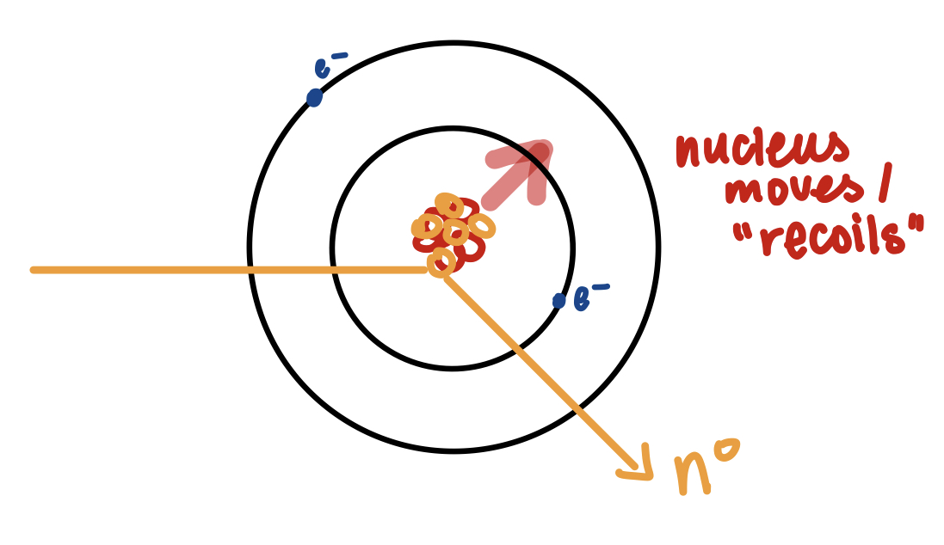
Calibration
Goal: signal amplitude $→$ energy deposited
Nuclear recoil:
Electronic recoil:
x-ray
Notes:
Signal (number of ionization e⁻) $→$ energy deposition
Dark matter will interact via nuclear recoil
Electronic recoil is used as an intermediate calibration source because it is easier to produce monoenergetic sources of that type
Calibration is important
It is important to calibrate at different energies so that we know how the detector behaves over a range of signal amplitudes (we need relatively higher and lower energy sources)

Slide 6
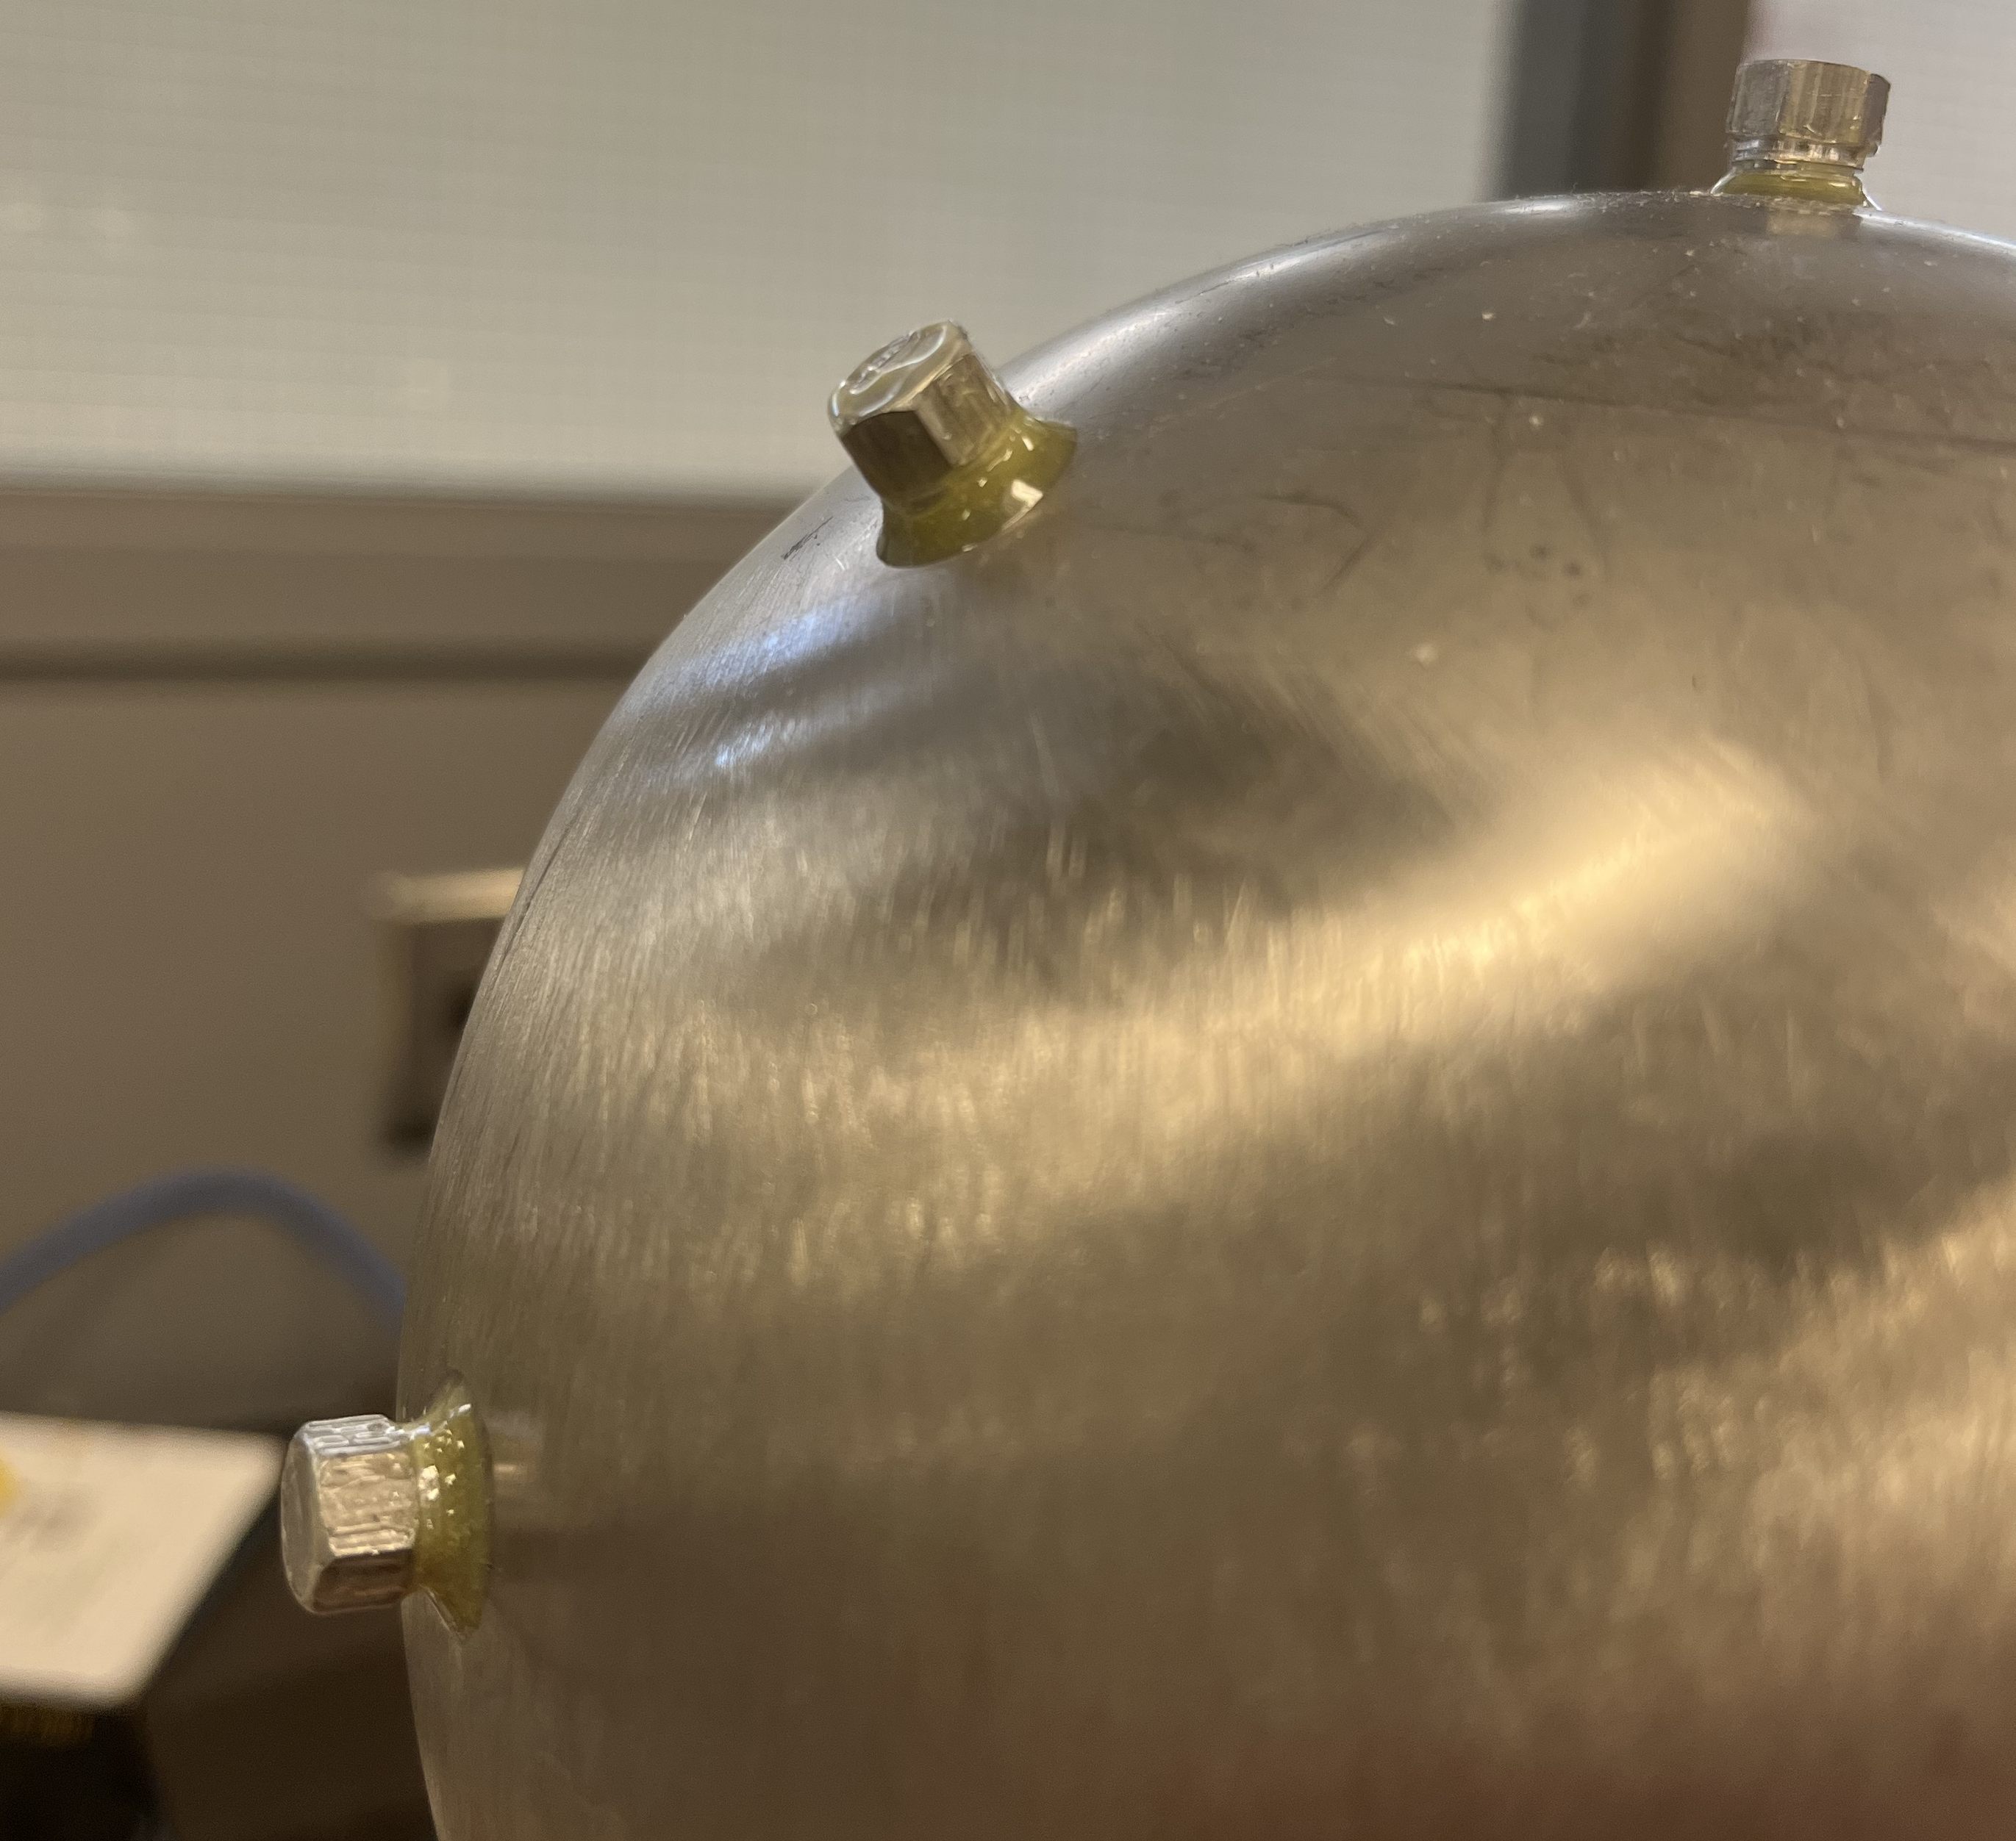
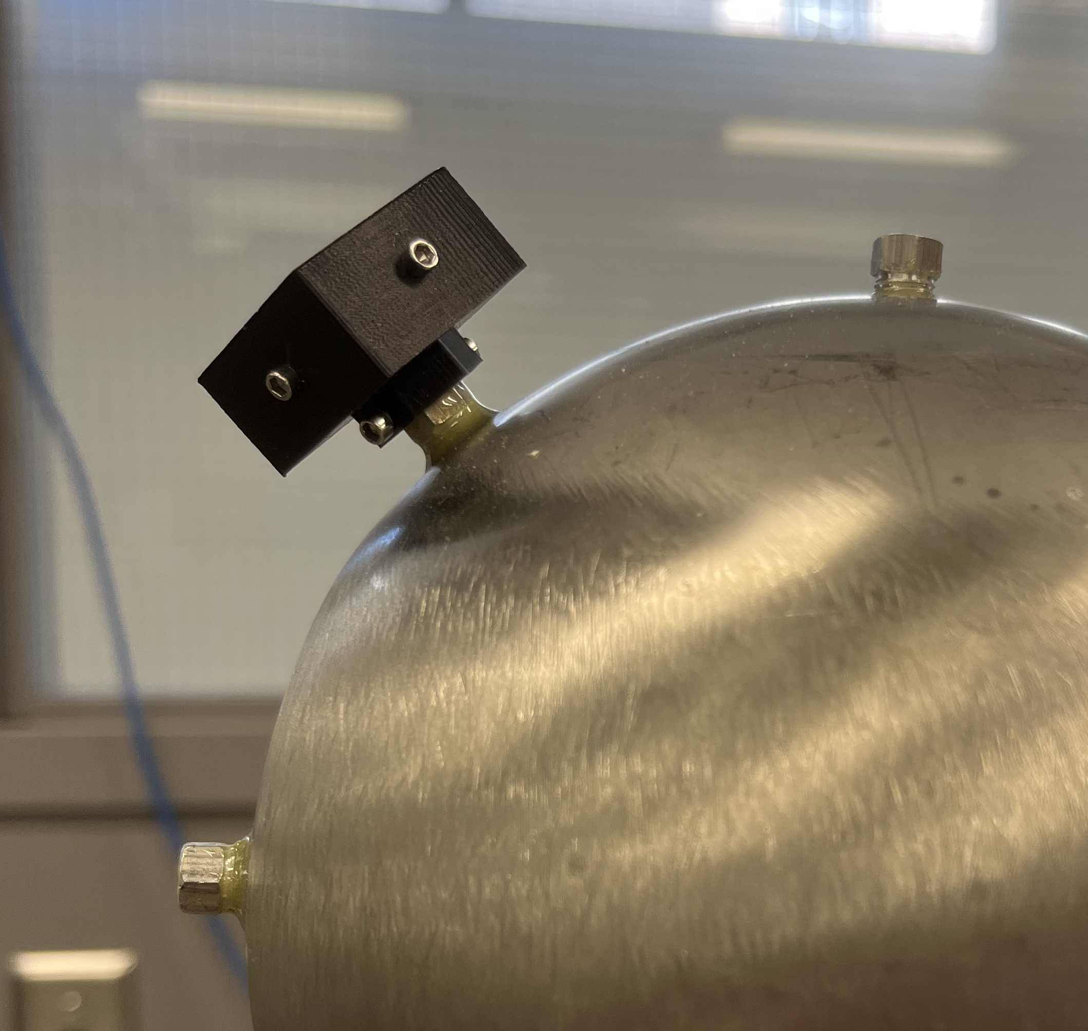
Calibration sources
Fe55 source in use
Source windows
Notes:
Interested in sources of energy 0.1 – 10 keV
Sources of energy < 3 keV will be stopped by 20 𝜇m of aluminium (which is what our source windows are made of)
We have to put the sources inside the spheres to achieve low energy calibration, or use gaseous sources (Ar37)
We have more control over the source location AND it is reusable if it is a solid source, Ar37 is not reusable

Slide 7
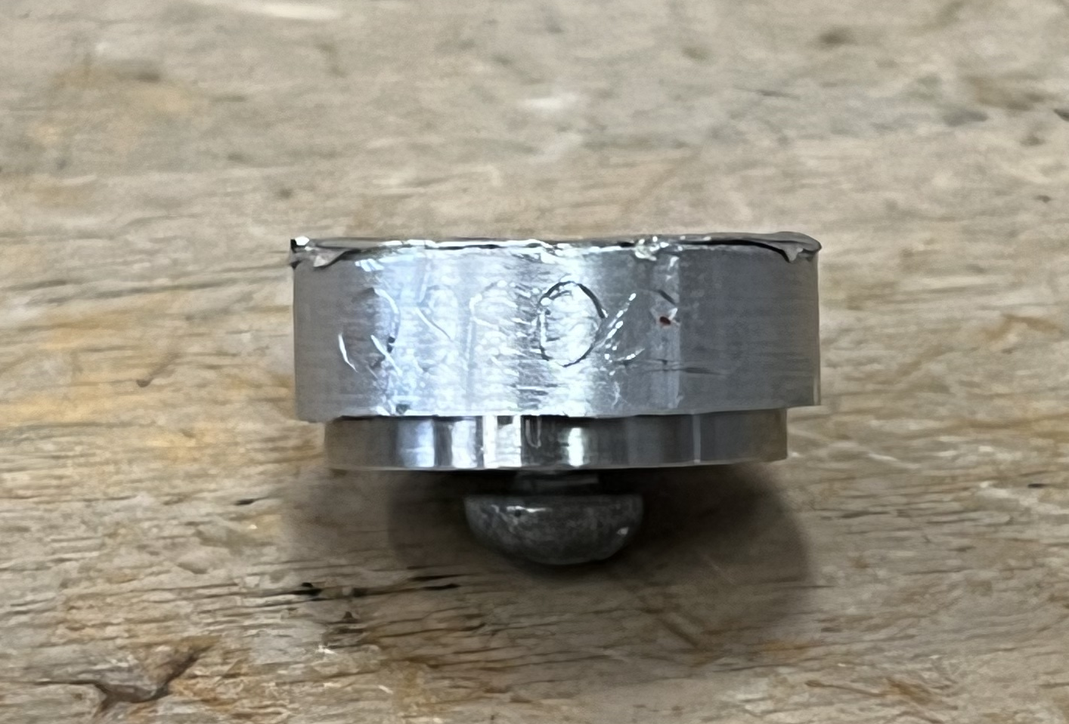

Am(Al) source
Al foil
Am-241 source activity: 37000 Bq $→$ 37000 $α$-particles /second
Screw
Notes:
For low energy dark matter experiments, any signal other than dark matter is unwanted -> alphas are very high energy, and they create track events
Problem: we need the perfect thickness of aluminium foil such that alphas are (mostly) stopped but all the x-rays can exit the foil and be detected
Our source is 1 uCurie (unsure of if it is 4 pi or 2 pi, referring to solid angle)
We would only see half of it because of the solid angle
1 uCurie is 37000 alphas in 4 pi
Of order 10,000 alphas per second

Slide 8
Goal: optimize Al foil thickness!
Notes:
Takes about 1 um of foil to stop aluminium x-rays
The x-rays should be produced very close to the surface
Alpha energy deposition in the foil follows a Bragg peak
Bragg peak shape is optimal for Am(Al) source because the most amount of energy is deposited closest to the surface
The less energy charged particles have, the more energy they lose when interacting with other things
We want a thickness of foil such that the alphas are absorbed very close to the surface of the foil

Slide 9
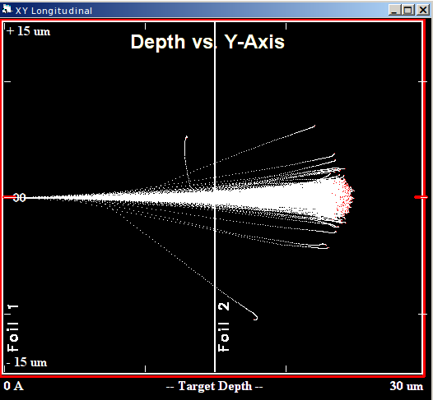

30 $μ$m of Al:

Slide 10
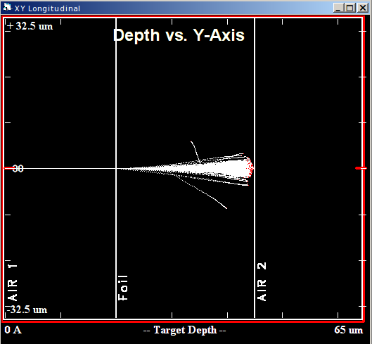


25 $μ$m of Al:
25 $μ$m

Slide 11
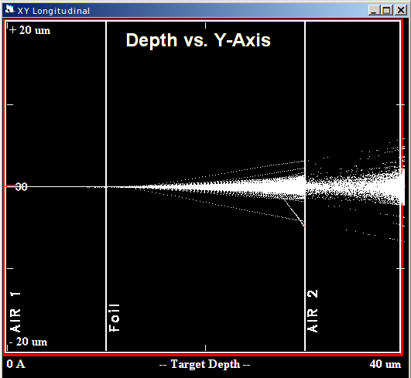


20 $μ$m of Al:
20 $μ$m

Slide 12

20 $μ$m of Al:
1.5 keV
Al x-rays
5.9 keV Fe55 x-rays
13.81 keV
Am-241 x-rays
17.7 keV
Am-241 x-rays
1.5 keV
Al x-rays

Slide 13
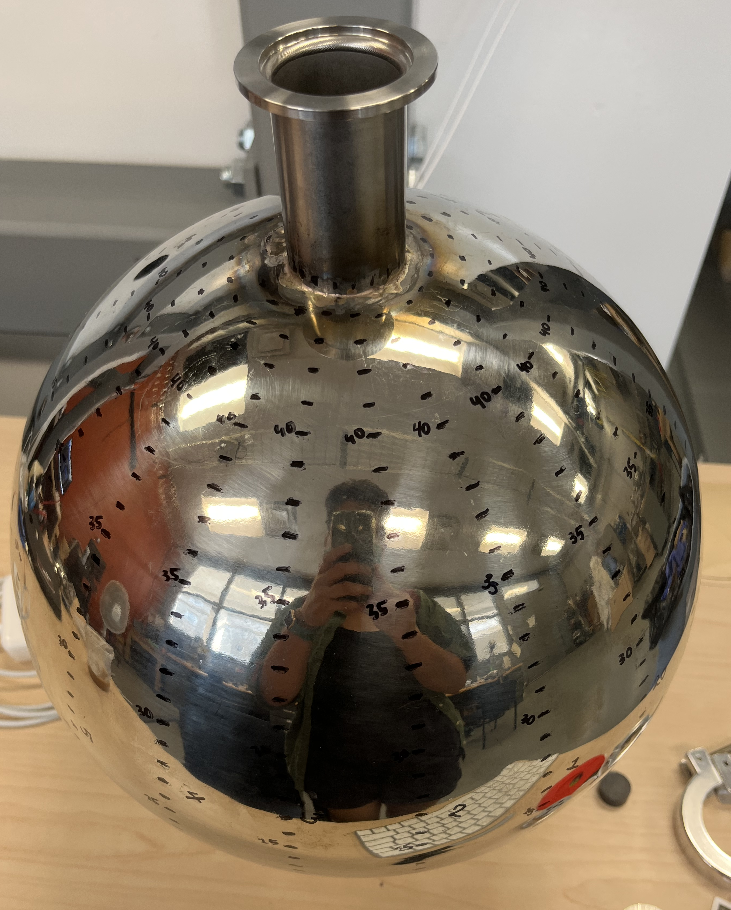
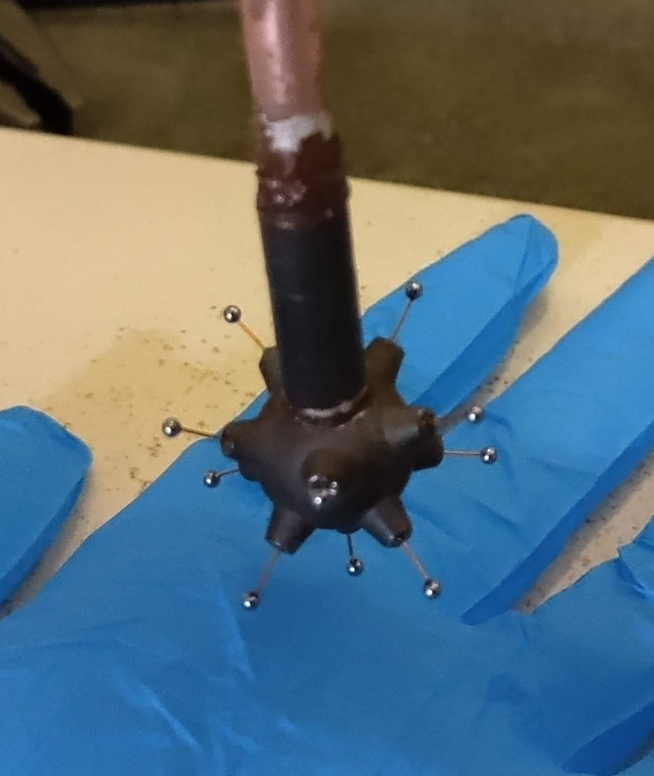
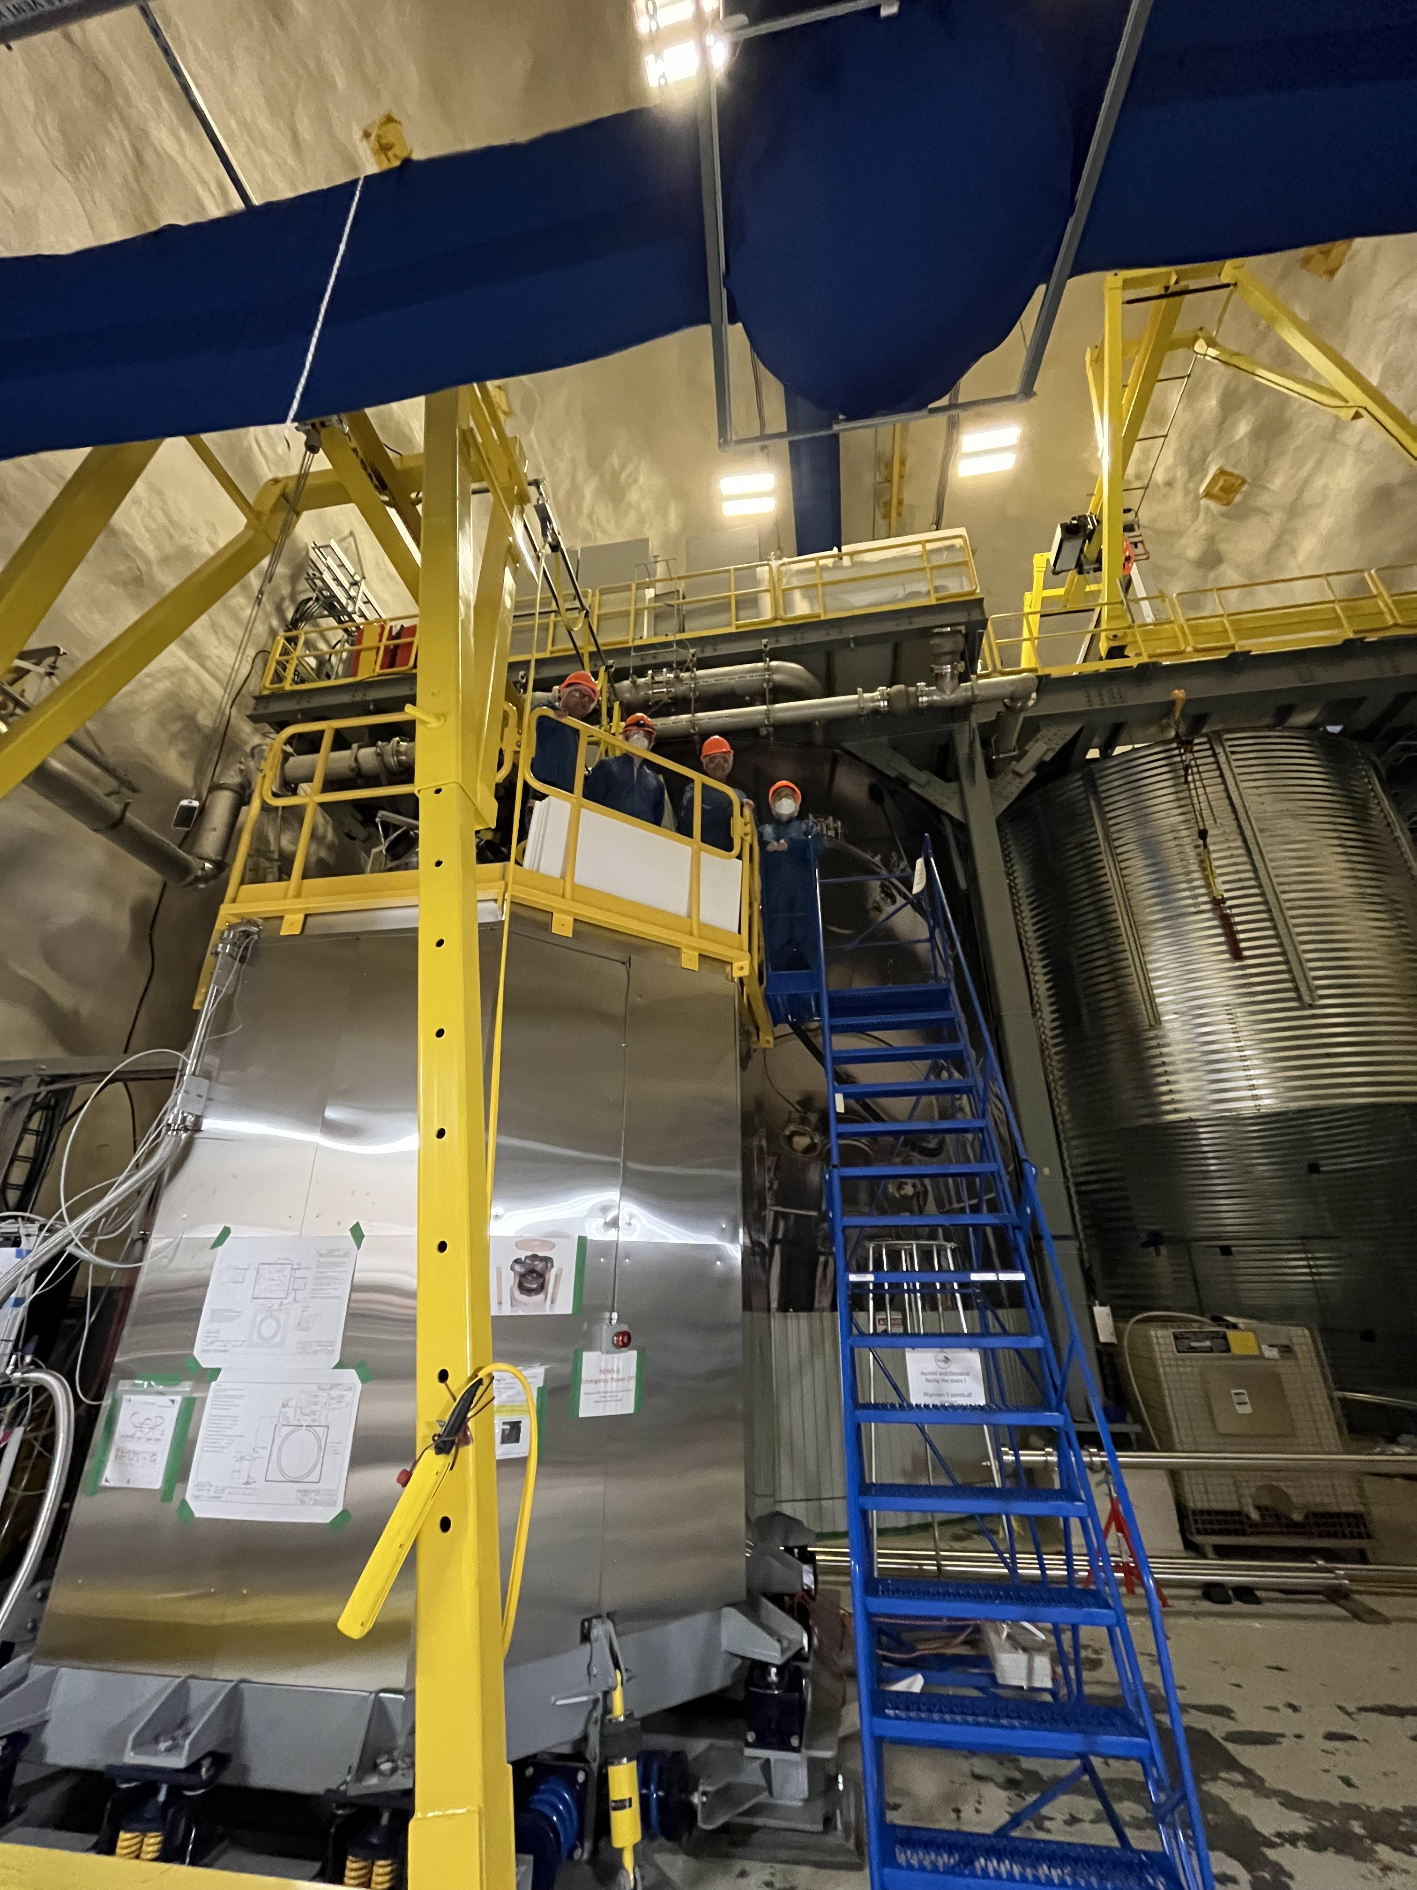
What’s next?

Slide 14
Back-up slides

Slide 15
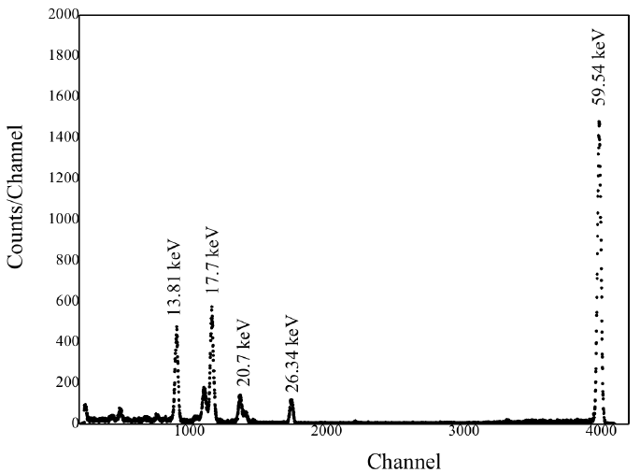
Am-241 emission spectrum
Al x-rays
~1.5 keV
Graph credit: Studying of characteristics of the HPGe detector for radioactivity measurements - Scientific Figure on ResearchGate. Available from: https://www.researchgate.net/figure/A-typical-spectrum-of-Am-241-source-to-detector-distance-of-20-cm_fig3_272498204 [accessed 11 Aug, 2022]

Slide 16

Extra slide: Al x-ray emission
$$α$$

Slide 17
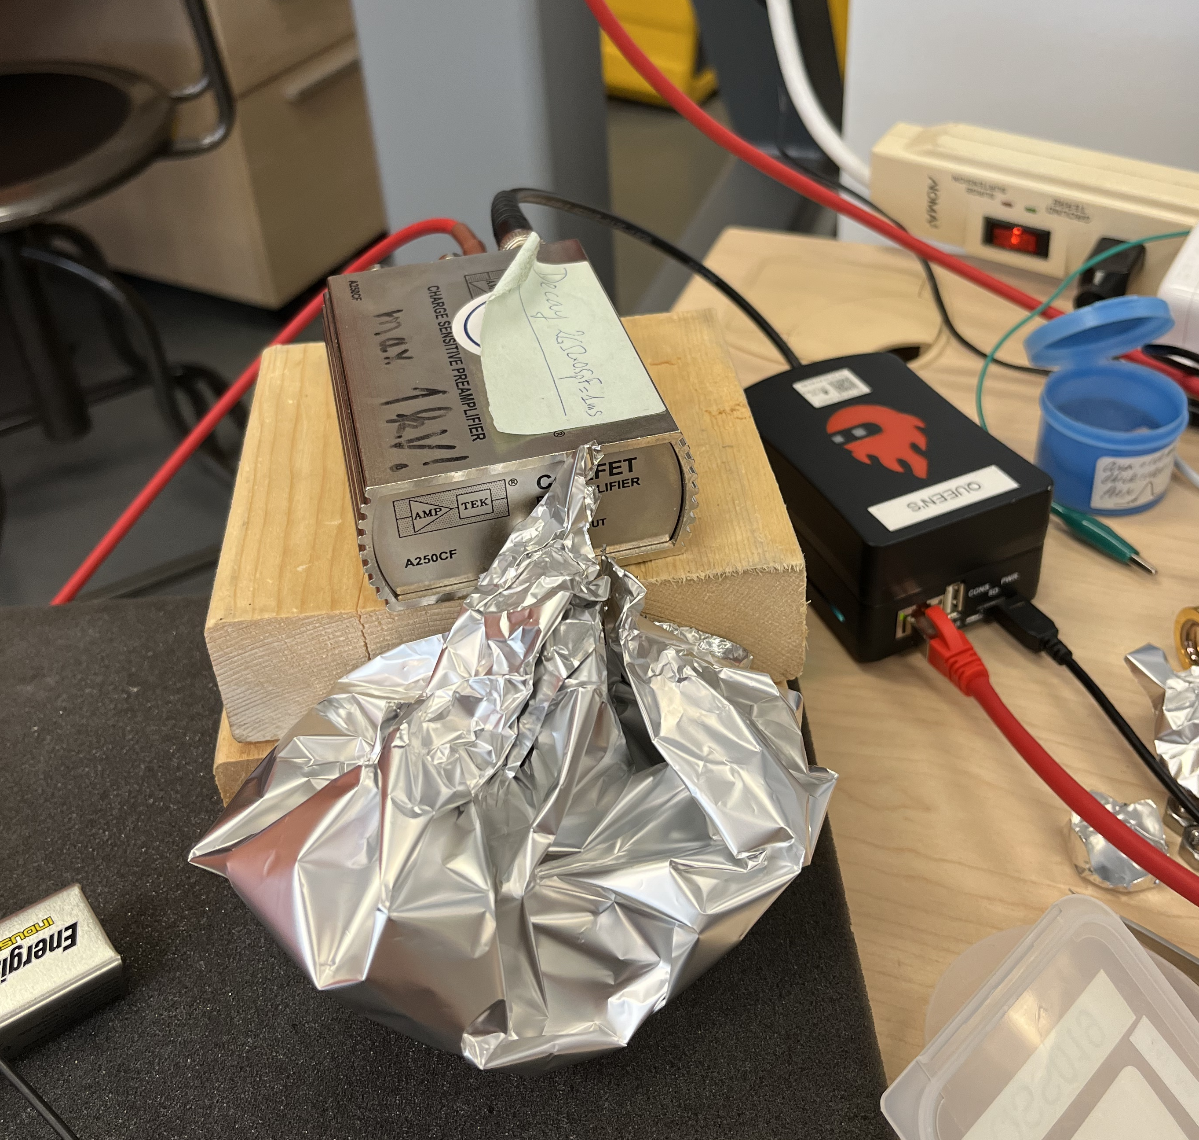
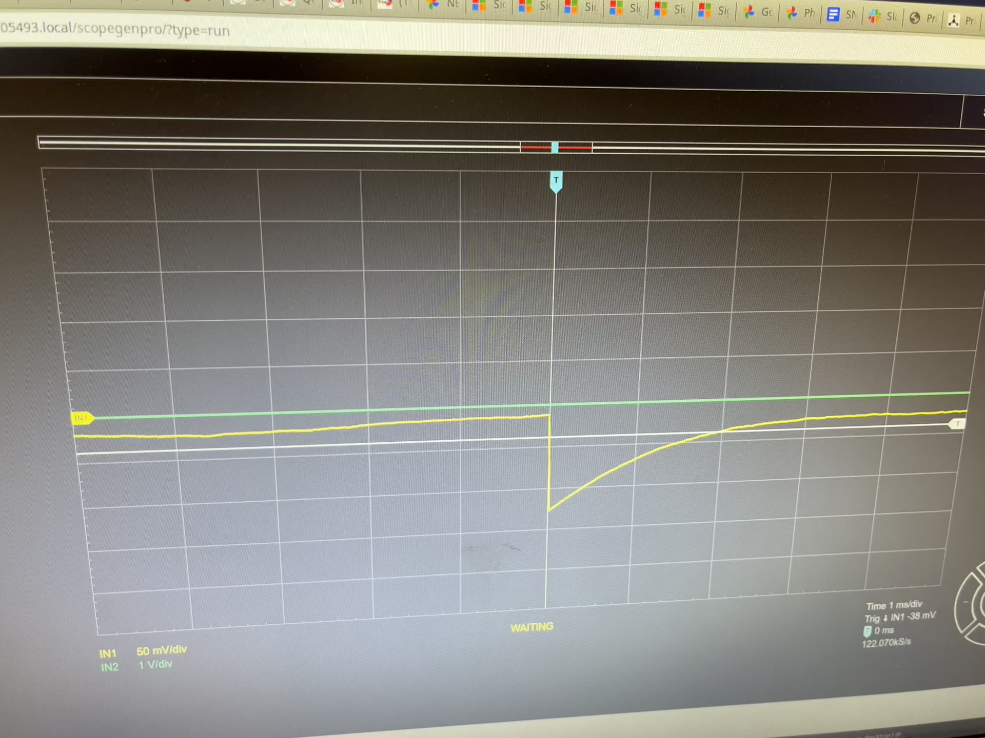
Alpha detector

