Slide 1
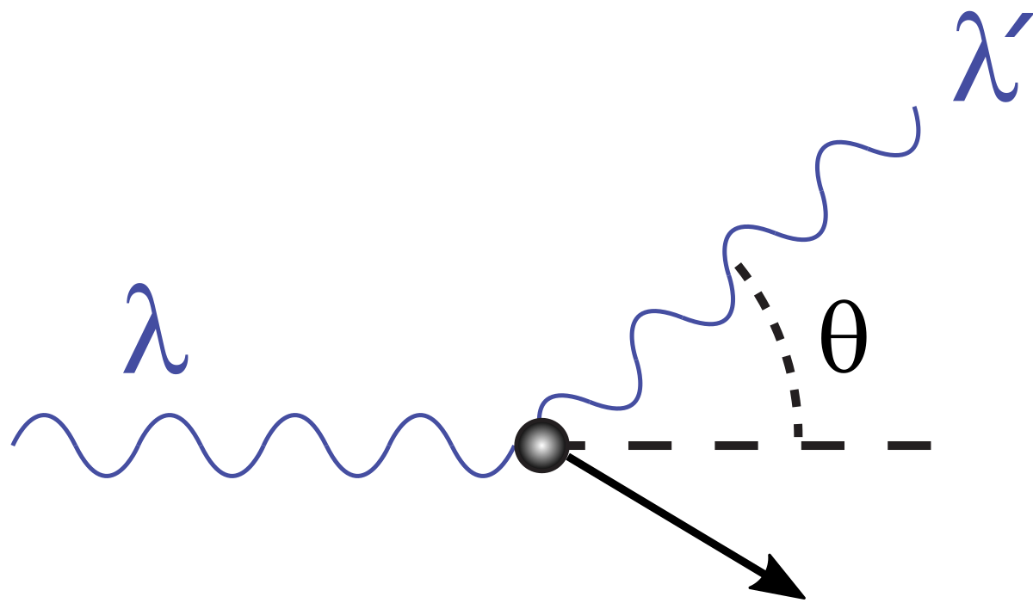
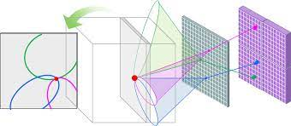



Development of a Compton Gamma-ray Imager using Cubes of CsI(Tl)
By: Fadi Younes
fadi.younes@mail.mcgill.ca
With: Professor David Hanna,
Dr. Stephen O’Brien,
Guilherme Caumo

Slide 2

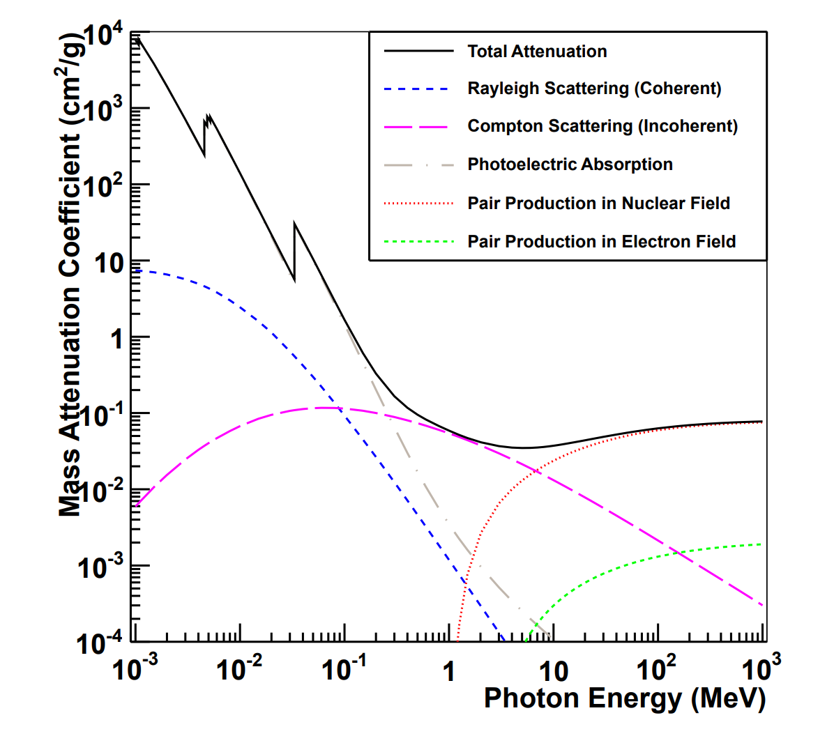
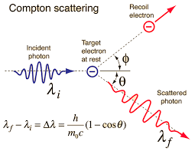
Underlying Theory for the Imager
The Compton equation is used to determine the opening angle of the cone and the position of the 2 photons is used to determine the axis of the cone. Multiple events are recorded and the intersection of multiple cones tells the location of the gamma-ray source.
Compton Scattering is best for detecting gamma rays of 100 keV to 10 MeV.

Slide 3
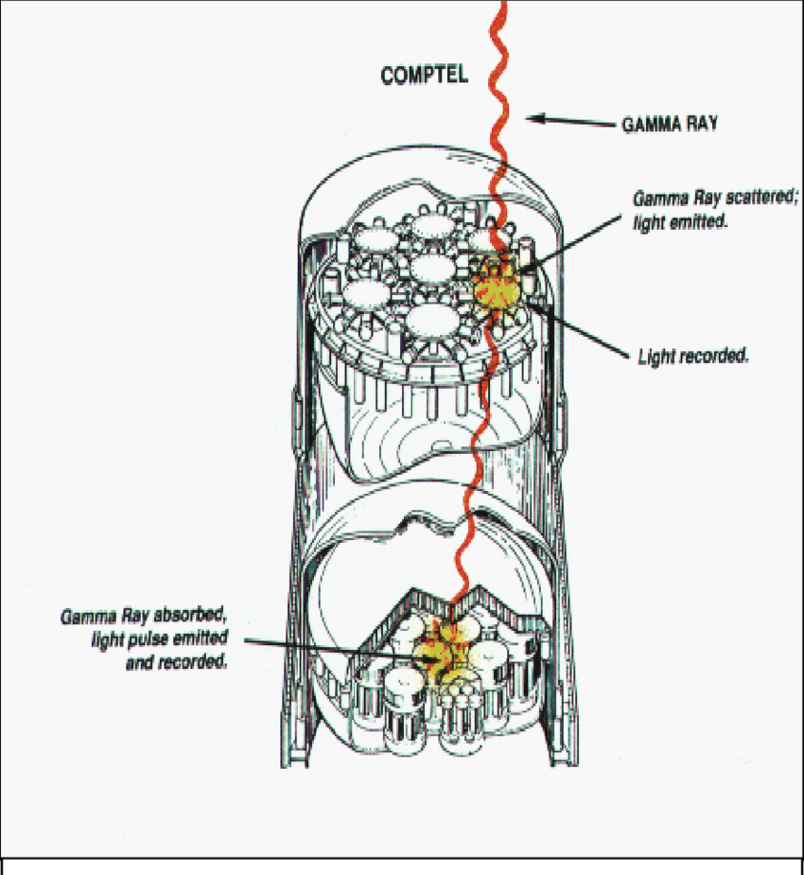
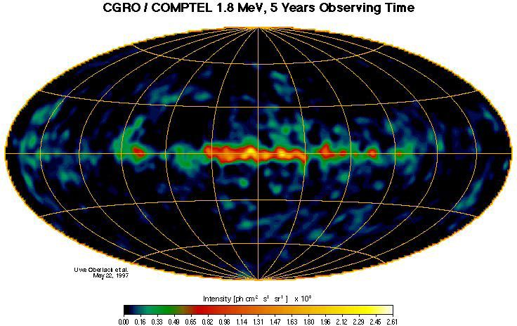
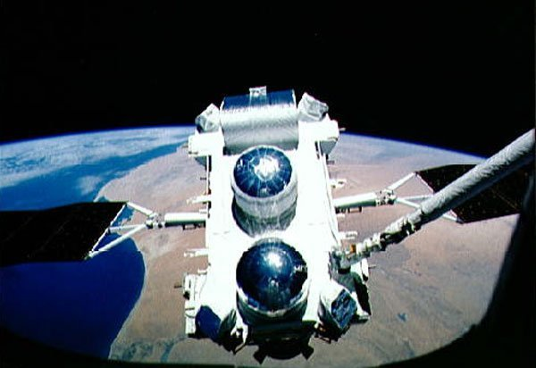
COMPTEL: MeV Compton gamma-ray telescope
100 keV – 10 MeV energy range which is important for nuclear astrophysics is not well studied because of angular and energy resolution limits.

Slide 4
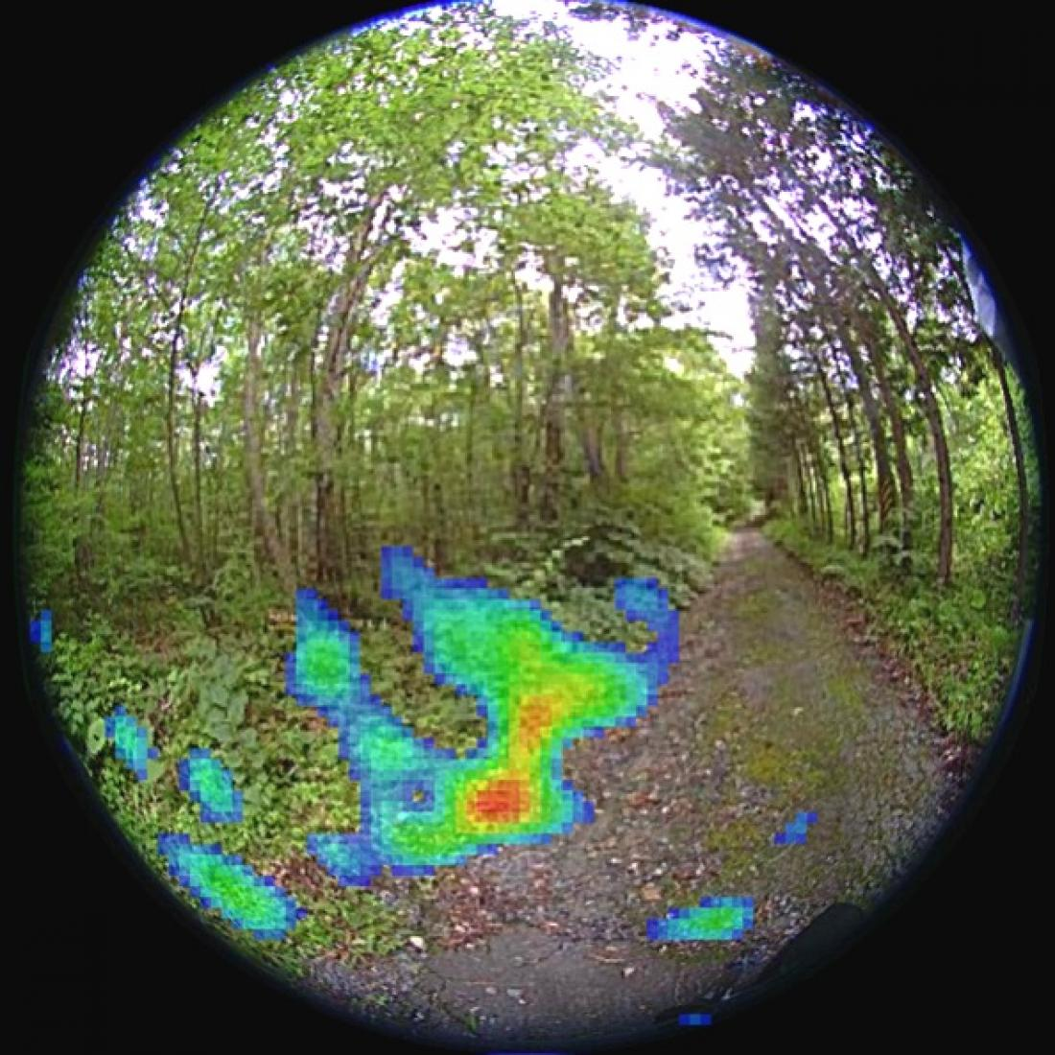
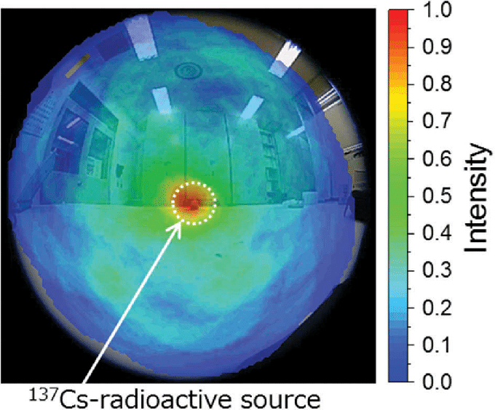
Possible Applications
This imager would have applications such as:
-Nuclear disaster decontamination
-Clandestine nuclear material detection
Compton camera mounted on a crawler robot, Sato et al., 2019.
Fukushima decontamination, Waseda University, 2015.

Slide 5
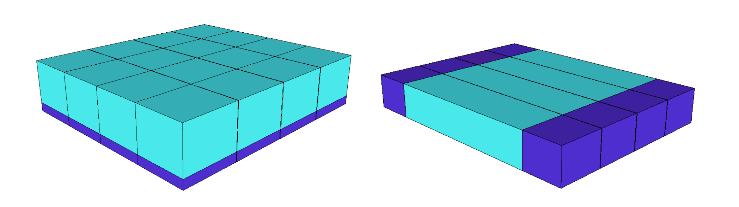
Improving current Compton Imagers
CsI Scintillator
PMT
NxN
2N
An improvement would be to use 2N electronics channels in place of NxN channels to reduce costs and power consumption of the compton imager.

Slide 6
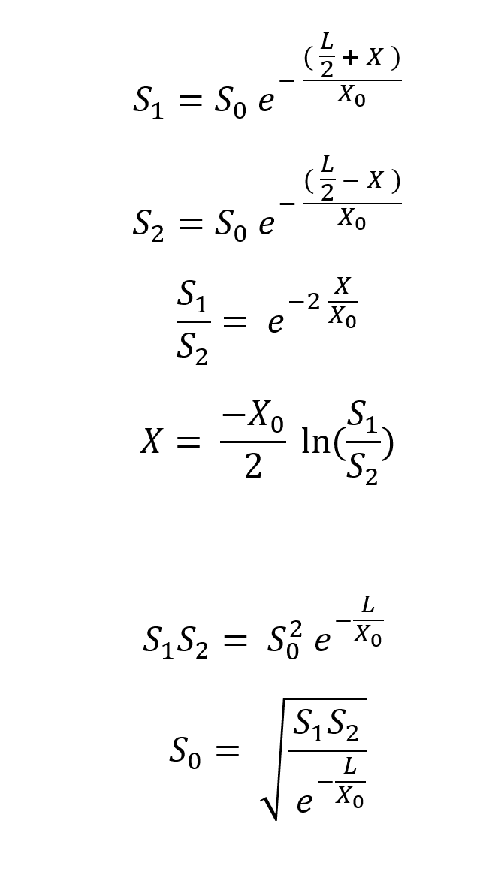
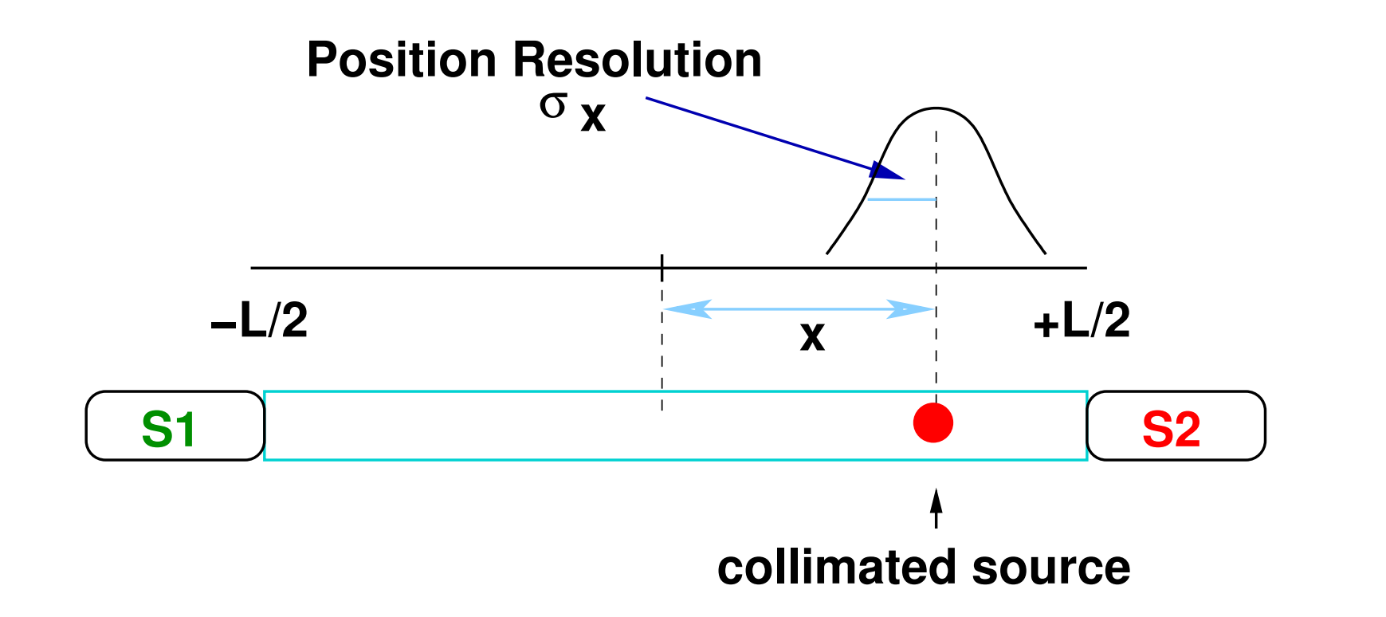
Determining the Position and Energy
S₀
Quotient of signals is used as proxy for position of photons and product of signals is used as proxy for energy of photons.

Slide 7
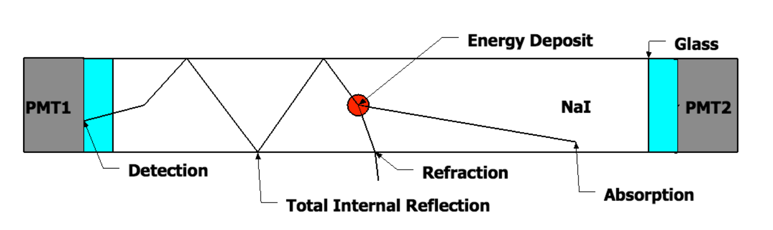
How the Scintillator bar works ?
Shortening the attenuation length by degrading the total internal reflection improves position resolution since it widens the difference between the two signals.
But this is not always necessary…

Slide 8
New design for the Scintillator bar
PMT 1
Plastic
cube
CsI
cube
PMT 2
Instead of using a bar of crystal where it is needed to degrade the attenuation length, one can use cubes and rely on Fresnel reflection to accomplish the same effect.
This is then all put into a plastic tube to hold everything in place.

Slide 9
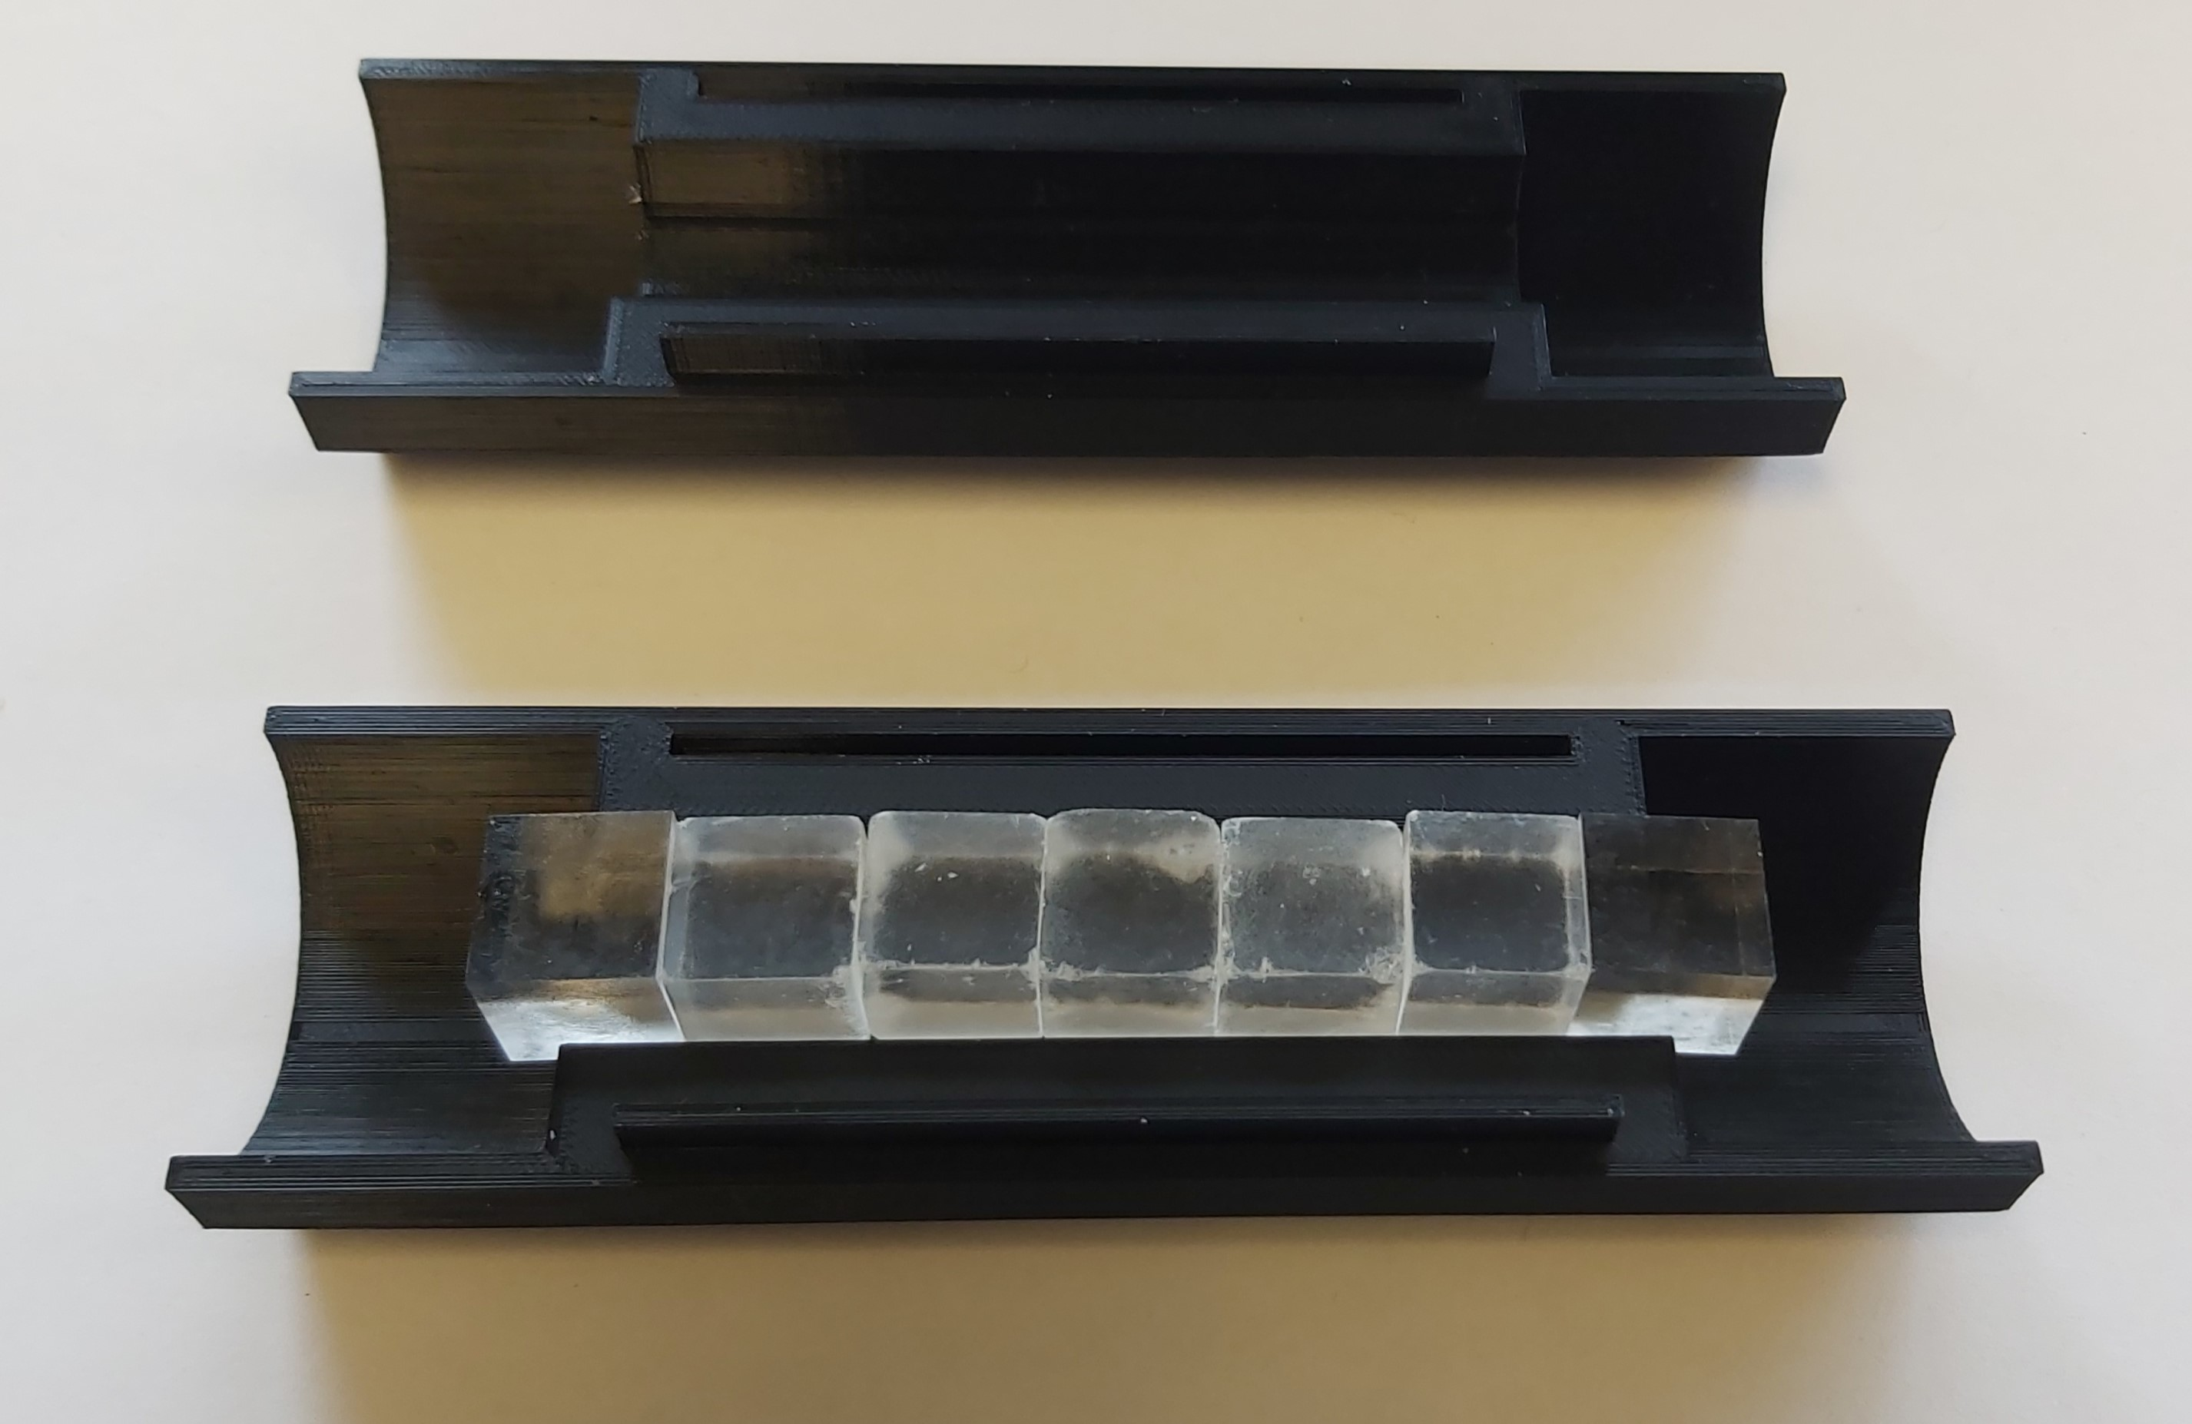
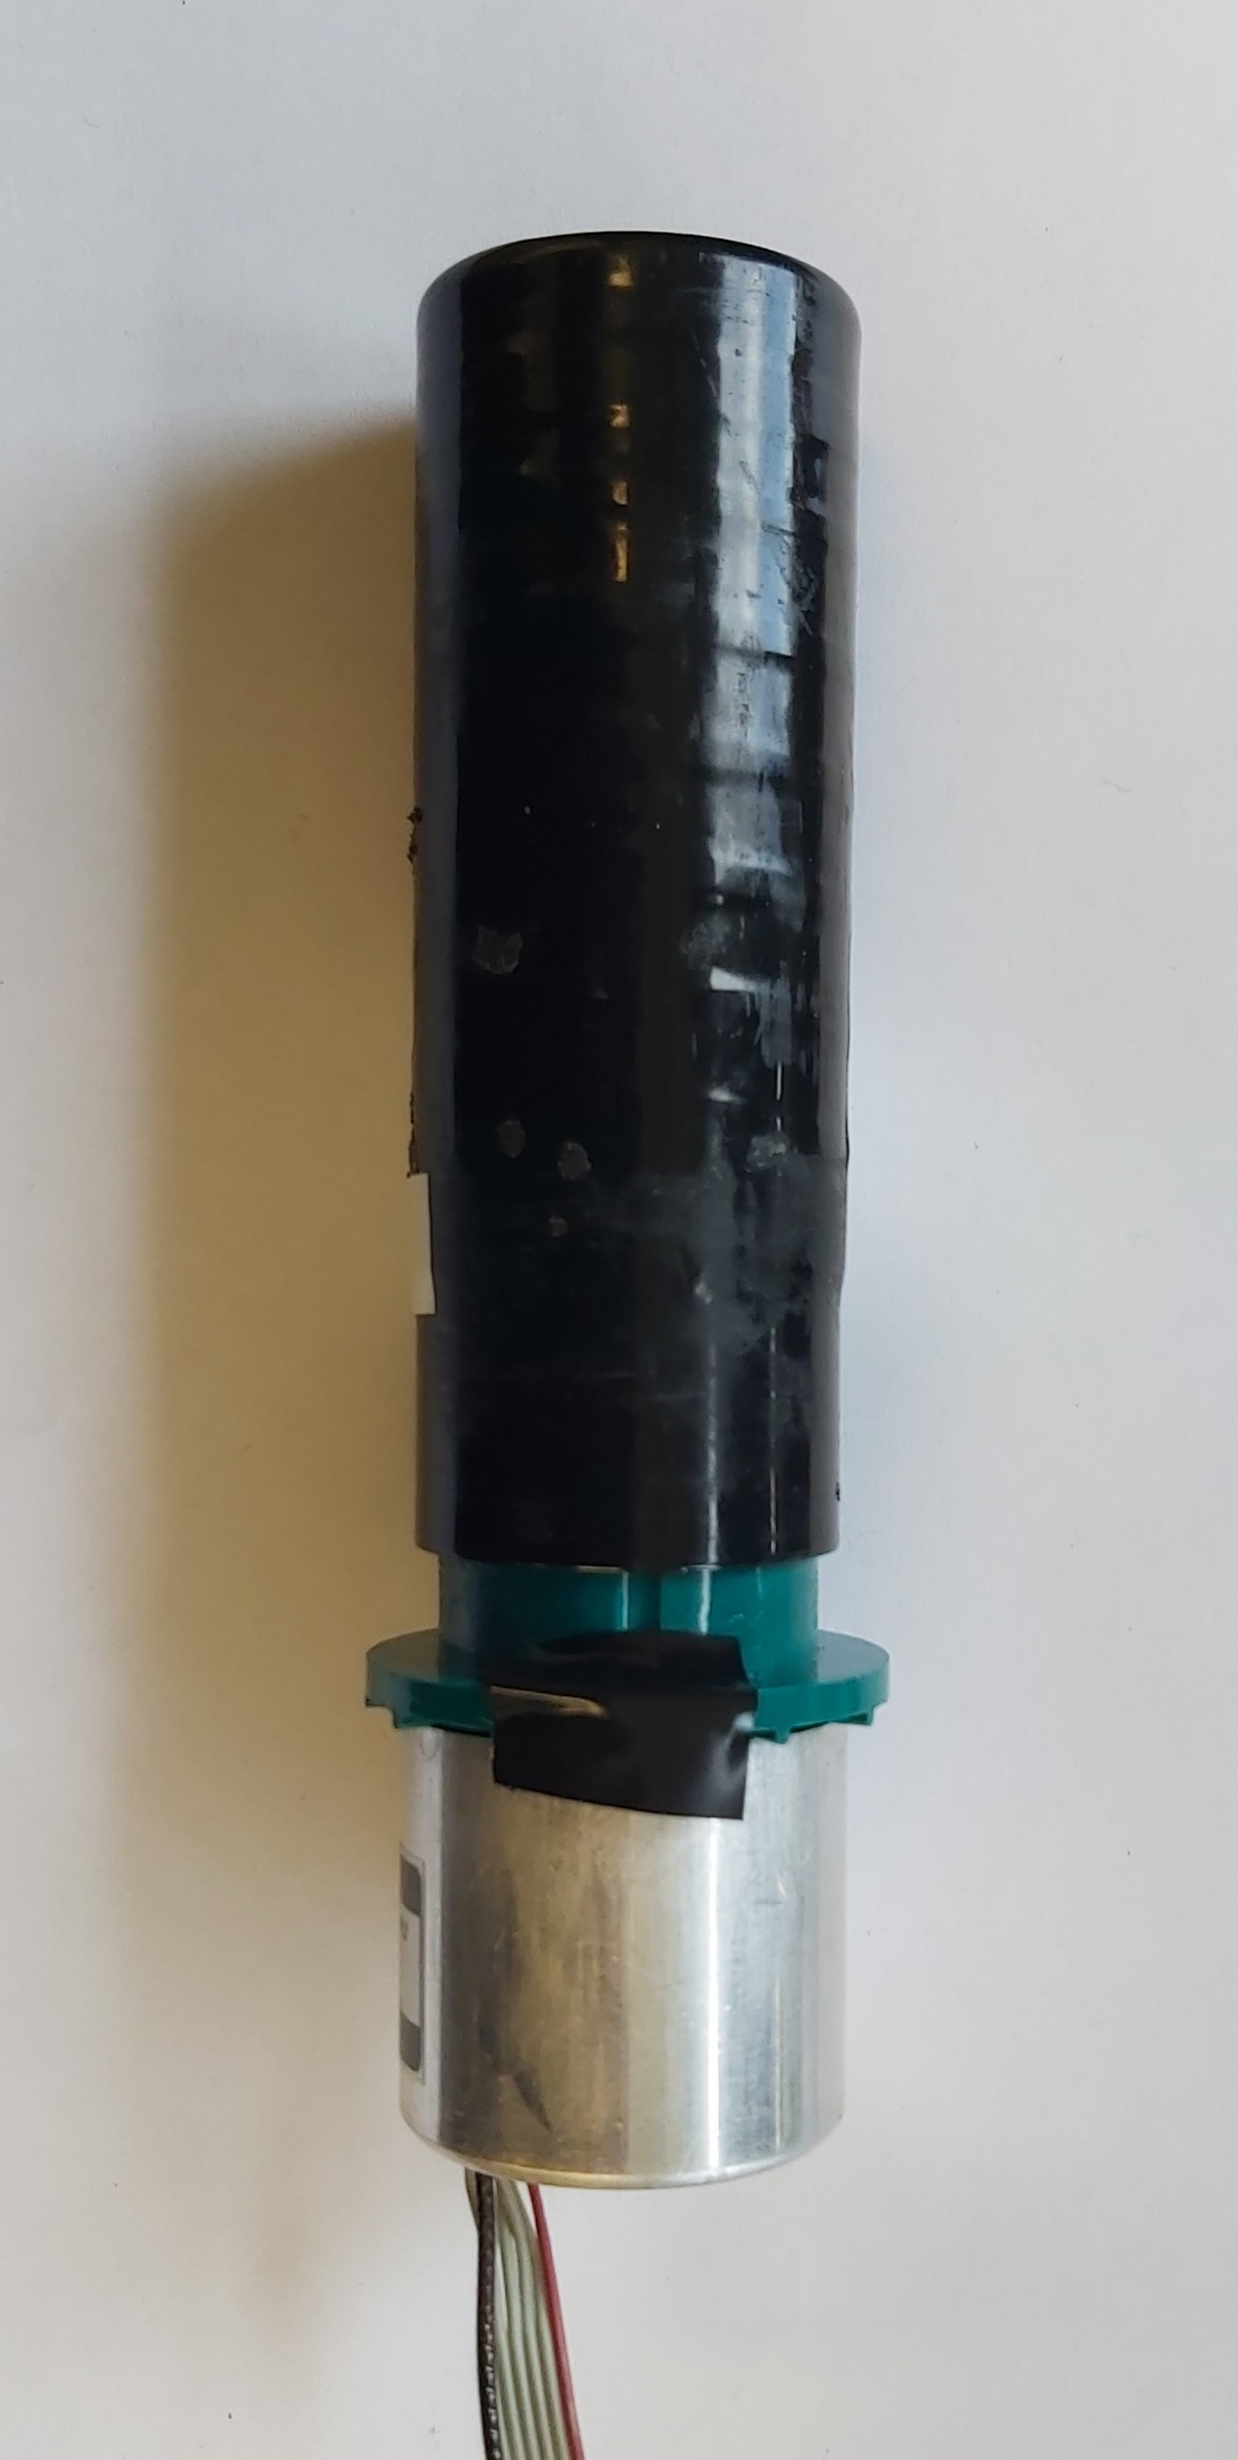
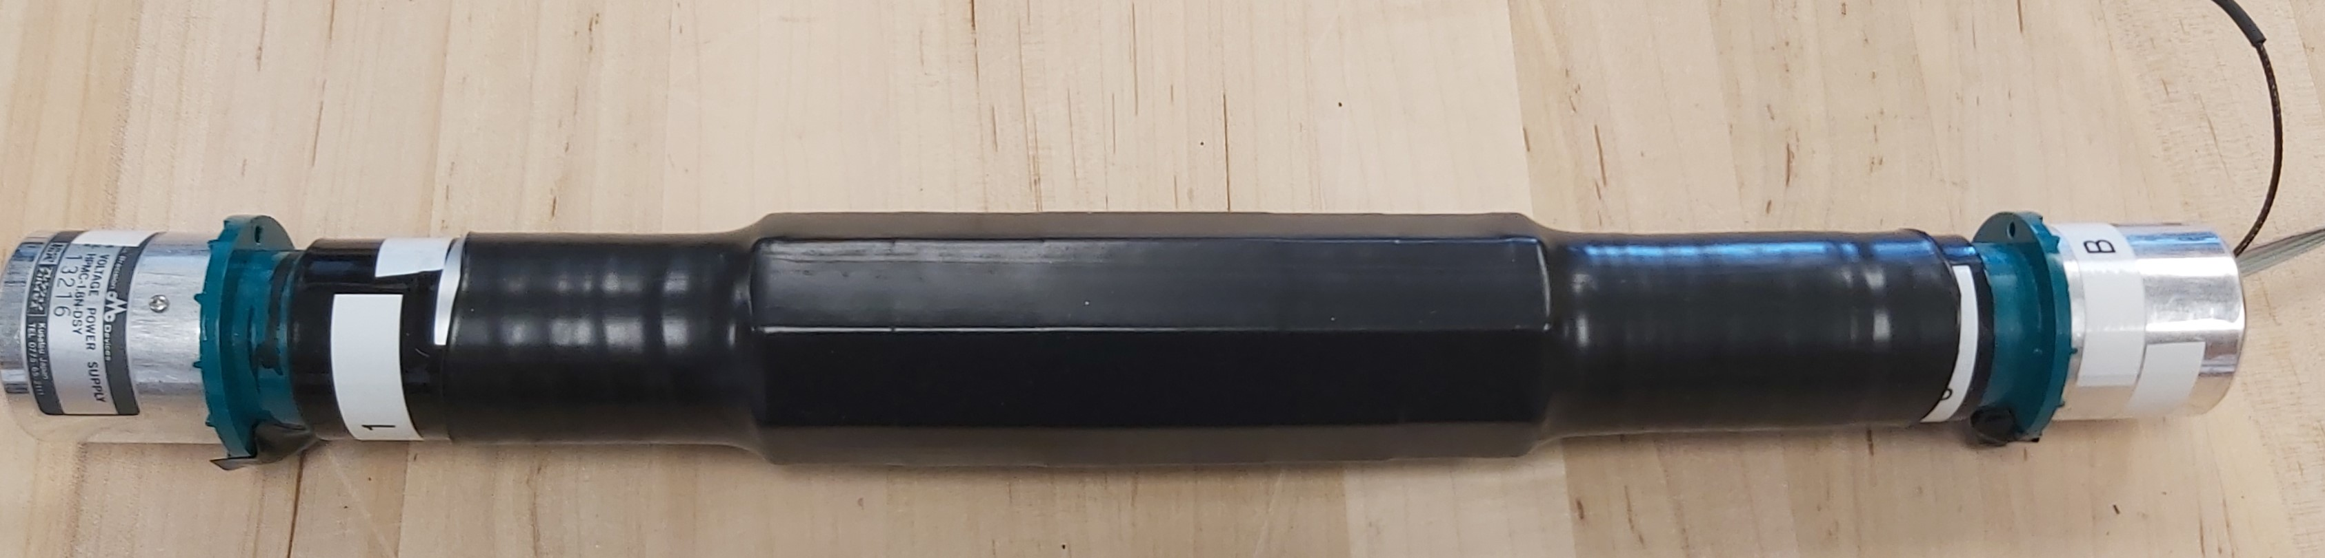
Assembling the imager
Tube’s inside.
Instead of using a bar of crystal where it is needed to degrade the attenuation length, one can use cubes and rely on Fresnel reflection to accomplish the same effect.
Five CsI cubes with a plastic cube acting as a light guide at each end.
Hamamatsu R580 PMT
Assembled tube.

Slide 10
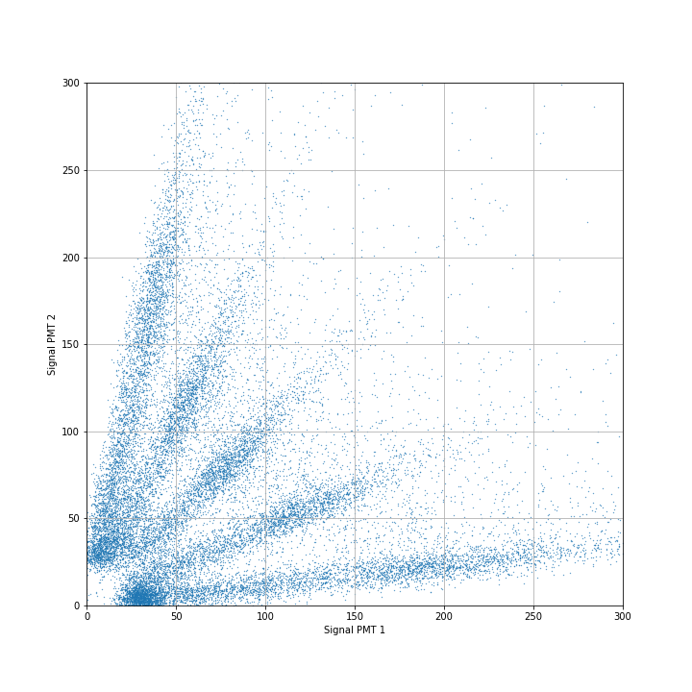
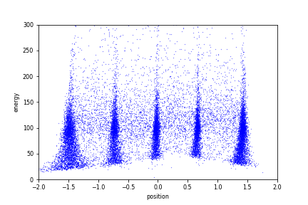
Preliminary results
Scatter plot of signal coming from PMT #1 on the X-axis and PMT #2 on the Y-axis.
Total signal coming from both PMTs as a function of position of the energy deposit. Determined using previous equations
Finger pattern is caused by the cubes design for scintillators.

Slide 11
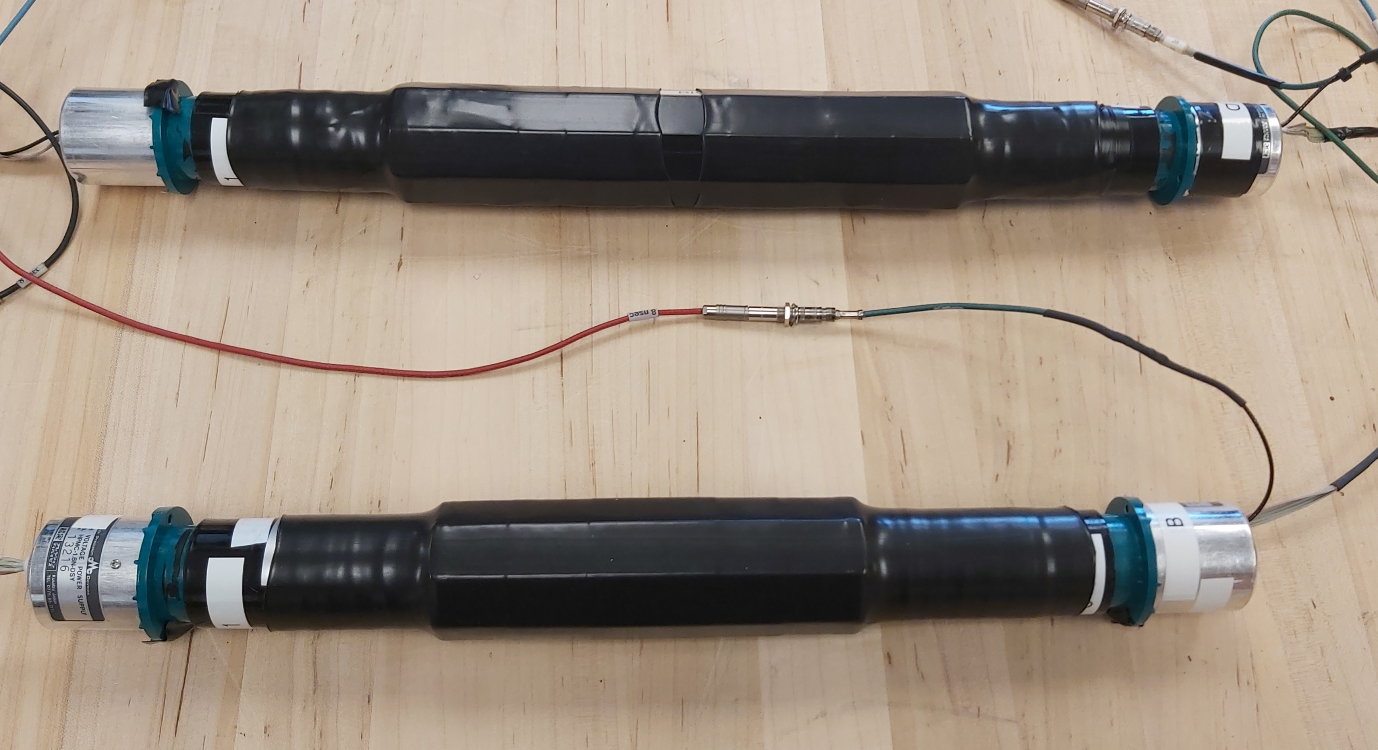
Still a lot of work needs to be done…
Future work:
-Get coincidences with 2 bars.
-Study energy resolution with the 2 signals.
-Try making virtual detector by moving vertically the bars to simulate a whole plane.
-Add tubes to the detector to complete each layers.
25mm cubes/absorber layer
15mm cubes/scatter layer

Slide 12
Electronics scheme for final design
Computer
PMT 1
PMT 3
Scatter layer
Absorber layer
Digitizer
Logic Unit
Trigger
Amplifier/
Splitter
Discriminator
PMT 2
PMT 4

Slide 13
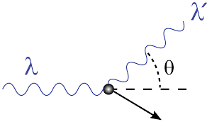
In Conclusion:
We are trying to improve the design of current Compton imagers by reducing the number of data channels from NxN to 2N, thus reducing costs which is important for security applications and reducing power consumption wich is important for space based applications. This is a work in progress.
Thank you very much for your time.

