Slide 1
Upgrading and updating the hpge-radiopurity.snolab.ca SNOLAB material database
2022-08-16
Gwyn Armstrong
Nanotechnology Engineering Student at University of Waterloo on Summer Co-op Term
Supervisor: Dr. Silvia Scorza
Canadian Astro-Particle Physics Summer Student Talk Competition 2022

Slide 2
Goal For Work Term
hpge-radiopurity.snolab.ca database updated with all the measurements from the HPGe counters running underground at SNOLAB.
Upgrade the material database with more features such as a new backup process.
2

Slide 3
Overview
Excel spreadsheets
  Difficulty searching
Created Python conversion script to convert .csv to .json to upload onto database
HPGe Database
  Easier to search for measurements
3

Slide 4
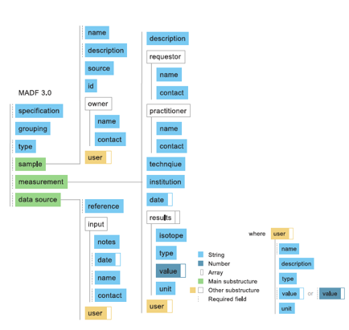
.json File Format
Material Assay Data Format (MADF)
Python conversion script retrieves data from excel spreadsheets and formats it as seen in Figure 1
Figure 1

Slide 5
https://hpge-radiopurity.snolab.ca/simple_search
Let’s look at how the database works and the features that it includes:
5

Slide 6
Questions?
6

